Slide 1
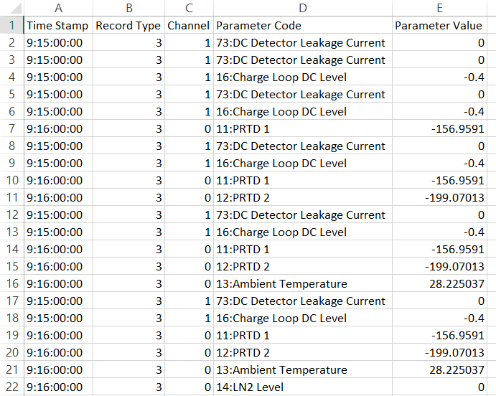
North iPA has recorded 524801*24=12,595,224 lines.
South iPA has recorded 524801*32=16,793,632 lines.
All csv files are downloaded from the iPA control panel app.
All log files from the CP-5 Plus controllers are still being recorded.
All files (1.4 GB) are stored on the PXCT Laptop and backed up at /mnt/analysis/e21010/iPA_Log.

Slide 2
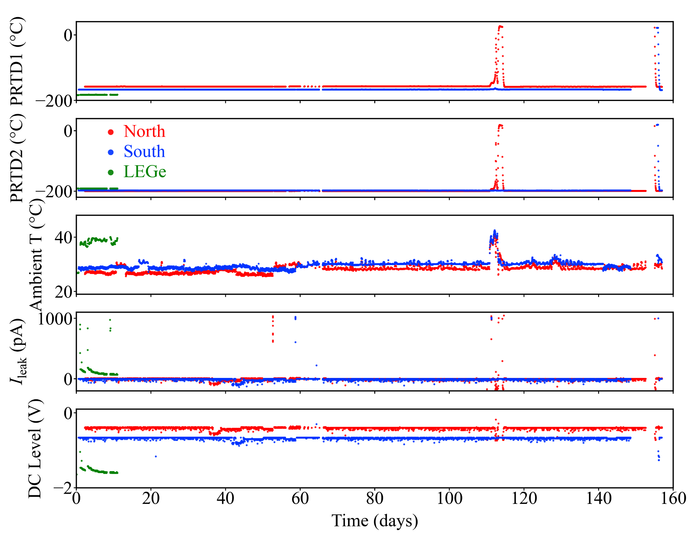
July
outage
August
outage
Notes:
Best figure iPA
PXCT_iPA_log.py
Fig_PXCT_iPA_log.png
South5596_iPA_Log_For_Plot.csv
South5596_iPA_Log_All_Manually_Adjusted.xlsx

Slide 3
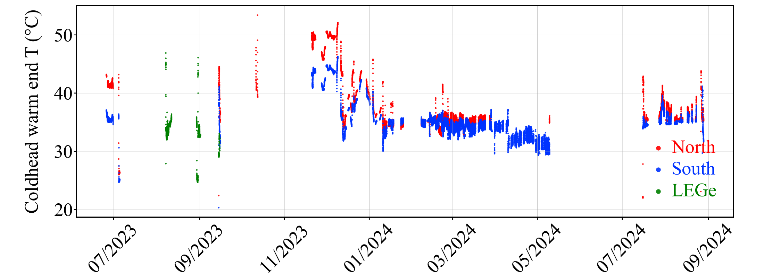
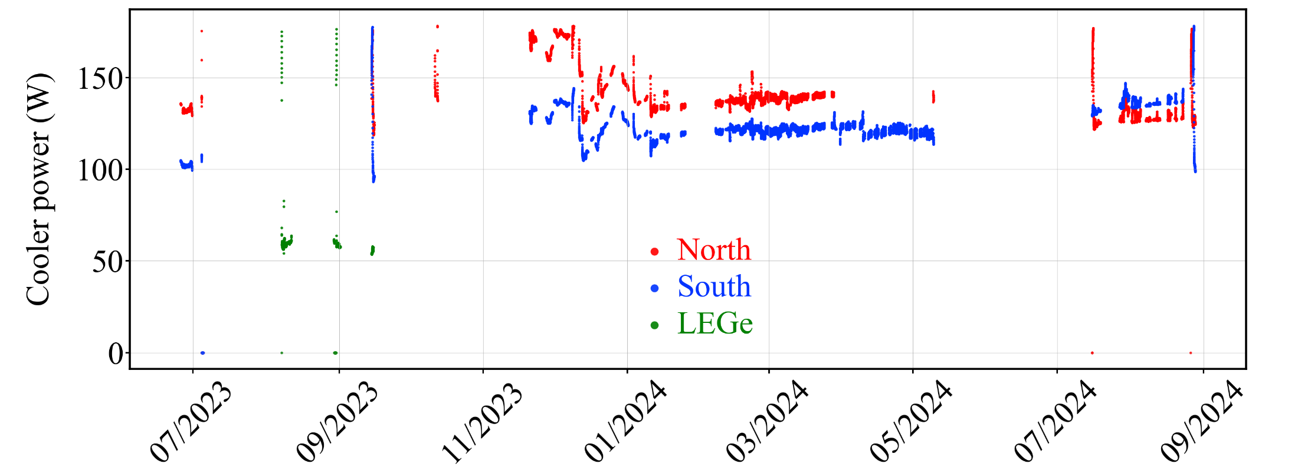
Notes:
Best figure Coldhead Temp, Cooler Power
PXCT_Controller_log.py
North_5593_controllerlog.txt
South_5596_controllerlog.txt

Slide 4
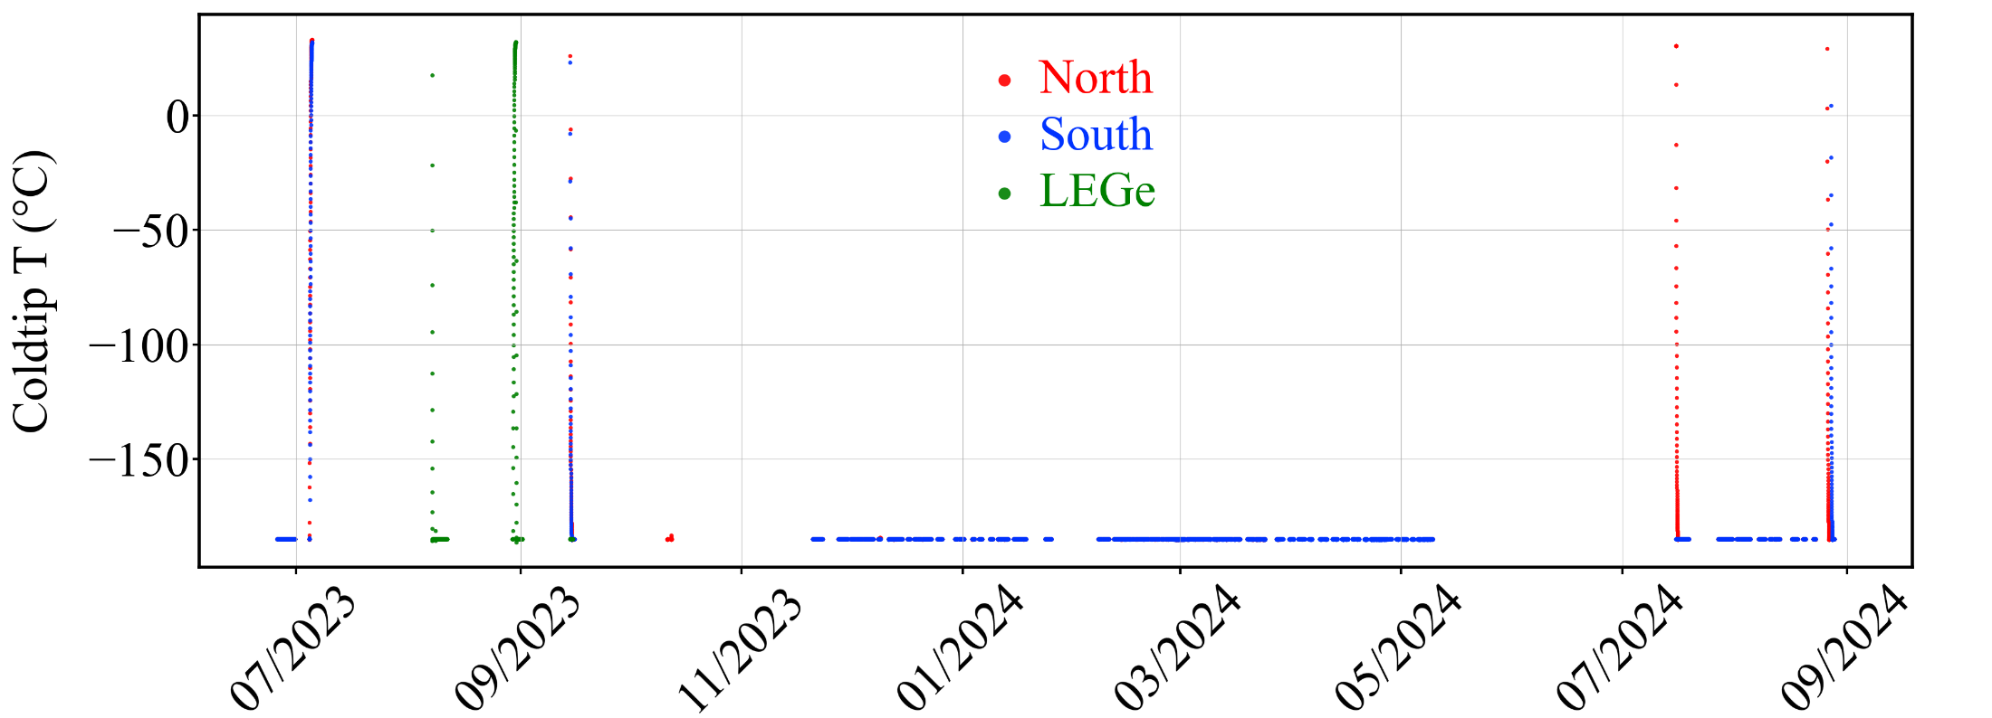
End of
E21010
Move into
place
July
outage
August
outage
Notes:
Best figure Coldtip Temp
PXCT_Controller_log.py
North_5593_controllerlog.txt
South_5596_controllerlog.txt

