Slide 1
E21010 Ge calibration and preliminary analysis

Slide 2
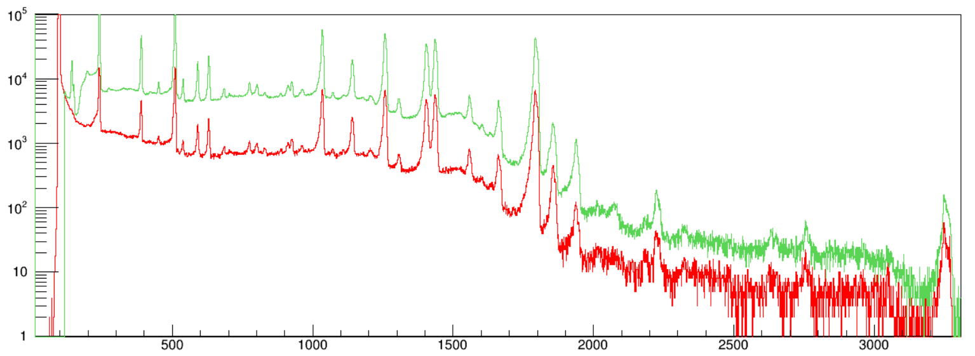
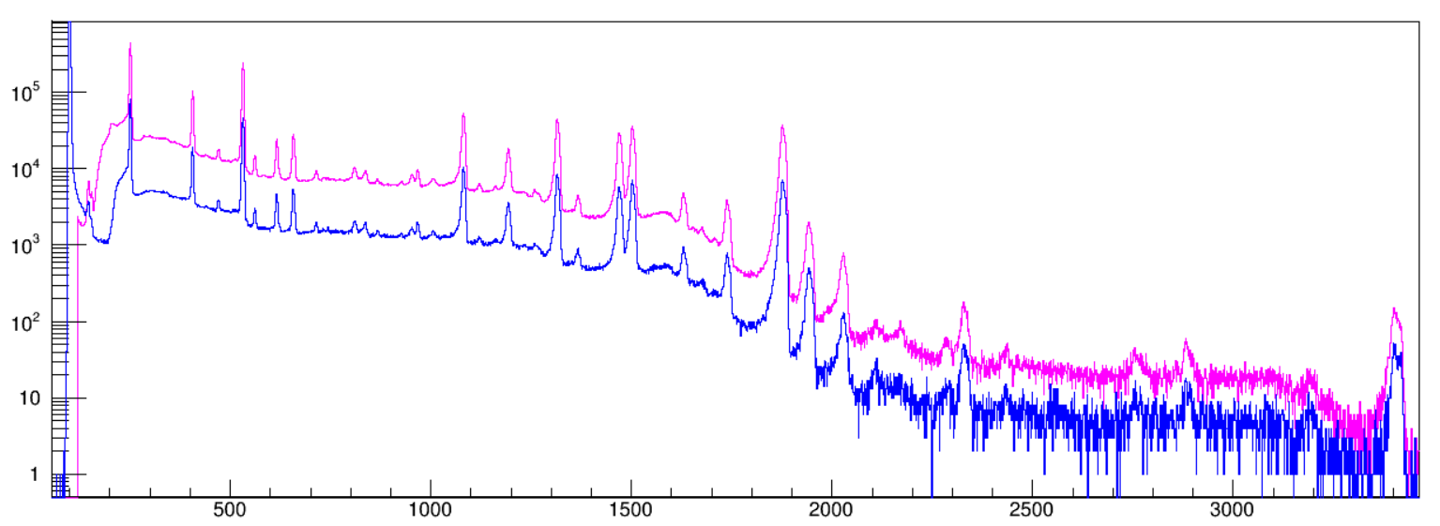
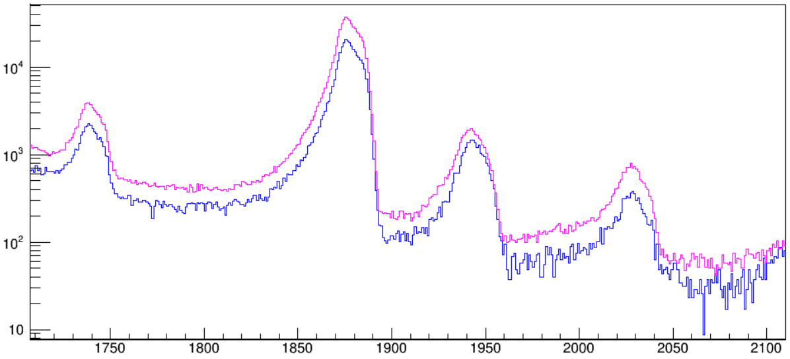
Run 121 152Eu calibration 89 mins
Run 015 152Eu calibration 31 mins
North
Run 121 152Eu calibration 89 mins
Run 015 152Eu calibration 31 mins
South
Zoom in
scaled

Slide 3
Source | Eγ (keV) | σEγ (keV)
40K→40Ar | 1460.820 | 0.005 | peak0
208Tl→208Pb | 2614.511 | 0.010 | peak1
152Eu→152Sm | 121.7817 | 0.003 | peak2
152Eu→152Sm | 244.6974 | 0.008 | peak3
152Eu→152Gd | 344.2785 | 0.012 | peak4
152Eu→152Gd | 778.9045 | 0.024 | peak5
152Eu→152Sm | 964.057 | 0.05 | peak6
152Eu→152Sm | 1408.013 | 0.03 | peak7
214Pb→214Bi | 351.9320 | 0.0021 | peak8
214Bi→214Po | 609.321 | 0.007 | peak9
214Bi→214Po | 1120.294 | 0.006 | peak10
214Bi→214Po | 1764.491 | 0.014 | peak11
214Bi→214Po | 2204.10 | 0.04 | peak12
214Bi→214Po | 2447.69 | 0.03 | peak13

Slide 4
An exponentially modified Gaussian (EMG) function of the form:
$$y=ax+b+\frac{N }{2τ}exp\left[\frac{1}{2}{\left(\frac{σ}{τ}\right)}^{2}+\frac{x−μ}{τ}\right]×erfc\left[\frac{1}{\sqrt{2}}\left(\frac{σ}{τ}+\frac{x−μ}{σ}\right)\right]$$
was used to fit each γ -ray line in the spectrum. The EMG is characterized by an exponential decay constant τ , width σ, mean μ, energy x, and area below the curve N. Also, a linear function is added to this formula to model the local background.

Slide 5
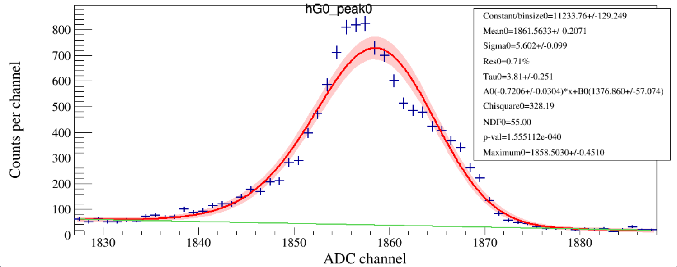
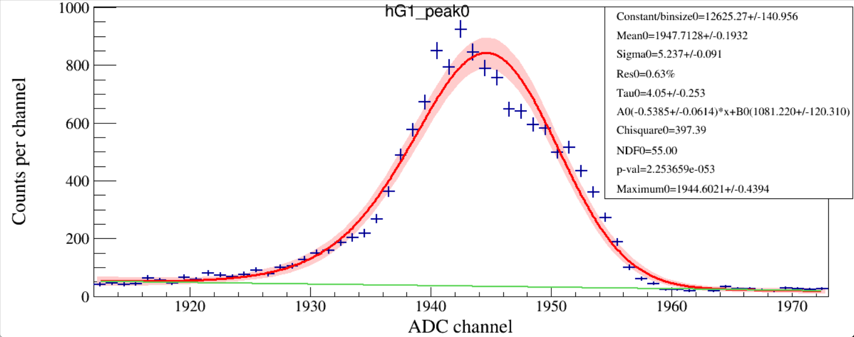
⁴⁰K 1460.820 ± 0.005 keV
Run 120

Slide 6
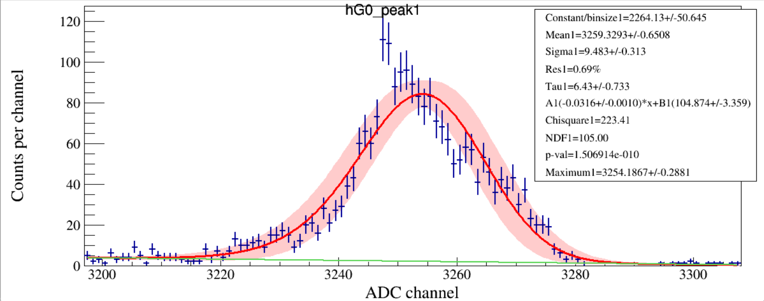
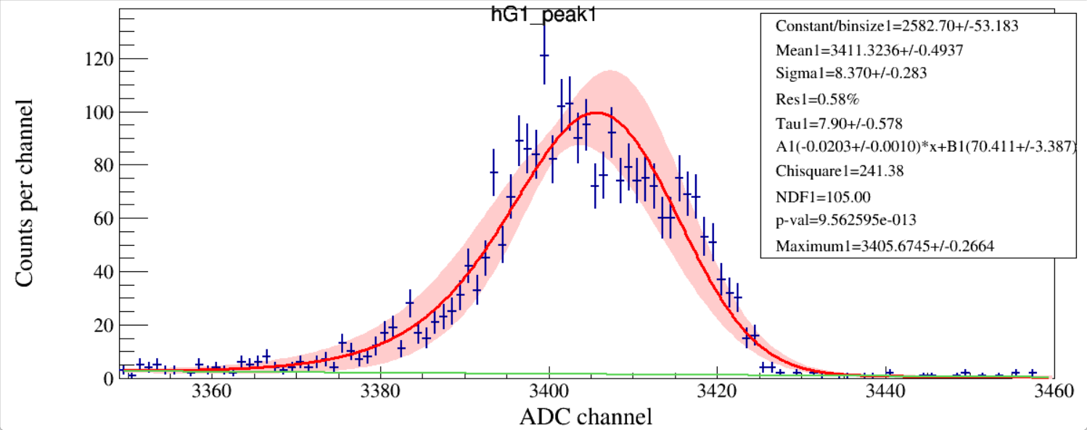
²⁰⁸Tl 2614.511 ± 0.010 keV
Run 120

Slide 7
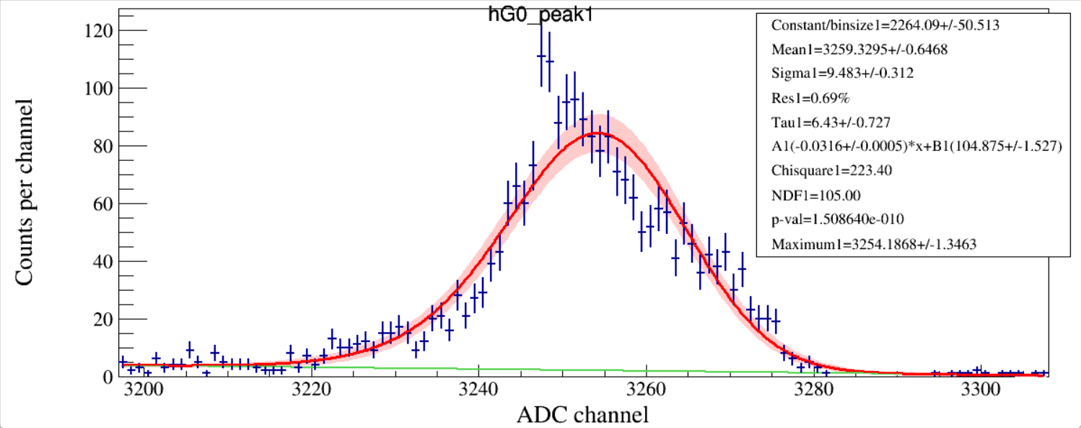
Identical data

Slide 8
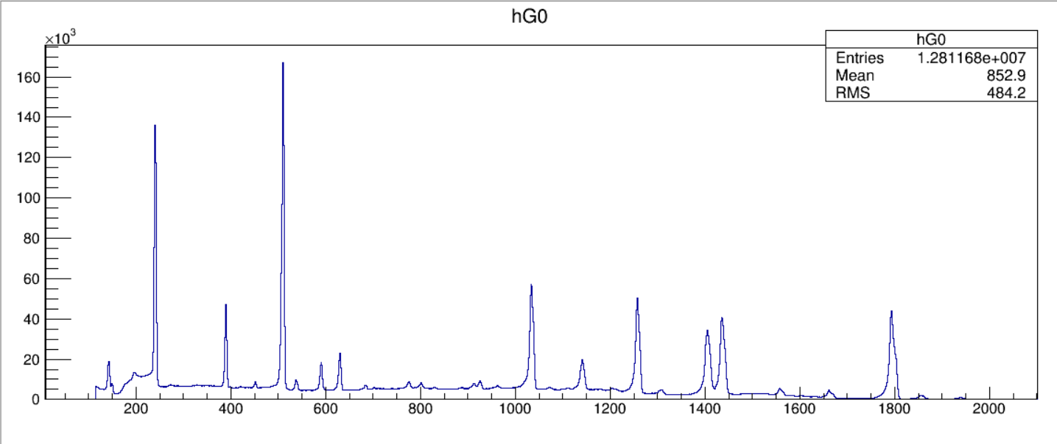
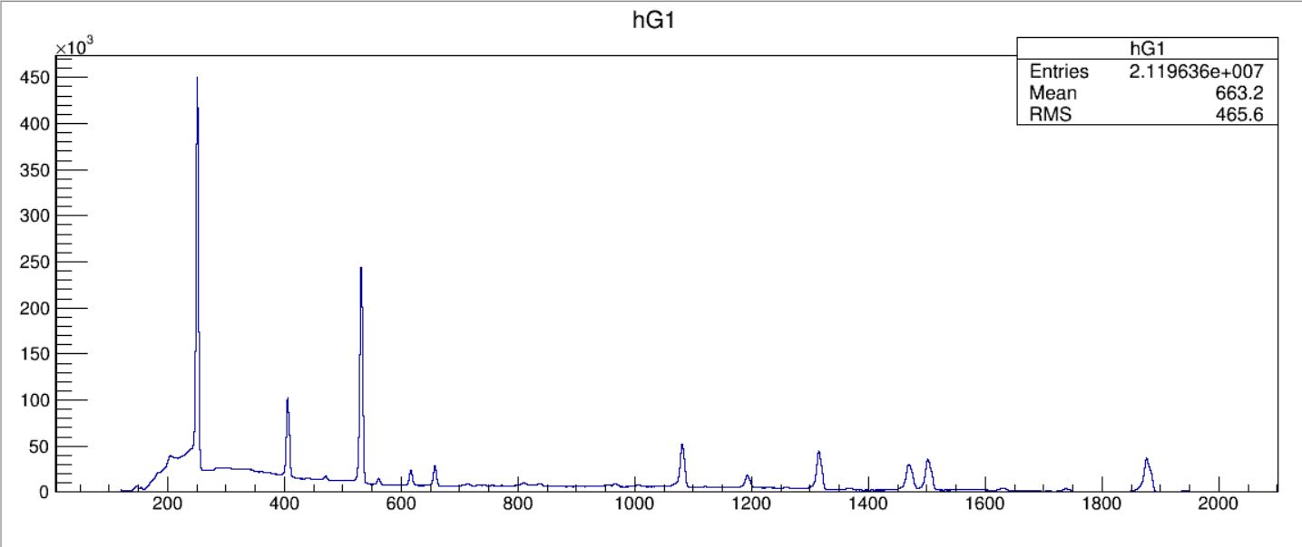
¹⁵²Eu
uncalibrated
Run 121

Slide 9
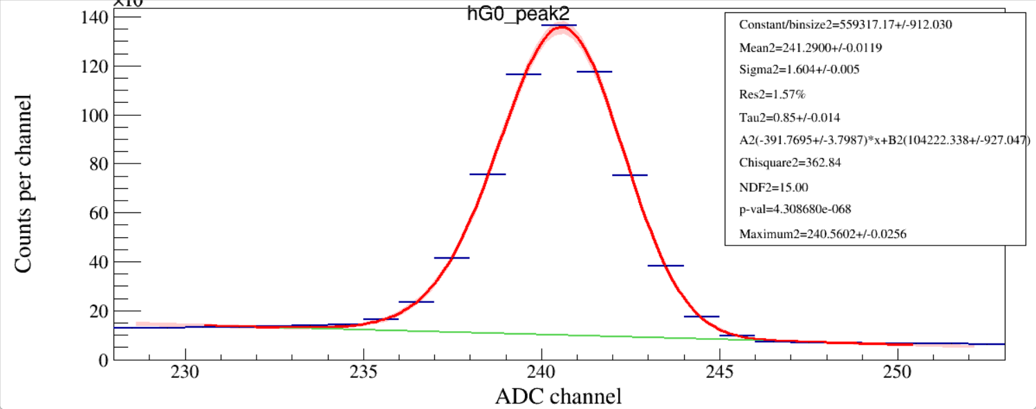
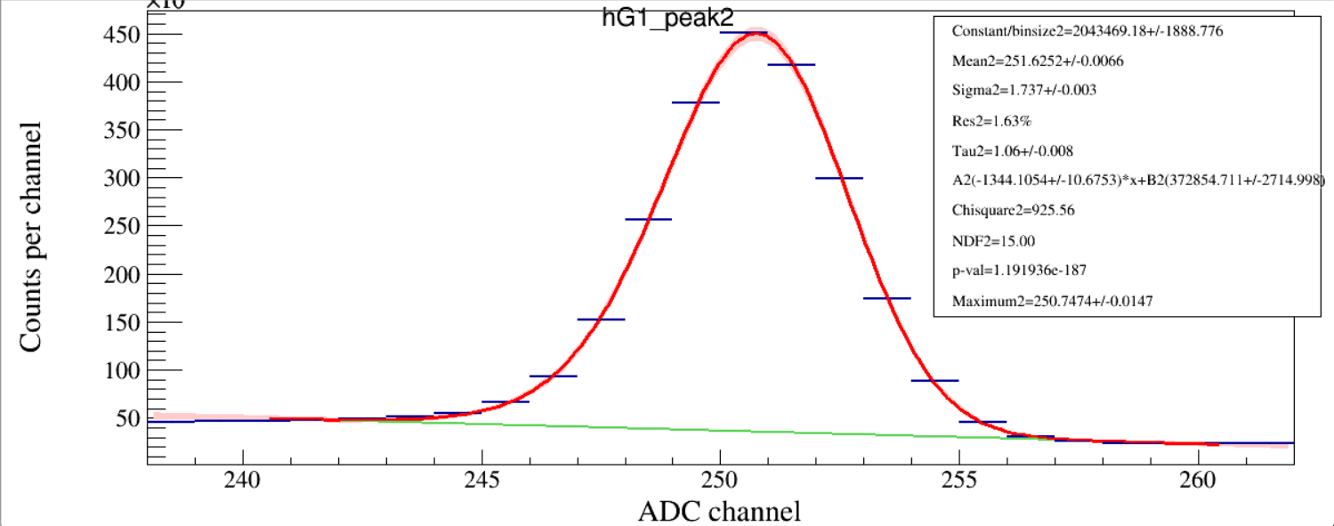
Run 121

Slide 10
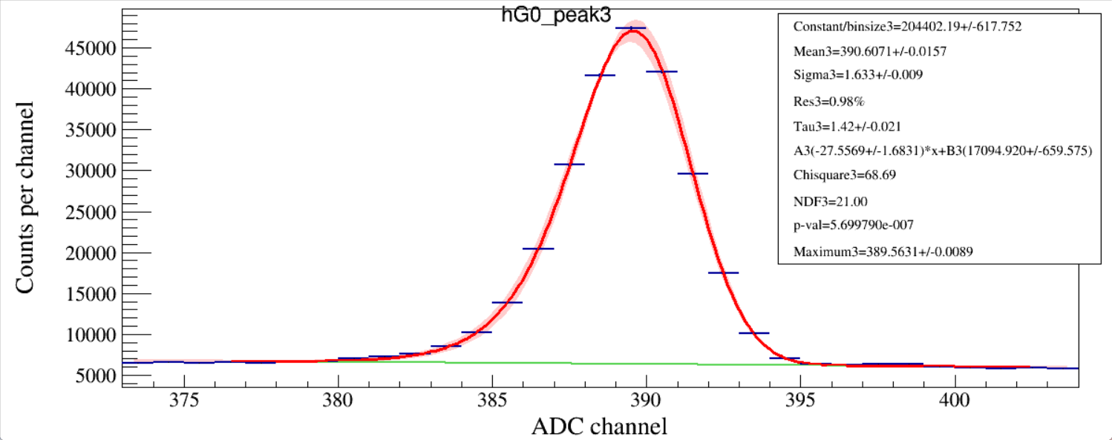
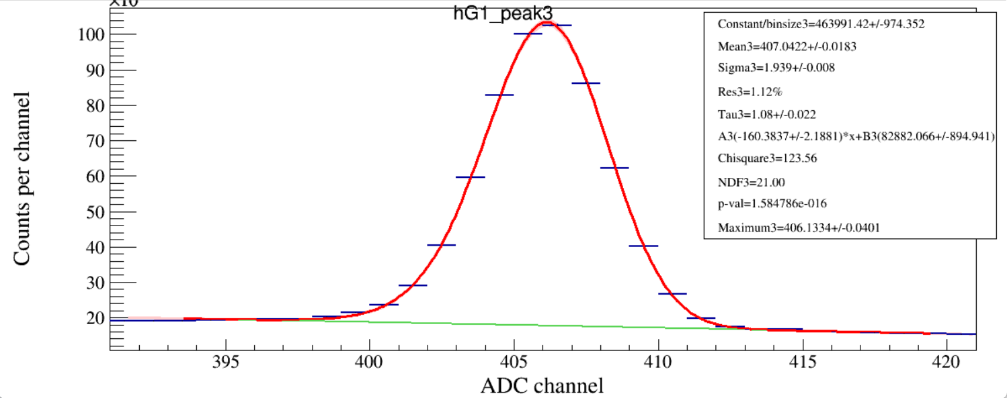
Run 121

Slide 11
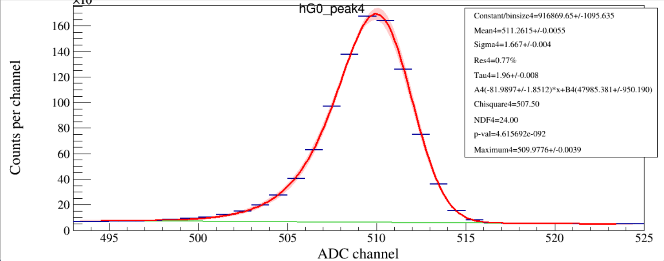
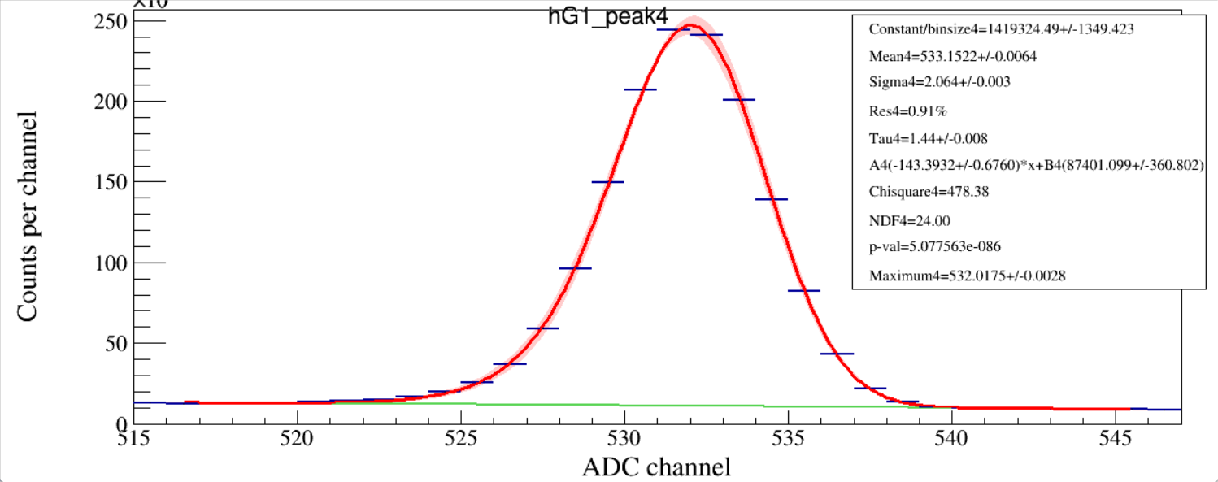
Run 121

Slide 12
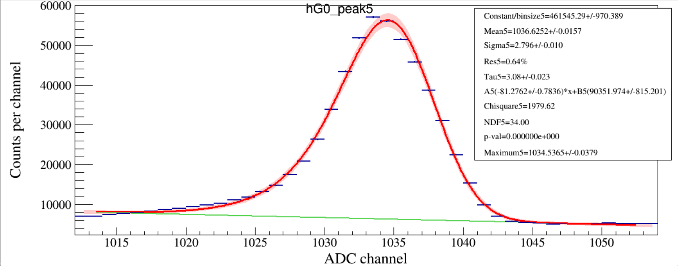
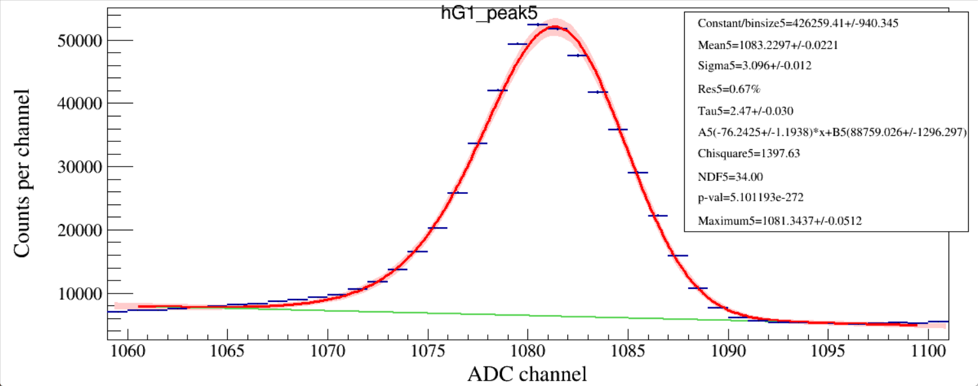
Run 121

Slide 13
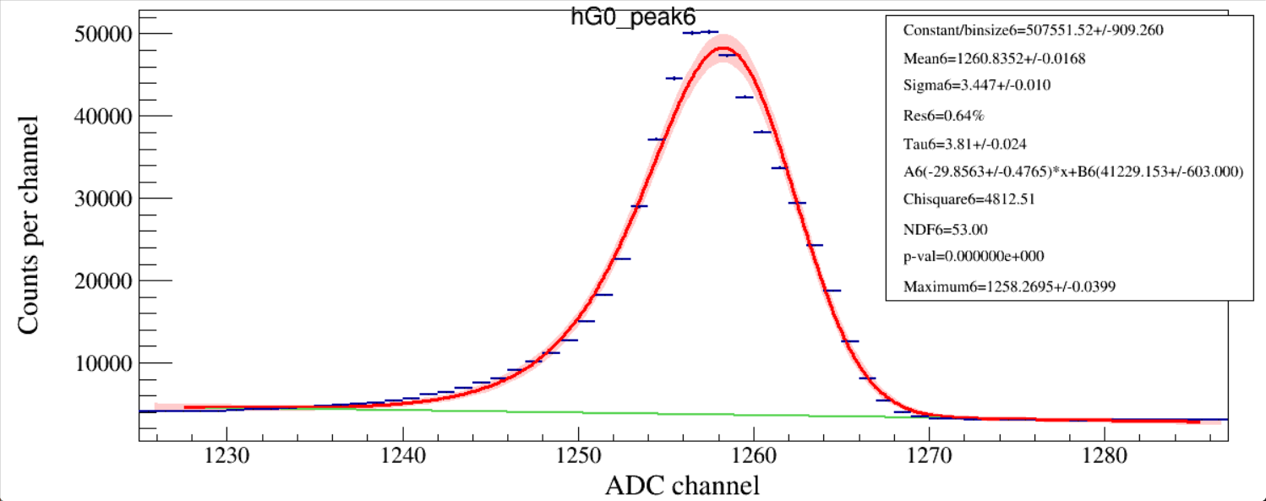
Run 121

Slide 14
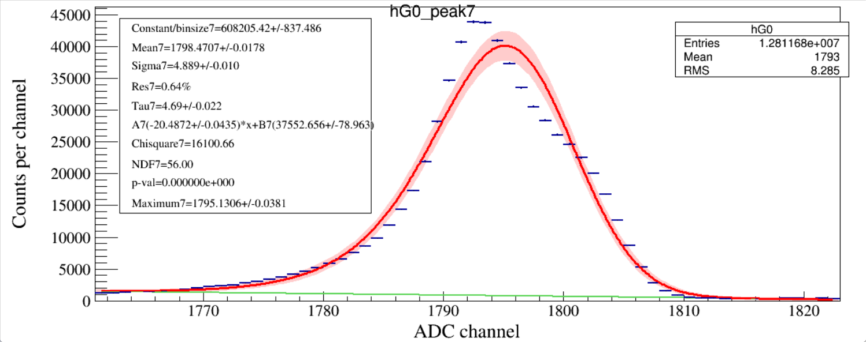
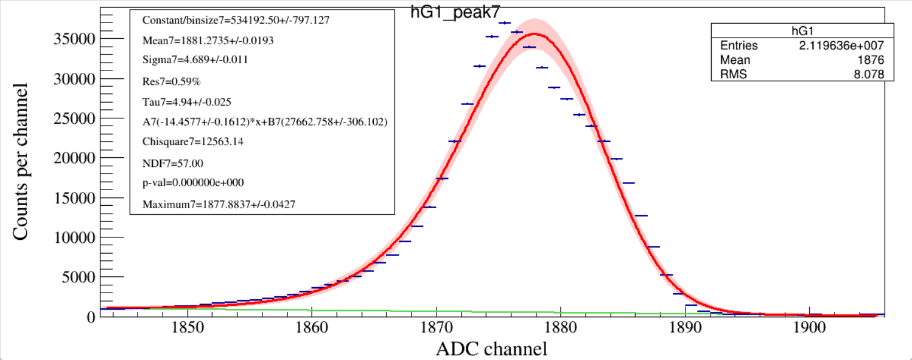
Run 121

Slide 15
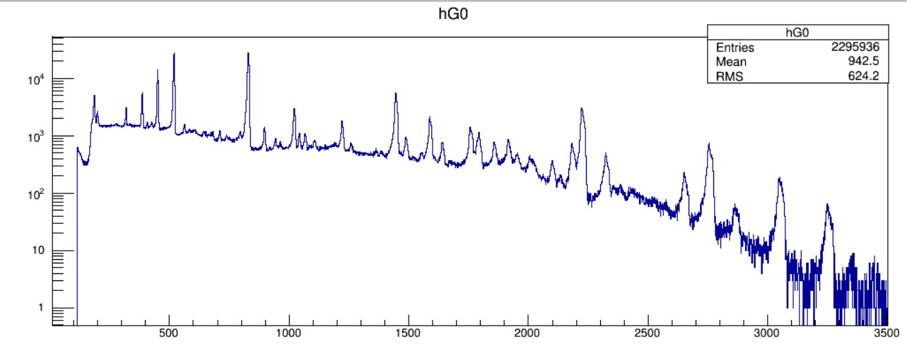
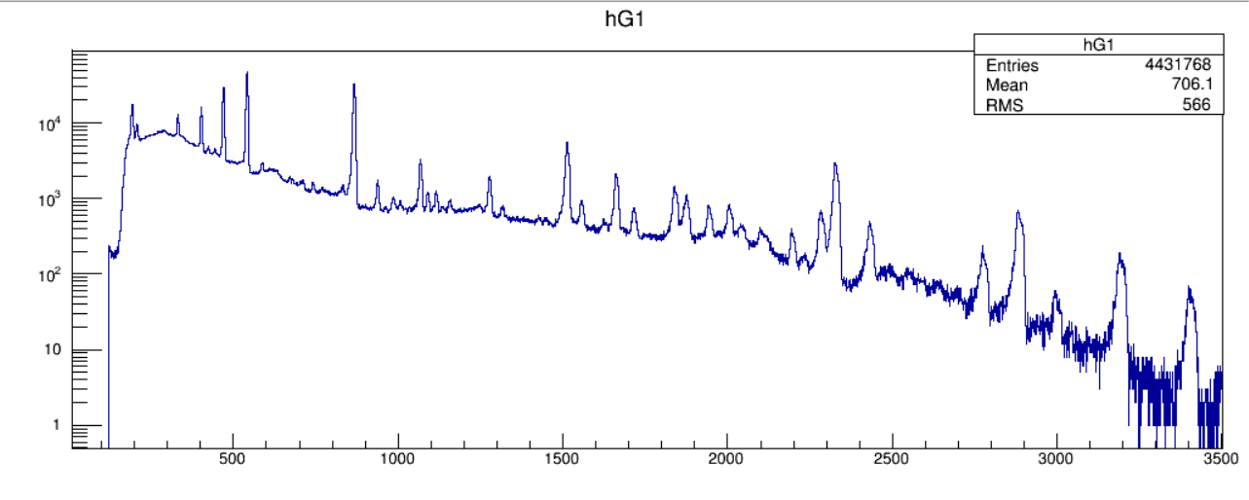
Run 122
²²⁶Ra
uncalibrated

Slide 16
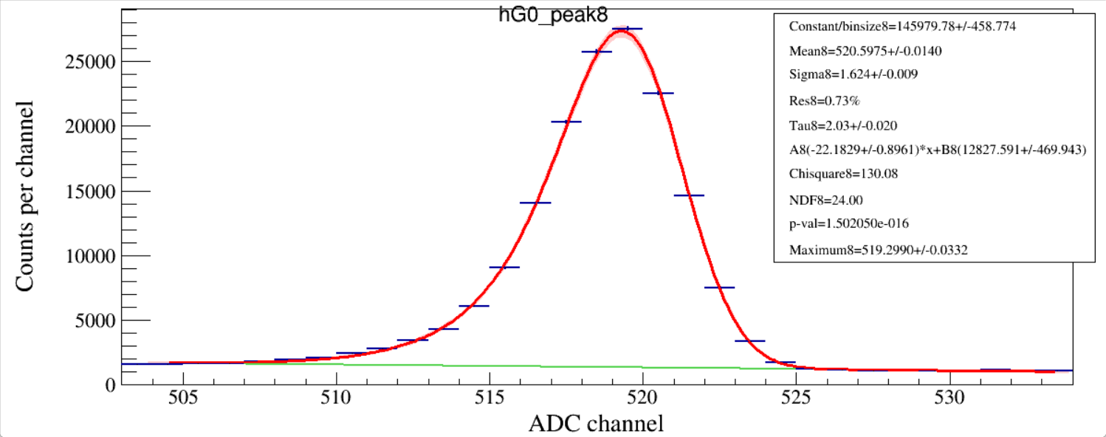
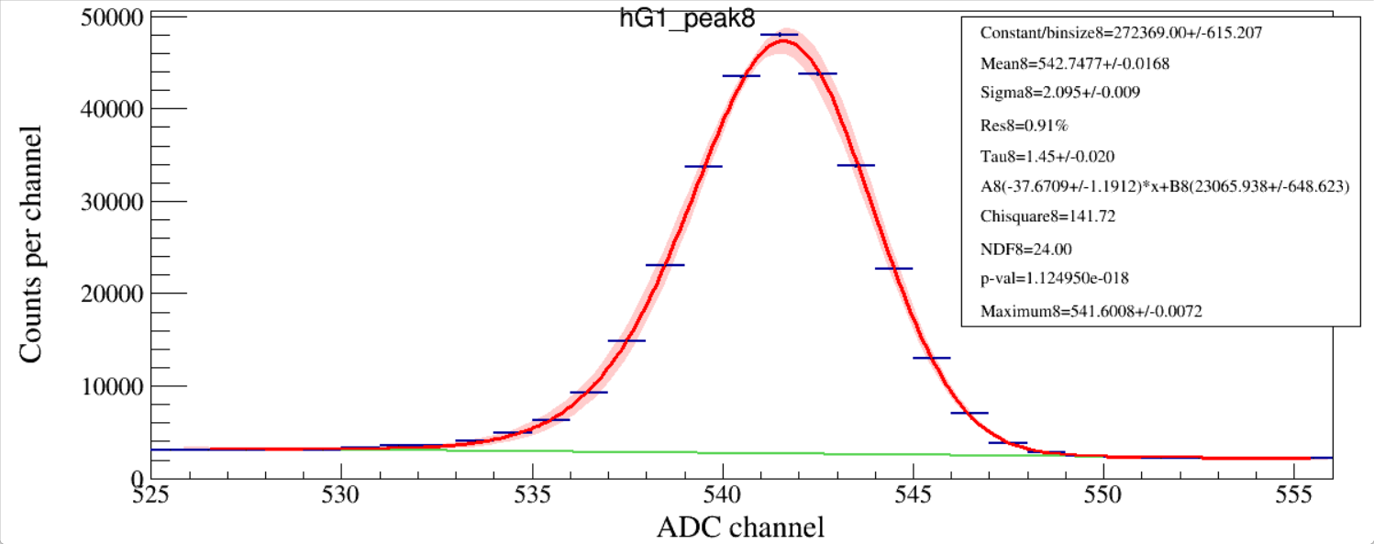
Run 122

Slide 17
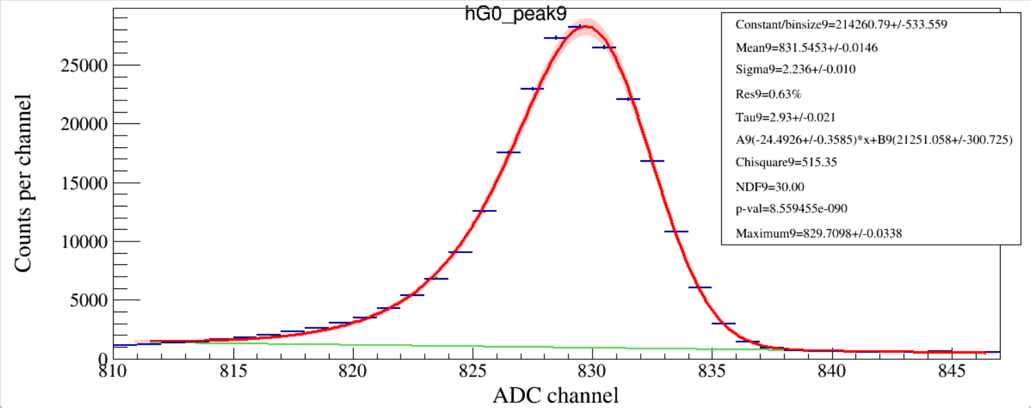
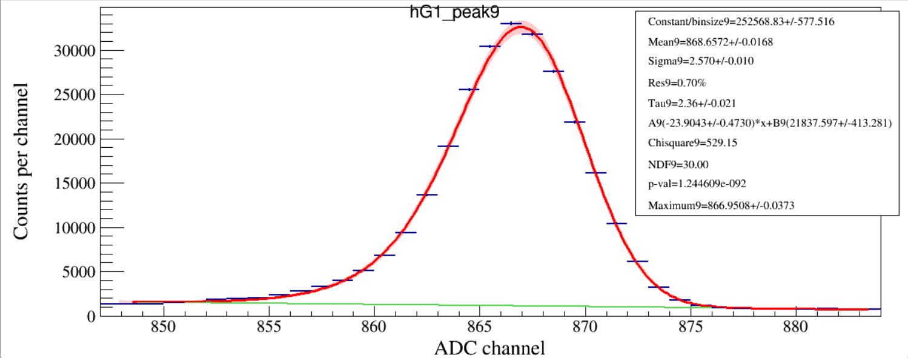
Run 122

Slide 18
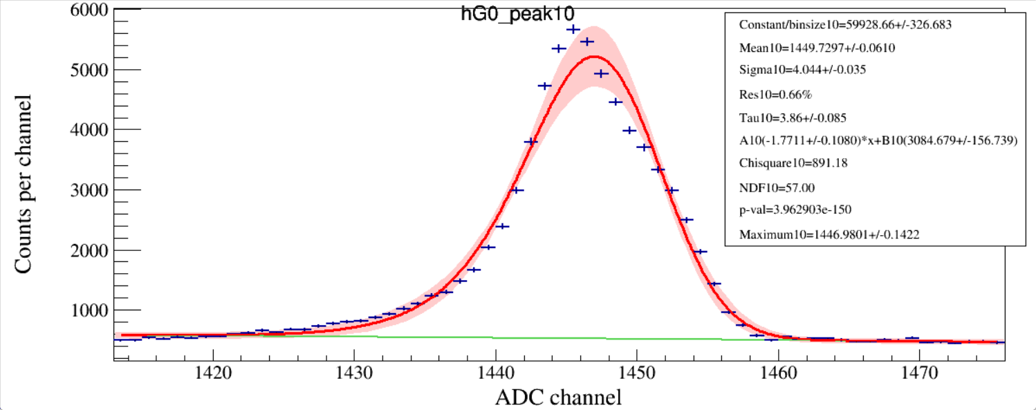
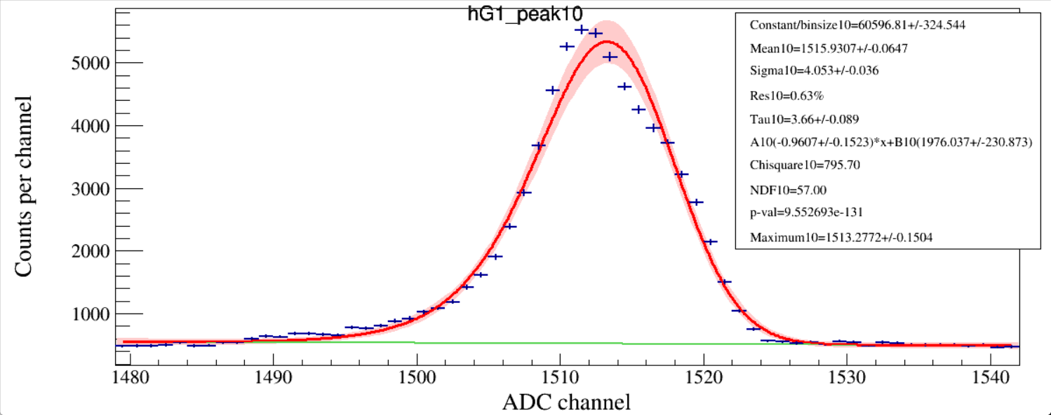
Run 122

Slide 19
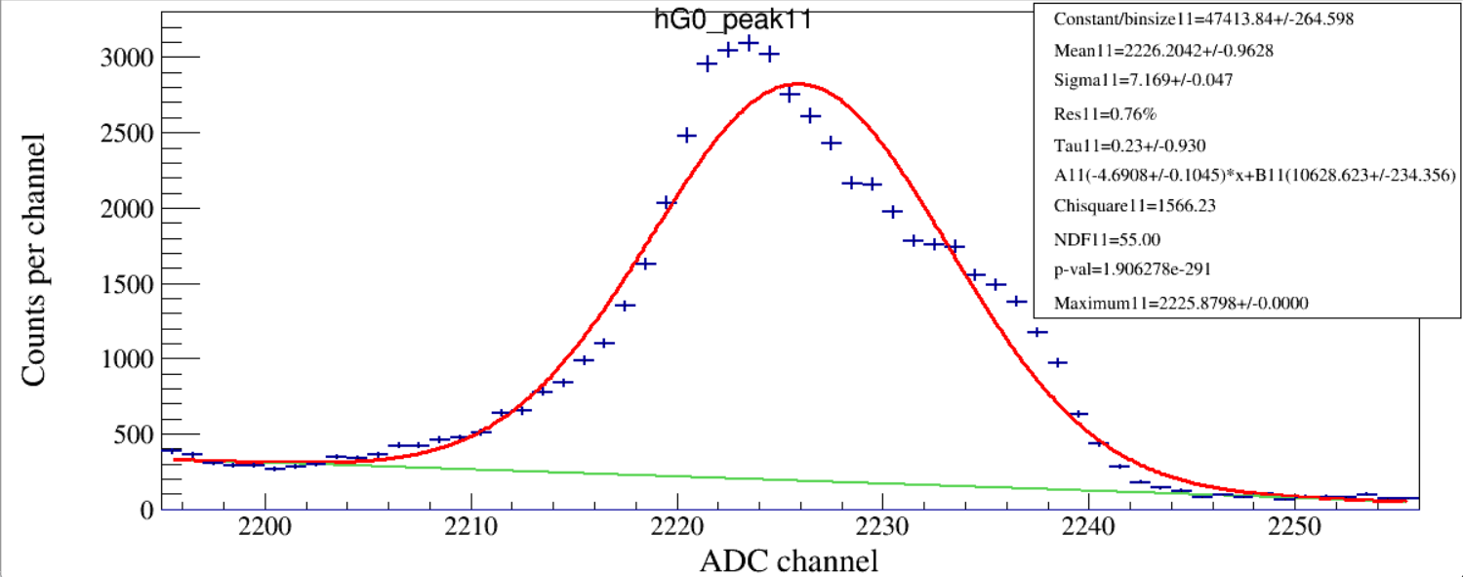
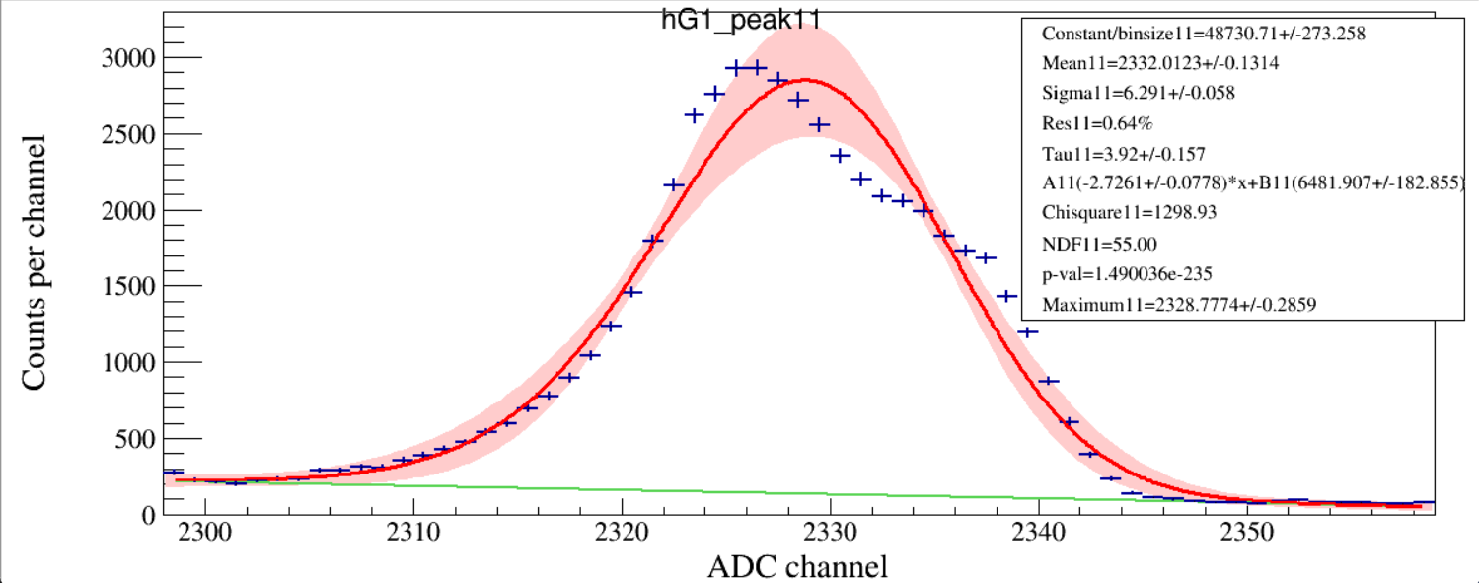
Run 122

Slide 20
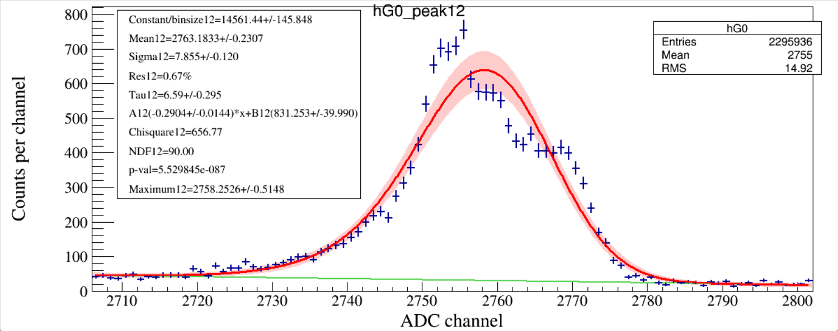
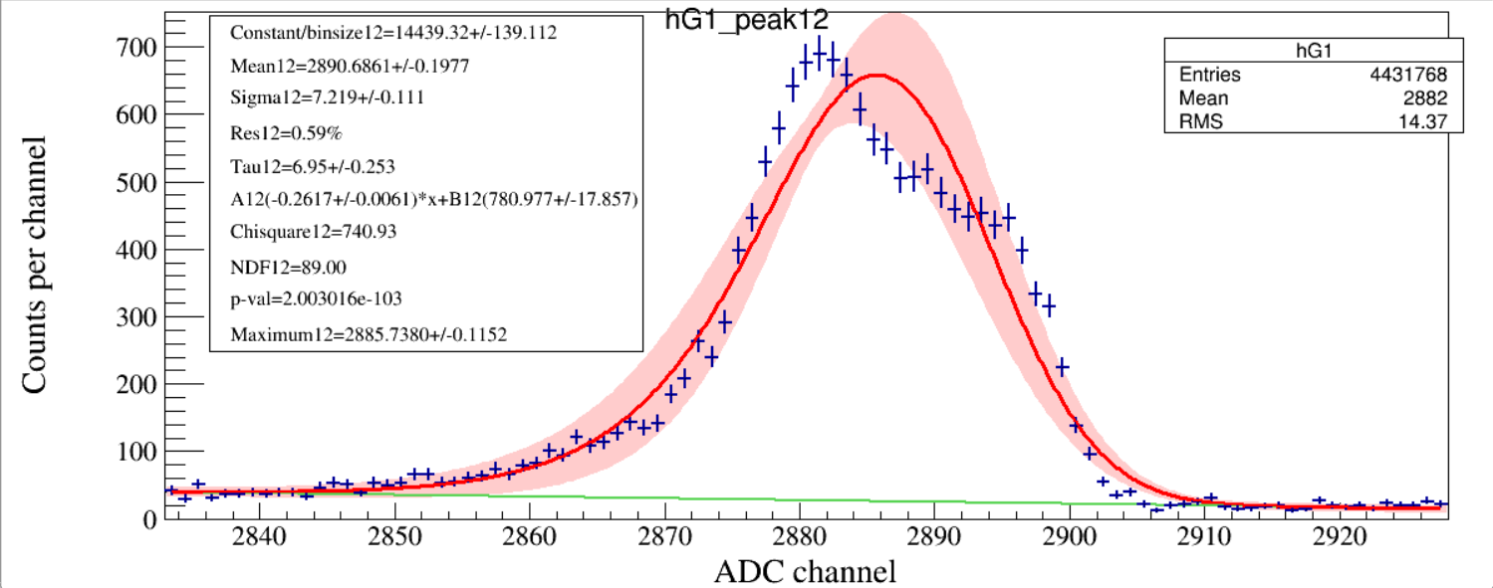
Run 122

Slide 21
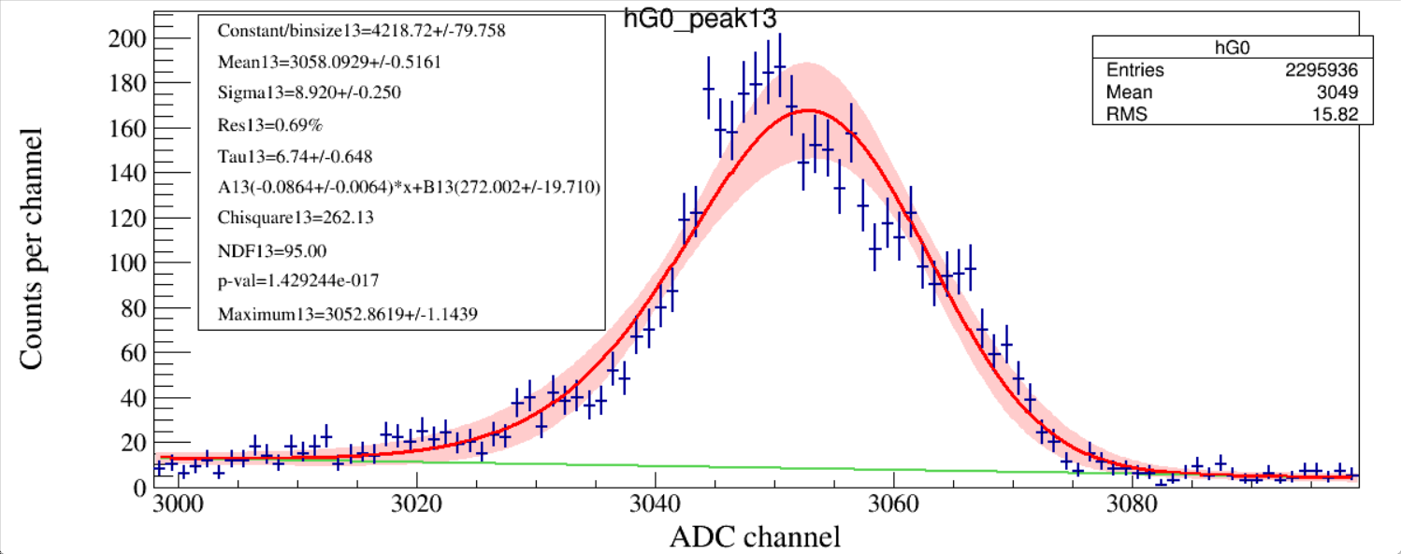
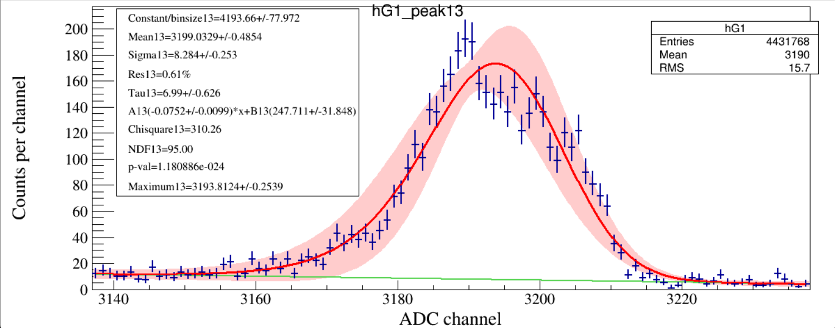
Run 122

Slide 22
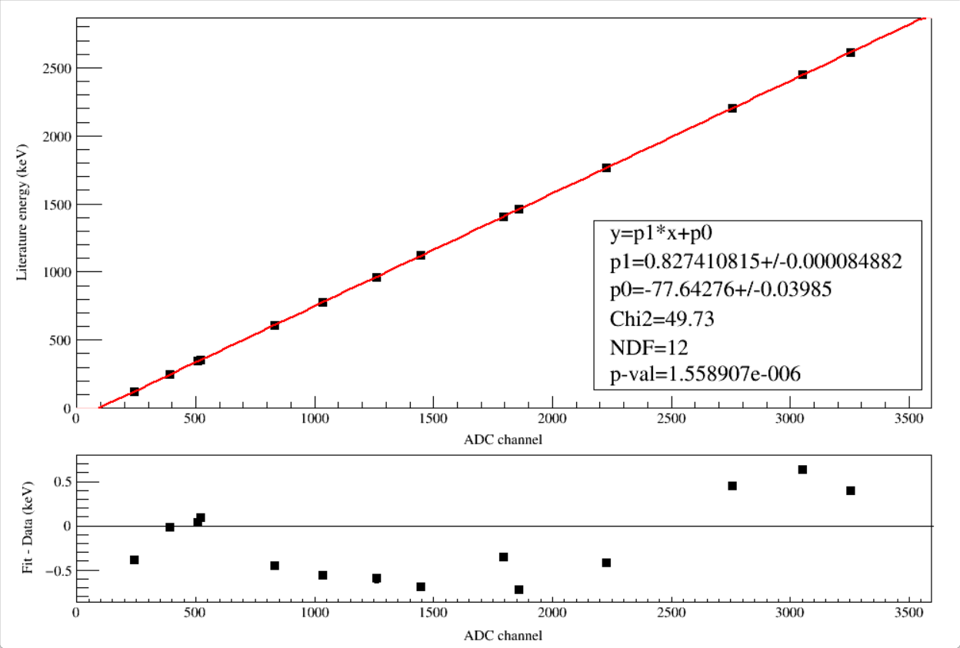
North_G0
Source | Eγ (keV) | σEγ
40K→40Ar | 1460.820 | 0.005 | peak0
208Tl→208Pb | 2614.511 | 0.010 | peak1
152Eu→152Sm | 121.7817 | 0.003 | peak2
152Eu→152Sm | 244.6974 | 0.008 | peak3
152Eu→152Gd | 344.2785 | 0.012 | peak4
152Eu→152Gd | 778.9045 | 0.024 | peak5
152Eu→152Sm | 964.057 | 0.05 | peak6
152Eu→152Sm | 1408.013 | 0.03 | peak7
214Pb→214Bi | 351.9320 | 0.0021 | peak8
214Bi→214Po | 609.321 | 0.007 | peak9
214Bi→214Po | 1120.294 | 0.006 | peak10
214Bi→214Po | 1764.491 | 0.014 | peak11
214Bi→214Po | 2204.10 | 0.04 | peak12
214Bi→214Po | 2447.69 | 0.03 | peak13

Slide 23
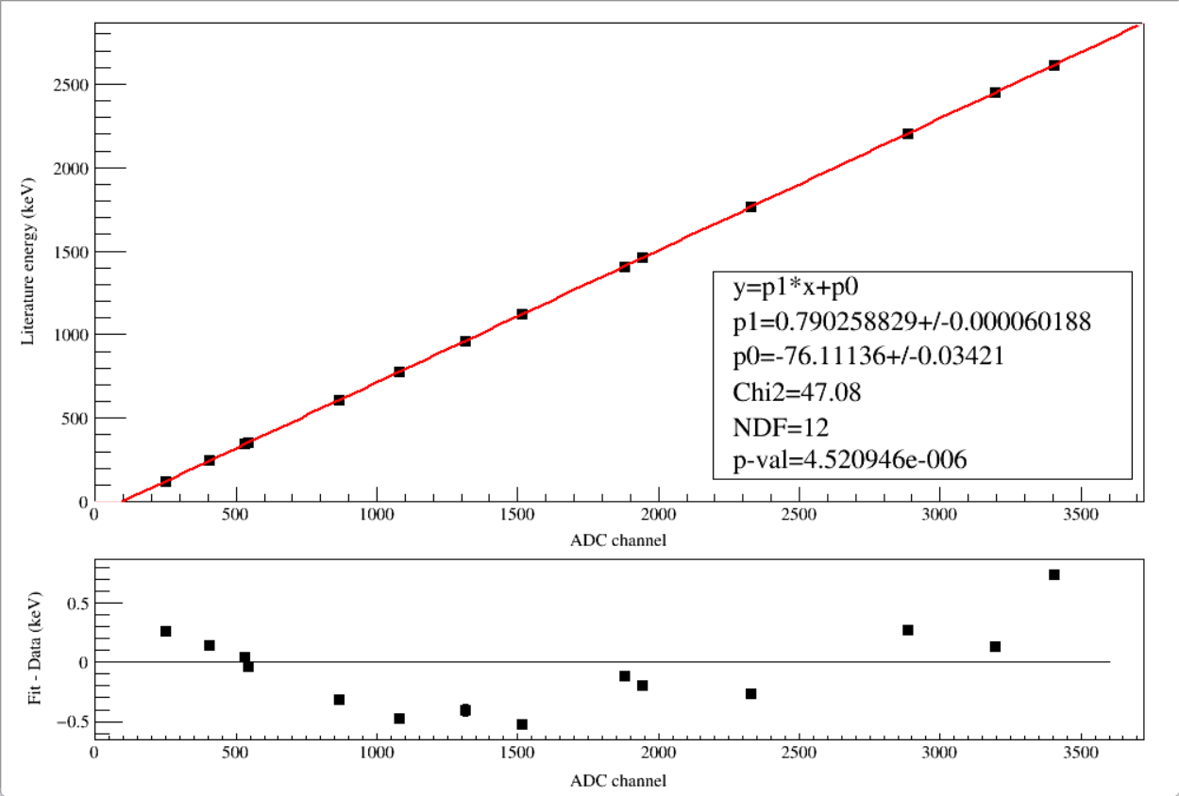
South_G1

Slide 24
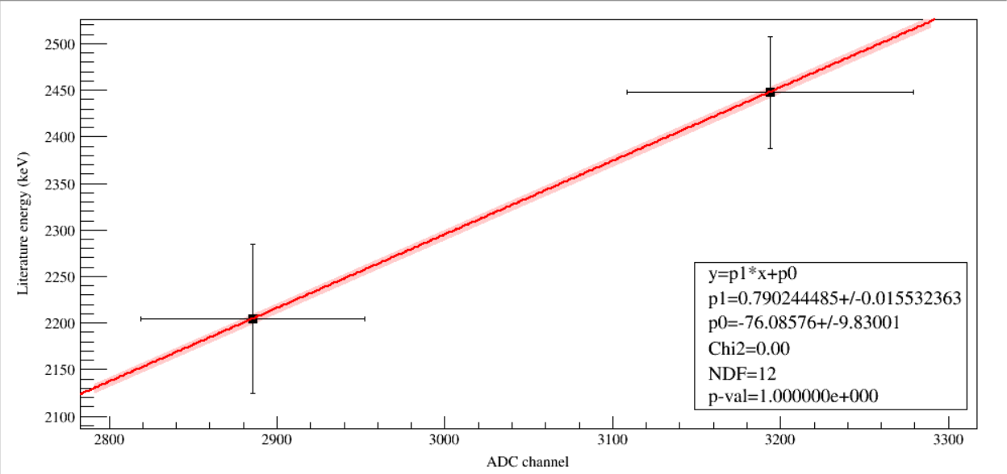
To determine calibration uncertainty at any energies, we need an uncertainty band.
y_err
x_err_proj
x_err
In case of a TGraphErrors object, ex, the error along x, is projected along the y-direction by calculating the function at the points x-exlow and x+exhigh.
The chisquare is computed as the sum of the quantity below at each point:
(y - f(x))**2
-----------------------------------
ey**2 + (0.5*(exl + exh)*f'(x))**2
where x and y are the point coordinates and f'(x) is the derivative of function f(x). This method to approximate the uncertainty in y because of the errors in x, is called "effective variance" method. The improvement, compared to the previously used method (f(x+ exhigh) - f(x-exlow))/2 is of (error of x)**2 order.

Slide 25
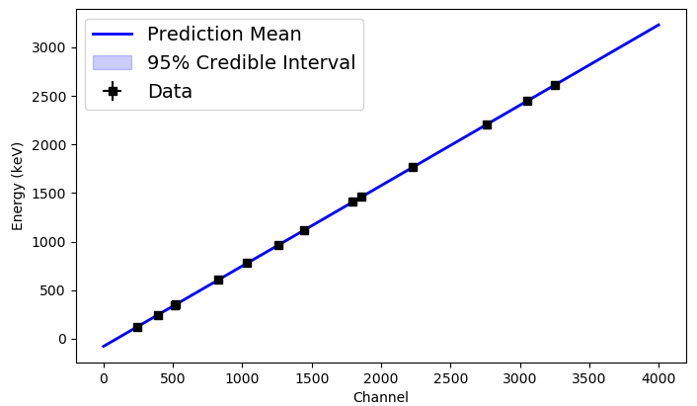
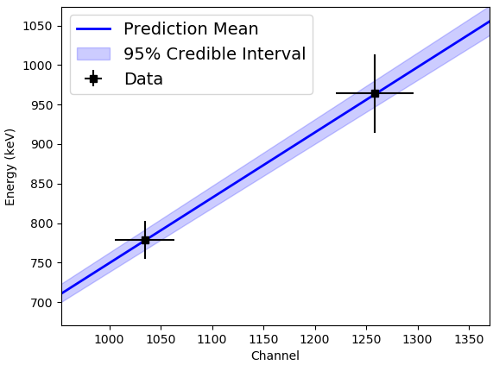
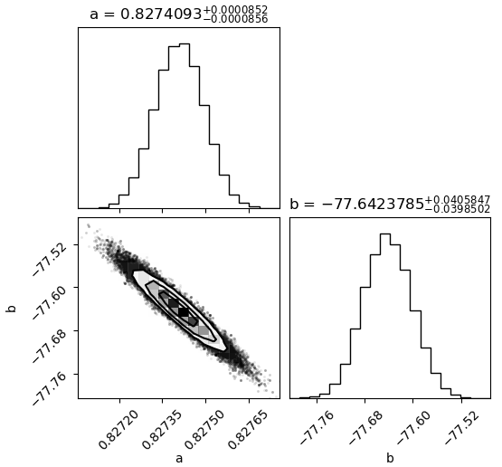
Zoom in to see the Uncertainty Band
emcee:
$$a={0.82741068}_{−0.00008454}^{+0.00008476}$$
$$b={−77.642875}_{−0.039866}^{+0.039859}$$
ROOT:
$$a=0.82741082±0.00008488$$
$$b=−77.642761±0.039847$$

Slide 26
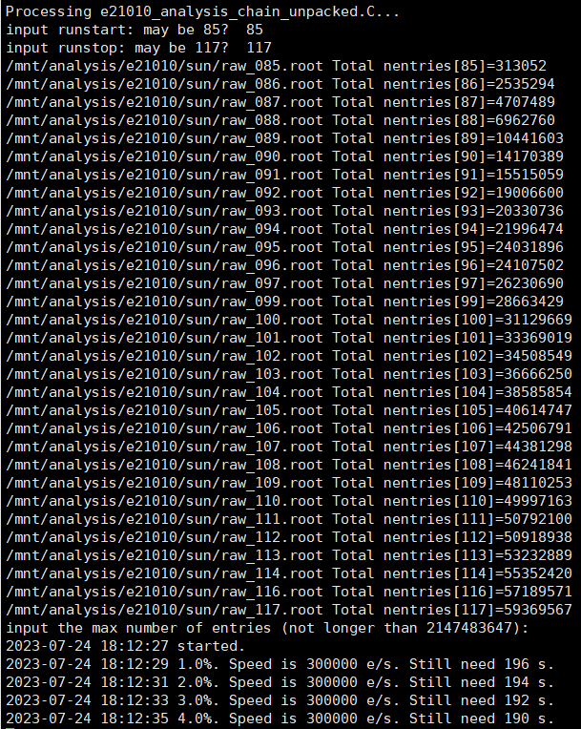
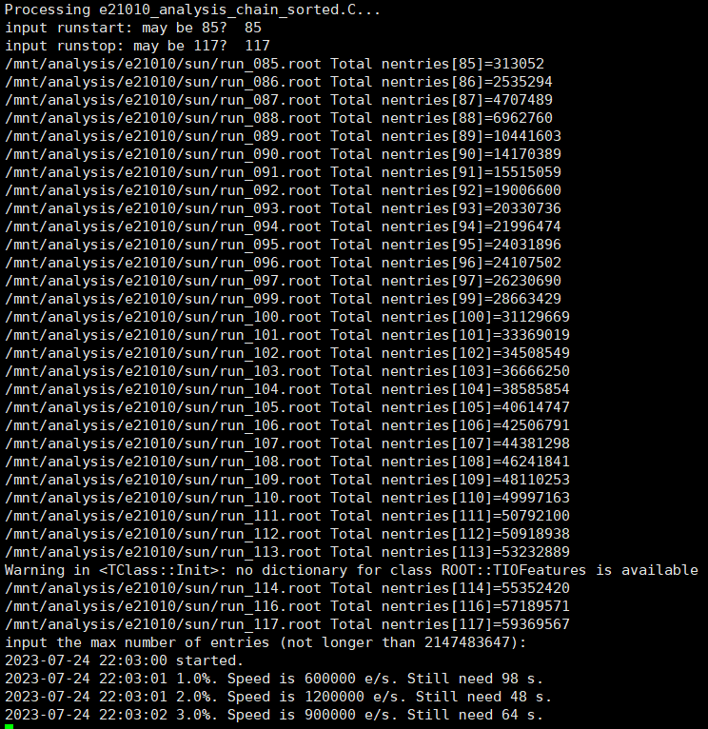

Slide 27
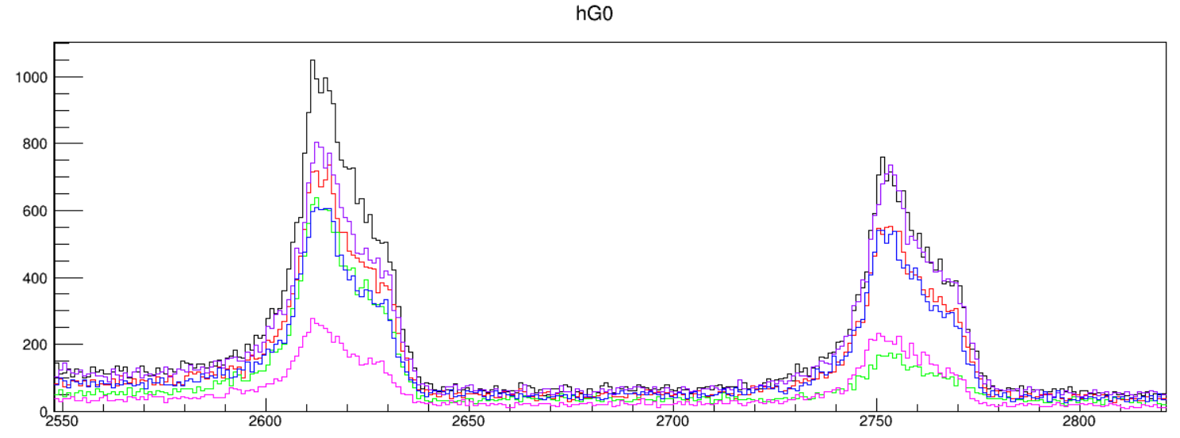
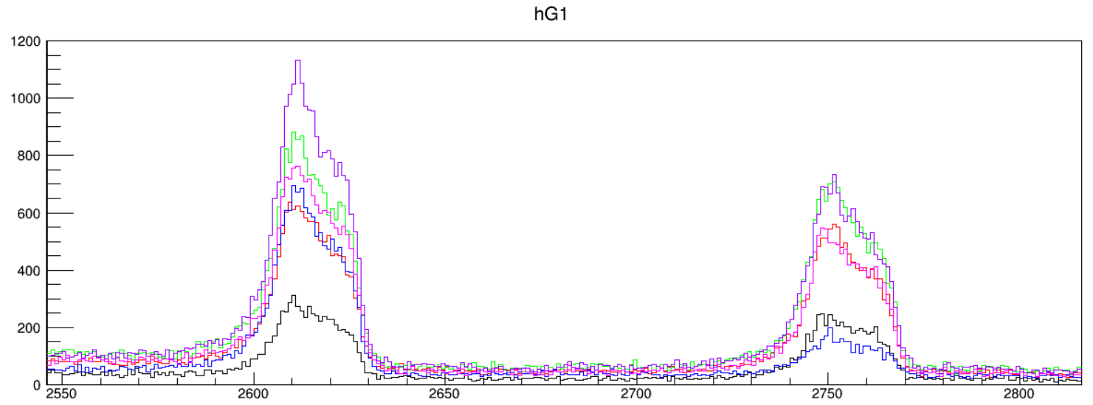
By 5 runs

Slide 28
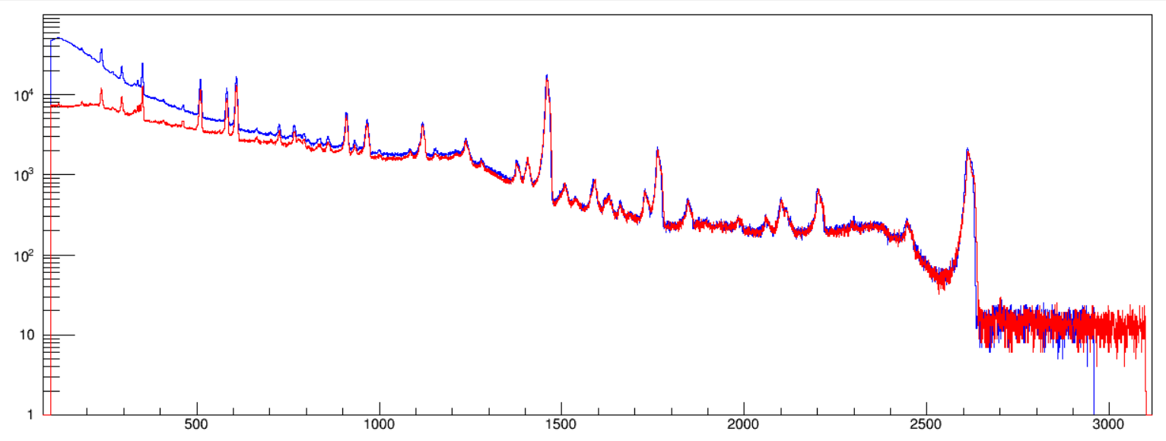
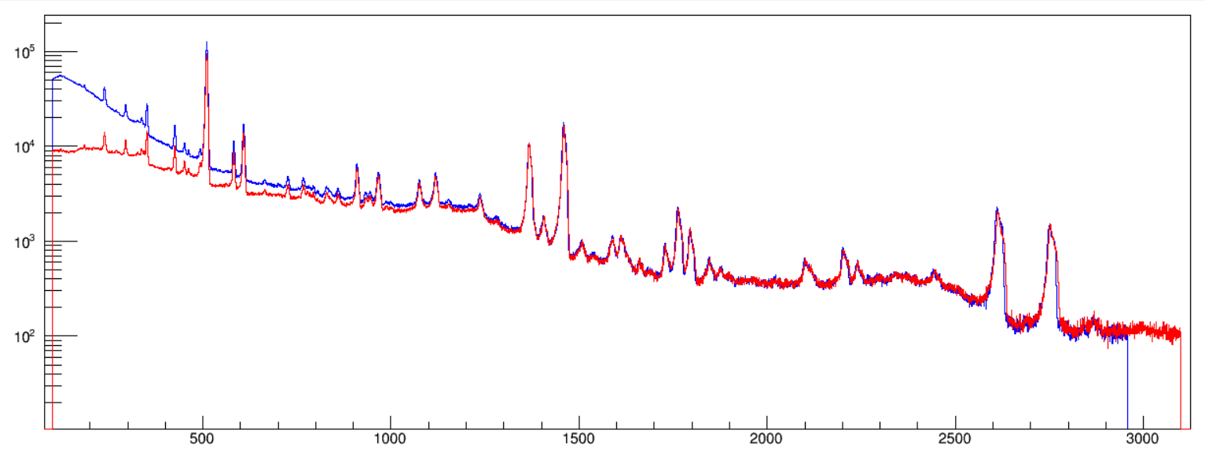
Run 046-074
All 22Al runs
North hG0
South hG1
Run 085-117
All 26P runs
North hG0
South hG1

Slide 29
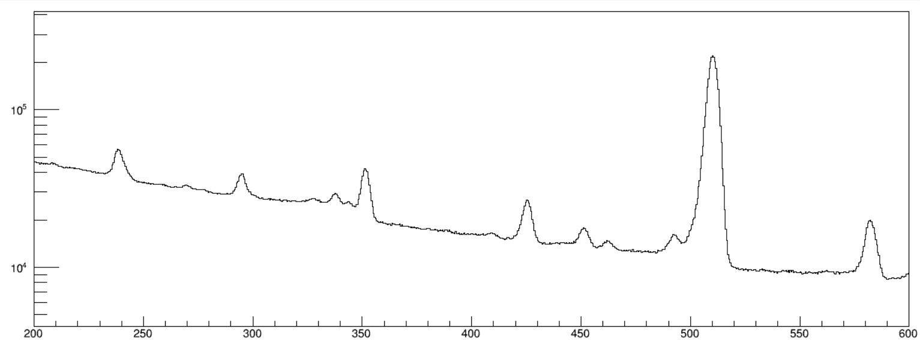
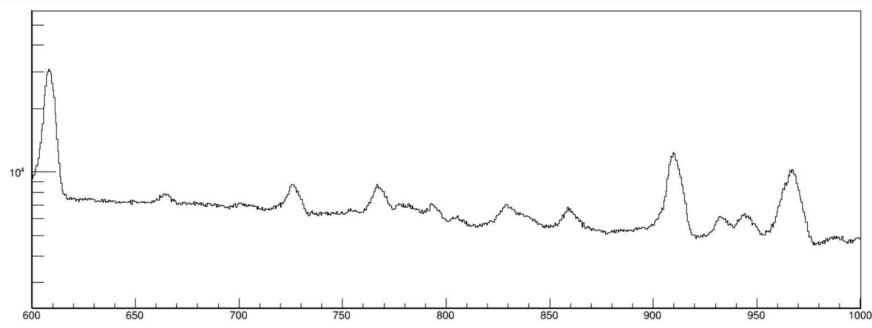
Raw γ-ray spectrum (hG0+hG1)
239
²¹²Pb
295
²¹⁴Pb
352
²¹⁴Pb
452
²⁵Al
583
²⁰⁸Tl
493
²⁵Al
609
²¹⁴Bi
911
²²⁸Ac
965
969
²²⁸Ac
829
²⁶Al
945
²⁵Al

Slide 30
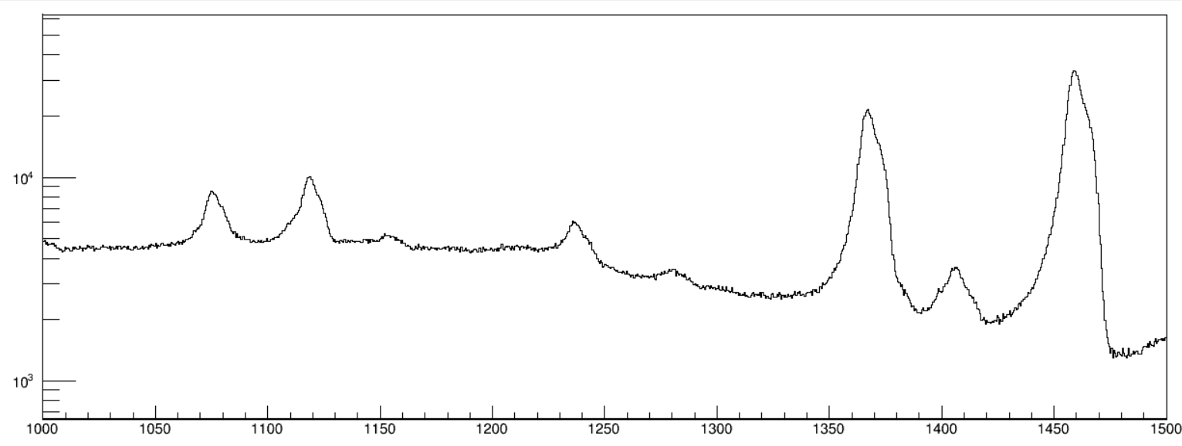
1369
²⁴Mg
205370
1461
⁴⁰K
1077
²⁴Mg
33962
1120
²¹⁴Bi
1238
²¹⁴Bi
1408
²¹⁴Bi
N₁₃₆₉ = 220387 based on counts in 1077
1764
²¹⁴Bi
1789
²⁵Al
1797
²⁶Si
1509
²¹⁴Bi
1588
²²⁸Ac
1612
²⁵Al
1730
²¹⁴Bi
1847
²¹⁴Bi

Slide 31
2204
²¹⁴Bi
2615*
²⁰⁸Tl
2754*
²⁴Mg
2119
²¹⁴Bi
2448
²¹⁴Bi
2615
²⁰⁸Tl
2754
²⁴Mg

