Slide 1
PXCT Timing Test
20240418

Slide 2
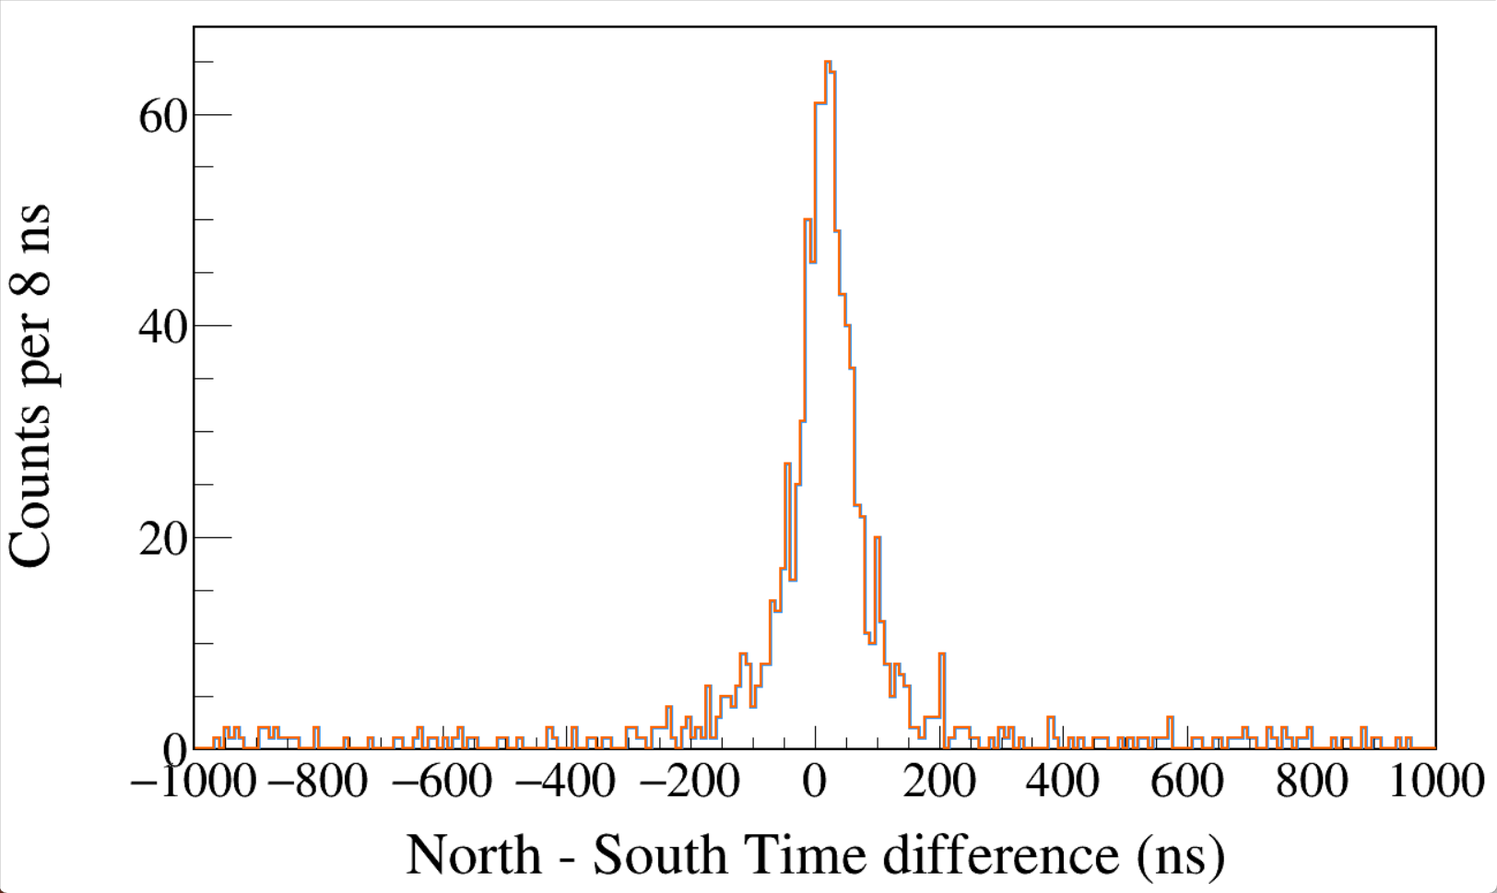
Run0234
60Co
Trigger Rise 0.016 μs
Trigger Gap 1.000 μs
CFD disabled
1100 < South < 1400
&&
1100 < North < 1400
CFD
LED
Notes:
TFile *_file0 = TFile::Open("F:/e21010/pxct/run0234_LEGe_XtRa_60Co_I7281_onChamberWall_window1us_TrigRise0.016us_TrigGap1.000us_CFDdisabled_cal.root");
TCanvas* canvaspeak = new TCanvas("canvaspeak", "canvaspeak", 1300, 800);//
canvaspeak->cd();//
canvaspeak->SetTopMargin(0.03);
canvaspeak->SetRightMargin(0.04);
canvaspeak->SetLeftMargin(0.13);
canvaspeak->SetBottomMargin(0.16);
canvaspeak->SetFrameLineWidth(2);
TH1D* htimestamps = new TH1D("htimestamps", "htimestamps", 250,-1000,1000);
htimestamps->Rebin(1);
htimestamps->SetStats(0);
htimestamps->SetTitle("");
htimestamps->GetXaxis()->SetTitle("North - South Time difference (ns)");
htimestamps->GetYaxis()->SetTitle("Counts per 8 ns");
htimestamps->GetXaxis()->CenterTitle();
htimestamps->GetYaxis()->CenterTitle();
htimestamps->GetXaxis()->SetLabelFont(132);
htimestamps->GetYaxis()->SetLabelFont(132);
htimestamps->GetXaxis()->SetLabelSize(0.06);
htimestamps->GetYaxis()->SetLabelSize(0.06);
htimestamps->GetXaxis()->SetTitleFont(132);
htimestamps->GetYaxis()->SetTitleFont(132);
htimestamps->GetXaxis()->SetTitleOffset(1.1);
htimestamps->GetYaxis()->SetTitleOffset(0.95);
htimestamps->GetXaxis()->SetTitleSize(0.07);
htimestamps->GetYaxis()->SetTitleSize(0.07);
htimestamps->GetXaxis()->SetRangeUser(-1000,1000);
//htimestamps->GetYaxis()->SetRangeUser(0,1700);
htimestamps->GetYaxis()->SetNdivisions(505);
htimestamps->SetLineWidth(3);
htimestamps->SetLineColor(kAzure+1);
tree->Draw("north_t-south_t>>htimestamps","south_e>1100&&south_e<1400&&north_e>1100&&north_e<1400");
tree->SetLineColor(kOrange+7);
tree->SetLineWidth(2);
tree->Draw("north_tled-south_tled","south_e>1100&&south_e<1400&&north_e>1100&&north_e<1400","same");

Slide 3
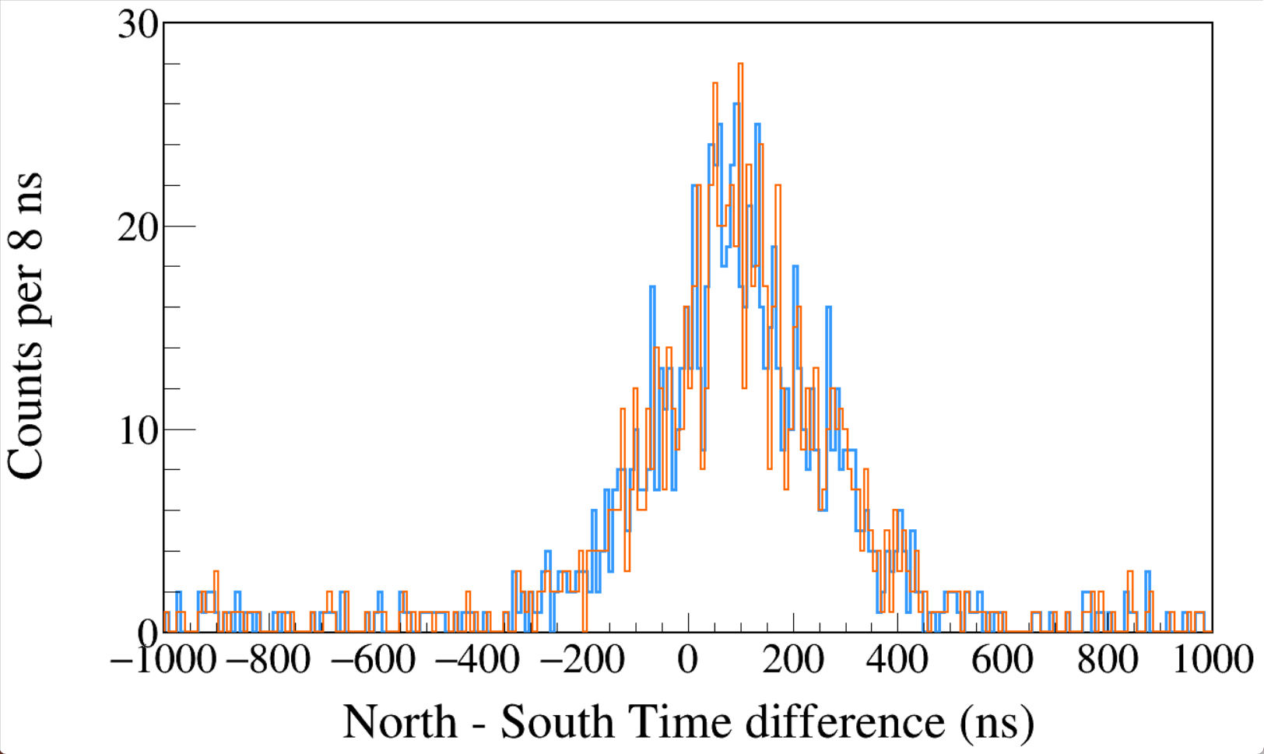
Run0235
60Co
Trigger Rise 0.016 μs
Trigger Gap 1.000 μs
CFD enabled
CFD Delay 0.504 μs
1100 < South < 1400
&&
1100 < North < 1400
CFD
LED
Notes:
TFile *_file0 = TFile::Open("F:/e21010/pxct/run0235_LEGe_XtRa_60Co_I7281_onChamberWall_window1us_TrigRise0.016us_TrigGap1.000us_CFDdelay0.504us_cal.root");
TCanvas* canvaspeak = new TCanvas("canvaspeak", "canvaspeak", 1300, 800);//
canvaspeak->cd();//
canvaspeak->SetTopMargin(0.03);
canvaspeak->SetRightMargin(0.04);
canvaspeak->SetLeftMargin(0.13);
canvaspeak->SetBottomMargin(0.16);
canvaspeak->SetFrameLineWidth(2);
TH1D* htimestamps = new TH1D("htimestamps", "htimestamps", 250,-1000,1000);
htimestamps->Rebin(1);
htimestamps->SetStats(0);
htimestamps->SetTitle("");
htimestamps->GetXaxis()->SetTitle("North - South Time difference (ns)");
htimestamps->GetYaxis()->SetTitle("Counts per 8 ns");
htimestamps->GetXaxis()->CenterTitle();
htimestamps->GetYaxis()->CenterTitle();
htimestamps->GetXaxis()->SetLabelFont(132);
htimestamps->GetYaxis()->SetLabelFont(132);
htimestamps->GetXaxis()->SetLabelSize(0.06);
htimestamps->GetYaxis()->SetLabelSize(0.06);
htimestamps->GetXaxis()->SetTitleFont(132);
htimestamps->GetYaxis()->SetTitleFont(132);
htimestamps->GetXaxis()->SetTitleOffset(1.1);
htimestamps->GetYaxis()->SetTitleOffset(0.95);
htimestamps->GetXaxis()->SetTitleSize(0.07);
htimestamps->GetYaxis()->SetTitleSize(0.07);
htimestamps->GetXaxis()->SetRangeUser(-1000,1000);
//htimestamps->GetYaxis()->SetRangeUser(0,1700);
htimestamps->GetYaxis()->SetNdivisions(505);
htimestamps->SetLineWidth(3);
htimestamps->SetLineColor(kAzure+1);
tree->Draw("north_t-south_t>>htimestamps","south_e>1100&&south_e<1400&&north_e>1100&&north_e<1400");
tree->SetLineColor(kOrange+7);
tree->SetLineWidth(2);
tree->Draw("north_tled-south_tled","south_e>1100&&south_e<1400&&north_e>1100&&north_e<1400","same");

Slide 4
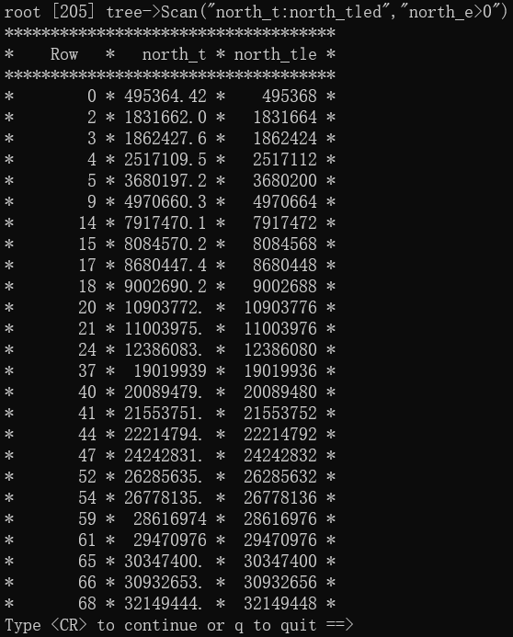
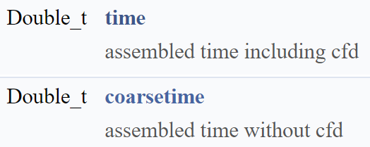
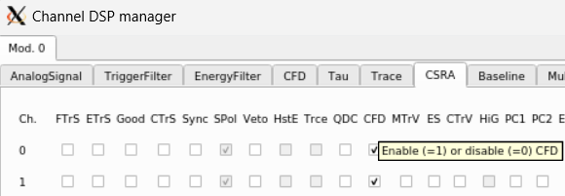
The time-stamp obtained from leading-edge triggering has a precision of 8 ns. However, in addition to the leading-edge triggering, the modules also employ a digital CFD algorithm that operates on the response of the trigger filter. The CFD algorithm provides timing measurements below the native sampling time of the module based on the zero-crossing time determined by linear interpolation between two points of the CFD algorithm.

