Slide 1
Lifetime of ²³Mg 7787 keV state (S2193)
1) Fit range
2) Bin width
3) Angular distribution
4) Bayesian analysis framework
5) Prior choices

Slide 2
Choice of priors

Slide 3
Summary of Nuclear Data from Literature
Literature | E_{x} (keV) | E_{γ} (keV) | I_{γ} (%) | R_{7.3/5.7} | Method | Comments
Sallaska_PRL2010 Sallaska_PRC2011 | 7784.7(12) | 5732 | 12(6) | 8.4(42) | ²²Na(p,γ)²³Mg
 |  | 7332.7(12) | 100
Jenkins_PRL2004 Jenkins_PRC2013 | 7784.6(11) | 7333.7(11) | 100 | ∞ | ¹²C(¹²C,nγ)²³Mg | E_{x} = 7785.2(13) by GLSC; E_{x} = 7785.7(11) by Oliver's recalculation
Iacob_PRC2006 | 7787.4 | 5736 | 20(5) | 5.0(12) | ²³Al(βγ)²³Mg
 |  | 7335.1 | 100
 |  | 7786 | 3.8(25)
Zhai_Thesis2007 | 7787.2(6) | 5735.4(7) | 23 | 4.3(12) | ²³Al(βγ)²³Mg
 |  | 7335.2(6) | 100
Fougeres_NC2023 | 7785.0(7) | 5734 | <3 | >32 | ³He(³²S,α)³¹S
 |  | $${7333.0}_{−2}^{+5}$$ | 100
Goldberg_Thesis2024 | 7787.3(5) | 5735.8(6) | 25 | 4.0(4) | ²³Al(βγ)²³Mg | https://arxiv.org/abs/2412.14734
 |  | 7335.1(9) | 100
Basunia_NDS2021 | 7784.7(8) | 5732 | 16(4) | 6.2(22) | Evaluation | E_{γ}: Weighted average of Sallaska and Jenkins; I_{γ}: Unweighted average of Sallaska and Iacob
 |  | 7333.2(11) | 100(6)

Slide 4
Emulator | PCGP_numPCs | PCGP_numPCs | PCGP_numPCs | PCGP_numPCs | PCGP_numPCs
Calibrator | directbayeswoodbury | directbayeswoodbury | directbayeswoodbury | directbayeswoodbury | directbayeswoodbury
Sampler | metropolis_hastings | metropolis_hastings | metropolis_hastings | metropolis_hastings | PTLMC
Prior (keV) | Gaussian Mean = 7332.7 Sigma = 1.2 | Gaussian Mean = 7335.1 Sigma = 0.9 | Gaussian Mean = 7333.2 Sigma = 1.1 | Bimodal Mean = 7332.7, 7333.7 Sigma = 1.2, 1.1 Weight = 0.5, 0.5 | Bimodal Mean = 7332.7, 7333.7 Sigma = 1.2, 1.1 Weight = 0.5, 0.5
E_{γ} (keV) | 7332.7(12) Sallaska_PRC2011 | 7335.1(9) Goldberg_Thesis2024 | 7333.2(11) Basunia_NDS2021 | 7332.7(12) Sallaska_PRC2011 7333.7(11) Jenkins_PRL2004 | 7332.7(12) Sallaska_PRC2011 7333.7(11) Jenkins_PRL2004
τ (fs) | $${6.3}_{−3.3}^{+3.9}$$ | $${9.5}_{−4.0}^{+4.6}$$ | $${7.0}_{−3.4}^{+3.8}$$ | $${7.2}_{−3.6}^{+3.8}$$ | $${7.5}_{−4.0}^{+3.9}$$
90% C.I. (fs) | <11.4 | <15.7 | <12.1 | <12.2 | <12.3

Slide 5
Gaussian Prior [Goldberg_Thesis2024]
Mean = 7335.1, Sigma = 0.9
Uniform Prior:
[7331.5, 7336.0]

Slide 6
Gaussian Prior [Basunia_NDS2021]
Mean = 7333.2, Sigma = 1.1
Bimodal Prior: [Sallaska_PRC2011] and [Jenkins_PRL2004]

Slide 7
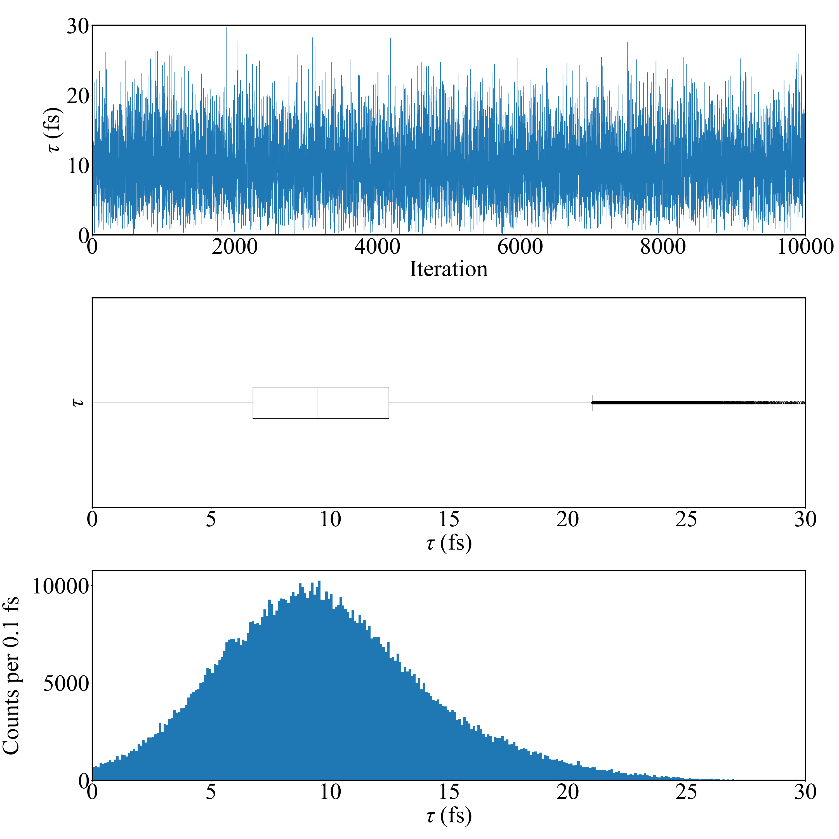
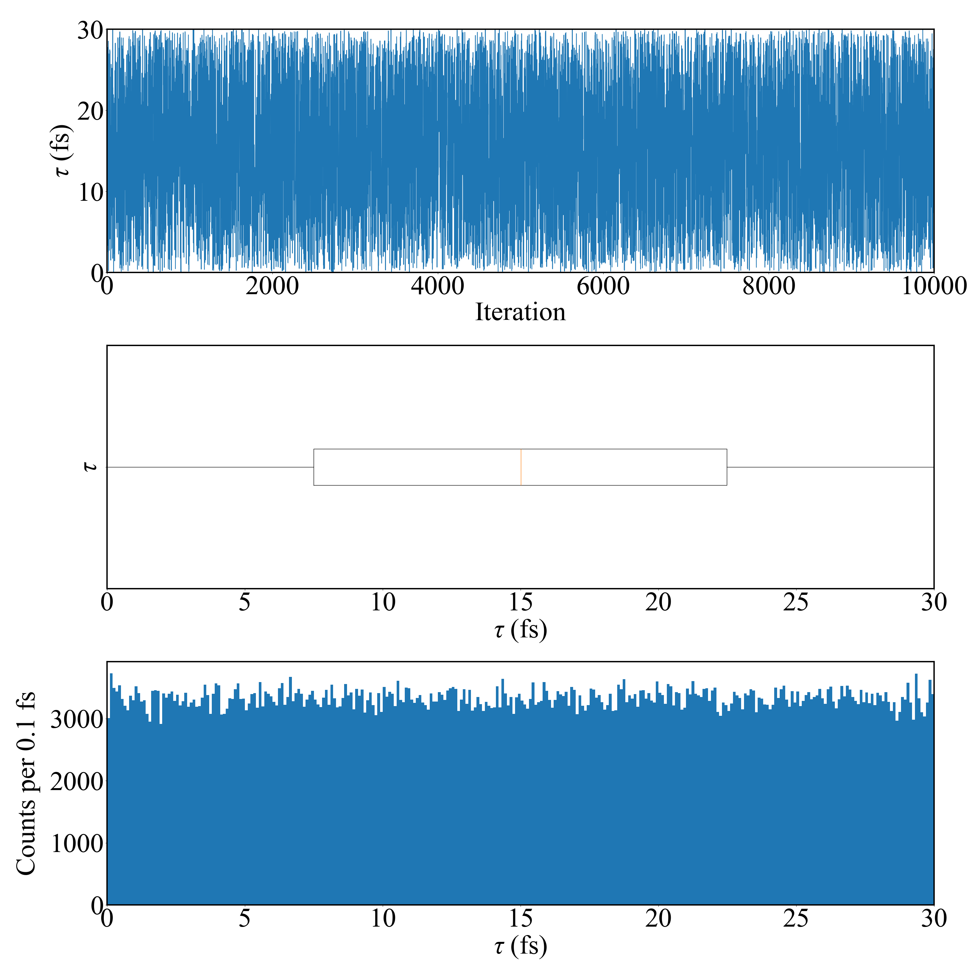
Emulation method: PCGP
Calibration method: directbayeswoodbury
Sampler: metropolis_hastings
Emulation method: PCGP
Calibration method: directbayeswoodbury
Sampler: metropolis_hastings
Eg prior: Lower bound Sallaska_PRC2011;
Higher bound Goldberg_Thesis2024
Tau = 15.014 +10.183 -10.200 fs
Eg prior: Goldberg_Thesis2024
Tau = 9.488 +4.589 -3.966 fs
Final Acceptance Rate: 0.23556
Final Acceptance Rate: 0.31992

Slide 8
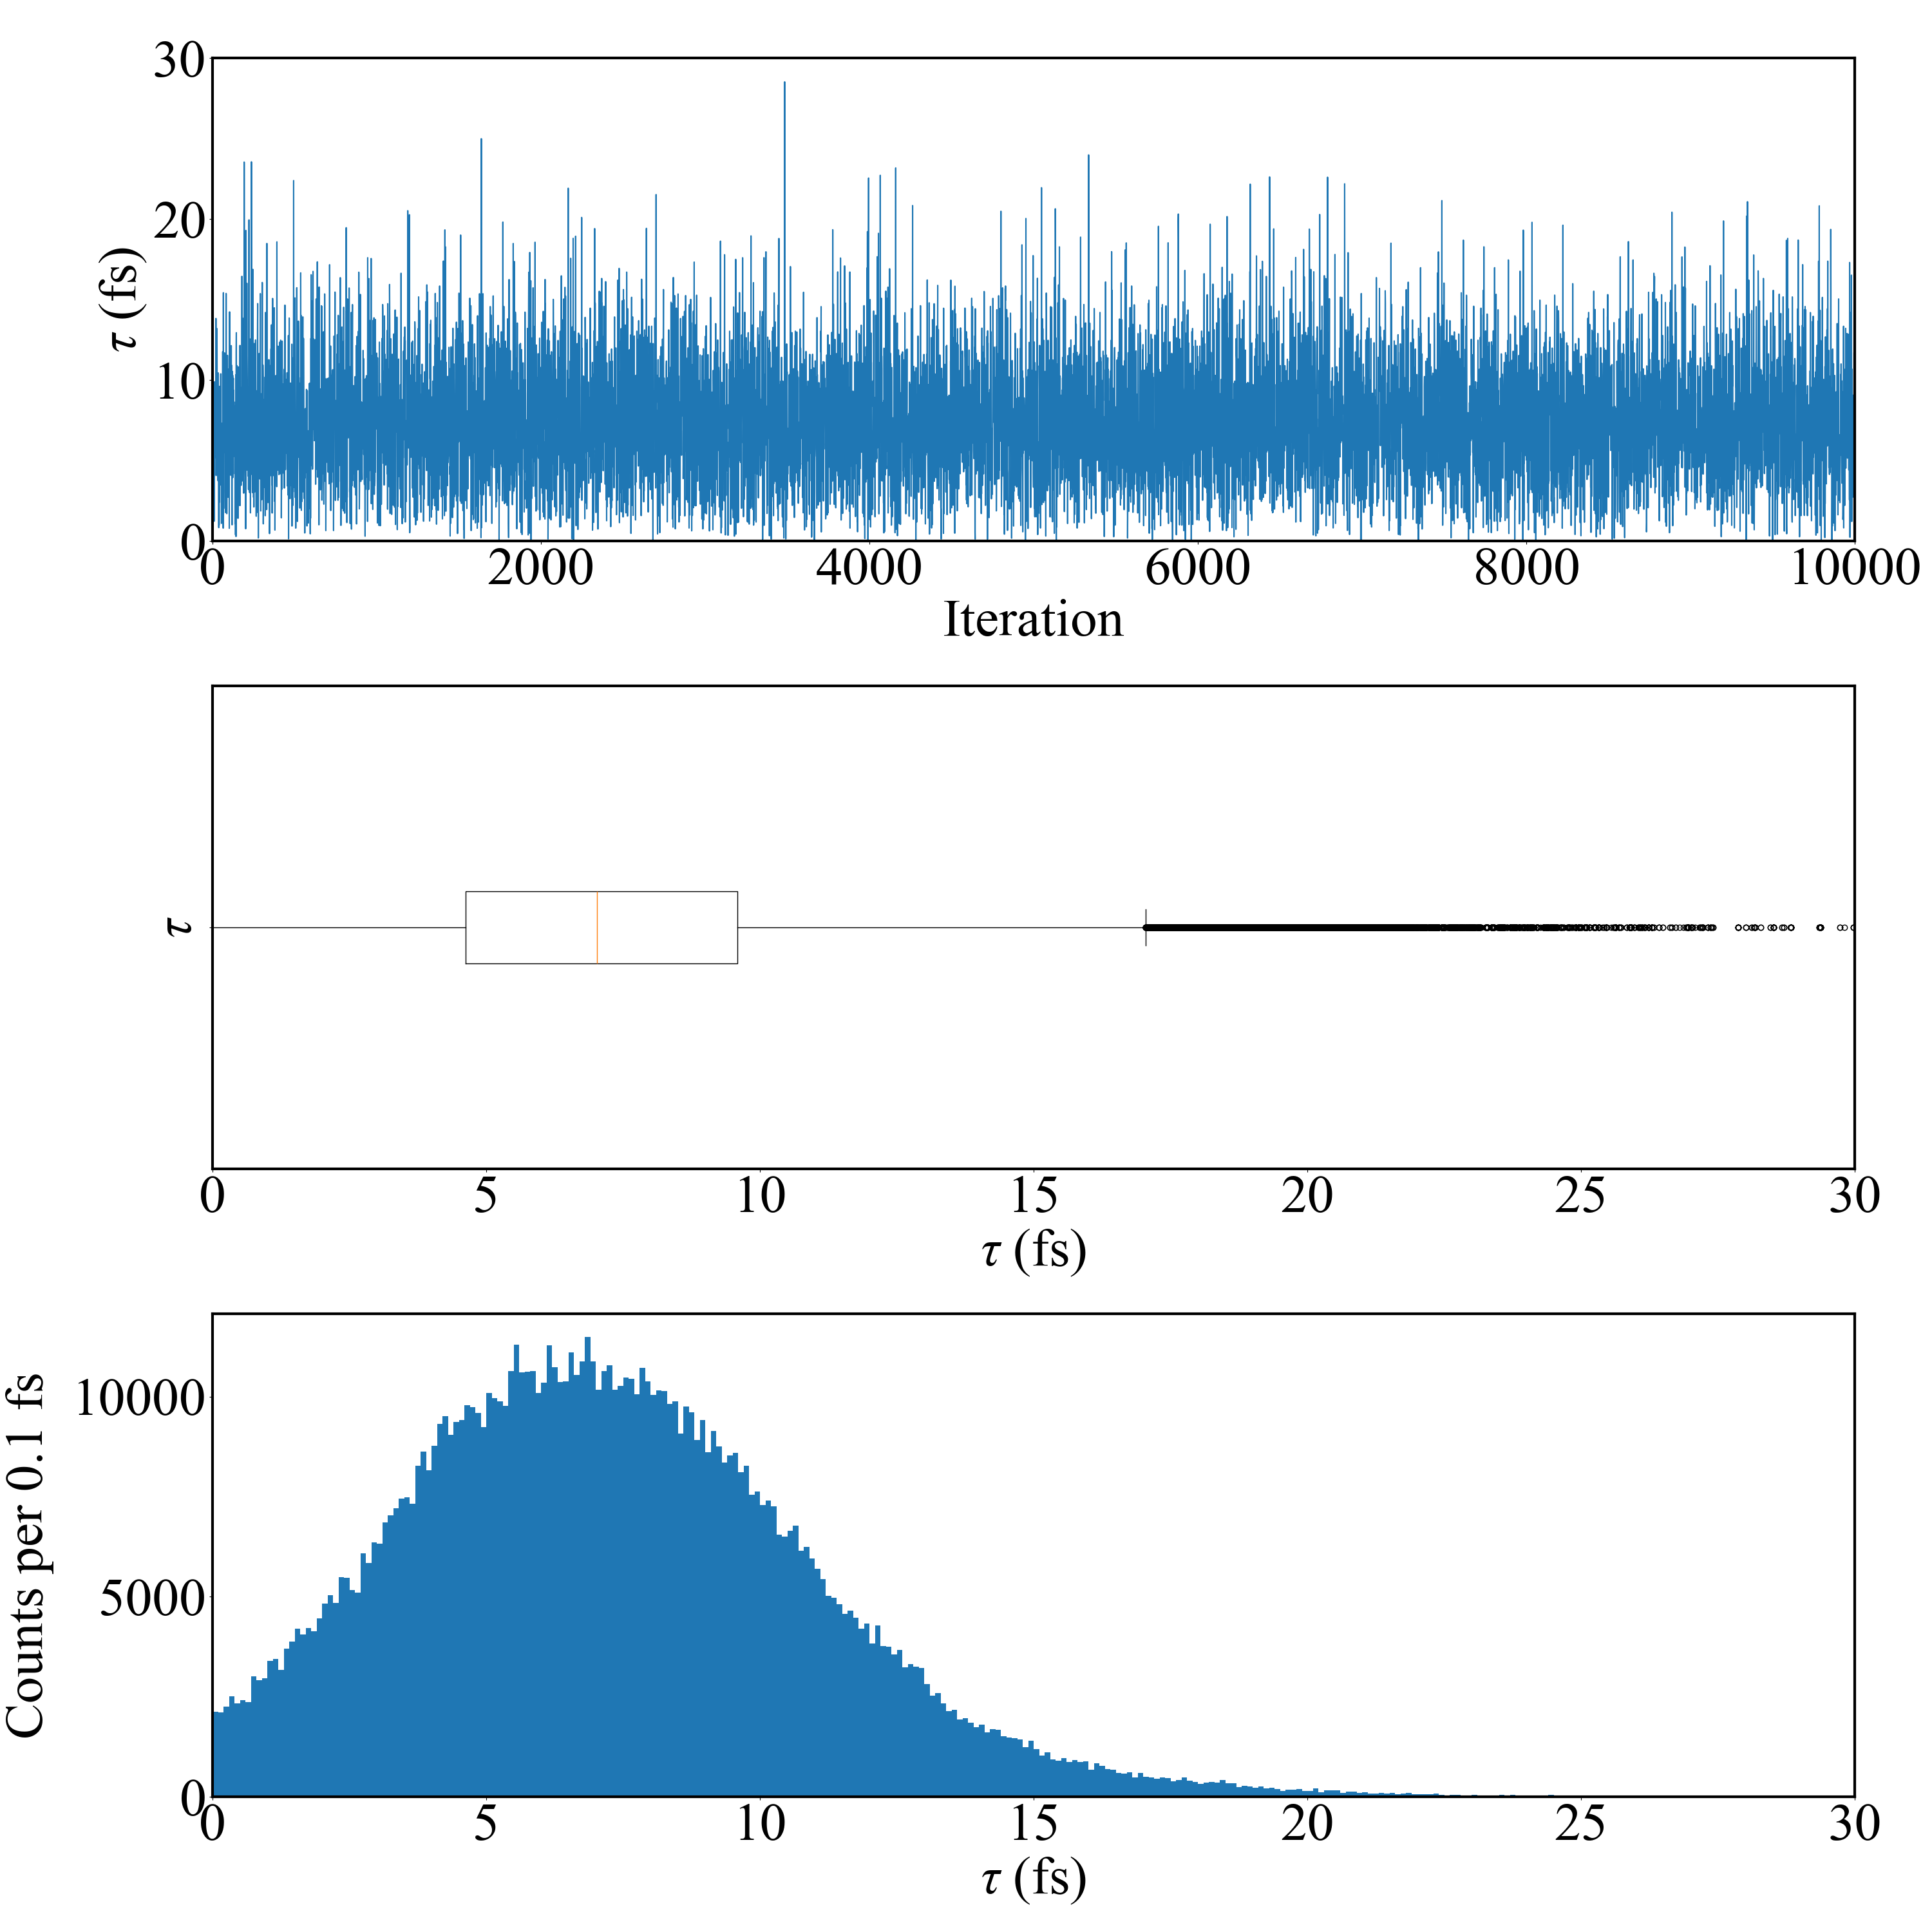
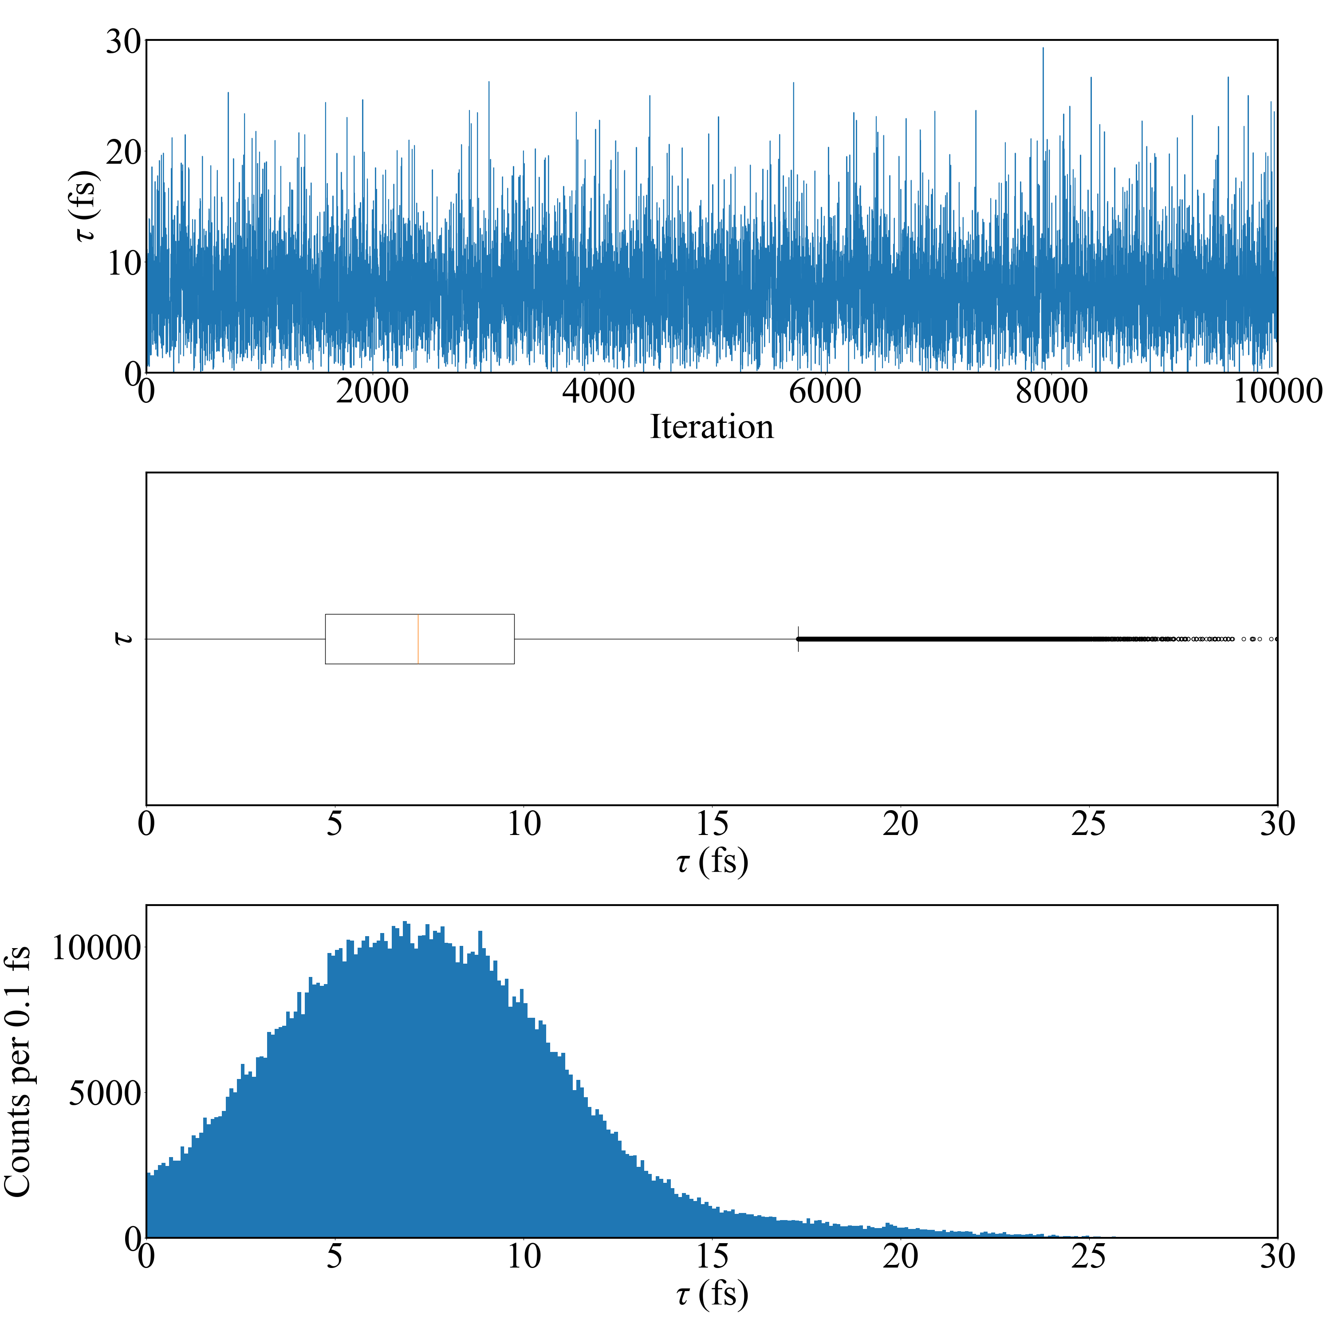
Emulation method: PCGP
Calibration method: directbayeswoodbury
Sampler: metropolis_hastings
Emulation method: PCGP
Calibration method: directbayeswoodbury
Sampler: metropolis_hastings
Eg prior: bimodal of Sallaska_PRC2011 and
Jenkins_PRL2004
Tau = 7.204 +3.788 -3.563 fs
Eg prior: Basunia_NDS2021
Tau = 7.021 +3.828 -3.424 fs
Final Acceptance Rate: 0.21566
Final Acceptance Rate: 0.22487

Slide 9
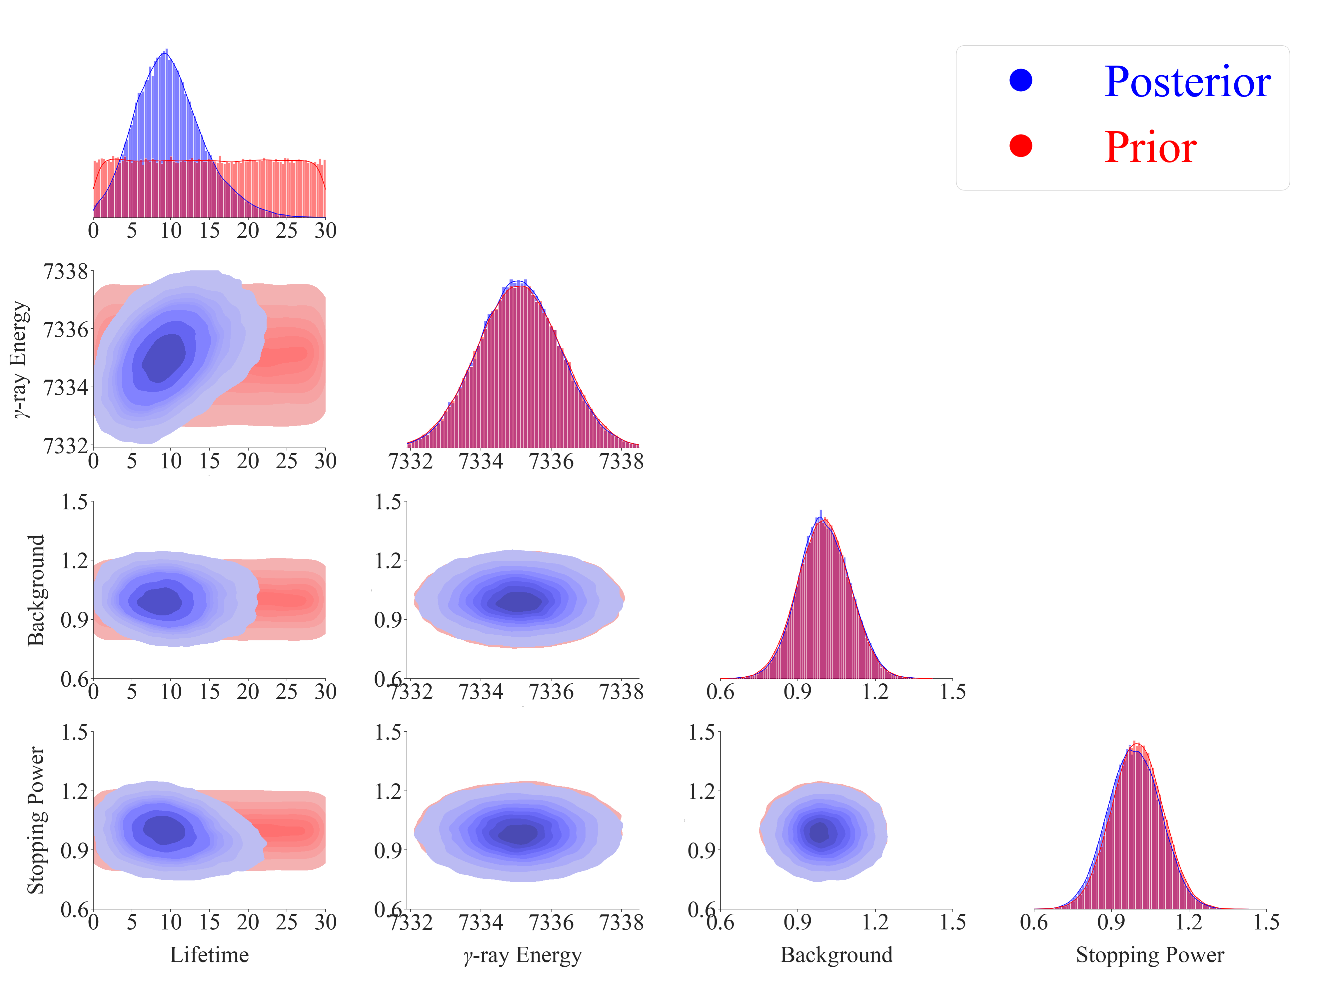
Gaussian Prior:
[Goldberg_Thesis2024]
Mean = 7335.1
Sigma = 0.9

Slide 10
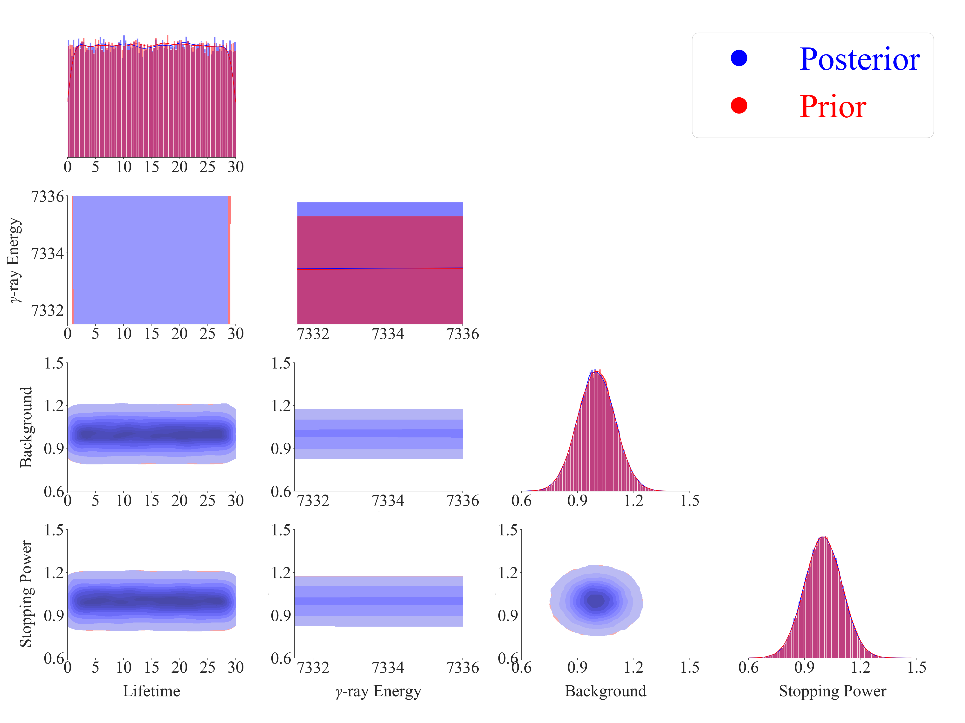
Uniform Prior:
[7331.5, 7336.0]

Slide 11
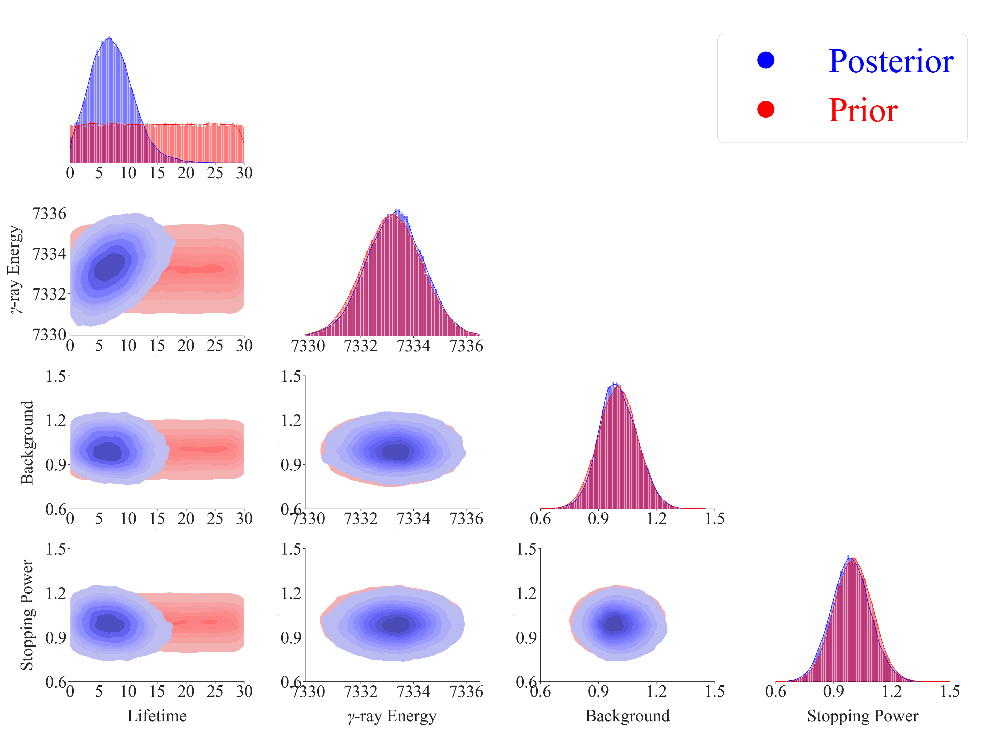
Gaussian Prior:
[Basunia_NDS2021]
Mean = 7333.2
Sigma = 1.1

Slide 12
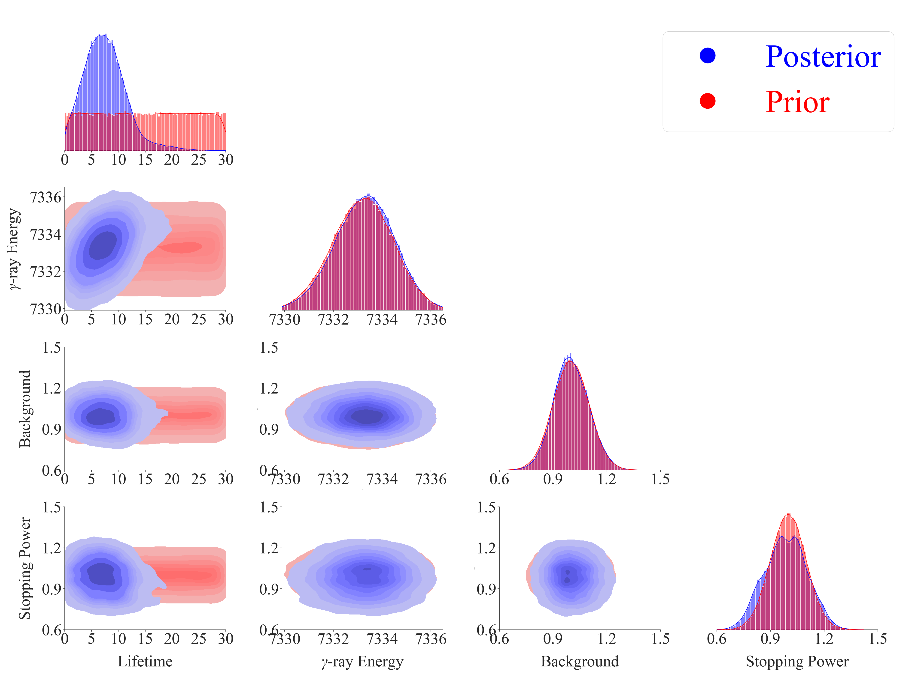
Bimodal Prior:
Mean = 7332.7, 7333.7
Sigma = 1.2, 1.1
Weight = 0.5, 0.5

Slide 13
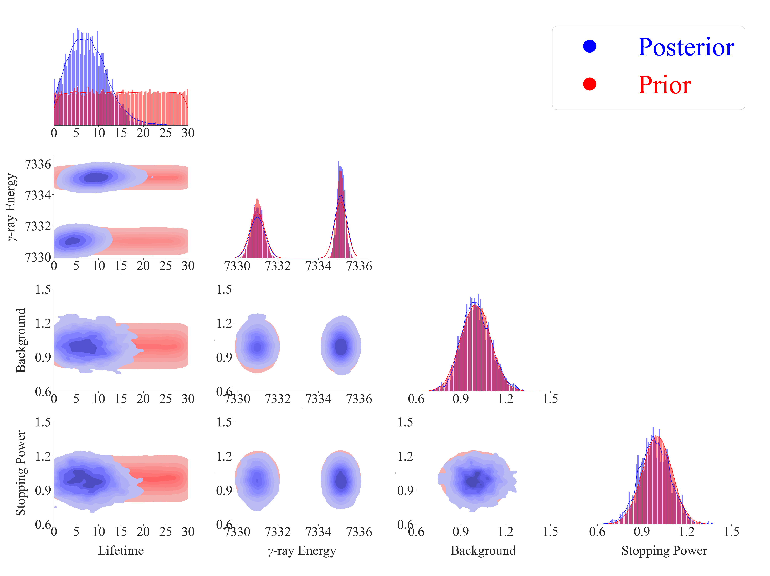
Tau = 7.432 +3.829 -3.776 fs
Test if Bimodal Prior works
Mean = 7331.0, 7335.1
Sigma = 0.3, 0.2
Weight = 0.5, 0.5
Emulation method: PCGP
Calibration method: directbayeswoodbury
Sampler: metropolis_hastings

Slide 14
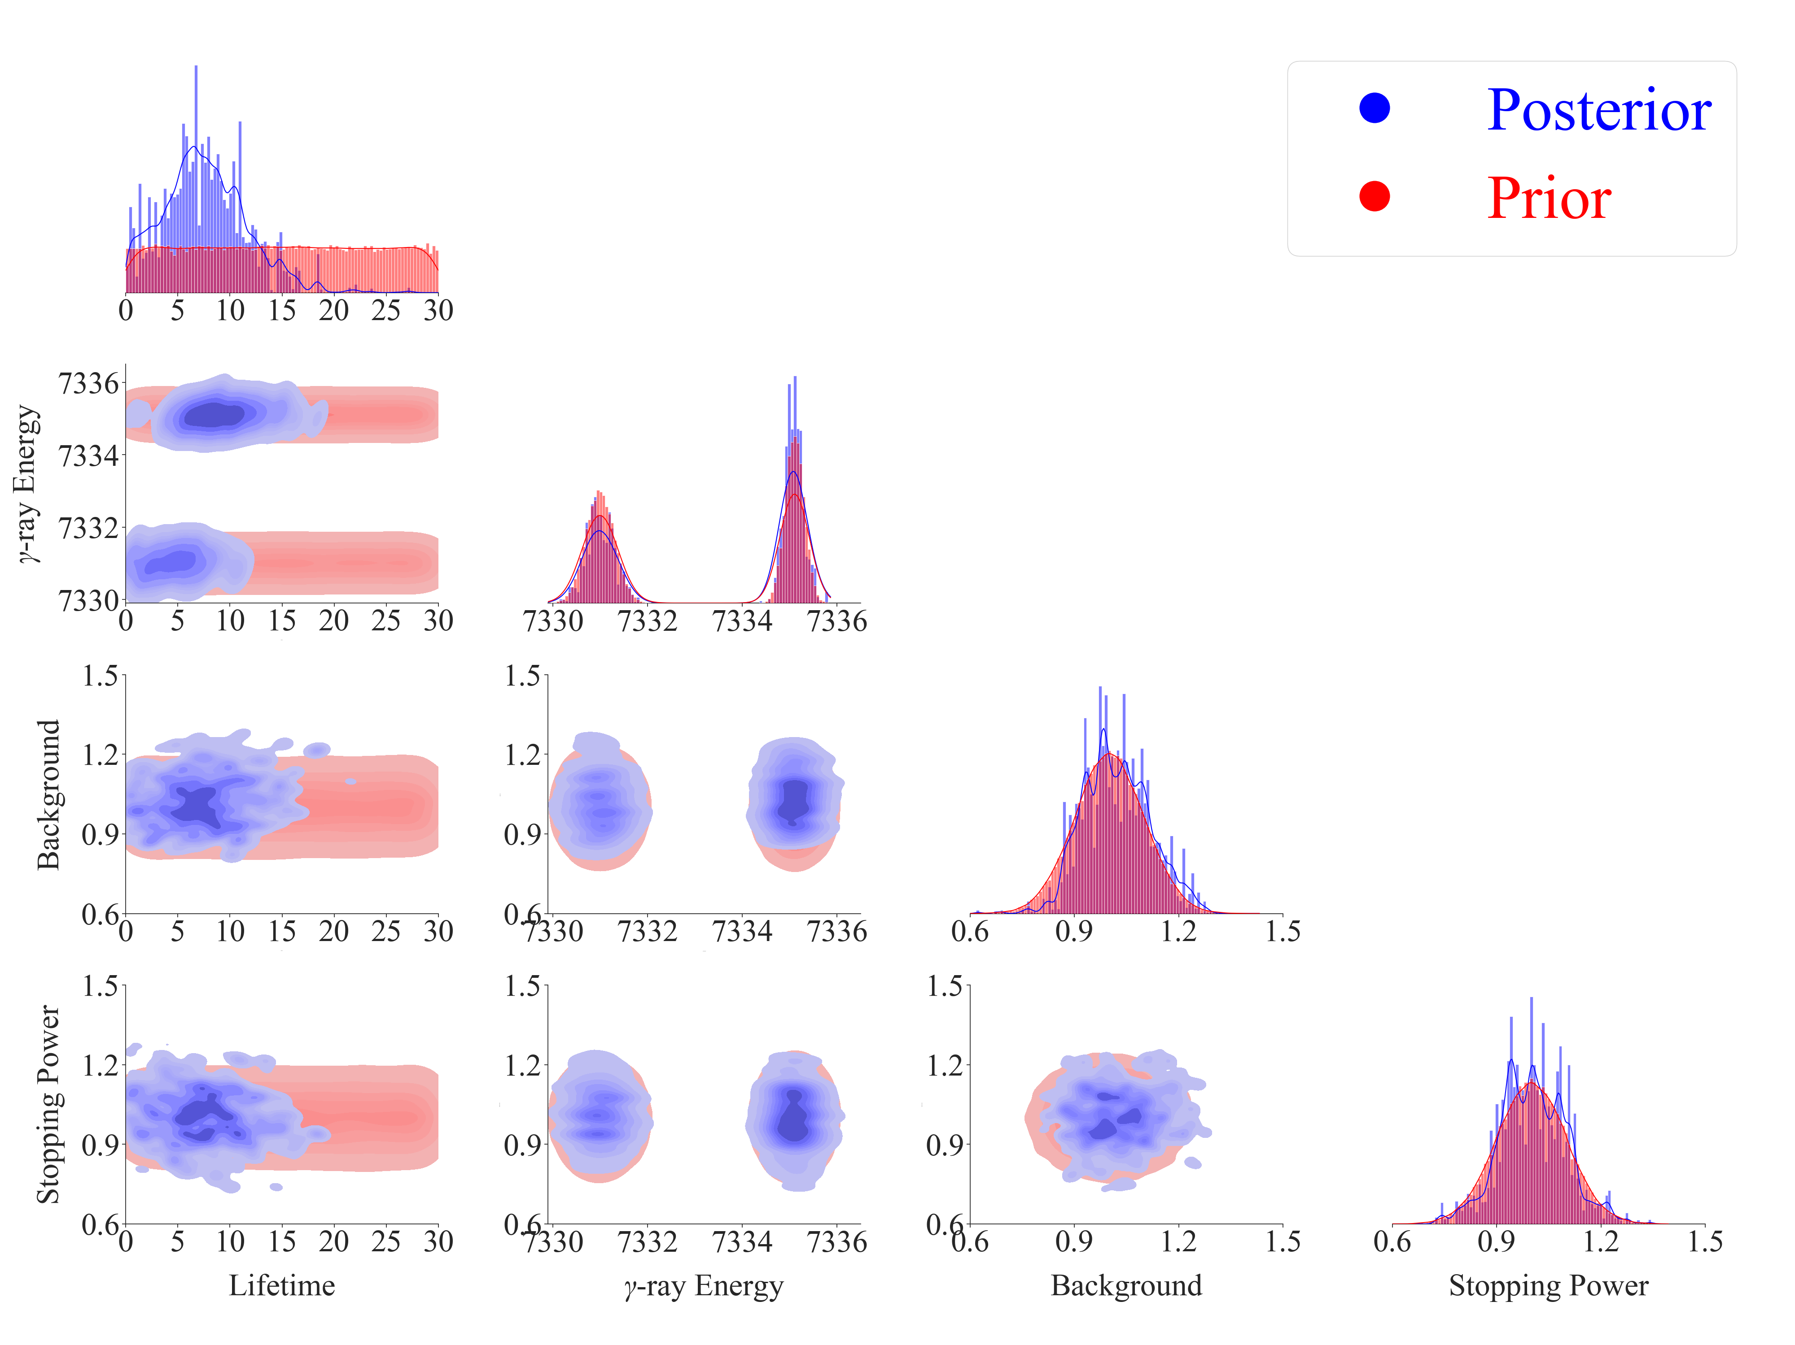
Tau = 7.318 +4.510 -4.062 fs
Test if Bimodal Prior works
Mean = 7331.0, 7335.1
Sigma = 0.3, 0.2
Weight = 0.5, 0.5
Emulation method: PCGP
Calibration method: directbayeswoodbury
Sampler: PTLMC
PTLMC is supposed to be suitable for handling multimodal distributions.

