Slide 1
Warm up
20240501

Slide 2
Dear Lijie,
concerning the temperature, I do not know what the manufacturer's recommendation is. But here some background. As you know the HPGe crystal sits in vacuum. But the vacuum isn't actively pumped and only maintained by an internal getter, usually zeolite. It provides a large active surface and just acts as a cryotrap, so it 'pumps' when it is cold. But when warming up at some point (about -100 C) it starts to outgas all the dirt it absorbed before. And the crystal is cold and may absorb the dirt, not good. If you then cool back down from this regime you 'freeze' the dirt at the crystal surface and degrades its performance. Therefore it is better to let the system warm up completely and then cool it down again. This ensures during the cool-down process that the getter stays colder than the crystal and the getter absorbs the restgas. Can I give a certain temperature? Not really. Up to -130 C I would consider it safe. But I always would 'feel' the temperature of the endcap fist. If it gets really cold, it means outgassing has already started. If you spot condensation this means the same thing.
Concerning leakage current, a good detector is in the pA and below range. Leakage current of 1 nA would be already very high and give a bad detector performance. Measuring those small currents is not trivial, therefore Ge supplies normally don't offer a current reading. But there is trick. Look at the noise band of the detector signal after a gaussian shaper. At 6 us shaping the noise needs to be narrower than at 3 us. If not, leakage current is already present.
My best tip: Just make sure that the cryocooler has power and is running.
cheers,
Dirk

Slide 3
1) HV-inhibit: Cold tip temp and PRTD1
We understand that there is a Cold tip temperature that can be observed either from the display of the Controller or the CP5-plus Control Panel application. Currently, the Cold tip temperatures for both our GX10020 are stable at -185°C. Based on the information provided in the manual, if it exceeds -160°C, the HV-inhibit feature will be triggered. Alright, we’ll closely monitor the Cold tip temperature throughout the duration of our experiment.
Wilhelm & Gabriela: The CP5-PLUS cooler power is regulated to maintain the cold tip temperature at the -185 C set point. As long as the cooler is functioning well, the cold tip temperature will have very little variance. For determining the state of health of the system, the cooler power is much more important to monitor. The cooler power is highly dependent on the room temperature, so it will fluctuate with ambient temperature. As long as the cooler power is less than about 150 Watts, the system should operate without issues. Above 150 Watts the cooler is nearing the maximum lift capabilities (~170 – 180 Watts), and preventive action may be necessary. This could include lower the ambient temperature (at least around the inlet and outlet fans of the CP5). If the inhibit cables are properly plugged into the controller, the CP5 system will send a HV-inhibit signal when the cold tip temperature exceeds -160 C. (–167C in our case because PRTD1 triggers inhibit in only 10 minutes. It takes 25 minutes to reach -160C) This will likely only happen if the cooler is turned off or not operating properly. On a side note, if you need to turn off the cooler to move the detector or other reason, you would typically have about five minutes or so before the detectors warms up too much and requires a full thermal cycle.

Slide 4
We have noticed another PRTD1 temperature that stabilizes at –158°C for the detector S/N5593 and –168°C for the detector S/N5596. We can monitor PRTD1 from the iPA Control Panel Application. However, we are not sure which part PRTD1 is measuring and are curious to know if there is a specific threshold for PRTD1. According to the manual, PRTD1 could potentially trigger HV-inhibit as well.
Wilhelm & Gabriela: The PRTD1 resistor is mounted on the crystal holder and is a representation of the temperature of the crystal. There are non-temperature dependencies on the resistance values (e.g. lead resistance), which is why the two detectors have slightly different temperatures; nevertheless, the relative changes in temperature are accurate. By default the HV-inhibit will occur at 10 degrees above the nominal temperature values in the spec sheet (For North, PRTD1 only increases 4 before it triggers HV-inhibit. Only 10 minutes after cooler stops and CP5 is at around –167 C.). On another side note, PRTD2 is mounted on the cold tip next to the CP5 cold tip resistor. Again, the PRTD2 may be 5-10 degrees different due to non-temperature dependencies, but it will also reflect the temperature of the cold tip.

Slide 5
2) Warm-up: Cold temp
The manual says if the controller displays a message that says, “The cryogenerator needs to warm up. Please wait. Cold temp: <actual sensor temperature>. It means the detector has started to warm up and needs to complete a full thermal cycle before it can be restarted.
We assume there is a preset warm-up temperature threshold. Once the “Cold temp” rises above that threshold, the detector must undergo a complete warm-up process. Is the "Cold temp" equivalent to the “Cold tip temperature”? and what is the threshold required for a full warm-up? –130°C? –100°C?
Wilhelm & Gabriela: The controller will prevent activation of the cooler when the cold tip temperature exceeds -150 C. In this condition, the cooler will not activate until the cold tip temperature exceeds 0C. This functionality is designed to prevent a partial thermal cycle of the detector. Note with large 100% detectors that you have, the detector may not be fully warm a the default cooler activation temperature, so we would recommend to allow a full 24 hour warm up before turning the cooler back on. You can monitor the PRTD1 value to gauge the crystal temperature, but note that this sensor is also mounted on the outside of the holder and is only representative of the true temperature of crystal when it is in thermal equilibrium.

Slide 6
Hello Lijie,
Regarding your questions detector S/N 13725, the white cap on the detector is simply a cover to protect the beryllium window during movement of the detector. The detector cryostat is fully self-contained with a vacuum, so it is safe (and even recommended) to test the detector external of your vacuum chamber to verify the detector is operating properly prior to installation in your scattering chamber.
Concerning evacuation/venting protocols for your scattering chamber once the detector is installed, there should be no issues regarding the evacuation of the chamber because the detector cryostat is itself already in a vacuum. One should be very careful, however, regarding venting of the chamber, a strong in-rush of gas can easily rupture the beryllium window. We don’t have a specific venting flow rate recommendation, but we advise use a needle valve system in which on can carefully introduce atmosphere to the chamber.
We wish you success in your experiments.
Best Regards,
Wilhelm
Wilhelm Mueller, PhD
Detector Engineering Manager
Mirion Technologies, Inc.

Slide 7
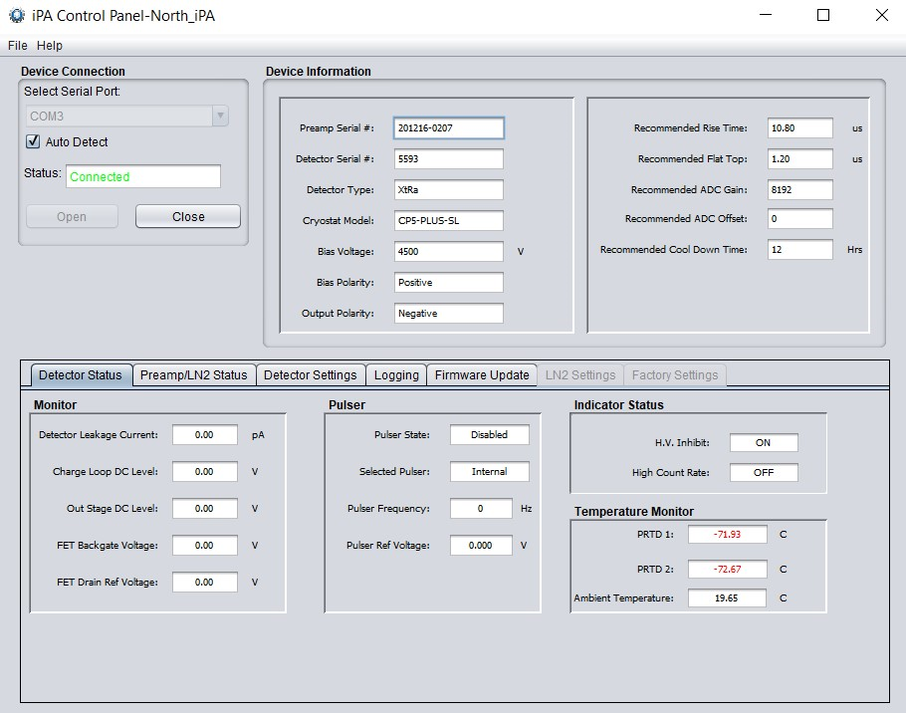
4 hours after the cooler was turned off

Slide 8
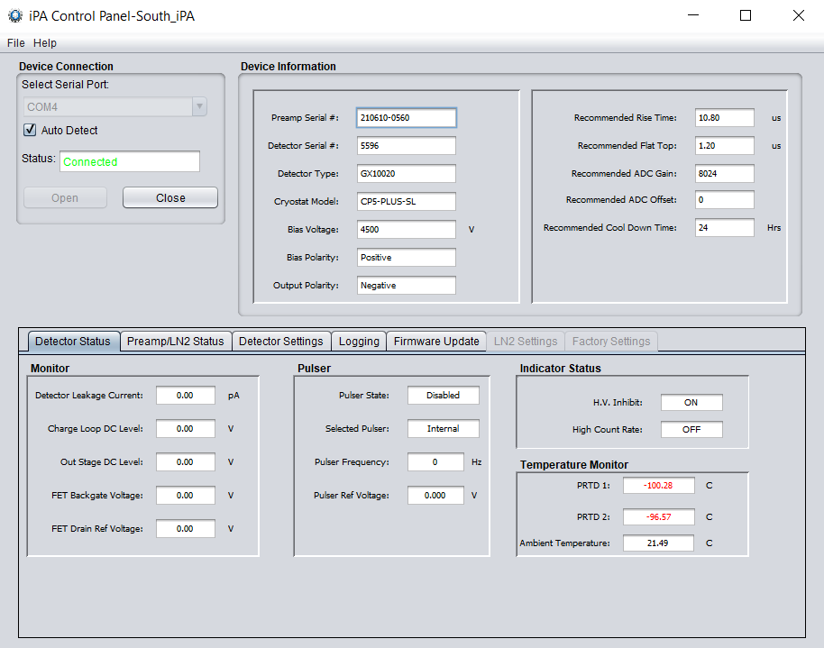
3.5 hours after the cooler was turned off

Slide 9
16 hours after the cooler was turned off

Slide 10
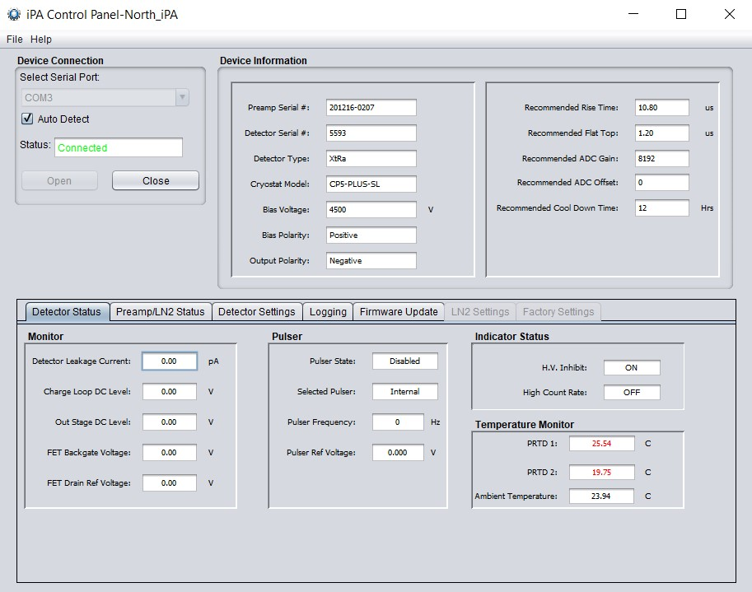
16 hours after the cooler was turned off

Slide 11
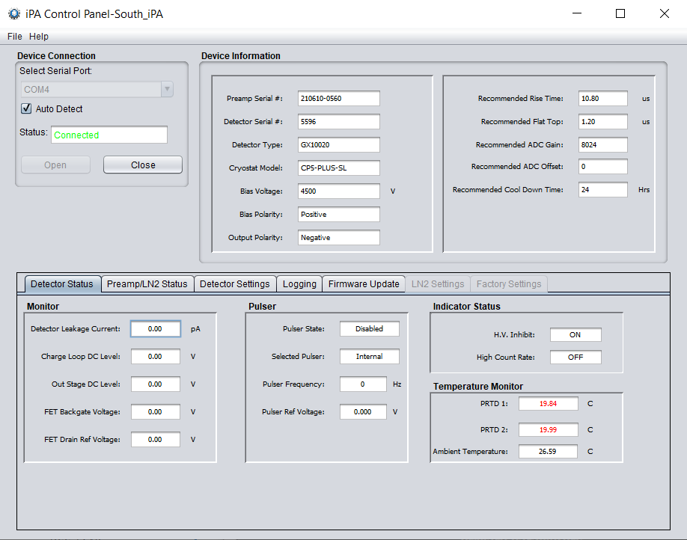
16 hours after the cooler was turned off

