Slide 1
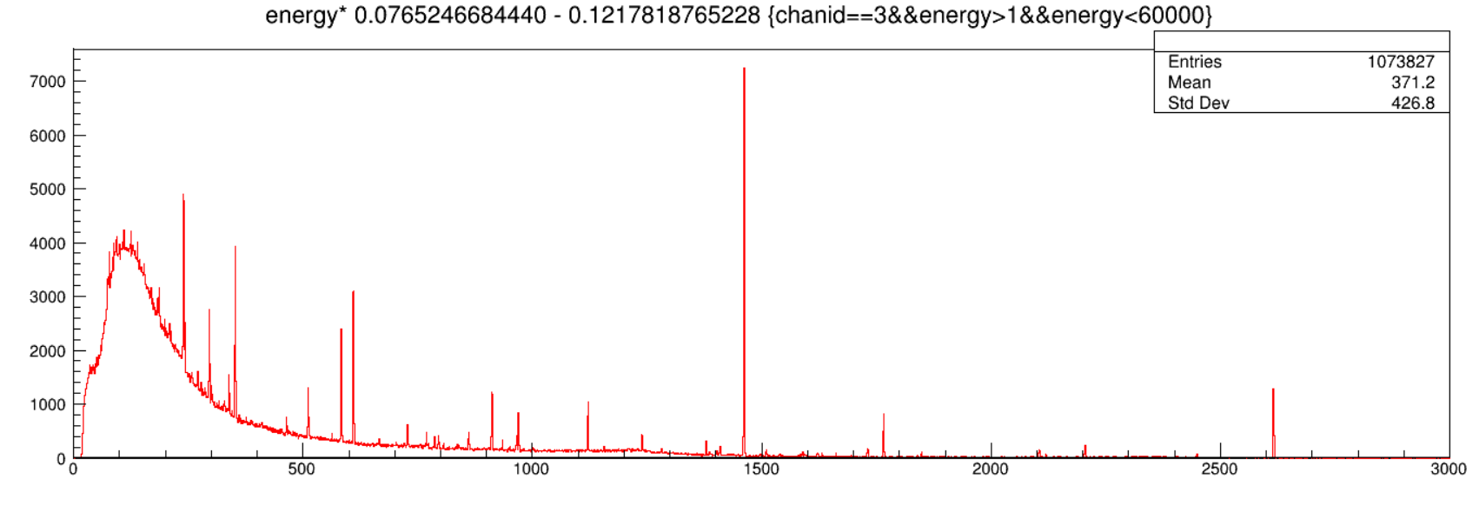
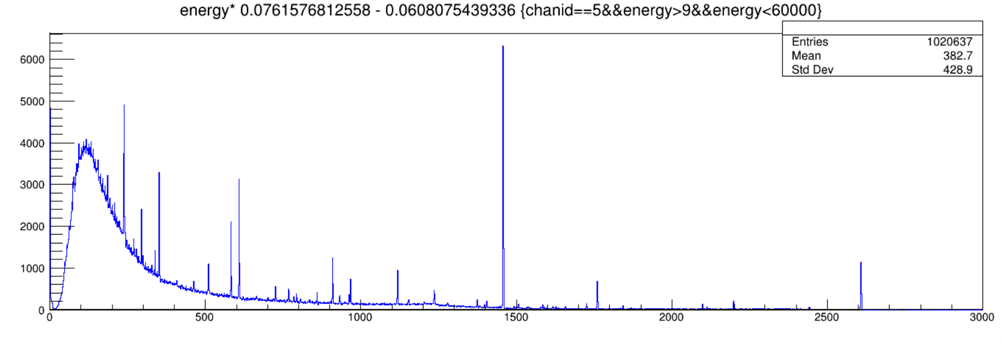
Run0162
Aug 23, 2024, 08:00-08:59 am
North
Run0162
Aug 23, 2024, 08:00-08:59 am
South
Notes:
dchan->Draw("energy* 0.0765246684440 - 0.1217818765228>>(3000,0,3000)","chanid==3&&energy>1&&energy<60000")
dchan->Draw("energy* 0.0761576812558 - 0.0608075439336>>(3000,0,3000)","chanid==5&&energy>9&&energy<60000")

Slide 2
Contingency plans for warm-up:
During normal operations, the cold tip is maintained at the preset −185◦C.
If the cold tip temperature rises above −160◦C, the controller will trigger the high-voltage inhibit.
If it further exceeds −150◦C, the controller will shut down the cooler, forcing the Ge to undergo a full thermal cycle.
Once the cold tip temperature reaches 0◦C, the controller will restart the cooler by default.
For large volume Ge, the Mirion engineer recommends manually turning off the cooler to allow the Ge to fully warm up and restarting the cooler after a prolonged period of at least 24 hours.

Slide 3
Each iPA is equipped with two 100-Ω Pt resistance temperature detectors thermally connected to the crystal holder (PRTD1) and the cold tip (PRTD2), respectively.
In our setup, the nominal PRTD1 temperatures are −182.6 ◦C (LEGe), −163.6 ◦C (XtRa1), and −170.9 ◦C (XtRa2), respectively, which represent the temperatures of the Ge crystals when
they are in thermal equilibrium.
If the temperature of either PRTD exceeds the nominal values by 10 ◦C, it can trigger the high-voltage inhibit via the iPA.
The two inhibit mechanisms via the controller and iPA operate independently, providing enhanced protection for the detector.
Our confidence in the Cryo-Pulse 5 Plus unit is demonstrated by the 5-year full warranty on the coldhead, in addition to the two year full warranty on the controller and the detector (in case of a new detector purchased together with a new CP5-PLUS unit).

Slide 4
Important Operation Consideration
Vacuum failure / Over-pressurization
When a cryostat exhibits signs of catastrophic vacuum failure, such as heavy moisture or ice formation on the surfaces, extremely high LN2 loss rate, and so forth, the adsorber (molecular sieves or charcoal), which normally maintains vacuum, may be virtually saturated.
When allowed to warm up, the adsorber will outgas and the pressure in the cryostat will rise. Cryostats and Dewars sold by Mirion Technologies have a pressure relieving seal-off valve which is designed to prevent dangerous levels of pressurization.
The pressure rise, however, can be high enough to break or break loose beryllium windows and/or end-caps. A frozen or ice clogged seal-off valve may fail to relieve pressure, resulting in dangerous levels of pressurization.

Slide 5
Precautions
For these reasons use extreme caution in handling cryostats with symptoms of catastrophic vacuum failure. When you do have to handle them, take the following precautions:
1. Stop using the failed unit immediately. Do not allow it to warm up until additional steps are taken to prevent damage or injury due to over-pressurization.
2. Drape a heavy towel or blanket over the end-cap and point the end-cap away from personnel and equipment. If the unit is in a shield, close the shield door.
3. Call the factory for further instructions if the incident occurs during working hours.
4. If it is impractical to keep the unit cold until advice is available from the factory, keep the end-cap covered with a heavy towel or blanket and place the unit in a restricted area in a container (corrugated cardboard, for example). If the unit is in a shield, let it warm up in the shield with the door closed.
5. After the unit has warmed up, cautiously check for over-pressurization (outwardly bulging end-caps or windows). If there are no signs of pressure, the unit may be shipped to the factory for repair. Consult the factory for shipping information.

Slide 6
Dear Lijie,
concerning the temperature, I do not know what the manufacturer's recommendation is. But here some background. As you know the HPGe crystal sits in vacuum. But the vacuum isn't actively pumped and only maintained by an internal getter, usually zeolite. It provides a large active surface and just acts as a cryotrap, so it 'pumps' when it is cold. But when warming up at some point (about -100 C) it starts to outgas all the dirt it absorbed before. And the crystal is cold and may absorb the dirt, not good. If you then cool back down from this regime you 'freeze' the dirt at the crystal surface and degrades its performance. Therefore it is better to let the system warm up completely and then cool it down again. This ensures during the cool-down process that the getter stays colder than the crystal and the getter absorbs the restgas. Can I give a certain temperature? Not really. Up to -130 C I would consider it safe. But I always would 'feel' the temperature of the endcap fist. If it gets really cold, it means outgassing has already started. If you spot condensation this means the same thing.
Concerning leakage current, a good detector is in the pA and below range. Leakage current of 1 nA would be already very high and give a bad detector performance. Measuring those small currents is not trivial, therefore Ge supplies normally don't offer a current reading. But there is trick. Look at the noise band of the detector signal after a gaussian shaper. At 6 us shaping the noise needs to be narrower than at 3 us. If not, leakage current is already present.
My best tip: Just make sure that the cryocooler has power and is running.
cheers,
Dirk June 15, 2023

Slide 7
One dewar filling of liquid nitrogen is sufficient for 10–12 h of continuous operation. Temperature is monitored over two platinum resistance thermometer (type PT100) readouts. A PT100 is positioned at the copper cooling finger, close to the dewar and another PT100 is located in close vicinity of the crystals. A typical cooling down cycle of the ATC detector takes 8–10 h going from room temperature below -180◦C. The temperature differences between the location of the PT100 close to the HPGe crystal and the actual temperature of the HPGe crystal is not accessible. Therefore, the cooling down period of the full triple cryostat assembly is prolonged over a period of 48 h in order to assure a temperature equilibrium which is very close to the measured PT100 values of typically 90–95 K.
J. Eberth et al., Eur. Phys. J. A 59, 179 (2023). Agata detector technology: recent progress and future developments

