Slide 1
Nuclear Structure and Decay
Lijie Sun
October 30, 2024

Slide 2
Nuclear Structure and Decay

Slide 3
Background
102 papers
1308 citations
30 experiments
2 NSFC grants as PI
1(2) proposals as co-spokesperson

Slide 4
Background
102 papers
1308 citations
30 experiments
2 NSFC grants as PI
1(2) proposals as co-spokesperson

Slide 5
Decay Scheme

Slide 6
Decay Scheme

Slide 7
Decay Scheme

Slide 8
Decay Scheme

Slide 9
Decay Scheme

Slide 10
Decay Scheme

Slide 11
Chart of Nuclides

Slide 12
Chart of Nuclides

Slide 13
Chart of Nuclides

Slide 14
Chart of Nuclides

Slide 15
Chart of Nuclides

Slide 16
Chart of Nuclides

Slide 17
Chart of Nuclides

Slide 18
Chart of Nuclides
Global Heavy Charged-Particle Decay Database. Updated: 6/11/2024.
J. C. Batchelder et al., At. Data Nucl. Data Tables 132, 101323 (2020).
M. Birch et al., Nucl. Data Sheets 128, 131 (2015).
J. Liang et al., Nucl. Data Sheets 168, 1 (2020).

Slide 19
Chart of Nuclides
M. Birch et al., Nucl. Data Sheets 128, 131 (2015).
J. Liang et al., Nucl. Data Sheets 168, 1 (2020).
J. C. Batchelder et al., At. Data Nucl. Data Tables 132, 101323 (2020).

Slide 20
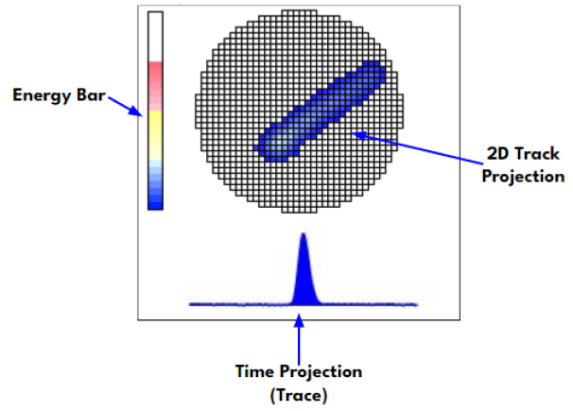
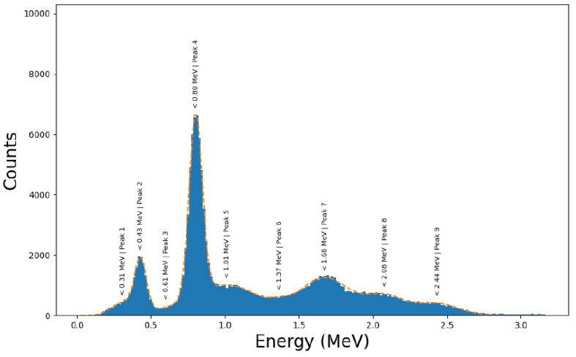
Gaseous Detector with Germanium Tagging (GADGET)
Beam
²⁰Mg(βp)
²⁰Na(βα)
preliminary
M. Friedman et al., Nucl. Instrum. Methods Phys. Res. A 940, 93 (2019).
R. Mahajan et al., Phys. Rev. C 110, 035807 (2024).

Slide 21
Gaseous Detector with Germanium Tagging (GADGET)

Slide 22
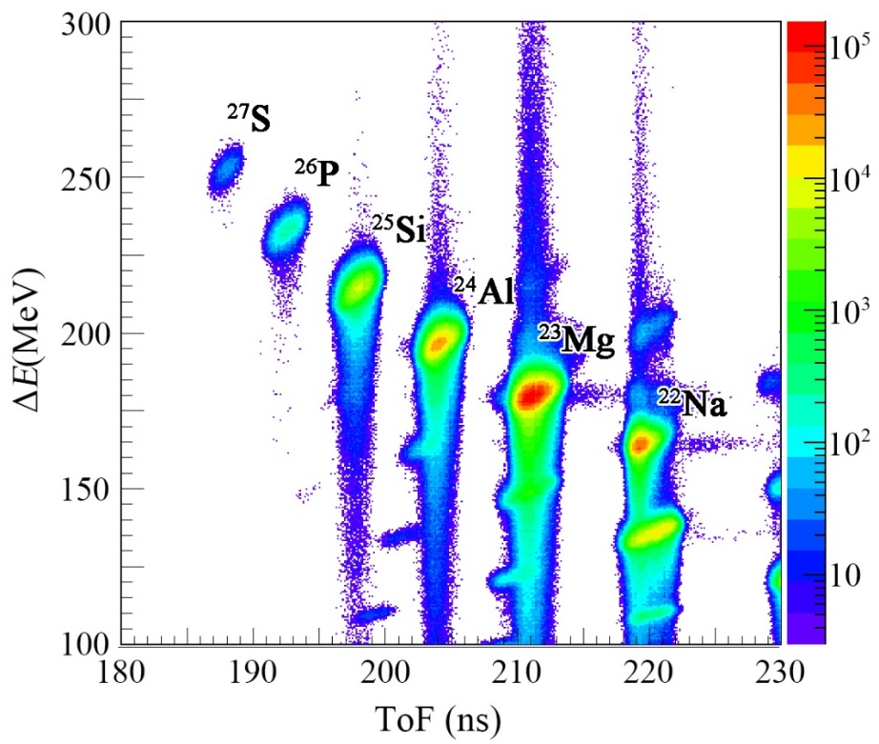
Silicon Detector Box
Beam
L. J. Sun et al., Nucl. Instrum. Methods Phys. Res. A 804, 1 (2015).
L. J. Sun et al., Phys. Rev. C 95, 014314 (2017).

Slide 23
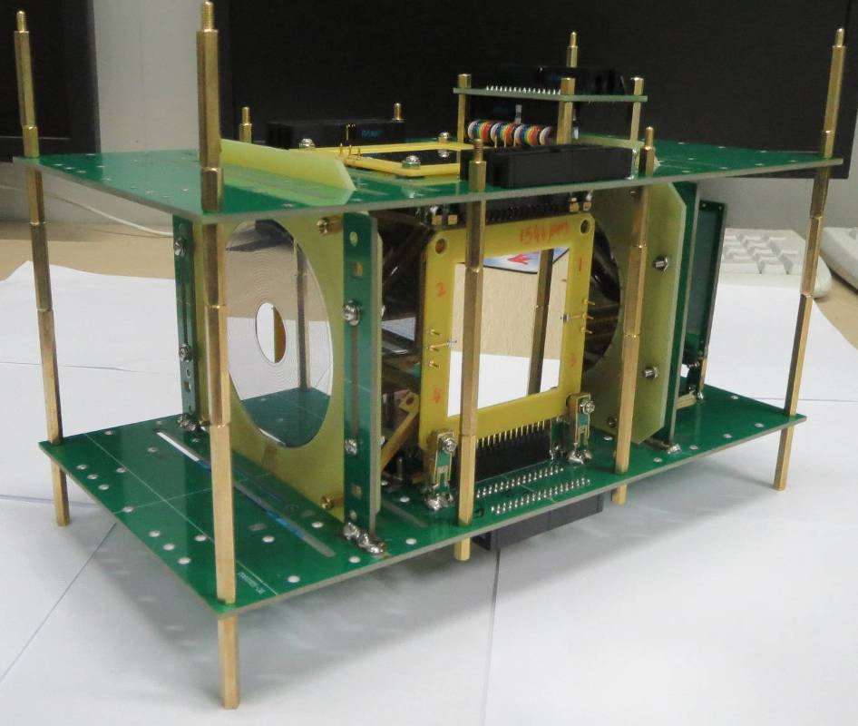
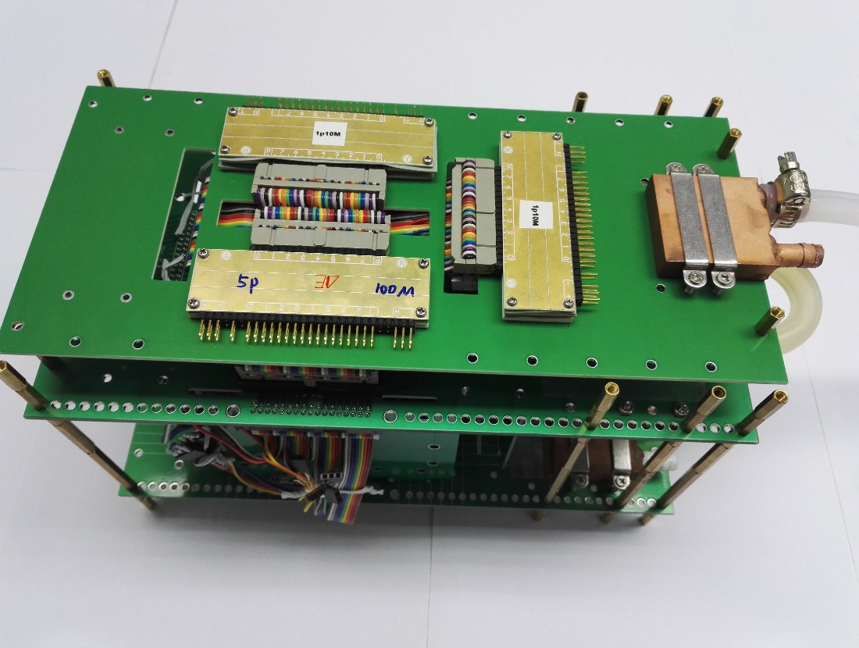
Silicon Detector Box
L. J. Sun et al., Nucl. Instrum. Methods Phys. Res. A 804, 1 (2015).
L. J. Sun et al., Phys. Rev. C 95, 014314 (2017).

Slide 24
Silicon Detector Box
Implantation:
Position
Energy
Time
Decay:
Position
Energy
Time
L. J. Sun et al., Nucl. Instrum. Methods Phys. Res. A 804, 1 (2015).
L. J. Sun et al., Phys. Rev. C 95, 014314 (2017).

Slide 25
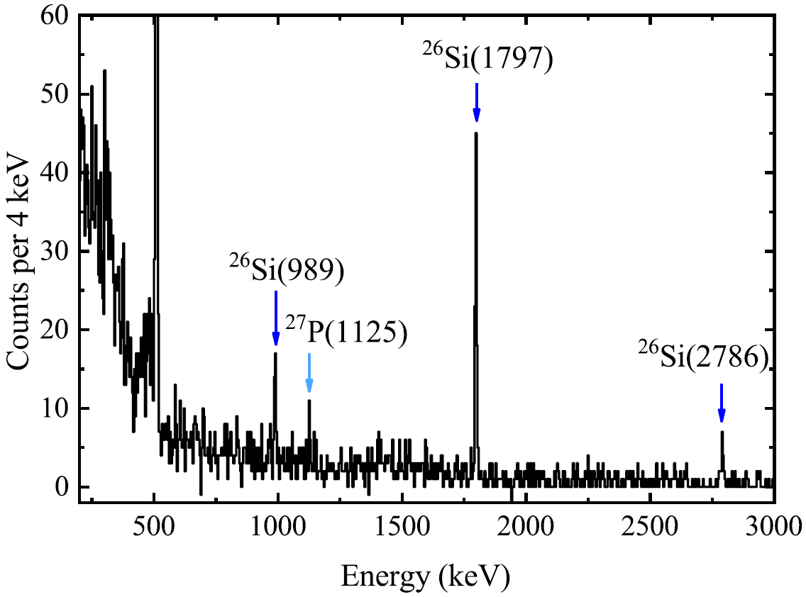
Implantation-Decay
L. J. Sun et al., Phys. Rev. C 99, 064312 (2019).

Slide 26
β Summing
S. Czajkowski et al., Nucl. Phys. A 628, 537 (1998).

Slide 27
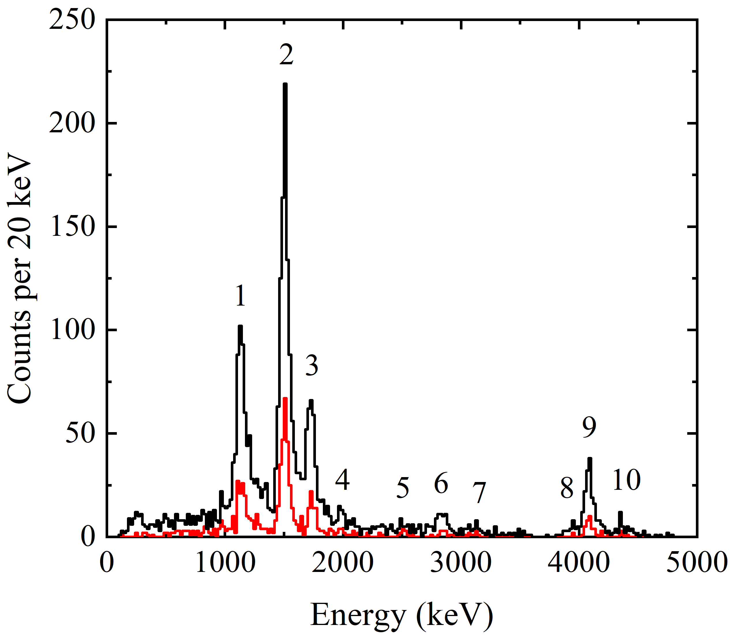
β Summing
²⁴Si
S. Czajkowski et al., Nucl. Phys. A 628, 537 (1998).
L. J. Sun et al., Nucl. Instrum. Methods Phys. Res. A 804, 1 (2015).
L. J. Sun et al., Phys. Rev. C 95, 014314 (2017).
With all transitions, now what?

Slide 28
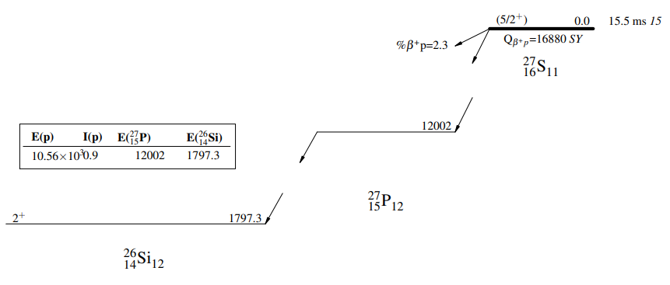
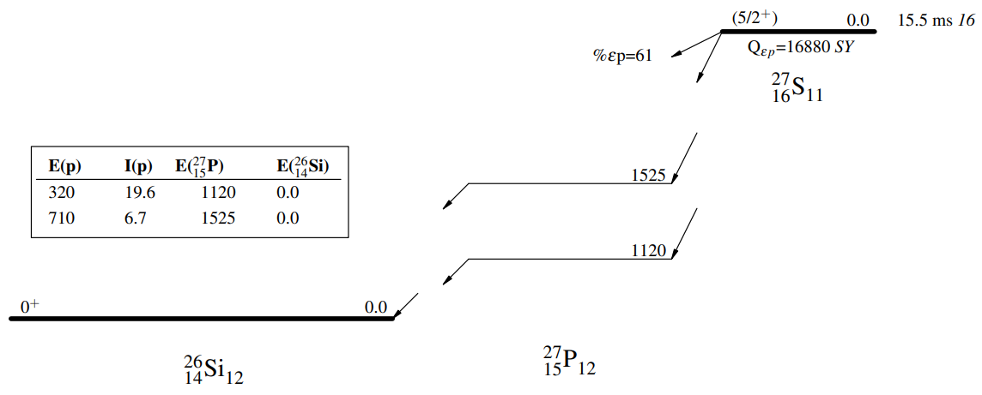
Decay Scheme
A variety of nuclear data.
L. J. Sun et al., Phys. Rev. C 99, 064312 (2019).
ENSDF
XUNDL

Slide 29
Decay Scheme
A variety of nuclear data.
L. J. Sun et al., Phys. Rev. C 99, 064312 (2019).
ENSDF
XUNDL

Slide 30
Mirror Asymmetry
5/2⁺
$$Q_{EC}=12743 keV$$
²⁵Si
5/2⁺
$$Q_{β−}=3835 keV$$
²⁵Na
5
3/2⁺
2801
3/2⁺
2673
4
5/2⁺
1965
5/2⁺
1789
(7/2)⁺
1612
3
7/2⁺
1612
3/2⁺
945
2
3/2⁺
975
Mirror energy difference (MED)
5/2⁺
0
1
5/2⁺
0
²⁵Al
²⁵Mg
L. J. Sun et al., Phys. Rev. C 103, 014322 (2021).
D. E. Alburger et al., Nucl. Phys. A 385, 474 (1982).

Slide 31
Mirror Asymmetry
$$δ=\frac{{ft}^{+}}{{ft}^{−}}−1 ={\left(\frac{M_{GT}^{−}}{M_{GT}^{+}}\right)}^{2}−1$$
Mirror-asymmetry parameter
L. J. Sun et al., Phys. Rev. C 103, 014322 (2021).
D. E. Alburger et al., Nucl. Phys. A 385, 474 (1982).

Slide 32
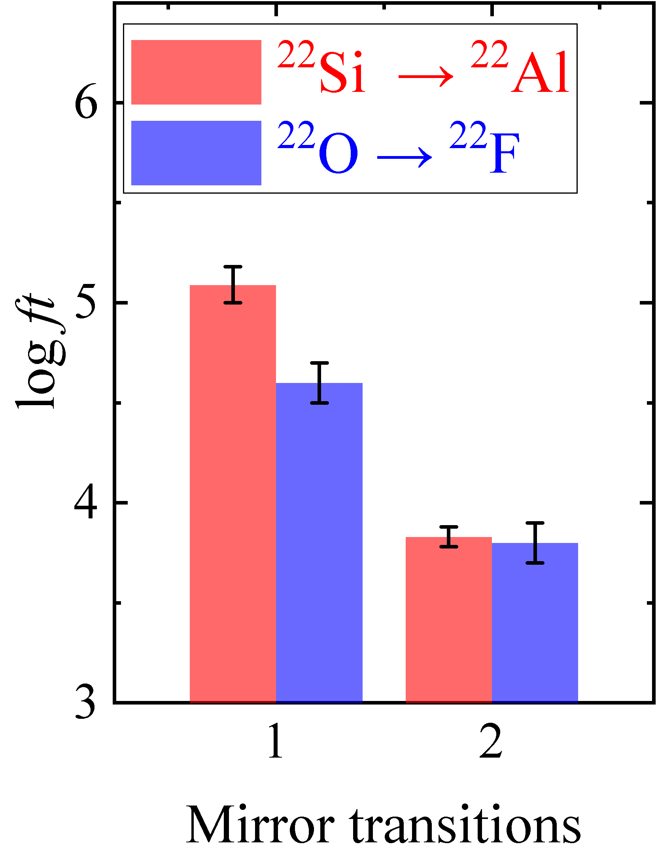
Mirror Asymmetry
J. Lee et al., Phys. Rev. Lett. 125, 192503 (2020).
L. Weissman et al., J. Phys. G: Nucl. Part. Phys. 31, 553 (2005).

Slide 33
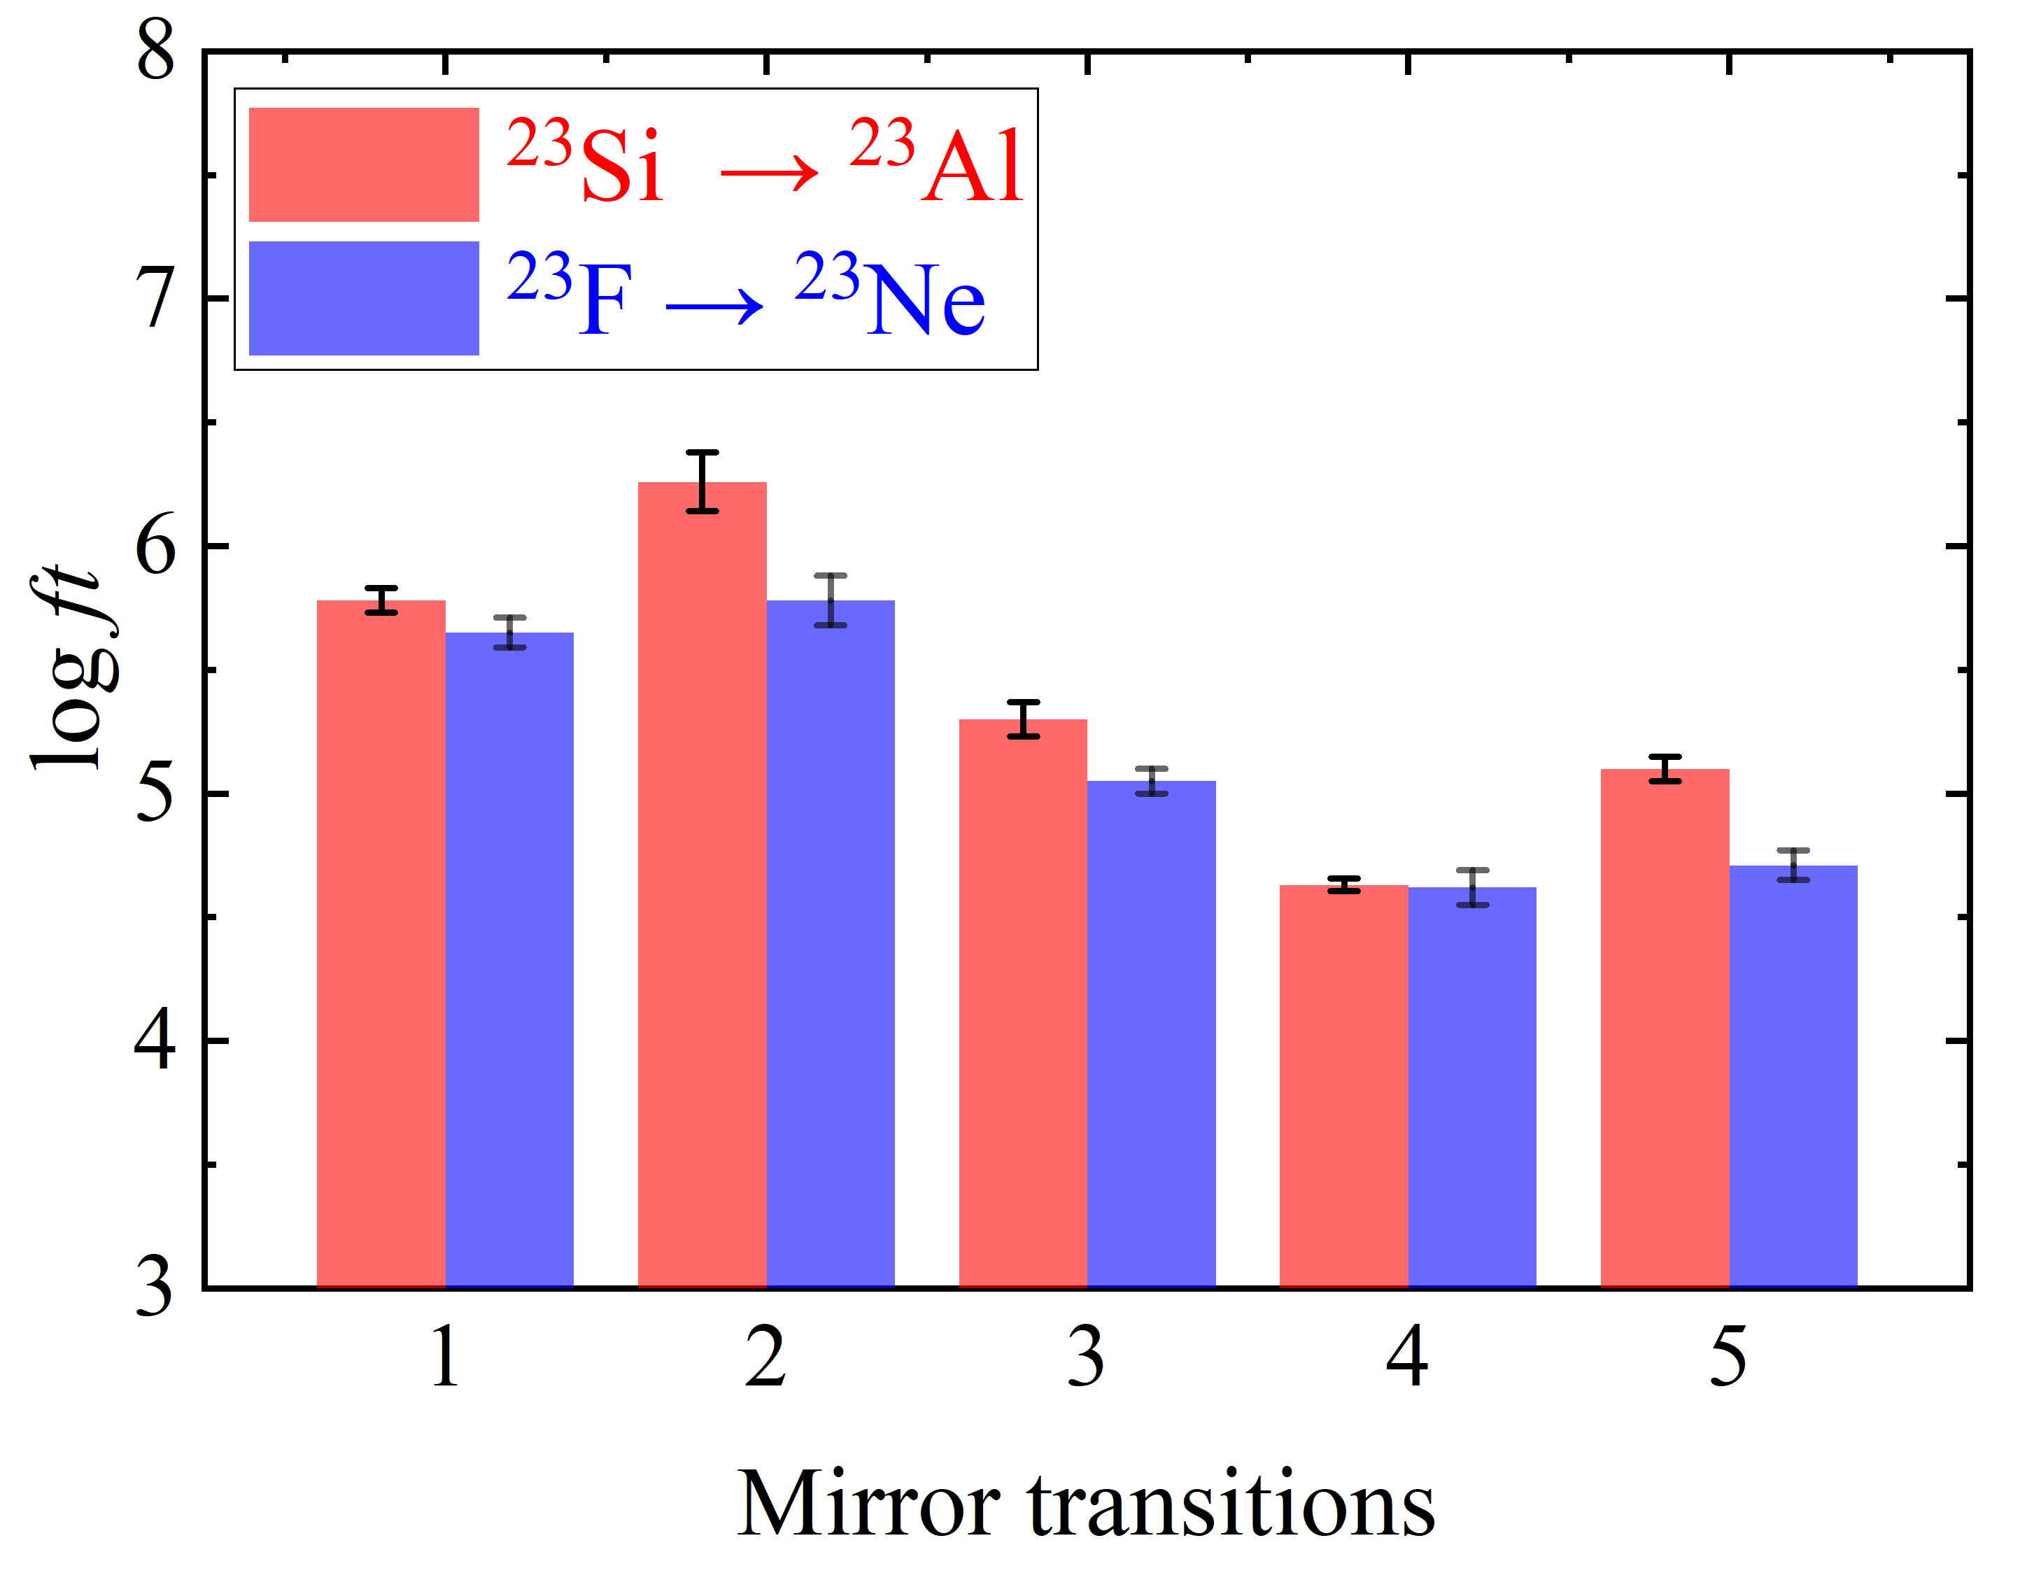
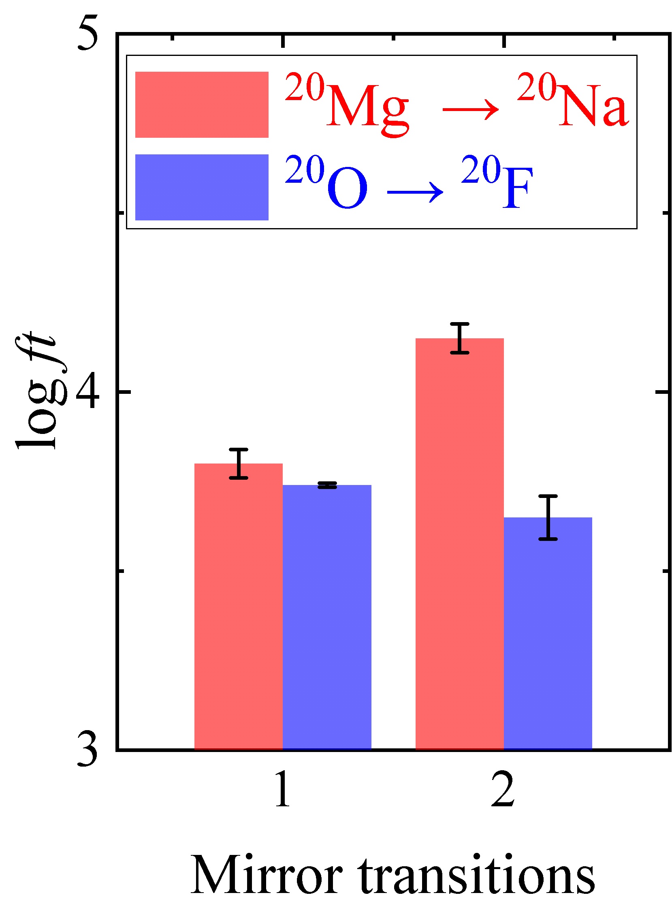
Mirror Asymmetry
preliminary
Large occupation of weakly bound or unbound 1s_{1/2} orbital by valence protons.

Slide 34
Isospin Conservation
$$J^{π},T, T_{z}$$
$$J^{π},T, T_{z}+1$$
Fermi
γ
$$T−\frac{3}{2},T_{z}+\frac{3}{2}$$
$$T−1, T_{z}+1$$

Slide 35
Isospin Mixing
Fragmentation of Fermi transition strength B(F)
Isospin mixing matrix element ν
Isospin impurity α²
$$J^{π},T, T_{z}$$
$$J^{π},T, T_{z}+1$$
Fermi
$$2p$$
$$J^{π},T−1, T_{z}+1$$
$$p$$
$$t=\frac{1}{2}$$
$$T−2,T_{z}+2$$
γ
$$T−\frac{3}{2},T_{z}+\frac{3}{2}$$
$$T−1, T_{z}+1$$

Slide 36
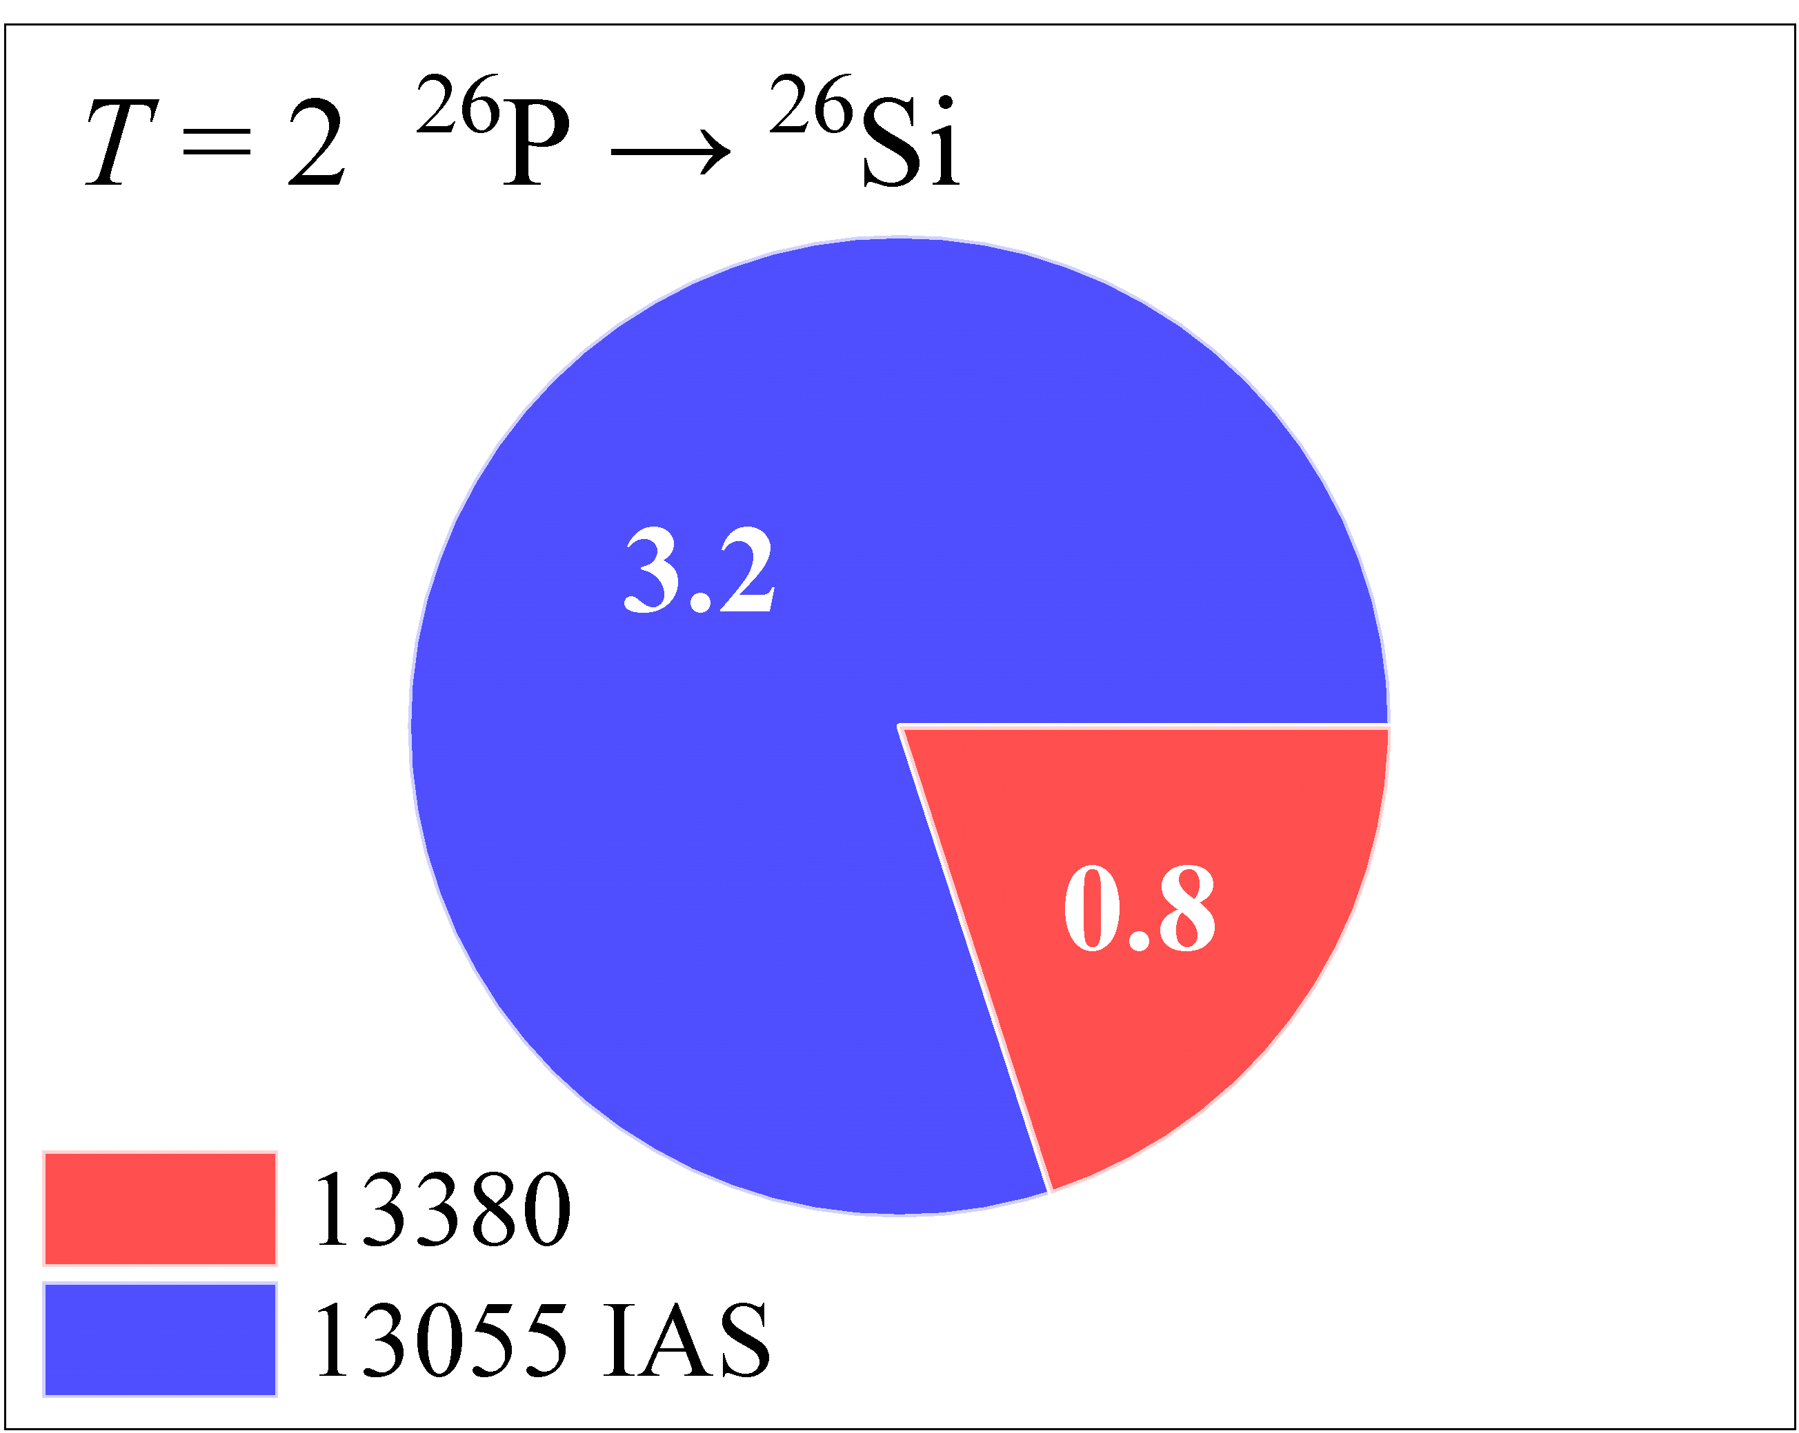
Isospin Mixing
J. J. Liu et al., Phys. Rev. Lett. 129, 242502 (2022).

Slide 37
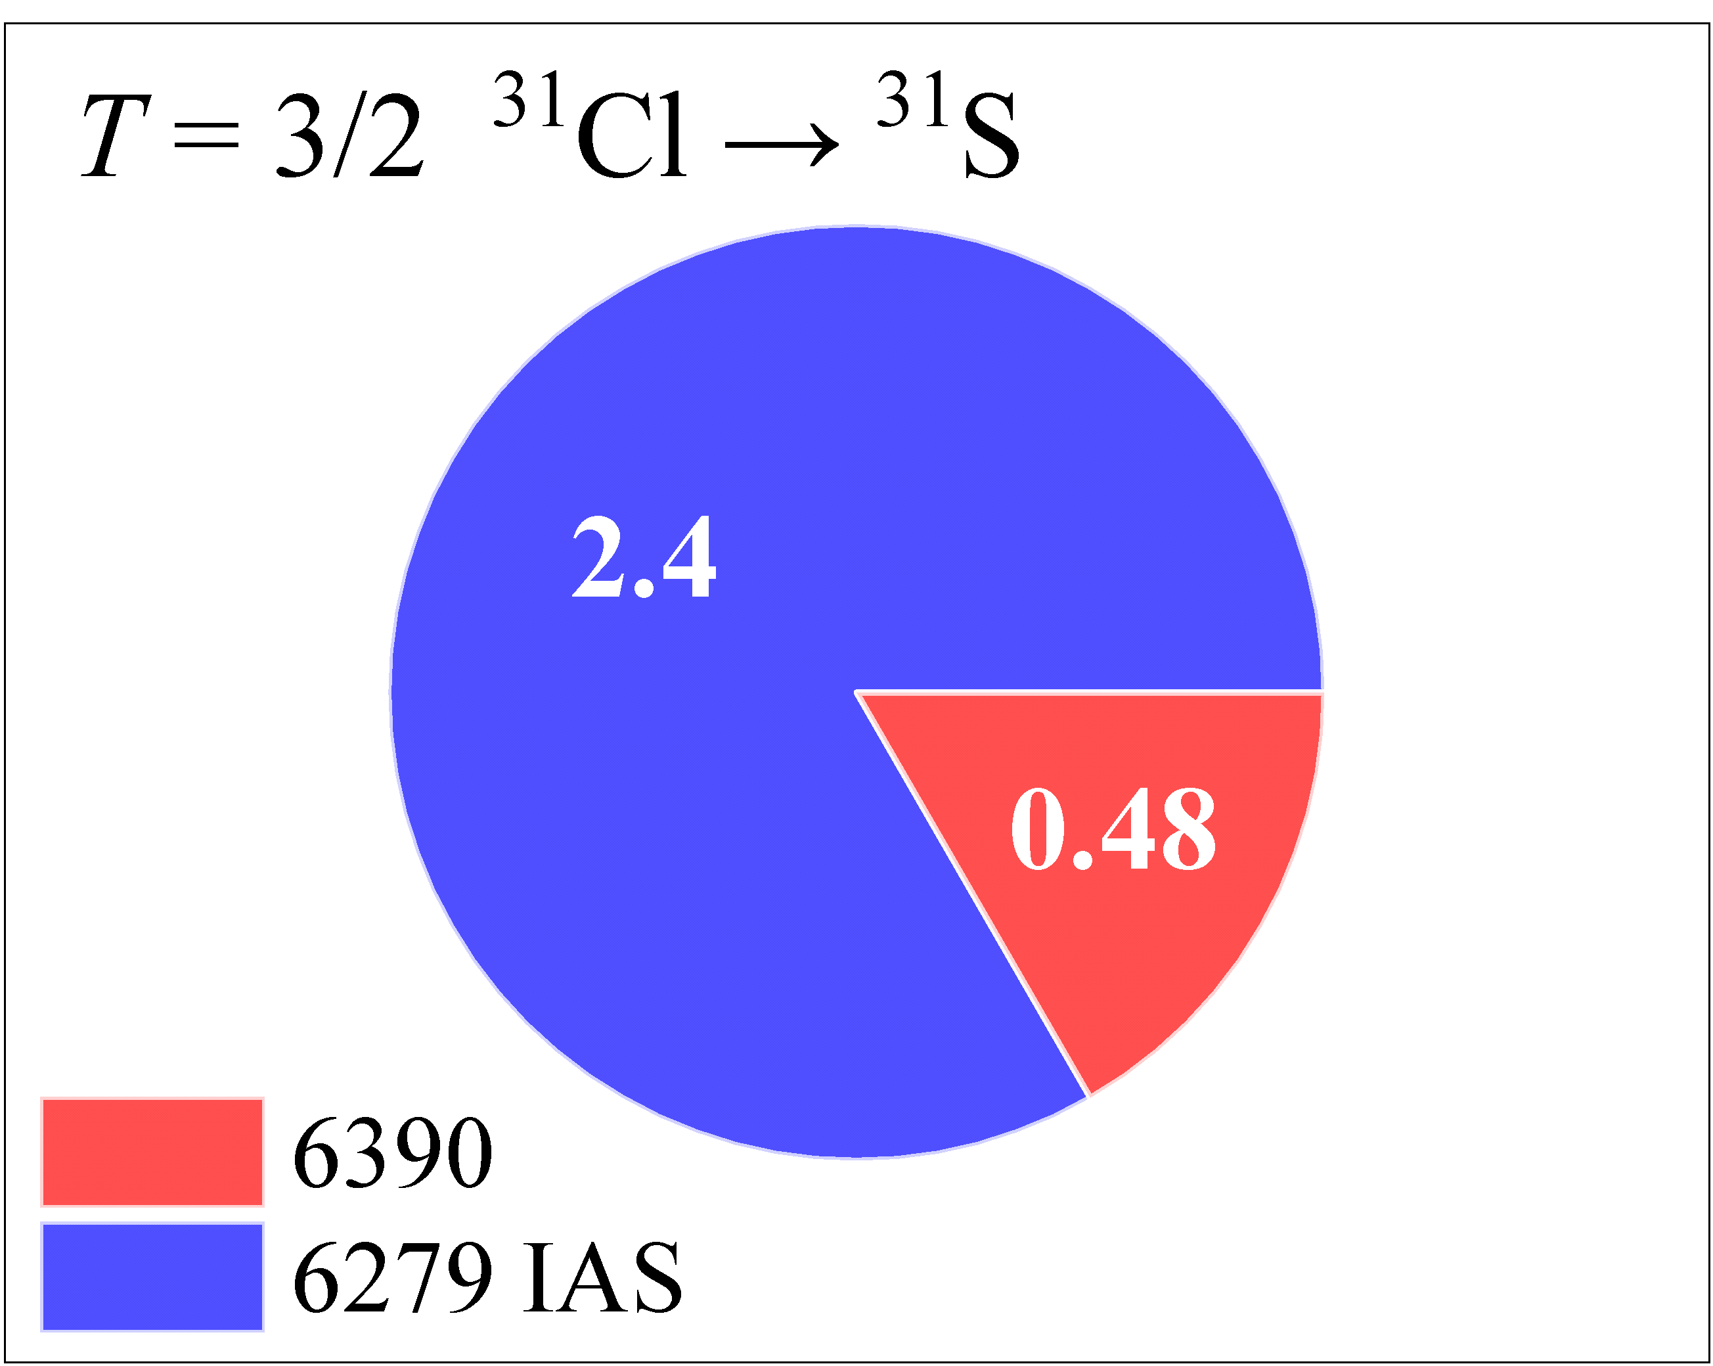
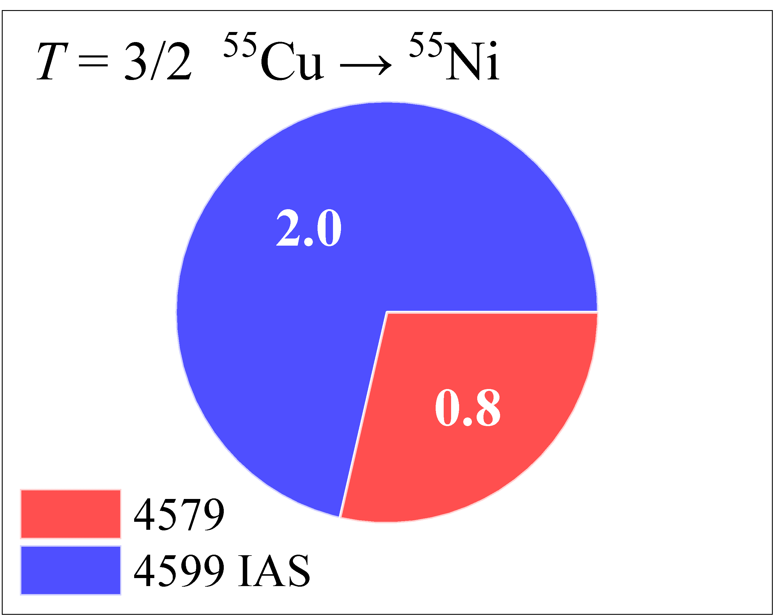
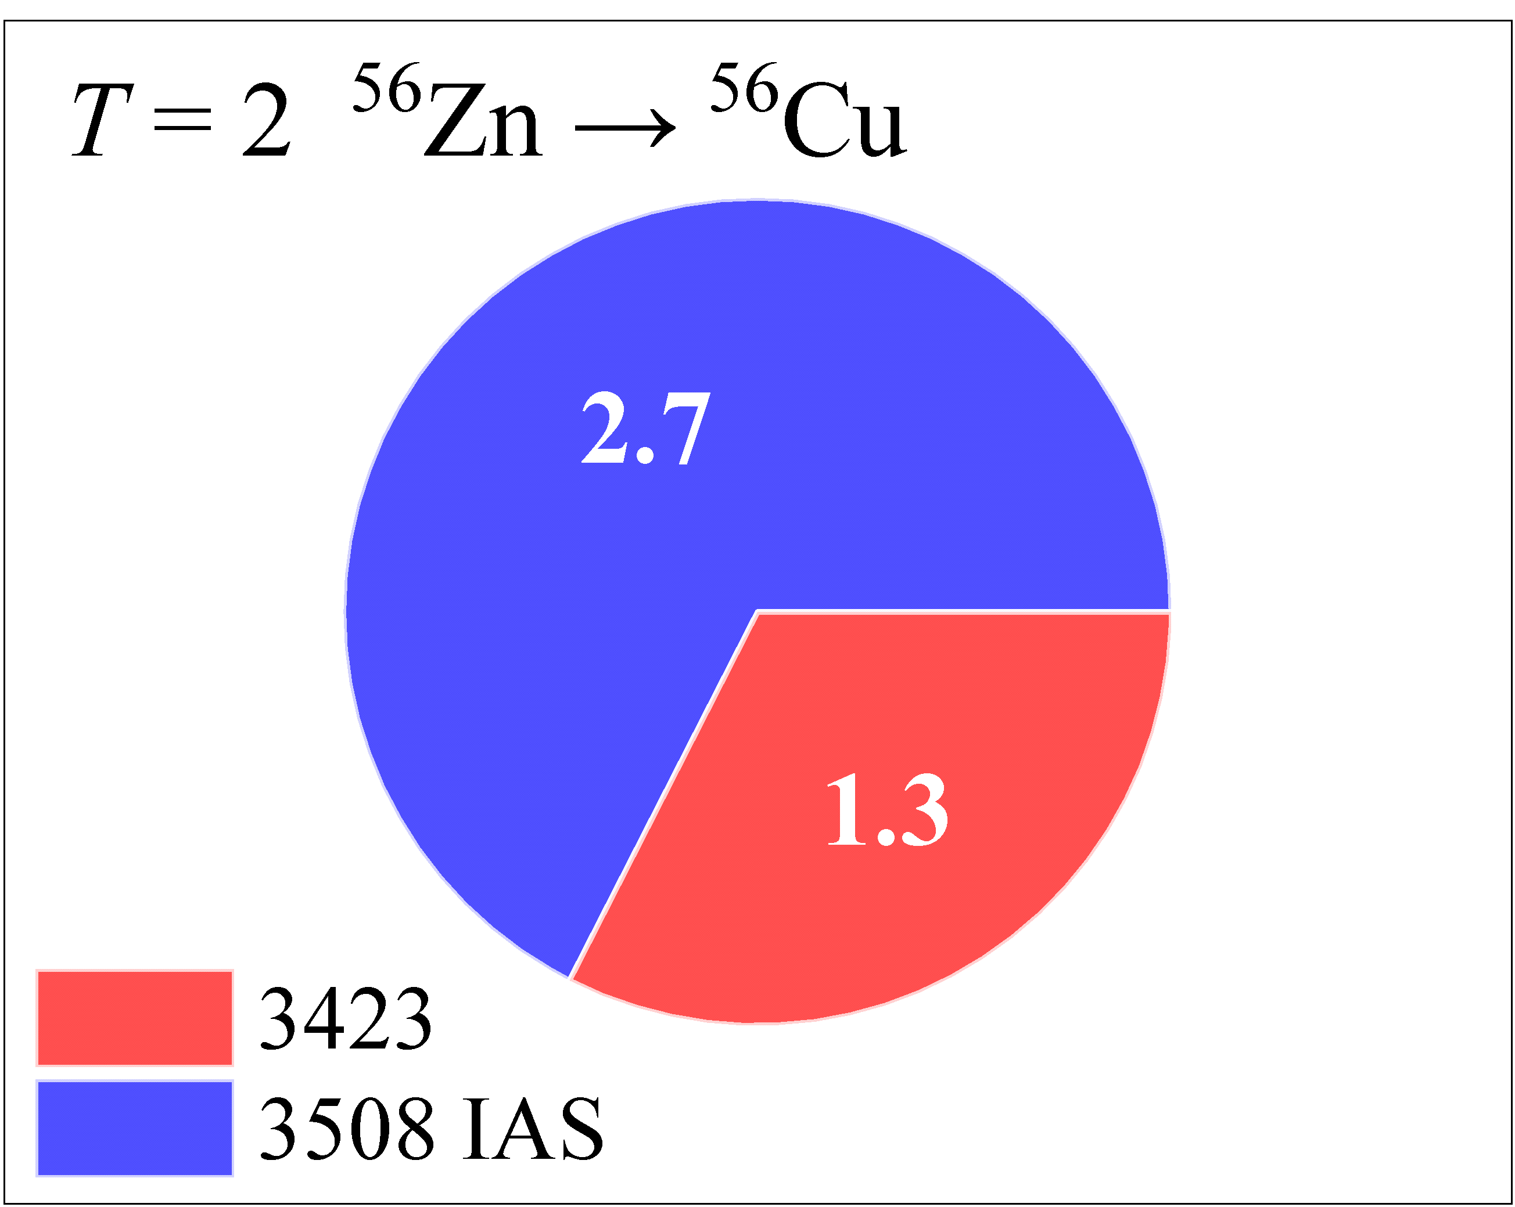
Fragmentation of the Fermi Strength
M. B. Bennett et al., Phys. Rev. Lett. 116, 102502 (2016).
V. Tripathi et al., Phys. Rev. Lett. 111, 262501 (2013).
S. E. A. Orrigo et al., Phys, Rev, Lett. 112, 222501 (2014).
J. J. Liu et al., Phys. Rev. Lett. 129, 242502 (2022).
H. Fynbo, E. Jensen, L. J. Sun, FRIB E25036 (pending).
green; wish prove

Slide 38
2p Emission Mechanism

Slide 39
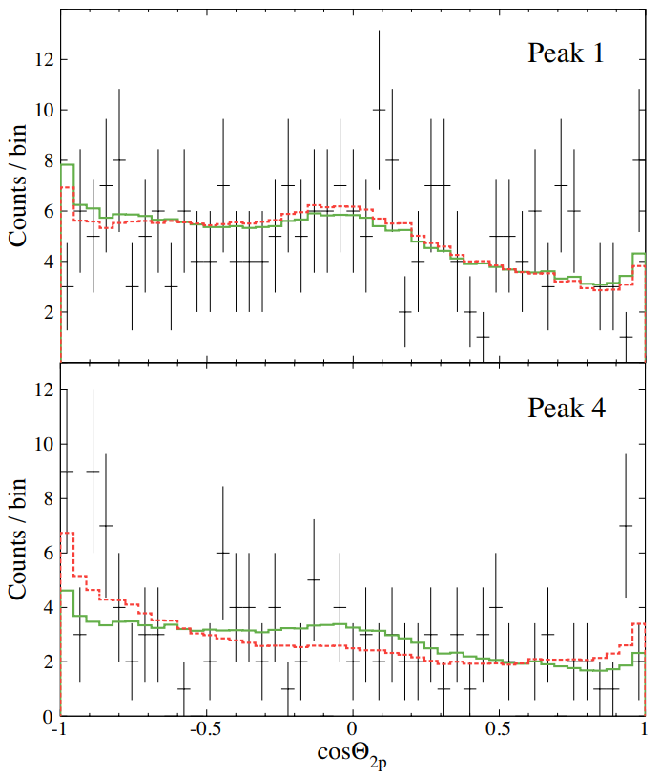
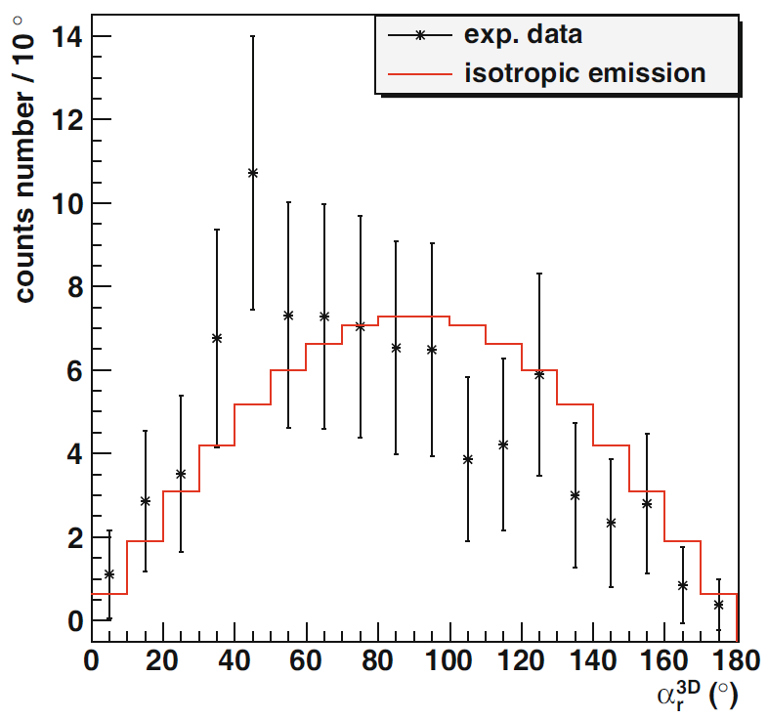
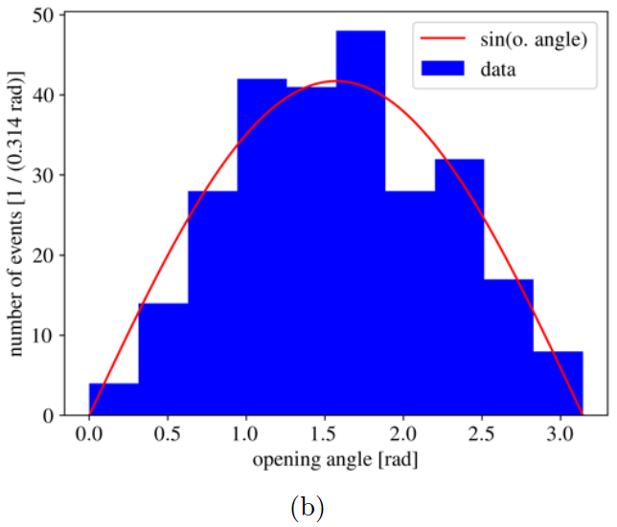
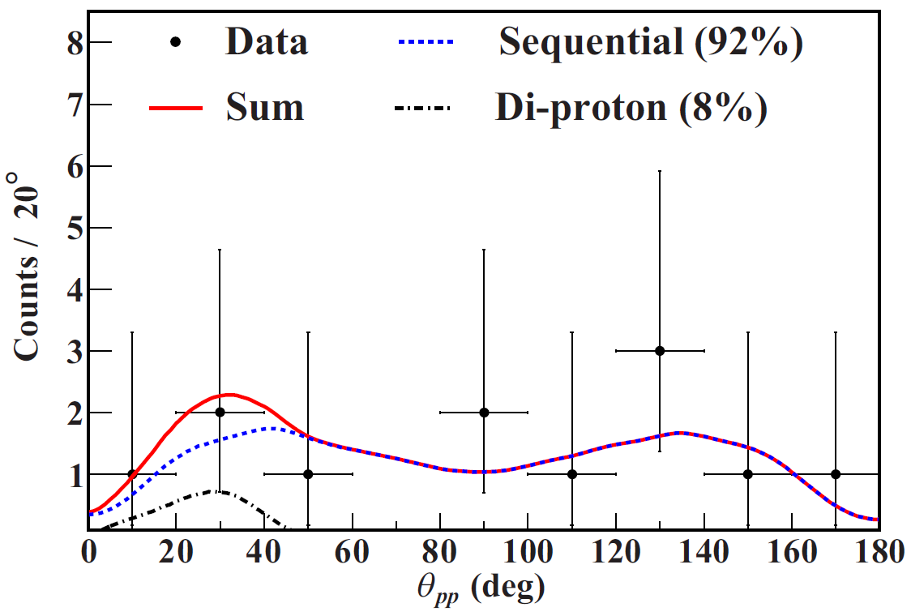
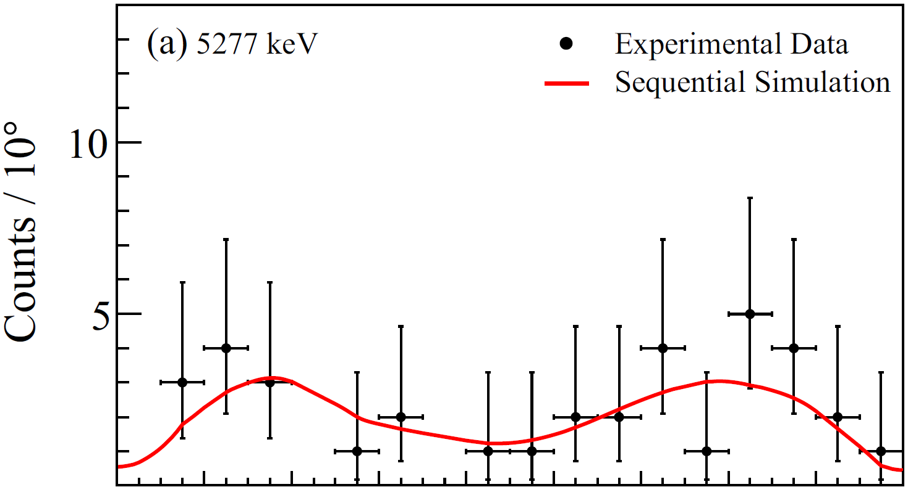
Angular correlation of 2p
⁴³Cr(β2p)⁴¹Sc
²³Si(β2p)²¹Na
³¹Ar(β2p)²⁹P
L. Audirac et al., Eur. Phys. J. A 48, 179 (2012).
A. A. Ciemny et al., Phys. Rev. C 106, 014317 (2022).
²⁷S(β2p)²⁵Al
²⁶P(β2p)²⁴Mg
G. T. Koldste et al., Phys. Rev. C 89, 064315 (2014).
G. Z. Shi et al., Phys. Rev. C 103, L061301 (2021).
J. J. Liu et al., Phys. Rev. Lett. 129, 242502 (2022).
H. Fynbo, E. Jensen, L. J. Sun, FRIB E25036/25037 (pending).

Slide 40
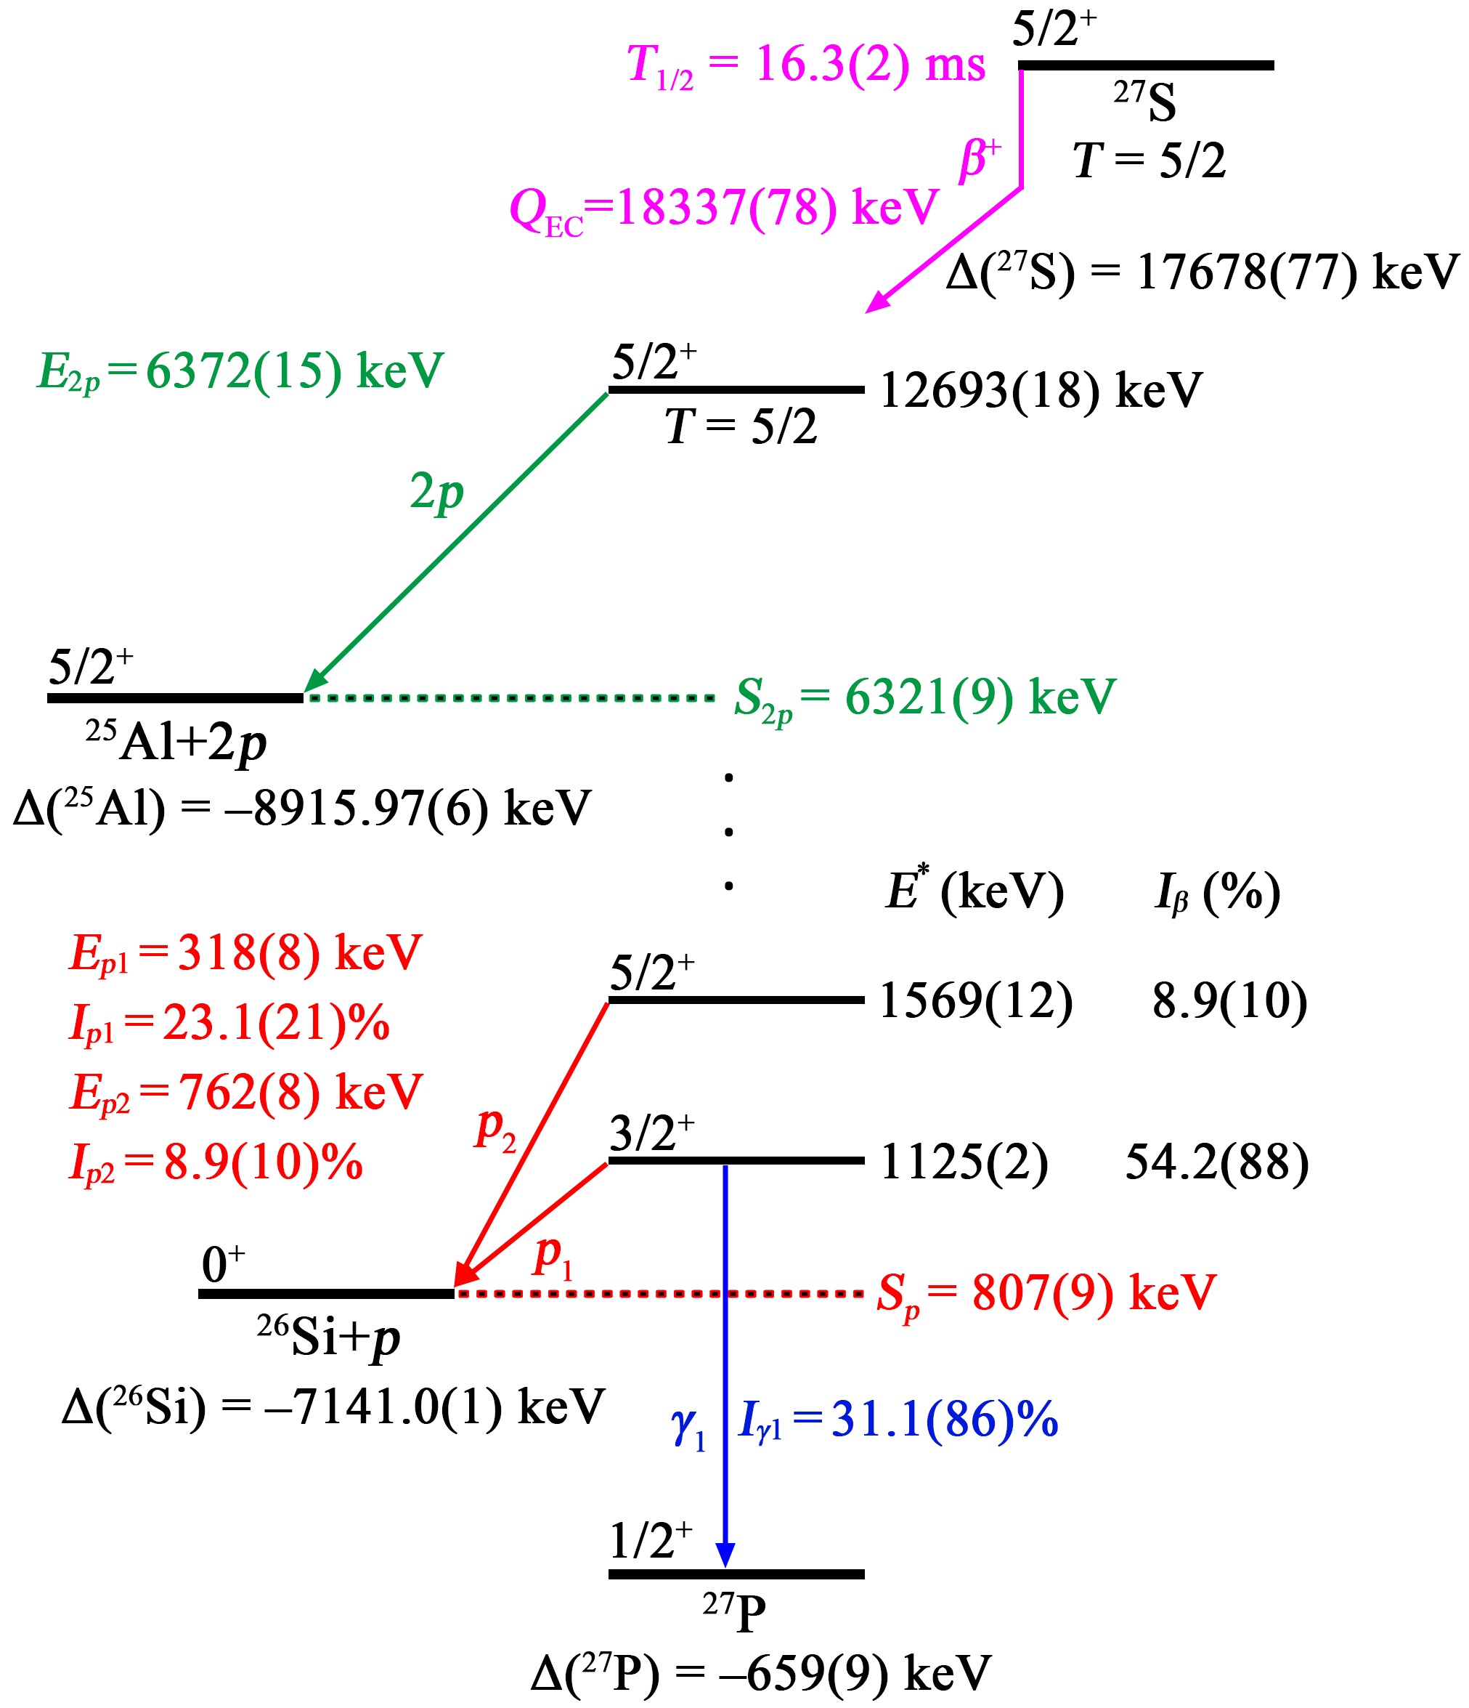
Coulomb Displacement Energy
M. S. Antony et al., At. Data Nucl. Data Tables 66, 1 (1997).
K. Miernik, Acta Phys. Pol. B 44, 483 (2013).

Slide 41
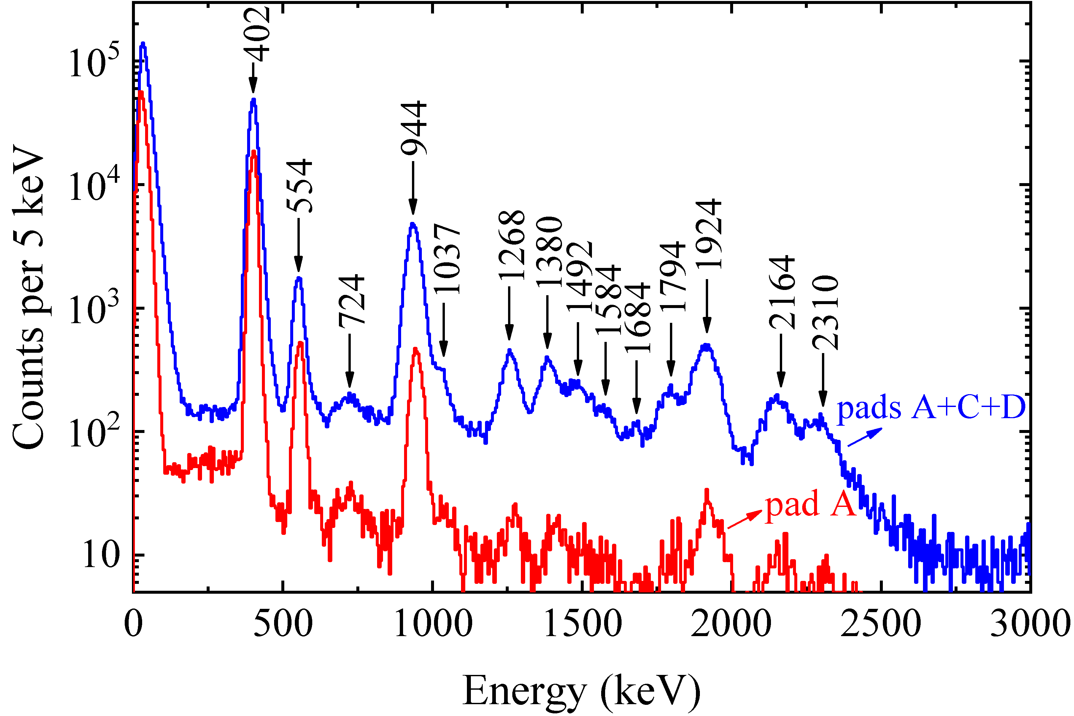
²⁵Si(βpγ)²⁴Mg
²⁵Si(βp)²⁴Mg
L. J. Sun et al., Phys. Rev. C 103, 014322 (2021).

Slide 42
Doppler Broadening of βpγ
Positron
Precursor
Neutrino

Slide 43
Doppler Broadening of βpγ
Positron
Daughter
Precursor
Neutrino

Slide 44
Doppler Broadening of βpγ
Positron
Proton
Daughter
Precursor
Neutrino
Recoil

Slide 45
Doppler Broadening of βpγ
Positron
Proton
Daughter
Precursor
γ ray
with a Doppler shift
Neutrino
Recoil

Slide 46
²⁵Si(βpγ)²⁴Mg
L. J. Sun et al., Phys. Rev. C 103, 014322 (2021).

Slide 47
²⁵Si(βpγ)²⁴Mg
L. J. Sun et al., Phys. Rev. C 103, 014322 (2021).

Slide 48
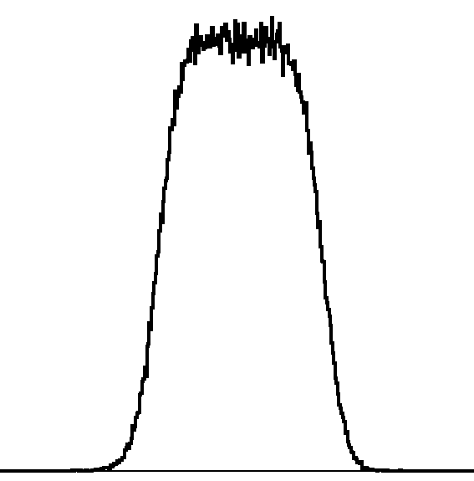
Doppler Broadening of βpγ
(Z, N)
β⁺
p₂
τ~fs-ps
γ₂
p₁
(Z–2, N+1)
γ₁
L. J. Sun et al., Phys. Rev. C 103, 014322 (2021).
(Z–1, N+1)

Slide 49
Doppler Broadening of βnγ
(Z, N)
β–
n₂
τ~fs-ps
n₁
γ₂
(Z+1, N–2)
γ₁
(Z+1, N–1)

Slide 50
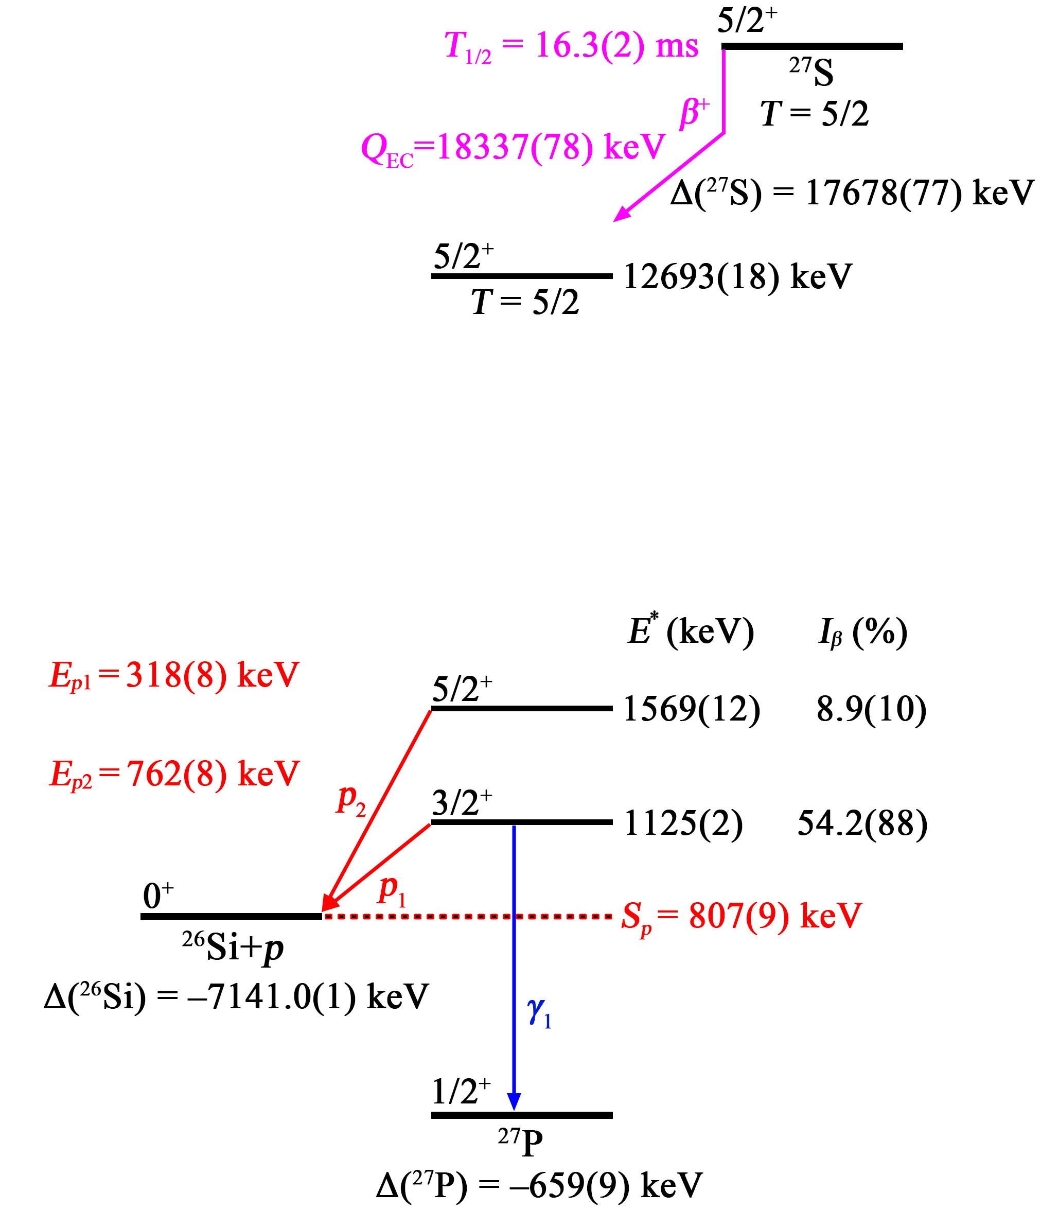
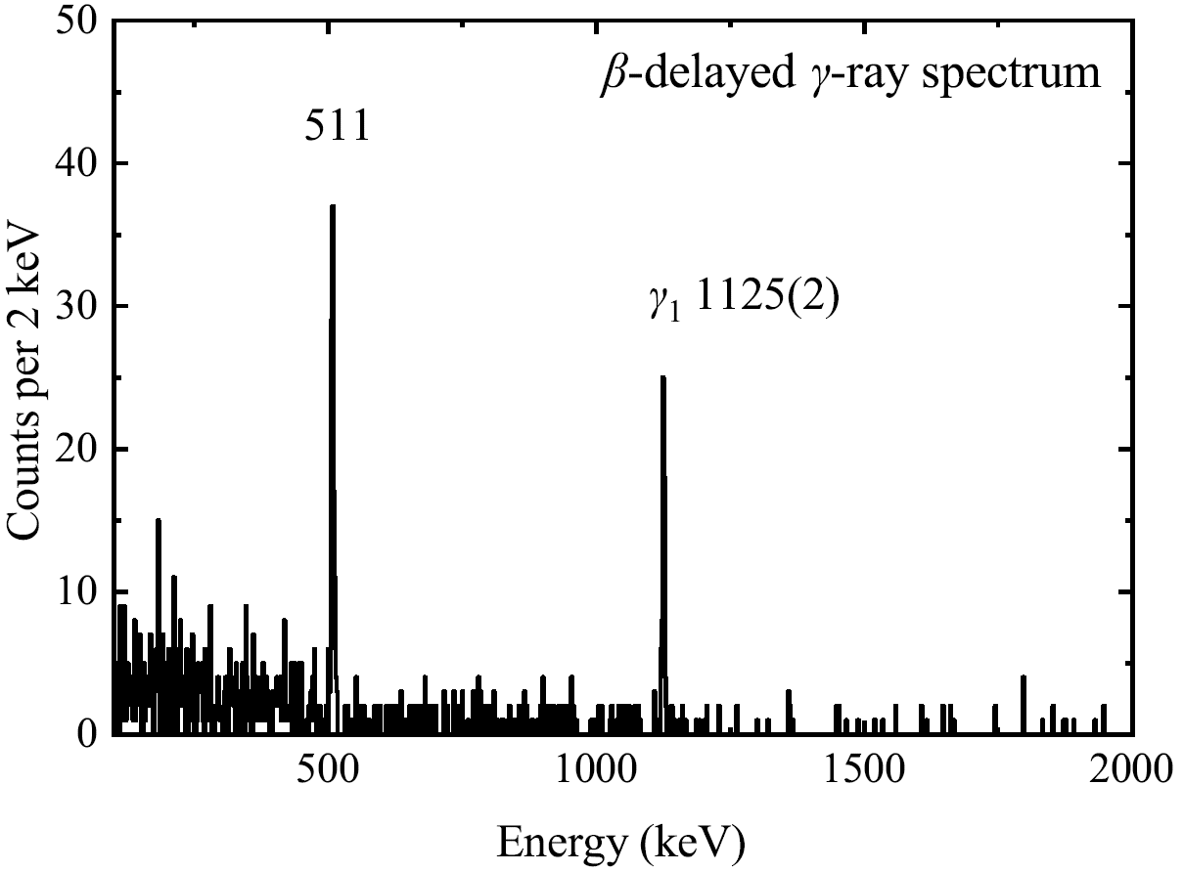
²⁷S(βγ)²⁷P, ²⁷S(βp)²⁶Si
p₂
40 μm
DSSD
p₁
γ₁
L. J. Sun et al., Phys. Rev. C 99, 064312 (2019).
L. J. Sun et al., Phys. Lett. B 802, 135213 (2020).

Slide 51
Mass of ²⁷P

Slide 52
²⁶Si(p,γ)²⁷P
$$N_{A}{〈σν〉}_{res}=N_{A}{\left(\frac{2π}{μkT}\right)}^{3/2}ℏ^{2}ωγexp\left(−\frac{E_{r}}{kT}\right)$$
$$ωγ= \frac{2J_{r}+1}{\left(2J_{p}+1\right)\left({2J}_{T}+1\right)}\frac{Γ_{p}Γ_{γ}}{Γ}$$
$$Γ=\frac{ℏ}{τ}$$
$$=\frac{2J_{r}+1}{\left(2J_{p}+1\right)\left({2J}_{T}+1\right)}B_{p}B_{γ}\frac{ℏ}{τ}$$
L. J. Sun et al., Phys. Rev. C 99, 064312 (2019).
L. J. Sun et al., Phys. Lett. B 802, 135213 (2020).

Slide 53
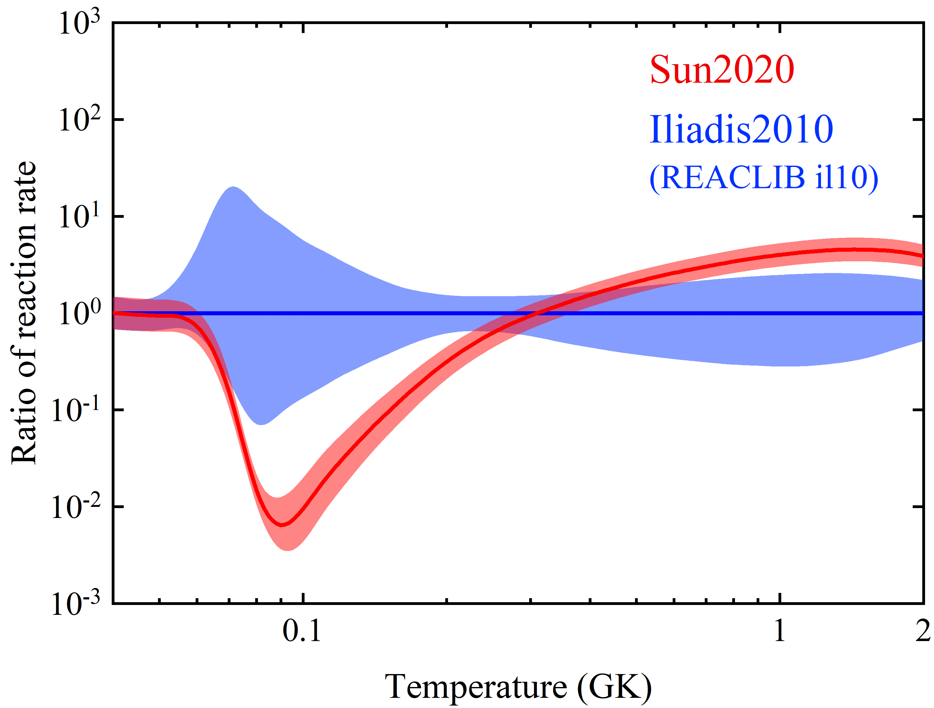
²⁶Si(p,γ)²⁷P
$$ωγ=\frac{2J_{r}+1}{\left(2J_{p}+1\right)\left({2J}_{T}+1\right)}B_{p}B_{γ}\frac{ℏ}{τ}$$
L. J. Sun et al., Phys. Rev. C 99, 064312 (2019).
L. J. Sun et al., Phys. Lett. B 802, 135213 (2020).

Slide 54
³⁰P(p,γ)³¹S
T. Budner et al., Phys. Rev. Lett. 128, 182701 (2022).
M. B. Bennett et al., Phys. Rev. Lett. 116, 102502 (2016).

Slide 55
Doppler Shift Lifetimes (DSL) @ TRIUMF
L. J. Sun et al., Phys. Lett. B 839, 137801 (2023).
L. J. Sun, B. Davids, C. Wrede. TRIUMF S2373.
Approved with high priority by EEC.
14× higher efficiency

Slide 56
Lifetimes of ³¹S Excited States
J^{π} | E_{x} (keV) | ³¹S state | τ (fs) [ENSDF] | τ (fs) [S1582]
3/2⁺ |  | 1248 | 720(180)
5/2⁺ |  | 2234 | 320(80)
1/2⁺ |  | 3076 | Unknown
3/2⁺ |  | 3435 | Unknown
(3/2)– |  | 4971 | Unknown
1/2⁺ |  | 5156 | Unknown
J. Chen et al., NDS 184, 29 (2022).
L. J. Sun et al., PLB 839, 137801 (2023).

Slide 57
Bayesian Uncertainty Quantification
Input
Output
L. J. Sun et al., Phys. Lett. B 839, 137801 (2023).
FRIB Theory Alliance

Slide 58
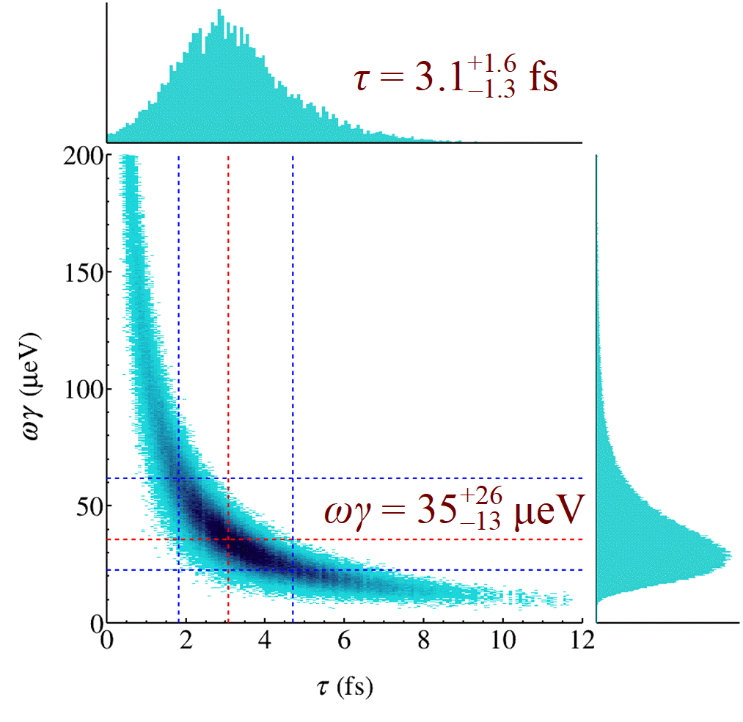
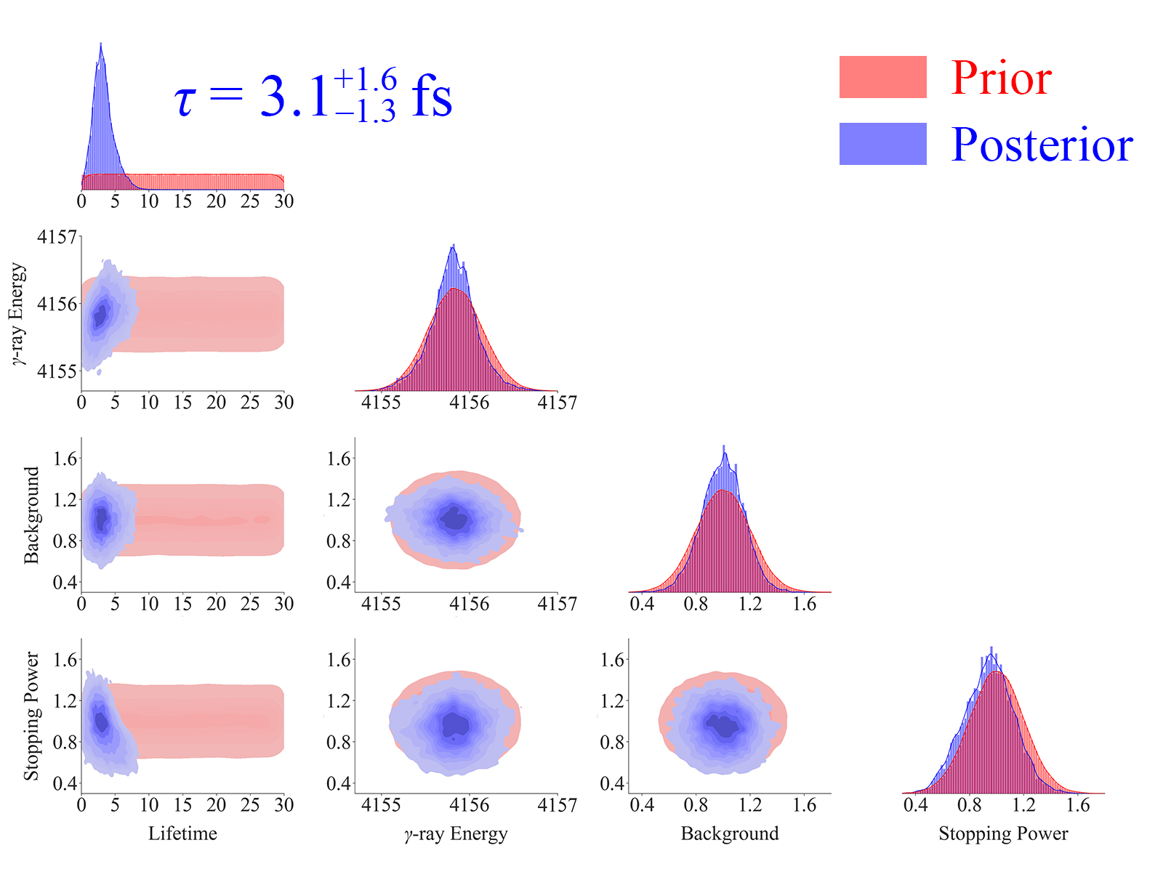
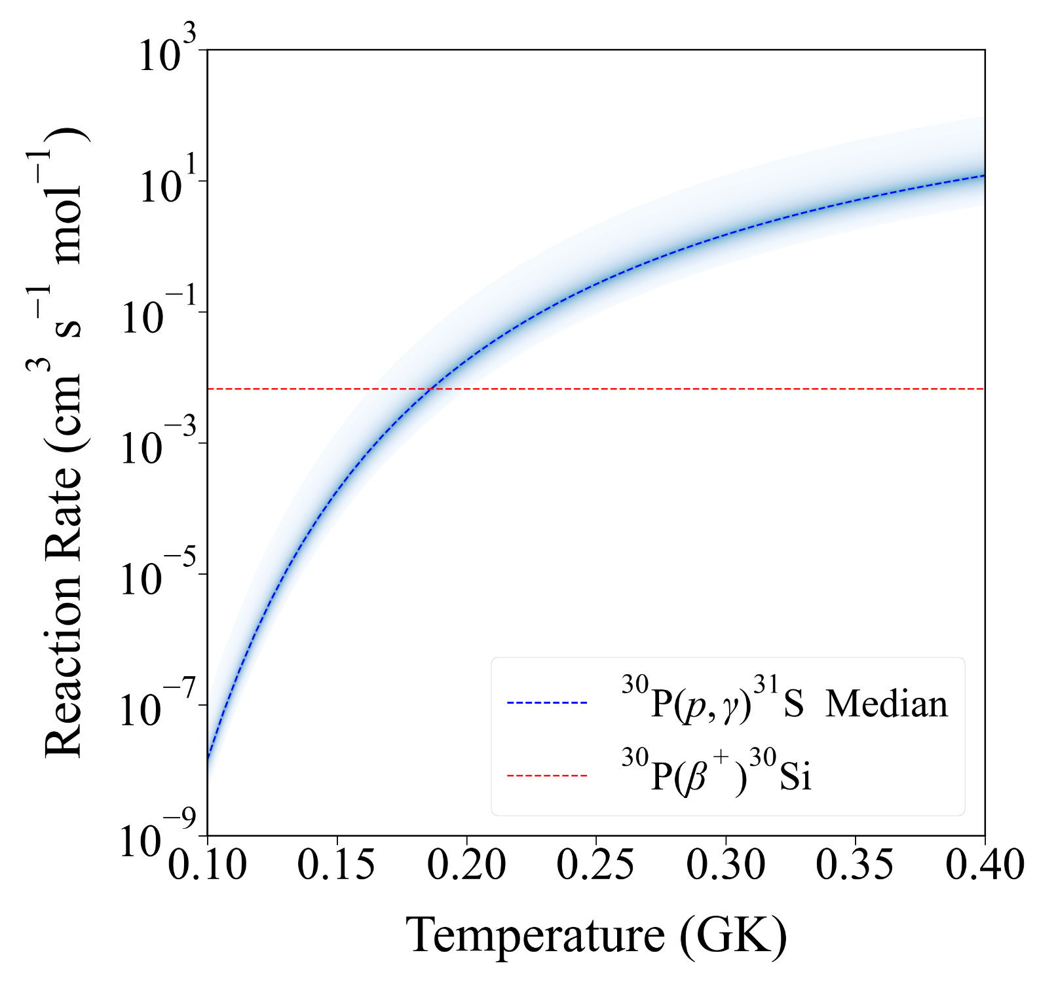
Credible Interval
TRIUMF S2373
L. J. Sun et al., Phys. Lett. B 839, 137801 (2023).

Slide 59
Particle X-ray Coincidence Technique (PXCT)

Slide 60
Particle X-ray Coincidence Technique (PXCT)

Slide 61
Particle X-ray Coincidence Technique (PXCT)

Slide 62
Particle X-ray Coincidence Technique (PXCT)

Slide 63
Particle X-ray Coincidence Technique (PXCT)

Slide 64
Particle X-ray Coincidence Technique (PXCT)

Slide 65
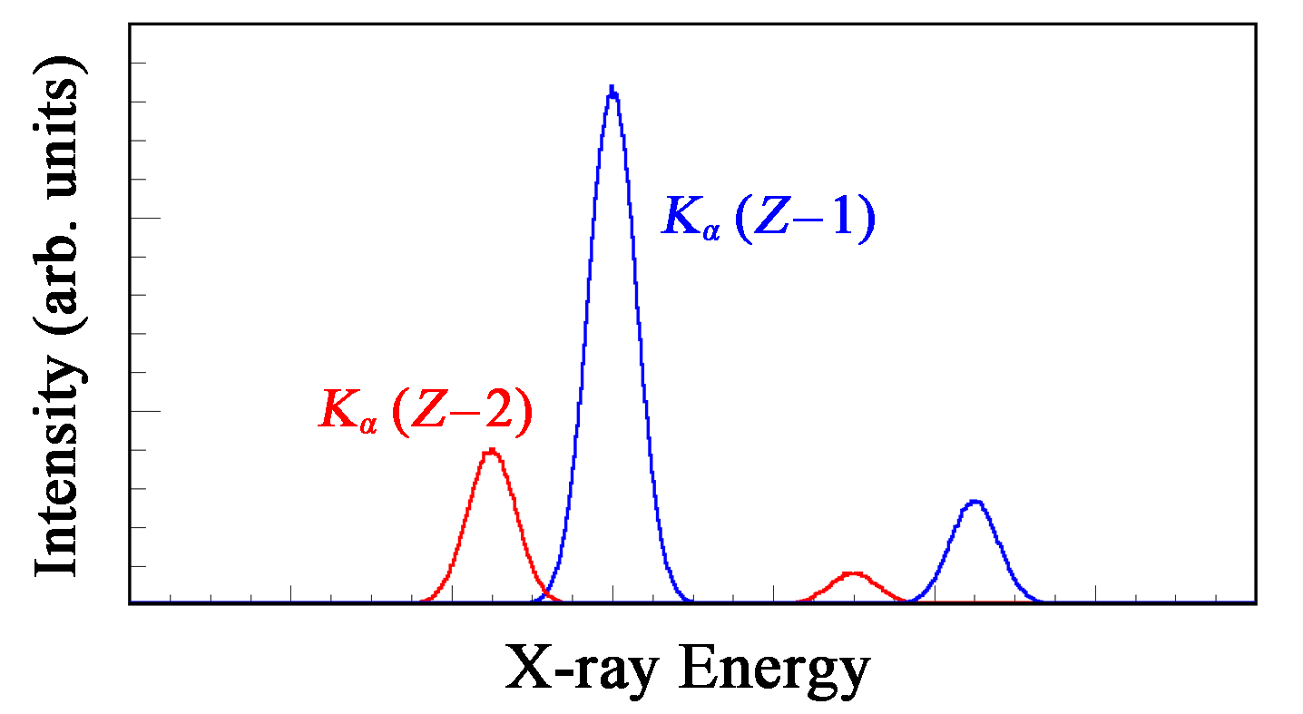
Particle X-ray Coincidence Technique (PXCT)
$$τ_{p−emit}=\frac{I_{KX(Z−1)}}{I_{KX(Z−2)}}τ_{Kshell}$$
Evaluated Atomic Data Library (EADL), 1991
J. C. Hardy et al., Phys. Rev. Lett. 37, 133 (1976).

Slide 66
Lifetimes and Branching Ratios Apparatus (LIBRA)
L. J. Sun et al., arXiv: 2410.16446.

Slide 67
Lifetimes and Branching Ratios Apparatus (LIBRA)
L. J. Sun et al., arXiv: 2410.16446.

Slide 68
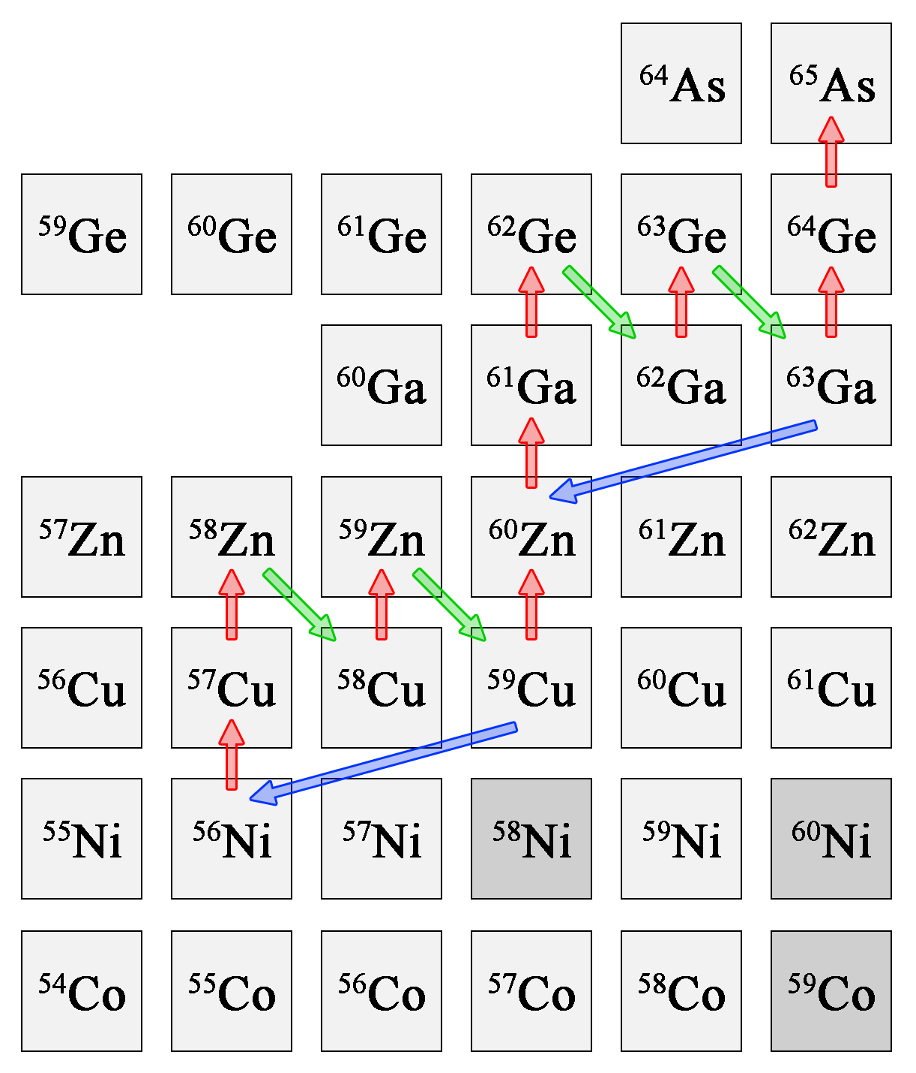
⁵⁹Cu(p,γ)⁶⁰Zn vs ⁵⁹Cu(p,α)⁵⁶Ni
rp process
⁶⁰Ga decay evaluated according to the ENSDF standards.
L. J. Sun et al., arXiv: 2410.16446 (2024).

Slide 69
X-ray Ratio and Lifetime
R_{Cu/Zn} = 0.68(10)
τ = 0.60(8) fs
L. J. Sun et al., arXiv: 2410.16446 (2024).

Slide 70
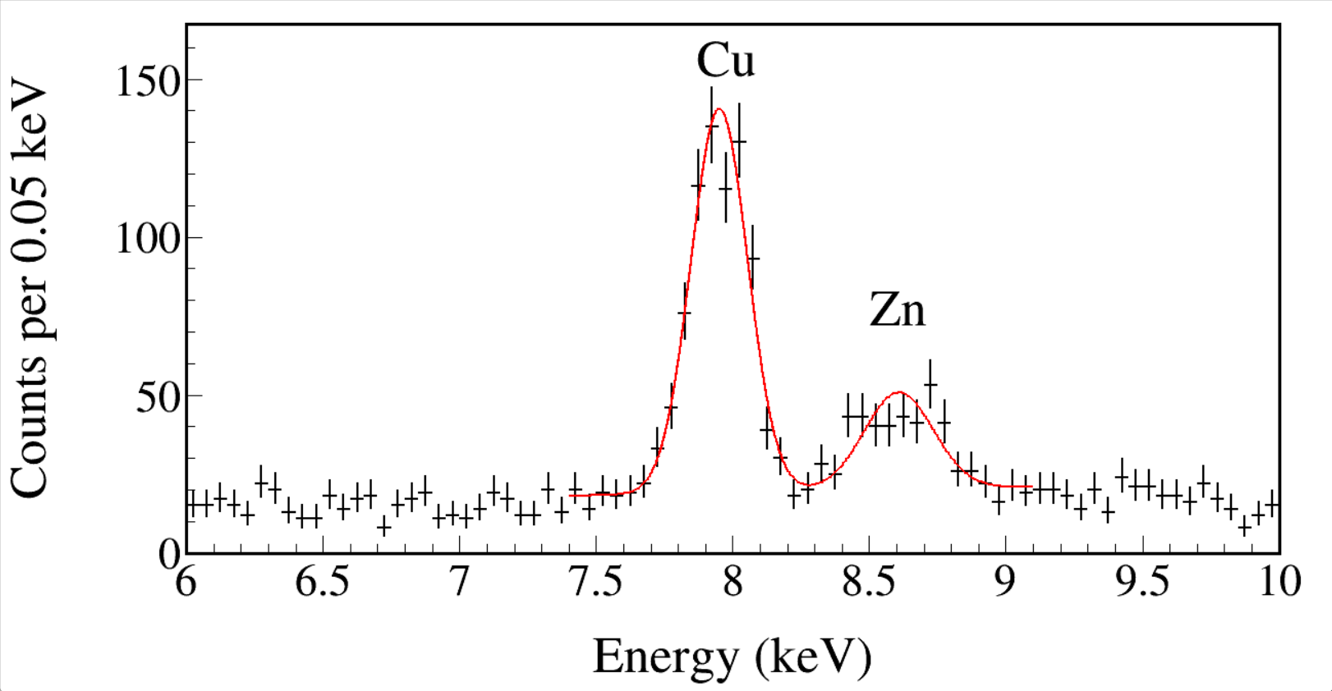
X-ray Ratio and Lifetime
R_{Cu/Zn} = 0.68(10)
τ = 0.60(8) fs
R_{Cu/Zn} = 3.6(6)
τ = 0.112(18) fs
L. J. Sun et al., arXiv: 2410.16446 (2024).

Slide 71
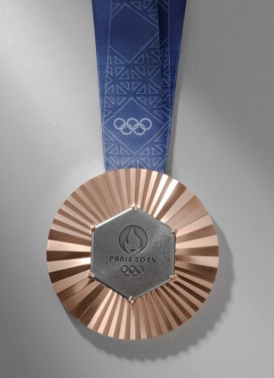
X-ray Ratio and Lifetime
R_{Cu/Zn} = 0.68(10)
τ = 0.60(8) fs
R_{Cu/Zn} = 19
R_{Cu/Zn} = 3.6(6)
τ = 0.112(18) fs
www.compoundchem.com
L. J. Sun et al., arXiv: 2410.16446 (2024).

Slide 72
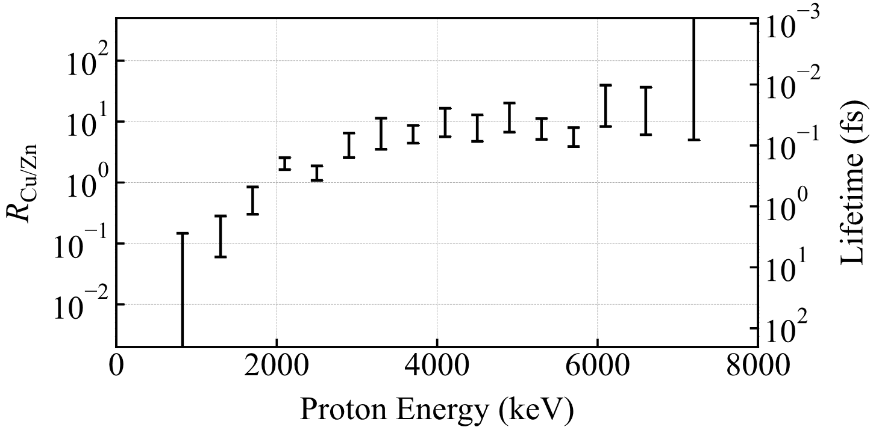
Evaluated ⁶⁰Ga Decay Scheme
L. J. Sun et al., arXiv: 2410.16446 (2024).

Slide 73
Lifetimes and Branching Ratios Apparatus (LIBRA)
LIBRA @ FRIB
Stopped beam diagnostics
Precision offline measurements
Decay Station @ NNDC
Addressing specific data needs and gaps in nuclear data through targeted experiments.
United States Nuclear Data Program Work Plan for FY2024

Slide 74
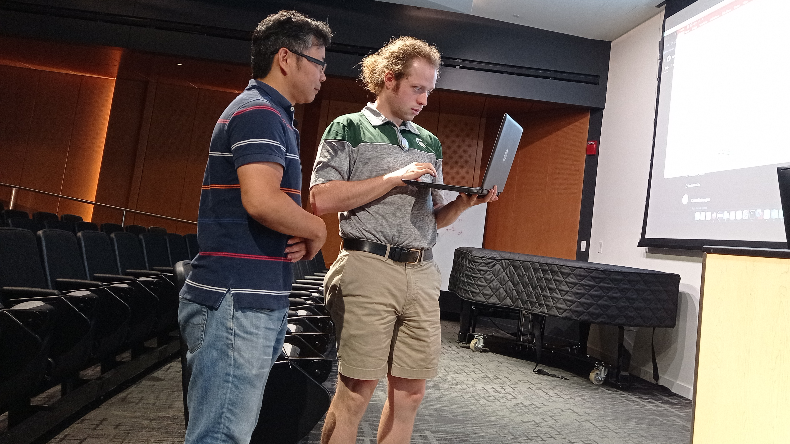
FRIB Integral Experimental Nuclear Data Services
20th Exotic Beam Summer School, FRIB
We provide professional and timely nuclear data support throughout all stages of research:
proposal preparation,
data taking,
data analysis,
publication preparation.

Slide 75
Takeaways
High-quality up-to-date nuclear data are essential for both nuclear structure and nuclear astrophysics.
A variety of nuclear data are constantly produced through experiments conducted at FRIB.
Olympic bronze medals typically contain 5-10% zinc.

Slide 76
Education and experience related to the position
L. J. Sun et al., Nucl. Instrum. Methods Phys. Res. A 804, 1 (2015).
L. J. Sun et al., Chin. Phys. Lett. 32, 012301 (2015).
L. J. Sun et al., Phys. Rev. C 95, 014314 (2017).
L. J. Sun et al., Phys. Rev. C 99, 064312 (2019).
L. J. Sun et al., Phys. Lett. B 802, 135213 (2020).
L. J. Sun et al., Phys. Rev. C 103, 014322 (2021).
L. J. Sun et al., Phys. Lett. B 839, 137801 (2023).
L. J. Sun et al., arXiv: 2410.16446 (2024).
102 papers
1308 citations
31 experiments
30 talks
2 grants as PI
1(2) proposals

Slide 78
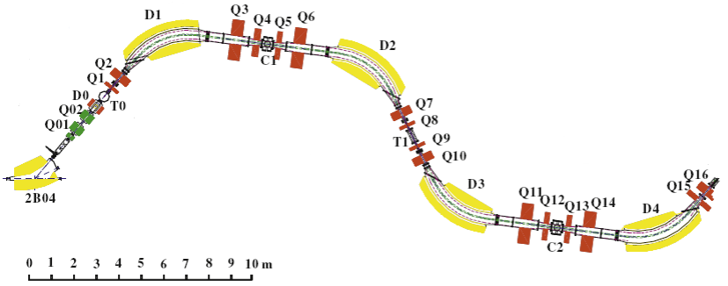
Lanzhou Heavy-ion Accelerator National Laboratory
ToF
Beam: ~ 80 MeV/u
~ 50-200 enA
Target: ⁹Be, ~ 1500 μm
Degrader: ²⁷Al, 500 μm

Slide 79
My Understanding of this Role
Compiling newly published structure and decay data and all data from FRIB for the XUNDL database.
Evaluating all available data for all nuclides of 2-3 mass chains per year for the ENSDF database.
Developing and maintaining utility and analysis codes for data compilation and evaluation.
Providing data support to FRIB experimenters through the FRIENDS (FRIB Integral Experimental Nuclear Data Services) project. Data checking and review for submitted manuscripts and PAC proposals.

Slide 80
United States Nuclear Data Program Work Plan for 2024
Work on the development of the next generation ENSDF format and develop applications that apply ML techniques to the new format.
Study in depth the possibilities of using AI and ML techniques in NSR, in collaboration with LBNL.
Maintain the Atlas of Neutron Resonances electronic files in preparation for a future update of the Atlas of Neutron Resonances. Continue working on the use of ML techniques to better determine resonance properties.

Slide 81
https://people.frib.msu.edu/~wrede/group

