Slide 1
Dear Lijie, your draft is quite epic. It reads more like a monograph than a technical paper. The whole section II (2 pages!) does not add anything other than the beta-decay spectroscopy aspect. Sorry, your two HPGe will not compete with dedicated beta-decay spectrometer like FDSi in respect of efficiency. Section III is similar, a lot of text from known literature and again closing with vague promises about LIBRA. I think those six pages can be easily condensed into one page of introduction answering "What is LIBRA for?". You likely won't even need a single formula as none of them is being used anywhere (well, (5) you might need explaining the PXCT technique.
The introduction outlines the following storyline: Astrophysical reaction rate → NiCu issue → 60Ga decay → PXCT. In previous versions of the draft, there were PXCT-specific formulas, such as level densities with the back-shifted Fermi gas model, which were all removed. The remaining formulas straightforwardly provide the audience with the essential ingredients that need to be measured for reaction rate calculations, including energy, spin/parity, lifetime, and decay branching ratios, etc.
The last round of A=60 ENSDF evaluation is 12 years old. We have conducted an up-to-date 60Ga decay data evaluation in accordance with the ENSDF standards, facilitating an accurate understanding of the pertinent nuclear structure properties. The details of the evaluation in previous versions were deleted, and only showing a decay scheme would be enough. Those values will be reflected in the NDS for A=60; however, this may not occur in the near future.

Slide 2
Section I “We provide a comprehensive description of the experimental setup and its performance tests, demonstrating the feasibility of employing LIBRA in a case study to address the NiCu cycle issue in Type I X-ray bursts (XRBs).”
Please be aware that later you *just* provide energy and timing resolution and efficiency results obtained from source data. A 'performance test' makes me expect you ran a 'real' experiment from which you demonstrate what you can do. As a reader I like to know something like 'if I have 10e3 particles per second, can I get a result with LIBRA within a reasonable time?'
The beam intensities in the stopped-beam area aren't quite there yet. The 60Ga experiment might be 5 years away. At the moment, the most we can provide are various source tests, Geant4 simulations, Shell model and Hauser-Feshbach statistical model calculations.
Table III has no relevance. Why listing all those experiments from other publications? You have absolutely nothing what your work as of now is adding to those results.
Same as Fig. 2, I find myself frequently referring to Table III. This table serves as a straightforward and essential source of information to help readers navigate more effectively. Actually, much of the PXCT literature from the 1970s did not clearly report X-ray energy values, their adopted atomic shell lifetimes/widths, or the range of lifetimes for the proton-emitting states obtained.
When I review other papers, I often find it impossible to navigate through the levels and have to draw a decay scheme if they don't show one in the paper. Therefore, I always require the authors to add a decay scheme to make the readers' lives easier.

Slide 3
Section IV A: You haven't had any beam yet so you do not need to write about production and delivery. The only LIBRA relevant aspect is that you can put a cup there.
That's why we use future tense "For the future experiment", "The ions will be guided and accelerated to 30 keV".
Section IV B: What I'm totally missing are some words about a concept. Like "Nuclei at low energy of XX keV implanted on a target foil surrounded by detection systems for beta, p, x-ray, gamma. When beta/p decay in coincidence you measure xray/gamma. Or even without coincidence condition, but natural bg? Explain the tilting angle of the target, won't the frame block off solid angle for particle and xray detection?"
The mechanical design drawing and photograph of LIBRA are shown in Fig. 4, which should be explanatory. In the text, we have mentioned that "the 60Ga beam will then be directed into the center of the foil. A 30-keV 60Ga beam can be fully stopped by a Mylar foil as thin as 50 nm … "
Good point on the angle. I have reviewed the geometry of the target holder and included a to-scale figure on the next slide. We added a cut-off to the holder frame to avoid blocking as much as possible. It should be relatively easy to fabricate an even thinner holder, considering the foil it supports is lightweight.

Slide 4
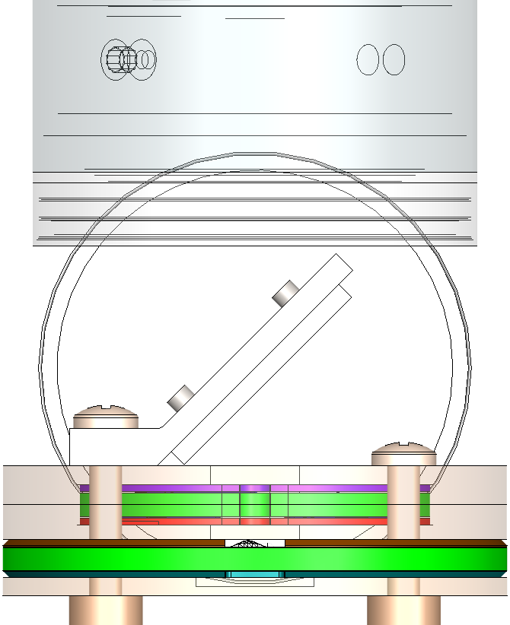
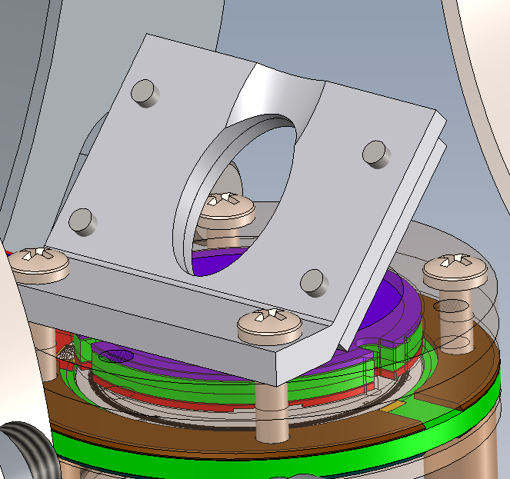
beam
Notes:
5.4/38*25=3.55 in ppt
5.4/38*10.5=1.49 in ppt
5.4/38*5.6=0.796 in ppt
5.4/38*12=1.705 in ppt
5.4/38*26=3.695 in ppt

Slide 5
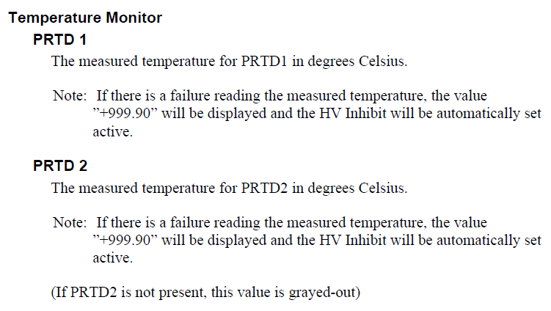
Section IV B: Please only put in relevant data, not stuff from a manual without consequence for your setup.
I have fully revised and refined the Electronics and Data Acquisition sections. I have rewritten them to be more concise. The temperatures of the controllers and PRTD sensors, along with their built-in safety mechanisms, have been moved to the supplemental material. These details are critical diagnostics for the benefit of future users and operators of the system.
For example, the manual only provides a vague explanation of the PRTD as shown in the screenshot below. The datasheet indicates that the normal value for the XtRa1 PRTD1 is -163.6°C. That was all we knew.
It was only during those power outages that I gradually found out what they really do. In our lab, the actual PRTD1 of XtRa1 is around -158.1°C, and during the AC outage, it couldn't maintain that temperature. We observed that once it reached -153.5°C, the HV-inhibit was triggered.
There are many HV-inhibit sensors, and understanding how those work together is definitely not something that can be easily understood by future users by reading the manual.

Slide 6
Section IV D. Data acquisition 93Ohm into Pixie? What is the 1kOhm? Are we dealing with impedance mismatching and therefore signal reflection in cables?
The iPA output signal is split into two channels with termination impedances of 93 Ω and 50 Ω, respectively. The input impedance of each channel in Pixie-16 is switchable between 50 Ω and 1 kΩ with a bunch of tiny jumpers. In our tests with both impedance combinations, we did not observe any reflection or oscillation. The only difference observed was in the signal amplitude. Since Dirk points this out, I think I should reconnect all 16 jumpers to the Pixie card and ensure that 50 Ω is used throughout.

Slide 7
Section V A: "Additionally, the LEGe count rate was ~3000 pps during the 152Eu test but only ~200 pps during the 241Am test, resulting in different DAQ dead time (Fig. 6)."
Then reduce the energy filter width for that test where you don't need optimum resolution. And it's an xray detector, should have a short filter anyways.
FIG. 8. Absolute X-ray photopeak detection efficiency of the LEGe detector. Why do we have uncertainties on the energy axis? Don't we know the source energies precisely? Here I see a problem. Figure 3 in the motivation cooks down the problem to "I just have to measure two x-ray intensities close in energy". Here now you have a dramatic change in efficiency with few 100eV difference in energy. Measured intensity uncertainties will highly affected by efficiency uncertainty.
As explained in the caption, the error bars along the x-axis also reflect the energy span for the multiple X rays within each group. ENSDF doesn't contain X-ray data. We adopted the LNHB database, which only reports X-ray intensities for L_{β} X rays instead of for each subline L_{β1,} L_{β2,} L_{β3,} L_{β4}, etc.
"The 241Am source used for this test is an open source, while the 152Eu source is encapsulated between two 60-μm thick Mylar tapes. The Mylar layer attenuates low-energy X-rays, but its impact diminishes for X rays above 10 keV. Additionally, the LEGe count rate was ~3000 pps during the 152Eu test but only ~200 pps during the 241Am test, resulting in different DDAS dead time. Therefore, the 152Eu efficiency curve represents a lower limit, while the 241Am efficiency curve represents an ideal setting. The 60Ga experimental condition with a 1.5 μm thick collection foil is expected to fall between these two scenarios, and we estimate the X-ray efficiencies at 8.0 and 8.6 keV to be 6.5−7.4% and 7.0−7.8%, respectively."
A relative 10% uncertainty on the efficiency is conservative, which is still small compared to the statistical uncertainty and the atomic data uncertainty explained in Section VI. The statistical uncertainty dominates even with a 20-day 9000-pps beam. If FRIB lives up to the rate calculator, that would mean 6 days of beam time.

Slide 8
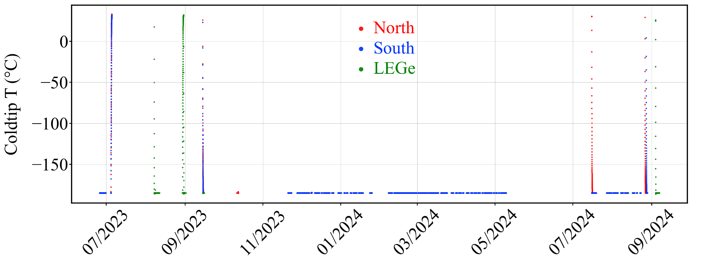
Section IV C: "The typical leakage currents of the two XtRa detectors are below 20 pA and below 100 pA for LEGe."
How do you now that? Have you measured that? I doubt it....
again, have you checked the leakage current on the LEGe?
See the next 8 plots. For a year, we have diligently documented all key operating parameters, including leakage currents.
End of
E21010
Move into
Test location
July
outage
August
outage

Slide 9
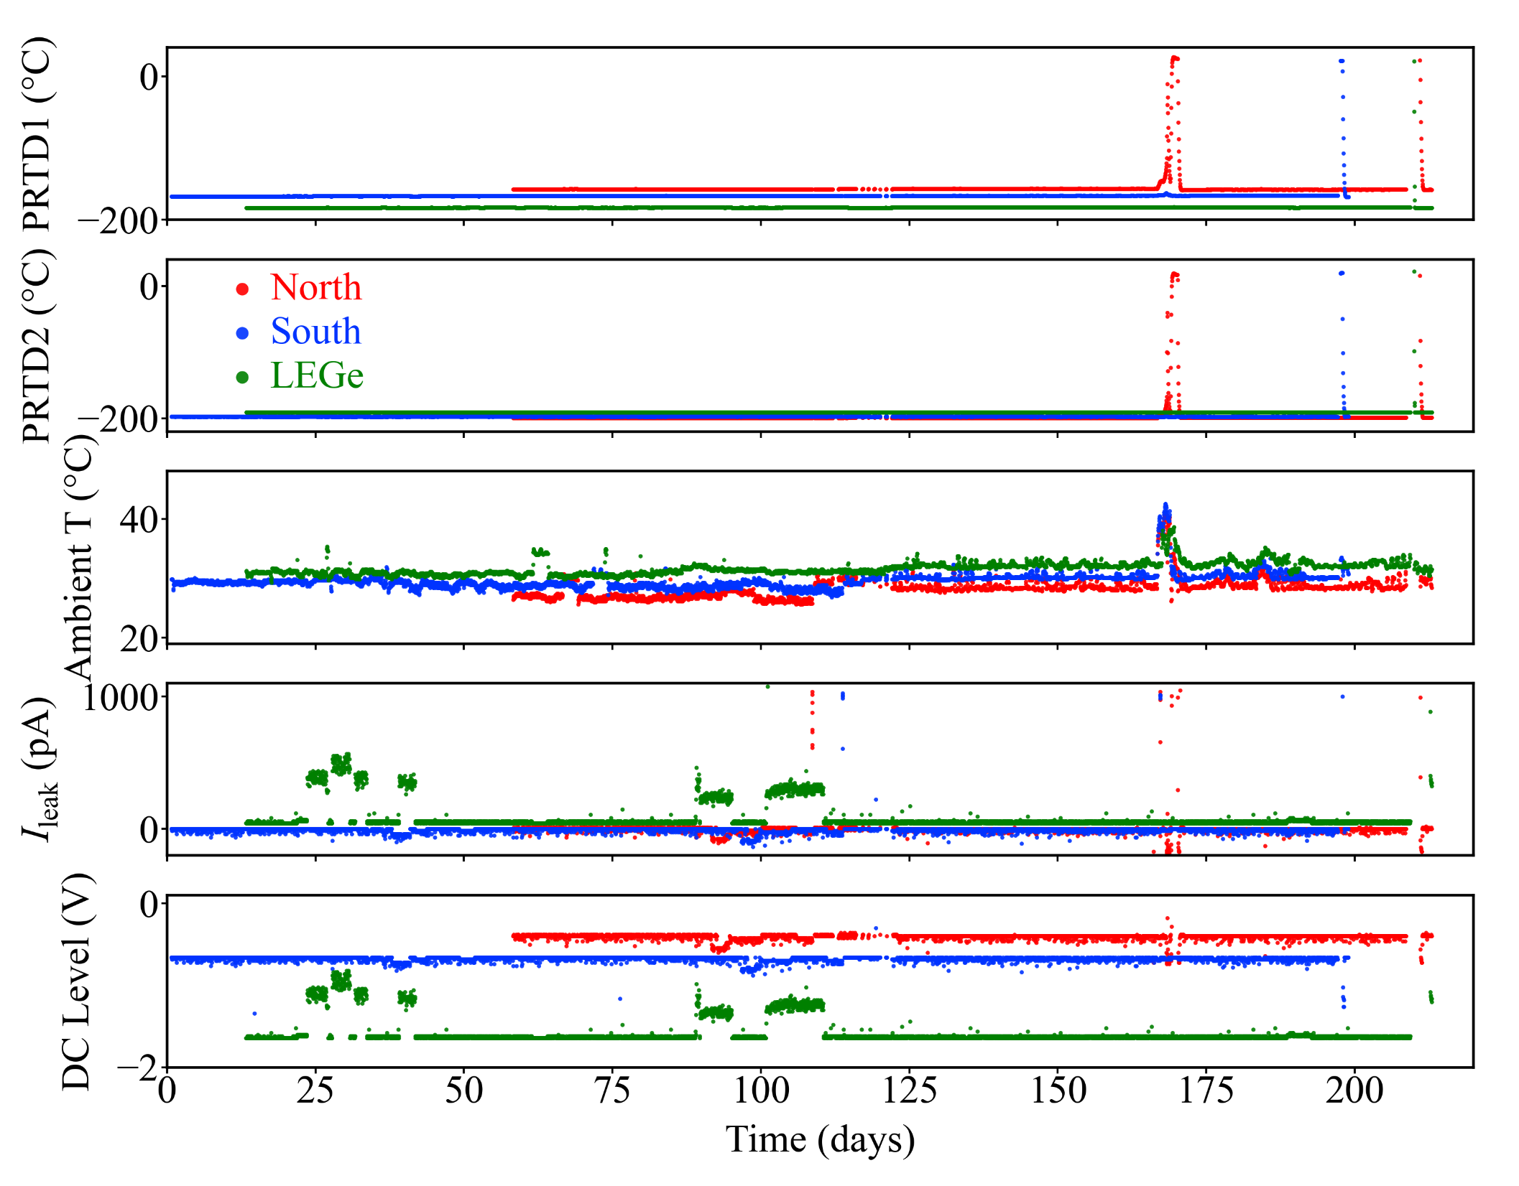
July
outage
August
outage

Slide 10
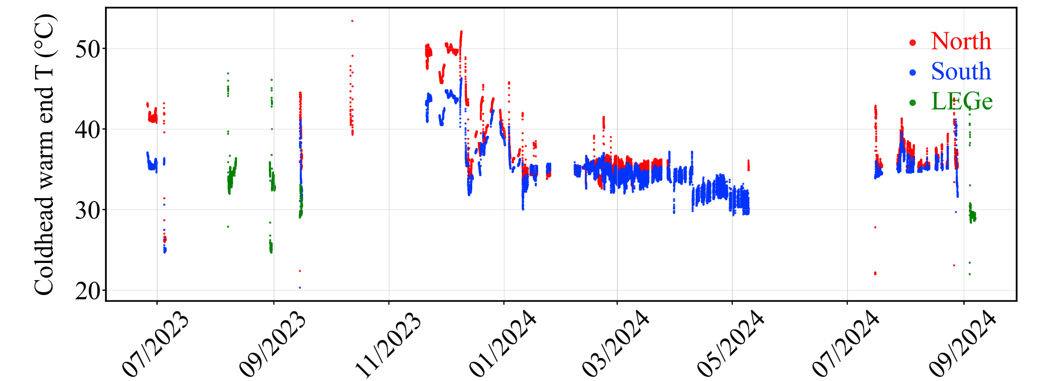
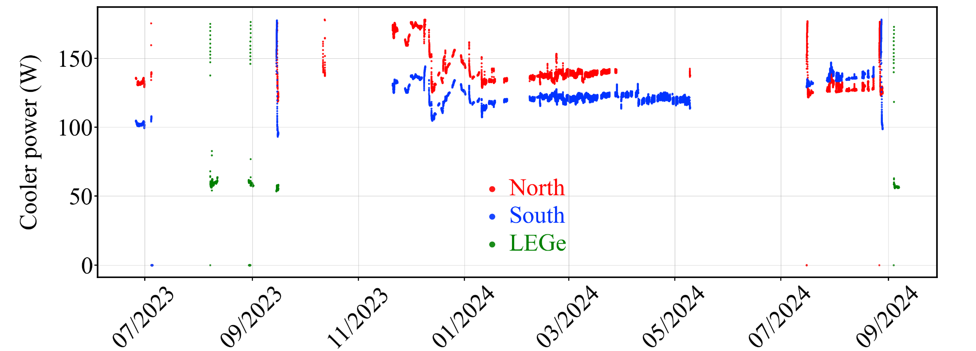

Slide 11
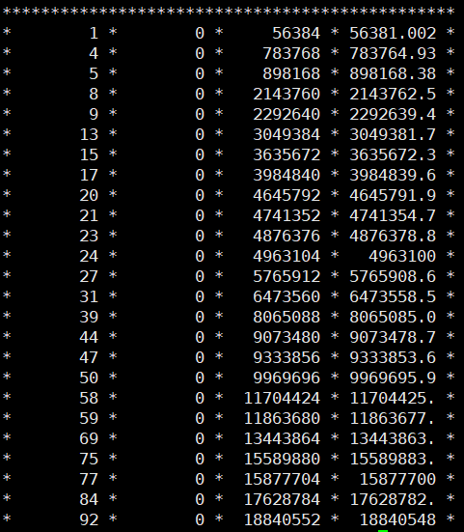
IV D. Data acquisition
I do not believe that PIXIE uses the computed CFD timestamp for event timestamping. This is done by the LED timestamp. What DDAS values do you use?
We have both LED and CFD timestamps
The DDAS filter parameters, which were summarized in a table that was removed in earlier revisions, will be included in the supplemental material.
For the trigger filter parameters and CFD parameters, they were determined to be the configuration that yielded the best timing during my 2-month extensive tests from April to May.

Slide 12
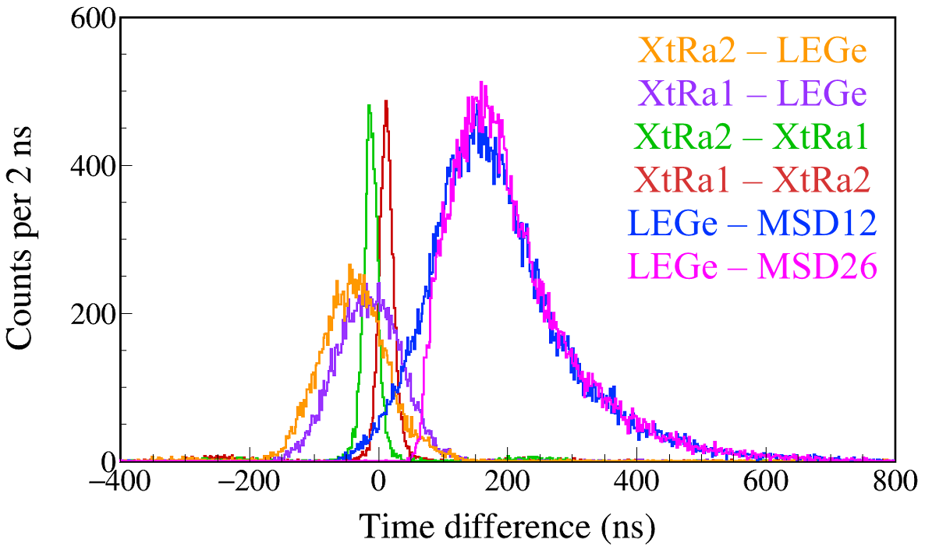
Using a dual pulser to test DDAS timing resolution:
The FWHM resolution of the time-difference distribution is estimated to be 0.46 ns. So the timing of DDAS itself is okay.
Feeding the pulser to each preamplifier's test input, the resulting FWHM timing resolutions are 37.4 ns (MSD12), 4.4 ns (MSD26), 1.2 ns (XtRa1), and 1.8 ns (XtRa2).
FDSi experiments all set ±10 μs event build window when they use DDAS.
We can say we have no problem setting a 500 ns event build window in DDAS under this timing resolution. In subsequent analysis, we can set coincidence/anti coincidence/background-subtraction windows of 100 ns or below.
This is enough for our experiments.
γ-γ
South 1332 – North 1173
North 1332 – South 1173
X-γ
North 1408 – LEGe 40,46
South 1408 – LEGe 40,46
α-γ
LEGe 59 – MSD12 2000
LEGe 59 – MSD26 3500

Slide 13
IV D. Data acquisition
"The pulse amplitude is extracted from the energy filter amplitude at approximately rise time plus gap time after triggering."
vague...and how do you know that? Have you looked into the PICIE firmware?
Based on the DDAS NIMA paper.
"If a second trigger arrives within the rise time plus gap time window, both events will be flagged as pile-up. The pile-up rejection is disabled, and therefore, the timestamp of the first event is preserved while the second is discarded. The amplitude of the second event is partially added to that of the first event, with the addition diminishing as the time interval between them grows. The count rate capacity of the detection system is primarily determined by the energy filter parameters chosen for each detector."
How that? I think maximum bandwidth that DDAS can transfer is equivalent to 60kHz, then it gets unstable. The energy filter setting determines two things: energy resolution and pile-up condition. What is an event loss for you? A DAQ deadtime is defined as how many events are acquired relative to a trigger rate. So 2 events, 2us apart, both put in the data stream do NOT count as a DAQ deadtime, even if the energy information is piled up. Fig 6 will make people upset, especially XIA folks. You just say here that at those modest rates the system isn't deadtime free (which XIA advocates claim and I concur to a certain extend)
Without any information on detector timing and experimental condition the 1us is without context. For example, if you're looking for tau of several 100ns, this build with is too short, in a prompt measurement and all detectors having 1ns timing it would be insanely long. Furthermore it seems to narrow for your HPGe. There timestamps come from leading edge timing which you know is quite bad.

Slide 14
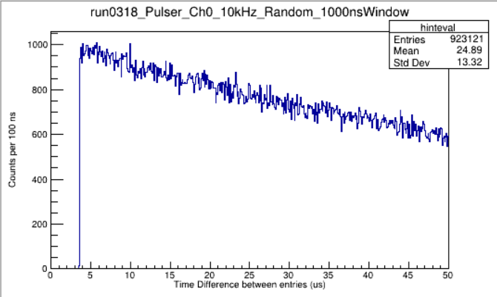
Pileup. In the pulser test Energy filter: T_{rise} = 2.944 us; T_{gap} = 0.768 us.
2.944+0.768+0.010=3.722 us
If a second event triggers the system within a time T_{PU} = T_{rise} + T_{gap} + 10 ns of the first event, both events are considered pile-up.
The same tests as in K. Starosta et al., Nucl. Instrum. Methods Phys. Res. A 610, 700 (2009).
"Dead time"
According to C.J. Prokop et al., Nucl. Instrum. Methods Phys. Res. A 741, 163 (2014), "The advantages of DDAS include better energy resolution than a traditional analog system, large dynamic range, lower energy thresholds, and a small acquisition dead-time." and "DDAS has increased the experimental capabilities of each array by providing energy and time measurements with nearly zero dead-time, low energy thresholds, and large dynamic range."
If T_{rise} + T_{gap} is set to nearly 0 in the energy filter, the DDAS can be considered "dead-time free". It's like we sell you a car and claim it can reach light speed if you drive in a vacuum. True, but not practical.
The next 3 slides explain the observed pile-up in detail.

Slide 15
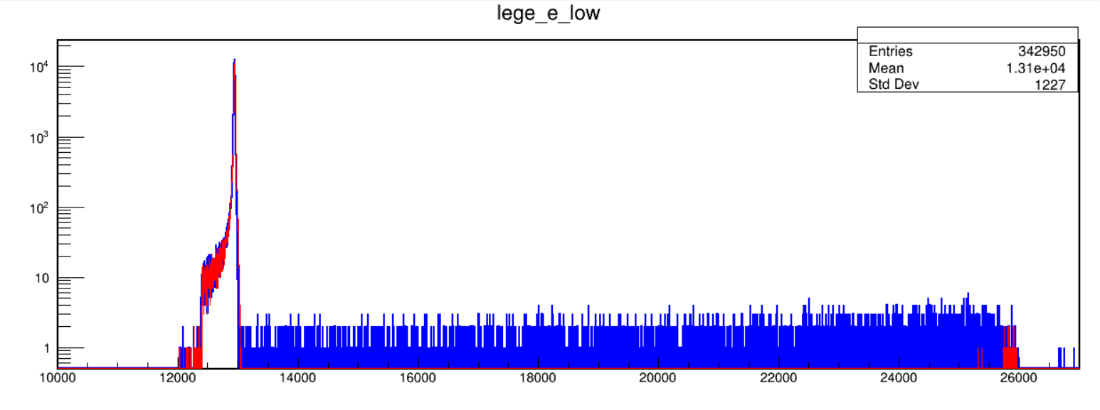
Random Pulser 3 kHz
Red: Reject pileup events by enabling PC1 in CSRA
Blue: Record all events
8 μs
Sum Energy ↑; Time intervals ↓
0 μs
For the energy filter parameters set for our LEGe detector, Trise+Tgap ≈ 8 us.
If the 2nd event occurs 0.1 μs after the 1st event, DDAS discards event2 and records Timestamp1 with Amplitude1+Amplitude2;
If the 2nd event occurs 4 μs after the 1st event, DDAS discards event2 and records Timestamp1 with Amplitude1+ half of Amplitude2;
If the 2nd event occurs 8 μs after the 1st event, DDAS discards event2 and records Timestamp1 with Amplitude1+ a tiny portion of Amplitude2;
If we select the "Pileup rejection mode", both timestamps and energies for both events are discarded.

Slide 16
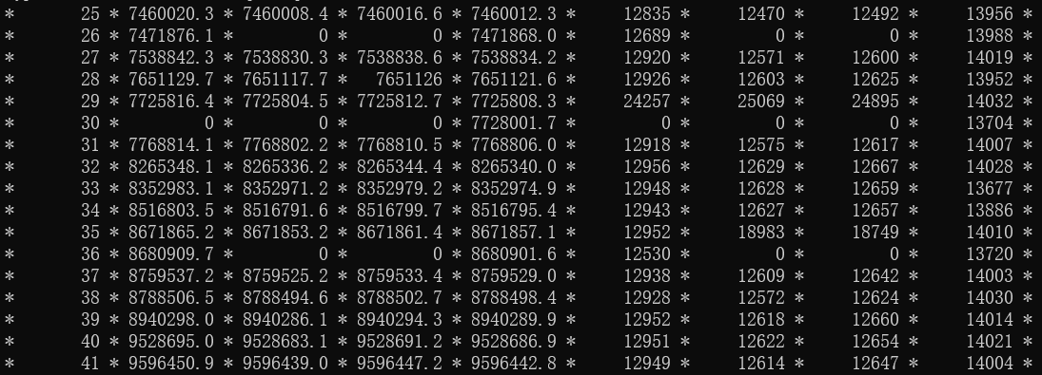
11.8
2.2
9.0
4.7
4.8

Slide 17
Section IV D: If a second trigger arrives within the rise time plus gap time window, both events will be flagged as a pile-up. In the tests conducted in the next section, pile-up rejection is turned off. As a result, the timestamp of the first event is preserved while the second is discarded for all the tests conducted in the next section. The amplitude of the second event is partially added to that of the first event, with the addition diminishing as the time interval between them increases. The count rate capacity of the detection system is primarily determined by the energy filter parameters selected for each detector.
I've rephrased the count rate capacity of DDAS to the count rate capacity of our detection system so that readers understand the count rates shown in Fig. 5 are specific to us.

Slide 18
The simulation of a specific case is not that much of interest. Critical benchmarks are missing, like beta-gamma efficiency, p-beta, beta-xray. Are they sufficient and effective for you setup. What is limiting them?
We have developed a Geant4 simulation package for LIBRA.
The general version of the simulation includes the geometric configuration of the setup and the detector response each characterized based on tests using radioactive sources.
Additionally, a theoretical 60Ga decay scheme has been implemented in a specific version of the simulation.
It is unlikely that β-X coincidence will occur, unless β decay results in substantial excitation or ionization of the daughter atom (shaking transitions).
In the stopped beam area 60Ga experiment, 60Ga is the only β-delayed proton precursor, and even if there is another proton emitter, β-p coincidence won't bring any benefits, making it likely useless for us.
βγ may be used for diagnostics/identification. If we really need to measure something that specifically benefits from βγ, we'll likely replace MSD26 with a larger-area silicon detector. The largest one in MSD series is MSD85, which is something to consider for the LIBRA2 upgrade.

