Slide 1
³¹Cl decay with GADGET-I (E17024)
2025Bu00
31Cl EC DECAY:XUNDL-22
31Cl ECP DECAY:XUNDL-6

Slide 2
General Comments
For A=30, M. Shamsuzzoha Basunia, Nuclear Data Sheets 197, 1 (2024) supersedes [47] M. Shamsuzzoha Basunia, Nuclear Data Sheets 111, 2331 (2010). So, Ref. [47] should be replaced, and all the cited excitation energies of ³⁰P states should be updated to the 2024 values.
The ³¹S excitation energies derived from E_{x}(³¹S) = S_{p} + E_{p(c.m.)} + E_{x}(³⁰P) may be revised, as well.
The total I_{βp} = 2.4(2)% is from Saastamoinen's Thesis and has been adopted by ENSDF, NUBASE, and Berkeyley's BEApR database.
Can we report our I_{βp_total}?
I got I_{βp} <= 2.08% based on Table I.

Slide 3
Comments for page 2
Our DSL1 PLB paper is not mentioned anywhere, which could be cited after "Indirect methods of spectroscopic study into the structure of ³¹S include … "

Slide 4
Comments for page 3
FIG. 2. Drift times of all β-delayed proton events detected in coincidence with 2234-keV γ-rays.
Why is the 2234-keV ³¹Cl β delayed γ ray in coincidence with protons? The drift time plot in Moshe's NIMA2019 paper was the time difference between ²⁵Si β-delayed protons and the following 1369-keV γ ray in ²⁴Mg.
Okay, if the figure is showing mostly "beta-gamma coincidences", the caption may be adjusted a little bit.

Slide 5
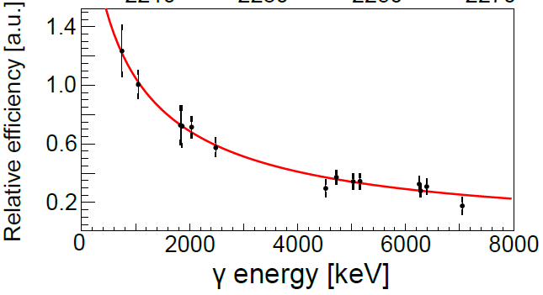
Comments for page 5
"The magnitude of the fit function from Figure 5 was scaled such that it intersects with the error bars of two data points, whose absolute γ-detection efficiencies have been independently verified."
What two data points? Was the curve not fitting the 12 data points shown in Fig. 5?
The text suggests we should be able to demonstrate an absolute efficiency plot?

Slide 6
Comments for page 6
The three strongest β-delayed proton decays were used as the standards for the first-order calibration. … plotted against the 806(2)-, 906(2)-, and 1027(1)-keV resonance energies, according to the most recent evaluated nuclear database [39];
Ref. [39] reported 806(2), 906(2), and 1026(2) keV.
Table I reports 805(2), 906(2), and 1027(1) keV.
Which set of three values is adopted as the standard?
Okay, if the second set is adopted, the 806(2) quoted in the text should be revised to 805(2).
6936-6130.65=805.35

Slide 7
Comments for page 6
Equation 5 suggests the 31S excitation energy should be Ex = 8418(3) keV, which is quite close to the level energy listed in the most recent Nuclear Data Sheets evaluation [Ex = 8424(3) keV] [citation]. Previous 31Cl β+ decay measurements [18, 19] attributed the 2.3-MeV β- delayed proton decay, visible in the Figure 6 spectra, to this same level.
Since you explicitly explained 8418(5) and 8422(2) in the text. Perhaps also mention the value of 8429(3) by Ref. [19]?
8424(3) can only be obtained via the weighted average of all three [8429(3), 8418(5), 8422(2)].

Slide 8
Comments for page 9
"We developed a simplified, geometric Monte Carlo (sgmc) model that was able to reproduce the more detailed geant4 results to within 3% up to 1.4-MeV proton energies."
Fig. 9 caption states "within 3% up to 1.5 MeV".

Slide 9
Comments for page 10
"Because we have definitively observe a proton-emitting level at 9421(8) keV that is in excellent agreement with previous studies."
observe → observed
There is no reference for the "previous studies" you mentioned.
I guess 9423(7) keV reported by https://doi.org/10.1103/PhysRevC.76.015803
should be cited here.

Slide 10
Comments for page 12
"This observation could be simply be attributed to the large systematic uncertainties associated with detecting high-energy protons in the GADGET system."
could be simply be → could simply be
"The 9328-keV state where we see the largest jump in B(GT)."
The B(GT) value at 9328 keV may need to be revised.
Please refer to the next slide for more information.

Slide 11
Comments for Table I
I_{rel} * 0.0131 = I_{abs} seems true for all but two states.
8557-keV state: I_{rel}(0.33+0.8)=1.13, *0.0131=0.015, I_{abs} = 0.015, good.
9238-keV state: I_{rel}(0.38+0.8)=1.18, *0.0131=0.015, I_{abs} = 0.005, ?
9328-keV state: I_{rel}(0.31+1.0)=1.31, *0.0131=0.017, I_{abs} = 0.027, ?

Slide 12
Comments for Table I
From E_{p} = 973(3) keV, we get E_{x} = 8558(3) keV
From E_{p} = 1715(4) keV, we get E_{x} = 8554(4) keV
Standard weighted average calculation gives E_{x} = 8557(2) keV.
If the (3) and (4) are statistical uncertainties, obtaining a (2) for E_{x} makes sense.
However, the uncertainties of E_{p} in this case are primarily systematic uncertainties.
Therefore, the uncertainty of E_{x} cannot be reduced during weighted average.
Hence, E_{x} = 8557(3) keV, the final uncertainty adopts the more precise E_{p}.

Slide 13
Comments for Table I
Caption "The β-feeding intensity Iβ of a given 31S level represents the probability of direct population from a single 31Cl β+ decay."
Population from both β⁺ and EC, I think.
I calculated the EC ratios. For ³¹S states E_{x} > 9 MeV, the EC contributions are >1% of β⁺.
Caption "The log(ft) values were determined using the NNDC LogftCalculator."
Well, that web calculator is actually an interface of the MSU LogftCalculator; part of the MSU RadiationReport Calculator.
https://github.com/IAEA-NSDDNetwork/RadiationReport

Slide 14
Comments for Table I
I have compiled the datasets from 2025Bu00. You can find the links below:
https://wikihost.frib.msu.edu/pxct/lib/exe/fetch.php?media=output_2025bu00_30p.pdf
https://wikihost.frib.msu.edu/pxct/lib/exe/fetch.php?media=logft_2025bu00_31s.pdf
We did not mention any spins or parities in the paper.
We can constrain the unknown J^{π} values of many high-lying ³¹S states.

