Slide 1
Lifetime of ²³Mg 7787 keV state (S2193)
1) Fit range
2) Bin width

Slide 2
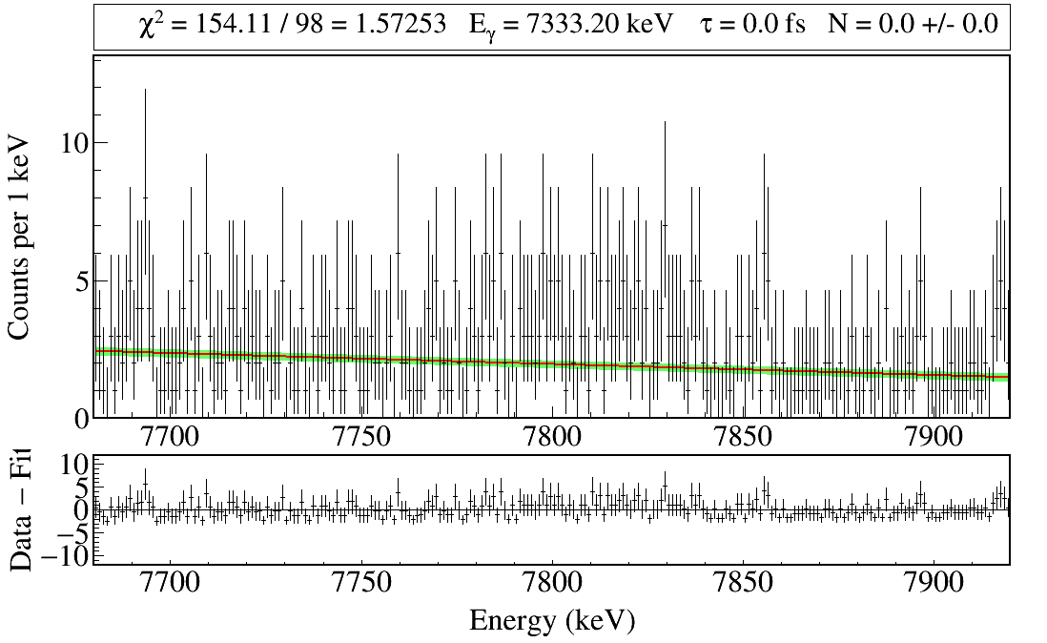
χ² is summed from 7750 to 7850 keV
Fitting Lexie's data with a linear function yields χ²/NDF = 1.57

Slide 3
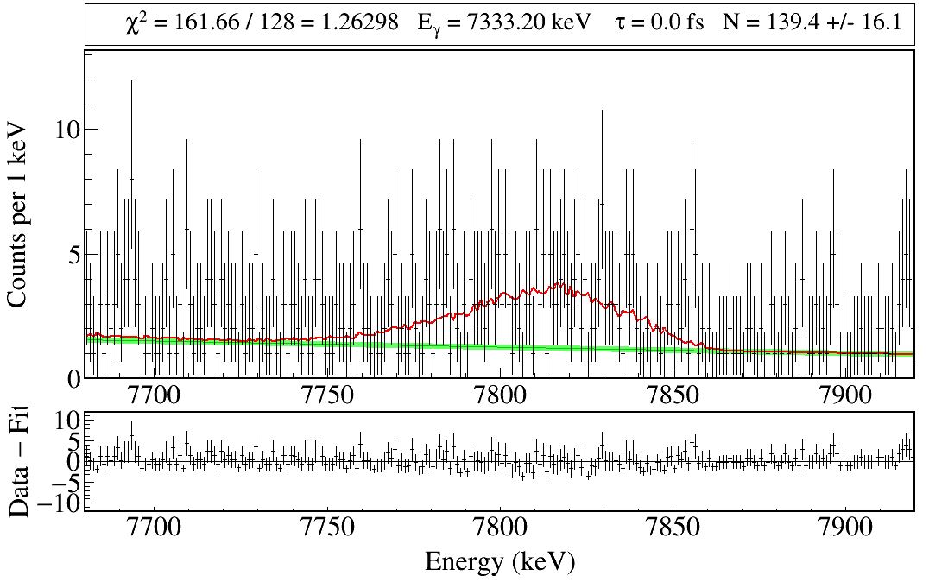
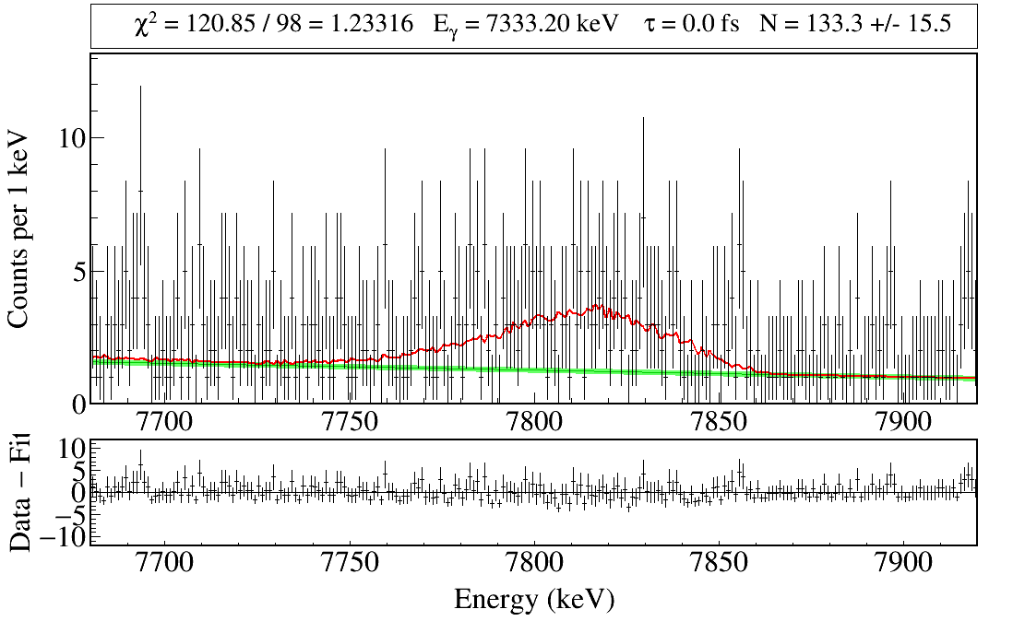
7740-7870
130 bins
7750-7850
100 bins

Slide 4
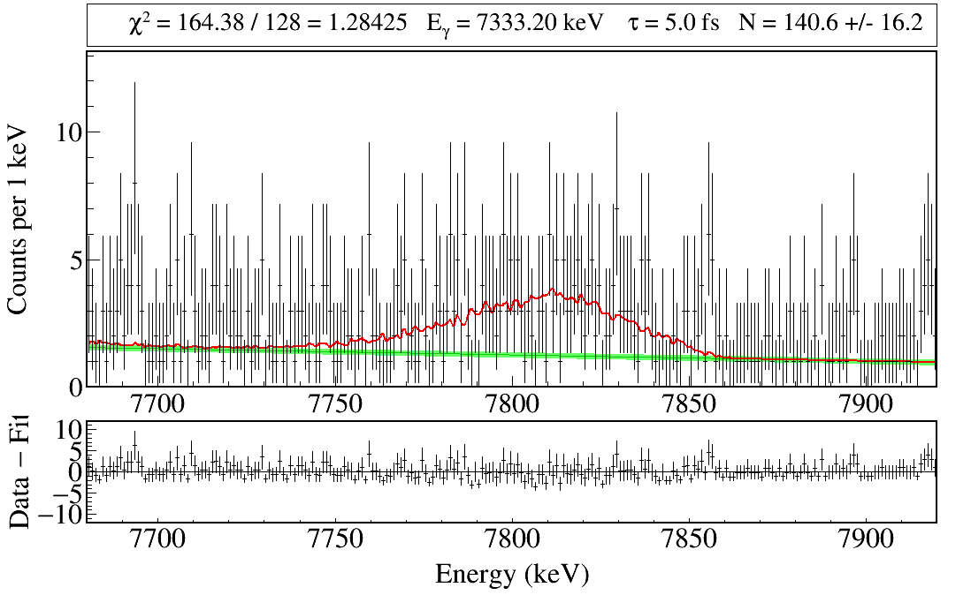
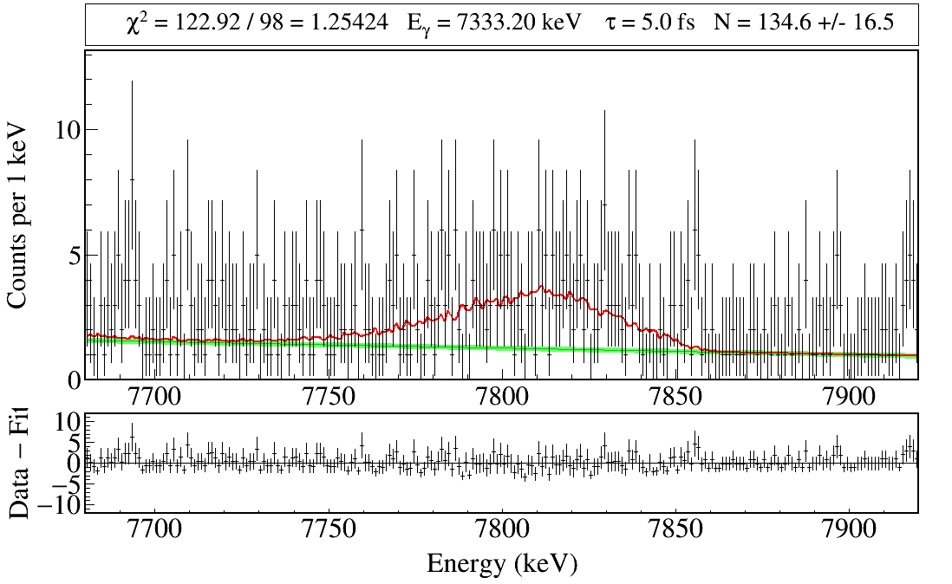
7740-7870
130 bins
7750-7850
100 bins

Slide 5
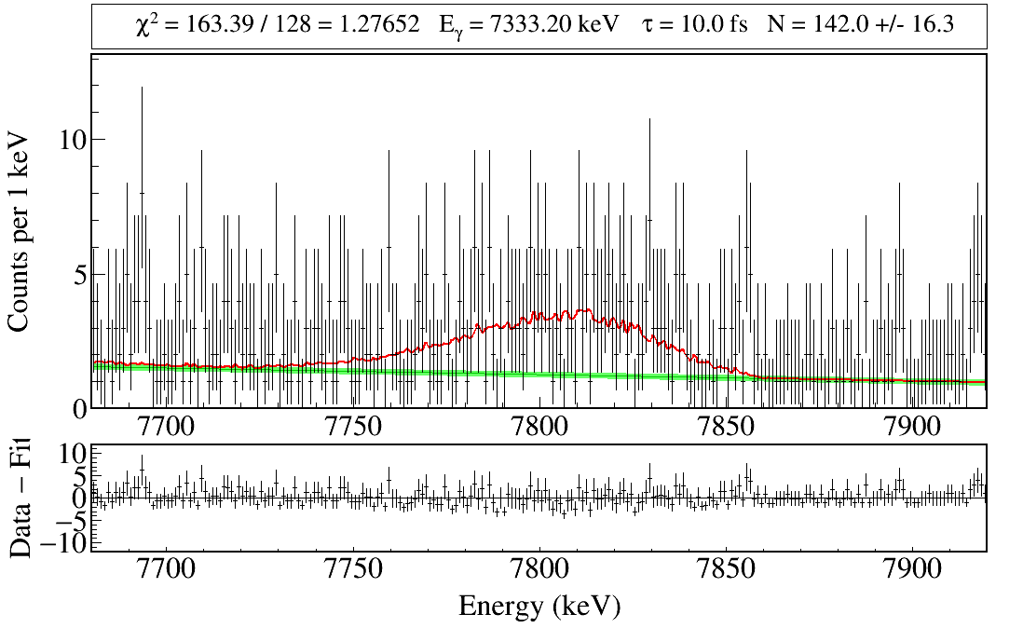
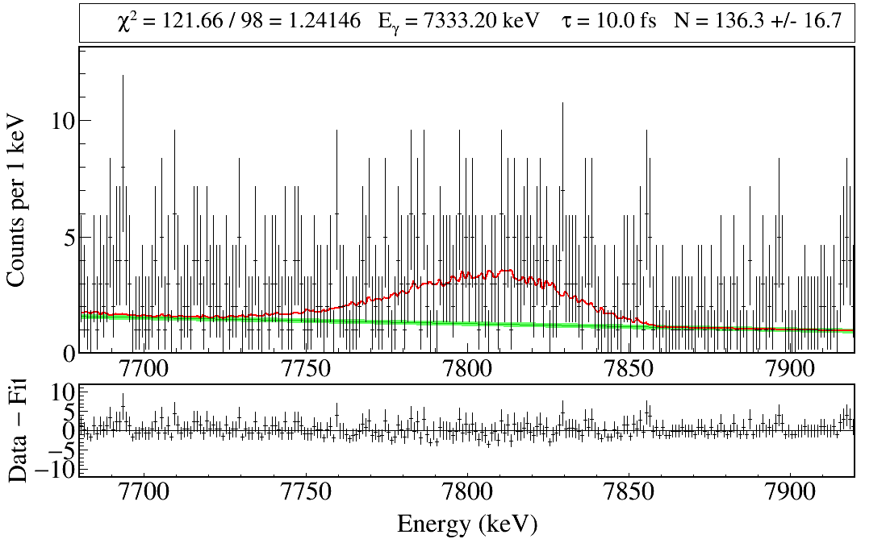
7740-7870
130 bins
7750-7850
100 bins

Slide 6
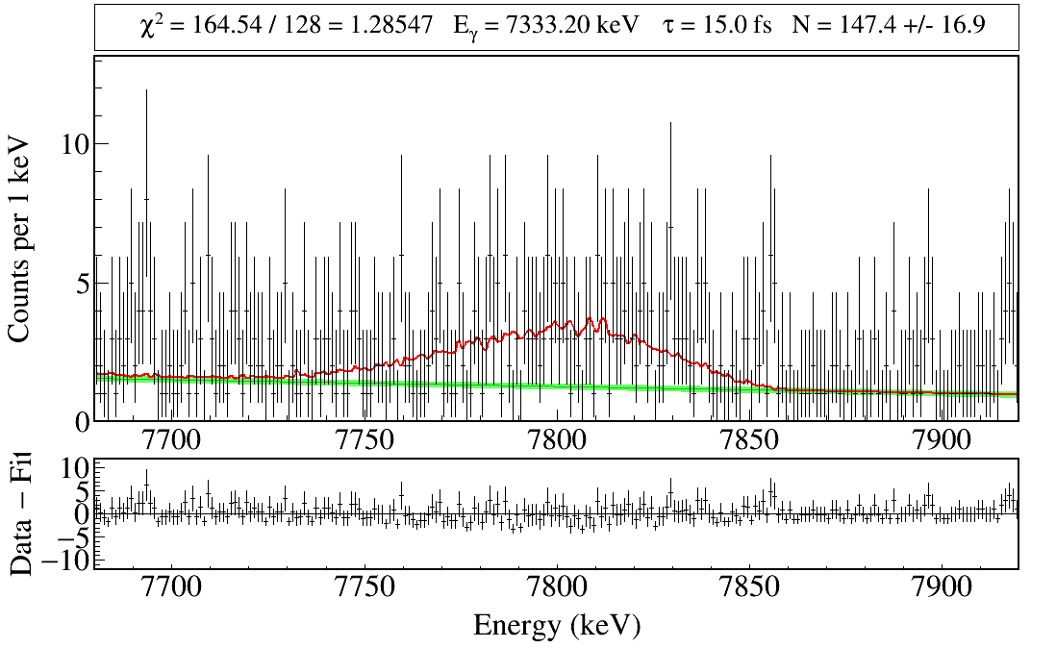
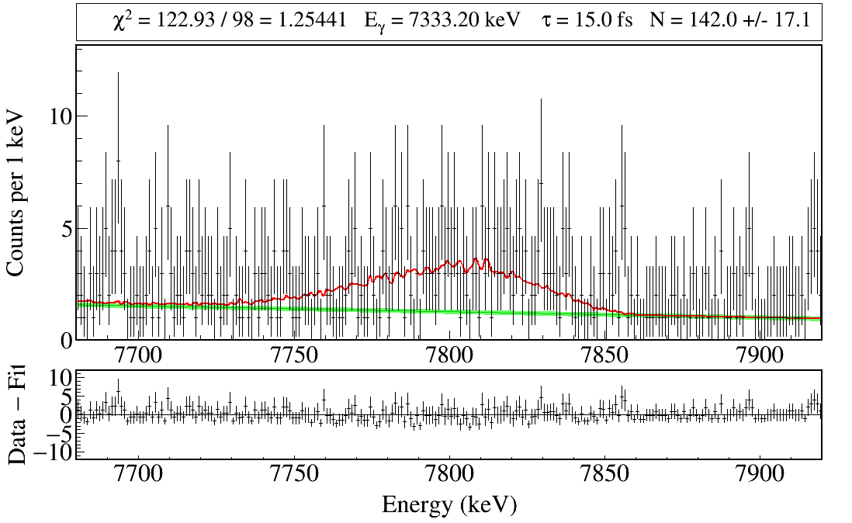
7740-7870
130 bins
7750-7850
100 bins

Slide 7
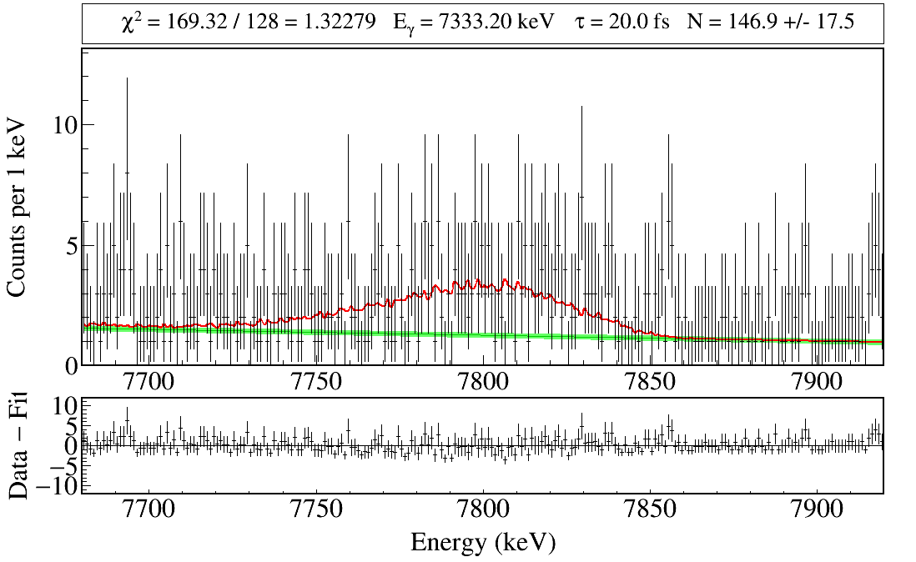
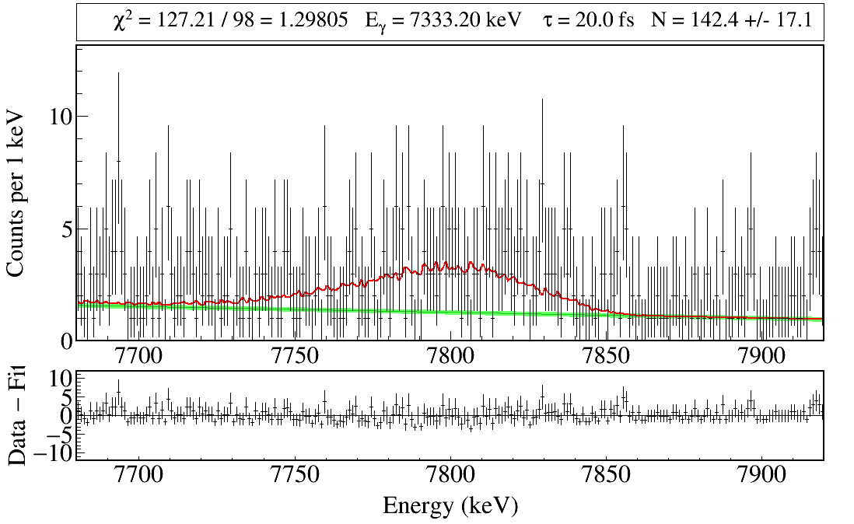
7740-7870
130 bins
7750-7850
100 bins

Slide 8
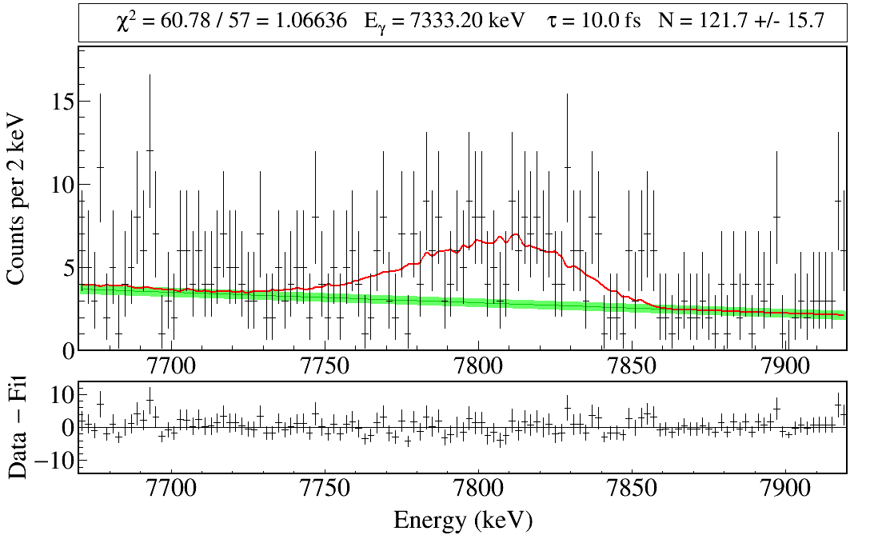
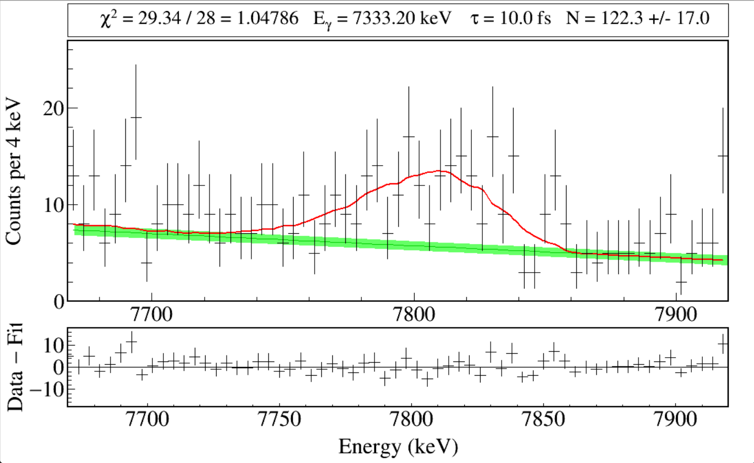
Rebin(2)
Rebin(4)

Slide 9
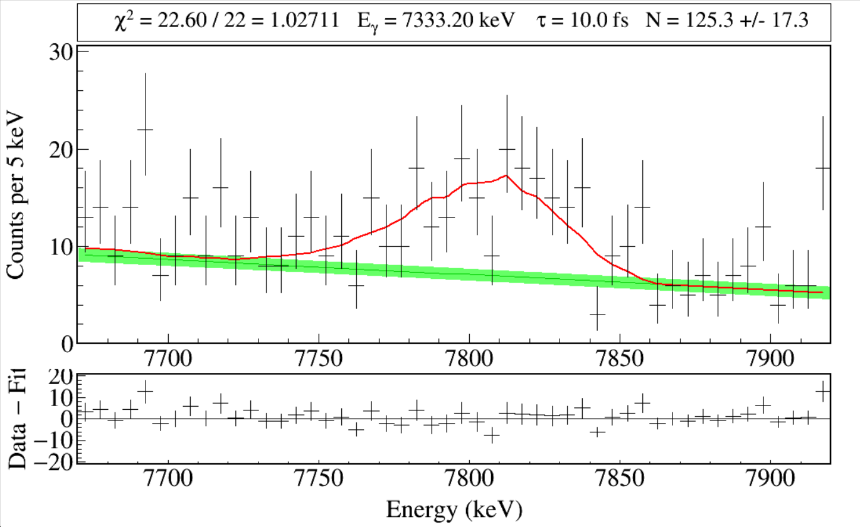
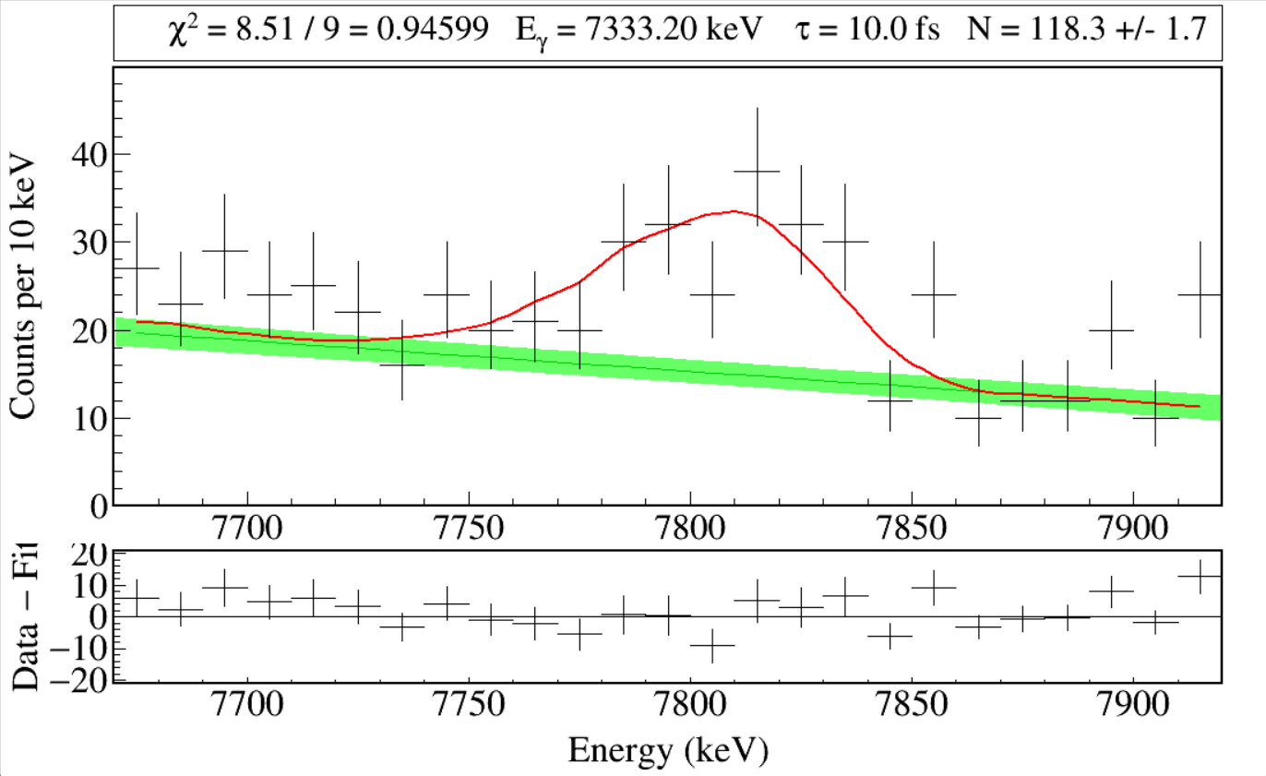
Rebin(5)
Rebining spectra by a factor of 5 seems to make bin counts sufficiently high to be considered Gaussian instead of Poisson.
Rebin(10)

Slide 10
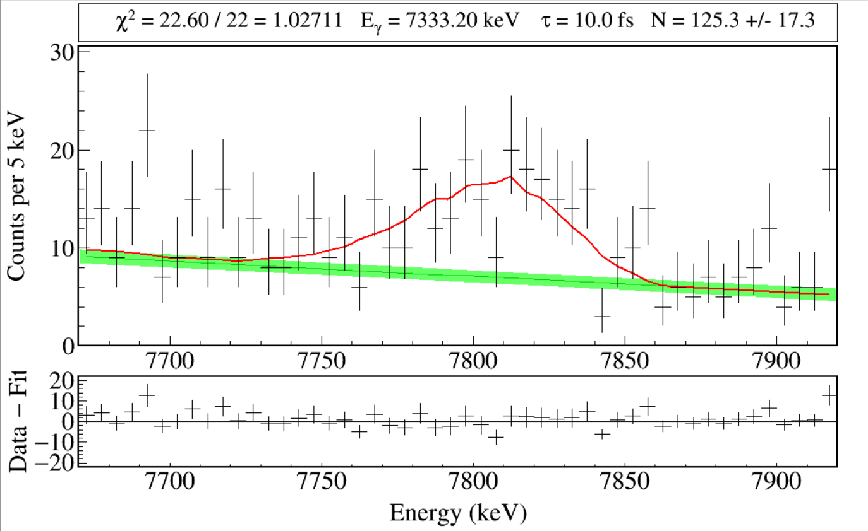
The fit range is highlighted by the blue area.

