Slide 1
Lifetime of ²³Mg 7787 keV state (S2193)
1) Fit range
2) Bin width
3) Bayesian

Slide 2
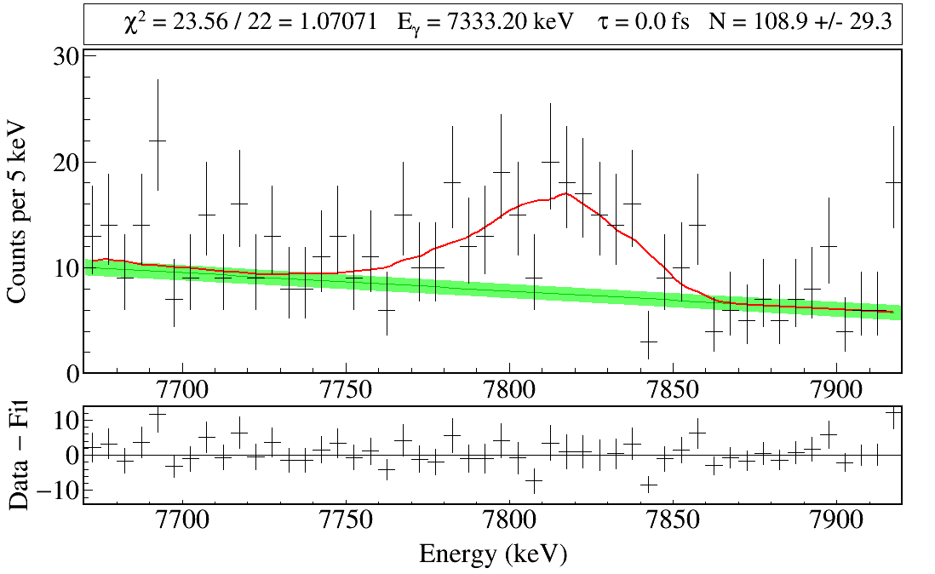

Slide 3
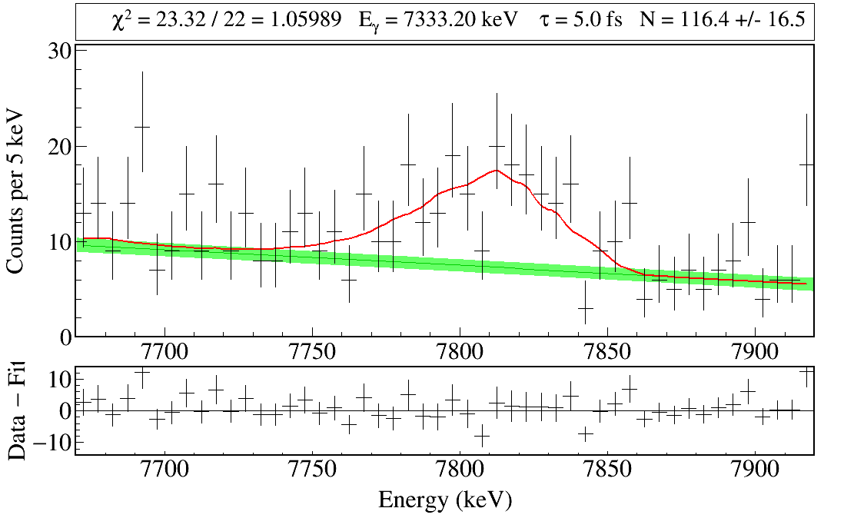

Slide 4
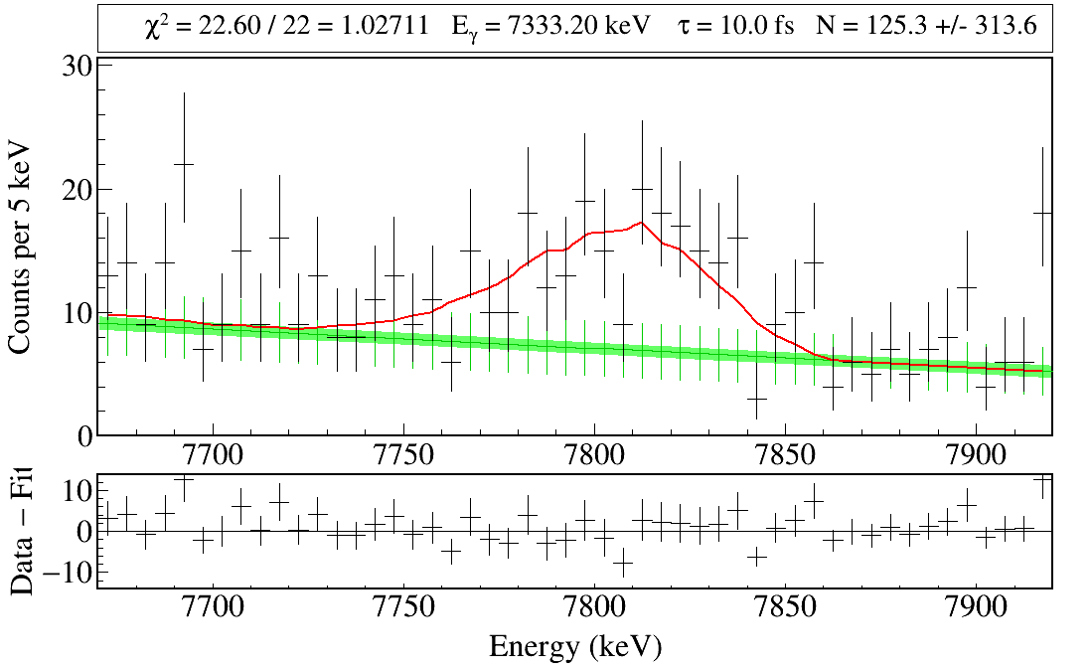

Slide 5
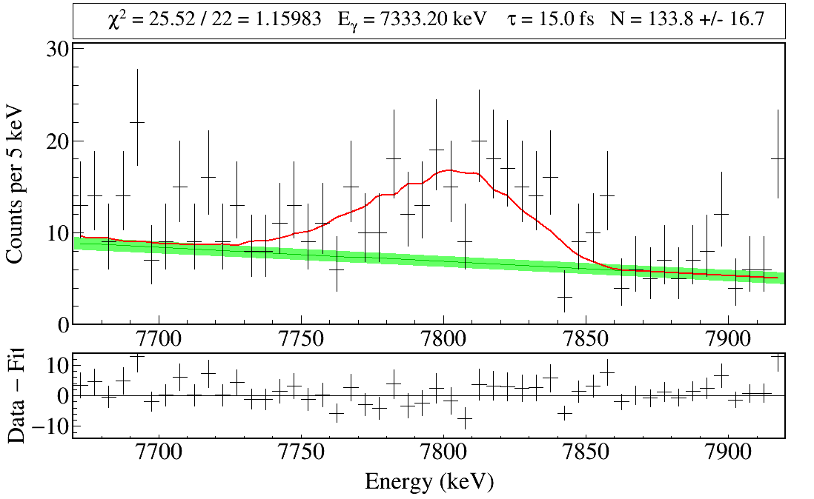

Slide 6
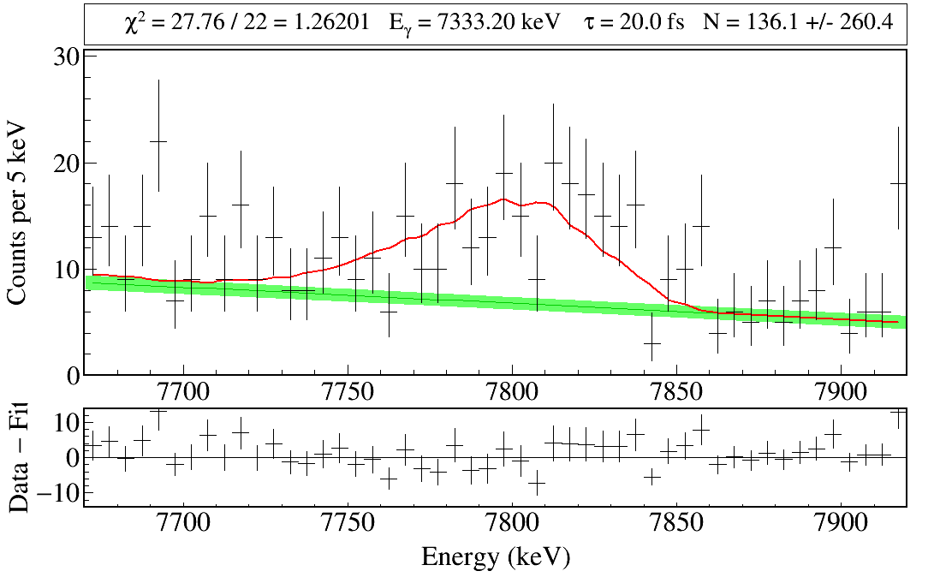

Slide 7
Gaussian Process Emulator

Slide 8
Prior vs Posterior Lineshapes

Slide 9
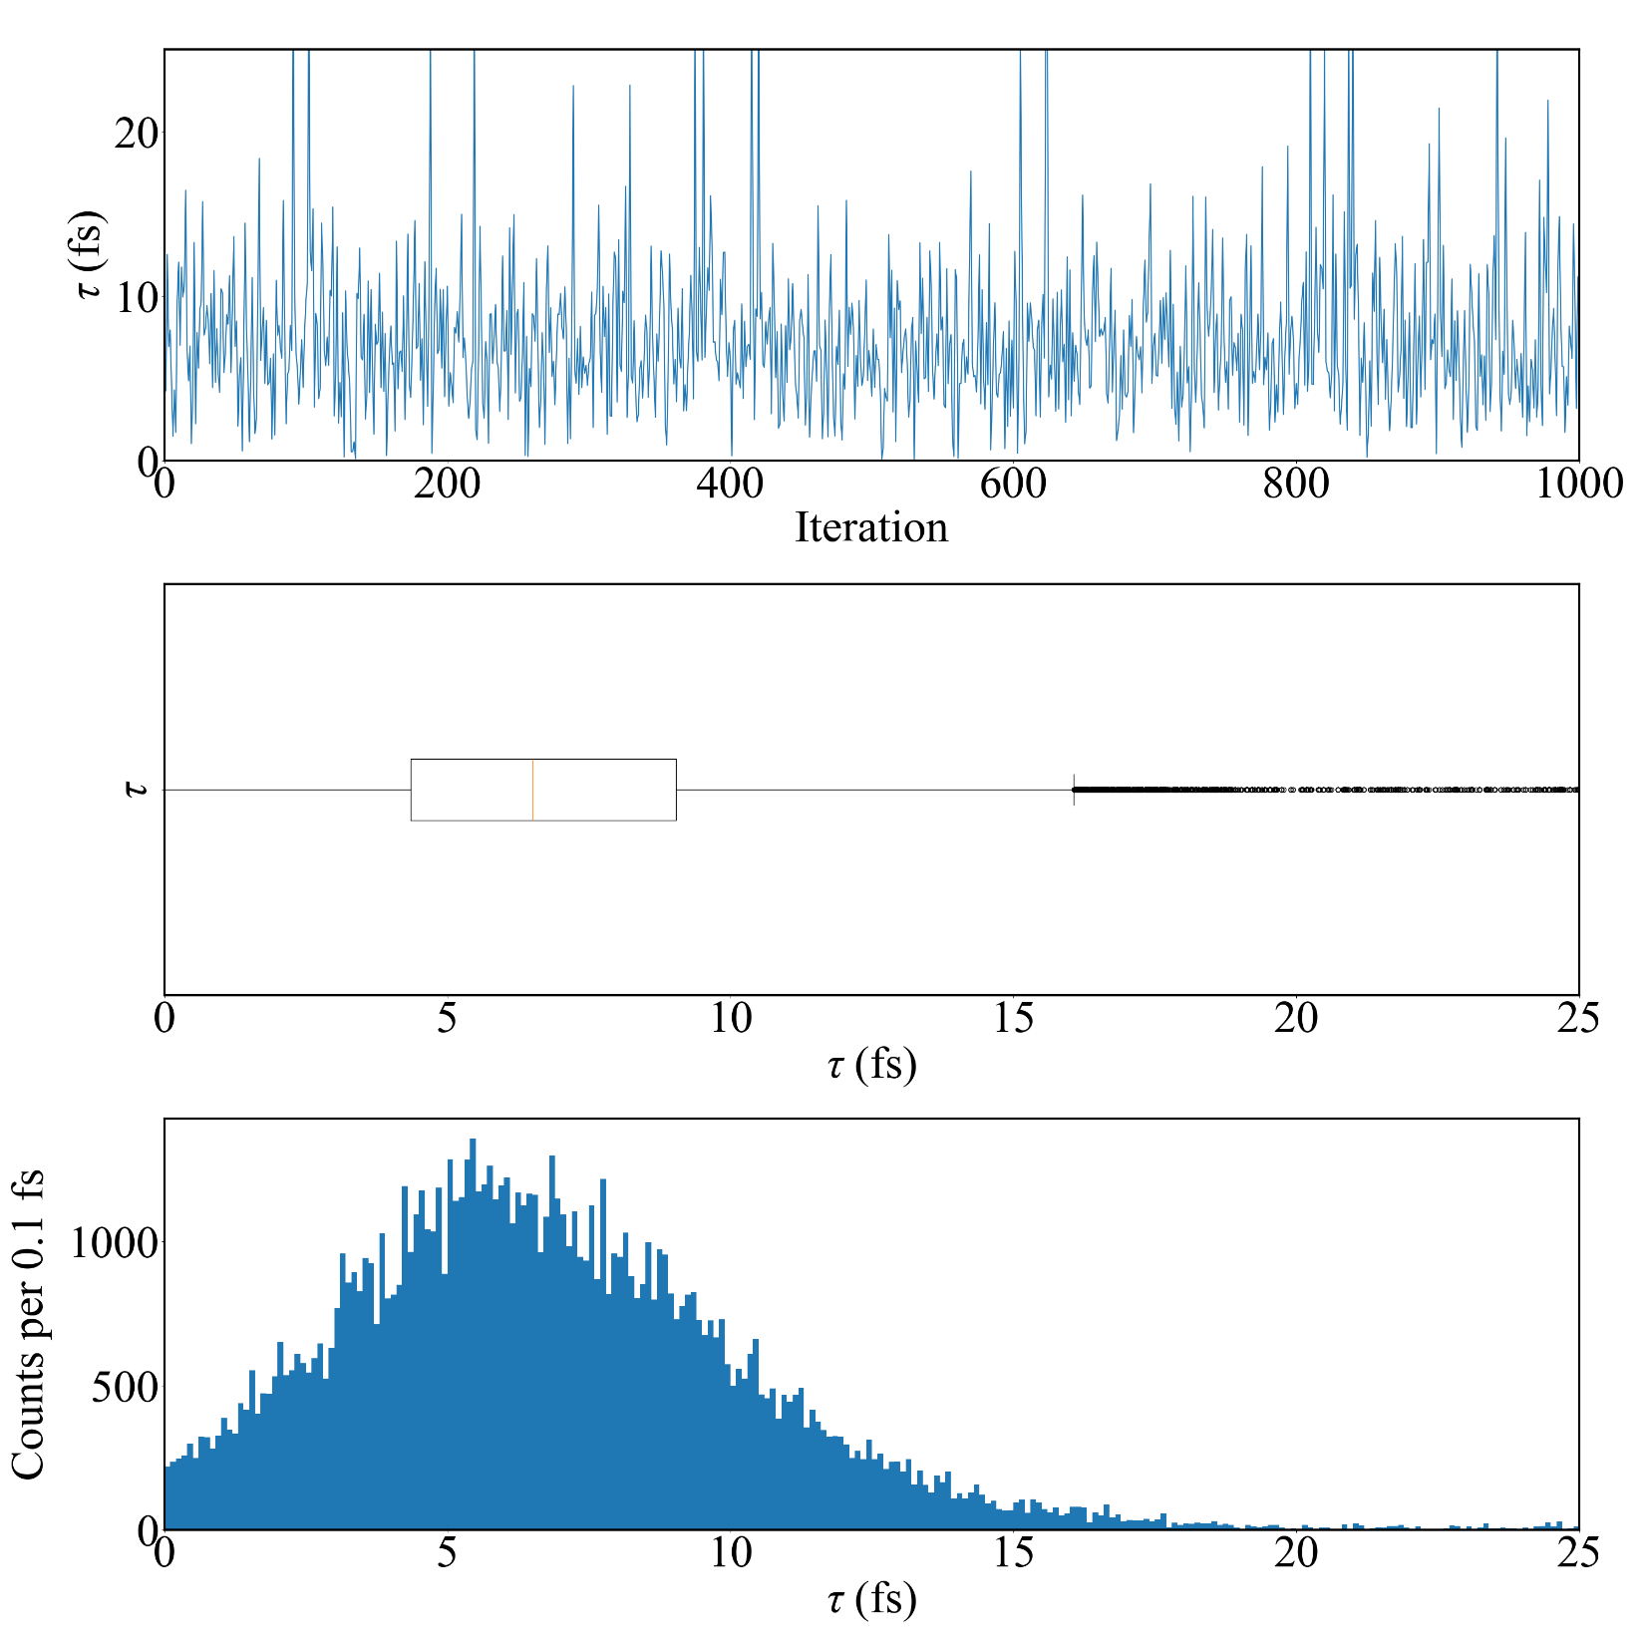
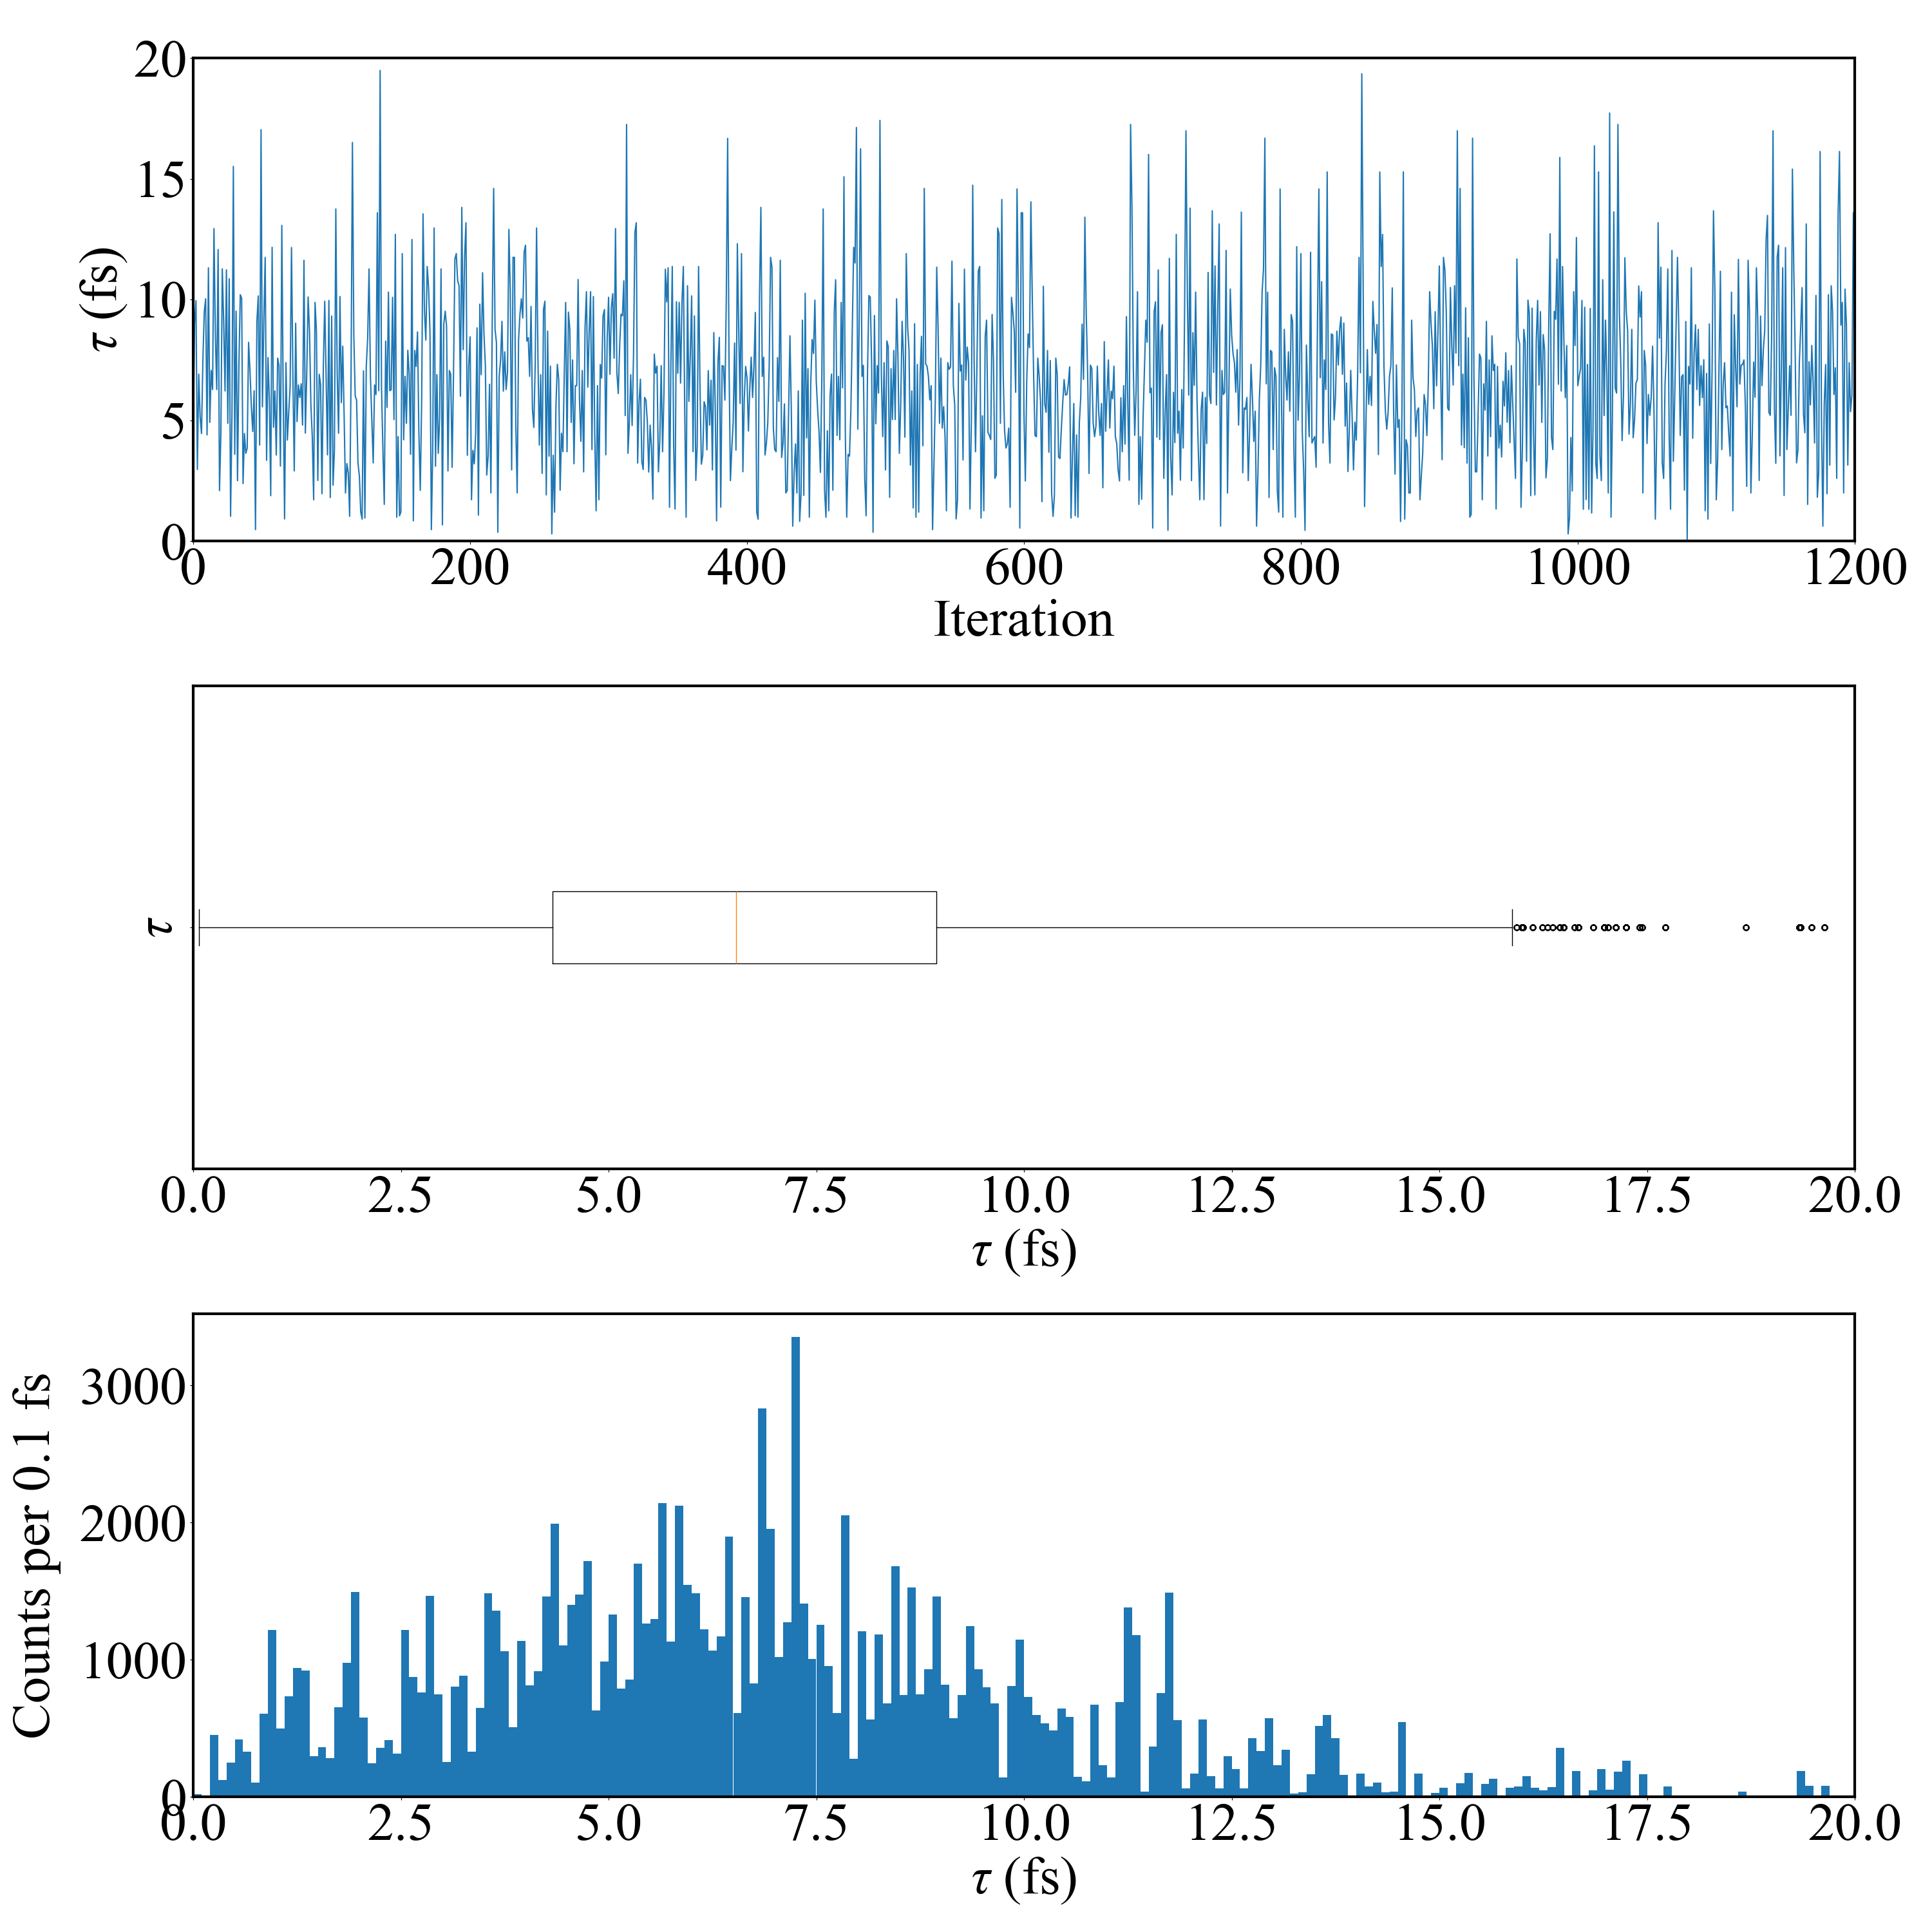
$$τ={6.5}_{−3.2}^{+3.9} fs$$
$$τ<11.7 fs (90\% CL)$$
$$τ={6.5}_{−3.3}^{+3.8} fs$$
$$τ<11.6 fs (90\% CL)$$
Sampler: Metropolis-Hastings
Sampler: Parallel Tempering Langevin Monte Carlo
Notes:
Sampler: Metropolis Hastings
16th percentile: 3.351
50th percentile: 6.504
84th percentile: 10.371
90th percentile: 11.702
Sampler: PTLMC
16th percentile: 3.233
50th percentile: 6.538
84th percentile: 10.300
90th percentile: 11.645
95th percentile: 13.367

Slide 10
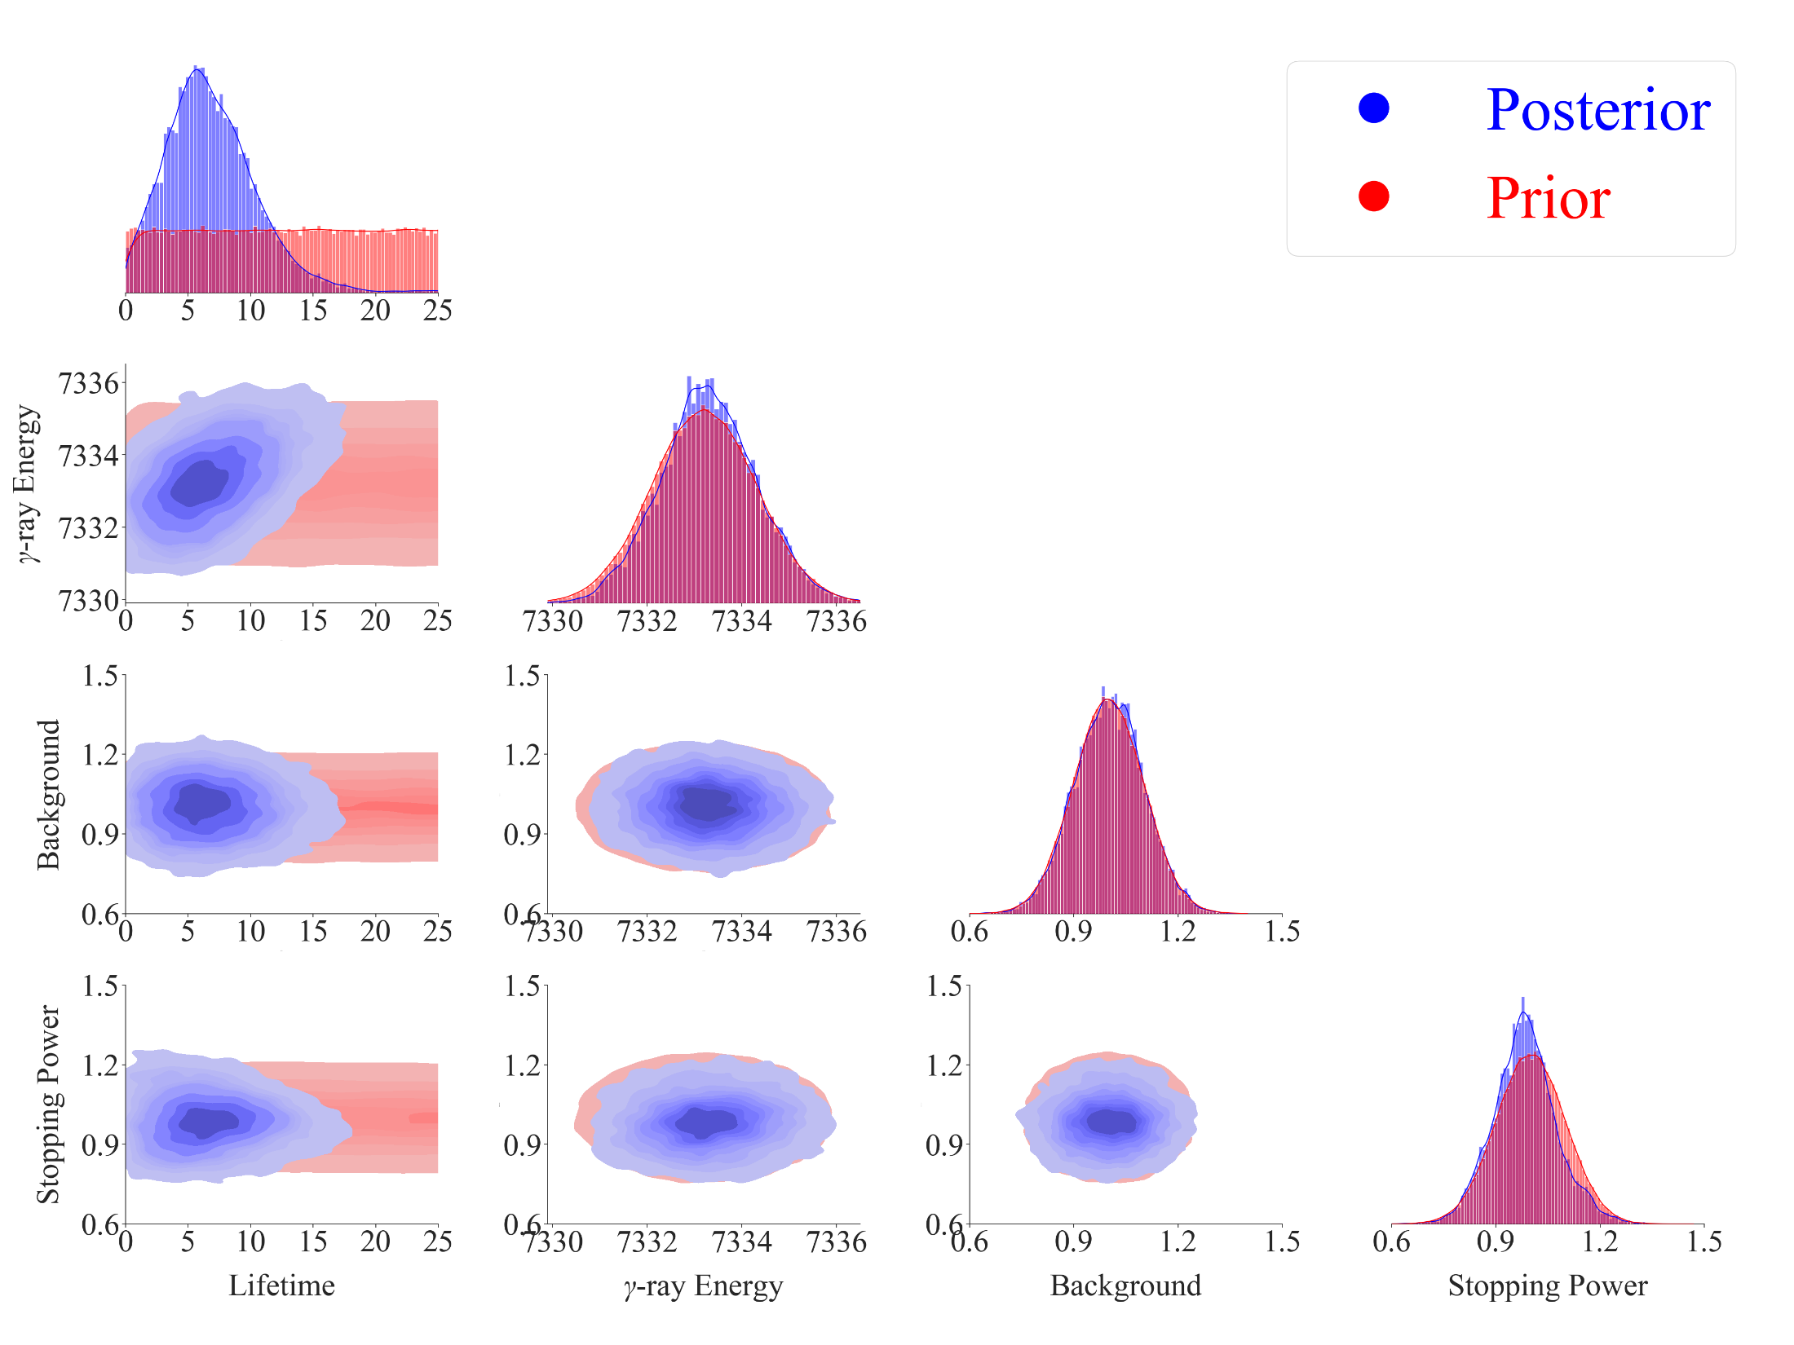
$$τ={6.5}_{−3.2}^{+3.9} fs$$
$$τ<11.7 fs (90\% CL)$$

Slide 11
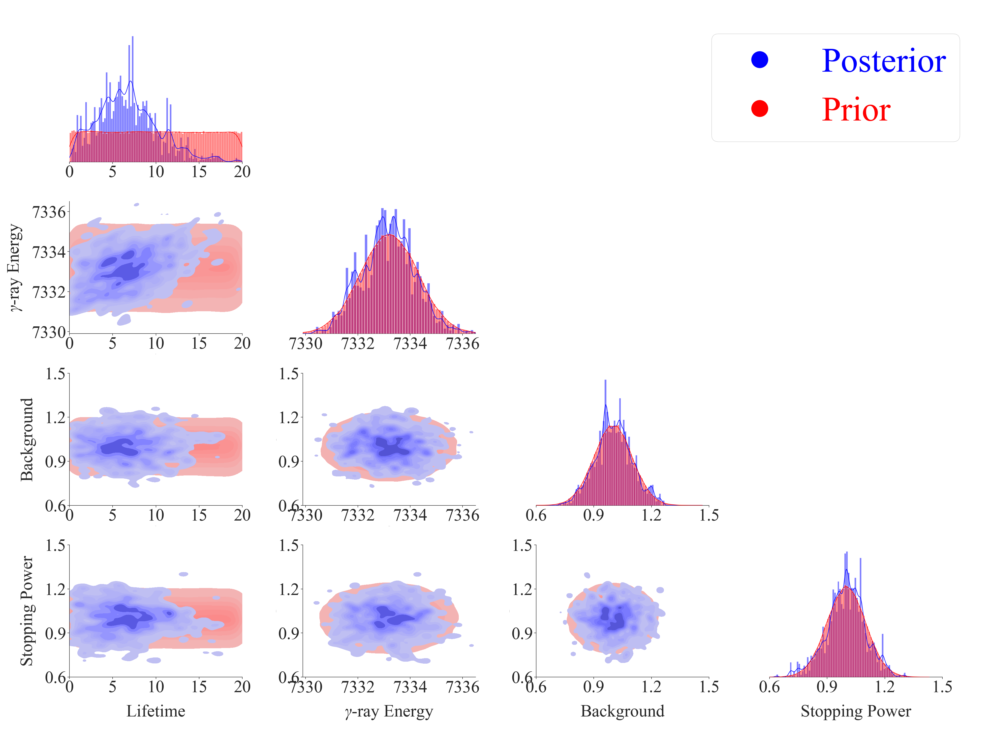
$$τ={6.5}_{−3.3}^{+3.8} fs$$
$$τ<11.6 fs (90\% CL)$$

