Slide 1
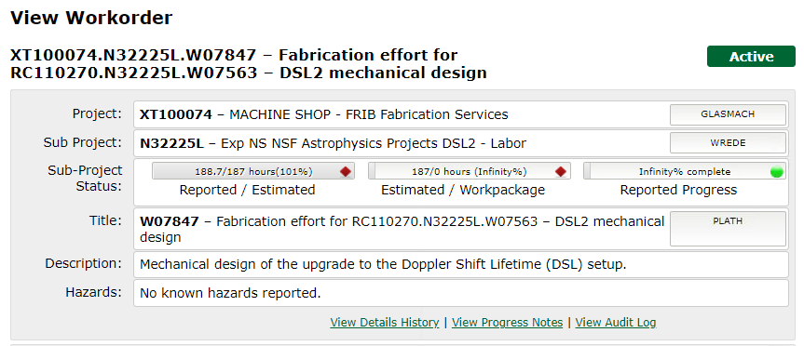
/mnt/departments/mechdesign/mechinfo/Drawing Release Documents

Slide 2
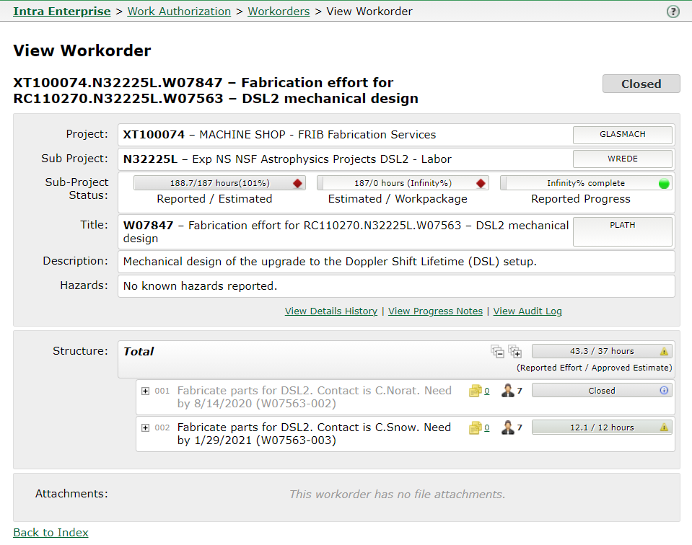

Slide 3
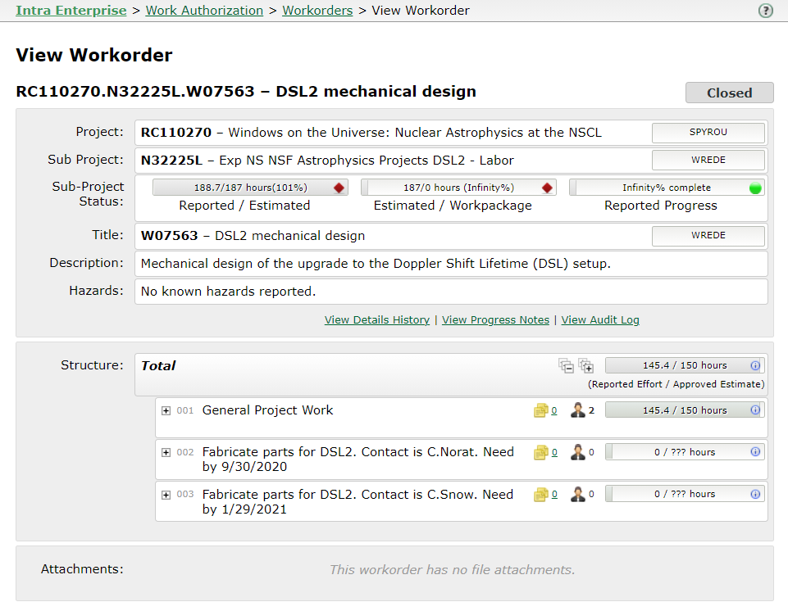

Slide 7
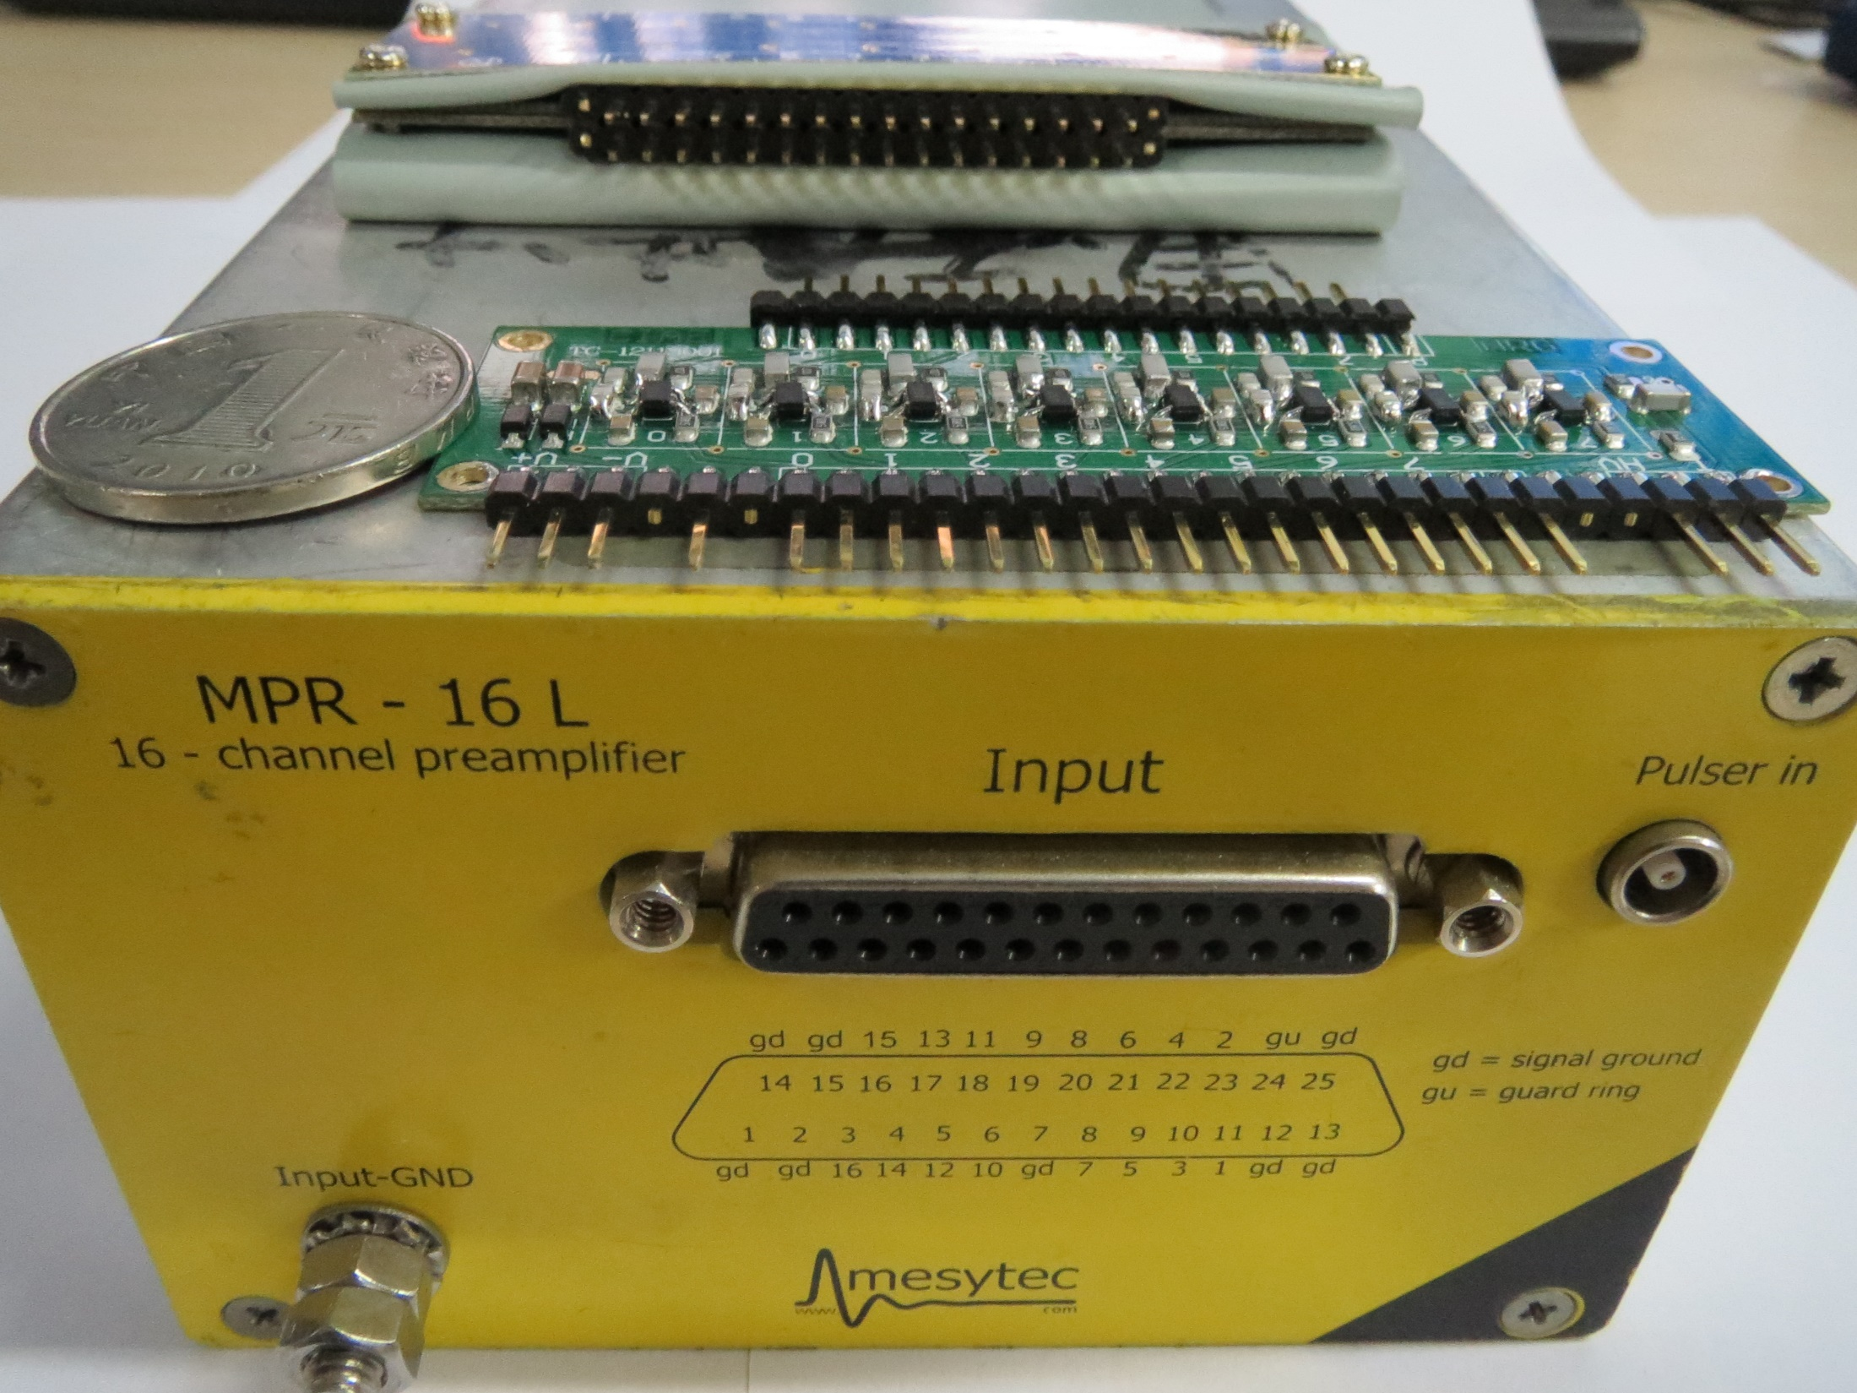

Slide 8
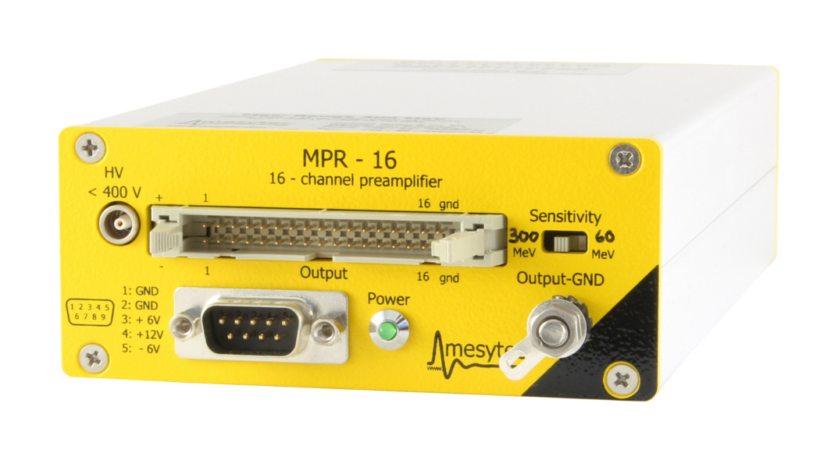
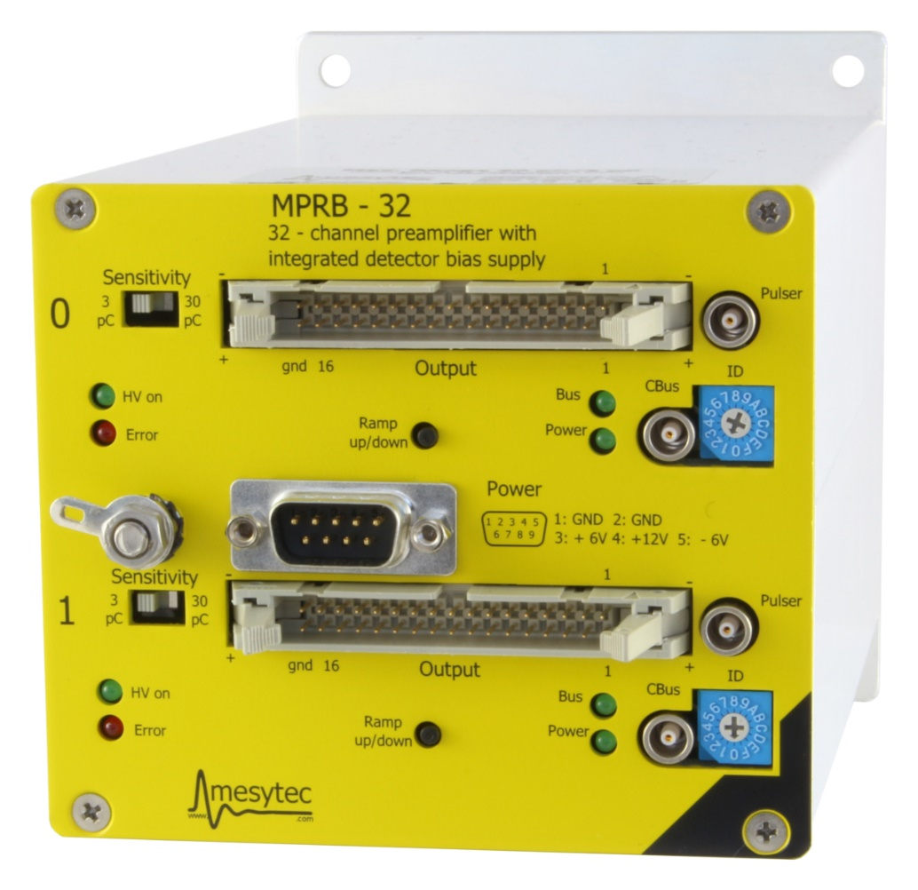
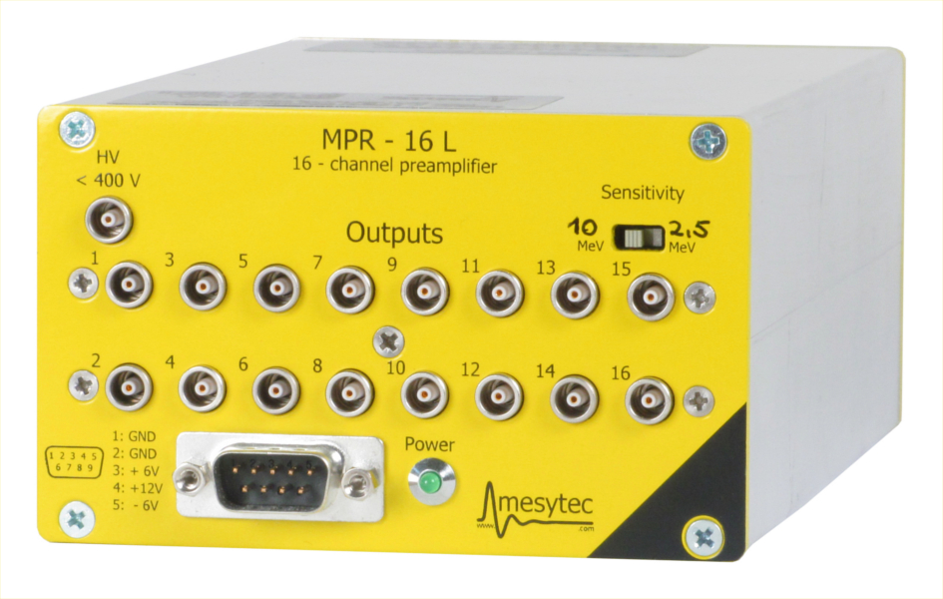

Slide 9
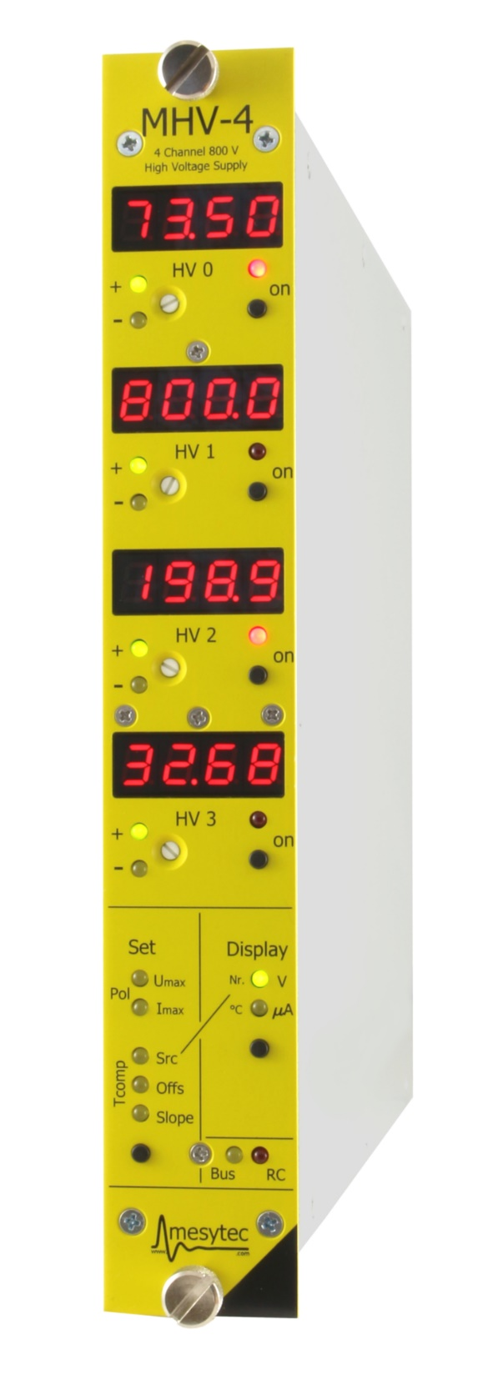
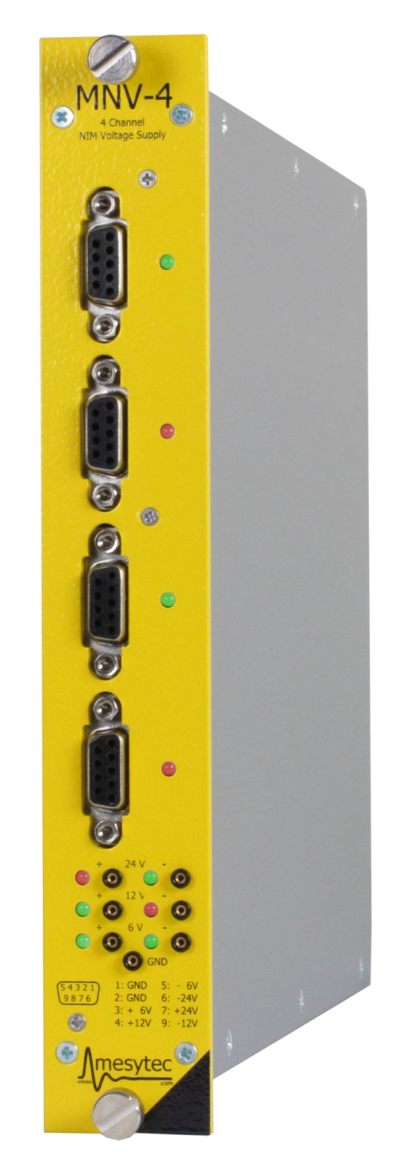
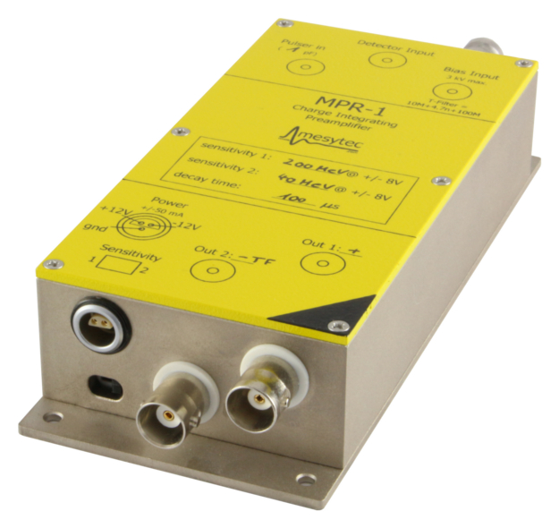

Slide 10
mesytec MDPP-32 is a fast high resolution time an amplitude digitizer. It is internally realized as a 32 channel adjustable low noise amplifier and a variable differentiation stage, followed by filters and 80 MHz sampling ADCs. The digitized data are analyzed in an FPGA and reconstructed with highest precision. This allows to achieve unique timing and amplitude resolution.

Slide 11
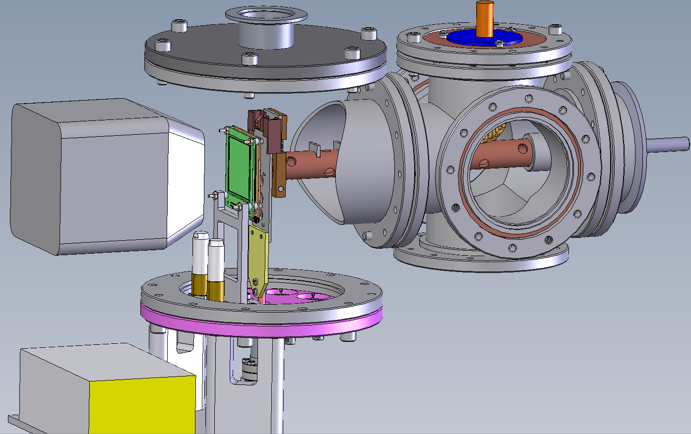

Slide 12
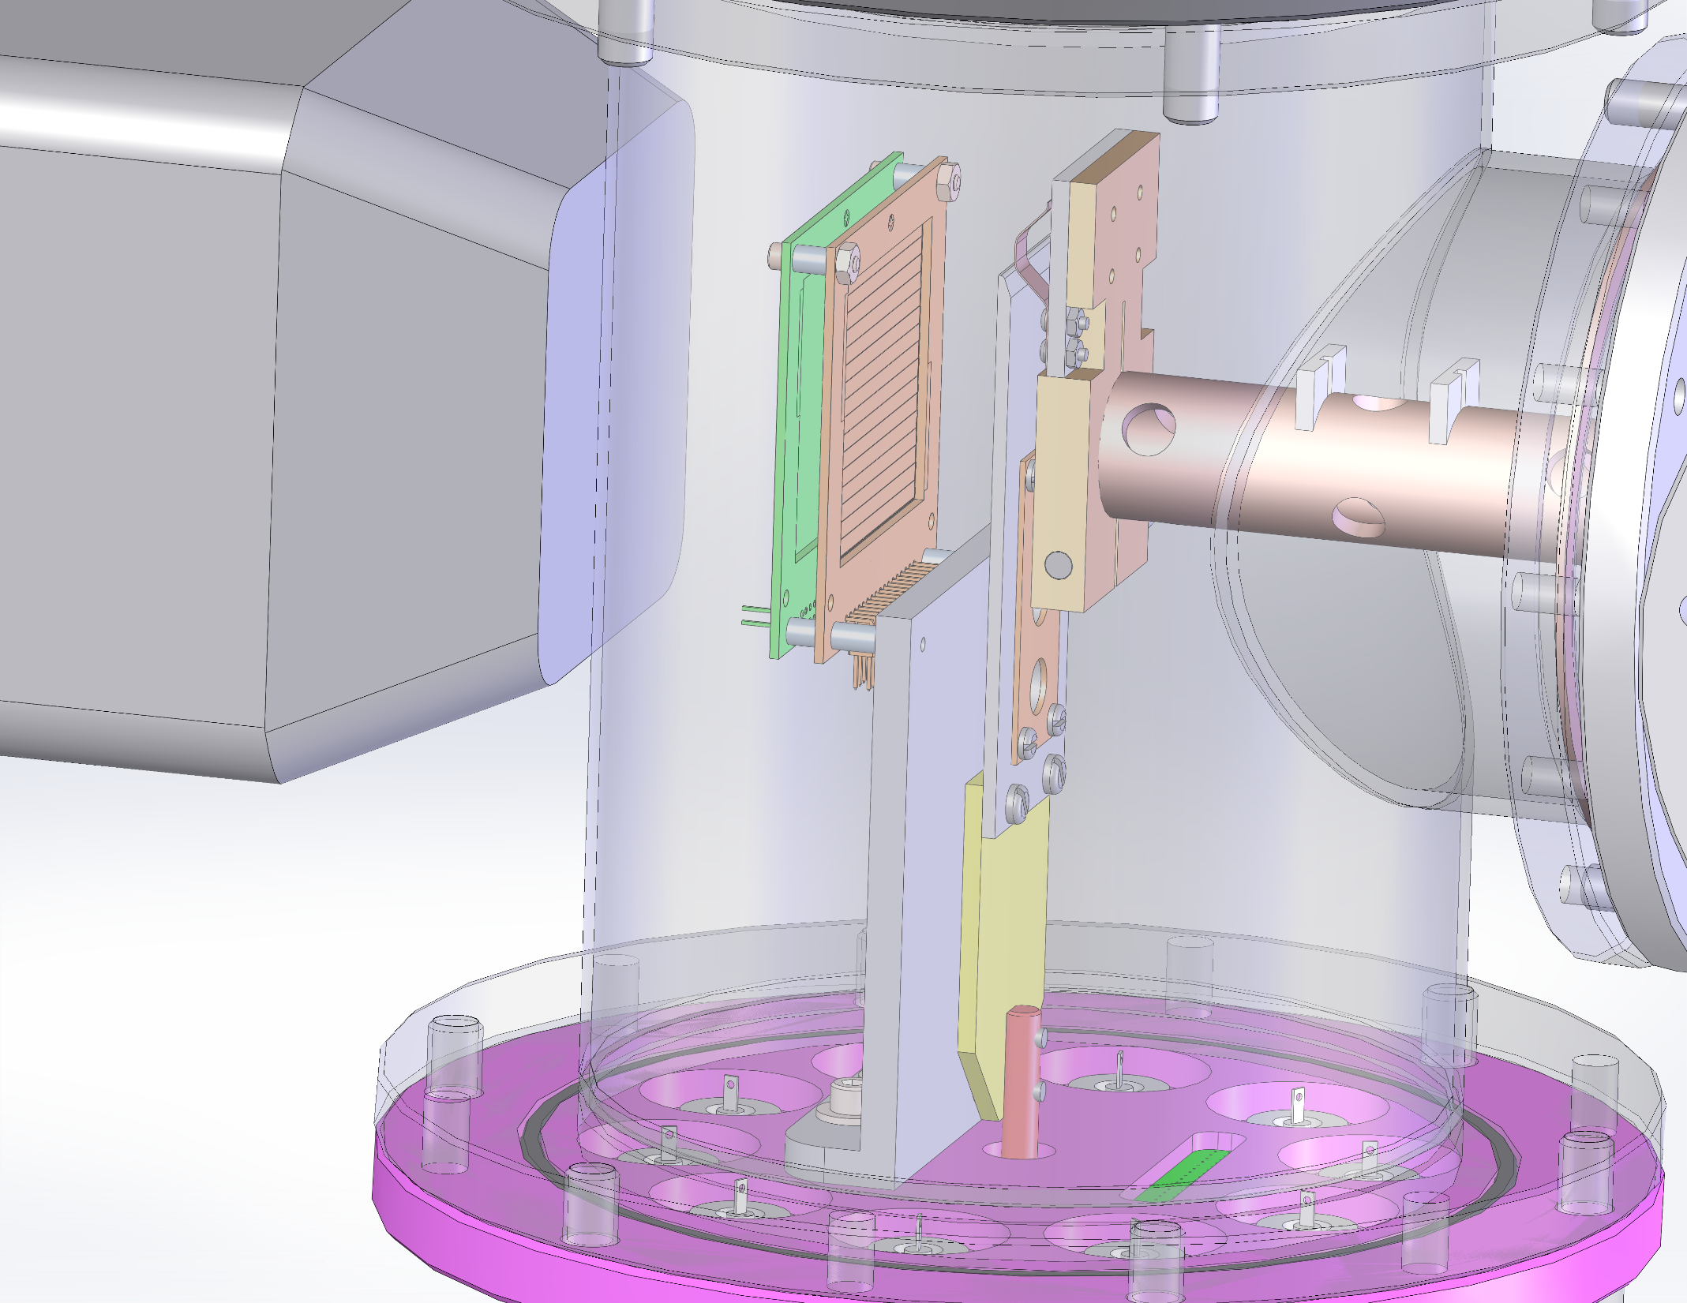
20200204 (Obsolete)

Slide 13
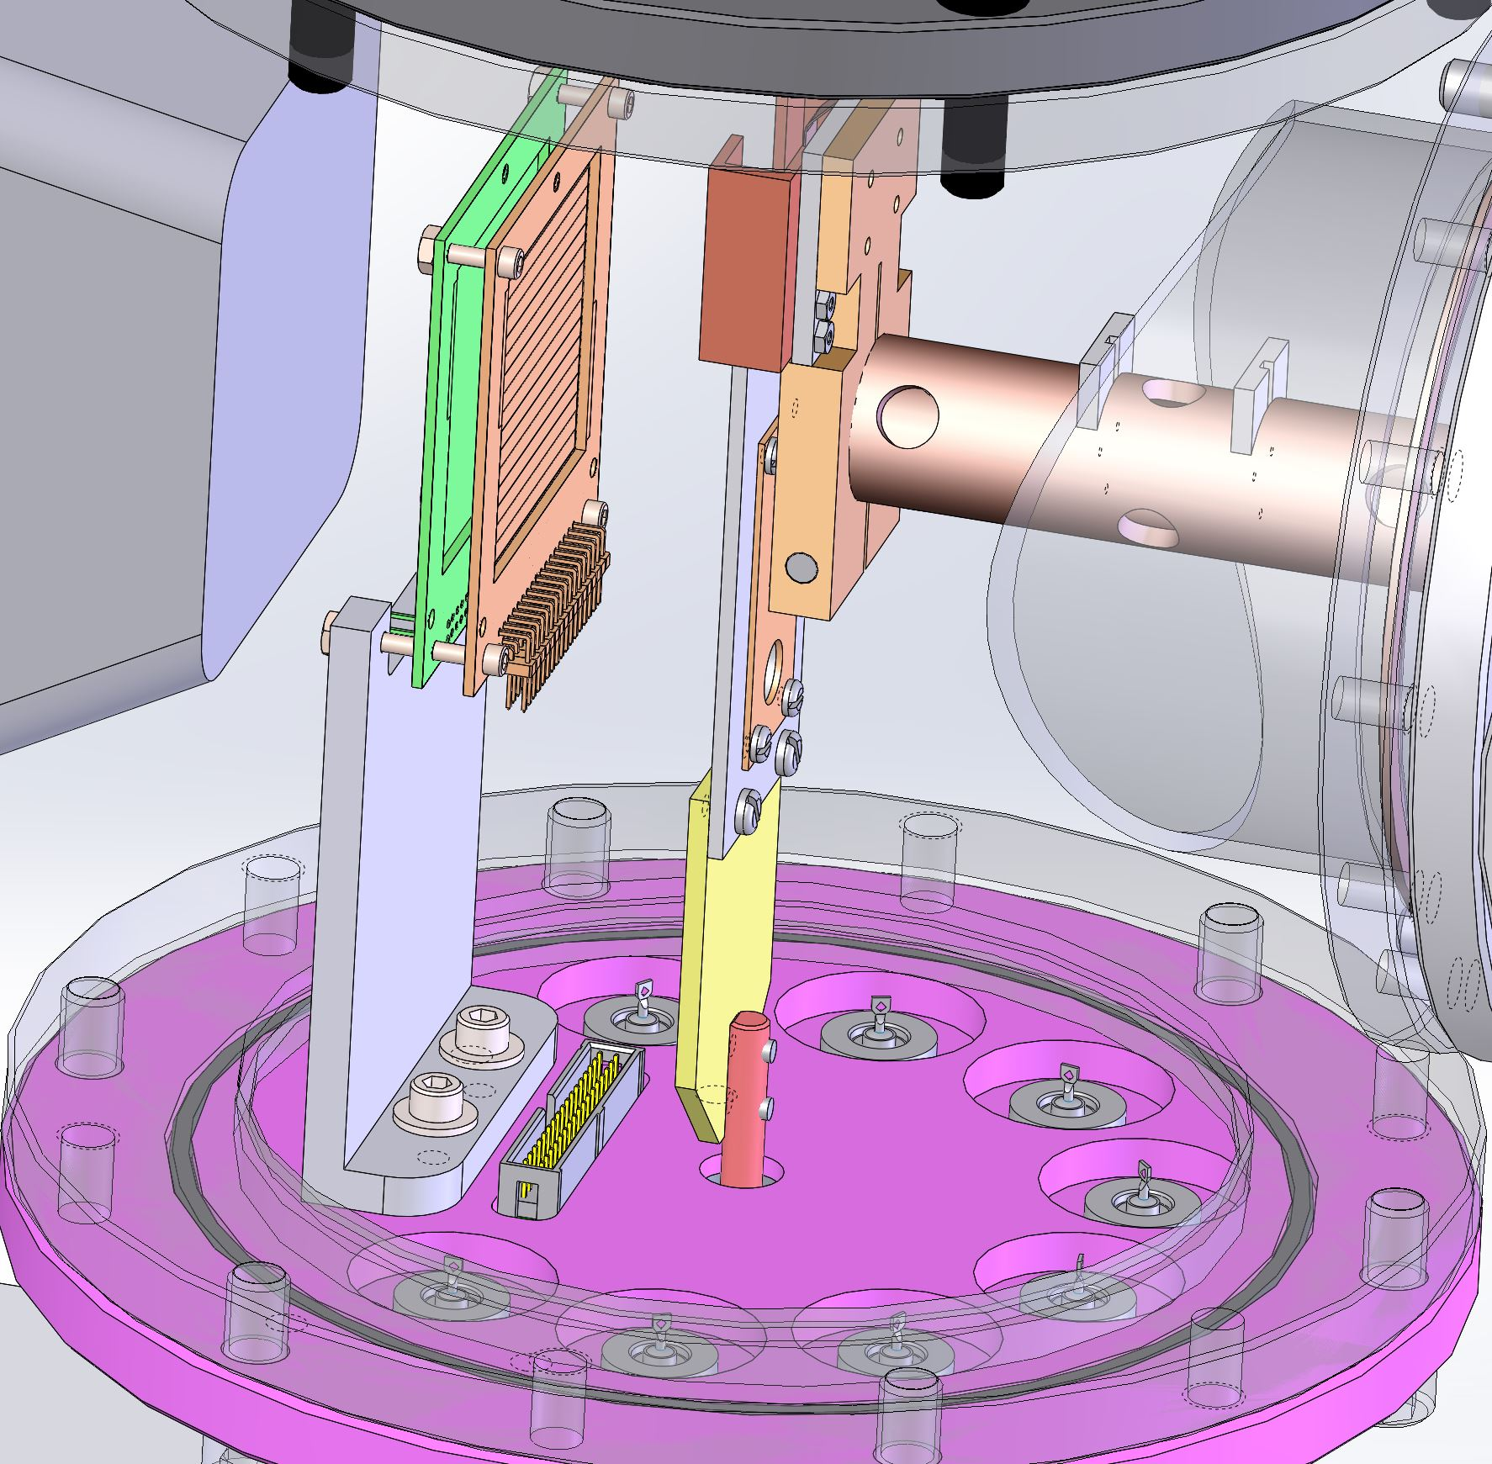
20200309 (Obsolete)

Slide 14
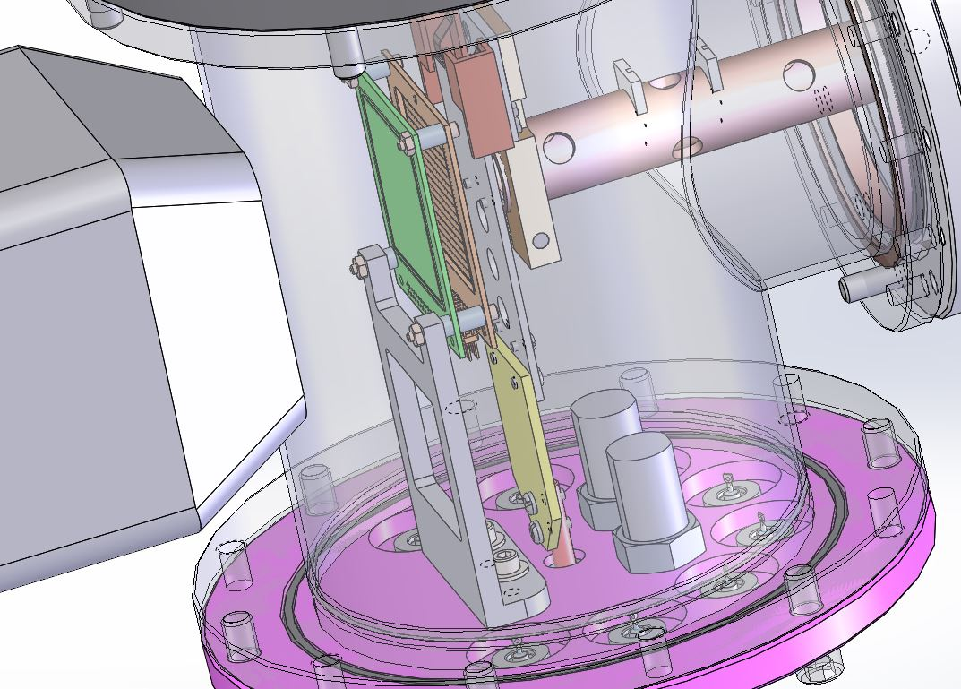
20200402 (Obsolete)

Slide 15
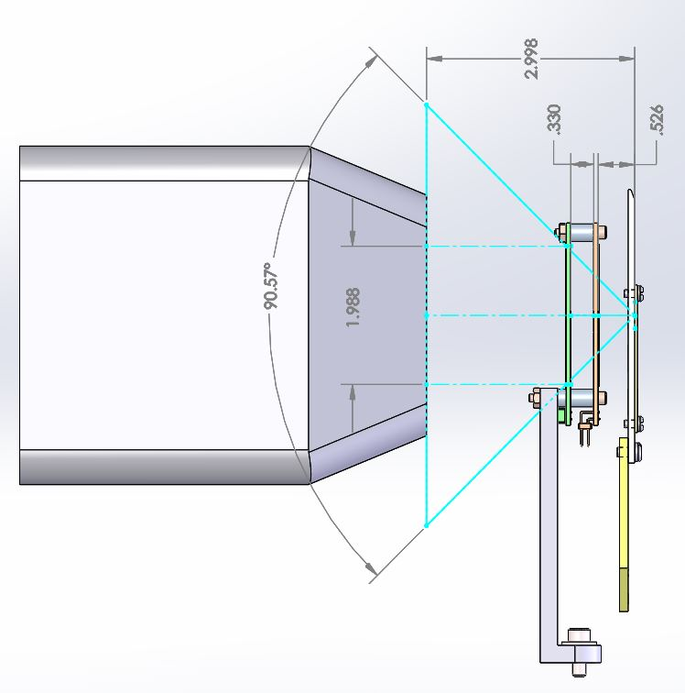
20200402 (Obsolete)

Slide 16
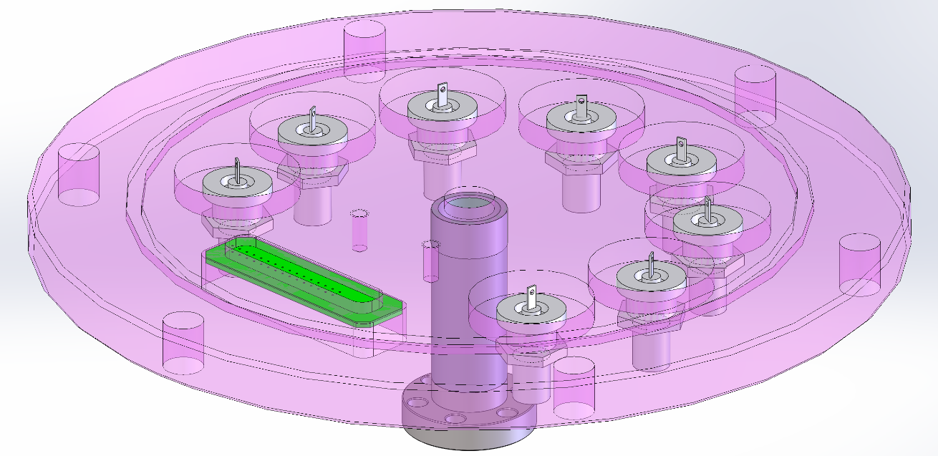
20200213 (Obsolete)

Slide 17
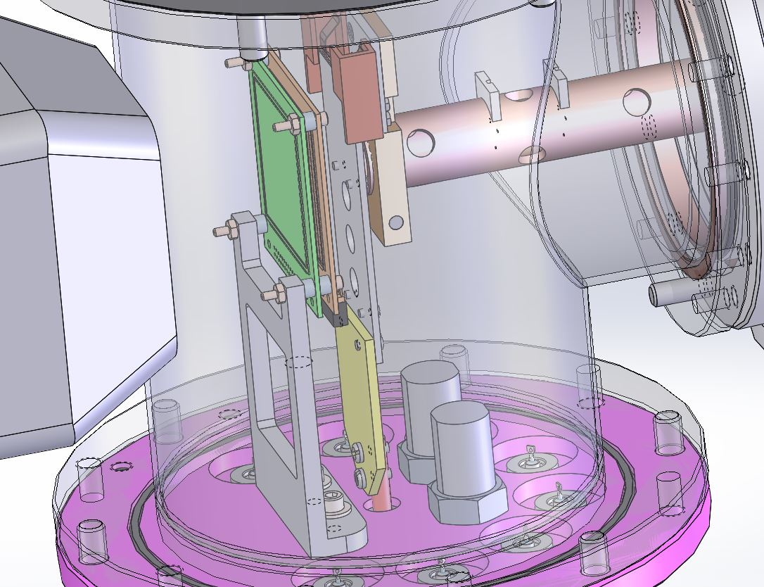
20200406 (Obsolete)

Slide 18
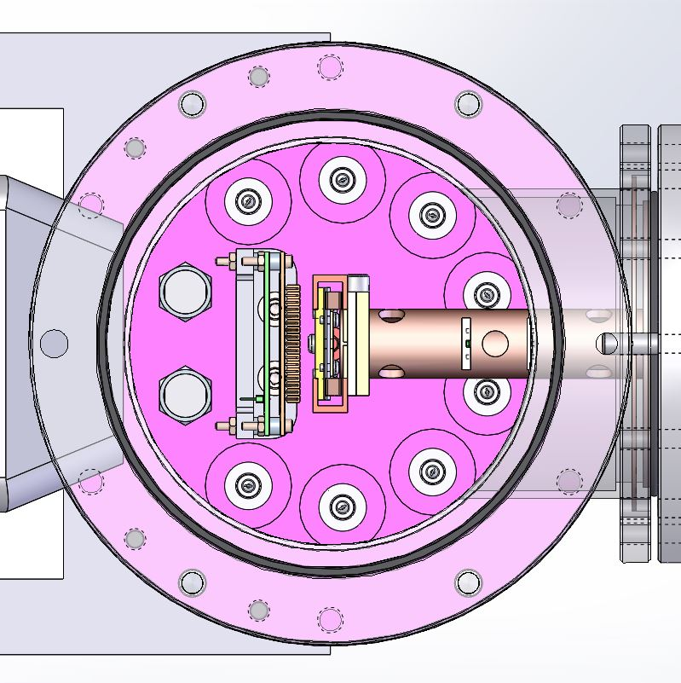
20200408 (Final)

Slide 19
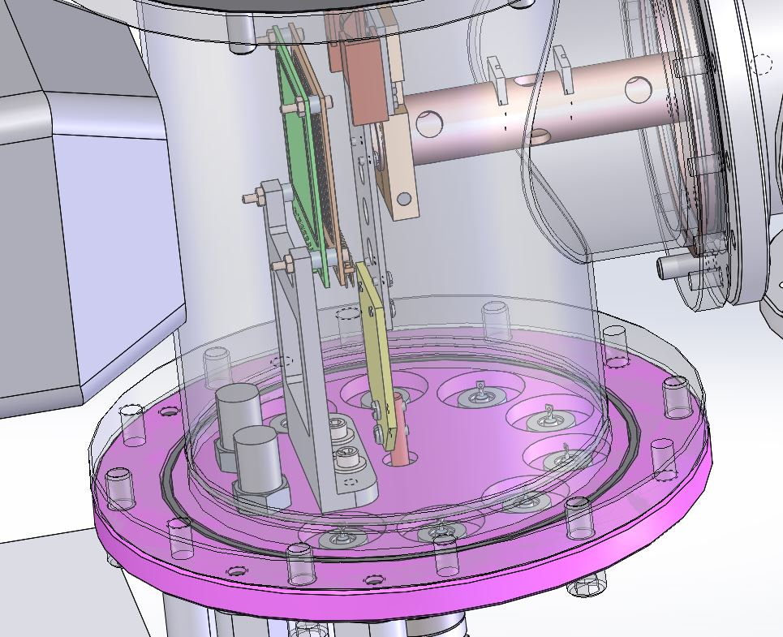
20200408 (Final)

Slide 20
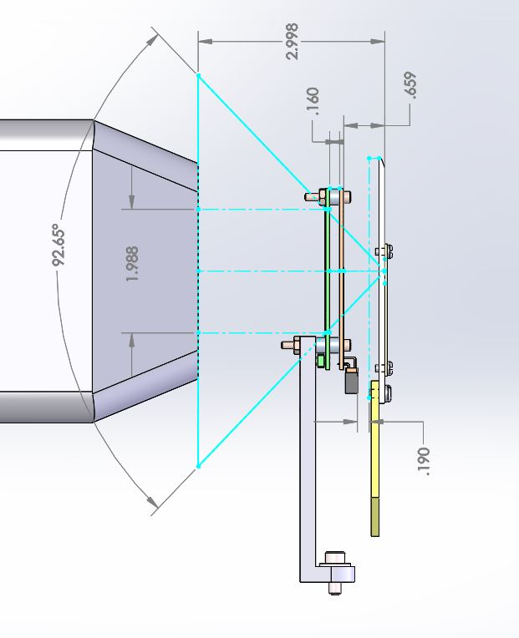
20200406 (Final)

Slide 21
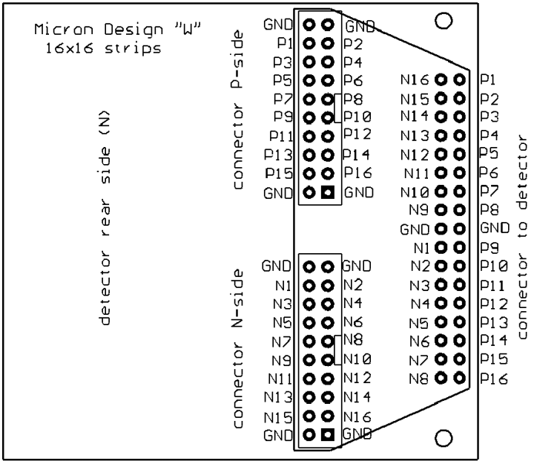
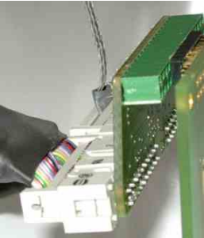
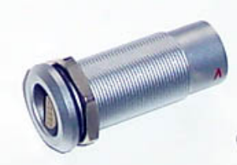
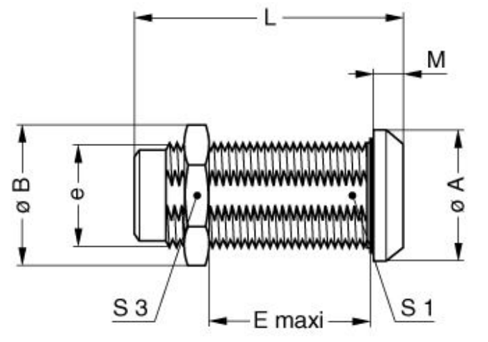
Cable for connecting detector (adapter) and vacuum feedthrough

Slide 22
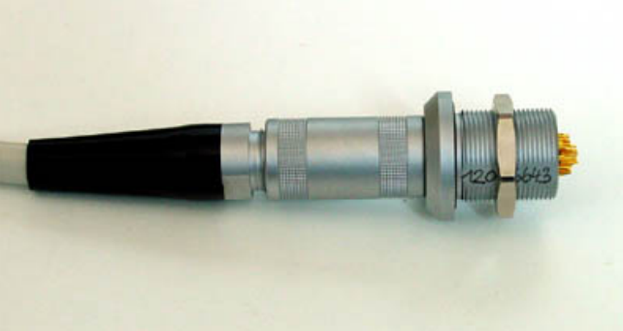
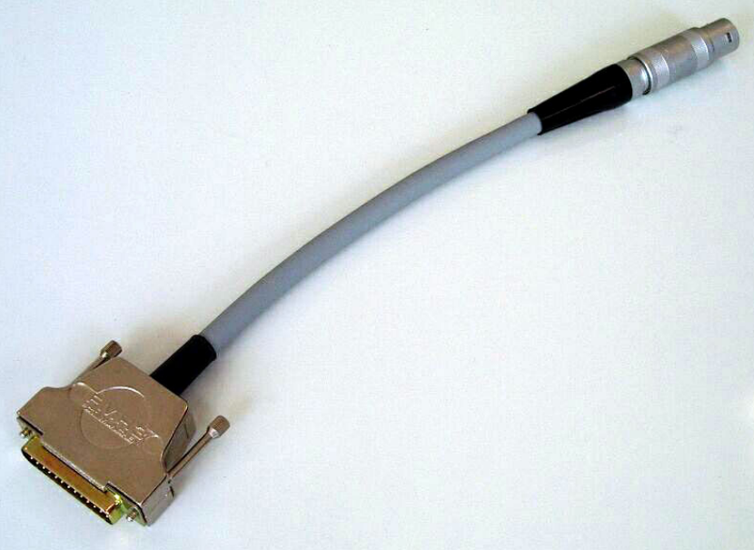
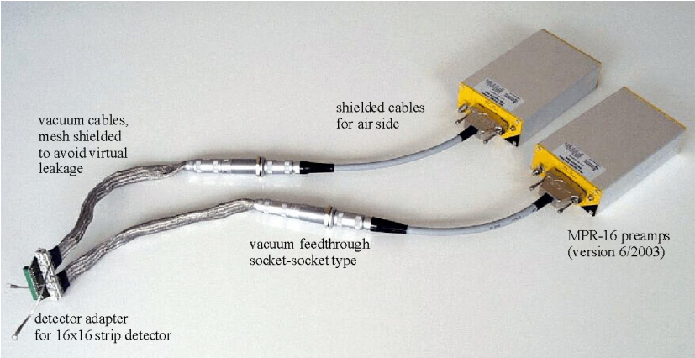

Slide 23
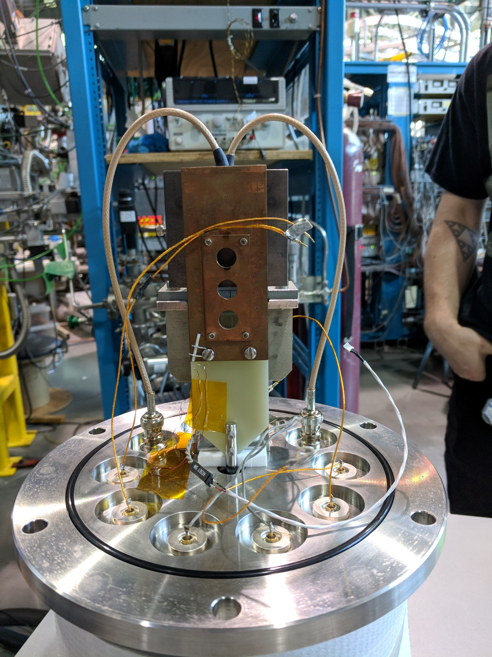

Slide 24
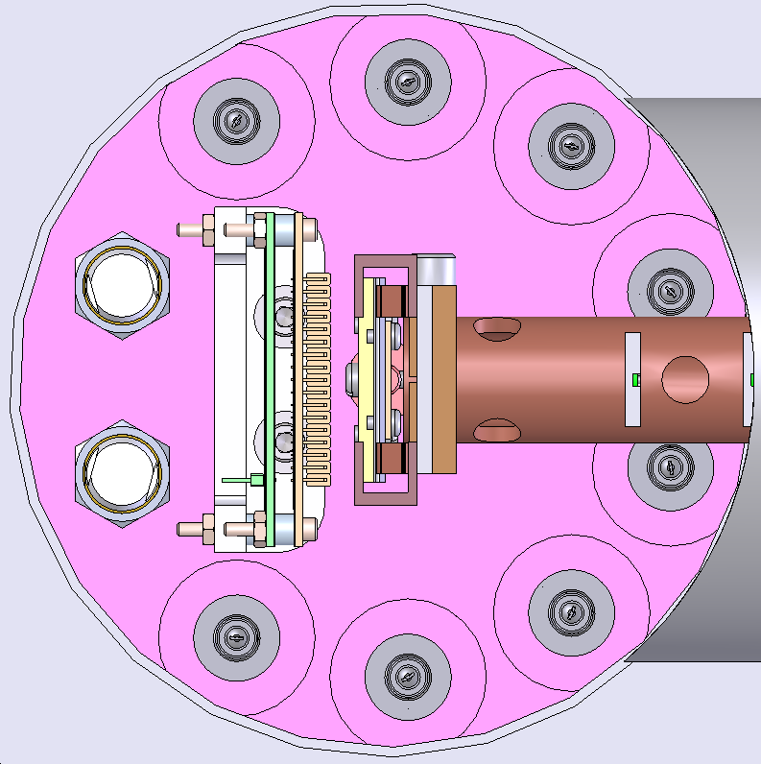
the 8 pins on the feedthru plate were used for the 2 Si detectors (2 pins), 2 aperture and 1 target ladder currents (3 pins), and two PT100 resistance thermometers (4 pins).
2 currents, 2 temperatures
you need two feedthroughs for each temperature.
Target current
PT100 resistance
thermometer
Collimator
DSSD
DSSD
Collimator
PT100 resistance
thermometer
SD

Slide 25
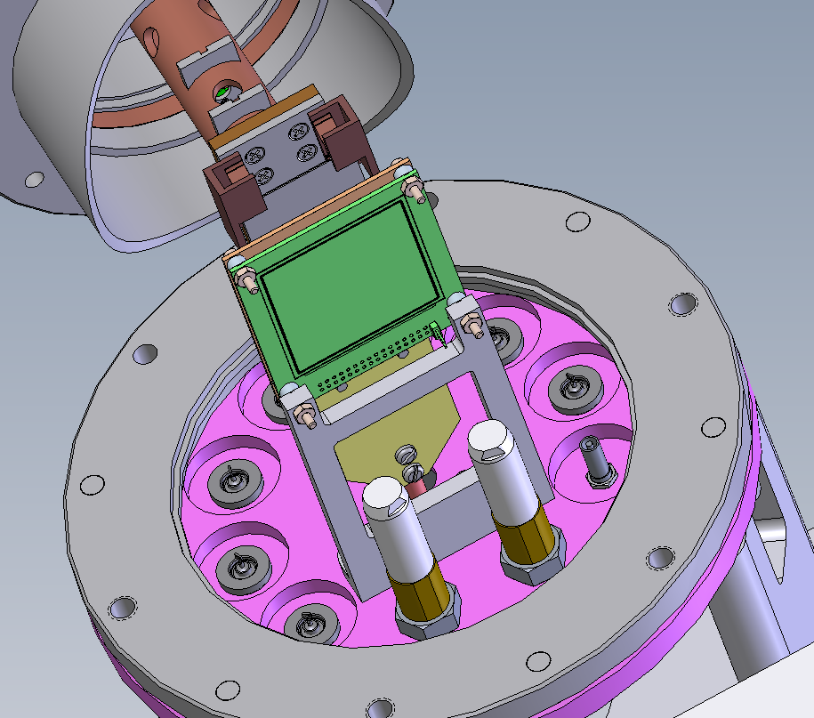
Notes:
SWH.00.250.CTMV

Slide 26
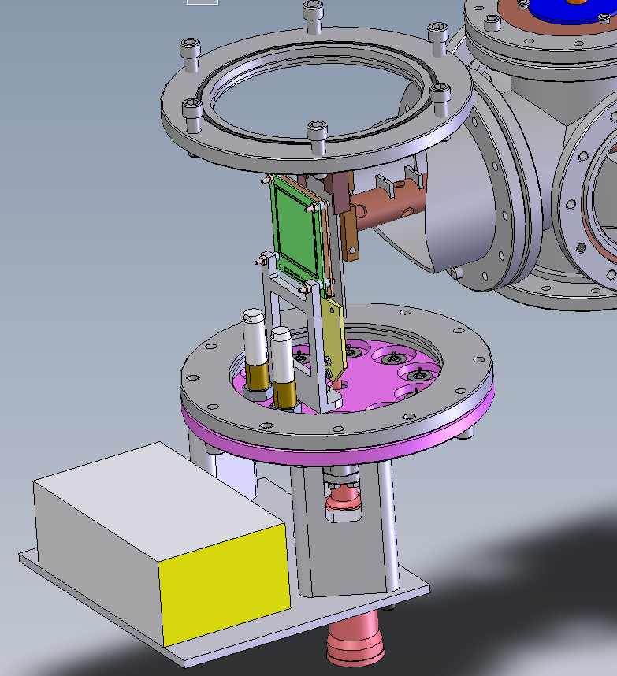

Slide 27
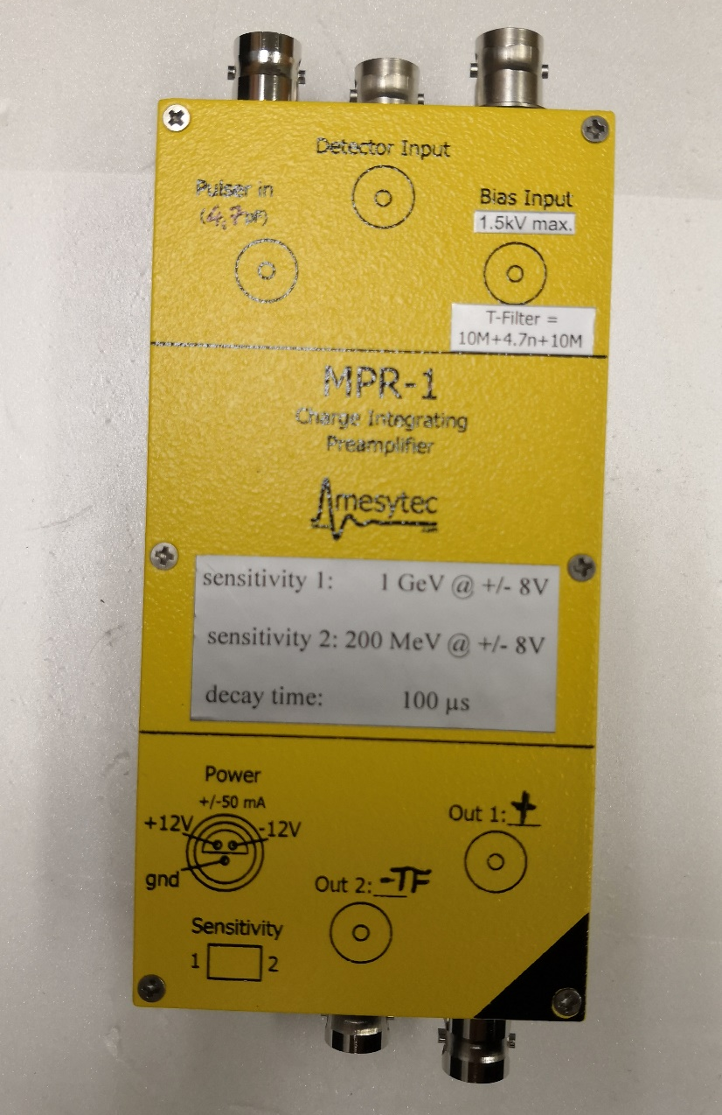
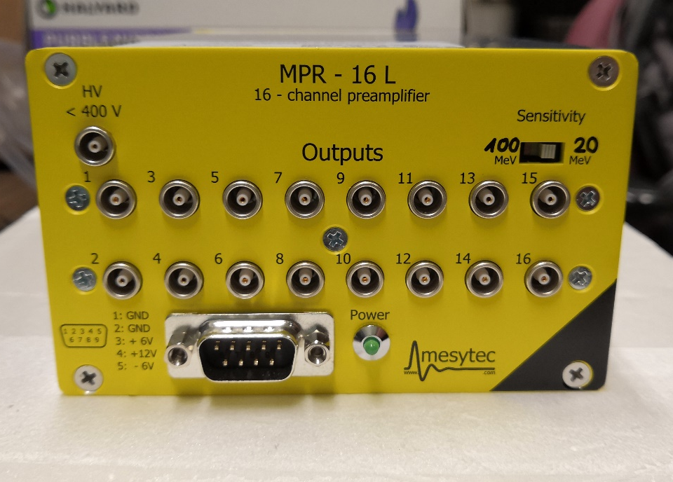
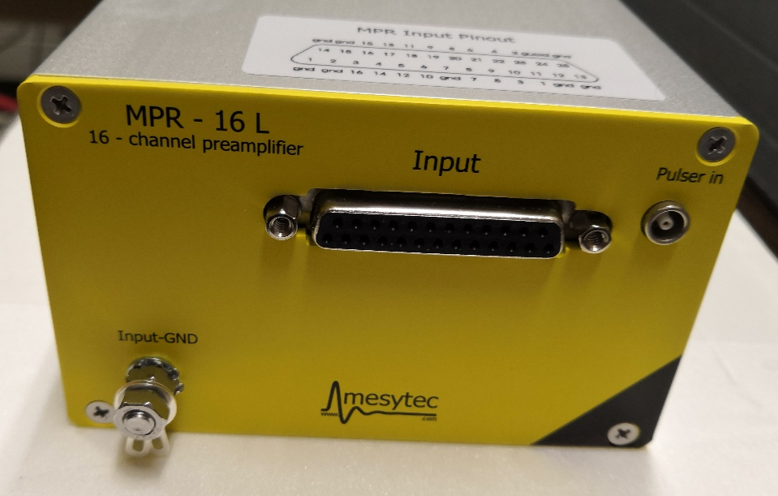
Mesytec preamp

Slide 28
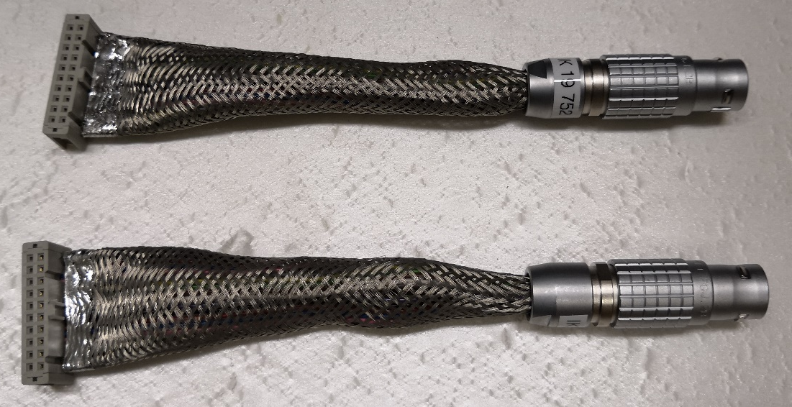
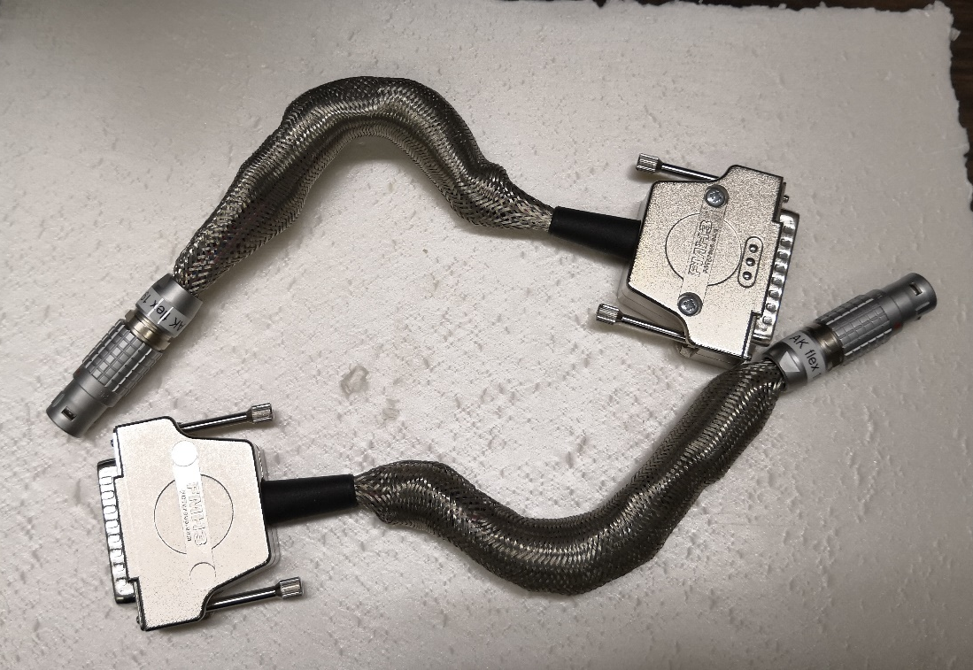
Mesytec cabling collection

Slide 29
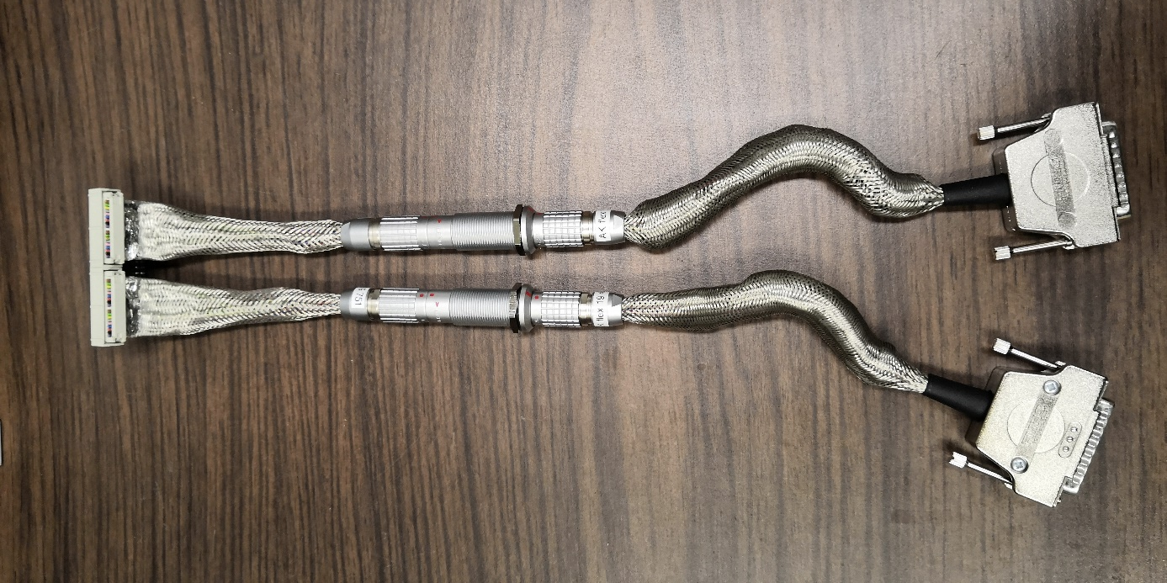
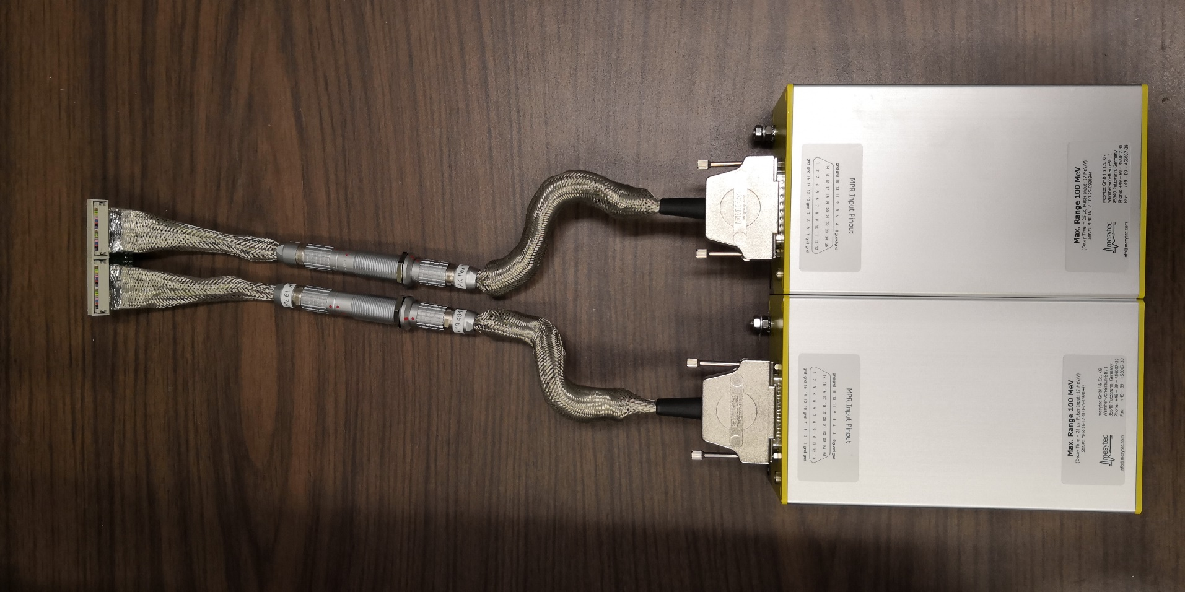

Slide 30
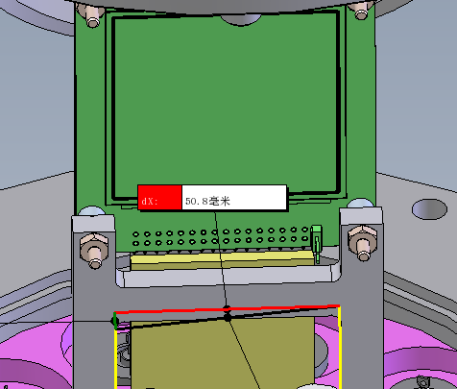
66 mm
Detector adapter
50.8 mm
Hi Craig,
Here is the Detector adapter designed by Mesytec Company. They don't provide the dimensions so I manually measured the dimensions and found it may interfere with the detector mount when connecting to the detector.
Detector mount

Slide 31
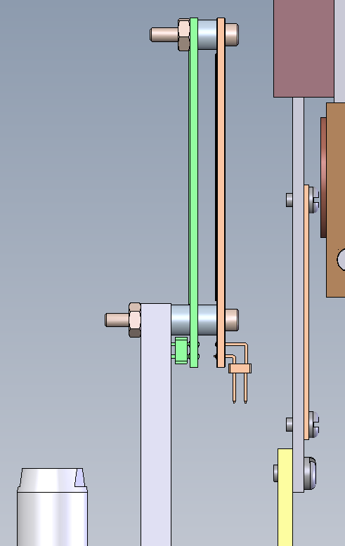
The pins at the bottom of the brown detector will be inserted into the green pin header of the detector adapter, but the adapter seems to overlap with the detector mount.
25 mm
17 mm

Slide 32
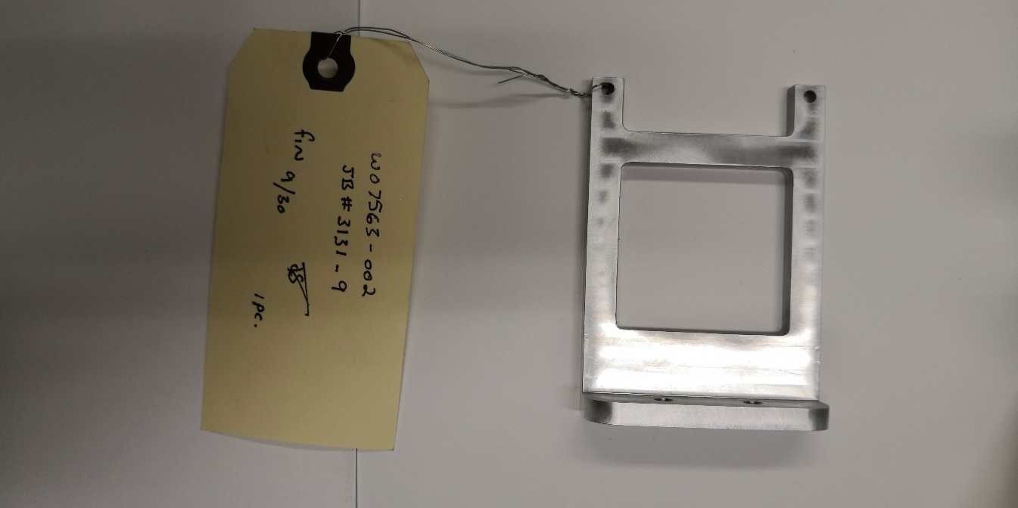
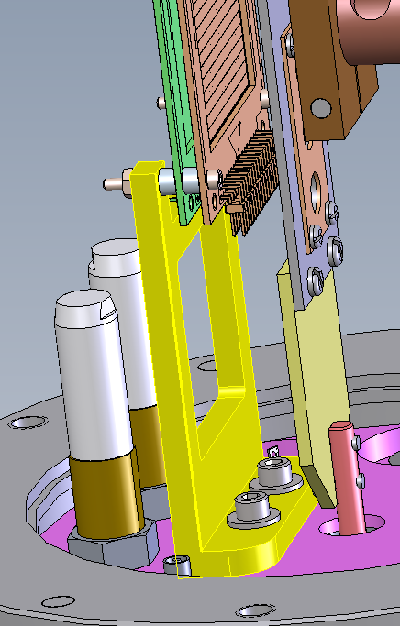
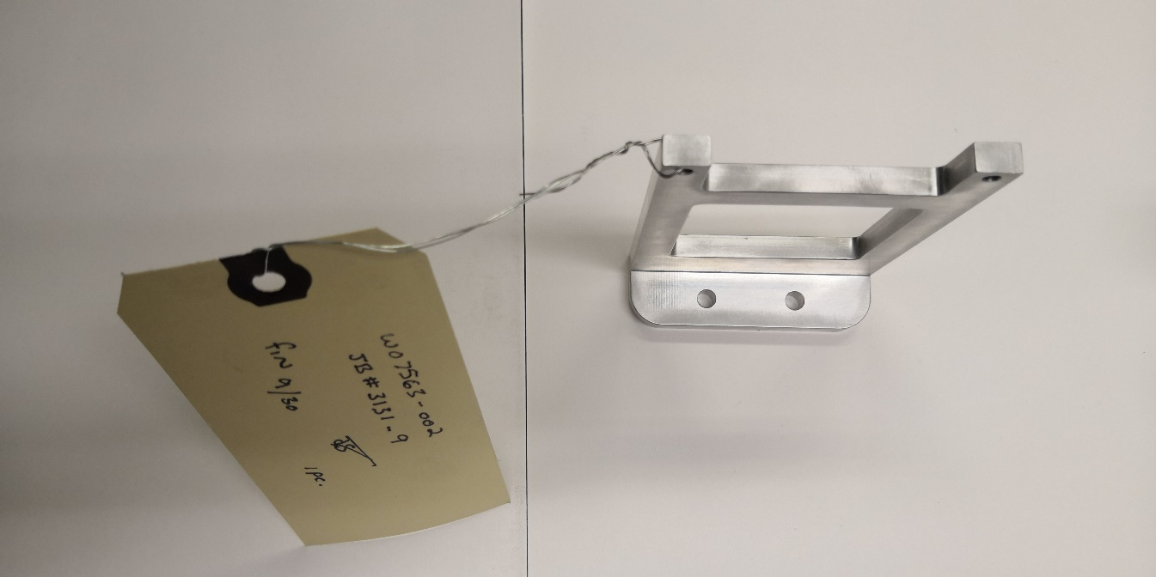

Slide 33
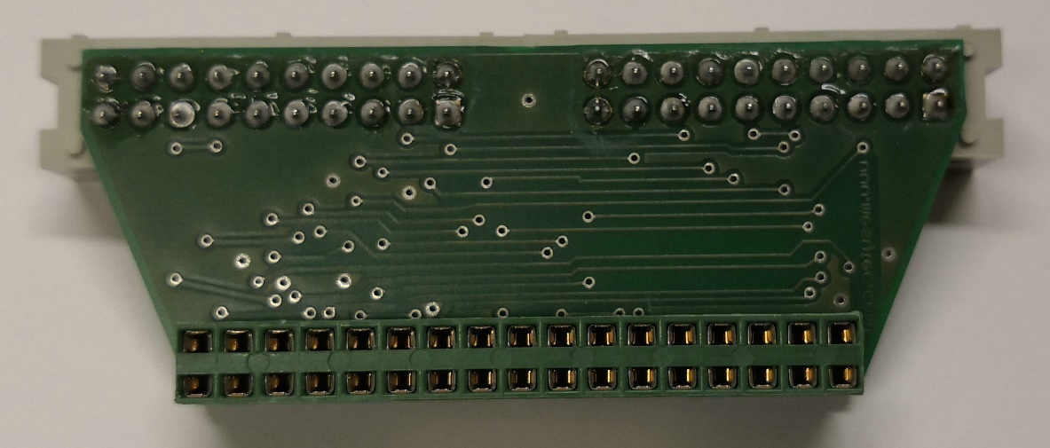
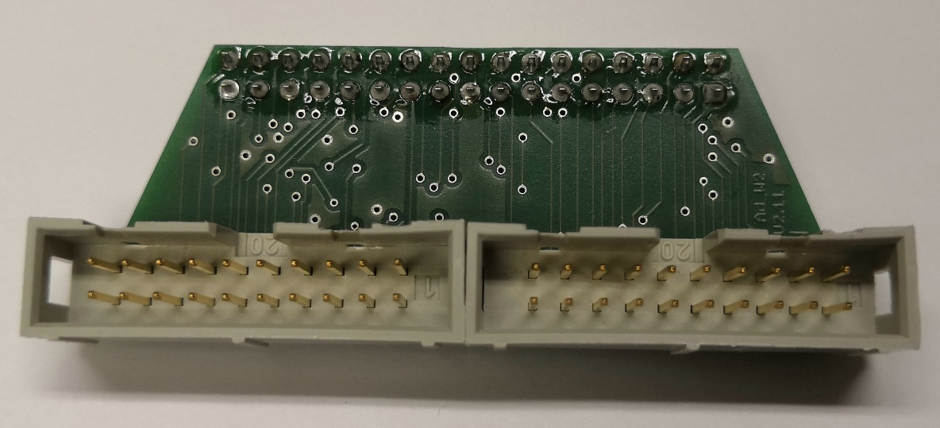
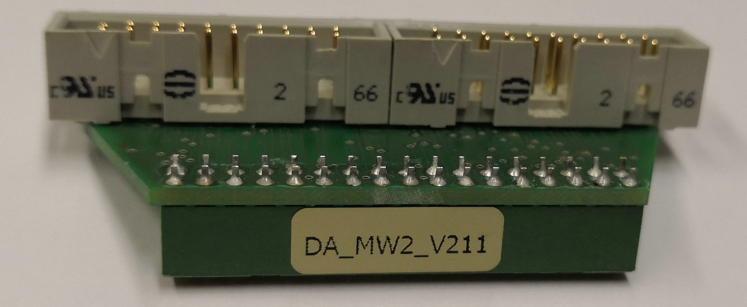
9
60
25
43
5
9
66
2
6
The units are millimeter. If you need to know any dimensions that are not shown here or not precise enough, I can measure it again.

Slide 34
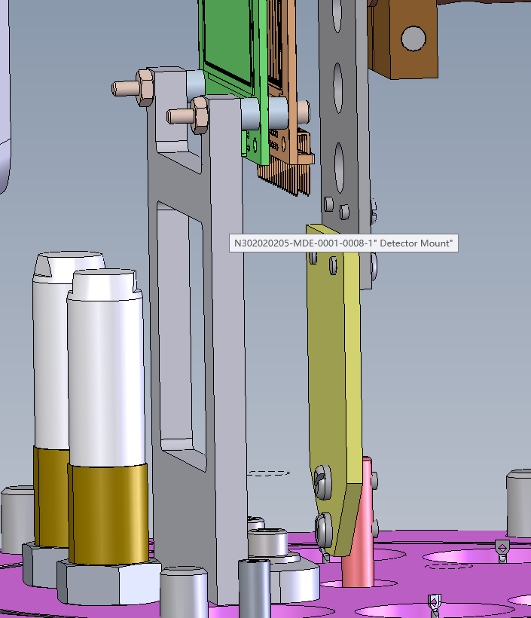
So, is that possible for you to add this detector adapter to the previous mechanical drawing and modify the detector mount so that they don't overlap?

Slide 35
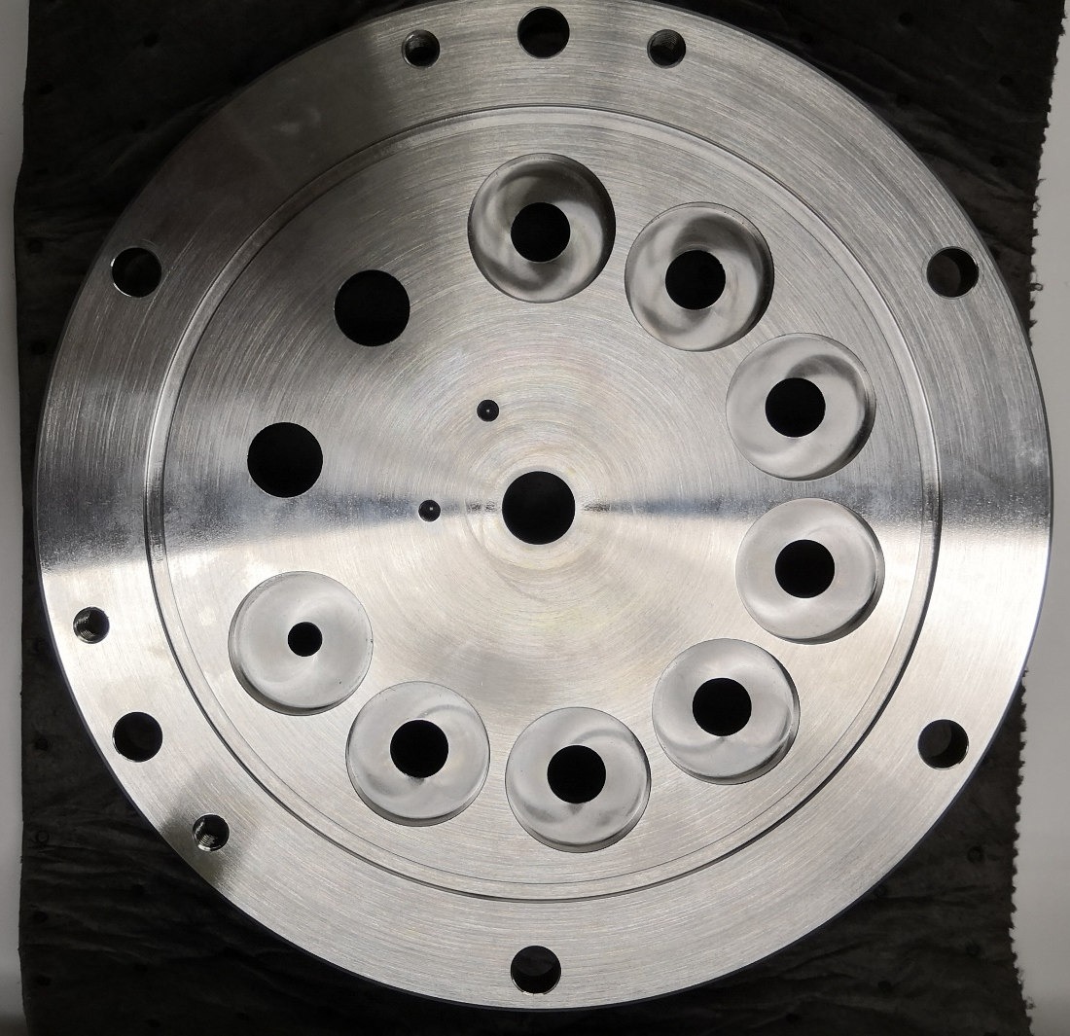
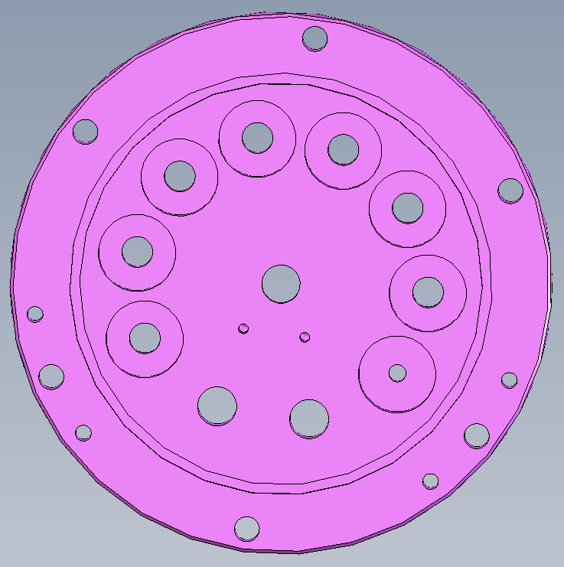

Slide 36
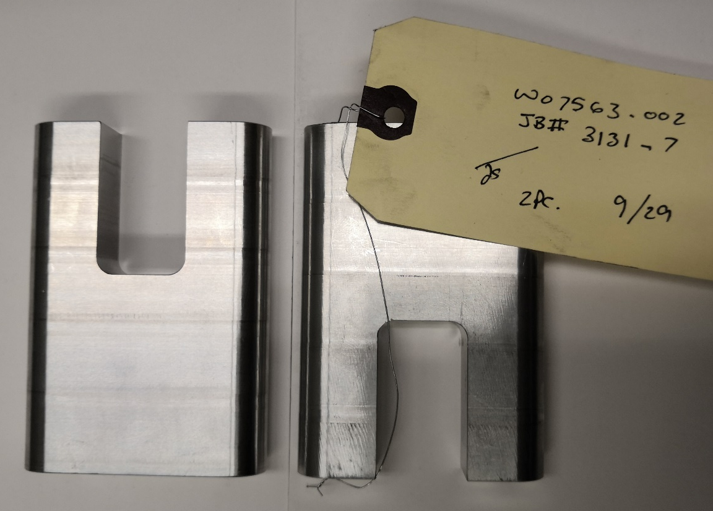

Slide 39
Hi Craig,
I didn't expect the preamp plus connector to be this long. Either arranging them on top of each other or side by side, the preamp support plate seems not long enough. Could you please design a longer one?

Slide 40
Hi Craig,
Thanks for ordering these small parts for us.
One of them is the O-ring #260 (see the pictures on the next two slides). It seems much smaller than our flange. I didn't open the packing. Is it possible to return it and get a new one?

Slide 41
O-ring #260

Slide 42
O-ring #260

Slide 43
Hi Craig,
We didn't receive the one LEMO Signal Feedthrough and seven Amphenol BNC Bulkhead Solder Jacks. Should we try to order them ourselves? Do you have any advice on which vendor we should contact?

Slide 44
Dear Craig, As the requestor, you are receiving this message to inform you that purchase requisition: 90569 A portion of purchase order C155996, with vendor: MCMASTER-CARR SUPPLY CO has arrived, see details below: : PO No. C155996 Line No: 1 Release No: 1 Receipt No: 1 Part: P/N 91251A658, 5/16-18 x 4 3/4" Lg. Steel SHCS Qty arrived: 4 Project ID: RC110270-N32225E PO No. C155996 Line No: 11 Release No: 1 Receipt No: 1 Part: P/N 92196A624, Pkg of 10, 3/8-16 x 1" Lg. SS SHCS Qty arrived: 1 Project ID: RC110270-N32225E PO No. C155996 Line No: 2 Release No: 1 Receipt No: 1 Part: P/N 92141A030, Pkg of 100, 5/16 SS Flatwasher Qty arrived: 1 Project ID: RC110270-N32225E PO No. C155996 Line No: 3 Release No: 1 Receipt No: 1 Part: P/N 91792A144, Pkg of 100, 6-32 x 1/4" Lg. SS Slotted PHMS Qty arrived: 1 Project ID: RC110270-N32225E PO No. C155996 Line No: 4 Release No: 1 Receipt No: 1 Part: P/N 91792A146, Pkg of 100, 6-32 x 3/8" Lg. SS Slotted PHMS Qty arrived: 1 Project ID: RC110270-N32225E PO No. C155996 Line No: 5 Release No: 1 Receipt No: 1 Part: P/N 9464K558, Pkg of 2, O-ring #260, 1/8W x 6 1/2" ID Viton Qty arrived: 1 Project ID: RC110270-N32225E PO No. C155996 Line No: 6 Release No: 1 Receipt No: 1 Part: P/N 92196A269, Pkg of 100, 10-32 x 1/2" Lg. SS SHCS Qty arrived: 1 Project ID: RC110270-N32225E PO No. C155996 Line No: 7 Release No: 1 Receipt No: 1 Part: P/N 92141A011, Pkg of 100, #10 SS Flatwasher Qty arrived: 1 Project ID: RC110270-N32225E PO No. C155996 Line No: 8 Release No: 1 Receipt No: 1 Part: P/N 91221A221, Pkg of 25, 4-40 x 1" Lg. Glass-filled Nylon SHCS Qty arrived: 1 Project ID: RC110270-N32225E PO No. C155996 Line No: 9 Release No: 1 Receipt No: 1 Part: P/N 91221A218, Pkg of 25, 4-40 x 5/8" Lg. Glass-filled Nylon SHCS Qty arrived: 1 Project ID: RC110270-N32225E
Please pick your item(s) at your earliest convenience in the Receiving Office. If you have any questions regarding this message, please contact: Christopher Giddings Phone Ext.: 7-7695

Slide 45
Hi Ben,
OK, thanks for the advice -- sounds great. Here is the information you requested:
Asset Name: Doppler Shift Lifetime 2 (DSL2)
Account that will fund asset purchases: RC110270-N32225E
Total Estimated cost of items to procure: $26,000
Estimated date of completion: 12/31/2020
Estimated useful life of asset after completion: 10 years
Thanks for your help,
Chris
Hi Lijie,
FYI -- the "Asset ID" mentioned below defines DSL2 as a single piece of equipment. This is valuable because equipment purchases at the lab do not incur overhead expenses. The Asset ID is also used for inventory purposes, which means that MSU may ask us to verify its location and condition periodically in the future.
Chris

Slide 46
Hi Cody,
Thanks for doing this. The purchases should go on RC110270-N32225E. The financial folks have classified DSL2 as "Equipment" so there should be no overhead charged. In case it comes up, the Asset ID for DSL2 is 536413. Lijie has quotes for the detectors, electronics, and cables, which will also go on this account, but we have not yet filled the account with funds because we don't know how much the other parts and materials will be. Could you provide an estimate for the other parts and materials? I believe we are also waiting for an estimate of hours from the shop to determine how much is needed in the Labor account for fabrication.
Best,
Chris

Slide 47
Cable for the backing detector

Slide 48
Glarks 112Pcs 2.54mm Male and Female Pin Header Connector Assortment Kit, 100pcs Stackable Shield Header and 12pcs Breakaway PCB Board Pin Header for Arduino Prototype Shield
1. What you get: This kit includes all types of pin headers you need, including 50pcs long needle female pin headers, 40pcs short needle female pin headers, 10 double pin headers, 12pcs breakaway male and female pin headers, stored in a transparent plastic box to meets all your needs in one kit
2. Material: Insulated plastic, hard metal pin
3. All Products Spacing: 2.54mm/0.1 inches; Number of Pins: 4/6/8/10/40; Row Type: Single row and double row
4. Feature: They are the perfect height for clearing the USB-B connector and great for stacking multiple shields
5. Application: Perfect used for wire connecting in the field of Automotive, electrical appliances and Internet, especially for the computer and breadboard

Slide 49
25.02*36=900.72

Slide 50
$31.42
$34.39
$47.48
$46.29
$48.67
$60.21
$48.67
$37.37
$49.27
The long signal cables are broken out at both ends into 16 short individual RG174 cables with SMA plugs for connection to the clover or GRIF-16 digitizer module.
A. B. Garnsworthy et al., Nucl. Instrum. Methods Phys. Res. A 918, 9 (2019).
Notes:
25.02*36=900.72
31.42*36=1131.12

Slide 51
Coaxial Cable, L00 (Lemo 00 compatible) to SMA, RG174, 10 foot, 50 ohm $31.42
L00SA-174-10 is a RG174 10 foot 50 ohm (3.05 meter) coax cable assembly with a L00 (Lemo 00 compatible) connector on one end and a SMA connector on the other end.
Coaxial Cable, L00 (Lemo 00 compatible) to SMA, RG188, 10 foot, 50 ohm $48.67
L00SA-188-10 is a RG188 10 foot 50 ohm (3.05 meter) coax cable assembly with a L00 (Lemo 00 compatible) connector on one end and a SMA connector on the other end.
Coaxial Cable, L00 (Lemo 00 compatible) to SMA, RG188 low noise, 10 foot, 50 ohm $60.21
L00SA-188LN-10 is a RG188 low noise 10 foot 50 ohm (3.05 meter) coax cable assembly with a L00 (Lemo 00 compatible) connector on one end and a SMA connector on the other end.
Coaxial Cable, L00 (Lemo 00 compatible) to SMA, RG196 low noise, 10 foot, 50 ohm $49.27
L00SA-196LN-10 is a RG196 low noise 10 foot 50 ohm (3.05 meter) coax cable assembly with a L00 (Lemo 00 compatible) connector on one end and a SMA connector on the other end.
Coaxial Cable, L00 (Lemo 00 compatible) to SMA, RG316, 10 foot, 50 ohm $37.37
L00SA-316-10 is a RG316 10 foot 50 ohm (3.05 meter) coax cable assembly with a L00 (Lemo 00 compatible) connector on one end and a SMA connector on the other end.
Coaxial Cable, L00 (Lemo 00 compatible) to SMA, RG316 double shielded, 10 foot, 50 ohm $48.67
L00SA-316DS-10 is a RG316 double shielded 10 foot 50 ohm (3.05 meter) coax cable assembly with a L00 (Lemo 00 compatible) connector on one end and a SMA connector on the other end.

Slide 52
Coaxial Cable, L00 (Lemo 00 compatible) to SMA, RG174 low noise, 10 foot, 50 ohm $46.29
L00SA-174LN-10 is a RG174 low noise 10 foot 50 ohm (3.05 meter) coax cable assembly with a L00 (Lemo 00 compatible) connector on one end and a SMA connector on the other end.
This is a "low noise" cable, with a carbon-impregnated conductive PVC layer added around the polyethylene dielectric; this layer helps to increase shielding, dissipate static charge, and reduce mechanically-generated electrical noise as the cable is flexed. This extra protection is useful for long cable runs, low-voltage signals, high-vibration environments, in applications including aerospace, automotive, NDT, strain gauges and accelerometers, and extremely high fidelity professional audio production. Low noise cable is generally not recommended for RF use. In our own testing, we see characteristics which differ from ordinary cable, including phase delay and impedance variations with frequency. In the field, we've seen mixed results in the GHz range; low noise cables seem to provide the best results at signal frequencies in the low MHz or lower. Ultrasonic NDT, for example, uses low-noise cable with signals as high as 100 MHz, but in transient pulse trains, where phase delay is less critical. The results you get will depend on the application, and as always you will want to do your own testing before ordering large quantities.
https://www.cdint.com/catalog/model/L00SA-174LN-6

Slide 53
Coaxial Cable, L00 (Lemo 00 compatible) to SMA, RG174 flexible (TPR jacket), 10 foot, 50 ohm $34.39
L00SA-174TPR-10 is a RG174 flexible (TPR jacket) 10 foot 50 ohm (3.05 meter) coax cable assembly with a L00 (Lemo 00 compatible) connector on one end and a SMA connector on the other end.
This cable assembly has a characteristic impedance of 50 ohms. 50 ohm coax cable, connectors, and adapters are commonly used in GPS and wifi (802.11 wireless LAN) antennas, ham transceivers, and other radio frequency (RF) analog and digital signaling, microwave, radar, hi-fidelity professional audio, non-destructive testing (NDT), oil and petroleum production, ultrasonic transducers, accelerometers, strain gauges, and some professional video applications. This cable has a thermoplastic rubber (TPR) jacket (also known as thermoplastic elastomer or TPE). This material is softer and more flexible than a standard PVC cable jacket, even at low temperatures. TPR is resistant to petroleum oils, many chemicals, ozone, and other environmental contamination sources. TPR-jacketed cables weather well and are abrasion-resistant. They are not cut-resistant or built to withstand longitudinal tension, so should not be buried or used in umbilical tether applications without additional protection.
You've likely seen TPR before -- it's the high-friction, rubbery material used as the jacket for many test bench leads and patch cables. The flexibility makes TPR-jacketed cables popular for use with handheld sensors and probes; we see them used a lot with ultrasonic contact transducers and eddy current probes. The flexibility and small bend radius of these cables makes them ideal for use with microphones, DF antennas, and other handheld or wearable devices, in robotic or mechatronic remote control and telemetry, automated or CNC machines, and precision motion control. Popular outdoor uses include flightline, oil rig, pipeline inspection, arctic, and other extreme environment applications where flexibility at low temperature is important.

Slide 54
Coaxial Cable, L00 (Lemo 00 compatible) to SMA, RG174 low loss, 10 foot, 50 ohm $47.48
L00SA-174LL-10 is a RG174 low loss 10 foot 50 ohm (3.05 meter) coax cable assembly with a L00 (Lemo 00 compatible) connector on one end and a SMA connector on the other end.
This is Belden's 7805 "low loss" cable. It's similar to RG174, but with a solid copper core and a layer of foil added under the braid. This combination causes less attenuation, providing roughly 50% more signal as measured in decibels. 7805 also works better at higher frequencies, and is rated up to 6 GHz. The foil layer also provides for better EMF shielding versus braid alone. Belden 7805 data sheet.
Belden 8216 data sheet (an example RG174/U, for comparison)
We see this cable used in fixed-place permanent installations such as wifi and GPS antenna extensions, other RF applications, low-voltage signal sources including radiation detectors and strain gauges, high-frequency or fast-rise transient signals, and other low-vibration applications in aerospace, nuclear physics, petroleum refining and chemical processing. This cable is not recommended for use in applications where it will undergo repeated cycles of flexing or vibration -- the solid core will eventually break under those conditions. You may instead want one of these stranded-core RG174 variants:
RG174 standard has a stranded core and PVC jacket.
RG174 TPR has a stranded core and TPR jacket. The TPR jacket provides for more flexibility, most useful in bench and handheld applications.
RG174 low noise has a stranded core, PVC jacket, and a carbon layer under the braid. The carbon layer reduces flexing-induced static and provides some additional shielding. It's best at lower frequencies -- see the notes on that page.

Slide 55
Impedance | 50 ohms | 50 ohms | 50 ohms
Inner Conductor Diameter | 0.812 mm | 0.48 mm
Dielectric Diameter | 2.95 mm | 1.52 mm
Shield Diameter | 3.53 mm | 2.23 mm
Capacitance | 93.5 pF/meter (28.5 pF/foot) | 124.6 pF/meter (38.0 pF/foot) | 101.7 pF/meter (31.0 pF/foot)
Minimum Operating Temperature | -40 C (-40.0 F) | -40 C (-40.0 F) | -55 C (-67.0 F)
Maximum Operating Temperature | 75 C (167.0 F) | 75 C (167.0 F) | 200 C (392.0 F)
Jacket Diameter | 4.95 mm | 2.79 mm | 2.48 mm
Jacket Material | PVC | PVC | FEP
Velocity Ratio | 80% | 66%
Core | stranded | stranded | Stranded
Related | RG-58 RG58A/U RG-58A/U | RG-174 RG174A/U RG-174A/U | RG-316
Price for 6 ft | $24.64 | $23.72 $35.27 for low noise | $28.34

Slide 57
About Low Loss Cable
This is Belden's 7805 "low loss" cable. It's similar to RG174, but with a solid copper core and a layer of foil added under the braid. This combination causes less attenuation, providing roughly 50% more signal as measured in decibels. 7805 also works better at higher frequencies, and is rated up to 6 GHz. The foil layer also provides for better EMF shielding versus braid alone.Belden 7805 data sheet.
Belden 8216 data sheet (an example RG174/U, for comparison)
We see this cable used in fixed-place permanent installations such as wifi and GPS antenna extensions, other RF applications, low-voltage signal sources including radiation detectors and strain gauges, high-frequency or fast-rise transient signals, and other low-vibration applications in aerospace, nuclear physics, petroleum refining and chemical processing. This cable is not recommended for use in applications where it will undergo repeated cycles of flexing or vibration -- the solid core will eventually break under those conditions. You may instead want one of these stranded-core RG174 variants:
RG174 standard has a stranded core and PVC jacket.
RG174 TPR has a stranded core and TPR jacket. The TPR jacket provides for more flexibility, most useful in bench and handheld applications.
RG174 low noise has a stranded core, PVC jacket, and a carbon layer under the braid. The carbon layer reduces flexing-induced static and provides some additional shielding. It's best at lower frequencies -- see the notes on that page.

Slide 58
About Low Noise Cable
This is a "low noise" cable, with a carbon-impregnated conductive PVC layer added around the polyethylene dielectric; this layer helps to increase shielding, dissipate static charge, and reduce mechanically-generated electrical noise as the cable is flexed. This extra protection is useful for long cable runs, low-voltage signals, high-vibration environments, in applications including aerospace, automotive, NDT, strain gauges and accelerometers, and extremely high fidelity professional audio production. Low noise cable is generally not recommended for RF use. In our own testing, we see characteristics which differ from ordinary cable, including phase delay and impedance variations with frequency. In the field, we've seen mixed results in the GHz range; low noise cables seem to provide the best results at signal frequencies in the low MHz or lower. Ultrasonic NDT, for example, uses low-noise cable with signals as high as 100 MHz, but in transient pulse trains, where phase delay is less critical. The results you get will depend on the application, and as always you will want to do your own testing before ordering large quantities.

Slide 60
³²S/²⁴Mg Beam

Slide 61
³²S/²⁴Mg Beam

Slide 62
²³Al foil
³²S/²⁴Mg Beam
Range of 75-MeV ²⁴Mg in Al: 29 μm
Range of 128-MeV ³²S in Al: 34 μm
Notes:
a piece of Al foil

Slide 63
Hi Lijie,
This morning I started worrying about damaging the Si detectors with direct or scattered beam. I'm not sure if we ever considered this in detail. In the original DSL, it was not an issue because the target foil completely stopped the beam from reaching the small Si aperture. But now the surface area is huge and it seems like there might be other ways for the beam to reach it, especially during beam tuning. Could you please check this?
Thanks,
Chris
The idea during beam tuning is that when the target ladder is in the “target out” position, a solid, cooled piece of Ta much larger than the beam spot is in between the Si detector and the beam, which will be completely stopped therein. There should be no danger to the Si detector as long as this design feature of the target ladder was not changed.
Cheers,
Barry

Slide 67
MPR-16L
Inside cable → Feedthrough → Outside cable → MPR-16L
Outside cable → MPR-16L
Adapter for Detector → Inside cable → Feedthrough → Outside cable → MPR-16L
Feedthrough → Outside cable → MPR-16L
MPR-16L High sensitivity: 20 MeV ↔ 4 V

Slide 68
Cable set picking up noise depends on its location.

Slide 69
Noise is small

Slide 70
Pulse generator
Amplitude 1 V, Rise time 145 ns, Fall time 9 μs
3.5 V pulse → MPR-16L
Amplitude 0.84 V, Rise time 109 ns, Fall time 8 μs
Low Sensitivity: 100 MeV ↔ 4 V

Slide 71
Pulse generator
Amplitude 11 V (Maximum for pulser), Rise time 150 ns, Fall time 10 μs
11 V pulse → MPR-16L
Amplitude - V (overflow, should be 13 V), Rise time - ns, Fall time - μs
High sensitivity: 20 MeV → 4 V

Slide 72
Pulse generator
Amplitude 11 V (Maximum for pulser), Rise time 150 ns, Fall time 10 μs
11 V pulse → MPR-16L
Amplitude 2.6 V, Rise time 110 ns, Fall time 8 μs
Low sensitivity: 100 MeV → 4 V

Slide 73
Pulse generator
Amplitude 4.2 V, Rise time 150 ns, Fall time 10 μs
4.2 V pulse → MPR-16L
Amplitude 1 V, Rise time 109 ns, Fall time 8 μs
High sensitivity: 100 MeV ↔ 4 V
4.2 V pulse → MPR-16L
Amplitude 5 V (maximum without overflow), Rise time 108 ns, Fall time 8 μs
High sensitivity: 20 MeV ↔ 4 V

Slide 74
1 V pulse → MPR-16L
Amplitude 1.2 V, Rise time 100 ns, Fall time 8 μs
11 V pulse → MPR-16L
High sensitivity: 20 MeV ↔ 4 V
High sensitivity: 20 MeV ↔ 4 V
Pulser | Sensitivity
 | 20 MeV | 100 MeV
1 V | 1.2 V | 0.24 V
3.5 V |  | 0.84 V
4.2 V | 5 V | 1 V
11 V | 13 V | 2.6 V
1 V pulse → MPR-16L
Amplitude 0.24 V, Rise time 100 ns, Fall time 8 μs
Low Sensitivity: 100 MeV ↔ 4 V
Low Sensitivity: 100 MeV ↔ 4 V
High sensitivity: 20 MeV ↔ 4 V

Slide 75
Pulse generator
Amplitude 4 V, Rise time 118 ns, Fall time 9 μs
Pulse generator
Amplitude 1 V, Rise time 102 ns, Fall time 10 μs
4 V pulse → MPR-1
Amplitude 2 V, Rise time 100 ns, Fall time 9 μs
Pulse generator
Amplitude 10 V, Rise time 146 ns, Fall time 9 μs
Low Sensitivity: 1 GeV ↔ 8 V

Slide 76
1 V pulse → MPR-1
Amplitude 2.5 V, Rise time 98 ns, Fall time 9 μs
10 V pulse → MPR-1
Amplitude overflow should be 25 V
High Sensitivity: 200 MeV ↔ 8 V
High Sensitivity: 200 MeV ↔ 8 V
4 V pulse → MPR-1
Amplitude 10 V (maximum without overflow), Rise time 109 ns, Fall time 9 μs
High Sensitivity: 200 MeV ↔ 8 V

Slide 77
1 V pulse → MPR-1
Amplitude 500 mV, Rise time 100 ns, Fall time 9 μs
Low Sensitivity: 1 GeV ↔ 8 V
Pulser | Sensitivity
 | 200 MeV | 1 GeV
1 V | 2.5 V | 0.5 V
4 V | 10 V | 2 V
10 V | 25 V | 5 V
10 V pulse → MPR-1
Amplitude 5 V, Rise time 100 ns, Fall time 9 μs
Low Sensitivity: 1 GeV ↔ 8 V
Low Sensitivity: 1 GeV ↔ 8 V
High sensitivity: 200 MeV ↔ 8 V

Slide 78
DSSD
SD
(³He,α)
DSSD
SD
15 MeV
48 MeV
MPR-16
MPR-1
MPR-16
MPR-1
50 Ω
50 Ω
50 Ω
50 Ω
20 or 100 MeV
200 or 1000 MeV
4 V
8 V
3 or 0.6 V
1.9 or 0.38 V
50 Ω
50 Ω
1 MΩ
1 MΩ
GRIF-16
GRIF-16
Oscilloscope
Oscilloscope
1 V
1 V
5 V
10 V
attenuator

Slide 79
DSSD
SD
(³He,α)
DSSD
SD
15 MeV
48 MeV
MPR-16
MPR-1
MPR-16
MPR-1
50 Ω
50 Ω
50 Ω
50 Ω
100 or 500 MeV
200 or 1000 MeV
4 V
8 V
0.6 or 0.12 V
1.9 or 0.38 V
50 Ω
50 Ω
1 MΩ
1 MΩ
GRIF-16
GRIF-16
Oscilloscope
Oscilloscope
1 V
1 V
5 V
10 V
attenuator

Slide 80
Max Amplitude: 2 V (50Ω input impedance) blue and yellow
Max Amplitude: 4 V (1MΩ input impedance) purple
Low sensitivity: 20 MeV MPR-16L

Slide 81
Max Pulse: 5 V
Amplitude: 1 V (50Ω input impedance) blue and yellow
Amplitude: 2 V (1MΩ input impedance) purple
Max Amplitude: 2 V (50Ω input impedance) blue and yellow
Max Amplitude: 4 V (1MΩ input impedance) purple
Low sensitivity: 100 MeV MPR-16L
High sensitivity: 20 MeV MPR-16L

Slide 82
Amplitude: 4 V (1MΩ input impedance)
Amplitude: 2 V (50Ω input impedance)
Low sensitivity: 1 GeV MPR-1
Low sensitivity: 1 GeV MPR-1
Amplitude: 8 V (1MΩ input impedance)
Amplitude: 4 V (50Ω input impedance)
High sensitivity: 200 MeV MPR-1
High sensitivity: 200 MeV MPR-1

Slide 83
Oscilloscope

Slide 84
The digitizers accept ±1 V inputs with a variable offset, so the dynamic range is 2 V.
Cheers,
Barry
Good news! The shipped MPR-16L are correct. Based on all the communication we had MESYTEC built these as MPR-16-L-2-100 which have 2V max output signal or about 1V at max. range of 100MeV for 50 Ohm. With this the energy range stated on the module is matching you requirements and the expected 55MeV signals.
For the cable adapter there are unfortunately no 3D drawings available. There is always the possibility to add a small cable piece in between.
Best regards,
Andreas

Slide 85
From: Robert Schneider <r.schneider@mesytec.com>
> Sensitivity: 100 MeV / 20 MeV, Max output: 2V, Impedance: 50Ω.
MPR-16-100MeV outputs 2V high ohmic, 1V at 50Ohms termination.
> MPR-1, Sensitivity: 1 GeV / 200 MeV, Max output: 8V, Impedance: 50Ω.
MPR1 outputs 8V high ohmic, 4V at 50Ohms termination.
Regards,
Andreas
“MPR1 outputs 8V high ohmic, 4V at 50Ohms termination.” Confirmed!
“MPR-16-100MeV outputs 2V high ohmic, 1V at 50Ohms termination.” It might be “MPR-16-100MeV outputs 4V high ohmic, 2V at 50Ohms termination.”

Slide 86
MPR-1
Sensitivity: 1 GeV / 200 MeV
Max output: 4 V
Impedance: 50 Ω

Slide 87
MPR-16L×2
Sensitivity: 100 MeV / 20 MeV
Max output: 2V
Impedance: 50Ω

Slide 88
I looked at the old preamp we used for our GADGET I. It's the same MPR-16L type.
Sensitivity: 100 MeV / 20 MeV

Slide 89
During our last NSCL experiment in S2 Vault, we borrowed a similar MPR-16L from Andrea Richard.
Sensitivity: 1500 MeV / 300 MeV

Slide 92
DSL2 Test Plan November 2020
Dimensions. I'll measure the dimensions of the detector adapter and send the numbers to Craig so that he can redesign and refabricate the detector mount. I guess we'll have to go to the Lab again after the new detector mount is fabricated, pack everything and ship them to TRIUMF.
Range. Andreas Ruben said "the MPR-16 outputs 2 V at high ohmic, 1 V at 50 Ω termination, and MPR1 outputs 8 V at high ohmic, 4 V at 50 Ω termination." However, I'm still skeptical about the range. I remember I saw very large signals from MPR-16 when I tested it the first time. This time I'll add a 50-Ω terminal to the oscilloscope to verify whether the preamps have the correct range.
Assembly. Since we have the feedthroughs, cables, screws and nuts, flange, preamp support plate, etc, I'll try to assemble all the separate component parts. One issue I have in mind is that the preamp support plate might not be big enough to hold three preamps.
Proton Detector. You mentioned "We will lose dry nitrogen gas supply in Room 1039 (Proton Detector Lab) from 12/7/2020 to 6/7/2021." Do I need to do something to accommodate the Proton Detector to the new situation?
Welcome. When I came here, Moshe put some Japanese snacks on my desk and wrote a greeting card as a welcome gift. Following the tradition, I prepared a similar gift for Ruchi. Since I may never be able to meet Ruchi in person, I hope I'm allowed to enter my office and put the gift on Ruchi's desk.

Slide 93
DSL2 Test Plan January 2021
Pick up the newly fabricated detector mount and preamp support plate from the Machine shop and replace the old ones. Assemble them with other component parts.
Install one LEMO Signal Feedthrough and seven Amphenol BNC Bulkhead Solder Jacks to the feedthrough plate.
Make a cable to connect the backing detector and the feedthrough.
Wrap up everything in proper material and ship them. Discuss with Barry, purchasing, and receiving.
Wrench for regulator.

Slide 94
DSL2 Test Plan February 2021
Pick up the newly fabricated detector mount and preamp support plate from the Machine shop and replace the old ones. Assemble them with other component parts.
Install one LEMO Signal Feedthrough and seven Amphenol BNC Bulkhead Solder Jacks to the feedthrough plate.
Pick up the pin header connectors and make a cable to connect the backing detector and the feedthrough.
Disassemble.
Wrap up everything in proper material and ship them. Discuss with Barry, purchasing, and receiving.

Slide 96
10 mm
13.2 mm
SD
DSSD
Target
18%
29%

Slide 97
5 mm
13.2 mm
SD
DSSD
Target
23%
29%

Slide 98
Current design
20200629
4.1 mm
16.7 mm
SD
DSSD
Target
20.6%
24.6%

Slide 99
24~26 mm
6.91 mm
16°
E
ΔE
Target
2.2%
5.9%

Slide 100
24~26 mm
6.91 mm
12.0 mm
8 mm
16°
19°
E
ΔE
Target
2.2%
3.3%

Slide 101
24~26 mm
6.91 mm
12.0 mm
8 mm
16°
19°
E
ΔE
Target
2.2%
3.3%

Slide 102
10.4 mm
22.6 mm
6.91 mm
15.6 mm
6.4 mm
DSL1
11.6°
11.8°
E
ΔE
Target
5.7 mm
18.4 mm
DSL2
25 mm
46°
54°
SD
DSSD
Target

Slide 103
Author | Oliver Kirsebom |  |  |  | Cathleen Fry
Literature | PRC2016
Reaction | ³He(²⁴Mg,²³Mg)α |  |  |  | ³He(³²S,³¹S)α
Beam | ²⁴Mg |  |  |  | ³²S
Beam energy | 75 MeV 3.1 MeV/u |  |  |  | 128 MeV 4 MeV/u
Target | ³He-implanted Au foil |  |  |  | ³He-implanted Au foil
Au foil | 22.6(2) μm |  |  |  | 2.5 cm×2.5 cm×25 μm
Implanted ³He | 30 keV 0.07 μm |  |  |  | 35 keV
areal density | 6.6×10¹⁷ cm^{–2} |  |  |  | 6×10¹⁷ cm^{–2}
ΔE thickness (μm) | 140 |  |  |  | 140
E thickness (μm) | 1000 |  |  |  | 1000
E_{x} of resonance (MeV) | 7.8 |  | gs |  | 6.4 |  | gs
E_{α} in total (MeV) | 26-6 |  | 40-20 |  | 44-16 |  | 56-28
Angle of α (degree) | 0 | 39 | 0 | 46 | 0 | 46 | 0 | 46
E_{α} in Au foil (MeV) | 4-6 | 6-6 | 3-5 | 5-8 | 3-7 | 5-12 | 3-5 | 4-7
E_{α} in ΔE (MeV) | 9-0 | 14-0 | 5-15 | 8-12 | 5-9 | 7-4 | 4-8 | 6-15
E_{α} in E (MeV) | 13-0 | 7-0 | 32-0 | 27-0 | 36-0 | 32-0 | 48-15 | 46-6
α
Energy range for MPR-16L: 15 MeV
Energy range for MPR-1: 48 MeV
46°

Slide 104
Author | Oliver Kirsebom |  |  |  |  |  | Cathleen Fry
Literature | PRC2016
Reaction | ³He(²⁴Mg,²³Mg)α |  |  |  |  |  | ³He(³²S,³¹S)α
Beam | ²⁴Mg |  |  |  |  |  | ³²S
Beam energy | 75 MeV 3.1 MeV/u |  |  |  |  |  | 128 MeV 4 MeV/u
Target | ³He-implanted Au foil |  |  |  |  |  | ³He-implanted Au foil
Au foil | 22.6(2) μm |  |  |  |  |  | 2.5 cm×2.5 cm×25 μm
Implanted ³He | 30 keV 0.07 μm |  |  |  |  |  | 35 keV
areal density | 6.6×10¹⁷ cm^{–2} |  |  |  |  |  | 6×10¹⁷ cm^{–2}
ΔE thickness (μm) | 100 |  | 140 |  | 250 |  | 100 |  | 140 |  | 250
E thickness (μm) | 1000 μm |  |  |  |  |  | 1000 μm
E_{x} of resonance (MeV) | 7.8 | 2.1 | 7.8 | 2.1 | 7.8 | 2.1 | 6.4 | 1.2 | 6.4 | 1.2 | 6.4 | 1.2
E_{α} in total (MeV) | 26 | 38 | 26 | 38 | 26 | 38 | 44 | 54 | 44 | 54 | 44 | 54
E_{α} in Au foil (MeV) | 4 | 3 | 4 | 3 | 4 | 3 | 3 | 3 | 3 | 3 | 3 | 3
E_{α} in ΔE (MeV) | 6 | 4 | 9 | 6 | 22 | 11 | 4 | 3 | 5 | 4 | 9 | 7
E_{α} in E (MeV) | 16 | 31 | 13 | 29 | 0 | 24 | 37 | 48 | 36 | 47 | 32 | 44
Comments | OK | OK | OK | OK | No! | OK | OK | Maybe | OK | OK | OK | OK
α
100+1000-μm silicon may be too thin to stop 55-MeV α

Slide 105
Author | Oliver Kirsebom |  |  |  |  |  | Cathleen Fry
Literature | PRC2016
Reaction | ³He(²⁴Mg,²³Mg)α |  |  |  |  |  | ³He(³²S,³¹S)α
Beam | ²⁴Mg |  |  |  |  |  | ³²S
Beam energy | 75 MeV 3.1 MeV/u |  |  |  |  |  | 128 MeV 4 MeV/u
Target | ³He-implanted Au foil |  |  |  |  |  | ³He-implanted Au foil
Au foil | 22.6(2) μm |  |  |  |  |  | 2.5 cm×2.5 cm×25 μm
Implanted ³He | 30 keV 0.07 μm |  |  |  |  |  | 35 keV
areal density | 6.6×10¹⁷ cm^{–2} |  |  |  |  |  | 6×10¹⁷ cm^{–2}
ΔE thickness (μm) | 100 |  | 140 |  | 250 |  | 100 |  | 140 |  | 250
E thickness (μm) | 1000 μm |  |  |  |  |  | 1000 μm
E_{x} of resonance (MeV) | 7.8 | 2.1 | 7.8 | 2.1 | 7.8 | 2.1 | 6.4 | 1.2 | 6.4 | 1.2 | 6.4 | 1.2
E_{α} in total (MeV) | 26 | 38 | 26 | 38 | 26 | 38 | 44 | 54 | 44 | 54 | 44 | 54
E_{α} in Au foil (MeV) | 7 | 5 | 7 | 5 | 7 | 5 | 5 | 4 | 5 | 4 | 5 | 4
E_{α} in ΔE (MeV) | 11 | 6 | 19 | 9 | 19 | 18 | 5 | 4 | 8 | 6 | 15 | 11
E_{α} in E (MeV) | 8 | 27 | 0 | 24 | 0 | 16 | 34 | 45 | 31 | 44 | 24 | 39
Comments | OK | OK | No! | OK | No! | OK | OK | OK | OK | OK | OK | OK
48°
α

Slide 106
Author | Oliver Kirsebom |  |  |  |  |  | Cathleen Fry
Literature | PRC2016
Reaction | ³He(²⁴Mg,²³Mg)α |  |  |  |  |  | ³He(³²S,³¹S)α
Beam | ²⁴Mg |  |  |  |  |  | ³²S
Beam energy | 75 MeV 3.1 MeV/u |  |  |  |  |  | 128 MeV 4 MeV/u
Target | ³He-implanted Au foil |  |  |  |  |  | ³He-implanted Au foil
Au foil | 22.6(2) μm |  |  |  |  |  | 2.5 cm×2.5 cm×25 μm
Implanted ³He | 30 keV 0.07 μm |  |  |  |  |  | 35 keV
areal density | 6.6×10¹⁷ cm^{–2} |  |  |  |  |  | 6×10¹⁷ cm^{–2}
ΔE thickness (μm) | 100 |  | 140 |  | 250 |  | 100 |  | 140 |  | 250
E thickness (μm) | 1000 μm |  |  |  |  |  | 1000 μm
E_{x} of resonance (MeV) | 7.8 | 2.1 | 7.8 | 2.1 | 7.8 | 2.1 | 6.4 | 1.2 | 6.4 | 1.2 | 6.4 | 1.2
E_{α} in total (MeV) | 26 | 38 | 26 | 38 | 26 | 38 | 44 | 54 | 44 | 54 | 44 | 54
E_{α} in Au foil (MeV) | 7 | 5 | 7 | 5 | 7 | 5 | 5 | 4 | 5 | 4 | 5 | 4
E_{α} in ΔE (MeV) | 9 | 6 | 15 | 9 | 19 | 18 | 5 | 4 | 8 | 6 | 15 | 11
E_{α} in E (MeV) | 10 | 27 | 4 | 24 | 0 | 16 | 34 | 45 | 31 | 44 | 24 | 39
Comments | OK | OK | OK | OK | No! | OK | OK | OK | OK | OK | OK | OK
39°
α
140 μm

Slide 107
23Mg gs
E(⁴He) ≤ 40 MeV
θ(⁴He)_{lab} ≤ 180°
23Mg 7787 keV
E(⁴He) _{lab} ≤ 26 MeV
θ(⁴He)_{lab} ≤ 39°
³He(²⁴Mg,²³Mg)α

Slide 109
Ebeam = 85 MeV

Slide 110
Kenneth S. Krane, Textbook
Clemens Herlitzius, Thesis 2013
Ebeam = 85 MeV
relativistic-kinematics-calculator
http://skisickness.com/2010/04/relativistic-kinematics-calculator/

Slide 111
Clemens Herlitzius, Thesis 2013
Ebeam = 85 MeV
Kenneth S. Krane, Textbook
relativistic-kinematics-calculator
http://skisickness.com/2010/04/relativistic-kinematics-calculator/

Slide 112
For the emission angles we generally assume isotropic distributions. The error introduced by this simplifying assumption has been estimated by trying a few different realistic anisotropic distributions and has been found to be negligible compared to other errors for all the transitions considered. Oliver Kirsebom et al., Phys. Rev. C 93, 025802 (2016).
relativistic-kinematics-calculator
Ebeam = 85 MeV
Clemens Herlitzius, Thesis 2013

Slide 113
Ebeam = 128 MeV

Slide 114
Ebeam = 128 MeV
θ_{α}
E_{α}
θ_{31S}
E_{31S}
Ejectile angle is randomly chosen. This is the starting point of the kinematics simulation.

Slide 115
Kinetic energy $E_{k}$
$$E_{k}=E−m_{0}c^{2}=m_{0}c^{2}\left[\sqrt{1+\frac{c^{2}p^{2}}{{\left(m_{0}c^{2}\right)}^{2}}}−1\right]$$
θ_{b}
Momentum $p$
θ_{Y}
$$p=m_{0}c^{2}\sqrt{\left[{\left(\frac{E_{k}}{m_{0}c^{2}}+1\right)}^{2}−1\right]} [{MeV}/c]$$
θ_{b}
E_{b}
Conservation of energy
Conservation of momentum
Q value and kinetic energies
$$p_{a}=p_{b}\cos{θ_{b}}+p_{Y}\cos{θ_{Y}}$$
θ_{Y}
E_{Y}
$$Q=E_{Y}+E_{b}−E_{X}−E_{a}$$
$$E_{X}=0$$
$$0=p_{b}\sin{θ_{b}}−p_{Y}\sin{θ_{Y}}$$
laboratory reference frame
$$Q=\left(M_{X}+M_{a}−M_{Y}−M_{b}\right)c^{2}$$
$$E_{b}={\left\{\frac{\sqrt{A_{a}A_{b}E_{a}}}{A_{Y}+A_{b}}\cos{θ_{b}}+\sqrt{{\left[\frac{A_{Y}−A_{a}}{A_{Y}+A_{b}}+\frac{A_{a}A_{b}{\left(cosθ_{b}\right)}^{2}}{{\left(A_{Y}+A_{b}\right)}^{2}}\right]E}_{a}+\frac{A_{Y}Q}{A_{Y}+A_{b}}}\right\}}^{2}$$

Slide 116
We determine the momenta of the α particle and the excited 23Mg* recoil in the center of mass (c.m.) frame, using the already sampled emission angles, and boost to the laboratory (lab) frame, always using relativistic kinematics.
O. S. Kirsebom et al., Phys. Rev. C 93, 025802 (2016).
In this simulation the initial α particle energies of the 3He(16O,α)15O reaction were
calculated using relativistic reaction kinematics.
Naomi Galinski, Thesis 2013.

Slide 117
http://skisickness.com/2010/04/relativistic-kinematics-calculator/

Slide 119
cm or lab

Slide 120
Reaction Kinematics
DSL2
DSL1
1248 ³¹S

Slide 123
E_{α} (MeV)
θ_{α} (deg) in lab frame

Slide 124
Naomi Galinski:
We report the lifetime uncertainty due to the excitation energy and ejectile angular distribution Legendre polynomial coefficient.
The angle of the γ ray was chosen from an isotropic distribution in the c.m. system since the results differed negligibly from those calculated with an anisotropic distribution.
Oliver Kirsebom:
In principle knowledge of the angular distribution of the α particles and the α-γ angular-correlation function is also required, but their effect on the line shape is rather small due to the limited angular acceptance.
For the emission angles we generally assume isotropic distributions. The error introduced by this simplifying assumption has been estimated by trying a few different realistic anisotropic distributions and has been found to be negligible compared to other errors for all the transitions considered, except the 2908 keV → g.s. transition where it gives an error of ±2 fs.

Slide 125
Ceramic packaging offers better heat conductivity than plastic.
Ceramic also offers improved electrical performance.
Ceramic packaging has the ability to be hermetically sealed, i.e., won't decrease the degree of air vacuum by releasing their own molecules.
Ceramic packaging is relatively expensive compared to plastic.
Barry Davids: the ceramic frame is certainly better suited to this application.
Colin Wilburn, Micron Managing Director: the ceramic package would be the most suitable.
Mark Bullough, Micron R&D Manager and Craig Hawkins, Micron Test Manager: we have been conducting tests for the lower temperature and have currently been able to test to –60℃ and more R & D is taking place.

Slide 127
Fantastic work! I just had two really minor questions / comments related to the cabling:
I'm sure you double checked it, but I'm having trouble seeing (1) that there will be enough space around the support structure for the W1 breakout board and (2) how the wires will go from the breakout board to the multi-pin round feedthroughs. Since it'll be cramped in that area between the target arm linear positioner and the detectors' support, I just want to make sure we can keep everything fits and isn't too strained. Connecting to those LEMO round multi-pin connectors can be tough, that wire bundle made up of stacked strips of ribbon cable surrounded by the braided shielding is quite stiff, so we need to make sure there's enough clearance to get the wires get them connected.
Similar worry on the outside cables. Those gray plastic cables are quite stiff, do the pre-amp supports have enough space between the bottom feedthrough plate and the pre-amp support to ensure the pre-amps will still be supported if they are pushed a bit?
-Nick
In practice, we mount the bottom feed-through flange with no wires connected. Then we stand on top of some stairs and reach down into the chamber to connect the cables. There is not much space. Maybe the design is OK for this, but we should assess whether or not there is enough room for hands.

Slide 128
Thanks for your note. I wanted to try to see if there is a way of providing a line of sight to ensure proper alignment of the detectors, apertures, and target ladder with respect to the beam axis, e.g. with a removable transparent blankoff flange or something. I don’t really see how we could do it and I think that as long as we ensure the longitudinal separations of the detectors and the target are fixed we don’t have to worry much about the transverse directions. This is both because the flange is pretty much self aligning and because we have position sensitive detectors. I would agree that Nick’s concern about being able to squeeze hands and inflexible cable connectors into tight spaces is warranted.
Barry
1) I'm glad to hear they won't be a problem! I had figured you were ready to address it, I just wanted to be sure. If there is space, I was thinking it might be better to have the Si detectors pins coming from the top rather than the bottom. That way we can reach through the top flange to connect / disconnect them. That doesn't really affect the parts / drawing at all, so it's something we can figure out when constructing DSL2.
2) I agree with you/Barry, I think we're okay. It would be nice to have a 4-way cross to house the Si detectors (this would allow for Barry's suggested alignment port), but it's probably too pricey because we'd need a custom Al window to get the Ge detector as close as it is currently in the design. We should consider adding alignment pins / markers when we construct DSL2. Those can be done in situ at TRIUMF, I'd imagine.
3) The DAQ is in a portable cart, and can be positioned as close or as far from the setup as possible. 3 m should be more than sufficient.
Nick

Slide 129
I think you're headed the right direction. One input line I would be careful about is the distance from the target to the silicon detector. In the drawings you should be able to pull the dimensions. The silicons mount on a sliding track, and due to a lack of communication/cross checks, the silicons ended up all the way back instead of all the way forward. This changes your alpha solid angle, which should change the gammas much, but requiring that coincidence, there could be subtle shifts.
I'm not sure the lineshapes in my thesis account for this. Anyhow, they're not fit, just done by eye, really just shown to demonstrate we have an idea of what we're doing.
Another thing to be mindful of is the energy calibration. In my thesis, I was quite rushed and haphazard in my calibration. After the gain match I did (there are temperature swings that correspond to several keV, so run by run linear matching is important), you can see the 6129 from 16O (where did it come from, who knows, but what else has a sufficiently long lived state for a stopped line at that energy???) is about 5 keV off. I found this somewhere between defending and my Frontiers poster, but didn't have time to fix it. That line is a good cross check for any calibrations you come up with.
More on the gain match: for the first run I had quite good luck using the gold coulex line (547) and a stopped line from 39K (carbon fusion evaporation, 3.8 MeV I think) in the first run. However, we reduced the carbon background by about an order of magnitude, so the statistics might be too low to use it well on this data. There's also a 2.8ish MeV line from fusion evap that's stronger, that might work better. Once I had a good gain match, the crystals were quite linear last time (about 1 keV off at the 6129 extrapolating from <4 MeV). There should be Cm-13C (6129 from 13C(a,n)16O) and 56Co data that should be good for cross checking the calibrations.
Sorry if this is a bit rambling. We could have some sort of call to discuss this in a few weeks if you'd like. We're looking at neutron beam August 28 (but likely to slip to September 4) so I'll be a bit sparse between now and a week or so after that, while we get settled in.

Slide 130
Another resource you may or may not have is Nick's notes from right after the run. We spent an afternoon after the run with me basically trying to brain dump every weird tip and trick I could think of, and he took notes. If you don't have them already, they might be worth asking him about, since it was from when this project was fresher in my mind.
Speaking of weird tricks, there are two room background lines in the 2016 data (I can't remember if they're in the 2018 or not) from Fe(n,g) at 7131 and 7145. I don't know how they got there or where they're from, but if you see two high energy bumps at/near those energies, we have seen them before...
Cathleen

Slide 131
Hi Lijie,
We spoke in this morning’s meeting about the budget and schedule for the DSL2 project.
As you know, the design is paid for in the current fiscal year.
The fabrication and purchasing will take place next fiscal year, which begins around August 1st, 2020. Our total budget for purchasing equipment is $40,000. This is nominally broken down into $25,000 for the Si detectors, preamps, and cables, $10,000 for the vacuum chamber and miscellaneous hardware, and $5,000 for 3He-implanted gold foil targets, but it is OK if we move funds across categories. We also have 200 hours of labor time for fabrication in the shop, beginning August 1st, 2020.
Based on the quotes, it looks like we can expect to spend $14,000 on the Si detectors and $7287 for the preamps and cables. So we seem to be well within budget, and we are on schedule.
Best,
Chris

Slide 132
Hi Lijie,
We spoke briefly the other day about the DSL2 budget. You mentioned that you might be able to contribute using your Chinese grant funds. I wanted to give you more accurate numbers of what we have available (more than I remembered).
200 hours of mechanical design time (equivalent to about $20,000)
200 hours of fabrication time (equivalent to about $20,000)
30 hours of technical support for assembly (equivalent to about $3,000)
$25,000 for silicon detector, DSSSD, preamps, cables
$10,000 for vacuum chamber and miscellaneous hardware
$5,000 for 3He ion-implanted targets
Chris

Slide 133
Dear Terri and Filomena,
Hope you are doing well considering the unusual global situation.
We are finally getting back to this project after a while. Are you still willing and able to collaborate with us? At this point your calculations will be useful to help us propose and plan two experiments (not just one):
1) The same experiment we were initially going to do in Munich, but we will have to do it elsewhere (likely TUNL or FSU) because we were never given a chance to run in Munich and now their accelerator is unfortunately shut down forever.
2) The same reaction at the same CM energy at TRIUMF, but in inverse kinematics with a 32S beam. My group is designing an upgrade to the Doppler Shift Lifetime setup there: DSL2, which will make it more sensitive to determine lifetimes of 31S states. The angular distributions of the alphas will affect the sensitivity.
For planning the experiments, we don't need anything particularly fancy and we don't need absolute cross sections: the same method that Terri used before is probably sufficient. We just need the shapes of the angular distributions of alphas for ell = 0,1,2,3,4 for a hypothetical excited state of 31S at 6.4 MeV.
I've Cc-d Lijie Sun, a Research Associate who is working with me on planning these experiments.
This time I'm happy to say that we are not in a huge hurry.
Hope this sounds interesting to you -- please let me know if you have any questions.
Have a nice weekend,

Slide 134
Hello Chris, Lijie, and Tamas,
I am doing quite well under the circumstances, and I hope the same is true for you. Thanks for reaching out regarding these projects.
These calculations should be pretty simple for me to get together since I already did most of this during the summer. I will just have to look back and remember what I did and send it over! I might be able to get to this in the next few days, but if not, I can put it on the top of my to-do list for next week, if that is ok?
The only caveat is that I plan on graduating quite soon (late May), so if there are additional calculations needed in the future, someone else will have to take over doing them. I will try to help with this by making sure I send you all relevant inputs and store the inputs and outputs somewhere they can be accessed after I am gone.
Let me know if that sounds good!
All the best,
Terri

Slide 135
Procurement Technical Representative PTR Training

Slide 136
Hi All,
I wanted to update you on the status of our mechanical design and solicit feedback on several items. Attached is an image of the design in progress by Cody Norat. You will see that we were able to keep essentially everything the same except for the Si detector hardware and feedthroughs. This will keep things simple and help to minimize the design and hardware expenses.
1) The drawings we received from TRIUMF did not have the ladder going through the copper channel that has been there as long as I can remember, so our drawing does not yet have it either. Was this added later? What is the purpose of it? Should we add it to the drawing? If so, Barry do you have the drawings or dimensions? If you don’t know what I mean, see Figure 4.6 of Cathleen’s thesis (attached).
2) The Si detectors in the drawing have their connectors on the bottom. This will minimize the length of the cables, which is optimal for noise, but will make them difficult to access from above. I’m not sure if this is really a problem, since I believe we can connect the cables before attaching the feedthrough plate and then just leave them. Do you see a problem with this? Actually I just noticed that the feedthrough for the ribbon cable is not in the best spot. I wonder if we should make a new feedthrough plate rather than modifying the old one.
3) We decided to fix the position of the Si detectors rather than making it x-y-z adjustable as in the previous setup. The nominal z-position is essentially the same as before and Lijie verified that this will improve both our overall solid angle and our angular resolution substantially. I don’t see any reason that we would want to adjust it in the future. Fixing the x-y position may leave us vulnerable to misalignment, but I would be surprised if we end up being off by more than a few mm and the detailed position information from the DSSSD will enable us to figure out where the beam axis truly is in analysis (we would probably do this anyway).
Please let me know if you have feedback on these issues or any other aspects of the design.
Thanks,
Chris

Slide 137
1) The drawings we received from TRIUMF did not have the ladder going through the copper channel that has been there as long as I can remember, so our drawing does not yet have it either. Was this added later? What is the purpose of it? Should we add it to the drawing? If so, Barry do you have the drawings or dimensions? If you don’t know what I mean, see Figure 4.6 of Cathleen’s thesis (attached).
Yes, two additional copper brackets were added after the initial design to increase heat transfer. Here’s a quote from my student Mythil Subramanian's thesis on these:
"Two additional Cu brackets of area ∼ 3.7 cm^2 each were attached to the shroud. The additional Cu brackets are made up of three plates - 2 parallel plates and a third perpendicular to the other two. The two parallel plates have the same width and height but were designed to have different lengths. The entire Cu bracket was mounted on the boron nitride piece by coupling the longer of the parallel plates to the boron nitride piece. The additional copper brackets cool down to the shroud temperature. The shorter parallel plate made contact with the target ladder after the shroud was cold. This plate was designed to be short to ensure that the ladder could move vertically without disturbing the alignment of the shroud and the additional Cu brackets.”
I don’t have any additional drawings. These brackets greatly improved the cooling and should be added in some form. Let me know if you need us to take more photos.

Slide 138
2) The Si detectors in the drawing have their connectors on the bottom. This will minimize the length of the cables, which is optimal for noise, but will make them difficult to access from above. I’m not sure if this is really a problem, since I believe we can connect the cables before attaching the feedthrough plate and then just leave them. Do you see a problem with this? Actually I just noticed that the feedthrough for the ribbon cable is not in the best spot. I wonder if we should make a new feedthrough plate rather than modifying the old one.
I agree that this should be optimized in a new feed through plate.

Slide 139
3) We decided to fix the position of the Si detectors rather than making it x-y-z adjustable as in the previous setup. The nominal z-position is essentially the same as before and Lijie verified that this will improve both our overall solid angle and our angular resolution substantially. I don’t see any reason that we would want to adjust it in the future. Fixing the x-y position may leave us vulnerable to misalignment, but I would be surprised if we end up being off by more than a few mm and the detailed position information from the DSSSD will enable us to figure out where the beam axis truly is in analysis (we would probably do this anyway).
The aperture plate in front of the SSBs defined their acceptance in cases where it was used, and otherwise the acceptance was defined by the 2nd SSB. Typical solid angles were 1 sr, so approximately 8% of 4 pi. I don’t see a problem with fixing the longitudinal position, as the angular resolution can be varied by grouping together multiple pixels. The only potential concern with large solid angle coverage would be count rate limitations due to elastic scattering of the 3He. The provision of another aperture plate would eliminate any potential downside here, but I don’t know that it would fit. Lijie might want to do some elastic scattering calculations for the largest angles to make sure this wouldn’t be a problem.
So, the thing that translation along the beam axis buys you is the opportunity to make the choice between angular resolution and solid angle coverage in the future. In the 23Mg and the 31S, the choice you want to make is for coverage, but this might not hold in other experiments. It may turn out that pulling the detector back doesn't buy you anything because of straggling in the target being a larger effect. Has this been considered?

Slide 140
Hi Barry et al.,
Thanks for your detailed feedback.
Any more information on the dimensions of additional Cu brackets would be great, so that Cody can include those in his drawings.
Cody will design a new flange for the bottom of the chamber. He needs to know how many feedthroughs are needed for things other than the Si detectors. I guess we typically read something like 3 currents and 3 temperatures, but I don’t recall the exact numbers. Does anyone recall? Is there anything else?
Lijie will work on the elastic-scattering calculations.
Cheers,
Chris

Slide 141
Hi All,
Sorry I'm late in replying. I also think fixing x-y-z is better to prevent alignment issues, like what was said previously.
But I do have a (kinda wacky) suggestion:
Chris / Lijie, I'm not sure how much money there is for the upgraded DSL, but what do you think of a custom vacuum chamber for the Si detectors? What I'm mainly thinking of: having a thin aluminum window close to the Si detectors, allowing us to position the HPGe as close as possibly. I attached a quick hand-drawing.
I've used this for implantation-decay measurements at recoil separators before, and it's actually not too bad to machine an inset aluminum plate to allow for the closer detector placement. But those vacuum chambers were an older-box style with a lot more surface area to accomodate the size of the clover detector. I don't think it would be feasibly with a standard conflat cross / dimensions, however. If it is possible, we could also have the feedthrus going thru the plate with the thin vacuum window. That would lessen the ribbon cable travel and decrease noise as well.
No sweat if you think it's too expensive / time consuming / not worth the effort. But I've been meaning to raise this as a possibility, considering the increase in our gamma detection efficiency. It does affect the bottom mounting plate / feedthru, so I'm sorry I didn't bring it up earlier. Thoughts?
Cheers,
Nick

Slide 142
Hello Lijie,
Unfortunately we don’t have such a part already designed.
We can design a PCB adapter that mates to the design W1 connectors and splits the signals in two lots of 16. The input would mate to the W1 assembly and the output could simply be solder pads or if you know what the mating connector is to Mesytec input this could be the output of the adapter board.
If the adapter needs to connect straight into the W1 assembly, would you prefer it to be ceramic, PCB would be cheaper ?
Please let me know and then I can advise Amanda to add this to the quotation.
Kind Regards
Susanne

Slide 143
Dear Lijie,
Thank you for contacting us in regards to the MESYTEC preamplifiers. The MPR-1 and
MPR-16/32 are the right units for your two detectors. Please find attached the quote and data sheets. We would have to further discuss the needed maximum energy range as well as the output connector type. I included the pin header version in the quote but there is also a Lemo version of the MPR-16.
I would also like to mention that MESYTEC offers the cable set with vacuum feed through and detector adapter for the W1.
Please let us know your comments!
Best regards,
Andreas

Slide 145
Hi Lijie,
No worries, I thought Chris & I had reviewed my current layout and it was deemed acceptable. I must have misunderstood.
I will modify the current detector spacing to get the Micron A-4366 0.52” from the target, which will increase the current spacing between the two detectors due to the connector layout. One thing to note in my design meeting summary, I need models/drawings for the copper c-channel guide that is missing from TRIUMF’s assembly, photos do not suffice. Getting the detectors this close to the target, I see there being a large possibility of interference with this component.
Once I’ve updated the detector spacing I will send for verification before continuing on any design work.
Thanks,
Cody
Hi Lijie and Cody,
Before I forget: we should also include in the design some way to hold the preamplifier boxes beneath the feedthrough plate (tray or table, for example). The cables to the preamps should be as short as possible. Before working on this in detail, we need to decide which preamps we’ll use.
Chris

Slide 146
Design Meeting Summary
MD Work Order #: W07563-001 Date: 27 February 2020
Project/Task: DSL2
Submitted by: C. Norat
Participants: D. Lawton, C. Norat, L. Sun, C. Wrede
Issues discussed/results:
1. Target-to-detector distance must be the same as previous experiment (0.52”) a. Micron A-4366 must be flipped 180 degrees to achieve this b. Spacing between A-4366 & A-4977 must increase to provide connector clearance
c. Detector spacing will be confirmed & finalized by Wrede prior to further design work
2. Models/drawings for copper C-channel drive guide must be provided by Wrede to verify there is no interference with new detector location. Photos do not suffice
3. 32-pin feedthrough will be relocated directly under the A-4366 connector
4. Wrede will provide mechanical design preamp model selection along with dimensions

Slide 147
Thanks Christopher!
Chris Wrede or Lijie, can one of you pick up these parts from receiving as they are for the DSL2 project?
Thanks,
Craig
Hi Craig,
My group is still working remotely, so we can't pick up the parts anytime soon. We hope to return to the lab before the end of September. We could pick up the parts then (Lijie, yes, we could store them in 1039). But doesn't the shop need some of these materials for the fabrication?
Chris

Slide 148
Hi Barry,
We are investigating if we can ship the DSL2 detectors and electronics directly to TRIUMF from the vendors. It seems sensible, since we don't intend to use them at MSU, but there is at least one extra hoop to jump through: we need to develop an "acceptance criteria list" on our end. Although we haven't made the list yet, I'm hoping it would just entail you promptly opening the boxes and ensuring that nothing is smashed. Would that be OK? If so, what shipping address and contact should we use? We still need to check if the vendors will do this.
Thanks,
Chris
Hi Chris,
Of course that would be fine, if it turns out to the best way. We would need to establish how we would do the importation in order to avoid paying duties. Please see this page: https://www.triumf.ca/how-write-endorsed-certificate-statement-letter
for SERO information. The only other option I know about is donation, which has worked for York when they were willing to donate their detectors for our use. This might be an option for you too. I have a sample letter for this too.
Let me know what you think.
I would get the shipping address for you after confirming the customs broker info.
Cheers,
Barry

Slide 149
Gold targets implanted with 3He
25 µm× 2.5 cm × 2.5 cm Au foil at the University of Montreal An areal density of 6× 10¹⁷ ions/cm² was implanted
The foil thickness was selected to completely stop heavy reaction products and unreacted beam, while allowing for the light particles to propagate through to the ∆E-E Si telescope.
The target was prepared at the Universite de Montreal by directing a 30 keV ³He beam onto 22.6 ± 0.2 μm thick Au foil. In this way the ³He ions were implanted at shallow depth with a number density of 6.6 × 10¹⁷ cm⁻².

Slide 152
13 γ-ray transitions
11 excited states

Slide 153
Items | Cost ($) | Export ($) | Shipping
W1 Si detector from Micron to measure the energy-loss of charged particles / backup | 7500 | – | UK→TRIUMF
MSX25 Si detector from Micron to measure the residual energy of charged particles | 5000 | – | UK→TRIUMF
Preamp MPR-16 from Mesytec to match the W1 Si detector (Junction side) | 2275.37 | 100 | Germany→Rm1039→TRIUMF
Preamp MPR-16 from Mesytec to match the W1 Si detector (Ohmic side) | 2275.37 | 100 | Germany→Rm1039→TRIUMF
Preamp MPR-1 from Mesytec to match the MSX25 Si detector | 1413 | 50 | Germany→Rm1039→TRIUMF
MST Cable Set from Mesytec to connect the W1 Si detector and the preamps | 1324 | 50 | Germany→Rm1039→TRIUMF
Bias supply MHV-4 from Mesytec to bias the Si detectors | 4423 | 200 | Germany→TRIUMF
Power distribution MNV-4 from Mesytec to power the preamps | 1106 | 40 | Germany→TRIUMF
36 LEMO-SMA cable assemblies (10 ft) to connect the preamps and the digitizers | 1131.12 | 40 | US→Rm1039→TRIUMF
Homemade Pin-Lemo cable for MSX25 Si detector | 14 | 0 | Rm1039→TRIUMF
2 Lemo feedthroughs and 10 BNC feedthroughs | 222.32 | 0 | Rm1039→TRIUMF
Feedthrough plate fabricated by the NSCL machine shop |  | 50 | Shop→Rm1039→TRIUMF
Preamp support plate (mount) fabricated by the NSCL machine shop |  | 20 | Shop→Rm1039→TRIUMF
Si detector mount fabricated by the NSCL machine shop |  | 10 | Shop→Rm1039→TRIUMF
Gold foils | 1000 | – | ?→TRIUMF
6L of ³He | 5655.57 | – | Linde→TRIUMF
Notes:
Acceptance Criteria Listing (ACL)
Document Control Center (DCC)

Slide 154
Author | Oliver Kirsebom | Cathleen Fry S1582 | DSL2
Reaction | ³He(²⁴Mg, ²³Mg)α | ³He(³²S,³¹S)α | 1) ³He(²⁴Mg, ²³Mg)α 2) ³He(³²S,³¹S)α
Target | ³He-implanted Au foil | ³He-implanted Au foil | ³He-implanted Au foil
Au foil | 22.6(2) μm | 2.5 cm×2.5 cm×25 μm
Implanted ³He | 30 keV 0.07 μm | 35 keV | 35 keV Provided by user
Place | Universite de Montreal | University of Montreal | TRIUMF
Areal density | 6.6×10¹⁷ cm^{–2} | 6×10¹⁷ cm^{–2}
ΔE thickness | 100 μm | 500 or 87 μm | 140 μm
E thickness | 500 μm | 1000 μm | 1000 μm

Slide 155
O. S. Kirsebom et al., Phys. Rev. C 93, 025802 (2016). Measurement of lifetimes in 23Mg

Slide 156
Compton and background suppression shields The suppression shields for the GRIFFIN HPGe 𝛾-ray detectors are formed from three components; a side shield, a back catcher, and a front shield, each fabricated from the high-density scintillator bismuth germanate (BGO). 3 cm

Slide 159
Meeting with Barry April 14, 2021
Shipping address is confirmed.
No need to worry about the thermometers and cables. Barry will handle those.
Equipment testing. Maybe this year or maybe January 2022 during the maintenance.
Future DSL2 experiments: Maybe remeasure the 15O resonances lifetimes.
Postdoc opportunities at TRIUMF. Barry has half postdocs and two graduate students. Fill in information on TRIUMF recruitment website.

Slide 161
Hi Ben,
We have been planning to purchase a few more DSL2-related equipment/material recently. 1) gold foil, 2) Helium-3 gas, 3) silicon detectors. We purchased these items before, and it looks like you helped us with all the previous orders. So, could you please advise us on how we proceed?
1) Ten pieces of Gold foils from Goodfellow Corporation.
We purchased gold foils from Goodfellow five years ago. It was 299-271-00 Gold Foil, 5 pcs, light-tight, 25mm x 25mm, 0.025mm thick, 99.99% pure. We plan to purchase ten pieces with the same specification, and they should be shipped directly to the TRIUMF Lab in Canada.
2) Six liters of Helium-3 gas from Linde Electronics & Specialty Gases.
I attached the Helium-3 quote from 2015. This one should also be shipped to TRIUMF, Canada.
3) Two silicon detectors from Micron Semiconductor Ltd.
We purchased one 140-μm thick W1- DSSD and one 1000-μm thick MSX25 detector through Micron in July 2020. We plan to purchase two more detectors (the same type and the same destination). I attached their invoice from last time. I guess the purchasing procedure will be exactly the same as last year.
Thanks!

Slide 162
41.3 mm
25 mm
23.8 mm
$1526 10 pcs
15.9 mm
10.0 mm
15 mm
20 mm
15 mm
DSL1 Target ladder

Slide 163
15 mm
25
30
15 mm
25
30
$153 per piece
10 pcs needed
$313 per piece
3 pcs needed

Slide 164
ORTEC B Series Totally Depleted Silicon Surface Barrier Detectors
9.8044 mm
Distance between two Si: 0.38 inches
=9.652 mm
0.817-0.386-0.336=0.095 = 2.413 mm

Slide 166
φ = 0.236 inches
φ = 0.64 mm
φ = 0.404 mm

Slide 167
SRIM
Geant4
Geant4
Geant4
SRIM
Geant4
Geant4
Geant4
0.5 ps
Neutron E_{cm} = 5 MeV
²⁸Mg E_{R} = 172 keV
Range of 172-keV ²⁸Mg in Al r = 0.28±0.08±0.07 μm (SRIM)
Range of 172-keV ²⁸Mg in Al r = 0.355(11) μm (LISE++)
∑dE/dx = 172 keV (SRIM) (Geant4)
∑dx = 0.35 μm (SRIM) = 0.36 μm (Geant4)

Slide 168
D = 14 mm
D = 19 mm
D = 24 mm

Slide 169
D = 14 mm
Original
D = 14 mm
D = 19 mm
D = 24 mm

Slide 170
τ
E_{x} = 3076 keV
E_{γ} = 3076 keV
sqrt(5.7^2+9.1^2)=10.7
E_{γ}
bkg
SP
AC

Slide 171
S1378
Distance between foil and collimator 2.44+10.2+1.60=14.24 mm
Distance between foil and ΔE center 2.44+10.2+1.60+4.5+3.9=22.64 mm
Distance between ΔE and Er center 9.652 mm
S1582

Slide 172
DSL1 setup

Slide 173
DSL1 setup

Slide 174
E
ΔE
Collimator
Target
θ
D = 14.04 mm
Φ = 6.4 mm
$$θ=arctan\left(\frac{Φ}{2D}\right)$$
$$=12.8°$$
Acceptance angle
(1.38-0.817)*25.4=14.3002

Slide 175
13 mm
6 mm shift
Green mount is closer to the ladder than reality
Notes:
2.17/3.37*20.8=13.3934718101

Slide 176
34.9 mm
50.8 mm
76.2 mm
76.2 mm
19.1 mm
14.01 px / 9.61 px = 1.45785639958
50.8 mm / 34.9 mm = 1.45558739255
50.8 mm / 14.01 px = 3.62598144183
34.9 mm / 9.61 px = 3.63163371488
14.04 mm / 3.63 = 3.87 px
SW-REA600
386 files

Slide 178
20.8 mm
14 mm
7 mm

Slide 179
20180808_145740
20160606_1445416
Socket Head Cap Screw

Slide 180
20180803_153453
Cathleen:
I don't know that we actually measured the distance. But, if you look at the DSL drawings, there is a mechanism to slide the holder for the silicon detectors forward and back, and for the second run, it was all the way back. I'm pretty sure the distance in the first run was 14 mm and that's all the way forward, which should give you a cross check on reading the drawings. Basically you're just cutting on the edge of the angular distribution of the light particles, which effects your gamma ray angular distribution a little bit. Once you set a reasonable distance from the drawing, if a few mm changes things by less than a keV, I wouldn't worry too much as you'll be dominated by other uncertainties.
12.7 mm

Slide 181
20160524_173757

Slide 182
20160524_171023
20160606_145245

Slide 183
20160520_170936
20180808_164057
106 pictures
I don't know that we actually measured the distance. But, if you look at the DSL drawings, there is a mechanism to slide the holder for the silicon detectors forward and back, and for the second run, it was all the way back.

Slide 184
Distance (D)
Green: 14.04 mm (θ = 13°)
Red: 16.04 mm (θ = 11°)
Blue: 18.04 mm (θ = 10°)
Diameter (Φ = 6.4 mm)
³¹S 3076-keV state
τ = 1 fs
Distance (D)
Green: 14.04 mm (θ = 13°)
Red: 16.04 mm (θ = 11°)
Blue: 18.04 mm (θ = 10°)
Diameter (Φ = 6.4 mm)
Notes:
arctan(0.0064/2/0.016) in degree

Slide 185
Diameter (Φ)
Green: 6.4 mm (θ = 13°)
Red: 4 mm (θ = 8°) = D = 24 mm
Blue: 2 mm (θ = 4°)
Diameter (Φ)
Green: 6.4 mm
Red: 4 mm
Blue: 2 mm

Slide 186
if(elab0<45000||elab0>47000) elab0 = 0; particle.cpp can't control Eg
if(e0>45000&&e0<47000){
h_Ealpha->Fill(e0/1000.0,1); sim_dsam.cpp
Diameter (Φ = 6.4 mm)
Distance (D = 14.04 mm)
Notes:
S31_Gamma3076_Eg3076.24_Tau1.0_SP1.00_AC0.0_Coll0.0064_Dis0.014

Slide 187
if(e0>45000&&e0<47000){
h_Ealpha->Fill(e0/1000.0,1); sim_dsam.cpp
Discard Ea and Eg when filling
Diameter (Φ = 6.4 mm)
Distance (D = 14.04 mm)
Normalize

Slide 188
if (alphaDetected && gammaDetected && e0>45000 && e0<47000) sim_dsam.cpp
Discard Ea and Eg when selecting coincidence
if(e0>45000&&e0<47000){
h_Ealpha->Fill(e0/1000.0,1); sim_dsam.cpp
Discard Ea and Eg when filling
Diameter (Φ = 6.4 mm)
Distance (D = 14.04 mm)
normalized

Slide 189
Diameter (Φ = 6.4 mm)
Distance (D = 14.04 mm)
Diameter (Φ = 6.4 mm)
Distance (D = 24.04 mm)
Notes:
TFile *_file0 = TFile::Open("D:/X/out/DSL/Eg3076/S31_Gamma3076_Eg3076.24_Tau1.0_SP1.00_AC0.0_Dis0.024_no_agate.root")
Ea->GetXaxis()->SetRangeUser(42,49)
Ea->Draw()
TFile *_file0 = TFile::Open("D:/X/out/DSL/Eg3076/S31_Gamma3076_Eg3076.24_Tau1.0_SP1.00_AC0.0_Dis0.024_agate45-47.root")
Ea->SetLineColor(2)
Ea->Draw("sames")
TFile *_file0 = TFile::Open("D:/X/out/DSL/Eg3076/S31_Gamma3076_Eg3076.24_Tau1.0_SP1.00_AC0.0_Dis0.024_no_agate.root")
Eg->GetXaxis()->SetRangeUser(3230,3330)
Eg->Draw()
TFile *_file0 = TFile::Open("D:/X/out/DSL/Eg3076/S31_Gamma3076_Eg3076.24_Tau1.0_SP1.00_AC0.0_Dis0.024_agate45-47.root")
Eg->SetLineColor(2)
Eg->Draw("sames")

Slide 190
Diameter (Φ = 6.4 mm)
Distance (D = 14.04 mm)
Diameter (Φ = 6.4 mm)
Distance (D = 24.04 mm)
Notes:
/mnt/analysis/s1582/Simulation/source/sim_dsam_SP1.00_AC0.0 /mnt/analysis/s1582/Simulation/InputCards_new/Eg4156/S31_Gamma4156_Eg4155.84_Tau1.0_SP1.00_AC0.0_Dis0.014_no_agate.txt
/mnt/analysis/s1582/Simulation/source/sim_dsam_SP1.00_AC0.0 /mnt/analysis/s1582/Simulation/InputCards_new/Eg4156/S31_Gamma4156_Eg4155.84_Tau1.0_SP1.00_AC0.0_Dis0.024_no_agate.txt
/mnt/analysis/s1582/Simulation/source/sim_dsam_agate38-40 /mnt/analysis/s1582/Simulation/InputCards_new/Eg4156/S31_Gamma4156_Eg4155.84_Tau1.0_SP1.00_AC0.0_Dis0.014_agate38-40.txt
/mnt/analysis/s1582/Simulation/source/sim_dsam_agate38-40 /mnt/analysis/s1582/Simulation/InputCards_new/Eg4156/S31_Gamma4156_Eg4155.84_Tau1.0_SP1.00_AC0.0_Dis0.024_agate38-40.txt
TFile *_file0 = TFile::Open("D:/X/out/DSL/Eg4156/S31_Gamma4156_Eg4155.84_Tau1.0_SP1.00_AC0.0_Dis0.024_no_agate.root")
Ea->GetXaxis()->SetRangeUser(37,42)
Ea->Draw()
TFile *_file0 = TFile::Open("D:/X/out/DSL/Eg4156/S31_Gamma4156_Eg4155.84_Tau1.0_SP1.00_AC0.0_Dis0.024_agate38-40.root")
Ea->SetLineColor(2)
Ea->Draw("sames")
TFile *_file0 = TFile::Open("D:/X/out/DSL/Eg4156/S31_Gamma4156_Eg4155.84_Tau1.0_SP1.00_AC0.0_Dis0.024_no_agate.root")
Eg->GetXaxis()->SetRangeUser(4380,4510)
Eg->Draw()
TFile *_file0 = TFile::Open("D:/X/out/DSL/Eg4156/S31_Gamma4156_Eg4155.84_Tau1.0_SP1.00_AC0.0_Dis0.024_agate38-40.root")
Eg->SetLineColor(2)
Eg->Draw("sames")
TFile *_file0 = TFile::Open("D:/X/out/DSL/Eg4156/S31_Gamma4156_Eg4155.84_Tau1.0_SP1.00_AC0.0_Dis0.014_no_agate.root")
Ea->GetXaxis()->SetRangeUser(35,42)
Ea->Draw()
TFile *_file0 = TFile::Open("D:/X/out/DSL/Eg4156/S31_Gamma4156_Eg4155.84_Tau1.0_SP1.00_AC0.0_Dis0.014_agate38-40.root")
Ea->SetLineColor(2)
Ea->Draw("sames")
TFile *_file0 = TFile::Open("D:/X/out/DSL/Eg4156/S31_Gamma4156_Eg4155.84_Tau1.0_SP1.00_AC0.0_Dis0.014_no_agate.root")
Eg->GetXaxis()->SetRangeUser(4380,4510)
Eg->Draw()
TFile *_file0 = TFile::Open("D:/X/out/DSL/Eg4156/S31_Gamma4156_Eg4155.84_Tau1.0_SP1.00_AC0.0_Dis0.014_agate38-40.root")
Eg->SetLineColor(2)
Eg->Draw("sames")

Slide 191
Diameter (Φ = 6.4 mm)
Distance (D = 14.04 mm)
Diameter (Φ = 6.4 mm)
Distance (D = 24.04 mm)

Slide 192
Beam spread = 0.2%
Oliver simu
Beam spread = 0.2%
Beam spread = 0

Slide 196
78 MeV ³¹S in gold foil
Red: 200 fs
Blue: 1000 fs
Red: 200 fs
Blue: 1000 fs

Slide 197
Beam / Projectile / Incident particle | ¹³C⁴⁺ | ¹⁶O⁴⁺
Target | ¹²C | ³He | ¹⁴N¹⁺
Backing foil | Self-supporting or Ni | Mg, Al, Ta, Au | Ta, W, Mo
Thickness of foil | 25 μm | 25 μm | 500 μm
Ejectile / Fragment | α | Proton
Recoil / Residual | ²¹Ne | ¹⁸F | ¹⁵O
Beam energy | 19.7 MeV | 26.51 MeV
Implanted areal density |  | 3.6×10¹⁷ ions/cm² | 13-21×10¹⁷ ions/cm²
Thickness of ΔE detector |  | 200 μm
Thickness of E detector |  | 1600 μm
γ-ray detector | Ge(Li) | Ge(Li)
Notes:
Tantalum, Tungsten, Molybdenum

Slide 202
ORTEC
B Series Totally Depleted Silicon Surface Barrier Radiation Detector
Nominal Equivalent** Stopping Power of Windows
800 Å Si
2250 Å Si

Slide 203
γ ray
⁴He
Au foil
ΔE-E Si
Collimator
Gold-plated mounting cans

Slide 204
Z
⁴He
³¹S
Gold
Vacuum
γ ray
Blue: 0–0.15 μm
Red: 0–1.5 μm

Slide 205
DSL1 Geometry
Two-body Kinematics
DSL1 Geometry
Two-body Kinematics
EMG Response Function
DSL2 Geometry
Two-body Kinematics
EMG Response Function

Slide 206
DSL1
DSL2

Slide 207
There are conflicts between the pictures, 2D drawings, and 3D drawings.

Slide 210
detector mount in simulation
detector mount in reality

Slide 211
DSL1
DSL2

Slide 212
Conversion of units
Coordinates
Boolean operations of solids
Definition of chemical composition
Notes:
/vis/viewer/set/viewpointThetaPhi 120 145

Slide 214
35 keV ³He ions in gold

Slide 215
Collimator
Cu frame
N=268
No collimator
Cu frame
N=284
No collimator
Al frame
N=376
No collimator
No frame
N=427
No collimator
Brass frame
N=277

Slide 216
DSL2/DSL1=1.64 at 1248 keV
due to less material between the target and the Ge detector
360 brass—also referred to as free-machining brass—is a copper-zinc alloy known for having the highest machinability

Slide 217
DSL1
DSL1
DSL2
DSL2
Notes:
tree->Draw("DSSD1e>>(400,0,4000)","DSSD1e>0")
tree->Draw("DSSD2e>>(1500,0,60000)","DSSD2e>0")
tree->Draw("DSSD1e>>(500,0,25000)","DSSD1e>0")
tree->Draw("DSSD2e>>(1200,0,60000)","DSSD2e>0")

Slide 218
DSL1
DSL1
DSL2
DSL2
Notes:
tree->Draw("DSSD1x:DSSD1y>>(50,75,125,50,75,125)","DSSD1e>0","colz")
tree->Draw("DSSD2x:DSSD2y>>(50,75,125,50,75,125)","DSSD2e>0","colz")

Slide 219
DSL1
1979/100000≈2%
DSL2
29996/100000≈30%
Notes:
tree->Draw("DSSD1e:DSSD2e","DSSD1e>0&&DSSD2e>0")

Slide 220
DSL1
DSL2
DSL1
DSL2
Notes:
tree->Draw("Clovere>>(1400,0,1400)","Clovere>0")
tree->Draw("Clovere>>(200,1200,1400)","Clovere>1200")

Slide 221
DSL2
DSL1
DSL2
Notes:
tree->Draw("Clovere>>(200,1200,1400)","Clovere>1200&&DSSD1e>100&&DSSD2e>100")

Slide 222
ΔE: 140 μm
E: 1000 μm
1248
1248
31S
6390
ΔE: 140 μm
E: 1000 μm
4156
2234
31S
Notes:
S31_Gamma1248_Tau500.0_all.root
tree->Draw("DSSD1e:DSSD2e>>(2500,0,50000,1100,0,22000)","DSSD1e>10&&DSSD2e>10","colz")
tree->Draw("Clovere>>(200,1200,1400)","Clovere>1200&&DSSD1e>10&&DSSD2e>10")

Slide 223
6390
ΔE: 140 μm
E: 1000 μm
4156
2234
31S
7787
ΔE: 140 μm
E: 1000 μm
7335
451
23Mg
Notes:
tree->Draw("DSSD1e:DSSD2e>>(2500,0,50000,1100,0,22000)","DSSD1e>10&&DSSD2e>10","colz")
tree->Draw("Clovere>>(200,4200,4600)","Clovere>4200&&DSSD1e>10&&DSSD2e>10")
tree->Draw("DSSD1e:DSSD2e>>(2500,0,50000,1100,0,22000)","DSSD1e>10&&DSSD2e>10","colz")
tree->Draw("Clovere>>(200,7500,7900)","Clovere>4200&&DSSD1e>10&&DSSD2e>10")

Slide 224
7787
ΔE: 140 μm
E: 1000 μm
7335
451
23Mg
7787
ΔE: 100 μm
E: 1000 μm
7335
451
23Mg
Notes:
tree->Draw("DSSD1e:DSSD2e>>(2500,0,50000,1100,0,22000)","DSSD1e>10&&DSSD2e>10","colz")
tree->Draw("Clovere>>(200,7500,7900)","Clovere>4200&&DSSD1e>10&&DSSD2e>10")

Slide 225
7787
ΔE: 140 μm
E: 1000 μm
7335
451
23Mg
7787
ΔE: 60 μm
E: 1000 μm
7335
451
23Mg
Notes:
tree->Draw("DSSD1e:DSSD2e>>(2500,0,50000,1100,0,22000)","DSSD1e>10&&DSSD2e>10","colz")
tree->Draw("Clovere>>(200,7500,7900)","Clovere>4200&&DSSD1e>10&&DSSD2e>10")

Slide 226
7787
ΔE: 60 μm
E: 1000 μm
7335
451
23Mg
451
ΔE: 60 μm
E: 1000 μm
451
23Mg
τ = 1.66 ps
Notes:
tree->Draw("DSSD1e:DSSD2e>>(2500,0,50000,1100,0,22000)","DSSD1e>10&&DSSD2e>10","colz")
tree->Draw("Clovere>>(140,430,500)","Clovere>430&&DSSD1e>10&&DSSD2e>10")

Slide 227
ungated
α gated
Notes:
tree->Draw("DSSD1e:DSSD2e>>(2500,0,50000,1100,0,22000)","DSSD1e>10&&DSSD2e>10","colz")
tree->Draw("DSSD1e+DSSD2e","DSSD1e>10&&DSSD2e>10","")
TH1F *Eg=new TH1F("Eg","Eg",8000,0.,8000)
tree->Draw("Clovere>>Eg","Clovere>2222&&Clovere<2420&&DSSD1e+DSSD2e>42000","")
tree->Draw("Clovere","Clovere>2222&&Clovere<2420","same")

Slide 228
Top-Left: 3He implantation depth
35 keV 3He in Au
distribution from SRIM/TRIM
Right: Sampling from the depth distribution histogram
Bottom-left: Depth distribution stored in a histogram and input to Geant
(nm)

Slide 230
30 keV 3He in Au

Slide 232
30 keV 3He in Au

Slide 233
Files output by TRIM. RANGE.txt contains the depth distribution.
30 keV 3He in Au
Notes:
txttoh1.C generates
depth.root
#include <iostream>
#include <fstream>
//#include <iomanip.h>
#include <math.h>
#include <time.h>
#include <map>
#include <TROOT.h>
#include <TSystem.h>
#include <TStyle.h>
#include <TCutG.h>
#include<TChain.h>
#include "TChain.h"
#include "TStyle.h"
#include "TCanvas.h"
#include "TEllipse.h"
#include "TString.h"
#include "TGraph.h"
#include "TSpectrum.h"
#include "TVirtualFitter.h"
#include "TRandom.h"
#include "TFile.h"
#include "TTree.h"
#include "TH1.h"
#include "TH2.h"
#include "TF1.h"
#include "TMath.h"
#include "TPaveText.h"
#include "TPad.h"
#include "string.h"
#include "stdlib.h"
#include "stdio.h"
#include "TLegend.h"
using namespace std;
void txttoh1()//read data from a txt file and copy histogram from a root file and file histos in a new root file.
{// input bin by bin, not event by event
int ii,jj;
float Channel[500];
float x,y,xe,ye;
long Count[500];
char rootname[80];
char rawrootname[80];
TCanvas *canvas;
int Entries=300;//modify
ifstream infile("C:/Si24/Si22peakcali/Xu/inputforh1.dat",ios::in);
sprintf(rootname,"%s","C:/Si24/Si22peakcali/Xu/outputforh1.root");
//sprintf(rawrootname,"C:/Si24/Si22peakcali/Xu/S27_pz_new.root");//modify if change path or nuclide
//TFile *fin = new TFile(rawrootname);//after this statement, you can use any ROOT command for this rootfile
//unsigned long nentries=T999->GetEntries();//读事件数
//cout<<rawrootname<<endl;
//cout<<" Entries="<<nentries<<endl;
TFile *fout = new TFile(rootname,"RECREATE");//输出文件//It's better to define histograms and then define fout, in case of draw bugs.
canvas=new TCanvas("c1","c1", 900,600);//建立画布
TH1F *h1 = new TH1F("depth","depth",100,-1.5,298.5);//create a histogram
// TH1D *h40pz = (TH1D*)fin->Get("himpl40pz");//read a histogram from another Root file
// TH1D *h304pz = (TH1D*)fin->Get("himpl304pz");//read a histogram from another Root file
string line;
int ibin = 0;
// while ( getline(infile, line) )
// {
// stringstream(line) >> x >> y;
// ibin=h1->FindBin(x);
// h1->SetBinContent(ibin,y);//SetBinContent(ibin starts from 1, bincontent);
// //h1->Fill(x);
// ibin++;
// }
while ( getline(infile, line) )
{
stringstream(line) >> x >> y;
ibin=h1->FindBin(x);
cout<<ibin<<' '<<x<<' '<<y<<endl;
h1->SetBinContent(ibin,y);//SetBinContent(ibin starts from 1, bincontent);
//h1->SetBinError(ibin,xe);//SetBinContent(ibin starts from 1, bincontent);
//h1->Fill(x);
ibin++;
}
// h40pz->Write();//this histo was copied, not new, this write statement cannot be omitted.
// h304pz->Write();//this histo was copied, not new, this write statement cannot be omitted.
h1->Write();// this write statement should be omitted.
// for(ii=0;ii<Entries;ii++)
// {
// infile>>Channel[ii]>>Count[ii];
// cout<<' '<<Channel[ii]<<' '<<Count[ii]<<endl;
// }//output for check
// for(ii=0;ii<Entries;ii++)
// {
// for(jj=0;jj<Count[ii];jj++)
// {
// h1->Fill(Channel[ii]);//每个channel即每一个bin的计数Fill Count次，算RMS的情况下，一般Count都=1
// }
// }
canvas->cd();//进入画布
h1->GetXaxis()->SetTitle("Depth (nm)");//轴名
h1->GetYaxis()->SetTitle("Counts per 3 nm");//轴名
h1->GetXaxis()->CenterTitle();//居中
h1->GetYaxis()->CenterTitle();//居中
h1->Draw();
canvas->Update();
cout<<"RMS= "<<setiosflags(ios::fixed)<<setprecision(9)<<h1->GetRMS();//you can also find the RMS in the rootfile
fout->Write();
fout->Close();
}

Slide 234
35-keV 3He in Au
30-keV 3He in Au

Slide 235
Ion dE/dx dE/dx Projected Longitudinal Lateral
Energy Elec. Nuclear Range Straggling Straggling
-------------- ---------- ---------- ---------- ---------- ----------
128.00 MeV 1.057E+04 1.013E+01 11.96 um 5963 A 7212 A
127.00 MeV 1.059E+04 1.019E+01 11.87 um 5936 A 7192 A
126.00 MeV 1.062E+04 1.026E+01 11.78 um 5911 A 7171 A
125.00 MeV 1.064E+04 1.033E+01 11.68 um 5889 A 7151 A
124.00 MeV 1.066E+04 1.040E+01 11.59 um 5871 A 7131 A
The stopping power of 128-MeV 32S in gold is approximately 10.6 MeV/um
128-MeV 32S ions pass through 0.1 um thick gold lose 1.06 MeV
128-MeV 32S ions pass through 0.2 um thick gold lose 2.12 MeV

Slide 236
Ion dE/dx dE/dx Projected Longitudinal Lateral
Energy Elec. Nuclear Range Straggling Straggling
-------------- ---------- ---------- ---------- ---------- ----------
75.00 MeV 7.181E+03 7.083E+00 10.29 um 5800 A 7194 A
74.00 MeV 7.209E+03 7.163E+00 10.15 um 5761 A 7159 A
73.00 MeV 7.237E+03 7.245E+00 10.01 um 5729 A 7124 A
72.00 MeV 7.266E+03 7.329E+00 9.87 um 5702 A 7089 A
71.00 MeV 7.294E+03 7.415E+00 9.74 um 5683 A 7054 A
70.00 MeV 7.322E+03 7.504E+00 9.60 um 5669 A 7019 A
65.00 MeV 7.470E+03 7.984E+00 8.93 um 5540 A 6845 A
60.00 MeV 7.621E+03 8.535E+00 8.27 um 5411 A 6672 A
55.00 MeV 7.782E+03 9.175E+00 7.62 um 5283 A 6499 A
30.00 MeV 8.381E+03 1.509E+01 4.56 um 4703 A 5591 A
32.50 MeV 8.345E+03 1.414E+01 4.86 um 4753 A 5689 A
35.00 MeV 8.298E+03 1.331E+01 5.15 um 4802 A 5785 A
37.50 MeV 8.241E+03 1.258E+01 5.45 um 4850 A 5878 A
40.00 MeV 8.178E+03 1.193E+01 5.76 um 4897 A 5970 A
45.00 MeV 8.039E+03 1.083E+01 6.37 um 5027 A 6149 A
50.00 MeV 7.914E+03 9.929E+00 6.99 um 5156 A 6325 A
The stopping power of 75-MeV 24Mg in gold is approximately 7.2 MeV/um
75-MeV 24Mg ions pass through 0.2 um thick gold lose 1.5 MeV

Slide 237
ΔE-E PID
E_{3He} = 35 keV
Depth = 0.1(1) μm
E_{24Mg beam} = 75 MeV
E_{3He} = 3000 keV
Depth = 4.7(4) μm
E_{24Mg beam} = 106 MeV
Doppler-shifted 7335-keV γ ray from 23Mg 7786-keV state
E_{3He} = 35 keV
Depth = 0.1(1) μm
E_{24Mg beam} = 75 MeV
E_{3He} = 3000 keV
Depth = 4.7(4) μm
E_{24Mg beam} = 106 MeV

Slide 238
γ ray
³¹S
depth
⁴He
vacuum
gold

Slide 239
Point source
d = 2 mm beam spot size
Cathleen thesis

Slide 240
Cathleen: In ISAC-II, typical beam characteristics include a 0.2% FWHM energy spread and 2 mm beam spot size.
Oliver:
a uniform circular transverse profile with d = 2.5 mm
a spread in the Doppler shift. In the present experiment the energy spread of the beam was 0.2% (FWHM).

Slide 241
Point source + monoenergetic beam
Point source + 0.2% beam energy spread
3D source + 0.2% beam energy spread

Slide 242
4156
4156 shifted

Slide 243
Ejectile: 4He =39 MeV
Recoil: 31S Ex=6.4 MeV
D = 9 mm
D = 14 mm
Notes:
tree->Draw("DSSD1e:DSSD2e>>(2000,0,40000,1100,0,22000)","DSSD1e>0&&DSSD2e>0","colz")
tree->Draw("DSSD1x:DSSD1y>>(1200,70,130,1200,70,130)","DSSD1x>0&&DSSD1y>0&&DSSD1e>0&&DSSD2e>0","colz")
tree->Draw("DSSD2x:DSSD2y>>(1200,70,130,1200,70,130)","DSSD2x>0&&DSSD2y>0&&DSSD1e>0&&DSSD2e>0","colz")

Slide 244
50×50 mm²
3×3 mm²
Notes:
tree->Draw("DSSD1e:DSSD2e>>(2000,0,40000,1100,0,22000)","DSSD1e>0&&DSSD2e>0","colz")
tree->Draw("DSSD1x:DSSD1y>>(1200,70,130,1200,70,130)","DSSD1x>0&&DSSD1y>0&&DSSD1e>0&&DSSD2e>0","colz")
tree->Draw("DSSD1e:DSSD2e>>(2000,0,40000,1100,0,22000)","DSSD1x>100&&DSSD1x<103&&DSSD1y>100&&DSSD1y<103&&DSSD1e>0&&DSSD2e>0","colz")
tree->Draw("DSSD1x:DSSD1y>>(1200,70,130,1200,70,130)","DSSD1x>100&&DSSD1x<103&&DSSD1y>100&&DSSD1y<103&&DSSD1e>0&&DSSD2e>0","colz")
tree->Draw("DSSD2x:DSSD2y>>(1200,70,130,1200,70,130)","DSSD2x>0&&DSSD2y>0&&DSSD1e>0&&DSSD2e>0","colz")

Slide 245
DSSD 75
DSSD 140
DSSD 100
DSSD 75
81:91:100
Notes:
TFile *_file0 = TFile::Open("F:/mid_files/S31_Gamma4156_Tau1.3_DSSD75um.root")
tree->Draw("DSSD1e:DSSD2e>>(2500,0,50000,1100,0,22000)","DSSD1e>0&&DSSD2e>0","")
670k
TFile *_file0 = TFile::Open("F:/mid_files/S31_Gamma4156_Tau1.3_DSSD100um.root")
tree->Draw("DSSD1e:DSSD2e","DSSD1e>0&&DSSD2e>0","same")
620k
TFile *_file0 = TFile::Open("F:/mid_files/S31_Gamma4156_Tau1.3_DSSD140um.root")
tree->Draw("DSSD1e:DSSD2e","DSSD1e>0&&DSSD2e>0","same")
550k
TH1F *Eg=new TH1F("Eg","Eg",10000,0.,10000);
tree->Draw("Clovere>>Eg","DSSD1e+DSSD2e>8000&&DSSD1e>0&&DSSD2e>0&&Clovere>600","")

Slide 246
83:93:100
Notes:
tree->Draw("DSSD1e+DSSD2e>>(3000,0,60000)","DSSD1e>0&&DSSD2e>0")
tree->Draw(“DSSD1e+DSSD2e”,“DSSD1e>0&&DSSD2e>0”,””)

Slide 247
DSSD 75
DSSD 140
DSSD 75
89:100
Notes:
TFile *_file0 = TFile::Open("F:/mid_files/S31_Gamma1248_Tau1000_DSSD75um.root")
tree->Draw("DSSD1e:DSSD2e>>(2500,0,50000,1100,0,22000)","DSSD1e>0&&DSSD2e>0","")
139k
TFile *_file0 = TFile::Open("F:/mid_files/S31_Gamma1248_Tau1000_DSSD140um.root")
tree->Draw("DSSD1e:DSSD2e","DSSD1e>0&&DSSD2e>0","same")
155k
TH1F *Eg=new TH1F("Eg","Eg",10000,0.,10000);
tree->Draw("Clovere>>Eg","DSSD1e+DSSD2e>8000&&DSSD1e>0&&DSSD2e>0&&Clovere>600","")

Slide 248
90:100
Notes:
TFile *_file0 = TFile::Open("F:/mid_files/S31_Gamma1248_Tau1000_DSSD75um.root")
tree->Draw("DSSD1e+DSSD2e>>(3000,0,60000)","DSSD1e>0&&DSSD2e>0")
(Long64_t)154648
TFile *_file0 = TFile::Open("F:/mid_files/S31_Gamma1248_Tau1000_DSSD140um.root")
tree->Draw("DSSD1e+DSSD2e","DSSD1e>0&&DSSD2e>0","same")
(Long64_t)138638

Slide 249
92:100
ΔE-E PID
DSSD 140
DSSD 75
92:100
E_{total}=ΔE+E
31S ground state
Eα = 56 MeV
Notes:
Punch through
α 51 MeV Range = 1063 μm
α 52 MeV Range = 1100 μm
α 53.2 MeV Range = 1145 μm
ΔE-E 75+1011=1086 μm

Slide 250
90:100
89:100
ΔE-E PID
E_{γ}
DSSD 140
DSSD 75
90:100
E_{total}=ΔE+E
31S 1st excited state
Ex = 1248 keV
Eγ = 1248 keV
Eα = 54 MeV

Slide 251
83:100
83:100
ΔE-E PID
E_{γ}
DSSD 140
DSSD 75
83:100
E_{total}=ΔE+E
31S resonance of interest
Ex = 6390 keV
Eγ = 4156 keV
Eα = 44 MeV
Notes:
TFile *_file0 = TFile::Open("F:/mid_files/S31_Gamma4156_Tau1.3_DSSD75um.root")
tree->Draw("DSSD1e:DSSD2e>>(2500,0,50000,1100,0,22000)","DSSD1e>0&&DSSD2e>0","")
TFile *_file0 = TFile::Open("F:/mid_files/S31_Gamma4156_Tau1.3_DSSD140um.root")
tree->Draw("DSSD1e:DSSD2e","DSSD1e>0&&DSSD2e>0","same")
tree->Draw("DSSD1e+DSSD2e>>(3000,0,60000)","DSSD1e>0&&DSSD2e>0")
tree->Draw("DSSD1e+DSSD2e","DSSD1e>0&&DSSD2e>0","same")
TH1F *Eg=new TH1F("Eg","Eg",10000,0.,10000)
tree->Draw("Clovere>>Eg","DSSD1e+DSSD2e>8000&&DSSD1e>0&&DSSD2e>0&&Clovere>400","")
tree->Draw("Clovere","DSSD1e+DSSD2e>8000&&DSSD1e>0&&DSSD2e>0&&Clovere>400",“same")

Slide 252
DSSD75
31S ground state
Eα = 56 MeV
31S resonance of interest
Eα = 44 MeV
My view on this question you raised is the following. I am not in favour of increasing efficiency and statistics at the cost of any punch-through which diminishes or eliminates our ability to identify particles or gate on specific excitation energies using the kinetic energy of the alpha particle. I would rather have good signal to noise and background discrimination than the extra efficiency. ------ Barry

Slide 253
Notes:
TCanvas *c1 = new TCanvas("c1", "c1",1200,800);
c1->SetFillColor(0);
c1->SetBorderMode(0);
c1->SetBorderSize(2);
c1->SetFrameBorderMode(0);
c1->SetFrameBorderMode(0);
PID->GetXaxis()->SetTitle("E (MeV)");
PID->GetXaxis()->SetRangeUser(0,70);
PID->GetXaxis()->CenterTitle(true);
PID->GetXaxis()->SetLabelFont(132);
PID->GetXaxis()->SetLabelSize(0.06);
PID->GetXaxis()->SetTitleSize(0.06);
PID->GetXaxis()->SetTitleOffset(1.1);
PID->GetXaxis()->SetTitleFont(132);
PID->GetYaxis()->SetTitle("#DeltaE (MeV)");
PID->GetYaxis()->SetRangeUser(0,20);
PID->GetYaxis()->CenterTitle(true);
PID->GetYaxis()->SetLabelFont(132);
PID->GetYaxis()->SetLabelSize(0.06);
PID->GetYaxis()->SetTitleSize(0.06);
PID->GetYaxis()->SetTitleOffset(0.8);
PID->GetYaxis()->SetTitleFont(132);
PID->GetYaxis()->SetNdivisions(505);
PID->GetZaxis()->SetLabelFont(132);
PID->GetZaxis()->SetLabelSize(0.05);
PID->GetZaxis()->SetTitleSize(0.05);
PID->GetZaxis()->SetTitleFont(132);
PID->Draw("colz");

Slide 254
α
pα
d
³He
³He_ex
E4He = 56 MeV 1253 μm in Silicon
E3He = 40.2 MeV 867 μm in Silicon
E2H = 28.2 MeV 2528 μm in Silicon
E1H = 34.8 MeV 6431 μm in Silicon
25 μm Au = 109 μm Si
87+1000 μm ΔE-E
Notes:
TCanvas *c1 = new TCanvas("c1", "c1",1200,800);
c1->SetFillColor(0);
c1->SetBorderMode(0);
c1->SetBorderSize(2);
c1->SetFrameBorderMode(0);
c1->SetFrameBorderMode(0);
PID->GetXaxis()->SetTitle("E (MeV)");
PID->GetXaxis()->SetRangeUser(0,70);
PID->GetXaxis()->CenterTitle(true);
PID->GetXaxis()->SetLabelFont(132);
PID->GetXaxis()->SetLabelSize(0.06);
PID->GetXaxis()->SetTitleSize(0.06);
PID->GetXaxis()->SetTitleOffset(1.1);
PID->GetXaxis()->SetTitleFont(132);
PID->GetYaxis()->SetTitle("#DeltaE (MeV)");
PID->GetYaxis()->SetRangeUser(0,20);
PID->GetYaxis()->CenterTitle(true);
PID->GetYaxis()->SetLabelFont(132);
PID->GetYaxis()->SetLabelSize(0.06);
PID->GetYaxis()->SetTitleSize(0.06);
PID->GetYaxis()->SetTitleOffset(0.8);
PID->GetYaxis()->SetTitleFont(132);
PID->GetYaxis()->SetNdivisions(505);
PID->GetZaxis()->SetLabelFont(132);
PID->GetZaxis()->SetLabelSize(0.05);
PID->GetZaxis()->SetTitleSize(0.05);
PID->GetZaxis()->SetTitleFont(132);
PID->Draw("colz");
gPad->SetLogz();
TFile *_file0 = TFile::Open("lowBiasCuts.root");
alphas->SetLineColor(2);
alphas->SetLineWidth(4);
alphas->Draw();

Slide 255
DSL1
DSL2
DSL2 pixel 1
Notes:
tree->Draw("DSSD1e+DSSD2e>>(3000,0,60000)","DSSD1e>0&&DSSD2e>0")
tree->Draw("DSSD1e+DSSD2e","DSSD1e>0&&DSSD2e>0&&DSSD1x>100&&DSSD1x<103&&DSSD1y>100&&DSSD1y<103","same")
tree->Draw("DSSD1e+DSSD2e","DSSD1e>0&&DSSD2e>0&&DSSD1x>103&&DSSD1x<106&&DSSD1y>103&&DSSD1y<106","same")
tree->Draw("DSSD1e+DSSD2e","DSSD1e>0&&DSSD2e>0&&DSSD1x>106&&DSSD1x<109&&DSSD1y>106&&DSSD1y<109","same")
tree->Draw("DSSD1e+DSSD2e","DSSD1e>0&&DSSD2e>0","same")

Slide 256
Pixel 1
DSL1
DSL2 pixel 1
DSL2 pixel 1 scaled
Notes:
TFile *_file1 = TFile::Open("ExG4_DSL1_tau5_4156.root");
TH1F *h1=new TH1F("h1","h1",2250,0,45000);
tree->Draw("DSSD1e+DSSD2e>>h1","DSSD1e>0&&DSSD2e>0");
TFile *_file2 = TFile::Open("ExG4_DSL2_tau5_4156.root");
TH1F *h2=new TH1F("h2","h2",2250,0,45000);
tree->Draw("DSSD1e+DSSD2e>>h2","DSSD1e>0&&DSSD2e>0&&DSSD1x>100&&DSSD1x<103&&DSSD1y>100&&DSSD1y<103","same");
TH1F *h3=new TH1F("h3","h3",2250,0,45000);
tree->Draw("DSSD1e+DSSD2e>>h3","DSSD1e>0&&DSSD2e>0&&DSSD1x>100&&DSSD1x<103&&DSSD1y>100&&DSSD1y<103","h same");
h3->Scale(4.2);
h3->Draw("h same");

Slide 257
DSL1
DSL2
DSL2 pixel 1
DSL2 pixel 2
DSL2 pixel 3

Slide 258
The distance between the ΔE detector and the target
2.3 cm (DSL1)
The distance between the E detector and the target
3.3 cm (DSL1)
The distance between the ΔE detector and the target
1.8 cm (DSL2)
The distance between the E detector and the target
2.4 cm (DSL2)
The distance between the Ge detector and the target
7.8 cm (DSL1)
The distance between the Ge detector and the target
7.8 cm (DSL2 planned)
The maximum α emission angle is 55.13 degrees (³¹S 6390-keV state).
The maximum α emission angle is 39.2 degrees (²⁴Mg 7787-keV state).
The acceptance angle for α particles is 46 degrees (limited by the E detector).

Slide 259
5.7 mm
18.4 mm
beam
25 mm
46°
54°
SD
DSSD
Target
The α corresponding to the 31S 6390-keV state has an emission angle of <55°, larger than the telescope coverage.
The α corresponding to the 23Mg 7787-keV state has an emission angle of <39°, smaller than the telescope coverage.

Slide 260
E_{α} (MeV)
E_{α} (MeV)
θ_{α} (deg) in lab frame
θ_{α} (deg) in lab frame
Based on reaction kinematics, the maximum α emission angle corresponding to the 31S 6390-keV state is 55 deg in the lab frame.
The α emission angle corresponding to lower-lying states is larger.
Based on reaction kinematics, the maximum α emission angle corresponding to the 23Mg 7787-keV state is 39 deg in the lab frame.
The α emission angle corresponding to lower-lying states is larger.

Slide 261
³¹S 6390
²³Mg 7787
α
α
Only a small fraction of the DSSD's 256 pixels will be used.

Slide 262
α
α
Should we pull back the Si telescope?
The space may be too tight, though.

Slide 263
DSL1
DSL2
22.6 mm
18.4 mm
80.2 mm
24.1 mm
80.2 mm
The original distance between the target and the Ge crystal was 8.02 cm.

Slide 264
ΔE with collimator in DSL1
Whole DSSD in DSL2

Slide 265
ΔE with collimator in DSL1
One DSSD pixel in DSL2
Notes:
tree->Draw("DSSD1x:DSSD1y>>(1200,70,130,1200,70,130)","DSSD1x>0&&DSSD1y>0&&DSSD1e>0&&DSSD2e>0","colz")

Slide 266
31S α emission angle is larger than the telescope coverage
Notes:
tree->Draw("DSSD2x:DSSD2y>>(16,75,125,16,75,125)","DSSD2x>0&&DSSD2y>0&&DSSD1e>0&&DSSD2e>0","colz")
tree->Draw("DSSD1e+DSSD2e>>(2250,0,45000)","DSSD1e>0&&DSSD2e>0")

Slide 267
23Mg α emission angle is smaller than the telescope coverage
Notes:
tree->Draw("DSSD2x:DSSD2y>>(16,75,125,16,75,125)","DSSD2x>0&&DSSD2y>0&&DSSD1e>0&&DSSD2e>0","colz")
TFile *_file0 = TFile::Open("Test/Mg23_Gamma7787_Eg7787.00_Tau1.0_SP1.00_AD0.0_Gepull100mm_DSL2.root");
tree->Draw("DSSD1e+DSSD2e>>(1250,0,25000)","DSSD1e>0&&DSSD2e>0");
tree->Draw("DSSD1e+DSSD2e","DSSD1e>0&&DSSD2e>0&&DSSD1x>97&&DSSD1x<103&&DSSD1y>97&&DSSD1y<103","same");
tree->Draw("DSSD1x:DSSD1y>>(1200,70,130,1200,70,130)","DSSD1x>97&&DSSD1x<103&&DSSD1y>97&&DSSD1y<103&&DSSD1e>0&&DSSD2e>0","colz");

Slide 268
1 fs Ge original distance
6 fs Ge original distance
1 fs Ge pull back 5 cm
6 fs Ge pull back 5 cm
1 fs Ge pull back 10 cm
6 fs Ge pull back 10 cm
3/2⁺
6390
Gated on α particles from ΔE-E
All 256 pixels are selected.
γ
5/2⁺
2234
1/2⁺
0
E_{γ} = 4156
³¹S

Slide 269
1 fs Ge original distance
6 fs Ge original distance
Gated on α particles from ΔE-E
Only the central 4 pixels are selected.

Slide 270
1 fs Ge pull back 5 cm
6 fs Ge pull back 5 cm
Gated on α particles from ΔE-E
Only the central 4 pixels are selected.

Slide 271
1 fs Ge pull back 10 cm
6 fs Ge pull back 10 cm
Gated on α particles from ΔE-E
Only the central 4 pixels are selected.

Slide 272
1 fs Ge original distance
6 fs Ge original distance
1 fs Ge pull back 10 cm
6 fs Ge pull back 10 cm
5/2⁺
7787
Gated on α particles from ΔE-E
All 256 pixels are selected.
γ
5/2⁺
451
3/2⁺
0
E_{γ} = 7336
²³Mg
Notes:
TFile *_file0 = TFile::Open("Test/Mg23_Gamma7787_Eg7787.00_Tau1.0_SP1.00_AD0.0_DSL2.root");
TH1F *Eg=new TH1F("Eg","Eg",10000,0.,10000);
tree->Draw("Clovere>>Eg","DSSD1e+DSSD2e>8000&&DSSD1e>0&&DSSD2e>0&&Clovere>600","");
TFile *_file0 = TFile::Open("Test/Mg23_Gamma7787_Eg7787.00_Tau6.0_SP1.00_AD0.0_DSL2.root");
tree->Draw("Clovere","DSSD1e+DSSD2e>8000&&DSSD1e>0&&DSSD2e>0&&Clovere>600","same");
TFile *_file0 = TFile::Open("Test/Mg23_Gamma7787_Eg7787.00_Tau1.0_SP1.00_AD0.0_Gepull100mm_DSL2.root");
tree->Draw("Clovere","DSSD1e+DSSD2e>8000&&DSSD1e>0&&DSSD2e>0&&Clovere>600","same");
TFile *_file0 = TFile::Open("Test/Mg23_Gamma7787_Eg7787.00_Tau6.0_SP1.00_AD0.0_Gepull100mm_DSL2.root");
tree->Draw("Clovere","DSSD1e+DSSD2e>8000&&DSSD1e>0&&DSSD2e>0&&Clovere>600","same");

Slide 273
1 fs Ge original distance
6 fs Ge original distance
Gated on α particles from ΔE-E
Only the central 4 pixels are selected.
Notes:
TFile *_file0 = TFile::Open("Test/Mg23_Gamma7787_Eg7787.00_Tau1.0_SP1.00_AD0.0_DSL2.root");
TH1F *Eg=new TH1F("Eg","Eg",10000,0.,10000);
tree->Draw("Clovere>>Eg","DSSD1e+DSSD2e>8000&&DSSD1e>0&&DSSD2e>0&&Clovere>600&&DSSD1x>97&&DSSD1x<103&&DSSD1y>97&&DSSD1y<103","");
TFile *_file0 = TFile::Open("Test/Mg23_Gamma7787_Eg7787.00_Tau6.0_SP1.00_AD0.0_DSL2.root");
tree->Draw("Clovere","DSSD1e+DSSD2e>8000&&DSSD1e>0&&DSSD2e>0&&Clovere>600&&DSSD1x>97&&DSSD1x<103&&DSSD1y>97&&DSSD1y<103","same");

Slide 274
1 fs Ge pull back 10 cm
6 fs Ge pull back 10 cm
Gated on α particles from ΔE-E
Only the central 4 pixels are selected.
Notes:
TFile *_file0 = TFile::Open("Test/Mg23_Gamma7787_Eg7787.00_Tau1.0_SP1.00_AD0.0_Gepull100mm_DSL2.root");
TH1F *Eg=new TH1F("Eg","Eg",10000,0.,10000);
tree->Draw("Clovere>>Eg","DSSD1e+DSSD2e>8000&&DSSD1e>0&&DSSD2e>0&&Clovere>600&&DSSD1x>97&&DSSD1x<103&&DSSD1y>97&&DSSD1y<103","");
TFile *_file0 = TFile::Open("Test/Mg23_Gamma7787_Eg7787.00_Tau6.0_SP1.00_AD0.0_Gepull100mm_DSL2.root");
tree->Draw("Clovere","DSSD1e+DSSD2e>8000&&DSSD1e>0&&DSSD2e>0&&Clovere>600&&DSSD1x>97&&DSSD1x<103&&DSSD1y>97&&DSSD1y<103","same");

Slide 275
1 fs Ge pull back 20 cm
6 fs Ge pull back 20 cm
All 256 pixels are selected.
1 fs Ge pull back 20 cm
6 fs Ge pull back 20 cm
Only the central 4 pixels are selected.
Notes:
TFile *_file0 = TFile::Open("Test/Mg23_Gamma7787_Eg7787.00_Tau1.0_SP1.00_AD0.0_Gepull200mm_DSL2.root");
TH1F *Eg=new TH1F("Eg","Eg",10000,0.,10000);
tree->Draw("Clovere>>Eg","DSSD1e+DSSD2e>8000&&DSSD1e>0&&DSSD2e>0&&Clovere>600","");
TFile *_file0 = TFile::Open("Test/Mg23_Gamma7787_Eg7787.00_Tau6.0_SP1.00_AD0.0_Gepull200mm_DSL2.root");
tree->Draw("Clovere","DSSD1e+DSSD2e>8000&&DSSD1e>0&&DSSD2e>0&&Clovere>600","same");
TFile *_file0 = TFile::Open("Test/Mg23_Gamma7787_Eg7787.00_Tau1.0_SP1.00_AD0.0_Gepull200mm_DSL2.root");
TH1F *Eg=new TH1F("Eg","Eg",10000,0.,10000);
tree->Draw("Clovere>>Eg","DSSD1e+DSSD2e>8000&&DSSD1e>0&&DSSD2e>0&&Clovere>600&&DSSD1x>97&&DSSD1x<103&&DSSD1y>97&&DSSD1y<103","");
TFile *_file0 = TFile::Open("Test/Mg23_Gamma7787_Eg7787.00_Tau6.0_SP1.00_AD0.0_Gepull200mm_DSL2.root");
tree->Draw("Clovere","DSSD1e+DSSD2e>8000&&DSSD1e>0&&DSSD2e>0&&Clovere>600&&DSSD1x>97&&DSSD1x<103&&DSSD1y>97&&DSSD1y<103","same");

Slide 276
1 fs Ge pull back 20 cm
6 fs Ge pull back 20 cm
All 256 pixels are selected.
I further pulled the Ge back a lot and simulated with extremely high statistics. There is indeed a clear distinction between the two lifetimes (high sensitivity).
1 fs Ge pull back 20 cm
6 fs Ge pull back 20 cm
Only the central 4 pixels are selected.

Slide 277
Detector | Assembly Number | Material
SSSD, DSSD | A-4365, A-4366 | Ceramic
DSSD | A-5000, A5001 | FR-4
The deadline for submission of all Proposals, Progress Reports, Letters of Intent, etc., is Monday, December 6th at 11:59 PST. Submissions should be made through the Science Applications Portal: https://mis.triumf.ca/science/index.jsf.
the upcoming Nuclear Physics Experiments Evaluation Committee (NP-EEC) Meeting, which will take place on January 24th & 25th, 2022

Slide 278
2p emitter | T_{1/2} (ms) | E_{2ptot} (keV) | I_{2p} (%) | Full FRIB beam (pps)
⁴⁵Fe | $$2.45±0.23$$ | 1154(16) | 70(4) | 7.5
⁴⁸Ni | $${2.1}_{−0.6}^{+1.4}$$ | 1310(40) | 70(20) | 0.23
⁵⁴Zn | $${1.59}_{−0.35}^{+0.60}$$ | 1480(20) | $${92}_{−13}^{+6}$$ | unknown
⁶⁷Kr | $$7.4±3.0$$ | 1690(17) | 37(14) | 3

Slide 279
451
7/2⁺
7787
7336
511
5/2⁺
451
7336+DS
451
7336 +DS-511
3/2⁺
0
²³Mg
7336 +DS+451
511
7/2⁺
7787
7787+DS
7787
7787+DS-511
5/2⁺
451
3/2⁺
0
²³Mg
wrong
Notes:
TH1F *Eg=new TH1F("Eg","Eg",10000,0.,10000);
tree->Draw("Clovere>>Eg","Clovere>0&&Clovere<10000&&DSSD1e+DSSD2e>10000&&DSSD1e>0&&DSSD2e>0","");

Slide 280
Simulation on My laptop.
Copy the simulation to fishtank without changing anything.

Slide 281
7336+DS
7787+DS
7787+DS-511
7336+DS-511
7336+DS+451
Simulation on My laptop.
Version: Geant4-10.2.3
Copy the simulation to fishtank without changing anything.
Version: Geant4-10.2.2
No matter how I change the final state, the transition always goes to the ground state.
7/2⁺
7787
7787
7336
5/2⁺
451
451
3/2⁺
0
²³Mg
Notes:
TH1F *Eg=new TH1F("Eg","Eg",10000,0.,10000);
tree->Draw("Clovere>>Eg","Clovere>0&&Clovere<10000&&DSSD1e+DSSD2e>10000&&DSSD1e>0&&DSSD2e>0","");

Slide 282
7336+DS
7336+DS-511
7336+DS+451
Simulation on My laptop.
Version: Geant4-10.2.3
Copy the simulation to fishtank. Don't change the Q-value. Only correct the excitation energy. The 7336-keV Doppler shifted peak can be reproduced (without random coincidence with the 451-keV γ transition).
Version: Geant4-10.2.2
7/2⁺
7787
7336
7336
5/2⁺
451
451
3/2⁺
0
²³Mg

Slide 283
Hi Chris and All,
I know the current 23Mg proposal includes us doing the 3He implantation at TRIUMF, but I wanted to propose a different avenue.
I recently connected with the CAMS facility at LLNL (a 10MV tandem + AMS system), and they have an implantation station and a lot of experience with He implantation. In late December, I applied for funds to do student research experiences at LLNL, and the CAMS funds were approved! This means that, as long as I supply a student and the target materials, they would welcome us to come on-site and do this deposition. The funds are set for this semester / summer, so the target could be available as early as mid-July.
The pros, as I see them:
It'd be nice to work with implantation experts + work on a well-used system designed for implantation
It could sharpen our beamtime request / simplify the narrative to the EEC
Though the concept of implantation is relatively simple and I'm sure we could figure it out, it's a new thing at TRIUMF and might not be as straightforward as we hope.
It helps build a stronger bridge to LLNL, which likely would lead to a long term source of different types of implanted targets
SJSU could take lead on the targets, so MSU and TRIUMF wouldn't have to worry about them.
The cons, as I see them:
Developing / demonstrating implantation at TRIUMF would be useful for future research efforts.
Need to ship 3He back to California.
What do you think? I sorry it's a bit short notice relative to the upcoming proposal, but the LLNL meeting only happened last month (luckily it happened in between the two variant waves), and the funds were just approved.
Cheers,
Nick

Slide 284
Hi Nick,
Happy New Year!
Nice that you got those funds and thanks for offering to put them toward this. We should consider it and have a discussion. As you say, there are pros and cons. I’d be particularly interested to hear Barry’s perspective.
I’ve included Lexie Weghorn on the thread. She is a new grad student working with me here at MSU and this will be her thesis project. She has experience making implanted targets and wants to be involved.
Best,
Chris

Slide 285
Hi All,
I met with Scott Tumey (the head of the CAMS facility) and I've got some answers about our concerns / logistics, summarized below. I'd be happy to have a quick zoom, if you'd like to discuss!
Timeframe: The implantations should only take 4 days, and can be done as early as the first few weeks in June. They're fairly flexible, schedule-wise. Scott says expect 2 days for tests and two days for production runs, we could make multiple targets during this time.
Implantation Energy: They generally do implantations at ~3 MeV for He. Now, that is obviously much deeper than we're used to and introduces longitudinal straggling. I did a quick srim calc, and it that the He would be stopped at ~4.6 um with longitudinal straggling of 0.42 um. Now, if we adjust the proposed beam energy such that it enters the 3He region of the target at 75 MeV (E_rel = 8.3 MeV) as stated in the proposal, there is a total beam energy loss of 6 MeV through the 3He region, such that it leaves the 3He region with 69 MeV (E_rel = 7.6 MeV). Though this will undoubtedly complicate the analysis, I think we should be able to figure it out? Obviously we need to know the energy loss in the target after the 3He anyways, and this would just be another component to include in that lineshape prediction.
Specs on implantation station: They have a clean cryogenic implantation station. Scott is aware of ion-induced oxidation and contamination, and they will take necessary steps to keep it as clean as possible.
Lexie / Chris visiting: tentative approval, as long as COVID cooperates.
3He: Possibly supplied by LLNL. Scott is looking into it.
All right! That's the cliff notes. Obviously the implantation depth is a bit different than how we've done them in the past, and introduces some wrinkles in the analysis. Please let me know your thoughts!
Cheers,
Nick

Slide 286
Hi Nick,
Thanks for looking into it and providing the info. All sounds good to me, except, maybe, the implantation depth. Two issues:
1) I was liking the idea that everything stays exactly the same for DSL1 and DSL2 experiments, except he Si array coverage. This is not essential, but certainly simplifies comparisons to DSL1 experiments.
2) I don’t know what this does to our sensitivity to the lifetime. There must be some straggling of the beams as they enter the foil. For the 3He, I worry that it will make for a relatively broad depth distribution. For the 24Mg/32S, I worry that it will smear the beam energy incident upon the 3He. I guess we need to do some simulations to help us understand this is detail.
I’ve Cc’d Lijie, as he might have intuition for this, having just completed an analysis.
Best,
Chris

Slide 287
Hi Nick,
Thanks for the detailed info!
Other than the thicker ³He region Barry mentioned, regarding “I did a quick srim calc, and it that the He would be stopped at ~4.6 um with longitudinal straggling of 0.42 um. Now, if we adjust the proposed beam energy such that it enters the 3He region of the target at 75 MeV (E_rel = 8.3 MeV) as stated in the proposal, there is a total beam energy loss of 6 MeV through the 3He region, such that it leaves the 3He region with 69 MeV (E_rel = 7.6 MeV). “
I ran some calculations based on your numbers:
1) Range of ³He = 4.6 μm. Yes!
2) Straggling of ³He = 0.42 μm. Yes!
3) Ebeam = 75 MeV (E_rel = 8.3 MeV). Yes!
4) Let’s assume all the ³He ions are stopped exactly at 4.6-μm of depth, the 75-MeV ²⁴Mg beam already lost 36 MeV to reach there, the remaining 39 MeV corresponds to E_rel = 4.3 MeV. In this scenario, the α particles corresponding to the ²³Mg key resonance have E_{α} = 9 MeV, which won’t be able to pass through our ΔE detector. I ran a rough Geant4 simulation, and I didn’t see any events on the ΔE-E PID plot, which is a big issue. I hope the ³He energy can be adjusted.
Thanks!
Thanks Lijie. I didn’t realize the energy loss of the 24Mg was so much. Unless LLNL can give us a lower-energy beam, we could just make the targets at TRIUMF, as originally planned.
Best,
Chris

Slide 288
HI Lijie et al,
Thanks! Can you re-run your simulation with a higher energy beam? Because we'd presumably increase the incident beam energy to account for the additional 4.6um of material before the 3He layer, so it would enter the 3He layer with 75MeV of energy. SRIM tells me that should be a beam energy of ~104 MeV. I'd imagine the alphas would get out of the target in that case, but it's still good to check the simulated response.
I'm still waiting to hear back from Scott, about the ion source + implantation station. Will update as soon as I know something! But I understand, it might be better to revert to the original plan.
Thanks,
Nick
We mentioned the second branch in the written proposal, but I didn’t want to focus on it during the short presentation. Hopefully we can do better than 4 fs precision with improved background and the extra branch. We can also gain some statistics compared to Oliver’s experiment if we keep the beam intensity consistently high (but not too high) around an average of 3 pnA.
Chris

Slide 289
When the γ ray is emitted from a long-live state, the emission usually happens when the recoil has undergone a series of collisions with the target atoms. The emission point is far away from the reaction point. Hence the Doppler shift is even less sensitive to varying the angular correlation. We therefore omitted the angular-correlation parameter for long-lived states.
Notes:
/vis/viewer/set/viewpointThetaPhi 90. 180.

Slide 290
Vacuum
Target
When the γ ray is emitted from a long-lived state, the emission usually happens when the recoil has undergone a series of collisions with the target atoms. The emission point is far away from the reaction point. Hence the observed lineshape is even less sensitive to varying the angular correlation. I, therefore, omitted the α-γ angular-correlation parameter AC₂ for long-lived states, which means I adopted isotropic distribution (AC₂ = 0) for long-lived states.
γ₁
γ₂
α
When choosing model parameters for an MCMC-based Bayesian analysis, there is a rule of thumb: "As many parameters as necessary, as few as possible". It is important to vary parameters that have a meaningful impact on the behavior of the model. I chose lifetime, γ-ray energy, background level, and stopping power as the four main parameters to vary. I further added an α-γ angular correlation parameter for short-lived states only. More parameters require more training points, which means more computation time. To be honest, the four-parameter Bayesian analysis is already a very laborious process. Hopefully, after the MSU BAND Collaboration releases its advanced Bayesian analysis tool, this analysis will be less painful.
Notes:
/vis/viewer/set/viewpointThetaPhi 90. 180.

Slide 291
There are two angular distributions involved:
angular distribution function of the α particles (θ_{α})
$$W\left(θ_{α}\right)=1+{AD}_{2}P_{2}\left(cosθ_{α}\right)+{AD}_{4}P_{4}\left(cosθ_{α}\right)$$
2) α-γ angular-correlation function (θ_{αγ})
$$W\left(θ_{αγ}\right)=1+{AC}_{2}P_{2}\left(cosθ_{αγ}\right)+{AC}_{4}P_{4}\left(cosθ_{αγ}\right)$$
Naomi Galinski:
We report the lifetime uncertainty due to the excitation energy and ejectile angular distribution Legendre polynomial coefficient.
The angle of the γ ray was chosen from an isotropic distribution in the c.m. system since the results differed negligibly from those calculated with an anisotropic distribution.
Oliver Kirsebom:
In principle knowledge of the angular distribution of the α particles and the γ-α angular-correlation function is also required, but their effect on the line shape is rather small due to the limited angular acceptance.
For the emission angles we generally assume isotropic distributions. The error introduced by this simplifying assumption has been estimated by trying a few different realistic anisotropic distributions and has been found to be negligible compared to other errors for all the transitions considered, except the 2908 keV → g.s. transition where it gives an error of ±2 fs.

Slide 292
1) $W\left(θ_{α}\right)=1+{AD}_{2}P_{2}\left(cosθ_{α}\right)+{AD}_{4}P_{4}\left(cosθ_{α}\right)$
θ_{α}: α emission angle with respect to the beam axis
Let's assume ${AD}_{2}=1,{AD}_{4}=0$. This may be an unrealistically strong forwarding distribution.
³¹S
6390-keV state
cosθ > 0.71
Reaction kinematics

Slide 293
$${AD}_{2}=0, {AD}_{4}=0$$
Assuming τ = 1 fs
DSL1
3/2⁺
6390
γ
$${AD}_{2}=1, {AD}_{4}=0$$
5/2⁺
2234
1/2⁺
0
³¹S
Very little difference was found for the shapes of γ rays from both short- and long-lived states.
So, for the α emission angles, I generally assume isotropic distributions.
Notes:
TH1F *Eg=new TH1F("Eg","Eg",10000,0.,10000);
tree->Draw("Clovere>>Eg","Clovere>0&&Clovere<10000&&DSSD1e+DSSD2e>10000&&DSSD1e>0&&DSSD2e>0","");

Slide 294
A₂ = 1
A₄ = 0
A₂ = 0
A₄ = 0
DSL2
$$W\left(θ\right)=1+A_{2}P_{2}\left(cosθ\right)+A_{4}P_{4}\left(cosθ\right)$$
θ: α emission angle with respect to the beam axis
Notes:
TH1F *Eg=new TH1F("Eg","Eg",10000,0.,10000);
tree->Draw("Clovere>>Eg","Clovere>0&&Clovere<10000&&DSSD1e+DSSD2e>10000&&DSSD1e>0&&DSSD2e>0","");

Slide 295
2) α-γ angular-correlation function (θ_{αγ})
$$W\left(θ_{αγ}\right)=1+{AC}_{2}P_{2}\left(cosθ_{αγ}\right)+{AC}_{4}P_{4}\left(cosθ_{αγ}\right)$$
Varying AC₂, some small changes were found for the shapes of γ rays from short-lived states, but not for long-lived states. So, I included the parameter AC₂ as a source of uncertainty in the Bayesian analysis.
AC2 = 0
AC2 = +0.4
AC2 = +0.8
1/2⁺
5156
γ
1/2⁺
0
³¹S
AC2 = 0
AC2 = –0.4
AC2 = –0.8

Slide 296
A₂ = 1
A₄ = 0
A₂ = 0
A₄ = 0
Counts distributions on the DSSD.
A₂ = 1
A₄ = 0
A₂ = 0
A₄ = 0
Notes:
tree->Draw("DSSD1x:DSSD1y>>(120,70,130,120,70,130)","DSSD1x>0&&DSSD1y>0&&DSSD1e>0&&DSSD2e>0","surf2")
tree->Draw("DSSD1e:DSSD2e>>(2000,0,40000,1100,0,22000)","DSSD1e>0&&DSSD2e>0","colz")
tree->Draw("DSSD1x:DSSD1y>>(1200,70,130,1200,70,130)","DSSD1x>0&&DSSD1y>0&&DSSD1e>0&&DSSD2e>0","colz")

Slide 297
A₂ = 1
A₄ = 0
A₂ = 0
A₄ = 0
Notes:
tree->SetMarkerColor(2)
tree->Draw("DSSD1e:DSSD2e","DSSD1e+DSSD2e>100&&DSSD1e>0&&DSSD2e>0","");

Slide 298
I just had a meeting with Barry Davids, Lexie, and Nick Esker about where we will make the targets for the experiment. We decided that we will indeed make them at TRIUMF, perhaps in March (MSU Spring Break very soon) or May (seems more likely), but this still needs to be negotiated with facility administrators. Barry mentioned that the implantation trip could also be a good time to start assembling DSL2. If that is the case it would really help if you could be there since you know all of the parts very well. Tomorrow is the deadline for beam scheduling requests and we were thinking to request to run the experiment in July or August: late enough that we have enough time to make sure the targets are done and to set up DSL2, but early enough to get the experiment done this summer. I think I recall you saying that it will be easiest for you to travel for the experiment up to July(?)
I also asked Barry about the beam properties. He said that they measured the beam energy spread for Naomi Galinski’s experiment (I believe that was 16O) and found it to be sigma = 0.086% corresponding to 0.2% FWHM. It shouldn’t be much different for other beams, so your assumption seems OK. He also thinks that using the SRIM implantation distribution is good, besides the fact that SRIM has some uncertainties. One time they actually measured the distribution using Rutherford backscattering and found it to be consistent with SRIM. He wasn’t very worried about any of the effects I mentioned below, so maybe you can disregard them. But he emphasized that if the beam intensity gets too high then the 3He can migrate due to heating (I think that would only make features in the peaks less sharp).
Best,
Chris

Slide 299
The main thing I’ve been thinking about lately is the sharp features in almost all of our peaks compared to simulation and our assumptions about the beam energy and the 3He implantation distribution. I recall you investigated the latter in some detail, and I think I you found it was not a big effect, but Oliver’s paper lists it as bigger than the beam-energy spread by an order of magnitude.
I’m not sure how the implantation distribution could become narrower to make sharper features. The only thing I can imagine is that diffusion creates a layer of high-density 3He near the surface of the gold, but I don’t know of any reason why it would concentrate there. Or, can we sputter away gold layers until the implanted 3He is at the surface? If that was the case, then the peaks should move around as the targets are bombarded. The other possibility is that we start some of the 3He concentrated near the surface (for some reason) and quickly blast it off. We did actually observe that whenever we moved the target to hit a fresh spot, our yield increased temporarily by something like 30% for maybe 15-30 minutes.
Anyway, the beam energy spread seems like a somewhat arbitrary number and we could double-check with TRIUMF if 0.2% is reasonable to assume.
One way to gain confidence in the beam energy spread and implantation distribution would be to analyze data from another 3He-induced reaction channel for a state of known lifetime and high statistics. But I guess you only have the 31S info based on Cathleen’s sorting(?) And I’m not sure if a good peak exists anyway.
Chris

Slide 300
I think it will make the paper more clear if you explicitly define your language regarding statistical significance in terms of standard deviations. Then there will be no ambiguity.
For the 5141-keV peak, I think the fit tells you if it is there or not. The fit says its significance is more than 3 standard deviations above zero, which is not completely insignificant. I agree that some of the counts might be from the 5/2+ state, so it is unclear if the excess is from the transition from the 6390-keV state and we shouldn’t use it for lifetime analysis of the 6390-keV state.
For the 4156-keV peak, I think your arguments are good, but I think 3.6(16) is not inconsistent with 1.66(9).
Chris

Slide 301
Dear Barry,
I wanted to touch base about our schedule for the first DSL2 experiment on 23Mg lifetimes.
(For others Cc’d, it is looking like the target implantations will happen in April, 2022, and the experiment will be scheduled sometime between October 3rd and December 24th, 2022.)
As we’ve discussed it is unlikely that Lexie and I will be able to travel for the target implantation, but we’d like to help support the effort. For example, I’ve asked Lexie to develop a model for the transverse beam distribution that we could use to optimize the target implantations. If you have info on the anticipated beam properties and their ranges, we could incorporate those into the model. Have specific dates been assigned for the implantation? It might be nice to have a remote meeting beforehand.
With the experiment running in Fall, Lexie and I will need to balance our academic responsibilities with the experiment and plan for a shorter trip. We were thinking it would be sensible to travel to TRIUMF in the summer to set up DSL2 and test it so that it is ready to go in Fall. That might make it more likely that Lijie could be there, too. If we do that, do you think it might be possible to leave DSL2 on the beamline until the experiment runs in Fall? We were thinking July or August since we had already blocked off our schedules for that time. Do you have constraints during that time?
Best,
Chris

Slide 302
Hi Lexie,
Great news: I just spoke on the phone with Barry and he has completed the 3He-Au target implantations at TRIUMF with the help of his student Cameron Angus and technician Peter Machule. Thanks again, Barry!
They started on Tuesday and 4:30pm and finished Thursday at 1:00am and managed to implant 3 targets because Keerthi was able to increase the 3He current from 1.3 microAmps to 3.2 uA. Barry followed his modified version of your Mathematica notebook and implanted three spots 2.7mm apart on each of the three targets. Each spot has an integrated current of 4.25 uA*h based on readings of the target-ladder current. The current on the ladder was not suppressed (I can explain what that means later) and may not be completely accurate (the more accurate Faraday Cup upstream was reading higher values).
Regarding potential contaminants, the pressure on an upstream gauge never exceeded 500 nTorr, which is good. The cooling shroud on the target got very cold, as low as -120degC, which is good. However, the target also got very cold (as low as -70degC) which is kind of bad because it could cause condensation on the target. However, the targets themselves wouldn’t have been as cold as the ladder because they are thin.
The lid is now off the Liquid Nitrogen container that cools the target shroud to allow it to evaporate and warm before venting the chamber. Barry will store the targets in the chamber for now. We could keep them in there until the experiment, or consider charactering them as we discussed. If we keep them in there then we would know the exact ladder positions corresponding to the implanted regions.
Barry’s main concerns would be condensation from the very low temperatures, and running blind on the beam tune such that we don’t have a measurement of the beam position or profile on the target.
Barry can correct or add to anything I wrote.
Please record this information, as it will be important later.
Thanks,
Chris

Slide 303
Hi Lijie,
I am actually in the process of figuring out where I'll be using GRSISort right now. I'll let you know once I know. Currently when I try to use it on fishtank I get an error message saying I need to update the version of ROOT used, which is doable, but I figured I'd only worry about updating ROOT on fishtank if I learn that's where I'll be using GRSISort.
I just looked through what's in GRSIData and as far as I can tell, at least most of it is in what we have on fishtank, it's just all spread out. In some cases we have more than what's in GRSIData, like in the "libraries" and "include" folders, although some of the folders on github have been updated within the last month so it's possible we don't have the newest versions of everything.
So far I've been trying to orient myself with what's in the files we have against the "wiki" on the GRSISort github, and I think I have a better feel for what's going on. It also looks to me like in our DSLOffline routine, the hits for the delta E detector came from the PacesHit class, and those for the E detector came from the SceptarHit class. Right now I'm in the process of writing up an email to Vinzenz to ask about how we'd add more channels, essentially, to the delta E detector. It feels like if I'm right about us having previously used PacesHit for the delta E detector, I should be able to fairly easily modify that info so there are more channels. I'll send that email shortly and let you know what I learn there as well.
I found that this thread ( https://bytemeta.vip/repo/GRIFFINCollaboration/GRSISort/issues/1168 ) in which Vinzenz and Ryan Dunlop answer a user's questions about GRSISort, and the section about GRSISort (3.2) in Ryan Dunlop's thesis ( https://inspirehep.net/files/0740753cef85409e4d4f2b65555171df ) were helpful to me in starting to understand more.
Thanks for reaching out, and I hope you're doing well as well!
Lexie

Slide 304
cd /home/sun/app/GRSISort
geany ~/.bashrc
source /home/sun/app/GRSISort/thisgrsi.sh
echo $GRSISYS
cd /home/sun/app/GRSISort
geany .grsirc
Add GRSI.ParserLibrary: $(GRSISYS)/GRSIData/lib/libGRSIData.so
make
cd /home/sun/app/GRSIsort/GRSIData
make
cd ..
make
cd /home/sun/app/GRSIsort/GRSIData
make
Try compiling Sort again if Data make shows errors, and vice versa.

Slide 305
grsisort

Slide 307
Cathleen's GRSiSort on my laptop
make

Slide 310
MPR-16
16-ch preamplifier
GRIF-16
W1 DSSD
16×16
MHV-4
MNV-4
MPR-16
16-ch preamplifier
GRIF-16
MSX25 Silicon Detector
MPR-1
1-ch preamplifier
HPGe 0°
4 ch
GRIF-16
HPGe 90°
4 ch

Slide 311
GRIF-16
GRIF-C slaves
GRIF-C master
MIDAS DAQ
GRSISort
Unpacking
Fragment building
Event building

Slide 312
Unpacking
once
Building

Slide 314
Thank you for taking time to answer my questions about using GRSISort! I am currently trying to prepare the software we'll use for testing our new silicon detectors for the DSL2 experiment at TRIUMF in August. The main change between setups is that DSL1 had a one-channel delta E silicon detector, and in DSL2 this will change to a 16x16 DSSD. It looks to me that in the software used for DSL1, this detector referenced the PacesHit class. I've attached the offline routine we used for the DSL1 experiment for reference. I've been specifically looking at the section around line 511. Do you have advice for where to start in modifying what we have in order for there to be 32 channels for this silicon detector instead of one? Secondly, do you know if using the GRIFFIN-style miniDAQ means we will be using GRSISort on a TRIUMF computer this August, or who in the collaboration I should reach out to to ask? It would be nice to get a feel for working with GRSISort on the computer I will be using later this summer if that is an option. I would also appreciate being included on the email list for the analysis meetings you mentioned! Thank you! Lexie Weghorn

Slide 315
Hi Lexie, I had a quick look at the code you've sent. It looks indeed like during the last experiment the data was simply treated like a Paces detector. This is fine to do if you have detectors with just one channel, but I think you'll want to do something different when using a DSSD. For a DSSD you want to add other checks and conditions to consider e.g. double hits or charge sharing between neighboring segments. We already have a detector like that implemented in the GRSIData library, the TS3 detector. This detector class has a vector for the ring hits and a vector for the segment hits (plus one transient, i.e. not written to file, vector for pixel hits that are calculated on the fly). Now this detector class is for a slightly different DSSD with 24 rings and 32 segments, but it would make a good starting point for your detector. So what I would suggest is that we add a new detector class to GRSIData (maybe called TDSL2 ?), based on the existing TS3 class. I can either give you some pointers on how to do this, or do it for you if you would prefer that. For the experiment you would then create a new cal-file that defines all the electronics channels (addresses) of your detector to be part of that new class (by using the right mnemonic for the channels). As for the offline program you sent, as far as I can see that one just creates histograms (and prints a little bit of output at the end), is that correct? In that case I would suggest using grsiproof instead as that allows you to use parallel processing of the data, speeding the progress up quite a bit. You can find example selectors in the GRSISort repository (in $GRSISYS/GRSIproof) which you could easily modify to create the same detectors your DSLOffline program creates. Cheers, Vinzenz

Slide 316
Hi Vinzenz,
Thank you for the info! I've also cc'ed Lijie Sun on this message so he can see it as well.
It sounds to me that adding a new TDSL2 detector class would be a good idea. I think I would like to try my hand at working on this, but I would greatly appreciate any pointers you have! I looked through the TS3 h file that I have in an "include" folder, but I'm finding it a little difficult to orient myself with everything happening in it.
I'll also look into GRSIproof! Thank you for the suggestion!
Best, Lexie

Slide 317
Hi Lexie,
The general process of adding a new class in GRSIData is
- create the new class and hit-class headers in the include folder and create a new subfolder in the analysis folder with the source files and a LinkDef.h file,
- add the new class in the util/config file (line 44),
- add the new class to the TGRSIMnemonic class (add a enum to the header file, an include to the source file, as well as cases for the EnumerateSystem and GetClassType functions switch statements), and
- add the new class to the header and source file of the TGRSIDetectorInformation class.
In your case, you would copy the TS3 and TS3Hit classes and change all references to TS3 to TDSL2 (simple find and replace).
This should be all you need for now, if you require different functions for your specific detector you can add/change those later.
Cheers,
Vinzenz

Slide 318
Hi Lexie,
I think you should be able to test everything on any linux machine that you have access too. Running everything on the machine that you will use during the experiment is a nice thing to check a few weeks before the experiment, but it's not necessary right now.
So GRSIProof is essentially a tool to easily run the creation and filling of histograms multithreaded. That means you can speed things up quite a bit when you make histograms which is the main thing you will probably do during the analysis (once the data has been sorted from midas-files into root-files you normally don't have to re-sort them).
Changing from you DSLOffline program to GRSIProof would be more than just doing a few edits, though you could probably copy large chunks of code from that program into a new selector to run with GRSIProof (I would suggest copying the ExampleEventSelector.C/h files, and renaming the class from ExampleEventSelector to whatever new name you want to use). But this is also not a required thing to do, I just think it could speed things up for you quite a bit after you put the work in to write the new selector.
You can create a cal-file beforehand if you want to, you might still have to edit a few addresses to fit the actual setup once you are there, but it would also be possible to do this during the experiment once you know the setup (e.g. during the calibrations before the experiment). I'm not a hundred percent sure how they will do the setup for that experiment, but there might even be an online calibration available that will the in the ODB (Online Data Base) within each midas-file. In that case you could sort a source-run and then export the cal-file to further edit it. If you want to work on this beforehand I can send you an example cal-file though.
Cheers,
Vinzenz

Slide 320
Items
W1 DSSD 139 μm ×2
MSX25 Si detector 1011 μm ×2
MST Cable Set
Homemade Pin-Lemo cable for MSX25 Si detector
Preamp MPR-16 ×2
Preamp MPR-1
Bias supply MHV-4
Power distribution MNV-4
LEMO-SMA cables 10 ft long ×36
Feedthrough plate
Lemo feedthroughs ×2 and BNC feedthroughs×10
Si detector mount
Preamp support plate
GRIF-16 digitizer modules ×3
A PC with GRIFFIN DAQ
Electronics crates / NIM bins
Pulser
Oscilloscope
Connectors/adapters/Lemo cables
Thermometers
Roughing pump
Turbo pump
Triple-α source
GRIFFIN Ge detector
Liquid nitrogen

Slide 321
Hi Lijie,
I've got a new list of questions for you regarding DSL2 parts and setup!
- We have two preamp support plates. Can you confirm that the smaller one is an old one that we don't plan to use?
- We noticed that the circuit board that connects the DSSD to the cables is kind of free-hanging, and we were wondering if you had previously had any thoughts about whether that would be an issue and if we need to insulate anything on the circuit board.
- We plan to test one of the silicon detectors at a time (i.e. E, then delta-E), but the detectors are put together as somewhat of a unit when they're mounted to their detector mount. Have you thought about how to best mount only one at a time for testing? We considered manufacturing a "blank" detector frame that mimics the delta-E detector frame without any detector material in it so that we'd still have the structure of the detector sandwich without the actual detector in the way. Thoughts on this idea?
- Do you have a list of what each feedthrough on the detector flange is intended for?
- We don't seem to have a BNC to SMA cable for connecting the MPR-1 preamp to the GRIF-16, while our MPR-16 preamps seem to have all their required cables. Is this a cable we ordered and are missing, or is it something we were expecting to find?
Thank you!
Lexie

Slide 322
On the packaging the new flange plate, there's a comment that it passed a vacuum check and we assume you're the one who tested that. Do you recall if you tested it with the feedthroughs in? We're wondering if we need to have the feedthroughs installed by a vacuum group (or someone who knows more about it) or if they were part of your vacuum test and they passed.
I didn't have a chamber to test the vacuum. I installed the feedthroughs by hand just to see if they fit/match and then removed them before shipping. See the picture below. You may need to borrow some screwdrivers/wrenches from TRIUMF.

Slide 323
We have two preamp support plates. Can you confirm that the smaller one is an old one that we don't plan to use?
Yes, use the longer one. I shipped the shorter one just for backup.
We noticed that the circuit board that connects the DSSD to the cables is kind of free-hanging, and we were wondering if you had previously had any thoughts about whether that would be an issue and if we need to insulate anything on the circuit board.
Yes, without the DSSD in place, the PCB adapter would be free-hanging. I assume you need to test the preamp first. The PCB would pick up noise if it touches something. Sometimes I use low outgassing tape to fix/wrap it temporarily.

Slide 324
We plan to test one of the silicon detectors at a time (i.e. E, then delta-E), but the detectors are put together as somewhat of a unit when they're mounted to their detector mount. Have you thought about how to best mount only one at a time for testing? We considered manufacturing a "blank" detector frame that mimics the delta-E detector frame without any detector material in it so that we'd still have the structure of the detector sandwich without the actual detector in the way. Thoughts on this idea?
The connecting cable may exert a force on the DSSD, but I believe just using two bottom mounting holes would be stable enough. In my experience, the blue ceramic frame is really sturdy/robust.
The colorful ribbon cable is more prone to damage during plug-in/unplug.

Slide 325
Do you have a list of what each feedthrough on the detector flange is intended for?
Target current
PT100 resistance
thermometer
The 10 feedthroughs on the plate are used for the 2 Si detectors (2 big Lemo + 1 small Lemo), 2 apertures and 1 target ladder current, and two PT100 resistance thermometers (4 pins).
You need two feedthroughs for each thermometer.
Barry has all the current/temperature cables.
Collimator
DSSD
DSSD
Collimator
PT100 resistance
thermometer
SD

Slide 326
We don't seem to have a BNC to SMA cable for connecting the MPR-1 preamp to the GRIF-16, while our MPR-16 preamps seem to have all their required cables. Is this a cable we ordered and are missing, or is it something we were expecting to find?
I purchased 36 LEMO-SMA cables. 32 of them are for the 32 W1-DSSD channels. 1 of them is for the 1 MSX-SD channel. The rest are backups.
There are tons of BNC-LEMO adapters (figure below) at NSCL. I always connect one of these to the MPR-1's output/input so that I can use LEMO cables.

Slide 327
Yet another question for you! I've attached an image from the manual about connecting the cabling to the detectors. Do you have input about which set of 16 strips should be biased to high voltage via the preamp and which should be the one connecting into the preamp with the 50 ohm terminator?
When you hold a DSSD like this, you're facing the front side (junction side), which uses the row of pins closer to you. You apply negative high voltage to its preamp, you'll see a negative signal on the oscilloscope.
The preamp for the back side (ohmic side) should be connected to a 50Ω terminator (equivalent to grounded).
The two MPR-16 preamps are exactly the same.
If you applied some voltage to one preamp and the leakage current seems huge, you'd know it's the wrong side.

Slide 328
Honestly, what sinks us here is the uncertainty in unshifted energy. Given all sorts of thoughts out there about the 4 keV discrepancy and the unclear status of what exactly is happening at 6.4 MeV and how exactly do all those states decay, we're going to have a bad time claiming an unshifted energy uncertainty better than 1 keV, which gives about a fs in systematics.
One way Frentz has an advantage over us is in the use of capture rather than transfer. In that case, you don't have to worry about the angular distribution of the outgoing light charged particle. That starts mattering a good bit somewhere around 3 fs. They also have the statistics to pull a detector quite far back, more tightly constraining the angular coverage. To do this with something like what we're trying to do, you might have a better chance with some angular resolution in your gamma detector as well, using a detector like TIGRESS or GRETINA.
However, Frentz also had a proton beam on a nitrogen target. It's not impossible, but it makes life harder, as the doppler shift is smaller. I can't point to just one thing that sketches me out about a <1 fs lifetime from DSAM, but I'm deeply skeptical.
All of that said, pushing to even lower lifetimes gets tricky because a popular method involves looking at x-rays before and after proton emission and using that ratio to constrain the lifetime. Given the small proton branches, that makes that method intractable.
If you're particularly invested and this rant wasn't enough, if I remember correctly, Chris Morse's thesis has a rather nice discussion of different mechanisms.
Cathleen

Slide 329
Going back to planning my first measurement, our goal was just 3 fs, which I'd estimated for our systematics limit (now, I'd probably up that just a little to 4 or 5 fs as I didn't treat the energy uncertainty well in that estimate).
Side note: with the increased statistics in DSL2 from the increased particle solid angle coverage, has anyone gone back through and looked at detector distance again, with some increased rate estimates? We were at 7.5 cm for my measurement because it was close aswe could get and we knew we would hurt for statistics. But if the drop in statistics for backing the detector away could be tolerated, the decrease in gamma angular coverage might buy some sensitivity at short lifetimes (~10 fs) as you'd have less broadening from just the fully shifted gamma ray, and could therefore potentially be more sensitive to variations in the low energy tail. If I remember correctly, both of the 19Ne and the 15O measurements used a longer distance from target to crystal face.
In the limit of infinite statistics and excellent position knowledge, you could deal with the detector geometry just fine, but in a realistic amount of beam time, there is a trade off to decreasing the statistics for better angular resolution. Centroid shifts could extracted either way, but given we have unshifted energy uncertainty, decreasing the angular range tightens up peak shape and could potentially help distinguish a slightly higher energy/longer lifetime from lower energy shorter lifetime from the details of the low energy tail (until you hit your detector resolution limit).
I'll be slow to respond this week as I've got electron beam for some detector characterization work.

Slide 330
The distance for the silicon, I'm not so worried about.
It's worth investigating potentially pulling the detector back. I'll see if I can find slides from when I went through this exercise previously. IIRC, a few cm back would've helped if we had statistics, and diminishing returns was somewhere around 12-14 cm back.
The decreased distance for the silicons will make the angular bins a little larger but that should still be manageable, since any resolution in charged particle angle is better than what we had.
I can't find my notes for the last time I went through, but basically I repeated the simulation at something like. 1 cm increments pulling back the germanium and assumed the gamma angular distribution was isotropic in the rest frame to estimate the loss in statistics from the solid angle. My intuition says probably something like 10 cm will be your sweet spot.
Lijie, for the DSL1 vs DSL2 numbers, are you using the first or second run for DSL1? We had the telescope pulled further back for run 2 (accidentally but it kinda saved us in my mind, and more clearly demonstrated the need for angular resolution in the charged particles that I've been pushing for since the beginning of 2016).
Could you remind me of the segment size on the delta E?
Cathleen

Slide 331
A general update is below the answers to the questions from Lijie's last email. 1). The data link between the GRIF-C and MIDAS is only a 1GBit/s link, but it is far more efficient than the GRIF-16 to GRIF-C 4GBit/s data link because it uses different protocols. The events per second equivalent is around 3 million events per second per GRIF-C. (There is an expectation for data Filtering/Triggering in the GRIF-C before data writing to disk). 2. Probably we can write in a triggerless mode which is a Filter we call "All_singles". It just accepts everything. Based on your timing plot from 2018 it looks like the 0.5microsecond coincidence window time is appropriate, but this should be checked in the new data. Lexie helped me get the Digitizers configured correctly this evening and then I added spectra to the online viewer here: http://kernidon.triumf.ca:8081/?cmd=custom&page=SpectrumViewer Attached is a quick snapshot of one DSSD channel before Lexie unbiased the detector for the night. This is before any optimization of the signal processing parameters. A few of the channels are a little noisey but overall things look very nice. I have suggested an investigation of the integration times to find an optimal value. The MSX signal is a positive signal so that channel has been renamed MSX01XP00X from MSX01XN00X. We also found that channel 9 of the 173 GRIF-16 is broken, or its channel in the rear-transition card. So we moved it to channel 10 where it is working well. Jonathan Williams informed me that he has found at TIGRESS that the functionality for reading the RF signal in the GRIF-16 has broken in our latest firmware revision. I was not aware of that. As such, we will not collect the RF signal. But you didnt want it anyway and it was just my suggestion. The HPGe are in our lab dressed in carriages and ready to go. They will be mounted into the stands and then moved into place tomorrow. Cheers Adam

Slide 332
Hi Adam,
In fact the DSSD is the delta E detector and the MSX-25 is the E detector. We will need both the front and the back strips of the DSSD for the analysis so the main delta E-E filter should be [MSX AND SIn AND SIp]. The 500 ns window should be fine. We weren't planning to run with a gamma source this time. There may be some suitable calibration lines from long-lived states populated in reactions on target contaminants. Last time we detected 6878 keV transitions in 28Si from 24Mg on 12C and/or 16O. There are 2 or 3 alphas from these reactions, so they would make it through the deltaE-E filter.
Thanks,
Barry
SIp
SIp
SIp
SIn
SIn
SIn
MSX
MSX
MSX
Ge
Ge
Ge
Ge
Ge
time
0.5 μs
0.5 μs
discard
0.5 μs
Event #1
Event #2
Event #3

Slide 333
Hi Lijie,
We have installed the DSL2 detectors in the chamber at the end of the beam line. We have two alpha sources in the chamber (one shining on each detector). We have biased the detectors and we are seeing signals out of all 33 Si channels. However, the signals of the two MPR16 pre-amps have opposite polarities. In principle, I suppose this is to be expected from a DSSD, but I doubt the GRIF-16 digitizers can handle signals of opposite polarities (need to check this). I'm wondering if I might have attached one of the inner ribbon cables the wrong way, but would like to avoid opening up the chamber to try different cabling configurations. Have you though about this?
Best,
Chris
Hi Lijie,
Thanks for your quick response, and in the middle of your night!
I'm glad to hear that this is to be expected and thanks for reminding me about the GRIF-16 inputs. Jonathan Williams from the GRIFFIN group just confirmed it. Lexie also checked the cabling manual and confirmed that we did set it up correctly, as far as she could tell. Now I won't have to go break things while investigating.
Now that we have alpha signals, Lexie will check to ensure that the bigger signals from the experiment will be small enough to be accommodated by the GRIF-16s.
Best,
Chris

Slide 334
Hi All,
Great news, and pretty good timing for the academic calendar! I'm hoping to attend with some SJSU students, if it fits with my class / family schedule.
I also have good news! In addition to the 3He targets made at TRIUMF, I just mailed one to Barry that was made at by LLNL+SJSU this summer. Just to remind y'all, I was working with the CAMS facility to use some of their 3He to try an implantation. We used their negative ion source, implanting at 30 keV, with a total beam dose of 3.82E17 over a ~1 cm x 0.75cm area for an implantation concentration of 5.11E17 ion / cm^2. Since this is within the specs of the other targets, we have an additional usable target, if we need!
This implantation ended up being a much longer development project than initially discussed with CAMS, and the effort was primarily driven by CAMS post-doc John Wilkinson in addition to myself and two SJSU students. He got quite invested in the making of this target, and has expressed interest in helping out with the beamtime if possible. I'll defer to spokespersons on this decision, but I would strongly support his inclusion if it's possible. What do y'all think?
Thanks! Looking forward to seeing DSL2 in action!
Best, Nick
CAMS Center for Accelerator Mass Spectrometry
CAMS is a signature facility of LLNL

Slide 335
Hello all, Looks like I will not be able to make it to the meeting. Here are updates on the setup preparations. The miniDAQ was moved over to DSL2 location today and all channels were tested as good. This system is ready for signals to be cabled in at any time. 4 digitizers One clover for DSL2 is currently in GRIFFIN and will be craned out on Thursday (1st Dec). The other clover for DSL2 setup is in our detector lab (ISAC-II, room 156). The LN2 filling was tested in that DSL2 location in late October. It requires 65 feet filling lines which is the longest we have done, but the tests were successful. I am not sure when we will move the clovers out there. We need to coordinate this with the TIGRESS beamtime because we will be using the same LN2 filling system and dont want to compromise that experiment. Most likely it will be between 5th and 9th Dec. Do you have a strong preference? The RF signal into the DAQ will be useful. We did it before but I dont know if the appropriate cable is still in that location. Cheers Adam

Slide 336
Brief list of major points discussed in last night's meeting:
Mesytec found no issues with the preamp we returned to them. It is in the process of being returned to TRIUMF, but is held up with a sales rep in the US. We'll pay for it to be shipped to TRIUMF.
Another mesytec MPR-16 is currently in use in the GADGET II setup at FRIB but will be free before I leave for TRIUMF on Dec. 7th. I'll bring it with me as backup.
Nick Esker implanted an additional ³He in gold foil target, and it is already at TRIUMF. It should be similar to the intended specs of the targets implanted at TRIUMF and has been determined through optical microscopy to appear even and free of blistering. We will replace the topmost of the three targets already on the ladder in the chamber with this target and will start the experiment on this target.
The scroll pump still needs to be added to the setup. The goal is to have this done first, hopefully getting it in by or on the 1st.
The leak in the E detector feedthrough appears to have fixed itself. No more issues when Barry last checked. We'll leave it be.
Need to look into the coulomb barrier for Mg on Cu. We discussed covering the copper target ladder with a gold foil to prevent activating the copper during beam tuning. Coulomb barrier calculations are attached to this post as images.
Four GRIF-16 digitizers have been tested with pulser events and deemed to be in good working condition. The miniDAQ was recently returned to the DSL setup.
Correspondence with the GRIFFIN collaboration about the online and offline sort codes is underway.
The thinner Si detector that Lijie Sun purchased is en route to TRIUMF, should arrive within the week.
Anyone with additional points or changes to the notes I took is welcome to post them in this thread.

Slide 337
MSX
DSSD

Slide 339
LLNL TARGET PID

Slide 340
TRIUMF Target PID

Slide 341
Up to yesterday around 5-6pm, we were using the "LLNL target center" target. Since then we have been using the top "TRIUMF target center" target.
The ratio of 3He:all counts that we have focused on so far is a rough measure of the signal:background because the 3He gate represents 3He elastic scattering and "all" represents mainly fusion evaporation from 24Mg beam reactions with 12C and 16O target contaminants. This ratio improved from about 0.004 with the LLNL to about 0.008 when the TRIUMF target was used. This indicates the TRIUMF target is cleaner, which is consistent with its appearance.
Vasil made a table of 3He/second/(nominal beam current) and we estimated that the TRIUMF target has about 30% less 3He than the LLNL target.
Barry stopped by and we decided to stick with the TRIUMF target to optimize signal:background ratio.

Slide 342
Friedhelm Ames informed me late this afternoon that despite considerable efforts over the weekend to extract 24Mg5+ from the ECR source, Operations would be unable to provide the beam to our experiment today. After some discussion I told him that as efforts tomorrow would likely be fruitless, and discretion being the better part of valour, I would prefer to wait until offline developments prove that adequate 24Mg5+ beam current can be maintained before using the balance of our shifts. Thus has part one of experiment S2193 ended.
Target ladder temperature shortly before beam was -57 ˚C, corresponding to a measurement of 77.5 Ω. Target ladder temperature shortly into the first run was -71 ˚C, corresponding to a measurement of 71.8 Ω.
Prior to delivery, Spencer measured the energy of the 24Mg5+ beam to be 75.005 ± 0.045 MeV.

Slide 343
Louis picked up the MPR-16, that came back from the company after they couldn't identify any issue with it and installed it left of the the other MPR-16.
Next I tried biasing the other MPR-16, for which I had to change the polarity to pos. of course since the bias is now supplied from the opposite side.
This reduced the noise by almost half to below 50 mV. Leakage current in DSSSD stayed the same. So I think it is better to apply the bias to the right box and keep the left terminated. How?
Leakage currents at 30 nA for the E detector and 5 nA for the delta-E.
E detector: 140.0 V, 47 nA
Delta-E detector: 10.00 V, 16 nA
Positive bias on the back side of the DSSD? To get rid of the noise.
The leakage currents of both silicon detectors keep decreasing. Is that due to cooling? Yes.
Why did you guys change the Si threshold during the experiment?

Slide 344
1. Ensure target ladder current is stable at all times (roughly 20nA on the striptool - SEBT1:FCF1)
- if this blue line disappears, wait for a minute and if it doesn't come back phone ops (7500) and check we still have beam: If the beam is off, stop the run and make an ELog entry. Start it again once beam is back.
2. Start & stop runs once per hour (ensure the "write data" box is ticked)
a) Try to record the start & stop times
3. Monitor the HITPATTERN online spectrum, making sure we don't lose peaks at channels: 39, 47, 48, 54
4. Once run is finished and the next one has been started, sort the data from the last run:
a) working in the "/tig/pterodon_data3/DSL" directory
b) run "./MakeAnalysis.sh <run number>"
c) run "./MakeHistograms.sh <run number>"
d) run "./SumRunHist.sh <run number>"
5. Now run "root Histograms/Sum_<run number>.root"
a) run "New TBrowser o"
b) look at histogram "Silicon-DSSD vs. E detector central pixl" and note down the total counts from the Entries number
c) now look at histogram "Silicon-DSSD vs. E detector gated on 3He" and note down the counts of 3He
d) get the ratio of these two numbers
6. Make an Elog entry with all this information (template on previous runs i.e. Run 254)
7. Update the Run Log spreadsheet
8. Periodically check the Griffin ADCs and check the channels are all still alive
Panic Instructions:
- Don't panic!
- If the computer screen locks - look to your right for the password (top of the page).
- If one of the strips on the DSSD drops out, try starting a new run. You can also try disabling and then re-enabling the channel if you know how. Call Victoria or Jonathan if this doesn't resolve the issue.
- If the DAQ crashes, phone either Jonathan or Victoria (phone numbers on shift log)

Slide 345
The fill on one of the germanium detectors wasn't working, so we will only use one germanium detector (at 0˚) during the experiment.
Source R-01206 (combined source R01206-1 + R01206-2) of 56Co with activity of 45.7 kBq at 28-Nov-22.
A lot of the photos uploaded to the Elog are low resolution (432×324). Could you please share the original photos? Google Drive? Done.
Did we record traces?

Slide 347
Anyone wishing to submit a Proposal or Letter of Intent must contact Allayne McGowan via sciencediv@triumf.ca by Tuesday, June 13th to request an experiment number. Once an experiment number has been assigned, submissions should be made through the Science Applications Portal, accessible via https://mis.triumf.ca/science/index.jsf . The deadline for submission of Progress Reports, Letters of Intent, & Proposals is Friday, June 16th at 23:59 PDT.
Please address any questions you may have about this process to me.
Regards,
Dr. Barry Davids
Acting Head,
Nuclear Physics Department
TRIUMF
604-222-7396

Slide 349
Al B
P Al
Si

Slide 350
Notes:
./tele vis
visualization

Slide 351
Vacuum
γ₂
α
Target
γ₁

Slide 352
Vacuum
γ₂
α
Target
γ₁

Slide 353
Vacuum
Target
α
γ₂
Recoil
Reaction point
γ₁

Slide 354
0 fs
2 fs
4 fs
6 fs
0 fs
2 fs
4 fs
6 fs
Notes:
TFile *_file0 = TFile::Open("F:/out/Eg4156/Em/S31_Gamma4156_Eg4155.84_Tau0.0_SP1.00_AC0.0_all.root");
TCanvas* canvaspeak = new TCanvas("canvaspeak", "canvaspeak", 1300, 800);//建立画布
canvaspeak->cd();//进入画布
canvaspeak->SetTopMargin(0.029);
canvaspeak->SetRightMargin(0.04);
canvaspeak->SetLeftMargin(0.13);
canvaspeak->SetBottomMargin(0.15);
canvaspeak->SetFrameLineWidth(2);
TH1D* he = new TH1D("he", "he", 8000, 0, 8000);
//he->Rebin(2);
he->SetLineWidth(2);
he->SetLineColor(1);
he->SetStats(0);
he->SetTitle("");
he->GetXaxis()->SetTitle("Energy (keV)");//轴名
he->GetYaxis()->SetTitle("Counts per 1 keV");//轴名
he->GetXaxis()->CenterTitle();//居中
he->GetYaxis()->CenterTitle();//居中
he->GetXaxis()->SetLabelFont(132);//坐标字体
he->GetYaxis()->SetLabelFont(132);//坐标字体
he->GetXaxis()->SetLabelSize(0.06);
he->GetYaxis()->SetLabelSize(0.06);
he->GetXaxis()->SetTitleFont(132);//轴名字体
he->GetYaxis()->SetTitleFont(132);//轴名字体
he->GetXaxis()->SetTitleOffset(1.0);//轴名偏移
he->GetYaxis()->SetTitleOffset(0.95);//轴名偏移
he->GetXaxis()->SetTitleSize(0.07);
he->GetYaxis()->SetTitleSize(0.07);
he->GetXaxis()->SetRangeUser(4370,4550);
//he->GetYaxis()->SetRangeUser(1,30000);
he->GetYaxis()->SetNdivisions(505);
tree->SetLineColor(2);
tree->SetLineWidth(2);
tree->Draw("Clovere>>he","Clovere>1&&DSSD1e>100&&DSSD2e>100");
TFile *_file1 = TFile::Open("F:/out/Eg4156/Em/S31_Gamma4156_Eg4155.84_Tau2.0_SP1.00_AC0.0_all.root");
tree->SetLineColor(1);
tree->SetLineWidth(2);
tree->Draw("Clovere","Clovere>1&&DSSD1e>100&&DSSD2e>100","same");
TFile *_file2 = TFile::Open("F:/out/Eg4156/Em/S31_Gamma4156_Eg4155.84_Tau4.0_SP1.00_AC0.0_all.root");
tree->SetLineColor(4);
tree->SetLineWidth(2);
tree->Draw("Clovere","Clovere>1&&DSSD1e>100&&DSSD2e>100","same");
TFile *_file3 = TFile::Open("F:/out/Eg4156/Em/S31_Gamma4156_Eg4155.84_Tau6.0_SP1.00_AC0.0_all.root");
tree->SetLineColor(kGreen+1);
tree->SetLineWidth(2);
tree->Draw("Clovere","Clovere>1&&DSSD1e>100&&DSSD2e>100","same");
TFile *_file4 = TFile::Open("F:/out/Eg4156/Em/S31_Gamma4156_Eg4155.84_Tau18.0_SP1.00_AC0.0_all.root");
tree->SetLineColor(kViolet);
tree->SetLineWidth(2);
tree->Draw("Clovere","Clovere>1&&DSSD1e>100&&DSSD2e>100","same");

Slide 355
0 fs
2 fs
4 fs
6 fs
18 fs

Slide 356
Notes:
C:\Si24\Si22peakcali\Fakedata_DSL2.C
1) Fill_histogram_random.C to generate Fakebackground.root
2) To generate a fake Doppler - shifted gamma peak
//TFile * fin = TFile::Open("F:/out/G4_rootfiles_with_tree_Eg4156/S31_Gamma4156_Eg4155.84_Tau0.0_SP1.00_AC0.0_all.root");
//TFile* fin = TFile::Open("F:/out/G4_rootfiles_with_tree_Eg4156/S31_Gamma4156_Eg4155.84_Tau5.0_SP1.00_AC0.0_all.root");
TFile* fin = TFile::Open("F:/out/G4_rootfiles_with_tree_Eg4156/S31_Gamma4156_Eg4155.84_Tau10.0_SP1.00_AC0.0_all.root");
TH1F* hfakepeak = new TH1F("hfakepeak", "hfakepeak", 8000, 0., 8000);
tree->Draw("Clovere>>hfakepeak", "Clovere>0&&Clovere<8000&&DSSD1e+DSSD2e>10000&&DSSD1e>100&&DSSD2e>100", "", 8.2e4);
//TFile* fout = new TFile("F:/out/G4_rootfiles_with_tree_Eg4156/Fakepeak_S31_Gamma4156_Eg4155.84_Tau0.0_SP1.00_AC0.0.root", "RECREATE");
//TFile* fout = new TFile("F:/out/G4_rootfiles_with_tree_Eg4156/Fakepeak_S31_Gamma4156_Eg4155.84_Tau5.0_SP1.00_AC0.0.root", "RECREATE");
TFile* fout = new TFile("F:/out/G4_rootfiles_with_tree_Eg4156/Fakepeak_S31_Gamma4156_Eg4155.84_Tau10.0_SP1.00_AC0.0.root", "RECREATE");
hfakepeak->Write();
fout->Close();
Get rid of G4 background below the peak
//TFile* fin1 = TFile::Open("F:/out/G4_rootfiles_with_tree_Eg4156/Fakepeak_S31_Gamma4156_Eg4155.84_Tau0.0_SP1.00_AC0.0.root");
//TFile* fin1 = TFile::Open("F:/out/G4_rootfiles_with_tree_Eg4156/Fakepeak_S31_Gamma4156_Eg4155.84_Tau5.0_SP1.00_AC0.0.root");
TFile* fin1 = TFile::Open("F:/out/G4_rootfiles_with_tree_Eg4156/Fakepeak_S31_Gamma4156_Eg4155.84_Tau10.0_SP1.00_AC0.0.root");
TH1F* hfakepurepeak = new TH1F("hfakepurepeak", "hfakepurepeak", 8000, 0, 8000);
//TF1 *pol1=new TF1("pol1","[0]*x+[1]",0,8000);//G4 bkg
//hfakepeak->Fit("pol1","MLE","", 4280,4380);
//hfakepeak->Fit("pol1","MLE","", 4280,4380);
//hfakepeak->Fit("pol1","MLE","", 4280,4380);
//double a = pol1->GetParameter(0);
//double b = pol1->GetParameter(1);
//for (int xbin=1;xbin<=8000;xbin++){
//double x = hfakepeak->GetBinCenter(xbin);
//int Bincount = hfakepeak->GetBinContent(xbin);
//if (b+a*x>=0) hfakepurepeak->SetBinContent(xbin,Bincount-(b+a*x));
//else hfakepurepeak->SetBinContent(xbin, Bincount);
//If (hfakepeak->GetBinContent(xbin)<0) hfakepurepeak->SetBinContent(xbin, 0);
//cout<<xbin<<" "<<Bincount<<" "<<(b+a*x)<<" "<<Bincount-(b+a*x)<<endl;
//}
for (int xbin = 4000; xbin <= 4383; xbin++) {
hfakepurepeak->SetBinContent(xbin, hfakepeak->GetBinContent(xbin + 530));
}
for (int xbin = 4384; xbin <= 8000; xbin++) {
hfakepurepeak->SetBinContent(xbin, hfakepeak->GetBinContent(xbin));
}
hfakepurepeak->Draw();
//TFile* fout2 = new TFile("F:/out/G4_rootfiles_with_tree_Eg4156/Fakepurepeak_S31_Gamma4156_Eg4155.84_Tau0.0_SP1.00_AC0.0.root", "RECREATE");
//TFile* fout2 = new TFile("F:/out/G4_rootfiles_with_tree_Eg4156/Fakepurepeak_S31_Gamma4156_Eg4155.84_Tau5.0_SP1.00_AC0.0.root", "RECREATE");
TFile* fout2 = new TFile("F:/out/G4_rootfiles_with_tree_Eg4156/Fakepurepeak_S31_Gamma4156_Eg4155.84_Tau10.0_SP1.00_AC0.0.root", "RECREATE");
hfakepurepeak->Write();
fout2->Close();
3) Combine the fake peak and fake background
TFile* fin2 = TFile::Open("F:/out/G4_rootfiles_with_tree_Eg4156/Fakebackground.root");
TFile* fin3 = TFile::Open("F:/out/G4_rootfiles_with_tree_Eg4156/Fakepurepeak_S31_Gamma4156_Eg4155.84_Tau10.0_SP1.00_AC0.0.root");
TH1F* hfakedata = new TH1F("hfakedata", "hfakedata", 8000, 0., 8000);
fin2->cd();
hfakedata->Add(hfakedata, hbackground_linear, 1, 1);
fin3->cd();
hfakedata->Add(hfakedata, hfakepurepeak, 1, 1);
hfakedata->Draw("");
TFile* fout3 = new TFile("F:/out/G4_rootfiles_with_tree_Eg4156/Fakedata_S31_Gamma4156_Eg4155.84_Tau10.0_SP1.00_AC0.0.root", "RECREATE");
hfakedata->Write();
fout3->Close();

Slide 357
0 fs
5 fs
10 fs
Notes:
TFile *_file0 = TFile::Open("F:/out/G4_rootfiles_with_tree_Eg4156/Fakedata_S31_Gamma4156_Eg4155.84_Tau0.0_SP1.00_AC0.0.root");
TCanvas* canvaspeak = new TCanvas("canvaspeak", "canvaspeak", 1300, 800);//建立画布
canvaspeak->cd();//进入画布
canvaspeak->SetTopMargin(0.029);
canvaspeak->SetRightMargin(0.04);
canvaspeak->SetLeftMargin(0.13);
canvaspeak->SetBottomMargin(0.15);
canvaspeak->SetFrameLineWidth(2);
//hfakedata->Rebin(2);
hfakedata->SetLineWidth(2);
hfakedata->SetLineColor(1);
hfakedata->SetStats(0);
hfakedata->SetTitle("");
hfakedata->GetXaxis()->SetTitle("Energy (keV)");//轴名
hfakedata->GetYaxis()->SetTitle("Counts per 1 keV");//轴名
hfakedata->GetXaxis()->CenterTitle();//居中
hfakedata->GetYaxis()->CenterTitle();//居中
hfakedata->GetXaxis()->SetLabelFont(132);//坐标字体
hfakedata->GetYaxis()->SetLabelFont(132);//坐标字体
hfakedata->GetXaxis()->SetLabelSize(0.06);
hfakedata->GetYaxis()->SetLabelSize(0.06);
hfakedata->GetXaxis()->SetTitleFont(132);//轴名字体
hfakedata->GetYaxis()->SetTitleFont(132);//轴名字体
hfakedata->GetXaxis()->SetTitleOffset(1.0);//轴名偏移
hfakedata->GetYaxis()->SetTitleOffset(0.95);//轴名偏移
hfakedata->GetXaxis()->SetTitleSize(0.07);
hfakedata->GetYaxis()->SetTitleSize(0.07);
hfakedata->GetXaxis()->SetRangeUser(4280,4660);
//hfakedata->GetYaxis()->SetRangeUser(1,30000);
hfakedata->GetYaxis()->SetNdivisions(505);
hfakedata->SetBinErrorOption(TH1::kPoisson);
hfakedata->Draw("e");
TFile *_file1 = TFile::Open("F:/out/G4_rootfiles_with_tree_Eg4156/Fakedata_S31_Gamma4156_Eg4155.84_Tau5.0_SP1.00_AC0.0.root");
hfakedata->SetStats(0);
hfakedata->SetLineWidth(2);
hfakedata->SetLineColor(2);
hfakedata->SetBinErrorOption(TH1::kPoisson);
hfakedata->Draw("esame");
TFile *_file2 = TFile::Open("F:/out/G4_rootfiles_with_tree_Eg4156/Fakedata_S31_Gamma4156_Eg4155.84_Tau10.0_SP1.00_AC0.0.root");
hfakedata->SetStats(0);
hfakedata->SetLineWidth(2);
hfakedata->SetLineColor(4);
hfakedata->SetBinErrorOption(TH1::kPoisson);
hfakedata->Draw("esame");

Slide 358
0 fs
5 fs
10 fs

Slide 359
Please note that the comparison program needs to be executed in ROOT 5.
Notes:
#include "TH1F.h"
//#include <cmath> //can't use pow() with this header
#include <stdlib.h>
#include "TMinuit.h"
#include "TFumili.h"
#include "TFile.h"
#include "TCanvas.h"
#include "TGraphErrors.h"
#include "TGraphAsymmErrors.h"
#include "TStyle.h"
#include "TLine.h"
#include <iostream>
#include <fstream>
#include <math.h>
#include <time.h>
#include <map>
#include <TROOT.h>
#include <TSystem.h>
#include <TStyle.h>
#include <TCutG.h>
#include <TChain.h>
#include <TMinuit.h>
#include "TChain.h"
#include "TStyle.h"
#include "TCanvas.h"
#include "TEllipse.h"
#include "TString.h"
#include "TGraph.h"
#include "TSpectrum.h"
#include "TVirtualFitter.h"
#include "TFitResult.h"
#include "TFitResultPtr.h"
#include "TRandom.h"
#include <TRandom3.h>
#include "TFile.h"
#include "TTree.h"
#include "TH1.h"
#include "TH2.h"
#include "TH3.h"
#include "TF1.h"
#include "TMath.h"
#include "TPaveText.h"
#include "TPad.h"
#include "string.h"
#include "stdlib.h"
#include "stdio.h"
#include "TLegend.h"
#include "TPaletteAxis.h"
using namespace std;
//ROOT 5 only. ROOT 6 doesn't give result.
//main_readhists; fcn(); comparehists(); main_draw_save;//search m o d i f y to change something
// one peak + linear fline two-part bkg. Recommended for final results!
// could subtract 2234's low-energy Compton bkg. // It could output some final figures.
TFile* fin_simu, * fin_data;
TH1F* h_simulated_spec, * h_measured_spec, * h_fit_background;
TH1F* h_simulated_spec_scaled_plus_fit_background_scaled;
const double Binsperkev = 1; //Number of bins per keV, the only place to change binwidth, all other variables is related to Binsperkev // 10 for NSCL, 2 for RIBLL, useless for DSL
const int binwidth = 1; //binwidths in units of keV
const int factor_rebin = 1; //simu and data Rebin factor
float bkgDown = 0.99;
float bkgUp = 1.01; // if you set bkgDown and bkgUp the same value, the bkg will be set to zero in minimization, which is wrong
const double E0_gamma = 4156; //Ex=6390
const int peakrange_min = 4410; //has to be even number
const int peakrange_max = 4520; //has to be even number
const int Ea = 39;
double T0_lifetime = 0;
int Lifetimestep = 1;
double centroid = 4155.84;
double Eg_uncertainty = 0.31;
int Yaxisrange = 15;
const double fitrange_min = 4280;
const double fitrange_max = 4660;
const int Nbins = 380;
const int Nbinspeak = 110;
double Tau_values[] = { 0.0, 2.0, 4.0, 6.0, 8.0, 10.0, 14.0, 18.0, 30.0 };
double Eg_values[] = { 4155.53, 4155.84, 4156.15 };
double Bkg_values[] = { 0.80, 1.00, 1.20 };
double SP_values[] = { 0.60, 1.00, 1.20 };
double AC_values[] = { 0.0 };
//double Tau_values[] = { 0.0};
// double Eg_values[] = { 4155.84 };
// double Bkg_values[] = { 1.00 };
// double SP_values[] = { 1.00 };
// double AC_values[] = { 0.0 };
Bool_t reject;
double Chi2 = 0;//Chi2 is global varible, use Chi2 to extract the minimized Chi2 obtained in fcn(), and output Chi2 in main().
long double LBayesian = 1;
double CompareHists(TH1F* his_fit, TH1F* his_data, int first_bin, int last_bin)
//compare two histograms (data and simulation). returns chi-square
//Two histograms must be with the same length
{
double chisquareNeyman = 0, chisquarePearson = 0, likelihood = 0; //chi square
long double ydata_factorial = 1;
LBayesian = 1;
double err_ydata = 0, residual, yfit, ydata;
for (int i = first_bin; i <= last_bin; i++) //loop over all bins
{
ydata = his_data->GetBinContent(i); //h_measured_spec
err_ydata = his_data->GetBinError(i);
yfit = his_fit->GetBinContent(i); //h_simulated_gammaspec_and_fit_background_combined
residual = ydata - yfit; //ML method
if (ydata != 0) { chisquareNeyman += residual * residual / ydata; }//Neyman Chi2 method
if (yfit != 0) { chisquarePearson += residual * residual / yfit; }//Pearson Chi2 method
if (yfit != 0 && ydata != 0) { likelihood += yfit - ydata + ydata * log(ydata / yfit); } //ML method
if (yfit != 0 && ydata == 0) { likelihood += yfit - ydata; } //ML method for bins with ydata = 0, the log term is zero.
//if(y[0]>0) dy[0] = (his_data->GetBinErrorLow(i)+his_data->GetBinErrorUp(i))/2;
//if(y[0]==0) dy[0] = his_data->GetBinErrorUp(i);//empty bin ErrorUp=1.8, ErrorLow=0, Error=0;
ydata_factorial = 1;
for (long ii = 1; ii <= ydata; ii++) ydata_factorial = ydata_factorial * ii; //Bayesian
//cout<<"yfit= "<<yfit<<" ydata= "<<ydata<<" ydata_factorial= "<<ydata_factorial<<" pow(yfit,ydata)= "<<pow(yfit,ydata)<<" LB= "<<(pow(yfit,ydata)/ydata_factorial)*exp(-yfit)<<endl; //Bayesian
if (yfit != 0 && ydata_factorial != 0) LBayesian *= (pow(yfit, ydata) / ydata_factorial) * exp(-yfit); //Bayesian
}
likelihood = likelihood * 2; //ML method
return likelihood; //ML method
}
Double_t fline(Double_t* x, Double_t* par) // pol1
{ // Double_t fcn(Double_t *x, Double_t *params)
if (reject && x[0] > peakrange_min && x[0] < peakrange_max)
{
TF1::RejectPoint();
return 0;
}
return par[0] + par[1] * x[0];
}
void fcn(Int_t& npar, Double_t* gin, Double_t& f, Double_t* par, Int_t iflag)
//npar number of free parameters involved in minimization
//gin partial derivatives (return values) computed gradient values (optional)
//f the function value itself (return value)
//par parameter values
//iflag flag word to switch between several actions of FCN
//Usually only f and par are essential
{
if (h_simulated_spec_scaled_plus_fit_background_scaled) delete h_simulated_spec_scaled_plus_fit_background_scaled;
h_simulated_spec_scaled_plus_fit_background_scaled = new TH1F("h_simulated_spec_scaled_plus_fit_background_scaled", "h_simulated_spec_scaled_plus_fit_background_scaled", 8000, 0, 8000);
//h_simulated_spec_scaled_plus_fit_background_scaled->Scale(par[0]); //Scale this histogram by a constant (relative intensity), determined by the minuit above
//h_simulated_gammaspec_and_fit_background_combined->Sumw2();//histogram is already filled, the sum of squares of weights is filled with the existing bin contents
//This function is automatically called when the histogram is created
h_simulated_spec_scaled_plus_fit_background_scaled->Add(h_simulated_spec, par[0]);
h_simulated_spec_scaled_plus_fit_background_scaled->Add(h_fit_background, par[1]);//h_simulated_gammaspec_and_fit_background_combined=p1+p2+p3+h_fit_background
// f = CompareHists
f = CompareHists(h_simulated_spec_scaled_plus_fit_background_scaled, h_measured_spec, peakrange_min + 1, peakrange_max);//first bin -> last bin peak region
// f = CompareHists(h_simulated_gammaspec_and_fit_background_combined,h_measured_spec,1,Nbins);//first bin -> last bin the same as the sentence above
Chi2 = f;//Chi2 is global varible, use Chi2 to extract the minimized Chi2 obtained in fcn(), and output Chi2 in main().
}
void Comparison_DSL2()
{
char simurootname[400], outrootname[400], outtxtname[400], outfigname[400], tname[400], hname[400];
sprintf(outtxtname, "%s%.0f%s%.0f%s", "D:/X/out/DSL2_Comparison/Eg", E0_gamma, "/DSL_31S", E0_gamma, "_model_y_values.dat");
FILE* outfilehist = fopen(outtxtname, "w"); // "w" stands for write, and it will create a new file if it doesn't exist or clear the file to zero length if it already exists.
sprintf(outtxtname, "%s%.0f%s%.0f%s", "D:/X/out/DSL2_Comparison/Eg", E0_gamma, "/DSL_31S", E0_gamma, "_model_parameter_values.dat");
FILE* outfilepara = fopen(outtxtname, "w"); //ofstream doesn't work
int i_how_many_comparisons_have_done = 0;
for (int iEg = 0; iEg < sizeof(Eg_values) / sizeof(Eg_values[0]); iEg++)
{
for (int iBkg = 0; iBkg < sizeof(Bkg_values) / sizeof(Bkg_values[0]); iBkg++)
{
for (int iSP = 0; iSP < sizeof(SP_values) / sizeof(SP_values[0]); iSP++)
{
for (int iAC = 0; iAC < sizeof(AC_values) / sizeof(AC_values[0]); iAC++)
{
// sprintf(b_name, "%s%.0f%s", "D:/X/out/DSL/Chi2/Chi2_Gamma", E0_gamma, "slice_vTau_G4.dat");
// FILE* outChi2file = fopen(b_name, "a"); //ofstream doesn't work
for (int iTau = 0; iTau < sizeof(Tau_values) / sizeof(Tau_values[0]); iTau++)
{
//readHists();
Chi2 = 0;//Chi2 is global varible, use Chi2 to extract the minimized Chi2 obtained in fcn(), and output Chi2 in main(). Must clean Chi2 before each run in main().
sprintf(simurootname, "%s%.0f%s%.0f%s%.2f%s%.1f%s%.2f%s%.1f%s", "F:/out/G4_rootfiles_with_tree_Eg", E0_gamma, "/S31_Gamma", E0_gamma, "_Eg", Eg_values[iEg], "_Tau", Tau_values[iTau], "_SP", SP_values[iSP], "_AC", AC_values[iAC], ".root");
//read in lots of simulation root files. Input root file names don't contain Bkg_values[iBkg], but output fig/dat/root file names contain Bkg_values[iBkg].
fin_simu = new TFile(simurootname); //Rootfile with Simulation histograms
cout << simurootname << endl;
fin_data = new TFile("F:/out/G4_rootfiles_with_tree_Eg4156/Fakedata_S31_Gamma4156_Eg4155.84_Tau5.0_SP1.00_AC0.0.root"); //Rootfile with Experimental Data Histogram modify
//Get Histograms from Simulation
sprintf(hname, "Eg");
h_simulated_spec = (TH1F*)fin_simu->Get(hname);
int G4bkg = 0; // 1 means keep G4 bkg in the spectrum, 0 means subtract G4 bkg from the spectrum (preferable).
if (E0_gamma == 4156 && G4bkg == 0) // get rid of the low-energy Geant bkg so that pure peak component can be used to do data-to-simu comparison
{
TF1* G4pol1 = new TF1("G4pol1", "[0]*x+[1]", 0, 8000);//G4 bkg
h_simulated_spec->Fit("G4pol1", "MLE0", "", fitrange_min, peakrange_min - 10);
h_simulated_spec->Fit("G4pol1", "MLE0", "", fitrange_min, peakrange_min - 10);
double aG4 = G4pol1->GetParameter(0);
double bG4 = G4pol1->GetParameter(1);
for (int ibin = fitrange_min+1; ibin <= fitrange_max; ibin++)
{
double ycount = h_simulated_spec->GetBinContent(ibin);
double xvalue = h_simulated_spec->GetBinCenter(ibin);
double ybkg = bG4 + aG4 * xvalue;
if (ybkg < 0) break;
h_simulated_spec->SetBinContent(ibin, ycount - ybkg); //subtract fitted Compton bkg from G4 simulated spectrum
//cout << ibin << " " << ycount << " " << ybkg << endl;
}
}
sprintf(hname, "%s", "hfakedata");//data histogram
h_measured_spec = (TH1F*)fin_data->Get(hname); //Get Gamma ray spectrum from data
h_fit_background = new TH1F("h_fit_background", "h_fit_background", 8000, 0, 8000);
// TF1 *f1=new TF1("f1","[0]+x*[1]",fitrange_min,fitrangelow2);
// TF1 *f2=new TF1("f2","[0]+x*[1]",fitrangehigh1,fitrangehigh2);
TF1* fl = new TF1("fl", fline, fitrange_min, fitrange_max, 2); //npar=2 is the number of free parameters used by the function pol1 //we want to fit only the linear background excluding the peak part reject = kTRUE;
fl->SetParLimits(1, -0.01, 0);
h_measured_spec->Fit(fl, "L0"); // "1" will draw a full curve, "0" will not draw the fitted curve in the excluded region // option "L" a likelihood fit is used instead of the default chi2 square fit. reject = kFALSE; //store 3 separate functions for visualization (three bands) can be scaled
TH1D* h_confidence_interval1 = new TH1D("h_confidence_interval1", "Fitted func with conf.band", (peakrange_min - fitrange_min) * 10, fitrange_min, peakrange_min);
(TVirtualFitter::GetFitter())->GetConfidenceIntervals(h_confidence_interval1, 0.997);
h_confidence_interval1->SetStats(kFALSE);
h_confidence_interval1->SetFillColor(kGreen - 7);
TH1D* h_confidence_interval2 = new TH1D("h_confidence_interval2", "Fitted func with conf.band", (fitrange_max - peakrange_max) * 10, peakrange_max, fitrange_max);
(TVirtualFitter::GetFitter())->GetConfidenceIntervals(h_confidence_interval2, 0.997);
h_confidence_interval2->SetStats(kFALSE);
h_confidence_interval2->SetFillColor(kGreen - 7);
TH1D* h_confidence_interval3 = new TH1D("h_confidence_interval3", "Fitted func with conf.band", (fitrange_max - fitrange_min) * 10, fitrange_min, fitrange_max);
(TVirtualFitter::GetFitter())->GetConfidenceIntervals(h_confidence_interval3, 0.997);
h_confidence_interval3->SetStats(kFALSE);
h_confidence_interval3->SetFillColor(kGreen - 7);
for (int ibin = fitrange_min+1; ibin <= fitrange_max; ibin++)
{
double b = fl->GetParameter(0) + h_fit_background->GetBinCenter(ibin) * fl->GetParameter(1);
b = b * Bkg_values[iBkg];
h_fit_background->SetBinContent(ibin, b);//fit data, get background histogram
}
//minuit**************************************************************************************************************************//
// const int nParams=4; //number of parameters that are to be found
const int nParams = 2; //number of parameters that are to be found
TMinuit* gMin = new TMinuit(nParams); //initialize TMinuit with a maximum of n parameters
gMin->SetFCN(fcn);//set the address of the minimization function// fcn里会调用CompareHists子函数
Double_t arglist[10];
Int_t ierflg = 0;//command executed normally
arglist[0] = 1;
// Double_t vstart[4] = {0.04,1.0,0.004,0.004};//initial guess par_Fit, par_bkg
// Double_t step[4] = {0.0001,0.01,0.0001,0.0001}; //fitting step
Double_t vstart[2] = { 0.2,1.0 };//initial guess par_Fit, par_bkg
Double_t step[2] = { 0.0001,0.001 }; //fitting step
gMin->mnparm(0, "a1", vstart[0], step[0], 0.00005, 10.0, ierflg);// par for simu
//parID, parName, initialGuess, step, lowLimit, highLimit, irrelevant //0.00几，因为是从百万高统计模拟的histo scale下来的
gMin->mnparm(1, "a2", vstart[1], step[1], bkgDown, bkgUp, ierflg);// par for bkg //bkg 基本0.9-1.2之间，不会跟拟合的本底水平差别太大
arglist[0] = 2000; //max number of fitting iterations
arglist[1] = 1.; //tolerance 1 means one sigma
gMin->mnexcm("MIGRAD", arglist, 2, ierflg); //run the minimization using MIGRAD // no need to change the number "2".
//minuit.mnexcm(command, argument list, argument number, error flag);
//command is a character array holding the command
//argument list a double array as the arguments
//argument number is the number of arguments
//error flag return value (!= 0)
//Precisely find the minimum, but you need to be careful since it assumes the inputs are close to the minimum
Double_t amin, edm, errdef;
Int_t nvpar, nparx, icstat;
gMin->mnstat(amin, edm, errdef, nvpar, nparx, icstat);
double pars[nParams], errs[nParams];
for (int i = 0; i < nParams; i++)
{
gMin->GetParameter(i, pars[i], errs[i]);
printf("pars= %f errs= %f\n", pars[i], errs[i]);
}
//visualization
TCanvas* c1 = new TCanvas("c1", "c1", 1100, 700);
c1->cd();
TPad* pad1 = new TPad("pad1", "The pad 70% of the height", 0.0, 0.3, 1.0, 1.0);// Double_t xlow, Double_t ylow, Double_t xup, Double_t yup,
TPad* pad2 = new TPad("pad2", "The pad 30% of the height", 0.0, 0.0, 1.0, 0.3);
pad1->SetTopMargin(0.08);
pad1->SetRightMargin(0.035);
pad1->SetLeftMargin(0.11);
pad1->SetBottomMargin(0.06);
pad1->SetFrameLineWidth(2);
//pad1->SetBorderMode(0);
pad2->SetTopMargin(0.03);
pad2->SetRightMargin(0.035);
pad2->SetLeftMargin(0.11);
pad2->SetBottomMargin(0.35);
pad2->SetFrameLineWidth(2);
//pad2->SetBorderMode(0);
pad1->Draw();
pad2->Draw();
pad1->cd();
gStyle->SetOptTitle(0);
h_measured_spec->SetStats(0);
h_measured_spec->SetLineColor(1);
h_measured_spec->SetMarkerColor(1);
h_measured_spec->SetLineWidth(1);
h_measured_spec->Sumw2(kFALSE);
h_measured_spec->SetBinErrorOption(TH1::kPoisson);//TH1::kNormal or TH1::kPoisson
h_measured_spec->Draw("e");
sprintf(tname, "%s%d%s", "Counts per ", binwidth, " keV");
//h_measured_spec->GetXaxis()->SetTitle("Energy (keV)");
h_measured_spec->GetYaxis()->SetTitle(tname);
h_measured_spec->GetXaxis()->SetLabelFont(132);
h_measured_spec->GetYaxis()->SetLabelFont(132);
h_measured_spec->GetXaxis()->SetTitleFont(132);
h_measured_spec->GetYaxis()->SetTitleFont(132);
h_measured_spec->GetXaxis()->SetLabelSize(0.06);
h_measured_spec->GetYaxis()->SetLabelSize(0.06);
h_measured_spec->GetXaxis()->CenterTitle();
h_measured_spec->GetYaxis()->CenterTitle();
//h_measured_spec->GetXaxis()->SetTitleOffset(0.8);
h_measured_spec->GetYaxis()->SetTitleOffset(0.84);
//h_measured_spec->GetXaxis()->SetTitleSize(0.05);
h_measured_spec->GetYaxis()->SetTitleSize(0.06);
h_measured_spec->GetXaxis()->SetNdivisions(505);//n = n1 + 100*n2 + 10000*n3
h_measured_spec->GetYaxis()->SetNdivisions(505);//n = n1 + 100*n2 + 10000*n3
h_measured_spec->GetYaxis()->SetTickLength(0.02);
h_measured_spec->GetXaxis()->SetRangeUser(fitrange_min, fitrange_max);
h_fit_background->Scale(pars[1]);//h_fit_background scaled up/down by up to 10%
// h_confidence_interval1->Scale(pars[1]);
// h_confidence_interval1->Draw("e3 same");
// h_confidence_interval2->Scale(pars[1]);
// h_confidence_interval2->Draw("e3 same");
h_confidence_interval3->Scale(pars[1]);
h_confidence_interval3->Draw("e3 same"); // background uncertainty band
h_fit_background->SetLineWidth(2);
h_simulated_spec->SetStats(0);
h_simulated_spec->SetLineColor(3);
h_simulated_spec->SetMarkerColor(3);
h_fit_background->SetStats(0);
h_fit_background->SetLineColor(4);
h_fit_background->SetMarkerColor(4);
h_simulated_spec_scaled_plus_fit_background_scaled->SetLineColor(kRed);
h_simulated_spec_scaled_plus_fit_background_scaled->SetMarkerColor(kRed);
h_simulated_spec_scaled_plus_fit_background_scaled->SetLineWidth(2);
h_simulated_spec_scaled_plus_fit_background_scaled->Draw("samec"); //“][”: Draw histogram without the vertical lines for the first and the last bin. Use it when superposing many histograms on the same picture.
pad1->RedrawAxis();
char paraprint[100];
TPaveText* textchi = new TPaveText(0.11, 0.93, 0.965, 0.99, "brNDC");//left, down, right, up
textchi->SetBorderSize(1);
textchi->SetFillColor(0);
textchi->SetTextAlign(12);//align = 10*HorizontalAlign + VerticalAlign, 12 means水平左对齐、垂直居中对齐
textchi->SetTextFont(132);//font = 10 * fontID + precision, 12+2,12 means Symbol; 13+2, 13 means News Times Roman
sprintf(paraprint, "#chi^{2} = %.2f / %d = %.5f E_{#gamma} = %.2f keV #tau = %.1f fs N = %.1f +/- %.1f", Chi2, (Nbinspeak - 2), Chi2 / (Nbinspeak - 2), Eg_values[iEg], Tau_values[iTau], pars[0] * 24000, errs[0] * 24000);
textchi->AddText(paraprint);
textchi->Draw();
// for residuals plot
pad2->cd();
double x_values[8000] = { 0 }, y_residuals[8000] = { 0 }, x_errors[8000] = { 0 }, y_errors[8000] = { 0 };
for (int ibin = fitrange_min + 1; ibin <= fitrange_max; ibin++)
{ // data array starts from [0], bin starts from [1]
x_values[ibin - 1] = h_measured_spec->GetBinCenter(ibin);
x_errors[ibin - 1] = binwidth / 2.0;
y_residuals[ibin - 1] = h_simulated_spec_scaled_plus_fit_background_scaled->GetBinContent(ibin) - h_measured_spec->GetBinContent(ibin);
y_errors[ibin - 1] = (h_measured_spec->GetBinErrorUp(ibin) + h_measured_spec->GetBinErrorLow(ibin)) / 2.0;
}
TGraph* graph_residual = new TGraphErrors(8000, x_values, y_residuals, x_errors, y_errors); //TGraph(n,x,y,ex,ey);
graph_residual->SetTitle("");//图名
graph_residual->GetXaxis()->SetTitle("Energy (keV)");//轴名
graph_residual->GetYaxis()->SetTitle("Fit - Data");//轴名
graph_residual->GetXaxis()->CenterTitle();//居中
graph_residual->GetYaxis()->CenterTitle();//居中
graph_residual->GetXaxis()->SetLabelFont(132);//坐标字体
graph_residual->GetYaxis()->SetLabelFont(132);//坐标字体
graph_residual->GetXaxis()->SetLabelSize(0.15);
graph_residual->GetYaxis()->SetLabelSize(0.15);
graph_residual->GetXaxis()->SetTitleFont(132);//轴名字体
graph_residual->GetYaxis()->SetTitleFont(132);//轴名字体
graph_residual->GetXaxis()->SetTitleOffset(1.1);//轴名偏移
graph_residual->GetYaxis()->SetTitleOffset(0.35);//轴名偏移
graph_residual->GetXaxis()->SetTitleSize(0.15);
graph_residual->GetYaxis()->SetTitleSize(0.15);
graph_residual->GetXaxis()->SetNdivisions(505);
graph_residual->GetYaxis()->SetNdivisions(505);
graph_residual->GetYaxis()->SetTickLength(0.02);
//graph_residual->SetStats(0);
graph_residual->GetXaxis()->SetRangeUser(fitrange_min, fitrange_max);
// graph_residual->GetYaxis()->SetRangeUser(-50, 50);
graph_residual->SetLineWidth(1);
graph_residual->SetLineColor(1);
graph_residual->SetMarkerStyle(6);
graph_residual->SetMarkerColor(1);
graph_residual->Draw("APZ");//"A": Axis are drawn around the graph, "P": The current marker is plotted at each point, "Z": Do not draw small horizontal and vertical lines the end of the error bars. Without "Z", the default is to draw these.
TLine* T1 = new TLine(fitrange_min, 0, fitrange_max, 0);
T1->Draw("R");//"R" means the line is drawn with the current line attributes
cout << "======= Eg= " << Eg_values[iEg] << " tau= " << Tau_values[iTau] << " fs" << endl;
//save text
//fprintf(outfile2, "%d %e", Tau_values[iTau], LBayesian);//LB is global varible, use LB to extract the LB corresponding to the minimum Chi2 iterated by fcn(), and output LB in main().// use this sentence to output 2D LB matrix
//fprintf(outChi2file, "%.0f %.3f", Tau_values[iTau], Chi2);//Chi2 is global varible, use Chi2 to extract the minimized Chi2 obtained in fcn(), and output Chi2 in main(). // use this sentence to output 1D2D chisquare matrix
sprintf(tname, "%s%.0f%s%.0f%s%.2f%s%.1f%s%.2f%s%.1f%s%.2f", "D:/X/out/DSL2_Comparison/Eg", E0_gamma, "/S31_Gamma", E0_gamma, "_Eg", Eg_values[iEg], "_Tau", Tau_values[iTau], "_SP", SP_values[iSP], "_AC", AC_values[iAC], "_Bkg", Bkg_values[iBkg]);
//save figure
sprintf(outfigname, "%s%s", tname, ".png");
c1->SaveAs(outfigname);
//save root file
sprintf(outrootname, "%s%s", tname, ".root");
TFile* outfileroot = new TFile(outrootname, "RECREATE");
h_measured_spec->Write("h_measured_spec");
h_simulated_spec_scaled_plus_fit_background_scaled->Write("h_simulated_gammaspec_and_fit_background_combined");
graph_residual->Write("graph_residual");
h_simulated_spec->Write("h_simulated_spec");
h_fit_background->Write("h_fit_background");
//save histogram bin counts for Surmise "model y values"
sprintf(outtxtname,"%s%.0f%s%.0f%s","D:/X/out/DSL2_Comparison/Eg",E0_gamma,"/DSL_31S",E0_gamma,"_model_y_values.dat");
FILE *outfilehist = fopen (outtxtname,"a"); //ofstream doesn't work
fprintf(outfilehist, "%d", i_how_many_comparisons_have_done);
for (int ibin = peakrange_min + 1; ibin <= peakrange_max; ibin++)
{
fprintf(outfilehist, " %.4f", h_simulated_spec_scaled_plus_fit_background_scaled->GetBinContent(ibin));
}
fprintf(outfilehist, "\n");
fclose(outfilehist);
// save parameters txt for Surmise "model parameters"
sprintf(outtxtname, "%s%.0f%s%.0f%s", "D:/X/out/DSL2_Comparison/Eg", E0_gamma, "/DSL_31S", E0_gamma, "_model_parameter_values.dat");
FILE *outfilepara = fopen (outtxtname,"a"); //ofstream doesn't work
fprintf(outfilepara, "%d %.1f %.2f %.2f %.2f\n", i_how_many_comparisons_have_done, Tau_values[iTau], Eg_values[iEg], Bkg_values[iBkg], SP_values[iSP]);
fclose(outfilepara);
cout << "i_how_many_comparisons_have_done= " << i_how_many_comparisons_have_done << endl;
i_how_many_comparisons_have_done++;
delete outfileroot;
} // for (iTau)
} // for (iAC)
} // for (iSP)
} // for (iBkg)
} // for(iEg)
}//main_readhists; fcn(); comparehists(); main_draw_save;

Slide 363
Notes:
#include "TH1F.h"
//#include <cmath> //can't use pow() with this header
#include <stdlib.h>
#include "TMinuit.h"
#include "TFumili.h"
#include "TFile.h"
#include "TCanvas.h"
#include "TGraphErrors.h"
#include "TGraphAsymmErrors.h"
#include "TStyle.h"
#include "TLine.h"
#include <iostream>
#include <fstream>
#include <math.h>
#include <time.h>
#include <map>
#include <TROOT.h>
#include <TSystem.h>
#include <TStyle.h>
#include <TCutG.h>
#include <TChain.h>
#include <TMinuit.h>
#include "TChain.h"
#include "TStyle.h"
#include "TCanvas.h"
#include "TEllipse.h"
#include "TString.h"
#include "TGraph.h"
#include "TSpectrum.h"
#include "TVirtualFitter.h"
#include "TFitResult.h"
#include "TFitResultPtr.h"
#include "TRandom.h"
#include <TRandom3.h>
#include "TFile.h"
#include "TTree.h"
#include "TH1.h"
#include "TH2.h"
#include "TH3.h"
#include "TF1.h"
#include "TMath.h"
#include "TPaveText.h"
#include "TPad.h"
#include "string.h"
#include "stdlib.h"
#include "stdio.h"
#include "TLegend.h"
#include "TPaletteAxis.h"
using namespace std;
//ROOT 5 only. ROOT 6 doesn't give result.
//main_readhists; fcn(); comparehists(); main_draw_save;//search m o d i f y to change something
// one peak + linear fline two-part bkg. Recommended for final results!
// could subtract 2234's low-energy Compton bkg. // It could output some final figures.
TFile* fin_simu, * fin_data;
TH1F* h_simulated_spec, * h_measured_spec, * h_fit_background;
TH1F* h_simulated_spec_scaled_plus_fit_background_scaled;
const double Binsperkev = 1; //Number of bins per keV, the only place to change binwidth, all other variables is related to Binsperkev // 10 for NSCL, 2 for RIBLL, useless for DSL
const int binwidth = 1; //binwidths in units of keV
const int factor_rebin = 1; //simu and data Rebin factor
float bkgDown = 0.99;
float bkgUp = 1.01; // if you set bkgDown and bkgUp the same value, the bkg will be set to zero in minimization, which is wrong
const double E0_gamma = 4156; //Ex=6390
const int peakrange_min = 4410; // bin = 4411; bin center = 4410.5
const int peakrange_max = 4520; // bin = 4520; bin center = 4519.5
const int Ea = 39;
double T0_lifetime = 0;
int Lifetimestep = 1;
double centroid = 4155.84;
double Eg_uncertainty = 0.31;
int Yaxisrange = 15;
const double fitrange_min = 4280; // bin = 4281; bin center = 4280.5
const double fitrange_max = 4660; // bin = 4660; bin center = 4659.5
const int num_bins_fullrange = 380;
const int num_bins_peak = 110;
double Low_bkg = 0.97;
double High_bkg = 1.03;
double Tau_values[] = { 0.0, 1.0, 2.0, 4.0, 6.0, 8.0, 10.0, 12.0, 14.0, 18.0, 30.0 };
double Eg_values[] = { 4155.53, 4155.84, 4156.15 };
double Bkg_values[] = { 0.90, 1.00, 1.10 };
double SP_values[] = { 0.60, 1.00, 1.20 };
double AC_values[] = { 0.0 };
// double Tau_values[] = { 1.0};
// double Eg_values[] = { 4155.84 };
// double Bkg_values[] = { 1.00 };
// double SP_values[] = { 1.20 };
// double AC_values[] = { 0.0 };
Bool_t reject;
double Chi2 = 0;//Chi2 is global varible, use Chi2 to extract the minimized Chi2 obtained in fcn(), and output Chi2 in main().
long double LBayesian = 1;
double CompareHists(TH1F* his_fit, TH1F* his_data, int first_bin, int last_bin)
//compare two histograms (data and simulation). returns chi-square
//Two histograms must be with the same length
{
double chisquareNeyman = 0, chisquarePearson = 0, likelihood = 0; //chi square
long double ydata_factorial = 1;
LBayesian = 1;
double err_ydata = 0, residual, yfit, ydata;
for (int i = first_bin; i <= last_bin; i++) //loop over all bins
{
ydata = his_data->GetBinContent(i); //h_measured_spec
err_ydata = his_data->GetBinError(i);
yfit = his_fit->GetBinContent(i); //h_simulated_gammaspec_and_fit_background_combined
residual = ydata - yfit; //ML method
if (ydata != 0) { chisquareNeyman += residual * residual / ydata; }//Neyman Chi2 method
if (yfit != 0) { chisquarePearson += residual * residual / yfit; }//Pearson Chi2 method
if (yfit != 0 && ydata != 0) { likelihood += yfit - ydata + ydata * log(ydata / yfit); } //ML method
if (yfit != 0 && ydata == 0) { likelihood += yfit - ydata; } //ML method for bins with ydata = 0, the log term is zero.
//if(y[0]>0) dy[0] = (his_data->GetBinErrorLow(i)+his_data->GetBinErrorUp(i))/2;
//if(y[0]==0) dy[0] = his_data->GetBinErrorUp(i);//empty bin ErrorUp=1.8, ErrorLow=0, Error=0;
ydata_factorial = 1;
for (long ii = 1; ii <= ydata; ii++) ydata_factorial = ydata_factorial * ii; //Bayesian
//cout<<"yfit= "<<yfit<<" ydata= "<<ydata<<" ydata_factorial= "<<ydata_factorial<<" pow(yfit,ydata)= "<<pow(yfit,ydata)<<" LB= "<<(pow(yfit,ydata)/ydata_factorial)*exp(-yfit)<<endl; //Bayesian
if (yfit != 0 && ydata_factorial != 0) LBayesian *= (pow(yfit, ydata) / ydata_factorial) * exp(-yfit); //Bayesian
}
likelihood = likelihood * 2; //ML method
return likelihood; //ML method
}
Double_t fline(Double_t* x, Double_t* par) // pol1
{ // Double_t fcn(Double_t *x, Double_t *params)
if (reject && x[0] > peakrange_min && x[0] < peakrange_max)
{
TF1::RejectPoint();
return 0;
}
return par[0] + par[1] * x[0];
}
void fcn(Int_t& npar, Double_t* gin, Double_t& f, Double_t* par, Int_t iflag)
//npar number of free parameters involved in minimization
//gin partial derivatives (return values) computed gradient values (optional)
//f the function value itself (return value)
//par parameter values
//iflag flag word to switch between several actions of FCN
//Usually only f and par are essential
{
if (h_simulated_spec_scaled_plus_fit_background_scaled) delete h_simulated_spec_scaled_plus_fit_background_scaled;
h_simulated_spec_scaled_plus_fit_background_scaled = new TH1F("h_simulated_spec_scaled_plus_fit_background_scaled", "h_simulated_spec_scaled_plus_fit_background_scaled", 8000, 0, 8000);
//h_simulated_spec_scaled_plus_fit_background_scaled->Scale(par[0]); //Scale this histogram by a constant (relative intensity), determined by the minuit above
//h_simulated_gammaspec_and_fit_background_combined->Sumw2();//histogram is already filled, the sum of squares of weights is filled with the existing bin contents
//This function is automatically called when the histogram is created
h_simulated_spec_scaled_plus_fit_background_scaled->Add(h_simulated_spec, par[0]);
h_simulated_spec_scaled_plus_fit_background_scaled->Add(h_fit_background, par[1]);//h_simulated_gammaspec_and_fit_background_combined=p1+p2+p3+h_fit_background
// f = CompareHists
f = CompareHists(h_simulated_spec_scaled_plus_fit_background_scaled, h_measured_spec, peakrange_min + 1, peakrange_max);//first bin -> last bin peak region
// f = CompareHists(h_simulated_gammaspec_and_fit_background_combined,h_measured_spec,1,num_bins_fullrange);//first bin -> last bin the same as the sentence above
Chi2 = f;//Chi2 is global varible, use Chi2 to extract the minimized Chi2 obtained in fcn(), and output Chi2 in main().
}
void Comparison_DSL2()
{
char simurootname[400], outrootname[400], outtxtname[400], outfigname[400], tname[400], hname[400];
sprintf(outtxtname, "%s%.0f%s%.0f%s", "D:/X/out/DSL2_Comparison/Eg", E0_gamma, "/DSL_31S", E0_gamma, "_model_y_values.dat");
FILE* outfilehist1 = fopen(outtxtname, "w"); // "w" stands for write, and it will create a new file if it doesn't exist or clear the file to zero length if it already exists.
sprintf(outtxtname, "%s%.0f%s%.0f%s", "D:/X/out/DSL2_Comparison/Eg", E0_gamma, "/DSL_31S", E0_gamma, "_model_y_values_var.dat");
FILE* outfilehist2 = fopen(outtxtname, "w"); // "w" stands for write, and it will create a new file if it doesn't exist or clear the file to zero length if it already exists.
sprintf(outtxtname, "%s%.0f%s%.0f%s", "D:/X/out/DSL2_Comparison/Eg", E0_gamma, "/DSL_31S", E0_gamma, "_model_parameter_values.dat");
FILE* outfilepara = fopen(outtxtname, "w"); // "w" stands for write, and it will create a new file if it doesn't exist or clear the file to zero length if it already exists.
int i_model_run = 0;
for (int iEg = 0; iEg < sizeof(Eg_values) / sizeof(Eg_values[0]); iEg++)
{
for (int iBkg = 0; iBkg < sizeof(Bkg_values) / sizeof(Bkg_values[0]); iBkg++)
{
for (int iSP = 0; iSP < sizeof(SP_values) / sizeof(SP_values[0]); iSP++)
{
for (int iAC = 0; iAC < sizeof(AC_values) / sizeof(AC_values[0]); iAC++)
{
// sprintf(b_name, "%s%.0f%s", "D:/X/out/DSL/Chi2/Chi2_Gamma", E0_gamma, "slice_vTau_G4.dat");
// FILE* outChi2file = fopen(b_name, "a"); //ofstream doesn't work
for (int iTau = 0; iTau < sizeof(Tau_values) / sizeof(Tau_values[0]); iTau++)
{
//readHists();
Chi2 = 0;//Chi2 is global varible, use Chi2 to extract the minimized Chi2 obtained in fcn(), and output Chi2 in main(). Must clean Chi2 before each run in main().
sprintf(simurootname, "%s%.0f%s%.0f%s%.2f%s%.1f%s%.2f%s%.1f%s", "F:/out/G4_rootfiles_with_tree_Eg", E0_gamma, "/S31_Gamma", E0_gamma, "_Eg", Eg_values[iEg], "_Tau", Tau_values[iTau], "_SP", SP_values[iSP], "_AC", AC_values[iAC], ".root");
//read in lots of simulation root files. Input root file names don't contain Bkg_values[iBkg], but output fig/dat/root file names contain Bkg_values[iBkg].
fin_simu = new TFile(simurootname); //Rootfile with Simulation histograms
cout << simurootname << endl;
fin_data = new TFile("F:/out/G4_rootfiles_with_tree_Eg4156/Fakedata_S31_Gamma4156_Eg4155.84_Tau5.0_SP1.00_AC0.0.root"); //Rootfile with Experimental Data Histogram modify
//Get Histograms from Simulation
sprintf(hname, "Eg");
h_simulated_spec = (TH1F*)fin_simu->Get(hname);
int G4bkg = 0; // 1 means keep G4 bkg in the spectrum, 0 means subtract G4 bkg from the spectrum (preferable).
if (E0_gamma == 4156 && G4bkg == 0) // get rid of the low-energy Geant bkg so that pure peak component can be used to do data-to-simu comparison
{
TF1* G4pol1 = new TF1("G4pol1", "[0]*x+[1]", 0, 8000);//G4 bkg
h_simulated_spec->Fit("G4pol1", "MLE0", "", fitrange_min, peakrange_min - 10);
h_simulated_spec->Fit("G4pol1", "MLE0", "", fitrange_min, peakrange_min - 10);
double aG4 = G4pol1->GetParameter(0);
double bG4 = G4pol1->GetParameter(1);
for (int ibin = fitrange_min+1; ibin <= fitrange_max; ibin++)
{
double ycount = h_simulated_spec->GetBinContent(ibin);
double xvalue = h_simulated_spec->GetBinCenter(ibin);
double ybkg = bG4 + aG4 * xvalue;
if (ybkg < 0) break;
h_simulated_spec->SetBinContent(ibin, ycount - ybkg); //subtract fitted Compton bkg from G4 simulated spectrum
//cout << ibin << " " << ycount << " " << ybkg << endl;
}
}
sprintf(hname, "%s", "hfakedata");//data histogram
h_measured_spec = (TH1F*)fin_data->Get(hname); //Get Gamma ray spectrum from data
h_fit_background = new TH1F("h_fit_background", "h_fit_background", 8000, 0, 8000);
// TF1 *f1=new TF1("f1","[0]+x*[1]",fitrange_min,fitrangelow2);
// TF1 *f2=new TF1("f2","[0]+x*[1]",fitrangehigh1,fitrangehigh2);
TF1* fl = new TF1("fl", fline, fitrange_min, fitrange_max, 2); //npar=2 is the number of free parameters used by the function pol1 //we want to fit only the linear background excluding the peak part reject = kTRUE;
fl->SetParLimits(1, -0.01, 0);
h_measured_spec->Fit(fl, "L0"); // "1" will draw a full curve, "0" will not draw the fitted curve in the excluded region // option "L" a likelihood fit is used instead of the default chi2 square fit. reject = kFALSE; //store 3 separate functions for visualization (three bands) can be scaled
TH1D* h_confidence_interval1 = new TH1D("h_confidence_interval1", "Fitted func with conf.band", (peakrange_min - fitrange_min) * 10, fitrange_min, peakrange_min);
(TVirtualFitter::GetFitter())->GetConfidenceIntervals(h_confidence_interval1, 0.683);
h_confidence_interval1->SetStats(kFALSE);
h_confidence_interval1->SetFillColor(kGreen - 7);
TH1D* h_confidence_interval2 = new TH1D("h_confidence_interval2", "Fitted func with conf.band", (fitrange_max - peakrange_max) * 10, peakrange_max, fitrange_max);
(TVirtualFitter::GetFitter())->GetConfidenceIntervals(h_confidence_interval2, 0.683);
h_confidence_interval2->SetStats(kFALSE);
h_confidence_interval2->SetFillColor(kGreen - 7);
TH1D* h_confidence_interval3 = new TH1D("h_confidence_interval3", "Fitted func with conf.band", (fitrange_max - fitrange_min) * 10, fitrange_min, fitrange_max);
(TVirtualFitter::GetFitter())->GetConfidenceIntervals(h_confidence_interval3, 0.683);
h_confidence_interval3->SetStats(kFALSE);
h_confidence_interval3->SetFillColor(kGreen - 7);
for (int ibin = fitrange_min+1; ibin <= fitrange_max; ibin++)
{
double b = fl->GetParameter(0) + h_fit_background->GetBinCenter(ibin) * fl->GetParameter(1);
if (Bkg_values[iBkg] == 1.1) { b = b * High_bkg; }
if (Bkg_values[iBkg] == 0.9) { b = b * Low_bkg; }
h_fit_background->SetBinContent(ibin, b);//fit data, get background histogram
}
//minuit**************************************************************************************************************************//
// const int nParams=4; //number of parameters that are to be found
const int nParams = 2; //number of parameters that are to be found
TMinuit* gMin = new TMinuit(nParams); //initialize TMinuit with a maximum of n parameters
gMin->SetFCN(fcn);//set the address of the minimization function// fcn里会调用CompareHists子函数
Double_t arglist[10];
Int_t ierflg = 0;//command executed normally
arglist[0] = 1;
// Double_t vstart[4] = {0.04,1.0,0.004,0.004};//initial guess par_Fit, par_bkg
// Double_t step[4] = {0.0001,0.01,0.0001,0.0001}; //fitting step
Double_t vstart[2] = { 0.2,1.0 };//initial guess par_Fit, par_bkg
Double_t step[2] = { 0.0001,0.001 }; //fitting step
gMin->mnparm(0, "a1", vstart[0], step[0], 0.00005, 10.0, ierflg);// par for simu
//parID, parName, initialGuess, step, lowLimit, highLimit, irrelevant //0.00几，因为是从百万高统计模拟的histo scale下来的
gMin->mnparm(1, "a2", vstart[1], step[1], bkgDown, bkgUp, ierflg);// par for bkg //bkg 基本0.9-1.2之间，不会跟拟合的本底水平差别太大
arglist[0] = 2000; //max number of fitting iterations
arglist[1] = 1.; //tolerance 1 means one sigma
gMin->mnexcm("MIGRAD", arglist, 2, ierflg); //run the minimization using MIGRAD // no need to change the number "2".
//minuit.mnexcm(command, argument list, argument number, error flag);
//command is a character array holding the command
//argument list a double array as the arguments
//argument number is the number of arguments
//error flag return value (!= 0)
//Precisely
// the minimum, but you need to be careful since it assumes the inputs are close to the minimum
Double_t amin, edm, errdef;
Int_t nvpar, nparx, icstat;
gMin->mnstat(amin, edm, errdef, nvpar, nparx, icstat);
double pars[nParams], errs[nParams];
for (int i = 0; i < nParams; i++)
{
gMin->GetParameter(i, pars[i], errs[i]);
printf("pars= %f errs= %f\n", pars[i], errs[i]);
}
//visualization
TCanvas* c1 = new TCanvas("c1", "c1", 1100, 700);
c1->cd();
TPad* pad1 = new TPad("pad1", "The pad 70% of the height", 0.0, 0.3, 1.0, 1.0);// Double_t xlow, Double_t ylow, Double_t xup, Double_t yup,
TPad* pad2 = new TPad("pad2", "The pad 30% of the height", 0.0, 0.0, 1.0, 0.3);
pad1->SetTopMargin(0.08);
pad1->SetRightMargin(0.035);
pad1->SetLeftMargin(0.11);
pad1->SetBottomMargin(0.06);
pad1->SetFrameLineWidth(2);
//pad1->SetBorderMode(0);
pad2->SetTopMargin(0.03);
pad2->SetRightMargin(0.035);
pad2->SetLeftMargin(0.11);
pad2->SetBottomMargin(0.35);
pad2->SetFrameLineWidth(2);
//pad2->SetBorderMode(0);
pad1->Draw();
pad2->Draw();
pad1->cd();
gStyle->SetOptTitle(0);
h_measured_spec->SetStats(0);
h_measured_spec->SetLineColor(1);
h_measured_spec->SetMarkerColor(1);
h_measured_spec->SetLineWidth(1);
h_measured_spec->Sumw2(kFALSE);
h_measured_spec->SetBinErrorOption(TH1::kPoisson);//TH1::kNormal or TH1::kPoisson
h_measured_spec->Draw("e");
sprintf(tname, "%s%d%s", "Counts per ", binwidth, " keV");
//h_measured_spec->GetXaxis()->SetTitle("Energy (keV)");
h_measured_spec->GetYaxis()->SetTitle(tname);
h_measured_spec->GetXaxis()->SetLabelFont(132);
h_measured_spec->GetYaxis()->SetLabelFont(132);
h_measured_spec->GetXaxis()->SetTitleFont(132);
h_measured_spec->GetYaxis()->SetTitleFont(132);
h_measured_spec->GetXaxis()->SetLabelSize(0.06);
h_measured_spec->GetYaxis()->SetLabelSize(0.06);
h_measured_spec->GetXaxis()->CenterTitle();
h_measured_spec->GetYaxis()->CenterTitle();
//h_measured_spec->GetXaxis()->SetTitleOffset(0.8);
h_measured_spec->GetYaxis()->SetTitleOffset(0.84);
//h_measured_spec->GetXaxis()->SetTitleSize(0.05);
h_measured_spec->GetYaxis()->SetTitleSize(0.06);
h_measured_spec->GetXaxis()->SetNdivisions(505);//n = n1 + 100*n2 + 10000*n3
h_measured_spec->GetYaxis()->SetNdivisions(505);//n = n1 + 100*n2 + 10000*n3
h_measured_spec->GetYaxis()->SetTickLength(0.02);
h_measured_spec->GetXaxis()->SetRangeUser(fitrange_min, fitrange_max);
h_fit_background->Scale(pars[1]);//h_fit_background scaled up/down by up to 10%
// h_confidence_interval1->Scale(pars[1]);
// h_confidence_interval1->Draw("e3 same");
// h_confidence_interval2->Scale(pars[1]);
// h_confidence_interval2->Draw("e3 same");
h_confidence_interval3->Scale(pars[1]);
h_confidence_interval3->Draw("e3 same"); // background uncertainty band
h_fit_background->SetLineWidth(2);
h_simulated_spec->SetStats(0);
h_simulated_spec->SetLineColor(3);
h_simulated_spec->SetMarkerColor(3);
h_fit_background->SetStats(0);
h_fit_background->SetLineColor(4);
h_fit_background->SetMarkerColor(4);
h_simulated_spec_scaled_plus_fit_background_scaled->SetLineColor(kRed);
h_simulated_spec_scaled_plus_fit_background_scaled->SetMarkerColor(kRed);
h_simulated_spec_scaled_plus_fit_background_scaled->SetLineWidth(2);
h_simulated_spec_scaled_plus_fit_background_scaled->Draw("samec"); //“][”: Draw histogram without the vertical lines for the first and the last bin. Use it when superposing many histograms on the same picture.
pad1->RedrawAxis();
char paraprint[100];
TPaveText* textchi = new TPaveText(0.11, 0.93, 0.965, 0.99, "brNDC");//left, down, right, up
textchi->SetBorderSize(1);
textchi->SetFillColor(0);
textchi->SetTextAlign(12);//align = 10*HorizontalAlign + VerticalAlign, 12 means水平左对齐、垂直居中对齐
textchi->SetTextFont(132);//font = 10 * fontID + precision, 12+2,12 means Symbol; 13+2, 13 means News Times Roman
sprintf(paraprint, "#chi^{2} = %.2f / %d = %.5f E_{#gamma} = %.2f keV #tau = %.1f fs N = %.1f +/- %.1f", Chi2, (num_bins_peak - 2), Chi2 / (num_bins_peak - 2), Eg_values[iEg], Tau_values[iTau], pars[0] * 24000, errs[0] * 24000);
textchi->AddText(paraprint);
textchi->Draw();
// for residuals plot
pad2->cd();
double x_values[8000] = { 0 }, y_residuals[8000] = { 0 }, x_errors[8000] = { 0 }, y_errors[8000] = { 0 };
for (int ibin = fitrange_min + 1; ibin <= fitrange_max; ibin++)
{ // data array starts from [0], bin starts from [1]
x_values[ibin - 1] = h_measured_spec->GetBinCenter(ibin);
x_errors[ibin - 1] = binwidth / 2.0;
y_residuals[ibin - 1] = h_simulated_spec_scaled_plus_fit_background_scaled->GetBinContent(ibin) - h_measured_spec->GetBinContent(ibin);
y_errors[ibin - 1] = (h_measured_spec->GetBinErrorUp(ibin) + h_measured_spec->GetBinErrorLow(ibin)) / 2.0;
}
TGraph* graph_residual = new TGraphErrors(8000, x_values, y_residuals, x_errors, y_errors); //TGraph(n,x,y,ex,ey);
graph_residual->SetTitle("");//图名
graph_residual->GetXaxis()->SetTitle("Energy (keV)");//轴名
graph_residual->GetYaxis()->SetTitle("Fit - Data");//轴名
graph_residual->GetXaxis()->CenterTitle();//居中
graph_residual->GetYaxis()->CenterTitle();//居中
graph_residual->GetXaxis()->SetLabelFont(132);//坐标字体
graph_residual->GetYaxis()->SetLabelFont(132);//坐标字体
graph_residual->GetXaxis()->SetLabelSize(0.15);
graph_residual->GetYaxis()->SetLabelSize(0.15);
graph_residual->GetXaxis()->SetTitleFont(132);//轴名字体
graph_residual->GetYaxis()->SetTitleFont(132);//轴名字体
graph_residual->GetXaxis()->SetTitleOffset(1.1);//轴名偏移
graph_residual->GetYaxis()->SetTitleOffset(0.35);//轴名偏移
graph_residual->GetXaxis()->SetTitleSize(0.15);
graph_residual->GetYaxis()->SetTitleSize(0.15);
graph_residual->GetXaxis()->SetNdivisions(505);
graph_residual->GetYaxis()->SetNdivisions(505);
graph_residual->GetYaxis()->SetTickLength(0.02);
//graph_residual->SetStats(0);
graph_residual->GetXaxis()->SetRangeUser(fitrange_min, fitrange_max);
// graph_residual->GetYaxis()->SetRangeUser(-50, 50);
graph_residual->SetLineWidth(1);
graph_residual->SetLineColor(1);
graph_residual->SetMarkerStyle(6);
graph_residual->SetMarkerColor(1);
graph_residual->Draw("APZ");//"A": Axis are drawn around the graph, "P": The current marker is plotted at each point, "Z": Do not draw small horizontal and vertical lines the end of the error bars. Without "Z", the default is to draw these.
TLine* T1 = new TLine(fitrange_min, 0, fitrange_max, 0);
T1->Draw("R");//"R" means the line is drawn with the current line attributes
cout << "======= Eg= " << Eg_values[iEg] << " tau= " << Tau_values[iTau] << " fs" << endl;
//save text
//fprintf(outfile2, "%d %e", Tau_values[iTau], LBayesian);//LB is global varible, use LB to extract the LB corresponding to the minimum Chi2 iterated by fcn(), and output LB in main().// use this sentence to output 2D LB matrix
//fprintf(outChi2file, "%.0f %.3f", Tau_values[iTau], Chi2);//Chi2 is global varible, use Chi2 to extract the minimized Chi2 obtained in fcn(), and output Chi2 in main(). // use this sentence to output 1D2D chisquare matrix
sprintf(tname, "%s%.0f%s%.0f%s%.2f%s%.1f%s%.2f%s%.1f%s%.2f", "D:/X/out/DSL2_Comparison/Eg", E0_gamma, "/S31_Gamma", E0_gamma, "_Eg", Eg_values[iEg], "_Tau", Tau_values[iTau], "_SP", SP_values[iSP], "_AC", AC_values[iAC], "_Bkg", Bkg_values[iBkg]);
//save figure
sprintf(outfigname, "%s%s", tname, ".png");
c1->SaveAs(outfigname);
//save root file
sprintf(outrootname, "%s%s", tname, ".root");
TFile* outfileroot = new TFile(outrootname, "RECREATE");
h_measured_spec->Write("h_measured_spec");
h_simulated_spec_scaled_plus_fit_background_scaled->Write("h_simulated_gammaspec_and_fit_background_combined");
graph_residual->Write("graph_residual");
h_simulated_spec->Write("h_simulated_spec");
h_fit_background->Write("h_fit_background");
//save histogram bin counts for Surmise "model y values full range"
sprintf(outtxtname,"%s%.0f%s%.0f%s","D:/X/out/DSL2_Comparison/Eg",E0_gamma,"/DSL_31S",E0_gamma,"_model_y_values.dat");
outfilehist1 = fopen (outtxtname,"a"); //ofstream doesn't work
fprintf(outfilehist1, "%d", i_model_run);
for (int ibin = fitrange_min + 1; ibin <= fitrange_max; ibin++)
{
fprintf(outfilehist1, " %.4f", h_simulated_spec_scaled_plus_fit_background_scaled->GetBinContent(ibin));
}
fprintf(outfilehist1, "\n");
fclose(outfilehist1);
//save histogram bin counts for Surmise "model y values errors full range" (this may be less important)
sprintf(outtxtname, "%s%.0f%s%.0f%s", "D:/X/out/DSL2_Comparison/Eg", E0_gamma, "/DSL_31S", E0_gamma, "_model_y_values_var.dat");
outfilehist2 = fopen(outtxtname, "a"); //ofstream doesn't work
fprintf(outfilehist2, "%d", i_model_run);
for (int ibin = fitrange_min + 1; ibin <= fitrange_max; ibin++)
{
fprintf(outfilehist2, " %.6f", errs[0] / pars[0] * h_simulated_spec_scaled_plus_fit_background_scaled->GetBinContent(ibin));
}
fprintf(outfilehist2, "\n");
fclose(outfilehist2);
// save parameters txt for Surmise "model parameters"
sprintf(outtxtname, "%s%.0f%s%.0f%s", "D:/X/out/DSL2_Comparison/Eg", E0_gamma, "/DSL_31S", E0_gamma, "_model_parameter_values.dat");
outfilepara = fopen (outtxtname,"a"); //ofstream doesn't work
fprintf(outfilepara, "%d %.1f %.2f %.2f %.2f\n", i_model_run, Tau_values[iTau], Eg_values[iEg], Bkg_values[iBkg], SP_values[iSP]);
fclose(outfilepara);
cout << "i_model_run= " << i_model_run << endl;
i_model_run++;
delete outfileroot;
} // for (iTau)
} // for (iAC)
} // for (iSP)
} // for (iBkg)
} // for(iEg)
}//main_readhists; fcn(); comparehists(); main_draw_save;

Slide 364
DSL1 85775
DSL2 943099
DSL2 inner pixel
DSL2 outer pixel
DSL1 612/85775=0.007135 γ/α
DSL2 8719/943099=0.009245 γ/α
Notes:
TFile *_file0 = TFile::Open("F:/out/G4_rootfiles_with_tree_Eg4156/S31_Gamma4156_Eg4155.84_Tau1.0_SP1.00_AC0.0_2m_DSL2.root");
TCanvas* canvaspeak = new TCanvas("canvaspeak", "canvaspeak", 1400, 553);//建立画布
canvaspeak->cd();//进入画布
canvaspeak->SetTopMargin(0.025);
canvaspeak->SetRightMargin(0.04);
canvaspeak->SetLeftMargin(0.11);
canvaspeak->SetBottomMargin(0.15);
canvaspeak->SetFrameLineWidth(2);
TH1D* he = new TH1D("he", "he", 1200,0,60000);
tree->Draw("DSSD1e+DSSD2e>>he","DSSD1e+DSSD2e>100&&DSSD1e>100&&DSSD2e>100");
//he->Rebin(2);
he->SetLineWidth(2);
he->SetLineColor(4);
he->SetStats(0);
he->SetTitle("");
he->GetXaxis()->SetTitle("Energy (keV)");//轴名
he->GetYaxis()->SetTitle("Counts per 50 keV");//轴名
he->GetXaxis()->CenterTitle();//居中
he->GetYaxis()->CenterTitle();//居中
he->GetXaxis()->SetLabelFont(132);//坐标字体
he->GetYaxis()->SetLabelFont(132);//坐标字体
he->GetXaxis()->SetLabelSize(0.06);
he->GetYaxis()->SetLabelSize(0.06);
he->GetXaxis()->SetTitleFont(132);//轴名字体
he->GetYaxis()->SetTitleFont(132);//轴名字体
he->GetXaxis()->SetTitleOffset(1.0);//轴名偏移
he->GetYaxis()->SetTitleOffset(0.8);//轴名偏移
he->GetXaxis()->SetTitleSize(0.07);
he->GetYaxis()->SetTitleSize(0.07);
he->GetXaxis()->SetRangeUser(10000,50000);
//he->GetYaxis()->SetRangeUser(1,30000);
he->GetXaxis()->SetNdivisions(505);
he->GetYaxis()->SetNdivisions(505);
he->SetBinErrorOption(TH1::kPoisson);
he->Draw();
tree->SetLineWidth(2);
tree->SetLineColor(kGreen+1);
tree->Draw("DSSD1e+DSSD2e","DSSD1e+DSSD2e>100&&DSSD1e>100&&DSSD2e>100&&DSSD1x>100&&DSSD1x<103&&DSSD1y>100&&DSSD1y<103","same");
tree->SetLineWidth(2);
tree->SetLineColor(kViolet);
tree->Draw("DSSD1e+DSSD2e","DSSD1e+DSSD2e>100&&DSSD1e>100&&DSSD2e>100&&DSSD1x>106&&DSSD1x<109&&DSSD1y>106&&DSSD1y<109","same");
TFile *_file1 = TFile::Open("F:/out/G4_rootfiles_with_tree_Eg4156/S31_Gamma4156_Eg4155.84_Tau1.0_SP1.00_AC0.0_2m_DSL1.root");
tree->SetLineWidth(2);
tree->SetLineColor(2);
tree->Draw("DSSD1e+DSSD2e","DSSD1e+DSSD2e>100&&DSSD1e>100&&DSSD2e>100","same");
gPad->RedrawAxis();
canvaspeak->SaveAs("F:/out/G4_rootfiles_with_tree_Eg4156/alpha_spectrum.png");

Slide 365
DSL1 612
DSL2 8719
DSL2 inner pixel
DSL2 outer pixel

Slide 366
DSL1 509
DSL2 7456
DSL2 inner pixel
DSL2 outer pixel
0.46 γ per hour DSL1
6.61 γ per hour DSL2
51/110/612*8719*152=1004 gammas
8*19=152

Slide 367
DSL1 2978
DSL2 43083
0.46 γ counts per hour in DSL1
6.61 γ counts per hour in DSL2
51/110/2978*43083*152=1020 counts in 19 shifts
8*19=152
Notes:
TFile *_file0 = TFile::Open("F:/out/Test_EECProposal_DS1vsDSL2_statistics/S31_Gamma4156_Eg4155.84_Tau1.0_SP1.00_AC0.0_10m_DSL2.root");
TCanvas* canvaspeak = new TCanvas("canvaspeak", "canvaspeak", 1400, 553);//建立画布
canvaspeak->cd();//进入画布
canvaspeak->SetTopMargin(0.025);
canvaspeak->SetRightMargin(0.03);
canvaspeak->SetLeftMargin(0.10);
canvaspeak->SetBottomMargin(0.15);
canvaspeak->SetFrameLineWidth(2);
TH1D* he = new TH1D("he", "he", 8000,0,8000);
tree->Draw("Clovere>>he", "Clovere>0&&Clovere<8000&&DSSD1e+DSSD2e>10000&&DSSD1e>100&&DSSD2e>100","");
//he->Rebin(2);
he->SetLineWidth(2);
he->SetLineColor(4);
he->SetStats(0);
he->SetTitle("");
he->GetXaxis()->SetTitle("Energy (keV)");//轴名
he->GetYaxis()->SetTitle("Counts per 1 keV");//轴名
he->GetXaxis()->CenterTitle();//居中
he->GetYaxis()->CenterTitle();//居中
he->GetXaxis()->SetLabelFont(132);//坐标字体
he->GetYaxis()->SetLabelFont(132);//坐标字体
he->GetXaxis()->SetLabelSize(0.06);
he->GetYaxis()->SetLabelSize(0.06);
he->GetXaxis()->SetTitleFont(132);//轴名字体
he->GetYaxis()->SetTitleFont(132);//轴名字体
he->GetXaxis()->SetTitleOffset(1.0);//轴名偏移
he->GetYaxis()->SetTitleOffset(0.6);//轴名偏移
he->GetXaxis()->SetTitleSize(0.07);
he->GetYaxis()->SetTitleSize(0.07);
he->GetXaxis()->SetRangeUser(4350.5,4570);
//he->GetYaxis()->SetRangeUser(1,30000);
he->GetXaxis()->SetNdivisions(505);
he->GetYaxis()->SetNdivisions(505);
he->GetXaxis()->SetTickLength(-0.015);
he->GetYaxis()->SetTickLength(-0.01);
he->GetYaxis()->SetLabelOffset(0.014);
he->SetBinErrorOption(TH1::kPoisson);
he->Draw();
tree->SetLineWidth(2);
tree->SetLineColor(kGreen+1);
tree->Draw("Clovere","Clovere>0&&Clovere<8000&&DSSD1e+DSSD2e>100&&DSSD1e>100&&DSSD2e>100&&DSSD1x>97&&DSSD1x<103&&DSSD1y>97&&DSSD1y<103","same");
tree->SetLineWidth(2);
tree->SetLineColor(1);
tree->Draw("Clovere","Clovere>0&&Clovere<8000&&DSSD1e>100&&DSSD2e>100&&DSSD1x>103&&DSSD1x<109&&DSSD1y>103&&DSSD1y<109","same");
TFile *_file1 = TFile::Open("F:/out/Test_EECProposal_DS1vsDSL2_statistics/S31_Gamma4156_Eg4155.84_Tau1.0_SP1.00_AC0.0_10m_DSL1.root");
tree->SetLineWidth(2);
tree->SetLineColor(2);
tree->Draw("Clovere","Clovere>0&&Clovere<8000&&DSSD1e+DSSD2e>100&&DSSD1e>100&&DSSD2e>100","same");
gPad->RedrawAxis();
canvaspeak->SaveAs("F:/out/Test_EECProposal_DS1vsDSL2_statistics/gamma_spectrum.png");

Slide 368
Notes:
Best figure alpha-gamma spectrum
TFile *_file0 = TFile::Open("F:/out/Test_EECProposal_DS1vsDSL2_statistics/S31_Gamma4156_Eg4155.84_Tau1.0_SP1.00_AC0.0_10m_DSL2.root");
TCanvas* canvaspeak = new TCanvas("canvaspeak", "canvaspeak", 1400, 553);//建立画布
canvaspeak->cd();//进入画布
canvaspeak->SetTopMargin(0.025);
canvaspeak->SetRightMargin(0.03);
canvaspeak->SetLeftMargin(0.10);
canvaspeak->SetBottomMargin(0.15);
canvaspeak->SetFrameLineWidth(2);
TH1D* he = new TH1D("he", "he", 1200,0,60000);
tree->Draw("DSSD1e+DSSD2e>>he","DSSD1e+DSSD2e>100&&DSSD1e>100&&DSSD2e>100");
//he->Rebin(2);
he->SetLineWidth(2);
he->SetLineColor(4);
he->SetStats(0);
he->SetTitle("");
he->GetXaxis()->SetTitle("Energy (keV)");//轴名
he->GetYaxis()->SetTitle("Counts per 50 keV");//轴名
he->GetXaxis()->CenterTitle();//居中
he->GetYaxis()->CenterTitle();//居中
he->GetXaxis()->SetLabelFont(132);//坐标字体
he->GetYaxis()->SetLabelFont(132);//坐标字体
he->GetXaxis()->SetLabelSize(0.06);
he->GetYaxis()->SetLabelSize(0.06);
he->GetXaxis()->SetTitleFont(132);//轴名字体
he->GetYaxis()->SetTitleFont(132);//轴名字体
he->GetXaxis()->SetTitleOffset(1.0);//轴名偏移
he->GetYaxis()->SetTitleOffset(0.7);//轴名偏移
he->GetXaxis()->SetTitleSize(0.07);
he->GetYaxis()->SetTitleSize(0.07);
he->GetXaxis()->SetRangeUser(0,45000);
//he->GetYaxis()->SetRangeUser(1,30000);
he->GetXaxis()->SetNdivisions(505);
he->GetYaxis()->SetNdivisions(505);
he->GetXaxis()->SetTickLength(-0.015);
he->GetYaxis()->SetTickLength(-0.01);
he->SetBinErrorOption(TH1::kPoisson);
he->Draw();
tree->SetLineWidth(2);
tree->SetLineColor(kGreen+1);
tree->Draw("DSSD1e+DSSD2e","DSSD1e+DSSD2e>100&&DSSD1e>100&&DSSD2e>100&&DSSD1x>97&&DSSD1x<103&&DSSD1y>97&&DSSD1y<103","same");
tree->SetLineWidth(2);
tree->SetLineColor(1);
tree->Draw("DSSD1e+DSSD2e","DSSD1e+DSSD2e>100&&DSSD1e>100&&DSSD2e>100&&DSSD1x>103&&DSSD1x<109&&DSSD1y>103&&DSSD1y<109","same");
TFile *_file1 = TFile::Open("F:/out/Test_EECProposal_DS1vsDSL2_statistics/S31_Gamma4156_Eg4155.84_Tau1.0_SP1.00_AC0.0_10m_DSL1.root");
tree->SetLineWidth(2);
tree->SetLineColor(2);
tree->Draw("DSSD1e+DSSD2e","DSSD1e+DSSD2e>100&&DSSD1e>100&&DSSD2e>100","same");
gPad->RedrawAxis();
canvaspeak->SaveAs("F:/out/Test_EECProposal_DS1vsDSL2_statistics/alpha_spectrum.png");
TFile *_file0 = TFile::Open("F:/out/Test_EECProposal_DS1vsDSL2_statistics/S31_Gamma4156_Eg4155.84_Tau1.0_SP1.00_AC0.0_10m_DSL2.root");
TCanvas* canvaspeak = new TCanvas("canvaspeak", "canvaspeak", 1400, 553);//建立画布
canvaspeak->cd();//进入画布
canvaspeak->SetTopMargin(0.025);
canvaspeak->SetRightMargin(0.03);
canvaspeak->SetLeftMargin(0.10);
canvaspeak->SetBottomMargin(0.15);
canvaspeak->SetFrameLineWidth(2);
TH1D* he = new TH1D("he", "he", 8000,0,8000);
tree->Draw("Clovere>>he", "Clovere>0&&Clovere<8000&&DSSD1e+DSSD2e>10000&&DSSD1e>100&&DSSD2e>100","");
//he->Rebin(2);
he->SetLineWidth(2);
he->SetLineColor(4);
he->SetStats(0);
he->SetTitle("");
he->GetXaxis()->SetTitle("Energy (keV)");//轴名
he->GetYaxis()->SetTitle("Counts per 1 keV");//轴名
he->GetXaxis()->CenterTitle();//居中
he->GetYaxis()->CenterTitle();//居中
he->GetXaxis()->SetLabelFont(132);//坐标字体
he->GetYaxis()->SetLabelFont(132);//坐标字体
he->GetXaxis()->SetLabelSize(0.06);
he->GetYaxis()->SetLabelSize(0.06);
he->GetXaxis()->SetTitleFont(132);//轴名字体
he->GetYaxis()->SetTitleFont(132);//轴名字体
he->GetXaxis()->SetTitleOffset(1.0);//轴名偏移
he->GetYaxis()->SetTitleOffset(0.7);//轴名偏移
he->GetXaxis()->SetTitleSize(0.07);
he->GetYaxis()->SetTitleSize(0.07);
he->GetXaxis()->SetRangeUser(4350.5,4570);
//he->GetYaxis()->SetRangeUser(1,30000);
he->GetXaxis()->SetNdivisions(505);
he->GetYaxis()->SetNdivisions(505);
he->GetXaxis()->SetTickLength(-0.015);
he->GetYaxis()->SetTickLength(-0.01);
he->GetYaxis()->SetLabelOffset(0.014);
he->SetBinErrorOption(TH1::kPoisson);
he->Draw();
tree->SetLineWidth(2);
tree->SetLineColor(kGreen+1);
tree->Draw("Clovere","Clovere>0&&Clovere<8000&&DSSD1e+DSSD2e>100&&DSSD1e>100&&DSSD2e>100&&DSSD1x>97&&DSSD1x<103&&DSSD1y>97&&DSSD1y<103","same");
tree->SetLineWidth(2);
tree->SetLineColor(1);
tree->Draw("Clovere","Clovere>0&&Clovere<8000&&DSSD1e>100&&DSSD2e>100&&DSSD1x>103&&DSSD1x<109&&DSSD1y>103&&DSSD1y<109","same");
TFile *_file1 = TFile::Open("F:/out/Test_EECProposal_DS1vsDSL2_statistics/S31_Gamma4156_Eg4155.84_Tau1.0_SP1.00_AC0.0_10m_DSL1.root");
tree->SetLineWidth(2);
tree->SetLineColor(2);
tree->Draw("Clovere","Clovere>0&&Clovere<8000&&DSSD1e+DSSD2e>100&&DSSD1e>100&&DSSD2e>100","same");
gPad->RedrawAxis();
canvaspeak->SaveAs("F:/out/Test_EECProposal_DS1vsDSL2_statistics/gamma_spectrum.png");

Slide 369
DSL1 612
DSL2 8719
DSL2 inner pixel
DSL2 outer pixel
Notes:
TFile *_file0 = TFile::Open("F:/out/G4_rootfiles_with_tree_Eg4156/S31_Gamma4156_Eg4155.84_Tau1.0_SP1.00_AC0.0_2m_DSL2.root");
TCanvas* canvaspeak = new TCanvas("canvaspeak", "canvaspeak", 1300, 600);//建立画布
canvaspeak->cd();//进入画布
canvaspeak->SetTopMargin(0.025);
canvaspeak->SetRightMargin(0.04);
canvaspeak->SetLeftMargin(0.11);
canvaspeak->SetBottomMargin(0.15);
canvaspeak->SetFrameLineWidth(2);
TH1D* he = new TH1D("he", "he", 8000,0,8000);
tree->Draw("Clovere>>he", "Clovere>0&&Clovere<8000&&DSSD1e+DSSD2e>10000&&DSSD1e>100&&DSSD2e>100","",1.53e5);
//he->Rebin(2);
he->SetLineWidth(2);
he->SetLineColor(4);
he->SetStats(0);
he->SetTitle("");
he->GetXaxis()->SetTitle("Energy (keV)");//轴名
he->GetYaxis()->SetTitle("Counts per 1 keV");//轴名
he->GetXaxis()->CenterTitle();//居中
he->GetYaxis()->CenterTitle();//居中
he->GetXaxis()->SetLabelFont(132);//坐标字体
he->GetYaxis()->SetLabelFont(132);//坐标字体
he->GetXaxis()->SetLabelSize(0.06);
he->GetYaxis()->SetLabelSize(0.06);
he->GetXaxis()->SetTitleFont(132);//轴名字体
he->GetYaxis()->SetTitleFont(132);//轴名字体
he->GetXaxis()->SetTitleOffset(1.0);//轴名偏移
he->GetYaxis()->SetTitleOffset(0.8);//轴名偏移
he->GetXaxis()->SetTitleSize(0.07);
he->GetYaxis()->SetTitleSize(0.07);
he->GetXaxis()->SetRangeUser(4350.5,4570);
//he->GetYaxis()->SetRangeUser(1,30000);
he->GetXaxis()->SetNdivisions(505);
he->GetYaxis()->SetNdivisions(505);
he->GetXaxis()->SetTickLength(-0.015);
he->GetYaxis()->SetTickLength(-0.015);
he->GetYaxis()->SetLabelOffset(0.017);
he->SetBinErrorOption(TH1::kPoisson);
he->Draw();
tree->SetLineWidth(2);
tree->SetLineColor(kGreen+1);
tree->Draw("Clovere","Clovere>0&&Clovere<8000&&DSSD1e+DSSD2e>100&&DSSD1e>100&&DSSD2e>100&&DSSD1x>100&&DSSD1x<103&&DSSD1y>100&&DSSD1y<103","same",1.53e5);
tree->SetLineWidth(2);
tree->SetLineColor(kViolet);
tree->Draw("Clovere","Clovere>0&&Clovere<8000&&DSSD1e>100&&DSSD2e>100&&DSSD1x>106&&DSSD1x<109&&DSSD1y>106&&DSSD1y<109","same",1.53e5);
TFile *_file1 = TFile::Open("F:/out/G4_rootfiles_with_tree_Eg4156/S31_Gamma4156_Eg4155.84_Tau1.0_SP1.00_AC0.0_2m_DSL1.root");
tree->SetLineWidth(2);
tree->SetLineColor(2);
tree->Draw("Clovere","Clovere>0&&Clovere<8000&&DSSD1e+DSSD2e>100&&DSSD1e>100&&DSSD2e>100","same",1.53e5);
gPad->RedrawAxis();
canvaspeak->SaveAs("F:/out/G4_rootfiles_with_tree_Eg4156/alpha_spectrum.png");

Slide 371
6390→2234
~50 counts
Notes:
TFile *_file0 = TFile::Open("W:/Storage_DSL/DSL_Comparison/Eg4156/S31_Gamma4156_Eg4155.84_Tau0.0_SP1.00_AC0.0_bkg1.0.root");
TCanvas* canvaspeak = new TCanvas("canvaspeak", "canvaspeak", 1050, 500);//建立画布
canvaspeak->cd();//进入画布
canvaspeak->SetTopMargin(0.032);
canvaspeak->SetRightMargin(0.02);
canvaspeak->SetLeftMargin(0.09);
canvaspeak->SetBottomMargin(0.17);
canvaspeak->SetFrameLineWidth(2);
hSega->Rebin(2);
hSega->SetLineWidth(2);
hSega->SetLineColor(4);
hSega->SetStats(0);
hSega->SetTitle("");
hSega->GetXaxis()->SetTitle("Energy (keV)");//轴名
hSega->GetYaxis()->SetTitle("Counts per 4 keV");//轴名
hSega->GetXaxis()->CenterTitle();//居中
hSega->GetYaxis()->CenterTitle();//居中
hSega->GetXaxis()->SetLabelFont(132);//坐标字体
hSega->GetYaxis()->SetLabelFont(132);//坐标字体
hSega->GetXaxis()->SetLabelSize(0.07);
hSega->GetYaxis()->SetLabelSize(0.07);
hSega->GetXaxis()->SetTitleFont(132);//轴名字体
hSega->GetYaxis()->SetTitleFont(132);//轴名字体
hSega->GetXaxis()->SetTitleOffset(1.0);//轴名偏移
hSega->GetYaxis()->SetTitleOffset(0.55);//轴名偏移
hSega->GetXaxis()->SetTitleSize(0.08);
hSega->GetYaxis()->SetTitleSize(0.08);
//hSega->GetXaxis()->SetRangeUser(100,6000);
hSega->GetYaxis()->SetRangeUser(0,20);
hSega->GetYaxis()->SetNdivisions(505);
hSega->GetYaxis()->SetTickLength(0.015);
hSega->Draw("");
canvaspeak->SaveAs("W:/Storage_DSL/DSL_Comparison/Eg4156/S31_Gamma4156_Eg4155.84_Tau0.0_SP1.00_AC0.0_bkg1.0_for_EEC_S2373.png");

