Slide 1
Likelihood function revisited yet again

Slide 2
Likelihood Function for a Single Trace
Let $y_{i}$ be the value which would be read out of time bin $i$ in the absence of any errors.
Assume that the value actually read out if $X_{i}=m y_{i}+c_{i}$.
m is a Gaussian random variable with expectation value 1 and variance $σ_{m}^{2}$ which represents uncertainty in pad gain matching. It takes the same value for all time bins in a given trace.
$c_{i}$ represents noise and other systematics, and is different and assumed independent for each time bin. It has expected value 0 and variance $σ_{c}^{2}$.
Given $\vec{y}$, the likelihood of observing $\vec{X}$is a multivariate Gaussian:
$$L\left(\vec{X} | \vec{y}\right)={\left(2π\right)}^{−\frac{k}{2}}{det⁡(Σ)}^{−1/2}exp⁡\left(−\frac{1}{2}{\left(\vec{X}−\vec{y}\right)}^{T}Σ\left(\vec{X}−\vec{y}\right)\right)$$
Where $Σ$ is the covariance matrix: $Σ_{ij}=E[\left(X_{i}−E[X_{i}]\right)\left(X_{j}−E[X_{j}]\right)]$

Slide 3
Likelihood Function for a Single Trace
We now need to calculate $Σ_{ij}$:
$$Σ_{ij}=E[\left(X_{i}−E\left[X_{i}\right]\right)\left(X_{j}−E\left[X_{j}\right]\right)]=E\left[X_{i}X_{j}\right]−E\left[X_{i}\right]E[X_{j}]$$
$X_{i}= m y_{i}+c_{i}$, so $E\left[X_{i}\right]=y_{i}$ because $E\left[m\right]=1$ and $E\left[c_{i}\right]=0$.
Now for $E\left[X_{i}X_{j}\right]$:
$$E\left[X_{i}X_{j}\right]=E\left[\left(m y_{i}+c_{i}\right)\left(m y_{j}+c_{j}\right)\right]=y_{i}y_{j}E\left[m^{2}\right]+y_{i}E\left[{mc}_{j}\right]+y_{j}E\left[{mc}_{i}\right]+E[c_{i}c_{j}]$$
$m$ is Gaussian with variance $σ_{m}^{2}$ and expected value 1, so:
$$σ_{m}^{2}=E\left[m^{2}\right]−E{\left[m\right]}^{2}=E\left[m^{2}\right]−1$$
And $y_{i}y_{j}E\left[m^{2}\right]=y_{i}y_{j}(σ_{m}^{2}+1)$
$E\left[m c_{j}\right]=0$ because m and $c_{j}$ are independent, and $E\left[c_{j}\right]=0$
And similarly $E\left[c_{i}c_{j}\right]=δ_{ij}σ_{c}^{2}$
So $Σ_{ij}=σ_{m}^{2}y_{i}y_{j}+δ_{ij}σ_{c}^{2}$

Slide 4
Likelihood Function of Multiple Traces
Assume the systematic uncertainty’s for pad gains are uncorrelated (this is likely not a perfect assumption). The if the likelihood function of observing trace $i$ is $L_{i}$, the likelihood function of observing all recorded traces is $L=\prod_{i}{L_{i}}$.

Slide 5
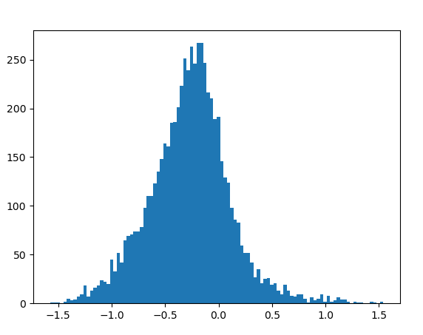
Estimate $σ_{m}$ and $σ_{c}$
Procedure:
fit 50 event in each of the 4 categories, minimizing residuals squared
For each trace with both simulated and observed peaks above 100 adc units, and where the observed and actual peak are no more than 3 time bins apart:
Calculate 2*(simulated_peak – observed_peak)/(simulated + observed)
Assume $σ_{m}$ is the standard deviation of this array
Perform maximum likelihood to determin $σ_{c}$
Result:
$σ_{m}=0.382$, $σ_{c}=16.9$
Mean=-0.27 (why isn’t this 0?)
Increasing threshold for selecting peaks reduces offset towards 0
Standard deviation=0.382

Slide 6
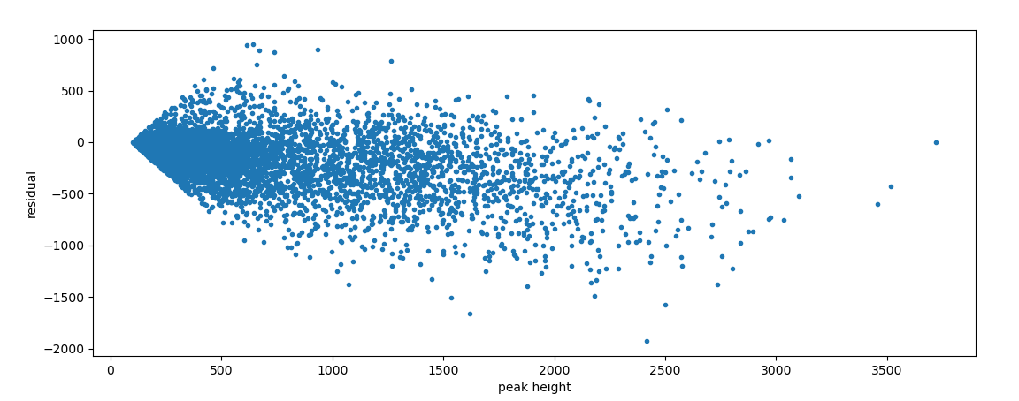
Simulated values 19% smaller
Could be adc scale, pressure, or shaping time
Bad background subtraction?

Slide 7
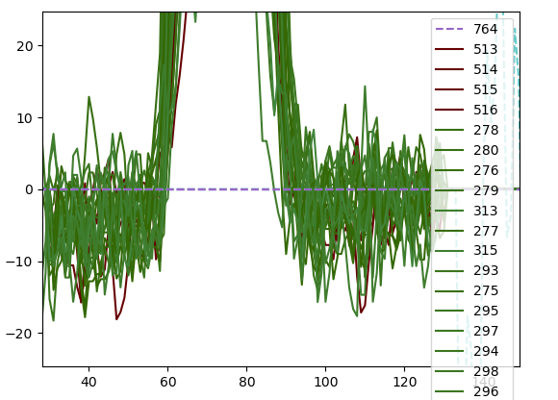
Background subtraction ok
Certainly not 45 adc counts off

Slide 8
2 Particle Events

Slide 9
Candidate Images from Tyler
These are not event numbers. The image numbers seem to be from run_0124/len900_ic6000000_pads5_eps1_samps1_poly2. Conversion to event numbers is on the right.:
Image # | Event # | Notes
47081 | 87480 | High z, hard to tell what’s going on
10451 | 19699 | Small peak part way along the track
27734 | 51777 | Peak part way along track, nice otherwise
36513 | 68192 | Nice candidate event
36455 | 68087
5501 | 10356
11453 | 21640
51906 | 96369
11465 | 21662
13910 | 26303
27058 | 50543
14332
39948
13392
20716
56386
23388
27860
51511
52912

Slide 11
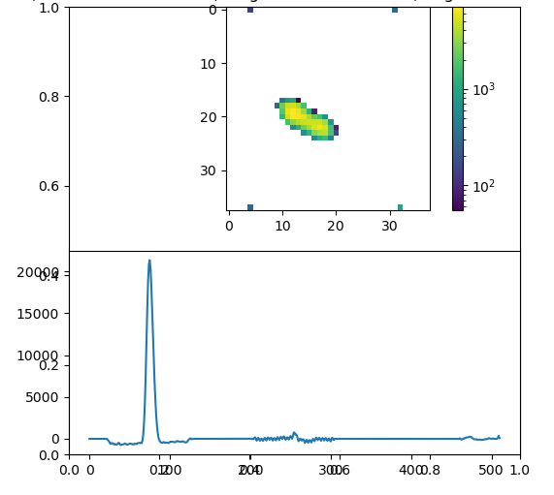
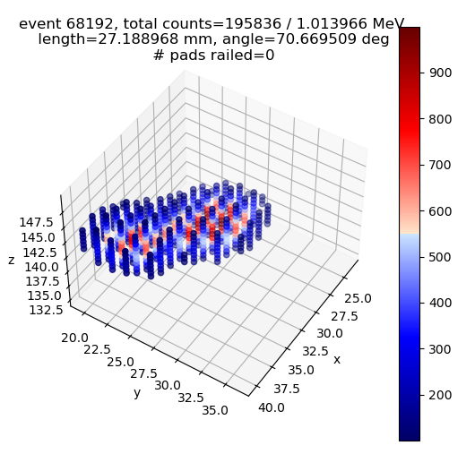
Event 68192

Slide 12
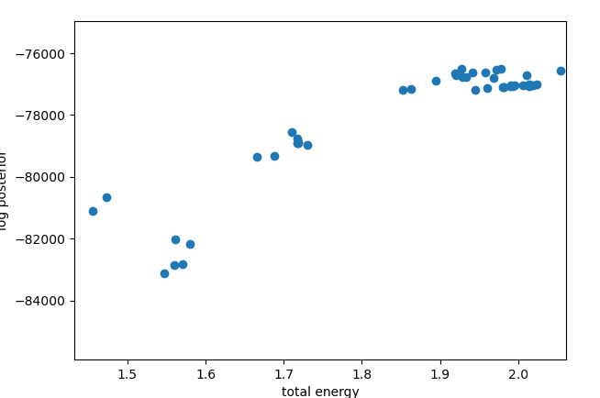
Event 68129 after 600 steps
This blob is in the right place
For 21Mg p-alpha

