Slide 1
E21010 for LECM

Slide 2
Notes:
https://www.linkedin.com/posts/department-of-physics-and-astronomy-aarhus-university_our-professor-hans-fynbo-and-two-phd-students-activity-7081906137096171520-x2PP?utm_source=share&utm_medium=member_desktop

Slide 3
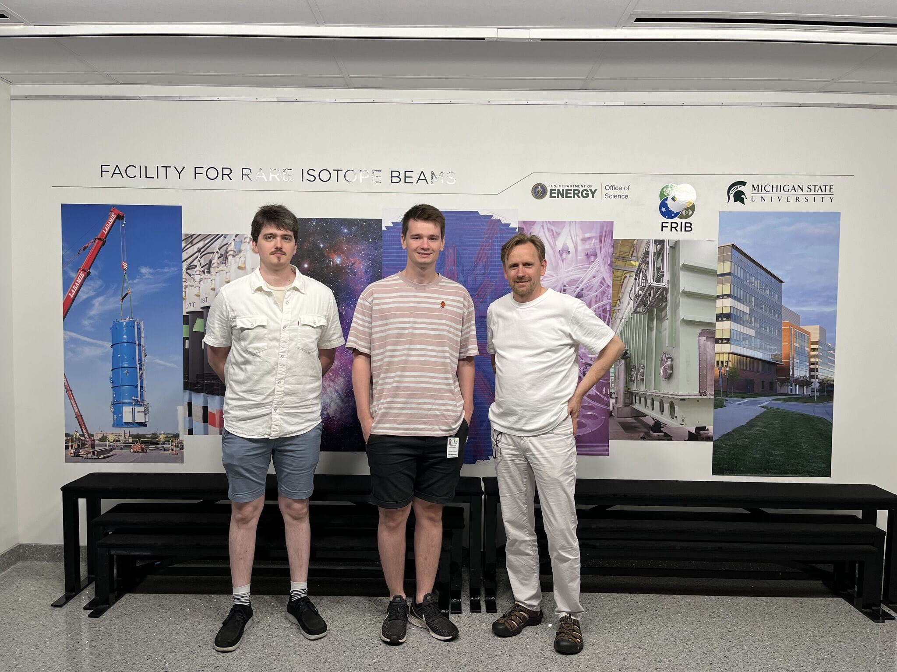

Slide 4
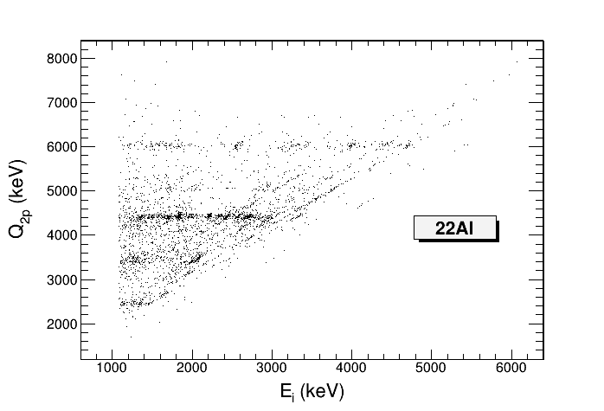
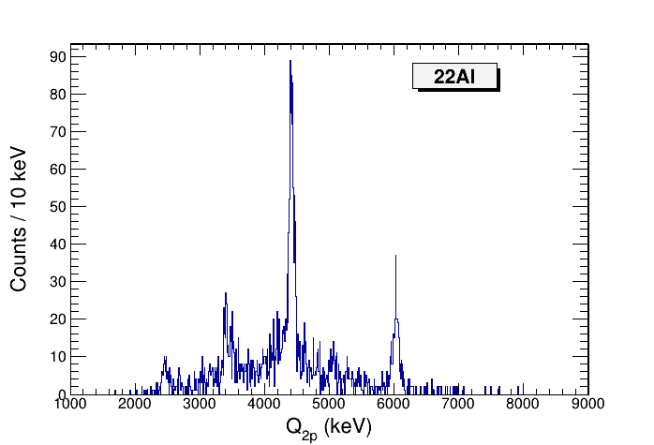
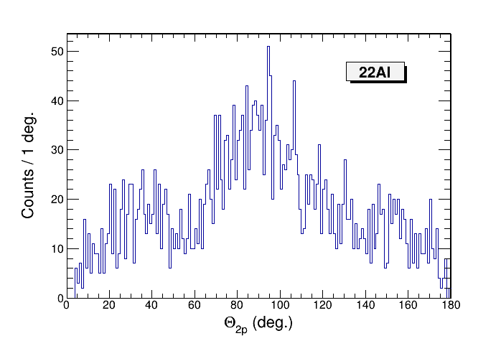
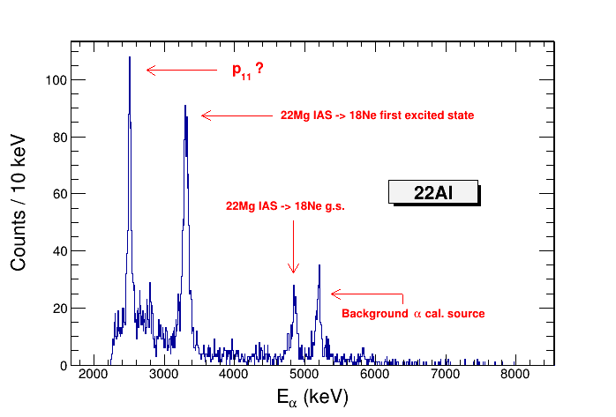
²²Al 28 hours of effective beam time

Slide 5
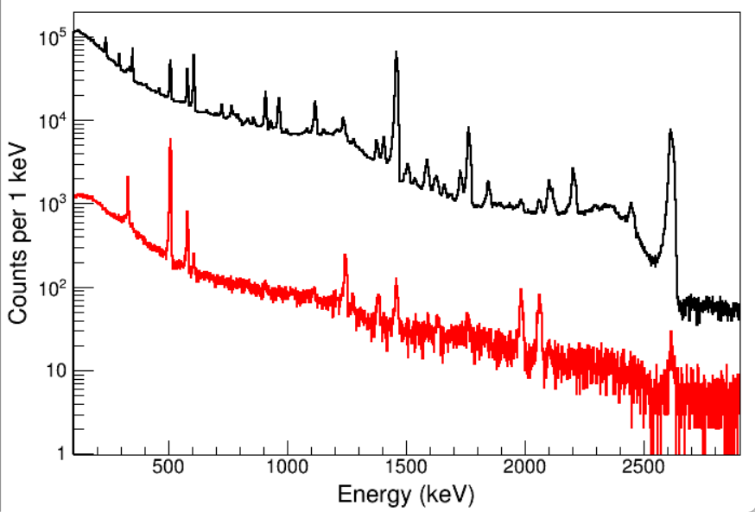
Raw γ-ray spectrum
Si Cube gated γ-ray spectrum
²²Al 28 hours of effective beam time

Slide 6
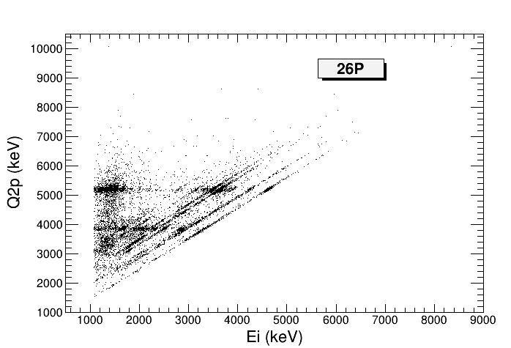
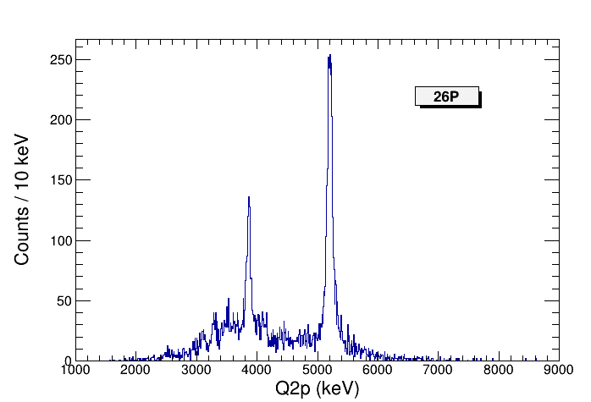
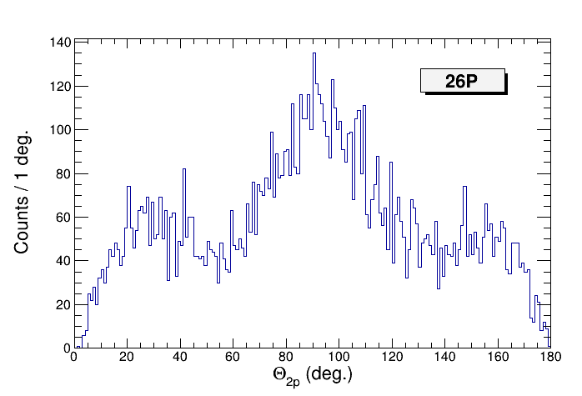
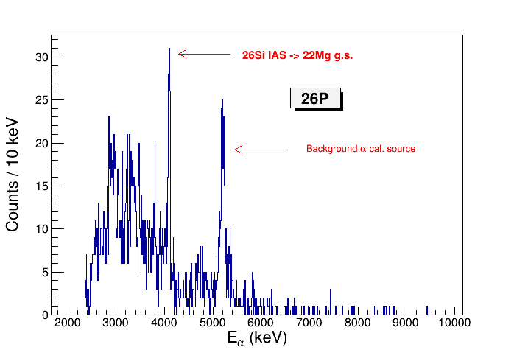
²⁶P 24 hours of effective beam time

Slide 7
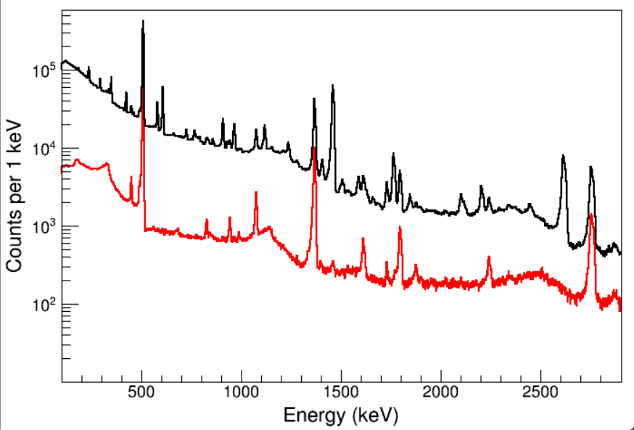
Raw γ-ray spectrum
Si Cube gated γ-ray spectrum
²⁶P 24 hours of effective beam time
Notes:
root -l sum_085_117_sorted.root
TH1F *hbG = new TH1F("hbG","hbG",8000,10,4010);
hbG->Add(hbG,hbG0);
hbG->Add(hbG,hbG1);
hbG->Rebin(2);
hbG->SetLineColor(2);
hbG->Draw();
TH1F *hG = new TH1F("hG","hG",8000,10,4010);
hG->Add(hG,hG0);
hG->Add(hG,hG1);
hG->Rebin(2);
hG->SetLineColor(1);
hG->Draw("same");

Slide 8
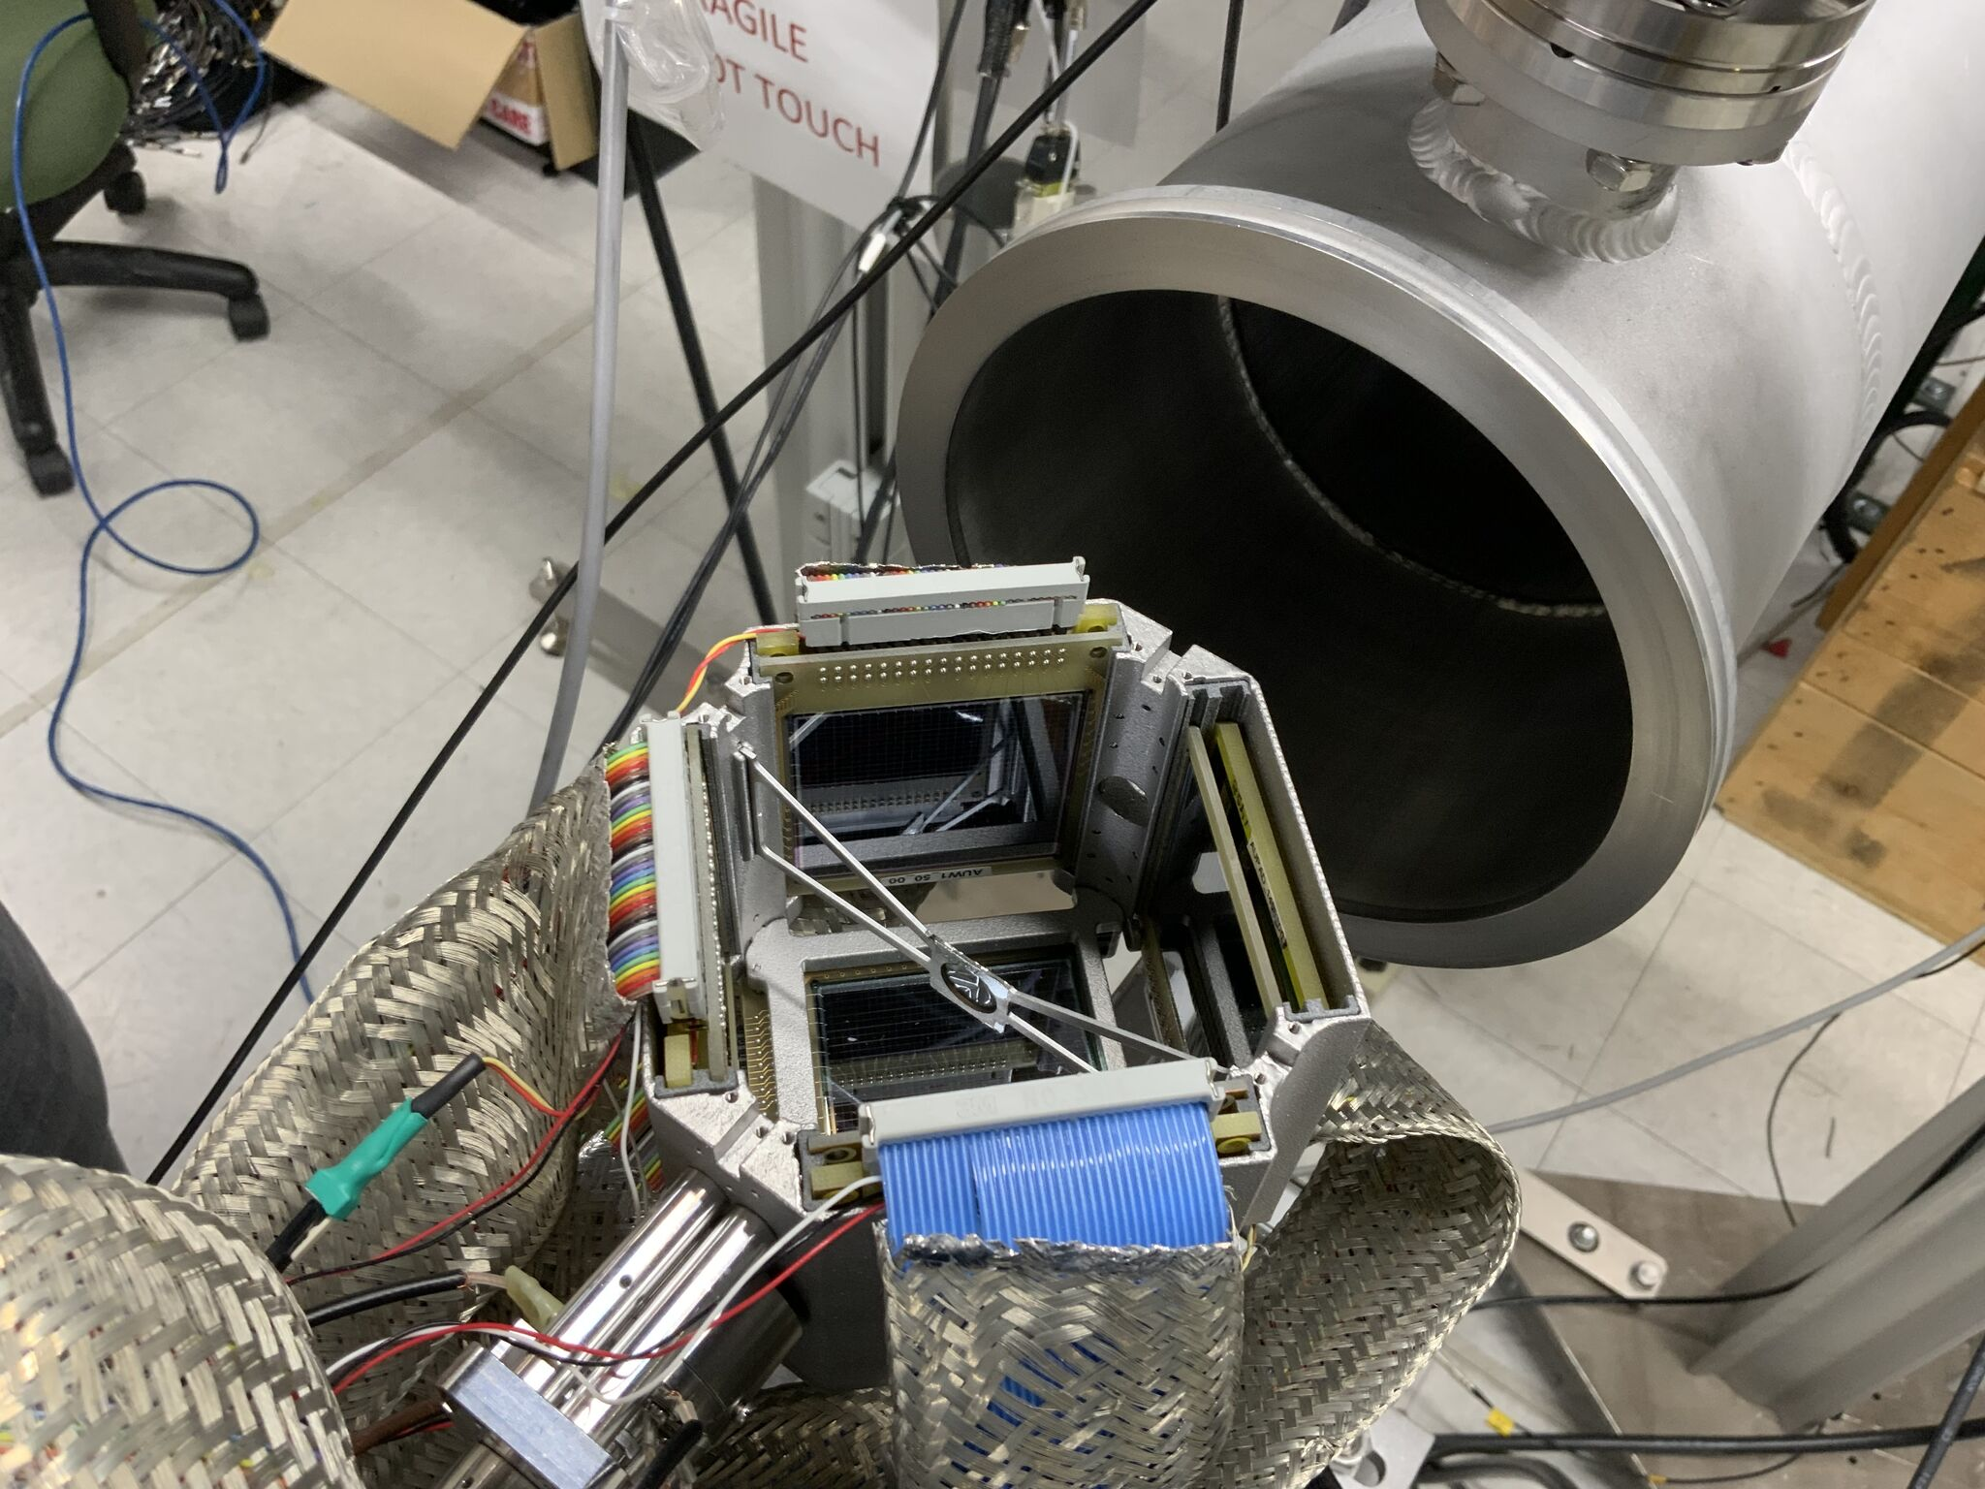

Slide 9
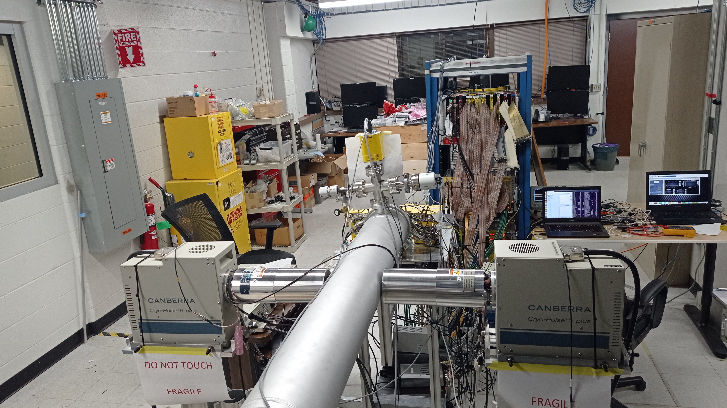

Slide 10
