Slide 1
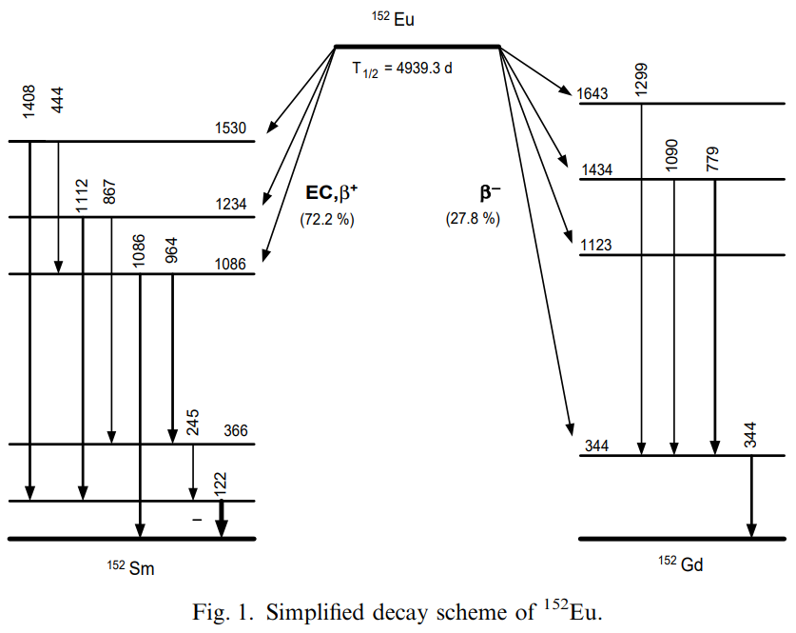
Notes:
Decay scheme of 152Eu
152Eu decay scheme

Slide 2
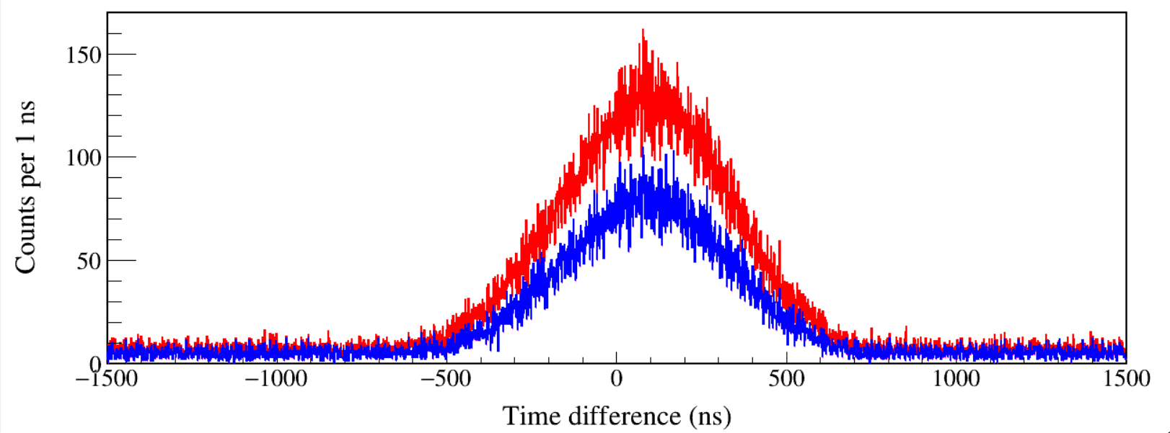
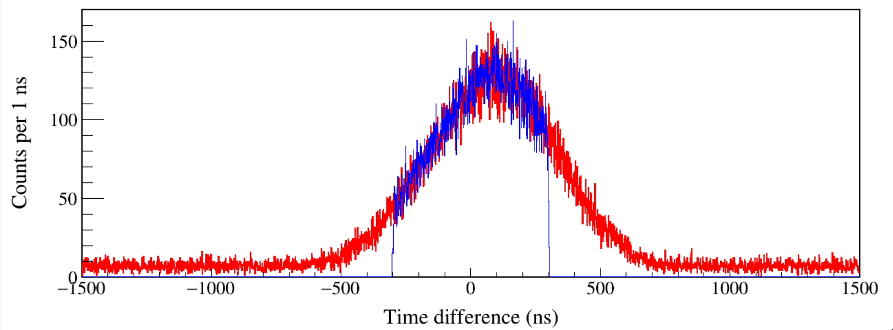
North_t – South_t
Run0204
Event build window 1.5 μs
100-1600 keV
130-1600 keV
North_t – South_t
Run0204
Event build window 1.5 μs
Run0205
Event build window 0.3 μs
Notes:
TFile *_file0 = TFile::Open("F:/e21010/pxct/run0204_XtRa_152Eu_Z2707_inChamber_vacuum_XtRa_12mm_away_window1.5us_CFDdelay_adjusted_cal.root");
TCanvas* canvaspeak = new TCanvas("canvaspeak", "canvaspeak", 1300, 800);//建立画布
canvaspeak->cd();//进入画布
canvaspeak->SetTopMargin(0.03);
canvaspeak->SetRightMargin(0.04);
canvaspeak->SetLeftMargin(0.13);
canvaspeak->SetBottomMargin(0.16);
canvaspeak->SetFrameLineWidth(2);
TH1D* htimestamps = new TH1D("htimestamps", "htimestamps", 3000,-1500,1500);
htimestamps->SetLineWidth(2);
htimestamps->Rebin(1);
htimestamps->SetStats(0);
htimestamps->SetTitle("");
htimestamps->GetXaxis()->SetTitle("Time difference (ns)");//轴名
htimestamps->GetYaxis()->SetTitle("Counts per 1 ns");//轴名
htimestamps->GetXaxis()->CenterTitle();//居中
htimestamps->GetYaxis()->CenterTitle();//居中
htimestamps->GetXaxis()->SetLabelFont(132);//坐标字体
htimestamps->GetYaxis()->SetLabelFont(132);//坐标字体
htimestamps->GetXaxis()->SetLabelSize(0.06);
htimestamps->GetYaxis()->SetLabelSize(0.06);
htimestamps->GetXaxis()->SetTitleFont(132);//轴名字体
htimestamps->GetYaxis()->SetTitleFont(132);//轴名字体
htimestamps->GetXaxis()->SetTitleOffset(1.1);//轴名偏移
htimestamps->GetYaxis()->SetTitleOffset(0.95);//轴名偏移
htimestamps->GetXaxis()->SetTitleSize(0.07);
htimestamps->GetYaxis()->SetTitleSize(0.07);
//htimestamps->GetXaxis()->SetRangeUser(-850,550);
//htimestamps->GetYaxis()->SetRangeUser(0,1700);
htimestamps->GetYaxis()->SetNdivisions(505);
htimestamps->SetLineWidth(2);
htimestamps->SetLineColor(2);
tree->Draw("north_t-south_t>>htimestamps","north_e>100&&north_e<1600&&south_e>100&&south_e<1600");
tree->SetLineColor(4);
tree->SetLineWidth(2);
tree->Draw("north_t-south_t","north_e>130&&north_e<1600&&south_e>130&&south_e<1600","same");
TFile *_file1 = TFile::Open("F:/e21010/pxct/run0205_XtRa_152Eu_Z2707_inChamber_vacuum_XtRa_12mm_away_window0.3us_CFDdelay_adjusted_cal.root");
tree->SetLineColor(4);
tree->SetLineWidth(1);
tree->Draw("north_t-south_t","north_e>100&&north_e<1600&&south_e>100&&south_e<1600","same");

Slide 3
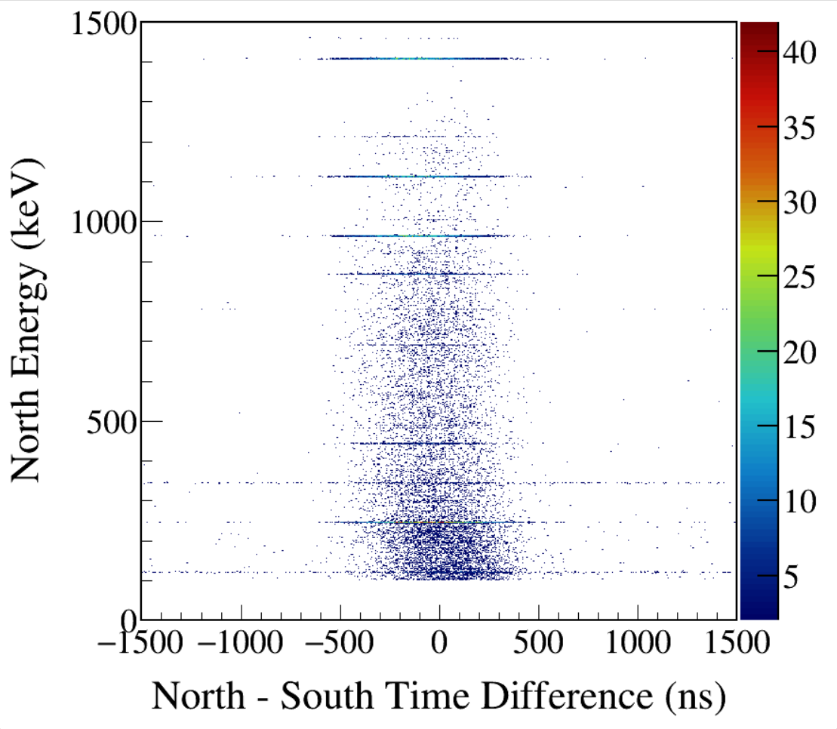
South 122-keV γ gated
1408
1213
1112
964
867
444
344
245
122
Notes:
TFile *_file0 = TFile::Open("F:/e21010/pxct/run0097_98_LEGe_XtRa_152Eu_inChamber_window1.5us_CFDdelay_adjusted_930min_efficiency_cal.root");
TCanvas* canvaspeak = new TCanvas("canvaspeak", "canvaspeak", 890, 800);
canvaspeak->cd();
canvaspeak->SetTopMargin(0.03);
canvaspeak->SetRightMargin(0.12);
canvaspeak->SetLeftMargin(0.17);
canvaspeak->SetBottomMargin(0.15);
canvaspeak->SetFrameLineWidth(2);
//canvaspeak->SetLogz();
TH2D* het = new TH2D("het", "het", 500,-1500,1500,750,0,1500); //x,y
tree->Draw("north_e:north_t-south_t>>het","north_e>100&&north_e<1500&&south_e>120&&south_e<123","colz"); //y:x
het->SetStats(0);
het->SetTitle("");
het->GetXaxis()->SetTitle("North - South Time Difference (ns)");
het->GetYaxis()->SetTitle("North Energy (keV)");
het->GetXaxis()->CenterTitle();
het->GetYaxis()->CenterTitle();
het->GetXaxis()->SetLabelFont(132);
het->GetYaxis()->SetLabelFont(132);
het->GetXaxis()->SetLabelSize(0.05);
het->GetYaxis()->SetLabelSize(0.05);
het->GetXaxis()->SetTitleFont(132);
het->GetYaxis()->SetTitleFont(132);
het->GetXaxis()->SetTitleOffset(1.1);
het->GetYaxis()->SetTitleOffset(1.4);
het->GetXaxis()->SetTitleSize(0.06);
het->GetYaxis()->SetTitleSize(0.06);
het->GetYaxis()->SetNdivisions(505);
//het->GetXaxis()->SetRangeUser(2001,4500);
//het->GetYaxis()->SetRangeUser(1000,2800);
het->SetMinimum(2);
//het->SetMaximum(100);
het->SetContour(99);
gStyle->SetPalette(kRainbow);
TPaletteAxis *palette = (TPaletteAxis*)het->GetListOfFunctions()->FindObject("palette");
palette->SetTitleFont(132);
palette->SetTitleSize(0.05);
palette->SetLabelFont(132);
palette->SetLabelSize(0.05);
palette->SetLineWidth(2);

Slide 4
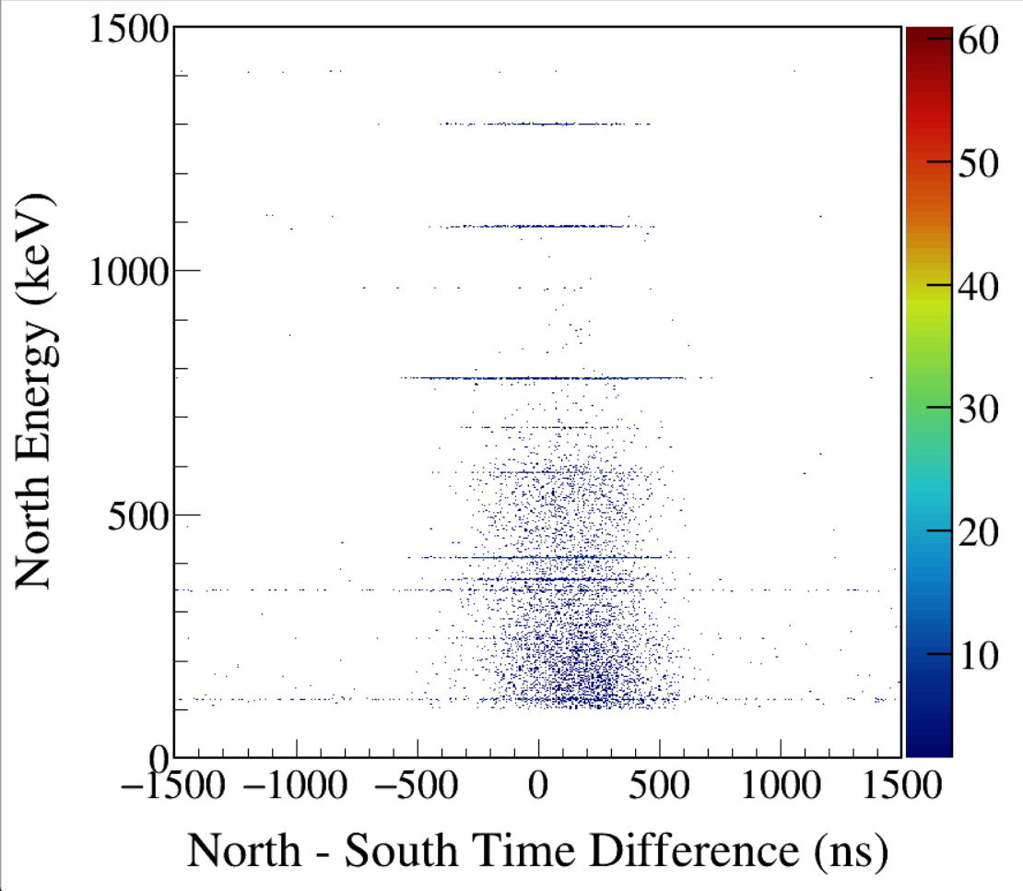
South 344-keV γ gated
1299
1089
779
411
344
122
Notes:
TFile *_file0 = TFile::Open("F:/e21010/pxct/run0097_98_LEGe_XtRa_152Eu_inChamber_window1.5us_CFDdelay_adjusted_930min_efficiency_cal.root");
TCanvas* canvaspeak = new TCanvas("canvaspeak", "canvaspeak", 890, 800);
canvaspeak->cd();
canvaspeak->SetTopMargin(0.03);
canvaspeak->SetRightMargin(0.12);
canvaspeak->SetLeftMargin(0.17);
canvaspeak->SetBottomMargin(0.15);
canvaspeak->SetFrameLineWidth(2);
//canvaspeak->SetLogz();
TH2D* het = new TH2D("het", "het", 500,-1500,1500,750,0,1500); //x,y
tree->Draw("north_e:north_t-south_t>>het","north_e>100&&north_e<1500&&south_e>342&&south_e<346","colz"); //y:x
het->SetStats(0);
het->SetTitle("");
het->GetXaxis()->SetTitle("North - South Time Difference (ns)");
het->GetYaxis()->SetTitle("North Energy (keV)");
het->GetXaxis()->CenterTitle();
het->GetYaxis()->CenterTitle();
het->GetXaxis()->SetLabelFont(132);
het->GetYaxis()->SetLabelFont(132);
het->GetXaxis()->SetLabelSize(0.05);
het->GetYaxis()->SetLabelSize(0.05);
het->GetXaxis()->SetTitleFont(132);
het->GetYaxis()->SetTitleFont(132);
het->GetXaxis()->SetTitleOffset(1.1);
het->GetYaxis()->SetTitleOffset(1.4);
het->GetXaxis()->SetTitleSize(0.06);
het->GetYaxis()->SetTitleSize(0.06);
het->GetYaxis()->SetNdivisions(505);
//het->GetXaxis()->SetRangeUser(2001,4500);
//het->GetYaxis()->SetRangeUser(1000,2800);
het->SetMinimum(2);
//het->SetMaximum(100);
het->SetContour(99);
gStyle->SetPalette(kRainbow);
TPaletteAxis *palette = (TPaletteAxis*)het->GetListOfFunctions()->FindObject("palette");
palette->SetTitleFont(132);
palette->SetTitleSize(0.05);
palette->SetLabelFont(132);
palette->SetLabelSize(0.05);
palette->SetLineWidth(2);

Slide 5
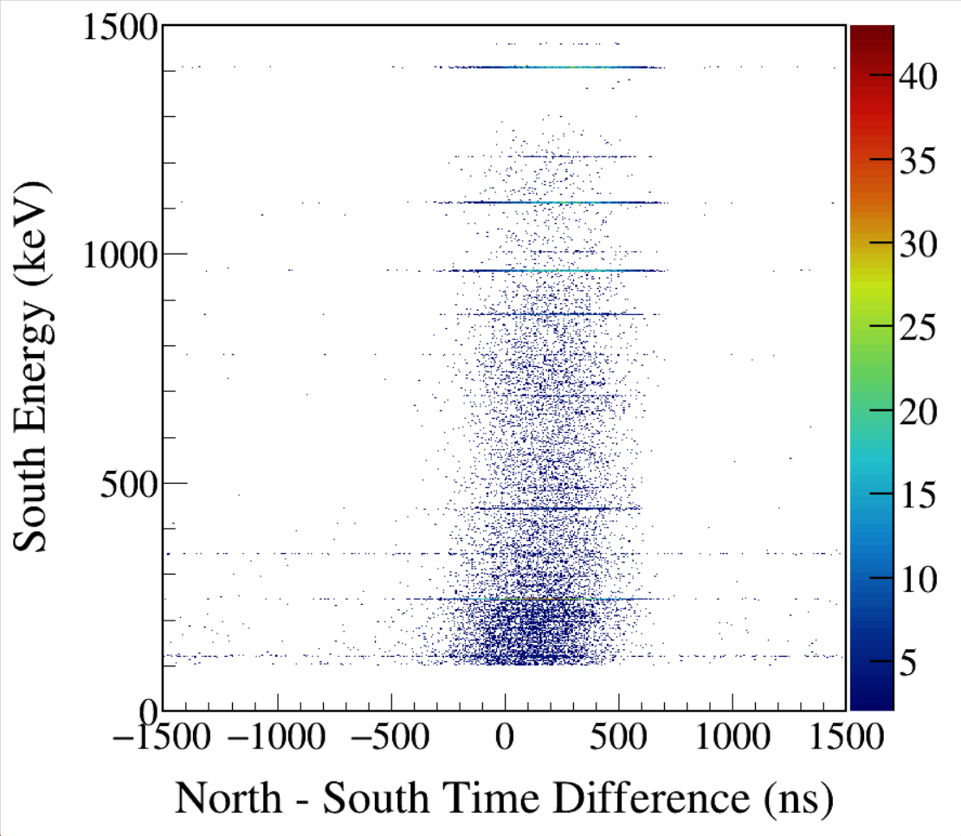
North 122-keV γ gated
1408
1213
1112
964
867
444
344
245
122
Notes:
TFile *_file0 = TFile::Open("F:/e21010/pxct/run0097_98_LEGe_XtRa_152Eu_inChamber_window1.5us_CFDdelay_adjusted_930min_efficiency_cal.root");
TCanvas* canvaspeak = new TCanvas("canvaspeak", "canvaspeak", 890, 800);
canvaspeak->cd();
canvaspeak->SetTopMargin(0.03);
canvaspeak->SetRightMargin(0.12);
canvaspeak->SetLeftMargin(0.17);
canvaspeak->SetBottomMargin(0.15);
canvaspeak->SetFrameLineWidth(2);
//canvaspeak->SetLogz();
TH2D* het = new TH2D("het", "het", 500,-1500,1500,750,0,1500); //x,y
tree->Draw("south_e:north_t-south_t>>het","north_e>120&&north_e<123&&south_e>100&&south_e<1500","colz"); //y:x
het->SetStats(0);
het->SetTitle("");
het->GetXaxis()->SetTitle("North - South Time Difference (ns)");
het->GetYaxis()->SetTitle("South Energy (keV)");
het->GetXaxis()->CenterTitle();
het->GetYaxis()->CenterTitle();
het->GetXaxis()->SetLabelFont(132);
het->GetYaxis()->SetLabelFont(132);
het->GetXaxis()->SetLabelSize(0.05);
het->GetYaxis()->SetLabelSize(0.05);
het->GetXaxis()->SetTitleFont(132);
het->GetYaxis()->SetTitleFont(132);
het->GetXaxis()->SetTitleOffset(1.1);
het->GetYaxis()->SetTitleOffset(1.4);
het->GetXaxis()->SetTitleSize(0.06);
het->GetYaxis()->SetTitleSize(0.06);
het->GetYaxis()->SetNdivisions(505);
//het->GetXaxis()->SetRangeUser(2001,4500);
//het->GetYaxis()->SetRangeUser(1000,2800);
het->SetMinimum(2);
//het->SetMaximum(100);
het->SetContour(99);
gStyle->SetPalette(kRainbow);
TPaletteAxis *palette = (TPaletteAxis*)het->GetListOfFunctions()->FindObject("palette");
palette->SetTitleFont(132);
palette->SetTitleSize(0.05);
palette->SetLabelFont(132);
palette->SetLabelSize(0.05);
palette->SetLineWidth(2);

Slide 6
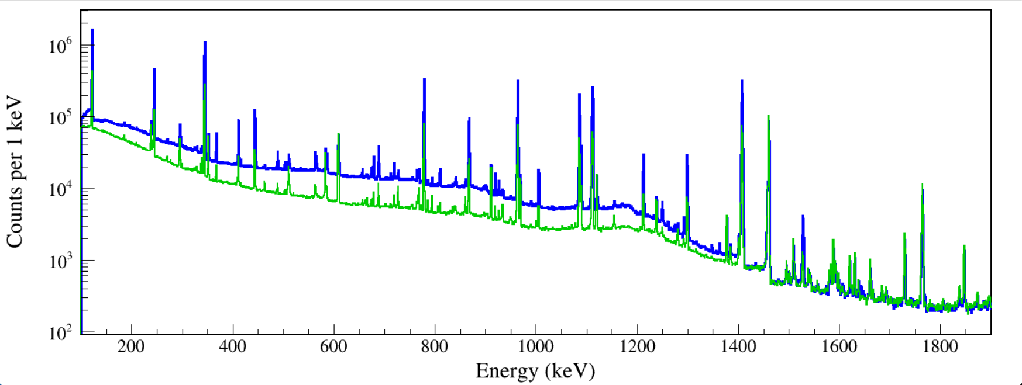
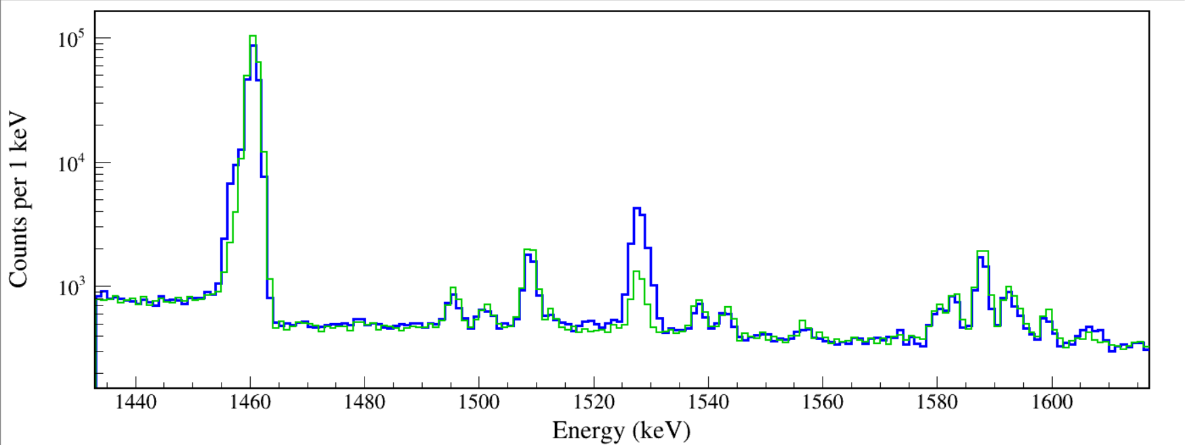
Source-to-South Distance
157 mm 13.54 hours
365 mm 13.54 hours
Bkg peaks: same
Decay peaks: ↓5.4
Sum peaks: ↓29
¹⁵²Sm
122+1408
¹⁵²Sm
1528
Notes:
TFile *_file0 = TFile::Open("run0205_0212_XtRa_152Eu_Z2707_inChamber_vacuum_XtRa_12mm_away_window0.3us_CFDdelay_adjusted_cal.root");
TCanvas* canvaspeak = new TCanvas("XtRa", "XtRa", 1400, 553);//建立画布
canvaspeak->cd();//进入画布
canvaspeak->SetTopMargin(0.025);
canvaspeak->SetRightMargin(0.03);
canvaspeak->SetLeftMargin(0.08);
canvaspeak->SetBottomMargin(0.13);
gStyle->SetFrameLineWidth(2);
gPad->SetLogy();
TH1D* he = new TH1D("he", "he", 2005,95,2100);
tree->Draw("south_e>>he","south_t>0&&south_t<48759000000000&&south_e>95");
he->SetLineColor(4);
he->SetLineWidth(3);
he->SetStats(0);
he->SetTitle("");
he->GetXaxis()->SetTitle("Energy (keV)");//轴名
he->GetYaxis()->SetTitle("Counts per 1 keV");//轴名
he->GetXaxis()->CenterTitle();//居中
he->GetYaxis()->CenterTitle();//居中
he->GetXaxis()->SetLabelFont(132);//坐标字体
he->GetYaxis()->SetLabelFont(132);//坐标字体
he->GetXaxis()->SetLabelSize(0.05);
he->GetYaxis()->SetLabelSize(0.05);
he->GetXaxis()->SetTitleFont(132);//轴名字体
he->GetYaxis()->SetTitleFont(132);//轴名字体
he->GetXaxis()->SetTitleOffset(1.0);//轴名偏移
he->GetYaxis()->SetTitleOffset(0.66);//轴名偏移
he->GetXaxis()->SetTitleSize(0.06);
he->GetYaxis()->SetTitleSize(0.06);
he->GetYaxis()->SetTickLength(0.015);
he->GetXaxis()->SetRangeUser(100,1900);
//he->GetYaxis()->SetRangeUser(5,4000000);
TFile *_file1 = TFile::Open("run0206_0207_XtRa_152Eu_Z2707_inChamber_vacuum_XtRa_220mm_away_window0.3us_CFDdelay_adjusted_cal.root");
tree->SetLineColor(kGreen+1);
tree->SetLineWidth(2);
tree->Draw("south_e","south_t>0&&south_t<48759000000000&&south_e>100","same");
gPad->RedrawAxis();

Slide 7
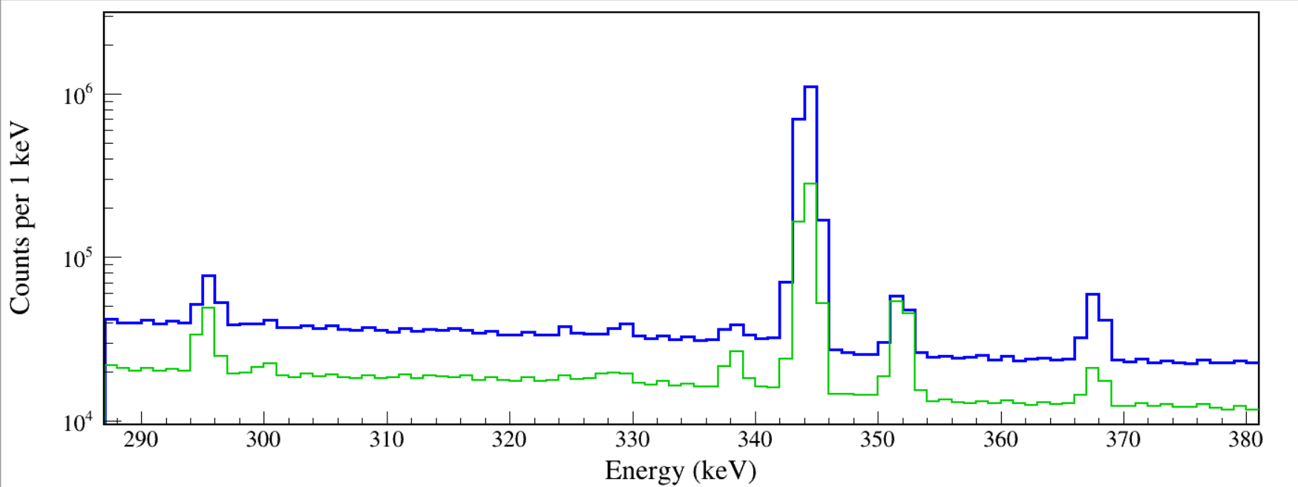
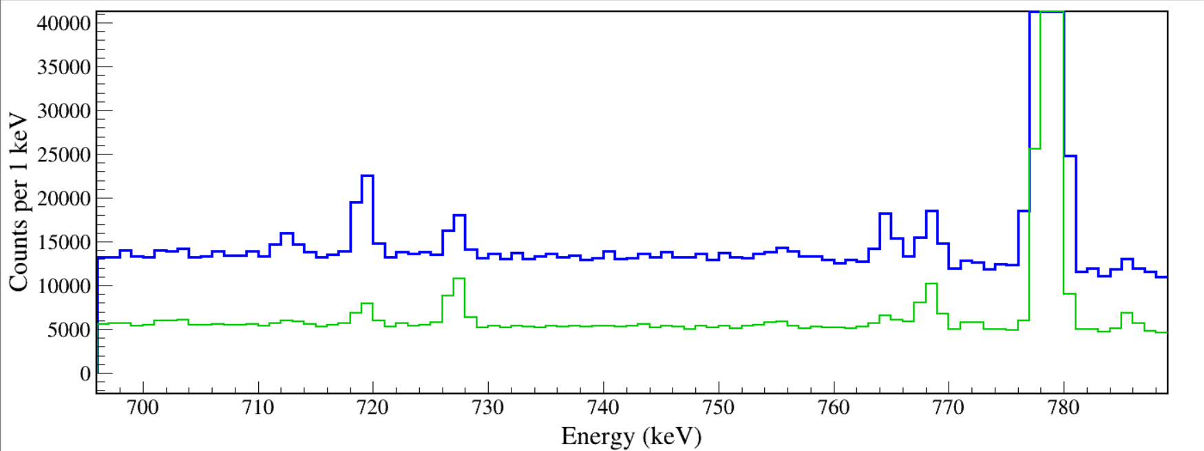
¹⁵²Sm
122+245
¹⁵²Gd
367
¹⁵²Sm
756
¹⁵²Gd
344+411

Slide 8
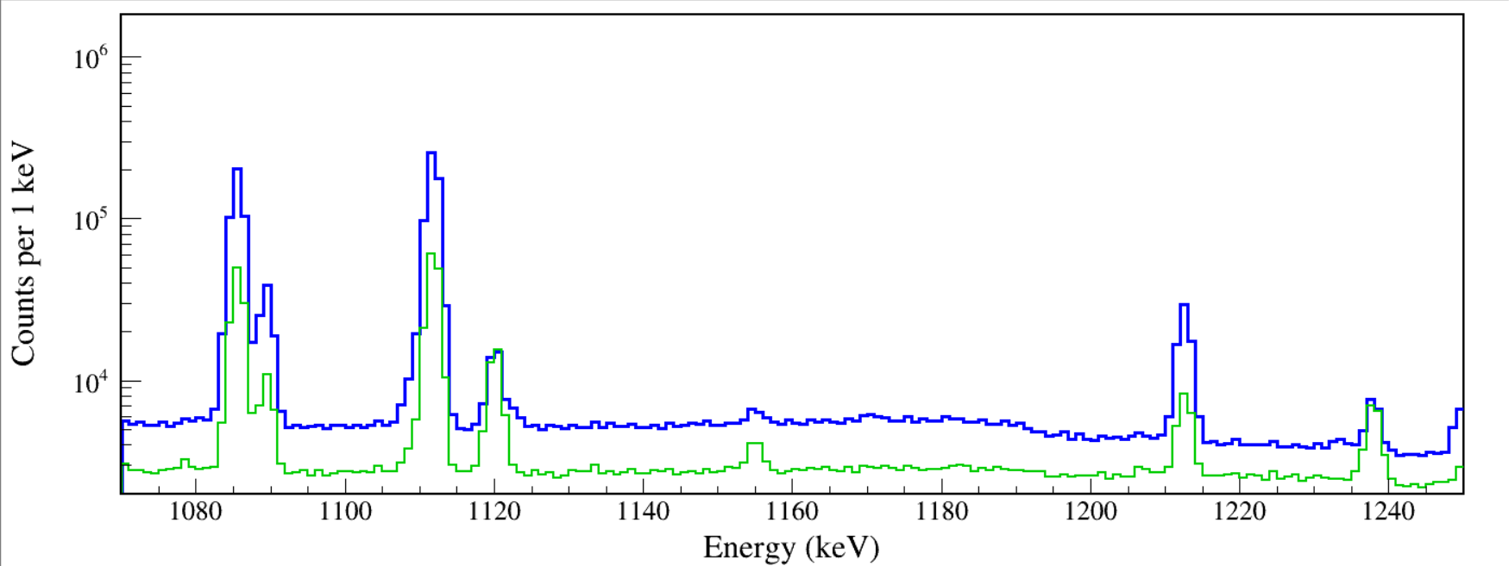
¹⁵²Sm
964+122
¹⁵²Sm
1085
¹⁵²Gd
1089
¹⁵²Gd
779+344
²¹⁴Po
1120
¹⁵²Sm
1112+122
²¹⁴Po
1238
We must account for all coincidences whether giving rise to a sum peak count or not.
Notes:
inconclusive evidence/results/tests

Slide 9
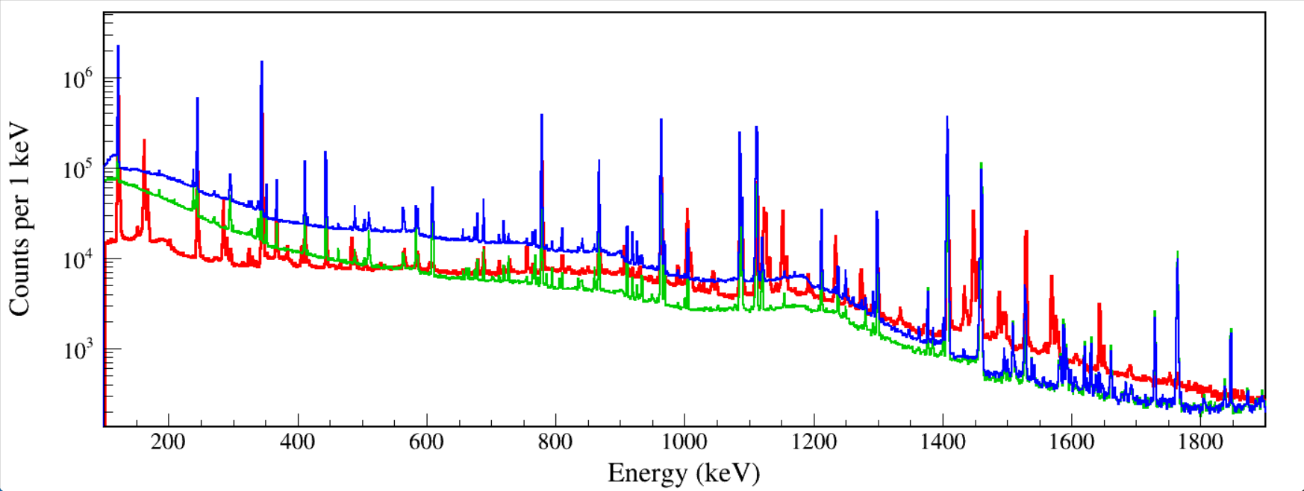
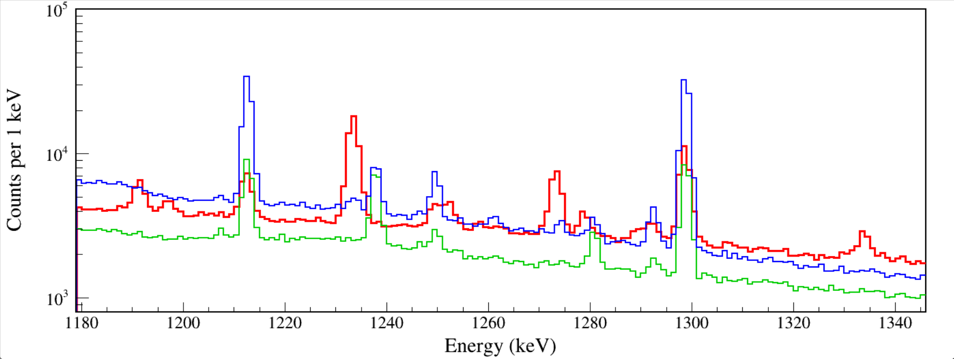
157 mm 13.54 hours PXCT
365 mm 13.54 hours Summing-free
7 mm 0.38 hours Extreme Summing
¹⁵²Sm
1112+122
²¹⁴Po
1238
Notes:
TFile *_file0 = TFile::Open("F:/e21010/pxct/run0213_North_152Eu_Z2707_On_Cap_window0.02us_CFDdelay_adjusted_Extreme_Summing_for_fun_cal.root");
TCanvas* canvaspeak = new TCanvas("XtRa", "XtRa", 1400, 553);//建立画布
canvaspeak->cd();//进入画布
canvaspeak->SetTopMargin(0.025);
canvaspeak->SetRightMargin(0.03);
canvaspeak->SetLeftMargin(0.08);
canvaspeak->SetBottomMargin(0.13);
gStyle->SetFrameLineWidth(2);
gPad->SetLogy();
TH1D* he = new TH1D("he", "he", 2005,95,2100);
tree->Draw("north_e>>he","north_t>0&&north_t<48759000000000&&north_e>95");
he->SetLineColor(2);
he->SetLineWidth(3);
he->SetStats(0);
he->SetTitle("");
he->GetXaxis()->SetTitle("Energy (keV)");//轴名
he->GetYaxis()->SetTitle("Counts per 1 keV");//轴名
he->GetXaxis()->CenterTitle();//居中
he->GetYaxis()->CenterTitle();//居中
he->GetXaxis()->SetLabelFont(132);//坐标字体
he->GetYaxis()->SetLabelFont(132);//坐标字体
he->GetXaxis()->SetLabelSize(0.05);
he->GetYaxis()->SetLabelSize(0.05);
he->GetXaxis()->SetTitleFont(132);//轴名字体
he->GetYaxis()->SetTitleFont(132);//轴名字体
he->GetXaxis()->SetTitleOffset(1.0);//轴名偏移
he->GetYaxis()->SetTitleOffset(0.66);//轴名偏移
he->GetXaxis()->SetTitleSize(0.06);
he->GetYaxis()->SetTitleSize(0.06);
he->GetYaxis()->SetTickLength(0.015);
he->GetXaxis()->SetRangeUser(100,1900);
//he->GetYaxis()->SetRangeUser(5,4000000);
TFile *_file1 = TFile::Open("F:/e21010/pxct/run0206_0207_XtRa_152Eu_Z2707_inChamber_vacuum_XtRa_220mm_away_window0.3us_CFDdelay_adjusted_cal.root");
tree->SetLineColor(kGreen+1);
tree->SetLineWidth(2);
tree->Draw("north_e","north_t>0&&north_t<48759000000000&&north_e>100","same");
gPad->RedrawAxis();
TFile *_file2 = TFile::Open("F:/e21010/pxct/run0205_0212_XtRa_152Eu_Z2707_inChamber_vacuum_XtRa_12mm_away_window0.3us_CFDdelay_adjusted_cal.root");
tree->SetLineColor(kBlue);
tree->SetLineWidth(2);
tree->Draw("north_e","north_t>0&&north_t<48759000000000&&north_e>100","same");
gPad->RedrawAxis();

Slide 10
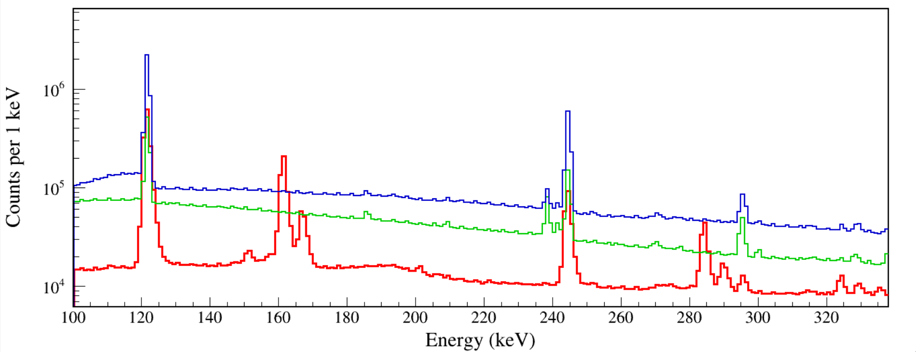
¹⁵²Sm
122+K_{α},K_{β}
¹⁵²Sm
122+K_{α},K_{β}
Notes:
TFile *_file0 = TFile::Open("F:/e21010/pxct/run0213_North_152Eu_Z2707_On_Cap_window0.02us_CFDdelay_adjusted_Extreme_Summing_for_fun_cal.root");
TCanvas* canvaspeak = new TCanvas("XtRa", "XtRa", 1400, 553);//建立画布
canvaspeak->cd();//进入画布
canvaspeak->SetTopMargin(0.025);
canvaspeak->SetRightMargin(0.03);
canvaspeak->SetLeftMargin(0.08);
canvaspeak->SetBottomMargin(0.13);
gStyle->SetFrameLineWidth(2);
gPad->SetLogy();
TH1D* he = new TH1D("he", "he", 2005,95,2100);
tree->Draw("north_e>>he","north_t>0&&north_t<48759000000000&&north_e>95");
he->SetLineColor(2);
he->SetLineWidth(3);
he->SetStats(0);
he->SetTitle("");
he->GetXaxis()->SetTitle("Energy (keV)");//轴名
he->GetYaxis()->SetTitle("Counts per 1 keV");//轴名
he->GetXaxis()->CenterTitle();//居中
he->GetYaxis()->CenterTitle();//居中
he->GetXaxis()->SetLabelFont(132);//坐标字体
he->GetYaxis()->SetLabelFont(132);//坐标字体
he->GetXaxis()->SetLabelSize(0.05);
he->GetYaxis()->SetLabelSize(0.05);
he->GetXaxis()->SetTitleFont(132);//轴名字体
he->GetYaxis()->SetTitleFont(132);//轴名字体
he->GetXaxis()->SetTitleOffset(1.0);//轴名偏移
he->GetYaxis()->SetTitleOffset(0.66);//轴名偏移
he->GetXaxis()->SetTitleSize(0.06);
he->GetYaxis()->SetTitleSize(0.06);
he->GetYaxis()->SetTickLength(0.015);
he->GetXaxis()->SetRangeUser(100,1900);
//he->GetYaxis()->SetRangeUser(5,4000000);
TFile *_file1 = TFile::Open("F:/e21010/pxct/run0206_0207_XtRa_152Eu_Z2707_inChamber_vacuum_XtRa_220mm_away_window0.3us_CFDdelay_adjusted_cal.root");
tree->SetLineColor(kGreen+1);
tree->SetLineWidth(2);
tree->Draw("north_e","north_t>0&&north_t<48759000000000&&north_e>100","same");
gPad->RedrawAxis();
TFile *_file2 = TFile::Open("F:/e21010/pxct/run0205_0212_XtRa_152Eu_Z2707_inChamber_vacuum_XtRa_12mm_away_window0.3us_CFDdelay_adjusted_cal.root");
tree->SetLineColor(kBlue);
tree->SetLineWidth(2);
tree->Draw("north_e","north_t>0&&north_t<48759000000000&&north_e>100","same");
gPad->RedrawAxis();

Slide 11
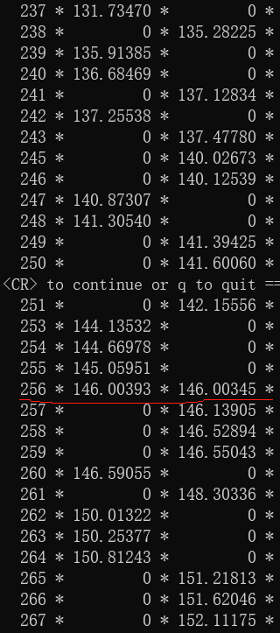
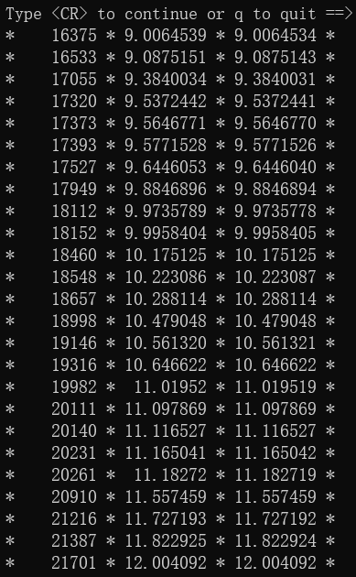
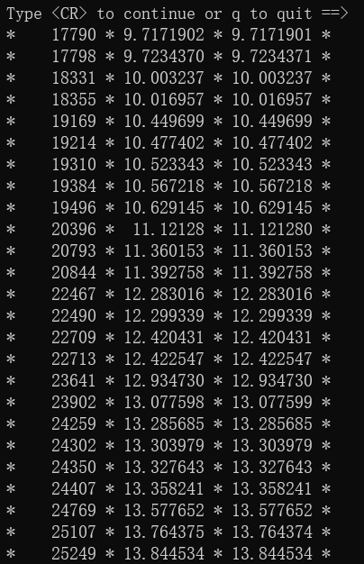
tree->Scan("north_t/1e9:south_t/1e9","north_e>100&&south_e>100")
Run0204
Event build window 1.5 μs
100 coincidences
12 s
tree->Scan("north_t/1e6:south_t/1e6","north_e>100||south_e>100")
Run0205
Event build window 0.3 μs
100 coincidences
13.8 s
Singles: occur once every ms
Coincidences: occur once every 100 ms

Slide 12
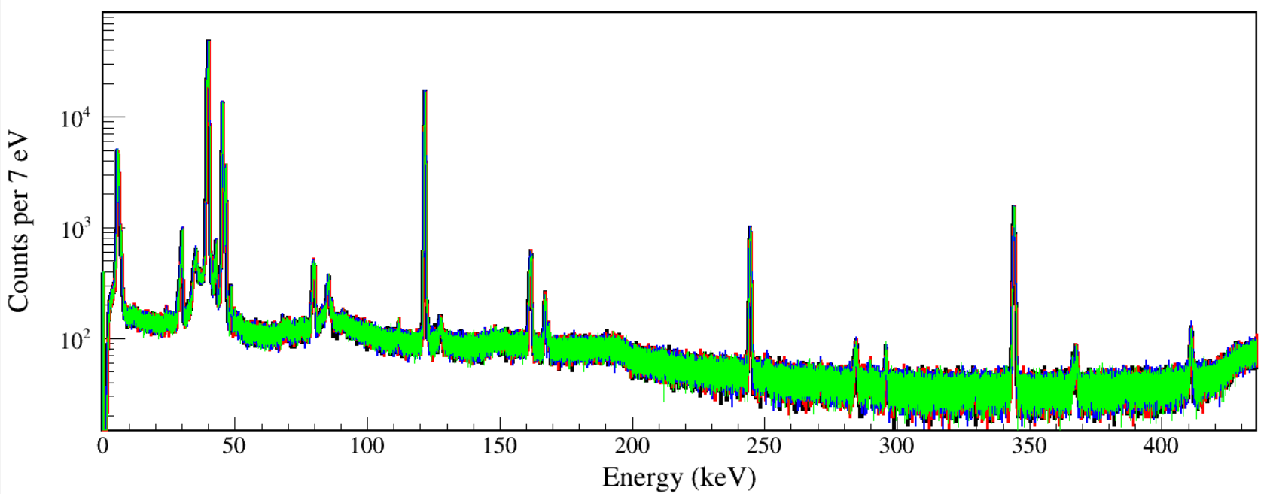
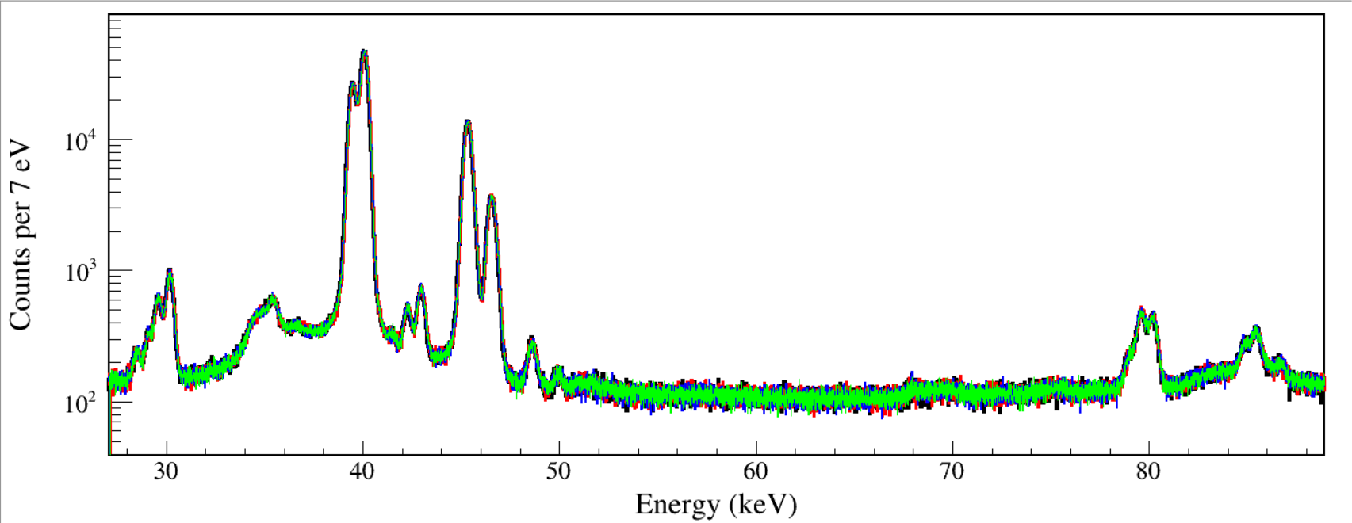
Run0211 event build window 10 us
Run0209 event build window 1.5 us
Run0208 event build window 0.1 us
Run0210 event build window 0.02 us
Sm
Kα
Sm
Kβ
Readout Event Build Window only affects coincidences between detectors and does not affect coincidences in a single detector.
double
Sm
Kα
double
Sm
Kβ
Notes:
TFile *_file0 = TFile::Open("F:/e21010/pxct/run0211_LEGe_152Eu_Z2707_inChamber_vacuum_window10us_CFDdelay_adjusted_cal.root");
TCanvas* canvaspeak = new TCanvas("LEGe", "LEGe", 1400, 553);//建立画布
canvaspeak->cd();//进入画布
canvaspeak->SetTopMargin(0.025);
canvaspeak->SetRightMargin(0.02);
canvaspeak->SetLeftMargin(0.08);
canvaspeak->SetBottomMargin(0.13);
canvaspeak->SetFrameLineWidth(2);
hlege_e->SetLineWidth(4);
hlege_e->Rebin(1);
hlege_e->SetLineColor(1);
hlege_e->SetStats(0);
hlege_e->SetTitle("");
hlege_e->GetXaxis()->SetTitle("Energy (keV)");//轴名
hlege_e->GetYaxis()->SetTitle("Counts per 7 eV");//轴名
hlege_e->GetXaxis()->CenterTitle();//居中
hlege_e->GetYaxis()->CenterTitle();//居中
hlege_e->GetXaxis()->SetLabelFont(132);//坐标字体
hlege_e->GetYaxis()->SetLabelFont(132);//坐标字体
hlege_e->GetXaxis()->SetLabelSize(0.05);
hlege_e->GetYaxis()->SetLabelSize(0.05);
hlege_e->GetXaxis()->SetTitleFont(132);//轴名字体
hlege_e->GetYaxis()->SetTitleFont(132);//轴名字体
hlege_e->GetXaxis()->SetTitleOffset(1.0);//轴名偏移
hlege_e->GetYaxis()->SetTitleOffset(0.66);//轴名偏移
hlege_e->GetXaxis()->SetTitleSize(0.06);
hlege_e->GetYaxis()->SetTitleSize(0.06);
hlege_e->GetYaxis()->SetTickLength(0.02);
//hlege_e->GetXaxis()->SetRangeUser(0,65);
hlege_e->GetYaxis()->SetNdivisions(505);
//hlege_e->GetYaxis()->SetRangeUser(1,20000);
hlege_e->Draw("hist");
TFile *_file1 = TFile::Open("F:/e21010/pxct/run0209_LEGe_152Eu_Z2707_inChamber_vacuum_window1.5us_CFDdelay_adjusted_cal.root");
hlege_e->SetLineColor(2);
hlege_e->SetLineWidth(3);
hlege_e->Draw("same");
TFile *_file2 = TFile::Open("F:/e21010/pxct/run0208_LEGe_152Eu_Z2707_inChamber_vacuum_window0.1us_CFDdelay_adjusted_cal.root");
hlege_e->SetLineColor(4);
hlege_e->SetLineWidth(2);
hlege_e->Draw("same");
TFile *_file3 = TFile::Open("F:/e21010/pxct/run0210_LEGe_152Eu_Z2707_inChamber_vacuum_window0.02us_CFDdelay_adjusted_cal.root");
hlege_e->SetLineColor(3);
hlege_e->SetLineWidth(1);
hlege_e->Draw("same");

Slide 13
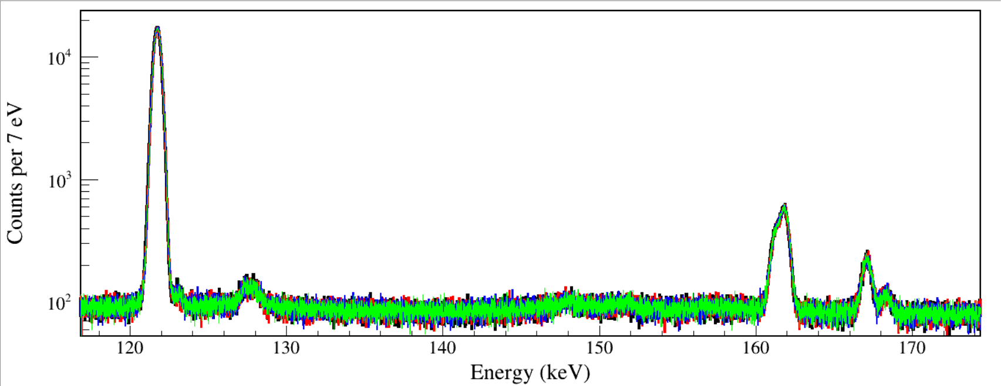
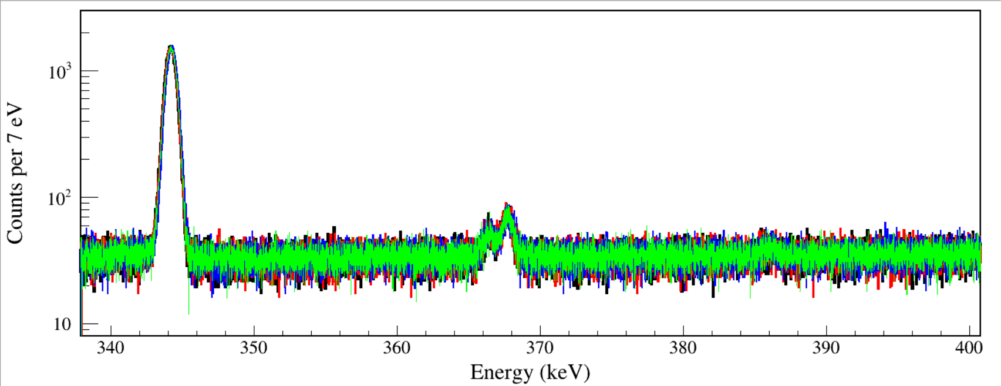
152Sm
122
122
+40
122
+45
122
+6
152Gd
345
Run0211 event build window 10 us
Run0209 event build window 1.5 us
Run0208 event build window 0.1 us
Run0210 event build window 0.02 us

