Slide 1
Lifetime of ²³Mg 7787 keV state (S2193)
1) Fit range
2) Bin width
3) Angular distribution
4) Bayesian analysis framework
5) Prior choices

Slide 2
DSL2-Surmise3
Analysis Framework

Slide 3
Emulation Method | Calibration Method | Utilities Method
indGP PCGP PCGP_numPCs PCGPR PCGPRG PCGPwM PCGPwImpute PCSK LCGP nuclear-ROSE | directbayes directbayeswoodbury mlbayeswoodbury simulationpost | metropolis_hastings LMC PTMC PTLMC
Green: recommend for DSL data analysis.

Slide 4
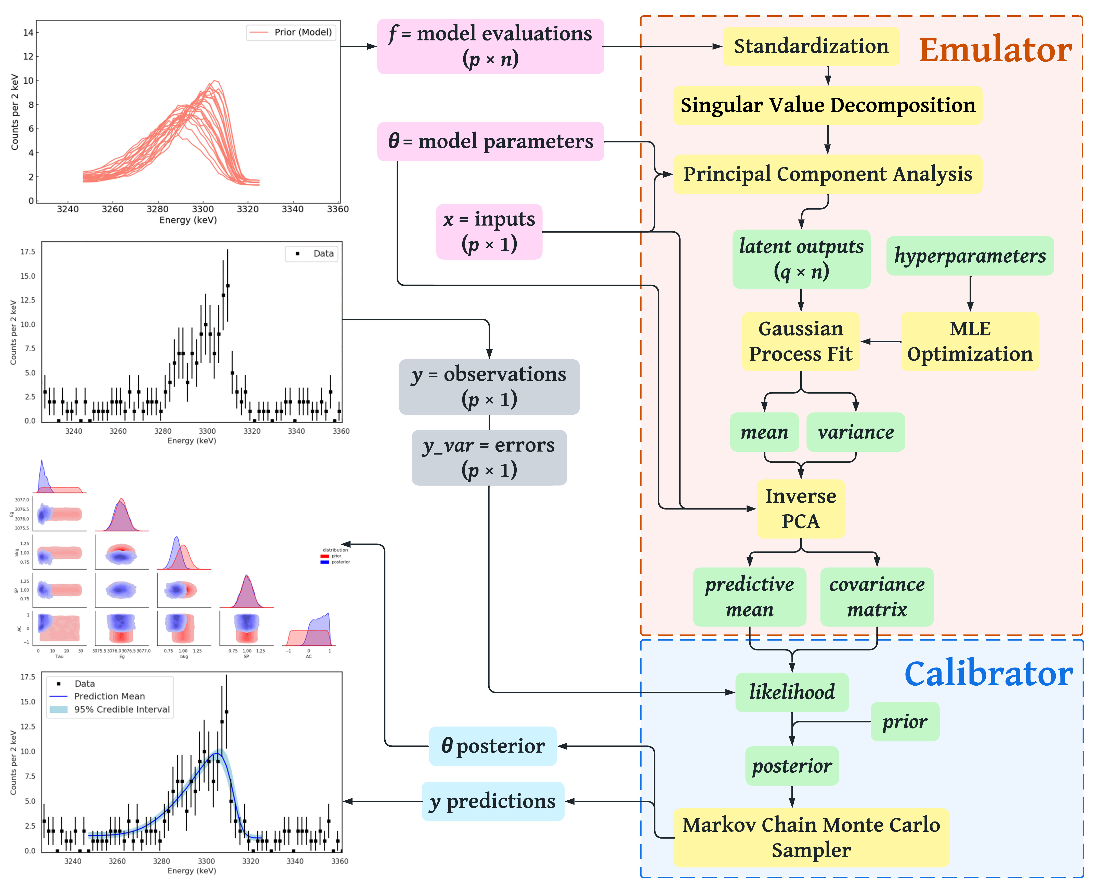
Notes:
Best figure Fig_DSL2_Bayesian_Surmise_workflow

Slide 5
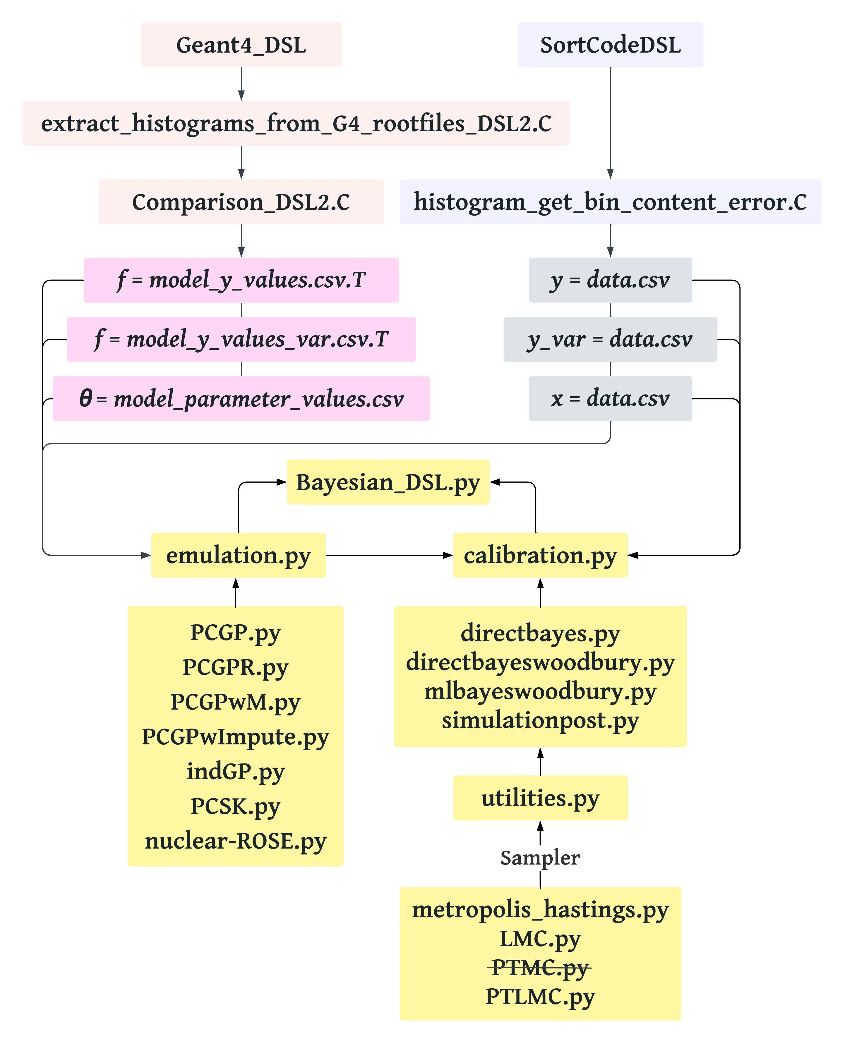
Notes:
Best figure Fig_DSL2_Surmise_structure_workflow

Slide 6
{Model emulation methods}
1) `indGP': skips the PCA dimensionality reduction step and builds independent emulators directly on the original outputs, hence, no epsilon is needed. However, the subsequent MCMC process incurs significant computational costs (CPU and RAM) associated with large covariance matrices. MCMC results look similar to PCGP.
2) 2) `PCGP': Principal Component Gaussian Process emulator uses PCA to reduce the dimensionality of the simulation output before fitting a Gaussian Process model to each Principal Component separately. `PCGP' is the default emulation method. A modified version `PCGP_numPCs' is recommended for DSL analysis.
3) `PCGPR': Principal Component Gaussian Process Regression utilizes scikit-learn's GaussianProcessRegressor for GP modeling.
4) `PCGPRG': Principal Component Gaussian Process Regression with Grouped observables. PCGPR emulation are performed for each subgroup separately.
Ref.~\cite{Liyanage_PRC2023} found that PCSK>PCGPR>PCGPR in terms of $R^2$ scores.
5) `PCGPwM': Principal Component Gaussian Process with Missingness properly handle missing points in the simulation output due to simulation failures through imputation and incorporating additional variance estimates at each point requiring imputation, before performing PCA and fitting Gaussian Process models.
Notes:
Best figure Fig_DSL2_Surmise_structure_workflow

Slide 7
6) `PCGPwImpute': Principal Component Gaussian Process with Imputation: extends PCGPwM by first externally imputing missing values using iterative imputation techniques (such as K-Nearest Neighbors, Bayesian Ridge Regression, or Random Forest) from scikit-learn, and then applies the PCGPwM method on the completed dataset.
7) `PCSK': Principal Component Stochastic Kriging.
Both PCGP and PCSK are Gaussian Process-based emulators. Both use PCA to reduce high-dimensional outputs into manageable dimensions for modeling. PCGP is developed to handle deterministic simulation models, where the simulator returns the same output every time given the same input parameters. PCGP considers mean but ignores any variance of simulation data.
8) `LCGP': Latent Component Gaussian Process handles stochastic multivariate outputs with heterogeneous errors~\cite{Chan_Thesis2023}. Unavailable in \textsc{surmise} version 0.3.0.
Our \textsc{geant}4 simulation model is stochastic, meaning that for the same input parameters, the simulator can return different outputs when being run multiple times. Instead of only taking into account the mean values of the emulator training data, the PCSK method also considers the standard deviation at the training points (`simsd'). The PCSK emulation incorporates this variation in the accuracy between the resulting data points, known as heteroscedasticity, by using stochastic kriging.
PCSK considers mean but ignores variance of simulation data during hyperparameter optimization, but considers variance in posterior predictive distribution.
PCGP and PCSK, with or without the uncertainties of the training data, give consistent posterior results, and both PCGP and PCSK outperform standard Gaussian Process implementations like Scikit GP in predictive accuracy and uncertainty estimation~\cite{Roch_PRC2024}.

Slide 8
{Model calibration methods}
1) `directbayes': default calibration method. It builds a log-posterior by combining a prior (fitinfo[`'thetaprior']) with a likelihood (loglik) comparing emulator‐predicted means/covariances to observed data. `directbayes' uses standard matrix operations. The final posterior samples are stored in fitinfo['thetarnd'].
2) `directbayeswoodbury': leverages the Woodbury identity to handle Gaussian covariance manipulations, which can be more efficient or numerically stable for large datasets. The final posterior samples are stored in fitinfo['thetarnd']. `directbayeswoodbury' is recommended for DSL analysis.
3) `mlbayeswoodbury': clf\_method must be a trained classifier (e.g., a scikit-learn model) that implements .predict\_proba(...) on each sampled theta to get acceptance probabilities, which it folds into the posterior. If this ML-based weighting is not needed, either pass clf\_method=None or use a different calibration method (directbayes or directbayeswoodbury).

Slide 9
{Utilities methods (samplers)}
1) `metropolis\_hastings': default sampler that draws from a target posterior distribution; recommended for DSL analysis.
2) `LMC': Langevin Monte Carlo uses gradient-based proposals to guide samples toward high-posterior regions, often improving acceptance over plain metropoli\_hastings. Users do not need to set stepParam explicitly: by default, LMC will estimate an initial scale from the starting samples and adapt from there. Users do not need to set burn-in explicitly. Instead, LMC uses an iterative procedure (e.g., maxiters=10, numsamppc=200) and tries to adapt acceptance rates. It then returns a single final chain (theta) with size numsamp.
3) `PTLMC': Parallel Tempering Langevin Monte Carlo combines Parallel Tempering (running multiple chains at different temperatures and exchanging states periodically) and Langevin Monte Carlo (using gradient-based proposals). PTLMC has the advantages of faster convergence, especially for complex or multimodal distributions, and reduced risk of trapping in local minima. In the analysis of the S2193 7333-keV $\gamma$-ray data, the posterior distribution exhibits numerous nearby local minima compared to that obtained using the Metropolis-Hastings sampler, indicating it is less suitable for DSL lineshape analysis. The overall credible intervals by integrating the posterior distributions are consistent with those from `metropolis\_hastings' sampling. The acceptance rate for PTLMC is approximately 0.004, while Metropolis-Hastings has an acceptance rate of about 0.22.
4) `PTMC': required positional arguments: `log\_likelihood' and `log\_prior'. PTMC is not supported in the version 0.3.0 of \textsc{surmise}.

Slide 10
Bayesian Model Emulation

Slide 11
Observables: 24 data points over 120 keV.
Prior Lineshapes: 201 simulation runs.
Principal Component Analysis
The first 12 PCs explain 99% of the variance, this means that by knowing the values of 12 PCs for each data point, we have a very good idea of where that data point is located in the original high-dimensional space.
Notes:
For example, if PC1 explains 75% of the variance, this means that by knowing the value of PC1 for each data point, we have a very good idea of where that data point is located in the original high-dimensional space. You can see that cumulative explained variance increases quickly at first as each additional component explains a large portion of the variance. After a certain point, the gain in explained variance slows down, suggesting that further components contribute less to capturing the structure of the data.
Explained Variance by each component is an important evaluation metric.

Slide 12
Emulator: PCGP
Emulator: PCSK with variances = 0
Randomly select 75% as training sets and the rest 25% as test sets.

Slide 13
Emulator: PCSK
Emulator: indGP
Randomly select 75% as training sets and the rest 25% as test sets.

Slide 14
Emulator: PCGP
Emulator: PCSK with variances = 0
Metrics for Evaluating Emulator Performance

Slide 15
Emulator: PCSK
Emulator: indGP
Metrics for Evaluating Emulator Performance

Slide 16
Emulator: PCGP
MSE = 3.0
SSE = 72.7
Emulator: PCSK with variances = 0
MSE = 1.8
SSE = 43.0
Metrics for Evaluating Emulator Performance
Notes:
PCSK, if 100% for training; 25% for test:
MSE = 0.43
SSE = 10.24

Slide 17
Emulator: PCSK
MSE = 2.1
SSE = 50.4
Emulator: indGP
MSE = 2.4
SSE = 56.3
Metrics for Evaluating Emulator Performance

Slide 18
Training for PCSK is often not performed successfully.
MSE = 0.0
SSE = 0.0

Slide 19
Training for PCSK is often not performed successfully.

Slide 20
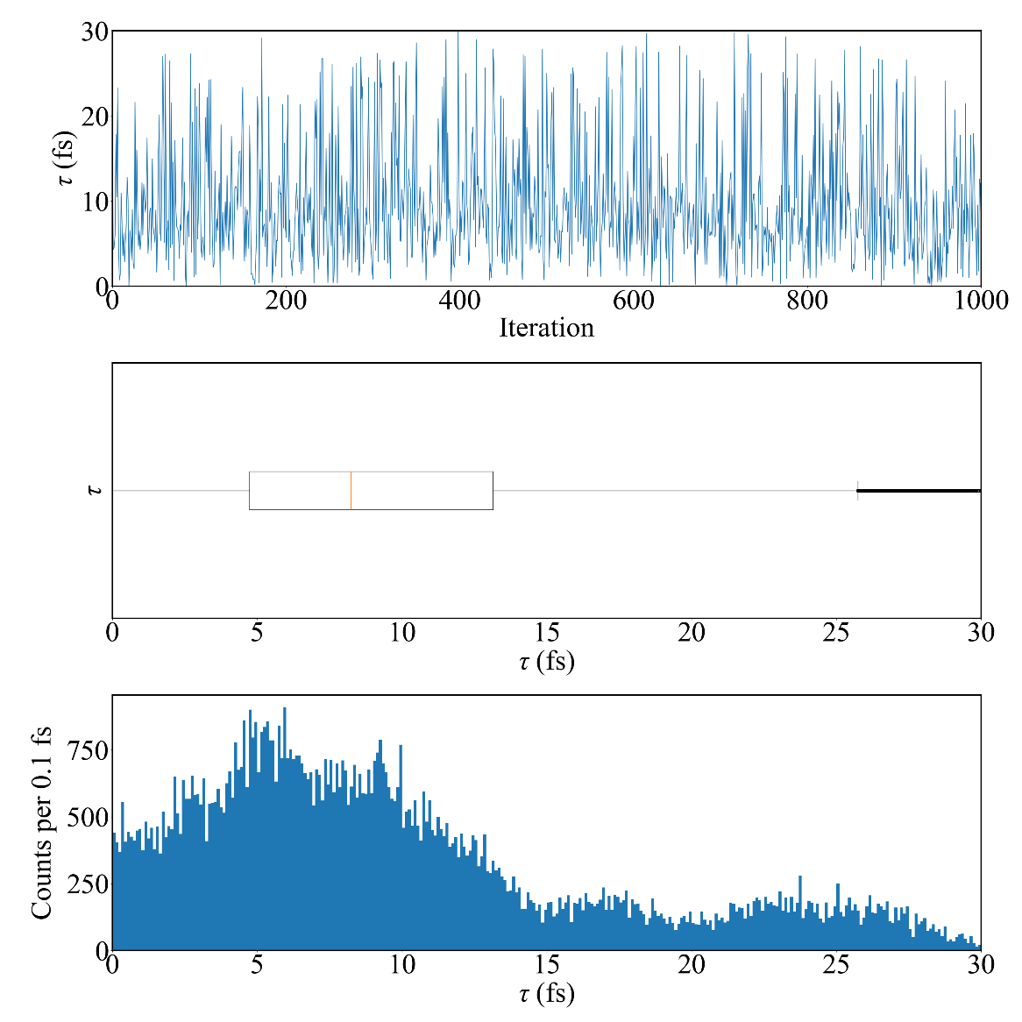
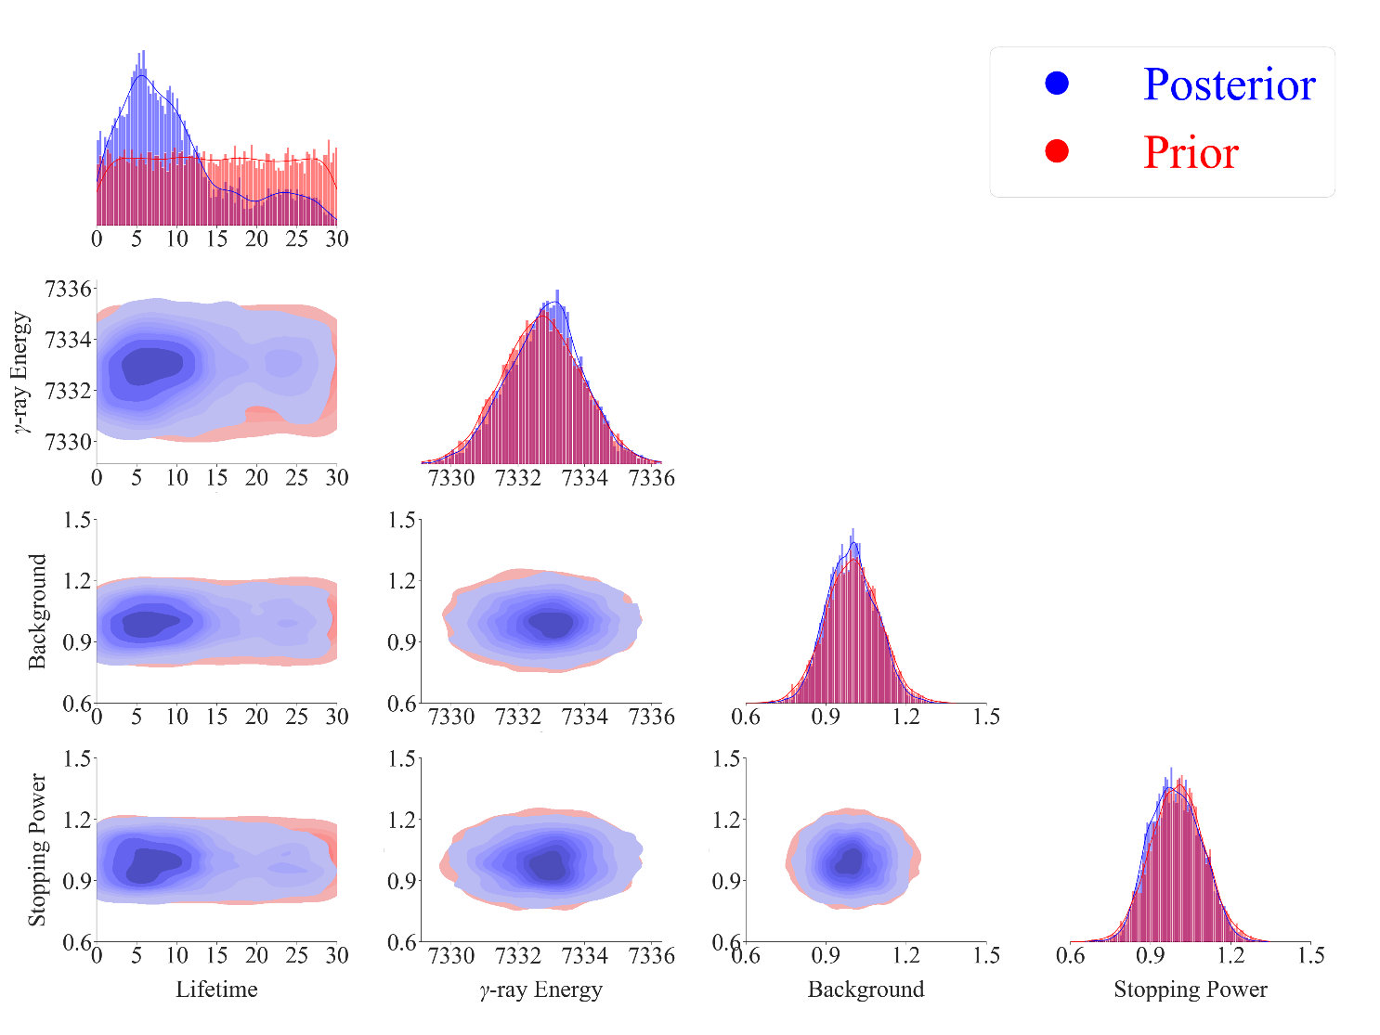
Training for PCSK is often not performed successfully.

Slide 21
Bayesian Model Calibration

Slide 22
Emulation method: PCGP
Calibration method: directbayeswoodbury
Sampler: metropolis_hastings
Emulation method: PCGP
Calibration method: directbayeswoodbury
Sampler: PTLMC
All 201 simulation runs as training sets.

Slide 23
Emulation method: PCSK
Calibration method: directbayeswoodbury
Sampler: metropolis_hastings
All 201 simulation runs as training sets.

Slide 24
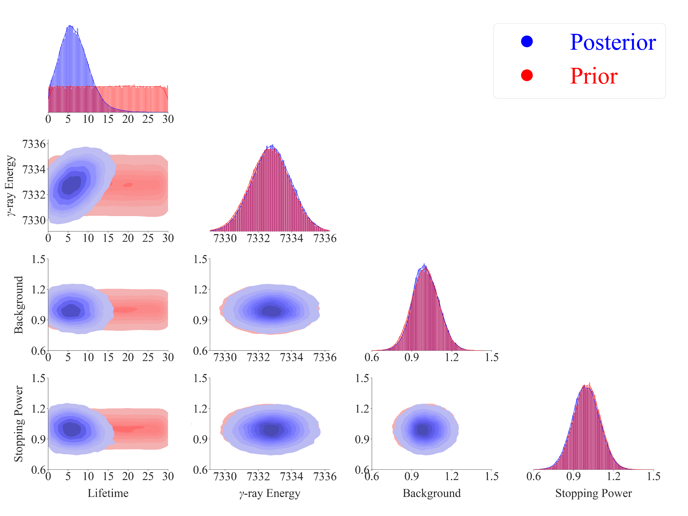
Emulation method: PCGP
Calibration method: directbayeswoodbury
Sampler: metropolis_hastings

Slide 25
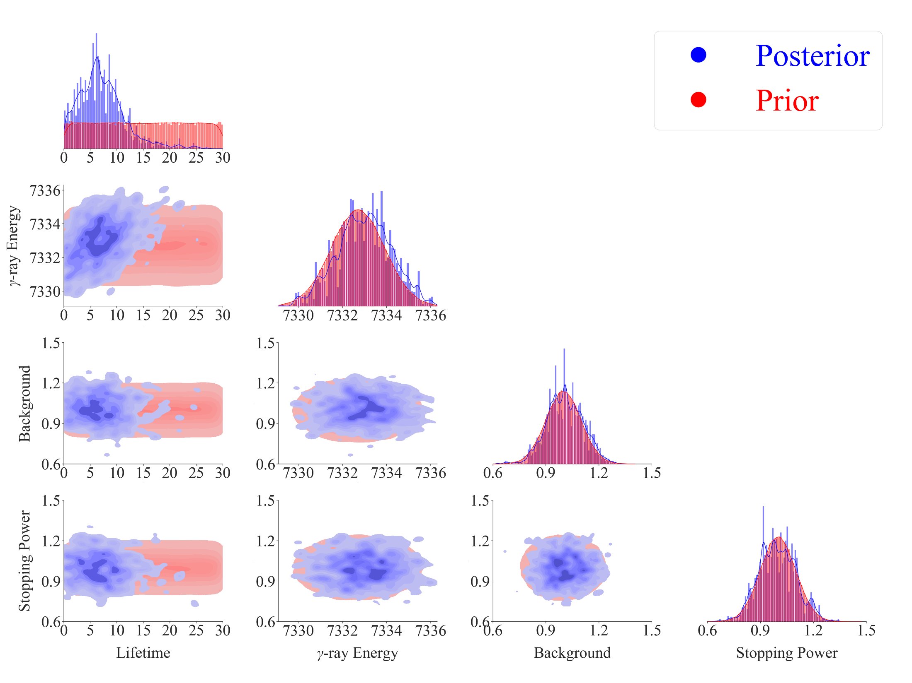
Emulation method: PCGP
Calibration method: directbayeswoodbury
Sampler: PTLMC

Slide 26
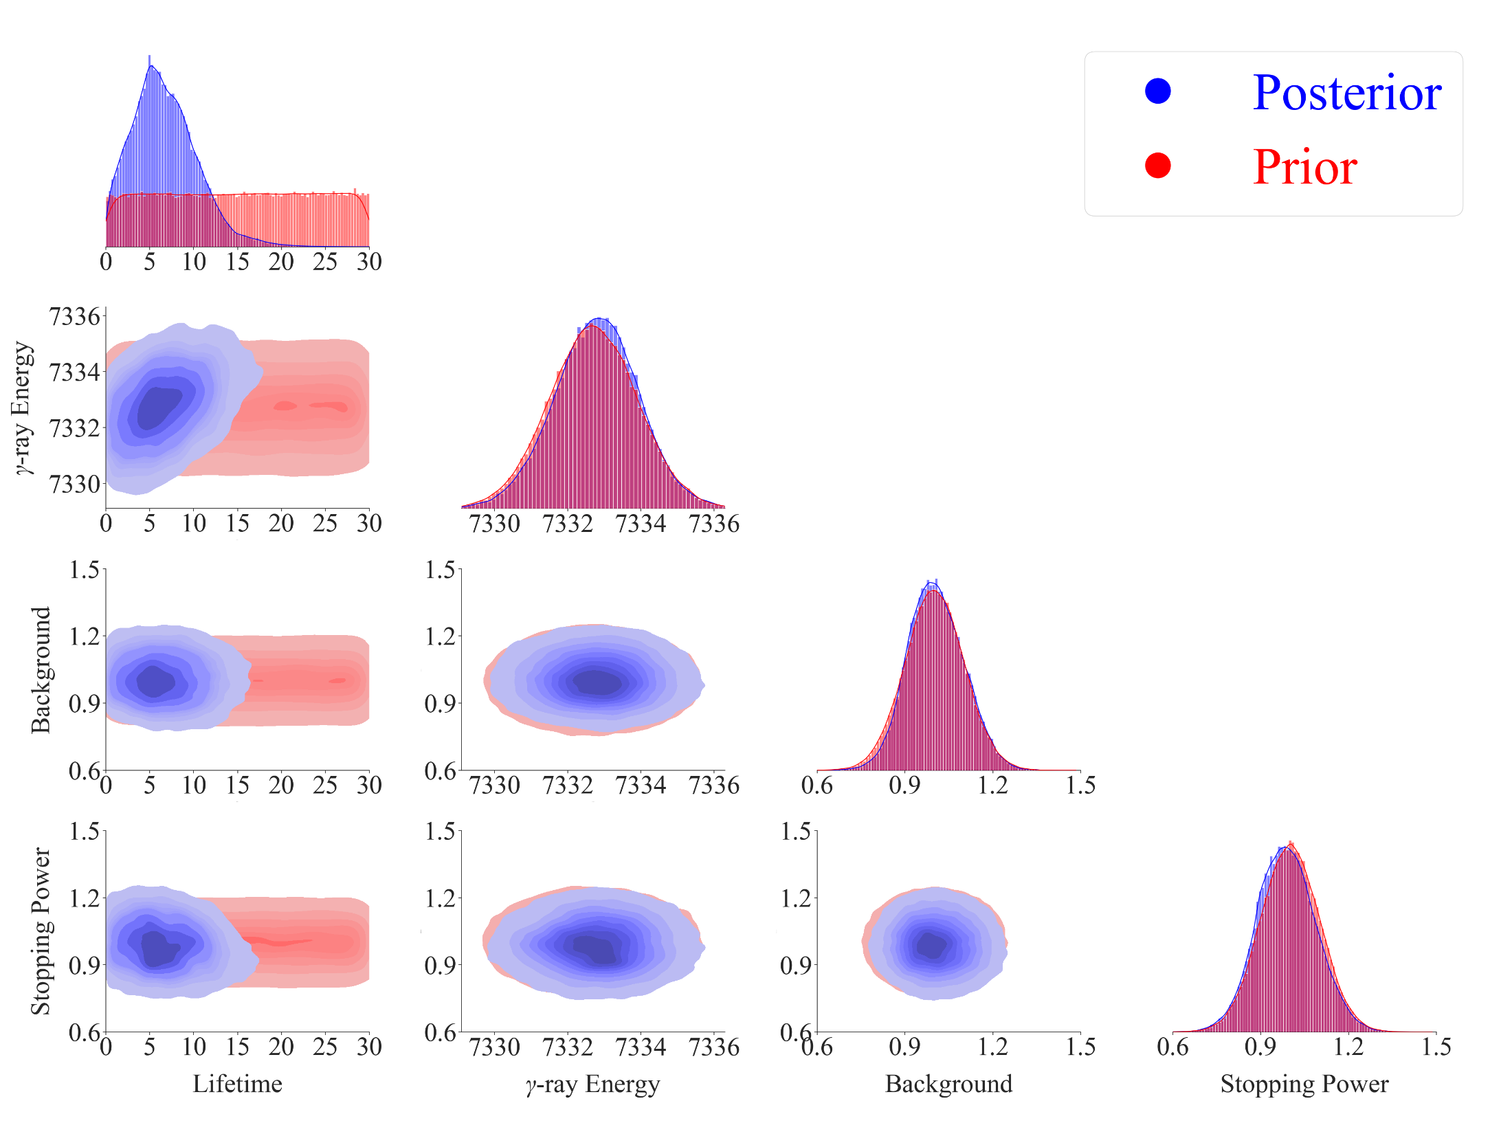
Emulation method: PCSK
Calibration method: directbayeswoodbury
Sampler: metropolis_hastings

Slide 27
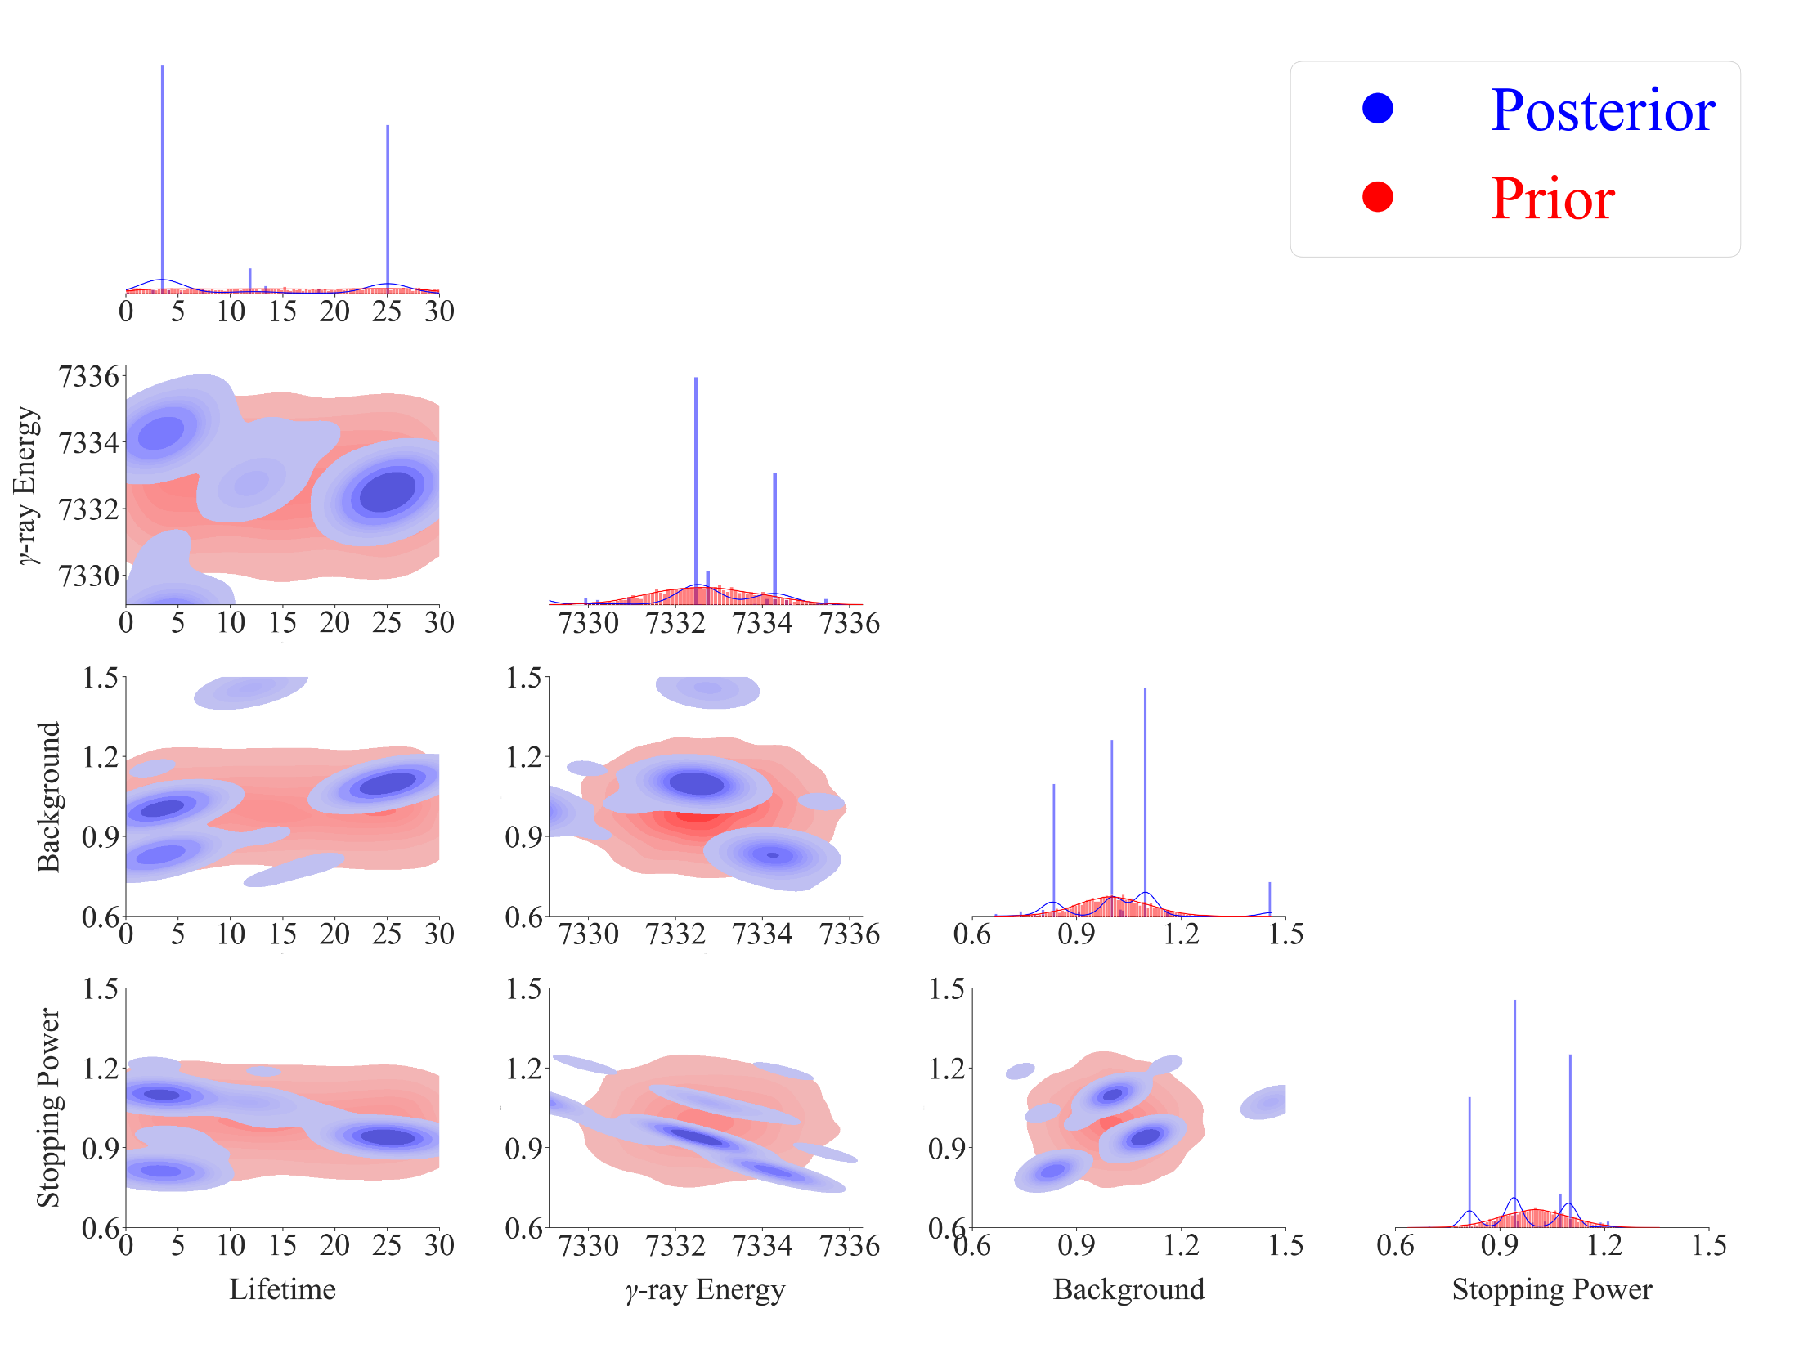
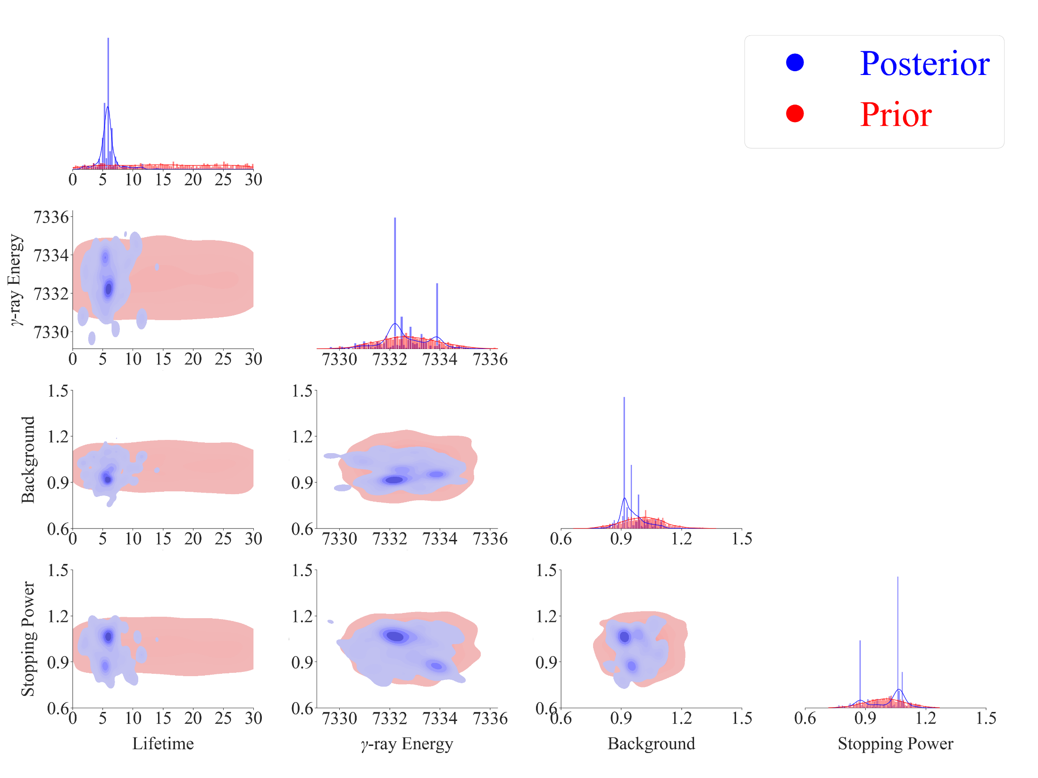
Emulation method: PCGP
Calibration method: directbayeswoodbury
Sampler: LMC

Slide 28
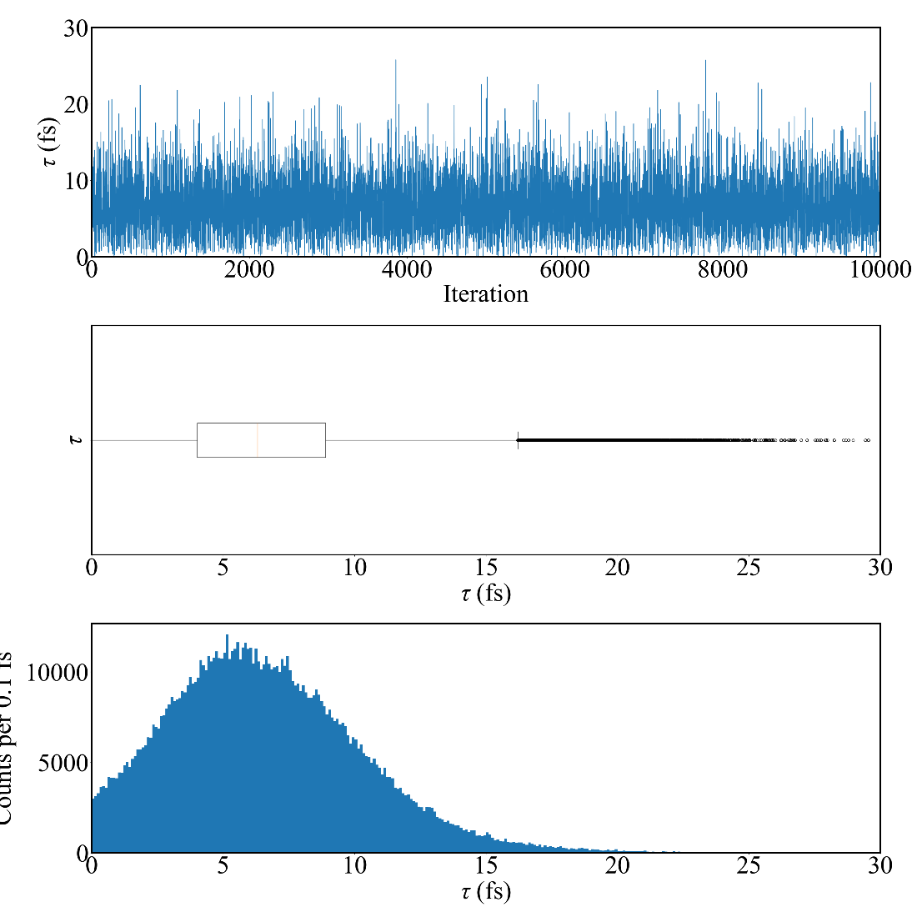
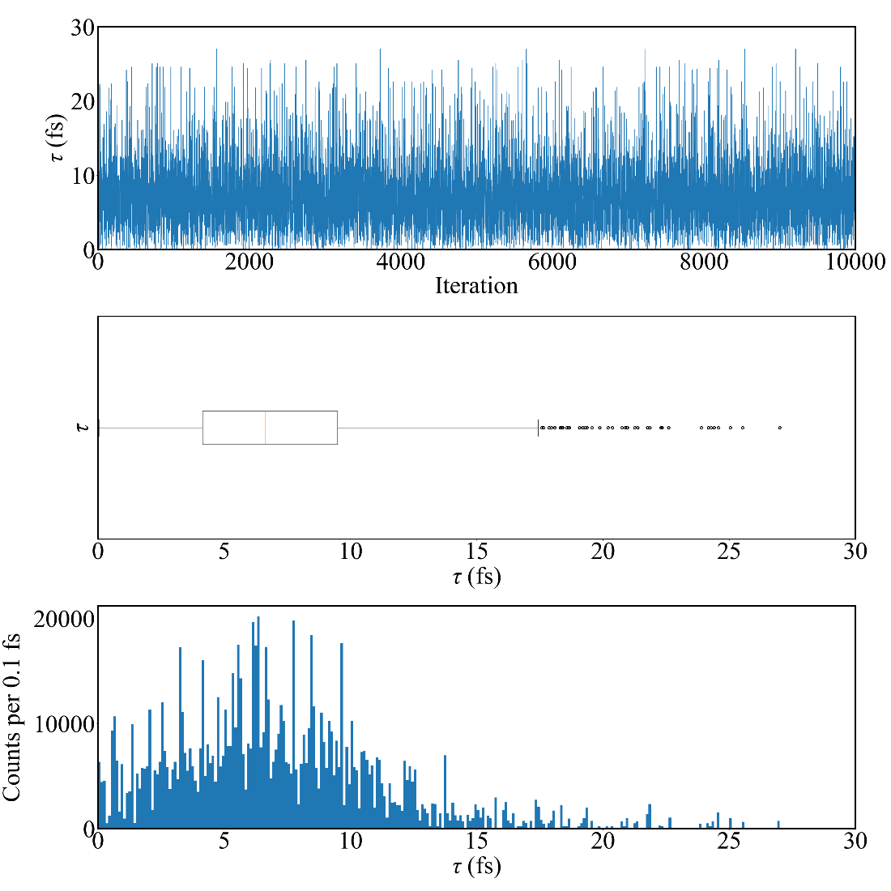
Emulation method: PCGP
Calibration method: directbayeswoodbury
Sampler: metropolis_hastings
Emulation method: PCGP
Calibration method: directbayeswoodbury
Sampler: PTLMC
Eg prior: Sallaska_PRC2011
Tau = 6.297 +3.890 -3.288 fs
Eg prior: Sallaska_PRC2011
Tau = 6.610 +4.169 -3.648 fs
Final Acceptance Rate: 0.21084
Final Acceptance Rate: 0.00424

Slide 29
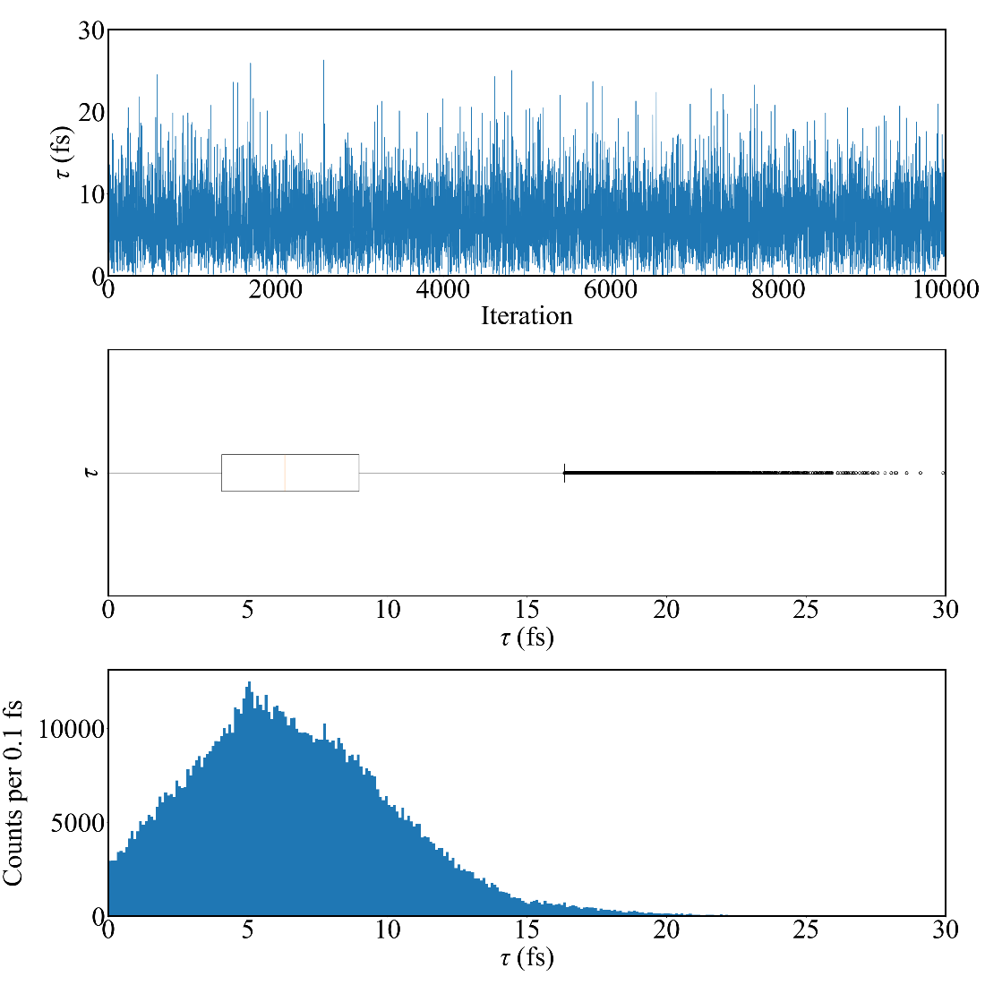
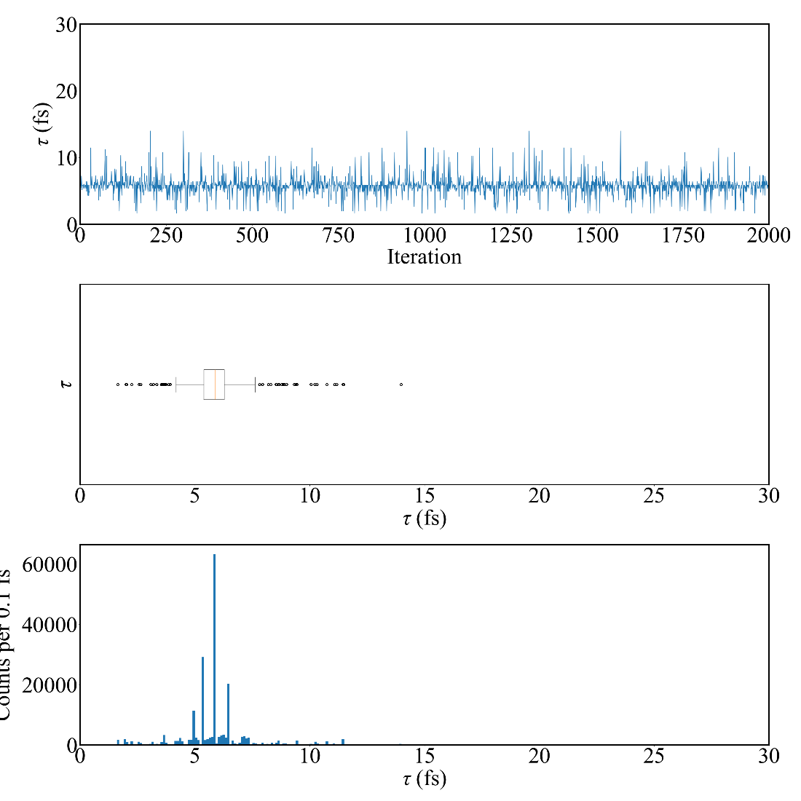
Initial sampler position dependent.
Emulation method: PCSK
Calibration method: directbayeswoodbury
Sampler: metropolis_hastings
Emulation method: PCGP
Calibration method: directbayeswoodbury
Sampler: LMC
Eg prior: Sallaska_PRC2011
Tau = 6.322 +3.951 -3.299 fs
Eg prior: Sallaska_PRC2011
Tau = 5.879 +0.538 -0.940 fs
Final Acceptance Rate: 0.20024
Final Acceptance Rate: 0.0568

