Slide 1
Stopping Power change due to ³He implantation
S2193

Slide 2
Letting c(x) denote the local relative concentration of ³He at depth x in the target, the local swelling is given by ΔV/V = Ac(x), where A = 0.75 ± 0.25.
We take c(x) to be the ³He depth profile predicted by SRIM normalized to the total number of implanted ³He atoms, 6.6 × 10¹⁷ cm⁻². [S2193: 4.68 × 10¹⁷ cm⁻²]
The concentration peaks at a depth of x₀ = 0.07 μm, reaching a maximum value of c(x₀) = 1.05. (verified)
where ρ_{Au} = 19.30 g/cm³ is the density of gold and (dE/ρdx)_{Au} and (dE/ρdx)_{3He} are the stopping powers in Au and ³He in units of MeV/(g/cm²).
 | LISE++ | SRIM
 | MeV / (mg/cm2) | MeV / (mg/cm2)
 | 4.28 | 4.14
 | 21.01 | 23.21
 | LISE++ | SRIM
 | MeV/um | MeV/um
45MeV 23Mg in Au | 8.269 | 7.993
45MeV 23Mg in He | 0.265 | 0.292

Slide 3
From TRIM
Converted to a ROOT file
Geant4 samples from the ROOT histogram

Slide 5
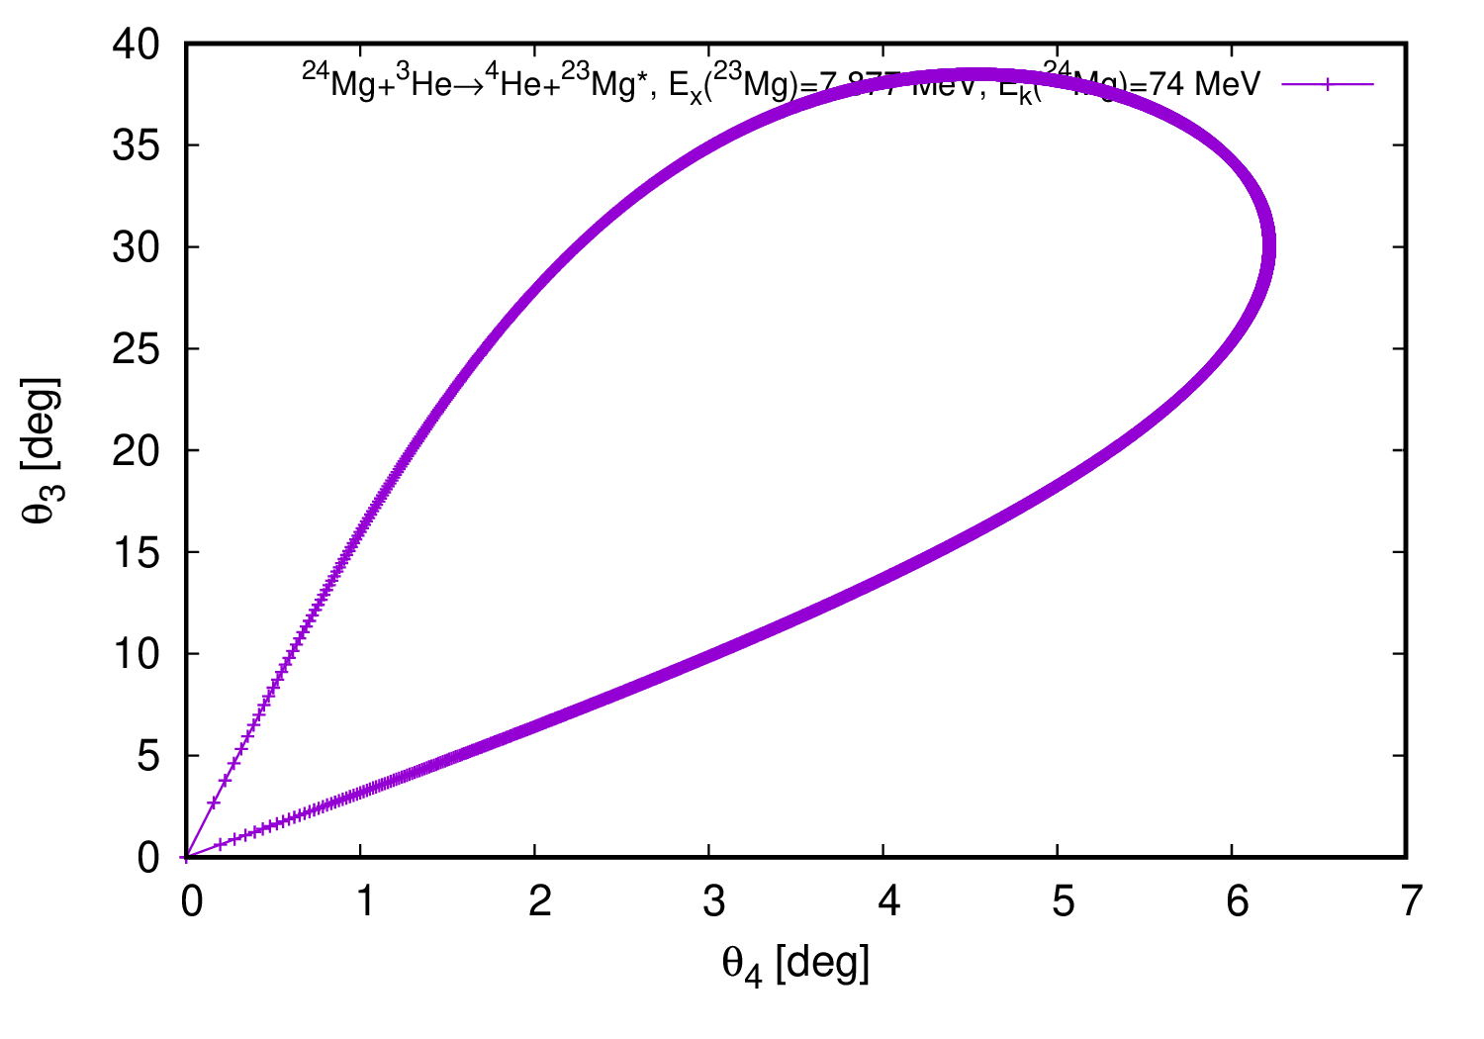
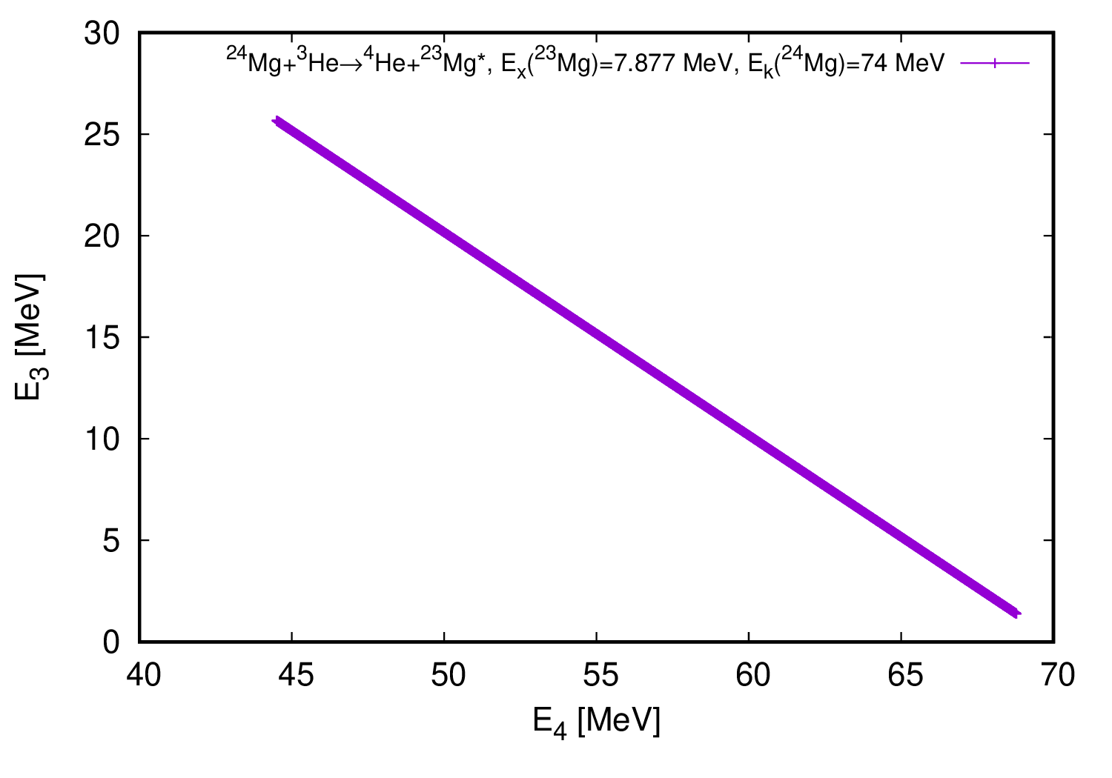
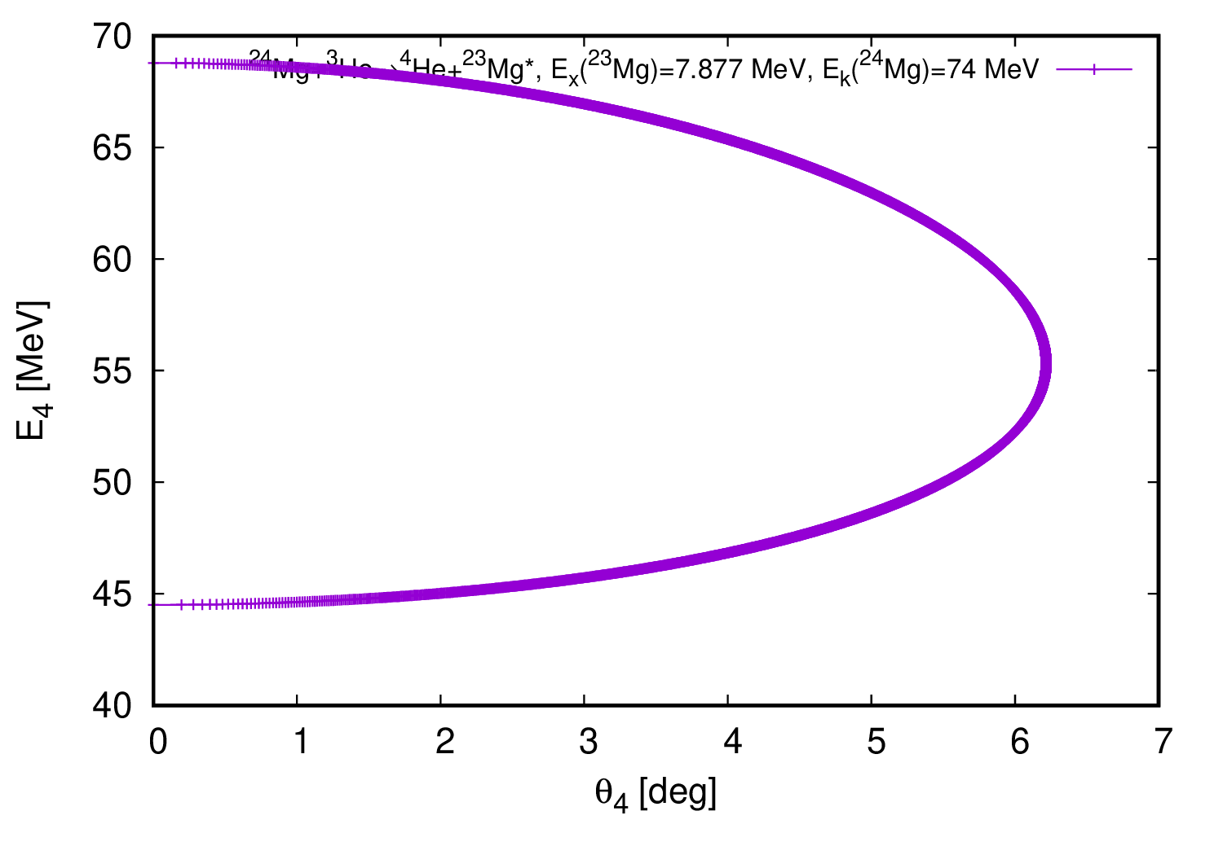
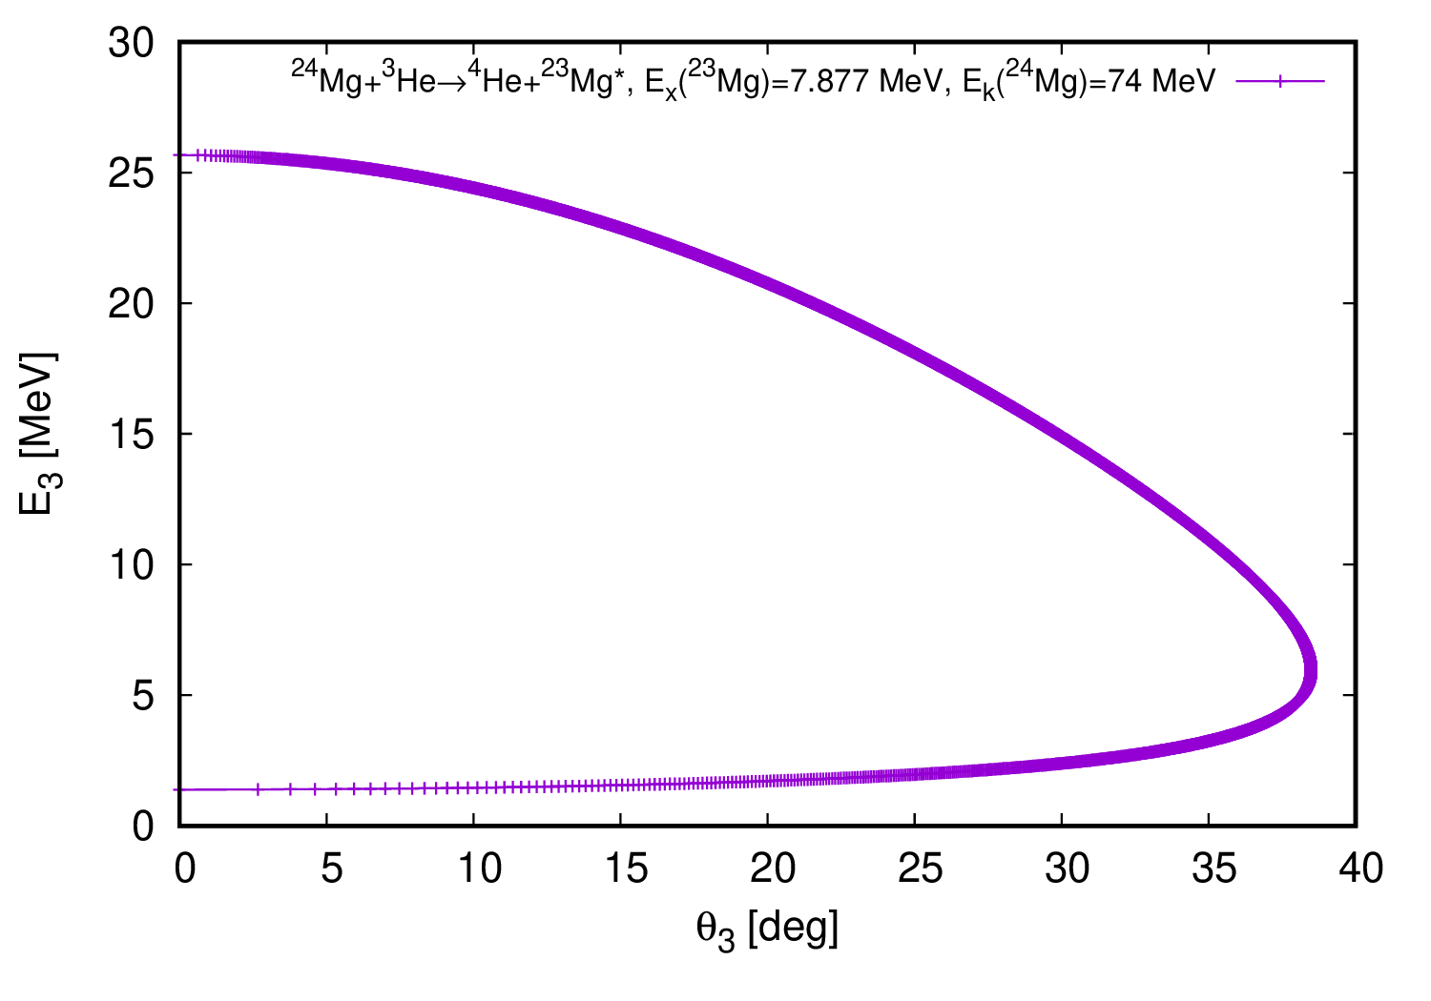

Slide 6
0.2 μm
24.8 μm
7.5 μm
50 MeV ²³Mg
50 MeV ²³Mg
Range = 7.7 μm in Au
E_{loss} = 0.05 MeV in 0.2 μm thick ³He layer
E_{loss} = 1.61 MeV in 0.2 μm thick Au
E_{loss} = 49.95-48.4 MeV in Au foil
v = 2.0 cm/ns = 2×10⁷ m/s
d = 0.2 μm = 2×10^{–7} m
t = d/v = 1×10¹⁴ s = 10 fs

Slide 7
γ 0.451
²³Mg 50
γ 7.336
α 20
α 20
γ 7.336
²³Mg 50
γ 0.451
TOF = 10 fs

Slide 8
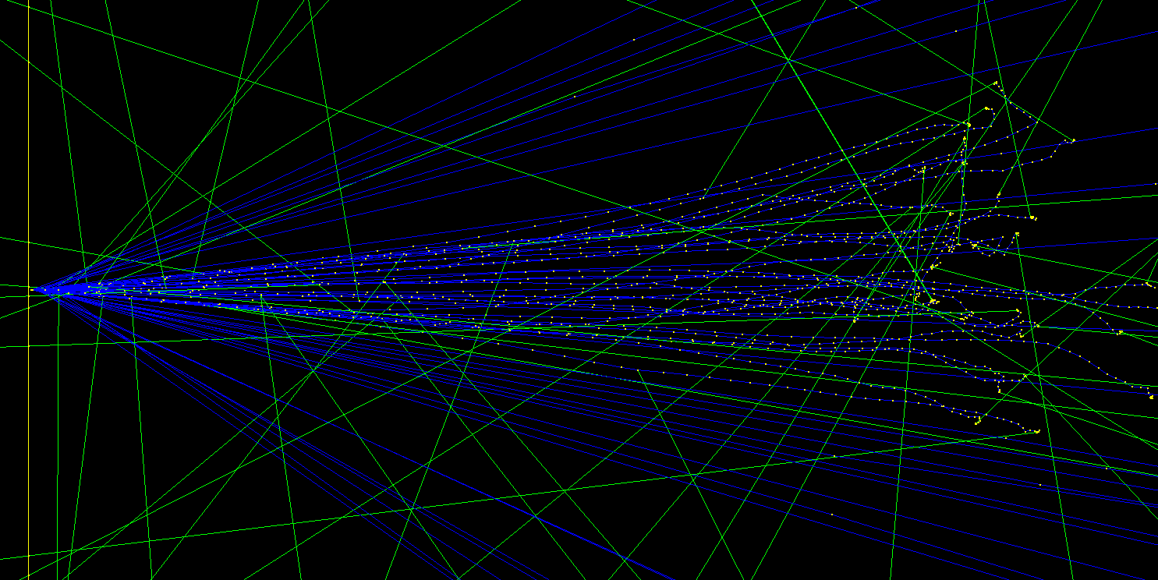
TOF = 10 fs

Slide 9
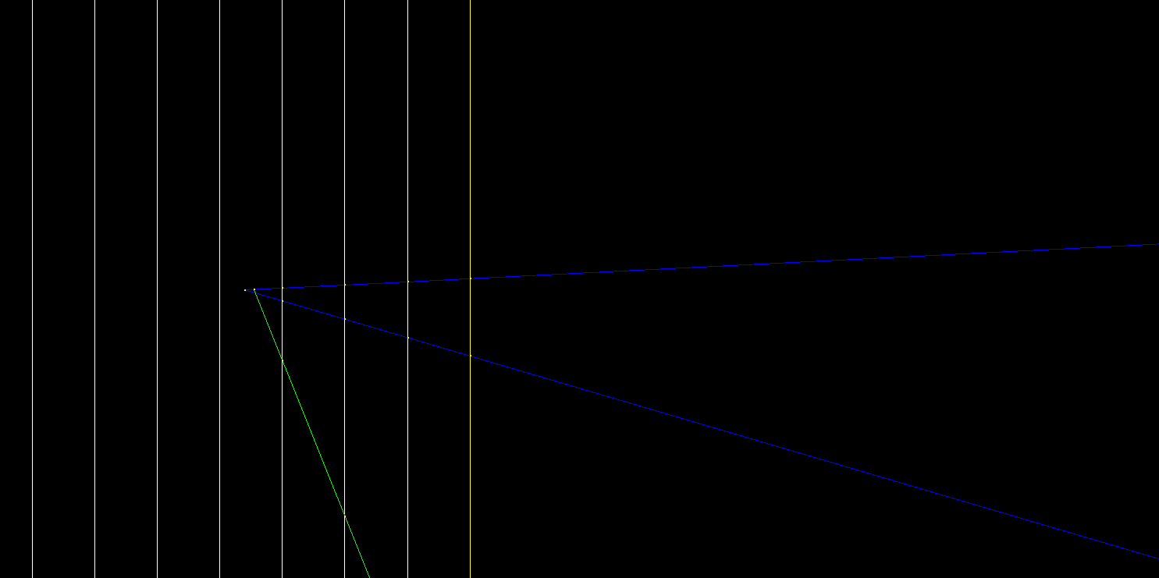
²³Mg 50
γ 7.336
α 20

Slide 10
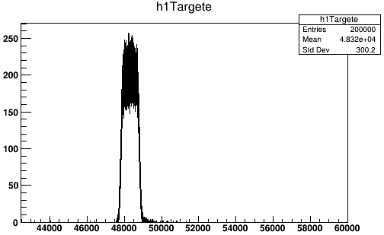
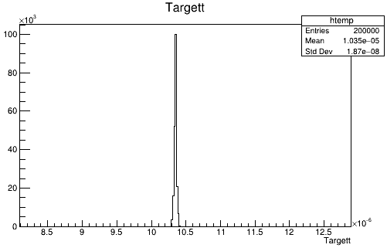
0.21 μm
24.79 μm
50 MeV ²³Mg
1.7 MeV
48.3 MeV
Au
Au
Eloss in Au layer
48.3 MeV
First step in Au layer
TOF = 10.3 fs

Slide 11
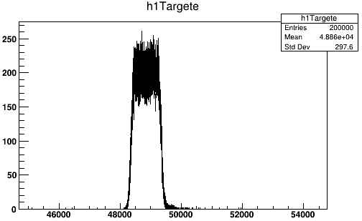
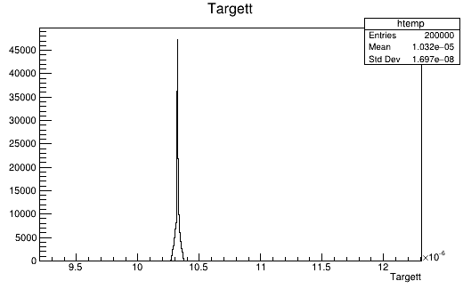
0.21 μm
24.79 μm
50 MeV ²³Mg
1.1 MeV
48.9 MeV
68%
Low-density
Au
Au
Eloss in Au layer
48.9 MeV
First step in Au layer
TOF = 10.3 fs

Slide 12
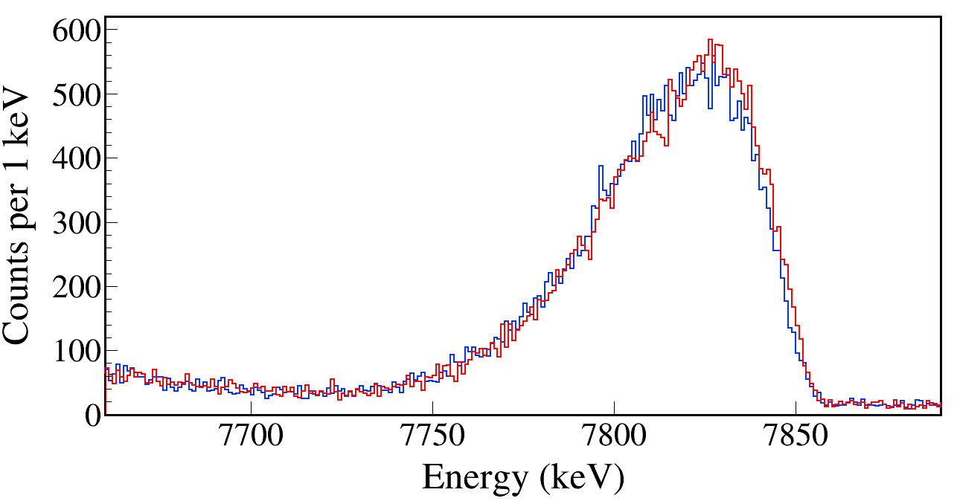
τ = 10 fs
E_{x} = 7787 keV
68% Au 200 nm + pure Au 24.8 μm
Pure Au 25 μm
68% represents the lowest-density layer.
Not the entire 200-nm layer reduced that much.
The red spectrum represents a somewhat exaggerated effect.
Notes:
TFile *_file0 = TFile::Open("Test/Mg23_Gamma7787_Eg7791.00_Tau10.0_SP1.00_AD1.0_PureAu.root");
TCanvas* canvaspeak = new TCanvas("canvaspeak", "canvaspeak", 1300, 700);
canvaspeak->cd();//
canvaspeak->SetTopMargin(0.038);
canvaspeak->SetRightMargin(0.025);
canvaspeak->SetLeftMargin(0.11);
canvaspeak->SetBottomMargin(0.17);
gStyle->SetFrameLineWidth(2);
canvaspeak->SetFrameLineWidth(3);
//gPad->SetLogy();
TH1F* Eg = new TH1F("Eg", "Eg", 9000, 0, 9000);
//Eg->Sumw2(kFALSE);
//Eg->SetBinErrorOption(TH1::kPoisson);//TH1::kNormal or TH1::kPoisson
Eg->SetLineWidth(2);
Eg->Rebin(1);
Eg->SetLineColor(kAzure);
Eg->SetStats(0);
Eg->SetTitle("");
Eg->GetXaxis()->SetTitle("Energy (keV)");
Eg->GetYaxis()->SetTitle("Counts per 1 keV");
Eg->GetXaxis()->CenterTitle();
Eg->GetYaxis()->CenterTitle();
Eg->GetXaxis()->SetLabelFont(132);
Eg->GetYaxis()->SetLabelFont(132);
Eg->GetXaxis()->SetLabelSize(0.07);
Eg->GetYaxis()->SetLabelSize(0.07);
Eg->GetXaxis()->SetTitleFont(132);
Eg->GetYaxis()->SetTitleFont(132);
Eg->GetXaxis()->SetTitleOffset(1.0);
Eg->GetYaxis()->SetTitleOffset(0.7);
Eg->GetXaxis()->SetTitleSize(0.08);
Eg->GetYaxis()->SetTitleSize(0.08);
Eg->GetYaxis()->SetTickLength(0.015);
Eg->GetXaxis()->SetRangeUser(7660, 7890);
Eg->GetXaxis()->SetNdivisions(105);
Eg->Scale(0.2);
//Eg->GetYaxis()->SetRangeUser(1, 4e5);
tree->Draw("Clovere>>Eg", "Clovere>0&&Clovere<9000","hist");
TFile *_file1 = TFile::Open("Test/Mg23_Gamma7787_Eg7791.00_Tau10.0_SP1.00_AD1.0_LowAu.root");
tree->SetLineColor(kRed);
tree->SetLineWidth(2);
tree->Draw("Clovere", Form("Clovere>0&&Clovere<9000"),"hsame");
gPad->RedrawAxis();
canvaspeak->SaveAs("HeAu.png");

