Slide 1
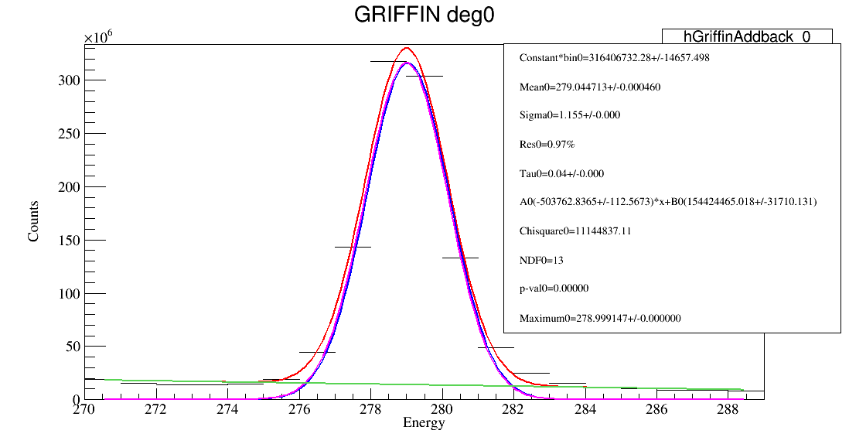
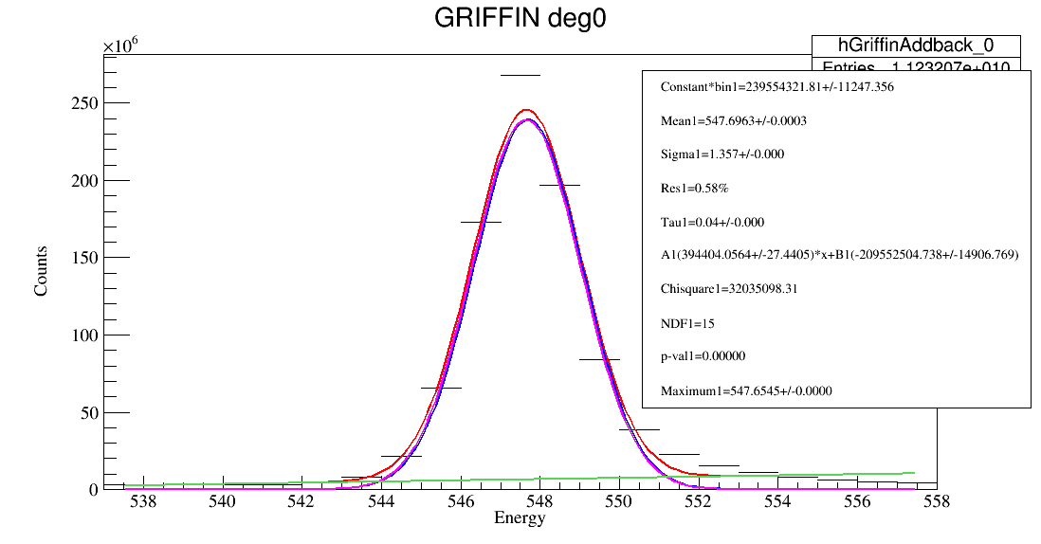
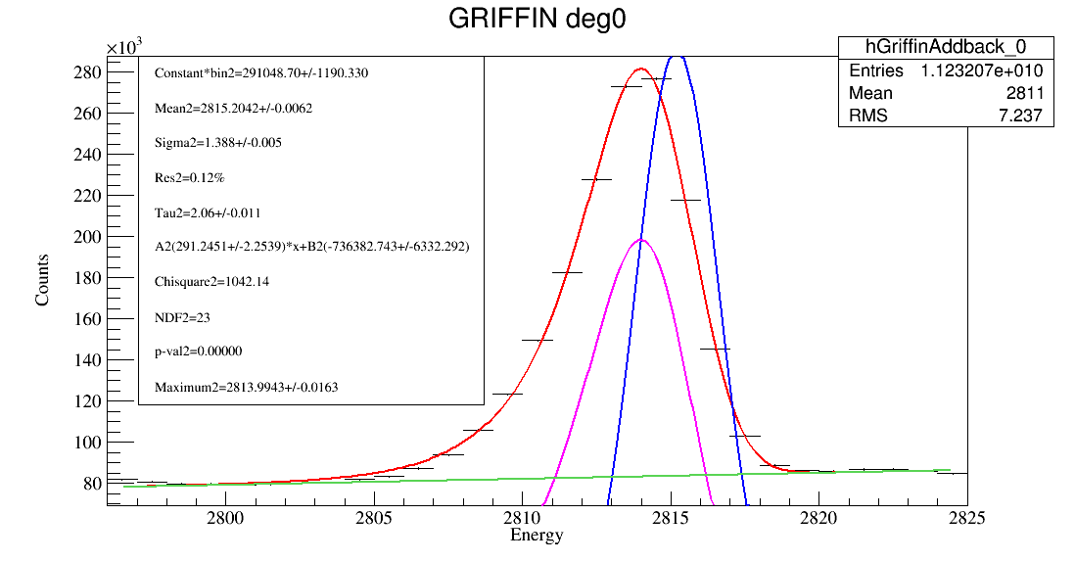
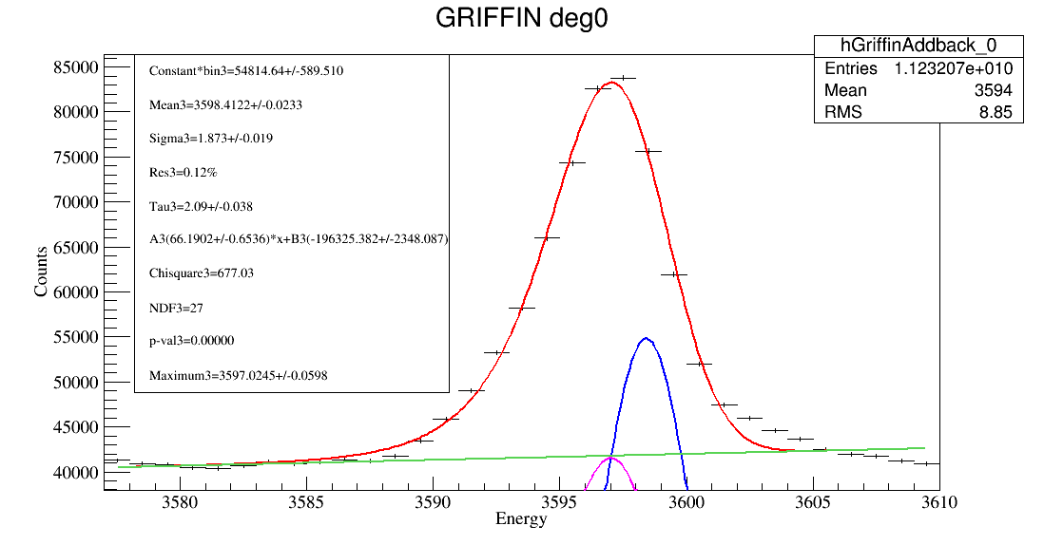
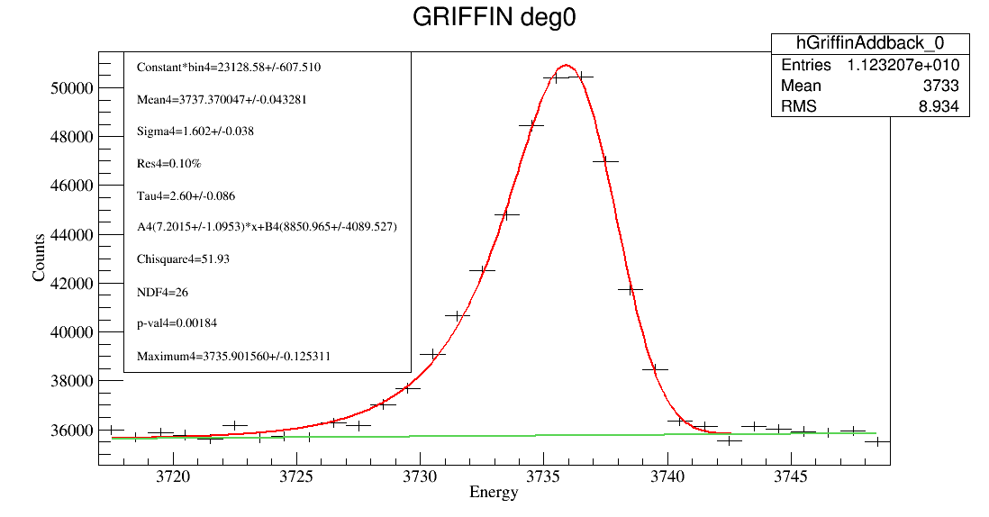
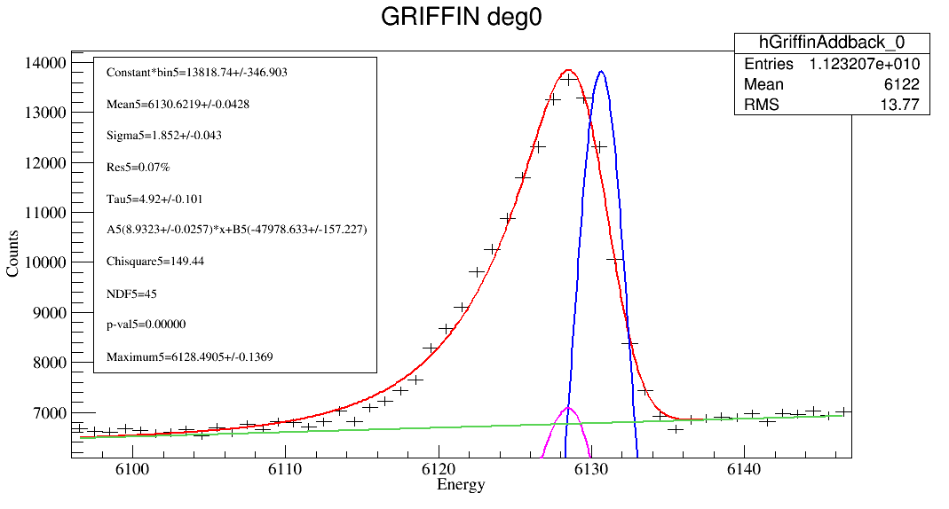
Six unshifted peaks for energy calibration

Slide 2
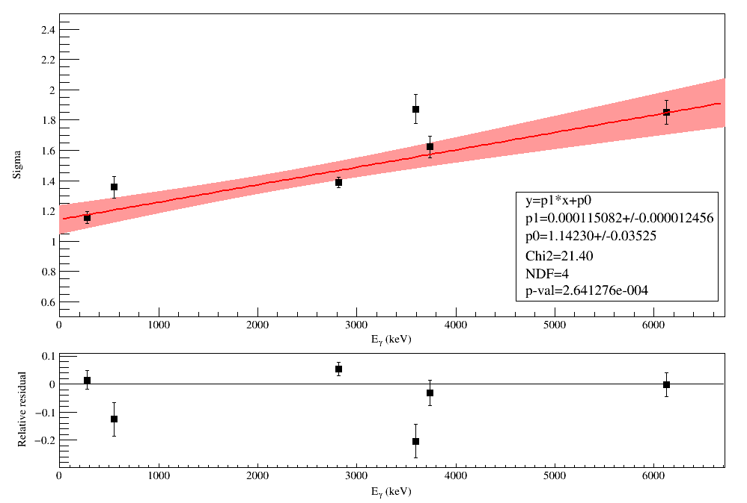
Response function characterization
$$f\left(x;N,μ,σ,τ,B\right)=\frac{N }{2τ}exp\left[\frac{1}{2}{\left(\frac{σ}{τ}\right)}^{2}+\frac{x−μ}{τ}\right]×erfc\left[\frac{1}{\sqrt{2}}\left(\frac{σ}{τ}+\frac{x−μ}{σ}\right)\right]+B$$
σ as a function of energy
Notes:
EMG Exponentially Modified Gaussian

Slide 3
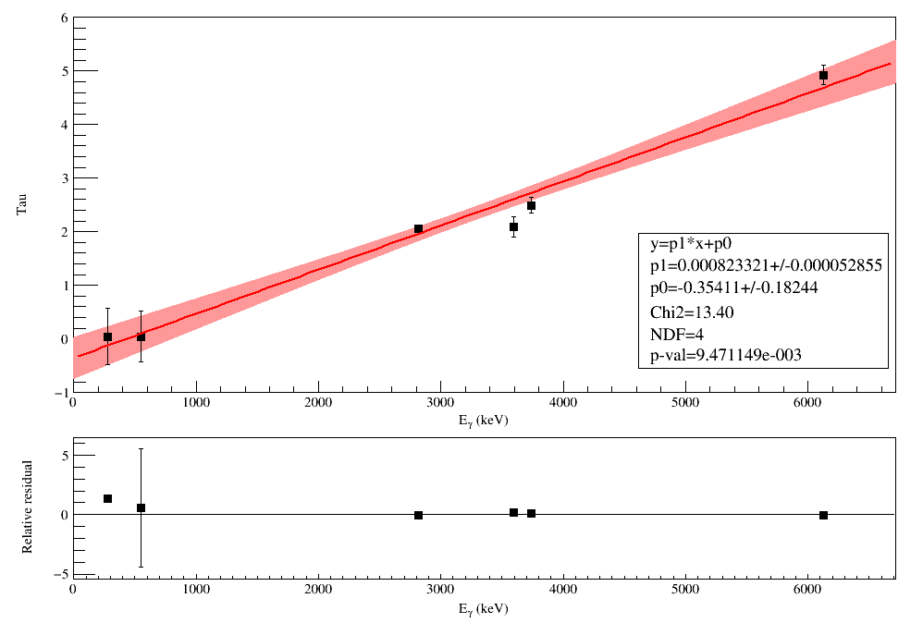
Response function characterization
$$f\left(x;N,μ,σ,τ,B\right)=\frac{N }{2τ}exp\left[\frac{1}{2}{\left(\frac{σ}{τ}\right)}^{2}+\frac{x−μ}{τ}\right]×erfc\left[\frac{1}{\sqrt{2}}\left(\frac{σ}{τ}+\frac{x−μ}{σ}\right)\right]+B$$
τ as a function of energy
Notes:
EMG Exponentially Modified Gaussian

Slide 4
The energy difference between Emax and Emean (μ) from DSL1.

