Slide 1
Lifetime of ²³Mg 7787 keV state (S2193)

Slide 2
Lineshape fit

Slide 3
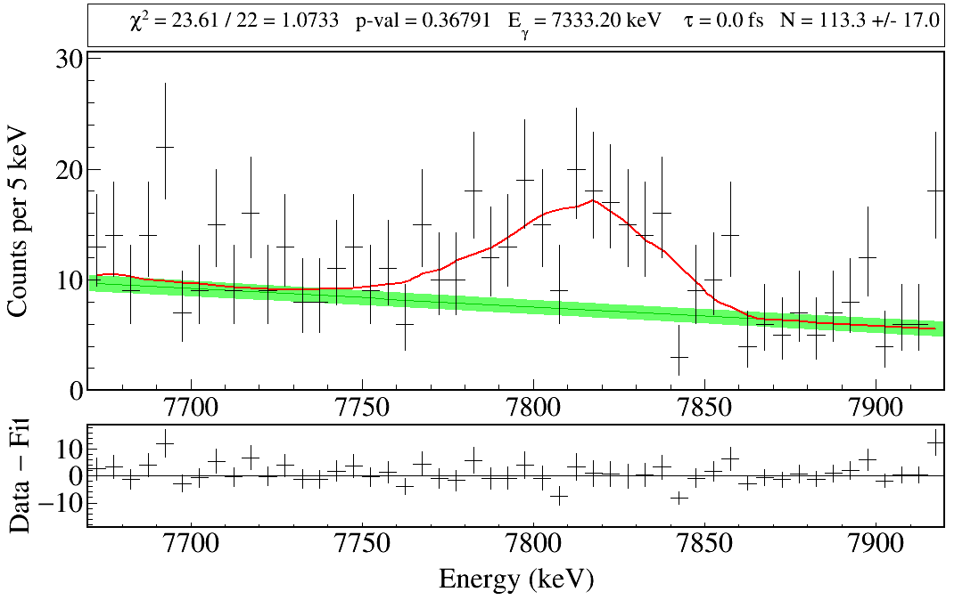
Isotropic α emission

Slide 4
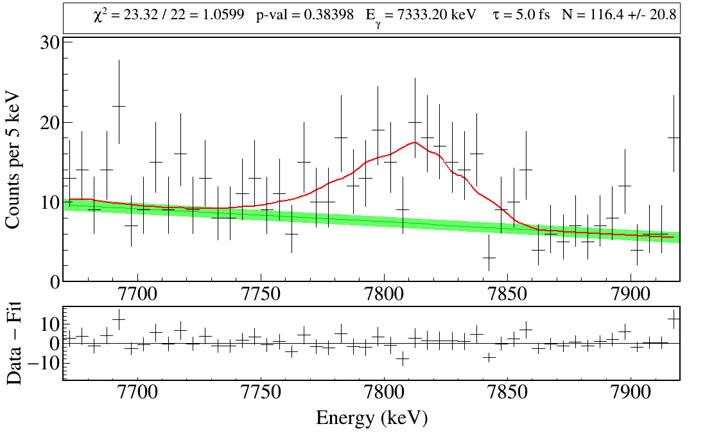
Isotropic α emission

Slide 5
Isotropic α emission

Slide 6
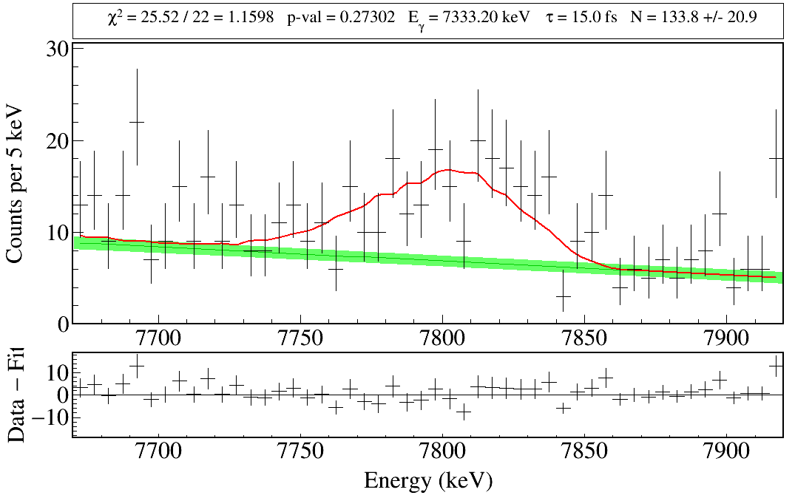
Isotropic α emission

Slide 7
Isotropic α emission

Slide 8
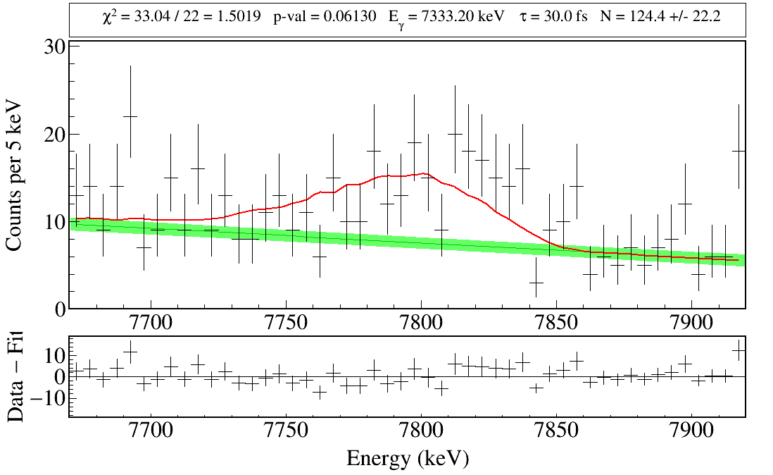
Isotropic α emission

Slide 9
Isotropic α emission

Slide 10
Isotropic α emission

Slide 11
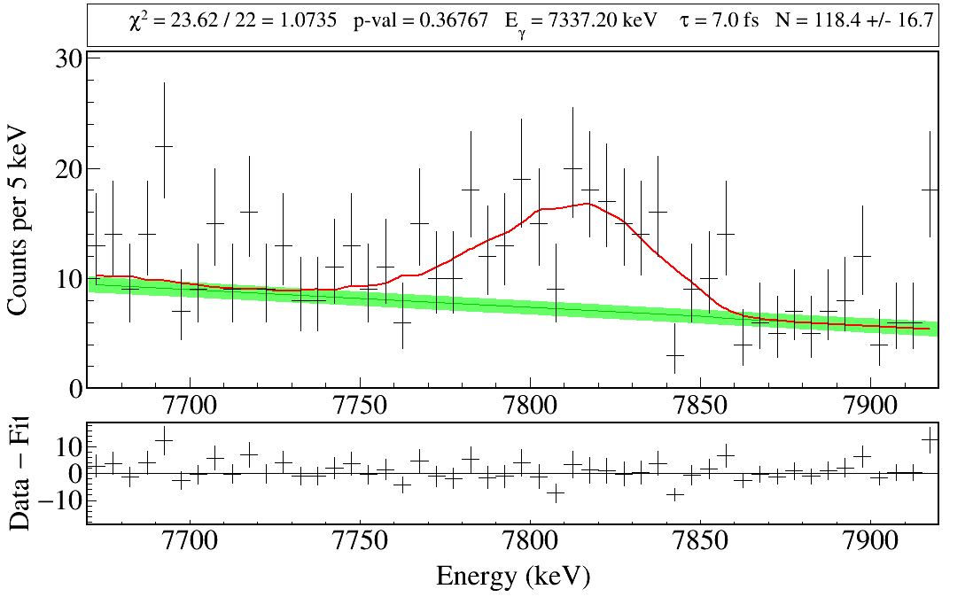
Isotropic α emission

Slide 12
α emission angular distribution

Slide 13
Isotropic α emission
${AD}_{2}=0,{AD}_{4}=0$.

Slide 14
Anisotropic α emission
${AD}_{2}=−0.9,{AD}_{4}=0$.
Larger α emission angle → lower α energy → higher recoil energy → larger Doppler shift

Slide 15
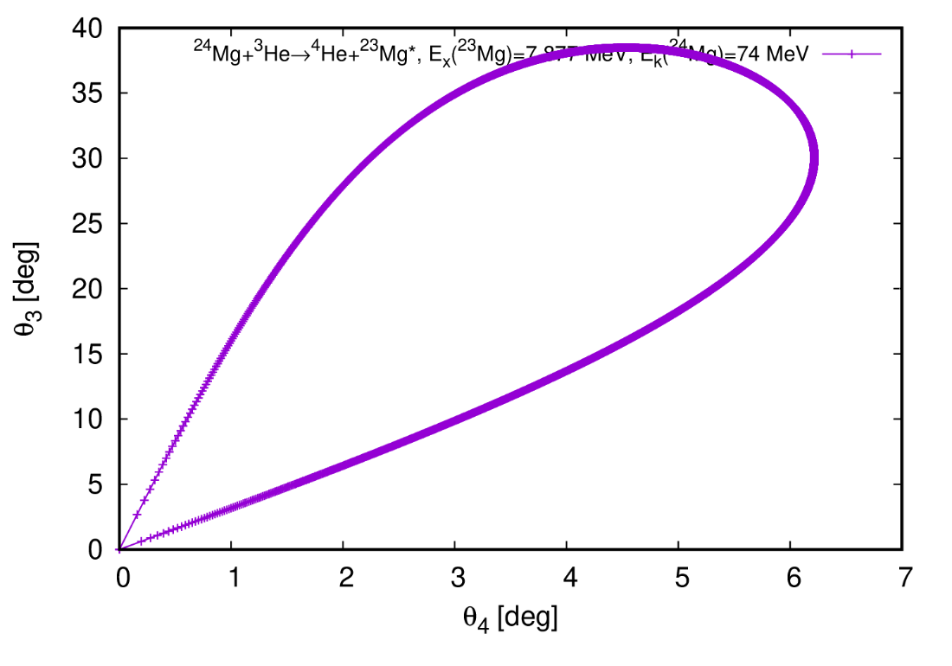
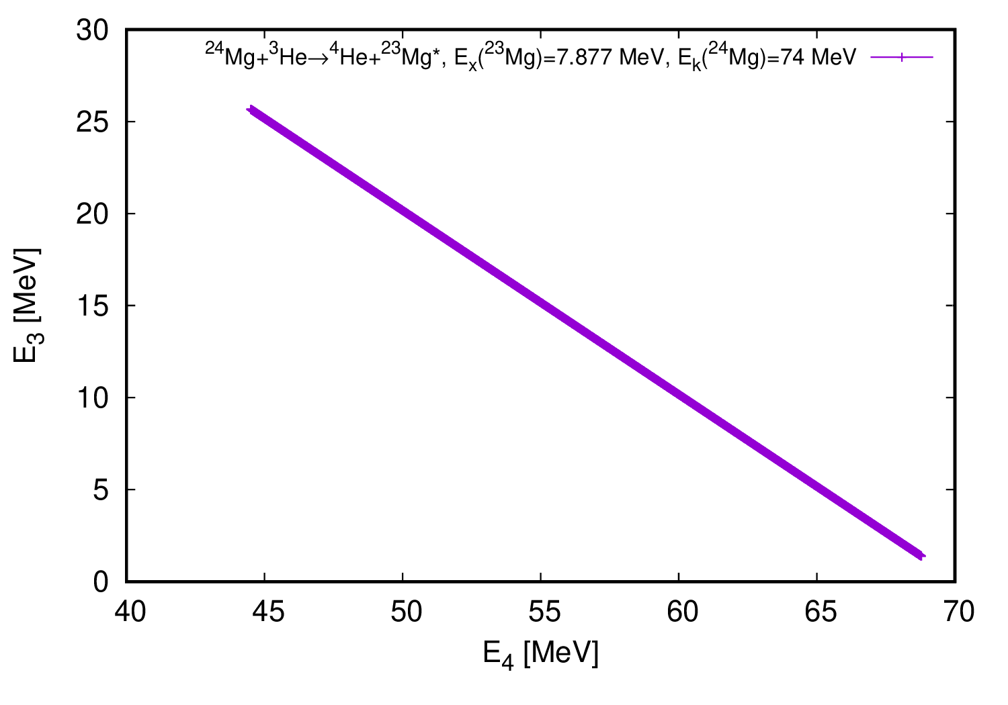
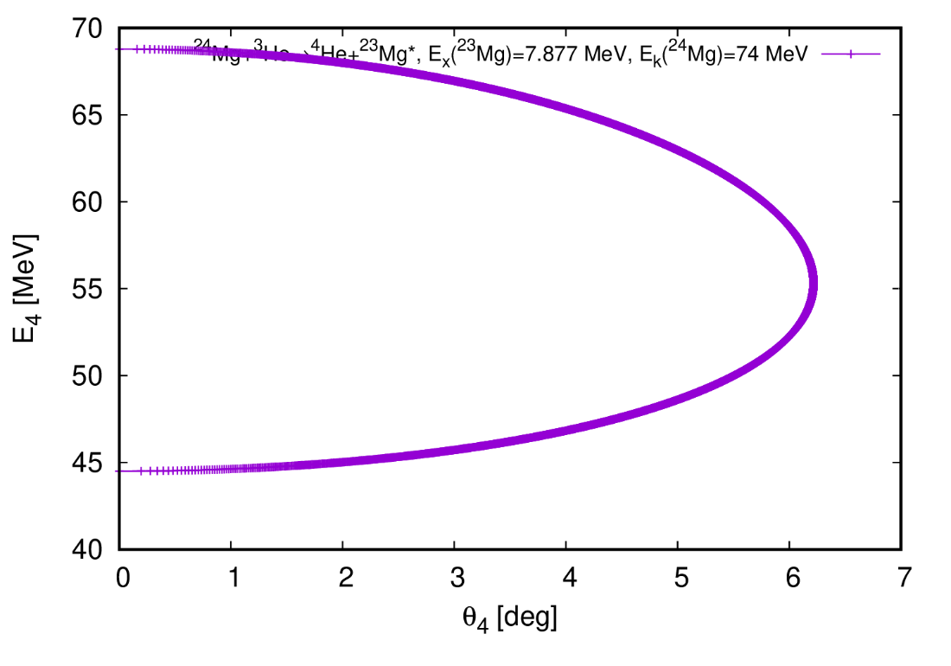
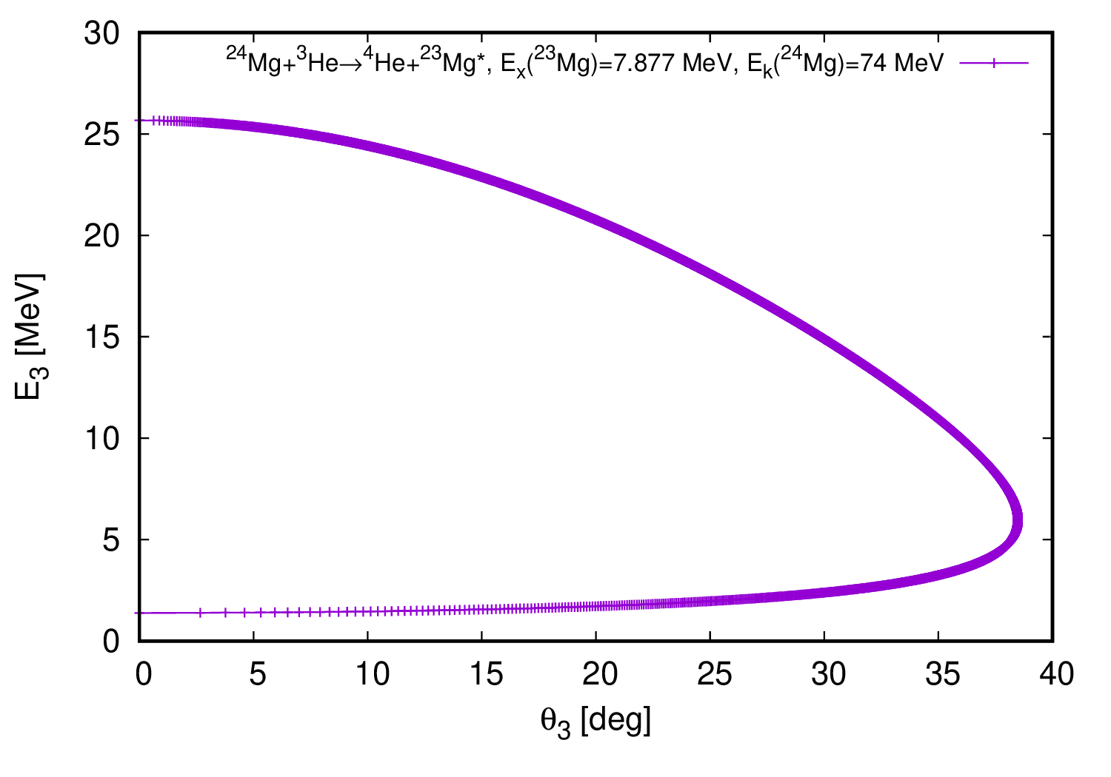
Larger α emission angle → lower α energy → higher recoil energy → larger Doppler shift

Slide 16
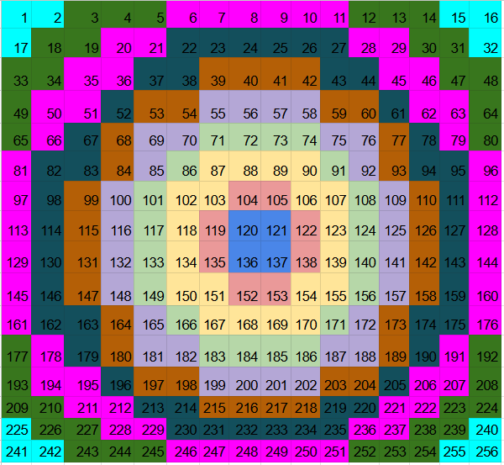
Ring Definition by Lexie

Slide 17
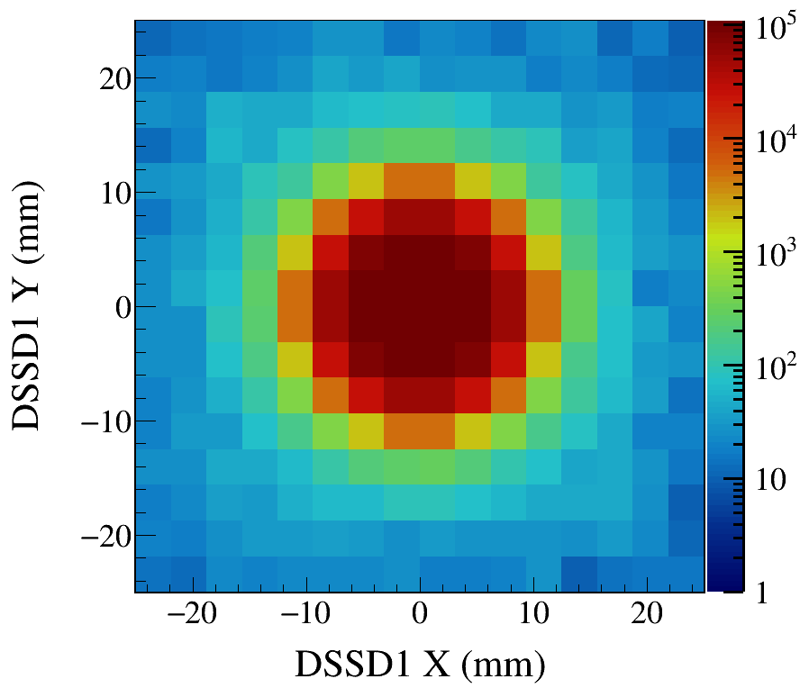
Isotropic α emission

Slide 18
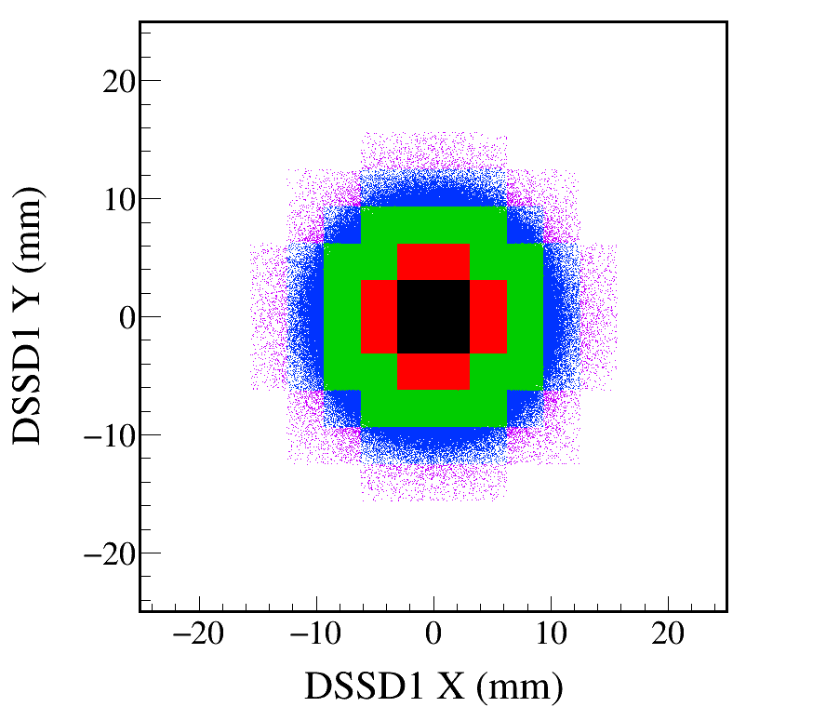
R1_ratio = 0.194871
R2_ratio = 0.351754
R3_ratio = 0.413421
R4_ratio = 0.0333036
R5_ratio = 0.00359599
No energy gates are applied.
Total number of events: 5,000,000
DSSD2e: 2,224,147
Notes:
tree_draw_alpha_count_ratios_DSL2.C
TFile* _file0 = TFile::Open("Mg23_Gamma7333_Eg7333.20_Tau7.0_SP1.00_AC0.0_all.root.");
TCanvas* canvaspeak = new TCanvas("canvaspeak", "canvaspeak", 890, 800);//
canvaspeak->cd();//
canvaspeak->SetTopMargin(0.03);
canvaspeak->SetRightMargin(0.12);
canvaspeak->SetLeftMargin(0.17);
canvaspeak->SetBottomMargin(0.15);
gStyle->SetFrameLineWidth(3);
canvaspeak->SetFrameLineWidth(3);
canvaspeak->SetLogz();
//TH2D* h2DSSD1xy = new TH2D("h2DSSD1xy", "h2DSSD1xy", 16, 75, 125, 16, 75, 125);
TH2D* h2DSSD1xy = new TH2D("h2DSSD1xy", "h2DSSD1xy", 1600, -25, 25, 1600, -25, 25);
TH1D* h1DSSD_total_e_Ring1 = new TH1D("h1DSSD_total_e_Ring1", "h1DSSD_total_e_Ring1", 6000, 0, 60000);
TH1D* h1DSSD_total_e_Ring2 = new TH1D("h1DSSD_total_e_Ring2", "h1DSSD_total_e_Ring2", 6000, 0, 60000);
TH1D* h1DSSD_total_e_Ring2_sub1 = new TH1D("h1DSSD_total_e_Ring2_sub1", "h1DSSD_total_e_Ring2_sub1", 6000, 0, 60000);
TH1D* h1DSSD_total_e_Ring2_sub2 = new TH1D("h1DSSD_total_e_Ring2_sub2", "h1DSSD_total_e_Ring2_sub2", 6000, 0, 60000);
TH1D* h1DSSD_total_e_Ring2_sub3 = new TH1D("h1DSSD_total_e_Ring2_sub3", "h1DSSD_total_e_Ring2_sub3", 6000, 0, 60000);
TH1D* h1DSSD_total_e_Ring2_sub4 = new TH1D("h1DSSD_total_e_Ring2_sub4", "h1DSSD_total_e_Ring2_sub4", 6000, 0, 60000);
TH1D* h1DSSD_total_e_Ring3 = new TH1D("h1DSSD_total_e_Ring3", "h1DSSD_total_e_Ring3", 6000, 0, 60000);
TH1D* h1DSSD_total_e_Ring3_sub1 = new TH1D("h1DSSD_total_e_Ring3_sub1", "h1DSSD_total_e_Ring3_sub1", 6000, 0, 60000);
TH1D* h1DSSD_total_e_Ring3_sub2 = new TH1D("h1DSSD_total_e_Ring3_sub2", "h1DSSD_total_e_Ring3_sub2", 6000, 0, 60000);
TH1D* h1DSSD_total_e_Ring3_sub3 = new TH1D("h1DSSD_total_e_Ring3_sub3", "h1DSSD_total_e_Ring3_sub3", 6000, 0, 60000);
TH1D* h1DSSD_total_e_Ring3_sub4 = new TH1D("h1DSSD_total_e_Ring3_sub4", "h1DSSD_total_e_Ring3_sub4", 6000, 0, 60000);
TH1D* h1DSSD_total_e_Ring3_sub5 = new TH1D("h1DSSD_total_e_Ring3_sub5", "h1DSSD_total_e_Ring3_sub5", 6000, 0, 60000);
TH1D* h1DSSD_total_e_Ring3_sub6 = new TH1D("h1DSSD_total_e_Ring3_sub6", "h1DSSD_total_e_Ring3_sub6", 6000, 0, 60000);
TH1D* h1DSSD_total_e_Ring3_sub7 = new TH1D("h1DSSD_total_e_Ring3_sub7", "h1DSSD_total_e_Ring3_sub7", 6000, 0, 60000);
TH1D* h1DSSD_total_e_Ring3_sub8 = new TH1D("h1DSSD_total_e_Ring3_sub8", "h1DSSD_total_e_Ring3_sub8", 6000, 0, 60000);
TH1D* h1DSSD_total_e_Ring4 = new TH1D("h1DSSD_total_e_Ring4", "h1DSSD_total_e_Ring4", 6000, 0, 60000);
TH1D* h1DSSD_total_e_Ring4_sub1 = new TH1D("h1DSSD_total_e_Ring4_sub1", "h1DSSD_total_e_Ring4_sub1", 6000, 0, 60000);
TH1D* h1DSSD_total_e_Ring4_sub2 = new TH1D("h1DSSD_total_e_Ring4_sub2", "h1DSSD_total_e_Ring4_sub2", 6000, 0, 60000);
TH1D* h1DSSD_total_e_Ring4_sub3 = new TH1D("h1DSSD_total_e_Ring4_sub3", "h1DSSD_total_e_Ring4_sub3", 6000, 0, 60000);
TH1D* h1DSSD_total_e_Ring4_sub4 = new TH1D("h1DSSD_total_e_Ring4_sub4", "h1DSSD_total_e_Ring4_sub4", 6000, 0, 60000);
TH1D* h1DSSD_total_e_Ring4_sub5 = new TH1D("h1DSSD_total_e_Ring4_sub5", "h1DSSD_total_e_Ring4_sub5", 6000, 0, 60000);
TH1D* h1DSSD_total_e_Ring4_sub6 = new TH1D("h1DSSD_total_e_Ring4_sub6", "h1DSSD_total_e_Ring4_sub6", 6000, 0, 60000);
TH1D* h1DSSD_total_e_Ring4_sub7 = new TH1D("h1DSSD_total_e_Ring4_sub7", "h1DSSD_total_e_Ring4_sub7", 6000, 0, 60000);
TH1D* h1DSSD_total_e_Ring4_sub8 = new TH1D("h1DSSD_total_e_Ring4_sub8", "h1DSSD_total_e_Ring4_sub8", 6000, 0, 60000);
TH1D* h1DSSD_total_e_Ring5 = new TH1D("h1DSSD_total_e_Ring5", "h1DSSD_total_e_Ring5", 6000, 0, 60000);
tree->Draw("DSSD1y-100:DSSD1x-100>>h2DSSD1xy", "DSSD1e+DSSD2e>100&&DSSD1e>100&&DSSD2e>100", "surf2");
tree->SetMarkerColor(1);
tree->Draw("DSSD1y-100:DSSD1x-100>>h2DSSD1xy", "DSSD1e+DSSD2e>100&&DSSD1e>100&&DSSD2e>100&&DSSD1x>96.875&&DSSD1x<103.125&&DSSD1y>96.875&&DSSD1y<103.125", "");
h1DSSD_total_e_Ring1->SetLineColor(1);
tree->Draw("DSSD1e+DSSD2e>>h1DSSD_total_e_Ring1", "DSSD1e+DSSD2e>100&&DSSD1e>100&&DSSD2e>100&&DSSD1x>96.875&&DSSD1x<103.125&&DSSD1y>96.875&&DSSD1y<103.125", "");
tree->SetMarkerColor(2);
tree->Draw("DSSD1y-100:DSSD1x-100", "DSSD1e+DSSD2e>100&&DSSD1e>100&&DSSD2e>100&&DSSD1x>96.875&&DSSD1x<103.125&&DSSD1y>103.125&&DSSD1y<106.25", "same");
tree->Draw("DSSD1y-100:DSSD1x-100", "DSSD1e+DSSD2e>100&&DSSD1e>100&&DSSD2e>100&&DSSD1x>96.875&&DSSD1x<103.125&&DSSD1y>93.75&&DSSD1y<96.875", "same");
tree->Draw("DSSD1y-100:DSSD1x-100", "DSSD1e+DSSD2e>100&&DSSD1e>100&&DSSD2e>100&&DSSD1x>103.125&&DSSD1x<106.25&&DSSD1y>96.875&&DSSD1y<103.125", "same");
tree->Draw("DSSD1y-100:DSSD1x-100", "DSSD1e+DSSD2e>100&&DSSD1e>100&&DSSD2e>100&&DSSD1x>93.75&&DSSD1x<96.875&&DSSD1y>96.875&&DSSD1y<103.125", "same");
tree->SetLineColor(2);
tree->Draw("DSSD1e+DSSD2e>>h1DSSD_total_e_Ring2_sub1", "DSSD1e+DSSD2e>100&&DSSD1e>100&&DSSD2e>100&&DSSD1x>96.875&&DSSD1x<103.125&&DSSD1y>103.125&&DSSD1y<106.25", "");
tree->Draw("DSSD1e+DSSD2e>>h1DSSD_total_e_Ring2_sub2", "DSSD1e+DSSD2e>100&&DSSD1e>100&&DSSD2e>100&&DSSD1x>96.875&&DSSD1x<103.125&&DSSD1y>93.75&&DSSD1y<96.875", "");
tree->Draw("DSSD1e+DSSD2e>>h1DSSD_total_e_Ring2_sub3", "DSSD1e+DSSD2e>100&&DSSD1e>100&&DSSD2e>100&&DSSD1x>103.125&&DSSD1x<106.25&&DSSD1y>96.875&&DSSD1y<103.125", "");
tree->Draw("DSSD1e+DSSD2e>>h1DSSD_total_e_Ring2_sub4", "DSSD1e+DSSD2e>100&&DSSD1e>100&&DSSD2e>100&&DSSD1x>93.75&&DSSD1x<96.875&&DSSD1y>96.875&&DSSD1y<103.125", "");
h1DSSD_total_e_Ring2->Add(h1DSSD_total_e_Ring2_sub1, h1DSSD_total_e_Ring2_sub2);
h1DSSD_total_e_Ring2->Add(h1DSSD_total_e_Ring2_sub3);
h1DSSD_total_e_Ring2->Add(h1DSSD_total_e_Ring2_sub4);
h1DSSD_total_e_Ring2->SetLineColor(2);
tree->SetMarkerColor(kGreen+1);
tree->Draw("DSSD1y-100:DSSD1x-100", "DSSD1e+DSSD2e>100&&DSSD1e>100&&DSSD2e>100&&DSSD1x>93.75&&DSSD1x<106.25&&DSSD1y>106.25&&DSSD1y<109.375", "same");
tree->Draw("DSSD1y-100:DSSD1x-100", "DSSD1e+DSSD2e>100&&DSSD1e>100&&DSSD2e>100&&DSSD1x>93.75&&DSSD1x<106.25&&DSSD1y>90.625&&DSSD1y<93.75", "same");
tree->Draw("DSSD1y-100:DSSD1x-100", "DSSD1e+DSSD2e>100&&DSSD1e>100&&DSSD2e>100&&DSSD1x>90.625&&DSSD1x<96.875&&DSSD1y>103.125&&DSSD1y<106.25", "same");
tree->Draw("DSSD1y-100:DSSD1x-100", "DSSD1e+DSSD2e>100&&DSSD1e>100&&DSSD2e>100&&DSSD1x>103.125&DSSD1x<109.375&&DSSD1y>103.125&&DSSD1y<106.25", "same");
tree->Draw("DSSD1y-100:DSSD1x-100", "DSSD1e+DSSD2e>100&&DSSD1e>100&&DSSD2e>100&&DSSD1x>90.625&&DSSD1x<93.75&&DSSD1y>96.875&&DSSD1y<103.125", "same");
tree->Draw("DSSD1y-100:DSSD1x-100", "DSSD1e+DSSD2e>100&&DSSD1e>100&&DSSD2e>100&&DSSD1x>106.25&&DSSD1x<109.375&&DSSD1y>96.875&&DSSD1y<103.125", "same");
tree->Draw("DSSD1y-100:DSSD1x-100", "DSSD1e+DSSD2e>100&&DSSD1e>100&&DSSD2e>100&&DSSD1x>90.625&&DSSD1x<96.875&&DSSD1y>93.75&&DSSD1y<96.875", "same");
tree->Draw("DSSD1y-100:DSSD1x-100", "DSSD1e+DSSD2e>100&&DSSD1e>100&&DSSD2e>100&&DSSD1x>103.125&&DSSD1x<109.375&&DSSD1y>93.75&&DSSD1y<96.875", "same");
tree->SetLineColor(kGreen+1);
tree->Draw("DSSD1e+DSSD2e>>h1DSSD_total_e_Ring3_sub1", "DSSD1e+DSSD2e>100&&DSSD1e>100&&DSSD2e>100&&DSSD1x>93.75&&DSSD1x<106.25&&DSSD1y>106.25&&DSSD1y<109.375", "");
tree->Draw("DSSD1e+DSSD2e>>h1DSSD_total_e_Ring3_sub2", "DSSD1e+DSSD2e>100&&DSSD1e>100&&DSSD2e>100&&DSSD1x>93.75&&DSSD1x<106.25&&DSSD1y>90.625&&DSSD1y<93.75", "");
tree->Draw("DSSD1e+DSSD2e>>h1DSSD_total_e_Ring3_sub3", "DSSD1e+DSSD2e>100&&DSSD1e>100&&DSSD2e>100&&DSSD1x>90.625&&DSSD1x<96.875&&DSSD1y>103.125&&DSSD1y<106.25", "");
tree->Draw("DSSD1e+DSSD2e>>h1DSSD_total_e_Ring3_sub4", "DSSD1e+DSSD2e>100&&DSSD1e>100&&DSSD2e>100&&DSSD1x>103.125&DSSD1x<109.375&&DSSD1y>103.125&&DSSD1y<106.25", "");
tree->Draw("DSSD1e+DSSD2e>>h1DSSD_total_e_Ring3_sub5", "DSSD1e+DSSD2e>100&&DSSD1e>100&&DSSD2e>100&&DSSD1x>90.625&&DSSD1x<93.75&&DSSD1y>96.875&&DSSD1y<103.125", "");
tree->Draw("DSSD1e+DSSD2e>>h1DSSD_total_e_Ring3_sub6", "DSSD1e+DSSD2e>100&&DSSD1e>100&&DSSD2e>100&&DSSD1x>106.25&&DSSD1x<109.375&&DSSD1y>96.875&&DSSD1y<103.125", "");
tree->Draw("DSSD1e+DSSD2e>>h1DSSD_total_e_Ring3_sub7", "DSSD1e+DSSD2e>100&&DSSD1e>100&&DSSD2e>100&&DSSD1x>90.625&&DSSD1x<96.875&&DSSD1y>93.75&&DSSD1y<96.875", "");
tree->Draw("DSSD1e+DSSD2e>>h1DSSD_total_e_Ring3_sub8", "DSSD1e+DSSD2e>100&&DSSD1e>100&&DSSD2e>100&&DSSD1x>103.125&&DSSD1x<109.375&&DSSD1y>93.75&&DSSD1y<96.875", "");
h1DSSD_total_e_Ring3->Add(h1DSSD_total_e_Ring3_sub1, h1DSSD_total_e_Ring3_sub2);
h1DSSD_total_e_Ring3->Add(h1DSSD_total_e_Ring3_sub3);
h1DSSD_total_e_Ring3->Add(h1DSSD_total_e_Ring3_sub4);
h1DSSD_total_e_Ring3->Add(h1DSSD_total_e_Ring3_sub5);
h1DSSD_total_e_Ring3->Add(h1DSSD_total_e_Ring3_sub6);
h1DSSD_total_e_Ring3->Add(h1DSSD_total_e_Ring3_sub7);
h1DSSD_total_e_Ring3->Add(h1DSSD_total_e_Ring3_sub8);
h1DSSD_total_e_Ring3->SetLineColor(kGreen+1);
tree->SetMarkerColor(kAzure);
tree->Draw("DSSD1y-100:DSSD1x-100", "DSSD1e+DSSD2e>100&&DSSD1e>100&&DSSD2e>100&&DSSD1x>93.75&&DSSD1x<106.25&&DSSD1y>109.375&&DSSD1y<112.5", "same");
tree->Draw("DSSD1y-100:DSSD1x-100", "DSSD1e+DSSD2e>100&&DSSD1e>100&&DSSD2e>100&&DSSD1x>93.75&&DSSD1x<106.25&&DSSD1y>87.5&&DSSD1y<90.625", "same");
tree->Draw("DSSD1y-100:DSSD1x-100", "DSSD1e+DSSD2e>100&&DSSD1e>100&&DSSD2e>100&&DSSD1x>90.625&&DSSD1x<93.75&&DSSD1y>106.25&&DSSD1y<109.375", "same");
tree->Draw("DSSD1y-100:DSSD1x-100", "DSSD1e+DSSD2e>100&&DSSD1e>100&&DSSD2e>100&&DSSD1x>106.25&DSSD1x<109.375&&DSSD1y>106.25&&DSSD1y<109.375", "same");
tree->Draw("DSSD1y-100:DSSD1x-100", "DSSD1e+DSSD2e>100&&DSSD1e>100&&DSSD2e>100&&DSSD1x>87.5&&DSSD1x<90.625&&DSSD1y>93.75&&DSSD1y<106.25", "same");
tree->Draw("DSSD1y-100:DSSD1x-100", "DSSD1e+DSSD2e>100&&DSSD1e>100&&DSSD2e>100&&DSSD1x>109.375&&DSSD1x<112.5&&DSSD1y>93.75&&DSSD1y<106.25", "same");
tree->Draw("DSSD1y-100:DSSD1x-100", "DSSD1e+DSSD2e>100&&DSSD1e>100&&DSSD2e>100&&DSSD1x>90.625&&DSSD1x<93.75&&DSSD1y>90.625&&DSSD1y<93.75", "same");
tree->Draw("DSSD1y-100:DSSD1x-100", "DSSD1e+DSSD2e>100&&DSSD1e>100&&DSSD2e>100&&DSSD1x>106.25&&DSSD1x<109.375&&DSSD1y>90.625&&DSSD1y<93.75", "same");
tree->SetLineColor(kAzure);
tree->Draw("DSSD1e+DSSD2e>>h1DSSD_total_e_Ring4_sub1", "DSSD1e+DSSD2e>100&&DSSD1e>100&&DSSD2e>100&&DSSD1x>93.75&&DSSD1x<106.25&&DSSD1y>109.375&&DSSD1y<112.5", "");
tree->Draw("DSSD1e+DSSD2e>>h1DSSD_total_e_Ring4_sub2", "DSSD1e+DSSD2e>100&&DSSD1e>100&&DSSD2e>100&&DSSD1x>93.75&&DSSD1x<106.25&&DSSD1y>87.5&&DSSD1y<90.625", "");
tree->Draw("DSSD1e+DSSD2e>>h1DSSD_total_e_Ring4_sub3", "DSSD1e+DSSD2e>100&&DSSD1e>100&&DSSD2e>100&&DSSD1x>90.625&&DSSD1x<93.75&&DSSD1y>106.25&&DSSD1y<109.375", "");
tree->Draw("DSSD1e+DSSD2e>>h1DSSD_total_e_Ring4_sub4", "DSSD1e+DSSD2e>100&&DSSD1e>100&&DSSD2e>100&&DSSD1x>106.25&&DSSD1x<109.375&&DSSD1y>106.25&&DSSD1y<109.375", "");
tree->Draw("DSSD1e+DSSD2e>>h1DSSD_total_e_Ring4_sub5", "DSSD1e+DSSD2e>100&&DSSD1e>100&&DSSD2e>100&&DSSD1x>87.5&&DSSD1x<90.625&&DSSD1y>93.75&&DSSD1y<106.25", "");
tree->Draw("DSSD1e+DSSD2e>>h1DSSD_total_e_Ring4_sub6", "DSSD1e+DSSD2e>100&&DSSD1e>100&&DSSD2e>100&&DSSD1x>109.375&&DSSD1x<112.5&&DSSD1y>93.75&&DSSD1y<106.25", "");
tree->Draw("DSSD1e+DSSD2e>>h1DSSD_total_e_Ring4_sub7", "DSSD1e+DSSD2e>100&&DSSD1e>100&&DSSD2e>100&&DSSD1x>90.625&&DSSD1x<93.75&&DSSD1y>90.625&&DSSD1y<93.75", "");
tree->Draw("DSSD1e+DSSD2e>>h1DSSD_total_e_Ring4_sub8", "DSSD1e+DSSD2e>100&&DSSD1e>100&&DSSD2e>100&&DSSD1x>106.25&&DSSD1x<109.375&&DSSD1y>90.625&&DSSD1y<93.75", "");
h1DSSD_total_e_Ring4->Add(h1DSSD_total_e_Ring4_sub1, h1DSSD_total_e_Ring4_sub2);
h1DSSD_total_e_Ring4->Add(h1DSSD_total_e_Ring4_sub3);
h1DSSD_total_e_Ring4->Add(h1DSSD_total_e_Ring4_sub4);
h1DSSD_total_e_Ring4->Add(h1DSSD_total_e_Ring4_sub5);
h1DSSD_total_e_Ring4->Add(h1DSSD_total_e_Ring4_sub6);
h1DSSD_total_e_Ring4->Add(h1DSSD_total_e_Ring4_sub7);
h1DSSD_total_e_Ring4->Add(h1DSSD_total_e_Ring4_sub8);
h1DSSD_total_e_Ring4->SetLineColor(kAzure);
tree->SetMarkerColor(kViolet);
tree->Draw("DSSD1y-100:DSSD1x-100", "DSSD1e+DSSD2e>100&&DSSD1e>100&&DSSD2e>100&&DSSD1x>93.75&&DSSD1x<106.25&&DSSD1y>112.5&&DSSD1y<115.625", "same");
tree->Draw("DSSD1y-100:DSSD1x-100", "DSSD1e+DSSD2e>100&&DSSD1e>100&&DSSD2e>100&&DSSD1x>93.75&&DSSD1x<106.25&&DSSD1y>84.375&&DSSD1y<87.5", "same");
tree->Draw("DSSD1y-100:DSSD1x-100", "DSSD1e+DSSD2e>100&&DSSD1e>100&&DSSD2e>100&&DSSD1x>87.5&&DSSD1x<93.75&&DSSD1y>109.375&&DSSD1y<112.5", "same");
tree->Draw("DSSD1y-100:DSSD1x-100", "DSSD1e+DSSD2e>100&&DSSD1e>100&&DSSD2e>100&&DSSD1x>106.25&DSSD1x<112.5&&DSSD1y>109.375&&DSSD1y<112.5", "same");
tree->Draw("DSSD1y-100:DSSD1x-100", "DSSD1e+DSSD2e>100&&DSSD1e>100&&DSSD2e>100&&DSSD1x>87.5&&DSSD1x<90.625&&DSSD1y>106.25&&DSSD1y<109.375", "same");
tree->Draw("DSSD1y-100:DSSD1x-100", "DSSD1e+DSSD2e>100&&DSSD1e>100&&DSSD2e>100&&DSSD1x>109.375&&DSSD1x<112.5&&DSSD1y>106.25&&DSSD1y<109.375", "same");
tree->Draw("DSSD1y-100:DSSD1x-100", "DSSD1e+DSSD2e>100&&DSSD1e>100&&DSSD2e>100&&DSSD1x>84.375&&DSSD1x<87.5&&DSSD1y>93.75&&DSSD1y<106.25", "same");
tree->Draw("DSSD1y-100:DSSD1x-100", "DSSD1e+DSSD2e>100&&DSSD1e>100&&DSSD2e>100&&DSSD1x>112.5&&DSSD1x<115.625&&DSSD1y>93.75&&DSSD1y<106.25", "same");
tree->Draw("DSSD1y-100:DSSD1x-100", "DSSD1e+DSSD2e>100&&DSSD1e>100&&DSSD2e>100&&DSSD1x>87.5&&DSSD1x<90.625&&DSSD1y>90.625&&DSSD1y<93.75", "same");
tree->Draw("DSSD1y-100:DSSD1x-100", "DSSD1e+DSSD2e>100&&DSSD1e>100&&DSSD2e>100&&DSSD1x>109.375&&DSSD1x<112.5&&DSSD1y>90.625&&DSSD1y<93.75", "same");
tree->Draw("DSSD1y-100:DSSD1x-100", "DSSD1e+DSSD2e>100&&DSSD1e>100&&DSSD2e>100&&DSSD1x>87.5&&DSSD1x<93.75&&DSSD1y>87.5&&DSSD1y<90.625", "same");
tree->Draw("DSSD1y-100:DSSD1x-100", "DSSD1e+DSSD2e>100&&DSSD1e>100&&DSSD2e>100&&DSSD1x>106.25&&DSSD1x<112.5&&DSSD1y>87.5&&DSSD1y<90.625", "same");
h2DSSD1xy->SetStats(0);
h2DSSD1xy->SetTitle("");
h2DSSD1xy->GetXaxis()->SetTitle("DSSD1 X (mm)");
h2DSSD1xy->GetYaxis()->SetTitle("DSSD1 Y (mm)");
h2DSSD1xy->GetXaxis()->CenterTitle();
h2DSSD1xy->GetYaxis()->CenterTitle();
h2DSSD1xy->GetXaxis()->SetLabelFont(132);
h2DSSD1xy->GetYaxis()->SetLabelFont(132);
h2DSSD1xy->GetXaxis()->SetLabelSize(0.05);
h2DSSD1xy->GetYaxis()->SetLabelSize(0.05);
h2DSSD1xy->GetXaxis()->SetTitleFont(132);
h2DSSD1xy->GetYaxis()->SetTitleFont(132);
h2DSSD1xy->GetXaxis()->SetTitleOffset(1.1);
h2DSSD1xy->GetYaxis()->SetTitleOffset(1.4);
h2DSSD1xy->GetXaxis()->SetTitleSize(0.06);
h2DSSD1xy->GetYaxis()->SetTitleSize(0.06);
h2DSSD1xy->GetXaxis()->SetNdivisions(505);
h2DSSD1xy->GetYaxis()->SetNdivisions(505);
h2DSSD1xy->GetXaxis()->SetRangeUser(-25, 25);
h2DSSD1xy->GetYaxis()->SetRangeUser(-25, 25);
h2DSSD1xy->SetMinimum(1);
//h2DSSD1xy->SetMaximum(100);
h2DSSD1xy->SetContour(99);
TPaletteAxis* palette = (TPaletteAxis*)h2DSSD1xy->GetListOfFunctions()->FindObject("palette");
gStyle->SetPalette(kRainbow);
palette->SetTitleFont(132);
palette->SetTitleSize(0.05);
palette->SetLabelFont(132);
palette->SetLabelSize(0.05);
palette->SetLineWidth(3);
canvaspeak->SaveAs("F:/out/G4_rootfiles_with_tree_Eg7333/DSL2_Fig_alpha_counts_rings.png");
h1DSSD_total_e_Ring1->Draw();
h1DSSD_total_e_Ring2->Draw("same");
h1DSSD_total_e_Ring3->Draw("same");
h1DSSD_total_e_Ring4->Draw("same");
h1DSSD_total_e_Ring1->SetStats(0);
h1DSSD_total_e_Ring1->SetTitle("");
h1DSSD_total_e_Ring1->GetXaxis()->SetTitle("DSSD1e+DSSD2e (keV)");
h1DSSD_total_e_Ring1->GetYaxis()->SetTitle("Counts per 10 keV");
h1DSSD_total_e_Ring1->GetXaxis()->CenterTitle();
h1DSSD_total_e_Ring1->GetYaxis()->CenterTitle();
h1DSSD_total_e_Ring1->GetXaxis()->SetLabelFont(132);
h1DSSD_total_e_Ring1->GetYaxis()->SetLabelFont(132);
h1DSSD_total_e_Ring1->GetXaxis()->SetLabelSize(0.05);
h1DSSD_total_e_Ring1->GetYaxis()->SetLabelSize(0.05);
h1DSSD_total_e_Ring1->GetXaxis()->SetTitleFont(132);
h1DSSD_total_e_Ring1->GetYaxis()->SetTitleFont(132);
h1DSSD_total_e_Ring1->GetXaxis()->SetTitleOffset(1.1);
h1DSSD_total_e_Ring1->GetYaxis()->SetTitleOffset(1.4);
h1DSSD_total_e_Ring1->GetXaxis()->SetTitleSize(0.06);
h1DSSD_total_e_Ring1->GetYaxis()->SetTitleSize(0.06);
h1DSSD_total_e_Ring1->GetXaxis()->SetNdivisions(505);
h1DSSD_total_e_Ring1->GetYaxis()->SetNdivisions(505);
h1DSSD_total_e_Ring1->GetYaxis()->SetTickLength(0.02);
double R1, R2, R3, R4, R5, R_total;
double Ea_min = 5000, Ea_max = 25000;
Ea_min = 17900; Ea_max = 20800;
R1 = tree->GetEntries(Form("DSSD1e+DSSD2e>%f&&DSSD1e+DSSD2e<%f&&DSSD1e>100&&DSSD2e>100&&DSSD1x>96.875&&DSSD1x<103.125&&DSSD1y>96.875&&DSSD1y<103.125", Ea_min, Ea_max));
Ea_min = 7000; Ea_max = 19200;
R2 = tree->GetEntries(Form("DSSD1e+DSSD2e>%f&&DSSD1e+DSSD2e<%f&&DSSD1e>100&&DSSD2e>100&&DSSD1x>96.875&&DSSD1x<103.125&&DSSD1y>103.125&&DSSD1y<106.25", Ea_min, Ea_max));
R2 += tree->GetEntries(Form("DSSD1e+DSSD2e>%f&&DSSD1e+DSSD2e<%f&&DSSD1e>100&&DSSD2e>100&&DSSD1x>96.875&&DSSD1x<103.125&&DSSD1y>93.75&&DSSD1y<96.875", Ea_min, Ea_max));
R2 += tree->GetEntries(Form("DSSD1e+DSSD2e>%f&&DSSD1e+DSSD2e<%f&&DSSD1e>100&&DSSD2e>100&&DSSD1x>103.125&&DSSD1x<106.25&&DSSD1y>96.875&&DSSD1y<103.125", Ea_min, Ea_max));
R2 += tree->GetEntries(Form("DSSD1e+DSSD2e>%f&&DSSD1e+DSSD2e<%f&&DSSD1e>100&&DSSD2e>100&&DSSD1x>93.75&&DSSD1x<96.875&&DSSD1y>96.875&&DSSD1y<103.125", Ea_min, Ea_max));
Ea_min = 4000; Ea_max = 15170;
R3 = tree->GetEntries(Form("DSSD1e+DSSD2e>%f&&DSSD1e+DSSD2e<%f&&DSSD1e>100&&DSSD2e>100&&DSSD1x>93.75&&DSSD1x<106.25&&DSSD1y>106.25&&DSSD1y<109.375", Ea_min, Ea_max));
R3 += tree->GetEntries(Form("DSSD1e+DSSD2e>%f&&DSSD1e+DSSD2e<%f&&DSSD1e>100&&DSSD2e>100&&DSSD1x>93.75&&DSSD1x<106.25&&DSSD1y>90.625&&DSSD1y<93.75", Ea_min, Ea_max));
R3 += tree->GetEntries(Form("DSSD1e+DSSD2e>%f&&DSSD1e+DSSD2e<%f&&DSSD1e>100&&DSSD2e>100&&DSSD1x>90.625&&DSSD1x<96.875&&DSSD1y>103.125&&DSSD1y<106.25", Ea_min, Ea_max));
R3 += tree->GetEntries(Form("DSSD1e+DSSD2e>%f&&DSSD1e+DSSD2e<%f&&DSSD1e>100&&DSSD2e>100&&DSSD1x>103.125&DSSD1x<109.375&&DSSD1y>103.125&&DSSD1y<106.25", Ea_min, Ea_max));
R3 += tree->GetEntries(Form("DSSD1e+DSSD2e>%f&&DSSD1e+DSSD2e<%f&&DSSD1e>100&&DSSD2e>100&&DSSD1x>90.625&&DSSD1x<93.75&&DSSD1y>96.875&&DSSD1y<103.125", Ea_min, Ea_max));
R3 += tree->GetEntries(Form("DSSD1e+DSSD2e>%f&&DSSD1e+DSSD2e<%f&&DSSD1e>100&&DSSD2e>100&&DSSD1x>106.25&&DSSD1x<109.375&&DSSD1y>96.875&&DSSD1y<103.125", Ea_min, Ea_max));
R3 += tree->GetEntries(Form("DSSD1e+DSSD2e>%f&&DSSD1e+DSSD2e<%f&&DSSD1e>100&&DSSD2e>100&&DSSD1x>90.625&&DSSD1x<96.875&&DSSD1y>93.75&&DSSD1y<96.875", Ea_min, Ea_max));
R3 += tree->GetEntries(Form("DSSD1e+DSSD2e>%f&&DSSD1e+DSSD2e<%f&&DSSD1e>100&&DSSD2e>100&&DSSD1x>103.125&&DSSD1x<109.375&&DSSD1y>93.75&&DSSD1y<96.875", Ea_min, Ea_max));
Ea_min = 2510; Ea_max = 10220;
R4 = tree->GetEntries(Form("DSSD1e+DSSD2e>%f&&DSSD1e+DSSD2e<%f&&DSSD1e>100&&DSSD2e>100&&DSSD1x>93.75&&DSSD1x<106.25&&DSSD1y>109.375&&DSSD1y<112.5", Ea_min, Ea_max));
R4 += tree->GetEntries(Form("DSSD1e+DSSD2e>%f&&DSSD1e+DSSD2e<%f&&DSSD1e>100&&DSSD2e>100&&DSSD1x>93.75&&DSSD1x<106.25&&DSSD1y>87.5&&DSSD1y<90.625", Ea_min, Ea_max));
R4 += tree->GetEntries(Form("DSSD1e+DSSD2e>%f&&DSSD1e+DSSD2e<%f&&DSSD1e>100&&DSSD2e>100&&DSSD1x>90.625&&DSSD1x<93.75&&DSSD1y>106.25&&DSSD1y<109.375", Ea_min, Ea_max));
R4 += tree->GetEntries(Form("DSSD1e+DSSD2e>%f&&DSSD1e+DSSD2e<%f&&DSSD1e>100&&DSSD2e>100&&DSSD1x>106.25&DSSD1x<109.375&&DSSD1y>106.25&&DSSD1y<109.375", Ea_min, Ea_max));
R4 += tree->GetEntries(Form("DSSD1e+DSSD2e>%f&&DSSD1e+DSSD2e<%f&&DSSD1e>100&&DSSD2e>100&&DSSD1x>87.5&&DSSD1x<90.625&&DSSD1y>93.75&&DSSD1y<106.25", Ea_min, Ea_max));
R4 += tree->GetEntries(Form("DSSD1e+DSSD2e>%f&&DSSD1e+DSSD2e<%f&&DSSD1e>100&&DSSD2e>100&&DSSD1x>109.375&&DSSD1x<112.5&&DSSD1y>93.75&&DSSD1y<106.25", Ea_min, Ea_max));
R4 += tree->GetEntries(Form("DSSD1e+DSSD2e>%f&&DSSD1e+DSSD2e<%f&&DSSD1e>100&&DSSD2e>100&&DSSD1x>90.625&&DSSD1x<93.75&&DSSD1y>90.625&&DSSD1y<93.75", Ea_min, Ea_max));
R4 += tree->GetEntries(Form("DSSD1e+DSSD2e>%f&&DSSD1e+DSSD2e<%f&&DSSD1e>100&&DSSD2e>100&&DSSD1x>106.25&&DSSD1x<109.375&&DSSD1y>90.625&&DSSD1y<93.75", Ea_min, Ea_max));
R5 = tree->GetEntries(Form("DSSD1e+DSSD2e>%f&&DSSD1e+DSSD2e<%f&&DSSD1e>100&&DSSD2e>100&&DSSD1x>93.75&&DSSD1x<106.25&&DSSD1y>112.5&&DSSD1y<115.625", Ea_min, Ea_max));
R5 += tree->GetEntries(Form("DSSD1e+DSSD2e>%f&&DSSD1e+DSSD2e<%f&&DSSD1e>100&&DSSD2e>100&&DSSD1x>93.75&&DSSD1x<106.25&&DSSD1y>84.375&&DSSD1y<87.5", Ea_min, Ea_max));
R5 += tree->GetEntries(Form("DSSD1e+DSSD2e>%f&&DSSD1e+DSSD2e<%f&&DSSD1e>100&&DSSD2e>100&&DSSD1x>87.5&&DSSD1x<93.75&&DSSD1y>109.375&&DSSD1y<112.5", Ea_min, Ea_max));
R5 += tree->GetEntries(Form("DSSD1e+DSSD2e>%f&&DSSD1e+DSSD2e<%f&&DSSD1e>100&&DSSD2e>100&&DSSD1x>106.25&DSSD1x<112.5&&DSSD1y>109.375&&DSSD1y<112.5", Ea_min, Ea_max));
R5 += tree->GetEntries(Form("DSSD1e+DSSD2e>%f&&DSSD1e+DSSD2e<%f&&DSSD1e>100&&DSSD2e>100&&DSSD1x>87.5&&DSSD1x<90.625&&DSSD1y>106.25&&DSSD1y<109.375", Ea_min, Ea_max));
R5 += tree->GetEntries(Form("DSSD1e+DSSD2e>%f&&DSSD1e+DSSD2e<%f&&DSSD1e>100&&DSSD2e>100&&DSSD1x>109.375&&DSSD1x<112.5&&DSSD1y>106.25&&DSSD1y<109.375", Ea_min, Ea_max));
R5 += tree->GetEntries(Form("DSSD1e+DSSD2e>%f&&DSSD1e+DSSD2e<%f&&DSSD1e>100&&DSSD2e>100&&DSSD1x>84.375&&DSSD1x<87.5&&DSSD1y>93.75&&DSSD1y<106.25", Ea_min, Ea_max));
R5 += tree->GetEntries(Form("DSSD1e+DSSD2e>%f&&DSSD1e+DSSD2e<%f&&DSSD1e>100&&DSSD2e>100&&DSSD1x>112.5&&DSSD1x<115.625&&DSSD1y>93.75&&DSSD1y<106.25", Ea_min, Ea_max));
R5 += tree->GetEntries(Form("DSSD1e+DSSD2e>%f&&DSSD1e+DSSD2e<%f&&DSSD1e>100&&DSSD2e>100&&DSSD1x>87.5&&DSSD1x<90.625&&DSSD1y>90.625&&DSSD1y<93.75", Ea_min, Ea_max));
R5 += tree->GetEntries(Form("DSSD1e+DSSD2e>%f&&DSSD1e+DSSD2e<%f&&DSSD1e>100&&DSSD2e>100&&DSSD1x>109.375&&DSSD1x<112.5&&DSSD1y>90.625&&DSSD1y<93.75", Ea_min, Ea_max));
R5 += tree->GetEntries(Form("DSSD1e+DSSD2e>%f&&DSSD1e+DSSD2e<%f&&DSSD1e>100&&DSSD2e>100&&DSSD1x>87.5&&DSSD1x<93.75&&DSSD1y>87.5&&DSSD1y<90.625", Ea_min, Ea_max));
R5 += tree->GetEntries(Form("DSSD1e+DSSD2e>%f&&DSSD1e+DSSD2e<%f&&DSSD1e>100&&DSSD2e>100&&DSSD1x>106.25&&DSSD1x<112.5&&DSSD1y>87.5&&DSSD1y<90.625", Ea_min, Ea_max));
R_total = tree->GetEntries("DSSD1e+DSSD2e>100&&DSSD1e>100&&DSSD2e>100");
cout << "R1 = " << R1 << endl;
cout << "R2 = " << R2 << endl;
cout << "R3 = " << R3 << endl;
cout << "R4 = " << R4 << endl;
cout << "R5 = " << R5 << endl;
cout << "R_total = " << R_total << endl;
double R1_ratio, R2_ratio, R3_ratio, R4_ratio, R5_ratio;
R1_ratio = R1 / R_total;
R2_ratio = R2 / R_total;
R3_ratio = R3 / R_total;
R4_ratio = R4 / R_total;
R5_ratio = R5 / R_total;
cout << "R1_ratio = " << R1_ratio << endl;
cout << "R2_ratio = " << R2_ratio << endl;
cout << "R3_ratio = " << R3_ratio << endl;
cout << "R4_ratio = " << R4_ratio << endl;
cout << "R5_ratio = " << R5_ratio << endl;

Slide 19
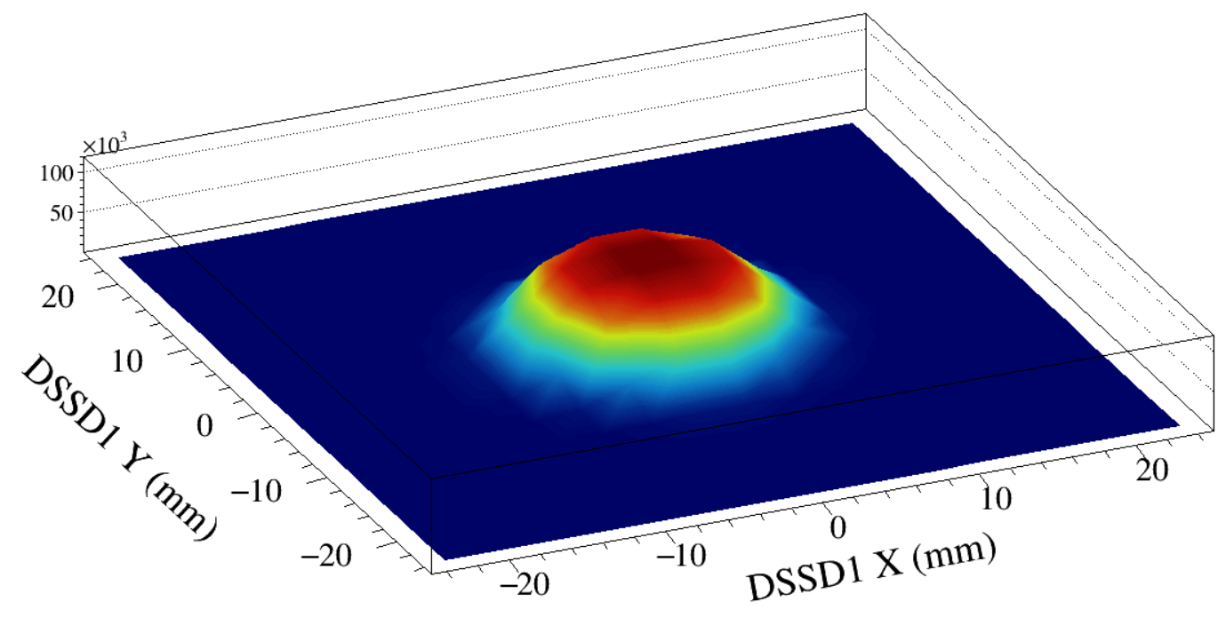
0.194871
0.351754
0.413421
0.0333036
0.00359599
Notes:
R1_ratio = 0.194871
R2_ratio = 0.351754
R3_ratio = 0.413421
R4_ratio = 0.0333036
R5_ratio = 0.00359599

Slide 20
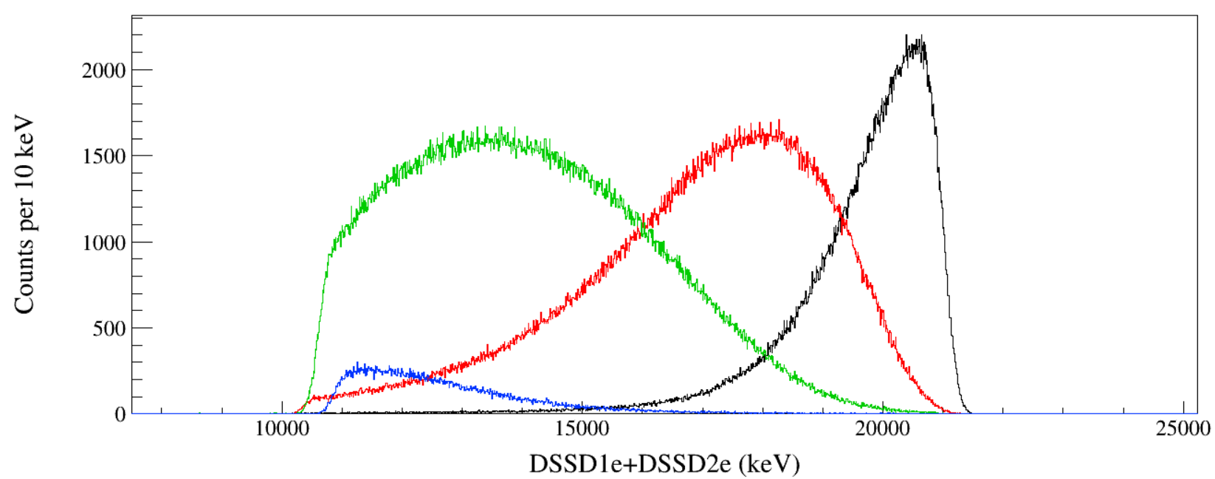
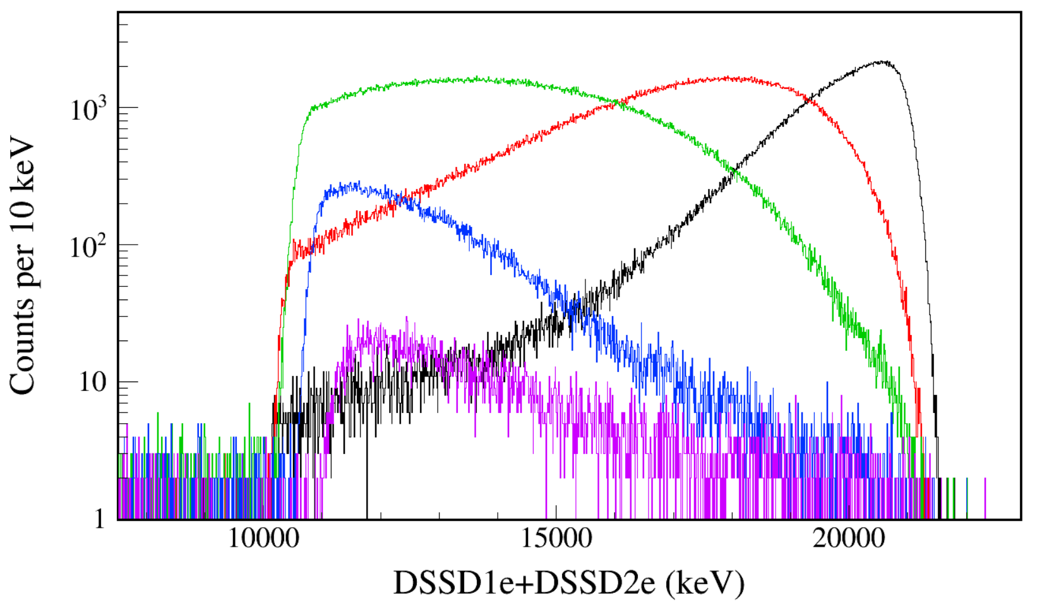
Ring1
Ring2
Ring3
Ring4
Ring1
Ring2
Ring3
Ring4
Ring5
Notes:
C:\Si24\root_scripts\tree_draw_alpha_count_ratios_DSL2.C

Slide 21
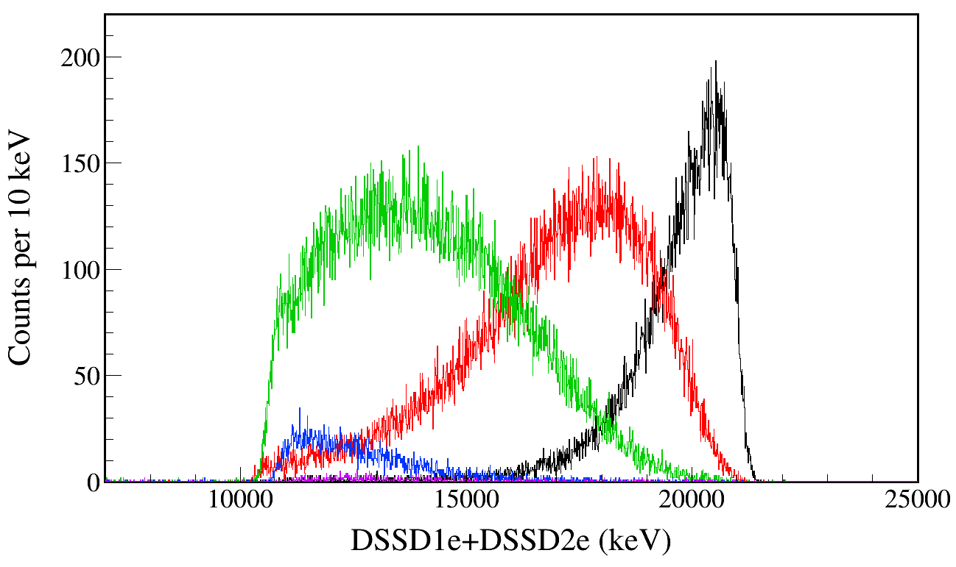
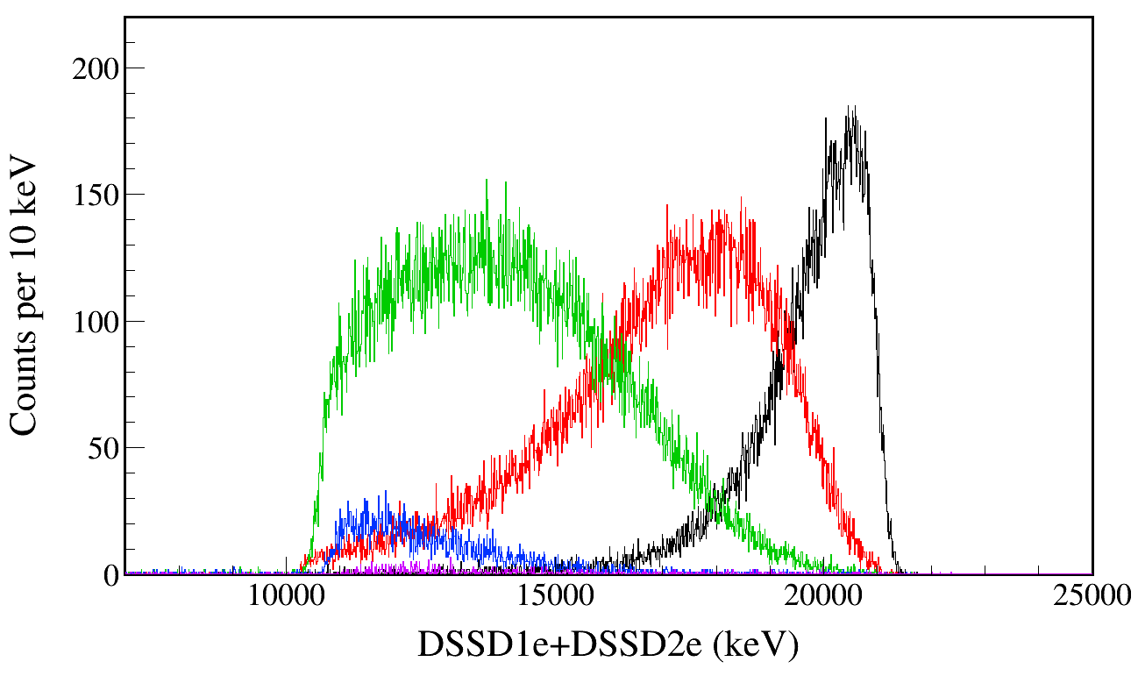
Ring1
Ring2
Ring3
Ring4
Ring5
Laptop
4e5 events
R1_ratio = 0.194871
R2_ratio = 0.351754
R3_ratio = 0.413421
R4_ratio = 0.0333036
R5_ratio = 0.00359599
No energy gates are applied.
5e6 events.
Ring1
Ring2
Ring3
Ring4
Ring5
Fishtank
4e5 events

Slide 22
α counts in each DSSD ring simulated by varying the A₂ coefficient.

Slide 23
α count ratios with identical energy gates and position gates.
 | Ea_min (keV) | Ea_max (keV) | LLNL | TRIUMF | Geant4
Ring1 | 17900 | 20800 | 398280 | 35892 | 433368
Ring2 | 7000 | 19200 | 1081850 | 106390 | 782252
Ring3 | 4000 | 15170 | 1705835 | 189984 | 919232
Ring4 | 2510 | 10220 | 733529 | 92555 | 73797
Ring5 |  |  |  |  | 7707
Sum |  |  | 3919494 | 424821 | 2216356
Ratio1 |  |  | 10% | 8% | 20%
Ratio2 |  |  | 28% | 25% | 35%
Ratio3 |  |  | 44% | 45% | 41%
Ratio4 |  |  | 19% | 22% | 3%
Ratio5 |  |  |  |  | 0%

Slide 24
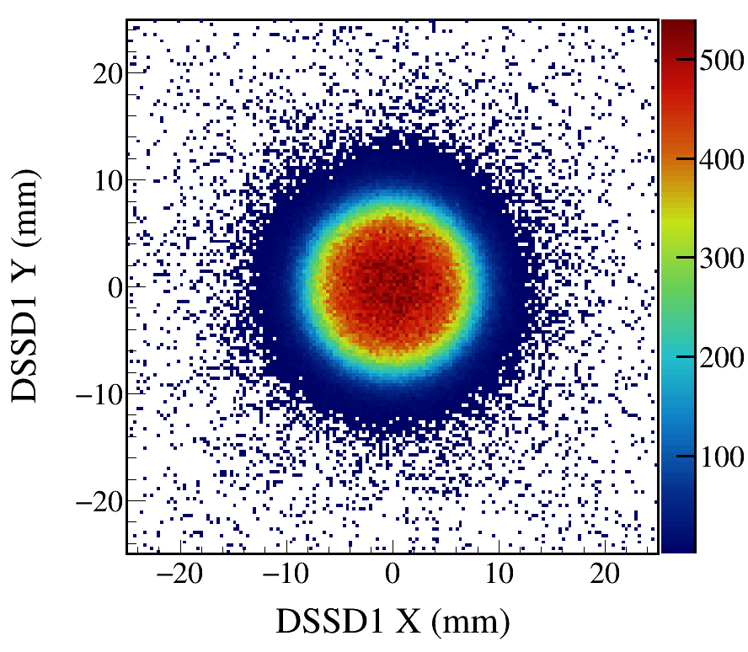
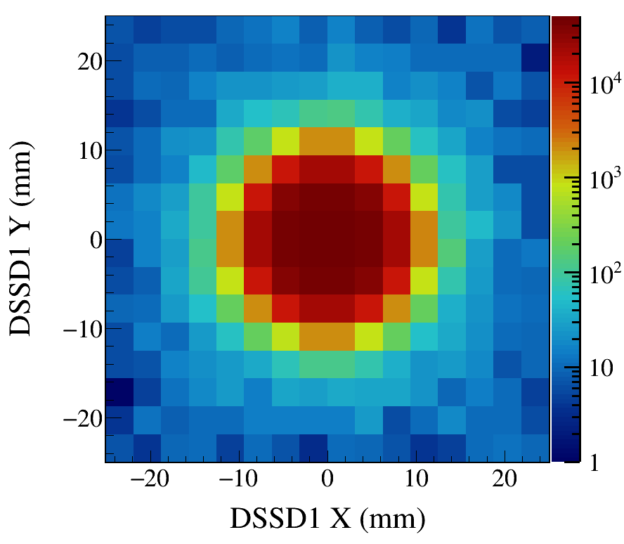
$$W\left(θ_{α}\right)=1+{AD}_{2}P_{2}\left(cosθ_{α}\right)+{AD}_{4}P_{4}\left(cosθ_{α}\right)$$
θ_{α}: α emission angle with respect to the beam axis
${AD}_{2}=1,{AD}_{4}=0$.
Notes:
DSL2_Fig_alpha_counts_rings_Mg23_Gamma7333_Eg7333.20_Tau7.0_SP1.00_AD1.0_all

Slide 25
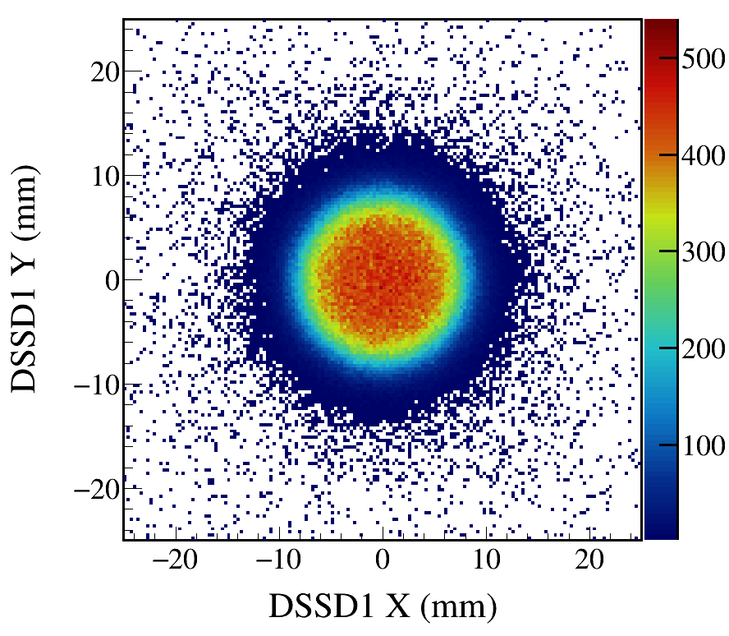
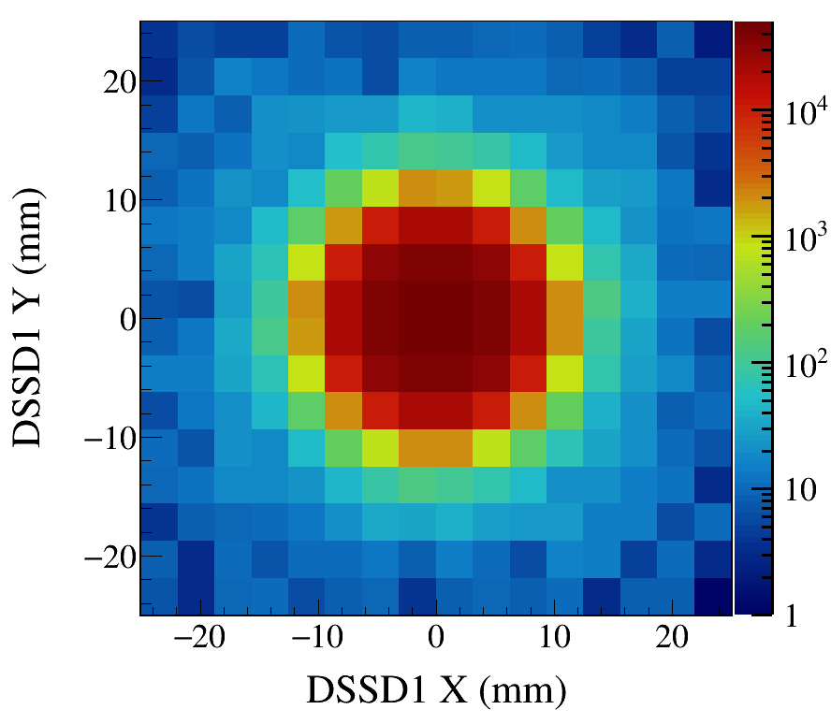
$$W\left(θ_{α}\right)=1+{AD}_{2}P_{2}\left(cosθ_{α}\right)+{AD}_{4}P_{4}\left(cosθ_{α}\right)$$
θ_{α}: α emission angle with respect to the beam axis
${AD}_{2}=0,{AD}_{4}=0$.
Notes:
DSL2_Fig_alpha_counts_rings_Mg23_Gamma7333_Eg7333.20_Tau7.0_SP1.00_AD0.0_all

Slide 26
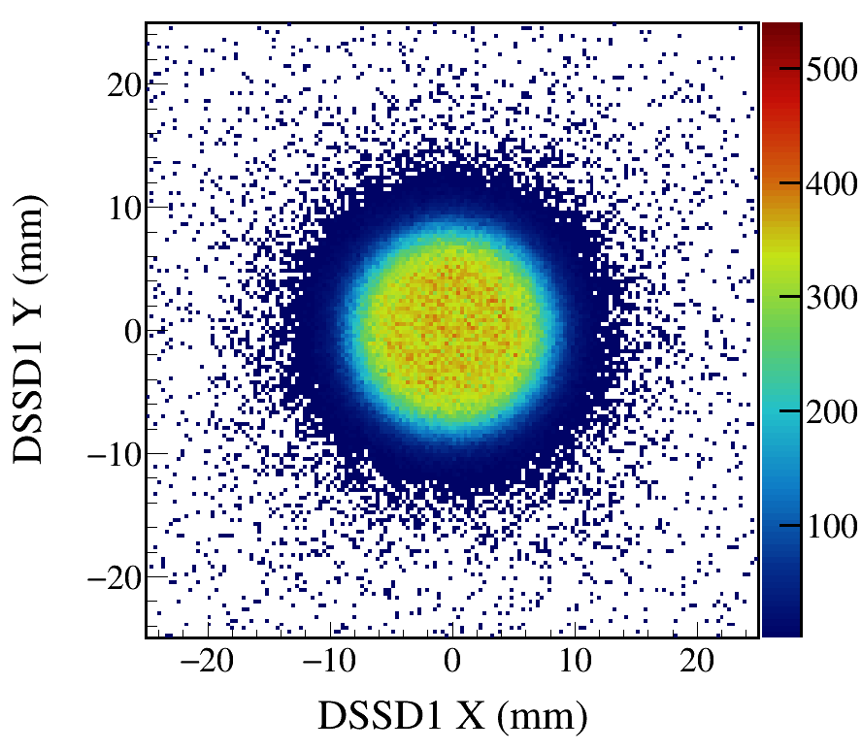
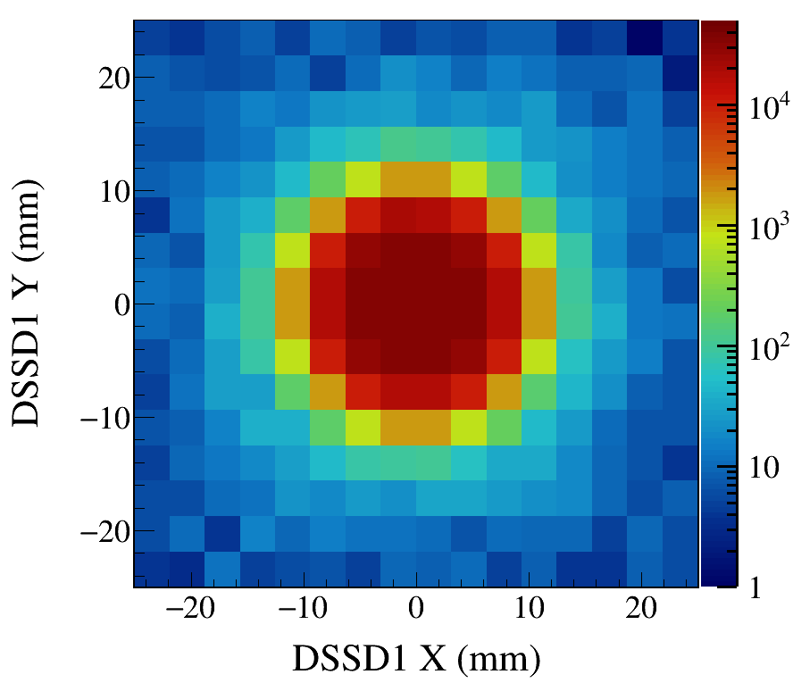
$$W\left(θ_{α}\right)=1+{AD}_{2}P_{2}\left(cosθ_{α}\right)+{AD}_{4}P_{4}\left(cosθ_{α}\right)$$
θ_{α}: α emission angle with respect to the beam axis
${AD}_{2}=−0.5,{AD}_{4}=0$.
Notes:
DSL2_Fig_alpha_counts_rings_Mg23_Gamma7333_Eg7333.20_Tau7.0_SP1.00_AD-0.5_all

Slide 27
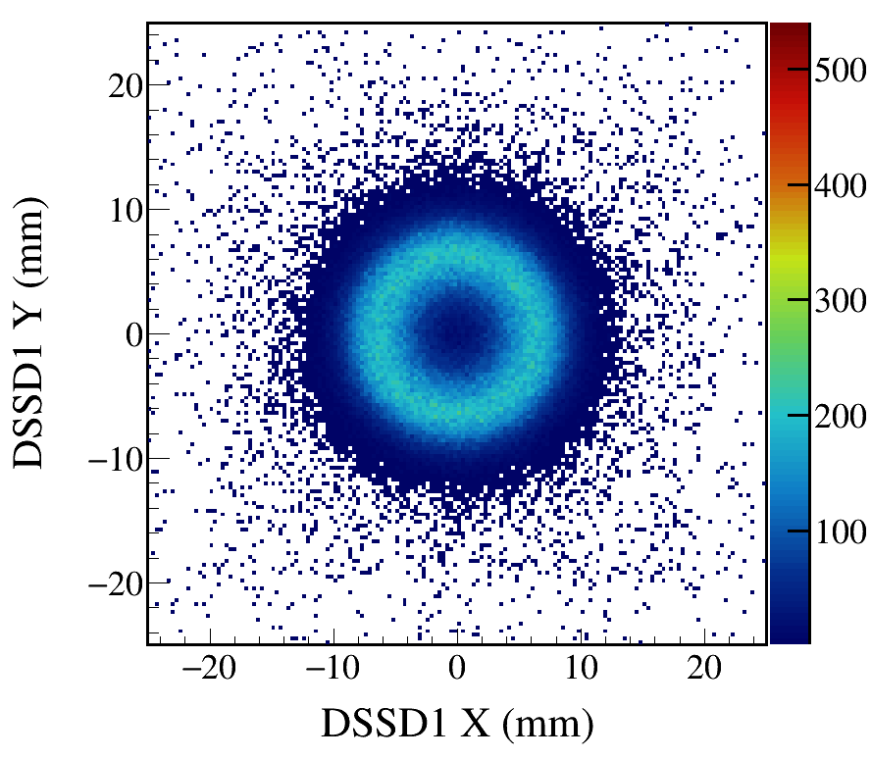
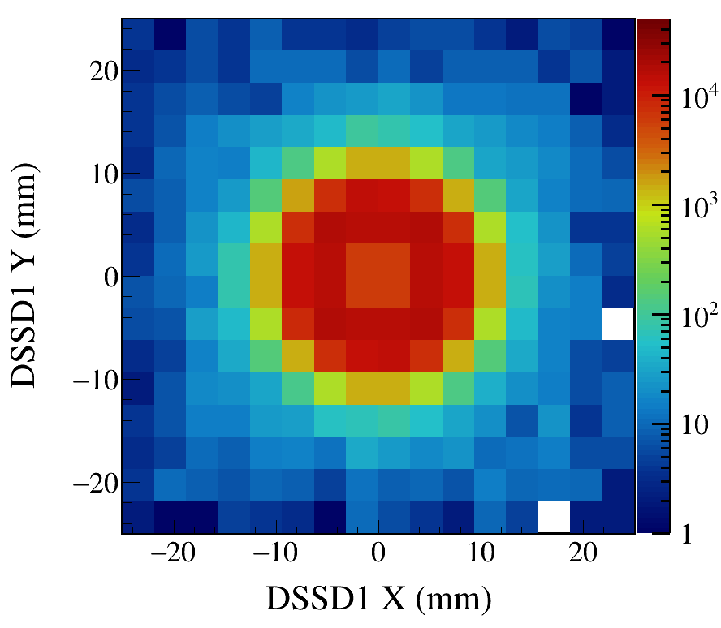
$$W\left(θ_{α}\right)=1+{AD}_{2}P_{2}\left(cosθ_{α}\right)+{AD}_{4}P_{4}\left(cosθ_{α}\right)$$
θ_{α}: α emission angle with respect to the beam axis
${AD}_{2}=−1,{AD}_{4}=0$.
Notes:
DSL2_Fig_alpha_counts_rings_Mg23_Gamma7333_Eg7333.20_Tau7.0_SP1.00_AD-1.0_all

Slide 29
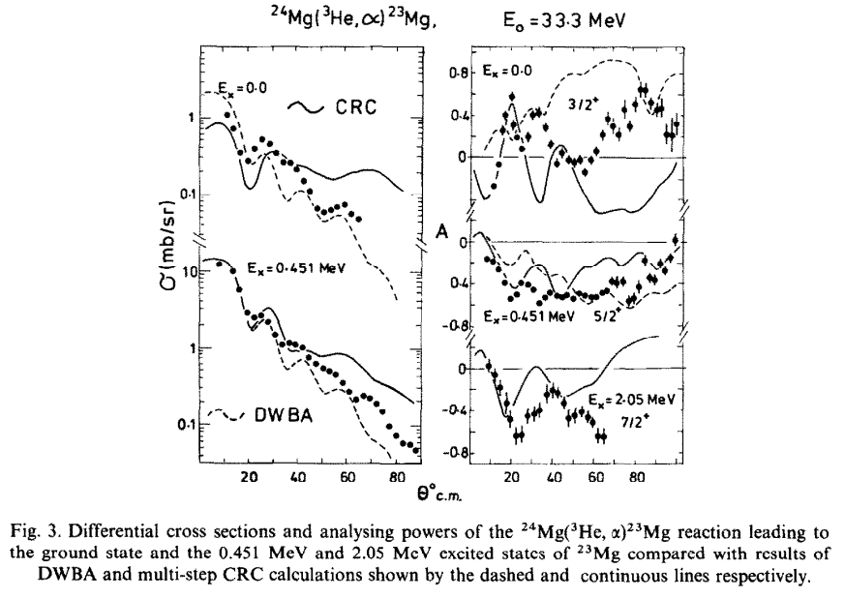
33.3 MeV polarized ³He beam
F. Entezami et al., Nucl. Phys. A 366, 1 (1981).

Slide 30
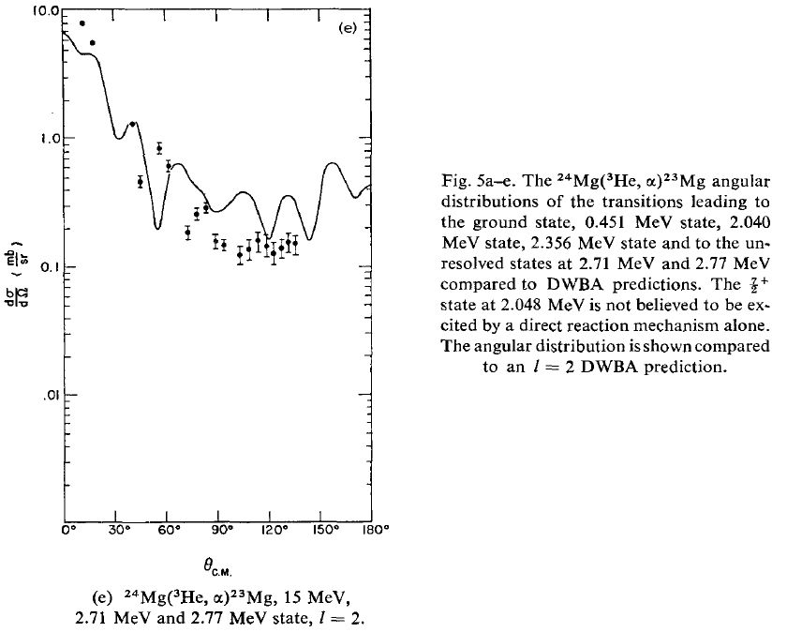
15 MeV ³He beam
J.M. Joyce et al., Nucl. Phys. A 132, 629 (1969).

Slide 31
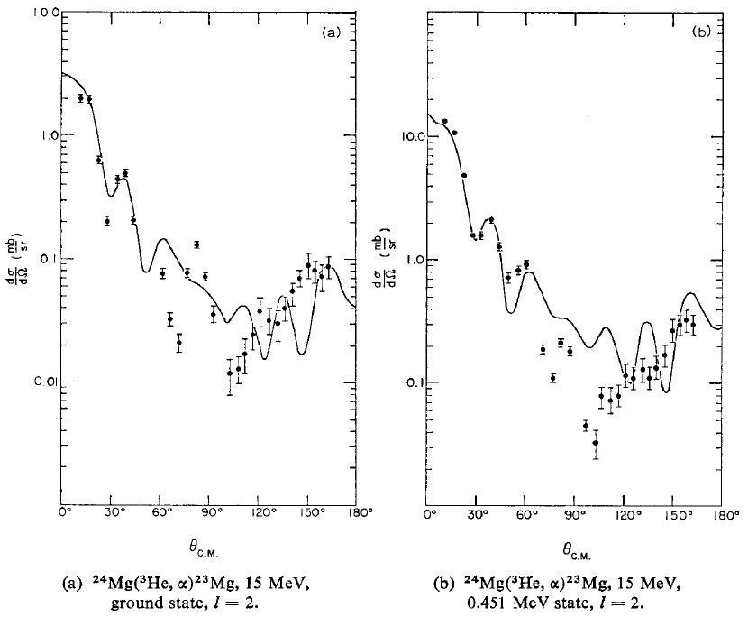

Slide 32
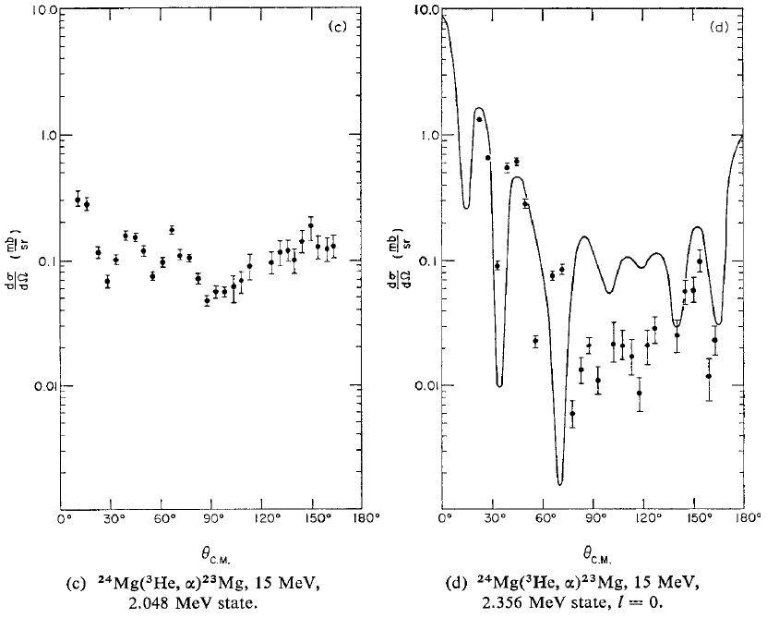

Slide 33
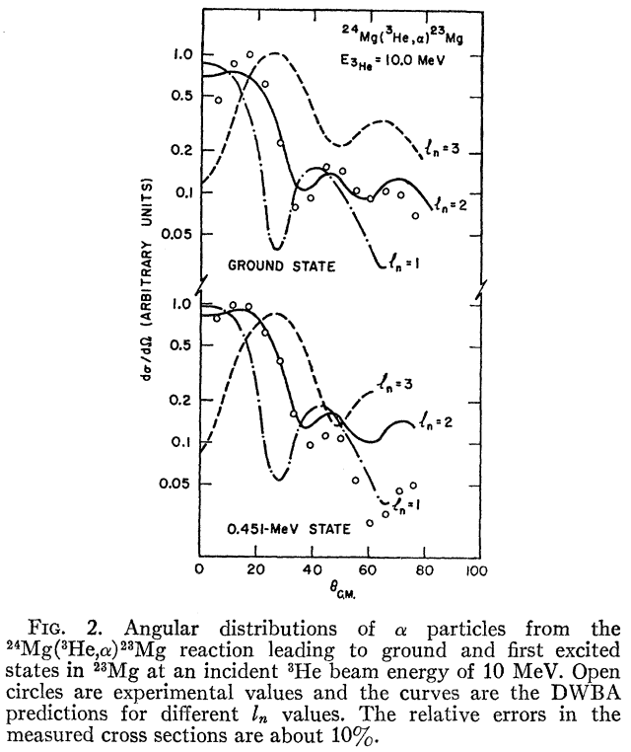
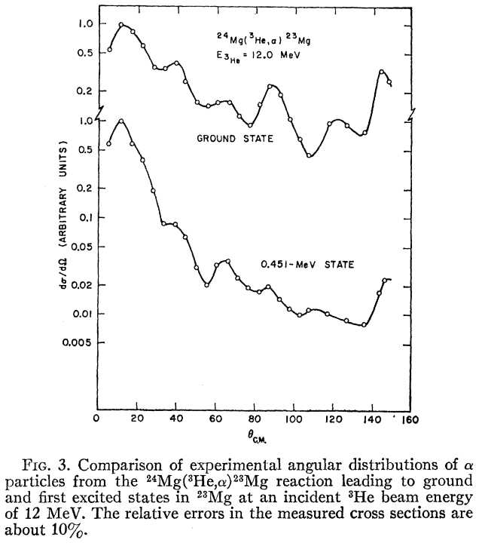
6 - 12 MeV ^{bombarding energies}
J. Dubois et al., Phys. Rev. 160, 925 (1967).

Slide 34
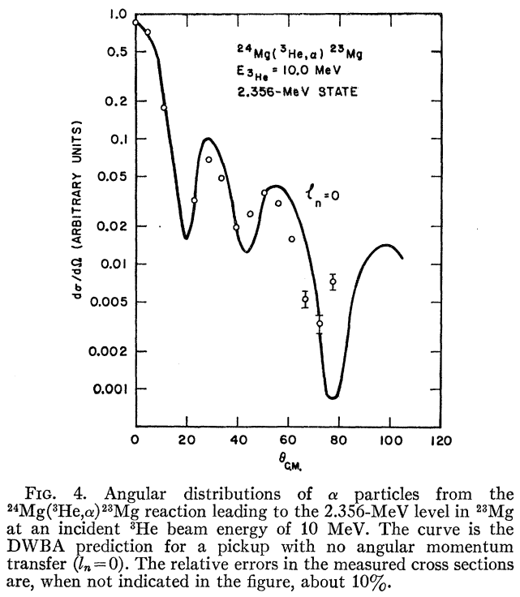
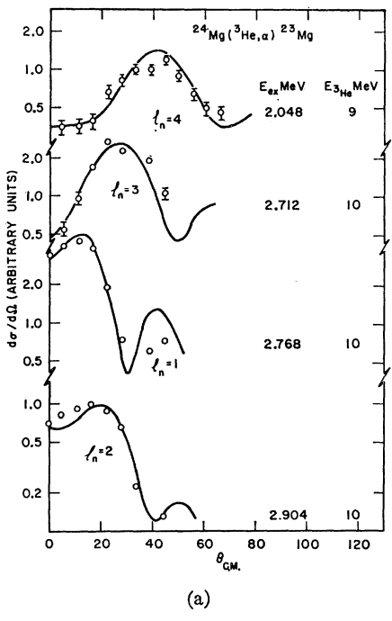

Slide 35
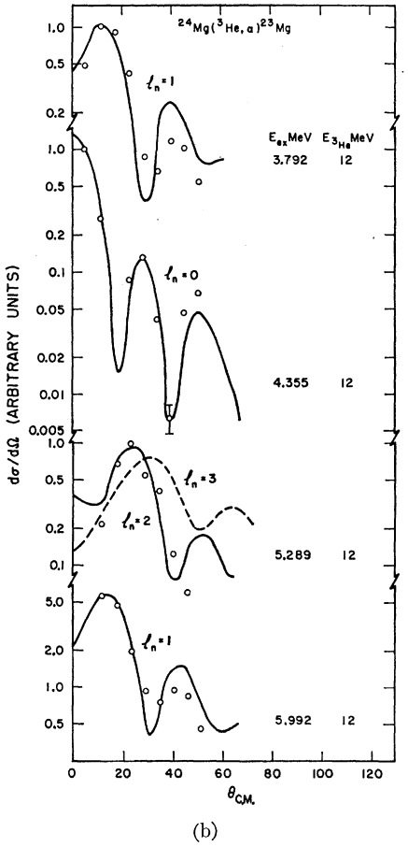

Slide 36
Emulator | PCGP_numPCs | PCGP_numPCs | PCGP_numPCs | PCGP_numPCs | PCGP_numPCs
Calibrator | directbayeswoodbury | directbayeswoodbury | directbayeswoodbury | directbayeswoodbury | directbayeswoodbury
Sampler | metropolis_hastings | metropolis_hastings | metropolis_hastings | metropolis_hastings | metropolis_hastings
Prior (keV) | Gaussian Mean = 7332.7 Sigma = 1.2 | Gaussian Mean = 7335.1 Sigma = 0.9 | Gaussian Mean = 7333.2 Sigma = 1.1 | Bimodal Mean = 7332.7, 7333.7 Sigma = 1.2, 1.1 Weight = 0.5, 0.5 | Trimodal Mean = 7332.7, 7333.7, 7335.1 Sigma = 1.2, 1.1, 0.9 Weight = 0.33, 0.33, 0.33
E_{γ} (keV) | 7332.7(12) Sallaska_PRC2011 | 7335.1(9) Goldberg_Thesis2024 | 7333.2(11) Basunia_NDS2021 | 7332.7(12) Sallaska_PRC2011 7333.7(11) Jenkins_PRL2004 | 7332.7(12) Sallaska_PRC2011 7333.7(11) Jenkins_PRL2004 7335.1(9) Goldberg_Thesis2024
τ (fs) | $${6.3}_{−3.3}^{+3.9}$$ | $${9.5}_{−4.0}^{+4.6}$$ | $${7.0}_{−3.4}^{+3.8}$$ | $${7.2}_{−3.6}^{+3.8}$$ | $${8.1}_{−4.0}^{+4.5}$$
90% C.I. (fs) | <11.4 | <15.7 | <12.1 | <12.2 | <13.5

Slide 37
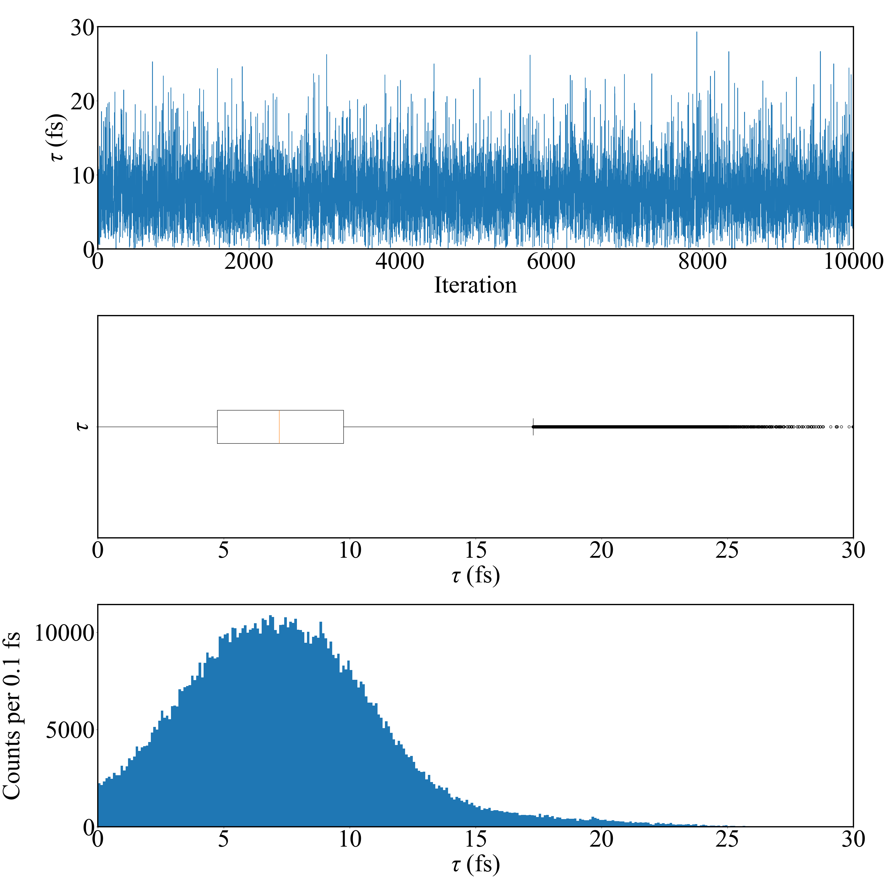
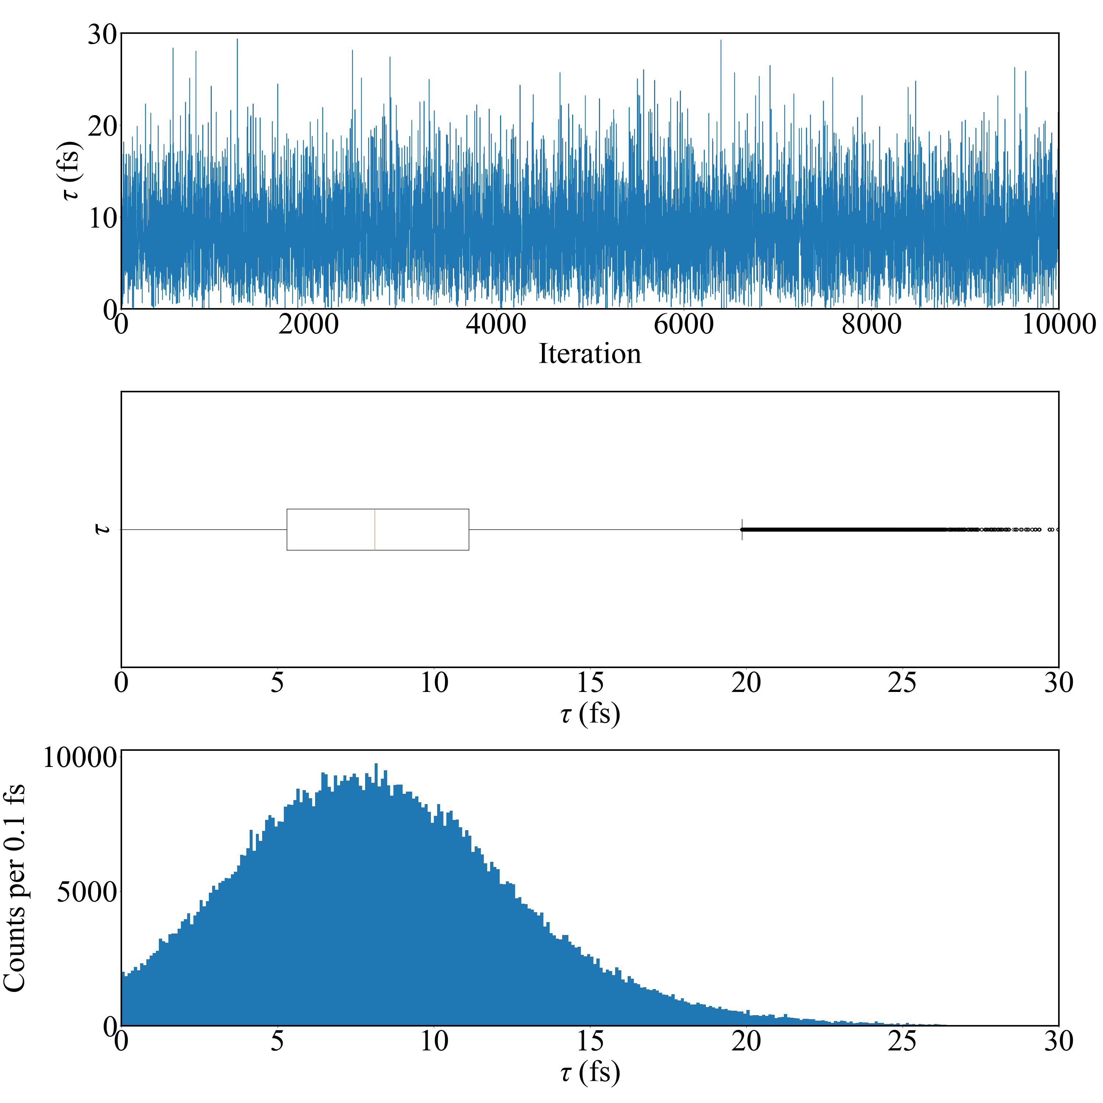
Emulation method: PCGP
Calibration method: directbayeswoodbury
Sampler: metropolis_hastings
Emulation method: PCGP
Calibration method: directbayeswoodbury
Sampler: metropolis_hastings
Eg prior: bimodal of Sallaska_PRC2011 and
Jenkins_PRL2004
Tau = 7.204 +3.788 -3.563 fs
Eg prior: trimodal of Sallaska_PRC2011, Jenkins_PRL2004, Goldberg_Thesis2024
Tau = 8.105 +4.537 -4.033 fs

Slide 38
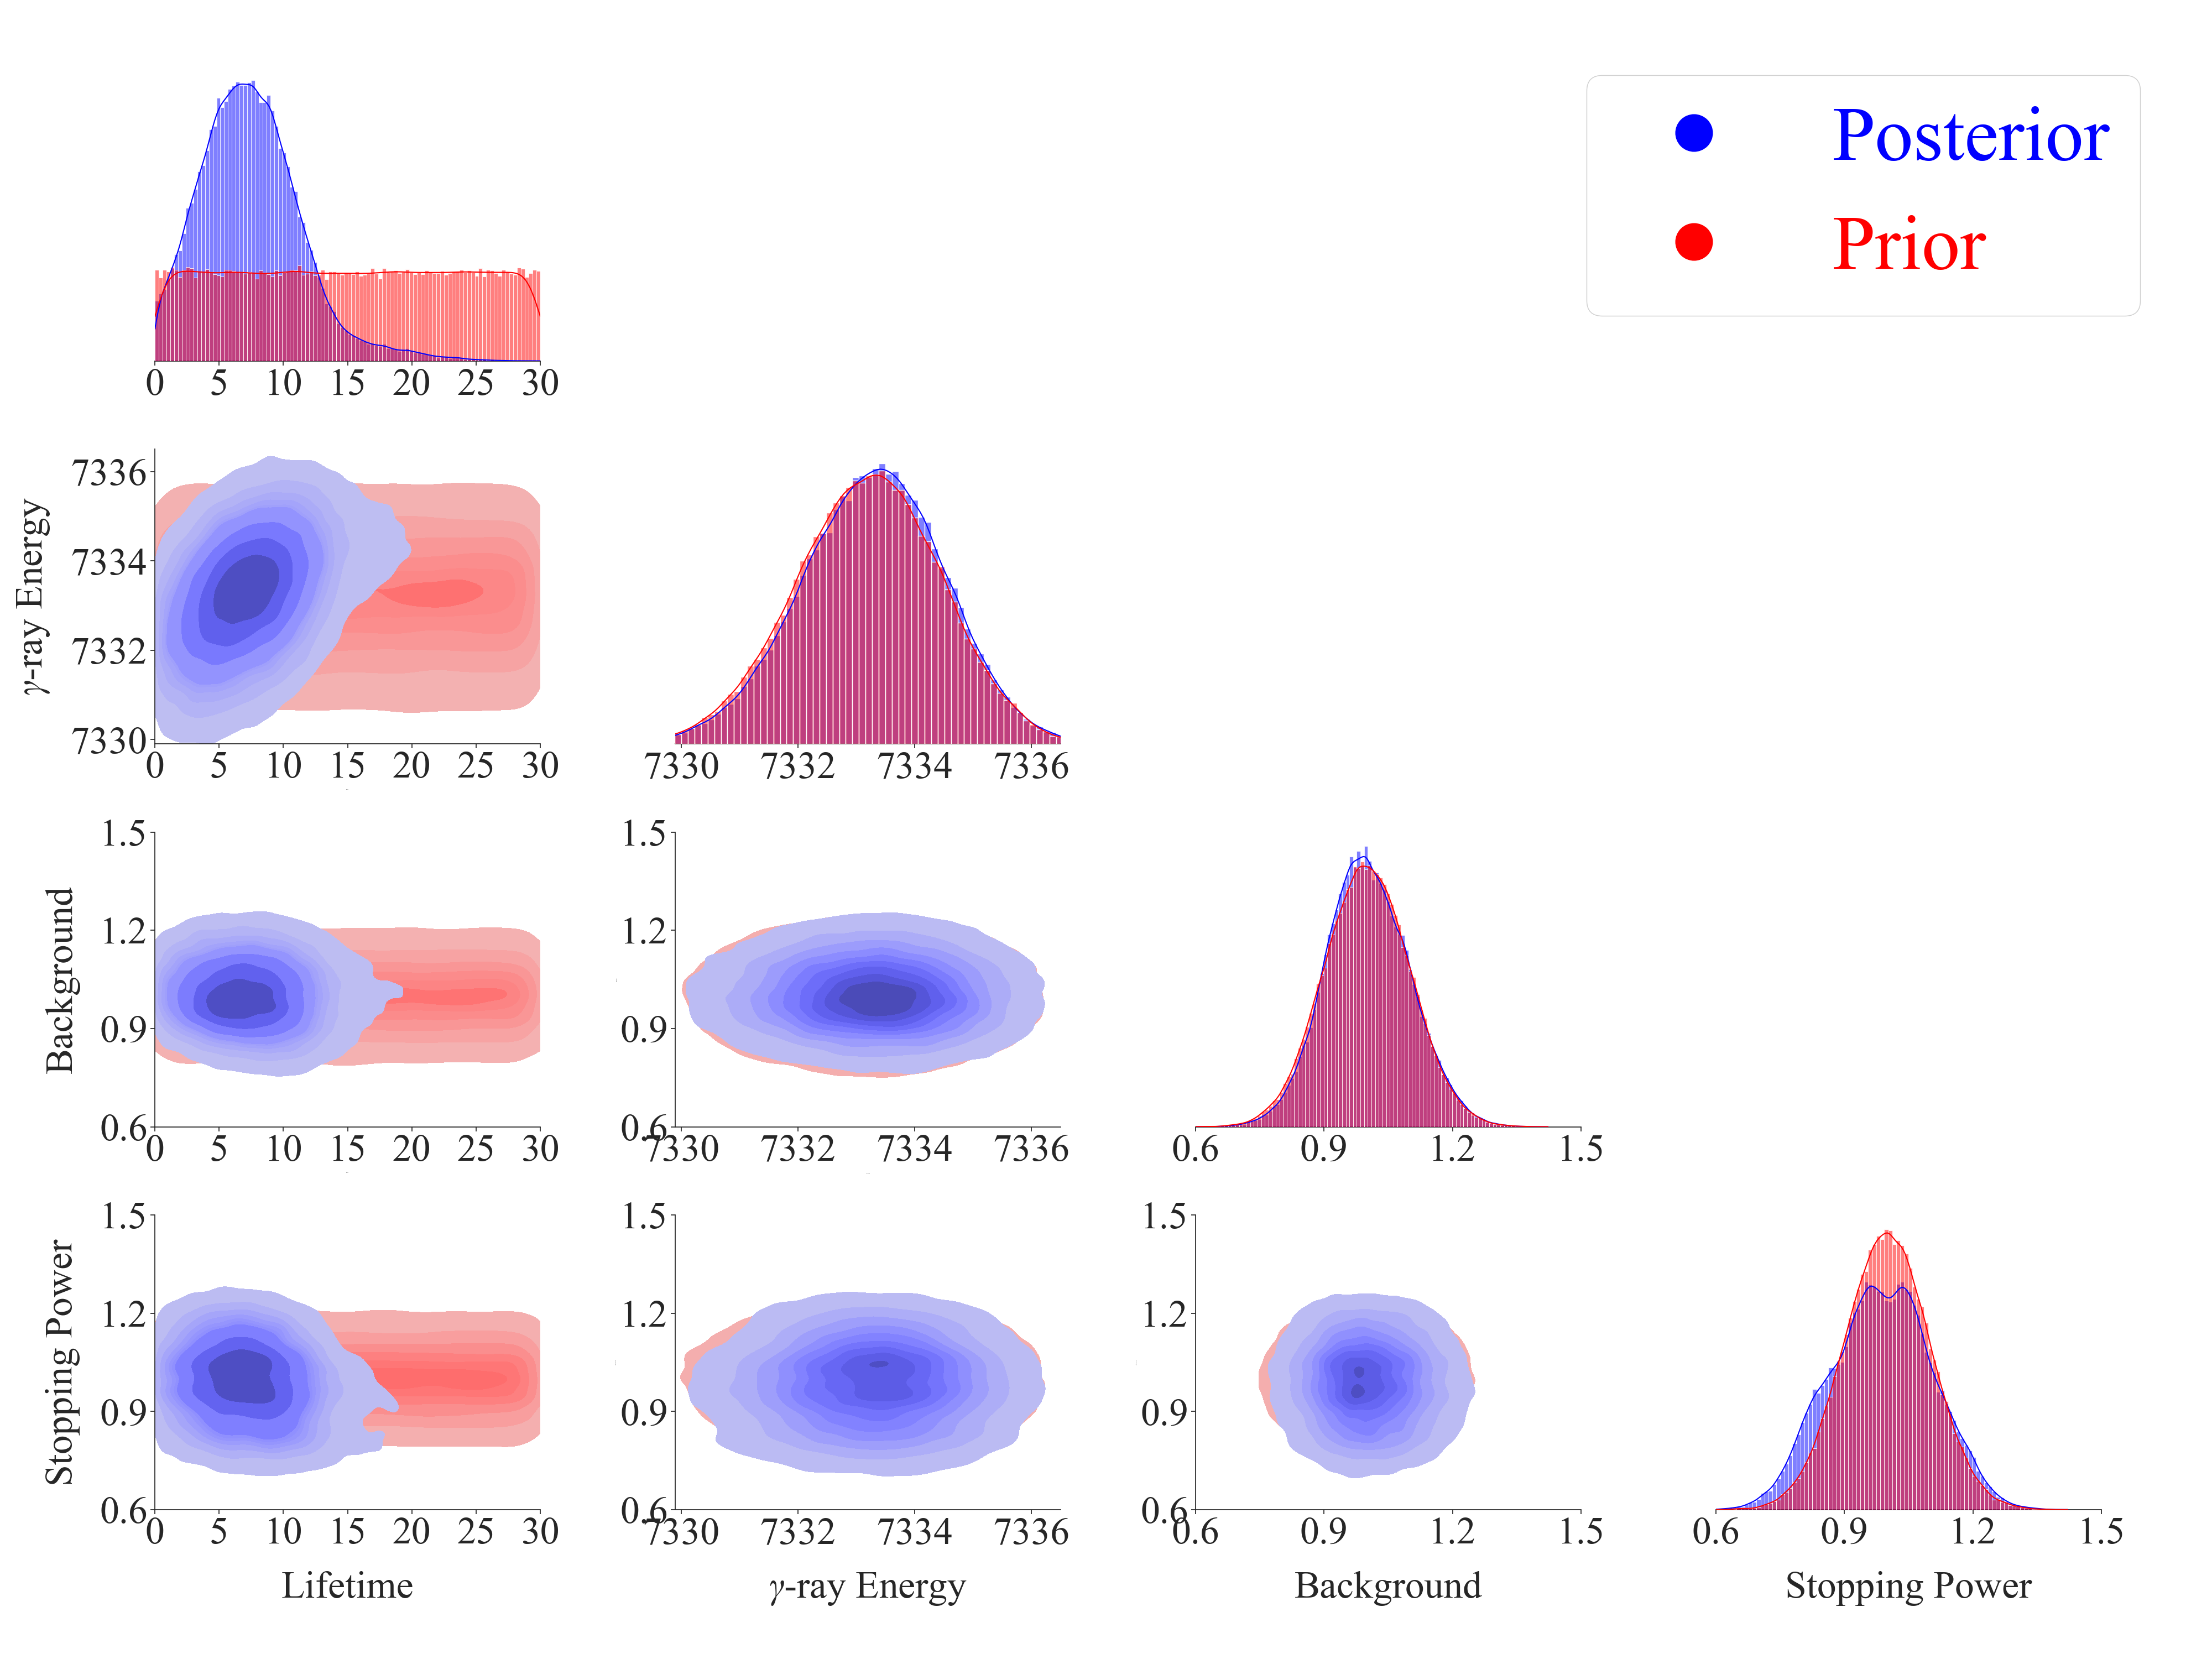
Bimodal Prior:
Mean = 7332.7, 7333.7
Sigma = 1.2, 1.1
Weight = 0.5, 0.5

Slide 39
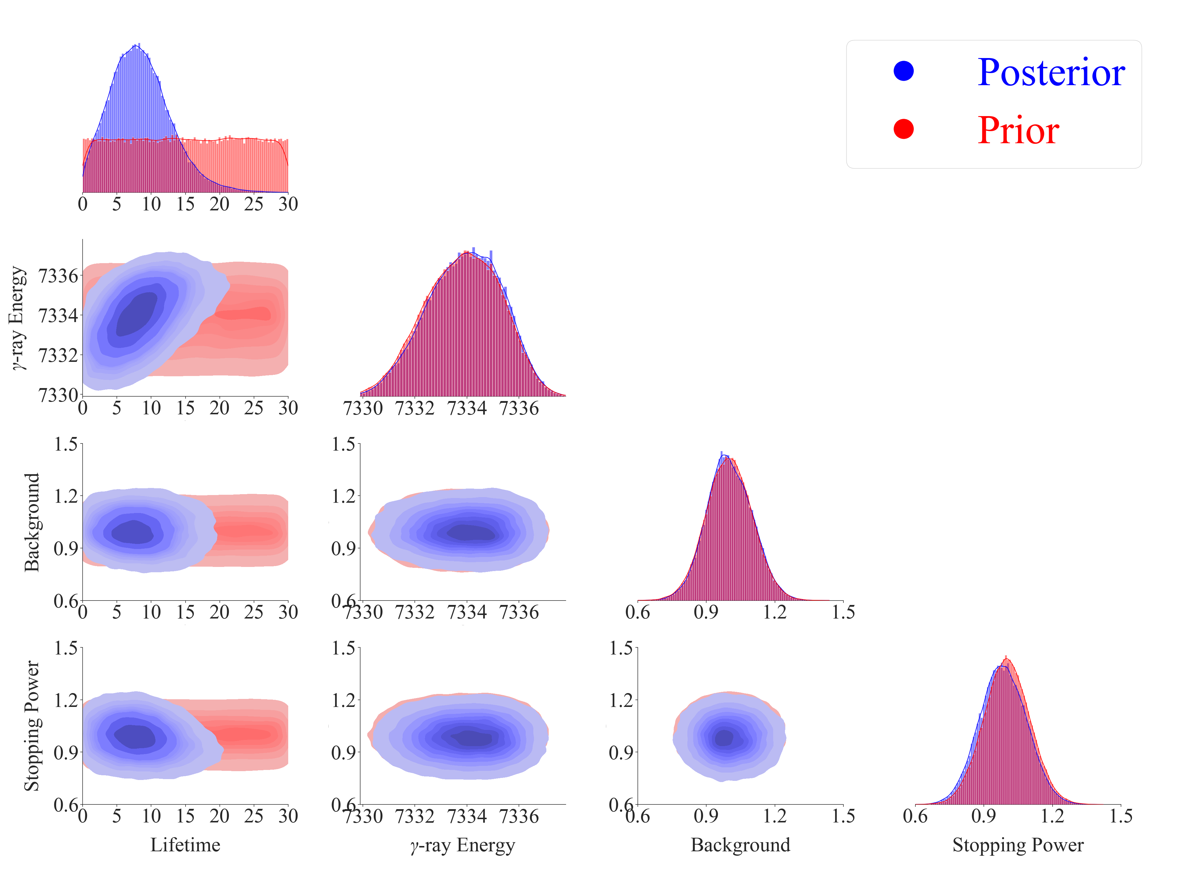
Trimodal Prior:
Mean = 7332.7, 7333.7, 7335.1
Sigma = 1.2, 1.1, 0.9
Weight = 0.33, 0.33, 0.33

Slide 40
Bayesian Priors

Slide 41
Emulator | PCGP_numPCs | PCGP_numPCs | PCGP_numPCs | PCGP_numPCs | PCGP_numPCs
Calibrator | directbayeswoodbury | directbayeswoodbury | directbayeswoodbury | directbayeswoodbury | directbayeswoodbury
Sampler | metropolis_hastings | metropolis_hastings | metropolis_hastings | metropolis_hastings | metropolis_hastings
Prior (keV) | Gaussian Mean = 7332.7 Sigma = 1.2 | Gaussian Mean = 7335.1 Sigma = 0.9 | Gaussian Mean = 7333.2 Sigma = 1.1 | Bimodal Mean = 7332.7, 7333.7 Sigma = 1.2, 1.1 Weight = 0.5, 0.5 | Trimodal Mean = 7332.7, 7333.7, 7335.1 Sigma = 1.2, 1.1, 0.9 Weight = 0.33, 0.33, 0.33
E_{γ} (keV) | 7332.7(12) Sallaska_PRC2011 | 7335.1(9) Goldberg_Thesis2024 | 7333.2(11) Basunia_NDS2021 | 7332.7(12) Sallaska_PRC2011 7333.7(11) Jenkins_PRL2004 | 7332.7(12) Sallaska_PRC2011 7333.7(11) Jenkins_PRL2004 7335.1(9) Goldberg_Thesis2024
τ (fs) | $${6.3}_{−3.3}^{+3.9}$$ | $${9.5}_{−4.0}^{+4.6}$$ | $${7.0}_{−3.4}^{+3.8}$$ | $${7.2}_{−3.6}^{+3.8}$$ | $${8.1}_{−4.0}^{+4.5}$$
90% C.I. (fs) | <11.4 | <15.7 | <12.1 | <12.2 | <13.5

Slide 42
Gaussian Prior [Goldberg_Thesis2024]
Mean = 7335.1, Sigma = 0.9
Uniform Prior:
[7331.5, 7336.0]

Slide 43
Gaussian Prior [Basunia_NDS2021]
Mean = 7333.2, Sigma = 1.1
Bimodal Prior: [Sallaska_PRC2011] and [Jenkins_PRL2004]

Slide 44
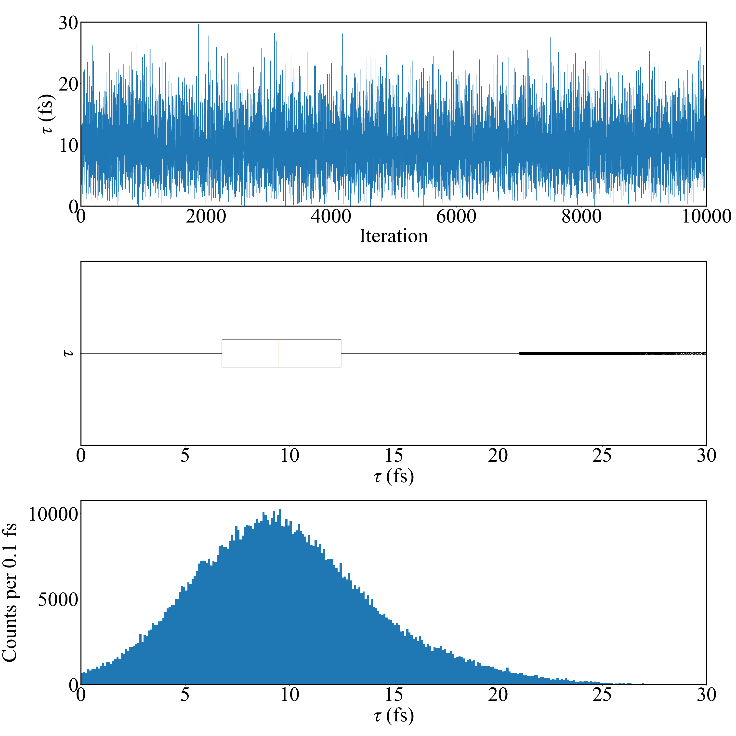
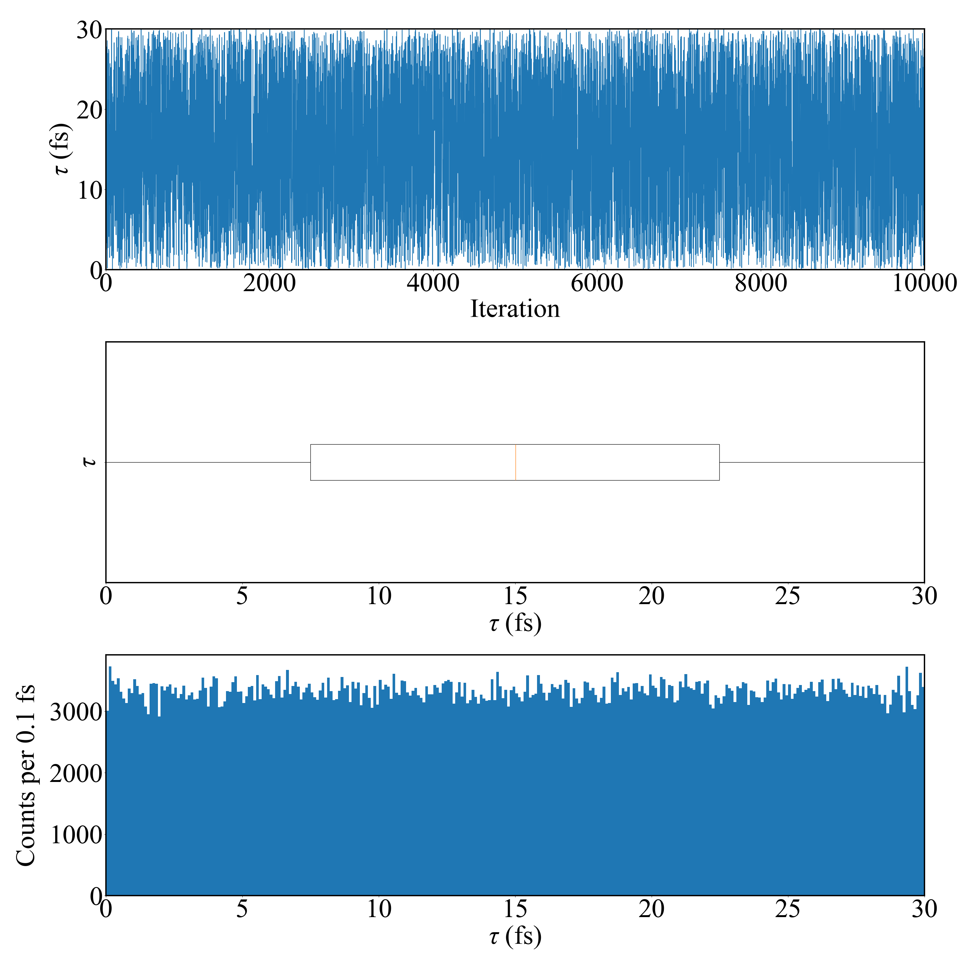
Emulation method: PCGP
Calibration method: directbayeswoodbury
Sampler: metropolis_hastings
Emulation method: PCGP
Calibration method: directbayeswoodbury
Sampler: metropolis_hastings
Eg prior: Lower bound Sallaska_PRC2011;
Higher bound Goldberg_Thesis2024
Tau = 15.014 +10.183 -10.200 fs
Eg prior: Goldberg_Thesis2024
Tau = 9.488 +4.589 -3.966 fs
Final Acceptance Rate: 0.23556
Final Acceptance Rate: 0.31992

Slide 45
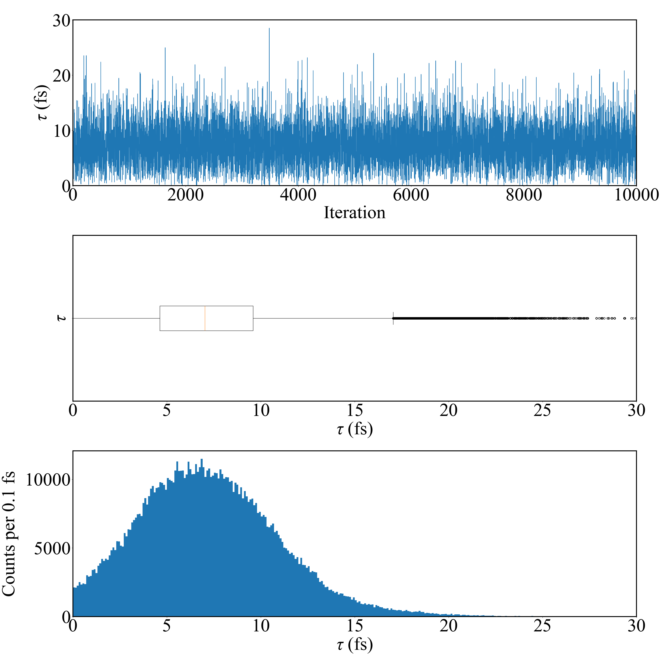
Emulation method: PCGP
Calibration method: directbayeswoodbury
Sampler: metropolis_hastings
Eg prior: Basunia_NDS2021
Tau = 7.021 +3.828 -3.424 fs
Final Acceptance Rate: 0.21566

Slide 46
Emulation method: PCGP
Calibration method: directbayeswoodbury
Sampler: metropolis_hastings
Emulation method: PCGP
Calibration method: directbayeswoodbury
Sampler: metropolis_hastings
Eg prior: bimodal of Sallaska_PRC2011 and
Jenkins_PRL2004
Tau = 7.204 +3.788 -3.563 fs
Eg prior: trimodal of Sallaska_PRC2011, Jenkins_PRL2004, Goldberg_Thesis2024
Tau = 8.105 +4.537 -4.033 fs
Final Acceptance Rate: 0.22487
Final Acceptance Rate: 0.229

Slide 47
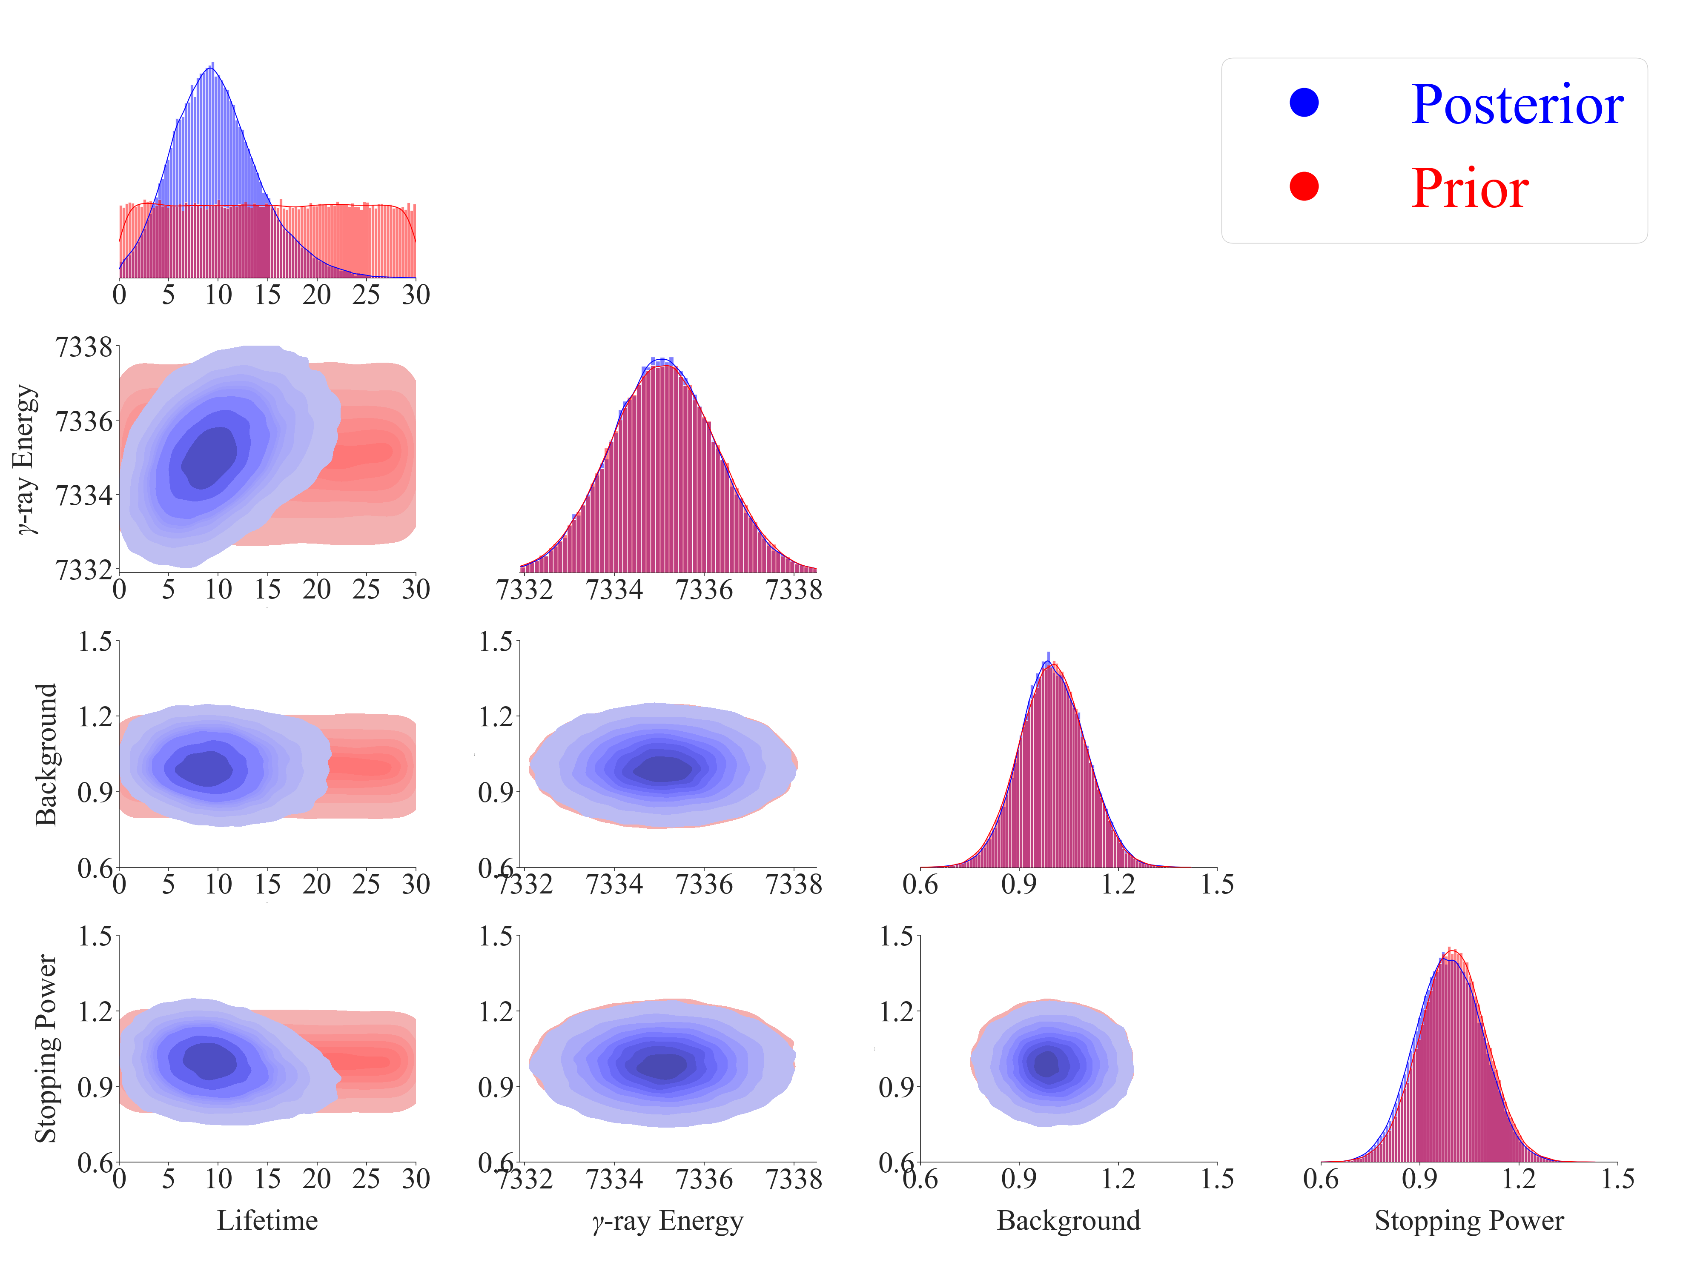
Gaussian Prior:
[Goldberg_Thesis2024]
Mean = 7335.1
Sigma = 0.9

Slide 48
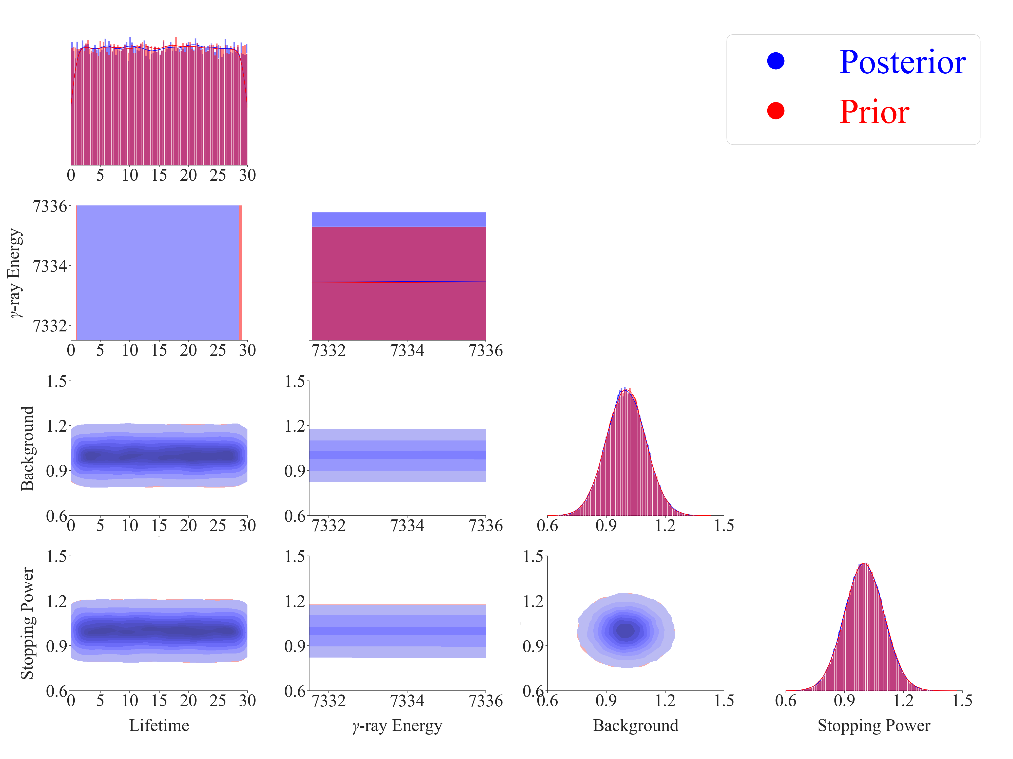
Uniform Prior:
[7331.5, 7336.0]

Slide 49
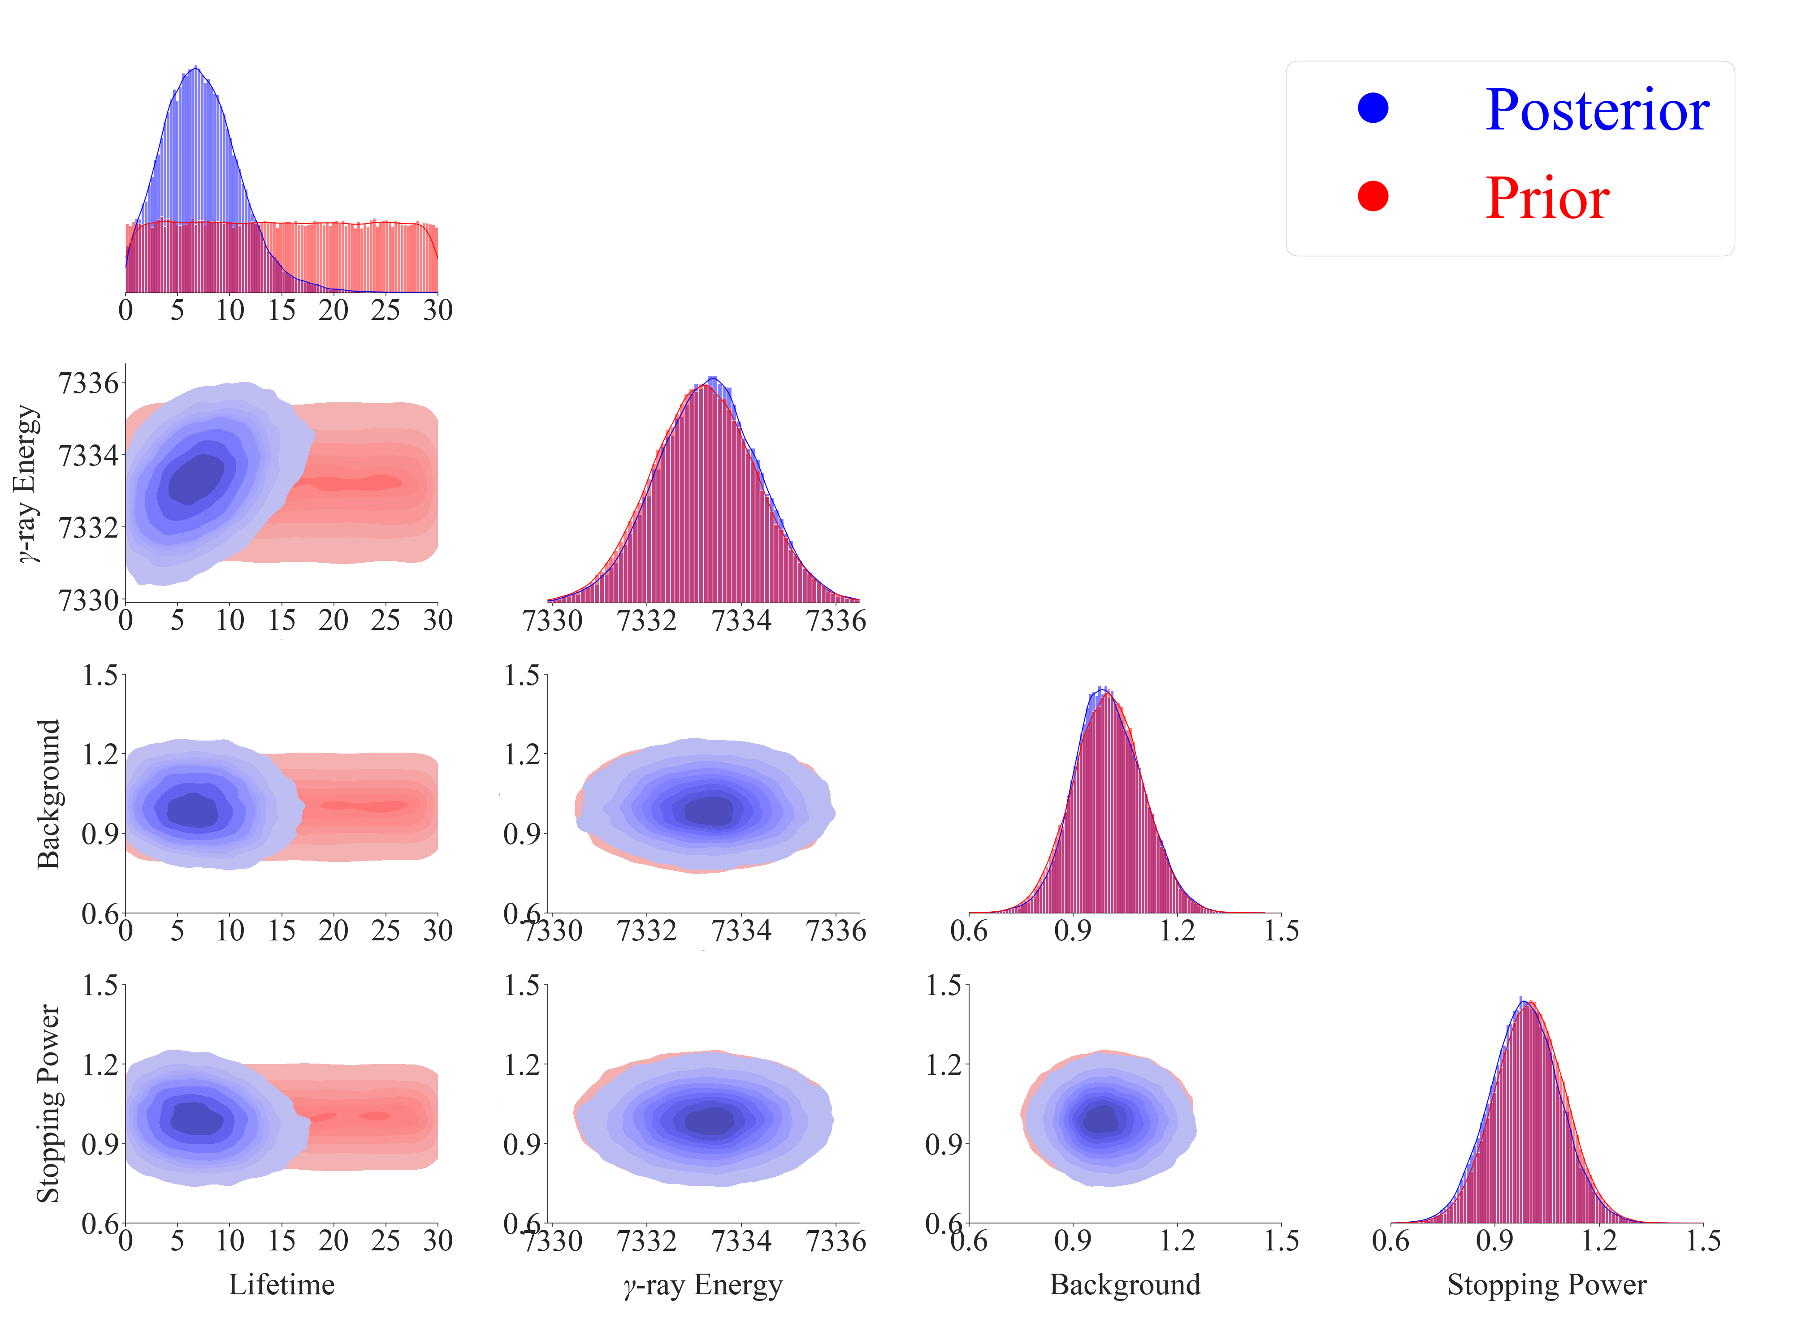
Gaussian Prior:
[Basunia_NDS2021]
Mean = 7333.2
Sigma = 1.1

Slide 50
Bimodal Prior:
Mean = 7332.7, 7333.7
Sigma = 1.2, 1.1
Weight = 0.5, 0.5

Slide 51
Trimodal Prior:
Mean = 7332.7, 7333.7, 7335.1
Sigma = 1.2, 1.1, 0.9
Weight = 0.33, 0.33, 0.33

Slide 52
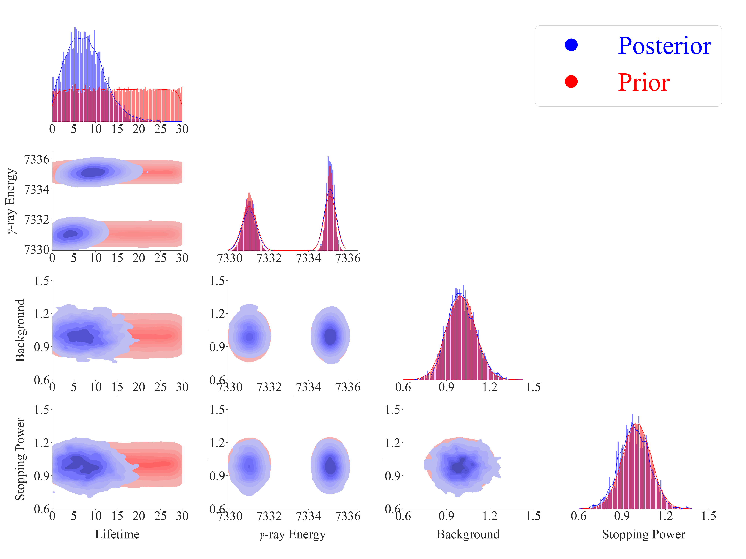
Tau = 7.432 +3.829 -3.776 fs
Test if Bimodal Prior works
Mean = 7331.0, 7335.1
Sigma = 0.3, 0.2
Weight = 0.5, 0.5
Emulation method: PCGP
Calibration method: directbayeswoodbury
Sampler: metropolis_hastings

Slide 53
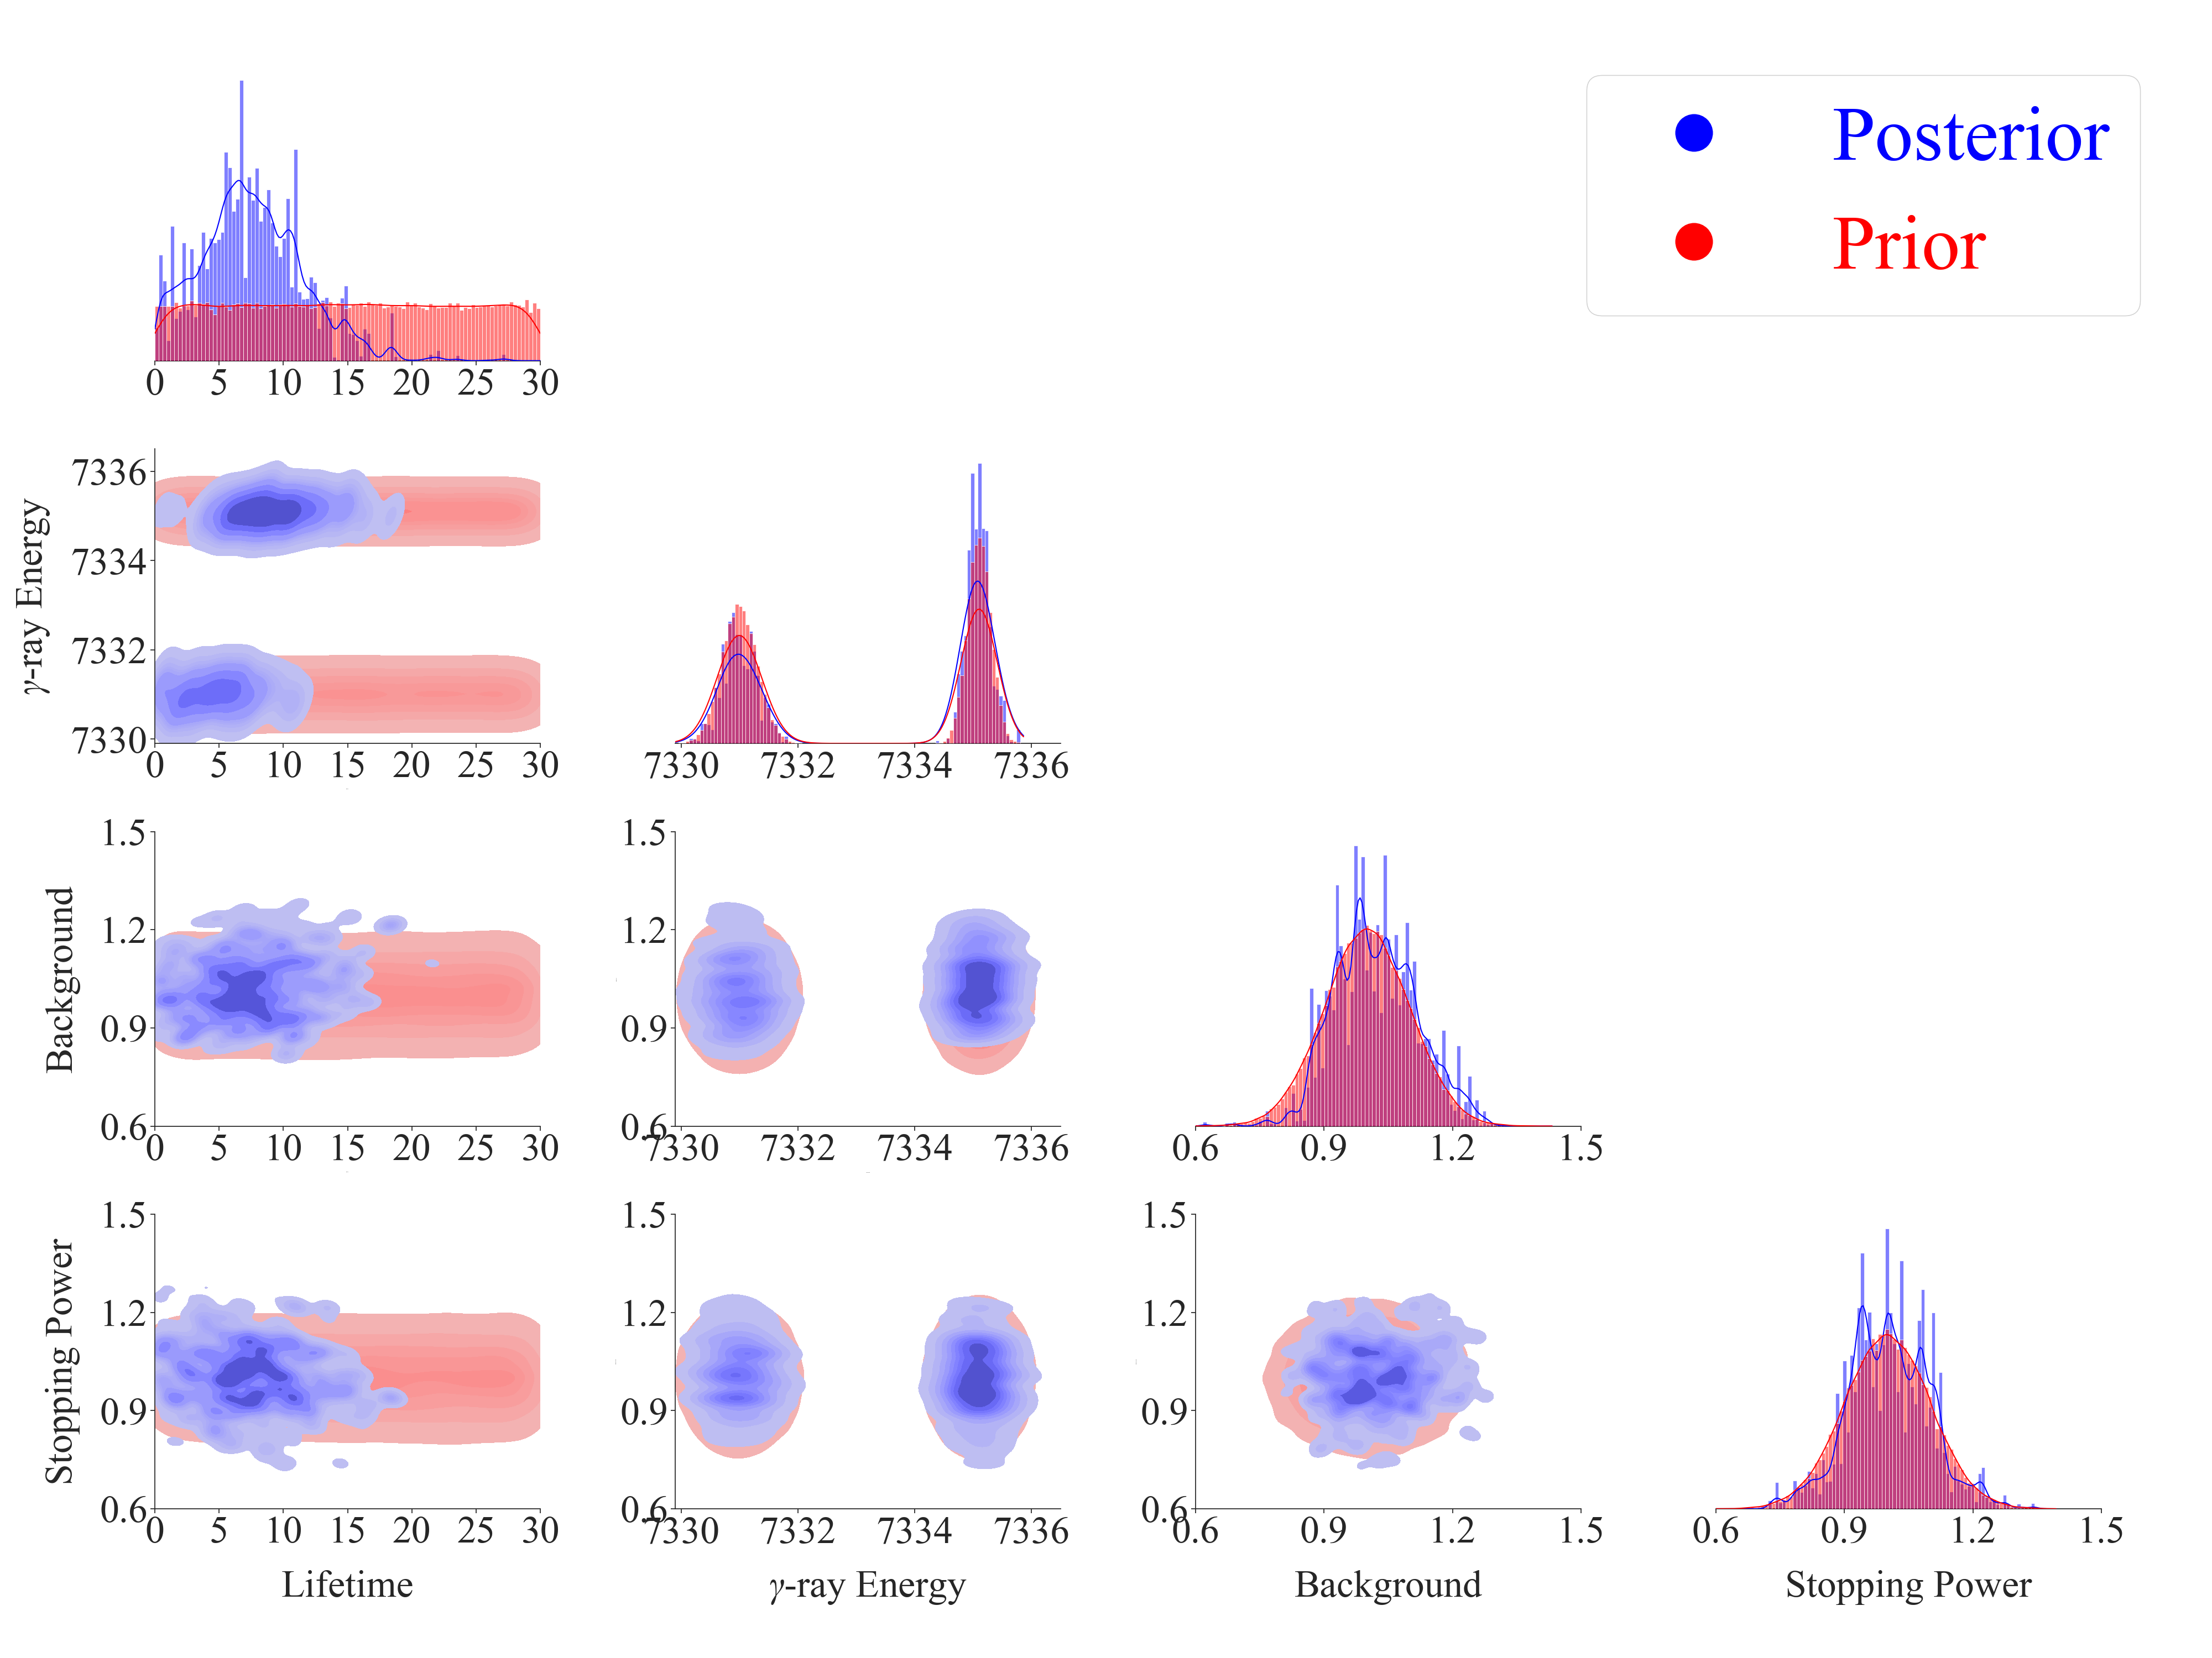
Tau = 7.318 +4.510 -4.062 fs
Test if Bimodal Prior works
Mean = 7331.0, 7335.1
Sigma = 0.3, 0.2
Weight = 0.5, 0.5
Emulation method: PCGP
Calibration method: directbayeswoodbury
Sampler: PTLMC
PTLMC is supposed to be suitable for handling multimodal distributions.

Slide 54
Summary of Nuclear Data from Literature
Literature | E_{x} (keV) | E_{γ} (keV) | I_{γ} (%) | R_{7.3/5.7} | Method | Comments
Sallaska_PRL2010 Sallaska_PRC2011 | 7784.7(12) | 5732 | 12(6) | 8.4(42) | ²²Na(p,γ)²³Mg
 |  | 7332.7(12) | 100
Jenkins_PRL2004 Jenkins_PRC2013 | 7784.6(11) | 7333.7(11) | 100 | ∞ | ¹²C(¹²C,nγ)²³Mg | E_{x} = 7785.2(13) by GLSC; E_{x} = 7785.7(11) by Oliver's recalculation
Iacob_PRC2006 | 7787.4 | 5736 | 20(5) | 5.0(12) | ²³Al(βγ)²³Mg
 |  | 7335.1 | 100
 |  | 7786 | 3.8(25)
Zhai_Thesis2007 | 7787.2(6) | 5735.4(7) | 23 | 4.3(12) | ²³Al(βγ)²³Mg
 |  | 7335.2(6) | 100
Fougeres_NC2023 | 7785.0(7) | 5734 | <3 | >32 | ³He(³²S,α)³¹S
 |  | $${7333.0}_{−2}^{+5}$$ | 100
Goldberg_Thesis2024 | 7787.3(5) | 5735.8(6) | 25 | 4.0(4) | ²³Al(βγ)²³Mg | https://arxiv.org/abs/2412.14734
 |  | 7335.1(9) | 100
Basunia_NDS2021 | 7784.7(8) | 5732 | 16(4) | 6.2(22) | Evaluation | E_{γ}: Weighted average of Sallaska and Jenkins; I_{γ}: Unweighted average of Sallaska and Iacob
 |  | 7333.2(11) | 100(6)

Slide 55
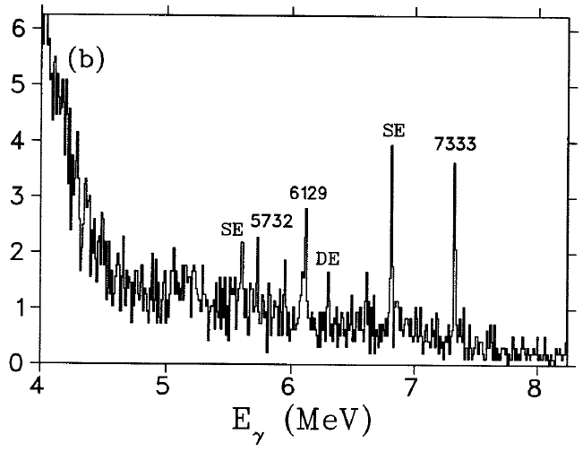
Anne Sallaska, Ph.D. Thesis, University of Washington, USA, 2010.

Slide 56
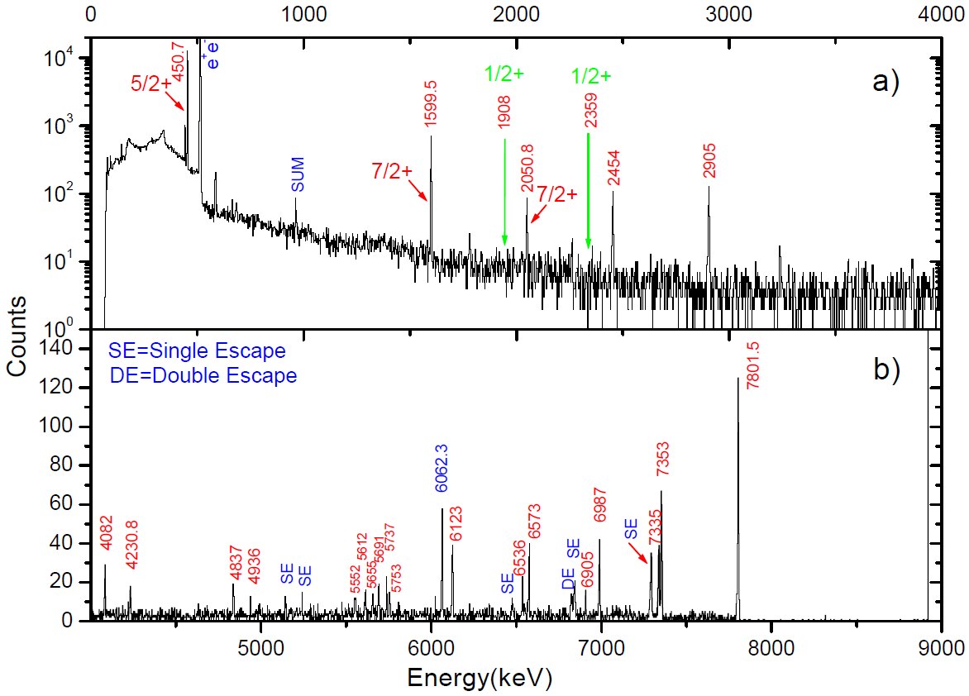
RUN November 2006
Yongjun Zhai, Ph.D. Thesis, Texas A&M University, USA, 2007.

Slide 57
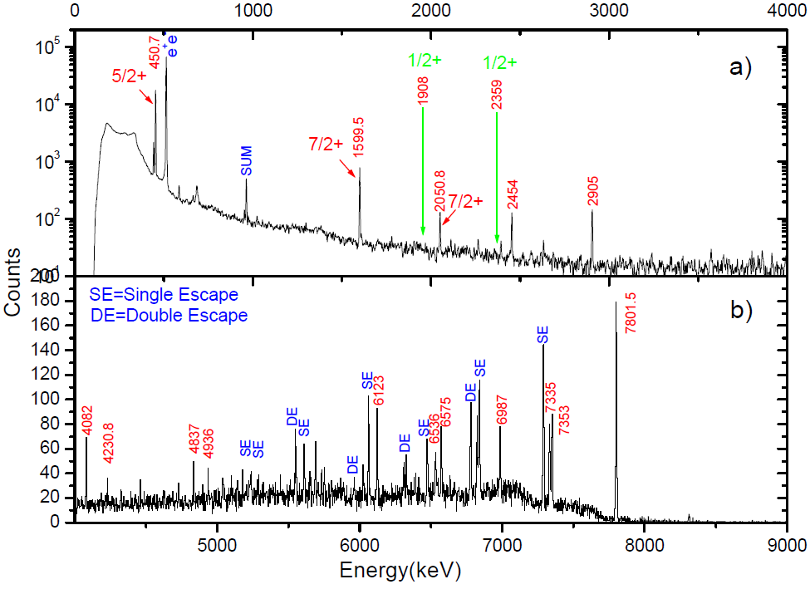
RUN Sept 2006
Yongjun Zhai, Ph.D. Thesis, Texas A&M University, USA, 2007.

Slide 58
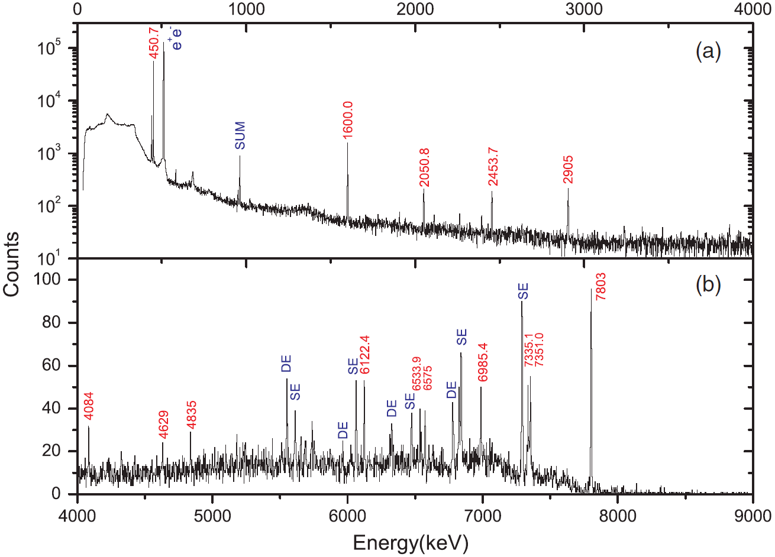
V. E. Iacob et al., Phys. Rev. C 74, 045810 (2006).

Slide 59
A. Saastamoinen et al., Phys. Rev. C 83, 045808 (2011).

Slide 60
Itay Goldberg, Master Thesis, Hebrew University of Jerusalem, Israel, 2024.

Slide 61
Bayesian Model Emulation

Slide 62
Observables: 24 data points over 120 keV.
Prior Lineshapes: 201 simulation runs.
Principal Component Analysis
The first 12 PCs explain 99% of the variance, this means that by knowing the values of 12 PCs for each data point, we have a very good idea of where that data point is located in the original high-dimensional space.
Notes:
For example, if PC1 explains 75% of the variance, this means that by knowing the value of PC1 for each data point, we have a very good idea of where that data point is located in the original high-dimensional space. You can see that cumulative explained variance increases quickly at first as each additional component explains a large portion of the variance. After a certain point, the gain in explained variance slows down, suggesting that further components contribute less to capturing the structure of the data.
Explained Variance by each component is an important evaluation metric.

Slide 63
Emulator: PCGP
Emulator: PCSK with variances = 0
Randomly select 75% as training sets and the rest 25% as test sets.

Slide 64
Emulator: PCSK
Emulator: indGP
Randomly select 75% as training sets and the rest 25% as test sets.

Slide 65
Emulator: PCGP
Emulator: PCSK with variances = 0
Metrics for Evaluating Emulator Performance

Slide 66
Emulator: PCSK
Emulator: indGP
Metrics for Evaluating Emulator Performance

Slide 67
Emulator: PCGP
MSE = 3.0
SSE = 72.7
Emulator: PCSK with variances = 0
MSE = 1.8
SSE = 43.0
Metrics for Evaluating Emulator Performance
Notes:
PCSK, if 100% for training; 25% for test:
MSE = 0.43
SSE = 10.24

Slide 68
Emulator: PCSK
MSE = 2.1
SSE = 50.4
Emulator: indGP
MSE = 2.4
SSE = 56.3
Metrics for Evaluating Emulator Performance

Slide 69
Training for PCSK is often not performed successfully.
MSE = 0.0
SSE = 0.0

Slide 70
Training for PCSK is often not performed successfully.

Slide 71
Training for PCSK is often not performed successfully.

Slide 72
Bayesian Model Calibration

Slide 73
Emulation method: PCGP
Calibration method: directbayeswoodbury
Sampler: metropolis_hastings
Emulation method: PCGP
Calibration method: directbayeswoodbury
Sampler: PTLMC
All 201 simulation runs as training sets.

Slide 74
Emulation method: PCSK
Calibration method: directbayeswoodbury
Sampler: metropolis_hastings
All 201 simulation runs as training sets.

Slide 75
Emulation method: PCGP
Calibration method: directbayeswoodbury
Sampler: metropolis_hastings

Slide 76
Emulation method: PCGP
Calibration method: directbayeswoodbury
Sampler: PTLMC

Slide 77
Emulation method: PCSK
Calibration method: directbayeswoodbury
Sampler: metropolis_hastings

Slide 78
Emulation method: PCGP
Calibration method: directbayeswoodbury
Sampler: LMC

Slide 79
Emulation method: PCGP
Calibration method: directbayeswoodbury
Sampler: metropolis_hastings
Emulation method: PCGP
Calibration method: directbayeswoodbury
Sampler: PTLMC
Eg prior: Sallaska_PRC2011
Tau = 6.297 +3.890 -3.288 fs
Eg prior: Sallaska_PRC2011
Tau = 6.610 +4.169 -3.648 fs
Final Acceptance Rate: 0.21084
Final Acceptance Rate: 0.00424

Slide 80
Initial sampler position dependent.
Emulation method: PCSK
Calibration method: directbayeswoodbury
Sampler: metropolis_hastings
Emulation method: PCGP
Calibration method: directbayeswoodbury
Sampler: LMC
Eg prior: Sallaska_PRC2011
Tau = 6.322 +3.951 -3.299 fs
Eg prior: Sallaska_PRC2011
Tau = 5.879 +0.538 -0.940 fs
Final Acceptance Rate: 0.20024
Final Acceptance Rate: 0.0568

Slide 81
Analysis Framework

Slide 82
Emulation Method | Calibration Method | Utilities Method
indGP PCGP PCGP_numPCs PCGPR PCGPRG PCGPwM PCGPwImpute PCSK LCGP nuclear-ROSE | directbayes directbayeswoodbury mlbayeswoodbury simulationpost | metropolis_hastings LMC PTMC PTLMC
Green: recommend for DSL data analysis.

Slide 83
Notes:
Best figure Fig_DSL2_Bayesian_Surmise_workflow

Slide 84
All the codes are available at https://github.com/sunlijie-msu/Bayesian_VS
(will be reorganized later)
Notes:
Best figure Fig_DSL2_Surmise_structure_workflow

