Slide 1
PXCT Ge Detector Timing Test (¹⁵²Eu)
20240430

Slide 2
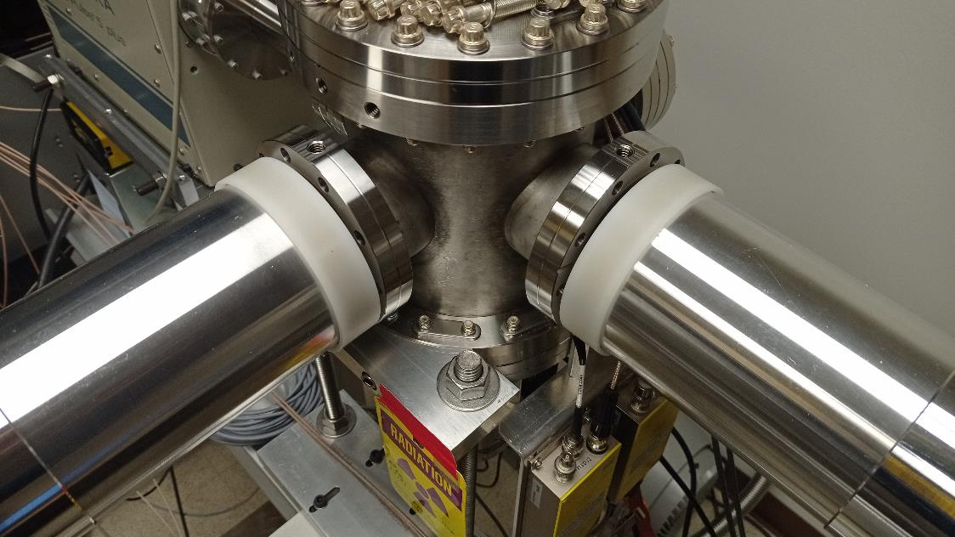
¹⁵²Eu Z2707 in chamber
¹⁵²Eu
K_{α} X ray 39-40 keV
K_{β} X ray 45-47 keV
¹⁵²Sm γ ray 122, 245, 1408 keV
¹⁵²Eu
LEGe
South Ge
North Ge

Slide 3
Optimized DDAS parameters for ¹⁵²Eu γ rays at 1408 keV and X rays at 39-47 keV:
Trigger Rise 0.064 μs
Trigger Gap 0.952 μs
0.016 μs ≤ Trigger Rise ≤ 1.000 μs; 0.000 μs ≤ Trigger Gap ≤ 1.000 μs
0.016 μs ≤ Trigger Rise + Trigger Gap ≤ 1.016 μs
Shorter Rise picks up noise more severely and doesn't improve timing resolution.
Longer Rise makes timing resolution worse.
Trigger Threshold 310 (LEGe), 300 (North), 700 (South)
Trigger Threshold ≤ 4096 ADC channel when Trigger Rise = 0.064 μs
Trigger Threshold just above noise yields the best timing resolution.
Increasing the Trigger Threshold results in a worse timing resolution.
CFD Delay 0.304 μs
CFD Scale 7
0.008 μs ≤ CFD Delay ≤ 0.504 μs; 0 ≤ CFD Scale ≤ 7
Longer CFD Delay makes timing resolution worse; shorter CFD Delay fails to correct some low-energy events and leads to an additional structure in the time distribution at low energies, both LEGe and XtRa need CFD Delay of 0.3 μs.
Reducing the CFD Scale either makes timing resolution worse or has no effect.

Slide 4
Best timing resolution for ¹⁵²Eu γ rays at 1408 keV and X rays at 39-47 keV:
CFD Delay 0.304 μs:
North – South σT ≈ 50 ns (interpolation)
Single XtRa ≈ 35 ns
XtRa – LEGe σT ≈ 50 ns
Single LEGe ≈ 35 ns

Slide 5
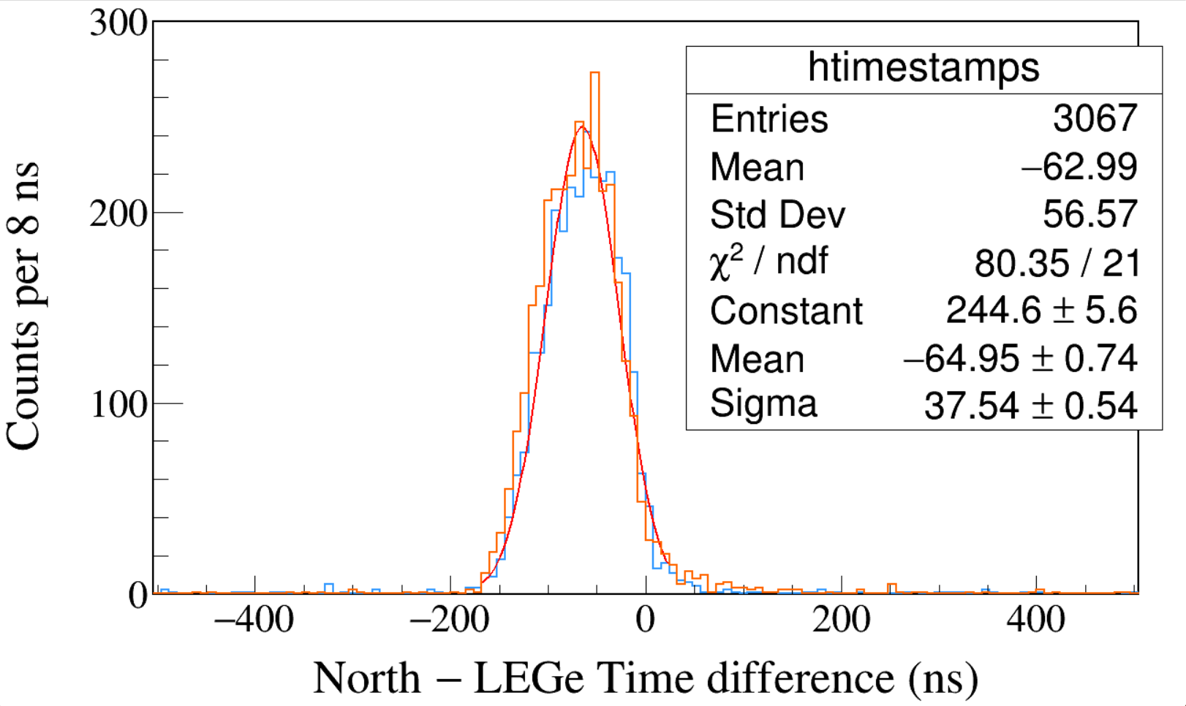
Run0264
152Eu 1-hour run
LED
Trigger Rise 0.064 μs
Trigger Gap 0.952 μs
Trigger Thresh 310, 300, 730
LED
LEGe 39||46 && North 1408
LEGe 39||46 && South 1408
Notes:
TFile *_file0 = TFile::Open("F:/e21010/pxct/run0264_LEGe_XtRa_152Eu_Z2707_OnLEGeCap_window1us_TrigRise0.064us_TrigGap0.952us_ThL310_N300_S730_LED_cal.root");
TCanvas* canvaspeak = new TCanvas("canvaspeak", "canvaspeak", 1300, 800);//
canvaspeak->cd();//
canvaspeak->SetTopMargin(0.03);
canvaspeak->SetRightMargin(0.04);
canvaspeak->SetLeftMargin(0.13);
canvaspeak->SetBottomMargin(0.16);
canvaspeak->SetFrameLineWidth(2);
TH1D* htimestamps = new TH1D("htimestamps", "htimestamps", 250,-1000,1000);
htimestamps->SetLineWidth(2);
htimestamps->Rebin(1);
//htimestamps->SetStats(0);
htimestamps->SetTitle("");
htimestamps->GetXaxis()->SetTitle("North #minus LEGe Time difference (ns)");
htimestamps->GetYaxis()->SetTitle("Counts per 8 ns");
htimestamps->GetXaxis()->CenterTitle();
htimestamps->GetYaxis()->CenterTitle();
htimestamps->GetXaxis()->SetLabelFont(132);
htimestamps->GetYaxis()->SetLabelFont(132);
htimestamps->GetXaxis()->SetLabelSize(0.06);
htimestamps->GetYaxis()->SetLabelSize(0.06);
htimestamps->GetXaxis()->SetTitleFont(132);
htimestamps->GetYaxis()->SetTitleFont(132);
htimestamps->GetXaxis()->SetTitleOffset(1.1);
htimestamps->GetYaxis()->SetTitleOffset(0.95);
htimestamps->GetXaxis()->SetTitleSize(0.07);
htimestamps->GetYaxis()->SetTitleSize(0.07);
htimestamps->GetXaxis()->SetRangeUser(-400,400);
//htimestamps->GetYaxis()->SetRangeUser(0,1700);
htimestamps->GetYaxis()->SetNdivisions(505);
htimestamps->SetLineWidth(2);
htimestamps->SetLineColor(kAzure+1);
tree->Draw("north_t-lege_t>>htimestamps","north_e>1405&&north_e<1411&&((lege_e>38.8&&lege_e<40.8)||(lege_e>44.8&&lege_e<47.2))","");
htimestamps->Sumw2(kFALSE);
htimestamps->SetBinErrorOption(TH1::kPoisson);//TH1::kNormal or TH1::kPoisson
tree->SetLineColor(kOrange+7);
tree->SetLineWidth(2);
tree->Draw("south_t-lege_t","south_e>1405&&south_e<1411&&((lege_e>38.8&&lege_e<40.8)||(lege_e>44.8&&lege_e<47.2))","same");

Slide 6
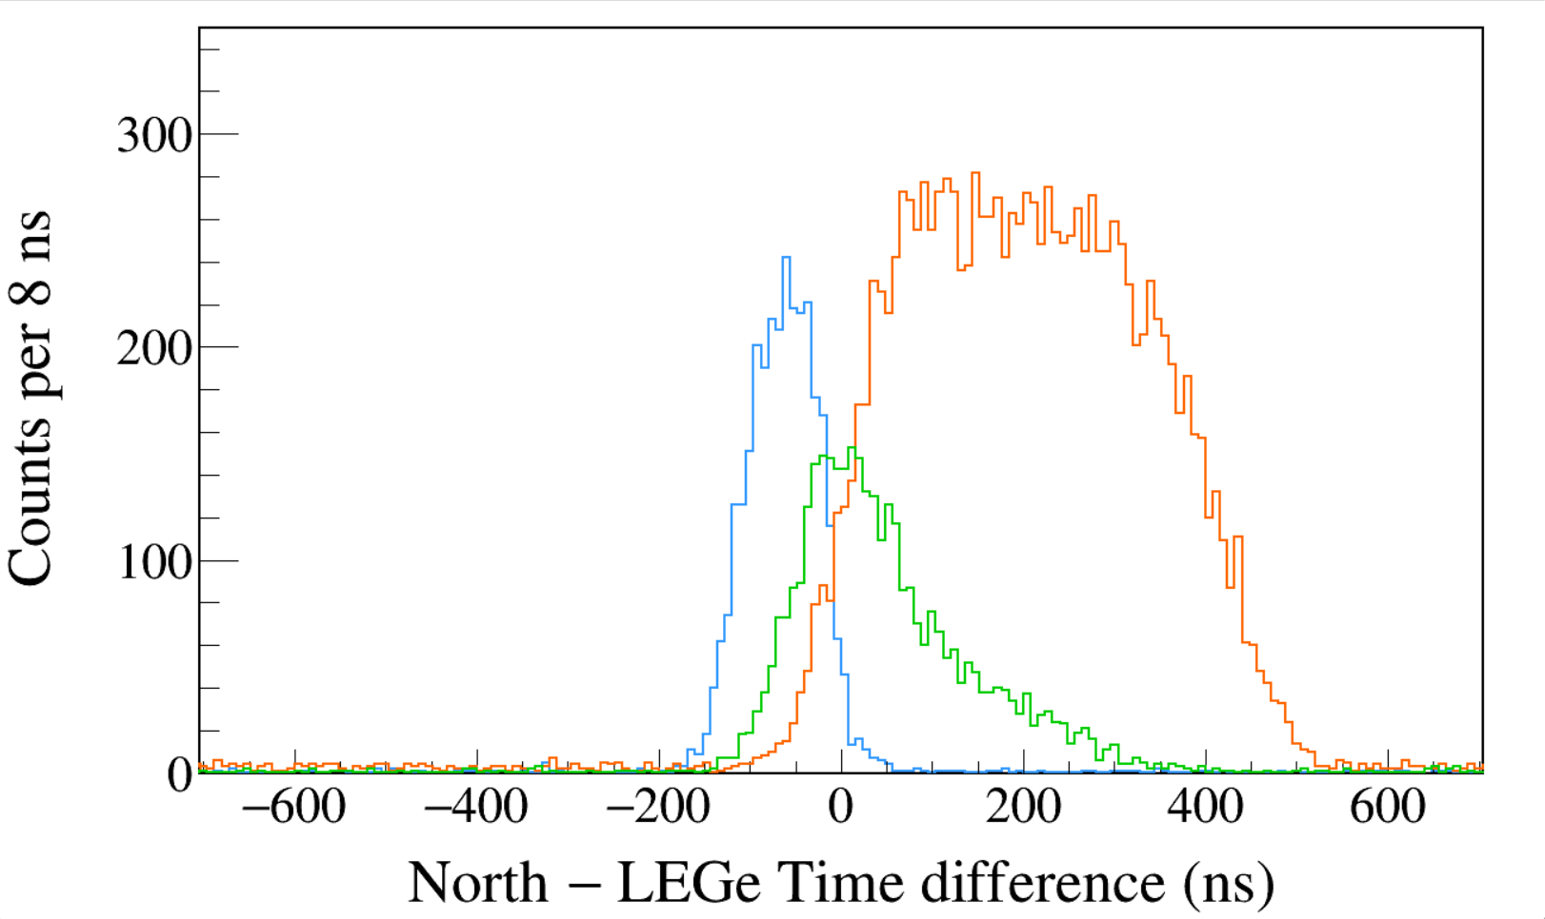
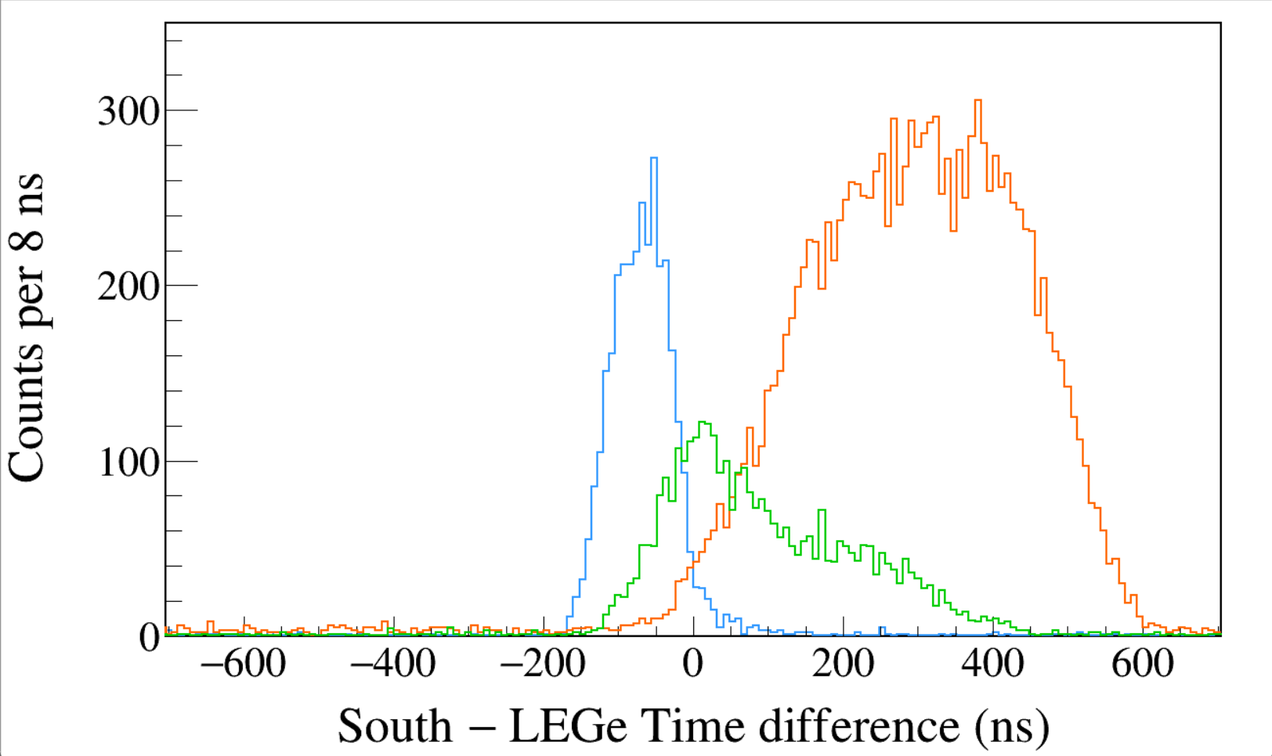
Run0264
152Eu 1-hour run
LED
Trigger Rise 0.064 μs
Trigger Gap 0.952 μs
Trigger Thresh 310, 300, 730
LED
LEGe 39||46 && North 1408
LEGe 39||46 && North 245
LEGe 39||46 && North 122
FWHM = 104 ns
Run0264
152Eu 1-hour run
LED
Trigger Rise 0.064 μs
Trigger Gap 0.952 μs
Trigger Thresh 310, 300, 730
LED
LEGe 39||46 && South 1408
LEGe 39||46 && South 245
LEGe 39||46 && South 122
Notes:
TFile *_file0 = TFile::Open("F:/e21010/pxct/run0264_LEGe_XtRa_152Eu_Z2707_OnLEGeCap_window1us_TrigRise0.064us_TrigGap0.952us_ThL310_N300_S730_LED_cal.root");
TCanvas* canvaspeak = new TCanvas("canvaspeak", "canvaspeak", 1300, 800);//
canvaspeak->cd();//
canvaspeak->SetTopMargin(0.03);
canvaspeak->SetRightMargin(0.04);
canvaspeak->SetLeftMargin(0.13);
canvaspeak->SetBottomMargin(0.16);
canvaspeak->SetFrameLineWidth(2);
TH1D* htimestamps = new TH1D("htimestamps", "htimestamps", 250,-1000,1000);
htimestamps->SetLineWidth(2);
htimestamps->Rebin(1);
//htimestamps->SetStats(0);
htimestamps->SetTitle("");
htimestamps->GetXaxis()->SetTitle("North #minus LEGe Time difference (ns)");
htimestamps->GetYaxis()->SetTitle("Counts per 8 ns");
htimestamps->GetXaxis()->CenterTitle();
htimestamps->GetYaxis()->CenterTitle();
htimestamps->GetXaxis()->SetLabelFont(132);
htimestamps->GetYaxis()->SetLabelFont(132);
htimestamps->GetXaxis()->SetLabelSize(0.06);
htimestamps->GetYaxis()->SetLabelSize(0.06);
htimestamps->GetXaxis()->SetTitleFont(132);
htimestamps->GetYaxis()->SetTitleFont(132);
htimestamps->GetXaxis()->SetTitleOffset(1.1);
htimestamps->GetYaxis()->SetTitleOffset(0.95);
htimestamps->GetXaxis()->SetTitleSize(0.07);
htimestamps->GetYaxis()->SetTitleSize(0.07);
htimestamps->GetXaxis()->SetRangeUser(-700,700);
htimestamps->GetYaxis()->SetRangeUser(0,350);
htimestamps->GetYaxis()->SetNdivisions(505);
htimestamps->SetLineWidth(2);
htimestamps->SetLineColor(kAzure+1);
tree->Draw("north_t-lege_t>>htimestamps","north_e>1405&&north_e<1411&&((lege_e>38.8&&lege_e<40.8)||(lege_e>44.8&&lege_e<47.2))","");
htimestamps->Sumw2(kFALSE);
htimestamps->SetBinErrorOption(TH1::kPoisson);//TH1::kNormal or TH1::kPoisson
tree->SetLineColor(kOrange+7);
tree->SetLineWidth(2);
tree->Draw("north_t-lege_t","north_e>120&&north_e<123&&((lege_e>38.8&&lege_e<40.8)||(lege_e>44.8&&lege_e<47.2))","same");
tree->SetLineColor(kGreen+1);
tree->SetLineWidth(2);
tree->Draw("north_t-lege_t","north_e>243&&north_e<246&&((lege_e>38.8&&lege_e<40.8)||(lege_e>44.8&&lege_e<47.2))","same");
TCanvas* canvaspeak = new TCanvas("canvaspeak", "canvaspeak", 1300, 800);//
canvaspeak->cd();//
canvaspeak->SetTopMargin(0.03);
canvaspeak->SetRightMargin(0.04);
canvaspeak->SetLeftMargin(0.13);
canvaspeak->SetBottomMargin(0.16);
canvaspeak->SetFrameLineWidth(2);
TH1D* htimestamps = new TH1D("htimestamps", "htimestamps", 250,-1000,1000);
htimestamps->SetLineWidth(2);
htimestamps->Rebin(1);
//htimestamps->SetStats(0);
htimestamps->SetTitle("");
htimestamps->GetXaxis()->SetTitle("South #minus LEGe Time difference (ns)");
htimestamps->GetYaxis()->SetTitle("Counts per 8 ns");
htimestamps->GetXaxis()->CenterTitle();
htimestamps->GetYaxis()->CenterTitle();
htimestamps->GetXaxis()->SetLabelFont(132);
htimestamps->GetYaxis()->SetLabelFont(132);
htimestamps->GetXaxis()->SetLabelSize(0.06);
htimestamps->GetYaxis()->SetLabelSize(0.06);
htimestamps->GetXaxis()->SetTitleFont(132);
htimestamps->GetYaxis()->SetTitleFont(132);
htimestamps->GetXaxis()->SetTitleOffset(1.1);
htimestamps->GetYaxis()->SetTitleOffset(0.95);
htimestamps->GetXaxis()->SetTitleSize(0.07);
htimestamps->GetYaxis()->SetTitleSize(0.07);
htimestamps->GetXaxis()->SetRangeUser(-700,700);
htimestamps->GetYaxis()->SetRangeUser(0,350);
htimestamps->GetYaxis()->SetNdivisions(505);
htimestamps->SetLineWidth(2);
htimestamps->SetLineColor(kAzure+1);
tree->Draw("south_t-lege_t>>htimestamps","south_e>1405&&south_e<1411&&((lege_e>38.8&&lege_e<40.8)||(lege_e>44.8&&lege_e<47.2))","");
htimestamps->Sumw2(kFALSE);
htimestamps->SetBinErrorOption(TH1::kPoisson);//TH1::kNormal or TH1::kPoisson
tree->SetLineColor(kOrange+7);
tree->SetLineWidth(2);
tree->Draw("south_t-lege_t","south_e>120&&south_e<123&&((lege_e>38.8&&lege_e<40.8)||(lege_e>44.8&&lege_e<47.2))","same");
tree->SetLineColor(kGreen+1);
tree->SetLineWidth(2);
tree->Draw("south_t-lege_t","south_e>243&&south_e<246&&((lege_e>38.8&&lege_e<40.8)||(lege_e>44.8&&lege_e<47.2))","same");

Slide 7
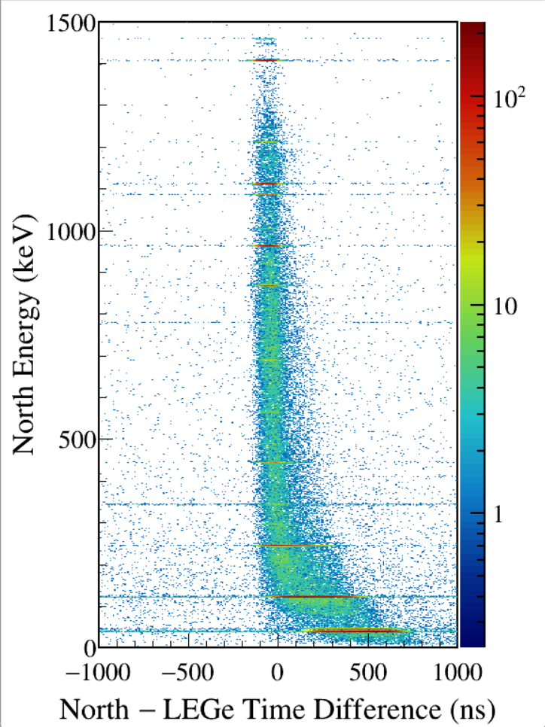
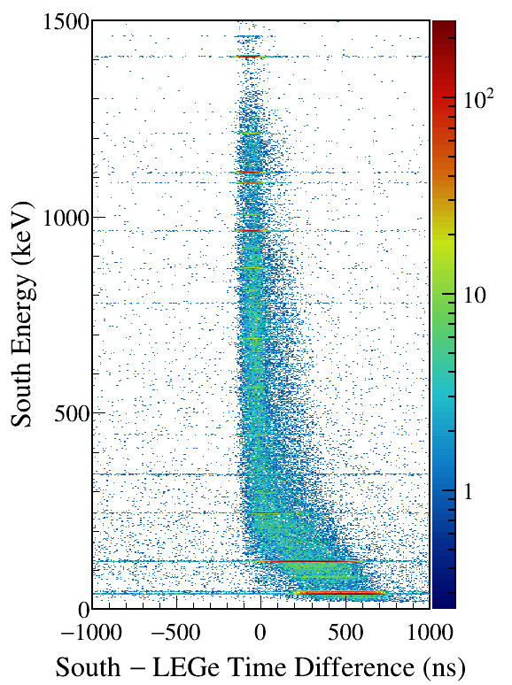
LEGe (39||46) Kα,Kβ gated
All LED runs are about the same.
Notes:
TFile *_file0 = TFile::Open("F:/e21010/pxct/run0264_LEGe_XtRa_152Eu_Z2707_OnLEGeCap_window1us_TrigRise0.064us_TrigGap0.952us_ThL310_N300_S730_LED_cal.root");
TCanvas* canvaspeak = new TCanvas("canvaspeak", "canvaspeak", 580, 800);
canvaspeak->cd();
canvaspeak->SetTopMargin(0.03);
canvaspeak->SetRightMargin(0.16);
canvaspeak->SetLeftMargin(0.18);
canvaspeak->SetBottomMargin(0.11);
canvaspeak->SetFrameLineWidth(2);
canvaspeak->SetLogz();
TH2D* het = new TH2D("het", "het", 250,-1000,1000,750,0,1500); //x,y
tree->Draw("north_e:north_t-lege_t>>het","north_e>1&&north_e<1500&&((lege_e>38.8&&lege_e<40.8)||(lege_e>44.8&&lege_e<47.2))","colz"); //y:x
het->SetStats(0);
het->SetTitle("");
het->GetXaxis()->SetTitle("North #minus LEGe Time Difference (ns)");
het->GetYaxis()->SetTitle("North Energy (keV)");
het->GetXaxis()->CenterTitle();
het->GetYaxis()->CenterTitle();
het->GetXaxis()->SetLabelFont(132);
het->GetYaxis()->SetLabelFont(132);
het->GetXaxis()->SetLabelSize(0.05);
het->GetYaxis()->SetLabelSize(0.05);
het->GetXaxis()->SetTitleFont(132);
het->GetYaxis()->SetTitleFont(132);
het->GetXaxis()->SetTitleOffset(0.9);
het->GetYaxis()->SetTitleOffset(1.4);
het->GetXaxis()->SetTitleSize(0.06);
het->GetYaxis()->SetTitleSize(0.06);
het->GetXaxis()->SetNdivisions(505);
het->GetYaxis()->SetNdivisions(505);
//het->GetXaxis()->SetRangeUser(2001,4500);
//het->GetYaxis()->SetRangeUser(1000,2800);
//het->SetMinimum(2);
//het->SetMaximum(100);
het->SetContour(99);
gStyle->SetPalette(kRainbow);
//gPad->SetLogz();
TPaletteAxis *palette = (TPaletteAxis*)het->GetListOfFunctions()->FindObject("palette");
palette->SetTitleFont(132);
palette->SetTitleSize(0.05);
palette->SetLabelFont(132);
palette->SetLabelSize(0.05);
palette->SetLineWidth(2);
canvaspeak->SaveAs("F:/e21010/pxct/1.png");
TCanvas* canvaspeak = new TCanvas("canvaspeak", "canvaspeak", 580, 800);
canvaspeak->cd();
canvaspeak->SetTopMargin(0.03);
canvaspeak->SetRightMargin(0.16);
canvaspeak->SetLeftMargin(0.18);
canvaspeak->SetBottomMargin(0.11);
canvaspeak->SetFrameLineWidth(2);
canvaspeak->SetLogz();
TH2D* het = new TH2D("het", "het", 250,-1000,1000,750,0,1500); //x,y
tree->Draw("south_e:south_t-lege_t>>het","south_e>1&&south_e<1500&&((lege_e>38.8&&lege_e<40.8)||(lege_e>44.8&&lege_e<47.2))","colz"); //y:x
het->SetStats(0);
het->SetTitle("");
het->GetXaxis()->SetTitle("South #minus LEGe Time Difference (ns)");
het->GetYaxis()->SetTitle("South Energy (keV)");
het->GetXaxis()->CenterTitle();
het->GetYaxis()->CenterTitle();
het->GetXaxis()->SetLabelFont(132);
het->GetYaxis()->SetLabelFont(132);
het->GetXaxis()->SetLabelSize(0.05);
het->GetYaxis()->SetLabelSize(0.05);
het->GetXaxis()->SetTitleFont(132);
het->GetYaxis()->SetTitleFont(132);
het->GetXaxis()->SetTitleOffset(0.9);
het->GetYaxis()->SetTitleOffset(1.4);
het->GetXaxis()->SetTitleSize(0.06);
het->GetYaxis()->SetTitleSize(0.06);
het->GetXaxis()->SetNdivisions(505);
het->GetYaxis()->SetNdivisions(505);
//het->GetXaxis()->SetRangeUser(2001,4500);
//het->GetYaxis()->SetRangeUser(1000,2800);
//het->SetMinimum(2);
//het->SetMaximum(100);
het->SetContour(99);
gStyle->SetPalette(kRainbow);
//gPad->SetLogz();
TPaletteAxis *palette = (TPaletteAxis*)het->GetListOfFunctions()->FindObject("palette");
palette->SetTitleFont(132);
palette->SetTitleSize(0.05);
palette->SetLabelFont(132);
palette->SetLabelSize(0.05);
palette->SetLineWidth(2);
canvaspeak->SaveAs("F:/e21010/pxct/2.png");

Slide 8
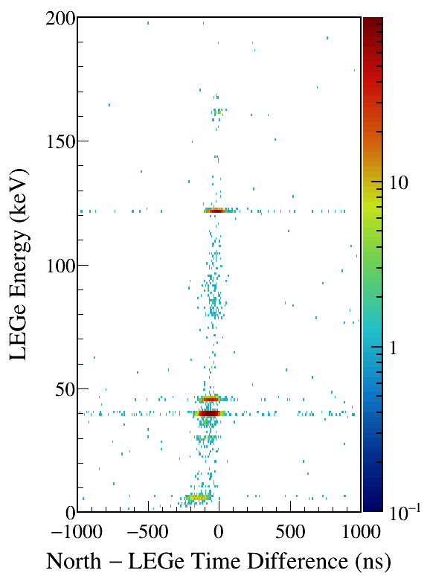
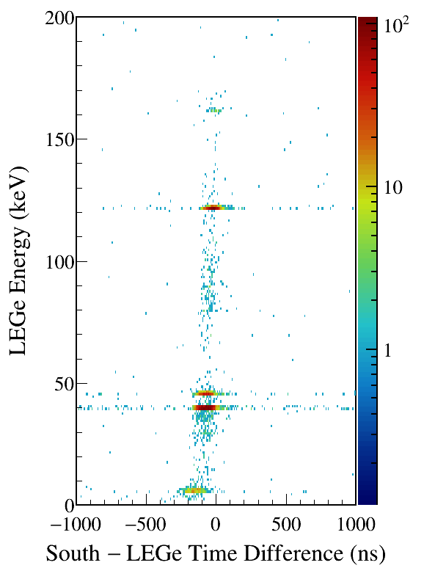
North/South 1408 gated
Notes:
TFile *_file0 = TFile::Open("F:/e21010/pxct/run0264_LEGe_XtRa_152Eu_Z2707_OnLEGeCap_window1us_TrigRise0.064us_TrigGap0.952us_ThL310_N300_S730_LED_cal.root");
TCanvas* canvaspeak = new TCanvas("canvaspeak", "canvaspeak", 580, 800);
canvaspeak->cd();
canvaspeak->SetTopMargin(0.03);
canvaspeak->SetRightMargin(0.16);
canvaspeak->SetLeftMargin(0.18);
canvaspeak->SetBottomMargin(0.11);
canvaspeak->SetFrameLineWidth(2);
canvaspeak->SetLogz();
TH2D* het = new TH2D("het", "het", 250,-1000,1000,200,0,200); //x,y
tree->Draw("lege_e:north_t-lege_t>>het","lege_e>1&&lege_e<200&&north_e>1405&&north_e<1411","colz"); //y:x
het->SetStats(0);
het->SetTitle("");
het->GetXaxis()->SetTitle("North #minus LEGe Time Difference (ns)");
het->GetYaxis()->SetTitle("LEGe Energy (keV)");
het->GetXaxis()->CenterTitle();
het->GetYaxis()->CenterTitle();
het->GetXaxis()->SetLabelFont(132);
het->GetYaxis()->SetLabelFont(132);
het->GetXaxis()->SetLabelSize(0.05);
het->GetYaxis()->SetLabelSize(0.05);
het->GetXaxis()->SetTitleFont(132);
het->GetYaxis()->SetTitleFont(132);
het->GetXaxis()->SetTitleOffset(0.9);
het->GetYaxis()->SetTitleOffset(1.4);
het->GetXaxis()->SetTitleSize(0.06);
het->GetYaxis()->SetTitleSize(0.06);
het->GetXaxis()->SetNdivisions(505);
het->GetYaxis()->SetNdivisions(505);
//het->GetXaxis()->SetRangeUser(2001,4500);
//het->GetYaxis()->SetRangeUser(1000,2800);
//het->SetMinimum(2);
//het->SetMaximum(100);
het->SetContour(99);
gStyle->SetPalette(kRainbow);
//gPad->SetLogz();
TPaletteAxis *palette = (TPaletteAxis*)het->GetListOfFunctions()->FindObject("palette");
palette->SetTitleFont(132);
palette->SetTitleSize(0.05);
palette->SetLabelFont(132);
palette->SetLabelSize(0.05);
palette->SetLineWidth(2);
canvaspeak->SaveAs("F:/e21010/pxct/1.png");
TCanvas* canvaspeak = new TCanvas("canvaspeak", "canvaspeak", 580, 800);
canvaspeak->cd();
canvaspeak->SetTopMargin(0.03);
canvaspeak->SetRightMargin(0.16);
canvaspeak->SetLeftMargin(0.18);
canvaspeak->SetBottomMargin(0.11);
canvaspeak->SetFrameLineWidth(2);
canvaspeak->SetLogz();
TH2D* het = new TH2D("het", "het", 250,-1000,1000,200,0,200); //x,y
tree->Draw("lege_e:south_t-lege_t>>het","lege_e>1&&lege_e<200&&south_e>1405&&south_e<1411","colz"); //y:x
het->SetStats(0);
het->SetTitle("");
het->GetXaxis()->SetTitle("South #minus LEGe Time Difference (ns)");
het->GetYaxis()->SetTitle("LEGe Energy (keV)");
het->GetXaxis()->CenterTitle();
het->GetYaxis()->CenterTitle();
het->GetXaxis()->SetLabelFont(132);
het->GetYaxis()->SetLabelFont(132);
het->GetXaxis()->SetLabelSize(0.05);
het->GetYaxis()->SetLabelSize(0.05);
het->GetXaxis()->SetTitleFont(132);
het->GetYaxis()->SetTitleFont(132);
het->GetXaxis()->SetTitleOffset(0.9);
het->GetYaxis()->SetTitleOffset(1.4);
het->GetXaxis()->SetTitleSize(0.06);
het->GetYaxis()->SetTitleSize(0.06);
het->GetXaxis()->SetNdivisions(505);
het->GetYaxis()->SetNdivisions(505);
//het->GetXaxis()->SetRangeUser(2001,4500);
//het->GetYaxis()->SetRangeUser(1000,2800);
//het->SetMinimum(2);
//het->SetMaximum(100);
het->SetContour(99);
gStyle->SetPalette(kRainbow);
//gPad->SetLogz();
TPaletteAxis *palette = (TPaletteAxis*)het->GetListOfFunctions()->FindObject("palette");
palette->SetTitleFont(132);
palette->SetTitleSize(0.05);
palette->SetLabelFont(132);
palette->SetLabelSize(0.05);
palette->SetLineWidth(2);
canvaspeak->SaveAs("F:/e21010/pxct/2.png");

Slide 9
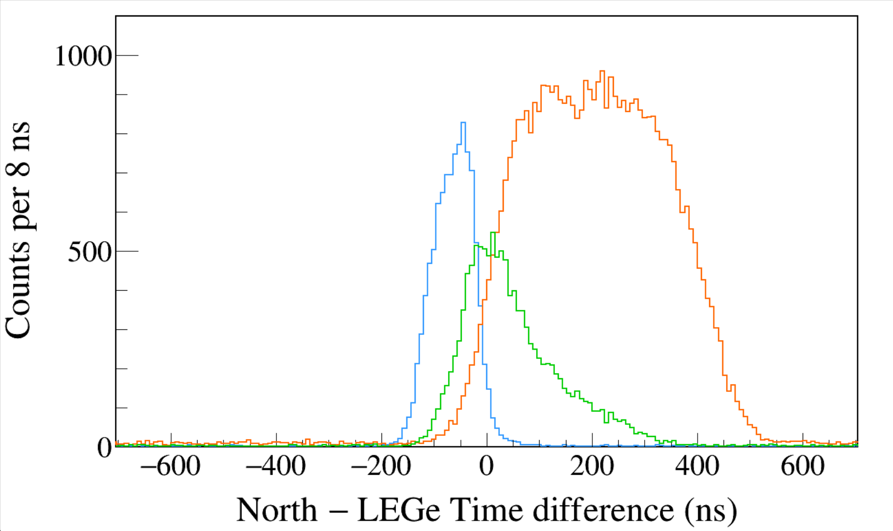
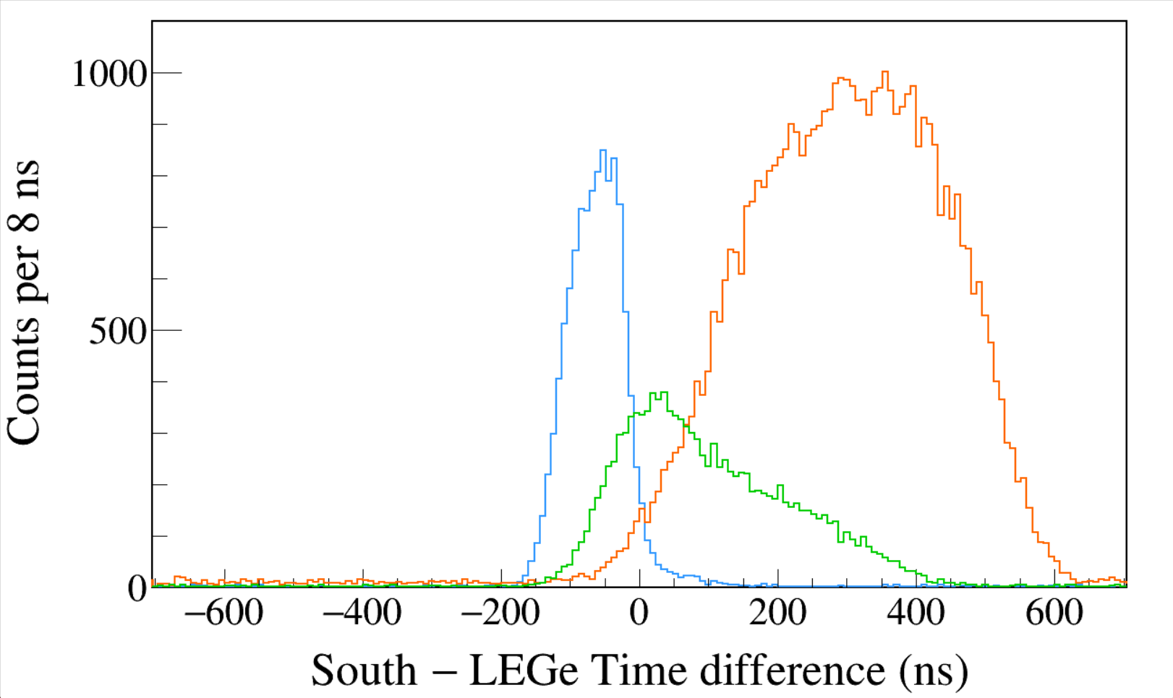
Run0289
152Eu 3-hour run
LED
Trigger Rise 0.064 μs
Trigger Gap 0.952 μs
Trigger Thresh 310, 300, 730
LED
LEGe 39||46 && North 1408
LEGe 39||46 && North 245
LEGe 39||46 && North 122
Run0289
152Eu 3-hour run
LED
Trigger Rise 0.064 μs
Trigger Gap 0.952 μs
Trigger Thresh 310, 300, 730
LED
LEGe 39||46 && South 1408
LEGe 39||46 && South 245
LEGe 39||46 && South 122
Notes:
TFile *_file0 = TFile::Open("F:/e21010/pxct/run0289_LEGe_XtRa_152Eu_Z2707_OnLEGeCap_window1us_TrigRise0.064us_TrigGap0.952us_ThL310_N300_S730_LED_cal.root");
TCanvas* canvaspeak = new TCanvas("canvaspeak", "canvaspeak", 1300, 800);//
canvaspeak->cd();//
canvaspeak->SetTopMargin(0.03);
canvaspeak->SetRightMargin(0.04);
canvaspeak->SetLeftMargin(0.13);
canvaspeak->SetBottomMargin(0.16);
canvaspeak->SetFrameLineWidth(2);
TH1D* htimestamps = new TH1D("htimestamps", "htimestamps", 250,-1000,1000);
htimestamps->SetLineWidth(2);
htimestamps->Rebin(1);
htimestamps->SetStats(0);
htimestamps->SetTitle("");
htimestamps->GetXaxis()->SetTitle("North #minus LEGe Time difference (ns)");
htimestamps->GetYaxis()->SetTitle("Counts per 8 ns");
htimestamps->GetXaxis()->CenterTitle();
htimestamps->GetYaxis()->CenterTitle();
htimestamps->GetXaxis()->SetLabelFont(132);
htimestamps->GetYaxis()->SetLabelFont(132);
htimestamps->GetXaxis()->SetLabelSize(0.06);
htimestamps->GetYaxis()->SetLabelSize(0.06);
htimestamps->GetXaxis()->SetTitleFont(132);
htimestamps->GetYaxis()->SetTitleFont(132);
htimestamps->GetXaxis()->SetTitleOffset(1.1);
htimestamps->GetYaxis()->SetTitleOffset(0.95);
htimestamps->GetXaxis()->SetTitleSize(0.07);
htimestamps->GetYaxis()->SetTitleSize(0.07);
htimestamps->GetXaxis()->SetRangeUser(-700,700);
htimestamps->GetYaxis()->SetRangeUser(0,400);
htimestamps->GetYaxis()->SetNdivisions(505);
htimestamps->SetLineWidth(2);
htimestamps->SetLineColor(kAzure+1);
tree->Draw("north_t-lege_t>>htimestamps","north_e>1405&&north_e<1411&&((lege_e>38.8&&lege_e<40.8)||(lege_e>44.8&&lege_e<47.2))","");
htimestamps->Sumw2(kFALSE);
htimestamps->SetBinErrorOption(TH1::kPoisson);//TH1::kNormal or TH1::kPoisson
tree->SetLineColor(kOrange+7);
tree->SetLineWidth(2);
tree->Draw("north_t-lege_t","north_e>120&&north_e<123&&((lege_e>38.8&&lege_e<40.8)||(lege_e>44.8&&lege_e<47.2))","same");
tree->SetLineColor(kGreen+1);
tree->SetLineWidth(2);
tree->Draw("north_t-lege_t","north_e>243&&north_e<246&&((lege_e>38.8&&lege_e<40.8)||(lege_e>44.8&&lege_e<47.2))","same");
TCanvas* canvaspeak = new TCanvas("canvaspeak", "canvaspeak", 1300, 800);//
canvaspeak->cd();//
canvaspeak->SetTopMargin(0.03);
canvaspeak->SetRightMargin(0.04);
canvaspeak->SetLeftMargin(0.13);
canvaspeak->SetBottomMargin(0.16);
canvaspeak->SetFrameLineWidth(2);
TH1D* htimestamps = new TH1D("htimestamps", "htimestamps", 250,-1000,1000);
htimestamps->SetLineWidth(2);
htimestamps->Rebin(1);
htimestamps->SetStats(0);
htimestamps->SetTitle("");
htimestamps->GetXaxis()->SetTitle("South #minus LEGe Time difference (ns)");
htimestamps->GetYaxis()->SetTitle("Counts per 8 ns");
htimestamps->GetXaxis()->CenterTitle();
htimestamps->GetYaxis()->CenterTitle();
htimestamps->GetXaxis()->SetLabelFont(132);
htimestamps->GetYaxis()->SetLabelFont(132);
htimestamps->GetXaxis()->SetLabelSize(0.06);
htimestamps->GetYaxis()->SetLabelSize(0.06);
htimestamps->GetXaxis()->SetTitleFont(132);
htimestamps->GetYaxis()->SetTitleFont(132);
htimestamps->GetXaxis()->SetTitleOffset(1.1);
htimestamps->GetYaxis()->SetTitleOffset(0.95);
htimestamps->GetXaxis()->SetTitleSize(0.07);
htimestamps->GetYaxis()->SetTitleSize(0.07);
htimestamps->GetXaxis()->SetRangeUser(-700,700);
htimestamps->GetYaxis()->SetRangeUser(0,400);
htimestamps->GetYaxis()->SetNdivisions(505);
htimestamps->SetLineWidth(2);
htimestamps->SetLineColor(kAzure+1);
tree->Draw("south_t-lege_t>>htimestamps","south_e>1405&&south_e<1411&&((lege_e>38.8&&lege_e<40.8)||(lege_e>44.8&&lege_e<47.2))","");
htimestamps->Sumw2(kFALSE);
htimestamps->SetBinErrorOption(TH1::kPoisson);//TH1::kNormal or TH1::kPoisson
tree->SetLineColor(kOrange+7);
tree->SetLineWidth(2);
tree->Draw("south_t-lege_t","south_e>120&&south_e<123&&((lege_e>38.8&&lege_e<40.8)||(lege_e>44.8&&lege_e<47.2))","same");
tree->SetLineColor(kGreen+1);
tree->SetLineWidth(2);
tree->Draw("south_t-lege_t","south_e>243&&south_e<246&&((lege_e>38.8&&lege_e<40.8)||(lege_e>44.8&&lege_e<47.2))","same");

Slide 10
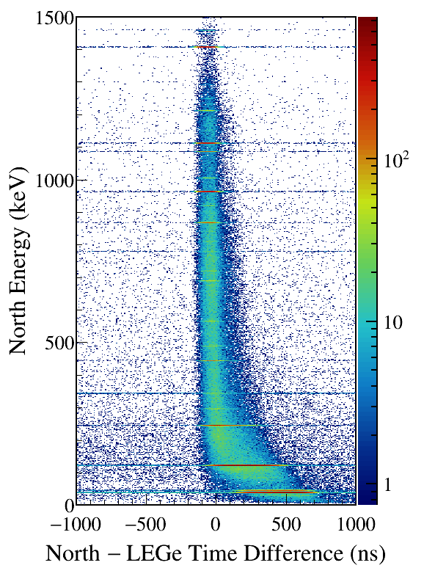
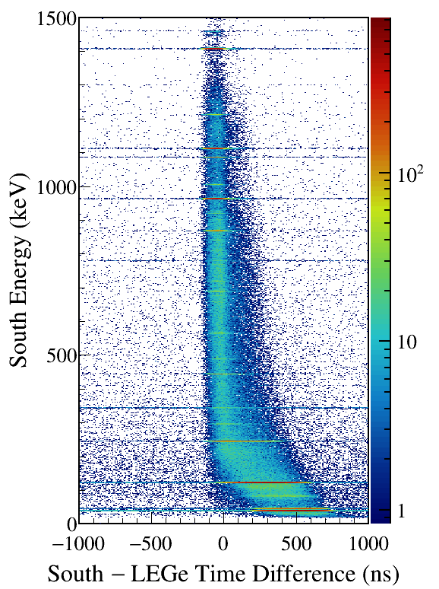
LEGe (39||46) Kα,Kβ gated
Notes:
TFile *_file0 = TFile::Open("F:/e21010/pxct/run0289_LEGe_XtRa_152Eu_Z2707_OnLEGeCap_window1us_TrigRise0.064us_TrigGap0.952us_ThL310_N300_S730_LED_cal.root");
TCanvas* canvaspeak = new TCanvas("canvaspeak", "canvaspeak", 580, 800);
canvaspeak->cd();
canvaspeak->SetTopMargin(0.03);
canvaspeak->SetRightMargin(0.16);
canvaspeak->SetLeftMargin(0.18);
canvaspeak->SetBottomMargin(0.11);
canvaspeak->SetFrameLineWidth(2);
canvaspeak->SetLogz();
TH2D* het = new TH2D("het", "het", 250,-1000,1000,750,0,1500); //x,y
tree->Draw("north_e:north_t-lege_t>>het","north_e>1&&north_e<1500&&((lege_e>38.8&&lege_e<40.8)||(lege_e>44.8&&lege_e<47.2))","colz"); //y:x
het->SetStats(0);
het->SetTitle("");
het->GetXaxis()->SetTitle("North #minus LEGe Time Difference (ns)");
het->GetYaxis()->SetTitle("North Energy (keV)");
het->GetXaxis()->CenterTitle();
het->GetYaxis()->CenterTitle();
het->GetXaxis()->SetLabelFont(132);
het->GetYaxis()->SetLabelFont(132);
het->GetXaxis()->SetLabelSize(0.05);
het->GetYaxis()->SetLabelSize(0.05);
het->GetXaxis()->SetTitleFont(132);
het->GetYaxis()->SetTitleFont(132);
het->GetXaxis()->SetTitleOffset(0.9);
het->GetYaxis()->SetTitleOffset(1.4);
het->GetXaxis()->SetTitleSize(0.06);
het->GetYaxis()->SetTitleSize(0.06);
het->GetXaxis()->SetNdivisions(505);
het->GetYaxis()->SetNdivisions(505);
//het->GetXaxis()->SetRangeUser(2001,4500);
//het->GetYaxis()->SetRangeUser(1000,2800);
//het->SetMinimum(2);
//het->SetMaximum(100);
het->SetContour(99);
gStyle->SetPalette(kRainbow);
//gPad->SetLogz();
TPaletteAxis *palette = (TPaletteAxis*)het->GetListOfFunctions()->FindObject("palette");
palette->SetTitleFont(132);
palette->SetTitleSize(0.05);
palette->SetLabelFont(132);
palette->SetLabelSize(0.05);
palette->SetLineWidth(2);
canvaspeak->SaveAs("F:/e21010/pxct/1.png");
TCanvas* canvaspeak = new TCanvas("canvaspeak", "canvaspeak", 580, 800);
canvaspeak->cd();
canvaspeak->SetTopMargin(0.03);
canvaspeak->SetRightMargin(0.16);
canvaspeak->SetLeftMargin(0.18);
canvaspeak->SetBottomMargin(0.11);
canvaspeak->SetFrameLineWidth(2);
canvaspeak->SetLogz();
TH2D* het = new TH2D("het", "het", 250,-1000,1000,750,0,1500); //x,y
tree->Draw("south_e:south_t-lege_t>>het","south_e>1&&south_e<1500&&((lege_e>38.8&&lege_e<40.8)||(lege_e>44.8&&lege_e<47.2))","colz"); //y:x
het->SetStats(0);
het->SetTitle("");
het->GetXaxis()->SetTitle("South #minus LEGe Time Difference (ns)");
het->GetYaxis()->SetTitle("South Energy (keV)");
het->GetXaxis()->CenterTitle();
het->GetYaxis()->CenterTitle();
het->GetXaxis()->SetLabelFont(132);
het->GetYaxis()->SetLabelFont(132);
het->GetXaxis()->SetLabelSize(0.05);
het->GetYaxis()->SetLabelSize(0.05);
het->GetXaxis()->SetTitleFont(132);
het->GetYaxis()->SetTitleFont(132);
het->GetXaxis()->SetTitleOffset(0.9);
het->GetYaxis()->SetTitleOffset(1.4);
het->GetXaxis()->SetTitleSize(0.06);
het->GetYaxis()->SetTitleSize(0.06);
het->GetXaxis()->SetNdivisions(505);
het->GetYaxis()->SetNdivisions(505);
//het->GetXaxis()->SetRangeUser(2001,4500);
//het->GetYaxis()->SetRangeUser(1000,2800);
//het->SetMinimum(2);
//het->SetMaximum(100);
het->SetContour(99);
gStyle->SetPalette(kRainbow);
//gPad->SetLogz();
TPaletteAxis *palette = (TPaletteAxis*)het->GetListOfFunctions()->FindObject("palette");
palette->SetTitleFont(132);
palette->SetTitleSize(0.05);
palette->SetLabelFont(132);
palette->SetLabelSize(0.05);
palette->SetLineWidth(2);
canvaspeak->SaveAs("F:/e21010/pxct/2.png");

Slide 11
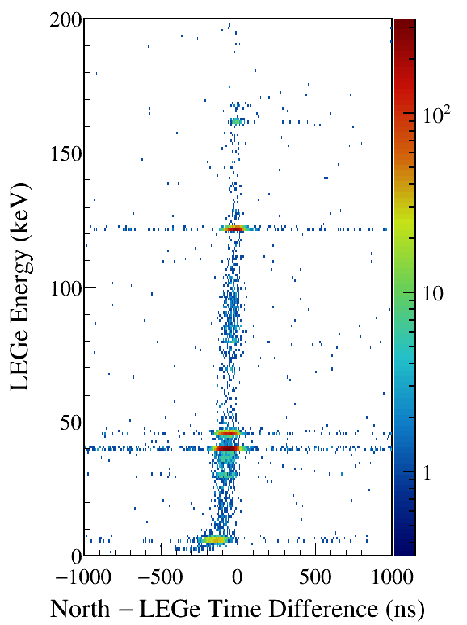
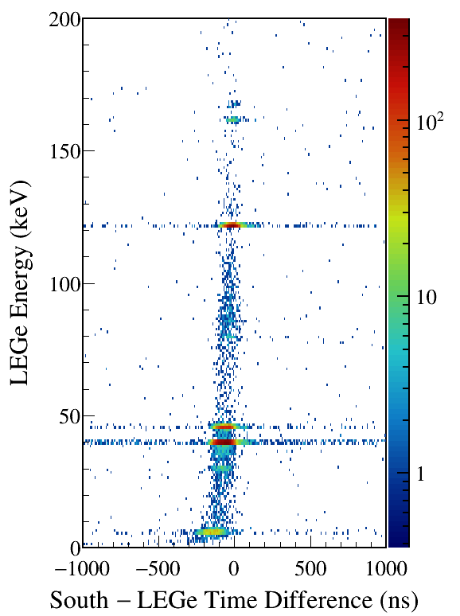
North/South 1408 gated
Notes:
TFile *_file0 = TFile::Open("F:/e21010/pxct/run0289_LEGe_XtRa_152Eu_Z2707_OnLEGeCap_window1us_TrigRise0.064us_TrigGap0.952us_ThL310_N300_S730_LED_cal.root");
TCanvas* canvaspeak = new TCanvas("canvaspeak", "canvaspeak", 580, 800);
canvaspeak->cd();
canvaspeak->SetTopMargin(0.03);
canvaspeak->SetRightMargin(0.16);
canvaspeak->SetLeftMargin(0.18);
canvaspeak->SetBottomMargin(0.11);
canvaspeak->SetFrameLineWidth(2);
canvaspeak->SetLogz();
TH2D* het = new TH2D("het", "het", 250,-1000,1000,200,0,200); //x,y
tree->Draw("lege_e:north_t-lege_t>>het","lege_e>1&&lege_e<200&&north_e>1405&&north_e<1411","colz"); //y:x
het->SetStats(0);
het->SetTitle("");
het->GetXaxis()->SetTitle("North #minus LEGe Time Difference (ns)");
het->GetYaxis()->SetTitle("LEGe Energy (keV)");
het->GetXaxis()->CenterTitle();
het->GetYaxis()->CenterTitle();
het->GetXaxis()->SetLabelFont(132);
het->GetYaxis()->SetLabelFont(132);
het->GetXaxis()->SetLabelSize(0.05);
het->GetYaxis()->SetLabelSize(0.05);
het->GetXaxis()->SetTitleFont(132);
het->GetYaxis()->SetTitleFont(132);
het->GetXaxis()->SetTitleOffset(0.9);
het->GetYaxis()->SetTitleOffset(1.4);
het->GetXaxis()->SetTitleSize(0.06);
het->GetYaxis()->SetTitleSize(0.06);
het->GetXaxis()->SetNdivisions(505);
het->GetYaxis()->SetNdivisions(505);
//het->GetXaxis()->SetRangeUser(2001,4500);
//het->GetYaxis()->SetRangeUser(1000,2800);
//het->SetMinimum(2);
//het->SetMaximum(100);
het->SetContour(99);
gStyle->SetPalette(kRainbow);
//gPad->SetLogz();
TPaletteAxis *palette = (TPaletteAxis*)het->GetListOfFunctions()->FindObject("palette");
palette->SetTitleFont(132);
palette->SetTitleSize(0.05);
palette->SetLabelFont(132);
palette->SetLabelSize(0.05);
palette->SetLineWidth(2);
canvaspeak->SaveAs("F:/e21010/pxct/1.png");
TCanvas* canvaspeak = new TCanvas("canvaspeak", "canvaspeak", 580, 800);
canvaspeak->cd();
canvaspeak->SetTopMargin(0.03);
canvaspeak->SetRightMargin(0.16);
canvaspeak->SetLeftMargin(0.18);
canvaspeak->SetBottomMargin(0.11);
canvaspeak->SetFrameLineWidth(2);
canvaspeak->SetLogz();
TH2D* het = new TH2D("het", "het", 250,-1000,1000,200,0,200); //x,y
tree->Draw("lege_e:south_t-lege_t>>het","lege_e>1&&lege_e<200&&south_e>1405&&south_e<1411","colz"); //y:x
het->SetStats(0);
het->SetTitle("");
het->GetXaxis()->SetTitle("South #minus LEGe Time Difference (ns)");
het->GetYaxis()->SetTitle("LEGe Energy (keV)");
het->GetXaxis()->CenterTitle();
het->GetYaxis()->CenterTitle();
het->GetXaxis()->SetLabelFont(132);
het->GetYaxis()->SetLabelFont(132);
het->GetXaxis()->SetLabelSize(0.05);
het->GetYaxis()->SetLabelSize(0.05);
het->GetXaxis()->SetTitleFont(132);
het->GetYaxis()->SetTitleFont(132);
het->GetXaxis()->SetTitleOffset(0.9);
het->GetYaxis()->SetTitleOffset(1.4);
het->GetXaxis()->SetTitleSize(0.06);
het->GetYaxis()->SetTitleSize(0.06);
het->GetXaxis()->SetNdivisions(505);
het->GetYaxis()->SetNdivisions(505);
//het->GetXaxis()->SetRangeUser(2001,4500);
//het->GetYaxis()->SetRangeUser(1000,2800);
//het->SetMinimum(2);
//het->SetMaximum(100);
het->SetContour(99);
gStyle->SetPalette(kRainbow);
//gPad->SetLogz();
TPaletteAxis *palette = (TPaletteAxis*)het->GetListOfFunctions()->FindObject("palette");
palette->SetTitleFont(132);
palette->SetTitleSize(0.05);
palette->SetLabelFont(132);
palette->SetLabelSize(0.05);
palette->SetLineWidth(2);
canvaspeak->SaveAs("F:/e21010/pxct/2.png");

Slide 12
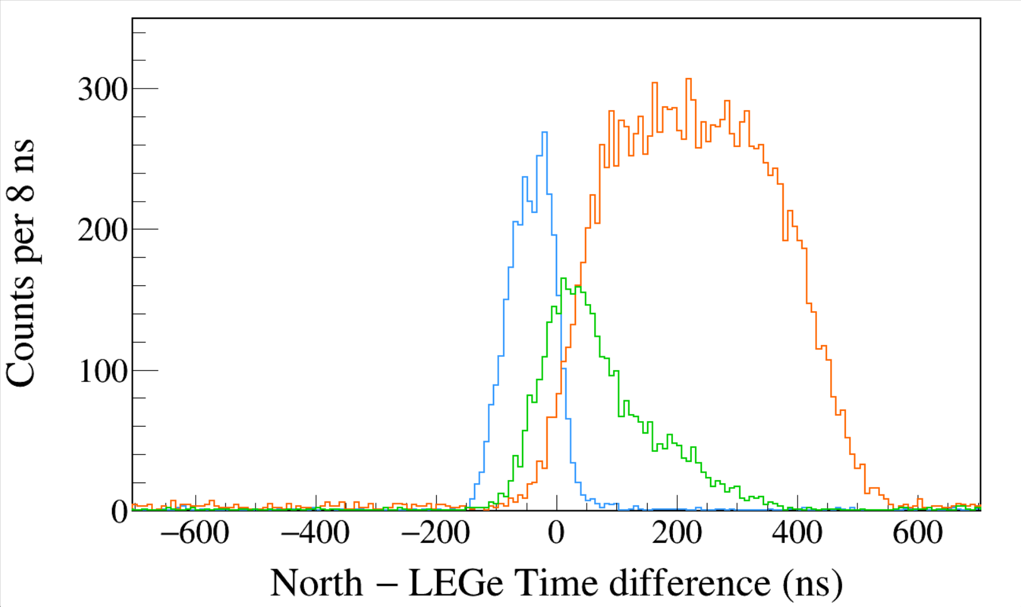
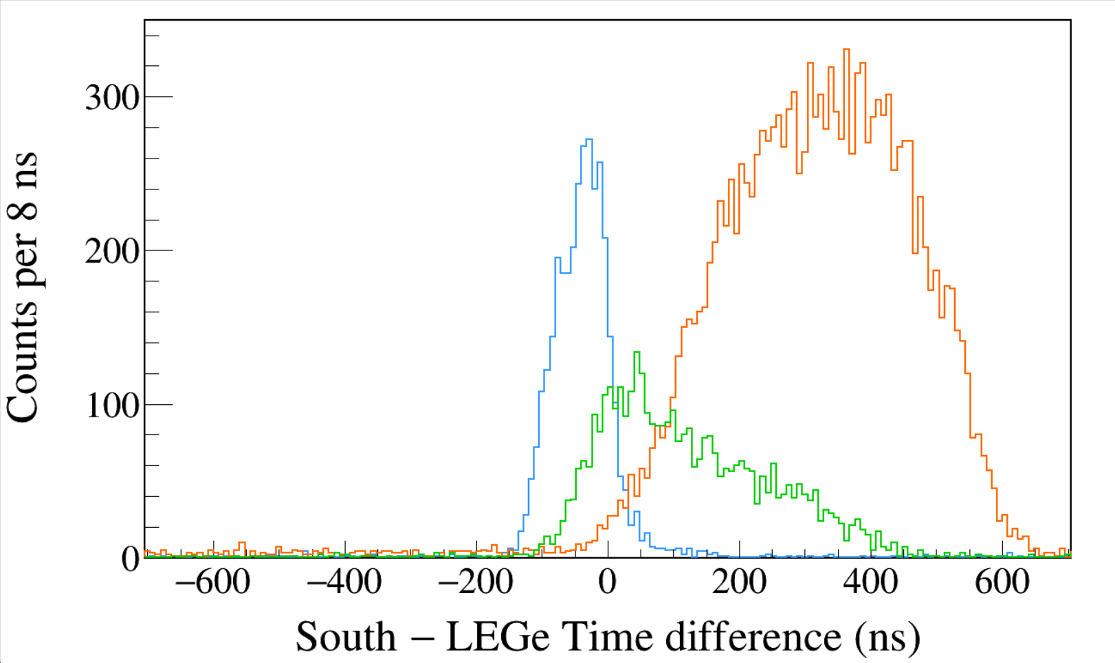
Run0290
152Eu 1-hour run
LED
Trigger Rise 0.016 μs
Trigger Gap 1.000 μs
Trigger Thresh 330, 300, 730
LED
LEGe 39||46 && North 1408
LEGe 39||46 && North 245
LEGe 39||46 && North 122
Run0290
152Eu 1-hour run
LED
Trigger Rise 0.016 μs
Trigger Gap 1.000 μs
Trigger Thresh 330, 300, 730
LED
LEGe 39||46 && South 1408
LEGe 39||46 && South 245
LEGe 39||46 && South 122
Notes:
TFile *_file0 = TFile::Open("F:/e21010/pxct/run0290_LEGe_XtRa_152Eu_Z2707_OnLEGeCap_window1us_TrigRise0.016_0.064us_TrigGap1.000_0.952us_ThL330_N300_S730_LED_cal.root");
TCanvas* canvaspeak = new TCanvas("canvaspeak", "canvaspeak", 1300, 800);//
canvaspeak->cd();//
canvaspeak->SetTopMargin(0.03);
canvaspeak->SetRightMargin(0.04);
canvaspeak->SetLeftMargin(0.13);
canvaspeak->SetBottomMargin(0.16);
canvaspeak->SetFrameLineWidth(2);
TH1D* htimestamps = new TH1D("htimestamps", "htimestamps", 250,-1000,1000);
htimestamps->SetLineWidth(2);
htimestamps->Rebin(1);
htimestamps->SetStats(0);
htimestamps->SetTitle("");
htimestamps->GetXaxis()->SetTitle("North #minus LEGe Time difference (ns)");
htimestamps->GetYaxis()->SetTitle("Counts per 8 ns");
htimestamps->GetXaxis()->CenterTitle();
htimestamps->GetYaxis()->CenterTitle();
htimestamps->GetXaxis()->SetLabelFont(132);
htimestamps->GetYaxis()->SetLabelFont(132);
htimestamps->GetXaxis()->SetLabelSize(0.06);
htimestamps->GetYaxis()->SetLabelSize(0.06);
htimestamps->GetXaxis()->SetTitleFont(132);
htimestamps->GetYaxis()->SetTitleFont(132);
htimestamps->GetXaxis()->SetTitleOffset(1.1);
htimestamps->GetYaxis()->SetTitleOffset(0.95);
htimestamps->GetXaxis()->SetTitleSize(0.07);
htimestamps->GetYaxis()->SetTitleSize(0.07);
htimestamps->GetXaxis()->SetRangeUser(-700,700);
htimestamps->GetYaxis()->SetRangeUser(0,350);
htimestamps->GetYaxis()->SetNdivisions(505);
htimestamps->SetLineWidth(2);
htimestamps->SetLineColor(kAzure+1);
tree->Draw("north_t-lege_t>>htimestamps","north_e>1405&&north_e<1411&&((lege_e>38.8&&lege_e<40.8)||(lege_e>44.8&&lege_e<47.2))","");
htimestamps->Sumw2(kFALSE);
htimestamps->SetBinErrorOption(TH1::kPoisson);//TH1::kNormal or TH1::kPoisson
tree->SetLineColor(kOrange+7);
tree->SetLineWidth(2);
tree->Draw("north_t-lege_t","north_e>120&&north_e<123&&((lege_e>38.8&&lege_e<40.8)||(lege_e>44.8&&lege_e<47.2))","same");
tree->SetLineColor(kGreen+1);
tree->SetLineWidth(2);
tree->Draw("north_t-lege_t","north_e>243&&north_e<246&&((lege_e>38.8&&lege_e<40.8)||(lege_e>44.8&&lege_e<47.2))","same");
TCanvas* canvaspeak = new TCanvas("canvaspeak", "canvaspeak", 1300, 800);//
canvaspeak->cd();//
canvaspeak->SetTopMargin(0.03);
canvaspeak->SetRightMargin(0.04);
canvaspeak->SetLeftMargin(0.13);
canvaspeak->SetBottomMargin(0.16);
canvaspeak->SetFrameLineWidth(2);
TH1D* htimestamps = new TH1D("htimestamps", "htimestamps", 250,-1000,1000);
htimestamps->SetLineWidth(2);
htimestamps->Rebin(1);
htimestamps->SetStats(0);
htimestamps->SetTitle("");
htimestamps->GetXaxis()->SetTitle("South #minus LEGe Time difference (ns)");
htimestamps->GetYaxis()->SetTitle("Counts per 8 ns");
htimestamps->GetXaxis()->CenterTitle();
htimestamps->GetYaxis()->CenterTitle();
htimestamps->GetXaxis()->SetLabelFont(132);
htimestamps->GetYaxis()->SetLabelFont(132);
htimestamps->GetXaxis()->SetLabelSize(0.06);
htimestamps->GetYaxis()->SetLabelSize(0.06);
htimestamps->GetXaxis()->SetTitleFont(132);
htimestamps->GetYaxis()->SetTitleFont(132);
htimestamps->GetXaxis()->SetTitleOffset(1.1);
htimestamps->GetYaxis()->SetTitleOffset(0.95);
htimestamps->GetXaxis()->SetTitleSize(0.07);
htimestamps->GetYaxis()->SetTitleSize(0.07);
htimestamps->GetXaxis()->SetRangeUser(-700,700);
htimestamps->GetYaxis()->SetRangeUser(0,350);
htimestamps->GetYaxis()->SetNdivisions(505);
htimestamps->SetLineWidth(2);
htimestamps->SetLineColor(kAzure+1);
tree->Draw("south_t-lege_t>>htimestamps","south_e>1405&&south_e<1411&&((lege_e>38.8&&lege_e<40.8)||(lege_e>44.8&&lege_e<47.2))","");
htimestamps->Sumw2(kFALSE);
htimestamps->SetBinErrorOption(TH1::kPoisson);//TH1::kNormal or TH1::kPoisson
tree->SetLineColor(kOrange+7);
tree->SetLineWidth(2);
tree->Draw("south_t-lege_t","south_e>120&&south_e<123&&((lege_e>38.8&&lege_e<40.8)||(lege_e>44.8&&lege_e<47.2))","same");
tree->SetLineColor(kGreen+1);
tree->SetLineWidth(2);
tree->Draw("south_t-lege_t","south_e>243&&south_e<246&&((lege_e>38.8&&lege_e<40.8)||(lege_e>44.8&&lege_e<47.2))","same");

Slide 13
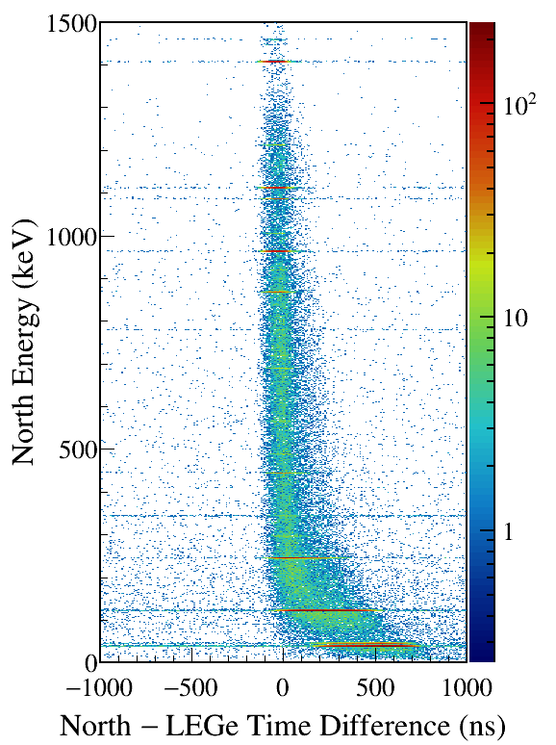
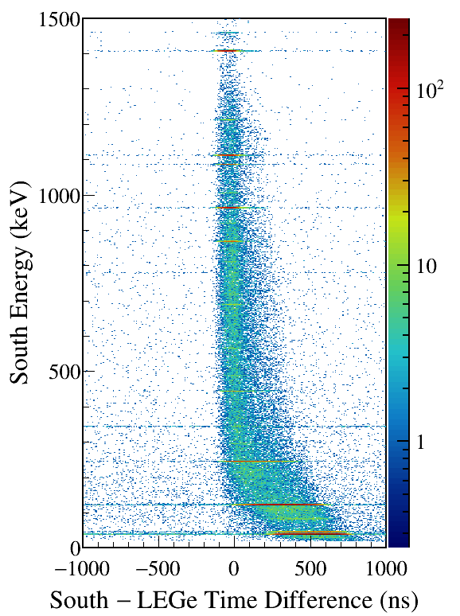
LEGe (39||46) Kα,Kβ gated
Notes:
TFile *_file0 = TFile::Open("F:/e21010/pxct/run0290_LEGe_XtRa_152Eu_Z2707_OnLEGeCap_window1us_TrigRise0.016_0.064us_TrigGap1.000_0.952us_ThL330_N300_S730_LED_cal.root");
TCanvas* canvaspeak = new TCanvas("canvaspeak", "canvaspeak", 580, 800);
canvaspeak->cd();
canvaspeak->SetTopMargin(0.03);
canvaspeak->SetRightMargin(0.16);
canvaspeak->SetLeftMargin(0.18);
canvaspeak->SetBottomMargin(0.11);
canvaspeak->SetFrameLineWidth(2);
canvaspeak->SetLogz();
TH2D* het = new TH2D("het", "het", 250,-1000,1000,750,0,1500); //x,y
tree->Draw("north_e:north_t-lege_t>>het","north_e>1&&north_e<1500&&((lege_e>38.8&&lege_e<40.8)||(lege_e>44.8&&lege_e<47.2))","colz"); //y:x
het->SetStats(0);
het->SetTitle("");
het->GetXaxis()->SetTitle("North #minus LEGe Time Difference (ns)");
het->GetYaxis()->SetTitle("North Energy (keV)");
het->GetXaxis()->CenterTitle();
het->GetYaxis()->CenterTitle();
het->GetXaxis()->SetLabelFont(132);
het->GetYaxis()->SetLabelFont(132);
het->GetXaxis()->SetLabelSize(0.05);
het->GetYaxis()->SetLabelSize(0.05);
het->GetXaxis()->SetTitleFont(132);
het->GetYaxis()->SetTitleFont(132);
het->GetXaxis()->SetTitleOffset(0.9);
het->GetYaxis()->SetTitleOffset(1.4);
het->GetXaxis()->SetTitleSize(0.06);
het->GetYaxis()->SetTitleSize(0.06);
het->GetXaxis()->SetNdivisions(505);
het->GetYaxis()->SetNdivisions(505);
//het->GetXaxis()->SetRangeUser(2001,4500);
//het->GetYaxis()->SetRangeUser(1000,2800);
//het->SetMinimum(2);
//het->SetMaximum(100);
het->SetContour(99);
gStyle->SetPalette(kRainbow);
//gPad->SetLogz();
TPaletteAxis *palette = (TPaletteAxis*)het->GetListOfFunctions()->FindObject("palette");
palette->SetTitleFont(132);
palette->SetTitleSize(0.05);
palette->SetLabelFont(132);
palette->SetLabelSize(0.05);
palette->SetLineWidth(2);
canvaspeak->SaveAs("F:/e21010/pxct/1.png");
TCanvas* canvaspeak = new TCanvas("canvaspeak", "canvaspeak", 580, 800);
canvaspeak->cd();
canvaspeak->SetTopMargin(0.03);
canvaspeak->SetRightMargin(0.16);
canvaspeak->SetLeftMargin(0.18);
canvaspeak->SetBottomMargin(0.11);
canvaspeak->SetFrameLineWidth(2);
canvaspeak->SetLogz();
TH2D* het = new TH2D("het", "het", 250,-1000,1000,750,0,1500); //x,y
tree->Draw("south_e:south_t-lege_t>>het","south_e>1&&south_e<1500&&((lege_e>38.8&&lege_e<40.8)||(lege_e>44.8&&lege_e<47.2))","colz"); //y:x
het->SetStats(0);
het->SetTitle("");
het->GetXaxis()->SetTitle("South #minus LEGe Time Difference (ns)");
het->GetYaxis()->SetTitle("South Energy (keV)");
het->GetXaxis()->CenterTitle();
het->GetYaxis()->CenterTitle();
het->GetXaxis()->SetLabelFont(132);
het->GetYaxis()->SetLabelFont(132);
het->GetXaxis()->SetLabelSize(0.05);
het->GetYaxis()->SetLabelSize(0.05);
het->GetXaxis()->SetTitleFont(132);
het->GetYaxis()->SetTitleFont(132);
het->GetXaxis()->SetTitleOffset(0.9);
het->GetYaxis()->SetTitleOffset(1.4);
het->GetXaxis()->SetTitleSize(0.06);
het->GetYaxis()->SetTitleSize(0.06);
het->GetXaxis()->SetNdivisions(505);
het->GetYaxis()->SetNdivisions(505);
//het->GetXaxis()->SetRangeUser(2001,4500);
//het->GetYaxis()->SetRangeUser(1000,2800);
//het->SetMinimum(2);
//het->SetMaximum(100);
het->SetContour(99);
gStyle->SetPalette(kRainbow);
//gPad->SetLogz();
TPaletteAxis *palette = (TPaletteAxis*)het->GetListOfFunctions()->FindObject("palette");
palette->SetTitleFont(132);
palette->SetTitleSize(0.05);
palette->SetLabelFont(132);
palette->SetLabelSize(0.05);
palette->SetLineWidth(2);
canvaspeak->SaveAs("F:/e21010/pxct/2.png");

Slide 14
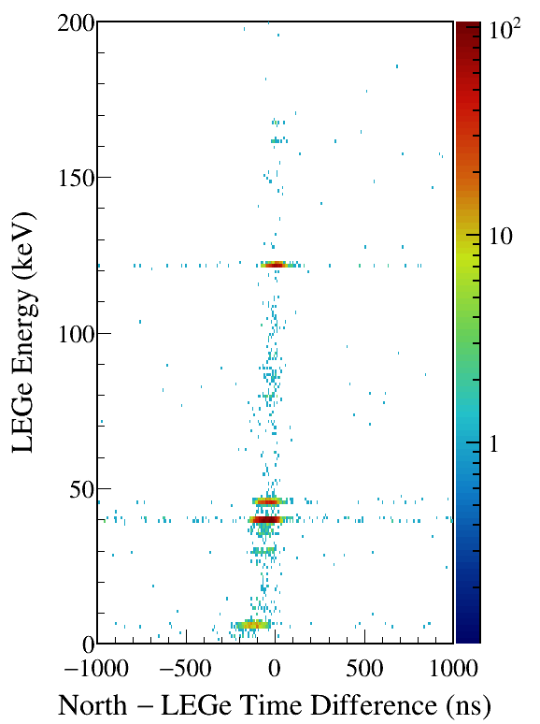
North/South 1408 gated
Notes:
TFile *_file0 = TFile::Open("F:/e21010/pxct/run0290_LEGe_XtRa_152Eu_Z2707_OnLEGeCap_window1us_TrigRise0.016_0.064us_TrigGap1.000_0.952us_ThL330_N300_S730_LED_cal.root");
TCanvas* canvaspeak = new TCanvas("canvaspeak", "canvaspeak", 580, 800);
canvaspeak->cd();
canvaspeak->SetTopMargin(0.03);
canvaspeak->SetRightMargin(0.16);
canvaspeak->SetLeftMargin(0.18);
canvaspeak->SetBottomMargin(0.11);
canvaspeak->SetFrameLineWidth(2);
canvaspeak->SetLogz();
TH2D* het = new TH2D("het", "het", 250,-1000,1000,200,0,200); //x,y
tree->Draw("lege_e:north_t-lege_t>>het","lege_e>1&&lege_e<200&&north_e>1405&&north_e<1411","colz"); //y:x
het->SetStats(0);
het->SetTitle("");
het->GetXaxis()->SetTitle("North #minus LEGe Time Difference (ns)");
het->GetYaxis()->SetTitle("LEGe Energy (keV)");
het->GetXaxis()->CenterTitle();
het->GetYaxis()->CenterTitle();
het->GetXaxis()->SetLabelFont(132);
het->GetYaxis()->SetLabelFont(132);
het->GetXaxis()->SetLabelSize(0.05);
het->GetYaxis()->SetLabelSize(0.05);
het->GetXaxis()->SetTitleFont(132);
het->GetYaxis()->SetTitleFont(132);
het->GetXaxis()->SetTitleOffset(0.9);
het->GetYaxis()->SetTitleOffset(1.4);
het->GetXaxis()->SetTitleSize(0.06);
het->GetYaxis()->SetTitleSize(0.06);
het->GetXaxis()->SetNdivisions(505);
het->GetYaxis()->SetNdivisions(505);
//het->GetXaxis()->SetRangeUser(2001,4500);
//het->GetYaxis()->SetRangeUser(1000,2800);
//het->SetMinimum(2);
//het->SetMaximum(100);
het->SetContour(99);
gStyle->SetPalette(kRainbow);
//gPad->SetLogz();
TPaletteAxis *palette = (TPaletteAxis*)het->GetListOfFunctions()->FindObject("palette");
palette->SetTitleFont(132);
palette->SetTitleSize(0.05);
palette->SetLabelFont(132);
palette->SetLabelSize(0.05);
palette->SetLineWidth(2);
canvaspeak->SaveAs("F:/e21010/pxct/1.png");
TCanvas* canvaspeak = new TCanvas("canvaspeak", "canvaspeak", 580, 800);
canvaspeak->cd();
canvaspeak->SetTopMargin(0.03);
canvaspeak->SetRightMargin(0.16);
canvaspeak->SetLeftMargin(0.18);
canvaspeak->SetBottomMargin(0.11);
canvaspeak->SetFrameLineWidth(2);
canvaspeak->SetLogz();
TH2D* het = new TH2D("het", "het", 250,-1000,1000,200,0,200); //x,y
tree->Draw("lege_e:south_t-lege_t>>het","lege_e>1&&lege_e<200&&south_e>1405&&south_e<1411","colz"); //y:x
het->SetStats(0);
het->SetTitle("");
het->GetXaxis()->SetTitle("South #minus LEGe Time Difference (ns)");
het->GetYaxis()->SetTitle("LEGe Energy (keV)");
het->GetXaxis()->CenterTitle();
het->GetYaxis()->CenterTitle();
het->GetXaxis()->SetLabelFont(132);
het->GetYaxis()->SetLabelFont(132);
het->GetXaxis()->SetLabelSize(0.05);
het->GetYaxis()->SetLabelSize(0.05);
het->GetXaxis()->SetTitleFont(132);
het->GetYaxis()->SetTitleFont(132);
het->GetXaxis()->SetTitleOffset(0.9);
het->GetYaxis()->SetTitleOffset(1.4);
het->GetXaxis()->SetTitleSize(0.06);
het->GetYaxis()->SetTitleSize(0.06);
het->GetXaxis()->SetNdivisions(505);
het->GetYaxis()->SetNdivisions(505);
//het->GetXaxis()->SetRangeUser(2001,4500);
//het->GetYaxis()->SetRangeUser(1000,2800);
//het->SetMinimum(2);
//het->SetMaximum(100);
het->SetContour(99);
gStyle->SetPalette(kRainbow);
//gPad->SetLogz();
TPaletteAxis *palette = (TPaletteAxis*)het->GetListOfFunctions()->FindObject("palette");
palette->SetTitleFont(132);
palette->SetTitleSize(0.05);
palette->SetLabelFont(132);
palette->SetLabelSize(0.05);
palette->SetLineWidth(2);
canvaspeak->SaveAs("F:/e21010/pxct/2.png");

Slide 15
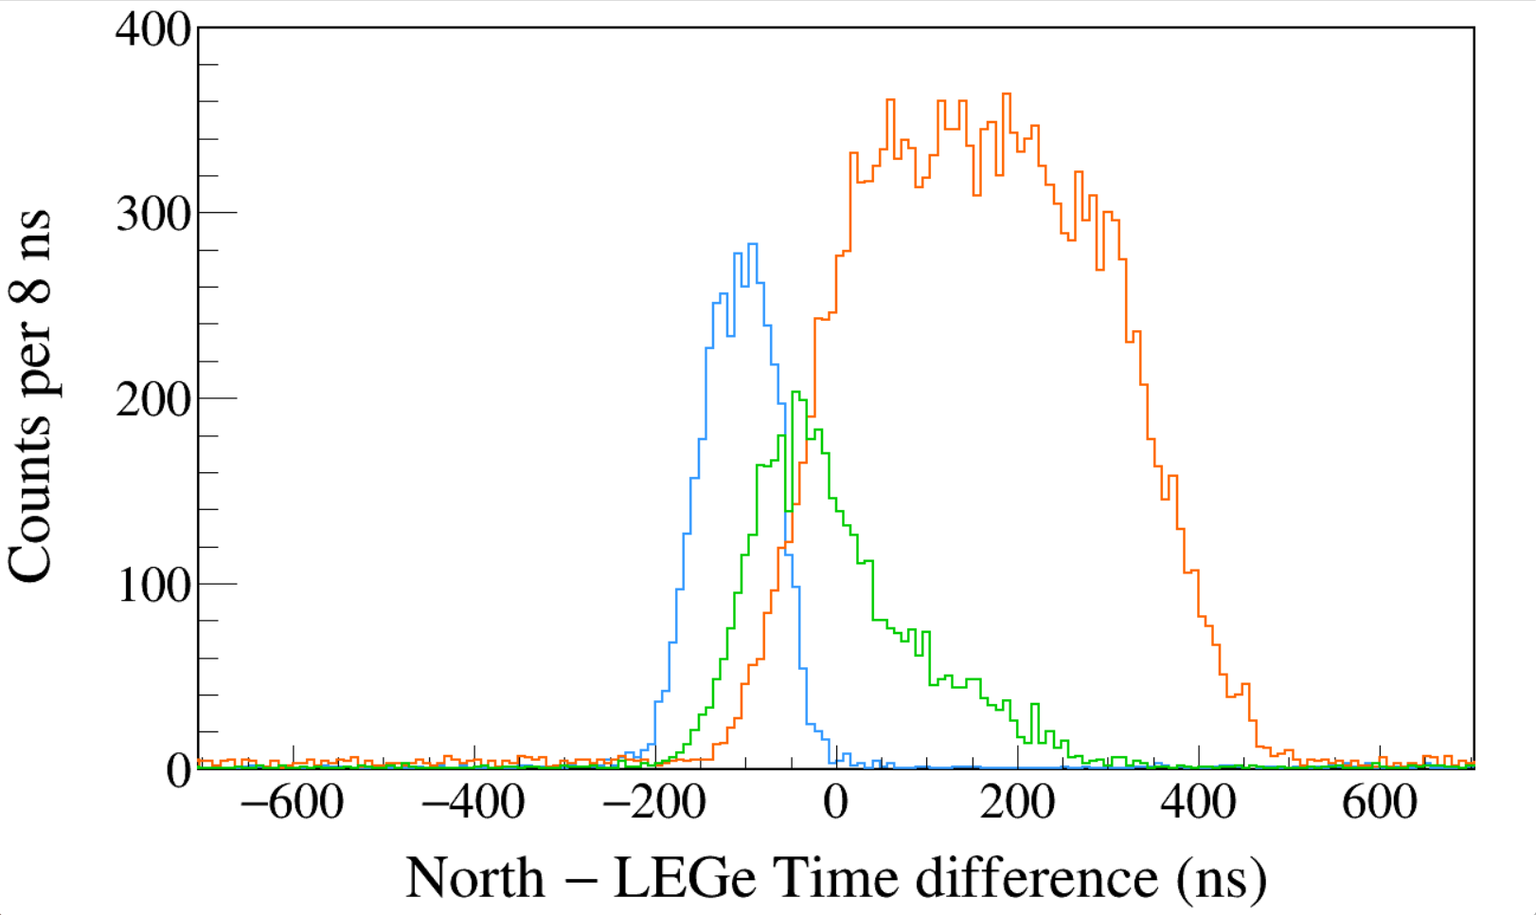
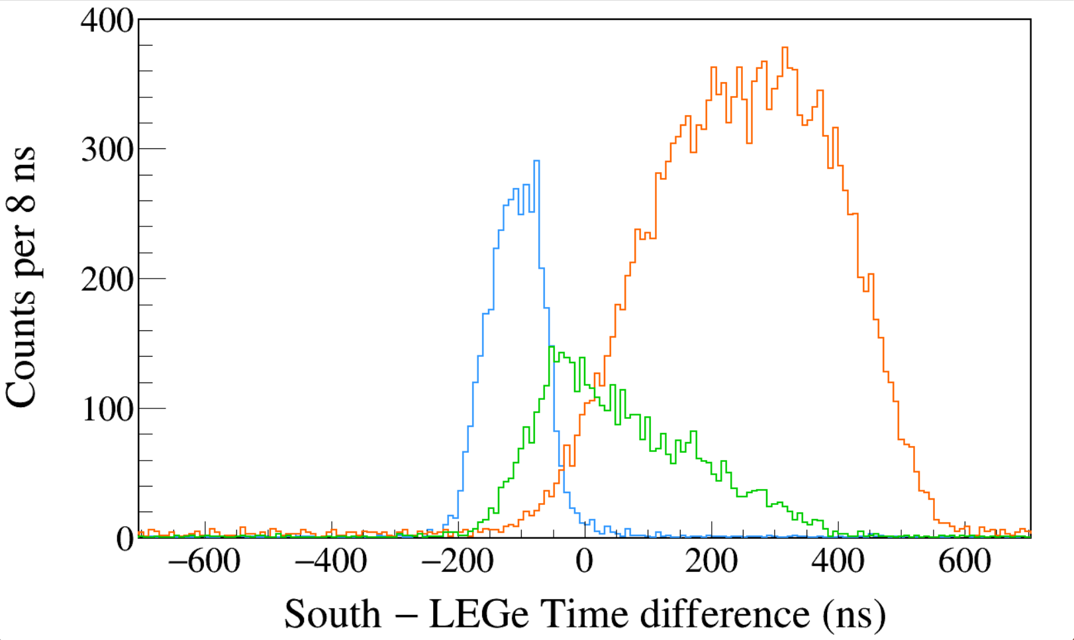
Run0294
152Eu 1-hour run
LED
Trigger Rise 0.400 μs
Trigger Gap 0.616 μs
Trigger Thresh 190, 300, 730
LED
LEGe 39||46 && North 1408
LEGe 39||46 && North 245
LEGe 39||46 && North 122
Run0294
152Eu 1-hour run
LED
Trigger Rise 0.400 μs
Trigger Gap 0.616 μs
Trigger Thresh 190, 300, 730
LED
LEGe 39||46 && South 1408
LEGe 39||46 && South 245
LEGe 39||46 && South 122
Notes:
TFile *_file0 = TFile::Open("F:/e21010/pxct/run0294_LEGe_XtRa_152Eu_Z2707_OnLEGeCap_window1us_TrigRise0.400_0.064us_TrigGap0.616_0.952us_ThL190_N300_S730_LED_cal.root");
TCanvas* canvaspeak = new TCanvas("canvaspeak", "canvaspeak", 1300, 800);//
canvaspeak->cd();//
canvaspeak->SetTopMargin(0.03);
canvaspeak->SetRightMargin(0.04);
canvaspeak->SetLeftMargin(0.13);
canvaspeak->SetBottomMargin(0.16);
canvaspeak->SetFrameLineWidth(2);
TH1D* htimestamps = new TH1D("htimestamps", "htimestamps", 250,-1000,1000);
htimestamps->SetLineWidth(2);
htimestamps->Rebin(1);
htimestamps->SetStats(0);
htimestamps->SetTitle("");
htimestamps->GetXaxis()->SetTitle("North #minus LEGe Time difference (ns)");
htimestamps->GetYaxis()->SetTitle("Counts per 8 ns");
htimestamps->GetXaxis()->CenterTitle();
htimestamps->GetYaxis()->CenterTitle();
htimestamps->GetXaxis()->SetLabelFont(132);
htimestamps->GetYaxis()->SetLabelFont(132);
htimestamps->GetXaxis()->SetLabelSize(0.06);
htimestamps->GetYaxis()->SetLabelSize(0.06);
htimestamps->GetXaxis()->SetTitleFont(132);
htimestamps->GetYaxis()->SetTitleFont(132);
htimestamps->GetXaxis()->SetTitleOffset(1.1);
htimestamps->GetYaxis()->SetTitleOffset(0.95);
htimestamps->GetXaxis()->SetTitleSize(0.07);
htimestamps->GetYaxis()->SetTitleSize(0.07);
htimestamps->GetXaxis()->SetRangeUser(-700,700);
htimestamps->GetYaxis()->SetRangeUser(0,400);
htimestamps->GetYaxis()->SetNdivisions(505);
htimestamps->SetLineWidth(2);
htimestamps->SetLineColor(kAzure+1);
tree->Draw("north_t-lege_t>>htimestamps","north_e>1405&&north_e<1411&&((lege_e>38.8&&lege_e<40.8)||(lege_e>44.8&&lege_e<47.2))","");
htimestamps->Sumw2(kFALSE);
htimestamps->SetBinErrorOption(TH1::kPoisson);//TH1::kNormal or TH1::kPoisson
tree->SetLineColor(kOrange+7);
tree->SetLineWidth(2);
tree->Draw("north_t-lege_t","north_e>120&&north_e<123&&((lege_e>38.8&&lege_e<40.8)||(lege_e>44.8&&lege_e<47.2))","same");
tree->SetLineColor(kGreen+1);
tree->SetLineWidth(2);
tree->Draw("north_t-lege_t","north_e>243&&north_e<246&&((lege_e>38.8&&lege_e<40.8)||(lege_e>44.8&&lege_e<47.2))","same");
TCanvas* canvaspeak = new TCanvas("canvaspeak", "canvaspeak", 1300, 800);//
canvaspeak->cd();//
canvaspeak->SetTopMargin(0.03);
canvaspeak->SetRightMargin(0.04);
canvaspeak->SetLeftMargin(0.13);
canvaspeak->SetBottomMargin(0.16);
canvaspeak->SetFrameLineWidth(2);
TH1D* htimestamps = new TH1D("htimestamps", "htimestamps", 250,-1000,1000);
htimestamps->SetLineWidth(2);
htimestamps->Rebin(1);
htimestamps->SetStats(0);
htimestamps->SetTitle("");
htimestamps->GetXaxis()->SetTitle("South #minus LEGe Time difference (ns)");
htimestamps->GetYaxis()->SetTitle("Counts per 8 ns");
htimestamps->GetXaxis()->CenterTitle();
htimestamps->GetYaxis()->CenterTitle();
htimestamps->GetXaxis()->SetLabelFont(132);
htimestamps->GetYaxis()->SetLabelFont(132);
htimestamps->GetXaxis()->SetLabelSize(0.06);
htimestamps->GetYaxis()->SetLabelSize(0.06);
htimestamps->GetXaxis()->SetTitleFont(132);
htimestamps->GetYaxis()->SetTitleFont(132);
htimestamps->GetXaxis()->SetTitleOffset(1.1);
htimestamps->GetYaxis()->SetTitleOffset(0.95);
htimestamps->GetXaxis()->SetTitleSize(0.07);
htimestamps->GetYaxis()->SetTitleSize(0.07);
htimestamps->GetXaxis()->SetRangeUser(-700,700);
htimestamps->GetYaxis()->SetRangeUser(0,400);
htimestamps->GetYaxis()->SetNdivisions(505);
htimestamps->SetLineWidth(2);
htimestamps->SetLineColor(kAzure+1);
tree->Draw("south_t-lege_t>>htimestamps","south_e>1405&&south_e<1411&&((lege_e>38.8&&lege_e<40.8)||(lege_e>44.8&&lege_e<47.2))","");
htimestamps->Sumw2(kFALSE);
htimestamps->SetBinErrorOption(TH1::kPoisson);//TH1::kNormal or TH1::kPoisson
tree->SetLineColor(kOrange+7);
tree->SetLineWidth(2);
tree->Draw("south_t-lege_t","south_e>120&&south_e<123&&((lege_e>38.8&&lege_e<40.8)||(lege_e>44.8&&lege_e<47.2))","same");
tree->SetLineColor(kGreen+1);
tree->SetLineWidth(2);
tree->Draw("south_t-lege_t","south_e>243&&south_e<246&&((lege_e>38.8&&lege_e<40.8)||(lege_e>44.8&&lege_e<47.2))","same");

Slide 16
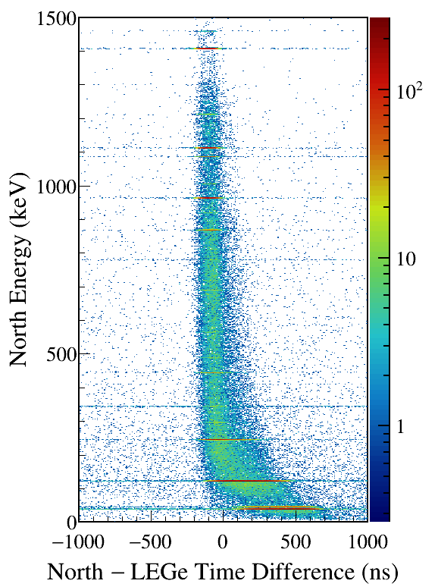
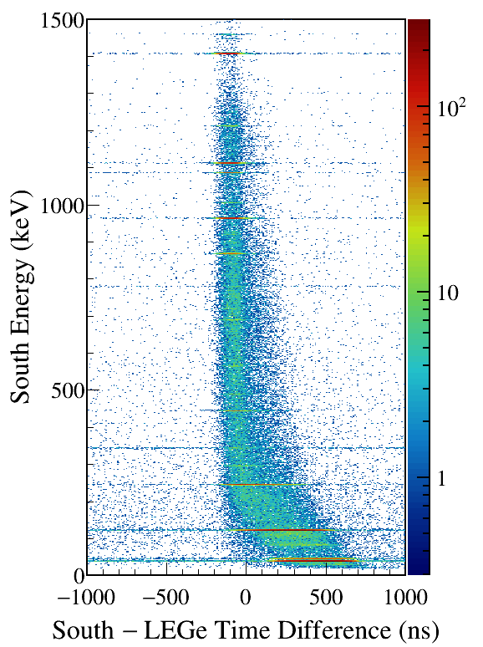
LEGe (39||46) Kα,Kβ gated
Notes:
TFile *_file0 = TFile::Open("F:/e21010/pxct/run0294_LEGe_XtRa_152Eu_Z2707_OnLEGeCap_window1us_TrigRise0.400_0.064us_TrigGap0.616_0.952us_ThL190_N300_S730_LED_cal.root");
TCanvas* canvaspeak = new TCanvas("canvaspeak", "canvaspeak", 580, 800);
canvaspeak->cd();
canvaspeak->SetTopMargin(0.03);
canvaspeak->SetRightMargin(0.16);
canvaspeak->SetLeftMargin(0.18);
canvaspeak->SetBottomMargin(0.11);
canvaspeak->SetFrameLineWidth(2);
canvaspeak->SetLogz();
TH2D* het = new TH2D("het", "het", 250,-1000,1000,750,0,1500); //x,y
tree->Draw("north_e:north_t-lege_t>>het","north_e>1&&north_e<1500&&((lege_e>38.8&&lege_e<40.8)||(lege_e>44.8&&lege_e<47.2))","colz"); //y:x
het->SetStats(0);
het->SetTitle("");
het->GetXaxis()->SetTitle("North #minus LEGe Time Difference (ns)");
het->GetYaxis()->SetTitle("North Energy (keV)");
het->GetXaxis()->CenterTitle();
het->GetYaxis()->CenterTitle();
het->GetXaxis()->SetLabelFont(132);
het->GetYaxis()->SetLabelFont(132);
het->GetXaxis()->SetLabelSize(0.05);
het->GetYaxis()->SetLabelSize(0.05);
het->GetXaxis()->SetTitleFont(132);
het->GetYaxis()->SetTitleFont(132);
het->GetXaxis()->SetTitleOffset(0.9);
het->GetYaxis()->SetTitleOffset(1.4);
het->GetXaxis()->SetTitleSize(0.06);
het->GetYaxis()->SetTitleSize(0.06);
het->GetXaxis()->SetNdivisions(505);
het->GetYaxis()->SetNdivisions(505);
//het->GetXaxis()->SetRangeUser(2001,4500);
//het->GetYaxis()->SetRangeUser(1000,2800);
//het->SetMinimum(2);
//het->SetMaximum(100);
het->SetContour(99);
gStyle->SetPalette(kRainbow);
//gPad->SetLogz();
TPaletteAxis *palette = (TPaletteAxis*)het->GetListOfFunctions()->FindObject("palette");
palette->SetTitleFont(132);
palette->SetTitleSize(0.05);
palette->SetLabelFont(132);
palette->SetLabelSize(0.05);
palette->SetLineWidth(2);
canvaspeak->SaveAs("F:/e21010/pxct/1.png");
TCanvas* canvaspeak = new TCanvas("canvaspeak", "canvaspeak", 580, 800);
canvaspeak->cd();
canvaspeak->SetTopMargin(0.03);
canvaspeak->SetRightMargin(0.16);
canvaspeak->SetLeftMargin(0.18);
canvaspeak->SetBottomMargin(0.11);
canvaspeak->SetFrameLineWidth(2);
canvaspeak->SetLogz();
TH2D* het = new TH2D("het", "het", 250,-1000,1000,750,0,1500); //x,y
tree->Draw("south_e:south_t-lege_t>>het","south_e>1&&south_e<1500&&((lege_e>38.8&&lege_e<40.8)||(lege_e>44.8&&lege_e<47.2))","colz"); //y:x
het->SetStats(0);
het->SetTitle("");
het->GetXaxis()->SetTitle("South #minus LEGe Time Difference (ns)");
het->GetYaxis()->SetTitle("South Energy (keV)");
het->GetXaxis()->CenterTitle();
het->GetYaxis()->CenterTitle();
het->GetXaxis()->SetLabelFont(132);
het->GetYaxis()->SetLabelFont(132);
het->GetXaxis()->SetLabelSize(0.05);
het->GetYaxis()->SetLabelSize(0.05);
het->GetXaxis()->SetTitleFont(132);
het->GetYaxis()->SetTitleFont(132);
het->GetXaxis()->SetTitleOffset(0.9);
het->GetYaxis()->SetTitleOffset(1.4);
het->GetXaxis()->SetTitleSize(0.06);
het->GetYaxis()->SetTitleSize(0.06);
het->GetXaxis()->SetNdivisions(505);
het->GetYaxis()->SetNdivisions(505);
//het->GetXaxis()->SetRangeUser(2001,4500);
//het->GetYaxis()->SetRangeUser(1000,2800);
//het->SetMinimum(2);
//het->SetMaximum(100);
het->SetContour(99);
gStyle->SetPalette(kRainbow);
//gPad->SetLogz();
TPaletteAxis *palette = (TPaletteAxis*)het->GetListOfFunctions()->FindObject("palette");
palette->SetTitleFont(132);
palette->SetTitleSize(0.05);
palette->SetLabelFont(132);
palette->SetLabelSize(0.05);
palette->SetLineWidth(2);
canvaspeak->SaveAs("F:/e21010/pxct/2.png");

Slide 17
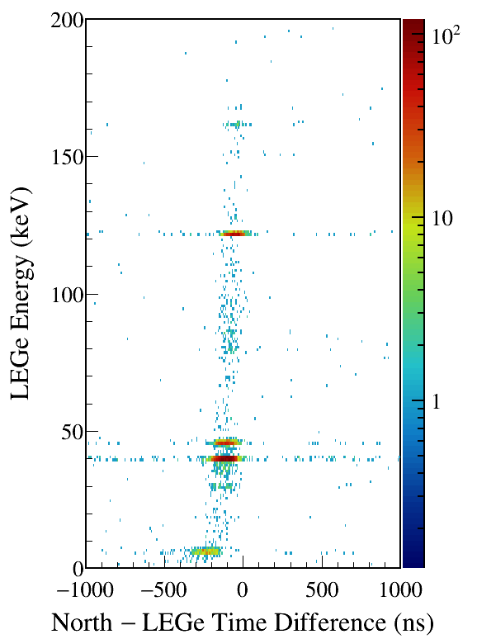
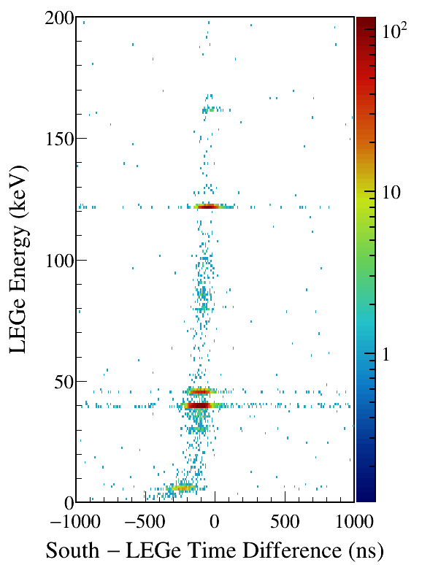
North/South 1408 gated
Notes:
TFile *_file0 = TFile::Open("F:/e21010/pxct/run0294_LEGe_XtRa_152Eu_Z2707_OnLEGeCap_window1us_TrigRise0.400_0.064us_TrigGap0.616_0.952us_ThL190_N300_S730_LED_cal.root");
TCanvas* canvaspeak = new TCanvas("canvaspeak", "canvaspeak", 580, 800);
canvaspeak->cd();
canvaspeak->SetTopMargin(0.03);
canvaspeak->SetRightMargin(0.16);
canvaspeak->SetLeftMargin(0.18);
canvaspeak->SetBottomMargin(0.11);
canvaspeak->SetFrameLineWidth(2);
canvaspeak->SetLogz();
TH2D* het = new TH2D("het", "het", 250,-1000,1000,200,0,200); //x,y
tree->Draw("lege_e:north_t-lege_t>>het","lege_e>1&&lege_e<200&&north_e>1405&&north_e<1411","colz"); //y:x
het->SetStats(0);
het->SetTitle("");
het->GetXaxis()->SetTitle("North #minus LEGe Time Difference (ns)");
het->GetYaxis()->SetTitle("LEGe Energy (keV)");
het->GetXaxis()->CenterTitle();
het->GetYaxis()->CenterTitle();
het->GetXaxis()->SetLabelFont(132);
het->GetYaxis()->SetLabelFont(132);
het->GetXaxis()->SetLabelSize(0.05);
het->GetYaxis()->SetLabelSize(0.05);
het->GetXaxis()->SetTitleFont(132);
het->GetYaxis()->SetTitleFont(132);
het->GetXaxis()->SetTitleOffset(0.9);
het->GetYaxis()->SetTitleOffset(1.4);
het->GetXaxis()->SetTitleSize(0.06);
het->GetYaxis()->SetTitleSize(0.06);
het->GetXaxis()->SetNdivisions(505);
het->GetYaxis()->SetNdivisions(505);
//het->GetXaxis()->SetRangeUser(2001,4500);
//het->GetYaxis()->SetRangeUser(1000,2800);
//het->SetMinimum(2);
//het->SetMaximum(100);
het->SetContour(99);
gStyle->SetPalette(kRainbow);
//gPad->SetLogz();
TPaletteAxis *palette = (TPaletteAxis*)het->GetListOfFunctions()->FindObject("palette");
palette->SetTitleFont(132);
palette->SetTitleSize(0.05);
palette->SetLabelFont(132);
palette->SetLabelSize(0.05);
palette->SetLineWidth(2);
canvaspeak->SaveAs("F:/e21010/pxct/1.png");
TCanvas* canvaspeak = new TCanvas("canvaspeak", "canvaspeak", 580, 800);
canvaspeak->cd();
canvaspeak->SetTopMargin(0.03);
canvaspeak->SetRightMargin(0.16);
canvaspeak->SetLeftMargin(0.18);
canvaspeak->SetBottomMargin(0.11);
canvaspeak->SetFrameLineWidth(2);
canvaspeak->SetLogz();
TH2D* het = new TH2D("het", "het", 250,-1000,1000,200,0,200); //x,y
tree->Draw("lege_e:south_t-lege_t>>het","lege_e>1&&lege_e<200&&south_e>1405&&south_e<1411","colz"); //y:x
het->SetStats(0);
het->SetTitle("");
het->GetXaxis()->SetTitle("South #minus LEGe Time Difference (ns)");
het->GetYaxis()->SetTitle("LEGe Energy (keV)");
het->GetXaxis()->CenterTitle();
het->GetYaxis()->CenterTitle();
het->GetXaxis()->SetLabelFont(132);
het->GetYaxis()->SetLabelFont(132);
het->GetXaxis()->SetLabelSize(0.05);
het->GetYaxis()->SetLabelSize(0.05);
het->GetXaxis()->SetTitleFont(132);
het->GetYaxis()->SetTitleFont(132);
het->GetXaxis()->SetTitleOffset(0.9);
het->GetYaxis()->SetTitleOffset(1.4);
het->GetXaxis()->SetTitleSize(0.06);
het->GetYaxis()->SetTitleSize(0.06);
het->GetXaxis()->SetNdivisions(505);
het->GetYaxis()->SetNdivisions(505);
//het->GetXaxis()->SetRangeUser(2001,4500);
//het->GetYaxis()->SetRangeUser(1000,2800);
//het->SetMinimum(2);
//het->SetMaximum(100);
het->SetContour(99);
gStyle->SetPalette(kRainbow);
//gPad->SetLogz();
TPaletteAxis *palette = (TPaletteAxis*)het->GetListOfFunctions()->FindObject("palette");
palette->SetTitleFont(132);
palette->SetTitleSize(0.05);
palette->SetLabelFont(132);
palette->SetLabelSize(0.05);
palette->SetLineWidth(2);
canvaspeak->SaveAs("F:/e21010/pxct/2.png");

Slide 18
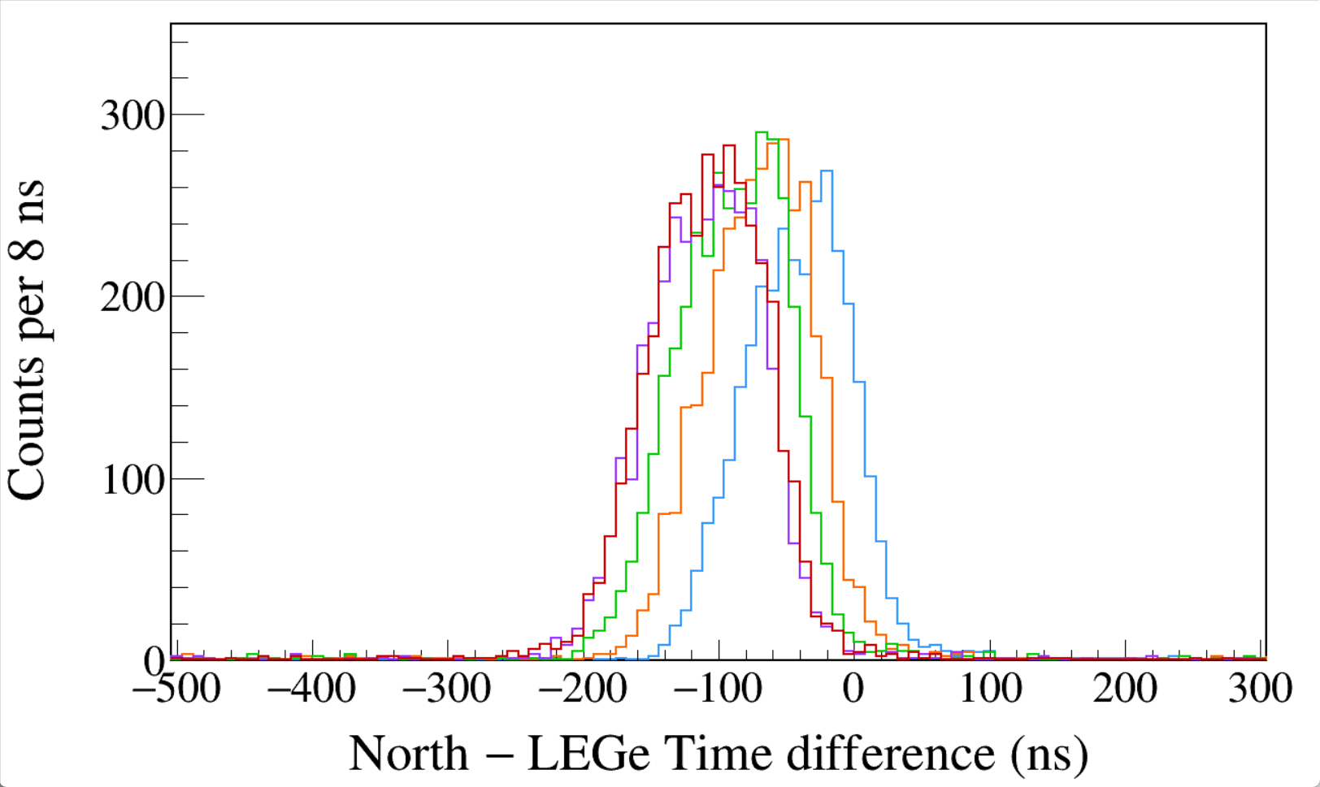
Run0290
152Eu 1-hour run
LED
Trigger Rise 0.016 μs
Trigger Gap 1.000 μs
Trigger Thresh 330, 300, 730
LED
LEGe 39||46 && North 1408
σ 37~40 ns
Run0290 0.016 + 1.000 μs
Run0291 0.112 + 0.904 μs
Run0292 0.200 + 0.816 μs
Run0293 0.304 + 0.712 μs
Run0294 0.400 + 0.616 μs
Notes:
TFile *_file0 = TFile::Open("F:/e21010/pxct/run0290_LEGe_XtRa_152Eu_Z2707_OnLEGeCap_window1us_TrigRise0.016_0.064us_TrigGap1.000_0.952us_ThL330_N300_S730_LED_cal.root");
TCanvas* canvaspeak = new TCanvas("canvaspeak", "canvaspeak", 1300, 800);//
canvaspeak->cd();//
canvaspeak->SetTopMargin(0.03);
canvaspeak->SetRightMargin(0.04);
canvaspeak->SetLeftMargin(0.13);
canvaspeak->SetBottomMargin(0.16);
canvaspeak->SetFrameLineWidth(2);
TH1D* htimestamps = new TH1D("htimestamps", "htimestamps", 250,-1000,1000);
htimestamps->SetLineWidth(2);
htimestamps->Rebin(1);
//htimestamps->SetStats(0);
htimestamps->SetTitle("");
htimestamps->GetXaxis()->SetTitle("North #minus LEGe Time difference (ns)");
htimestamps->GetYaxis()->SetTitle("Counts per 8 ns");
htimestamps->GetXaxis()->CenterTitle();
htimestamps->GetYaxis()->CenterTitle();
htimestamps->GetXaxis()->SetLabelFont(132);
htimestamps->GetYaxis()->SetLabelFont(132);
htimestamps->GetXaxis()->SetLabelSize(0.06);
htimestamps->GetYaxis()->SetLabelSize(0.06);
htimestamps->GetXaxis()->SetTitleFont(132);
htimestamps->GetYaxis()->SetTitleFont(132);
htimestamps->GetXaxis()->SetTitleOffset(1.1);
htimestamps->GetYaxis()->SetTitleOffset(0.95);
htimestamps->GetXaxis()->SetTitleSize(0.07);
htimestamps->GetYaxis()->SetTitleSize(0.07);
htimestamps->GetXaxis()->SetRangeUser(-500,300);
htimestamps->GetYaxis()->SetRangeUser(0,350);
htimestamps->GetYaxis()->SetNdivisions(505);
htimestamps->SetLineWidth(2);
htimestamps->SetLineColor(kAzure+1);
tree->Draw("north_t-lege_t>>htimestamps","north_e>1405&&north_e<1411&&((lege_e>38.8&&lege_e<40.8)||(lege_e>44.8&&lege_e<47.2))","");
htimestamps->Sumw2(kFALSE);
htimestamps->SetBinErrorOption(TH1::kPoisson);//TH1::kNormal or TH1::kPoisson
TFile *_file1 = TFile::Open("F:/e21010/pxct/run0291_LEGe_XtRa_152Eu_Z2707_OnLEGeCap_window1us_TrigRise0.112_0.064us_TrigGap0.904_0.952us_ThL270_N300_S730_LED_cal.root");
tree->SetLineColor(kOrange+7);
tree->SetLineWidth(2);
tree->Draw("north_t-lege_t","north_e>1405&&north_e<1411&&((lege_e>38.8&&lege_e<40.8)||(lege_e>44.8&&lege_e<47.2))","sames");
TFile *_file1 = TFile::Open("F:/e21010/pxct/run0292_LEGe_XtRa_152Eu_Z2707_OnLEGeCap_window1us_TrigRise0.200_0.064us_TrigGap0.816_0.952us_ThL240_N300_S730_LED_cal.root");
tree->SetLineColor(kGreen+1);
tree->SetLineWidth(2);
tree->Draw("north_t-lege_t","north_e>1405&&north_e<1411&&((lege_e>38.8&&lege_e<40.8)||(lege_e>44.8&&lege_e<47.2))","sames");
TFile *_file1 = TFile::Open("F:/e21010/pxct/run0293_LEGe_XtRa_152Eu_Z2707_OnLEGeCap_window1us_TrigRise0.304_0.064us_TrigGap0.712_0.952us_ThL210_N300_S730_LED_cal.root");
tree->SetLineColor(kViolet+1);
tree->SetLineWidth(2);
tree->Draw("north_t-lege_t","north_e>1405&&north_e<1411&&((lege_e>38.8&&lege_e<40.8)||(lege_e>44.8&&lege_e<47.2))","sames");
TFile *_file1 = TFile::Open("F:/e21010/pxct/run0294_LEGe_XtRa_152Eu_Z2707_OnLEGeCap_window1us_TrigRise0.400_0.064us_TrigGap0.616_0.952us_ThL190_N300_S730_LED_cal.root");
tree->SetLineColor(kRed+1);
tree->SetLineWidth(2);
tree->Draw("north_t-lege_t","north_e>1405&&north_e<1411&&((lege_e>38.8&&lege_e<40.8)||(lege_e>44.8&&lege_e<47.2))","sames");

Slide 19
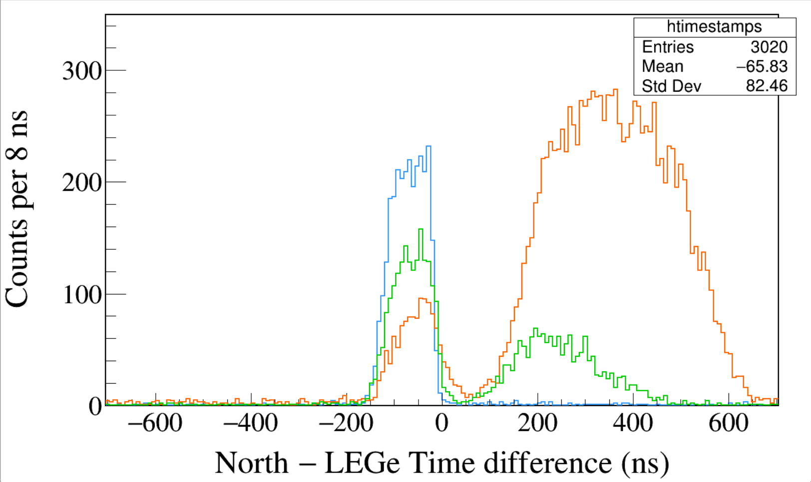
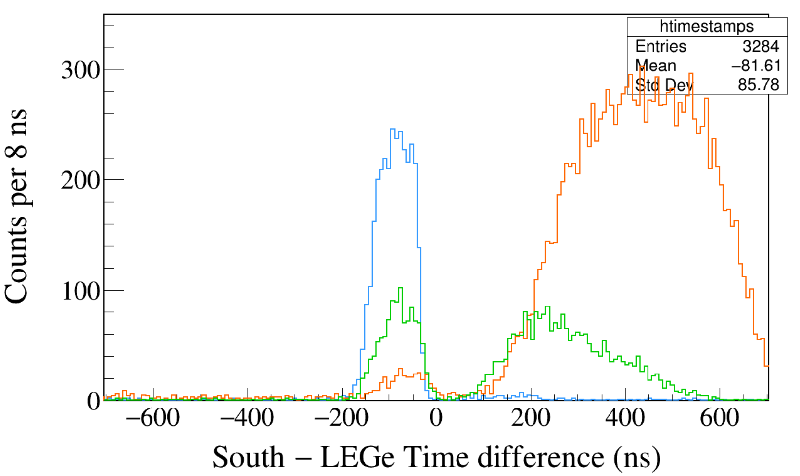
Run0265
152Eu 1-hour run
Trigger Rise 0.064 μs
Trigger Gap 0.952 μs
Trigger Thresh 310, 300, 730
CFD Delay 0.120 μs
CFD Scale 7
LEGe 39||46 && North 1408
LEGe 39||46 && North 245
LEGe 39||46 && North 122
FWHM ≈ 104 ns
Run0265
152Eu 1-hour run
Trigger Rise 0.064 μs
Trigger Gap 0.952 μs
Trigger Thresh 310, 300, 730
CFD Delay 0.120 μs
CFD Scale 7
LEGe 39||46 && South 1408
LEGe 39||46 && South 245
LEGe 39||46 && South 122
Notes:
TFile *_file0 = TFile::Open("F:/e21010/pxct/run0265_LEGe_XtRa_152Eu_Z2707_OnLEGeCap_window1us_TrigRise0.064us_TrigGap0.952us_ThL310_N300_S730_CFDDelay0.120us_Scale7_cal.root");
TCanvas* canvaspeak = new TCanvas("canvaspeak", "canvaspeak", 1300, 800);//
canvaspeak->cd();//
canvaspeak->SetTopMargin(0.03);
canvaspeak->SetRightMargin(0.04);
canvaspeak->SetLeftMargin(0.13);
canvaspeak->SetBottomMargin(0.16);
canvaspeak->SetFrameLineWidth(2);
TH1D* htimestamps = new TH1D("htimestamps", "htimestamps", 250,-1000,1000);
htimestamps->SetLineWidth(2);
htimestamps->Rebin(1);
//htimestamps->SetStats(0);
htimestamps->SetTitle("");
htimestamps->GetXaxis()->SetTitle("North #minus LEGe Time difference (ns)");
htimestamps->GetYaxis()->SetTitle("Counts per 8 ns");
htimestamps->GetXaxis()->CenterTitle();
htimestamps->GetYaxis()->CenterTitle();
htimestamps->GetXaxis()->SetLabelFont(132);
htimestamps->GetYaxis()->SetLabelFont(132);
htimestamps->GetXaxis()->SetLabelSize(0.06);
htimestamps->GetYaxis()->SetLabelSize(0.06);
htimestamps->GetXaxis()->SetTitleFont(132);
htimestamps->GetYaxis()->SetTitleFont(132);
htimestamps->GetXaxis()->SetTitleOffset(1.1);
htimestamps->GetYaxis()->SetTitleOffset(0.95);
htimestamps->GetXaxis()->SetTitleSize(0.07);
htimestamps->GetYaxis()->SetTitleSize(0.07);
htimestamps->GetXaxis()->SetRangeUser(-700,700);
htimestamps->GetYaxis()->SetRangeUser(0,350);
htimestamps->GetYaxis()->SetNdivisions(505);
htimestamps->SetLineWidth(2);
htimestamps->SetLineColor(kAzure+1);
tree->Draw("north_t-lege_t>>htimestamps","north_e>1405&&north_e<1411&&((lege_e>38.8&&lege_e<40.8)||(lege_e>44.8&&lege_e<47.2))","");
htimestamps->Sumw2(kFALSE);
htimestamps->SetBinErrorOption(TH1::kPoisson);//TH1::kNormal or TH1::kPoisson
tree->SetLineColor(kOrange+7);
tree->SetLineWidth(2);
tree->Draw("north_t-lege_t","north_e>120&&north_e<123&&((lege_e>38.8&&lege_e<40.8)||(lege_e>44.8&&lege_e<47.2))","same");
tree->SetLineColor(kGreen+1);
tree->SetLineWidth(2);
tree->Draw("north_t-lege_t","north_e>243&&north_e<246&&((lege_e>38.8&&lege_e<40.8)||(lege_e>44.8&&lege_e<47.2))","same");
TFile *_file0 = TFile::Open("F:/e21010/pxct/run0265_LEGe_XtRa_152Eu_Z2707_OnLEGeCap_window1us_TrigRise0.064us_TrigGap0.952us_ThL310_N300_S730_CFDDelay0.120us_Scale7_cal.root");
TCanvas* canvaspeak = new TCanvas("canvaspeak", "canvaspeak", 1300, 800);//
canvaspeak->cd();//
canvaspeak->SetTopMargin(0.03);
canvaspeak->SetRightMargin(0.04);
canvaspeak->SetLeftMargin(0.13);
canvaspeak->SetBottomMargin(0.16);
canvaspeak->SetFrameLineWidth(2);
TH1D* htimestamps = new TH1D("htimestamps", "htimestamps", 250,-1000,1000);
htimestamps->SetLineWidth(2);
htimestamps->Rebin(1);
//htimestamps->SetStats(0);
htimestamps->SetTitle("");
htimestamps->GetXaxis()->SetTitle("South #minus LEGe Time difference (ns)");
htimestamps->GetYaxis()->SetTitle("Counts per 8 ns");
htimestamps->GetXaxis()->CenterTitle();
htimestamps->GetYaxis()->CenterTitle();
htimestamps->GetXaxis()->SetLabelFont(132);
htimestamps->GetYaxis()->SetLabelFont(132);
htimestamps->GetXaxis()->SetLabelSize(0.06);
htimestamps->GetYaxis()->SetLabelSize(0.06);
htimestamps->GetXaxis()->SetTitleFont(132);
htimestamps->GetYaxis()->SetTitleFont(132);
htimestamps->GetXaxis()->SetTitleOffset(1.1);
htimestamps->GetYaxis()->SetTitleOffset(0.95);
htimestamps->GetXaxis()->SetTitleSize(0.07);
htimestamps->GetYaxis()->SetTitleSize(0.07);
htimestamps->GetXaxis()->SetRangeUser(-700,700);
htimestamps->GetYaxis()->SetRangeUser(0,350);
htimestamps->GetYaxis()->SetNdivisions(505);
htimestamps->SetLineWidth(2);
htimestamps->SetLineColor(kAzure+1);
tree->Draw("south_t-lege_t>>htimestamps","south_e>1405&&south_e<1411&&((lege_e>38.8&&lege_e<40.8)||(lege_e>44.8&&lege_e<47.2))","");
htimestamps->Sumw2(kFALSE);
htimestamps->SetBinErrorOption(TH1::kPoisson);//TH1::kNormal or TH1::kPoisson
tree->SetLineColor(kOrange+7);
tree->SetLineWidth(2);
tree->Draw("south_t-lege_t","south_e>120&&south_e<123&&((lege_e>38.8&&lege_e<40.8)||(lege_e>44.8&&lege_e<47.2))","same");
tree->SetLineColor(kGreen+1);
tree->SetLineWidth(2);
tree->Draw("south_t-lege_t","south_e>243&&south_e<246&&((lege_e>38.8&&lege_e<40.8)||(lege_e>44.8&&lege_e<47.2))","same");

Slide 20
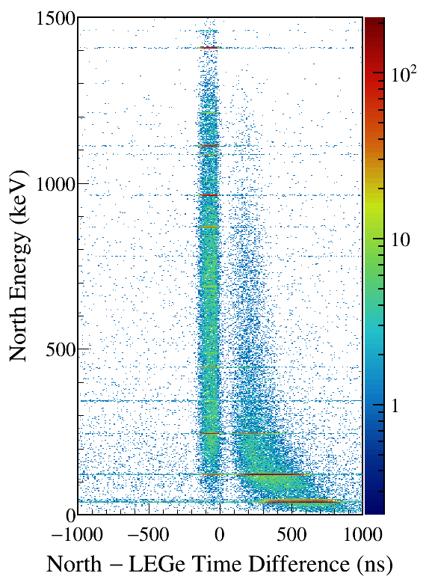
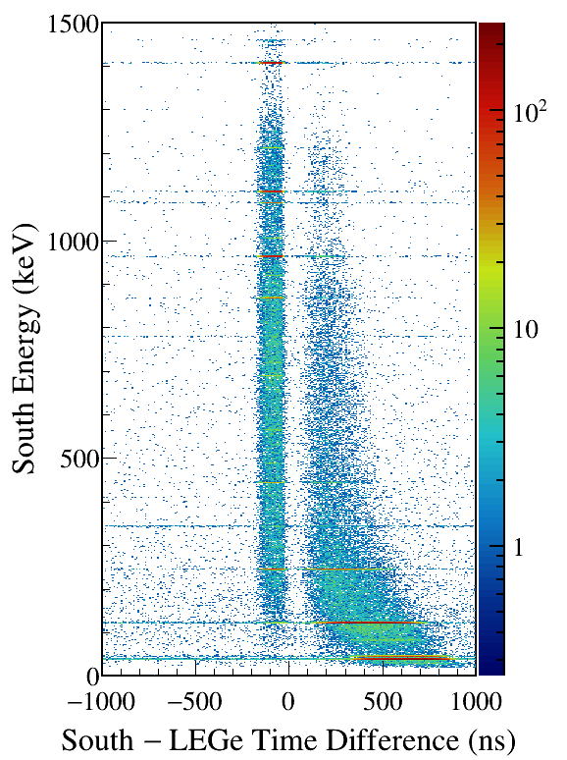
LEGe (39||46) Kα,Kβ gated
Notes:
TFile *_file0 = TFile::Open("F:/e21010/pxct/run0265_LEGe_XtRa_152Eu_Z2707_OnLEGeCap_window1us_TrigRise0.064us_TrigGap0.952us_ThL310_N300_S730_CFDDelay0.120us_Scale7_cal.root");
TCanvas* canvaspeak = new TCanvas("canvaspeak", "canvaspeak", 580, 800);
canvaspeak->cd();
canvaspeak->SetTopMargin(0.03);
canvaspeak->SetRightMargin(0.16);
canvaspeak->SetLeftMargin(0.18);
canvaspeak->SetBottomMargin(0.11);
canvaspeak->SetFrameLineWidth(2);
canvaspeak->SetLogz();
TH2D* het = new TH2D("het", "het", 250,-1000,1000,750,0,1500); //x,y
tree->Draw("north_e:north_t-lege_t>>het","north_e>1&&north_e<1500&&((lege_e>38.8&&lege_e<40.8)||(lege_e>44.8&&lege_e<47.2))","colz"); //y:x
het->SetStats(0);
het->SetTitle("");
het->GetXaxis()->SetTitle("North #minus LEGe Time Difference (ns)");
het->GetYaxis()->SetTitle("North Energy (keV)");
het->GetXaxis()->CenterTitle();
het->GetYaxis()->CenterTitle();
het->GetXaxis()->SetLabelFont(132);
het->GetYaxis()->SetLabelFont(132);
het->GetXaxis()->SetLabelSize(0.05);
het->GetYaxis()->SetLabelSize(0.05);
het->GetXaxis()->SetTitleFont(132);
het->GetYaxis()->SetTitleFont(132);
het->GetXaxis()->SetTitleOffset(0.9);
het->GetYaxis()->SetTitleOffset(1.4);
het->GetXaxis()->SetTitleSize(0.06);
het->GetYaxis()->SetTitleSize(0.06);
het->GetXaxis()->SetNdivisions(505);
het->GetYaxis()->SetNdivisions(505);
//het->GetXaxis()->SetRangeUser(2001,4500);
//het->GetYaxis()->SetRangeUser(1000,2800);
//het->SetMinimum(2);
//het->SetMaximum(100);
het->SetContour(99);
gStyle->SetPalette(kRainbow);
//gPad->SetLogz();
TPaletteAxis *palette = (TPaletteAxis*)het->GetListOfFunctions()->FindObject("palette");
palette->SetTitleFont(132);
palette->SetTitleSize(0.05);
palette->SetLabelFont(132);
palette->SetLabelSize(0.05);
palette->SetLineWidth(2);
canvaspeak->SaveAs("F:/e21010/pxct/1.png");
TCanvas* canvaspeak = new TCanvas("canvaspeak", "canvaspeak", 580, 800);
canvaspeak->cd();
canvaspeak->SetTopMargin(0.03);
canvaspeak->SetRightMargin(0.16);
canvaspeak->SetLeftMargin(0.18);
canvaspeak->SetBottomMargin(0.11);
canvaspeak->SetFrameLineWidth(2);
canvaspeak->SetLogz();
TH2D* het = new TH2D("het", "het", 250,-1000,1000,750,0,1500); //x,y
tree->Draw("south_e:south_t-lege_t>>het","south_e>1&&south_e<1500&&((lege_e>38.8&&lege_e<40.8)||(lege_e>44.8&&lege_e<47.2))","colz"); //y:x
het->SetStats(0);
het->SetTitle("");
het->GetXaxis()->SetTitle("South #minus LEGe Time Difference (ns)");
het->GetYaxis()->SetTitle("South Energy (keV)");
het->GetXaxis()->CenterTitle();
het->GetYaxis()->CenterTitle();
het->GetXaxis()->SetLabelFont(132);
het->GetYaxis()->SetLabelFont(132);
het->GetXaxis()->SetLabelSize(0.05);
het->GetYaxis()->SetLabelSize(0.05);
het->GetXaxis()->SetTitleFont(132);
het->GetYaxis()->SetTitleFont(132);
het->GetXaxis()->SetTitleOffset(0.9);
het->GetYaxis()->SetTitleOffset(1.4);
het->GetXaxis()->SetTitleSize(0.06);
het->GetYaxis()->SetTitleSize(0.06);
het->GetXaxis()->SetNdivisions(505);
het->GetYaxis()->SetNdivisions(505);
//het->GetXaxis()->SetRangeUser(2001,4500);
//het->GetYaxis()->SetRangeUser(1000,2800);
//het->SetMinimum(2);
//het->SetMaximum(100);
het->SetContour(99);
gStyle->SetPalette(kRainbow);
//gPad->SetLogz();
TPaletteAxis *palette = (TPaletteAxis*)het->GetListOfFunctions()->FindObject("palette");
palette->SetTitleFont(132);
palette->SetTitleSize(0.05);
palette->SetLabelFont(132);
palette->SetLabelSize(0.05);
palette->SetLineWidth(2);
canvaspeak->SaveAs("F:/e21010/pxct/2.png");

Slide 21
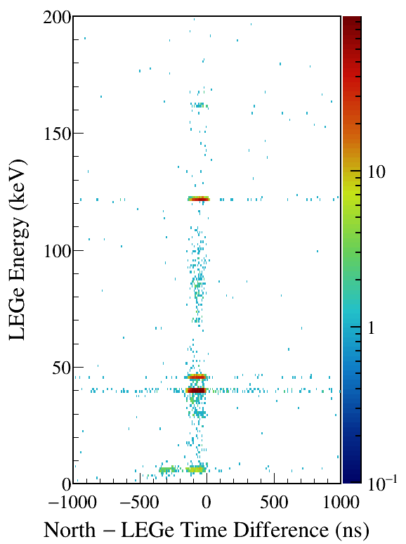
North/South 1408 gated
Notes:
TFile *_file0 = TFile::Open("F:/e21010/pxct/run0265_LEGe_XtRa_152Eu_Z2707_OnLEGeCap_window1us_TrigRise0.064us_TrigGap0.952us_ThL310_N300_S730_CFDDelay0.120us_Scale7_cal.root");
TCanvas* canvaspeak = new TCanvas("canvaspeak", "canvaspeak", 580, 800);
canvaspeak->cd();
canvaspeak->SetTopMargin(0.03);
canvaspeak->SetRightMargin(0.16);
canvaspeak->SetLeftMargin(0.18);
canvaspeak->SetBottomMargin(0.11);
canvaspeak->SetFrameLineWidth(2);
canvaspeak->SetLogz();
TH2D* het = new TH2D("het", "het", 250,-1000,1000,200,0,200); //x,y
tree->Draw("lege_e:north_t-lege_t>>het","lege_e>1&&lege_e<200&&north_e>1405&&north_e<1411","colz"); //y:x
het->SetStats(0);
het->SetTitle("");
het->GetXaxis()->SetTitle("North #minus LEGe Time Difference (ns)");
het->GetYaxis()->SetTitle("LEGe Energy (keV)");
het->GetXaxis()->CenterTitle();
het->GetYaxis()->CenterTitle();
het->GetXaxis()->SetLabelFont(132);
het->GetYaxis()->SetLabelFont(132);
het->GetXaxis()->SetLabelSize(0.05);
het->GetYaxis()->SetLabelSize(0.05);
het->GetXaxis()->SetTitleFont(132);
het->GetYaxis()->SetTitleFont(132);
het->GetXaxis()->SetTitleOffset(0.9);
het->GetYaxis()->SetTitleOffset(1.4);
het->GetXaxis()->SetTitleSize(0.06);
het->GetYaxis()->SetTitleSize(0.06);
het->GetXaxis()->SetNdivisions(505);
het->GetYaxis()->SetNdivisions(505);
//het->GetXaxis()->SetRangeUser(2001,4500);
//het->GetYaxis()->SetRangeUser(1000,2800);
//het->SetMinimum(2);
//het->SetMaximum(100);
het->SetContour(99);
gStyle->SetPalette(kRainbow);
//gPad->SetLogz();
TPaletteAxis *palette = (TPaletteAxis*)het->GetListOfFunctions()->FindObject("palette");
palette->SetTitleFont(132);
palette->SetTitleSize(0.05);
palette->SetLabelFont(132);
palette->SetLabelSize(0.05);
palette->SetLineWidth(2);
canvaspeak->SaveAs("F:/e21010/pxct/1.png");
TCanvas* canvaspeak = new TCanvas("canvaspeak", "canvaspeak", 580, 800);
canvaspeak->cd();
canvaspeak->SetTopMargin(0.03);
canvaspeak->SetRightMargin(0.16);
canvaspeak->SetLeftMargin(0.18);
canvaspeak->SetBottomMargin(0.11);
canvaspeak->SetFrameLineWidth(2);
canvaspeak->SetLogz();
TH2D* het = new TH2D("het", "het", 250,-1000,1000,200,0,200); //x,y
tree->Draw("lege_e:south_t-lege_t>>het","lege_e>1&&lege_e<200&&south_e>1405&&south_e<1411","colz"); //y:x
het->SetStats(0);
het->SetTitle("");
het->GetXaxis()->SetTitle("South #minus LEGe Time Difference (ns)");
het->GetYaxis()->SetTitle("LEGe Energy (keV)");
het->GetXaxis()->CenterTitle();
het->GetYaxis()->CenterTitle();
het->GetXaxis()->SetLabelFont(132);
het->GetYaxis()->SetLabelFont(132);
het->GetXaxis()->SetLabelSize(0.05);
het->GetYaxis()->SetLabelSize(0.05);
het->GetXaxis()->SetTitleFont(132);
het->GetYaxis()->SetTitleFont(132);
het->GetXaxis()->SetTitleOffset(0.9);
het->GetYaxis()->SetTitleOffset(1.4);
het->GetXaxis()->SetTitleSize(0.06);
het->GetYaxis()->SetTitleSize(0.06);
het->GetXaxis()->SetNdivisions(505);
het->GetYaxis()->SetNdivisions(505);
//het->GetXaxis()->SetRangeUser(2001,4500);
//het->GetYaxis()->SetRangeUser(1000,2800);
//het->SetMinimum(2);
//het->SetMaximum(100);
het->SetContour(99);
gStyle->SetPalette(kRainbow);
//gPad->SetLogz();
TPaletteAxis *palette = (TPaletteAxis*)het->GetListOfFunctions()->FindObject("palette");
palette->SetTitleFont(132);
palette->SetTitleSize(0.05);
palette->SetLabelFont(132);
palette->SetLabelSize(0.05);
palette->SetLineWidth(2);
canvaspeak->SaveAs("F:/e21010/pxct/2.png");

Slide 22
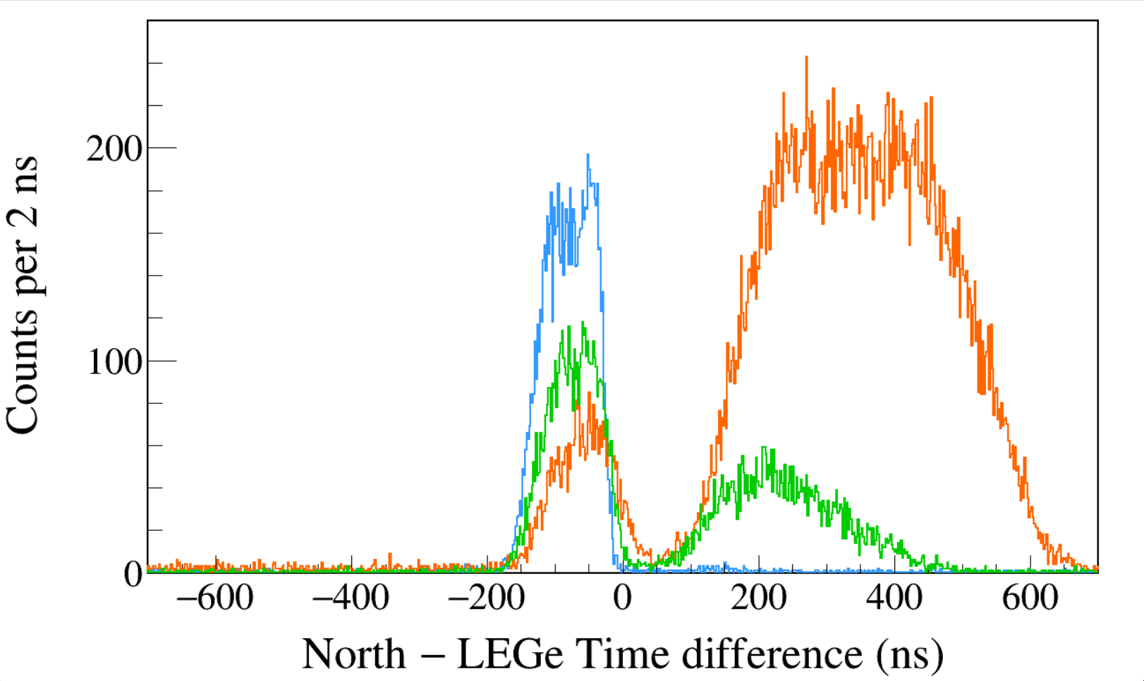
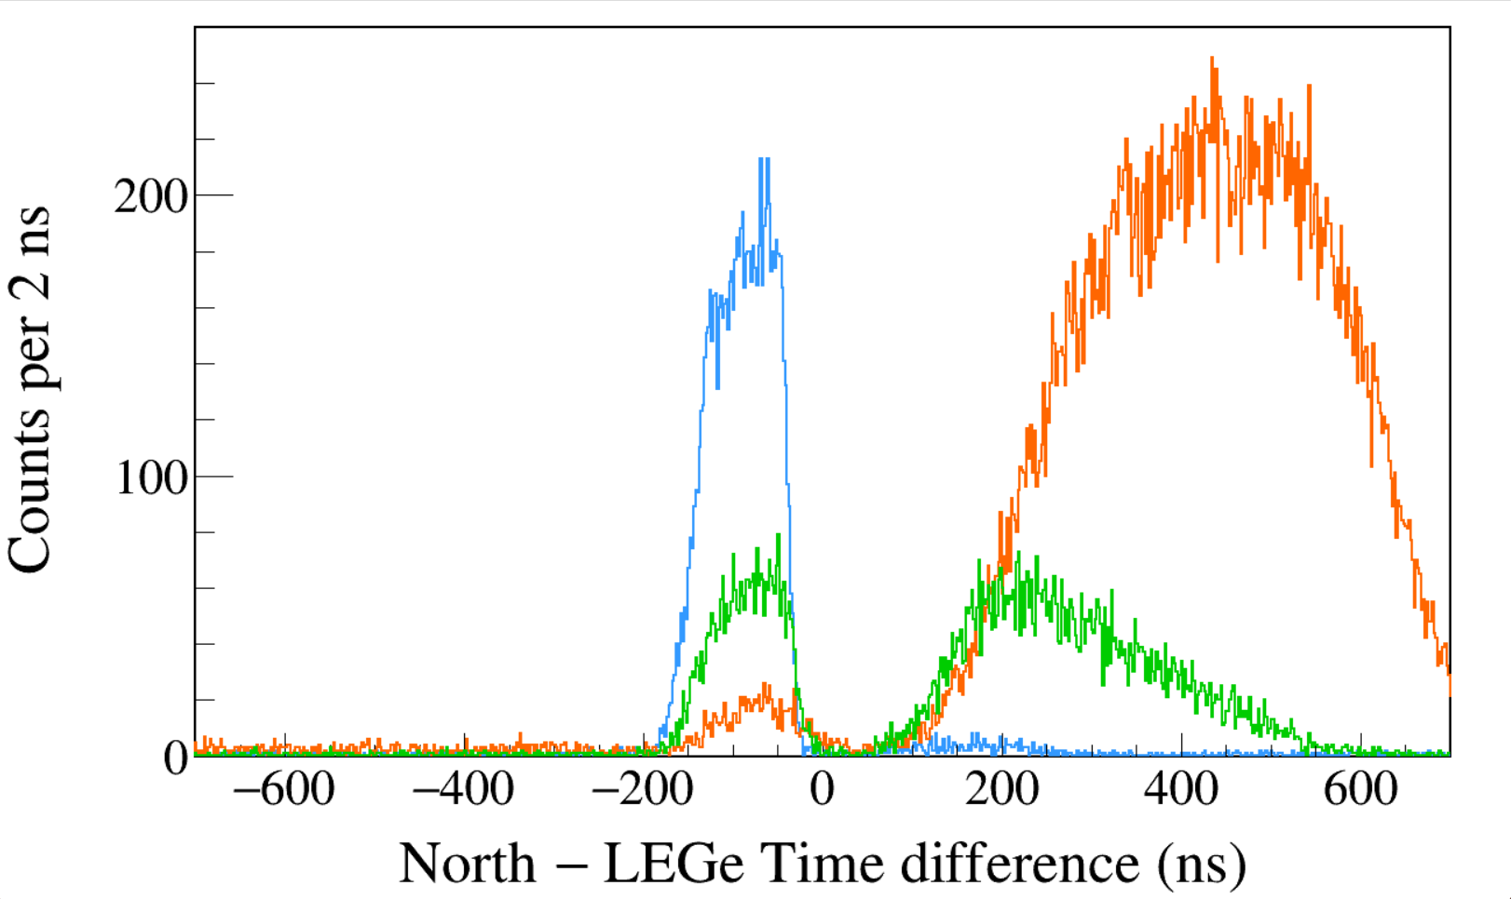
Run0274
152Eu 3-hour run
Trigger Rise 0.064 μs
Trigger Gap 0.952 μs
Trigger Thresh 310, 300, 730
CFD Delay 0.120 μs
CFD Scale 7
LEGe 39||46 && North 1408
LEGe 39||46 && North 245
LEGe 39||46 && North 122
Run0274
152Eu 3-hour run
Trigger Rise 0.064 μs
Trigger Gap 0.952 μs
Trigger Thresh 310, 300, 730
CFD Delay 0.120 μs
CFD Scale 7
LEGe 39||46 && South 1408
LEGe 39||46 && South 245
LEGe 39||46 && South 122
Notes:
TFile *_file0 = TFile::Open("F:/e21010/pxct/run0274_LEGe_XtRa_152Eu_Z2707_OnLEGeCap_window1us_TrigRise0.064us_TrigGap0.952us_ThL310_N300_S730_CFDDelay0.120us_Scale7_cal.root");
TCanvas* canvaspeak = new TCanvas("canvaspeak", "canvaspeak", 1300, 800);//
canvaspeak->cd();//
canvaspeak->SetTopMargin(0.03);
canvaspeak->SetRightMargin(0.04);
canvaspeak->SetLeftMargin(0.13);
canvaspeak->SetBottomMargin(0.16);
canvaspeak->SetFrameLineWidth(2);
TH1D* htimestamps = new TH1D("htimestamps", "htimestamps", 1000,-1000,1000);
htimestamps->SetLineWidth(2);
htimestamps->Rebin(1);
htimestamps->SetStats(0);
htimestamps->SetTitle("");
htimestamps->GetXaxis()->SetTitle("North #minus LEGe Time difference (ns)");
htimestamps->GetYaxis()->SetTitle("Counts per 2 ns");
htimestamps->GetXaxis()->CenterTitle();
htimestamps->GetYaxis()->CenterTitle();
htimestamps->GetXaxis()->SetLabelFont(132);
htimestamps->GetYaxis()->SetLabelFont(132);
htimestamps->GetXaxis()->SetLabelSize(0.06);
htimestamps->GetYaxis()->SetLabelSize(0.06);
htimestamps->GetXaxis()->SetTitleFont(132);
htimestamps->GetYaxis()->SetTitleFont(132);
htimestamps->GetXaxis()->SetTitleOffset(1.1);
htimestamps->GetYaxis()->SetTitleOffset(0.95);
htimestamps->GetXaxis()->SetTitleSize(0.07);
htimestamps->GetYaxis()->SetTitleSize(0.07);
htimestamps->GetXaxis()->SetRangeUser(-700,700);
htimestamps->GetYaxis()->SetRangeUser(0,1000);
htimestamps->GetYaxis()->SetNdivisions(505);
htimestamps->SetLineWidth(2);
htimestamps->SetLineColor(kAzure+1);
tree->Draw("north_t-lege_t>>htimestamps","north_e>1405&&north_e<1411&&((lege_e>38.8&&lege_e<40.8)||(lege_e>44.8&&lege_e<47.2))","");
htimestamps->Sumw2(kFALSE);
htimestamps->SetBinErrorOption(TH1::kPoisson);//TH1::kNormal or TH1::kPoisson
tree->SetLineColor(kOrange+7);
tree->SetLineWidth(2);
tree->Draw("north_t-lege_t","north_e>120&&north_e<123&&((lege_e>38.8&&lege_e<40.8)||(lege_e>44.8&&lege_e<47.2))","same");
tree->SetLineColor(kGreen+1);
tree->SetLineWidth(2);
tree->Draw("north_t-lege_t","north_e>243&&north_e<246&&((lege_e>38.8&&lege_e<40.8)||(lege_e>44.8&&lege_e<47.2))","same");
TCanvas* canvaspeak = new TCanvas("canvaspeak", "canvaspeak", 1300, 800);//
canvaspeak->cd();//
canvaspeak->SetTopMargin(0.03);
canvaspeak->SetRightMargin(0.04);
canvaspeak->SetLeftMargin(0.13);
canvaspeak->SetBottomMargin(0.16);
canvaspeak->SetFrameLineWidth(2);
TH1D* htimestamps = new TH1D("htimestamps", "htimestamps", 1000,-1000,1000);
htimestamps->SetLineWidth(2);
htimestamps->Rebin(1);
htimestamps->SetStats(0);
htimestamps->SetTitle("");
htimestamps->GetXaxis()->SetTitle("South #minus LEGe Time difference (ns)");
htimestamps->GetYaxis()->SetTitle("Counts per 2 ns");
htimestamps->GetXaxis()->CenterTitle();
htimestamps->GetYaxis()->CenterTitle();
htimestamps->GetXaxis()->SetLabelFont(132);
htimestamps->GetYaxis()->SetLabelFont(132);
htimestamps->GetXaxis()->SetLabelSize(0.06);
htimestamps->GetYaxis()->SetLabelSize(0.06);
htimestamps->GetXaxis()->SetTitleFont(132);
htimestamps->GetYaxis()->SetTitleFont(132);
htimestamps->GetXaxis()->SetTitleOffset(1.1);
htimestamps->GetYaxis()->SetTitleOffset(0.95);
htimestamps->GetXaxis()->SetTitleSize(0.07);
htimestamps->GetYaxis()->SetTitleSize(0.07);
htimestamps->GetXaxis()->SetRangeUser(-700,700);
htimestamps->GetYaxis()->SetRangeUser(0,500);
htimestamps->GetYaxis()->SetNdivisions(505);
htimestamps->SetLineWidth(2);
htimestamps->SetLineColor(kAzure+1);
tree->Draw("south_t-lege_t>>htimestamps","south_e>1405&&south_e<1411&&((lege_e>38.8&&lege_e<40.8)||(lege_e>44.8&&lege_e<47.2))","");
htimestamps->Sumw2(kFALSE);
htimestamps->SetBinErrorOption(TH1::kPoisson);//TH1::kNormal or TH1::kPoisson
tree->SetLineColor(kOrange+7);
tree->SetLineWidth(2);
tree->Draw("south_t-lege_t","south_e>120&&south_e<123&&((lege_e>38.8&&lege_e<40.8)||(lege_e>44.8&&lege_e<47.2))","same");
tree->SetLineColor(kGreen+1);
tree->SetLineWidth(2);
tree->Draw("south_t-lege_t","south_e>243&&south_e<246&&((lege_e>38.8&&lege_e<40.8)||(lege_e>44.8&&lege_e<47.2))","same");

Slide 23
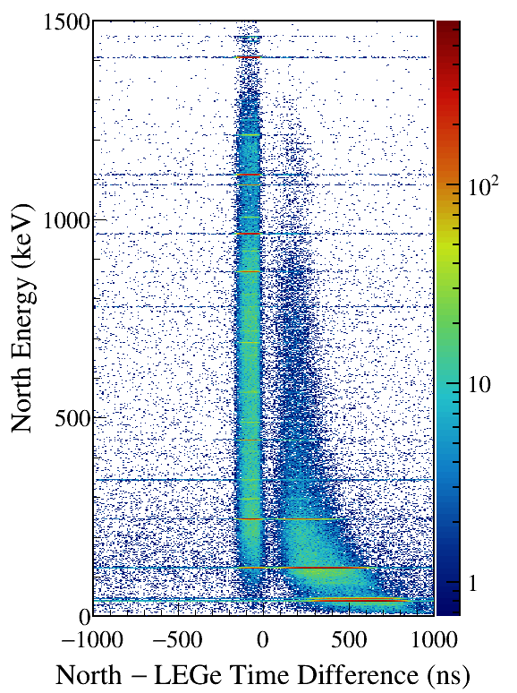
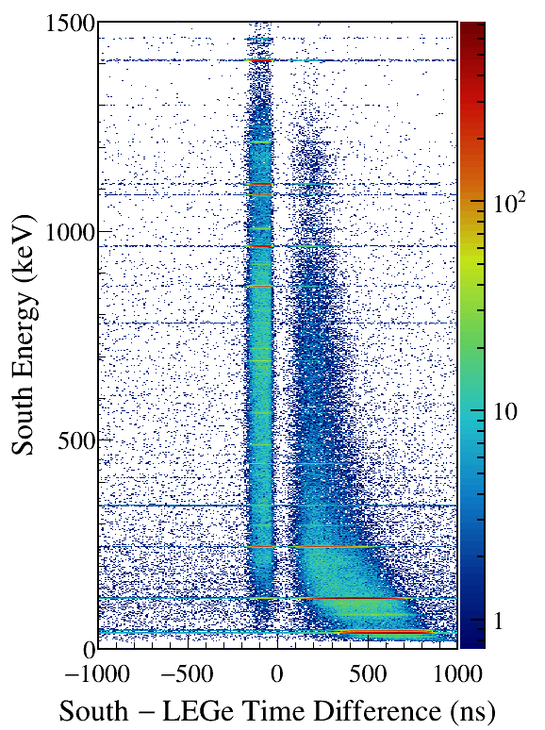
LEGe (39||46) Kα,Kβ gated
Notes:
TFile *_file0 = TFile::Open("F:/e21010/pxct/run0274_LEGe_XtRa_152Eu_Z2707_OnLEGeCap_window1us_TrigRise0.064us_TrigGap0.952us_ThL310_N300_S730_CFDDelay0.120us_Scale7_cal.root");
TCanvas* canvaspeak = new TCanvas("canvaspeak", "canvaspeak", 580, 800);
canvaspeak->cd();
canvaspeak->SetTopMargin(0.03);
canvaspeak->SetRightMargin(0.16);
canvaspeak->SetLeftMargin(0.18);
canvaspeak->SetBottomMargin(0.11);
canvaspeak->SetFrameLineWidth(2);
canvaspeak->SetLogz();
TH2D* het = new TH2D("het", "het", 250,-1000,1000,750,0,1500); //x,y
tree->Draw("north_e:north_t-lege_t>>het","north_e>1&&north_e<1500&&((lege_e>38.8&&lege_e<40.8)||(lege_e>44.8&&lege_e<47.2))","colz"); //y:x
het->SetStats(0);
het->SetTitle("");
het->GetXaxis()->SetTitle("North #minus LEGe Time Difference (ns)");
het->GetYaxis()->SetTitle("North Energy (keV)");
het->GetXaxis()->CenterTitle();
het->GetYaxis()->CenterTitle();
het->GetXaxis()->SetLabelFont(132);
het->GetYaxis()->SetLabelFont(132);
het->GetXaxis()->SetLabelSize(0.05);
het->GetYaxis()->SetLabelSize(0.05);
het->GetXaxis()->SetTitleFont(132);
het->GetYaxis()->SetTitleFont(132);
het->GetXaxis()->SetTitleOffset(0.9);
het->GetYaxis()->SetTitleOffset(1.4);
het->GetXaxis()->SetTitleSize(0.06);
het->GetYaxis()->SetTitleSize(0.06);
het->GetXaxis()->SetNdivisions(505);
het->GetYaxis()->SetNdivisions(505);
//het->GetXaxis()->SetRangeUser(2001,4500);
//het->GetYaxis()->SetRangeUser(1000,2800);
//het->SetMinimum(2);
//het->SetMaximum(100);
het->SetContour(99);
gStyle->SetPalette(kRainbow);
//gPad->SetLogz();
TPaletteAxis *palette = (TPaletteAxis*)het->GetListOfFunctions()->FindObject("palette");
palette->SetTitleFont(132);
palette->SetTitleSize(0.05);
palette->SetLabelFont(132);
palette->SetLabelSize(0.05);
palette->SetLineWidth(2);
canvaspeak->SaveAs("F:/e21010/pxct/1.png");
TCanvas* canvaspeak = new TCanvas("canvaspeak", "canvaspeak", 580, 800);
canvaspeak->cd();
canvaspeak->SetTopMargin(0.03);
canvaspeak->SetRightMargin(0.16);
canvaspeak->SetLeftMargin(0.18);
canvaspeak->SetBottomMargin(0.11);
canvaspeak->SetFrameLineWidth(2);
canvaspeak->SetLogz();
TH2D* het = new TH2D("het", "het", 250,-1000,1000,750,0,1500); //x,y
tree->Draw("south_e:south_t-lege_t>>het","south_e>1&&south_e<1500&&((lege_e>38.8&&lege_e<40.8)||(lege_e>44.8&&lege_e<47.2))","colz"); //y:x
het->SetStats(0);
het->SetTitle("");
het->GetXaxis()->SetTitle("South #minus LEGe Time Difference (ns)");
het->GetYaxis()->SetTitle("South Energy (keV)");
het->GetXaxis()->CenterTitle();
het->GetYaxis()->CenterTitle();
het->GetXaxis()->SetLabelFont(132);
het->GetYaxis()->SetLabelFont(132);
het->GetXaxis()->SetLabelSize(0.05);
het->GetYaxis()->SetLabelSize(0.05);
het->GetXaxis()->SetTitleFont(132);
het->GetYaxis()->SetTitleFont(132);
het->GetXaxis()->SetTitleOffset(0.9);
het->GetYaxis()->SetTitleOffset(1.4);
het->GetXaxis()->SetTitleSize(0.06);
het->GetYaxis()->SetTitleSize(0.06);
het->GetXaxis()->SetNdivisions(505);
het->GetYaxis()->SetNdivisions(505);
//het->GetXaxis()->SetRangeUser(2001,4500);
//het->GetYaxis()->SetRangeUser(1000,2800);
//het->SetMinimum(2);
//het->SetMaximum(100);
het->SetContour(99);
gStyle->SetPalette(kRainbow);
//gPad->SetLogz();
TPaletteAxis *palette = (TPaletteAxis*)het->GetListOfFunctions()->FindObject("palette");
palette->SetTitleFont(132);
palette->SetTitleSize(0.05);
palette->SetLabelFont(132);
palette->SetLabelSize(0.05);
palette->SetLineWidth(2);
canvaspeak->SaveAs("F:/e21010/pxct/2.png");

Slide 24
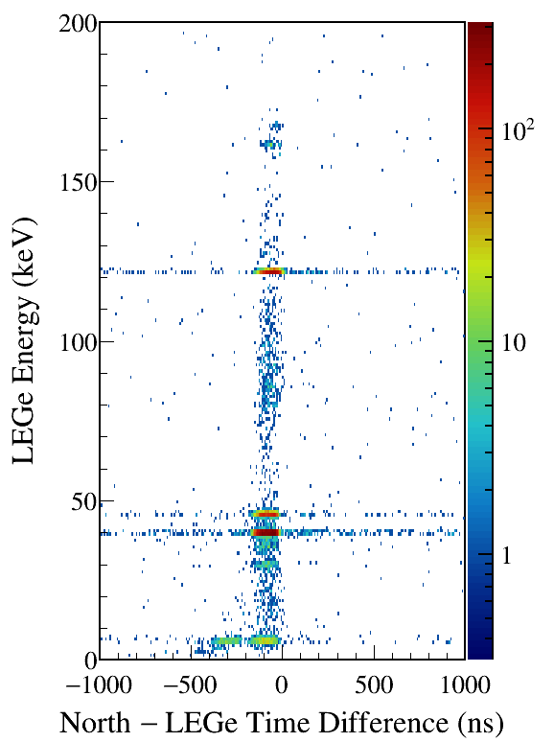
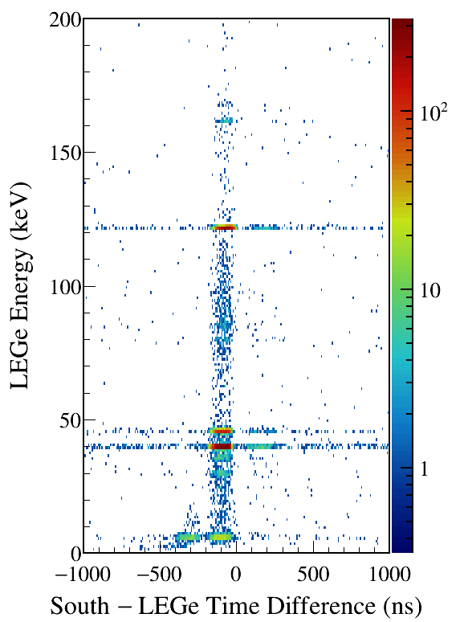
North/South 1408 gated
Notes:
TFile *_file0 = TFile::Open("F:/e21010/pxct/run0274_LEGe_XtRa_152Eu_Z2707_OnLEGeCap_window1us_TrigRise0.064us_TrigGap0.952us_ThL310_N300_S730_CFDDelay0.120us_Scale7_cal.root");
TCanvas* canvaspeak = new TCanvas("canvaspeak", "canvaspeak", 580, 800);
canvaspeak->cd();
canvaspeak->SetTopMargin(0.03);
canvaspeak->SetRightMargin(0.16);
canvaspeak->SetLeftMargin(0.18);
canvaspeak->SetBottomMargin(0.11);
canvaspeak->SetFrameLineWidth(2);
canvaspeak->SetLogz();
TH2D* het = new TH2D("het", "het", 250,-1000,1000,200,0,200); //x,y
tree->Draw("lege_e:north_t-lege_t>>het","lege_e>1&&lege_e<200&&north_e>1405&&north_e<1411","colz"); //y:x
het->SetStats(0);
het->SetTitle("");
het->GetXaxis()->SetTitle("North #minus LEGe Time Difference (ns)");
het->GetYaxis()->SetTitle("LEGe Energy (keV)");
het->GetXaxis()->CenterTitle();
het->GetYaxis()->CenterTitle();
het->GetXaxis()->SetLabelFont(132);
het->GetYaxis()->SetLabelFont(132);
het->GetXaxis()->SetLabelSize(0.05);
het->GetYaxis()->SetLabelSize(0.05);
het->GetXaxis()->SetTitleFont(132);
het->GetYaxis()->SetTitleFont(132);
het->GetXaxis()->SetTitleOffset(0.9);
het->GetYaxis()->SetTitleOffset(1.4);
het->GetXaxis()->SetTitleSize(0.06);
het->GetYaxis()->SetTitleSize(0.06);
het->GetXaxis()->SetNdivisions(505);
het->GetYaxis()->SetNdivisions(505);
//het->GetXaxis()->SetRangeUser(2001,4500);
//het->GetYaxis()->SetRangeUser(1000,2800);
//het->SetMinimum(2);
//het->SetMaximum(100);
het->SetContour(99);
gStyle->SetPalette(kRainbow);
//gPad->SetLogz();
TPaletteAxis *palette = (TPaletteAxis*)het->GetListOfFunctions()->FindObject("palette");
palette->SetTitleFont(132);
palette->SetTitleSize(0.05);
palette->SetLabelFont(132);
palette->SetLabelSize(0.05);
palette->SetLineWidth(2);
canvaspeak->SaveAs("F:/e21010/pxct/1.png");
TCanvas* canvaspeak = new TCanvas("canvaspeak", "canvaspeak", 580, 800);
canvaspeak->cd();
canvaspeak->SetTopMargin(0.03);
canvaspeak->SetRightMargin(0.16);
canvaspeak->SetLeftMargin(0.18);
canvaspeak->SetBottomMargin(0.11);
canvaspeak->SetFrameLineWidth(2);
canvaspeak->SetLogz();
TH2D* het = new TH2D("het", "het", 250,-1000,1000,200,0,200); //x,y
tree->Draw("lege_e:south_t-lege_t>>het","lege_e>1&&lege_e<200&&south_e>1405&&south_e<1411","colz"); //y:x
het->SetStats(0);
het->SetTitle("");
het->GetXaxis()->SetTitle("South #minus LEGe Time Difference (ns)");
het->GetYaxis()->SetTitle("LEGe Energy (keV)");
het->GetXaxis()->CenterTitle();
het->GetYaxis()->CenterTitle();
het->GetXaxis()->SetLabelFont(132);
het->GetYaxis()->SetLabelFont(132);
het->GetXaxis()->SetLabelSize(0.05);
het->GetYaxis()->SetLabelSize(0.05);
het->GetXaxis()->SetTitleFont(132);
het->GetYaxis()->SetTitleFont(132);
het->GetXaxis()->SetTitleOffset(0.9);
het->GetYaxis()->SetTitleOffset(1.4);
het->GetXaxis()->SetTitleSize(0.06);
het->GetYaxis()->SetTitleSize(0.06);
het->GetXaxis()->SetNdivisions(505);
het->GetYaxis()->SetNdivisions(505);
//het->GetXaxis()->SetRangeUser(2001,4500);
//het->GetYaxis()->SetRangeUser(1000,2800);
//het->SetMinimum(2);
//het->SetMaximum(100);
het->SetContour(99);
gStyle->SetPalette(kRainbow);
//gPad->SetLogz();
TPaletteAxis *palette = (TPaletteAxis*)het->GetListOfFunctions()->FindObject("palette");
palette->SetTitleFont(132);
palette->SetTitleSize(0.05);
palette->SetLabelFont(132);
palette->SetLabelSize(0.05);
palette->SetLineWidth(2);
canvaspeak->SaveAs("F:/e21010/pxct/2.png");

Slide 25
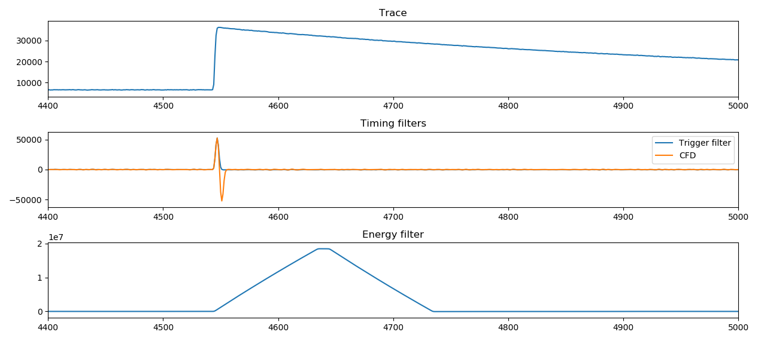
Trigger Rise 0.200 μs
Trigger Gap 0.104 μs
CFD Delay 0.304 μs
CFD Scale 0

Slide 26
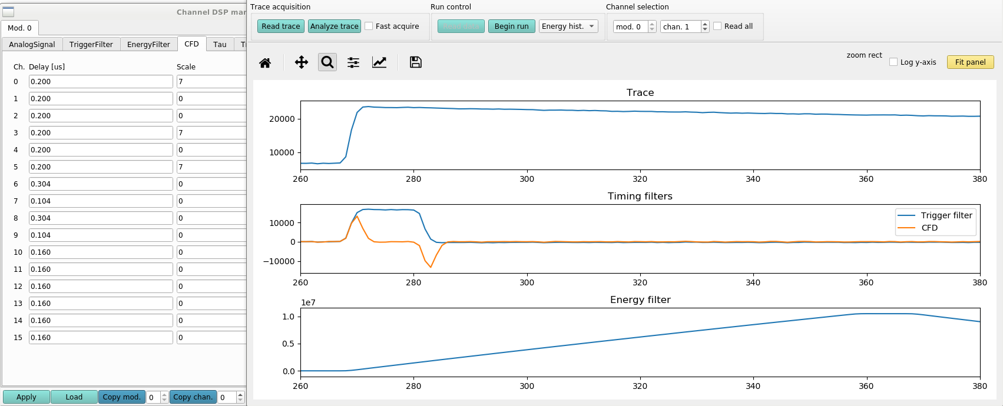
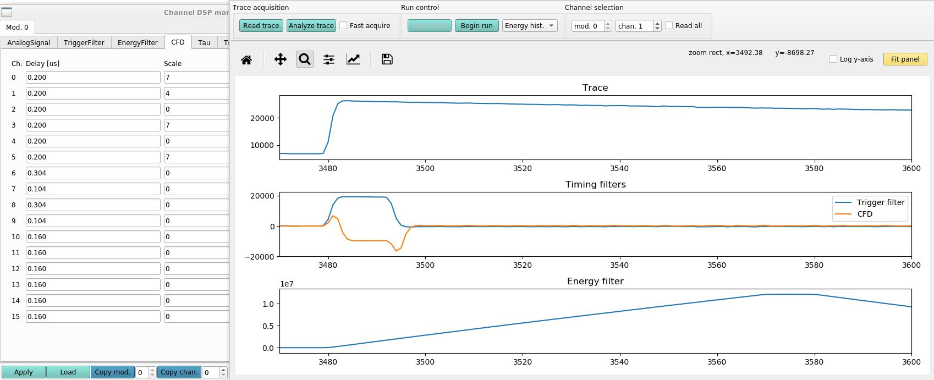
CFD Delay 0.200 μs
CFD Scale 0
CFD Delay 0.200 μs
CFD Scale 4

Slide 27
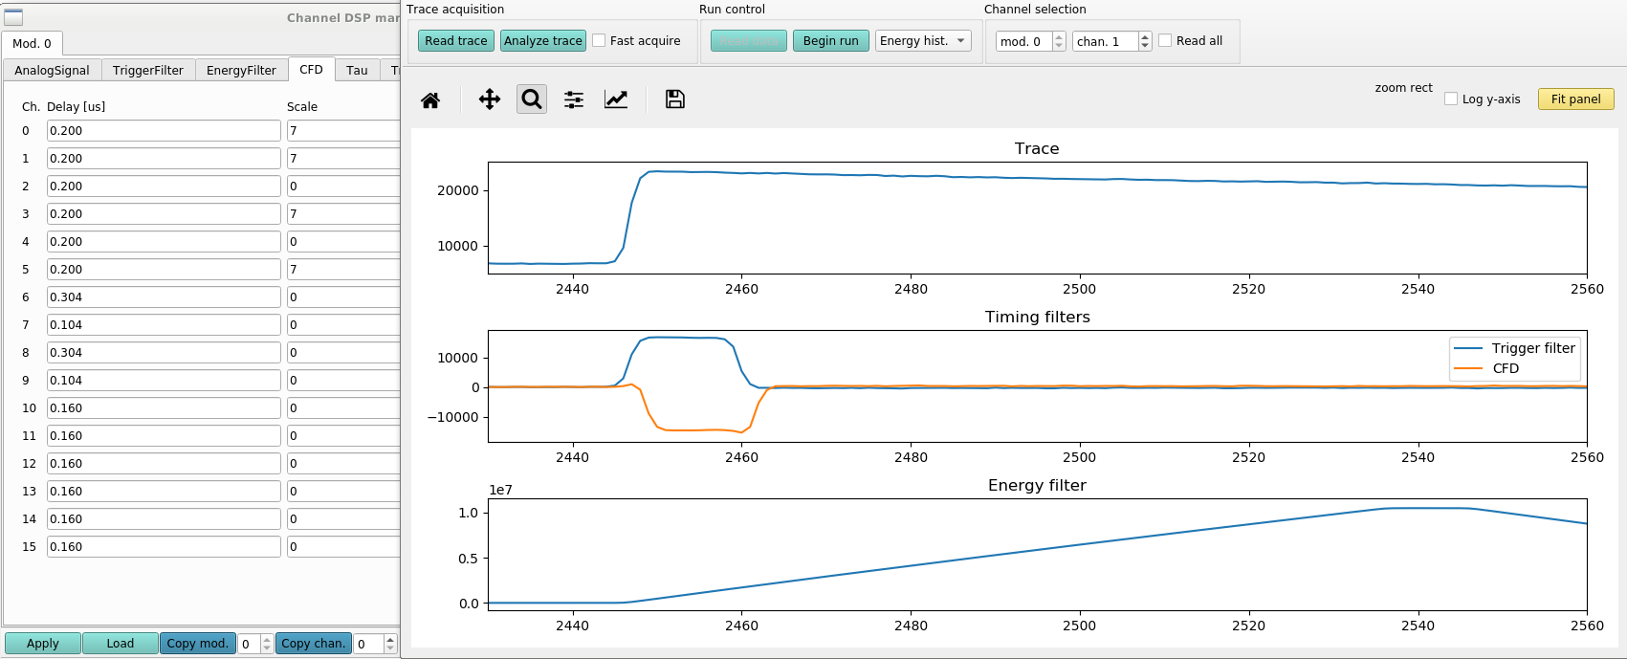
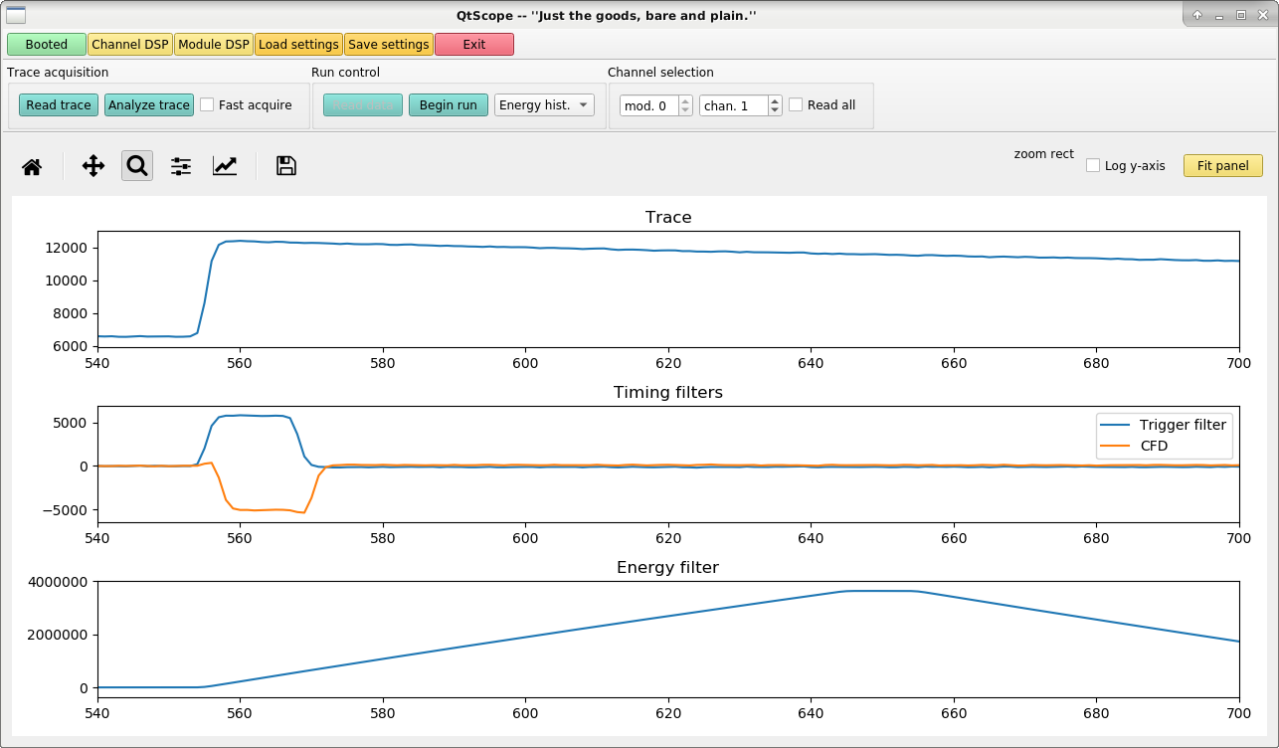
CFD Delay 0.200 μs
CFD Scale 7
CFD Delay 0.120 μs
CFD Scale 7

Slide 28
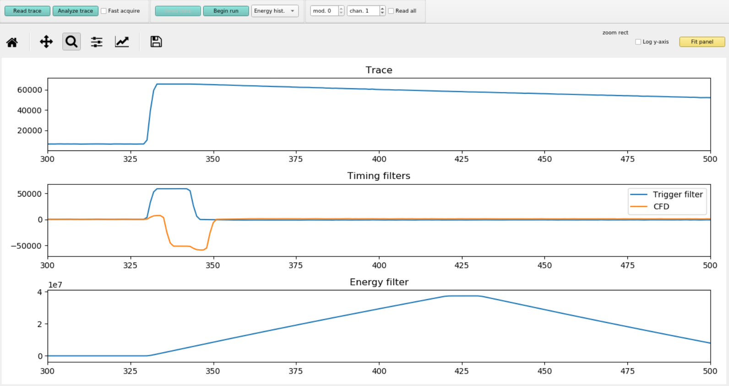
CFD Delay 0.400 μs
CFD Scale 7

Slide 29
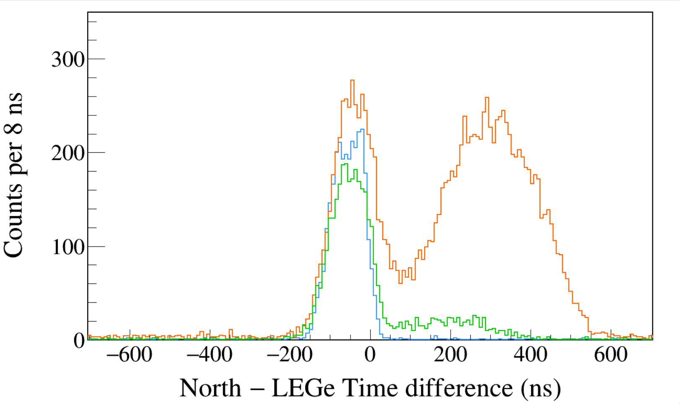
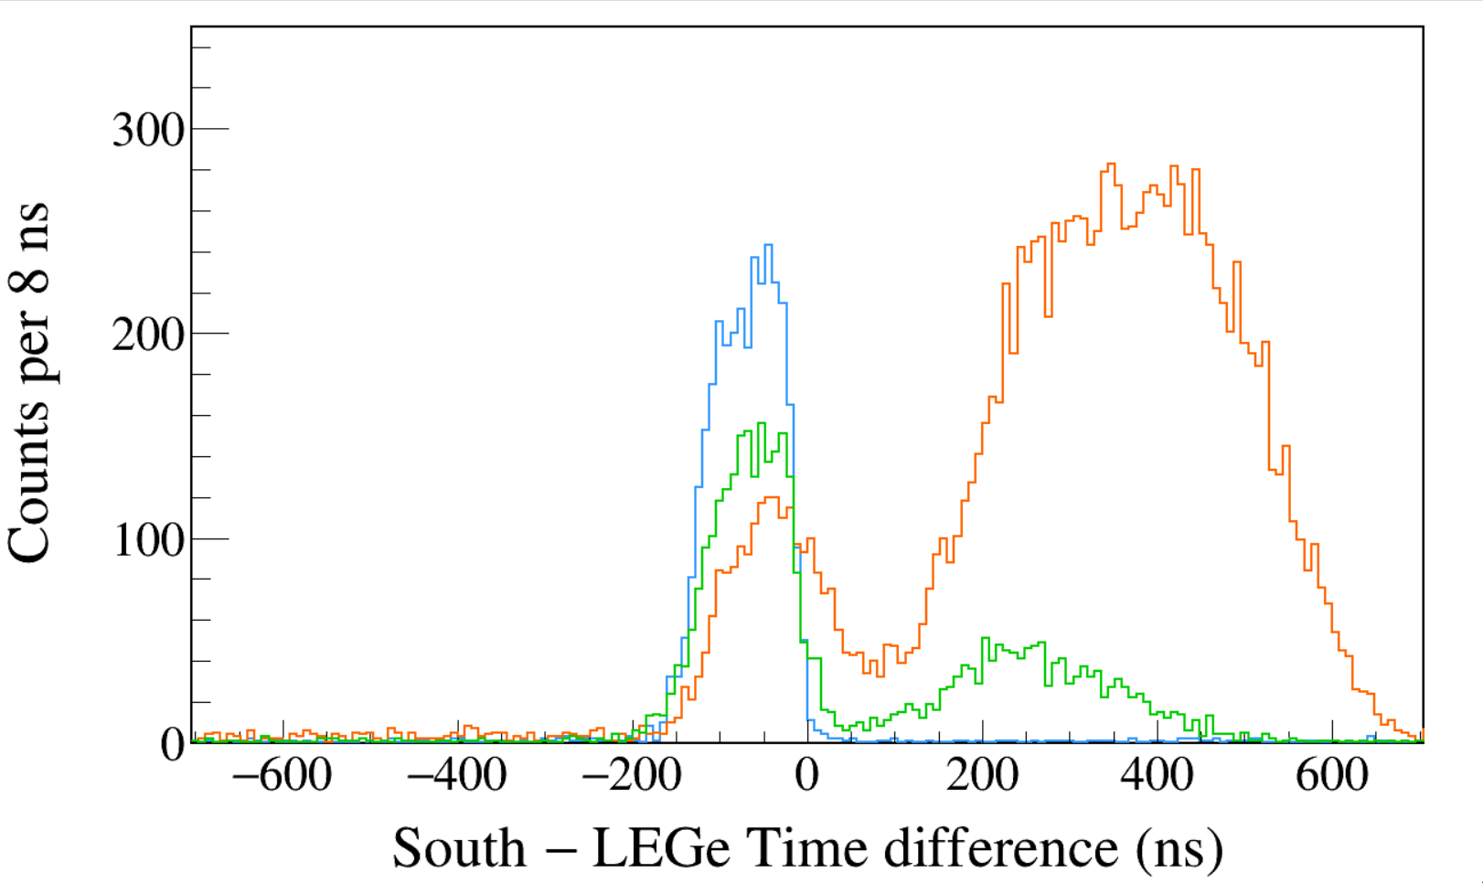
Run0266
152Eu
Trigger Rise 0.064 μs
Trigger Gap 0.952 μs
Trigger Thresh 310, 300, 730
CFD Delay 0.200 μs
CFD Scale 7
LEGe 39||46 && North 1408
LEGe 39||46 && North 245
LEGe 39||46 && North 122
Run0266
152Eu
Trigger Rise 0.064 μs
Trigger Gap 0.952 μs
Trigger Thresh 310, 300, 730
CFD Delay 0.200 μs
CFD Scale 7
LEGe 39||46 && South 1408
LEGe 39||46 && South 245
LEGe 39||46 && South 122
Notes:
TFile *_file0 = TFile::Open("F:/e21010/pxct/run0266_LEGe_XtRa_152Eu_Z2707_OnLEGeCap_window1us_TrigRise0.064us_TrigGap0.952us_ThL310_N300_S730_CFDDelay0.200us_Scale7_cal.root");
TCanvas* canvaspeak = new TCanvas("canvaspeak", "canvaspeak", 1300, 800);//
canvaspeak->cd();//
canvaspeak->SetTopMargin(0.03);
canvaspeak->SetRightMargin(0.04);
canvaspeak->SetLeftMargin(0.13);
canvaspeak->SetBottomMargin(0.16);
canvaspeak->SetFrameLineWidth(2);
TH1D* htimestamps = new TH1D("htimestamps", "htimestamps", 250,-1000,1000);
htimestamps->SetLineWidth(2);
htimestamps->Rebin(1);
htimestamps->SetStats(0);
htimestamps->SetTitle("");
htimestamps->GetXaxis()->SetTitle("North #minus LEGe Time difference (ns)");
htimestamps->GetYaxis()->SetTitle("Counts per 8 ns");
htimestamps->GetXaxis()->CenterTitle();
htimestamps->GetYaxis()->CenterTitle();
htimestamps->GetXaxis()->SetLabelFont(132);
htimestamps->GetYaxis()->SetLabelFont(132);
htimestamps->GetXaxis()->SetLabelSize(0.06);
htimestamps->GetYaxis()->SetLabelSize(0.06);
htimestamps->GetXaxis()->SetTitleFont(132);
htimestamps->GetYaxis()->SetTitleFont(132);
htimestamps->GetXaxis()->SetTitleOffset(1.1);
htimestamps->GetYaxis()->SetTitleOffset(0.95);
htimestamps->GetXaxis()->SetTitleSize(0.07);
htimestamps->GetYaxis()->SetTitleSize(0.07);
htimestamps->GetXaxis()->SetRangeUser(-700,700);
htimestamps->GetYaxis()->SetRangeUser(0,350);
htimestamps->GetYaxis()->SetNdivisions(505);
htimestamps->SetLineWidth(2);
htimestamps->SetLineColor(kAzure+1);
tree->Draw("north_t-lege_t>>htimestamps","north_e>1405&&north_e<1411&&((lege_e>38.8&&lege_e<40.8)||(lege_e>44.8&&lege_e<47.2))","");
htimestamps->Sumw2(kFALSE);
htimestamps->SetBinErrorOption(TH1::kPoisson);//TH1::kNormal or TH1::kPoisson
tree->SetLineColor(kOrange+7);
tree->SetLineWidth(2);
tree->Draw("north_t-lege_t","north_e>120&&north_e<123&&((lege_e>38.8&&lege_e<40.8)||(lege_e>44.8&&lege_e<47.2))","same");
tree->SetLineColor(kGreen+1);
tree->SetLineWidth(2);
tree->Draw("north_t-lege_t","north_e>243&&north_e<246&&((lege_e>38.8&&lege_e<40.8)||(lege_e>44.8&&lege_e<47.2))","same");
TH1D* htimestamps = new TH1D("htimestamps", "htimestamps", 250,-1000,1000);
htimestamps->SetLineWidth(2);
htimestamps->Rebin(1);
htimestamps->SetStats(0);
htimestamps->SetTitle("");
htimestamps->GetXaxis()->SetTitle("South #minus LEGe Time difference (ns)");
htimestamps->GetYaxis()->SetTitle("Counts per 8 ns");
htimestamps->GetXaxis()->CenterTitle();
htimestamps->GetYaxis()->CenterTitle();
htimestamps->GetXaxis()->SetLabelFont(132);
htimestamps->GetYaxis()->SetLabelFont(132);
htimestamps->GetXaxis()->SetLabelSize(0.06);
htimestamps->GetYaxis()->SetLabelSize(0.06);
htimestamps->GetXaxis()->SetTitleFont(132);
htimestamps->GetYaxis()->SetTitleFont(132);
htimestamps->GetXaxis()->SetTitleOffset(1.1);
htimestamps->GetYaxis()->SetTitleOffset(0.95);
htimestamps->GetXaxis()->SetTitleSize(0.07);
htimestamps->GetYaxis()->SetTitleSize(0.07);
htimestamps->GetXaxis()->SetRangeUser(-700,700);
htimestamps->GetYaxis()->SetRangeUser(0,350);
htimestamps->GetYaxis()->SetNdivisions(505);
htimestamps->SetLineWidth(2);
htimestamps->SetLineColor(kAzure+1);
tree->Draw("south_t-lege_t>>htimestamps","south_e>1405&&south_e<1411&&((lege_e>38.8&&lege_e<40.8)||(lege_e>44.8&&lege_e<47.2))","");
htimestamps->Sumw2(kFALSE);
htimestamps->SetBinErrorOption(TH1::kPoisson);//TH1::kNormal or TH1::kPoisson
tree->SetLineColor(kOrange+7);
tree->SetLineWidth(2);
tree->Draw("south_t-lege_t","south_e>120&&south_e<123&&((lege_e>38.8&&lege_e<40.8)||(lege_e>44.8&&lege_e<47.2))","same");
tree->SetLineColor(kGreen+1);
tree->SetLineWidth(2);
tree->Draw("south_t-lege_t","south_e>243&&south_e<246&&((lege_e>38.8&&lege_e<40.8)||(lege_e>44.8&&lege_e<47.2))","same");

Slide 30
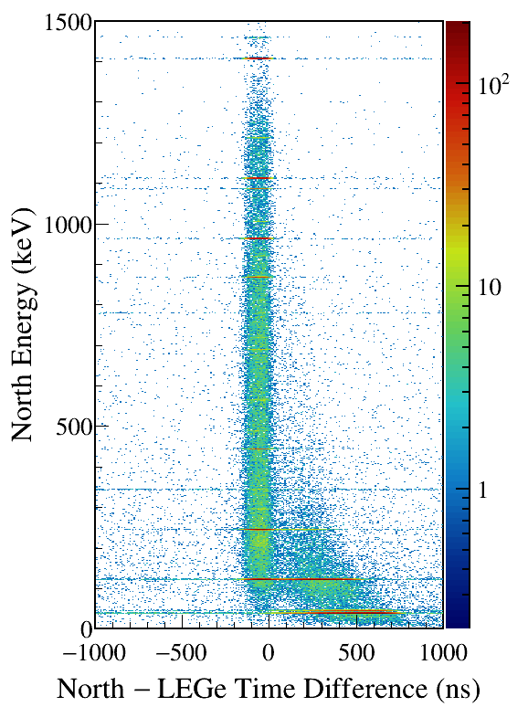
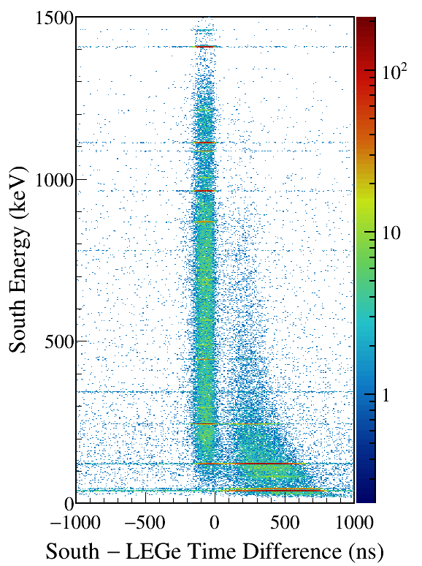
LEGe (39||46) Kα,Kβ gated
Notes:
TFile *_file0 = TFile::Open("F:/e21010/pxct/run0266_LEGe_XtRa_152Eu_Z2707_OnLEGeCap_window1us_TrigRise0.064us_TrigGap0.952us_ThL310_N300_S730_CFDDelay0.200us_Scale7_cal.root");
TCanvas* canvaspeak = new TCanvas("canvaspeak", "canvaspeak", 580, 800);
canvaspeak->cd();
canvaspeak->SetTopMargin(0.03);
canvaspeak->SetRightMargin(0.16);
canvaspeak->SetLeftMargin(0.18);
canvaspeak->SetBottomMargin(0.11);
canvaspeak->SetFrameLineWidth(2);
canvaspeak->SetLogz();
TH2D* het = new TH2D("het", "het", 250,-1000,1000,750,0,1500); //x,y
tree->Draw("north_e:north_t-lege_t>>het","north_e>1&&north_e<1500&&((lege_e>38.8&&lege_e<40.8)||(lege_e>44.8&&lege_e<47.2))","colz"); //y:x
het->SetStats(0);
het->SetTitle("");
het->GetXaxis()->SetTitle("North #minus LEGe Time Difference (ns)");
het->GetYaxis()->SetTitle("North Energy (keV)");
het->GetXaxis()->CenterTitle();
het->GetYaxis()->CenterTitle();
het->GetXaxis()->SetLabelFont(132);
het->GetYaxis()->SetLabelFont(132);
het->GetXaxis()->SetLabelSize(0.05);
het->GetYaxis()->SetLabelSize(0.05);
het->GetXaxis()->SetTitleFont(132);
het->GetYaxis()->SetTitleFont(132);
het->GetXaxis()->SetTitleOffset(0.9);
het->GetYaxis()->SetTitleOffset(1.4);
het->GetXaxis()->SetTitleSize(0.06);
het->GetYaxis()->SetTitleSize(0.06);
het->GetXaxis()->SetNdivisions(505);
het->GetYaxis()->SetNdivisions(505);
//het->GetXaxis()->SetRangeUser(2001,4500);
//het->GetYaxis()->SetRangeUser(1000,2800);
//het->SetMinimum(2);
//het->SetMaximum(100);
het->SetContour(99);
gStyle->SetPalette(kRainbow);
//gPad->SetLogz();
TPaletteAxis *palette = (TPaletteAxis*)het->GetListOfFunctions()->FindObject("palette");
palette->SetTitleFont(132);
palette->SetTitleSize(0.05);
palette->SetLabelFont(132);
palette->SetLabelSize(0.05);
palette->SetLineWidth(2);
canvaspeak->SaveAs("F:/e21010/pxct/1.png");
TH2D* het = new TH2D("het", "het", 250,-1000,1000,750,0,1500); //x,y
tree->Draw("south_e:south_t-lege_t>>het","south_e>1&&south_e<1500&&((lege_e>38.8&&lege_e<40.8)||(lege_e>44.8&&lege_e<47.2))","colz"); //y:x
het->SetStats(0);
het->SetTitle("");
het->GetXaxis()->SetTitle("South #minus LEGe Time Difference (ns)");
het->GetYaxis()->SetTitle("South Energy (keV)");
het->GetXaxis()->CenterTitle();
het->GetYaxis()->CenterTitle();
het->GetXaxis()->SetLabelFont(132);
het->GetYaxis()->SetLabelFont(132);
het->GetXaxis()->SetLabelSize(0.05);
het->GetYaxis()->SetLabelSize(0.05);
het->GetXaxis()->SetTitleFont(132);
het->GetYaxis()->SetTitleFont(132);
het->GetXaxis()->SetTitleOffset(0.9);
het->GetYaxis()->SetTitleOffset(1.4);
het->GetXaxis()->SetTitleSize(0.06);
het->GetYaxis()->SetTitleSize(0.06);
het->GetXaxis()->SetNdivisions(505);
het->GetYaxis()->SetNdivisions(505);
//het->GetXaxis()->SetRangeUser(2001,4500);
//het->GetYaxis()->SetRangeUser(1000,2800);
//het->SetMinimum(2);
//het->SetMaximum(100);
het->SetContour(99);
gStyle->SetPalette(kRainbow);
//gPad->SetLogz();
TPaletteAxis *palette = (TPaletteAxis*)het->GetListOfFunctions()->FindObject("palette");
palette->SetTitleFont(132);
palette->SetTitleSize(0.05);
palette->SetLabelFont(132);
palette->SetLabelSize(0.05);
palette->SetLineWidth(2);
canvaspeak->SaveAs("F:/e21010/pxct/2.png");

Slide 31
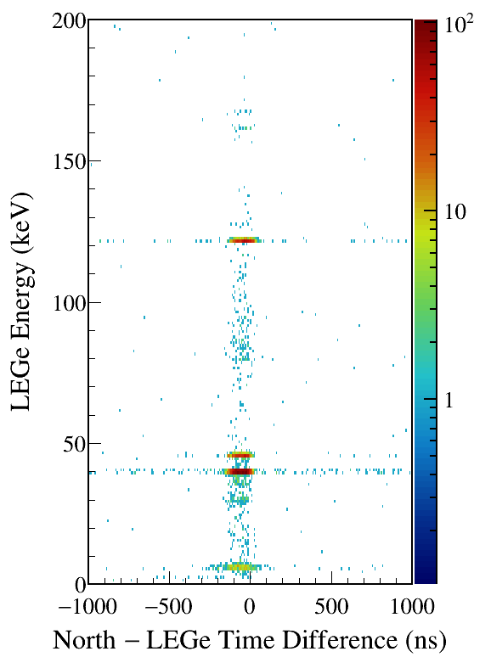
North/South 1408 gated
Notes:
TFile *_file0 = TFile::Open("F:/e21010/pxct/run0266_LEGe_XtRa_152Eu_Z2707_OnLEGeCap_window1us_TrigRise0.064us_TrigGap0.952us_ThL310_N300_S730_CFDDelay0.200us_Scale7_cal.root");
TCanvas* canvaspeak = new TCanvas("canvaspeak", "canvaspeak", 580, 800);
canvaspeak->cd();
canvaspeak->SetTopMargin(0.03);
canvaspeak->SetRightMargin(0.16);
canvaspeak->SetLeftMargin(0.18);
canvaspeak->SetBottomMargin(0.11);
canvaspeak->SetFrameLineWidth(2);
canvaspeak->SetLogz();
TH2D* het = new TH2D("het", "het", 250,-1000,1000,200,0,200); //x,y
tree->Draw("lege_e:north_t-lege_t>>het","lege_e>1&&lege_e<200&&north_e>1405&&north_e<1411","colz"); //y:x
het->SetStats(0);
het->SetTitle("");
het->GetXaxis()->SetTitle("North #minus LEGe Time Difference (ns)");
het->GetYaxis()->SetTitle("LEGe Energy (keV)");
het->GetXaxis()->CenterTitle();
het->GetYaxis()->CenterTitle();
het->GetXaxis()->SetLabelFont(132);
het->GetYaxis()->SetLabelFont(132);
het->GetXaxis()->SetLabelSize(0.05);
het->GetYaxis()->SetLabelSize(0.05);
het->GetXaxis()->SetTitleFont(132);
het->GetYaxis()->SetTitleFont(132);
het->GetXaxis()->SetTitleOffset(0.9);
het->GetYaxis()->SetTitleOffset(1.4);
het->GetXaxis()->SetTitleSize(0.06);
het->GetYaxis()->SetTitleSize(0.06);
het->GetXaxis()->SetNdivisions(505);
het->GetYaxis()->SetNdivisions(505);
//het->GetXaxis()->SetRangeUser(2001,4500);
//het->GetYaxis()->SetRangeUser(1000,2800);
//het->SetMinimum(2);
//het->SetMaximum(100);
het->SetContour(99);
gStyle->SetPalette(kRainbow);
//gPad->SetLogz();
TPaletteAxis *palette = (TPaletteAxis*)het->GetListOfFunctions()->FindObject("palette");
palette->SetTitleFont(132);
palette->SetTitleSize(0.05);
palette->SetLabelFont(132);
palette->SetLabelSize(0.05);
palette->SetLineWidth(2);
canvaspeak->SaveAs("F:/e21010/pxct/1.png");
TCanvas* canvaspeak = new TCanvas("canvaspeak", "canvaspeak", 580, 800);
canvaspeak->cd();
canvaspeak->SetTopMargin(0.03);
canvaspeak->SetRightMargin(0.16);
canvaspeak->SetLeftMargin(0.18);
canvaspeak->SetBottomMargin(0.11);
canvaspeak->SetFrameLineWidth(2);
canvaspeak->SetLogz();
TH2D* het = new TH2D("het", "het", 250,-1000,1000,200,0,200); //x,y
tree->Draw("lege_e:south_t-lege_t>>het","lege_e>1&&lege_e<200&&south_e>1405&&south_e<1411","colz"); //y:x
het->SetStats(0);
het->SetTitle("");
het->GetXaxis()->SetTitle("South #minus LEGe Time Difference (ns)");
het->GetYaxis()->SetTitle("LEGe Energy (keV)");
het->GetXaxis()->CenterTitle();
het->GetYaxis()->CenterTitle();
het->GetXaxis()->SetLabelFont(132);
het->GetYaxis()->SetLabelFont(132);
het->GetXaxis()->SetLabelSize(0.05);
het->GetYaxis()->SetLabelSize(0.05);
het->GetXaxis()->SetTitleFont(132);
het->GetYaxis()->SetTitleFont(132);
het->GetXaxis()->SetTitleOffset(0.9);
het->GetYaxis()->SetTitleOffset(1.4);
het->GetXaxis()->SetTitleSize(0.06);
het->GetYaxis()->SetTitleSize(0.06);
het->GetXaxis()->SetNdivisions(505);
het->GetYaxis()->SetNdivisions(505);
//het->GetXaxis()->SetRangeUser(2001,4500);
//het->GetYaxis()->SetRangeUser(1000,2800);
//het->SetMinimum(2);
//het->SetMaximum(100);
het->SetContour(99);
gStyle->SetPalette(kRainbow);
//gPad->SetLogz();
TPaletteAxis *palette = (TPaletteAxis*)het->GetListOfFunctions()->FindObject("palette");
palette->SetTitleFont(132);
palette->SetTitleSize(0.05);
palette->SetLabelFont(132);
palette->SetLabelSize(0.05);
palette->SetLineWidth(2);
canvaspeak->SaveAs("F:/e21010/pxct/2.png");

Slide 32
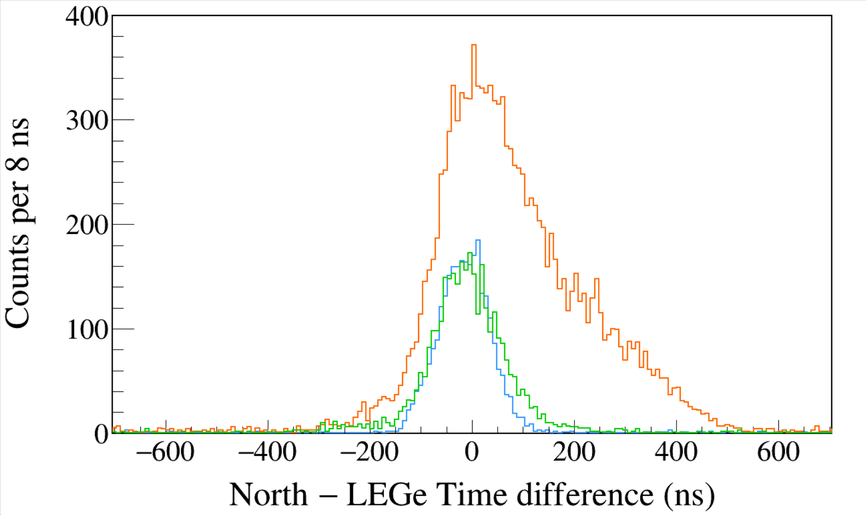
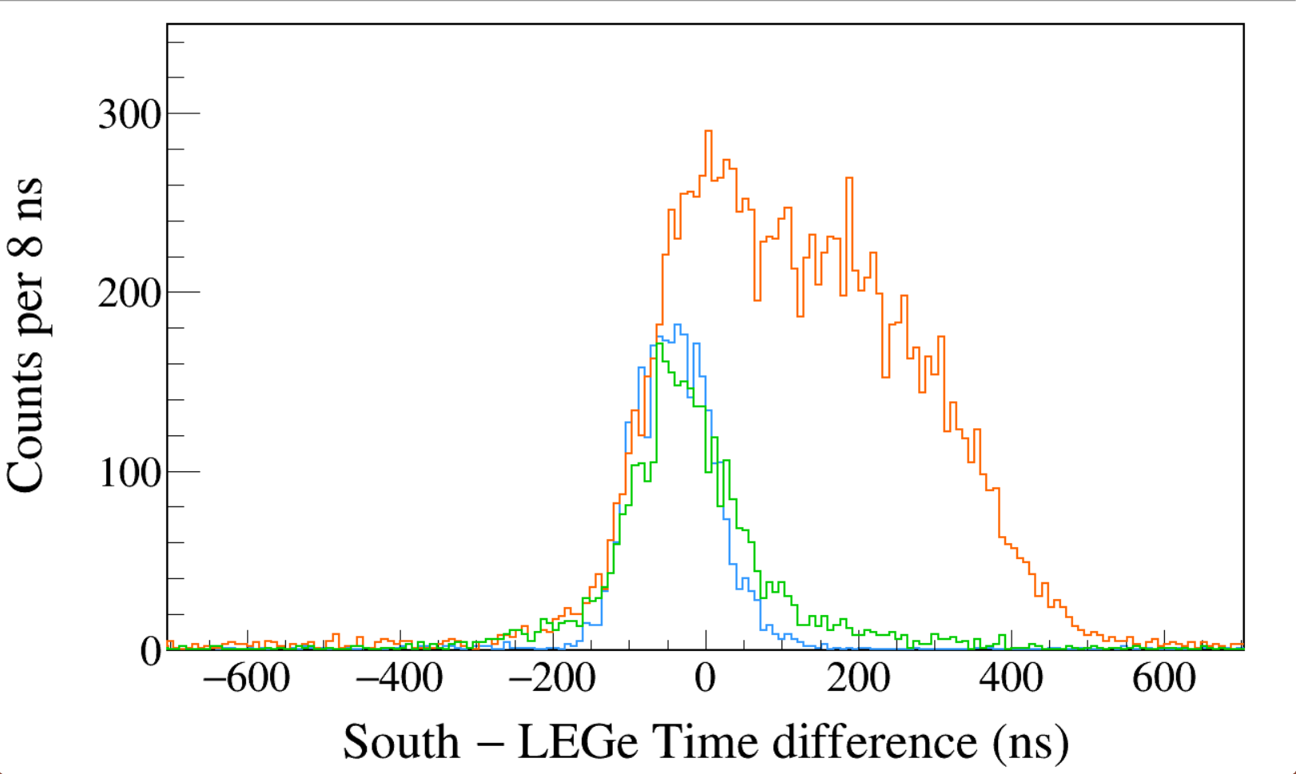
Run0267
152Eu
Trigger Rise 0.064 μs
Trigger Gap 0.952 μs
Trigger Thresh 310, 300, 730
CFD Delay 0.304 μs
CFD Scale 7
LEGe 39||46 && North 1408
LEGe 39||46 && North 245
LEGe 39||46 && North 122
FWHM = 110 ns
Run0267
152Eu
Trigger Rise 0.064 μs
Trigger Gap 0.952 μs
Trigger Thresh 310, 300, 730
CFD Delay 0.304 μs
CFD Scale 7
LEGe 39||46 && South 1408
LEGe 39||46 && South 245
LEGe 39||46 && South 122
Same as run0276
Notes:
TFile *_file0 = TFile::Open("F:/e21010/pxct/run0267_LEGe_XtRa_152Eu_Z2707_OnLEGeCap_window1us_TrigRise0.064us_TrigGap0.952us_ThL310_N300_S730_CFDDelay0.304us_Scale7_cal.root");
TCanvas* canvaspeak = new TCanvas("canvaspeak", "canvaspeak", 1300, 800);//
canvaspeak->cd();//
canvaspeak->SetTopMargin(0.03);
canvaspeak->SetRightMargin(0.04);
canvaspeak->SetLeftMargin(0.13);
canvaspeak->SetBottomMargin(0.16);
canvaspeak->SetFrameLineWidth(2);
TH1D* htimestamps = new TH1D("htimestamps", "htimestamps", 250,-1000,1000);
htimestamps->SetLineWidth(2);
htimestamps->Rebin(1);
htimestamps->SetStats(0);
htimestamps->SetTitle("");
htimestamps->GetXaxis()->SetTitle("North #minus LEGe Time difference (ns)");
htimestamps->GetYaxis()->SetTitle("Counts per 8 ns");
htimestamps->GetXaxis()->CenterTitle();
htimestamps->GetYaxis()->CenterTitle();
htimestamps->GetXaxis()->SetLabelFont(132);
htimestamps->GetYaxis()->SetLabelFont(132);
htimestamps->GetXaxis()->SetLabelSize(0.06);
htimestamps->GetYaxis()->SetLabelSize(0.06);
htimestamps->GetXaxis()->SetTitleFont(132);
htimestamps->GetYaxis()->SetTitleFont(132);
htimestamps->GetXaxis()->SetTitleOffset(1.1);
htimestamps->GetYaxis()->SetTitleOffset(0.95);
htimestamps->GetXaxis()->SetTitleSize(0.07);
htimestamps->GetYaxis()->SetTitleSize(0.07);
htimestamps->GetXaxis()->SetRangeUser(-700,700);
htimestamps->GetYaxis()->SetRangeUser(0,350);
htimestamps->GetYaxis()->SetNdivisions(505);
htimestamps->SetLineWidth(2);
htimestamps->SetLineColor(kAzure+1);
tree->Draw("north_t-lege_t>>htimestamps","north_e>1405&&north_e<1411&&((lege_e>38.8&&lege_e<40.8)||(lege_e>44.8&&lege_e<47.2))","");
htimestamps->Sumw2(kFALSE);
htimestamps->SetBinErrorOption(TH1::kPoisson);//TH1::kNormal or TH1::kPoisson
tree->SetLineColor(kOrange+7);
tree->SetLineWidth(2);
tree->Draw("north_t-lege_t","north_e>120&&north_e<123&&((lege_e>38.8&&lege_e<40.8)||(lege_e>44.8&&lege_e<47.2))","same");
tree->SetLineColor(kGreen+1);
tree->SetLineWidth(2);
tree->Draw("north_t-lege_t","north_e>243&&north_e<246&&((lege_e>38.8&&lege_e<40.8)||(lege_e>44.8&&lege_e<47.2))","same");
TFile *_file0 = TFile::Open("F:/e21010/pxct/run0267_LEGe_XtRa_152Eu_Z2707_OnLEGeCap_window1us_TrigRise0.064us_TrigGap0.952us_ThL310_N300_S730_CFDDelay0.304us_Scale7_cal.root");
TCanvas* canvaspeak = new TCanvas("canvaspeak", "canvaspeak", 1300, 800);//
canvaspeak->cd();//
canvaspeak->SetTopMargin(0.03);
canvaspeak->SetRightMargin(0.04);
canvaspeak->SetLeftMargin(0.13);
canvaspeak->SetBottomMargin(0.16);
canvaspeak->SetFrameLineWidth(2);
TH1D* htimestamps = new TH1D("htimestamps", "htimestamps", 250,-1000,1000);
htimestamps->SetLineWidth(2);
htimestamps->Rebin(1);
htimestamps->SetStats(0);
htimestamps->SetTitle("");
htimestamps->GetXaxis()->SetTitle("South #minus LEGe Time difference (ns)");
htimestamps->GetYaxis()->SetTitle("Counts per 8 ns");
htimestamps->GetXaxis()->CenterTitle();
htimestamps->GetYaxis()->CenterTitle();
htimestamps->GetXaxis()->SetLabelFont(132);
htimestamps->GetYaxis()->SetLabelFont(132);
htimestamps->GetXaxis()->SetLabelSize(0.06);
htimestamps->GetYaxis()->SetLabelSize(0.06);
htimestamps->GetXaxis()->SetTitleFont(132);
htimestamps->GetYaxis()->SetTitleFont(132);
htimestamps->GetXaxis()->SetTitleOffset(1.1);
htimestamps->GetYaxis()->SetTitleOffset(0.95);
htimestamps->GetXaxis()->SetTitleSize(0.07);
htimestamps->GetYaxis()->SetTitleSize(0.07);
htimestamps->GetXaxis()->SetRangeUser(-700,700);
htimestamps->GetYaxis()->SetRangeUser(0,350);
htimestamps->GetYaxis()->SetNdivisions(505);
htimestamps->SetLineWidth(2);
htimestamps->SetLineColor(kAzure+1);
tree->Draw("south_t-lege_t>>htimestamps","south_e>1405&&south_e<1411&&((lege_e>38.8&&lege_e<40.8)||(lege_e>44.8&&lege_e<47.2))","");
htimestamps->Sumw2(kFALSE);
htimestamps->SetBinErrorOption(TH1::kPoisson);//TH1::kNormal or TH1::kPoisson
tree->SetLineColor(kOrange+7);
tree->SetLineWidth(2);
tree->Draw("south_t-lege_t","south_e>120&&south_e<123&&((lege_e>38.8&&lege_e<40.8)||(lege_e>44.8&&lege_e<47.2))","same");
tree->SetLineColor(kGreen+1);
tree->SetLineWidth(2);
tree->Draw("south_t-lege_t","south_e>243&&south_e<246&&((lege_e>38.8&&lege_e<40.8)||(lege_e>44.8&&lege_e<47.2))","same");

Slide 33
LEGe (39||46) Kα,Kβ gated
Notes:
TFile *_file0 = TFile::Open("F:/e21010/pxct/run0267_LEGe_XtRa_152Eu_Z2707_OnLEGeCap_window1us_TrigRise0.064us_TrigGap0.952us_ThL310_N300_S730_CFDDelay0.304us_Scale7_cal.root");
TCanvas* canvaspeak = new TCanvas("canvaspeak", "canvaspeak", 580, 800);
canvaspeak->cd();
canvaspeak->SetTopMargin(0.03);
canvaspeak->SetRightMargin(0.16);
canvaspeak->SetLeftMargin(0.18);
canvaspeak->SetBottomMargin(0.11);
canvaspeak->SetFrameLineWidth(2);
canvaspeak->SetLogz();
TH2D* het = new TH2D("het", "het", 250,-1000,1000,750,0,1500); //x,y
tree->Draw("north_e:north_t-lege_t>>het","north_e>1&&north_e<1500&&((lege_e>38.8&&lege_e<40.8)||(lege_e>44.8&&lege_e<47.2))","colz"); //y:x
het->SetStats(0);
het->SetTitle("");
het->GetXaxis()->SetTitle("North #minus LEGe Time Difference (ns)");
het->GetYaxis()->SetTitle("North Energy (keV)");
het->GetXaxis()->CenterTitle();
het->GetYaxis()->CenterTitle();
het->GetXaxis()->SetLabelFont(132);
het->GetYaxis()->SetLabelFont(132);
het->GetXaxis()->SetLabelSize(0.05);
het->GetYaxis()->SetLabelSize(0.05);
het->GetXaxis()->SetTitleFont(132);
het->GetYaxis()->SetTitleFont(132);
het->GetXaxis()->SetTitleOffset(0.9);
het->GetYaxis()->SetTitleOffset(1.4);
het->GetXaxis()->SetTitleSize(0.06);
het->GetYaxis()->SetTitleSize(0.06);
het->GetXaxis()->SetNdivisions(505);
het->GetYaxis()->SetNdivisions(505);
//het->GetXaxis()->SetRangeUser(2001,4500);
//het->GetYaxis()->SetRangeUser(1000,2800);
//het->SetMinimum(2);
//het->SetMaximum(100);
het->SetContour(99);
gStyle->SetPalette(kRainbow);
//gPad->SetLogz();
TPaletteAxis *palette = (TPaletteAxis*)het->GetListOfFunctions()->FindObject("palette");
palette->SetTitleFont(132);
palette->SetTitleSize(0.05);
palette->SetLabelFont(132);
palette->SetLabelSize(0.05);
palette->SetLineWidth(2);
canvaspeak->SaveAs("F:/e21010/pxct/1.png");
TCanvas* canvaspeak = new TCanvas("canvaspeak", "canvaspeak", 580, 800);
canvaspeak->cd();
canvaspeak->SetTopMargin(0.03);
canvaspeak->SetRightMargin(0.16);
canvaspeak->SetLeftMargin(0.18);
canvaspeak->SetBottomMargin(0.11);
canvaspeak->SetFrameLineWidth(2);
canvaspeak->SetLogz();
TH2D* het = new TH2D("het", "het", 250,-1000,1000,750,0,1500); //x,y
tree->Draw("south_e:south_t-lege_t>>het","south_e>1&&south_e<1500&&((lege_e>38.8&&lege_e<40.8)||(lege_e>44.8&&lege_e<47.2))","colz"); //y:x
het->SetStats(0);
het->SetTitle("");
het->GetXaxis()->SetTitle("South #minus LEGe Time Difference (ns)");
het->GetYaxis()->SetTitle("South Energy (keV)");
het->GetXaxis()->CenterTitle();
het->GetYaxis()->CenterTitle();
het->GetXaxis()->SetLabelFont(132);
het->GetYaxis()->SetLabelFont(132);
het->GetXaxis()->SetLabelSize(0.05);
het->GetYaxis()->SetLabelSize(0.05);
het->GetXaxis()->SetTitleFont(132);
het->GetYaxis()->SetTitleFont(132);
het->GetXaxis()->SetTitleOffset(0.9);
het->GetYaxis()->SetTitleOffset(1.4);
het->GetXaxis()->SetTitleSize(0.06);
het->GetYaxis()->SetTitleSize(0.06);
het->GetXaxis()->SetNdivisions(505);
het->GetYaxis()->SetNdivisions(505);
//het->GetXaxis()->SetRangeUser(2001,4500);
//het->GetYaxis()->SetRangeUser(1000,2800);
//het->SetMinimum(2);
//het->SetMaximum(100);
het->SetContour(99);
gStyle->SetPalette(kRainbow);
//gPad->SetLogz();
TPaletteAxis *palette = (TPaletteAxis*)het->GetListOfFunctions()->FindObject("palette");
palette->SetTitleFont(132);
palette->SetTitleSize(0.05);
palette->SetLabelFont(132);
palette->SetLabelSize(0.05);
palette->SetLineWidth(2);
canvaspeak->SaveAs("F:/e21010/pxct/2.png");

Slide 34
North/South 1408 gated
Notes:
TFile *_file0 = TFile::Open("F:/e21010/pxct/run0267_LEGe_XtRa_152Eu_Z2707_OnLEGeCap_window1us_TrigRise0.064us_TrigGap0.952us_ThL310_N300_S730_CFDDelay0.304us_Scale7_cal.root");
TCanvas* canvaspeak = new TCanvas("canvaspeak", "canvaspeak", 580, 800);
canvaspeak->cd();
canvaspeak->SetTopMargin(0.03);
canvaspeak->SetRightMargin(0.16);
canvaspeak->SetLeftMargin(0.18);
canvaspeak->SetBottomMargin(0.11);
canvaspeak->SetFrameLineWidth(2);
canvaspeak->SetLogz();
TH2D* het = new TH2D("het", "het", 250,-1000,1000,200,0,200); //x,y
tree->Draw("lege_e:north_t-lege_t>>het","lege_e>1&&lege_e<200&&north_e>1405&&north_e<1411","colz"); //y:x
het->SetStats(0);
het->SetTitle("");
het->GetXaxis()->SetTitle("North #minus LEGe Time Difference (ns)");
het->GetYaxis()->SetTitle("LEGe Energy (keV)");
het->GetXaxis()->CenterTitle();
het->GetYaxis()->CenterTitle();
het->GetXaxis()->SetLabelFont(132);
het->GetYaxis()->SetLabelFont(132);
het->GetXaxis()->SetLabelSize(0.05);
het->GetYaxis()->SetLabelSize(0.05);
het->GetXaxis()->SetTitleFont(132);
het->GetYaxis()->SetTitleFont(132);
het->GetXaxis()->SetTitleOffset(0.9);
het->GetYaxis()->SetTitleOffset(1.4);
het->GetXaxis()->SetTitleSize(0.06);
het->GetYaxis()->SetTitleSize(0.06);
het->GetXaxis()->SetNdivisions(505);
het->GetYaxis()->SetNdivisions(505);
//het->GetXaxis()->SetRangeUser(2001,4500);
//het->GetYaxis()->SetRangeUser(1000,2800);
//het->SetMinimum(2);
//het->SetMaximum(100);
het->SetContour(99);
gStyle->SetPalette(kRainbow);
//gPad->SetLogz();
TPaletteAxis *palette = (TPaletteAxis*)het->GetListOfFunctions()->FindObject("palette");
palette->SetTitleFont(132);
palette->SetTitleSize(0.05);
palette->SetLabelFont(132);
palette->SetLabelSize(0.05);
palette->SetLineWidth(2);
canvaspeak->SaveAs("F:/e21010/pxct/1.png");
TCanvas* canvaspeak = new TCanvas("canvaspeak", "canvaspeak", 580, 800);
canvaspeak->cd();
canvaspeak->SetTopMargin(0.03);
canvaspeak->SetRightMargin(0.16);
canvaspeak->SetLeftMargin(0.18);
canvaspeak->SetBottomMargin(0.11);
canvaspeak->SetFrameLineWidth(2);
canvaspeak->SetLogz();
TH2D* het = new TH2D("het", "het", 250,-1000,1000,200,0,200); //x,y
tree->Draw("lege_e:south_t-lege_t>>het","lege_e>1&&lege_e<200&&south_e>1405&&south_e<1411","colz"); //y:x
het->SetStats(0);
het->SetTitle("");
het->GetXaxis()->SetTitle("South #minus LEGe Time Difference (ns)");
het->GetYaxis()->SetTitle("LEGe Energy (keV)");
het->GetXaxis()->CenterTitle();
het->GetYaxis()->CenterTitle();
het->GetXaxis()->SetLabelFont(132);
het->GetYaxis()->SetLabelFont(132);
het->GetXaxis()->SetLabelSize(0.05);
het->GetYaxis()->SetLabelSize(0.05);
het->GetXaxis()->SetTitleFont(132);
het->GetYaxis()->SetTitleFont(132);
het->GetXaxis()->SetTitleOffset(0.9);
het->GetYaxis()->SetTitleOffset(1.4);
het->GetXaxis()->SetTitleSize(0.06);
het->GetYaxis()->SetTitleSize(0.06);
het->GetXaxis()->SetNdivisions(505);
het->GetYaxis()->SetNdivisions(505);
//het->GetXaxis()->SetRangeUser(2001,4500);
//het->GetYaxis()->SetRangeUser(1000,2800);
//het->SetMinimum(2);
//het->SetMaximum(100);
het->SetContour(99);
gStyle->SetPalette(kRainbow);
//gPad->SetLogz();
TPaletteAxis *palette = (TPaletteAxis*)het->GetListOfFunctions()->FindObject("palette");
palette->SetTitleFont(132);
palette->SetTitleSize(0.05);
palette->SetLabelFont(132);
palette->SetLabelSize(0.05);
palette->SetLineWidth(2);
canvaspeak->SaveAs("F:/e21010/pxct/2.png");

Slide 35
Run0268
152Eu
Trigger Rise 0.064 μs
Trigger Gap 0.952 μs
Trigger Thresh 310, 300, 730
CFD Delay 0.400 μs
CFD Scale 7
LEGe 39||46 && North 1408
LEGe 39||46 && North 245
LEGe 39||46 && North 122
Run0268
152Eu
Trigger Rise 0.064 μs
Trigger Gap 0.952 μs
Trigger Thresh 310, 300, 730
CFD Delay 0.400 μs
CFD Scale 7
LEGe 39||46 && South 1408
LEGe 39||46 && South 245
LEGe 39||46 && South 122
Notes:
TFile *_file0 = TFile::Open("F:/e21010/pxct/run0268_LEGe_XtRa_152Eu_Z2707_OnLEGeCap_window1us_TrigRise0.064us_TrigGap0.952us_ThL310_N300_S730_CFDDelay0.400us_Scale7_cal.root");
TCanvas* canvaspeak = new TCanvas("canvaspeak", "canvaspeak", 1300, 800);//
canvaspeak->cd();//
canvaspeak->SetTopMargin(0.03);
canvaspeak->SetRightMargin(0.04);
canvaspeak->SetLeftMargin(0.13);
canvaspeak->SetBottomMargin(0.16);
canvaspeak->SetFrameLineWidth(2);
TH1D* htimestamps = new TH1D("htimestamps", "htimestamps", 250,-1000,1000);
htimestamps->SetLineWidth(2);
htimestamps->Rebin(1);
htimestamps->SetStats(0);
htimestamps->SetTitle("");
htimestamps->GetXaxis()->SetTitle("North #minus LEGe Time difference (ns)");
htimestamps->GetYaxis()->SetTitle("Counts per 8 ns");
htimestamps->GetXaxis()->CenterTitle();
htimestamps->GetYaxis()->CenterTitle();
htimestamps->GetXaxis()->SetLabelFont(132);
htimestamps->GetYaxis()->SetLabelFont(132);
htimestamps->GetXaxis()->SetLabelSize(0.06);
htimestamps->GetYaxis()->SetLabelSize(0.06);
htimestamps->GetXaxis()->SetTitleFont(132);
htimestamps->GetYaxis()->SetTitleFont(132);
htimestamps->GetXaxis()->SetTitleOffset(1.1);
htimestamps->GetYaxis()->SetTitleOffset(0.95);
htimestamps->GetXaxis()->SetTitleSize(0.07);
htimestamps->GetYaxis()->SetTitleSize(0.07);
htimestamps->GetXaxis()->SetRangeUser(-700,700);
htimestamps->GetYaxis()->SetRangeUser(0,350);
htimestamps->GetYaxis()->SetNdivisions(505);
htimestamps->SetLineWidth(2);
htimestamps->SetLineColor(kAzure+1);
tree->Draw("north_t-lege_t>>htimestamps","north_e>1405&&north_e<1411&&((lege_e>38.8&&lege_e<40.8)||(lege_e>44.8&&lege_e<47.2))","");
htimestamps->Sumw2(kFALSE);
htimestamps->SetBinErrorOption(TH1::kPoisson);//TH1::kNormal or TH1::kPoisson
tree->SetLineColor(kOrange+7);
tree->SetLineWidth(2);
tree->Draw("north_t-lege_t","north_e>120&&north_e<123&&((lege_e>38.8&&lege_e<40.8)||(lege_e>44.8&&lege_e<47.2))","same");
tree->SetLineColor(kGreen+1);
tree->SetLineWidth(2);
tree->Draw("north_t-lege_t","north_e>243&&north_e<246&&((lege_e>38.8&&lege_e<40.8)||(lege_e>44.8&&lege_e<47.2))","same");
TCanvas* canvaspeak = new TCanvas("canvaspeak", "canvaspeak", 1300, 800);//
canvaspeak->cd();//
canvaspeak->SetTopMargin(0.03);
canvaspeak->SetRightMargin(0.04);
canvaspeak->SetLeftMargin(0.13);
canvaspeak->SetBottomMargin(0.16);
canvaspeak->SetFrameLineWidth(2);
TH1D* htimestamps = new TH1D("htimestamps", "htimestamps", 250,-1000,1000);
htimestamps->SetLineWidth(2);
htimestamps->Rebin(1);
htimestamps->SetStats(0);
htimestamps->SetTitle("");
htimestamps->GetXaxis()->SetTitle("South #minus LEGe Time difference (ns)");
htimestamps->GetYaxis()->SetTitle("Counts per 8 ns");
htimestamps->GetXaxis()->CenterTitle();
htimestamps->GetYaxis()->CenterTitle();
htimestamps->GetXaxis()->SetLabelFont(132);
htimestamps->GetYaxis()->SetLabelFont(132);
htimestamps->GetXaxis()->SetLabelSize(0.06);
htimestamps->GetYaxis()->SetLabelSize(0.06);
htimestamps->GetXaxis()->SetTitleFont(132);
htimestamps->GetYaxis()->SetTitleFont(132);
htimestamps->GetXaxis()->SetTitleOffset(1.1);
htimestamps->GetYaxis()->SetTitleOffset(0.95);
htimestamps->GetXaxis()->SetTitleSize(0.07);
htimestamps->GetYaxis()->SetTitleSize(0.07);
htimestamps->GetXaxis()->SetRangeUser(-700,700);
htimestamps->GetYaxis()->SetRangeUser(0,350);
htimestamps->GetYaxis()->SetNdivisions(505);
htimestamps->SetLineWidth(2);
htimestamps->SetLineColor(kAzure+1);
tree->Draw("south_t-lege_t>>htimestamps","south_e>1405&&south_e<1411&&((lege_e>38.8&&lege_e<40.8)||(lege_e>44.8&&lege_e<47.2))","");
htimestamps->Sumw2(kFALSE);
htimestamps->SetBinErrorOption(TH1::kPoisson);//TH1::kNormal or TH1::kPoisson
tree->SetLineColor(kOrange+7);
tree->SetLineWidth(2);
tree->Draw("south_t-lege_t","south_e>120&&south_e<123&&((lege_e>38.8&&lege_e<40.8)||(lege_e>44.8&&lege_e<47.2))","same");
tree->SetLineColor(kGreen+1);
tree->SetLineWidth(2);
tree->Draw("south_t-lege_t","south_e>243&&south_e<246&&((lege_e>38.8&&lege_e<40.8)||(lege_e>44.8&&lege_e<47.2))","same");

Slide 36
LEGe (39||46) Kα,Kβ gated
Notes:
TFile *_file0 = TFile::Open("F:/e21010/pxct/run0268_LEGe_XtRa_152Eu_Z2707_OnLEGeCap_window1us_TrigRise0.064us_TrigGap0.952us_ThL310_N300_S730_CFDDelay0.400us_Scale7_cal.root");
TCanvas* canvaspeak = new TCanvas("canvaspeak", "canvaspeak", 580, 800);
canvaspeak->cd();
canvaspeak->SetTopMargin(0.03);
canvaspeak->SetRightMargin(0.16);
canvaspeak->SetLeftMargin(0.18);
canvaspeak->SetBottomMargin(0.11);
canvaspeak->SetFrameLineWidth(2);
canvaspeak->SetLogz();
TH2D* het = new TH2D("het", "het", 250,-1000,1000,750,0,1500); //x,y
tree->Draw("north_e:north_t-lege_t>>het","north_e>1&&north_e<1500&&((lege_e>38.8&&lege_e<40.8)||(lege_e>44.8&&lege_e<47.2))","colz"); //y:x
het->SetStats(0);
het->SetTitle("");
het->GetXaxis()->SetTitle("North #minus LEGe Time Difference (ns)");
het->GetYaxis()->SetTitle("North Energy (keV)");
het->GetXaxis()->CenterTitle();
het->GetYaxis()->CenterTitle();
het->GetXaxis()->SetLabelFont(132);
het->GetYaxis()->SetLabelFont(132);
het->GetXaxis()->SetLabelSize(0.05);
het->GetYaxis()->SetLabelSize(0.05);
het->GetXaxis()->SetTitleFont(132);
het->GetYaxis()->SetTitleFont(132);
het->GetXaxis()->SetTitleOffset(0.9);
het->GetYaxis()->SetTitleOffset(1.4);
het->GetXaxis()->SetTitleSize(0.06);
het->GetYaxis()->SetTitleSize(0.06);
het->GetXaxis()->SetNdivisions(505);
het->GetYaxis()->SetNdivisions(505);
//het->GetXaxis()->SetRangeUser(2001,4500);
//het->GetYaxis()->SetRangeUser(1000,2800);
//het->SetMinimum(2);
//het->SetMaximum(100);
het->SetContour(99);
gStyle->SetPalette(kRainbow);
//gPad->SetLogz();
TPaletteAxis *palette = (TPaletteAxis*)het->GetListOfFunctions()->FindObject("palette");
palette->SetTitleFont(132);
palette->SetTitleSize(0.05);
palette->SetLabelFont(132);
palette->SetLabelSize(0.05);
palette->SetLineWidth(2);
canvaspeak->SaveAs("F:/e21010/pxct/1.png");
TCanvas* canvaspeak = new TCanvas("canvaspeak", "canvaspeak", 580, 800);
canvaspeak->cd();
canvaspeak->SetTopMargin(0.03);
canvaspeak->SetRightMargin(0.16);
canvaspeak->SetLeftMargin(0.18);
canvaspeak->SetBottomMargin(0.11);
canvaspeak->SetFrameLineWidth(2);
canvaspeak->SetLogz();
TH2D* het = new TH2D("het", "het", 250,-1000,1000,750,0,1500); //x,y
tree->Draw("south_e:south_t-lege_t>>het","south_e>1&&south_e<1500&&((lege_e>38.8&&lege_e<40.8)||(lege_e>44.8&&lege_e<47.2))","colz"); //y:x
het->SetStats(0);
het->SetTitle("");
het->GetXaxis()->SetTitle("South #minus LEGe Time Difference (ns)");
het->GetYaxis()->SetTitle("South Energy (keV)");
het->GetXaxis()->CenterTitle();
het->GetYaxis()->CenterTitle();
het->GetXaxis()->SetLabelFont(132);
het->GetYaxis()->SetLabelFont(132);
het->GetXaxis()->SetLabelSize(0.05);
het->GetYaxis()->SetLabelSize(0.05);
het->GetXaxis()->SetTitleFont(132);
het->GetYaxis()->SetTitleFont(132);
het->GetXaxis()->SetTitleOffset(0.9);
het->GetYaxis()->SetTitleOffset(1.4);
het->GetXaxis()->SetTitleSize(0.06);
het->GetYaxis()->SetTitleSize(0.06);
het->GetXaxis()->SetNdivisions(505);
het->GetYaxis()->SetNdivisions(505);
//het->GetXaxis()->SetRangeUser(2001,4500);
//het->GetYaxis()->SetRangeUser(1000,2800);
//het->SetMinimum(2);
//het->SetMaximum(100);
het->SetContour(99);
gStyle->SetPalette(kRainbow);
//gPad->SetLogz();
TPaletteAxis *palette = (TPaletteAxis*)het->GetListOfFunctions()->FindObject("palette");
palette->SetTitleFont(132);
palette->SetTitleSize(0.05);
palette->SetLabelFont(132);
palette->SetLabelSize(0.05);
palette->SetLineWidth(2);
canvaspeak->SaveAs("F:/e21010/pxct/2.png");

Slide 37
North/South 1408 gated
Notes:
TFile *_file0 = TFile::Open("F:/e21010/pxct/run0268_LEGe_XtRa_152Eu_Z2707_OnLEGeCap_window1us_TrigRise0.064us_TrigGap0.952us_ThL310_N300_S730_CFDDelay0.400us_Scale7_cal.root");
TCanvas* canvaspeak = new TCanvas("canvaspeak", "canvaspeak", 580, 800);
canvaspeak->cd();
canvaspeak->SetTopMargin(0.03);
canvaspeak->SetRightMargin(0.16);
canvaspeak->SetLeftMargin(0.18);
canvaspeak->SetBottomMargin(0.11);
canvaspeak->SetFrameLineWidth(2);
canvaspeak->SetLogz();
TH2D* het = new TH2D("het", "het", 250,-1000,1000,200,0,200); //x,y
tree->Draw("lege_e:north_t-lege_t>>het","lege_e>1&&lege_e<200&&north_e>1405&&north_e<1411","colz"); //y:x
het->SetStats(0);
het->SetTitle("");
het->GetXaxis()->SetTitle("North #minus LEGe Time Difference (ns)");
het->GetYaxis()->SetTitle("LEGe Energy (keV)");
het->GetXaxis()->CenterTitle();
het->GetYaxis()->CenterTitle();
het->GetXaxis()->SetLabelFont(132);
het->GetYaxis()->SetLabelFont(132);
het->GetXaxis()->SetLabelSize(0.05);
het->GetYaxis()->SetLabelSize(0.05);
het->GetXaxis()->SetTitleFont(132);
het->GetYaxis()->SetTitleFont(132);
het->GetXaxis()->SetTitleOffset(0.9);
het->GetYaxis()->SetTitleOffset(1.4);
het->GetXaxis()->SetTitleSize(0.06);
het->GetYaxis()->SetTitleSize(0.06);
het->GetXaxis()->SetNdivisions(505);
het->GetYaxis()->SetNdivisions(505);
//het->GetXaxis()->SetRangeUser(2001,4500);
//het->GetYaxis()->SetRangeUser(1000,2800);
//het->SetMinimum(2);
//het->SetMaximum(100);
het->SetContour(99);
gStyle->SetPalette(kRainbow);
//gPad->SetLogz();
TPaletteAxis *palette = (TPaletteAxis*)het->GetListOfFunctions()->FindObject("palette");
palette->SetTitleFont(132);
palette->SetTitleSize(0.05);
palette->SetLabelFont(132);
palette->SetLabelSize(0.05);
palette->SetLineWidth(2);
canvaspeak->SaveAs("F:/e21010/pxct/1.png");
TCanvas* canvaspeak = new TCanvas("canvaspeak", "canvaspeak", 580, 800);
canvaspeak->cd();
canvaspeak->SetTopMargin(0.03);
canvaspeak->SetRightMargin(0.16);
canvaspeak->SetLeftMargin(0.18);
canvaspeak->SetBottomMargin(0.11);
canvaspeak->SetFrameLineWidth(2);
canvaspeak->SetLogz();
TH2D* het = new TH2D("het", "het", 250,-1000,1000,200,0,200); //x,y
tree->Draw("lege_e:south_t-lege_t>>het","lege_e>1&&lege_e<200&&south_e>1405&&south_e<1411","colz"); //y:x
het->SetStats(0);
het->SetTitle("");
het->GetXaxis()->SetTitle("South #minus LEGe Time Difference (ns)");
het->GetYaxis()->SetTitle("LEGe Energy (keV)");
het->GetXaxis()->CenterTitle();
het->GetYaxis()->CenterTitle();
het->GetXaxis()->SetLabelFont(132);
het->GetYaxis()->SetLabelFont(132);
het->GetXaxis()->SetLabelSize(0.05);
het->GetYaxis()->SetLabelSize(0.05);
het->GetXaxis()->SetTitleFont(132);
het->GetYaxis()->SetTitleFont(132);
het->GetXaxis()->SetTitleOffset(0.9);
het->GetYaxis()->SetTitleOffset(1.4);
het->GetXaxis()->SetTitleSize(0.06);
het->GetYaxis()->SetTitleSize(0.06);
het->GetXaxis()->SetNdivisions(505);
het->GetYaxis()->SetNdivisions(505);
//het->GetXaxis()->SetRangeUser(2001,4500);
//het->GetYaxis()->SetRangeUser(1000,2800);
//het->SetMinimum(2);
//het->SetMaximum(100);
het->SetContour(99);
gStyle->SetPalette(kRainbow);
//gPad->SetLogz();
TPaletteAxis *palette = (TPaletteAxis*)het->GetListOfFunctions()->FindObject("palette");
palette->SetTitleFont(132);
palette->SetTitleSize(0.05);
palette->SetLabelFont(132);
palette->SetLabelSize(0.05);
palette->SetLineWidth(2);
canvaspeak->SaveAs("F:/e21010/pxct/2.png");

Slide 38
Run0269
152Eu
LEGe Trigger Rise 0.200 μs
LEGe Trigger Gap 0.816 μs
XtRa Trigger Rise 0.064 μs
XtRa Trigger Gap 0.952 μs
Trigger Thresh 310, 300, 730
CFD Delay 0.200 μs
CFD Scale 7
LEGe 39||46 && North 1408
LEGe 39||46 && North 245
LEGe 39||46 && North 122
Very similar to Run0266
Run0269
152Eu
LEGe Trigger Rise 0.200 μs
LEGe Trigger Gap 0.816 μs
XtRa Trigger Rise 0.064 μs
XtRa Trigger Gap 0.952 μs
Trigger Thresh 310, 300, 730
CFD Delay 0.200 μs
CFD Scale 7
LEGe 39||46 && South 1408
LEGe 39||46 && South 245
LEGe 39||46 && South 122
Notes:
TFile *_file0 = TFile::Open("F:/e21010/pxct/run0269_LEGe_XtRa_152Eu_Z2707_OnLEGeCap_window1us_TrigRise0.200_0.064us_TrigGap0.816_0.952us_ThL310_N300_S730_CFDDelay0.200us_Scale7_cal.root");
TCanvas* canvaspeak = new TCanvas("canvaspeak", "canvaspeak", 1300, 800);//
canvaspeak->cd();//
canvaspeak->SetTopMargin(0.03);
canvaspeak->SetRightMargin(0.04);
canvaspeak->SetLeftMargin(0.13);
canvaspeak->SetBottomMargin(0.16);
canvaspeak->SetFrameLineWidth(2);
TH1D* htimestamps = new TH1D("htimestamps", "htimestamps", 250,-1000,1000);
htimestamps->SetLineWidth(2);
htimestamps->Rebin(1);
htimestamps->SetStats(0);
htimestamps->SetTitle("");
htimestamps->GetXaxis()->SetTitle("North #minus LEGe Time difference (ns)");
htimestamps->GetYaxis()->SetTitle("Counts per 8 ns");
htimestamps->GetXaxis()->CenterTitle();
htimestamps->GetYaxis()->CenterTitle();
htimestamps->GetXaxis()->SetLabelFont(132);
htimestamps->GetYaxis()->SetLabelFont(132);
htimestamps->GetXaxis()->SetLabelSize(0.06);
htimestamps->GetYaxis()->SetLabelSize(0.06);
htimestamps->GetXaxis()->SetTitleFont(132);
htimestamps->GetYaxis()->SetTitleFont(132);
htimestamps->GetXaxis()->SetTitleOffset(1.1);
htimestamps->GetYaxis()->SetTitleOffset(0.95);
htimestamps->GetXaxis()->SetTitleSize(0.07);
htimestamps->GetYaxis()->SetTitleSize(0.07);
htimestamps->GetXaxis()->SetRangeUser(-700,700);
htimestamps->GetYaxis()->SetRangeUser(0,350);
htimestamps->GetYaxis()->SetNdivisions(505);
htimestamps->SetLineWidth(2);
htimestamps->SetLineColor(kAzure+1);
tree->Draw("north_t-lege_t>>htimestamps","north_e>1405&&north_e<1411&&((lege_e>38.8&&lege_e<40.8)||(lege_e>44.8&&lege_e<47.2))","");
htimestamps->Sumw2(kFALSE);
htimestamps->SetBinErrorOption(TH1::kPoisson);//TH1::kNormal or TH1::kPoisson
tree->SetLineColor(kOrange+7);
tree->SetLineWidth(2);
tree->Draw("north_t-lege_t","north_e>120&&north_e<123&&((lege_e>38.8&&lege_e<40.8)||(lege_e>44.8&&lege_e<47.2))","same");
tree->SetLineColor(kGreen+1);
tree->SetLineWidth(2);
tree->Draw("north_t-lege_t","north_e>243&&north_e<246&&((lege_e>38.8&&lege_e<40.8)||(lege_e>44.8&&lege_e<47.2))","same");
TFile *_file0 = TFile::Open("F:/e21010/pxct/run0269_LEGe_XtRa_152Eu_Z2707_OnLEGeCap_window1us_TrigRise0.200_0.064us_TrigGap0.816_0.952us_ThL310_N300_S730_CFDDelay0.200us_Scale7_cal.root");
TCanvas* canvaspeak = new TCanvas("canvaspeak", "canvaspeak", 1300, 800);//
canvaspeak->cd();//
canvaspeak->SetTopMargin(0.03);
canvaspeak->SetRightMargin(0.04);
canvaspeak->SetLeftMargin(0.13);
canvaspeak->SetBottomMargin(0.16);
canvaspeak->SetFrameLineWidth(2);
TH1D* htimestamps = new TH1D("htimestamps", "htimestamps", 250,-1000,1000);
htimestamps->SetLineWidth(2);
htimestamps->Rebin(1);
htimestamps->SetStats(0);
htimestamps->SetTitle("");
htimestamps->GetXaxis()->SetTitle("South #minus LEGe Time difference (ns)");
htimestamps->GetYaxis()->SetTitle("Counts per 8 ns");
htimestamps->GetXaxis()->CenterTitle();
htimestamps->GetYaxis()->CenterTitle();
htimestamps->GetXaxis()->SetLabelFont(132);
htimestamps->GetYaxis()->SetLabelFont(132);
htimestamps->GetXaxis()->SetLabelSize(0.06);
htimestamps->GetYaxis()->SetLabelSize(0.06);
htimestamps->GetXaxis()->SetTitleFont(132);
htimestamps->GetYaxis()->SetTitleFont(132);
htimestamps->GetXaxis()->SetTitleOffset(1.1);
htimestamps->GetYaxis()->SetTitleOffset(0.95);
htimestamps->GetXaxis()->SetTitleSize(0.07);
htimestamps->GetYaxis()->SetTitleSize(0.07);
htimestamps->GetXaxis()->SetRangeUser(-700,700);
htimestamps->GetYaxis()->SetRangeUser(0,350);
htimestamps->GetYaxis()->SetNdivisions(505);
htimestamps->SetLineWidth(2);
htimestamps->SetLineColor(kAzure+1);
tree->Draw("south_t-lege_t>>htimestamps","south_e>1405&&south_e<1411&&((lege_e>38.8&&lege_e<40.8)||(lege_e>44.8&&lege_e<47.2))","");
htimestamps->Sumw2(kFALSE);
htimestamps->SetBinErrorOption(TH1::kPoisson);//TH1::kNormal or TH1::kPoisson
tree->SetLineColor(kOrange+7);
tree->SetLineWidth(2);
tree->Draw("south_t-lege_t","south_e>120&&south_e<123&&((lege_e>38.8&&lege_e<40.8)||(lege_e>44.8&&lege_e<47.2))","same");
tree->SetLineColor(kGreen+1);
tree->SetLineWidth(2);
tree->Draw("south_t-lege_t","south_e>243&&south_e<246&&((lege_e>38.8&&lege_e<40.8)||(lege_e>44.8&&lege_e<47.2))","same");

Slide 39
LEGe (39||46) Kα,Kβ gated
Notes:
TFile *_file0 = TFile::Open("F:/e21010/pxct/run0269_LEGe_XtRa_152Eu_Z2707_OnLEGeCap_window1us_TrigRise0.200_0.064us_TrigGap0.816_0.952us_ThL310_N300_S730_CFDDelay0.200us_Scale7_cal.root");
TCanvas* canvaspeak = new TCanvas("canvaspeak", "canvaspeak", 580, 800);
canvaspeak->cd();
canvaspeak->SetTopMargin(0.03);
canvaspeak->SetRightMargin(0.16);
canvaspeak->SetLeftMargin(0.18);
canvaspeak->SetBottomMargin(0.11);
canvaspeak->SetFrameLineWidth(2);
canvaspeak->SetLogz();
TH2D* het = new TH2D("het", "het", 250,-1000,1000,750,0,1500); //x,y
tree->Draw("north_e:north_t-lege_t>>het","north_e>1&&north_e<1500&&((lege_e>38.8&&lege_e<40.8)||(lege_e>44.8&&lege_e<47.2))","colz"); //y:x
het->SetStats(0);
het->SetTitle("");
het->GetXaxis()->SetTitle("North #minus LEGe Time Difference (ns)");
het->GetYaxis()->SetTitle("North Energy (keV)");
het->GetXaxis()->CenterTitle();
het->GetYaxis()->CenterTitle();
het->GetXaxis()->SetLabelFont(132);
het->GetYaxis()->SetLabelFont(132);
het->GetXaxis()->SetLabelSize(0.05);
het->GetYaxis()->SetLabelSize(0.05);
het->GetXaxis()->SetTitleFont(132);
het->GetYaxis()->SetTitleFont(132);
het->GetXaxis()->SetTitleOffset(0.9);
het->GetYaxis()->SetTitleOffset(1.4);
het->GetXaxis()->SetTitleSize(0.06);
het->GetYaxis()->SetTitleSize(0.06);
het->GetXaxis()->SetNdivisions(505);
het->GetYaxis()->SetNdivisions(505);
//het->GetXaxis()->SetRangeUser(2001,4500);
//het->GetYaxis()->SetRangeUser(1000,2800);
//het->SetMinimum(2);
//het->SetMaximum(100);
het->SetContour(99);
gStyle->SetPalette(kRainbow);
//gPad->SetLogz();
TPaletteAxis *palette = (TPaletteAxis*)het->GetListOfFunctions()->FindObject("palette");
palette->SetTitleFont(132);
palette->SetTitleSize(0.05);
palette->SetLabelFont(132);
palette->SetLabelSize(0.05);
palette->SetLineWidth(2);
canvaspeak->SaveAs("F:/e21010/pxct/1.png");
TCanvas* canvaspeak = new TCanvas("canvaspeak", "canvaspeak", 580, 800);
canvaspeak->cd();
canvaspeak->SetTopMargin(0.03);
canvaspeak->SetRightMargin(0.16);
canvaspeak->SetLeftMargin(0.18);
canvaspeak->SetBottomMargin(0.11);
canvaspeak->SetFrameLineWidth(2);
canvaspeak->SetLogz();
TH2D* het = new TH2D("het", "het", 250,-1000,1000,750,0,1500); //x,y
tree->Draw("south_e:south_t-lege_t>>het","south_e>1&&south_e<1500&&((lege_e>38.8&&lege_e<40.8)||(lege_e>44.8&&lege_e<47.2))","colz"); //y:x
het->SetStats(0);
het->SetTitle("");
het->GetXaxis()->SetTitle("South #minus LEGe Time Difference (ns)");
het->GetYaxis()->SetTitle("South Energy (keV)");
het->GetXaxis()->CenterTitle();
het->GetYaxis()->CenterTitle();
het->GetXaxis()->SetLabelFont(132);
het->GetYaxis()->SetLabelFont(132);
het->GetXaxis()->SetLabelSize(0.05);
het->GetYaxis()->SetLabelSize(0.05);
het->GetXaxis()->SetTitleFont(132);
het->GetYaxis()->SetTitleFont(132);
het->GetXaxis()->SetTitleOffset(0.9);
het->GetYaxis()->SetTitleOffset(1.4);
het->GetXaxis()->SetTitleSize(0.06);
het->GetYaxis()->SetTitleSize(0.06);
het->GetXaxis()->SetNdivisions(505);
het->GetYaxis()->SetNdivisions(505);
//het->GetXaxis()->SetRangeUser(2001,4500);
//het->GetYaxis()->SetRangeUser(1000,2800);
//het->SetMinimum(2);
//het->SetMaximum(100);
het->SetContour(99);
gStyle->SetPalette(kRainbow);
//gPad->SetLogz();
TPaletteAxis *palette = (TPaletteAxis*)het->GetListOfFunctions()->FindObject("palette");
palette->SetTitleFont(132);
palette->SetTitleSize(0.05);
palette->SetLabelFont(132);
palette->SetLabelSize(0.05);
palette->SetLineWidth(2);
canvaspeak->SaveAs("F:/e21010/pxct/2.png");

Slide 40
North/South 1408 gated. LEGe Trigger Rise and Gap have very little impact.
Notes:
TFile *_file0 = TFile::Open("F:/e21010/pxct/run0269_LEGe_XtRa_152Eu_Z2707_OnLEGeCap_window1us_TrigRise0.200_0.064us_TrigGap0.816_0.952us_ThL310_N300_S730_CFDDelay0.200us_Scale7_cal.root");
TCanvas* canvaspeak = new TCanvas("canvaspeak", "canvaspeak", 580, 800);
canvaspeak->cd();
canvaspeak->SetTopMargin(0.03);
canvaspeak->SetRightMargin(0.16);
canvaspeak->SetLeftMargin(0.18);
canvaspeak->SetBottomMargin(0.11);
canvaspeak->SetFrameLineWidth(2);
canvaspeak->SetLogz();
TH2D* het = new TH2D("het", "het", 250,-1000,1000,200,0,200); //x,y
tree->Draw("lege_e:north_t-lege_t>>het","lege_e>1&&lege_e<200&&north_e>1405&&north_e<1411","colz"); //y:x
het->SetStats(0);
het->SetTitle("");
het->GetXaxis()->SetTitle("North #minus LEGe Time Difference (ns)");
het->GetYaxis()->SetTitle("LEGe Energy (keV)");
het->GetXaxis()->CenterTitle();
het->GetYaxis()->CenterTitle();
het->GetXaxis()->SetLabelFont(132);
het->GetYaxis()->SetLabelFont(132);
het->GetXaxis()->SetLabelSize(0.05);
het->GetYaxis()->SetLabelSize(0.05);
het->GetXaxis()->SetTitleFont(132);
het->GetYaxis()->SetTitleFont(132);
het->GetXaxis()->SetTitleOffset(0.9);
het->GetYaxis()->SetTitleOffset(1.4);
het->GetXaxis()->SetTitleSize(0.06);
het->GetYaxis()->SetTitleSize(0.06);
het->GetXaxis()->SetNdivisions(505);
het->GetYaxis()->SetNdivisions(505);
//het->GetXaxis()->SetRangeUser(2001,4500);
//het->GetYaxis()->SetRangeUser(1000,2800);
//het->SetMinimum(2);
//het->SetMaximum(100);
het->SetContour(99);
gStyle->SetPalette(kRainbow);
//gPad->SetLogz();
TPaletteAxis *palette = (TPaletteAxis*)het->GetListOfFunctions()->FindObject("palette");
palette->SetTitleFont(132);
palette->SetTitleSize(0.05);
palette->SetLabelFont(132);
palette->SetLabelSize(0.05);
palette->SetLineWidth(2);
canvaspeak->SaveAs("F:/e21010/pxct/1.png");
TCanvas* canvaspeak = new TCanvas("canvaspeak", "canvaspeak", 580, 800);
canvaspeak->cd();
canvaspeak->SetTopMargin(0.03);
canvaspeak->SetRightMargin(0.16);
canvaspeak->SetLeftMargin(0.18);
canvaspeak->SetBottomMargin(0.11);
canvaspeak->SetFrameLineWidth(2);
canvaspeak->SetLogz();
TH2D* het = new TH2D("het", "het", 250,-1000,1000,200,0,200); //x,y
tree->Draw("lege_e:south_t-lege_t>>het","lege_e>1&&lege_e<200&&south_e>1405&&south_e<1411","colz"); //y:x
het->SetStats(0);
het->SetTitle("");
het->GetXaxis()->SetTitle("South #minus LEGe Time Difference (ns)");
het->GetYaxis()->SetTitle("LEGe Energy (keV)");
het->GetXaxis()->CenterTitle();
het->GetYaxis()->CenterTitle();
het->GetXaxis()->SetLabelFont(132);
het->GetYaxis()->SetLabelFont(132);
het->GetXaxis()->SetLabelSize(0.05);
het->GetYaxis()->SetLabelSize(0.05);
het->GetXaxis()->SetTitleFont(132);
het->GetYaxis()->SetTitleFont(132);
het->GetXaxis()->SetTitleOffset(0.9);
het->GetYaxis()->SetTitleOffset(1.4);
het->GetXaxis()->SetTitleSize(0.06);
het->GetYaxis()->SetTitleSize(0.06);
het->GetXaxis()->SetNdivisions(505);
het->GetYaxis()->SetNdivisions(505);
//het->GetXaxis()->SetRangeUser(2001,4500);
//het->GetYaxis()->SetRangeUser(1000,2800);
//het->SetMinimum(2);
//het->SetMaximum(100);
het->SetContour(99);
gStyle->SetPalette(kRainbow);
//gPad->SetLogz();
TPaletteAxis *palette = (TPaletteAxis*)het->GetListOfFunctions()->FindObject("palette");
palette->SetTitleFont(132);
palette->SetTitleSize(0.05);
palette->SetLabelFont(132);
palette->SetLabelSize(0.05);
palette->SetLineWidth(2);
canvaspeak->SaveAs("F:/e21010/pxct/2.png");

Slide 41
Run0270
152Eu
LEGe Trigger Rise 0.064 μs
LEGe Trigger Gap 0.600 μs
XtRa Trigger Rise 0.064 μs
XtRa Trigger Gap 0.952 μs
Trigger Thresh 310, 300, 730
CFD Delay 0.304 μs
CFD Scale 7
LEGe 39||46 && North 1408
LEGe 39||46 && North 245
LEGe 39||46 && North 122
Very similar to Run0267
Run0270
152Eu
LEGe Trigger Rise 0.064 μs
LEGe Trigger Gap 0.600 μs
XtRa Trigger Rise 0.064 μs
XtRa Trigger Gap 0.952 μs
Trigger Thresh 310, 300, 730
CFD Delay 0.304 μs
CFD Scale 7
LEGe 39||46 && South 1408
LEGe 39||46 && South 245
LEGe 39||46 && South 122
Notes:
TFile *_file0 = TFile::Open("F:/e21010/pxct/run0270_LEGe_XtRa_152Eu_Z2707_OnLEGeCap_window1us_TrigRise0.064_0.064us_TrigGap0.600_0.952us_ThL310_N300_S730_CFDDelay0.304us_Scale7_cal.root");
TCanvas* canvaspeak = new TCanvas("canvaspeak", "canvaspeak", 1300, 800);//
canvaspeak->cd();//
canvaspeak->SetTopMargin(0.03);
canvaspeak->SetRightMargin(0.04);
canvaspeak->SetLeftMargin(0.13);
canvaspeak->SetBottomMargin(0.16);
canvaspeak->SetFrameLineWidth(2);
TH1D* htimestamps = new TH1D("htimestamps", "htimestamps", 250,-1000,1000);
htimestamps->SetLineWidth(2);
htimestamps->Rebin(1);
htimestamps->SetStats(0);
htimestamps->SetTitle("");
htimestamps->GetXaxis()->SetTitle("North #minus LEGe Time difference (ns)");
htimestamps->GetYaxis()->SetTitle("Counts per 8 ns");
htimestamps->GetXaxis()->CenterTitle();
htimestamps->GetYaxis()->CenterTitle();
htimestamps->GetXaxis()->SetLabelFont(132);
htimestamps->GetYaxis()->SetLabelFont(132);
htimestamps->GetXaxis()->SetLabelSize(0.06);
htimestamps->GetYaxis()->SetLabelSize(0.06);
htimestamps->GetXaxis()->SetTitleFont(132);
htimestamps->GetYaxis()->SetTitleFont(132);
htimestamps->GetXaxis()->SetTitleOffset(1.1);
htimestamps->GetYaxis()->SetTitleOffset(0.95);
htimestamps->GetXaxis()->SetTitleSize(0.07);
htimestamps->GetYaxis()->SetTitleSize(0.07);
htimestamps->GetXaxis()->SetRangeUser(-700,700);
htimestamps->GetYaxis()->SetRangeUser(0,350);
htimestamps->GetYaxis()->SetNdivisions(505);
htimestamps->SetLineWidth(2);
htimestamps->SetLineColor(kAzure+1);
tree->Draw("north_t-lege_t>>htimestamps","north_e>1405&&north_e<1411&&((lege_e>38.8&&lege_e<40.8)||(lege_e>44.8&&lege_e<47.2))","");
htimestamps->Sumw2(kFALSE);
htimestamps->SetBinErrorOption(TH1::kPoisson);//TH1::kNormal or TH1::kPoisson
tree->SetLineColor(kOrange+7);
tree->SetLineWidth(2);
tree->Draw("north_t-lege_t","north_e>120&&north_e<123&&((lege_e>38.8&&lege_e<40.8)||(lege_e>44.8&&lege_e<47.2))","same");
tree->SetLineColor(kGreen+1);
tree->SetLineWidth(2);
tree->Draw("north_t-lege_t","north_e>243&&north_e<246&&((lege_e>38.8&&lege_e<40.8)||(lege_e>44.8&&lege_e<47.2))","same");
TCanvas* canvaspeak = new TCanvas("canvaspeak", "canvaspeak", 1300, 800);//
canvaspeak->cd();//
canvaspeak->SetTopMargin(0.03);
canvaspeak->SetRightMargin(0.04);
canvaspeak->SetLeftMargin(0.13);
canvaspeak->SetBottomMargin(0.16);
canvaspeak->SetFrameLineWidth(2);
TH1D* htimestamps = new TH1D("htimestamps", "htimestamps", 250,-1000,1000);
htimestamps->SetLineWidth(2);
htimestamps->Rebin(1);
htimestamps->SetStats(0);
htimestamps->SetTitle("");
htimestamps->GetXaxis()->SetTitle("South #minus LEGe Time difference (ns)");
htimestamps->GetYaxis()->SetTitle("Counts per 8 ns");
htimestamps->GetXaxis()->CenterTitle();
htimestamps->GetYaxis()->CenterTitle();
htimestamps->GetXaxis()->SetLabelFont(132);
htimestamps->GetYaxis()->SetLabelFont(132);
htimestamps->GetXaxis()->SetLabelSize(0.06);
htimestamps->GetYaxis()->SetLabelSize(0.06);
htimestamps->GetXaxis()->SetTitleFont(132);
htimestamps->GetYaxis()->SetTitleFont(132);
htimestamps->GetXaxis()->SetTitleOffset(1.1);
htimestamps->GetYaxis()->SetTitleOffset(0.95);
htimestamps->GetXaxis()->SetTitleSize(0.07);
htimestamps->GetYaxis()->SetTitleSize(0.07);
htimestamps->GetXaxis()->SetRangeUser(-700,700);
htimestamps->GetYaxis()->SetRangeUser(0,350);
htimestamps->GetYaxis()->SetNdivisions(505);
htimestamps->SetLineWidth(2);
htimestamps->SetLineColor(kAzure+1);
tree->Draw("south_t-lege_t>>htimestamps","south_e>1405&&south_e<1411&&((lege_e>38.8&&lege_e<40.8)||(lege_e>44.8&&lege_e<47.2))","");
htimestamps->Sumw2(kFALSE);
htimestamps->SetBinErrorOption(TH1::kPoisson);//TH1::kNormal or TH1::kPoisson
tree->SetLineColor(kOrange+7);
tree->SetLineWidth(2);
tree->Draw("south_t-lege_t","south_e>120&&south_e<123&&((lege_e>38.8&&lege_e<40.8)||(lege_e>44.8&&lege_e<47.2))","same");
tree->SetLineColor(kGreen+1);
tree->SetLineWidth(2);
tree->Draw("south_t-lege_t","south_e>243&&south_e<246&&((lege_e>38.8&&lege_e<40.8)||(lege_e>44.8&&lege_e<47.2))","same");

Slide 42
LEGe (39||46) Kα,Kβ gated
Notes:
TFile *_file0 = TFile::Open("F:/e21010/pxct/run0270_LEGe_XtRa_152Eu_Z2707_OnLEGeCap_window1us_TrigRise0.064_0.064us_TrigGap0.600_0.952us_ThL310_N300_S730_CFDDelay0.304us_Scale7_cal.root");
TCanvas* canvaspeak = new TCanvas("canvaspeak", "canvaspeak", 580, 800);
canvaspeak->cd();
canvaspeak->SetTopMargin(0.03);
canvaspeak->SetRightMargin(0.16);
canvaspeak->SetLeftMargin(0.18);
canvaspeak->SetBottomMargin(0.11);
canvaspeak->SetFrameLineWidth(2);
canvaspeak->SetLogz();
TH2D* het = new TH2D("het", "het", 250,-1000,1000,750,0,1500); //x,y
tree->Draw("north_e:north_t-lege_t>>het","north_e>1&&north_e<1500&&((lege_e>38.8&&lege_e<40.8)||(lege_e>44.8&&lege_e<47.2))","colz"); //y:x
het->SetStats(0);
het->SetTitle("");
het->GetXaxis()->SetTitle("North #minus LEGe Time Difference (ns)");
het->GetYaxis()->SetTitle("North Energy (keV)");
het->GetXaxis()->CenterTitle();
het->GetYaxis()->CenterTitle();
het->GetXaxis()->SetLabelFont(132);
het->GetYaxis()->SetLabelFont(132);
het->GetXaxis()->SetLabelSize(0.05);
het->GetYaxis()->SetLabelSize(0.05);
het->GetXaxis()->SetTitleFont(132);
het->GetYaxis()->SetTitleFont(132);
het->GetXaxis()->SetTitleOffset(0.9);
het->GetYaxis()->SetTitleOffset(1.4);
het->GetXaxis()->SetTitleSize(0.06);
het->GetYaxis()->SetTitleSize(0.06);
het->GetXaxis()->SetNdivisions(505);
het->GetYaxis()->SetNdivisions(505);
//het->GetXaxis()->SetRangeUser(2001,4500);
//het->GetYaxis()->SetRangeUser(1000,2800);
//het->SetMinimum(2);
//het->SetMaximum(100);
het->SetContour(99);
gStyle->SetPalette(kRainbow);
//gPad->SetLogz();
TPaletteAxis *palette = (TPaletteAxis*)het->GetListOfFunctions()->FindObject("palette");
palette->SetTitleFont(132);
palette->SetTitleSize(0.05);
palette->SetLabelFont(132);
palette->SetLabelSize(0.05);
palette->SetLineWidth(2);
canvaspeak->SaveAs("F:/e21010/pxct/1.png");
TCanvas* canvaspeak = new TCanvas("canvaspeak", "canvaspeak", 580, 800);
canvaspeak->cd();
canvaspeak->SetTopMargin(0.03);
canvaspeak->SetRightMargin(0.16);
canvaspeak->SetLeftMargin(0.18);
canvaspeak->SetBottomMargin(0.11);
canvaspeak->SetFrameLineWidth(2);
canvaspeak->SetLogz();
TH2D* het = new TH2D("het", "het", 250,-1000,1000,750,0,1500); //x,y
tree->Draw("south_e:south_t-lege_t>>het","south_e>1&&south_e<1500&&((lege_e>38.8&&lege_e<40.8)||(lege_e>44.8&&lege_e<47.2))","colz"); //y:x
het->SetStats(0);
het->SetTitle("");
het->GetXaxis()->SetTitle("South #minus LEGe Time Difference (ns)");
het->GetYaxis()->SetTitle("South Energy (keV)");
het->GetXaxis()->CenterTitle();
het->GetYaxis()->CenterTitle();
het->GetXaxis()->SetLabelFont(132);
het->GetYaxis()->SetLabelFont(132);
het->GetXaxis()->SetLabelSize(0.05);
het->GetYaxis()->SetLabelSize(0.05);
het->GetXaxis()->SetTitleFont(132);
het->GetYaxis()->SetTitleFont(132);
het->GetXaxis()->SetTitleOffset(0.9);
het->GetYaxis()->SetTitleOffset(1.4);
het->GetXaxis()->SetTitleSize(0.06);
het->GetYaxis()->SetTitleSize(0.06);
het->GetXaxis()->SetNdivisions(505);
het->GetYaxis()->SetNdivisions(505);
//het->GetXaxis()->SetRangeUser(2001,4500);
//het->GetYaxis()->SetRangeUser(1000,2800);
//het->SetMinimum(2);
//het->SetMaximum(100);
het->SetContour(99);
gStyle->SetPalette(kRainbow);
//gPad->SetLogz();
TPaletteAxis *palette = (TPaletteAxis*)het->GetListOfFunctions()->FindObject("palette");
palette->SetTitleFont(132);
palette->SetTitleSize(0.05);
palette->SetLabelFont(132);
palette->SetLabelSize(0.05);
palette->SetLineWidth(2);
canvaspeak->SaveAs("F:/e21010/pxct/2.png");

Slide 43
North/South 1408 gated. LEGe Trigger Gap has little impact.
Notes:
TFile *_file0 = TFile::Open("F:/e21010/pxct/run0270_LEGe_XtRa_152Eu_Z2707_OnLEGeCap_window1us_TrigRise0.064_0.064us_TrigGap0.600_0.952us_ThL310_N300_S730_CFDDelay0.304us_Scale7_cal.root");
TCanvas* canvaspeak = new TCanvas("canvaspeak", "canvaspeak", 580, 800);
canvaspeak->cd();
canvaspeak->SetTopMargin(0.03);
canvaspeak->SetRightMargin(0.16);
canvaspeak->SetLeftMargin(0.18);
canvaspeak->SetBottomMargin(0.11);
canvaspeak->SetFrameLineWidth(2);
canvaspeak->SetLogz();
TH2D* het = new TH2D("het", "het", 250,-1000,1000,200,0,200); //x,y
tree->Draw("lege_e:north_t-lege_t>>het","lege_e>1&&lege_e<200&&north_e>1405&&north_e<1411","colz"); //y:x
het->SetStats(0);
het->SetTitle("");
het->GetXaxis()->SetTitle("North #minus LEGe Time Difference (ns)");
het->GetYaxis()->SetTitle("LEGe Energy (keV)");
het->GetXaxis()->CenterTitle();
het->GetYaxis()->CenterTitle();
het->GetXaxis()->SetLabelFont(132);
het->GetYaxis()->SetLabelFont(132);
het->GetXaxis()->SetLabelSize(0.05);
het->GetYaxis()->SetLabelSize(0.05);
het->GetXaxis()->SetTitleFont(132);
het->GetYaxis()->SetTitleFont(132);
het->GetXaxis()->SetTitleOffset(0.9);
het->GetYaxis()->SetTitleOffset(1.4);
het->GetXaxis()->SetTitleSize(0.06);
het->GetYaxis()->SetTitleSize(0.06);
het->GetXaxis()->SetNdivisions(505);
het->GetYaxis()->SetNdivisions(505);
//het->GetXaxis()->SetRangeUser(2001,4500);
//het->GetYaxis()->SetRangeUser(1000,2800);
//het->SetMinimum(2);
//het->SetMaximum(100);
het->SetContour(99);
gStyle->SetPalette(kRainbow);
//gPad->SetLogz();
TPaletteAxis *palette = (TPaletteAxis*)het->GetListOfFunctions()->FindObject("palette");
palette->SetTitleFont(132);
palette->SetTitleSize(0.05);
palette->SetLabelFont(132);
palette->SetLabelSize(0.05);
palette->SetLineWidth(2);
canvaspeak->SaveAs("F:/e21010/pxct/1.png");
TCanvas* canvaspeak = new TCanvas("canvaspeak", "canvaspeak", 580, 800);
canvaspeak->cd();
canvaspeak->SetTopMargin(0.03);
canvaspeak->SetRightMargin(0.16);
canvaspeak->SetLeftMargin(0.18);
canvaspeak->SetBottomMargin(0.11);
canvaspeak->SetFrameLineWidth(2);
canvaspeak->SetLogz();
TH2D* het = new TH2D("het", "het", 250,-1000,1000,200,0,200); //x,y
tree->Draw("lege_e:south_t-lege_t>>het","lege_e>1&&lege_e<200&&south_e>1405&&south_e<1411","colz"); //y:x
het->SetStats(0);
het->SetTitle("");
het->GetXaxis()->SetTitle("South #minus LEGe Time Difference (ns)");
het->GetYaxis()->SetTitle("LEGe Energy (keV)");
het->GetXaxis()->CenterTitle();
het->GetYaxis()->CenterTitle();
het->GetXaxis()->SetLabelFont(132);
het->GetYaxis()->SetLabelFont(132);
het->GetXaxis()->SetLabelSize(0.05);
het->GetYaxis()->SetLabelSize(0.05);
het->GetXaxis()->SetTitleFont(132);
het->GetYaxis()->SetTitleFont(132);
het->GetXaxis()->SetTitleOffset(0.9);
het->GetYaxis()->SetTitleOffset(1.4);
het->GetXaxis()->SetTitleSize(0.06);
het->GetYaxis()->SetTitleSize(0.06);
het->GetXaxis()->SetNdivisions(505);
het->GetYaxis()->SetNdivisions(505);
//het->GetXaxis()->SetRangeUser(2001,4500);
//het->GetYaxis()->SetRangeUser(1000,2800);
//het->SetMinimum(2);
//het->SetMaximum(100);
het->SetContour(99);
gStyle->SetPalette(kRainbow);
//gPad->SetLogz();
TPaletteAxis *palette = (TPaletteAxis*)het->GetListOfFunctions()->FindObject("palette");
palette->SetTitleFont(132);
palette->SetTitleSize(0.05);
palette->SetLabelFont(132);
palette->SetLabelSize(0.05);
palette->SetLineWidth(2);
canvaspeak->SaveAs("F:/e21010/pxct/2.png");

Slide 44
Run0279
152Eu
Trigger Rise 0.064 μs
Trigger Gap 0.952 μs
Trigger Thresh 310, 300, 730
LEGe CFD Delay 0.104 μs
XtRa CFD Delay 0.304 μs
CFD Scale 7
LEGe 39||46 && North 1408
LEGe 39||46 && North 245
LEGe 39||46 && North 122
FWHM = 117 ns
Run0279
152Eu
Trigger Rise 0.064 μs
Trigger Gap 0.952 μs
Trigger Thresh 310, 300, 730
LEGe CFD Delay 0.104 μs
XtRa CFD Delay 0.304 μs
CFD Scale 7
LEGe 39||46 && South 1408
LEGe 39||46 && South 245
LEGe 39||46 && South 122
Notes:
TFile *_file0 = TFile::Open("F:/e21010/pxct/run0279_LEGe_XtRa_152Eu_Z2707_OnLEGeCap_window1us_TrigRise0.064us_TrigGap0.952us_ThL310_N300_S730_CFDDelay0.104_0.304us_Scale7_cal.root");
TCanvas* canvaspeak = new TCanvas("canvaspeak", "canvaspeak", 1300, 800);//
canvaspeak->cd();//
canvaspeak->SetTopMargin(0.03);
canvaspeak->SetRightMargin(0.04);
canvaspeak->SetLeftMargin(0.13);
canvaspeak->SetBottomMargin(0.16);
canvaspeak->SetFrameLineWidth(2);
TH1D* htimestamps = new TH1D("htimestamps", "htimestamps", 500,-1000,1000);
htimestamps->SetLineWidth(2);
htimestamps->Rebin(1);
htimestamps->SetStats(0);
htimestamps->SetTitle("");
htimestamps->GetXaxis()->SetTitle("North #minus LEGe Time difference (ns)");
htimestamps->GetYaxis()->SetTitle("Counts per 4 ns");
htimestamps->GetXaxis()->CenterTitle();
htimestamps->GetYaxis()->CenterTitle();
htimestamps->GetXaxis()->SetLabelFont(132);
htimestamps->GetYaxis()->SetLabelFont(132);
htimestamps->GetXaxis()->SetLabelSize(0.06);
htimestamps->GetYaxis()->SetLabelSize(0.06);
htimestamps->GetXaxis()->SetTitleFont(132);
htimestamps->GetYaxis()->SetTitleFont(132);
htimestamps->GetXaxis()->SetTitleOffset(1.1);
htimestamps->GetYaxis()->SetTitleOffset(0.95);
htimestamps->GetXaxis()->SetTitleSize(0.07);
htimestamps->GetYaxis()->SetTitleSize(0.07);
htimestamps->GetXaxis()->SetRangeUser(-700,700);
htimestamps->GetYaxis()->SetRangeUser(0,230);
htimestamps->GetYaxis()->SetNdivisions(505);
htimestamps->SetLineWidth(2);
htimestamps->SetLineColor(kAzure+1);
tree->Draw("north_t-lege_t>>htimestamps","north_e>1405&&north_e<1411&&((lege_e>38.8&&lege_e<40.8)||(lege_e>44.8&&lege_e<47.2))","");
htimestamps->Sumw2(kFALSE);
htimestamps->SetBinErrorOption(TH1::kPoisson);//TH1::kNormal or TH1::kPoisson
tree->SetLineColor(kOrange+7);
tree->SetLineWidth(2);
tree->Draw("north_t-lege_t","north_e>120&&north_e<123&&((lege_e>38.8&&lege_e<40.8)||(lege_e>44.8&&lege_e<47.2))","same");
tree->SetLineColor(kGreen+1);
tree->SetLineWidth(2);
tree->Draw("north_t-lege_t","north_e>243&&north_e<246&&((lege_e>38.8&&lege_e<40.8)||(lege_e>44.8&&lege_e<47.2))","same");
TCanvas* canvaspeak = new TCanvas("canvaspeak", "canvaspeak", 1300, 800);//
canvaspeak->cd();//
canvaspeak->SetTopMargin(0.03);
canvaspeak->SetRightMargin(0.04);
canvaspeak->SetLeftMargin(0.13);
canvaspeak->SetBottomMargin(0.16);
canvaspeak->SetFrameLineWidth(2);
TH1D* htimestamps = new TH1D("htimestamps", "htimestamps", 500,-1000,1000);
htimestamps->SetLineWidth(2);
htimestamps->Rebin(1);
htimestamps->SetStats(0);
htimestamps->SetTitle("");
htimestamps->GetXaxis()->SetTitle("South #minus LEGe Time difference (ns)");
htimestamps->GetYaxis()->SetTitle("Counts per 4 ns");
htimestamps->GetXaxis()->CenterTitle();
htimestamps->GetYaxis()->CenterTitle();
htimestamps->GetXaxis()->SetLabelFont(132);
htimestamps->GetYaxis()->SetLabelFont(132);
htimestamps->GetXaxis()->SetLabelSize(0.06);
htimestamps->GetYaxis()->SetLabelSize(0.06);
htimestamps->GetXaxis()->SetTitleFont(132);
htimestamps->GetYaxis()->SetTitleFont(132);
htimestamps->GetXaxis()->SetTitleOffset(1.1);
htimestamps->GetYaxis()->SetTitleOffset(0.95);
htimestamps->GetXaxis()->SetTitleSize(0.07);
htimestamps->GetYaxis()->SetTitleSize(0.07);
htimestamps->GetXaxis()->SetRangeUser(-700,700);
htimestamps->GetYaxis()->SetRangeUser(0,230);
htimestamps->GetYaxis()->SetNdivisions(505);
htimestamps->SetLineWidth(2);
htimestamps->SetLineColor(kAzure+1);
tree->Draw("south_t-lege_t>>htimestamps","south_e>1405&&south_e<1411&&((lege_e>38.8&&lege_e<40.8)||(lege_e>44.8&&lege_e<47.2))","");
htimestamps->Sumw2(kFALSE);
htimestamps->SetBinErrorOption(TH1::kPoisson);//TH1::kNormal or TH1::kPoisson
tree->SetLineColor(kOrange+7);
tree->SetLineWidth(2);
tree->Draw("south_t-lege_t","south_e>120&&south_e<123&&((lege_e>38.8&&lege_e<40.8)||(lege_e>44.8&&lege_e<47.2))","same");
tree->SetLineColor(kGreen+1);
tree->SetLineWidth(2);
tree->Draw("south_t-lege_t","south_e>243&&south_e<246&&((lege_e>38.8&&lege_e<40.8)||(lege_e>44.8&&lege_e<47.2))","same");
tree->SetLineColor(kOrange+7);
tree->SetLineWidth(2);
tree->Draw("north_t-lege_t","north_e>120&&north_e<123&&((lege_e>38.8&&lege_e<40.8)||(lege_e>44.8&&lege_e<47.2))","same");
tree->SetLineColor(kGreen+1);
tree->SetLineWidth(2);
tree->Draw("north_t-lege_t","north_e>243&&north_e<246&&((lege_e>38.8&&lege_e<40.8)||(lege_e>44.8&&lege_e<47.2))","same");
TCanvas* canvaspeak = new TCanvas("canvaspeak", "canvaspeak", 1300, 800);//
canvaspeak->cd();//
canvaspeak->SetTopMargin(0.03);
canvaspeak->SetRightMargin(0.04);
canvaspeak->SetLeftMargin(0.13);
canvaspeak->SetBottomMargin(0.16);
canvaspeak->SetFrameLineWidth(2);
TH1D* htimestamps = new TH1D("htimestamps", "htimestamps", 1000,-1000,1000);
htimestamps->SetLineWidth(2);
htimestamps->Rebin(1);
htimestamps->SetStats(0);
htimestamps->SetTitle("");
htimestamps->GetXaxis()->SetTitle("South #minus LEGe Time difference (ns)");
htimestamps->GetYaxis()->SetTitle("Counts per 2 ns");
htimestamps->GetXaxis()->CenterTitle();
htimestamps->GetYaxis()->CenterTitle();
htimestamps->GetXaxis()->SetLabelFont(132);
htimestamps->GetYaxis()->SetLabelFont(132);
htimestamps->GetXaxis()->SetLabelSize(0.06);
htimestamps->GetYaxis()->SetLabelSize(0.06);
htimestamps->GetXaxis()->SetTitleFont(132);
htimestamps->GetYaxis()->SetTitleFont(132);
htimestamps->GetXaxis()->SetTitleOffset(1.1);
htimestamps->GetYaxis()->SetTitleOffset(0.95);
htimestamps->GetXaxis()->SetTitleSize(0.07);
htimestamps->GetYaxis()->SetTitleSize(0.07);
htimestamps->GetXaxis()->SetRangeUser(-700,700);
htimestamps->GetYaxis()->SetRangeUser(0,230);
htimestamps->GetYaxis()->SetNdivisions(505);
htimestamps->SetLineWidth(2);
htimestamps->SetLineColor(kAzure+1);
tree->Draw("south_t-lege_t>>htimestamps","south_e>1405&&south_e<1411&&((lege_e>38.8&&lege_e<40.8)||(lege_e>44.8&&lege_e<47.2))","");
htimestamps->Sumw2(kFALSE);
htimestamps->SetBinErrorOption(TH1::kPoisson);//TH1::kNormal or TH1::kPoisson
tree->SetLineColor(kOrange+7);
tree->SetLineWidth(2);
tree->Draw("south_t-lege_t","south_e>120&&south_e<123&&((lege_e>38.8&&lege_e<40.8)||(lege_e>44.8&&lege_e<47.2))","same");
tree->SetLineColor(kGreen+1);
tree->SetLineWidth(2);
tree->Draw("south_t-lege_t","south_e>243&&south_e<246&&((lege_e>38.8&&lege_e<40.8)||(lege_e>44.8&&lege_e<47.2))","same");

Slide 45
LEGe (39||46) Kα,Kβ gated
Notes:
TFile *_file0 = TFile::Open("F:/e21010/pxct/run0279_LEGe_XtRa_152Eu_Z2707_OnLEGeCap_window1us_TrigRise0.064us_TrigGap0.952us_ThL310_N300_S730_CFDDelay0.104_0.304us_Scale7_cal.root");
TCanvas* canvaspeak = new TCanvas("canvaspeak", "canvaspeak", 580, 800);
canvaspeak->cd();
canvaspeak->SetTopMargin(0.03);
canvaspeak->SetRightMargin(0.16);
canvaspeak->SetLeftMargin(0.18);
canvaspeak->SetBottomMargin(0.11);
canvaspeak->SetFrameLineWidth(2);
canvaspeak->SetLogz();
TH2D* het = new TH2D("het", "het", 250,-1000,1000,750,0,1500); //x,y
tree->Draw("north_e:north_t-lege_t>>het","north_e>1&&north_e<1500&&((lege_e>38.8&&lege_e<40.8)||(lege_e>44.8&&lege_e<47.2))","colz"); //y:x
het->SetStats(0);
het->SetTitle("");
het->GetXaxis()->SetTitle("North #minus LEGe Time Difference (ns)");
het->GetYaxis()->SetTitle("North Energy (keV)");
het->GetXaxis()->CenterTitle();
het->GetYaxis()->CenterTitle();
het->GetXaxis()->SetLabelFont(132);
het->GetYaxis()->SetLabelFont(132);
het->GetXaxis()->SetLabelSize(0.05);
het->GetYaxis()->SetLabelSize(0.05);
het->GetXaxis()->SetTitleFont(132);
het->GetYaxis()->SetTitleFont(132);
het->GetXaxis()->SetTitleOffset(0.9);
het->GetYaxis()->SetTitleOffset(1.4);
het->GetXaxis()->SetTitleSize(0.06);
het->GetYaxis()->SetTitleSize(0.06);
het->GetXaxis()->SetNdivisions(505);
het->GetYaxis()->SetNdivisions(505);
//het->GetXaxis()->SetRangeUser(2001,4500);
//het->GetYaxis()->SetRangeUser(1000,2800);
//het->SetMinimum(2);
//het->SetMaximum(100);
het->SetContour(99);
gStyle->SetPalette(kRainbow);
//gPad->SetLogz();
TPaletteAxis *palette = (TPaletteAxis*)het->GetListOfFunctions()->FindObject("palette");
palette->SetTitleFont(132);
palette->SetTitleSize(0.05);
palette->SetLabelFont(132);
palette->SetLabelSize(0.05);
palette->SetLineWidth(2);
canvaspeak->SaveAs("F:/e21010/pxct/1.png");
TCanvas* canvaspeak = new TCanvas("canvaspeak", "canvaspeak", 580, 800);
canvaspeak->cd();
canvaspeak->SetTopMargin(0.03);
canvaspeak->SetRightMargin(0.16);
canvaspeak->SetLeftMargin(0.18);
canvaspeak->SetBottomMargin(0.11);
canvaspeak->SetFrameLineWidth(2);
canvaspeak->SetLogz();
TH2D* het = new TH2D("het", "het", 250,-1000,1000,750,0,1500); //x,y
tree->Draw("south_e:south_t-lege_t>>het","south_e>1&&south_e<1500&&((lege_e>38.8&&lege_e<40.8)||(lege_e>44.8&&lege_e<47.2))","colz"); //y:x
het->SetStats(0);
het->SetTitle("");
het->GetXaxis()->SetTitle("South #minus LEGe Time Difference (ns)");
het->GetYaxis()->SetTitle("South Energy (keV)");
het->GetXaxis()->CenterTitle();
het->GetYaxis()->CenterTitle();
het->GetXaxis()->SetLabelFont(132);
het->GetYaxis()->SetLabelFont(132);
het->GetXaxis()->SetLabelSize(0.05);
het->GetYaxis()->SetLabelSize(0.05);
het->GetXaxis()->SetTitleFont(132);
het->GetYaxis()->SetTitleFont(132);
het->GetXaxis()->SetTitleOffset(0.9);
het->GetYaxis()->SetTitleOffset(1.4);
het->GetXaxis()->SetTitleSize(0.06);
het->GetYaxis()->SetTitleSize(0.06);
het->GetXaxis()->SetNdivisions(505);
het->GetYaxis()->SetNdivisions(505);
//het->GetXaxis()->SetRangeUser(2001,4500);
//het->GetYaxis()->SetRangeUser(1000,2800);
//het->SetMinimum(2);
//het->SetMaximum(100);
het->SetContour(99);
gStyle->SetPalette(kRainbow);
//gPad->SetLogz();
TPaletteAxis *palette = (TPaletteAxis*)het->GetListOfFunctions()->FindObject("palette");
palette->SetTitleFont(132);
palette->SetTitleSize(0.05);
palette->SetLabelFont(132);
palette->SetLabelSize(0.05);
palette->SetLineWidth(2);
canvaspeak->SaveAs("F:/e21010/pxct/2.png");

Slide 46
LEGe CFD Delay 0.104 μs
North/South 1408 gated.
Notes:
TFile *_file0 = TFile::Open("F:/e21010/pxct/run0279_LEGe_XtRa_152Eu_Z2707_OnLEGeCap_window1us_TrigRise0.064us_TrigGap0.952us_ThL310_N300_S730_CFDDelay0.104_0.304us_Scale7_cal.root");
TCanvas* canvaspeak = new TCanvas("canvaspeak", "canvaspeak", 580, 800);
canvaspeak->cd();
canvaspeak->SetTopMargin(0.03);
canvaspeak->SetRightMargin(0.16);
canvaspeak->SetLeftMargin(0.18);
canvaspeak->SetBottomMargin(0.11);
canvaspeak->SetFrameLineWidth(2);
canvaspeak->SetLogz();
TH2D* het = new TH2D("het", "het", 250,-1000,1000,200,0,200); //x,y
tree->Draw("lege_e:north_t-lege_t>>het","lege_e>1&&lege_e<200&&north_e>1405&&north_e<1411","colz"); //y:x
het->SetStats(0);
het->SetTitle("");
het->GetXaxis()->SetTitle("North #minus LEGe Time Difference (ns)");
het->GetYaxis()->SetTitle("LEGe Energy (keV)");
het->GetXaxis()->CenterTitle();
het->GetYaxis()->CenterTitle();
het->GetXaxis()->SetLabelFont(132);
het->GetYaxis()->SetLabelFont(132);
het->GetXaxis()->SetLabelSize(0.05);
het->GetYaxis()->SetLabelSize(0.05);
het->GetXaxis()->SetTitleFont(132);
het->GetYaxis()->SetTitleFont(132);
het->GetXaxis()->SetTitleOffset(0.9);
het->GetYaxis()->SetTitleOffset(1.4);
het->GetXaxis()->SetTitleSize(0.06);
het->GetYaxis()->SetTitleSize(0.06);
het->GetXaxis()->SetNdivisions(505);
het->GetYaxis()->SetNdivisions(505);
//het->GetXaxis()->SetRangeUser(2001,4500);
//het->GetYaxis()->SetRangeUser(1000,2800);
//het->SetMinimum(2);
//het->SetMaximum(100);
het->SetContour(99);
gStyle->SetPalette(kRainbow);
//gPad->SetLogz();
TPaletteAxis *palette = (TPaletteAxis*)het->GetListOfFunctions()->FindObject("palette");
palette->SetTitleFont(132);
palette->SetTitleSize(0.05);
palette->SetLabelFont(132);
palette->SetLabelSize(0.05);
palette->SetLineWidth(2);
canvaspeak->SaveAs("F:/e21010/pxct/1.png");
TCanvas* canvaspeak = new TCanvas("canvaspeak", "canvaspeak", 580, 800);
canvaspeak->cd();
canvaspeak->SetTopMargin(0.03);
canvaspeak->SetRightMargin(0.16);
canvaspeak->SetLeftMargin(0.18);
canvaspeak->SetBottomMargin(0.11);
canvaspeak->SetFrameLineWidth(2);
canvaspeak->SetLogz();
TH2D* het = new TH2D("het", "het", 250,-1000,1000,200,0,200); //x,y
tree->Draw("lege_e:south_t-lege_t>>het","lege_e>1&&lege_e<200&&south_e>1405&&south_e<1411","colz"); //y:x
het->SetStats(0);
het->SetTitle("");
het->GetXaxis()->SetTitle("South #minus LEGe Time Difference (ns)");
het->GetYaxis()->SetTitle("LEGe Energy (keV)");
het->GetXaxis()->CenterTitle();
het->GetYaxis()->CenterTitle();
het->GetXaxis()->SetLabelFont(132);
het->GetYaxis()->SetLabelFont(132);
het->GetXaxis()->SetLabelSize(0.05);
het->GetYaxis()->SetLabelSize(0.05);
het->GetXaxis()->SetTitleFont(132);
het->GetYaxis()->SetTitleFont(132);
het->GetXaxis()->SetTitleOffset(0.9);
het->GetYaxis()->SetTitleOffset(1.4);
het->GetXaxis()->SetTitleSize(0.06);
het->GetYaxis()->SetTitleSize(0.06);
het->GetXaxis()->SetNdivisions(505);
het->GetYaxis()->SetNdivisions(505);
//het->GetXaxis()->SetRangeUser(2001,4500);
//het->GetYaxis()->SetRangeUser(1000,2800);
//het->SetMinimum(2);
//het->SetMaximum(100);
het->SetContour(99);
gStyle->SetPalette(kRainbow);
//gPad->SetLogz();
TPaletteAxis *palette = (TPaletteAxis*)het->GetListOfFunctions()->FindObject("palette");
palette->SetTitleFont(132);
palette->SetTitleSize(0.05);
palette->SetLabelFont(132);
palette->SetLabelSize(0.05);
palette->SetLineWidth(2);
canvaspeak->SaveAs("F:/e21010/pxct/2.png");

Slide 47
Run0271
152Eu
Trigger Rise 0.064 μs
Trigger Gap 0.952 μs
Trigger Thresh 310, 300, 730
LEGe CFD Delay 0.120 μs
XtRa CFD Delay 0.304 μs
LEGe CFD Scale 3
XtRa CFD Scale 7
LEGe 39||46 && North 1408
LEGe 39||46 && North 245
LEGe 39||46 && North 122
FWHM = 120 ns
Run0271
152Eu
Trigger Rise 0.064 μs
Trigger Gap 0.952 μs
Trigger Thresh 310, 300, 730
LEGe CFD Delay 0.120 μs
XtRa CFD Delay 0.304 μs
LEGe CFD Scale 3
XtRa CFD Scale 7
LEGe 39||46 && South 1408
LEGe 39||46 && South 245
LEGe 39||46 && South 122
Notes:
TFile *_file0 = TFile::Open("F:/e21010/pxct/run0271_LEGe_XtRa_152Eu_Z2707_OnLEGeCap_window1us_TrigRise0.064us_TrigGap0.952us_ThL310_N300_S730_CFDDelay0.120_0.304us_Scale3_7.root");
TCanvas* canvaspeak = new TCanvas("canvaspeak", "canvaspeak", 1300, 800);//
canvaspeak->cd();//
canvaspeak->SetTopMargin(0.03);
canvaspeak->SetRightMargin(0.04);
canvaspeak->SetLeftMargin(0.13);
canvaspeak->SetBottomMargin(0.16);
canvaspeak->SetFrameLineWidth(2);
TH1D* htimestamps = new TH1D("htimestamps", "htimestamps", 250,-1000,1000);
htimestamps->SetLineWidth(2);
htimestamps->Rebin(1);
htimestamps->SetStats(0);
htimestamps->SetTitle("");
htimestamps->GetXaxis()->SetTitle("North #minus LEGe Time difference (ns)");
htimestamps->GetYaxis()->SetTitle("Counts per 8 ns");
htimestamps->GetXaxis()->CenterTitle();
htimestamps->GetYaxis()->CenterTitle();
htimestamps->GetXaxis()->SetLabelFont(132);
htimestamps->GetYaxis()->SetLabelFont(132);
htimestamps->GetXaxis()->SetLabelSize(0.06);
htimestamps->GetYaxis()->SetLabelSize(0.06);
htimestamps->GetXaxis()->SetTitleFont(132);
htimestamps->GetYaxis()->SetTitleFont(132);
htimestamps->GetXaxis()->SetTitleOffset(1.1);
htimestamps->GetYaxis()->SetTitleOffset(0.95);
htimestamps->GetXaxis()->SetTitleSize(0.07);
htimestamps->GetYaxis()->SetTitleSize(0.07);
htimestamps->GetXaxis()->SetRangeUser(-700,700);
htimestamps->GetYaxis()->SetRangeUser(0,350);
htimestamps->GetYaxis()->SetNdivisions(505);
htimestamps->SetLineWidth(2);
htimestamps->SetLineColor(kAzure+1);
tree->Draw("north_t-lege_t>>htimestamps","north_e>1405&&north_e<1411&&((lege_e>38.8&&lege_e<40.8)||(lege_e>44.8&&lege_e<47.2))","");
htimestamps->Sumw2(kFALSE);
htimestamps->SetBinErrorOption(TH1::kPoisson);//TH1::kNormal or TH1::kPoisson
tree->SetLineColor(kOrange+7);
tree->SetLineWidth(2);
tree->Draw("north_t-lege_t","north_e>120&&north_e<123&&((lege_e>38.8&&lege_e<40.8)||(lege_e>44.8&&lege_e<47.2))","same");
tree->SetLineColor(kGreen+1);
tree->SetLineWidth(2);
tree->Draw("north_t-lege_t","north_e>243&&north_e<246&&((lege_e>38.8&&lege_e<40.8)||(lege_e>44.8&&lege_e<47.2))","same");
TCanvas* canvaspeak = new TCanvas("canvaspeak", "canvaspeak", 1300, 800);//
canvaspeak->cd();//
canvaspeak->SetTopMargin(0.03);
canvaspeak->SetRightMargin(0.04);
canvaspeak->SetLeftMargin(0.13);
canvaspeak->SetBottomMargin(0.16);
canvaspeak->SetFrameLineWidth(2);
TH1D* htimestamps = new TH1D("htimestamps", "htimestamps", 250,-1000,1000);
htimestamps->SetLineWidth(2);
htimestamps->Rebin(1);
htimestamps->SetStats(0);
htimestamps->SetTitle("");
htimestamps->GetXaxis()->SetTitle("South #minus LEGe Time difference (ns)");
htimestamps->GetYaxis()->SetTitle("Counts per 8 ns");
htimestamps->GetXaxis()->CenterTitle();
htimestamps->GetYaxis()->CenterTitle();
htimestamps->GetXaxis()->SetLabelFont(132);
htimestamps->GetYaxis()->SetLabelFont(132);
htimestamps->GetXaxis()->SetLabelSize(0.06);
htimestamps->GetYaxis()->SetLabelSize(0.06);
htimestamps->GetXaxis()->SetTitleFont(132);
htimestamps->GetYaxis()->SetTitleFont(132);
htimestamps->GetXaxis()->SetTitleOffset(1.1);
htimestamps->GetYaxis()->SetTitleOffset(0.95);
htimestamps->GetXaxis()->SetTitleSize(0.07);
htimestamps->GetYaxis()->SetTitleSize(0.07);
htimestamps->GetXaxis()->SetRangeUser(-700,700);
htimestamps->GetYaxis()->SetRangeUser(0,350);
htimestamps->GetYaxis()->SetNdivisions(505);
htimestamps->SetLineWidth(2);
htimestamps->SetLineColor(kAzure+1);
tree->Draw("south_t-lege_t>>htimestamps","south_e>1405&&south_e<1411&&((lege_e>38.8&&lege_e<40.8)||(lege_e>44.8&&lege_e<47.2))","");
htimestamps->Sumw2(kFALSE);
htimestamps->SetBinErrorOption(TH1::kPoisson);//TH1::kNormal or TH1::kPoisson
tree->SetLineColor(kOrange+7);
tree->SetLineWidth(2);
tree->Draw("south_t-lege_t","south_e>120&&south_e<123&&((lege_e>38.8&&lege_e<40.8)||(lege_e>44.8&&lege_e<47.2))","same");
tree->SetLineColor(kGreen+1);
tree->SetLineWidth(2);
tree->Draw("south_t-lege_t","south_e>243&&south_e<246&&((lege_e>38.8&&lege_e<40.8)||(lege_e>44.8&&lege_e<47.2))","same");

Slide 48
LEGe (39||46) Kα,Kβ gated
Notes:
TFile *_file0 = TFile::Open("F:/e21010/pxct/run0271_LEGe_XtRa_152Eu_Z2707_OnLEGeCap_window1us_TrigRise0.064us_TrigGap0.952us_ThL310_N300_S730_CFDDelay0.120_0.304us_Scale3_7.root");
TCanvas* canvaspeak = new TCanvas("canvaspeak", "canvaspeak", 580, 800);
canvaspeak->cd();
canvaspeak->SetTopMargin(0.03);
canvaspeak->SetRightMargin(0.16);
canvaspeak->SetLeftMargin(0.18);
canvaspeak->SetBottomMargin(0.11);
canvaspeak->SetFrameLineWidth(2);
canvaspeak->SetLogz();
TH2D* het = new TH2D("het", "het", 250,-1000,1000,750,0,1500); //x,y
tree->Draw("north_e:north_t-lege_t>>het","north_e>1&&north_e<1500&&((lege_e>38.8&&lege_e<40.8)||(lege_e>44.8&&lege_e<47.2))","colz"); //y:x
het->SetStats(0);
het->SetTitle("");
het->GetXaxis()->SetTitle("North #minus LEGe Time Difference (ns)");
het->GetYaxis()->SetTitle("North Energy (keV)");
het->GetXaxis()->CenterTitle();
het->GetYaxis()->CenterTitle();
het->GetXaxis()->SetLabelFont(132);
het->GetYaxis()->SetLabelFont(132);
het->GetXaxis()->SetLabelSize(0.05);
het->GetYaxis()->SetLabelSize(0.05);
het->GetXaxis()->SetTitleFont(132);
het->GetYaxis()->SetTitleFont(132);
het->GetXaxis()->SetTitleOffset(0.9);
het->GetYaxis()->SetTitleOffset(1.4);
het->GetXaxis()->SetTitleSize(0.06);
het->GetYaxis()->SetTitleSize(0.06);
het->GetXaxis()->SetNdivisions(505);
het->GetYaxis()->SetNdivisions(505);
//het->GetXaxis()->SetRangeUser(2001,4500);
//het->GetYaxis()->SetRangeUser(1000,2800);
//het->SetMinimum(2);
//het->SetMaximum(100);
het->SetContour(99);
gStyle->SetPalette(kRainbow);
//gPad->SetLogz();
TPaletteAxis *palette = (TPaletteAxis*)het->GetListOfFunctions()->FindObject("palette");
palette->SetTitleFont(132);
palette->SetTitleSize(0.05);
palette->SetLabelFont(132);
palette->SetLabelSize(0.05);
palette->SetLineWidth(2);
canvaspeak->SaveAs("F:/e21010/pxct/1.png");
TCanvas* canvaspeak = new TCanvas("canvaspeak", "canvaspeak", 580, 800);
canvaspeak->cd();
canvaspeak->SetTopMargin(0.03);
canvaspeak->SetRightMargin(0.16);
canvaspeak->SetLeftMargin(0.18);
canvaspeak->SetBottomMargin(0.11);
canvaspeak->SetFrameLineWidth(2);
canvaspeak->SetLogz();
TH2D* het = new TH2D("het", "het", 250,-1000,1000,750,0,1500); //x,y
tree->Draw("south_e:south_t-lege_t>>het","south_e>1&&south_e<1500&&((lege_e>38.8&&lege_e<40.8)||(lege_e>44.8&&lege_e<47.2))","colz"); //y:x
het->SetStats(0);
het->SetTitle("");
het->GetXaxis()->SetTitle("South #minus LEGe Time Difference (ns)");
het->GetYaxis()->SetTitle("South Energy (keV)");
het->GetXaxis()->CenterTitle();
het->GetYaxis()->CenterTitle();
het->GetXaxis()->SetLabelFont(132);
het->GetYaxis()->SetLabelFont(132);
het->GetXaxis()->SetLabelSize(0.05);
het->GetYaxis()->SetLabelSize(0.05);
het->GetXaxis()->SetTitleFont(132);
het->GetYaxis()->SetTitleFont(132);
het->GetXaxis()->SetTitleOffset(0.9);
het->GetYaxis()->SetTitleOffset(1.4);
het->GetXaxis()->SetTitleSize(0.06);
het->GetYaxis()->SetTitleSize(0.06);
het->GetXaxis()->SetNdivisions(505);
het->GetYaxis()->SetNdivisions(505);
//het->GetXaxis()->SetRangeUser(2001,4500);
//het->GetYaxis()->SetRangeUser(1000,2800);
//het->SetMinimum(2);
//het->SetMaximum(100);
het->SetContour(99);
gStyle->SetPalette(kRainbow);
//gPad->SetLogz();
TPaletteAxis *palette = (TPaletteAxis*)het->GetListOfFunctions()->FindObject("palette");
palette->SetTitleFont(132);
palette->SetTitleSize(0.05);
palette->SetLabelFont(132);
palette->SetLabelSize(0.05);
palette->SetLineWidth(2);
canvaspeak->SaveAs("F:/e21010/pxct/2.png");

Slide 49
North/South 1408 gated. LEGe CFD Delay and Scale also have very little impact.
Notes:
TFile *_file0 = TFile::Open("F:/e21010/pxct/run0271_LEGe_XtRa_152Eu_Z2707_OnLEGeCap_window1us_TrigRise0.064us_TrigGap0.952us_ThL310_N300_S730_CFDDelay0.120_0.304us_Scale3_7.root");
TCanvas* canvaspeak = new TCanvas("canvaspeak", "canvaspeak", 580, 800);
canvaspeak->cd();
canvaspeak->SetTopMargin(0.03);
canvaspeak->SetRightMargin(0.16);
canvaspeak->SetLeftMargin(0.18);
canvaspeak->SetBottomMargin(0.11);
canvaspeak->SetFrameLineWidth(2);
canvaspeak->SetLogz();
TH2D* het = new TH2D("het", "het", 250,-1000,1000,200,0,200); //x,y
tree->Draw("lege_e:north_t-lege_t>>het","lege_e>1&&lege_e<200&&north_e>1405&&north_e<1411","colz"); //y:x
het->SetStats(0);
het->SetTitle("");
het->GetXaxis()->SetTitle("North #minus LEGe Time Difference (ns)");
het->GetYaxis()->SetTitle("LEGe Energy (keV)");
het->GetXaxis()->CenterTitle();
het->GetYaxis()->CenterTitle();
het->GetXaxis()->SetLabelFont(132);
het->GetYaxis()->SetLabelFont(132);
het->GetXaxis()->SetLabelSize(0.05);
het->GetYaxis()->SetLabelSize(0.05);
het->GetXaxis()->SetTitleFont(132);
het->GetYaxis()->SetTitleFont(132);
het->GetXaxis()->SetTitleOffset(0.9);
het->GetYaxis()->SetTitleOffset(1.4);
het->GetXaxis()->SetTitleSize(0.06);
het->GetYaxis()->SetTitleSize(0.06);
het->GetXaxis()->SetNdivisions(505);
het->GetYaxis()->SetNdivisions(505);
//het->GetXaxis()->SetRangeUser(2001,4500);
//het->GetYaxis()->SetRangeUser(1000,2800);
//het->SetMinimum(2);
//het->SetMaximum(100);
het->SetContour(99);
gStyle->SetPalette(kRainbow);
//gPad->SetLogz();
TPaletteAxis *palette = (TPaletteAxis*)het->GetListOfFunctions()->FindObject("palette");
palette->SetTitleFont(132);
palette->SetTitleSize(0.05);
palette->SetLabelFont(132);
palette->SetLabelSize(0.05);
palette->SetLineWidth(2);
canvaspeak->SaveAs("F:/e21010/pxct/1.png");
TCanvas* canvaspeak = new TCanvas("canvaspeak", "canvaspeak", 580, 800);
canvaspeak->cd();
canvaspeak->SetTopMargin(0.03);
canvaspeak->SetRightMargin(0.16);
canvaspeak->SetLeftMargin(0.18);
canvaspeak->SetBottomMargin(0.11);
canvaspeak->SetFrameLineWidth(2);
canvaspeak->SetLogz();
TH2D* het = new TH2D("het", "het", 250,-1000,1000,200,0,200); //x,y
tree->Draw("lege_e:south_t-lege_t>>het","lege_e>1&&lege_e<200&&south_e>1405&&south_e<1411","colz"); //y:x
het->SetStats(0);
het->SetTitle("");
het->GetXaxis()->SetTitle("South #minus LEGe Time Difference (ns)");
het->GetYaxis()->SetTitle("LEGe Energy (keV)");
het->GetXaxis()->CenterTitle();
het->GetYaxis()->CenterTitle();
het->GetXaxis()->SetLabelFont(132);
het->GetYaxis()->SetLabelFont(132);
het->GetXaxis()->SetLabelSize(0.05);
het->GetYaxis()->SetLabelSize(0.05);
het->GetXaxis()->SetTitleFont(132);
het->GetYaxis()->SetTitleFont(132);
het->GetXaxis()->SetTitleOffset(0.9);
het->GetYaxis()->SetTitleOffset(1.4);
het->GetXaxis()->SetTitleSize(0.06);
het->GetYaxis()->SetTitleSize(0.06);
het->GetXaxis()->SetNdivisions(505);
het->GetYaxis()->SetNdivisions(505);
//het->GetXaxis()->SetRangeUser(2001,4500);
//het->GetYaxis()->SetRangeUser(1000,2800);
//het->SetMinimum(2);
//het->SetMaximum(100);
het->SetContour(99);
gStyle->SetPalette(kRainbow);
//gPad->SetLogz();
TPaletteAxis *palette = (TPaletteAxis*)het->GetListOfFunctions()->FindObject("palette");
palette->SetTitleFont(132);
palette->SetTitleSize(0.05);
palette->SetLabelFont(132);
palette->SetLabelSize(0.05);
palette->SetLineWidth(2);
canvaspeak->SaveAs("F:/e21010/pxct/2.png");

Slide 50
Run0272
152Eu
Trigger Rise 0.064 μs
Trigger Gap 0.952 μs
Trigger Thresh 310, 300, 730
LEGe CFD Delay 0.304 μs
XtRa CFD Delay 0.120 μs
CFD Scale 7
LEGe 39||46 && North 1408
LEGe 39||46 && North 245
LEGe 39||46 && North 122
Very similar to Run0265
Short XtRa CFD Delay leads to additional structure at low energies
Short LEGe CFD Delay leads to additional structure at low energies
Run0272
152Eu
Trigger Rise 0.064 μs
Trigger Gap 0.952 μs
Trigger Thresh 310, 300, 730
LEGe CFD Delay 0.304 μs
XtRa CFD Delay 0.120 μs
CFD Scale 7
LEGe 39||46 && South 1408
LEGe 39||46 && South 245
LEGe 39||46 && South 122
Notes:
TFile *_file0 = TFile::Open("F:/e21010/pxct/run0272_LEGe_XtRa_152Eu_Z2707_OnLEGeCap_window1us_TrigRise0.064us_TrigGap0.952us_ThL310_N300_S730_CFDDelay0.304_0.120us_Scale7_cal.root");
TCanvas* canvaspeak = new TCanvas("canvaspeak", "canvaspeak", 1300, 800);//
canvaspeak->cd();//
canvaspeak->SetTopMargin(0.03);
canvaspeak->SetRightMargin(0.04);
canvaspeak->SetLeftMargin(0.13);
canvaspeak->SetBottomMargin(0.16);
canvaspeak->SetFrameLineWidth(2);
TH1D* htimestamps = new TH1D("htimestamps", "htimestamps", 250,-1000,1000);
htimestamps->SetLineWidth(2);
htimestamps->Rebin(1);
htimestamps->SetStats(0);
htimestamps->SetTitle("");
htimestamps->GetXaxis()->SetTitle("North #minus LEGe Time difference (ns)");
htimestamps->GetYaxis()->SetTitle("Counts per 8 ns");
htimestamps->GetXaxis()->CenterTitle();
htimestamps->GetYaxis()->CenterTitle();
htimestamps->GetXaxis()->SetLabelFont(132);
htimestamps->GetYaxis()->SetLabelFont(132);
htimestamps->GetXaxis()->SetLabelSize(0.06);
htimestamps->GetYaxis()->SetLabelSize(0.06);
htimestamps->GetXaxis()->SetTitleFont(132);
htimestamps->GetYaxis()->SetTitleFont(132);
htimestamps->GetXaxis()->SetTitleOffset(1.1);
htimestamps->GetYaxis()->SetTitleOffset(0.95);
htimestamps->GetXaxis()->SetTitleSize(0.07);
htimestamps->GetYaxis()->SetTitleSize(0.07);
htimestamps->GetXaxis()->SetRangeUser(-700,700);
htimestamps->GetYaxis()->SetRangeUser(0,350);
htimestamps->GetYaxis()->SetNdivisions(505);
htimestamps->SetLineWidth(2);
htimestamps->SetLineColor(kAzure+1);
tree->Draw("north_t-lege_t>>htimestamps","north_e>1405&&north_e<1411&&((lege_e>38.8&&lege_e<40.8)||(lege_e>44.8&&lege_e<47.2))","");
htimestamps->Sumw2(kFALSE);
htimestamps->SetBinErrorOption(TH1::kPoisson);//TH1::kNormal or TH1::kPoisson
tree->SetLineColor(kOrange+7);
tree->SetLineWidth(2);
tree->Draw("north_t-lege_t","north_e>120&&north_e<123&&((lege_e>38.8&&lege_e<40.8)||(lege_e>44.8&&lege_e<47.2))","same");
tree->SetLineColor(kGreen+1);
tree->SetLineWidth(2);
tree->Draw("north_t-lege_t","north_e>243&&north_e<246&&((lege_e>38.8&&lege_e<40.8)||(lege_e>44.8&&lege_e<47.2))","same");

Slide 51
LEGe (39||46) Kα,Kβ gated
Notes:
TFile *_file0 = TFile::Open("F:/e21010/pxct/run0272_LEGe_XtRa_152Eu_Z2707_OnLEGeCap_window1us_TrigRise0.064us_TrigGap0.952us_ThL310_N300_S730_CFDDelay0.304_0.120us_Scale7_cal.root");
TCanvas* canvaspeak = new TCanvas("canvaspeak", "canvaspeak", 580, 800);
canvaspeak->cd();
canvaspeak->SetTopMargin(0.03);
canvaspeak->SetRightMargin(0.16);
canvaspeak->SetLeftMargin(0.18);
canvaspeak->SetBottomMargin(0.11);
canvaspeak->SetFrameLineWidth(2);
canvaspeak->SetLogz();
TH2D* het = new TH2D("het", "het", 250,-1000,1000,750,0,1500); //x,y
tree->Draw("north_e:north_t-lege_t>>het","north_e>1&&north_e<1500&&((lege_e>38.8&&lege_e<40.8)||(lege_e>44.8&&lege_e<47.2))","colz"); //y:x
het->SetStats(0);
het->SetTitle("");
het->GetXaxis()->SetTitle("North #minus LEGe Time Difference (ns)");
het->GetYaxis()->SetTitle("North Energy (keV)");
het->GetXaxis()->CenterTitle();
het->GetYaxis()->CenterTitle();
het->GetXaxis()->SetLabelFont(132);
het->GetYaxis()->SetLabelFont(132);
het->GetXaxis()->SetLabelSize(0.05);
het->GetYaxis()->SetLabelSize(0.05);
het->GetXaxis()->SetTitleFont(132);
het->GetYaxis()->SetTitleFont(132);
het->GetXaxis()->SetTitleOffset(0.9);
het->GetYaxis()->SetTitleOffset(1.4);
het->GetXaxis()->SetTitleSize(0.06);
het->GetYaxis()->SetTitleSize(0.06);
het->GetXaxis()->SetNdivisions(505);
het->GetYaxis()->SetNdivisions(505);
//het->GetXaxis()->SetRangeUser(2001,4500);
//het->GetYaxis()->SetRangeUser(1000,2800);
//het->SetMinimum(2);
//het->SetMaximum(100);
het->SetContour(99);
gStyle->SetPalette(kRainbow);
//gPad->SetLogz();
TPaletteAxis *palette = (TPaletteAxis*)het->GetListOfFunctions()->FindObject("palette");
palette->SetTitleFont(132);
palette->SetTitleSize(0.05);
palette->SetLabelFont(132);
palette->SetLabelSize(0.05);
palette->SetLineWidth(2);
canvaspeak->SaveAs("F:/e21010/pxct/1.png");
TCanvas* canvaspeak = new TCanvas("canvaspeak", "canvaspeak", 580, 800);
canvaspeak->cd();
canvaspeak->SetTopMargin(0.03);
canvaspeak->SetRightMargin(0.16);
canvaspeak->SetLeftMargin(0.18);
canvaspeak->SetBottomMargin(0.11);
canvaspeak->SetFrameLineWidth(2);
canvaspeak->SetLogz();
TH2D* het = new TH2D("het", "het", 250,-1000,1000,750,0,1500); //x,y
tree->Draw("south_e:south_t-lege_t>>het","south_e>1&&south_e<1500&&((lege_e>38.8&&lege_e<40.8)||(lege_e>44.8&&lege_e<47.2))","colz"); //y:x
het->SetStats(0);
het->SetTitle("");
het->GetXaxis()->SetTitle("South #minus LEGe Time Difference (ns)");
het->GetYaxis()->SetTitle("South Energy (keV)");
het->GetXaxis()->CenterTitle();
het->GetYaxis()->CenterTitle();
het->GetXaxis()->SetLabelFont(132);
het->GetYaxis()->SetLabelFont(132);
het->GetXaxis()->SetLabelSize(0.05);
het->GetYaxis()->SetLabelSize(0.05);
het->GetXaxis()->SetTitleFont(132);
het->GetYaxis()->SetTitleFont(132);
het->GetXaxis()->SetTitleOffset(0.9);
het->GetYaxis()->SetTitleOffset(1.4);
het->GetXaxis()->SetTitleSize(0.06);
het->GetYaxis()->SetTitleSize(0.06);
het->GetXaxis()->SetNdivisions(505);
het->GetYaxis()->SetNdivisions(505);
//het->GetXaxis()->SetRangeUser(2001,4500);
//het->GetYaxis()->SetRangeUser(1000,2800);
//het->SetMinimum(2);
//het->SetMaximum(100);
het->SetContour(99);
gStyle->SetPalette(kRainbow);
//gPad->SetLogz();
TPaletteAxis *palette = (TPaletteAxis*)het->GetListOfFunctions()->FindObject("palette");
palette->SetTitleFont(132);
palette->SetTitleSize(0.05);
palette->SetLabelFont(132);
palette->SetLabelSize(0.05);
palette->SetLineWidth(2);
canvaspeak->SaveAs("F:/e21010/pxct/2.png");

Slide 52
North/South 1408 gated.
Notes:
TFile *_file0 = TFile::Open("F:/e21010/pxct/run0272_LEGe_XtRa_152Eu_Z2707_OnLEGeCap_window1us_TrigRise0.064us_TrigGap0.952us_ThL310_N300_S730_CFDDelay0.304_0.120us_Scale7_cal.root");
TCanvas* canvaspeak = new TCanvas("canvaspeak", "canvaspeak", 580, 800);
canvaspeak->cd();
canvaspeak->SetTopMargin(0.03);
canvaspeak->SetRightMargin(0.16);
canvaspeak->SetLeftMargin(0.18);
canvaspeak->SetBottomMargin(0.11);
canvaspeak->SetFrameLineWidth(2);
canvaspeak->SetLogz();
TH2D* het = new TH2D("het", "het", 250,-1000,1000,200,0,200); //x,y
tree->Draw("lege_e:north_t-lege_t>>het","lege_e>1&&lege_e<200&&north_e>1405&&north_e<1411","colz"); //y:x
het->SetStats(0);
het->SetTitle("");
het->GetXaxis()->SetTitle("North #minus LEGe Time Difference (ns)");
het->GetYaxis()->SetTitle("LEGe Energy (keV)");
het->GetXaxis()->CenterTitle();
het->GetYaxis()->CenterTitle();
het->GetXaxis()->SetLabelFont(132);
het->GetYaxis()->SetLabelFont(132);
het->GetXaxis()->SetLabelSize(0.05);
het->GetYaxis()->SetLabelSize(0.05);
het->GetXaxis()->SetTitleFont(132);
het->GetYaxis()->SetTitleFont(132);
het->GetXaxis()->SetTitleOffset(0.9);
het->GetYaxis()->SetTitleOffset(1.4);
het->GetXaxis()->SetTitleSize(0.06);
het->GetYaxis()->SetTitleSize(0.06);
het->GetXaxis()->SetNdivisions(505);
het->GetYaxis()->SetNdivisions(505);
//het->GetXaxis()->SetRangeUser(2001,4500);
//het->GetYaxis()->SetRangeUser(1000,2800);
//het->SetMinimum(2);
//het->SetMaximum(100);
het->SetContour(99);
gStyle->SetPalette(kRainbow);
//gPad->SetLogz();
TPaletteAxis *palette = (TPaletteAxis*)het->GetListOfFunctions()->FindObject("palette");
palette->SetTitleFont(132);
palette->SetTitleSize(0.05);
palette->SetLabelFont(132);
palette->SetLabelSize(0.05);
palette->SetLineWidth(2);
canvaspeak->SaveAs("F:/e21010/pxct/1.png");
TCanvas* canvaspeak = new TCanvas("canvaspeak", "canvaspeak", 580, 800);
canvaspeak->cd();
canvaspeak->SetTopMargin(0.03);
canvaspeak->SetRightMargin(0.16);
canvaspeak->SetLeftMargin(0.18);
canvaspeak->SetBottomMargin(0.11);
canvaspeak->SetFrameLineWidth(2);
canvaspeak->SetLogz();
TH2D* het = new TH2D("het", "het", 250,-1000,1000,200,0,200); //x,y
tree->Draw("lege_e:south_t-lege_t>>het","lege_e>1&&lege_e<200&&south_e>1405&&south_e<1411","colz"); //y:x
het->SetStats(0);
het->SetTitle("");
het->GetXaxis()->SetTitle("South #minus LEGe Time Difference (ns)");
het->GetYaxis()->SetTitle("LEGe Energy (keV)");
het->GetXaxis()->CenterTitle();
het->GetYaxis()->CenterTitle();
het->GetXaxis()->SetLabelFont(132);
het->GetYaxis()->SetLabelFont(132);
het->GetXaxis()->SetLabelSize(0.05);
het->GetYaxis()->SetLabelSize(0.05);
het->GetXaxis()->SetTitleFont(132);
het->GetYaxis()->SetTitleFont(132);
het->GetXaxis()->SetTitleOffset(0.9);
het->GetYaxis()->SetTitleOffset(1.4);
het->GetXaxis()->SetTitleSize(0.06);
het->GetYaxis()->SetTitleSize(0.06);
het->GetXaxis()->SetNdivisions(505);
het->GetYaxis()->SetNdivisions(505);
//het->GetXaxis()->SetRangeUser(2001,4500);
//het->GetYaxis()->SetRangeUser(1000,2800);
//het->SetMinimum(2);
//het->SetMaximum(100);
het->SetContour(99);
gStyle->SetPalette(kRainbow);
//gPad->SetLogz();
TPaletteAxis *palette = (TPaletteAxis*)het->GetListOfFunctions()->FindObject("palette");
palette->SetTitleFont(132);
palette->SetTitleSize(0.05);
palette->SetLabelFont(132);
palette->SetLabelSize(0.05);
palette->SetLineWidth(2);
canvaspeak->SaveAs("F:/e21010/pxct/2.png");

Slide 53
Run0273
152Eu
Trigger Rise 0.064 μs
Trigger Gap 0.952 μs
Trigger Thresh 310, 300, 730
CFD Delay 0.120 μs
LEGe CFD Scale 0
XtRa CFD Scale 7
LEGe 39||46 && North 1408
LEGe 39||46 && North 245
LEGe 39||46 && North 122
A small CFD Scale always seems bad.
Run0273
152Eu
Trigger Rise 0.064 μs
Trigger Gap 0.952 μs
Trigger Thresh 310, 300, 730
CFD Delay 0.120 μs
LEGe CFD Scale 0
XtRa CFD Scale 7
LEGe 39||46 && South 1408
LEGe 39||46 && South 245
LEGe 39||46 && South 122
Notes:
TFile *_file0 = TFile::Open("F:/e21010/pxct/run0273_LEGe_XtRa_152Eu_Z2707_OnLEGeCap_window1us_TrigRise0.064us_TrigGap0.952us_ThL310_N300_S730_CFDDelay0.120us_Scale0_7_cal.root");
TCanvas* canvaspeak = new TCanvas("canvaspeak", "canvaspeak", 1300, 800);//
canvaspeak->cd();//
canvaspeak->SetTopMargin(0.03);
canvaspeak->SetRightMargin(0.04);
canvaspeak->SetLeftMargin(0.13);
canvaspeak->SetBottomMargin(0.16);
canvaspeak->SetFrameLineWidth(2);
TH1D* htimestamps = new TH1D("htimestamps", "htimestamps", 250,-1000,1000);
htimestamps->SetLineWidth(2);
htimestamps->Rebin(1);
htimestamps->SetStats(0);
htimestamps->SetTitle("");
htimestamps->GetXaxis()->SetTitle("North #minus LEGe Time difference (ns)");
htimestamps->GetYaxis()->SetTitle("Counts per 8 ns");
htimestamps->GetXaxis()->CenterTitle();
htimestamps->GetYaxis()->CenterTitle();
htimestamps->GetXaxis()->SetLabelFont(132);
htimestamps->GetYaxis()->SetLabelFont(132);
htimestamps->GetXaxis()->SetLabelSize(0.06);
htimestamps->GetYaxis()->SetLabelSize(0.06);
htimestamps->GetXaxis()->SetTitleFont(132);
htimestamps->GetYaxis()->SetTitleFont(132);
htimestamps->GetXaxis()->SetTitleOffset(1.1);
htimestamps->GetYaxis()->SetTitleOffset(0.95);
htimestamps->GetXaxis()->SetTitleSize(0.07);
htimestamps->GetYaxis()->SetTitleSize(0.07);
htimestamps->GetXaxis()->SetRangeUser(-700,700);
htimestamps->GetYaxis()->SetRangeUser(0,350);
htimestamps->GetYaxis()->SetNdivisions(505);
htimestamps->SetLineWidth(2);
htimestamps->SetLineColor(kAzure+1);
tree->Draw("north_t-lege_t>>htimestamps","north_e>1405&&north_e<1411&&((lege_e>38.8&&lege_e<40.8)||(lege_e>44.8&&lege_e<47.2))","");
htimestamps->Sumw2(kFALSE);
htimestamps->SetBinErrorOption(TH1::kPoisson);//TH1::kNormal or TH1::kPoisson
tree->SetLineColor(kOrange+7);
tree->SetLineWidth(2);
tree->Draw("north_t-lege_t","north_e>120&&north_e<123&&((lege_e>38.8&&lege_e<40.8)||(lege_e>44.8&&lege_e<47.2))","same");
tree->SetLineColor(kGreen+1);
tree->SetLineWidth(2);
tree->Draw("north_t-lege_t","north_e>243&&north_e<246&&((lege_e>38.8&&lege_e<40.8)||(lege_e>44.8&&lege_e<47.2))","same");
TFile *_file0 = TFile::Open("F:/e21010/pxct/run0273_LEGe_XtRa_152Eu_Z2707_OnLEGeCap_window1us_TrigRise0.064us_TrigGap0.952us_ThL310_N300_S730_CFDDelay0.120us_Scale0_7_cal.root");
TCanvas* canvaspeak = new TCanvas("canvaspeak", "canvaspeak", 1300, 800);//
canvaspeak->cd();//
canvaspeak->SetTopMargin(0.03);
canvaspeak->SetRightMargin(0.04);
canvaspeak->SetLeftMargin(0.13);
canvaspeak->SetBottomMargin(0.16);
canvaspeak->SetFrameLineWidth(2);
TH1D* htimestamps = new TH1D("htimestamps", "htimestamps", 250,-1000,1000);
htimestamps->SetLineWidth(2);
htimestamps->Rebin(1);
htimestamps->SetStats(0);
htimestamps->SetTitle("");
htimestamps->GetXaxis()->SetTitle("South #minus LEGe Time difference (ns)");
htimestamps->GetYaxis()->SetTitle("Counts per 8 ns");
htimestamps->GetXaxis()->CenterTitle();
htimestamps->GetYaxis()->CenterTitle();
htimestamps->GetXaxis()->SetLabelFont(132);
htimestamps->GetYaxis()->SetLabelFont(132);
htimestamps->GetXaxis()->SetLabelSize(0.06);
htimestamps->GetYaxis()->SetLabelSize(0.06);
htimestamps->GetXaxis()->SetTitleFont(132);
htimestamps->GetYaxis()->SetTitleFont(132);
htimestamps->GetXaxis()->SetTitleOffset(1.1);
htimestamps->GetYaxis()->SetTitleOffset(0.95);
htimestamps->GetXaxis()->SetTitleSize(0.07);
htimestamps->GetYaxis()->SetTitleSize(0.07);
htimestamps->GetXaxis()->SetRangeUser(-700,700);
htimestamps->GetYaxis()->SetRangeUser(0,350);
htimestamps->GetYaxis()->SetNdivisions(505);
htimestamps->SetLineWidth(2);
htimestamps->SetLineColor(kAzure+1);
tree->Draw("south_t-lege_t>>htimestamps","south_e>1405&&south_e<1411&&((lege_e>38.8&&lege_e<40.8)||(lege_e>44.8&&lege_e<47.2))","");
htimestamps->Sumw2(kFALSE);
htimestamps->SetBinErrorOption(TH1::kPoisson);//TH1::kNormal or TH1::kPoisson
tree->SetLineColor(kOrange+7);
tree->SetLineWidth(2);
tree->Draw("south_t-lege_t","south_e>120&&south_e<123&&((lege_e>38.8&&lege_e<40.8)||(lege_e>44.8&&lege_e<47.2))","same");
tree->SetLineColor(kGreen+1);
tree->SetLineWidth(2);
tree->Draw("south_t-lege_t","south_e>243&&south_e<246&&((lege_e>38.8&&lege_e<40.8)||(lege_e>44.8&&lege_e<47.2))","same");

Slide 54
LEGe (39||46) Kα,Kβ gated
Notes:
TFile *_file0 = TFile::Open("F:/e21010/pxct/run0273_LEGe_XtRa_152Eu_Z2707_OnLEGeCap_window1us_TrigRise0.064us_TrigGap0.952us_ThL310_N300_S730_CFDDelay0.120us_Scale0_7_cal.root");
TCanvas* canvaspeak = new TCanvas("canvaspeak", "canvaspeak", 580, 800);
canvaspeak->cd();
canvaspeak->SetTopMargin(0.03);
canvaspeak->SetRightMargin(0.16);
canvaspeak->SetLeftMargin(0.18);
canvaspeak->SetBottomMargin(0.11);
canvaspeak->SetFrameLineWidth(2);
canvaspeak->SetLogz();
TH2D* het = new TH2D("het", "het", 250,-1000,1000,750,0,1500); //x,y
tree->Draw("north_e:north_t-lege_t>>het","north_e>1&&north_e<1500&&((lege_e>38.8&&lege_e<40.8)||(lege_e>44.8&&lege_e<47.2))","colz"); //y:x
het->SetStats(0);
het->SetTitle("");
het->GetXaxis()->SetTitle("North #minus LEGe Time Difference (ns)");
het->GetYaxis()->SetTitle("North Energy (keV)");
het->GetXaxis()->CenterTitle();
het->GetYaxis()->CenterTitle();
het->GetXaxis()->SetLabelFont(132);
het->GetYaxis()->SetLabelFont(132);
het->GetXaxis()->SetLabelSize(0.05);
het->GetYaxis()->SetLabelSize(0.05);
het->GetXaxis()->SetTitleFont(132);
het->GetYaxis()->SetTitleFont(132);
het->GetXaxis()->SetTitleOffset(0.9);
het->GetYaxis()->SetTitleOffset(1.4);
het->GetXaxis()->SetTitleSize(0.06);
het->GetYaxis()->SetTitleSize(0.06);
het->GetXaxis()->SetNdivisions(505);
het->GetYaxis()->SetNdivisions(505);
//het->GetXaxis()->SetRangeUser(2001,4500);
//het->GetYaxis()->SetRangeUser(1000,2800);
//het->SetMinimum(2);
//het->SetMaximum(100);
het->SetContour(99);
gStyle->SetPalette(kRainbow);
//gPad->SetLogz();
TPaletteAxis *palette = (TPaletteAxis*)het->GetListOfFunctions()->FindObject("palette");
palette->SetTitleFont(132);
palette->SetTitleSize(0.05);
palette->SetLabelFont(132);
palette->SetLabelSize(0.05);
palette->SetLineWidth(2);
canvaspeak->SaveAs("F:/e21010/pxct/1.png");
TCanvas* canvaspeak = new TCanvas("canvaspeak", "canvaspeak", 580, 800);
canvaspeak->cd();
canvaspeak->SetTopMargin(0.03);
canvaspeak->SetRightMargin(0.16);
canvaspeak->SetLeftMargin(0.18);
canvaspeak->SetBottomMargin(0.11);
canvaspeak->SetFrameLineWidth(2);
canvaspeak->SetLogz();
TH2D* het = new TH2D("het", "het", 250,-1000,1000,750,0,1500); //x,y
tree->Draw("south_e:south_t-lege_t>>het","south_e>1&&south_e<1500&&((lege_e>38.8&&lege_e<40.8)||(lege_e>44.8&&lege_e<47.2))","colz"); //y:x
het->SetStats(0);
het->SetTitle("");
het->GetXaxis()->SetTitle("South #minus LEGe Time Difference (ns)");
het->GetYaxis()->SetTitle("South Energy (keV)");
het->GetXaxis()->CenterTitle();
het->GetYaxis()->CenterTitle();
het->GetXaxis()->SetLabelFont(132);
het->GetYaxis()->SetLabelFont(132);
het->GetXaxis()->SetLabelSize(0.05);
het->GetYaxis()->SetLabelSize(0.05);
het->GetXaxis()->SetTitleFont(132);
het->GetYaxis()->SetTitleFont(132);
het->GetXaxis()->SetTitleOffset(0.9);
het->GetYaxis()->SetTitleOffset(1.4);
het->GetXaxis()->SetTitleSize(0.06);
het->GetYaxis()->SetTitleSize(0.06);
het->GetXaxis()->SetNdivisions(505);
het->GetYaxis()->SetNdivisions(505);
//het->GetXaxis()->SetRangeUser(2001,4500);
//het->GetYaxis()->SetRangeUser(1000,2800);
//het->SetMinimum(2);
//het->SetMaximum(100);
het->SetContour(99);
gStyle->SetPalette(kRainbow);
//gPad->SetLogz();
TPaletteAxis *palette = (TPaletteAxis*)het->GetListOfFunctions()->FindObject("palette");
palette->SetTitleFont(132);
palette->SetTitleSize(0.05);
palette->SetLabelFont(132);
palette->SetLabelSize(0.05);
palette->SetLineWidth(2);
canvaspeak->SaveAs("F:/e21010/pxct/2.png");

Slide 55
Run0275
152Eu
Trigger Rise 0.064 μs
Trigger Gap 0.952 μs
Trigger Thresh 310, 300, 730
CFD Delay 0.120 μs
LEGe CFD Scale 2
XtRa CFD Scale 7
LEGe 39||46 && North 1408
LEGe 39||46 && North 245
LEGe 39||46 && North 122
Run0275
152Eu
Trigger Rise 0.064 μs
Trigger Gap 0.952 μs
Trigger Thresh 310, 300, 730
CFD Delay 0.120 μs
LEGe CFD Scale 2
XtRa CFD Scale 7
LEGe 39||46 && South 1408
LEGe 39||46 && South 245
LEGe 39||46 && South 122
Notes:
TFile *_file0 = TFile::Open("F:/e21010/pxct/run0275_LEGe_XtRa_152Eu_Z2707_OnLEGeCap_window1us_TrigRise0.064us_TrigGap0.952us_ThL310_N300_S730_CFDDelay0.120us_Scale2_7_cal.root");
TCanvas* canvaspeak = new TCanvas("canvaspeak", "canvaspeak", 1300, 800);//
canvaspeak->cd();//
canvaspeak->SetTopMargin(0.03);
canvaspeak->SetRightMargin(0.04);
canvaspeak->SetLeftMargin(0.13);
canvaspeak->SetBottomMargin(0.16);
canvaspeak->SetFrameLineWidth(2);
TH1D* htimestamps = new TH1D("htimestamps", "htimestamps", 500,-1000,1000);
htimestamps->SetLineWidth(2);
htimestamps->Rebin(1);
htimestamps->SetStats(0);
htimestamps->SetTitle("");
htimestamps->GetXaxis()->SetTitle("North #minus LEGe Time difference (ns)");
htimestamps->GetYaxis()->SetTitle("Counts per 4 ns");
htimestamps->GetXaxis()->CenterTitle();
htimestamps->GetYaxis()->CenterTitle();
htimestamps->GetXaxis()->SetLabelFont(132);
htimestamps->GetYaxis()->SetLabelFont(132);
htimestamps->GetXaxis()->SetLabelSize(0.06);
htimestamps->GetYaxis()->SetLabelSize(0.06);
htimestamps->GetXaxis()->SetTitleFont(132);
htimestamps->GetYaxis()->SetTitleFont(132);
htimestamps->GetXaxis()->SetTitleOffset(1.1);
htimestamps->GetYaxis()->SetTitleOffset(0.95);
htimestamps->GetXaxis()->SetTitleSize(0.07);
htimestamps->GetYaxis()->SetTitleSize(0.07);
htimestamps->GetXaxis()->SetRangeUser(-700,700);
htimestamps->GetYaxis()->SetRangeUser(0,1000);
htimestamps->GetYaxis()->SetNdivisions(505);
htimestamps->SetLineWidth(2);
htimestamps->SetLineColor(kAzure+1);
tree->Draw("north_t-lege_t>>htimestamps","north_e>1405&&north_e<1411&&((lege_e>38.8&&lege_e<40.8)||(lege_e>44.8&&lege_e<47.2))","");
htimestamps->Sumw2(kFALSE);
htimestamps->SetBinErrorOption(TH1::kPoisson);//TH1::kNormal or TH1::kPoisson
tree->SetLineColor(kOrange+7);
tree->SetLineWidth(2);
tree->Draw("north_t-lege_t","north_e>120&&north_e<123&&((lege_e>38.8&&lege_e<40.8)||(lege_e>44.8&&lege_e<47.2))","same");
tree->SetLineColor(kGreen+1);
tree->SetLineWidth(2);
tree->Draw("north_t-lege_t","north_e>243&&north_e<246&&((lege_e>38.8&&lege_e<40.8)||(lege_e>44.8&&lege_e<47.2))","same");
TFile *_file0 = TFile::Open("F:/e21010/pxct/run0275_LEGe_XtRa_152Eu_Z2707_OnLEGeCap_window1us_TrigRise0.064us_TrigGap0.952us_ThL310_N300_S730_CFDDelay0.120us_Scale2_7_cal.root");
TCanvas* canvaspeak = new TCanvas("canvaspeak", "canvaspeak", 1300, 800);//
canvaspeak->cd();//
canvaspeak->SetTopMargin(0.03);
canvaspeak->SetRightMargin(0.04);
canvaspeak->SetLeftMargin(0.13);
canvaspeak->SetBottomMargin(0.16);
canvaspeak->SetFrameLineWidth(2);
TH1D* htimestamps = new TH1D("htimestamps", "htimestamps", 500,-1000,1000);
htimestamps->SetLineWidth(2);
htimestamps->Rebin(1);
htimestamps->SetStats(0);
htimestamps->SetTitle("");
htimestamps->GetXaxis()->SetTitle("South #minus LEGe Time difference (ns)");
htimestamps->GetYaxis()->SetTitle("Counts per 4 ns");
htimestamps->GetXaxis()->CenterTitle();
htimestamps->GetYaxis()->CenterTitle();
htimestamps->GetXaxis()->SetLabelFont(132);
htimestamps->GetYaxis()->SetLabelFont(132);
htimestamps->GetXaxis()->SetLabelSize(0.06);
htimestamps->GetYaxis()->SetLabelSize(0.06);
htimestamps->GetXaxis()->SetTitleFont(132);
htimestamps->GetYaxis()->SetTitleFont(132);
htimestamps->GetXaxis()->SetTitleOffset(1.1);
htimestamps->GetYaxis()->SetTitleOffset(0.95);
htimestamps->GetXaxis()->SetTitleSize(0.07);
htimestamps->GetYaxis()->SetTitleSize(0.07);
htimestamps->GetXaxis()->SetRangeUser(-700,700);
htimestamps->GetYaxis()->SetRangeUser(0,500);
htimestamps->GetYaxis()->SetNdivisions(505);
htimestamps->SetLineWidth(2);
htimestamps->SetLineColor(kAzure+1);
tree->Draw("south_t-lege_t>>htimestamps","south_e>1405&&south_e<1411&&((lege_e>38.8&&lege_e<40.8)||(lege_e>44.8&&lege_e<47.2))","");
htimestamps->Sumw2(kFALSE);
htimestamps->SetBinErrorOption(TH1::kPoisson);//TH1::kNormal or TH1::kPoisson
tree->SetLineColor(kOrange+7);
tree->SetLineWidth(2);
tree->Draw("south_t-lege_t","south_e>120&&south_e<123&&((lege_e>38.8&&lege_e<40.8)||(lege_e>44.8&&lege_e<47.2))","same");
tree->SetLineColor(kGreen+1);
tree->SetLineWidth(2);
tree->Draw("south_t-lege_t","south_e>243&&south_e<246&&((lege_e>38.8&&lege_e<40.8)||(lege_e>44.8&&lege_e<47.2))","same");

Slide 56
Notes:
TFile *_file0 = TFile::Open("F:/e21010/pxct/run0275_LEGe_XtRa_152Eu_Z2707_OnLEGeCap_window1us_TrigRise0.064us_TrigGap0.952us_ThL310_N300_S730_CFDDelay0.120us_Scale2_7_cal.root");
TCanvas* canvaspeak = new TCanvas("canvaspeak", "canvaspeak", 580, 800);
canvaspeak->cd();
canvaspeak->SetTopMargin(0.03);
canvaspeak->SetRightMargin(0.16);
canvaspeak->SetLeftMargin(0.18);
canvaspeak->SetBottomMargin(0.11);
canvaspeak->SetFrameLineWidth(2);
canvaspeak->SetLogz();
TH2D* het = new TH2D("het", "het", 250,-1000,1000,750,0,1500); //x,y
tree->Draw("north_e:north_t-lege_t>>het","north_e>1&&north_e<1500&&((lege_e>38.8&&lege_e<40.8)||(lege_e>44.8&&lege_e<47.2))","colz"); //y:x
het->SetStats(0);
het->SetTitle("");
het->GetXaxis()->SetTitle("North #minus LEGe Time Difference (ns)");
het->GetYaxis()->SetTitle("North Energy (keV)");
het->GetXaxis()->CenterTitle();
het->GetYaxis()->CenterTitle();
het->GetXaxis()->SetLabelFont(132);
het->GetYaxis()->SetLabelFont(132);
het->GetXaxis()->SetLabelSize(0.05);
het->GetYaxis()->SetLabelSize(0.05);
het->GetXaxis()->SetTitleFont(132);
het->GetYaxis()->SetTitleFont(132);
het->GetXaxis()->SetTitleOffset(0.9);
het->GetYaxis()->SetTitleOffset(1.4);
het->GetXaxis()->SetTitleSize(0.06);
het->GetYaxis()->SetTitleSize(0.06);
het->GetXaxis()->SetNdivisions(505);
het->GetYaxis()->SetNdivisions(505);
//het->GetXaxis()->SetRangeUser(2001,4500);
//het->GetYaxis()->SetRangeUser(1000,2800);
//het->SetMinimum(2);
//het->SetMaximum(100);
het->SetContour(99);
gStyle->SetPalette(kRainbow);
//gPad->SetLogz();
TPaletteAxis *palette = (TPaletteAxis*)het->GetListOfFunctions()->FindObject("palette");
palette->SetTitleFont(132);
palette->SetTitleSize(0.05);
palette->SetLabelFont(132);
palette->SetLabelSize(0.05);
palette->SetLineWidth(2);
canvaspeak->SaveAs("F:/e21010/pxct/1.png");
TCanvas* canvaspeak = new TCanvas("canvaspeak", "canvaspeak", 580, 800);
canvaspeak->cd();
canvaspeak->SetTopMargin(0.03);
canvaspeak->SetRightMargin(0.16);
canvaspeak->SetLeftMargin(0.18);
canvaspeak->SetBottomMargin(0.11);
canvaspeak->SetFrameLineWidth(2);
canvaspeak->SetLogz();
TH2D* het = new TH2D("het", "het", 250,-1000,1000,750,0,1500); //x,y
tree->Draw("south_e:south_t-lege_t>>het","south_e>1&&south_e<1500&&((lege_e>38.8&&lege_e<40.8)||(lege_e>44.8&&lege_e<47.2))","colz"); //y:x
het->SetStats(0);
het->SetTitle("");
het->GetXaxis()->SetTitle("South #minus LEGe Time Difference (ns)");
het->GetYaxis()->SetTitle("South Energy (keV)");
het->GetXaxis()->CenterTitle();
het->GetYaxis()->CenterTitle();
het->GetXaxis()->SetLabelFont(132);
het->GetYaxis()->SetLabelFont(132);
het->GetXaxis()->SetLabelSize(0.05);
het->GetYaxis()->SetLabelSize(0.05);
het->GetXaxis()->SetTitleFont(132);
het->GetYaxis()->SetTitleFont(132);
het->GetXaxis()->SetTitleOffset(0.9);
het->GetYaxis()->SetTitleOffset(1.4);
het->GetXaxis()->SetTitleSize(0.06);
het->GetYaxis()->SetTitleSize(0.06);
het->GetXaxis()->SetNdivisions(505);
het->GetYaxis()->SetNdivisions(505);
//het->GetXaxis()->SetRangeUser(2001,4500);
//het->GetYaxis()->SetRangeUser(1000,2800);
//het->SetMinimum(2);
//het->SetMaximum(100);
het->SetContour(99);
gStyle->SetPalette(kRainbow);
//gPad->SetLogz();
TPaletteAxis *palette = (TPaletteAxis*)het->GetListOfFunctions()->FindObject("palette");
palette->SetTitleFont(132);
palette->SetTitleSize(0.05);
palette->SetLabelFont(132);
palette->SetLabelSize(0.05);
palette->SetLineWidth(2);
canvaspeak->SaveAs("F:/e21010/pxct/2.png");

Slide 57
Run0276
152Eu 5-hour run
Trigger Rise 0.064 μs
Trigger Gap 0.952 μs
Trigger Thresh 310, 300, 730
CFD Delay 0.304 μs
CFD Scale 7
LEGe 39||46 && North 1408
LEGe 39||46 && North 245
LEGe 39||46 && North 122
FWHM = 117 ns
Run0276
152Eu
Trigger Rise 0.064 μs
Trigger Gap 0.952 μs
Trigger Thresh 310, 300, 730
CFD Delay 0.304 μs
CFD Scale 7
LEGe 39||46 && South 1408
LEGe 39||46 && South 245
LEGe 39||46 && South 122
Same as run0267
Optimized
Notes:
TFile *_file0 = TFile::Open("F:/e21010/pxct/run0276_LEGe_XtRa_152Eu_Z2707_OnLEGeCap_window1us_TrigRise0.064us_TrigGap0.952us_ThL310_N300_S730_CFDDelay0.304us_Scale7_cal.root");
TCanvas* canvaspeak = new TCanvas("canvaspeak", "canvaspeak", 1300, 800);//
canvaspeak->cd();//
canvaspeak->SetTopMargin(0.03);
canvaspeak->SetRightMargin(0.04);
canvaspeak->SetLeftMargin(0.13);
canvaspeak->SetBottomMargin(0.16);
canvaspeak->SetFrameLineWidth(2);
TH1D* htimestamps = new TH1D("htimestamps", "htimestamps", 500,-1000,1000);
htimestamps->SetLineWidth(2);
htimestamps->Rebin(1);
htimestamps->SetStats(0);
htimestamps->SetTitle("");
htimestamps->GetXaxis()->SetTitle("North #minus LEGe Time difference (ns)");
htimestamps->GetYaxis()->SetTitle("Counts per 4 ns");
htimestamps->GetXaxis()->CenterTitle();
htimestamps->GetYaxis()->CenterTitle();
htimestamps->GetXaxis()->SetLabelFont(132);
htimestamps->GetYaxis()->SetLabelFont(132);
htimestamps->GetXaxis()->SetLabelSize(0.06);
htimestamps->GetYaxis()->SetLabelSize(0.06);
htimestamps->GetXaxis()->SetTitleFont(132);
htimestamps->GetYaxis()->SetTitleFont(132);
htimestamps->GetXaxis()->SetTitleOffset(1.1);
htimestamps->GetYaxis()->SetTitleOffset(0.95);
htimestamps->GetXaxis()->SetTitleSize(0.07);
htimestamps->GetYaxis()->SetTitleSize(0.07);
htimestamps->GetXaxis()->SetRangeUser(-700,700);
htimestamps->GetYaxis()->SetRangeUser(0,1000);
htimestamps->GetYaxis()->SetNdivisions(505);
htimestamps->SetLineWidth(2);
htimestamps->SetLineColor(kAzure+1);
tree->Draw("north_t-lege_t>>htimestamps","north_e>1405&&north_e<1411&&((lege_e>38.8&&lege_e<40.8)||(lege_e>44.8&&lege_e<47.2))","");
htimestamps->Sumw2(kFALSE);
htimestamps->SetBinErrorOption(TH1::kPoisson);//TH1::kNormal or TH1::kPoisson
tree->SetLineColor(kOrange+7);
tree->SetLineWidth(2);
tree->Draw("north_t-lege_t","north_e>120&&north_e<123&&((lege_e>38.8&&lege_e<40.8)||(lege_e>44.8&&lege_e<47.2))","same");
tree->SetLineColor(kGreen+1);
tree->SetLineWidth(2);
tree->Draw("north_t-lege_t","north_e>243&&north_e<246&&((lege_e>38.8&&lege_e<40.8)||(lege_e>44.8&&lege_e<47.2))","same");
TCanvas* canvaspeak = new TCanvas("canvaspeak", "canvaspeak", 1300, 800);//
canvaspeak->cd();//
canvaspeak->SetTopMargin(0.03);
canvaspeak->SetRightMargin(0.04);
canvaspeak->SetLeftMargin(0.13);
canvaspeak->SetBottomMargin(0.16);
canvaspeak->SetFrameLineWidth(2);
TH1D* htimestamps = new TH1D("htimestamps", "htimestamps", 500,-1000,1000);
htimestamps->SetLineWidth(2);
htimestamps->Rebin(1);
htimestamps->SetStats(0);
htimestamps->SetTitle("");
htimestamps->GetXaxis()->SetTitle("South #minus LEGe Time difference (ns)");
htimestamps->GetYaxis()->SetTitle("Counts per 4 ns");
htimestamps->GetXaxis()->CenterTitle();
htimestamps->GetYaxis()->CenterTitle();
htimestamps->GetXaxis()->SetLabelFont(132);
htimestamps->GetYaxis()->SetLabelFont(132);
htimestamps->GetXaxis()->SetLabelSize(0.06);
htimestamps->GetYaxis()->SetLabelSize(0.06);
htimestamps->GetXaxis()->SetTitleFont(132);
htimestamps->GetYaxis()->SetTitleFont(132);
htimestamps->GetXaxis()->SetTitleOffset(1.1);
htimestamps->GetYaxis()->SetTitleOffset(0.95);
htimestamps->GetXaxis()->SetTitleSize(0.07);
htimestamps->GetYaxis()->SetTitleSize(0.07);
htimestamps->GetXaxis()->SetRangeUser(-700,700);
htimestamps->GetYaxis()->SetRangeUser(0,500);
htimestamps->GetYaxis()->SetNdivisions(505);
htimestamps->SetLineWidth(2);
htimestamps->SetLineColor(kAzure+1);
tree->Draw("south_t-lege_t>>htimestamps","south_e>1405&&south_e<1411&&((lege_e>38.8&&lege_e<40.8)||(lege_e>44.8&&lege_e<47.2))","");
htimestamps->Sumw2(kFALSE);
htimestamps->SetBinErrorOption(TH1::kPoisson);//TH1::kNormal or TH1::kPoisson
tree->SetLineColor(kOrange+7);
tree->SetLineWidth(2);
tree->Draw("south_t-lege_t","south_e>120&&south_e<123&&((lege_e>38.8&&lege_e<40.8)||(lege_e>44.8&&lege_e<47.2))","same");
tree->SetLineColor(kGreen+1);
tree->SetLineWidth(2);
tree->Draw("south_t-lege_t","south_e>243&&south_e<246&&((lege_e>38.8&&lege_e<40.8)||(lege_e>44.8&&lege_e<47.2))","same");

Slide 58
Notes:
TFile *_file0 = TFile::Open("F:/e21010/pxct/run0276_LEGe_XtRa_152Eu_Z2707_OnLEGeCap_window1us_TrigRise0.064us_TrigGap0.952us_ThL310_N300_S730_CFDDelay0.304us_Scale7_cal.root");
TCanvas* canvaspeak = new TCanvas("canvaspeak", "canvaspeak", 580, 800);
canvaspeak->cd();
canvaspeak->SetTopMargin(0.03);
canvaspeak->SetRightMargin(0.16);
canvaspeak->SetLeftMargin(0.18);
canvaspeak->SetBottomMargin(0.11);
canvaspeak->SetFrameLineWidth(2);
canvaspeak->SetLogz();
TH2D* het = new TH2D("het", "het", 250,-1000,1000,750,0,1500); //x,y
tree->Draw("north_e:north_t-lege_t>>het","north_e>1&&north_e<1500&&((lege_e>38.8&&lege_e<40.8)||(lege_e>44.8&&lege_e<47.2))","colz"); //y:x
het->SetStats(0);
het->SetTitle("");
het->GetXaxis()->SetTitle("North #minus LEGe Time Difference (ns)");
het->GetYaxis()->SetTitle("North Energy (keV)");
het->GetXaxis()->CenterTitle();
het->GetYaxis()->CenterTitle();
het->GetXaxis()->SetLabelFont(132);
het->GetYaxis()->SetLabelFont(132);
het->GetXaxis()->SetLabelSize(0.05);
het->GetYaxis()->SetLabelSize(0.05);
het->GetXaxis()->SetTitleFont(132);
het->GetYaxis()->SetTitleFont(132);
het->GetXaxis()->SetTitleOffset(0.9);
het->GetYaxis()->SetTitleOffset(1.4);
het->GetXaxis()->SetTitleSize(0.06);
het->GetYaxis()->SetTitleSize(0.06);
het->GetXaxis()->SetNdivisions(505);
het->GetYaxis()->SetNdivisions(505);
//het->GetXaxis()->SetRangeUser(2001,4500);
//het->GetYaxis()->SetRangeUser(1000,2800);
//het->SetMinimum(2);
//het->SetMaximum(100);
het->SetContour(99);
gStyle->SetPalette(kRainbow);
//gPad->SetLogz();
TPaletteAxis *palette = (TPaletteAxis*)het->GetListOfFunctions()->FindObject("palette");
palette->SetTitleFont(132);
palette->SetTitleSize(0.05);
palette->SetLabelFont(132);
palette->SetLabelSize(0.05);
palette->SetLineWidth(2);
canvaspeak->SaveAs("F:/e21010/pxct/1.png");
TCanvas* canvaspeak = new TCanvas("canvaspeak", "canvaspeak", 580, 800);
canvaspeak->cd();
canvaspeak->SetTopMargin(0.03);
canvaspeak->SetRightMargin(0.16);
canvaspeak->SetLeftMargin(0.18);
canvaspeak->SetBottomMargin(0.11);
canvaspeak->SetFrameLineWidth(2);
canvaspeak->SetLogz();
TH2D* het = new TH2D("het", "het", 250,-1000,1000,750,0,1500); //x,y
tree->Draw("south_e:south_t-lege_t>>het","south_e>1&&south_e<1500&&((lege_e>38.8&&lege_e<40.8)||(lege_e>44.8&&lege_e<47.2))","colz"); //y:x
het->SetStats(0);
het->SetTitle("");
het->GetXaxis()->SetTitle("South #minus LEGe Time Difference (ns)");
het->GetYaxis()->SetTitle("South Energy (keV)");
het->GetXaxis()->CenterTitle();
het->GetYaxis()->CenterTitle();
het->GetXaxis()->SetLabelFont(132);
het->GetYaxis()->SetLabelFont(132);
het->GetXaxis()->SetLabelSize(0.05);
het->GetYaxis()->SetLabelSize(0.05);
het->GetXaxis()->SetTitleFont(132);
het->GetYaxis()->SetTitleFont(132);
het->GetXaxis()->SetTitleOffset(0.9);
het->GetYaxis()->SetTitleOffset(1.4);
het->GetXaxis()->SetTitleSize(0.06);
het->GetYaxis()->SetTitleSize(0.06);
het->GetXaxis()->SetNdivisions(505);
het->GetYaxis()->SetNdivisions(505);
//het->GetXaxis()->SetRangeUser(2001,4500);
//het->GetYaxis()->SetRangeUser(1000,2800);
//het->SetMinimum(2);
//het->SetMaximum(100);
het->SetContour(99);
gStyle->SetPalette(kRainbow);
//gPad->SetLogz();
TPaletteAxis *palette = (TPaletteAxis*)het->GetListOfFunctions()->FindObject("palette");
palette->SetTitleFont(132);
palette->SetTitleSize(0.05);
palette->SetLabelFont(132);
palette->SetLabelSize(0.05);
palette->SetLineWidth(2);
canvaspeak->SaveAs("F:/e21010/pxct/2.png");

Slide 59
Notes:
TFile *_file0 = TFile::Open("F:/e21010/pxct/run0276_LEGe_XtRa_152Eu_Z2707_OnLEGeCap_window1us_TrigRise0.064us_TrigGap0.952us_ThL310_N300_S730_CFDDelay0.304us_Scale7_cal.root");
TCanvas* canvaspeak = new TCanvas("canvaspeak", "canvaspeak", 580, 800);
canvaspeak->cd();
canvaspeak->SetTopMargin(0.03);
canvaspeak->SetRightMargin(0.16);
canvaspeak->SetLeftMargin(0.18);
canvaspeak->SetBottomMargin(0.11);
canvaspeak->SetFrameLineWidth(2);
canvaspeak->SetLogz();
TH2D* het = new TH2D("het", "het", 250,-1000,1000,200,0,200); //x,y
tree->Draw("lege_e:north_t-lege_t>>het","lege_e>1&&lege_e<200&&north_e>1405&&north_e<1411","colz"); //y:x
het->SetStats(0);
het->SetTitle("");
het->GetXaxis()->SetTitle("North #minus LEGe Time Difference (ns)");
het->GetYaxis()->SetTitle("LEGe Energy (keV)");
het->GetXaxis()->CenterTitle();
het->GetYaxis()->CenterTitle();
het->GetXaxis()->SetLabelFont(132);
het->GetYaxis()->SetLabelFont(132);
het->GetXaxis()->SetLabelSize(0.05);
het->GetYaxis()->SetLabelSize(0.05);
het->GetXaxis()->SetTitleFont(132);
het->GetYaxis()->SetTitleFont(132);
het->GetXaxis()->SetTitleOffset(0.9);
het->GetYaxis()->SetTitleOffset(1.4);
het->GetXaxis()->SetTitleSize(0.06);
het->GetYaxis()->SetTitleSize(0.06);
het->GetXaxis()->SetNdivisions(505);
het->GetYaxis()->SetNdivisions(505);
//het->GetXaxis()->SetRangeUser(2001,4500);
//het->GetYaxis()->SetRangeUser(1000,2800);
//het->SetMinimum(2);
//het->SetMaximum(100);
het->SetContour(99);
gStyle->SetPalette(kRainbow);
//gPad->SetLogz();
TPaletteAxis *palette = (TPaletteAxis*)het->GetListOfFunctions()->FindObject("palette");
palette->SetTitleFont(132);
palette->SetTitleSize(0.05);
palette->SetLabelFont(132);
palette->SetLabelSize(0.05);
palette->SetLineWidth(2);
canvaspeak->SaveAs("F:/e21010/pxct/1.png");
TCanvas* canvaspeak = new TCanvas("canvaspeak", "canvaspeak", 580, 800);
canvaspeak->cd();
canvaspeak->SetTopMargin(0.03);
canvaspeak->SetRightMargin(0.16);
canvaspeak->SetLeftMargin(0.18);
canvaspeak->SetBottomMargin(0.11);
canvaspeak->SetFrameLineWidth(2);
canvaspeak->SetLogz();
TH2D* het = new TH2D("het", "het", 250,-1000,1000,200,0,200); //x,y
tree->Draw("lege_e:south_t-lege_t>>het","lege_e>1&&lege_e<200&&south_e>1405&&south_e<1411","colz"); //y:x
het->SetStats(0);
het->SetTitle("");
het->GetXaxis()->SetTitle("South #minus LEGe Time Difference (ns)");
het->GetYaxis()->SetTitle("LEGe Energy (keV)");
het->GetXaxis()->CenterTitle();
het->GetYaxis()->CenterTitle();
het->GetXaxis()->SetLabelFont(132);
het->GetYaxis()->SetLabelFont(132);
het->GetXaxis()->SetLabelSize(0.05);
het->GetYaxis()->SetLabelSize(0.05);
het->GetXaxis()->SetTitleFont(132);
het->GetYaxis()->SetTitleFont(132);
het->GetXaxis()->SetTitleOffset(0.9);
het->GetYaxis()->SetTitleOffset(1.4);
het->GetXaxis()->SetTitleSize(0.06);
het->GetYaxis()->SetTitleSize(0.06);
het->GetXaxis()->SetNdivisions(505);
het->GetYaxis()->SetNdivisions(505);
//het->GetXaxis()->SetRangeUser(2001,4500);
//het->GetYaxis()->SetRangeUser(1000,2800);
//het->SetMinimum(2);
//het->SetMaximum(100);
het->SetContour(99);
gStyle->SetPalette(kRainbow);
//gPad->SetLogz();
TPaletteAxis *palette = (TPaletteAxis*)het->GetListOfFunctions()->FindObject("palette");
palette->SetTitleFont(132);
palette->SetTitleSize(0.05);
palette->SetLabelFont(132);
palette->SetLabelSize(0.05);
palette->SetLineWidth(2);
canvaspeak->SaveAs("F:/e21010/pxct/2.png");

Slide 60
Run0285
152Eu 1-hour run
Trigger Rise 0.064 μs
Trigger Gap 0.952 μs
Trigger Thresh 310, 300, 730
LEGe CFD Delay 0.200 μs
XtRa CFD Delay 0.304 μs
CFD Scale 7
LEGe 39||46 && North 1408
LEGe 39||46 && North 245
LEGe 39||46 && North 122
FWHM = 120 ns
Run0285
152Eu 1-hour run
Trigger Rise 0.064 μs
Trigger Gap 0.952 μs
Trigger Thresh 310, 300, 730
LEGe CFD Delay 0.200 μs
XtRa CFD Delay 0.304 μs
CFD Scale 7
LEGe 39||46 && South 1408
LEGe 39||46 && South 245
LEGe 39||46 && South 122
LEGe CFD Scale 7
Notes:
TFile *_file0 = TFile::Open("F:/e21010/pxct/run0285_LEGe_XtRa_152Eu_Z2707_OnLEGeCap_window1us_TrigRise0.064us_TrigGap0.952us_ThL310_N300_S730_CFDDelay0.200_0.304us_Scale7_cal.root");
TCanvas* canvaspeak = new TCanvas("canvaspeak", "canvaspeak", 1300, 800);//
canvaspeak->cd();//
canvaspeak->SetTopMargin(0.03);
canvaspeak->SetRightMargin(0.04);
canvaspeak->SetLeftMargin(0.13);
canvaspeak->SetBottomMargin(0.16);
canvaspeak->SetFrameLineWidth(2);
TH1D* htimestamps = new TH1D("htimestamps", "htimestamps", 500,-1000,1000);
htimestamps->SetLineWidth(2);
htimestamps->Rebin(1);
htimestamps->SetStats(0);
htimestamps->SetTitle("");
htimestamps->GetXaxis()->SetTitle("North #minus LEGe Time difference (ns)");
htimestamps->GetYaxis()->SetTitle("Counts per 4 ns");
htimestamps->GetXaxis()->CenterTitle();
htimestamps->GetYaxis()->CenterTitle();
htimestamps->GetXaxis()->SetLabelFont(132);
htimestamps->GetYaxis()->SetLabelFont(132);
htimestamps->GetXaxis()->SetLabelSize(0.06);
htimestamps->GetYaxis()->SetLabelSize(0.06);
htimestamps->GetXaxis()->SetTitleFont(132);
htimestamps->GetYaxis()->SetTitleFont(132);
htimestamps->GetXaxis()->SetTitleOffset(1.1);
htimestamps->GetYaxis()->SetTitleOffset(0.95);
htimestamps->GetXaxis()->SetTitleSize(0.07);
htimestamps->GetYaxis()->SetTitleSize(0.07);
htimestamps->GetXaxis()->SetRangeUser(-700,700);
htimestamps->GetYaxis()->SetRangeUser(0,250);
htimestamps->GetYaxis()->SetNdivisions(505);
htimestamps->SetLineWidth(2);
htimestamps->SetLineColor(kAzure+1);
tree->Draw("north_t-lege_t>>htimestamps","north_e>1405&&north_e<1411&&((lege_e>38.8&&lege_e<40.8)||(lege_e>44.8&&lege_e<47.2))","");
htimestamps->Sumw2(kFALSE);
htimestamps->SetBinErrorOption(TH1::kPoisson);//TH1::kNormal or TH1::kPoisson
tree->SetLineColor(kOrange+7);
tree->SetLineWidth(2);
tree->Draw("north_t-lege_t","north_e>120&&north_e<123&&((lege_e>38.8&&lege_e<40.8)||(lege_e>44.8&&lege_e<47.2))","same");
tree->SetLineColor(kGreen+1);
tree->SetLineWidth(2);
tree->Draw("north_t-lege_t","north_e>243&&north_e<246&&((lege_e>38.8&&lege_e<40.8)||(lege_e>44.8&&lege_e<47.2))","same");
TCanvas* canvaspeak = new TCanvas("canvaspeak", "canvaspeak", 1300, 800);//
canvaspeak->cd();//
canvaspeak->SetTopMargin(0.03);
canvaspeak->SetRightMargin(0.04);
canvaspeak->SetLeftMargin(0.13);
canvaspeak->SetBottomMargin(0.16);
canvaspeak->SetFrameLineWidth(2);
TH1D* htimestamps = new TH1D("htimestamps", "htimestamps", 500,-1000,1000);
htimestamps->SetLineWidth(2);
htimestamps->Rebin(1);
htimestamps->SetStats(0);
htimestamps->SetTitle("");
htimestamps->GetXaxis()->SetTitle("South #minus LEGe Time difference (ns)");
htimestamps->GetYaxis()->SetTitle("Counts per 4 ns");
htimestamps->GetXaxis()->CenterTitle();
htimestamps->GetYaxis()->CenterTitle();
htimestamps->GetXaxis()->SetLabelFont(132);
htimestamps->GetYaxis()->SetLabelFont(132);
htimestamps->GetXaxis()->SetLabelSize(0.06);
htimestamps->GetYaxis()->SetLabelSize(0.06);
htimestamps->GetXaxis()->SetTitleFont(132);
htimestamps->GetYaxis()->SetTitleFont(132);
htimestamps->GetXaxis()->SetTitleOffset(1.1);
htimestamps->GetYaxis()->SetTitleOffset(0.95);
htimestamps->GetXaxis()->SetTitleSize(0.07);
htimestamps->GetYaxis()->SetTitleSize(0.07);
htimestamps->GetXaxis()->SetRangeUser(-700,700);
htimestamps->GetYaxis()->SetRangeUser(0,250);
htimestamps->GetYaxis()->SetNdivisions(505);
htimestamps->SetLineWidth(2);
htimestamps->SetLineColor(kAzure+1);
tree->Draw("south_t-lege_t>>htimestamps","south_e>1405&&south_e<1411&&((lege_e>38.8&&lege_e<40.8)||(lege_e>44.8&&lege_e<47.2))","");
htimestamps->Sumw2(kFALSE);
htimestamps->SetBinErrorOption(TH1::kPoisson);//TH1::kNormal or TH1::kPoisson
tree->SetLineColor(kOrange+7);
tree->SetLineWidth(2);
tree->Draw("south_t-lege_t","south_e>120&&south_e<123&&((lege_e>38.8&&lege_e<40.8)||(lege_e>44.8&&lege_e<47.2))","same");
tree->SetLineColor(kGreen+1);
tree->SetLineWidth(2);
tree->Draw("south_t-lege_t","south_e>243&&south_e<246&&((lege_e>38.8&&lege_e<40.8)||(lege_e>44.8&&lege_e<47.2))","same");

Slide 61
Notes:
TFile *_file0 = TFile::Open("F:/e21010/pxct/run0285_LEGe_XtRa_152Eu_Z2707_OnLEGeCap_window1us_TrigRise0.064us_TrigGap0.952us_ThL310_N300_S730_CFDDelay0.200_0.304us_Scale7_cal.root");
TCanvas* canvaspeak = new TCanvas("canvaspeak", "canvaspeak", 580, 800);
canvaspeak->cd();
canvaspeak->SetTopMargin(0.03);
canvaspeak->SetRightMargin(0.16);
canvaspeak->SetLeftMargin(0.18);
canvaspeak->SetBottomMargin(0.11);
canvaspeak->SetFrameLineWidth(2);
canvaspeak->SetLogz();
TH2D* het = new TH2D("het", "het", 250,-1000,1000,750,0,1500); //x,y
tree->Draw("north_e:north_t-lege_t>>het","north_e>1&&north_e<1500&&((lege_e>38.8&&lege_e<40.8)||(lege_e>44.8&&lege_e<47.2))","colz"); //y:x
het->SetStats(0);
het->SetTitle("");
het->GetXaxis()->SetTitle("North #minus LEGe Time Difference (ns)");
het->GetYaxis()->SetTitle("North Energy (keV)");
het->GetXaxis()->CenterTitle();
het->GetYaxis()->CenterTitle();
het->GetXaxis()->SetLabelFont(132);
het->GetYaxis()->SetLabelFont(132);
het->GetXaxis()->SetLabelSize(0.05);
het->GetYaxis()->SetLabelSize(0.05);
het->GetXaxis()->SetTitleFont(132);
het->GetYaxis()->SetTitleFont(132);
het->GetXaxis()->SetTitleOffset(0.9);
het->GetYaxis()->SetTitleOffset(1.4);
het->GetXaxis()->SetTitleSize(0.06);
het->GetYaxis()->SetTitleSize(0.06);
het->GetXaxis()->SetNdivisions(505);
het->GetYaxis()->SetNdivisions(505);
//het->GetXaxis()->SetRangeUser(2001,4500);
//het->GetYaxis()->SetRangeUser(1000,2800);
//het->SetMinimum(2);
//het->SetMaximum(100);
het->SetContour(99);
gStyle->SetPalette(kRainbow);
//gPad->SetLogz();
TPaletteAxis *palette = (TPaletteAxis*)het->GetListOfFunctions()->FindObject("palette");
palette->SetTitleFont(132);
palette->SetTitleSize(0.05);
palette->SetLabelFont(132);
palette->SetLabelSize(0.05);
palette->SetLineWidth(2);
canvaspeak->SaveAs("F:/e21010/pxct/1.png");
TCanvas* canvaspeak = new TCanvas("canvaspeak", "canvaspeak", 580, 800);
canvaspeak->cd();
canvaspeak->SetTopMargin(0.03);
canvaspeak->SetRightMargin(0.16);
canvaspeak->SetLeftMargin(0.18);
canvaspeak->SetBottomMargin(0.11);
canvaspeak->SetFrameLineWidth(2);
canvaspeak->SetLogz();
TH2D* het = new TH2D("het", "het", 250,-1000,1000,750,0,1500); //x,y
tree->Draw("south_e:south_t-lege_t>>het","south_e>1&&south_e<1500&&((lege_e>38.8&&lege_e<40.8)||(lege_e>44.8&&lege_e<47.2))","colz"); //y:x
het->SetStats(0);
het->SetTitle("");
het->GetXaxis()->SetTitle("South #minus LEGe Time Difference (ns)");
het->GetYaxis()->SetTitle("South Energy (keV)");
het->GetXaxis()->CenterTitle();
het->GetYaxis()->CenterTitle();
het->GetXaxis()->SetLabelFont(132);
het->GetYaxis()->SetLabelFont(132);
het->GetXaxis()->SetLabelSize(0.05);
het->GetYaxis()->SetLabelSize(0.05);
het->GetXaxis()->SetTitleFont(132);
het->GetYaxis()->SetTitleFont(132);
het->GetXaxis()->SetTitleOffset(0.9);
het->GetYaxis()->SetTitleOffset(1.4);
het->GetXaxis()->SetTitleSize(0.06);
het->GetYaxis()->SetTitleSize(0.06);
het->GetXaxis()->SetNdivisions(505);
het->GetYaxis()->SetNdivisions(505);
//het->GetXaxis()->SetRangeUser(2001,4500);
//het->GetYaxis()->SetRangeUser(1000,2800);
//het->SetMinimum(2);
//het->SetMaximum(100);
het->SetContour(99);
gStyle->SetPalette(kRainbow);
//gPad->SetLogz();
TPaletteAxis *palette = (TPaletteAxis*)het->GetListOfFunctions()->FindObject("palette");
palette->SetTitleFont(132);
palette->SetTitleSize(0.05);
palette->SetLabelFont(132);
palette->SetLabelSize(0.05);
palette->SetLineWidth(2);
canvaspeak->SaveAs("F:/e21010/pxct/2.png");

Slide 62
Notes:
TFile *_file0 = TFile::Open("F:/e21010/pxct/run0285_LEGe_XtRa_152Eu_Z2707_OnLEGeCap_window1us_TrigRise0.064us_TrigGap0.952us_ThL310_N300_S730_CFDDelay0.200_0.304us_Scale7_cal.root");
TCanvas* canvaspeak = new TCanvas("canvaspeak", "canvaspeak", 580, 800);
canvaspeak->cd();
canvaspeak->SetTopMargin(0.03);
canvaspeak->SetRightMargin(0.16);
canvaspeak->SetLeftMargin(0.18);
canvaspeak->SetBottomMargin(0.11);
canvaspeak->SetFrameLineWidth(2);
canvaspeak->SetLogz();
TH2D* het = new TH2D("het", "het", 250,-1000,1000,200,0,200); //x,y
tree->Draw("lege_e:north_t-lege_t>>het","lege_e>1&&lege_e<200&&north_e>1405&&north_e<1411","colz"); //y:x
het->SetStats(0);
het->SetTitle("");
het->GetXaxis()->SetTitle("North #minus LEGe Time Difference (ns)");
het->GetYaxis()->SetTitle("LEGe Energy (keV)");
het->GetXaxis()->CenterTitle();
het->GetYaxis()->CenterTitle();
het->GetXaxis()->SetLabelFont(132);
het->GetYaxis()->SetLabelFont(132);
het->GetXaxis()->SetLabelSize(0.05);
het->GetYaxis()->SetLabelSize(0.05);
het->GetXaxis()->SetTitleFont(132);
het->GetYaxis()->SetTitleFont(132);
het->GetXaxis()->SetTitleOffset(0.9);
het->GetYaxis()->SetTitleOffset(1.4);
het->GetXaxis()->SetTitleSize(0.06);
het->GetYaxis()->SetTitleSize(0.06);
het->GetXaxis()->SetNdivisions(505);
het->GetYaxis()->SetNdivisions(505);
//het->GetXaxis()->SetRangeUser(2001,4500);
//het->GetYaxis()->SetRangeUser(1000,2800);
//het->SetMinimum(2);
//het->SetMaximum(100);
het->SetContour(99);
gStyle->SetPalette(kRainbow);
//gPad->SetLogz();
TPaletteAxis *palette = (TPaletteAxis*)het->GetListOfFunctions()->FindObject("palette");
palette->SetTitleFont(132);
palette->SetTitleSize(0.05);
palette->SetLabelFont(132);
palette->SetLabelSize(0.05);
palette->SetLineWidth(2);
canvaspeak->SaveAs("F:/e21010/pxct/1.png");
TCanvas* canvaspeak = new TCanvas("canvaspeak", "canvaspeak", 580, 800);
canvaspeak->cd();
canvaspeak->SetTopMargin(0.03);
canvaspeak->SetRightMargin(0.16);
canvaspeak->SetLeftMargin(0.18);
canvaspeak->SetBottomMargin(0.11);
canvaspeak->SetFrameLineWidth(2);
canvaspeak->SetLogz();
TH2D* het = new TH2D("het", "het", 250,-1000,1000,200,0,200); //x,y
tree->Draw("lege_e:south_t-lege_t>>het","lege_e>1&&lege_e<200&&south_e>1405&&south_e<1411","colz"); //y:x
het->SetStats(0);
het->SetTitle("");
het->GetXaxis()->SetTitle("South #minus LEGe Time Difference (ns)");
het->GetYaxis()->SetTitle("LEGe Energy (keV)");
het->GetXaxis()->CenterTitle();
het->GetYaxis()->CenterTitle();
het->GetXaxis()->SetLabelFont(132);
het->GetYaxis()->SetLabelFont(132);
het->GetXaxis()->SetLabelSize(0.05);
het->GetYaxis()->SetLabelSize(0.05);
het->GetXaxis()->SetTitleFont(132);
het->GetYaxis()->SetTitleFont(132);
het->GetXaxis()->SetTitleOffset(0.9);
het->GetYaxis()->SetTitleOffset(1.4);
het->GetXaxis()->SetTitleSize(0.06);
het->GetYaxis()->SetTitleSize(0.06);
het->GetXaxis()->SetNdivisions(505);
het->GetYaxis()->SetNdivisions(505);
//het->GetXaxis()->SetRangeUser(2001,4500);
//het->GetYaxis()->SetRangeUser(1000,2800);
//het->SetMinimum(2);
//het->SetMaximum(100);
het->SetContour(99);
gStyle->SetPalette(kRainbow);
//gPad->SetLogz();
TPaletteAxis *palette = (TPaletteAxis*)het->GetListOfFunctions()->FindObject("palette");
palette->SetTitleFont(132);
palette->SetTitleSize(0.05);
palette->SetLabelFont(132);
palette->SetLabelSize(0.05);
palette->SetLineWidth(2);
canvaspeak->SaveAs("F:/e21010/pxct/2.png");

Slide 63
Run0286
152Eu 0.7-hour run
Trigger Rise 0.064 μs
Trigger Gap 0.952 μs
Trigger Thresh 310, 300, 730
LEGe CFD Delay 0.200 μs
XtRa CFD Delay 0.304 μs
LEGe CFD Scale 4
XtRa CFD Scale 7
LEGe 39||46 && North 1408
LEGe 39||46 && North 245
LEGe 39||46 && North 122
FWHM = 120 ns
Run0286
152Eu 0.7-hour run
Trigger Rise 0.064 μs
Trigger Gap 0.952 μs
Trigger Thresh 310, 300, 730
LEGe CFD Delay 0.200 μs
XtRa CFD Delay 0.304 μs
LEGe CFD Scale 4
XtRa CFD Scale 7
LEGe 39||46 && South 1408
LEGe 39||46 && South 245
LEGe 39||46 && South 122
LEGe CFD Scale 4
Notes:
TFile *_file0 = TFile::Open("F:/e21010/pxct/run0286_LEGe_XtRa_152Eu_Z2707_OnLEGeCap_window1us_TrigRise0.064us_TrigGap0.952us_ThL310_N300_S730_CFDDelay0.200_0.304us_Scale4_7_cal.root");
TCanvas* canvaspeak = new TCanvas("canvaspeak", "canvaspeak", 1300, 800);//
canvaspeak->cd();//
canvaspeak->SetTopMargin(0.03);
canvaspeak->SetRightMargin(0.04);
canvaspeak->SetLeftMargin(0.13);
canvaspeak->SetBottomMargin(0.16);
canvaspeak->SetFrameLineWidth(2);
TH1D* htimestamps = new TH1D("htimestamps", "htimestamps", 500,-1000,1000);
htimestamps->SetLineWidth(2);
htimestamps->Rebin(1);
htimestamps->SetStats(0);
htimestamps->SetTitle("");
htimestamps->GetXaxis()->SetTitle("North #minus LEGe Time difference (ns)");
htimestamps->GetYaxis()->SetTitle("Counts per 4 ns");
htimestamps->GetXaxis()->CenterTitle();
htimestamps->GetYaxis()->CenterTitle();
htimestamps->GetXaxis()->SetLabelFont(132);
htimestamps->GetYaxis()->SetLabelFont(132);
htimestamps->GetXaxis()->SetLabelSize(0.06);
htimestamps->GetYaxis()->SetLabelSize(0.06);
htimestamps->GetXaxis()->SetTitleFont(132);
htimestamps->GetYaxis()->SetTitleFont(132);
htimestamps->GetXaxis()->SetTitleOffset(1.1);
htimestamps->GetYaxis()->SetTitleOffset(0.95);
htimestamps->GetXaxis()->SetTitleSize(0.07);
htimestamps->GetYaxis()->SetTitleSize(0.07);
htimestamps->GetXaxis()->SetRangeUser(-700,700);
htimestamps->GetYaxis()->SetRangeUser(0,200);
htimestamps->GetYaxis()->SetNdivisions(505);
htimestamps->SetLineWidth(2);
htimestamps->SetLineColor(kAzure+1);
tree->Draw("north_t-lege_t>>htimestamps","north_e>1405&&north_e<1411&&((lege_e>38.8&&lege_e<40.8)||(lege_e>44.8&&lege_e<47.2))","");
htimestamps->Sumw2(kFALSE);
htimestamps->SetBinErrorOption(TH1::kPoisson);//TH1::kNormal or TH1::kPoisson
tree->SetLineColor(kOrange+7);
tree->SetLineWidth(2);
tree->Draw("north_t-lege_t","north_e>120&&north_e<123&&((lege_e>38.8&&lege_e<40.8)||(lege_e>44.8&&lege_e<47.2))","same");
tree->SetLineColor(kGreen+1);
tree->SetLineWidth(2);
tree->Draw("north_t-lege_t","north_e>243&&north_e<246&&((lege_e>38.8&&lege_e<40.8)||(lege_e>44.8&&lege_e<47.2))","same");
TCanvas* canvaspeak = new TCanvas("canvaspeak", "canvaspeak", 1300, 800);//
canvaspeak->cd();//
canvaspeak->SetTopMargin(0.03);
canvaspeak->SetRightMargin(0.04);
canvaspeak->SetLeftMargin(0.13);
canvaspeak->SetBottomMargin(0.16);
canvaspeak->SetFrameLineWidth(2);
TH1D* htimestamps = new TH1D("htimestamps", "htimestamps", 500,-1000,1000);
htimestamps->SetLineWidth(2);
htimestamps->Rebin(1);
htimestamps->SetStats(0);
htimestamps->SetTitle("");
htimestamps->GetXaxis()->SetTitle("South #minus LEGe Time difference (ns)");
htimestamps->GetYaxis()->SetTitle("Counts per 4 ns");
htimestamps->GetXaxis()->CenterTitle();
htimestamps->GetYaxis()->CenterTitle();
htimestamps->GetXaxis()->SetLabelFont(132);
htimestamps->GetYaxis()->SetLabelFont(132);
htimestamps->GetXaxis()->SetLabelSize(0.06);
htimestamps->GetYaxis()->SetLabelSize(0.06);
htimestamps->GetXaxis()->SetTitleFont(132);
htimestamps->GetYaxis()->SetTitleFont(132);
htimestamps->GetXaxis()->SetTitleOffset(1.1);
htimestamps->GetYaxis()->SetTitleOffset(0.95);
htimestamps->GetXaxis()->SetTitleSize(0.07);
htimestamps->GetYaxis()->SetTitleSize(0.07);
htimestamps->GetXaxis()->SetRangeUser(-700,700);
htimestamps->GetYaxis()->SetRangeUser(0,200);
htimestamps->GetYaxis()->SetNdivisions(505);
htimestamps->SetLineWidth(2);
htimestamps->SetLineColor(kAzure+1);
tree->Draw("south_t-lege_t>>htimestamps","south_e>1405&&south_e<1411&&((lege_e>38.8&&lege_e<40.8)||(lege_e>44.8&&lege_e<47.2))","");
htimestamps->Sumw2(kFALSE);
htimestamps->SetBinErrorOption(TH1::kPoisson);//TH1::kNormal or TH1::kPoisson
tree->SetLineColor(kOrange+7);
tree->SetLineWidth(2);
tree->Draw("south_t-lege_t","south_e>120&&south_e<123&&((lege_e>38.8&&lege_e<40.8)||(lege_e>44.8&&lege_e<47.2))","same");
tree->SetLineColor(kGreen+1);
tree->SetLineWidth(2);
tree->Draw("south_t-lege_t","south_e>243&&south_e<246&&((lege_e>38.8&&lege_e<40.8)||(lege_e>44.8&&lege_e<47.2))","same");

Slide 64
Notes:
TFile *_file0 = TFile::Open("F:/e21010/pxct/run0286_LEGe_XtRa_152Eu_Z2707_OnLEGeCap_window1us_TrigRise0.064us_TrigGap0.952us_ThL310_N300_S730_CFDDelay0.200_0.304us_Scale4_7_cal.root");
TCanvas* canvaspeak = new TCanvas("canvaspeak", "canvaspeak", 580, 800);
canvaspeak->cd();
canvaspeak->SetTopMargin(0.03);
canvaspeak->SetRightMargin(0.16);
canvaspeak->SetLeftMargin(0.18);
canvaspeak->SetBottomMargin(0.11);
canvaspeak->SetFrameLineWidth(2);
canvaspeak->SetLogz();
TH2D* het = new TH2D("het", "het", 250,-1000,1000,750,0,1500); //x,y
tree->Draw("north_e:north_t-lege_t>>het","north_e>1&&north_e<1500&&((lege_e>38.8&&lege_e<40.8)||(lege_e>44.8&&lege_e<47.2))","colz"); //y:x
het->SetStats(0);
het->SetTitle("");
het->GetXaxis()->SetTitle("North #minus LEGe Time Difference (ns)");
het->GetYaxis()->SetTitle("North Energy (keV)");
het->GetXaxis()->CenterTitle();
het->GetYaxis()->CenterTitle();
het->GetXaxis()->SetLabelFont(132);
het->GetYaxis()->SetLabelFont(132);
het->GetXaxis()->SetLabelSize(0.05);
het->GetYaxis()->SetLabelSize(0.05);
het->GetXaxis()->SetTitleFont(132);
het->GetYaxis()->SetTitleFont(132);
het->GetXaxis()->SetTitleOffset(0.9);
het->GetYaxis()->SetTitleOffset(1.4);
het->GetXaxis()->SetTitleSize(0.06);
het->GetYaxis()->SetTitleSize(0.06);
het->GetXaxis()->SetNdivisions(505);
het->GetYaxis()->SetNdivisions(505);
//het->GetXaxis()->SetRangeUser(2001,4500);
//het->GetYaxis()->SetRangeUser(1000,2800);
//het->SetMinimum(2);
//het->SetMaximum(100);
het->SetContour(99);
gStyle->SetPalette(kRainbow);
//gPad->SetLogz();
TPaletteAxis *palette = (TPaletteAxis*)het->GetListOfFunctions()->FindObject("palette");
palette->SetTitleFont(132);
palette->SetTitleSize(0.05);
palette->SetLabelFont(132);
palette->SetLabelSize(0.05);
palette->SetLineWidth(2);
canvaspeak->SaveAs("F:/e21010/pxct/1.png");
TCanvas* canvaspeak = new TCanvas("canvaspeak", "canvaspeak", 580, 800);
canvaspeak->cd();
canvaspeak->SetTopMargin(0.03);
canvaspeak->SetRightMargin(0.16);
canvaspeak->SetLeftMargin(0.18);
canvaspeak->SetBottomMargin(0.11);
canvaspeak->SetFrameLineWidth(2);
canvaspeak->SetLogz();
TH2D* het = new TH2D("het", "het", 250,-1000,1000,750,0,1500); //x,y
tree->Draw("south_e:south_t-lege_t>>het","south_e>1&&south_e<1500&&((lege_e>38.8&&lege_e<40.8)||(lege_e>44.8&&lege_e<47.2))","colz"); //y:x
het->SetStats(0);
het->SetTitle("");
het->GetXaxis()->SetTitle("South #minus LEGe Time Difference (ns)");
het->GetYaxis()->SetTitle("South Energy (keV)");
het->GetXaxis()->CenterTitle();
het->GetYaxis()->CenterTitle();
het->GetXaxis()->SetLabelFont(132);
het->GetYaxis()->SetLabelFont(132);
het->GetXaxis()->SetLabelSize(0.05);
het->GetYaxis()->SetLabelSize(0.05);
het->GetXaxis()->SetTitleFont(132);
het->GetYaxis()->SetTitleFont(132);
het->GetXaxis()->SetTitleOffset(0.9);
het->GetYaxis()->SetTitleOffset(1.4);
het->GetXaxis()->SetTitleSize(0.06);
het->GetYaxis()->SetTitleSize(0.06);
het->GetXaxis()->SetNdivisions(505);
het->GetYaxis()->SetNdivisions(505);
//het->GetXaxis()->SetRangeUser(2001,4500);
//het->GetYaxis()->SetRangeUser(1000,2800);
//het->SetMinimum(2);
//het->SetMaximum(100);
het->SetContour(99);
gStyle->SetPalette(kRainbow);
//gPad->SetLogz();
TPaletteAxis *palette = (TPaletteAxis*)het->GetListOfFunctions()->FindObject("palette");
palette->SetTitleFont(132);
palette->SetTitleSize(0.05);
palette->SetLabelFont(132);
palette->SetLabelSize(0.05);
palette->SetLineWidth(2);
canvaspeak->SaveAs("F:/e21010/pxct/2.png");

Slide 65
Notes:
TFile *_file0 = TFile::Open("F:/e21010/pxct/run0286_LEGe_XtRa_152Eu_Z2707_OnLEGeCap_window1us_TrigRise0.064us_TrigGap0.952us_ThL310_N300_S730_CFDDelay0.200_0.304us_Scale4_7_cal.root");
TCanvas* canvaspeak = new TCanvas("canvaspeak", "canvaspeak", 580, 800);
canvaspeak->cd();
canvaspeak->SetTopMargin(0.03);
canvaspeak->SetRightMargin(0.16);
canvaspeak->SetLeftMargin(0.18);
canvaspeak->SetBottomMargin(0.11);
canvaspeak->SetFrameLineWidth(2);
canvaspeak->SetLogz();
TH2D* het = new TH2D("het", "het", 250,-1000,1000,200,0,200); //x,y
tree->Draw("lege_e:north_t-lege_t>>het","lege_e>1&&lege_e<200&&north_e>1405&&north_e<1411","colz"); //y:x
het->SetStats(0);
het->SetTitle("");
het->GetXaxis()->SetTitle("North #minus LEGe Time Difference (ns)");
het->GetYaxis()->SetTitle("LEGe Energy (keV)");
het->GetXaxis()->CenterTitle();
het->GetYaxis()->CenterTitle();
het->GetXaxis()->SetLabelFont(132);
het->GetYaxis()->SetLabelFont(132);
het->GetXaxis()->SetLabelSize(0.05);
het->GetYaxis()->SetLabelSize(0.05);
het->GetXaxis()->SetTitleFont(132);
het->GetYaxis()->SetTitleFont(132);
het->GetXaxis()->SetTitleOffset(0.9);
het->GetYaxis()->SetTitleOffset(1.4);
het->GetXaxis()->SetTitleSize(0.06);
het->GetYaxis()->SetTitleSize(0.06);
het->GetXaxis()->SetNdivisions(505);
het->GetYaxis()->SetNdivisions(505);
//het->GetXaxis()->SetRangeUser(2001,4500);
//het->GetYaxis()->SetRangeUser(1000,2800);
//het->SetMinimum(2);
//het->SetMaximum(100);
het->SetContour(99);
gStyle->SetPalette(kRainbow);
//gPad->SetLogz();
TPaletteAxis *palette = (TPaletteAxis*)het->GetListOfFunctions()->FindObject("palette");
palette->SetTitleFont(132);
palette->SetTitleSize(0.05);
palette->SetLabelFont(132);
palette->SetLabelSize(0.05);
palette->SetLineWidth(2);
canvaspeak->SaveAs("F:/e21010/pxct/1.png");
TCanvas* canvaspeak = new TCanvas("canvaspeak", "canvaspeak", 580, 800);
canvaspeak->cd();
canvaspeak->SetTopMargin(0.03);
canvaspeak->SetRightMargin(0.16);
canvaspeak->SetLeftMargin(0.18);
canvaspeak->SetBottomMargin(0.11);
canvaspeak->SetFrameLineWidth(2);
canvaspeak->SetLogz();
TH2D* het = new TH2D("het", "het", 250,-1000,1000,200,0,200); //x,y
tree->Draw("lege_e:south_t-lege_t>>het","lege_e>1&&lege_e<200&&south_e>1405&&south_e<1411","colz"); //y:x
het->SetStats(0);
het->SetTitle("");
het->GetXaxis()->SetTitle("South #minus LEGe Time Difference (ns)");
het->GetYaxis()->SetTitle("LEGe Energy (keV)");
het->GetXaxis()->CenterTitle();
het->GetYaxis()->CenterTitle();
het->GetXaxis()->SetLabelFont(132);
het->GetYaxis()->SetLabelFont(132);
het->GetXaxis()->SetLabelSize(0.05);
het->GetYaxis()->SetLabelSize(0.05);
het->GetXaxis()->SetTitleFont(132);
het->GetYaxis()->SetTitleFont(132);
het->GetXaxis()->SetTitleOffset(0.9);
het->GetYaxis()->SetTitleOffset(1.4);
het->GetXaxis()->SetTitleSize(0.06);
het->GetYaxis()->SetTitleSize(0.06);
het->GetXaxis()->SetNdivisions(505);
het->GetYaxis()->SetNdivisions(505);
//het->GetXaxis()->SetRangeUser(2001,4500);
//het->GetYaxis()->SetRangeUser(1000,2800);
//het->SetMinimum(2);
//het->SetMaximum(100);
het->SetContour(99);
gStyle->SetPalette(kRainbow);
//gPad->SetLogz();
TPaletteAxis *palette = (TPaletteAxis*)het->GetListOfFunctions()->FindObject("palette");
palette->SetTitleFont(132);
palette->SetTitleSize(0.05);
palette->SetLabelFont(132);
palette->SetLabelSize(0.05);
palette->SetLineWidth(2);
canvaspeak->SaveAs("F:/e21010/pxct/2.png");

Slide 66
Run0287
152Eu 1-hour run
Trigger Rise 0.064 μs
Trigger Gap 0.952 μs
Trigger Thresh 310, 300, 730
LEGe CFD Delay 0.200 μs
XtRa CFD Delay 0.304 μs
LEGe CFD Scale 1
XtRa CFD Scale 7
LEGe 39||46 && North 1408
LEGe 39||46 && North 245
LEGe 39||46 && North 122
FWHM = 120 ns
Run0287
152Eu 1-hour run
Trigger Rise 0.064 μs
Trigger Gap 0.952 μs
Trigger Thresh 310, 300, 730
LEGe CFD Delay 0.200 μs
XtRa CFD Delay 0.304 μs
LEGe CFD Scale 1
XtRa CFD Scale 7
LEGe 39||46 && South 1408
LEGe 39||46 && South 245
LEGe 39||46 && South 122
LEGe CFD Scale 1
Notes:
TFile *_file0 = TFile::Open("F:/e21010/pxct/run0287_LEGe_XtRa_152Eu_Z2707_OnLEGeCap_window1us_TrigRise0.064us_TrigGap0.952us_ThL310_N300_S730_CFDDelay0.200_0.304us_Scale1_7_cal.root");
TCanvas* canvaspeak = new TCanvas("canvaspeak", "canvaspeak", 1300, 800);//
canvaspeak->cd();//
canvaspeak->SetTopMargin(0.03);
canvaspeak->SetRightMargin(0.04);
canvaspeak->SetLeftMargin(0.13);
canvaspeak->SetBottomMargin(0.16);
canvaspeak->SetFrameLineWidth(2);
TH1D* htimestamps = new TH1D("htimestamps", "htimestamps", 500,-1000,1000);
htimestamps->SetLineWidth(2);
htimestamps->Rebin(1);
htimestamps->SetStats(0);
htimestamps->SetTitle("");
htimestamps->GetXaxis()->SetTitle("North #minus LEGe Time difference (ns)");
htimestamps->GetYaxis()->SetTitle("Counts per 4 ns");
htimestamps->GetXaxis()->CenterTitle();
htimestamps->GetYaxis()->CenterTitle();
htimestamps->GetXaxis()->SetLabelFont(132);
htimestamps->GetYaxis()->SetLabelFont(132);
htimestamps->GetXaxis()->SetLabelSize(0.06);
htimestamps->GetYaxis()->SetLabelSize(0.06);
htimestamps->GetXaxis()->SetTitleFont(132);
htimestamps->GetYaxis()->SetTitleFont(132);
htimestamps->GetXaxis()->SetTitleOffset(1.1);
htimestamps->GetYaxis()->SetTitleOffset(0.95);
htimestamps->GetXaxis()->SetTitleSize(0.07);
htimestamps->GetYaxis()->SetTitleSize(0.07);
htimestamps->GetXaxis()->SetRangeUser(-700,700);
htimestamps->GetYaxis()->SetRangeUser(0,250);
htimestamps->GetYaxis()->SetNdivisions(505);
htimestamps->SetLineWidth(2);
htimestamps->SetLineColor(kAzure+1);
tree->Draw("north_t-lege_t>>htimestamps","north_e>1405&&north_e<1411&&((lege_e>38.8&&lege_e<40.8)||(lege_e>44.8&&lege_e<47.2))","");
htimestamps->Sumw2(kFALSE);
htimestamps->SetBinErrorOption(TH1::kPoisson);//TH1::kNormal or TH1::kPoisson
tree->SetLineColor(kOrange+7);
tree->SetLineWidth(2);
tree->Draw("north_t-lege_t","north_e>120&&north_e<123&&((lege_e>38.8&&lege_e<40.8)||(lege_e>44.8&&lege_e<47.2))","same");
tree->SetLineColor(kGreen+1);
tree->SetLineWidth(2);
tree->Draw("north_t-lege_t","north_e>243&&north_e<246&&((lege_e>38.8&&lege_e<40.8)||(lege_e>44.8&&lege_e<47.2))","same");
TCanvas* canvaspeak = new TCanvas("canvaspeak", "canvaspeak", 1300, 800);//
canvaspeak->cd();//
canvaspeak->SetTopMargin(0.03);
canvaspeak->SetRightMargin(0.04);
canvaspeak->SetLeftMargin(0.13);
canvaspeak->SetBottomMargin(0.16);
canvaspeak->SetFrameLineWidth(2);
TH1D* htimestamps = new TH1D("htimestamps", "htimestamps", 500,-1000,1000);
htimestamps->SetLineWidth(2);
htimestamps->Rebin(1);
htimestamps->SetStats(0);
htimestamps->SetTitle("");
htimestamps->GetXaxis()->SetTitle("South #minus LEGe Time difference (ns)");
htimestamps->GetYaxis()->SetTitle("Counts per 4 ns");
htimestamps->GetXaxis()->CenterTitle();
htimestamps->GetYaxis()->CenterTitle();
htimestamps->GetXaxis()->SetLabelFont(132);
htimestamps->GetYaxis()->SetLabelFont(132);
htimestamps->GetXaxis()->SetLabelSize(0.06);
htimestamps->GetYaxis()->SetLabelSize(0.06);
htimestamps->GetXaxis()->SetTitleFont(132);
htimestamps->GetYaxis()->SetTitleFont(132);
htimestamps->GetXaxis()->SetTitleOffset(1.1);
htimestamps->GetYaxis()->SetTitleOffset(0.95);
htimestamps->GetXaxis()->SetTitleSize(0.07);
htimestamps->GetYaxis()->SetTitleSize(0.07);
htimestamps->GetXaxis()->SetRangeUser(-700,700);
htimestamps->GetYaxis()->SetRangeUser(0,250);
htimestamps->GetYaxis()->SetNdivisions(505);
htimestamps->SetLineWidth(2);
htimestamps->SetLineColor(kAzure+1);
tree->Draw("south_t-lege_t>>htimestamps","south_e>1405&&south_e<1411&&((lege_e>38.8&&lege_e<40.8)||(lege_e>44.8&&lege_e<47.2))","");
htimestamps->Sumw2(kFALSE);
htimestamps->SetBinErrorOption(TH1::kPoisson);//TH1::kNormal or TH1::kPoisson
tree->SetLineColor(kOrange+7);
tree->SetLineWidth(2);
tree->Draw("south_t-lege_t","south_e>120&&south_e<123&&((lege_e>38.8&&lege_e<40.8)||(lege_e>44.8&&lege_e<47.2))","same");
tree->SetLineColor(kGreen+1);
tree->SetLineWidth(2);
tree->Draw("south_t-lege_t","south_e>243&&south_e<246&&((lege_e>38.8&&lege_e<40.8)||(lege_e>44.8&&lege_e<47.2))","same");

Slide 67
Notes:
TFile *_file0 = TFile::Open("F:/e21010/pxct/run0287_LEGe_XtRa_152Eu_Z2707_OnLEGeCap_window1us_TrigRise0.064us_TrigGap0.952us_ThL310_N300_S730_CFDDelay0.200_0.304us_Scale1_7_cal.root");
TCanvas* canvaspeak = new TCanvas("canvaspeak", "canvaspeak", 580, 800);
canvaspeak->cd();
canvaspeak->SetTopMargin(0.03);
canvaspeak->SetRightMargin(0.16);
canvaspeak->SetLeftMargin(0.18);
canvaspeak->SetBottomMargin(0.11);
canvaspeak->SetFrameLineWidth(2);
canvaspeak->SetLogz();
TH2D* het = new TH2D("het", "het", 250,-1000,1000,750,0,1500); //x,y
tree->Draw("north_e:north_t-lege_t>>het","north_e>1&&north_e<1500&&((lege_e>38.8&&lege_e<40.8)||(lege_e>44.8&&lege_e<47.2))","colz"); //y:x
het->SetStats(0);
het->SetTitle("");
het->GetXaxis()->SetTitle("North #minus LEGe Time Difference (ns)");
het->GetYaxis()->SetTitle("North Energy (keV)");
het->GetXaxis()->CenterTitle();
het->GetYaxis()->CenterTitle();
het->GetXaxis()->SetLabelFont(132);
het->GetYaxis()->SetLabelFont(132);
het->GetXaxis()->SetLabelSize(0.05);
het->GetYaxis()->SetLabelSize(0.05);
het->GetXaxis()->SetTitleFont(132);
het->GetYaxis()->SetTitleFont(132);
het->GetXaxis()->SetTitleOffset(0.9);
het->GetYaxis()->SetTitleOffset(1.4);
het->GetXaxis()->SetTitleSize(0.06);
het->GetYaxis()->SetTitleSize(0.06);
het->GetXaxis()->SetNdivisions(505);
het->GetYaxis()->SetNdivisions(505);
//het->GetXaxis()->SetRangeUser(2001,4500);
//het->GetYaxis()->SetRangeUser(1000,2800);
//het->SetMinimum(2);
//het->SetMaximum(100);
het->SetContour(99);
gStyle->SetPalette(kRainbow);
//gPad->SetLogz();
TPaletteAxis *palette = (TPaletteAxis*)het->GetListOfFunctions()->FindObject("palette");
palette->SetTitleFont(132);
palette->SetTitleSize(0.05);
palette->SetLabelFont(132);
palette->SetLabelSize(0.05);
palette->SetLineWidth(2);
canvaspeak->SaveAs("F:/e21010/pxct/1.png");
TCanvas* canvaspeak = new TCanvas("canvaspeak", "canvaspeak", 580, 800);
canvaspeak->cd();
canvaspeak->SetTopMargin(0.03);
canvaspeak->SetRightMargin(0.16);
canvaspeak->SetLeftMargin(0.18);
canvaspeak->SetBottomMargin(0.11);
canvaspeak->SetFrameLineWidth(2);
canvaspeak->SetLogz();
TH2D* het = new TH2D("het", "het", 250,-1000,1000,750,0,1500); //x,y
tree->Draw("south_e:south_t-lege_t>>het","south_e>1&&south_e<1500&&((lege_e>38.8&&lege_e<40.8)||(lege_e>44.8&&lege_e<47.2))","colz"); //y:x
het->SetStats(0);
het->SetTitle("");
het->GetXaxis()->SetTitle("South #minus LEGe Time Difference (ns)");
het->GetYaxis()->SetTitle("South Energy (keV)");
het->GetXaxis()->CenterTitle();
het->GetYaxis()->CenterTitle();
het->GetXaxis()->SetLabelFont(132);
het->GetYaxis()->SetLabelFont(132);
het->GetXaxis()->SetLabelSize(0.05);
het->GetYaxis()->SetLabelSize(0.05);
het->GetXaxis()->SetTitleFont(132);
het->GetYaxis()->SetTitleFont(132);
het->GetXaxis()->SetTitleOffset(0.9);
het->GetYaxis()->SetTitleOffset(1.4);
het->GetXaxis()->SetTitleSize(0.06);
het->GetYaxis()->SetTitleSize(0.06);
het->GetXaxis()->SetNdivisions(505);
het->GetYaxis()->SetNdivisions(505);
//het->GetXaxis()->SetRangeUser(2001,4500);
//het->GetYaxis()->SetRangeUser(1000,2800);
//het->SetMinimum(2);
//het->SetMaximum(100);
het->SetContour(99);
gStyle->SetPalette(kRainbow);
//gPad->SetLogz();
TPaletteAxis *palette = (TPaletteAxis*)het->GetListOfFunctions()->FindObject("palette");
palette->SetTitleFont(132);
palette->SetTitleSize(0.05);
palette->SetLabelFont(132);
palette->SetLabelSize(0.05);
palette->SetLineWidth(2);
canvaspeak->SaveAs("F:/e21010/pxct/2.png");

Slide 68
As long as the CFD Delay is long enough, a small CFD Scale is still fine.
Notes:
TFile *_file0 = TFile::Open("F:/e21010/pxct/run0287_LEGe_XtRa_152Eu_Z2707_OnLEGeCap_window1us_TrigRise0.064us_TrigGap0.952us_ThL310_N300_S730_CFDDelay0.200_0.304us_Scale1_7_cal.root");
TCanvas* canvaspeak = new TCanvas("canvaspeak", "canvaspeak", 580, 800);
canvaspeak->cd();
canvaspeak->SetTopMargin(0.03);
canvaspeak->SetRightMargin(0.16);
canvaspeak->SetLeftMargin(0.18);
canvaspeak->SetBottomMargin(0.11);
canvaspeak->SetFrameLineWidth(2);
canvaspeak->SetLogz();
TH2D* het = new TH2D("het", "het", 250,-1000,1000,200,0,200); //x,y
tree->Draw("lege_e:north_t-lege_t>>het","lege_e>1&&lege_e<200&&north_e>1405&&north_e<1411","colz"); //y:x
het->SetStats(0);
het->SetTitle("");
het->GetXaxis()->SetTitle("North #minus LEGe Time Difference (ns)");
het->GetYaxis()->SetTitle("LEGe Energy (keV)");
het->GetXaxis()->CenterTitle();
het->GetYaxis()->CenterTitle();
het->GetXaxis()->SetLabelFont(132);
het->GetYaxis()->SetLabelFont(132);
het->GetXaxis()->SetLabelSize(0.05);
het->GetYaxis()->SetLabelSize(0.05);
het->GetXaxis()->SetTitleFont(132);
het->GetYaxis()->SetTitleFont(132);
het->GetXaxis()->SetTitleOffset(0.9);
het->GetYaxis()->SetTitleOffset(1.4);
het->GetXaxis()->SetTitleSize(0.06);
het->GetYaxis()->SetTitleSize(0.06);
het->GetXaxis()->SetNdivisions(505);
het->GetYaxis()->SetNdivisions(505);
//het->GetXaxis()->SetRangeUser(2001,4500);
//het->GetYaxis()->SetRangeUser(1000,2800);
//het->SetMinimum(2);
//het->SetMaximum(100);
het->SetContour(99);
gStyle->SetPalette(kRainbow);
//gPad->SetLogz();
TPaletteAxis *palette = (TPaletteAxis*)het->GetListOfFunctions()->FindObject("palette");
palette->SetTitleFont(132);
palette->SetTitleSize(0.05);
palette->SetLabelFont(132);
palette->SetLabelSize(0.05);
palette->SetLineWidth(2);
canvaspeak->SaveAs("F:/e21010/pxct/1.png");
TCanvas* canvaspeak = new TCanvas("canvaspeak", "canvaspeak", 580, 800);
canvaspeak->cd();
canvaspeak->SetTopMargin(0.03);
canvaspeak->SetRightMargin(0.16);
canvaspeak->SetLeftMargin(0.18);
canvaspeak->SetBottomMargin(0.11);
canvaspeak->SetFrameLineWidth(2);
canvaspeak->SetLogz();
TH2D* het = new TH2D("het", "het", 250,-1000,1000,200,0,200); //x,y
tree->Draw("lege_e:south_t-lege_t>>het","lege_e>1&&lege_e<200&&south_e>1405&&south_e<1411","colz"); //y:x
het->SetStats(0);
het->SetTitle("");
het->GetXaxis()->SetTitle("South #minus LEGe Time Difference (ns)");
het->GetYaxis()->SetTitle("LEGe Energy (keV)");
het->GetXaxis()->CenterTitle();
het->GetYaxis()->CenterTitle();
het->GetXaxis()->SetLabelFont(132);
het->GetYaxis()->SetLabelFont(132);
het->GetXaxis()->SetLabelSize(0.05);
het->GetYaxis()->SetLabelSize(0.05);
het->GetXaxis()->SetTitleFont(132);
het->GetYaxis()->SetTitleFont(132);
het->GetXaxis()->SetTitleOffset(0.9);
het->GetYaxis()->SetTitleOffset(1.4);
het->GetXaxis()->SetTitleSize(0.06);
het->GetYaxis()->SetTitleSize(0.06);
het->GetXaxis()->SetNdivisions(505);
het->GetYaxis()->SetNdivisions(505);
//het->GetXaxis()->SetRangeUser(2001,4500);
//het->GetYaxis()->SetRangeUser(1000,2800);
//het->SetMinimum(2);
//het->SetMaximum(100);
het->SetContour(99);
gStyle->SetPalette(kRainbow);
//gPad->SetLogz();
TPaletteAxis *palette = (TPaletteAxis*)het->GetListOfFunctions()->FindObject("palette");
palette->SetTitleFont(132);
palette->SetTitleSize(0.05);
palette->SetLabelFont(132);
palette->SetLabelSize(0.05);
palette->SetLineWidth(2);
canvaspeak->SaveAs("F:/e21010/pxct/2.png");

Slide 69
Run0277
152Eu
Trigger Rise 0.064 μs
LEGe Trigger Gap 0.305 μs
XtRa Trigger Gap 0.952 μs
Trigger Thresh 310, 300, 730
CFD Delay 0.304 μs
CFD Scale 7
LEGe 39||46 && North 1408
LEGe 39||46 && North 245
LEGe 39||46 && North 122
FWHM = 111 ns
Run0277
152Eu
Trigger Rise 0.064 μs
LEGe Trigger Gap 0.305 μs
XtRa Trigger Gap 0.952 μs
Trigger Thresh 310, 300, 730
CFD Delay 0.304 μs
CFD Scale 7
LEGe 39||46 && South 1408
LEGe 39||46 && South 245
LEGe 39||46 && South 122
A shorter LEGe Trigger Gap is fine.
Notes:
TFile *_file0 = TFile::Open("F:/e21010/pxct/run0277_LEGe_XtRa_152Eu_Z2707_OnLEGeCap_window1us_TrigRise0.064us_TrigGap0.304us_0.952us_ThL310_N300_S730_CFDDelay0.304us_Scale7_cal.root");
TCanvas* canvaspeak = new TCanvas("canvaspeak", "canvaspeak", 1300, 800);//
canvaspeak->cd();//
canvaspeak->SetTopMargin(0.03);
canvaspeak->SetRightMargin(0.04);
canvaspeak->SetLeftMargin(0.13);
canvaspeak->SetBottomMargin(0.16);
canvaspeak->SetFrameLineWidth(2);
TH1D* htimestamps = new TH1D("htimestamps", "htimestamps", 500,-1000,1000);
htimestamps->SetLineWidth(2);
htimestamps->Rebin(1);
htimestamps->SetStats(0);
htimestamps->SetTitle("");
htimestamps->GetXaxis()->SetTitle("North #minus LEGe Time difference (ns)");
htimestamps->GetYaxis()->SetTitle("Counts per 4 ns");
htimestamps->GetXaxis()->CenterTitle();
htimestamps->GetYaxis()->CenterTitle();
htimestamps->GetXaxis()->SetLabelFont(132);
htimestamps->GetYaxis()->SetLabelFont(132);
htimestamps->GetXaxis()->SetLabelSize(0.06);
htimestamps->GetYaxis()->SetLabelSize(0.06);
htimestamps->GetXaxis()->SetTitleFont(132);
htimestamps->GetYaxis()->SetTitleFont(132);
htimestamps->GetXaxis()->SetTitleOffset(1.1);
htimestamps->GetYaxis()->SetTitleOffset(0.95);
htimestamps->GetXaxis()->SetTitleSize(0.07);
htimestamps->GetYaxis()->SetTitleSize(0.07);
htimestamps->GetXaxis()->SetRangeUser(-700,700);
htimestamps->GetYaxis()->SetRangeUser(0,200);
htimestamps->GetYaxis()->SetNdivisions(505);
htimestamps->SetLineWidth(2);
htimestamps->SetLineColor(kAzure+1);
tree->Draw("north_t-lege_t>>htimestamps","north_e>1405&&north_e<1411&&((lege_e>38.8&&lege_e<40.8)||(lege_e>44.8&&lege_e<47.2))","");
htimestamps->Sumw2(kFALSE);
htimestamps->SetBinErrorOption(TH1::kPoisson);//TH1::kNormal or TH1::kPoisson
tree->SetLineColor(kOrange+7);
tree->SetLineWidth(2);
tree->Draw("north_t-lege_t","north_e>120&&north_e<123&&((lege_e>38.8&&lege_e<40.8)||(lege_e>44.8&&lege_e<47.2))","same");
tree->SetLineColor(kGreen+1);
tree->SetLineWidth(2);
tree->Draw("north_t-lege_t","north_e>243&&north_e<246&&((lege_e>38.8&&lege_e<40.8)||(lege_e>44.8&&lege_e<47.2))","same");
TCanvas* canvaspeak = new TCanvas("canvaspeak", "canvaspeak", 1300, 800);//
canvaspeak->cd();//
canvaspeak->SetTopMargin(0.03);
canvaspeak->SetRightMargin(0.04);
canvaspeak->SetLeftMargin(0.13);
canvaspeak->SetBottomMargin(0.16);
canvaspeak->SetFrameLineWidth(2);
TH1D* htimestamps = new TH1D("htimestamps", "htimestamps", 500,-1000,1000);
htimestamps->SetLineWidth(2);
htimestamps->Rebin(1);
htimestamps->SetStats(0);
htimestamps->SetTitle("");
htimestamps->GetXaxis()->SetTitle("South #minus LEGe Time difference (ns)");
htimestamps->GetYaxis()->SetTitle("Counts per 4 ns");
htimestamps->GetXaxis()->CenterTitle();
htimestamps->GetYaxis()->CenterTitle();
htimestamps->GetXaxis()->SetLabelFont(132);
htimestamps->GetYaxis()->SetLabelFont(132);
htimestamps->GetXaxis()->SetLabelSize(0.06);
htimestamps->GetYaxis()->SetLabelSize(0.06);
htimestamps->GetXaxis()->SetTitleFont(132);
htimestamps->GetYaxis()->SetTitleFont(132);
htimestamps->GetXaxis()->SetTitleOffset(1.1);
htimestamps->GetYaxis()->SetTitleOffset(0.95);
htimestamps->GetXaxis()->SetTitleSize(0.07);
htimestamps->GetYaxis()->SetTitleSize(0.07);
htimestamps->GetXaxis()->SetRangeUser(-700,700);
htimestamps->GetYaxis()->SetRangeUser(0,200);
htimestamps->GetYaxis()->SetNdivisions(505);
htimestamps->SetLineWidth(2);
htimestamps->SetLineColor(kAzure+1);
tree->Draw("south_t-lege_t>>htimestamps","south_e>1405&&south_e<1411&&((lege_e>38.8&&lege_e<40.8)||(lege_e>44.8&&lege_e<47.2))","");
htimestamps->Sumw2(kFALSE);
htimestamps->SetBinErrorOption(TH1::kPoisson);//TH1::kNormal or TH1::kPoisson
tree->SetLineColor(kOrange+7);
tree->SetLineWidth(2);
tree->Draw("south_t-lege_t","south_e>120&&south_e<123&&((lege_e>38.8&&lege_e<40.8)||(lege_e>44.8&&lege_e<47.2))","same");
tree->SetLineColor(kGreen+1);
tree->SetLineWidth(2);
tree->Draw("south_t-lege_t","south_e>243&&south_e<246&&((lege_e>38.8&&lege_e<40.8)||(lege_e>44.8&&lege_e<47.2))","same");

Slide 70
Notes:
TFile *_file0 = TFile::Open("F:/e21010/pxct/run0277_LEGe_XtRa_152Eu_Z2707_OnLEGeCap_window1us_TrigRise0.064us_TrigGap0.304us_0.952us_ThL310_N300_S730_CFDDelay0.304us_Scale7_cal.root");
TCanvas* canvaspeak = new TCanvas("canvaspeak", "canvaspeak", 580, 800);
canvaspeak->cd();
canvaspeak->SetTopMargin(0.03);
canvaspeak->SetRightMargin(0.16);
canvaspeak->SetLeftMargin(0.18);
canvaspeak->SetBottomMargin(0.11);
canvaspeak->SetFrameLineWidth(2);
canvaspeak->SetLogz();
TH2D* het = new TH2D("het", "het", 250,-1000,1000,750,0,1500); //x,y
tree->Draw("north_e:north_t-lege_t>>het","north_e>1&&north_e<1500&&((lege_e>38.8&&lege_e<40.8)||(lege_e>44.8&&lege_e<47.2))","colz"); //y:x
het->SetStats(0);
het->SetTitle("");
het->GetXaxis()->SetTitle("North #minus LEGe Time Difference (ns)");
het->GetYaxis()->SetTitle("North Energy (keV)");
het->GetXaxis()->CenterTitle();
het->GetYaxis()->CenterTitle();
het->GetXaxis()->SetLabelFont(132);
het->GetYaxis()->SetLabelFont(132);
het->GetXaxis()->SetLabelSize(0.05);
het->GetYaxis()->SetLabelSize(0.05);
het->GetXaxis()->SetTitleFont(132);
het->GetYaxis()->SetTitleFont(132);
het->GetXaxis()->SetTitleOffset(0.9);
het->GetYaxis()->SetTitleOffset(1.4);
het->GetXaxis()->SetTitleSize(0.06);
het->GetYaxis()->SetTitleSize(0.06);
het->GetXaxis()->SetNdivisions(505);
het->GetYaxis()->SetNdivisions(505);
//het->GetXaxis()->SetRangeUser(2001,4500);
//het->GetYaxis()->SetRangeUser(1000,2800);
//het->SetMinimum(2);
//het->SetMaximum(100);
het->SetContour(99);
gStyle->SetPalette(kRainbow);
//gPad->SetLogz();
TPaletteAxis *palette = (TPaletteAxis*)het->GetListOfFunctions()->FindObject("palette");
palette->SetTitleFont(132);
palette->SetTitleSize(0.05);
palette->SetLabelFont(132);
palette->SetLabelSize(0.05);
palette->SetLineWidth(2);
canvaspeak->SaveAs("F:/e21010/pxct/1.png");
TCanvas* canvaspeak = new TCanvas("canvaspeak", "canvaspeak", 580, 800);
canvaspeak->cd();
canvaspeak->SetTopMargin(0.03);
canvaspeak->SetRightMargin(0.16);
canvaspeak->SetLeftMargin(0.18);
canvaspeak->SetBottomMargin(0.11);
canvaspeak->SetFrameLineWidth(2);
canvaspeak->SetLogz();
TH2D* het = new TH2D("het", "het", 250,-1000,1000,750,0,1500); //x,y
tree->Draw("south_e:south_t-lege_t>>het","south_e>1&&south_e<1500&&((lege_e>38.8&&lege_e<40.8)||(lege_e>44.8&&lege_e<47.2))","colz"); //y:x
het->SetStats(0);
het->SetTitle("");
het->GetXaxis()->SetTitle("South #minus LEGe Time Difference (ns)");
het->GetYaxis()->SetTitle("South Energy (keV)");
het->GetXaxis()->CenterTitle();
het->GetYaxis()->CenterTitle();
het->GetXaxis()->SetLabelFont(132);
het->GetYaxis()->SetLabelFont(132);
het->GetXaxis()->SetLabelSize(0.05);
het->GetYaxis()->SetLabelSize(0.05);
het->GetXaxis()->SetTitleFont(132);
het->GetYaxis()->SetTitleFont(132);
het->GetXaxis()->SetTitleOffset(0.9);
het->GetYaxis()->SetTitleOffset(1.4);
het->GetXaxis()->SetTitleSize(0.06);
het->GetYaxis()->SetTitleSize(0.06);
het->GetXaxis()->SetNdivisions(505);
het->GetYaxis()->SetNdivisions(505);
//het->GetXaxis()->SetRangeUser(2001,4500);
//het->GetYaxis()->SetRangeUser(1000,2800);
//het->SetMinimum(2);
//het->SetMaximum(100);
het->SetContour(99);
gStyle->SetPalette(kRainbow);
//gPad->SetLogz();
TPaletteAxis *palette = (TPaletteAxis*)het->GetListOfFunctions()->FindObject("palette");
palette->SetTitleFont(132);
palette->SetTitleSize(0.05);
palette->SetLabelFont(132);
palette->SetLabelSize(0.05);
palette->SetLineWidth(2);
canvaspeak->SaveAs("F:/e21010/pxct/2.png");

Slide 71
Notes:
TFile *_file0 = TFile::Open("F:/e21010/pxct/run0277_LEGe_XtRa_152Eu_Z2707_OnLEGeCap_window1us_TrigRise0.064us_TrigGap0.304us_0.952us_ThL310_N300_S730_CFDDelay0.304us_Scale7_cal.root");
TCanvas* canvaspeak = new TCanvas("canvaspeak", "canvaspeak", 580, 800);
canvaspeak->cd();
canvaspeak->SetTopMargin(0.03);
canvaspeak->SetRightMargin(0.16);
canvaspeak->SetLeftMargin(0.18);
canvaspeak->SetBottomMargin(0.11);
canvaspeak->SetFrameLineWidth(2);
canvaspeak->SetLogz();
TH2D* het = new TH2D("het", "het", 250,-1000,1000,200,0,200); //x,y
tree->Draw("lege_e:north_t-lege_t>>het","lege_e>1&&lege_e<200&&north_e>1405&&north_e<1411","colz"); //y:x
het->SetStats(0);
het->SetTitle("");
het->GetXaxis()->SetTitle("North #minus LEGe Time Difference (ns)");
het->GetYaxis()->SetTitle("LEGe Energy (keV)");
het->GetXaxis()->CenterTitle();
het->GetYaxis()->CenterTitle();
het->GetXaxis()->SetLabelFont(132);
het->GetYaxis()->SetLabelFont(132);
het->GetXaxis()->SetLabelSize(0.05);
het->GetYaxis()->SetLabelSize(0.05);
het->GetXaxis()->SetTitleFont(132);
het->GetYaxis()->SetTitleFont(132);
het->GetXaxis()->SetTitleOffset(0.9);
het->GetYaxis()->SetTitleOffset(1.4);
het->GetXaxis()->SetTitleSize(0.06);
het->GetYaxis()->SetTitleSize(0.06);
het->GetXaxis()->SetNdivisions(505);
het->GetYaxis()->SetNdivisions(505);
//het->GetXaxis()->SetRangeUser(2001,4500);
//het->GetYaxis()->SetRangeUser(1000,2800);
//het->SetMinimum(2);
//het->SetMaximum(100);
het->SetContour(99);
gStyle->SetPalette(kRainbow);
//gPad->SetLogz();
TPaletteAxis *palette = (TPaletteAxis*)het->GetListOfFunctions()->FindObject("palette");
palette->SetTitleFont(132);
palette->SetTitleSize(0.05);
palette->SetLabelFont(132);
palette->SetLabelSize(0.05);
palette->SetLineWidth(2);
canvaspeak->SaveAs("F:/e21010/pxct/1.png");
TCanvas* canvaspeak = new TCanvas("canvaspeak", "canvaspeak", 580, 800);
canvaspeak->cd();
canvaspeak->SetTopMargin(0.03);
canvaspeak->SetRightMargin(0.16);
canvaspeak->SetLeftMargin(0.18);
canvaspeak->SetBottomMargin(0.11);
canvaspeak->SetFrameLineWidth(2);
canvaspeak->SetLogz();
TH2D* het = new TH2D("het", "het", 250,-1000,1000,200,0,200); //x,y
tree->Draw("lege_e:south_t-lege_t>>het","lege_e>1&&lege_e<200&&south_e>1405&&south_e<1411","colz"); //y:x
het->SetStats(0);
het->SetTitle("");
het->GetXaxis()->SetTitle("South #minus LEGe Time Difference (ns)");
het->GetYaxis()->SetTitle("LEGe Energy (keV)");
het->GetXaxis()->CenterTitle();
het->GetYaxis()->CenterTitle();
het->GetXaxis()->SetLabelFont(132);
het->GetYaxis()->SetLabelFont(132);
het->GetXaxis()->SetLabelSize(0.05);
het->GetYaxis()->SetLabelSize(0.05);
het->GetXaxis()->SetTitleFont(132);
het->GetYaxis()->SetTitleFont(132);
het->GetXaxis()->SetTitleOffset(0.9);
het->GetYaxis()->SetTitleOffset(1.4);
het->GetXaxis()->SetTitleSize(0.06);
het->GetYaxis()->SetTitleSize(0.06);
het->GetXaxis()->SetNdivisions(505);
het->GetYaxis()->SetNdivisions(505);
//het->GetXaxis()->SetRangeUser(2001,4500);
//het->GetYaxis()->SetRangeUser(1000,2800);
//het->SetMinimum(2);
//het->SetMaximum(100);
het->SetContour(99);
gStyle->SetPalette(kRainbow);
//gPad->SetLogz();
TPaletteAxis *palette = (TPaletteAxis*)het->GetListOfFunctions()->FindObject("palette");
palette->SetTitleFont(132);
palette->SetTitleSize(0.05);
palette->SetLabelFont(132);
palette->SetLabelSize(0.05);
palette->SetLineWidth(2);
canvaspeak->SaveAs("F:/e21010/pxct/2.png");

Slide 72
Run0278
152Eu
LEGe Trigger Rise 0.200 μs
XtRa Trigger Rise 0.064 μs
LEGe Trigger Gap 0.104 μs
XtRa Trigger Gap 0.952 μs
Trigger Thresh 250, 300, 730
CFD Delay 0.304 μs
LEGe CFD Scale 0
XtRa CFD Scale 7
LEGe 39||46 && North 1408
LEGe 39||46 && North 245
LEGe 39||46 && North 122
FWHM = 120 ns
Run0278
152Eu
LEGe Trigger Rise 0.200 μs
XtRa Trigger Rise 0.064 μs
LEGe Trigger Gap 0.104 μs
XtRa Trigger Gap 0.952 μs
Trigger Thresh 250, 300, 730
CFD Delay 0.304 μs
LEGe CFD Scale 0
XtRa CFD Scale 7
LEGe 39||46 && South 1408
LEGe 39||46 && South 245
LEGe 39||46 && South 122
Old LEGe settings used for the 237Np state lifetime measurement.
Notes:
TFile *_file0 = TFile::Open("F:/e21010/pxct/run0278_LEGe_XtRa_152Eu_Z2707_OnLEGeCap_window1us_TrigRise0.200us_0.064us_TrigGap0.104us_0.952us_ThL250_N300_S730_CFDDelay0.304us_Scale0_7_cal.root");
TCanvas* canvaspeak = new TCanvas("canvaspeak", "canvaspeak", 1300, 800);//
canvaspeak->cd();//
canvaspeak->SetTopMargin(0.03);
canvaspeak->SetRightMargin(0.04);
canvaspeak->SetLeftMargin(0.13);
canvaspeak->SetBottomMargin(0.16);
canvaspeak->SetFrameLineWidth(2);
TH1D* htimestamps = new TH1D("htimestamps", "htimestamps", 500,-1000,1000);
htimestamps->SetLineWidth(2);
htimestamps->Rebin(1);
htimestamps->SetStats(0);
htimestamps->SetTitle("");
htimestamps->GetXaxis()->SetTitle("North #minus LEGe Time difference (ns)");
htimestamps->GetYaxis()->SetTitle("Counts per 4 ns");
htimestamps->GetXaxis()->CenterTitle();
htimestamps->GetYaxis()->CenterTitle();
htimestamps->GetXaxis()->SetLabelFont(132);
htimestamps->GetYaxis()->SetLabelFont(132);
htimestamps->GetXaxis()->SetLabelSize(0.06);
htimestamps->GetYaxis()->SetLabelSize(0.06);
htimestamps->GetXaxis()->SetTitleFont(132);
htimestamps->GetYaxis()->SetTitleFont(132);
htimestamps->GetXaxis()->SetTitleOffset(1.1);
htimestamps->GetYaxis()->SetTitleOffset(0.95);
htimestamps->GetXaxis()->SetTitleSize(0.07);
htimestamps->GetYaxis()->SetTitleSize(0.07);
htimestamps->GetXaxis()->SetRangeUser(-700,700);
htimestamps->GetYaxis()->SetRangeUser(0,200);
htimestamps->GetYaxis()->SetNdivisions(505);
htimestamps->SetLineWidth(2);
htimestamps->SetLineColor(kAzure+1);
tree->Draw("north_t-lege_t>>htimestamps","north_e>1405&&north_e<1411&&((lege_e>38.8&&lege_e<40.8)||(lege_e>44.8&&lege_e<47.2))","");
htimestamps->Sumw2(kFALSE);
htimestamps->SetBinErrorOption(TH1::kPoisson);//TH1::kNormal or TH1::kPoisson
tree->SetLineColor(kOrange+7);
tree->SetLineWidth(2);
tree->Draw("north_t-lege_t","north_e>120&&north_e<123&&((lege_e>38.8&&lege_e<40.8)||(lege_e>44.8&&lege_e<47.2))","same");
tree->SetLineColor(kGreen+1);
tree->SetLineWidth(2);
tree->Draw("north_t-lege_t","north_e>243&&north_e<246&&((lege_e>38.8&&lege_e<40.8)||(lege_e>44.8&&lege_e<47.2))","same");
TCanvas* canvaspeak = new TCanvas("canvaspeak", "canvaspeak", 1300, 800);//
canvaspeak->cd();//
canvaspeak->SetTopMargin(0.03);
canvaspeak->SetRightMargin(0.04);
canvaspeak->SetLeftMargin(0.13);
canvaspeak->SetBottomMargin(0.16);
canvaspeak->SetFrameLineWidth(2);
TH1D* htimestamps = new TH1D("htimestamps", "htimestamps", 500,-1000,1000);
htimestamps->SetLineWidth(2);
htimestamps->Rebin(1);
htimestamps->SetStats(0);
htimestamps->SetTitle("");
htimestamps->GetXaxis()->SetTitle("South #minus LEGe Time difference (ns)");
htimestamps->GetYaxis()->SetTitle("Counts per 4 ns");
htimestamps->GetXaxis()->CenterTitle();
htimestamps->GetYaxis()->CenterTitle();
htimestamps->GetXaxis()->SetLabelFont(132);
htimestamps->GetYaxis()->SetLabelFont(132);
htimestamps->GetXaxis()->SetLabelSize(0.06);
htimestamps->GetYaxis()->SetLabelSize(0.06);
htimestamps->GetXaxis()->SetTitleFont(132);
htimestamps->GetYaxis()->SetTitleFont(132);
htimestamps->GetXaxis()->SetTitleOffset(1.1);
htimestamps->GetYaxis()->SetTitleOffset(0.95);
htimestamps->GetXaxis()->SetTitleSize(0.07);
htimestamps->GetYaxis()->SetTitleSize(0.07);
htimestamps->GetXaxis()->SetRangeUser(-700,700);
htimestamps->GetYaxis()->SetRangeUser(0,200);
htimestamps->GetYaxis()->SetNdivisions(505);
htimestamps->SetLineWidth(2);
htimestamps->SetLineColor(kAzure+1);
tree->Draw("south_t-lege_t>>htimestamps","south_e>1405&&south_e<1411&&((lege_e>38.8&&lege_e<40.8)||(lege_e>44.8&&lege_e<47.2))","");
htimestamps->Sumw2(kFALSE);
htimestamps->SetBinErrorOption(TH1::kPoisson);//TH1::kNormal or TH1::kPoisson
tree->SetLineColor(kOrange+7);
tree->SetLineWidth(2);
tree->Draw("south_t-lege_t","south_e>120&&south_e<123&&((lege_e>38.8&&lege_e<40.8)||(lege_e>44.8&&lege_e<47.2))","same");
tree->SetLineColor(kGreen+1);
tree->SetLineWidth(2);
tree->Draw("south_t-lege_t","south_e>243&&south_e<246&&((lege_e>38.8&&lege_e<40.8)||(lege_e>44.8&&lege_e<47.2))","same");

Slide 73
Notes:
TFile *_file0 = TFile::Open("F:/e21010/pxct/run0278_LEGe_XtRa_152Eu_Z2707_OnLEGeCap_window1us_TrigRise0.200us_0.064us_TrigGap0.104us_0.304us_0.952us_ThL250_N300_S730_CFDDelay0.304us_Scale0_7_cal.root");
TCanvas* canvaspeak = new TCanvas("canvaspeak", "canvaspeak", 580, 800);
canvaspeak->cd();
canvaspeak->SetTopMargin(0.03);
canvaspeak->SetRightMargin(0.16);
canvaspeak->SetLeftMargin(0.18);
canvaspeak->SetBottomMargin(0.11);
canvaspeak->SetFrameLineWidth(2);
canvaspeak->SetLogz();
TH2D* het = new TH2D("het", "het", 250,-1000,1000,750,0,1500); //x,y
tree->Draw("north_e:north_t-lege_t>>het","north_e>1&&north_e<1500&&((lege_e>38.8&&lege_e<40.8)||(lege_e>44.8&&lege_e<47.2))","colz"); //y:x
het->SetStats(0);
het->SetTitle("");
het->GetXaxis()->SetTitle("North #minus LEGe Time Difference (ns)");
het->GetYaxis()->SetTitle("North Energy (keV)");
het->GetXaxis()->CenterTitle();
het->GetYaxis()->CenterTitle();
het->GetXaxis()->SetLabelFont(132);
het->GetYaxis()->SetLabelFont(132);
het->GetXaxis()->SetLabelSize(0.05);
het->GetYaxis()->SetLabelSize(0.05);
het->GetXaxis()->SetTitleFont(132);
het->GetYaxis()->SetTitleFont(132);
het->GetXaxis()->SetTitleOffset(0.9);
het->GetYaxis()->SetTitleOffset(1.4);
het->GetXaxis()->SetTitleSize(0.06);
het->GetYaxis()->SetTitleSize(0.06);
het->GetXaxis()->SetNdivisions(505);
het->GetYaxis()->SetNdivisions(505);
//het->GetXaxis()->SetRangeUser(2001,4500);
//het->GetYaxis()->SetRangeUser(1000,2800);
//het->SetMinimum(2);
//het->SetMaximum(100);
het->SetContour(99);
gStyle->SetPalette(kRainbow);
//gPad->SetLogz();
TPaletteAxis *palette = (TPaletteAxis*)het->GetListOfFunctions()->FindObject("palette");
palette->SetTitleFont(132);
palette->SetTitleSize(0.05);
palette->SetLabelFont(132);
palette->SetLabelSize(0.05);
palette->SetLineWidth(2);
canvaspeak->SaveAs("F:/e21010/pxct/1.png");
TCanvas* canvaspeak = new TCanvas("canvaspeak", "canvaspeak", 580, 800);
canvaspeak->cd();
canvaspeak->SetTopMargin(0.03);
canvaspeak->SetRightMargin(0.16);
canvaspeak->SetLeftMargin(0.18);
canvaspeak->SetBottomMargin(0.11);
canvaspeak->SetFrameLineWidth(2);
canvaspeak->SetLogz();
TH2D* het = new TH2D("het", "het", 250,-1000,1000,750,0,1500); //x,y
tree->Draw("south_e:south_t-lege_t>>het","south_e>1&&south_e<1500&&((lege_e>38.8&&lege_e<40.8)||(lege_e>44.8&&lege_e<47.2))","colz"); //y:x
het->SetStats(0);
het->SetTitle("");
het->GetXaxis()->SetTitle("South #minus LEGe Time Difference (ns)");
het->GetYaxis()->SetTitle("South Energy (keV)");
het->GetXaxis()->CenterTitle();
het->GetYaxis()->CenterTitle();
het->GetXaxis()->SetLabelFont(132);
het->GetYaxis()->SetLabelFont(132);
het->GetXaxis()->SetLabelSize(0.05);
het->GetYaxis()->SetLabelSize(0.05);
het->GetXaxis()->SetTitleFont(132);
het->GetYaxis()->SetTitleFont(132);
het->GetXaxis()->SetTitleOffset(0.9);
het->GetYaxis()->SetTitleOffset(1.4);
het->GetXaxis()->SetTitleSize(0.06);
het->GetYaxis()->SetTitleSize(0.06);
het->GetXaxis()->SetNdivisions(505);
het->GetYaxis()->SetNdivisions(505);
//het->GetXaxis()->SetRangeUser(2001,4500);
//het->GetYaxis()->SetRangeUser(1000,2800);
//het->SetMinimum(2);
//het->SetMaximum(100);
het->SetContour(99);
gStyle->SetPalette(kRainbow);
//gPad->SetLogz();
TPaletteAxis *palette = (TPaletteAxis*)het->GetListOfFunctions()->FindObject("palette");
palette->SetTitleFont(132);
palette->SetTitleSize(0.05);
palette->SetLabelFont(132);
palette->SetLabelSize(0.05);
palette->SetLineWidth(2);
canvaspeak->SaveAs("F:/e21010/pxct/2.png");

Slide 74
Notes:
TFile *_file0 = TFile::Open("F:/e21010/pxct/run0278_LEGe_XtRa_152Eu_Z2707_OnLEGeCap_window1us_TrigRise0.200us_0.064us_TrigGap0.104us_0.304us_0.952us_ThL250_N300_S730_CFDDelay0.304us_Scale0_7_cal.root");
TCanvas* canvaspeak = new TCanvas("canvaspeak", "canvaspeak", 1300, 800);//
canvaspeak->cd();//
canvaspeak->SetTopMargin(0.03);
canvaspeak->SetRightMargin(0.04);
canvaspeak->SetLeftMargin(0.13);
canvaspeak->SetBottomMargin(0.16);
canvaspeak->SetFrameLineWidth(2);
TH1D* htimestamps = new TH1D("htimestamps", "htimestamps", 500,-1000,1000);
htimestamps->SetLineWidth(2);
htimestamps->Rebin(1);
htimestamps->SetStats(0);
htimestamps->SetTitle("");
htimestamps->GetXaxis()->SetTitle("North #minus LEGe Time difference (ns)");
htimestamps->GetYaxis()->SetTitle("Counts per 4 ns");
htimestamps->GetXaxis()->CenterTitle();
htimestamps->GetYaxis()->CenterTitle();
htimestamps->GetXaxis()->SetLabelFont(132);
htimestamps->GetYaxis()->SetLabelFont(132);
htimestamps->GetXaxis()->SetLabelSize(0.06);
htimestamps->GetYaxis()->SetLabelSize(0.06);
htimestamps->GetXaxis()->SetTitleFont(132);
htimestamps->GetYaxis()->SetTitleFont(132);
htimestamps->GetXaxis()->SetTitleOffset(1.1);
htimestamps->GetYaxis()->SetTitleOffset(0.95);
htimestamps->GetXaxis()->SetTitleSize(0.07);
htimestamps->GetYaxis()->SetTitleSize(0.07);
htimestamps->GetXaxis()->SetRangeUser(-700,700);
htimestamps->GetYaxis()->SetRangeUser(0,200);
htimestamps->GetYaxis()->SetNdivisions(505);
htimestamps->SetLineWidth(2);
htimestamps->SetLineColor(kAzure+1);
tree->Draw("north_t-lege_t>>htimestamps","north_e>1405&&north_e<1411&&((lege_e>38.8&&lege_e<40.8)||(lege_e>44.8&&lege_e<47.2))","");
htimestamps->Sumw2(kFALSE);
htimestamps->SetBinErrorOption(TH1::kPoisson);//TH1::kNormal or TH1::kPoisson
tree->SetLineColor(kOrange+7);
tree->SetLineWidth(2);
tree->Draw("north_t-lege_t","north_e>120&&north_e<123&&((lege_e>38.8&&lege_e<40.8)||(lege_e>44.8&&lege_e<47.2))","same");
tree->SetLineColor(kGreen+1);
tree->SetLineWidth(2);
tree->Draw("north_t-lege_t","north_e>243&&north_e<246&&((lege_e>38.8&&lege_e<40.8)||(lege_e>44.8&&lege_e<47.2))","same");
TCanvas* canvaspeak = new TCanvas("canvaspeak", "canvaspeak", 1300, 800);//
canvaspeak->cd();//
canvaspeak->SetTopMargin(0.03);
canvaspeak->SetRightMargin(0.04);
canvaspeak->SetLeftMargin(0.13);
canvaspeak->SetBottomMargin(0.16);
canvaspeak->SetFrameLineWidth(2);
TH1D* htimestamps = new TH1D("htimestamps", "htimestamps", 500,-1000,1000);
htimestamps->SetLineWidth(2);
htimestamps->Rebin(1);
htimestamps->SetStats(0);
htimestamps->SetTitle("");
htimestamps->GetXaxis()->SetTitle("South #minus LEGe Time difference (ns)");
htimestamps->GetYaxis()->SetTitle("Counts per 4 ns");
htimestamps->GetXaxis()->CenterTitle();
htimestamps->GetYaxis()->CenterTitle();
htimestamps->GetXaxis()->SetLabelFont(132);
htimestamps->GetYaxis()->SetLabelFont(132);
htimestamps->GetXaxis()->SetLabelSize(0.06);
htimestamps->GetYaxis()->SetLabelSize(0.06);
htimestamps->GetXaxis()->SetTitleFont(132);
htimestamps->GetYaxis()->SetTitleFont(132);
htimestamps->GetXaxis()->SetTitleOffset(1.1);
htimestamps->GetYaxis()->SetTitleOffset(0.95);
htimestamps->GetXaxis()->SetTitleSize(0.07);
htimestamps->GetYaxis()->SetTitleSize(0.07);
htimestamps->GetXaxis()->SetRangeUser(-700,700);
htimestamps->GetYaxis()->SetRangeUser(0,200);
htimestamps->GetYaxis()->SetNdivisions(505);
htimestamps->SetLineWidth(2);
htimestamps->SetLineColor(kAzure+1);
tree->Draw("south_t-lege_t>>htimestamps","south_e>1405&&south_e<1411&&((lege_e>38.8&&lege_e<40.8)||(lege_e>44.8&&lege_e<47.2))","");
htimestamps->Sumw2(kFALSE);
htimestamps->SetBinErrorOption(TH1::kPoisson);//TH1::kNormal or TH1::kPoisson
tree->SetLineColor(kOrange+7);
tree->SetLineWidth(2);
tree->Draw("south_t-lege_t","south_e>120&&south_e<123&&((lege_e>38.8&&lege_e<40.8)||(lege_e>44.8&&lege_e<47.2))","same");
tree->SetLineColor(kGreen+1);
tree->SetLineWidth(2);
tree->Draw("south_t-lege_t","south_e>243&&south_e<246&&((lege_e>38.8&&lege_e<40.8)||(lege_e>44.8&&lege_e<47.2))","same");

Slide 75
DB- Pulser split with a BNC TEE
DB-2 Pulser split by a BNC tee adapter and fed into Ch2 and Ch4 directly. No Ge involved.
Trigger Rise 0.064 μs
Trigger Gap 0.952 μs
Threshold 300, 730
CFD Delay 0.304 μs
CFD Scale 7
North – South LED
North – South CFD
FWHM = 0.30 ns
Notes:
TFile *_file0 = TFile::Open("F:/e21010/pxct/run0280_Pulser_window1us_TrigRise0.064us_TrigGap0.952us_ThN300_S730_LED_cal.root");
TCanvas* canvaspeak = new TCanvas("canvaspeak", "canvaspeak", 1300, 800);//
canvaspeak->cd();//
canvaspeak->SetTopMargin(0.06);
canvaspeak->SetRightMargin(0.04);
canvaspeak->SetLeftMargin(0.13);
canvaspeak->SetBottomMargin(0.16);
canvaspeak->SetFrameLineWidth(3);
TH1D* htimestamps = new TH1D("htimestamps", "htimestamps",1600,-80,80);
htimestamps->SetLineWidth(2);
htimestamps->Rebin(1);
htimestamps->SetStats(0);
htimestamps->SetTitle("");
htimestamps->GetXaxis()->SetTitle("North #minus South Time difference (ns)");
htimestamps->GetYaxis()->SetTitle("Counts per 0.1 ns");
htimestamps->GetXaxis()->CenterTitle();
htimestamps->GetYaxis()->CenterTitle();
htimestamps->GetXaxis()->SetLabelFont(132);
htimestamps->GetYaxis()->SetLabelFont(132);
htimestamps->GetXaxis()->SetLabelSize(0.06);
htimestamps->GetYaxis()->SetLabelSize(0.06);
htimestamps->GetXaxis()->SetTitleFont(132);
htimestamps->GetYaxis()->SetTitleFont(132);
htimestamps->GetXaxis()->SetTitleOffset(1.1);
htimestamps->GetYaxis()->SetTitleOffset(0.95);
htimestamps->GetXaxis()->SetTitleSize(0.07);
htimestamps->GetYaxis()->SetTitleSize(0.07);
htimestamps->GetXaxis()->SetRangeUser(-40,10);
//htimestamps->GetYaxis()->SetRangeUser(0,1000);
htimestamps->GetYaxis()->SetNdivisions(505);
htimestamps->SetLineWidth(2);
htimestamps->SetLineColor(kAzure+1);
tree->Draw("north_t_low-south_t_low>>htimestamps","north_e_low>100&&south_e_low>100","");
htimestamps->Sumw2(kFALSE);
htimestamps->SetBinErrorOption(TH1::kPoisson);//TH1::kNormal or TH1::kPoisson
TFile *_file0 = TFile::Open("F:/e21010/pxct/run0281_Pulser_window1us_TrigRise0.064us_TrigGap0.952us_ThN300_S730_CFDDelay0.304us_Scale7_cal.root");
tree->SetLineColor(kOrange+7);
tree->SetLineWidth(2);
tree->Draw("north_t_low-south_t_low","north_e_low>100&&south_e_low>100","same");
gPad->RedrawAxis();

Slide 76
DB-2 Pulser split by a BNC tee adapter and fed into Ch2 and Ch4 directly. No Ge involved.
Changed threshold.
So, every parameter is identical for the two channels.
Trigger Rise 0.064 μs
Trigger Gap 0.952 μs
Threshold 300
CFD Delay 0.304 μs
CFD Scale 7
North – South LED
North – South CFD
FWHM = 0.29 ns
Notes:
TFile *_file0 = TFile::Open("F:/e21010/pxct/run0282_Pulser_window1us_TrigRise0.064us_TrigGap0.952us_ThN300_S300_LED_cal.root");
TCanvas* canvaspeak = new TCanvas("canvaspeak", "canvaspeak", 1300, 800);//
canvaspeak->cd();//
canvaspeak->SetTopMargin(0.06);
canvaspeak->SetRightMargin(0.04);
canvaspeak->SetLeftMargin(0.13);
canvaspeak->SetBottomMargin(0.16);
canvaspeak->SetFrameLineWidth(3);
TH1D* htimestamps = new TH1D("htimestamps", "htimestamps",16000,-80,80);
htimestamps->SetLineWidth(2);
htimestamps->Rebin(1);
htimestamps->SetStats(0);
htimestamps->SetTitle("");
htimestamps->GetXaxis()->SetTitle("North #minus South Time difference (ns)");
htimestamps->GetYaxis()->SetTitle("Counts per 0.01 ns");
htimestamps->GetXaxis()->CenterTitle();
htimestamps->GetYaxis()->CenterTitle();
htimestamps->GetXaxis()->SetLabelFont(132);
htimestamps->GetYaxis()->SetLabelFont(132);
htimestamps->GetXaxis()->SetLabelSize(0.06);
htimestamps->GetYaxis()->SetLabelSize(0.06);
htimestamps->GetXaxis()->SetTitleFont(132);
htimestamps->GetYaxis()->SetTitleFont(132);
htimestamps->GetXaxis()->SetTitleOffset(1.1);
htimestamps->GetYaxis()->SetTitleOffset(0.95);
htimestamps->GetXaxis()->SetTitleSize(0.07);
htimestamps->GetYaxis()->SetTitleSize(0.07);
htimestamps->GetXaxis()->SetRangeUser(-40,10);
//htimestamps->GetYaxis()->SetRangeUser(0,1000);
htimestamps->GetYaxis()->SetNdivisions(505);
htimestamps->SetLineWidth(2);
htimestamps->SetLineColor(kAzure+1);
tree->Draw("north_t_low-south_t_low>>htimestamps","north_e_low>100&&south_e_low>100","");
htimestamps->Sumw2(kFALSE);
htimestamps->SetBinErrorOption(TH1::kPoisson);//TH1::kNormal or TH1::kPoisson
TFile *_file0 = TFile::Open("F:/e21010/pxct/run0283_Pulser_window1us_TrigRise0.064us_TrigGap0.952us_ThN300_S300_CFDDelay0.304us_Scale7_cal.root");
tree->SetLineColor(kOrange+7);
tree->SetLineWidth(2);
tree->Draw("north_t_low-south_t_low","north_e_low>100&&south_e_low>100","same");
gPad->RedrawAxis();

Slide 77
The detector timing characteristic was measured from γ-γ coincidences with a ⁶⁰Co source. For each detector, the decomposition process reports the time stamp of the leading-edge trigger and the so-called t₀ value. The time t₀ describes the signal start in a trace ensemble of a crystal and is a fit parameter computed in the signal decomposition process. As the traces are aligned and read out relative to the leading-edge trigger, the sum of the leading-edge time value and t₀ provides the detector time with sub-bin timing granularity. The γ-γ coincidence timing for events with two or more detectors fired is calculated as the difference between those detector times, while the time of the detector reporting the highest energy is taken as the timing reference. A coincidence timing resolution of 14 ns FWHM was achieved for all GRETINA events gated on the 1173–1332 keV coincidences. This value worsens to 20 ns when the 1173 keV gate is changed to detected γ-ray energies of around 300 keV (Compton events) in the same data. At this energy of 300 keV, the timing peak starts to develop an additional structure towards later detector times, extending up to 300 ns. At 300 keV this region of events with worse timing contains around 5% of the events while at 100 keV this number increases to 40%. As a consequence, careful consideration is needed for placing time gates in the analysis of low-energy γ-ray yields, as too tightly set timing gates can easily cut into GRETINA's low-energy efficiency.
A coincidence window width of 600 ns is typically used to accommodate the time walk in the GRETINA trigger signals originating from the leading-edge discriminator algorithms used on the GRETINA digitizer boards and the signal rise times exceeding 400 ns in the large-volume Ge crystals.
D. Weisshaar et al., Nucl. Instrum. Methods Phys. Res. A 847, 187 (2017).

Slide 78
TrigerRise: 0.15 μs; TriggerGap: 0.10 μs; CFDDelay: 0.16 μs Run0218
TrigerRise: 0.15 μs; TriggerGap: 0.10 μs; CFDDelay: 0.50 μs Run0219
TrigerRise: 0.50 μs; TriggerGap: 0.50 μs; CFDDelay: 0.50 μs Run0220
RMS
307
280
277
60Co
1173-1332 gated
Notes:
TFile *_file0 = TFile::Open("run0218_LEGe_XtRa_MSD26_60Co_I7281_inChamber_vacuum_XtRa_12mm_away_window1us_CFDdelay_adjusted_AnalogGain1.0_cal.root");
TCanvas* canvaspeak = new TCanvas("canvaspeak", "canvaspeak", 1300, 800);//
canvaspeak->cd();//
canvaspeak->SetTopMargin(0.03);
canvaspeak->SetRightMargin(0.04);
canvaspeak->SetLeftMargin(0.13);
canvaspeak->SetBottomMargin(0.16);
canvaspeak->SetFrameLineWidth(2);
TH1D* htimestamps = new TH1D("htimestamps", "htimestamps", 1500,-1500,1500);
htimestamps->SetLineWidth(2);
htimestamps->Rebin(1);
htimestamps->SetStats(0);
htimestamps->SetTitle("");
htimestamps->GetXaxis()->SetTitle("Time difference (ns)");
htimestamps->GetYaxis()->SetTitle("Counts per 2 ns");
htimestamps->GetXaxis()->CenterTitle();
htimestamps->GetYaxis()->CenterTitle();
htimestamps->GetXaxis()->SetLabelFont(132);
htimestamps->GetYaxis()->SetLabelFont(132);
htimestamps->GetXaxis()->SetLabelSize(0.06);
htimestamps->GetYaxis()->SetLabelSize(0.06);
htimestamps->GetXaxis()->SetTitleFont(132);
htimestamps->GetYaxis()->SetTitleFont(132);
htimestamps->GetXaxis()->SetTitleOffset(1.1);
htimestamps->GetYaxis()->SetTitleOffset(0.95);
htimestamps->GetXaxis()->SetTitleSize(0.07);
htimestamps->GetYaxis()->SetTitleSize(0.07);
htimestamps->GetXaxis()->SetRangeUser(-1000,1000);
htimestamps->GetYaxis()->SetRangeUser(0,11);
htimestamps->GetYaxis()->SetNdivisions(505);
htimestamps->SetLineWidth(2);
htimestamps->SetLineColor(1);
tree->SetLineColor(1);
tree->SetLineWidth(2);
tree->Draw("north_t-south_t>>htimestamps","south_e>1165&&south_e<1340&&north_e>1165&&north_e<1340","",4.8e6);
TFile *_file1 = TFile::Open("run0219_LEGe_XtRa_MSD26_60Co_I7281_inChamber_vacuum_XtRa_12mm_away_window1us_CFDdelay0.5usforXtRa_AnalogGain1.0_cal.root");
tree->SetLineColor(2);
tree->SetLineWidth(2);
tree->Draw("north_t-south_t","south_e>1165&&south_e<1340&&north_e>1165&&north_e<1340","same",4.8e6);
TFile *_file2 = TFile::Open("run0220_LEGe_XtRa_MSD26_60Co_I7281_inChamber_vacuum_XtRa_12mm_away_window1us_CFDdelay0.5us_TriggerRiseandGap0.5usforXtRa_AnalogGain1.0_cal.root");
tree->SetLineColor(4);
tree->SetLineWidth(2);
tree->Draw("north_t-south_t","south_e>1165&&south_e<1340&&north_e>1165&&north_e<1340","same",4.8e6);

Slide 79
Run0219
60Co South 1173 and 1332 both gated
TriggerRise 0.15 μs
TriggerGap 0.10 μs
CFDdelay 0.50 μs
Run0220
60Co South 1173 and 1332 both gated
TriggerRise 0.50 μs
TriggerGap 0.50 μs
CFDdelay 0.50 μs
Notes:
TFile *_file0 = TFile::Open("F:/e21010/pxct/run0220_LEGe_XtRa_MSD26_60Co_I7281_inChamber_vacuum_XtRa_12mm_away_window1us_CFDdelay0.5us_TriggerRiseandGap0.5usforXtRa_AnalogGain1.0_cal.root");
TFile *_file1 = TFile::Open("F:/e21010/pxct/run0219_LEGe_XtRa_MSD26_60Co_I7281_inChamber_vacuum_XtRa_12mm_away_window1us_CFDdelay0.5usforXtRa_AnalogGain1.0_cal.root");
TCanvas* canvaspeak = new TCanvas("canvaspeak", "canvaspeak", 890, 800);
canvaspeak->cd();
canvaspeak->SetTopMargin(0.03);
canvaspeak->SetRightMargin(0.12);
canvaspeak->SetLeftMargin(0.17);
canvaspeak->SetBottomMargin(0.15);
canvaspeak->SetFrameLineWidth(2);
//canvaspeak->SetLogz();
TH2D* het = new TH2D("het", "het", 200,-1000,1000,250,0,1500); //x,y
tree->Draw("north_e:north_t-south_t>>het","north_e>100&&north_e<1500&&south_e>1165&&south_e<1340","colz"); //y:x
het->SetStats(0);
het->SetTitle("");
het->GetXaxis()->SetTitle("North - South Time Difference (ns)");
het->GetYaxis()->SetTitle("North Energy (keV)");
het->GetXaxis()->CenterTitle();
het->GetYaxis()->CenterTitle();
het->GetXaxis()->SetLabelFont(132);
het->GetYaxis()->SetLabelFont(132);
het->GetXaxis()->SetLabelSize(0.05);
het->GetYaxis()->SetLabelSize(0.05);
het->GetXaxis()->SetTitleFont(132);
het->GetYaxis()->SetTitleFont(132);
het->GetXaxis()->SetTitleOffset(1.1);
het->GetYaxis()->SetTitleOffset(1.4);
het->GetXaxis()->SetTitleSize(0.06);
het->GetYaxis()->SetTitleSize(0.06);
het->GetXaxis()->SetNdivisions(505);
het->GetYaxis()->SetNdivisions(505);
//het->GetXaxis()->SetRangeUser(2001,4500);
//het->GetYaxis()->SetRangeUser(1000,2800);
//het->SetMinimum(2);
//het->SetMaximum(100);
het->SetContour(99);
gStyle->SetPalette(kRainbow);
TPaletteAxis *palette = (TPaletteAxis*)het->GetListOfFunctions()->FindObject("palette");
palette->SetTitleFont(132);
palette->SetTitleSize(0.05);
palette->SetLabelFont(132);
palette->SetLabelSize(0.05);
palette->SetLineWidth(2);

Slide 80
Run0218
60Co LEGe 1173 and 1332 both gated
TriggerRise 0.15 μs
TriggerGap 0.10 μs
CFDdelay 0.16 μs
Run0219
60Co LEGe 1173 and 1332 both gated
TriggerRise 0.15 μs
TriggerGap 0.10 μs
CFDdelay 0.50 μs
Notes:
TFile *_file0 = TFile::Open("F:/e21010/pxct/run0220_LEGe_XtRa_MSD26_60Co_I7281_inChamber_vacuum_XtRa_12mm_away_window1us_CFDdelay0.5us_TriggerRiseandGap0.5usforXtRa_AnalogGain1.0_cal.root");
TFile *_file1 = TFile::Open("F:/e21010/pxct/run0219_LEGe_XtRa_MSD26_60Co_I7281_inChamber_vacuum_XtRa_12mm_away_window1us_CFDdelay0.5usforXtRa_AnalogGain1.0_cal.root");
TFile *_file2 = TFile::Open("F:/e21010/pxct/run0218_LEGe_XtRa_MSD26_60Co_I7281_inChamber_vacuum_XtRa_12mm_away_window1us_CFDdelay_adjusted_AnalogGain1.0_cal.root");
TCanvas* canvaspeak = new TCanvas("canvaspeak", "canvaspeak", 890, 800);
canvaspeak->cd();
canvaspeak->SetTopMargin(0.03);
canvaspeak->SetRightMargin(0.12);
canvaspeak->SetLeftMargin(0.17);
canvaspeak->SetBottomMargin(0.15);
canvaspeak->SetFrameLineWidth(2);
//canvaspeak->SetLogz();
TH2D* het = new TH2D("het", "het", 200,-1000,1000,250,0,1500); //x,y
tree->Draw("north_e:north_t-lege_t>>het","north_e>100&&north_e<1500&&lege_e>1165&&lege_e<1340","colz",4.8e6); //y:x
het->SetStats(0);
het->SetTitle("");
het->GetXaxis()->SetTitle("North - LEGe Time Difference (ns)");
het->GetYaxis()->SetTitle("North Energy (keV)");
het->GetXaxis()->CenterTitle();
het->GetYaxis()->CenterTitle();
het->GetXaxis()->SetLabelFont(132);
het->GetYaxis()->SetLabelFont(132);
het->GetXaxis()->SetLabelSize(0.05);
het->GetYaxis()->SetLabelSize(0.05);
het->GetXaxis()->SetTitleFont(132);
het->GetYaxis()->SetTitleFont(132);
het->GetXaxis()->SetTitleOffset(1.1);
het->GetYaxis()->SetTitleOffset(1.4);
het->GetXaxis()->SetTitleSize(0.06);
het->GetYaxis()->SetTitleSize(0.06);
het->GetXaxis()->SetNdivisions(505);
het->GetYaxis()->SetNdivisions(505);
//het->GetXaxis()->SetRangeUser(2001,4500);
//het->GetYaxis()->SetRangeUser(1000,2800);
//het->SetMinimum(2);
//het->SetMaximum(100);
het->SetContour(99);
gStyle->SetPalette(kRainbow);
TPaletteAxis *palette = (TPaletteAxis*)het->GetListOfFunctions()->FindObject("palette");
palette->SetTitleFont(132);
palette->SetTitleSize(0.05);
palette->SetLabelFont(132);
palette->SetLabelSize(0.05);
palette->SetLineWidth(2);

Slide 81
1332
1173
North 1173-gated
North 1332-gated
Notes:
TFile *_file0 = TFile::Open("F:/e21010/pxct/run0215_LEGe_XtRa_MSD26_60Co_I7281_inChamber_vacuum_XtRa_12mm_away_window1us_CFDdelay_adjusted_cal.root");
TCanvas* canvaspeak = new TCanvas("canvaspeak", "canvaspeak", 890, 800);
canvaspeak->cd();
canvaspeak->SetTopMargin(0.03);
canvaspeak->SetRightMargin(0.12);
canvaspeak->SetLeftMargin(0.17);
canvaspeak->SetBottomMargin(0.15);
canvaspeak->SetFrameLineWidth(2);
//canvaspeak->SetLogz();
TH2D* het = new TH2D("het", "het", 400,-1000,1000,1500,0,1500); //x,y
tree->Draw("south_e:north_t-south_t>>het","north_e>1329&&north_e<1334&&south_e>100&&south_e<1500","colz"); //y:x
tree->Draw("north_e:north_t-south_t>>het","south_e>1329&&south_e<1334&&north_e>100&&north_e<1500","colz"); //y:x
tree->Draw("south_e:north_t-south_t>>het","north_e>1170&&north_e<1175&&south_e>100&&south_e<1500","colz"); //y:x
tree->Draw("north_e:north_t-south_t>>het","south_e>1170&&south_e<1175&&north_e>100&&north_e<1500","colz"); //y:x
het->SetStats(0);
het->SetTitle("");
het->GetXaxis()->SetTitle("North - South Time Difference (ns)");
het->GetYaxis()->SetTitle("South Energy (keV)");
//het->GetYaxis()->SetTitle("North Energy (keV)");
het->GetXaxis()->CenterTitle();
het->GetYaxis()->CenterTitle();
het->GetXaxis()->SetLabelFont(132);
het->GetYaxis()->SetLabelFont(132);
het->GetXaxis()->SetLabelSize(0.05);
het->GetYaxis()->SetLabelSize(0.05);
het->GetXaxis()->SetTitleFont(132);
het->GetYaxis()->SetTitleFont(132);
het->GetXaxis()->SetTitleOffset(1.1);
het->GetYaxis()->SetTitleOffset(1.4);
het->GetXaxis()->SetTitleSize(0.06);
het->GetYaxis()->SetTitleSize(0.06);
het->GetXaxis()->SetNdivisions(505);
het->GetYaxis()->SetNdivisions(505);
//het->GetXaxis()->SetRangeUser(2001,4500);
//het->GetYaxis()->SetRangeUser(1000,2800);
het->SetMinimum(2);
//het->SetMaximum(100);
het->SetContour(99);
gStyle->SetPalette(kRainbow);
TPaletteAxis *palette = (TPaletteAxis*)het->GetListOfFunctions()->FindObject("palette");
palette->SetTitleFont(132);
palette->SetTitleSize(0.05);
palette->SetLabelFont(132);
palette->SetLabelSize(0.05);
palette->SetLineWidth(2);

Slide 82
1332
1173
South 1173-gated
South 1332-gated
Notes:
TFile *_file0 = TFile::Open("F:/e21010/pxct/run0215_LEGe_XtRa_MSD26_60Co_I7281_inChamber_vacuum_XtRa_12mm_away_window1us_CFDdelay_adjusted_cal.root");
TCanvas* canvaspeak = new TCanvas("canvaspeak", "canvaspeak", 890, 800);
canvaspeak->cd();
canvaspeak->SetTopMargin(0.03);
canvaspeak->SetRightMargin(0.12);
canvaspeak->SetLeftMargin(0.17);
canvaspeak->SetBottomMargin(0.15);
canvaspeak->SetFrameLineWidth(2);
//canvaspeak->SetLogz();
TH2D* het = new TH2D("het", "het", 400,-1000,1000,1500,0,1500); //x,y
tree->Draw("south_e:north_t-south_t>>het","north_e>1329&&north_e<1334&&south_e>100&&south_e<1500","colz"); //y:x
tree->Draw("north_e:north_t-south_t>>het","south_e>1329&&south_e<1334&&north_e>100&&north_e<1500","colz"); //y:x
tree->Draw("south_e:north_t-south_t>>het","north_e>1170&&north_e<1175&&south_e>100&&south_e<1500","colz"); //y:x
tree->Draw("north_e:north_t-south_t>>het","south_e>1170&&south_e<1175&&north_e>100&&north_e<1500","colz"); //y:x
het->SetStats(0);
het->SetTitle("");
het->GetXaxis()->SetTitle("North - South Time Difference (ns)");
//het->GetYaxis()->SetTitle("South Energy (keV)");
het->GetYaxis()->SetTitle("North Energy (keV)");
het->GetXaxis()->CenterTitle();
het->GetYaxis()->CenterTitle();
het->GetXaxis()->SetLabelFont(132);
het->GetYaxis()->SetLabelFont(132);
het->GetXaxis()->SetLabelSize(0.05);
het->GetYaxis()->SetLabelSize(0.05);
het->GetXaxis()->SetTitleFont(132);
het->GetYaxis()->SetTitleFont(132);
het->GetXaxis()->SetTitleOffset(1.1);
het->GetYaxis()->SetTitleOffset(1.4);
het->GetXaxis()->SetTitleSize(0.06);
het->GetYaxis()->SetTitleSize(0.06);
het->GetXaxis()->SetNdivisions(505);
het->GetYaxis()->SetNdivisions(505);
//het->GetXaxis()->SetRangeUser(2001,4500);
//het->GetYaxis()->SetRangeUser(1000,2800);
het->SetMinimum(2);
//het->SetMaximum(100);
het->SetContour(99);
gStyle->SetPalette(kRainbow);
TPaletteAxis *palette = (TPaletteAxis*)het->GetListOfFunctions()->FindObject("palette");
palette->SetTitleFont(132);
palette->SetTitleSize(0.05);
palette->SetLabelFont(132);
palette->SetLabelSize(0.05);
palette->SetLineWidth(2);

Slide 83
run0222
1408
run0221
1408
1213
1213
1112
1112
964
964
867
867
444
444
344
344
245
245
122
122
South 122-keV γ gated
CFD disabled in CSRA
South 122-keV γ gated
CFD enabled in CSRA
Notes:
TFile *_file1 = TFile::Open("F:/e21010/pxct/run0222_LEGe_XtRa_152Eu_Z2707_inChamber_atmosphere_XtRa_20ishmm_away_window1us_CFDoff_AnalogGain4.0_cal.root");
TFile *_file0 = TFile::Open("F:/e21010/pxct/run0221_LEGe_XtRa_152Eu_Z2707_inChamber_atmosphere_XtRa_20ishmm_away_window1us_CFDdelay0.16us_AnalogGain4.0_cal.root");
TCanvas* canvaspeak = new TCanvas("canvaspeak", "canvaspeak", 890, 800);
canvaspeak->cd();
canvaspeak->SetTopMargin(0.03);
canvaspeak->SetRightMargin(0.12);
canvaspeak->SetLeftMargin(0.17);
canvaspeak->SetBottomMargin(0.15);
canvaspeak->SetFrameLineWidth(2);
//canvaspeak->SetLogz();
TH2D* het = new TH2D("het", "het", 200,-1000,1000,250,0,1500); //x,y
tree->Draw("north_e:north_t-south_t>>het","north_e>100&&north_e<1500&&south_e>120&&south_e<123","colz"); //y:x
het->SetStats(0);
het->SetTitle("");
het->GetXaxis()->SetTitle("North - South Time Difference (ns)");
het->GetYaxis()->SetTitle("North Energy (keV)");
het->GetXaxis()->CenterTitle();
het->GetYaxis()->CenterTitle();
het->GetXaxis()->SetLabelFont(132);
het->GetYaxis()->SetLabelFont(132);
het->GetXaxis()->SetLabelSize(0.05);
het->GetYaxis()->SetLabelSize(0.05);
het->GetXaxis()->SetTitleFont(132);
het->GetYaxis()->SetTitleFont(132);
het->GetXaxis()->SetTitleOffset(1.1);
het->GetYaxis()->SetTitleOffset(1.4);
het->GetXaxis()->SetTitleSize(0.06);
het->GetYaxis()->SetTitleSize(0.06);
het->GetXaxis()->SetNdivisions(505);
het->GetYaxis()->SetNdivisions(505);
//het->GetXaxis()->SetRangeUser(2001,4500);
//het->GetYaxis()->SetRangeUser(1000,2800);
//het->SetMinimum(2);
//het->SetMaximum(100);
het->SetContour(99);
gStyle->SetPalette(kRainbow);
TPaletteAxis *palette = (TPaletteAxis*)het->GetListOfFunctions()->FindObject("palette");
palette->SetTitleFont(132);
palette->SetTitleSize(0.05);
palette->SetLabelFont(132);
palette->SetLabelSize(0.05);
palette->SetLineWidth(2);

Slide 84
run0222
run0221
1299
1299
1089
1089
779
779
411
411
344
344
122
122
South 344-keV γ gated
CFD disabled in CSRA
South 344-keV γ gated
CFD enabled in CSRA
CFD delay 0.16 μs
Notes:
TFile *_file1 = TFile::Open("F:/e21010/pxct/run0222_LEGe_XtRa_152Eu_Z2707_inChamber_atmosphere_XtRa_20ishmm_away_window1us_CFDoff_AnalogGain4.0_cal.root");
TFile *_file0 = TFile::Open("F:/e21010/pxct/run0221_LEGe_XtRa_152Eu_Z2707_inChamber_atmosphere_XtRa_20ishmm_away_window1us_CFDdelay0.16us_AnalogGain4.0_cal.root");
TCanvas* canvaspeak = new TCanvas("canvaspeak", "canvaspeak", 890, 800);
canvaspeak->cd();
canvaspeak->SetTopMargin(0.03);
canvaspeak->SetRightMargin(0.12);
canvaspeak->SetLeftMargin(0.17);
canvaspeak->SetBottomMargin(0.15);
canvaspeak->SetFrameLineWidth(2);
//canvaspeak->SetLogz();
TH2D* het = new TH2D("het", "het", 200,-1000,1000,250,0,1500); //x,y
//tree->Draw("north_e:north_t-south_t>>het","north_e>100&&north_e<1500&&south_e>120&&south_e<123","colz"); //y:x
tree->Draw("north_e:north_t-south_t>>het","north_e>100&&north_e<1500&&south_e>342&&south_e<346","colz"); //y:x
het->SetStats(0);
het->SetTitle("");
het->GetXaxis()->SetTitle("North - South Time Difference (ns)");
het->GetYaxis()->SetTitle("North Energy (keV)");
het->GetXaxis()->CenterTitle();
het->GetYaxis()->CenterTitle();
het->GetXaxis()->SetLabelFont(132);
het->GetYaxis()->SetLabelFont(132);
het->GetXaxis()->SetLabelSize(0.05);
het->GetYaxis()->SetLabelSize(0.05);
het->GetXaxis()->SetTitleFont(132);
het->GetYaxis()->SetTitleFont(132);
het->GetXaxis()->SetTitleOffset(1.1);
het->GetYaxis()->SetTitleOffset(1.4);
het->GetXaxis()->SetTitleSize(0.06);
het->GetYaxis()->SetTitleSize(0.06);
het->GetXaxis()->SetNdivisions(505);
het->GetYaxis()->SetNdivisions(505);
//het->GetXaxis()->SetRangeUser(2001,4500);
//het->GetYaxis()->SetRangeUser(1000,2800);
//het->SetMinimum(2);
//het->SetMaximum(100);
het->SetContour(99);
gStyle->SetPalette(kRainbow);
TPaletteAxis *palette = (TPaletteAxis*)het->GetListOfFunctions()->FindObject("palette");
palette->SetTitleFont(132);
palette->SetTitleSize(0.05);
palette->SetLabelFont(132);
palette->SetLabelSize(0.05);
palette->SetLineWidth(2);

Slide 85
run0224
1408
run0223
1408
1213
1213
1112
1112
964
964
867
867
444
444
344
344
245
245
122
122
North 122-keV γ gated
CFD disabled in CSRA
North 122-keV γ gated
CFD enabled in CSRA
CFD delay 0.5 μs
The 122-keV signal on North is small, and it will result in a delay in the leading edge timing, which in turn will produce bigger timestamps. So North_t – South_t is positive, but when the signal on South is also small, the North_t – South_t shifts towards zero.
Notes:
TFile *_file1 = TFile::Open("F:/e21010/pxct/run0223_LEGe_XtRa_152Eu_Z2707_inChamber_atmosphere_XtRa_12ishmm_away_window1us_CFDdelay0.5us_AnalogGain4.0_cal.root");
TFile *_file0 = TFile::Open("F:/e21010/pxct/run0224_LEGe_XtRa_152Eu_Z2707_inChamber_atmosphere_XtRa_12ishmm_away_window1us_CFDoff_AnalogGain4.0_cal.root");
TCanvas* canvaspeak = new TCanvas("canvaspeak", "canvaspeak", 890, 800);
canvaspeak->cd();
canvaspeak->SetTopMargin(0.03);
canvaspeak->SetRightMargin(0.12);
canvaspeak->SetLeftMargin(0.17);
canvaspeak->SetBottomMargin(0.15);
canvaspeak->SetFrameLineWidth(2);
//canvaspeak->SetLogz();
TH2D* het = new TH2D("het", "het", 200,-1000,1000,500,0,1500); //x,y
tree->Draw("south_e:north_t-south_t>>het","south_e>100&&south_e<1500&&north_e>120&&north_e<123","colz"); //y:x
//tree->Draw("south_e:north_t-south_t>>het","south_e>100&&south_e<1500&&north_e>342&&north_e<346","colz"); //y:x
het->SetStats(0);
het->SetTitle("");
het->GetXaxis()->SetTitle("North - South Time Difference (ns)");
het->GetYaxis()->SetTitle("South Energy (keV)");
het->GetXaxis()->CenterTitle();
het->GetYaxis()->CenterTitle();
het->GetXaxis()->SetLabelFont(132);
het->GetYaxis()->SetLabelFont(132);
het->GetXaxis()->SetLabelSize(0.05);
het->GetYaxis()->SetLabelSize(0.05);
het->GetXaxis()->SetTitleFont(132);
het->GetYaxis()->SetTitleFont(132);
het->GetXaxis()->SetTitleOffset(1.1);
het->GetYaxis()->SetTitleOffset(1.4);
het->GetXaxis()->SetTitleSize(0.06);
het->GetYaxis()->SetTitleSize(0.06);
het->GetXaxis()->SetNdivisions(505);
het->GetYaxis()->SetNdivisions(505);
//het->GetXaxis()->SetRangeUser(2001,4500);
//het->GetYaxis()->SetRangeUser(1000,2800);
het->SetMinimum(1);
//het->SetMaximum(100);
het->SetContour(99);
gStyle->SetPalette(kRainbow);
TPaletteAxis *palette = (TPaletteAxis*)het->GetListOfFunctions()->FindObject("palette");
palette->SetTitleFont(132);
palette->SetTitleSize(0.05);
palette->SetLabelFont(132);
palette->SetLabelSize(0.05);
palette->SetLineWidth(2);

Slide 86
run0224
run0223
1299
1299
1089
1089
779
779
411
411
344
344
122
122
North 344-keV γ gated
CFD disabled in CSRA
North 344-keV γ gated
CFD enabled in CSRA
CFD delay 0.5 μs
The 344-keV signal on North is not so small, so it will result in less delay in the leading edge timing, which in turn will produce not-so-large timestamps. So North_t – South_t is close to zero, but when the signal on South is also small, i.e., large timestamps, the North_t – South_t shifts towards negative.
Notes:
TFile *_file1 = TFile::Open("F:/e21010/pxct/run0223_LEGe_XtRa_152Eu_Z2707_inChamber_atmosphere_XtRa_12ishmm_away_window1us_CFDdelay0.5us_AnalogGain4.0_cal.root");
TFile *_file0 = TFile::Open("F:/e21010/pxct/run0224_LEGe_XtRa_152Eu_Z2707_inChamber_atmosphere_XtRa_12ishmm_away_window1us_CFDoff_AnalogGain4.0_cal.root");
TCanvas* canvaspeak = new TCanvas("canvaspeak", "canvaspeak", 890, 800);
canvaspeak->cd();
canvaspeak->SetTopMargin(0.03);
canvaspeak->SetRightMargin(0.12);
canvaspeak->SetLeftMargin(0.17);
canvaspeak->SetBottomMargin(0.15);
canvaspeak->SetFrameLineWidth(2);
//canvaspeak->SetLogz();
TH2D* het = new TH2D("het", "het", 200,-1000,1000,500,0,1500); //x,y
//tree->Draw("south_e:north_t-south_t>>het","south_e>100&&south_e<1500&&north_e>120&&north_e<123","colz"); //y:x
tree->Draw("south_e:north_t-south_t>>het","south_e>100&&south_e<1500&&north_e>342&&north_e<346","colz"); //y:x
het->SetStats(0);
het->SetTitle("");
het->GetXaxis()->SetTitle("North - South Time Difference (ns)");
het->GetYaxis()->SetTitle("South Energy (keV)");
het->GetXaxis()->CenterTitle();
het->GetYaxis()->CenterTitle();
het->GetXaxis()->SetLabelFont(132);
het->GetYaxis()->SetLabelFont(132);
het->GetXaxis()->SetLabelSize(0.05);
het->GetYaxis()->SetLabelSize(0.05);
het->GetXaxis()->SetTitleFont(132);
het->GetYaxis()->SetTitleFont(132);
het->GetXaxis()->SetTitleOffset(1.1);
het->GetYaxis()->SetTitleOffset(1.4);
het->GetXaxis()->SetTitleSize(0.06);
het->GetYaxis()->SetTitleSize(0.06);
het->GetXaxis()->SetNdivisions(505);
het->GetYaxis()->SetNdivisions(505);
//het->GetXaxis()->SetRangeUser(2001,4500);
//het->GetYaxis()->SetRangeUser(1000,2800);
het->SetMinimum(1);
//het->SetMaximum(100);
het->SetContour(99);
gStyle->SetPalette(kRainbow);
TPaletteAxis *palette = (TPaletteAxis*)het->GetListOfFunctions()->FindObject("palette");
palette->SetTitleFont(132);
palette->SetTitleSize(0.05);
palette->SetLabelFont(132);
palette->SetLabelSize(0.05);
palette->SetLineWidth(2);

Slide 87
run0224
1408
run0223
1408
1213
1213
1112
1112
964
964
867
867
444
444
344
344
245
245
122
122
South 122-keV γ gated
CFD disabled in CSRA
South 122-keV γ gated
CFD enabled in CSRA
CFD delay 0.5 μs
When the signal on the North is smaller, it will result in a delay in the leading edge timing, which in turn will produce bigger timestamps.
Notes:
TFile *_file1 = TFile::Open("F:/e21010/pxct/run0223_LEGe_XtRa_152Eu_Z2707_inChamber_atmosphere_XtRa_12ishmm_away_window1us_CFDdelay0.5us_AnalogGain4.0_cal.root");
TFile *_file0 = TFile::Open("F:/e21010/pxct/run0224_LEGe_XtRa_152Eu_Z2707_inChamber_atmosphere_XtRa_12ishmm_away_window1us_CFDoff_AnalogGain4.0_cal.root");
TCanvas* canvaspeak = new TCanvas("canvaspeak", "canvaspeak", 890, 800);
canvaspeak->cd();
canvaspeak->SetTopMargin(0.03);
canvaspeak->SetRightMargin(0.12);
canvaspeak->SetLeftMargin(0.17);
canvaspeak->SetBottomMargin(0.15);
canvaspeak->SetFrameLineWidth(2);
//canvaspeak->SetLogz();
TH2D* het = new TH2D("het", "het", 200,-1000,1000,500,0,1500); //x,y
tree->Draw("north_e:north_t-south_t>>het","north_e>100&&north_e<1500&&south_e>120&&south_e<123","colz"); //y:x
//tree->Draw("north_e:north_t-south_t>>het","north_e>100&&north_e<1500&&south_e>342&&south_e<346","colz"); //y:x
het->SetStats(0);
het->SetTitle("");
het->GetXaxis()->SetTitle("North - South Time Difference (ns)");
het->GetYaxis()->SetTitle("North Energy (keV)");
het->GetXaxis()->CenterTitle();
het->GetYaxis()->CenterTitle();
het->GetXaxis()->SetLabelFont(132);
het->GetYaxis()->SetLabelFont(132);
het->GetXaxis()->SetLabelSize(0.05);
het->GetYaxis()->SetLabelSize(0.05);
het->GetXaxis()->SetTitleFont(132);
het->GetYaxis()->SetTitleFont(132);
het->GetXaxis()->SetTitleOffset(1.1);
het->GetYaxis()->SetTitleOffset(1.4);
het->GetXaxis()->SetTitleSize(0.06);
het->GetYaxis()->SetTitleSize(0.06);
het->GetXaxis()->SetNdivisions(505);
het->GetYaxis()->SetNdivisions(505);
//het->GetXaxis()->SetRangeUser(2001,4500);
//het->GetYaxis()->SetRangeUser(1000,2800);
het->SetMinimum(1);
//het->SetMaximum(100);
het->SetContour(99);
gStyle->SetPalette(kRainbow);
TPaletteAxis *palette = (TPaletteAxis*)het->GetListOfFunctions()->FindObject("palette");
palette->SetTitleFont(132);
palette->SetTitleSize(0.05);
palette->SetLabelFont(132);
palette->SetLabelSize(0.05);
palette->SetLineWidth(2);

Slide 88
run0224
run0223
1299
1299
1089
1089
779
779
411
411
344
344
122
122
South 344-keV γ gated
CFD disabled in CSRA
South 344-keV γ gated
CFD enabled in CSRA
CFD delay 0.5 μs
When the signal on the North is smaller, it will result in a delay in the leading edge timing, which in turn will produce bigger timestamps.
Notes:
TFile *_file1 = TFile::Open("F:/e21010/pxct/run0223_LEGe_XtRa_152Eu_Z2707_inChamber_atmosphere_XtRa_12ishmm_away_window1us_CFDdelay0.5us_AnalogGain4.0_cal.root");
TFile *_file0 = TFile::Open("F:/e21010/pxct/run0224_LEGe_XtRa_152Eu_Z2707_inChamber_atmosphere_XtRa_12ishmm_away_window1us_CFDoff_AnalogGain4.0_cal.root");
TCanvas* canvaspeak = new TCanvas("canvaspeak", "canvaspeak", 890, 800);
canvaspeak->cd();
canvaspeak->SetTopMargin(0.03);
canvaspeak->SetRightMargin(0.12);
canvaspeak->SetLeftMargin(0.17);
canvaspeak->SetBottomMargin(0.15);
canvaspeak->SetFrameLineWidth(2);
//canvaspeak->SetLogz();
TH2D* het = new TH2D("het", "het", 200,-1000,1000,500,0,1500); //x,y
//tree->Draw("north_e:north_t-south_t>>het","north_e>100&&north_e<1500&&south_e>120&&south_e<123","colz"); //y:x
tree->Draw("north_e:north_t-south_t>>het","north_e>100&&north_e<1500&&south_e>342&&south_e<346","colz"); //y:x
het->SetStats(0);
het->SetTitle("");
het->GetXaxis()->SetTitle("North - South Time Difference (ns)");
het->GetYaxis()->SetTitle("North Energy (keV)");
het->GetXaxis()->CenterTitle();
het->GetYaxis()->CenterTitle();
het->GetXaxis()->SetLabelFont(132);
het->GetYaxis()->SetLabelFont(132);
het->GetXaxis()->SetLabelSize(0.05);
het->GetYaxis()->SetLabelSize(0.05);
het->GetXaxis()->SetTitleFont(132);
het->GetYaxis()->SetTitleFont(132);
het->GetXaxis()->SetTitleOffset(1.1);
het->GetYaxis()->SetTitleOffset(1.4);
het->GetXaxis()->SetTitleSize(0.06);
het->GetYaxis()->SetTitleSize(0.06);
het->GetXaxis()->SetNdivisions(505);
het->GetYaxis()->SetNdivisions(505);
//het->GetXaxis()->SetRangeUser(2001,4500);
//het->GetYaxis()->SetRangeUser(1000,2800);
het->SetMinimum(1);
//het->SetMaximum(100);
het->SetContour(99);
gStyle->SetPalette(kRainbow);
TPaletteAxis *palette = (TPaletteAxis*)het->GetListOfFunctions()->FindObject("palette");
palette->SetTitleFont(132);
palette->SetTitleSize(0.05);
palette->SetLabelFont(132);
palette->SetLabelSize(0.05);
palette->SetLineWidth(2);

Slide 89
run0224
1408
run0223
1408
1213
1213
1112
1112
964
964
867
867
444
444
344
344
245
245
122
122
LEGe 122-keV γ gated
CFD disabled in CSRA
LEGe 122-keV γ gated
CFD enabled in CSRA
CFD delay 0.5 μs

Slide 90
run0224
1408
run0223
1408
1213
1213
1112
1112
964
964
867
867
779
779
444
444
344
344
245
245
122
122
LEGe 40-keV K_{α} gated
CFD disabled in CSRA
LEGe 40-keV K_{α} gated
CFD enabled in CSRA
CFD delay 0.5 μs

Slide 91
run0225
1408
run0225
1408
1213
1213
1112
1112
964
964
867
867
779
779
444
444
344
344
245
245
122
122
LEGe 122-keV γ gated
CFD enabled in CSRA
CFD delay 0.3 μs
LEGe 40-keV K_{α} gated
CFD enabled in CSRA
CFD delay 0.3 μs
Notes:
TFile *_file0 = TFile::Open("F:/e21010/pxct/run0225_LEGe_XtRa_152Eu_Z2707_inChamber_atmosphere_XtRa_12mm_away_window1us_CFDdelay0.3us_AnalogGain4.0_cal.root");
TCanvas* canvaspeak = new TCanvas("canvaspeak", "canvaspeak", 890, 800);
canvaspeak->cd();
canvaspeak->SetTopMargin(0.03);
canvaspeak->SetRightMargin(0.12);
canvaspeak->SetLeftMargin(0.17);
canvaspeak->SetBottomMargin(0.15);
canvaspeak->SetFrameLineWidth(2);
//canvaspeak->SetLogz();
TH2D* het = new TH2D("het", "het", 400,-1000,1000,500,0,1500); //x,y
//tree->Draw("north_e:north_t-lege_t>>het","north_e>100&&north_e<1500&&lege_e>120&&lege_e<123","colz"); //y:x
tree->Draw("north_e:north_t-lege_t>>het","north_e>100&&north_e<1500&&lege_e>38&&lege_e<42","colz"); //y:x
het->SetStats(0);
het->SetTitle("");
het->GetXaxis()->SetTitle("North - LEGe Time Difference (ns)");
het->GetYaxis()->SetTitle("North Energy (keV)");
het->GetXaxis()->CenterTitle();
het->GetYaxis()->CenterTitle();
het->GetXaxis()->SetLabelFont(132);
het->GetYaxis()->SetLabelFont(132);
het->GetXaxis()->SetLabelSize(0.05);
het->GetYaxis()->SetLabelSize(0.05);
het->GetXaxis()->SetTitleFont(132);
het->GetYaxis()->SetTitleFont(132);
het->GetXaxis()->SetTitleOffset(1.1);
het->GetYaxis()->SetTitleOffset(1.4);
het->GetXaxis()->SetTitleSize(0.06);
het->GetYaxis()->SetTitleSize(0.06);
het->GetXaxis()->SetNdivisions(505);
het->GetYaxis()->SetNdivisions(505);
//het->GetXaxis()->SetRangeUser(2001,4500);
//het->GetYaxis()->SetRangeUser(1000,2800);
het->SetMinimum(2);
//het->SetMaximum(100);
het->SetContour(99);
gStyle->SetPalette(kRainbow);
TPaletteAxis *palette = (TPaletteAxis*)het->GetListOfFunctions()->FindObject("palette");
palette->SetTitleFont(132);
palette->SetTitleSize(0.05);
palette->SetLabelFont(132);
palette->SetLabelSize(0.05);
palette->SetLineWidth(2);

Slide 92
344
245
122

Slide 93
Run0225 152Eu
CFD Delay 0.3 us
RMS = 239
Run0075 152Eu
CFD Delay 0.16 us
RMS = 247

Slide 94
Run0075 ¹⁵²Eu
100 < E_{γ} < 1600
Run0216-0218 ⁶⁰Co
1100 < E_{γ} < 1400
Notes:
TFile *_file0 = TFile::Open("F:/e21010/pxct/run0216_0217_0218_LEGe_XtRa_MSD26_60Co_I7281_inChamber_vacuum_XtRa_12mm_away_window1us_CFDdelay_adjusted_AnalogGain1.0_cal.root");
TCanvas* canvaspeak = new TCanvas("canvaspeak", "canvaspeak", 1300, 800);//
canvaspeak->cd();//
canvaspeak->SetTopMargin(0.03);
canvaspeak->SetRightMargin(0.04);
canvaspeak->SetLeftMargin(0.13);
canvaspeak->SetBottomMargin(0.16);
canvaspeak->SetFrameLineWidth(2);
TH1D* htimestamps = new TH1D("htimestamps", "htimestamps", 1500,-1500,1500);
htimestamps->SetLineWidth(2);
htimestamps->Rebin(1);
htimestamps->SetStats(0);
htimestamps->SetTitle("");
htimestamps->GetXaxis()->SetTitle("North - South Time difference (ns)");
htimestamps->GetYaxis()->SetTitle("Counts per 2 ns");
htimestamps->GetXaxis()->CenterTitle();
htimestamps->GetYaxis()->CenterTitle();
htimestamps->GetXaxis()->SetLabelFont(132);
htimestamps->GetYaxis()->SetLabelFont(132);
htimestamps->GetXaxis()->SetLabelSize(0.06);
htimestamps->GetYaxis()->SetLabelSize(0.06);
htimestamps->GetXaxis()->SetTitleFont(132);
htimestamps->GetYaxis()->SetTitleFont(132);
htimestamps->GetXaxis()->SetTitleOffset(1.1);
htimestamps->GetYaxis()->SetTitleOffset(0.95);
htimestamps->GetXaxis()->SetTitleSize(0.07);
htimestamps->GetYaxis()->SetTitleSize(0.07);
htimestamps->GetXaxis()->SetRangeUser(-1000,1000);
//htimestamps->GetYaxis()->SetRangeUser(0,1700);
htimestamps->GetYaxis()->SetNdivisions(505);
htimestamps->SetLineWidth(2);
htimestamps->SetLineColor(kAzure+1);
tree->Draw("north_t-south_t>>htimestamps","south_e>1100&&south_e<1400&&north_e>1100&&north_e<1400");
TFile *_file1 = TFile::Open("F:/e21010/pxct/run0075_LEGe_MSD_XtRa_241Am_inChamber_nocollimator_152Eu_outChamber_CFDdelay_adjusted_1511min_cal.root");
tree->SetLineColor(kOrange+7);
tree->SetLineWidth(2);
tree->Draw("north_t-south_t","north_e>100&&north_e<1600&&south_e>100&&south_e<1600","same");

Slide 95
Run0224 ¹⁵²Eu
CFD off
100 < E_{γ} < 1600
Run0223 ¹⁵²Eu
CFD delay 0.5 us
100 < E_{γ} < 1600
Notes:
TFile *_file0 = TFile::Open("F:/e21010/pxct/run0223_LEGe_XtRa_152Eu_Z2707_inChamber_atmosphere_XtRa_12ishmm_away_window1us_CFDdelay0.5us_AnalogGain4.0_cal.root");
TCanvas* canvaspeak = new TCanvas("canvaspeak", "canvaspeak", 1300, 800);//
canvaspeak->cd();//
canvaspeak->SetTopMargin(0.03);
canvaspeak->SetRightMargin(0.04);
canvaspeak->SetLeftMargin(0.13);
canvaspeak->SetBottomMargin(0.16);
canvaspeak->SetFrameLineWidth(2);
TH1D* htimestamps = new TH1D("htimestamps", "htimestamps", 300,-1200,1200);
htimestamps->SetLineWidth(2);
htimestamps->Rebin(1);
htimestamps->SetStats(0);
htimestamps->SetTitle("");
htimestamps->GetXaxis()->SetTitle("North - South Time difference (ns)");
htimestamps->GetYaxis()->SetTitle("Counts per 8 ns");
htimestamps->GetXaxis()->CenterTitle();
htimestamps->GetYaxis()->CenterTitle();
htimestamps->GetXaxis()->SetLabelFont(132);
htimestamps->GetYaxis()->SetLabelFont(132);
htimestamps->GetXaxis()->SetLabelSize(0.06);
htimestamps->GetYaxis()->SetLabelSize(0.06);
htimestamps->GetXaxis()->SetTitleFont(132);
htimestamps->GetYaxis()->SetTitleFont(132);
htimestamps->GetXaxis()->SetTitleOffset(1.1);
htimestamps->GetYaxis()->SetTitleOffset(0.95);
htimestamps->GetXaxis()->SetTitleSize(0.07);
htimestamps->GetYaxis()->SetTitleSize(0.07);
htimestamps->GetXaxis()->SetRangeUser(-1000,1000);
htimestamps->GetYaxis()->SetRangeUser(0,1500);
htimestamps->GetYaxis()->SetNdivisions(505);
htimestamps->SetLineWidth(2);
htimestamps->SetLineColor(kAzure+1);
//tree->Draw("north_t-south_t>>htimestamps","north_e>100&&north_e<1600&&south_e>100&&south_e<1600");
//tree->Draw("north_t-south_t>>htimestamps","north_e>119&&north_e<125&&south_e>100&&south_e<1600","");
//tree->Draw("north_t-south_t>>htimestamps","north_e>339&&north_e<348&&south_e>100&&south_e<1600","");
tree->Draw("north_t-south_t>>htimestamps","north_e>1107&&north_e<1117&&south_e>100&&south_e<1600","");
TFile *_file1 = TFile::Open("F:/e21010/pxct/run0224_LEGe_XtRa_152Eu_Z2707_inChamber_atmosphere_XtRa_12ishmm_away_window1us_CFDoff_AnalogGain4.0_cal.root");
tree->SetLineColor(kOrange+7);
tree->SetLineWidth(2);
//tree->Draw("north_t-south_t","north_e>100&&north_e<1600&&south_e>100&&south_e<1600","same");
//tree->Draw("north_t-south_t","north_e>119&&north_e<125&&south_e>100&&south_e<1600","same");
//tree->Draw("north_t-south_t","north_e>339&&north_e<348&&south_e>100&&south_e<1600","same");
tree->Draw("north_t-south_t","north_e>1107&&north_e<1117&&south_e>100&&south_e<1600","same");

Slide 96
Run0224 ¹⁵²Eu
CFD off
E_{γ gate} = 122
Run0223 ¹⁵²Eu
CFD delay 0.5 us
E_{γ gate} = 122
Run0224 ¹⁵²Eu
CFD off
E_{γ gate} = 344
Run0223 ¹⁵²Eu
CFD delay 0.5 us
E_{γ gate} = 344
Notes:
TFile *_file0 = TFile::Open("F:/e21010/pxct/run0223_LEGe_XtRa_152Eu_Z2707_inChamber_atmosphere_XtRa_12ishmm_away_window1us_CFDdelay0.5us_AnalogGain4.0_cal.root");
TCanvas* canvaspeak = new TCanvas("canvaspeak", "canvaspeak", 1300, 800);//
canvaspeak->cd();//
canvaspeak->SetTopMargin(0.03);
canvaspeak->SetRightMargin(0.04);
canvaspeak->SetLeftMargin(0.13);
canvaspeak->SetBottomMargin(0.16);
canvaspeak->SetFrameLineWidth(2);
TH1D* htimestamps = new TH1D("htimestamps", "htimestamps", 300,-1200,1200);
htimestamps->SetLineWidth(2);
htimestamps->Rebin(1);
htimestamps->SetStats(0);
htimestamps->SetTitle("");
htimestamps->GetXaxis()->SetTitle("North - South Time difference (ns)");
htimestamps->GetYaxis()->SetTitle("Counts per 8 ns");
htimestamps->GetXaxis()->CenterTitle();
htimestamps->GetYaxis()->CenterTitle();
htimestamps->GetXaxis()->SetLabelFont(132);
htimestamps->GetYaxis()->SetLabelFont(132);
htimestamps->GetXaxis()->SetLabelSize(0.06);
htimestamps->GetYaxis()->SetLabelSize(0.06);
htimestamps->GetXaxis()->SetTitleFont(132);
htimestamps->GetYaxis()->SetTitleFont(132);
htimestamps->GetXaxis()->SetTitleOffset(1.1);
htimestamps->GetYaxis()->SetTitleOffset(0.95);
htimestamps->GetXaxis()->SetTitleSize(0.07);
htimestamps->GetYaxis()->SetTitleSize(0.07);
htimestamps->GetXaxis()->SetRangeUser(-1000,1000);
htimestamps->GetYaxis()->SetRangeUser(0,1500);
htimestamps->GetYaxis()->SetNdivisions(505);
htimestamps->SetLineWidth(2);
htimestamps->SetLineColor(kAzure+1);
//tree->Draw("north_t-south_t>>htimestamps","north_e>100&&north_e<1600&&south_e>100&&south_e<1600");
//tree->Draw("north_t-south_t>>htimestamps","north_e>119&&north_e<125&&south_e>100&&south_e<1600","");
//tree->Draw("north_t-south_t>>htimestamps","north_e>339&&north_e<348&&south_e>100&&south_e<1600","");
tree->Draw("north_t-south_t>>htimestamps","north_e>1107&&north_e<1117&&south_e>100&&south_e<1600","");
TFile *_file1 = TFile::Open("F:/e21010/pxct/run0224_LEGe_XtRa_152Eu_Z2707_inChamber_atmosphere_XtRa_12ishmm_away_window1us_CFDoff_AnalogGain4.0_cal.root");
tree->SetLineColor(kOrange+7);
tree->SetLineWidth(2);
//tree->Draw("north_t-south_t","north_e>100&&north_e<1600&&south_e>100&&south_e<1600","same");
//tree->Draw("north_t-south_t","north_e>119&&north_e<125&&south_e>100&&south_e<1600","same");
//tree->Draw("north_t-south_t","north_e>339&&north_e<348&&south_e>100&&south_e<1600","same");
tree->Draw("north_t-south_t","north_e>1107&&north_e<1117&&south_e>100&&south_e<1600","same");

Slide 97
Run0224 ¹⁵²Eu
CFD off
E_{γ gate} = 1112
Run0223 ¹⁵²Eu
CFD delay 0.5 us
E_{γ gate} = 1112
No matter how I varied the filter parameters, either CFD or Leading Edge is enabled, I found that a few hundred ns coincidence window is needed to cover the time distribution between detectors.
Enabling CFD made the time distribution energy-independent in comparison to Leading Edge Timing.
Notes:
TFile *_file0 = TFile::Open("F:/e21010/pxct/run0223_LEGe_XtRa_152Eu_Z2707_inChamber_atmosphere_XtRa_12ishmm_away_window1us_CFDdelay0.5us_AnalogGain4.0_cal.root");
TCanvas* canvaspeak = new TCanvas("canvaspeak", "canvaspeak", 1300, 800);//
canvaspeak->cd();//
canvaspeak->SetTopMargin(0.03);
canvaspeak->SetRightMargin(0.04);
canvaspeak->SetLeftMargin(0.13);
canvaspeak->SetBottomMargin(0.16);
canvaspeak->SetFrameLineWidth(2);
TH1D* htimestamps = new TH1D("htimestamps", "htimestamps", 300,-1200,1200);
htimestamps->SetLineWidth(2);
htimestamps->Rebin(1);
htimestamps->SetStats(0);
htimestamps->SetTitle("");
htimestamps->GetXaxis()->SetTitle("North - South Time difference (ns)");
htimestamps->GetYaxis()->SetTitle("Counts per 8 ns");
htimestamps->GetXaxis()->CenterTitle();
htimestamps->GetYaxis()->CenterTitle();
htimestamps->GetXaxis()->SetLabelFont(132);
htimestamps->GetYaxis()->SetLabelFont(132);
htimestamps->GetXaxis()->SetLabelSize(0.06);
htimestamps->GetYaxis()->SetLabelSize(0.06);
htimestamps->GetXaxis()->SetTitleFont(132);
htimestamps->GetYaxis()->SetTitleFont(132);
htimestamps->GetXaxis()->SetTitleOffset(1.1);
htimestamps->GetYaxis()->SetTitleOffset(0.95);
htimestamps->GetXaxis()->SetTitleSize(0.07);
htimestamps->GetYaxis()->SetTitleSize(0.07);
htimestamps->GetXaxis()->SetRangeUser(-1000,1000);
htimestamps->GetYaxis()->SetRangeUser(0,1500);
htimestamps->GetYaxis()->SetNdivisions(505);
htimestamps->SetLineWidth(2);
htimestamps->SetLineColor(kAzure+1);
//tree->Draw("north_t-south_t>>htimestamps","north_e>100&&north_e<1600&&south_e>100&&south_e<1600");
//tree->Draw("north_t-south_t>>htimestamps","north_e>119&&north_e<125&&south_e>100&&south_e<1600","");
//tree->Draw("north_t-south_t>>htimestamps","north_e>339&&north_e<348&&south_e>100&&south_e<1600","");
tree->Draw("north_t-south_t>>htimestamps","north_e>1107&&north_e<1117&&south_e>100&&south_e<1600","");
TFile *_file1 = TFile::Open("F:/e21010/pxct/run0224_LEGe_XtRa_152Eu_Z2707_inChamber_atmosphere_XtRa_12ishmm_away_window1us_CFDoff_AnalogGain4.0_cal.root");
tree->SetLineColor(kOrange+7);
tree->SetLineWidth(2);
//tree->Draw("north_t-south_t","north_e>100&&north_e<1600&&south_e>100&&south_e<1600","same");
//tree->Draw("north_t-south_t","north_e>119&&north_e<125&&south_e>100&&south_e<1600","same");
//tree->Draw("north_t-south_t","north_e>339&&north_e<348&&south_e>100&&south_e<1600","same");
tree->Draw("north_t-south_t","north_e>1107&&north_e<1117&&south_e>100&&south_e<1600","same");

