Slide 1
Particle X-ray Coincidence Technique at FRIB
Chris Wrede Department of Physics and Astronomy National Superconducting Cyclotron Laboratory Michigan State University
Low Energy Community Meeting, Decay Station WG August 11th, 2020

Slide 2
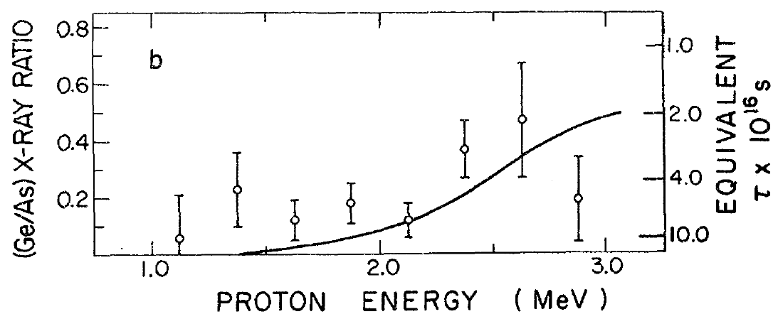
Particle X-ray Coincidence Technique (PXCT)
Following EC decay to proton unbound states, the timescales for X-ray emission and proton emission are similar (range of 0.1 to 1.0 fs)
PXCT measures X-ray spectrum in coincidence with protons to determine statistical distribution of resonance lifetimes
J. C. Hardy et al., Phys. Rev. Lett. 37, 133 (1976)
Figure credit: Lijie Sun

Slide 3
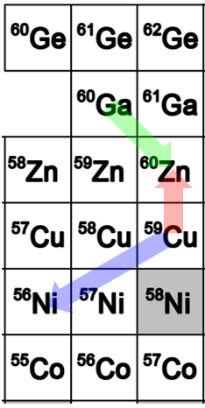
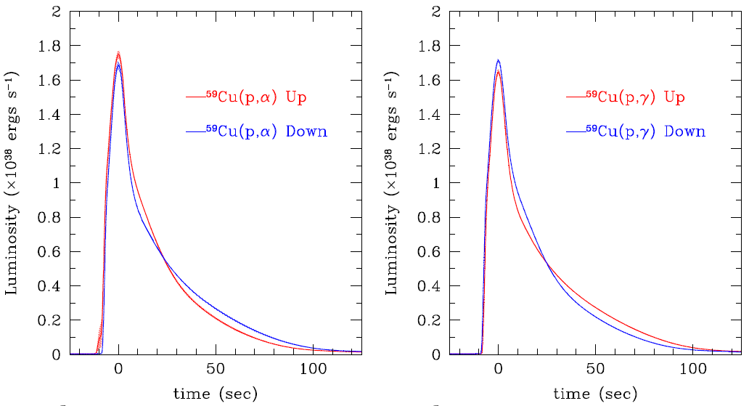
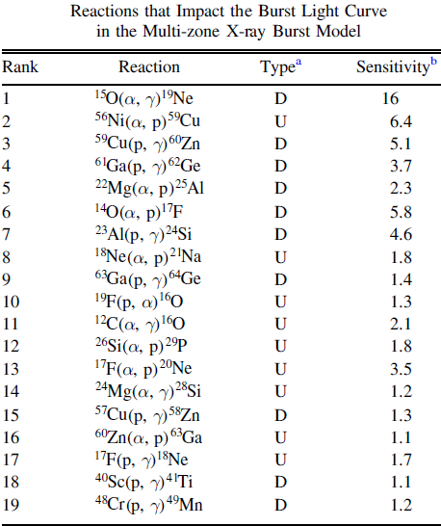
Idea to extend PXCT method at FRIB Example: NiCu cycle in X-ray bursts
Figure credit: Lijie Sun
We plan to use PXCT to measure the lifetimes τ of isolated resonances
Simultaneously, we plan to measure the branching ratios for proton, α, and γ-ray emission: Γ_{p}/Γ, Γ_{α}/Γ, and Γ_{γ}/Γ
Thus, we can measure resonance strengths in the ⁵⁹Cu(p,γ)⁶⁰Zn and ⁵⁹Cu(p,α)⁵⁶Ni reactions using the EC decay of ⁶⁰Ga to ⁶⁰Zn
R. Cyburt et al., Astrophys. J. 830, 55 (2016)

Slide 4
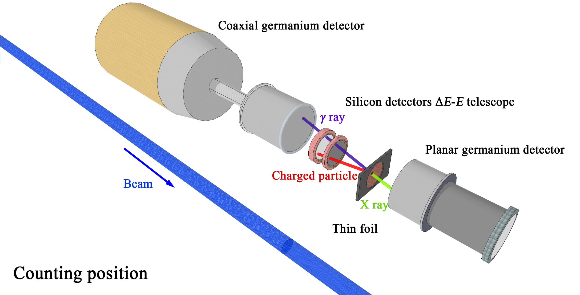
(Minimal) PXCT concept for FRIB
We have discussed using SeGA or DEGA instead of a single Ge detector for γ-ray detection
Figure credit: Lijie Sun

Slide 5
PXCT timeline
2019 NSF proposal for PXCT accepted
2021 Design of PXCT setup complete
2022 Construction of PXCT setup complete & FRIB operational
2022 Commissioning the PXCT setup with a stopped beam of ⁷³Kr
2024 FRIB at full power delivers ⁶⁰Ga at an intensity of 1.2×10⁵ pps
2024 Achieve similar statistics for ⁶⁰Ga decay as previous PXCT measurements
PXCT Collaboration:
Tamas Budner, Moshe Friedman, Lijie Sun, Jason Surbrook, Tyler Wheeler, Chris Wrede, … , FDS Collaboration?, …
Contact: Chris Wrede, wrede@nscl.msu.edu

