Slide 1
PXCT Ge Detector Timing Test (⁶⁰Co)
20240427

Slide 2
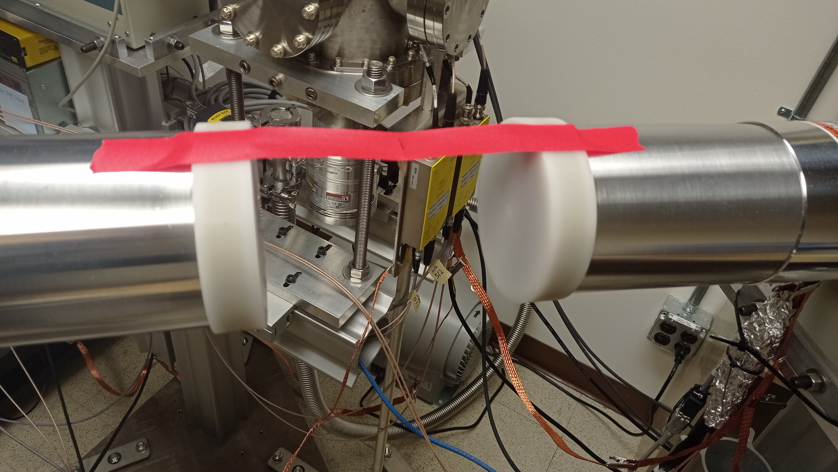
⁶⁰Co
South Ge
⁶⁰Co
South Ge
North Ge
North Ge
Before 4/21/2024 (Run235), 60Co source I7281 was placed at the edge of the chamber.
After 4/22/2024 (Run236), 60Co source I7281 was placed in the middle of the two Ge facing each other. Source-to-window distance: 8 cm.

Slide 3
Optimized DDAS parameters for ⁶⁰Co γ rays at 1173 keV and 1332 keV:
Trigger Rise 0.064 μs
Trigger Gap 0.952 μs
0.016 μs ≤ Trigger Rise ≤ 1.000 μs; 0.000 μs ≤ Trigger Gap ≤ 1.000 μs
0.016 μs ≤ Trigger Rise + Trigger Gap ≤ 1.016 μs
Shorter Rise picks up noise more severely and doesn't improve timing resolution.
Longer Rise makes timing resolution worse.
Trigger Threshold 300 (North), 700 (South)
Trigger Threshold ≤ 4096 ADC channel when Trigger Rise = 0.064 μs
Trigger Threshold just above noise yields the best timing resolution.
Increasing the Trigger Threshold results in a worse timing resolution.
CFD Delay 0.120 μs
CFD Scale 7
0.008 μs ≤ CFD Delay ≤ 0.504 μs; 0 ≤ CFD Scale ≤ 7
Longer CFD Delay makes timing resolution worse; shorter CFD Delay improves timing resolution but fails to correct some low-energy events.
Reducing the CFD Scale either makes timing resolution worse or has no effect.

Slide 4
Best timing resolution for ⁶⁰Co γ rays at 1173 keV and 1332 keV:
LED Timing:
North – South FWHM = 53 ns.
Single Ge FWHM = 37 ns.
CFD Timing:
North – South FWHM = 24 ns.
Single Ge FWHM = 17 ns.
North – LEGe FWHM = 54 ns.
Single LEGe FWHM = sqrt(54^2-17^2) = 51 ns.

Slide 5
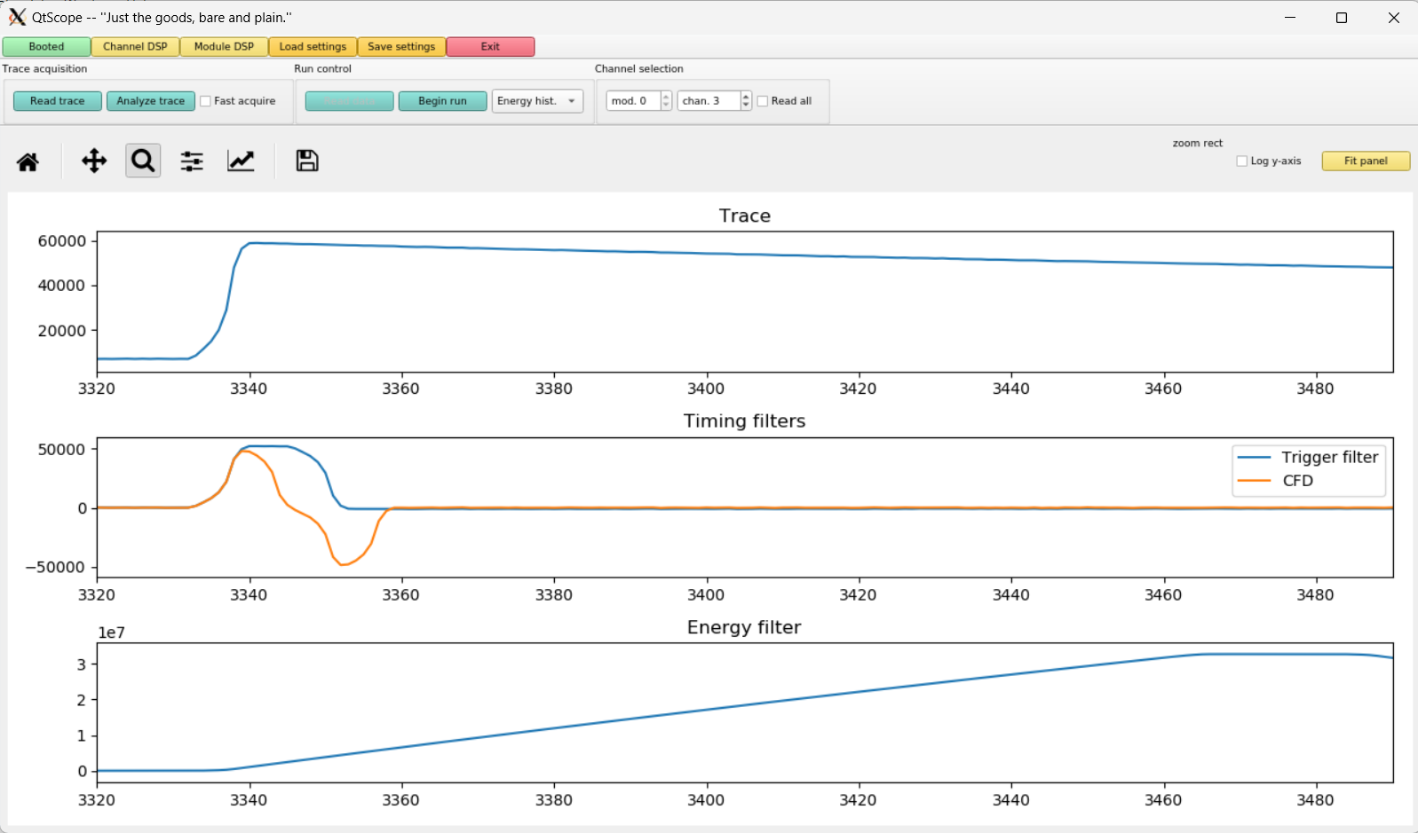
North Ge
80 ns time bin
Trigger Rise 0.016 μs
Trigger Gap 1.000 μs
CFD Delay 0.504 μs
13.6 μs
DDAS allowed inputs:
0.016 μs ≤ Trigger Rise ≤ 1.000 μs; 0.000 μs ≤ Trigger Gap ≤ 1.000 μs
0.016 μs ≤ Trigger Rise + Trigger Gap ≤ 1.016 μs
0.008 μs ≤ CFD Delay ≤ 0.504 μs

Slide 6
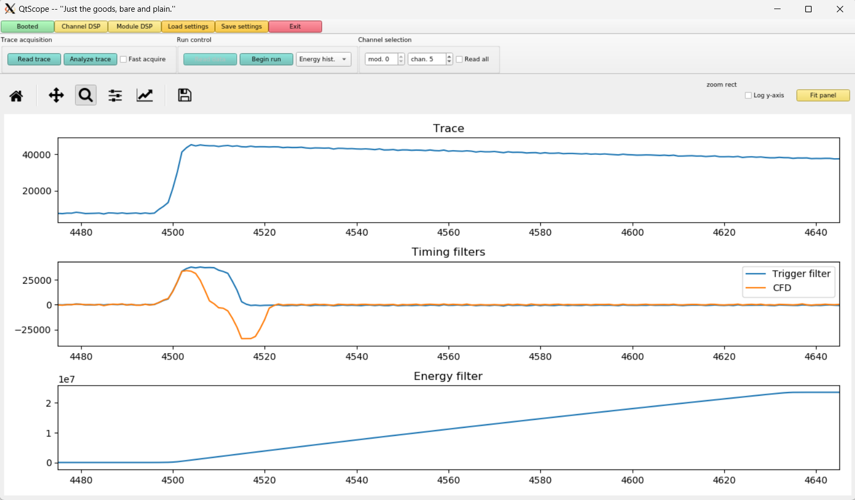
South Ge
80 ns time bin
Trigger Rise 0.016 μs
Trigger Gap 1.000 μs
CFD Delay 0.504 μs
13.6 μs
DDAS allowed inputs:
0.016 μs ≤ Trigger Rise ≤ 1.000 μs; 0.000 μs ≤ Trigger Gap ≤ 1.000 μs
0.016 μs ≤ Trigger Rise + Trigger Gap ≤ 1.016 μs
0.008 μs ≤ CFD Delay ≤ 0.504 μs; 0 ≤ CFD Scale ≤ 7

Slide 7
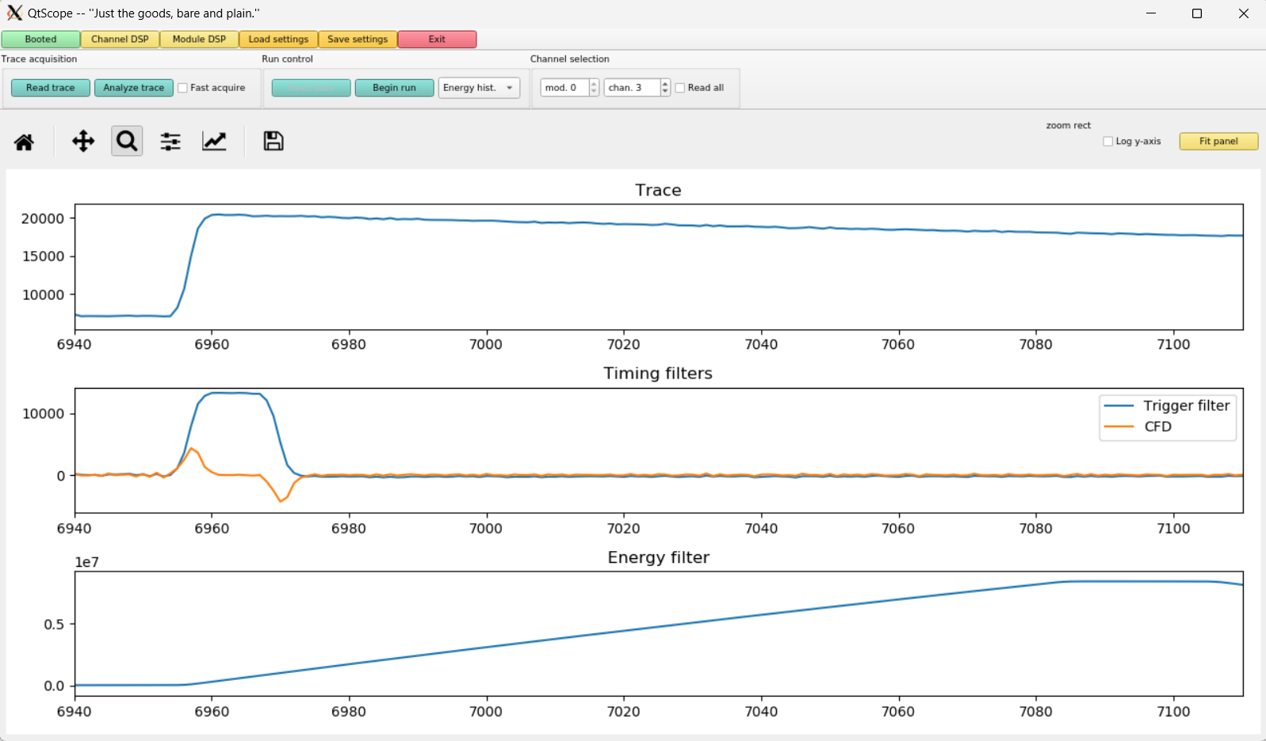
Trigger Rise 0.016 μs
Trigger Gap 1.000 μs
CFD Delay 0.008 μs
DDAS allowed inputs:
0.016 μs ≤ Trigger Rise ≤ 1.000 μs; 0.000 μs ≤ Trigger Gap ≤ 1.000 μs
0.016 μs ≤ Trigger Rise + Trigger Gap ≤ 1.016 μs
0.008 μs ≤ CFD Delay ≤ 0.504 μs

Slide 8
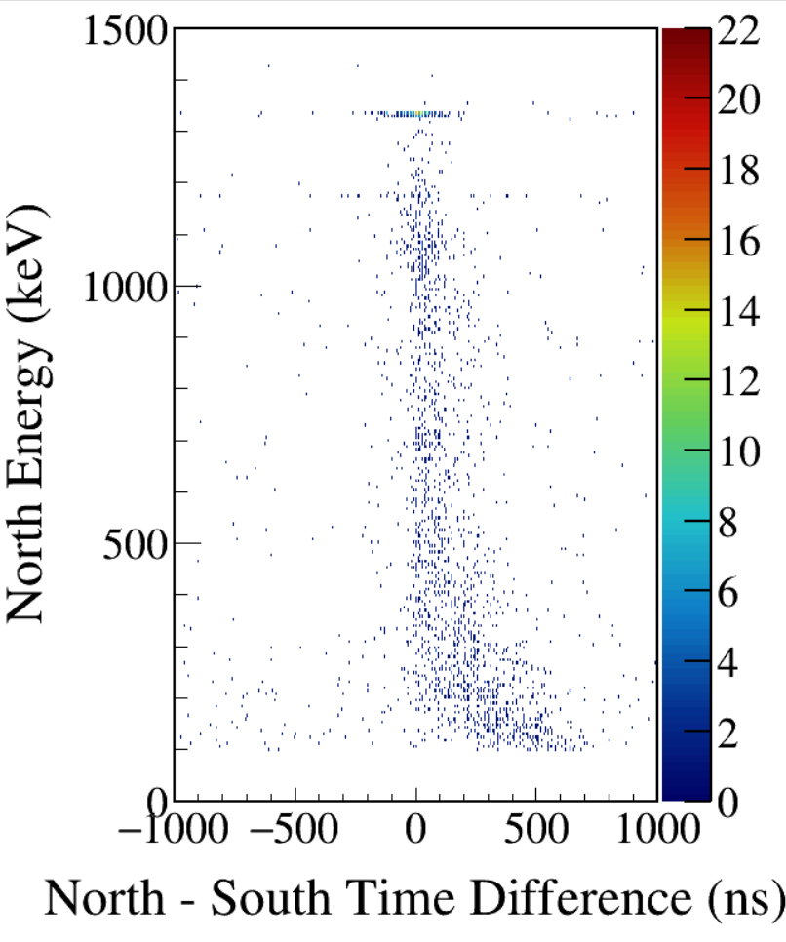
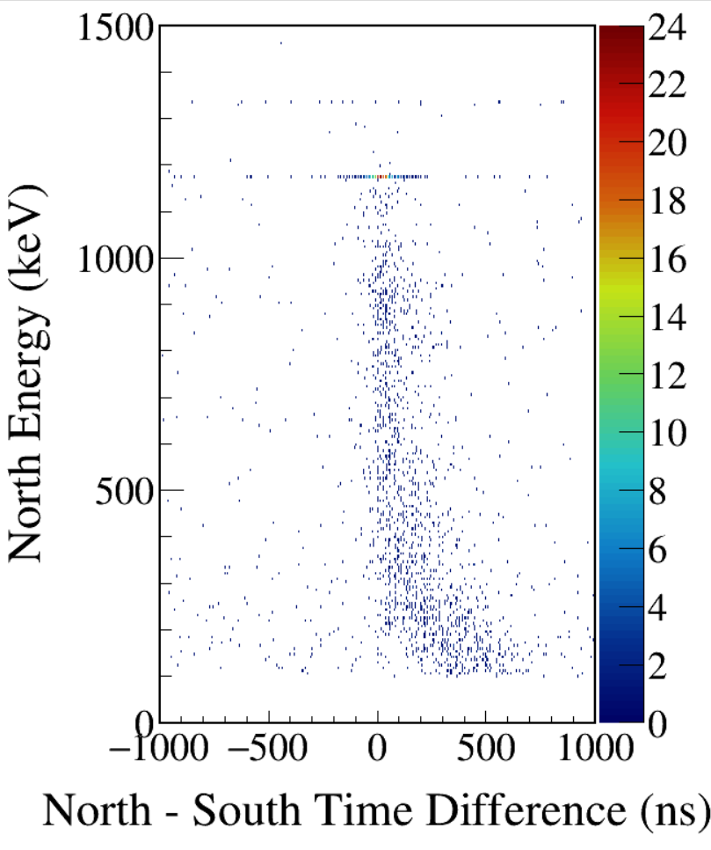
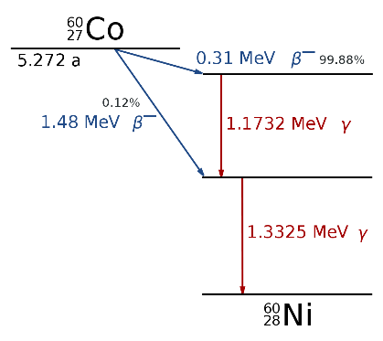
South 1173-gated
South 1332-gated
CFD disabled
Notes:
TFile *_file0 = TFile::Open("F:/e21010/pxct/run0234_LEGe_XtRa_60Co_I7281_onChamberWall_window1us_TrigRise0.016us_TrigGap1.000us_CFDdisabled_cal.root");

Slide 9
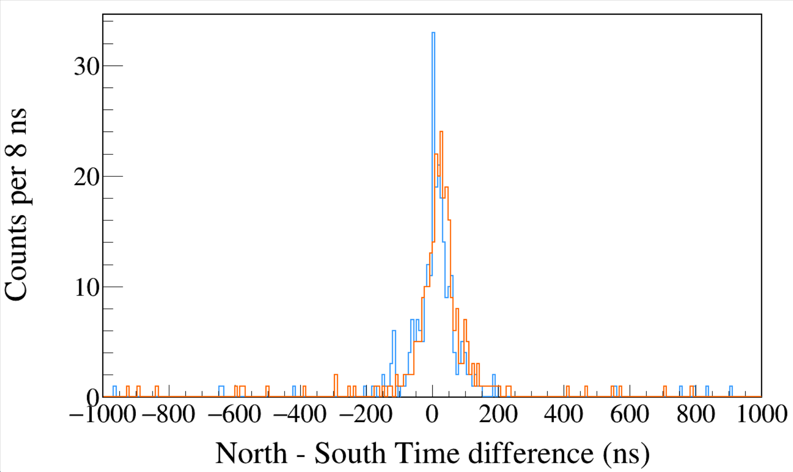
Run0234
60Co
Trigger Rise 0.016 μs
Trigger Gap 1.000 μs
CFD disabled
South 1173 && North 1332
South 1332 && North 1173
Notes:
TFile *_file0 = TFile::Open("F:/e21010/pxct/run0234_LEGe_XtRa_60Co_I7281_onChamberWall_window1us_TrigRise0.016us_TrigGap1.000us_CFDdisabled_cal.root");
TCanvas* canvaspeak = new TCanvas("canvaspeak", "canvaspeak", 1300, 800);//
canvaspeak->cd();//
canvaspeak->SetTopMargin(0.03);
canvaspeak->SetRightMargin(0.04);
canvaspeak->SetLeftMargin(0.13);
canvaspeak->SetBottomMargin(0.16);
canvaspeak->SetFrameLineWidth(2);
TH1D* htimestamps = new TH1D("htimestamps", "htimestamps", 250,-1000,1000);
htimestamps->SetLineWidth(2);
htimestamps->Rebin(1);
htimestamps->SetStats(0);
htimestamps->SetTitle("");
htimestamps->GetXaxis()->SetTitle("North - South Time difference (ns)");
htimestamps->GetYaxis()->SetTitle("Counts per 8 ns");
htimestamps->GetXaxis()->CenterTitle();
htimestamps->GetYaxis()->CenterTitle();
htimestamps->GetXaxis()->SetLabelFont(132);
htimestamps->GetYaxis()->SetLabelFont(132);
htimestamps->GetXaxis()->SetLabelSize(0.06);
htimestamps->GetYaxis()->SetLabelSize(0.06);
htimestamps->GetXaxis()->SetTitleFont(132);
htimestamps->GetYaxis()->SetTitleFont(132);
htimestamps->GetXaxis()->SetTitleOffset(1.1);
htimestamps->GetYaxis()->SetTitleOffset(0.95);
htimestamps->GetXaxis()->SetTitleSize(0.07);
htimestamps->GetYaxis()->SetTitleSize(0.07);
htimestamps->GetXaxis()->SetRangeUser(-1000,1000);
//htimestamps->GetYaxis()->SetRangeUser(0,1700);
htimestamps->GetYaxis()->SetNdivisions(505);
htimestamps->SetLineWidth(2);
htimestamps->SetLineColor(kAzure+1);
tree->Draw("north_t-south_t>>htimestamps","south_e>1170&&south_e<1176&&north_e>1330&&north_e<1336");
tree->SetLineColor(kOrange+7);
tree->SetLineWidth(2);
tree->Draw("north_t-south_t","north_e>1170&&north_e<1176&&south_e>1330&&south_e<1336","same");

Slide 10
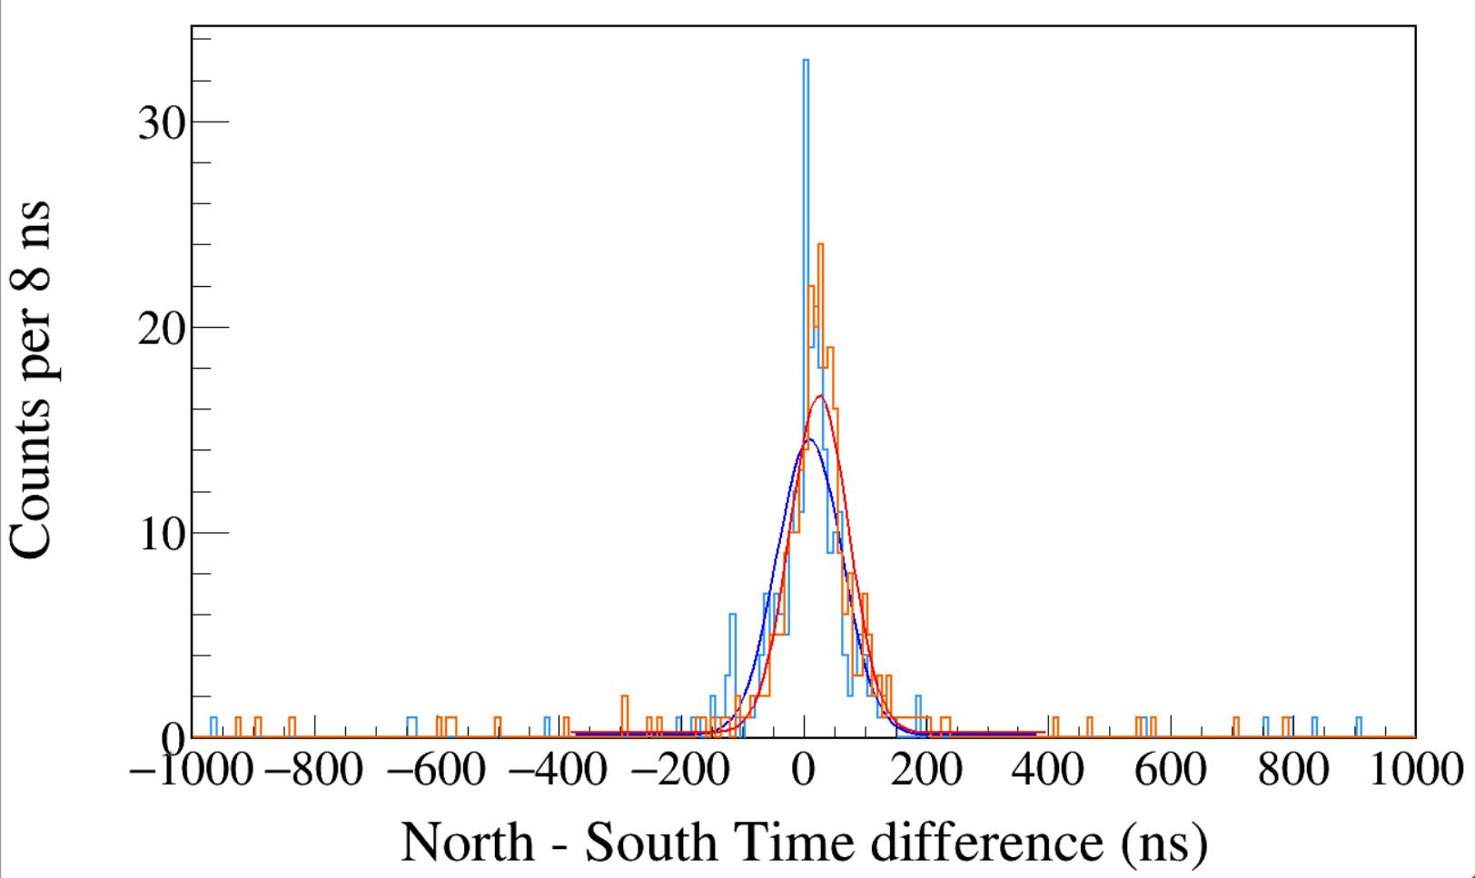
Run0234
60Co
Trigger Rise 0.016 μs
Trigger Gap 1.000 μs
CFD disabled
South 1173 && North 1332
South 1332 && North 1173
Gaus+Pol0
Maximum Likelihood fit
σ = 53.5±4.1 ns
σ = 48.0±3.4 ns
Notes:
1 p0 1.64270e+01 1.41900e+00 6.20346e-05 1.56447e-05
2 p1 2.50753e+01 3.32565e+00 4.67799e-04 5.07087e-06
3 p2 4.80429e+01 3.40137e+00 2.53603e-04 -6.55361e-04
4 p3 2.42054e-01 7.48229e-02 2.66104e-04 -1.07011e-04
1 p0 1.44347e+01 1.28491e+00 9.38742e-04 9.75539e-05
2 p1 9.05892e+00 3.74533e+00 3.67425e-03 1.30510e-06
3 p2 5.35094e+01 4.13808e+00 2.44989e-03 9.89734e-06
4 p3 1.26209e-01 7.07167e-02 5.31291e-05 1.74313e-03

Slide 11
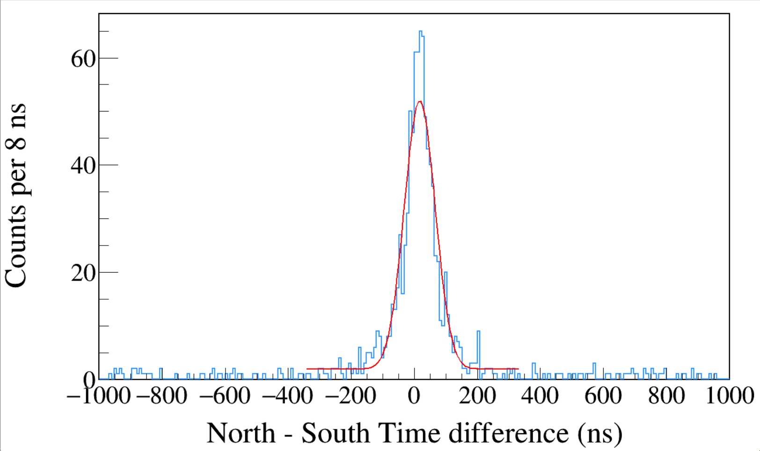
Run0234
60Co
TriggerRise 0.016 μs
TriggerGap 1.000 μs
CFD disabled
1100 < South < 1400
&&
1100 < North < 1400
σ = 48.9±2.2 ns
FWHM = 115 ns
south_e>1100&&south_e<1400&&north_e>1100&&north_e<1400
Notes:
1 p0 5.00736e+01 2.50190e+00 1.07834e-06 -6.15443e-03
2 p1 1.69694e+01 2.03526e+00 4.92766e-05 1.82634e-04
3 p2 4.88717e+01 2.18911e+00 7.07957e-06 2.65064e-05
4 p3 1.92034e+00 2.27605e-01 4.57769e-05 -3.80445e-04

Slide 12
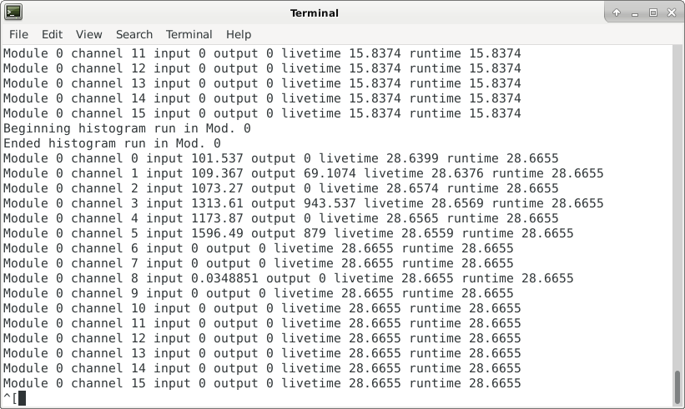

Slide 13
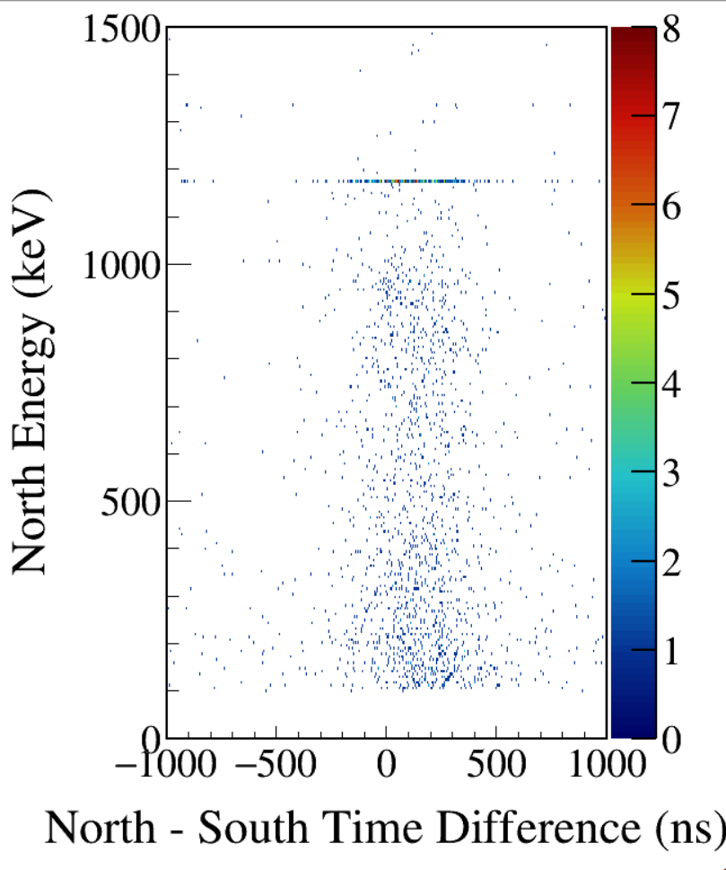
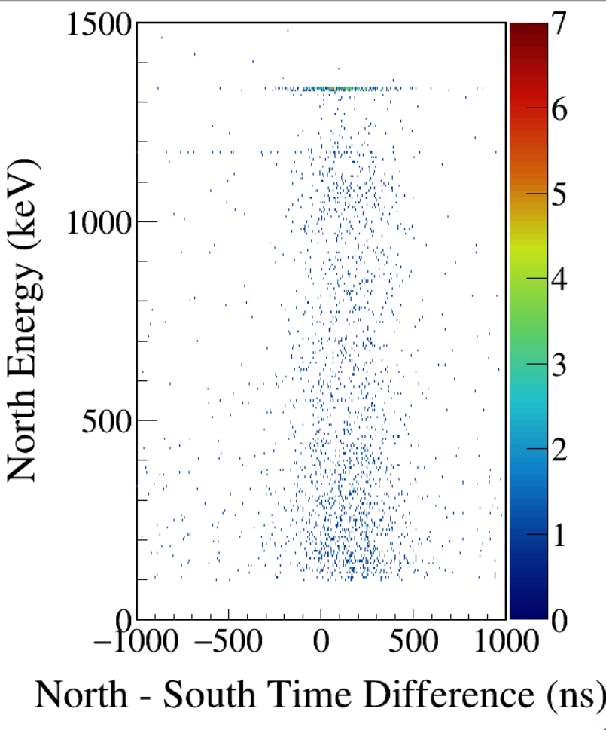
South 1173-gated
South 1332-gated
CFD enabled
Notes:
TFile *_file0 = TFile::Open("F:/e21010/pxct/run0235_LEGe_XtRa_60Co_I7281_onChamberWall_window1us_TrigRise0.016us_TrigGap1.000us_CFDdelay0.504us_cal.root");

Slide 14
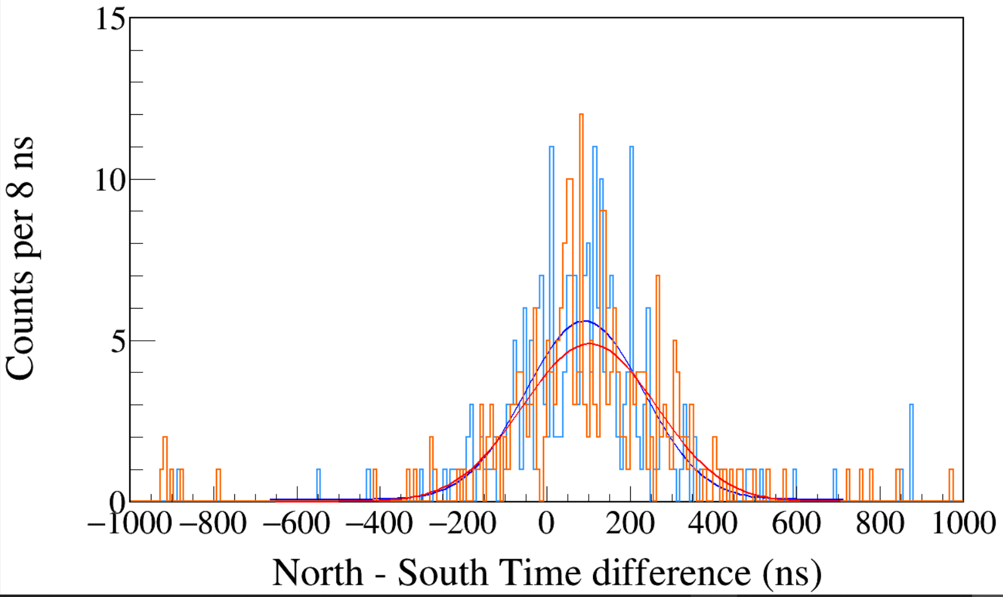
Run0235
60Co
Trigger Rise 0.016 μs
Trigger Gap 1.000 μs
CFD enabled
CFD Delay 0.504 μs
South 1173 && North 1332
South 1332 && North 1173
Gaus+Pol0
Maximum Likelihood fit
σ = 141.5±7.6 ns
σ = 160.4±7.4 ns
Notes:
TFile *_file0 = TFile::Open("F:/e21010/pxct/run0235_LEGe_XtRa_60Co_I7281_onChamberWall_window1us_TrigRise0.016us_TrigGap1.000us_CFDdelay0.504us_cal.root");
TCanvas* canvaspeak = new TCanvas("canvaspeak", "canvaspeak", 1300, 800);//
canvaspeak->cd();//
canvaspeak->SetTopMargin(0.03);
canvaspeak->SetRightMargin(0.04);
canvaspeak->SetLeftMargin(0.13);
canvaspeak->SetBottomMargin(0.16);
canvaspeak->SetFrameLineWidth(2);
TH1D* htimestamps = new TH1D("htimestamps", "htimestamps", 250,-1000,1000);
htimestamps->SetLineWidth(2);
htimestamps->Rebin(1);
htimestamps->SetStats(0);
htimestamps->SetTitle("");
htimestamps->GetXaxis()->SetTitle("North - South Time difference (ns)");
htimestamps->GetYaxis()->SetTitle("Counts per 8 ns");
htimestamps->GetXaxis()->CenterTitle();
htimestamps->GetYaxis()->CenterTitle();
htimestamps->GetXaxis()->SetLabelFont(132);
htimestamps->GetYaxis()->SetLabelFont(132);
htimestamps->GetXaxis()->SetLabelSize(0.06);
htimestamps->GetYaxis()->SetLabelSize(0.06);
htimestamps->GetXaxis()->SetTitleFont(132);
htimestamps->GetYaxis()->SetTitleFont(132);
htimestamps->GetXaxis()->SetTitleOffset(1.1);
htimestamps->GetYaxis()->SetTitleOffset(0.95);
htimestamps->GetXaxis()->SetTitleSize(0.07);
htimestamps->GetYaxis()->SetTitleSize(0.07);
htimestamps->GetXaxis()->SetRangeUser(-1000,1000);
//htimestamps->GetYaxis()->SetRangeUser(0,1700);
htimestamps->GetYaxis()->SetNdivisions(505);
htimestamps->SetLineWidth(2);
htimestamps->SetLineColor(kAzure+1);
tree->Draw("north_t-south_t>>htimestamps","south_e>1170&&south_e<1176&&north_e>1330&&north_e<1336");
tree->SetLineColor(kOrange+7);
tree->SetLineWidth(2);
tree->Draw("north_t-south_t","north_e>1170&&north_e<1176&&south_e>1330&&south_e<1336","same");

Slide 15
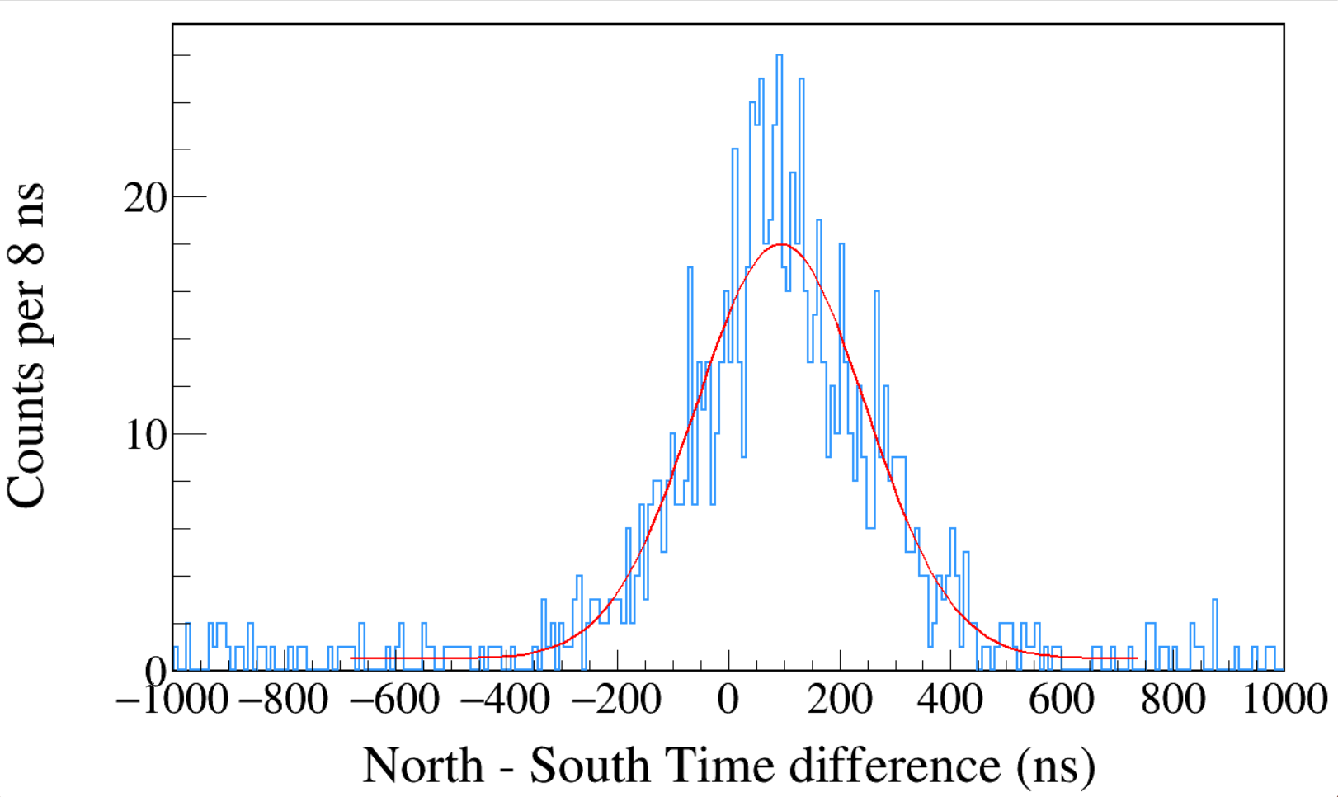
Run0235
60Co
Trigger Rise 0.016 μs
Trigger Gap 1.000 μs
CFD enabled
CFD Delay 0.504 μs
1100 < South < 1400
&&
1100 < North < 1400
σ = 153.3±5.2 ns
FWHM = 361 ns
Notes:
TFile *_file0 = TFile::Open("F:/e21010/pxct/run0235_LEGe_XtRa_60Co_I7281_onChamberWall_window1us_TrigRise0.016us_TrigGap1.000us_CFDdelay0.504us_cal.root");
TCanvas* canvaspeak = new TCanvas("canvaspeak", "canvaspeak", 1300, 800);//
canvaspeak->cd();//
canvaspeak->SetTopMargin(0.03);
canvaspeak->SetRightMargin(0.04);
canvaspeak->SetLeftMargin(0.13);
canvaspeak->SetBottomMargin(0.16);
canvaspeak->SetFrameLineWidth(2);
TH1D* htimestamps = new TH1D("htimestamps", "htimestamps", 250,-1000,1000);
htimestamps->SetLineWidth(2);
htimestamps->Rebin(1);
htimestamps->SetStats(0);
htimestamps->SetTitle("");
htimestamps->GetXaxis()->SetTitle("North - South Time difference (ns)");
htimestamps->GetYaxis()->SetTitle("Counts per 8 ns");
htimestamps->GetXaxis()->CenterTitle();
htimestamps->GetYaxis()->CenterTitle();
htimestamps->GetXaxis()->SetLabelFont(132);
htimestamps->GetYaxis()->SetLabelFont(132);
htimestamps->GetXaxis()->SetLabelSize(0.06);
htimestamps->GetYaxis()->SetLabelSize(0.06);
htimestamps->GetXaxis()->SetTitleFont(132);
htimestamps->GetYaxis()->SetTitleFont(132);
htimestamps->GetXaxis()->SetTitleOffset(1.1);
htimestamps->GetYaxis()->SetTitleOffset(0.95);
htimestamps->GetXaxis()->SetTitleSize(0.07);
htimestamps->GetYaxis()->SetTitleSize(0.07);
htimestamps->GetXaxis()->SetRangeUser(-1000,1000);
//htimestamps->GetYaxis()->SetRangeUser(0,1700);
htimestamps->GetYaxis()->SetNdivisions(505);
htimestamps->SetLineWidth(2);
htimestamps->SetLineColor(kAzure+1);
tree->Draw("north_t-south_t>>htimestamps","south_e>1100&&south_e<1400&&north_e>1100&&north_e<1400");

Slide 16
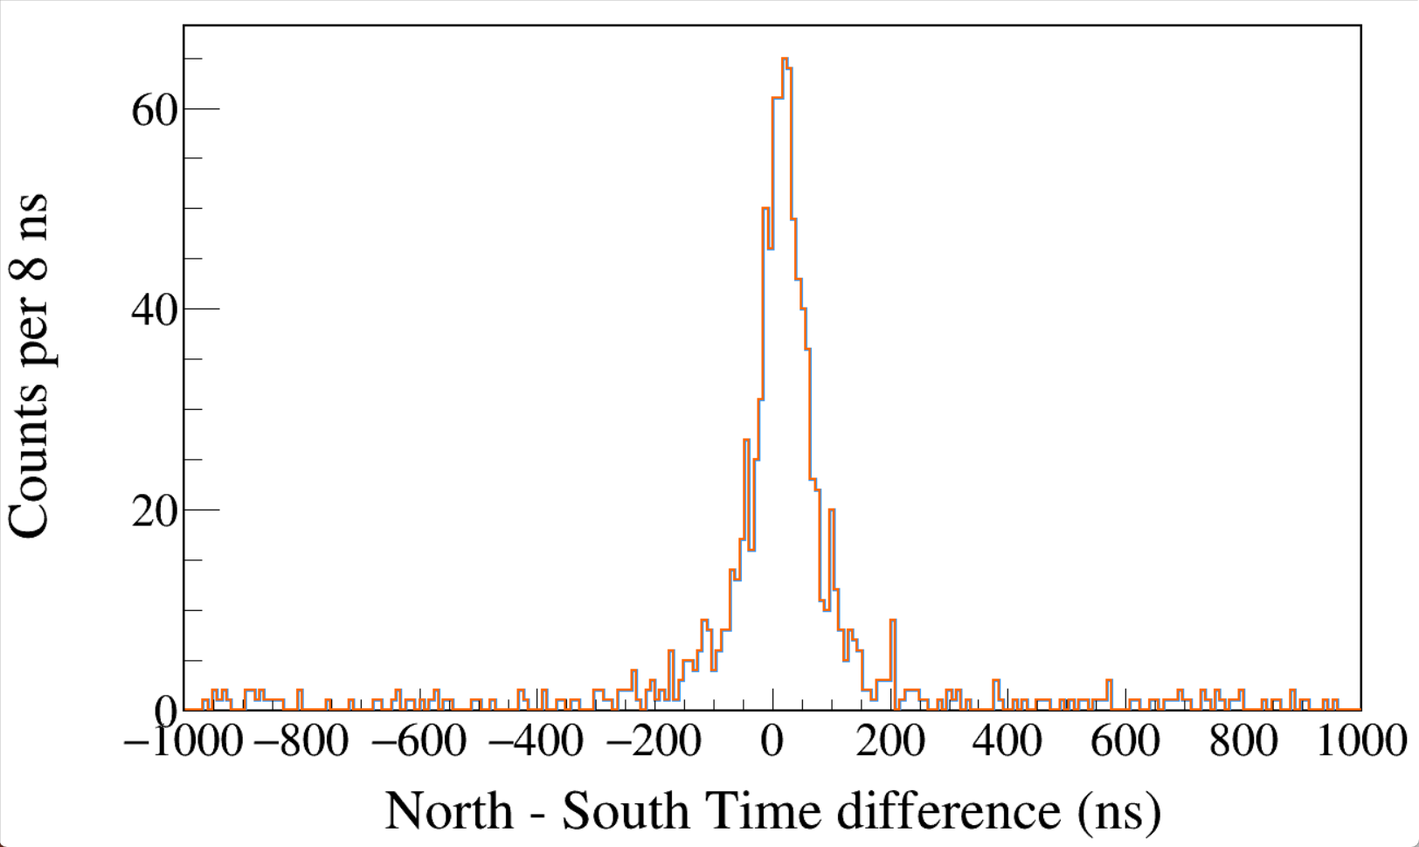
Run0234
60Co
Trigger Rise 0.016 μs
Trigger Gap 1.000 μs
CFD disabled
1100 < South < 1400
&&
1100 < North < 1400
CFD
LED
Notes:
TFile *_file0 = TFile::Open("F:/e21010/pxct/run0234_LEGe_XtRa_60Co_I7281_onChamberWall_window1us_TrigRise0.016us_TrigGap1.000us_CFDdisabled_cal.root");
TCanvas* canvaspeak = new TCanvas("canvaspeak", "canvaspeak", 1300, 800);//
canvaspeak->cd();//
canvaspeak->SetTopMargin(0.03);
canvaspeak->SetRightMargin(0.04);
canvaspeak->SetLeftMargin(0.13);
canvaspeak->SetBottomMargin(0.16);
canvaspeak->SetFrameLineWidth(2);
TH1D* htimestamps = new TH1D("htimestamps", "htimestamps", 250,-1000,1000);
htimestamps->Rebin(1);
htimestamps->SetStats(0);
htimestamps->SetTitle("");
htimestamps->GetXaxis()->SetTitle("North - South Time difference (ns)");
htimestamps->GetYaxis()->SetTitle("Counts per 8 ns");
htimestamps->GetXaxis()->CenterTitle();
htimestamps->GetYaxis()->CenterTitle();
htimestamps->GetXaxis()->SetLabelFont(132);
htimestamps->GetYaxis()->SetLabelFont(132);
htimestamps->GetXaxis()->SetLabelSize(0.06);
htimestamps->GetYaxis()->SetLabelSize(0.06);
htimestamps->GetXaxis()->SetTitleFont(132);
htimestamps->GetYaxis()->SetTitleFont(132);
htimestamps->GetXaxis()->SetTitleOffset(1.1);
htimestamps->GetYaxis()->SetTitleOffset(0.95);
htimestamps->GetXaxis()->SetTitleSize(0.07);
htimestamps->GetYaxis()->SetTitleSize(0.07);
htimestamps->GetXaxis()->SetRangeUser(-1000,1000);
//htimestamps->GetYaxis()->SetRangeUser(0,1700);
htimestamps->GetYaxis()->SetNdivisions(505);
htimestamps->SetLineWidth(3);
htimestamps->SetLineColor(kAzure+1);
tree->Draw("north_t-south_t>>htimestamps","south_e>1100&&south_e<1400&&north_e>1100&&north_e<1400");
tree->SetLineColor(kOrange+7);
tree->SetLineWidth(2);
tree->Draw("north_tled-south_tled","south_e>1100&&south_e<1400&&north_e>1100&&north_e<1400","same");

Slide 17
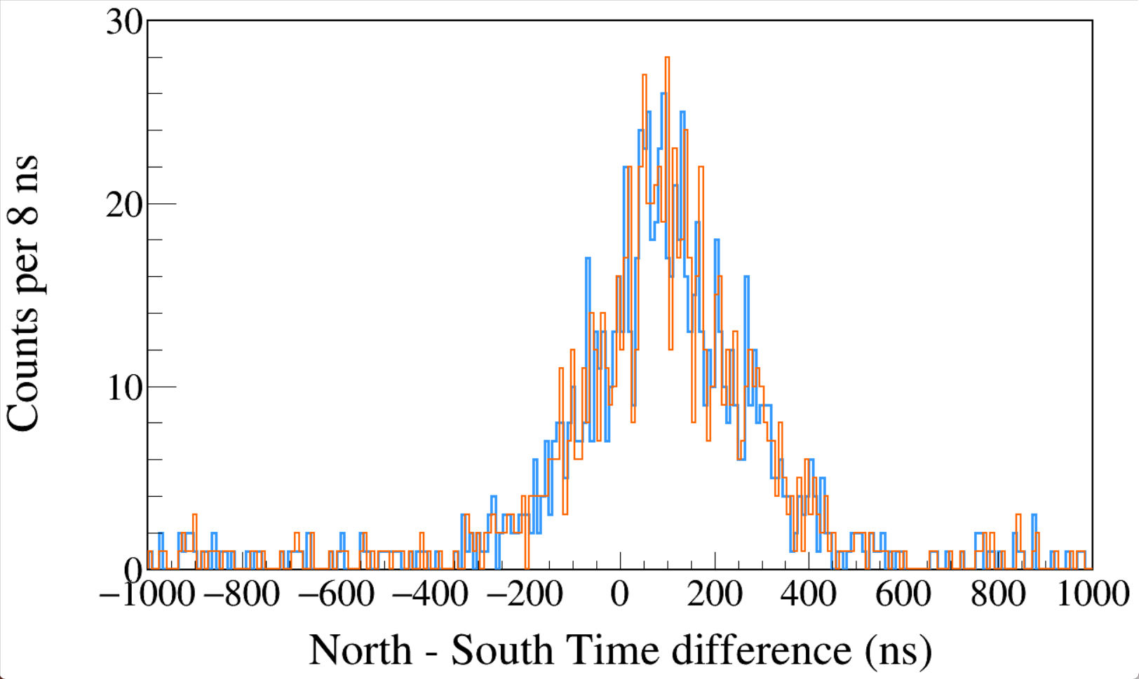
Run0235
60Co
Trigger Rise 0.016 μs
Trigger Gap 1.000 μs
CFD enabled
CFD Delay 0.504 μs
1100 < South < 1400
&&
1100 < North < 1400
CFD
LED
Notes:
TFile *_file0 = TFile::Open("F:/e21010/pxct/run0235_LEGe_XtRa_60Co_I7281_onChamberWall_window1us_TrigRise0.016us_TrigGap1.000us_CFDdelay0.504us_cal.root");
TCanvas* canvaspeak = new TCanvas("canvaspeak", "canvaspeak", 1300, 800);//
canvaspeak->cd();//
canvaspeak->SetTopMargin(0.03);
canvaspeak->SetRightMargin(0.04);
canvaspeak->SetLeftMargin(0.13);
canvaspeak->SetBottomMargin(0.16);
canvaspeak->SetFrameLineWidth(2);
TH1D* htimestamps = new TH1D("htimestamps", "htimestamps", 250,-1000,1000);
htimestamps->Rebin(1);
htimestamps->SetStats(0);
htimestamps->SetTitle("");
htimestamps->GetXaxis()->SetTitle("North - South Time difference (ns)");
htimestamps->GetYaxis()->SetTitle("Counts per 8 ns");
htimestamps->GetXaxis()->CenterTitle();
htimestamps->GetYaxis()->CenterTitle();
htimestamps->GetXaxis()->SetLabelFont(132);
htimestamps->GetYaxis()->SetLabelFont(132);
htimestamps->GetXaxis()->SetLabelSize(0.06);
htimestamps->GetYaxis()->SetLabelSize(0.06);
htimestamps->GetXaxis()->SetTitleFont(132);
htimestamps->GetYaxis()->SetTitleFont(132);
htimestamps->GetXaxis()->SetTitleOffset(1.1);
htimestamps->GetYaxis()->SetTitleOffset(0.95);
htimestamps->GetXaxis()->SetTitleSize(0.07);
htimestamps->GetYaxis()->SetTitleSize(0.07);
htimestamps->GetXaxis()->SetRangeUser(-1000,1000);
//htimestamps->GetYaxis()->SetRangeUser(0,1700);
htimestamps->GetYaxis()->SetNdivisions(505);
htimestamps->SetLineWidth(3);
htimestamps->SetLineColor(kAzure+1);
tree->Draw("north_t-south_t>>htimestamps","south_e>1100&&south_e<1400&&north_e>1100&&north_e<1400");
tree->SetLineColor(kOrange+7);
tree->SetLineWidth(2);
tree->Draw("north_tled-south_tled","south_e>1100&&south_e<1400&&north_e>1100&&north_e<1400","same");

Slide 18
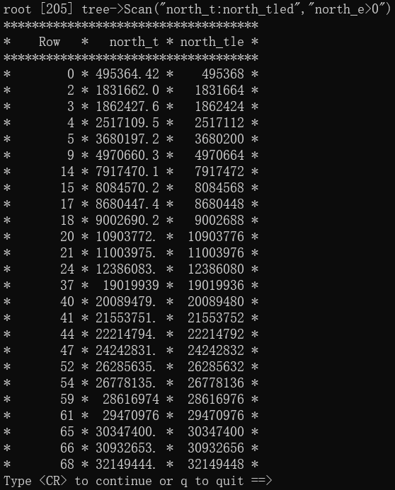
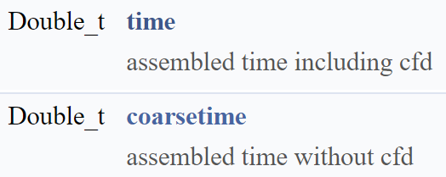
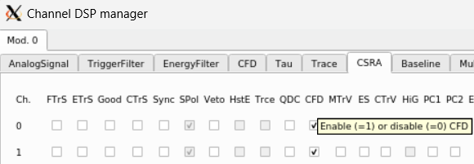
The time-stamp obtained from leading-edge triggering has a precision of 8 ns. However, in addition to the leading-edge triggering, the modules also employ a digital CFD algorithm that operates on the response of the trigger filter. The CFD algorithm provides timing measurements below the native sampling time of the module based on the zero-crossing time determined by linear interpolation between two points of the CFD algorithm.

Slide 19
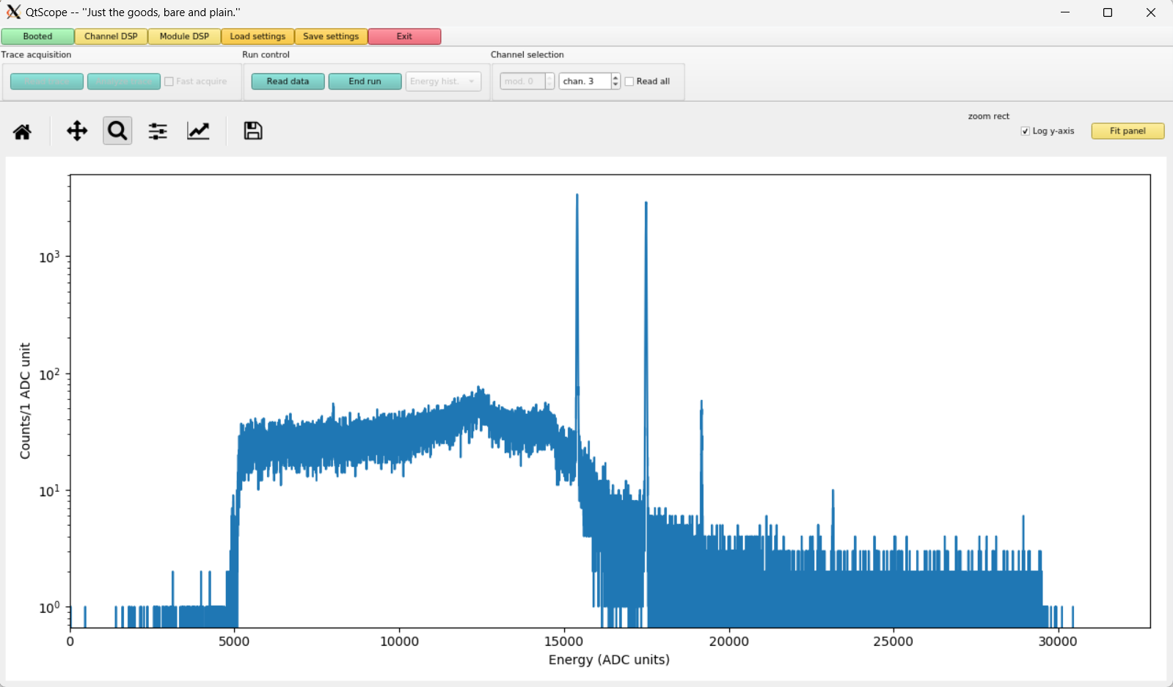
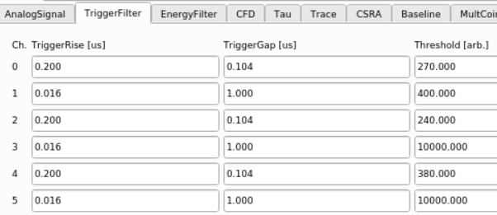
Trigger
Threshold
10,000
Channel numbers are halved in QtScope.
Module 0 channel 3 input 1553.94 output 1433.8 livetime 452.783 runtime 452.942
Module 0 channel 5 input 1647.95 output 1409.68 livetime 452.766 runtime 452.942

Slide 20
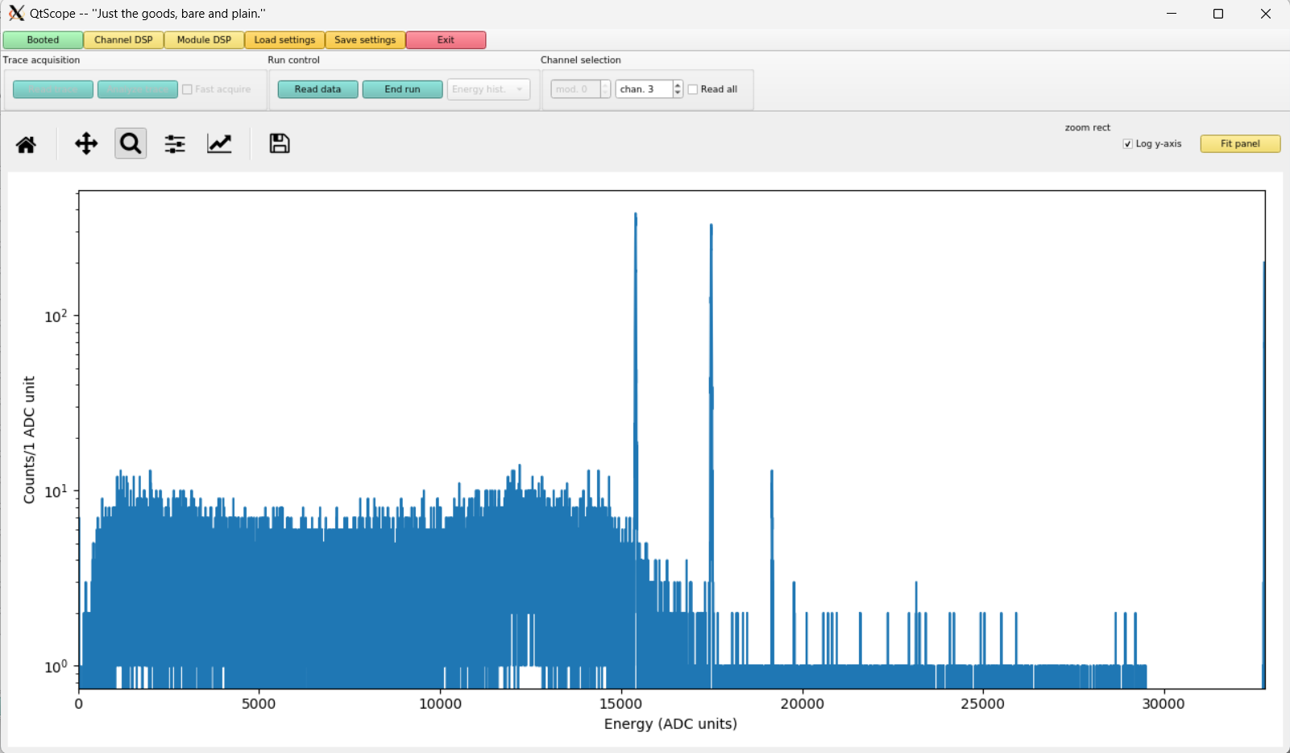
If the Trigger Threshold is too low, there will be many counts in the lowest and highest bins.
Module 0 channel 3 input 3099.45 output 1840.24 livetime 82.3595 runtime 82.3912
Module 0 channel 5 input 3133.24 output 1695.05 livetime 82.3627 runtime 82.3912

Slide 21
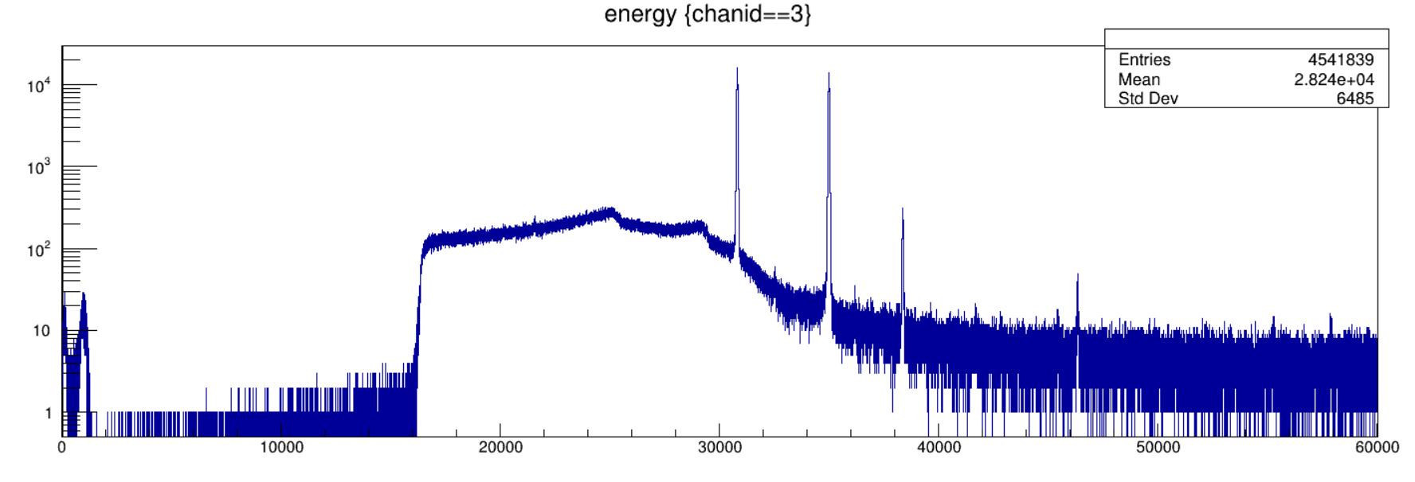
Trigger filter
Threshold
16384
610 keV
The range of allowed Trigger Threshold is related to Trigger Rise.
Trigger Rise = 0.016 μs; Trigger Threshold ≤ 16384
Trigger Rise = 0.048 μs; Trigger Threshold ≤ 5461
Trigger Rise = 0.064 μs; Trigger Threshold ≤ 4096
Trigger Rise = 0.104 μs; Trigger Threshold ≤ 2520
First, test how the threshold affects the timing resolution.

Slide 22
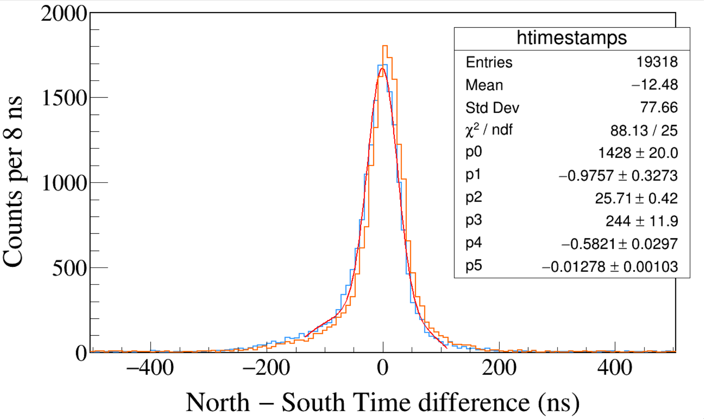
Run0256
60Co
Leading Edge Discrimination
Trigger Rise 0.016 μs
Trigger Gap 1.000 μs
Trigger Threshold 550, 1500
South 1173 && North 1332
South 1332 && North 1173
σT = 26 ns. σT is parameter p2 on all slides.
3-hour long run. The runs after this are mostly 1-hour run.
Notes:
TFile *_file0 = TFile::Open("F:/e21010/pxct/run0256_LEGe_XtRa_60Co_I7281_MiddleXtRa_window1us_TrigRise0.016us_TrigGap1.000us_ThN550_ThS1500_LED_cal.root");
TCanvas* canvaspeak = new TCanvas("canvaspeak", "canvaspeak", 1300, 800);//
canvaspeak->cd();//
canvaspeak->SetTopMargin(0.03);
canvaspeak->SetRightMargin(0.04);
canvaspeak->SetLeftMargin(0.13);
canvaspeak->SetBottomMargin(0.16);
canvaspeak->SetFrameLineWidth(2);
TH1D* htimestamps = new TH1D("htimestamps", "htimestamps", 250,-1000,1000);
htimestamps->SetLineWidth(2);
htimestamps->Rebin(1);
//htimestamps->SetStats(0);
htimestamps->SetTitle("");
htimestamps->GetXaxis()->SetTitle("North #minus South Time difference (ns)");
htimestamps->GetYaxis()->SetTitle("Counts per 8 ns");
htimestamps->GetXaxis()->CenterTitle();
htimestamps->GetYaxis()->CenterTitle();
htimestamps->GetXaxis()->SetLabelFont(132);
htimestamps->GetYaxis()->SetLabelFont(132);
htimestamps->GetXaxis()->SetLabelSize(0.06);
htimestamps->GetYaxis()->SetLabelSize(0.06);
htimestamps->GetXaxis()->SetTitleFont(132);
htimestamps->GetYaxis()->SetTitleFont(132);
htimestamps->GetXaxis()->SetTitleOffset(1.1);
htimestamps->GetYaxis()->SetTitleOffset(0.95);
htimestamps->GetXaxis()->SetTitleSize(0.07);
htimestamps->GetYaxis()->SetTitleSize(0.07);
htimestamps->GetXaxis()->SetRangeUser(-500,500);
//htimestamps->GetYaxis()->SetRangeUser(0,1700);
htimestamps->GetYaxis()->SetNdivisions(505);
htimestamps->SetLineWidth(2);
htimestamps->SetLineColor(kAzure+1);
tree->Draw("north_t-south_t>>htimestamps","south_e>1170&&south_e<1176&&north_e>1330&&north_e<1336");
tree->SetLineColor(kOrange+7);
tree->SetLineWidth(2);
tree->Draw("north_t-south_t","north_e>1170&&north_e<1176&&south_e>1330&&south_e<1336","same");

Slide 23
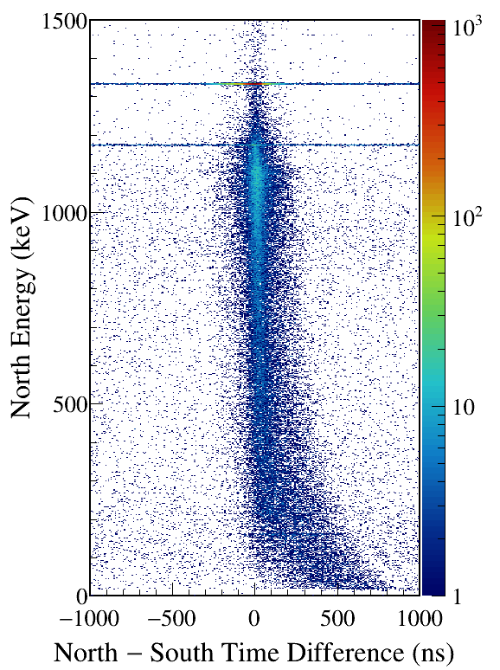
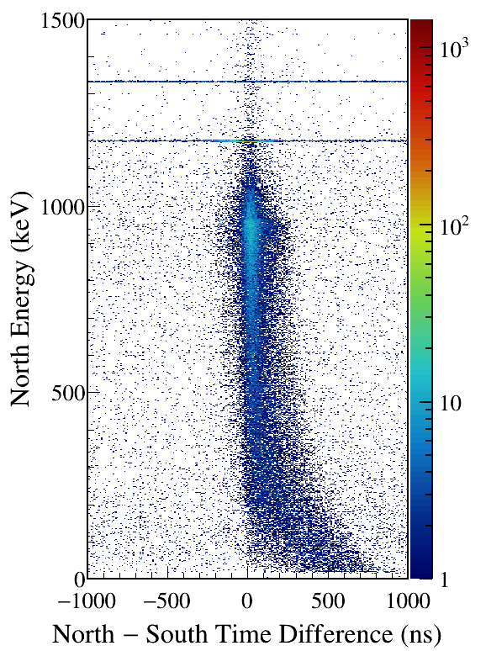
Notes:
TFile *_file0 = TFile::Open("F:/e21010/pxct/run0256_LEGe_XtRa_60Co_I7281_MiddleXtRa_window1us_TrigRise0.016us_TrigGap1.000us_ThN550_ThS1500_LED_cal.root");
TCanvas* canvaspeak = new TCanvas("canvaspeak", "canvaspeak", 580, 800);
canvaspeak->cd();
canvaspeak->SetTopMargin(0.03);
canvaspeak->SetRightMargin(0.16);
canvaspeak->SetLeftMargin(0.18);
canvaspeak->SetBottomMargin(0.11);
canvaspeak->SetFrameLineWidth(2);
canvaspeak->SetLogz();
TH2D* het = new TH2D("het", "het", 250,-1000,1000,750,0,1500); //x,y
//tree->Draw("north_e:north_t-south_t>>het","north_e>1&&north_e<1500&&south_e>1170&&south_e<1176","colz"); //y:x
tree->Draw("north_e:north_t-south_t>>het","north_e>1&&north_e<1500&&south_e>1330&&south_e<1336","colz"); //y:x
het->SetStats(0);
het->SetTitle("");
het->GetXaxis()->SetTitle("North #minus South Time Difference (ns)");
het->GetYaxis()->SetTitle("North Energy (keV)");
het->GetXaxis()->CenterTitle();
het->GetYaxis()->CenterTitle();
het->GetXaxis()->SetLabelFont(132);
het->GetYaxis()->SetLabelFont(132);
het->GetXaxis()->SetLabelSize(0.05);
het->GetYaxis()->SetLabelSize(0.05);
het->GetXaxis()->SetTitleFont(132);
het->GetYaxis()->SetTitleFont(132);
het->GetXaxis()->SetTitleOffset(0.9);
het->GetYaxis()->SetTitleOffset(1.4);
het->GetXaxis()->SetTitleSize(0.06);
het->GetYaxis()->SetTitleSize(0.06);
het->GetXaxis()->SetNdivisions(505);
het->GetYaxis()->SetNdivisions(505);
//het->GetXaxis()->SetRangeUser(2001,4500);
//het->GetYaxis()->SetRangeUser(1000,2800);
//het->SetMinimum(2);
//het->SetMaximum(100);
het->SetContour(99);
gStyle->SetPalette(kRainbow);
//gPad->SetLogz();
TPaletteAxis *palette = (TPaletteAxis*)het->GetListOfFunctions()->FindObject("palette");
palette->SetTitleFont(132);
palette->SetTitleSize(0.05);
palette->SetLabelFont(132);
palette->SetLabelSize(0.05);
palette->SetLineWidth(2);
canvaspeak->SaveAs("F:/e21010/pxct/1.png");
canvaspeak->cd();
tree->Draw("north_e:north_t-south_t>>het","north_e>1&&north_e<1500&&south_e>1170&&south_e<1176","colz"); //y:x
het->SetContour(99);
canvaspeak->SaveAs("F:/e21010/pxct/2.png");

Slide 24
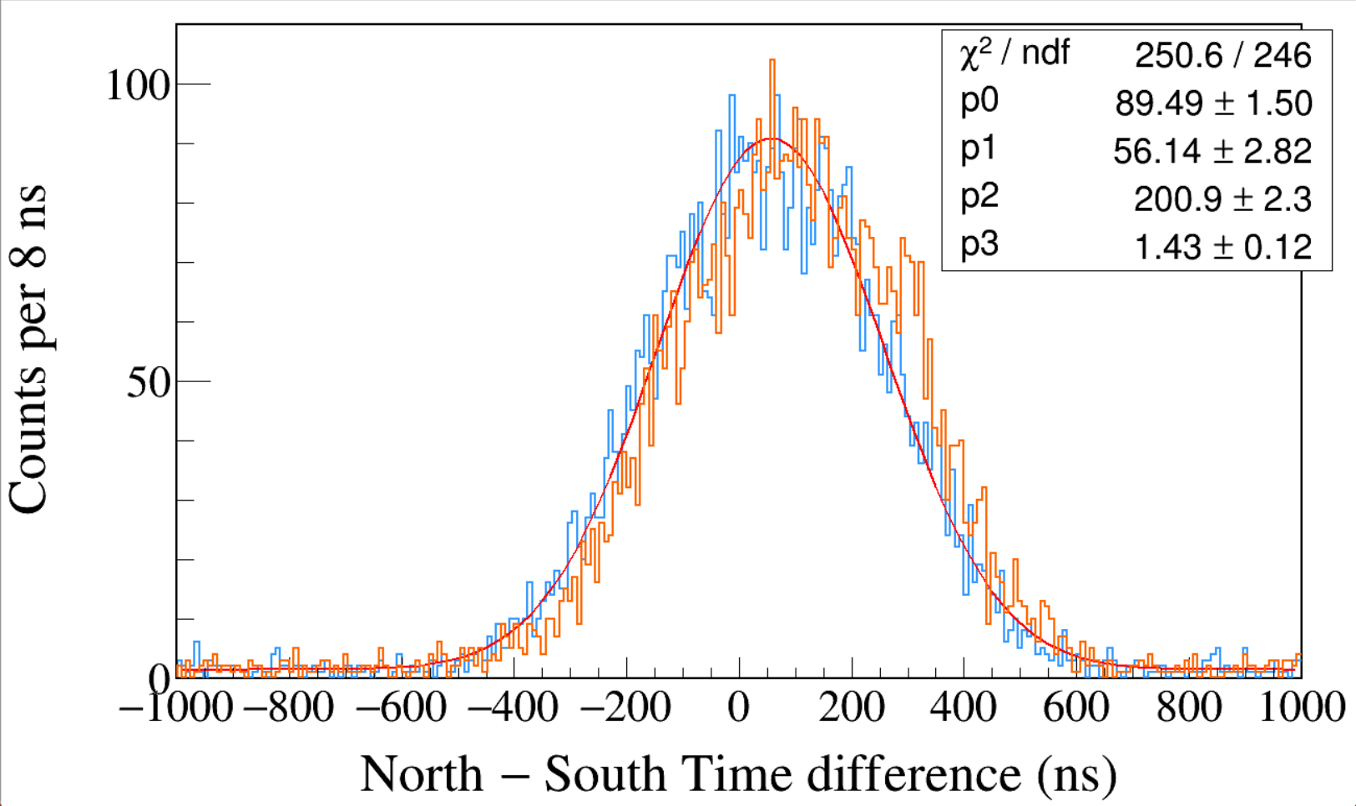
Run0237
60Co
Leading Edge
Trigger Rise 0.016 μs
Trigger Gap 1.000 μs
Trigger Threshold 16384
South 1173 && North 1332
South 1332 && North 1173
High Trigger Threshold is bad. Threshold just above noise is good.
Notes:
TFile *_file0 = TFile::Open("F:/e21010/pxct/run0237_LEGe_XtRa_60Co_I7281_MiddleXtRa_window1us_TrigRise0.016us_TrigGap1.000us_ThN16384_ThS16384_LED_cal.root");
TCanvas* canvaspeak = new TCanvas("canvaspeak", "canvaspeak", 1300, 800);//
canvaspeak->cd();//
canvaspeak->SetTopMargin(0.03);
canvaspeak->SetRightMargin(0.04);
canvaspeak->SetLeftMargin(0.13);
canvaspeak->SetBottomMargin(0.16);
canvaspeak->SetFrameLineWidth(2);
TH1D* htimestamps = new TH1D("htimestamps", "htimestamps", 250,-1000,1000);
htimestamps->SetLineWidth(2);
htimestamps->Rebin(1);
//htimestamps->SetStats(0);
htimestamps->SetTitle("");
htimestamps->GetXaxis()->SetTitle("North #minus South Time difference (ns)");
htimestamps->GetYaxis()->SetTitle("Counts per 8 ns");
htimestamps->GetXaxis()->CenterTitle();
htimestamps->GetYaxis()->CenterTitle();
htimestamps->GetXaxis()->SetLabelFont(132);
htimestamps->GetYaxis()->SetLabelFont(132);
htimestamps->GetXaxis()->SetLabelSize(0.06);
htimestamps->GetYaxis()->SetLabelSize(0.06);
htimestamps->GetXaxis()->SetTitleFont(132);
htimestamps->GetYaxis()->SetTitleFont(132);
htimestamps->GetXaxis()->SetTitleOffset(1.1);
htimestamps->GetYaxis()->SetTitleOffset(0.95);
htimestamps->GetXaxis()->SetTitleSize(0.07);
htimestamps->GetYaxis()->SetTitleSize(0.07);
htimestamps->GetXaxis()->SetRangeUser(-1000,1000);
//htimestamps->GetYaxis()->SetRangeUser(0,1700);
htimestamps->GetYaxis()->SetNdivisions(505);
htimestamps->SetLineWidth(2);
htimestamps->SetLineColor(kAzure+1);
tree->Draw("north_t-south_t>>htimestamps","south_e>1170&&south_e<1176&&north_e>1330&&north_e<1336");
tree->SetLineColor(kOrange+7);
tree->SetLineWidth(2);
tree->Draw("north_t-south_t","north_e>1170&&north_e<1176&&south_e>1330&&south_e<1336","same");

Slide 25
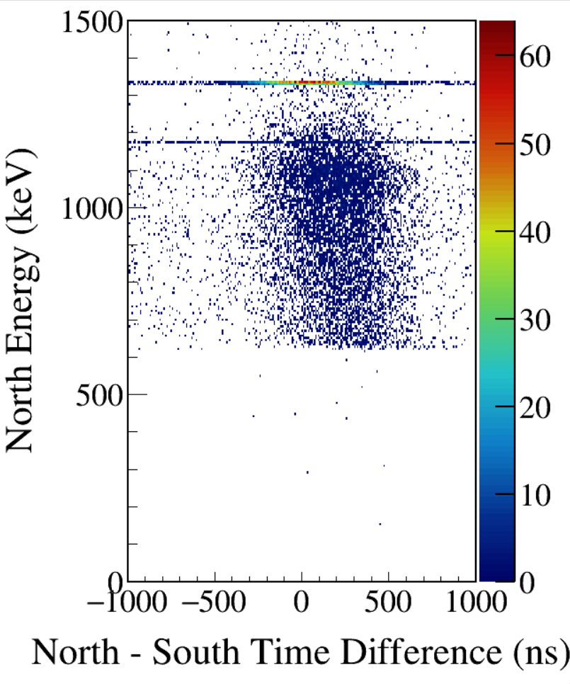
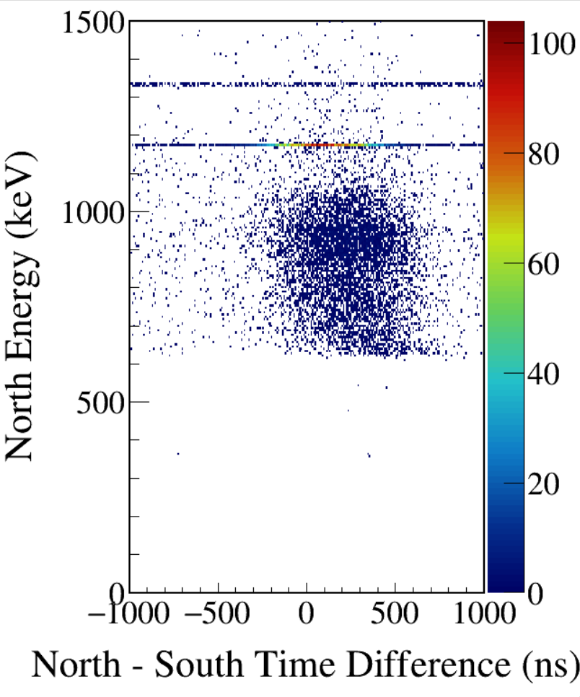
Notes:
TFile *_file0 = TFile::Open("F:/e21010/pxct/run0237_LEGe_XtRa_60Co_I7281_MiddleXtRa_window1us_TrigRise0.016us_TrigGap1.000us_ThN16384_ThS16384_LED_cal.root");

Slide 26
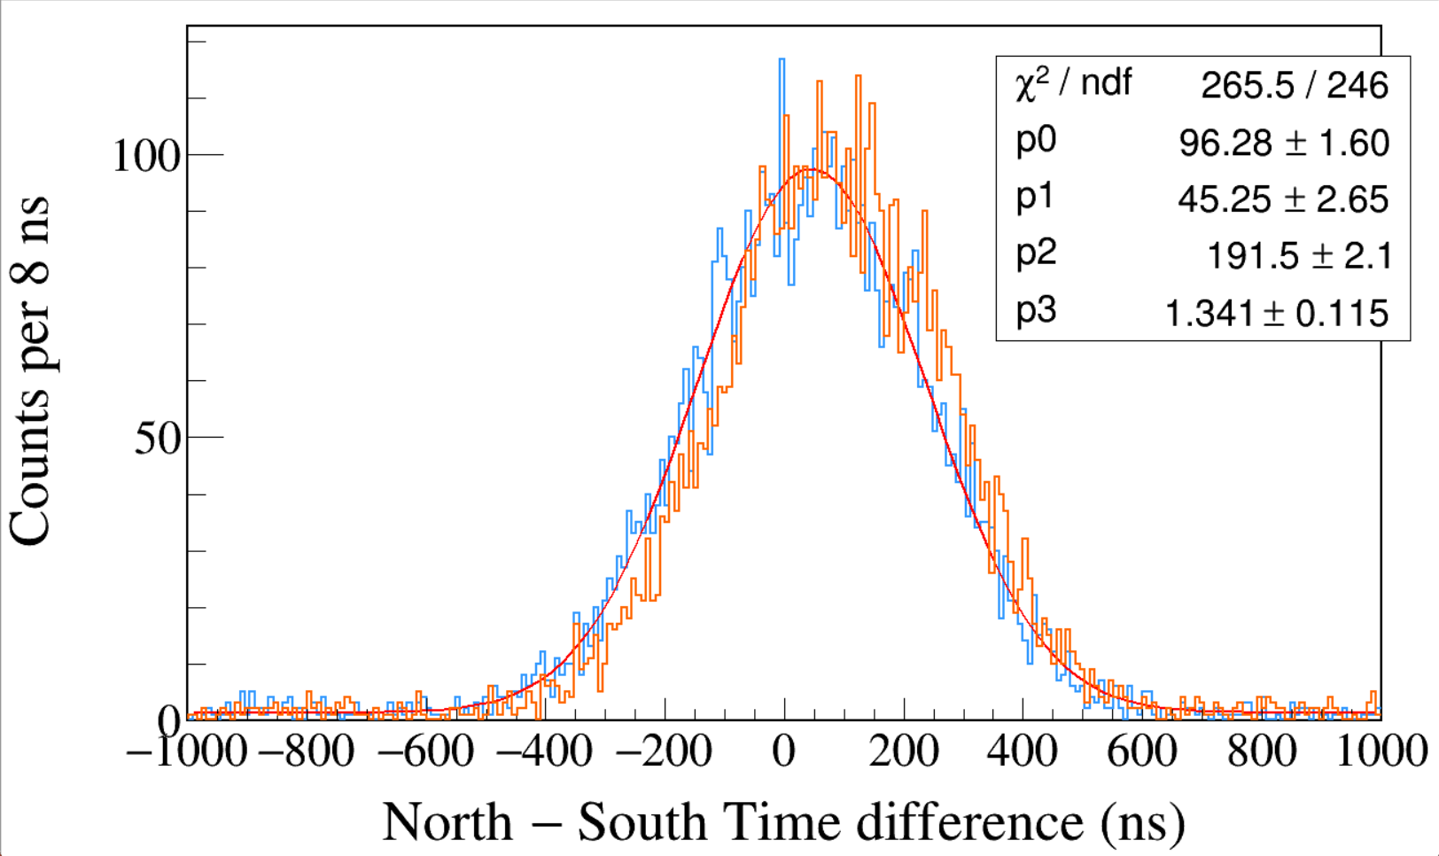
Run0236
60Co
Leading Edge
Trigger Rise 0.016 μs
Trigger Gap 1.000 μs
Trigger Threshold 10000
South 1173 && North 1332
South 1332 && North 1173
High Trigger Threshold is bad. Threshold just above noise is good.
Notes:
TFile *_file0 = TFile::Open("F:/e21010/pxct/run0236_LEGe_XtRa_60Co_I7281_MiddleXtRa_window1us_TrigRise0.016us_TrigGap1.000us_ThN10000_ThS10000_LED_cal.root");
TCanvas* canvaspeak = new TCanvas("canvaspeak", "canvaspeak", 1300, 800);//
canvaspeak->cd();//
canvaspeak->SetTopMargin(0.03);
canvaspeak->SetRightMargin(0.04);
canvaspeak->SetLeftMargin(0.13);
canvaspeak->SetBottomMargin(0.16);
canvaspeak->SetFrameLineWidth(2);
TH1D* htimestamps = new TH1D("htimestamps", "htimestamps", 250,-1000,1000);
htimestamps->SetLineWidth(2);
htimestamps->Rebin(1);
//htimestamps->SetStats(0);
htimestamps->SetTitle("");
htimestamps->GetXaxis()->SetTitle("North #minus South Time difference (ns)");
htimestamps->GetYaxis()->SetTitle("Counts per 8 ns");
htimestamps->GetXaxis()->CenterTitle();
htimestamps->GetYaxis()->CenterTitle();
htimestamps->GetXaxis()->SetLabelFont(132);
htimestamps->GetYaxis()->SetLabelFont(132);
htimestamps->GetXaxis()->SetLabelSize(0.06);
htimestamps->GetYaxis()->SetLabelSize(0.06);
htimestamps->GetXaxis()->SetTitleFont(132);
htimestamps->GetYaxis()->SetTitleFont(132);
htimestamps->GetXaxis()->SetTitleOffset(1.1);
htimestamps->GetYaxis()->SetTitleOffset(0.95);
htimestamps->GetXaxis()->SetTitleSize(0.07);
htimestamps->GetYaxis()->SetTitleSize(0.07);
htimestamps->GetXaxis()->SetRangeUser(-1000,1000);
//htimestamps->GetYaxis()->SetRangeUser(0,1700);
htimestamps->GetYaxis()->SetNdivisions(505);
htimestamps->SetLineWidth(2);
htimestamps->SetLineColor(kAzure+1);
tree->Draw("north_t-south_t>>htimestamps","south_e>1170&&south_e<1176&&north_e>1330&&north_e<1336");
tree->SetLineColor(kOrange+7);
tree->SetLineWidth(2);
tree->Draw("north_t-south_t","north_e>1170&&north_e<1176&&south_e>1330&&south_e<1336","same");

Slide 27
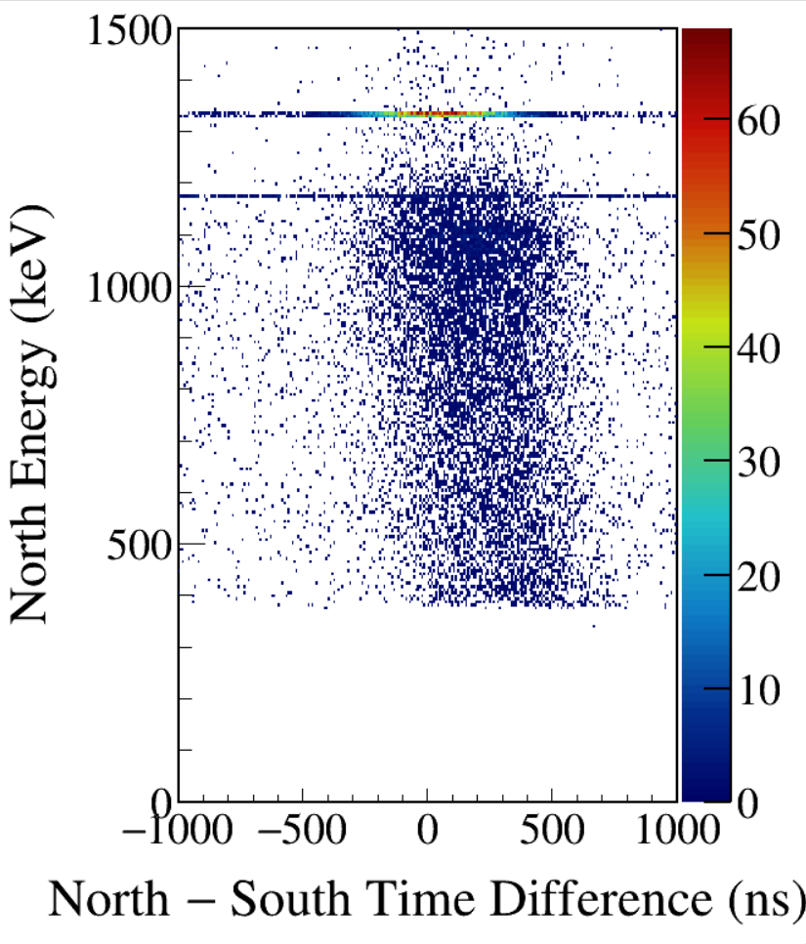
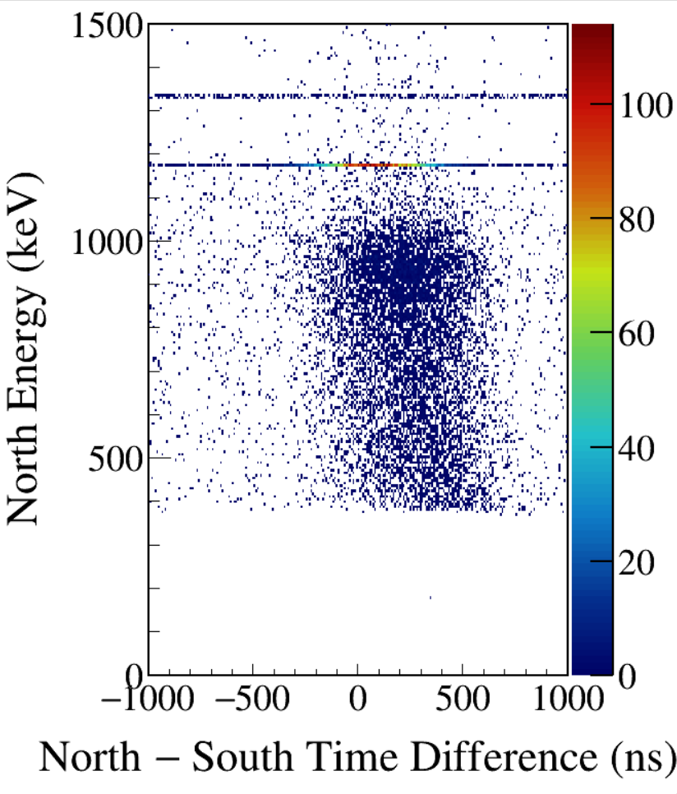
Notes:
TFile *_file0 = TFile::Open("F:/e21010/pxct/run0236_LEGe_XtRa_60Co_I7281_MiddleXtRa_window1us_TrigRise0.016us_TrigGap1.000us_ThN10000_ThS10000_LED_cal.root");

Slide 28
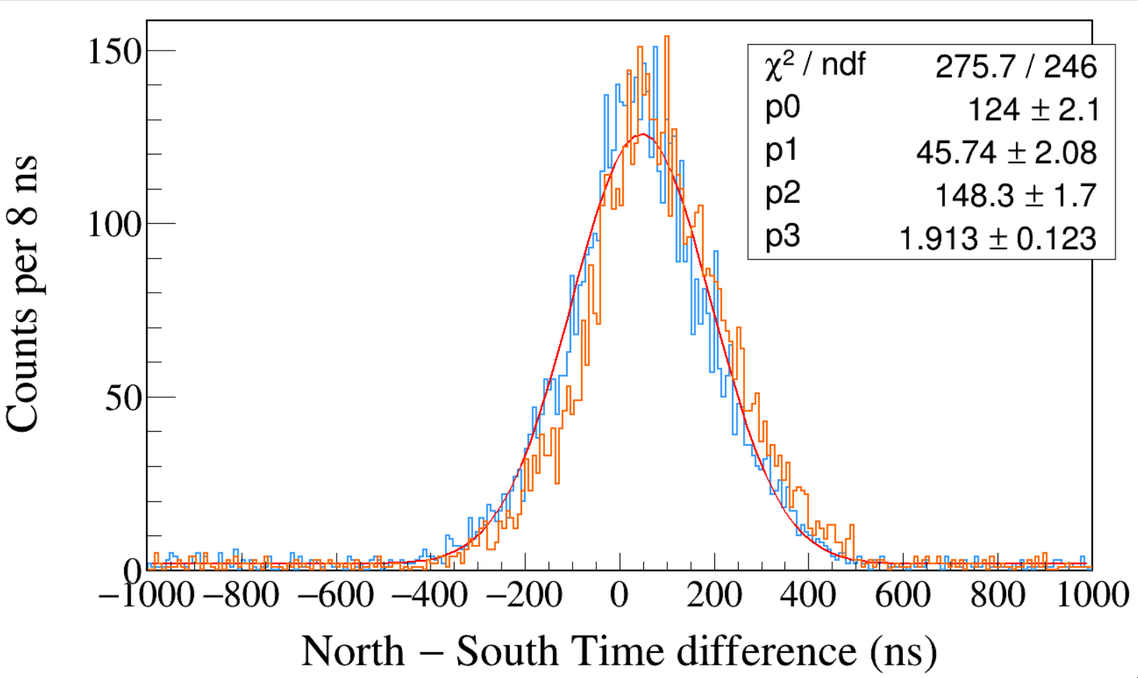
Run0239
60Co
Leading Edge
Trigger Rise 0.016 μs
Trigger Gap 1.000 μs
Trigger Threshold 5000
South 1173 && North 1332
South 1332 && North 1173
High Trigger Threshold is bad. Threshold just above noise is good.
Notes:
TFile *_file0 = TFile::Open("F:/e21010/pxct/run0239_LEGe_XtRa_60Co_I7281_MiddleXtRa_window1us_TrigRise0.016us_TrigGap1.000us_ThN5000_ThS5000_LED_cal.root");
TCanvas* canvaspeak = new TCanvas("canvaspeak", "canvaspeak", 1300, 800);//
canvaspeak->cd();//
canvaspeak->SetTopMargin(0.03);
canvaspeak->SetRightMargin(0.04);
canvaspeak->SetLeftMargin(0.13);
canvaspeak->SetBottomMargin(0.16);
canvaspeak->SetFrameLineWidth(2);
TH1D* htimestamps = new TH1D("htimestamps", "htimestamps", 250,-1000,1000);
htimestamps->SetLineWidth(2);
htimestamps->Rebin(1);
//htimestamps->SetStats(0);
htimestamps->SetTitle("");
htimestamps->GetXaxis()->SetTitle("North #minus South Time difference (ns)");
htimestamps->GetYaxis()->SetTitle("Counts per 8 ns");
htimestamps->GetXaxis()->CenterTitle();
htimestamps->GetYaxis()->CenterTitle();
htimestamps->GetXaxis()->SetLabelFont(132);
htimestamps->GetYaxis()->SetLabelFont(132);
htimestamps->GetXaxis()->SetLabelSize(0.06);
htimestamps->GetYaxis()->SetLabelSize(0.06);
htimestamps->GetXaxis()->SetTitleFont(132);
htimestamps->GetYaxis()->SetTitleFont(132);
htimestamps->GetXaxis()->SetTitleOffset(1.1);
htimestamps->GetYaxis()->SetTitleOffset(0.95);
htimestamps->GetXaxis()->SetTitleSize(0.07);
htimestamps->GetYaxis()->SetTitleSize(0.07);
htimestamps->GetXaxis()->SetRangeUser(-1000,1000);
//htimestamps->GetYaxis()->SetRangeUser(0,1700);
htimestamps->GetYaxis()->SetNdivisions(505);
htimestamps->SetLineWidth(2);
htimestamps->SetLineColor(kAzure+1);
tree->Draw("north_t-south_t>>htimestamps","south_e>1170&&south_e<1176&&north_e>1330&&north_e<1336");
tree->SetLineColor(kOrange+7);
tree->SetLineWidth(2);
tree->Draw("north_t-south_t","north_e>1170&&north_e<1176&&south_e>1330&&south_e<1336","same");

Slide 29
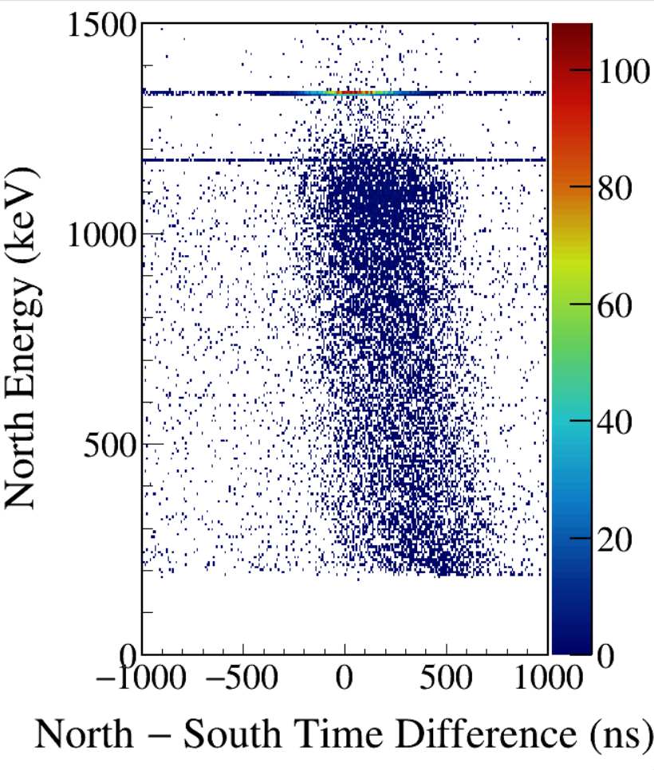
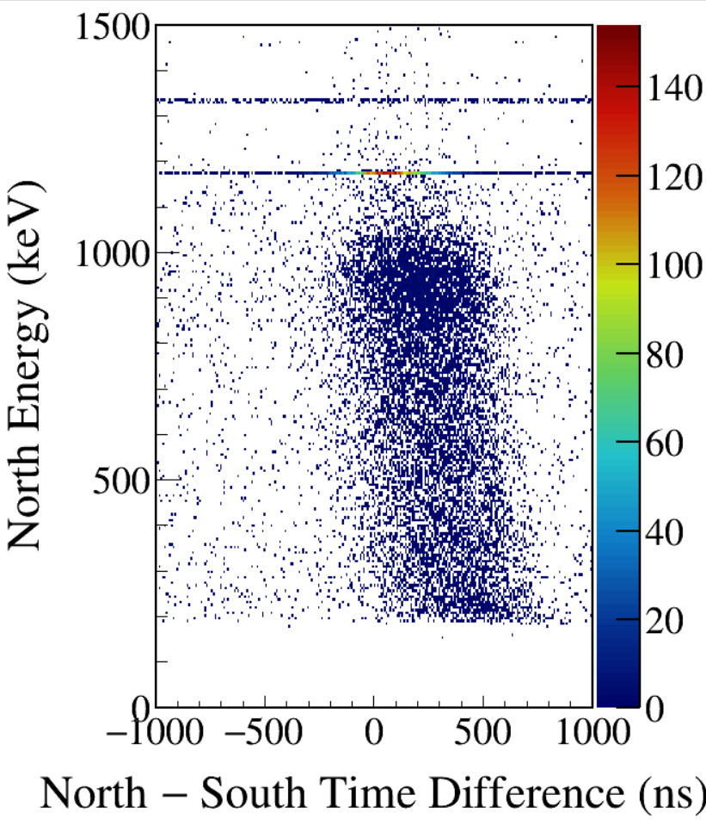
Notes:
TFile *_file0 = TFile::Open("F:/e21010/pxct/run0239_LEGe_XtRa_60Co_I7281_MiddleXtRa_window1us_TrigRise0.016us_TrigGap1.000us_ThN5000_ThS5000_LED_cal.root");

Slide 30
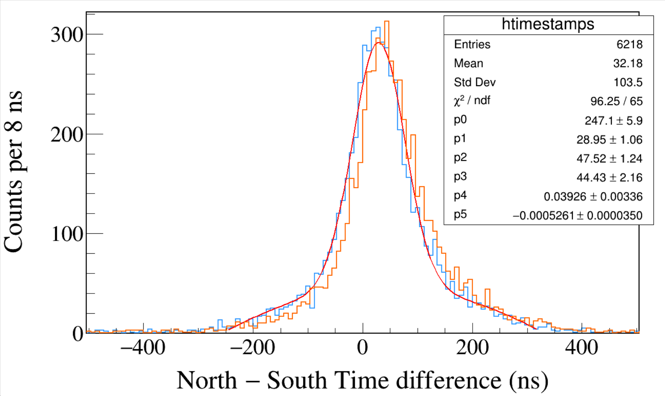
Run0241
60Co
Leading Edge
Trigger Rise 0.016 μs
Trigger Gap 1.000 μs
Trigger Threshold 2000
South 1173 && North 1332
South 1332 && North 1173
High Trigger Threshold is bad. Threshold just above noise is good.
Notes:
TFile *_file0 = TFile::Open("F:/e21010/pxct/run0241_LEGe_XtRa_60Co_I7281_MiddleXtRa_window1us_TrigRise0.016us_TrigGap1.000us_ThN2000_ThS2000_LED_cal.root");
TCanvas* canvaspeak = new TCanvas("canvaspeak", "canvaspeak", 1300, 800);//
canvaspeak->cd();//
canvaspeak->SetTopMargin(0.03);
canvaspeak->SetRightMargin(0.04);
canvaspeak->SetLeftMargin(0.13);
canvaspeak->SetBottomMargin(0.16);
canvaspeak->SetFrameLineWidth(2);
TH1D* htimestamps = new TH1D("htimestamps", "htimestamps", 250,-1000,1000);
htimestamps->SetLineWidth(2);
htimestamps->Rebin(1);
//htimestamps->SetStats(0);
htimestamps->SetTitle("");
htimestamps->GetXaxis()->SetTitle("North #minus South Time difference (ns)");
htimestamps->GetYaxis()->SetTitle("Counts per 8 ns");
htimestamps->GetXaxis()->CenterTitle();
htimestamps->GetYaxis()->CenterTitle();
htimestamps->GetXaxis()->SetLabelFont(132);
htimestamps->GetYaxis()->SetLabelFont(132);
htimestamps->GetXaxis()->SetLabelSize(0.06);
htimestamps->GetYaxis()->SetLabelSize(0.06);
htimestamps->GetXaxis()->SetTitleFont(132);
htimestamps->GetYaxis()->SetTitleFont(132);
htimestamps->GetXaxis()->SetTitleOffset(1.1);
htimestamps->GetYaxis()->SetTitleOffset(0.95);
htimestamps->GetXaxis()->SetTitleSize(0.07);
htimestamps->GetYaxis()->SetTitleSize(0.07);
htimestamps->GetXaxis()->SetRangeUser(-1000,1000);
//htimestamps->GetYaxis()->SetRangeUser(0,1700);
htimestamps->GetYaxis()->SetNdivisions(505);
htimestamps->SetLineWidth(2);
htimestamps->SetLineColor(kAzure+1);
tree->Draw("north_t-south_t>>htimestamps","south_e>1170&&south_e<1176&&north_e>1330&&north_e<1336");
tree->SetLineColor(kOrange+7);
tree->SetLineWidth(2);
tree->Draw("north_t-south_t","north_e>1170&&north_e<1176&&south_e>1330&&south_e<1336","same");

Slide 31
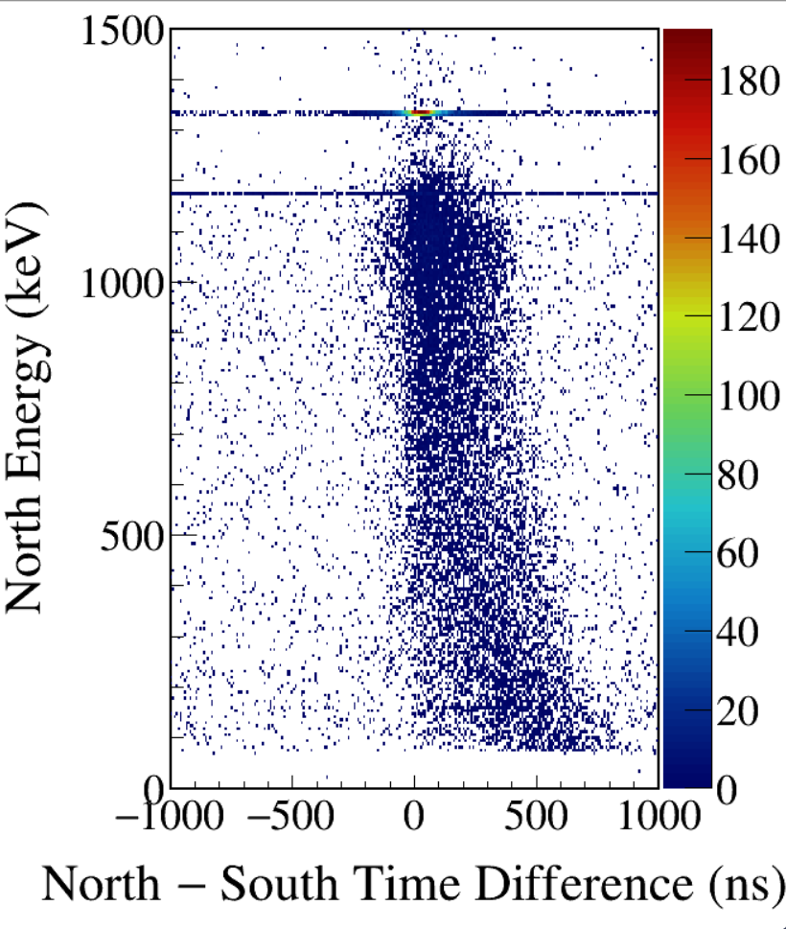
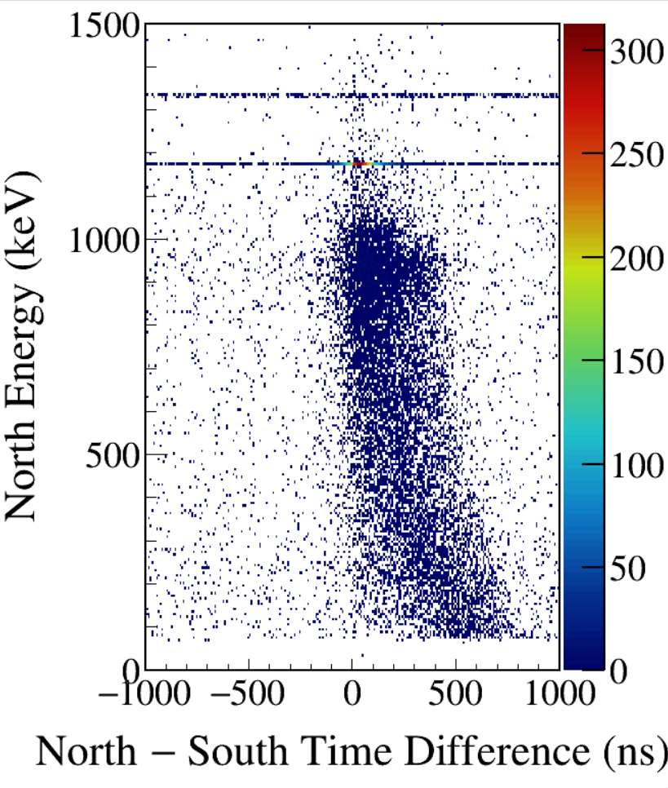
Notes:
TFile *_file0 = TFile::Open("F:/e21010/pxct/run0241_LEGe_XtRa_60Co_I7281_MiddleXtRa_window1us_TrigRise0.016us_TrigGap1.000us_ThN2000_ThS2000_LED_cal.root");

Slide 32
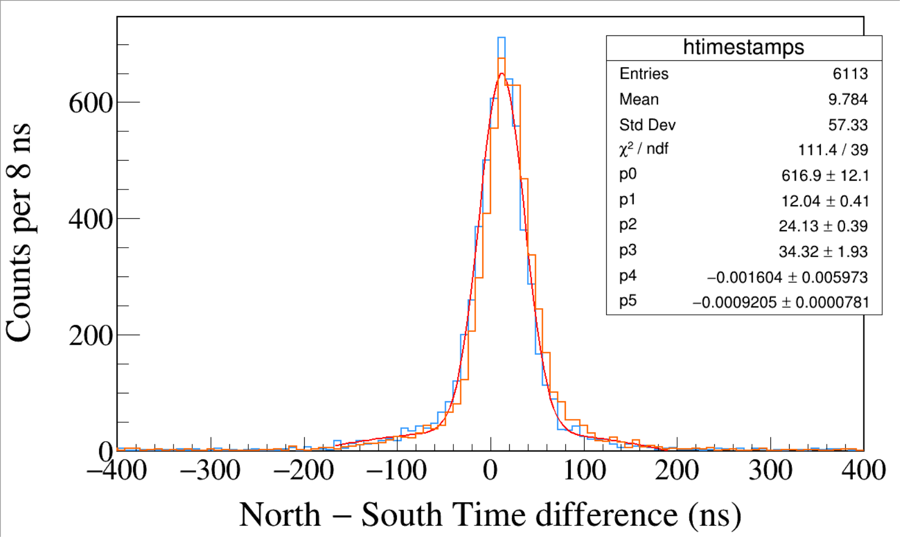
Run0240
60Co
Leading Edge
Trigger Rise 0.016 μs
Trigger Gap 1.000 μs
Trigger Threshold 500, 950
South 1173 && North 1332
South 1332 && North 1173
High Trigger Threshold is bad. Threshold just above noise is good.
Notes:
TFile *_file0 = TFile::Open("F:/e21010/pxct/run0240_LEGe_XtRa_60Co_I7281_MiddleXtRa_window1us_TrigRise0.016us_TrigGap1.000us_ThN500_ThS950_LED_cal.root");
TCanvas* canvaspeak = new TCanvas("canvaspeak", "canvaspeak", 1300, 800);//
canvaspeak->cd();//
canvaspeak->SetTopMargin(0.03);
canvaspeak->SetRightMargin(0.04);
canvaspeak->SetLeftMargin(0.13);
canvaspeak->SetBottomMargin(0.16);
canvaspeak->SetFrameLineWidth(2);
TH1D* htimestamps = new TH1D("htimestamps", "htimestamps", 250,-1000,1000);
htimestamps->SetLineWidth(2);
htimestamps->Rebin(1);
//htimestamps->SetStats(0);
htimestamps->SetTitle("");
htimestamps->GetXaxis()->SetTitle("North #minus South Time difference (ns)");
htimestamps->GetYaxis()->SetTitle("Counts per 8 ns");
htimestamps->GetXaxis()->CenterTitle();
htimestamps->GetYaxis()->CenterTitle();
htimestamps->GetXaxis()->SetLabelFont(132);
htimestamps->GetYaxis()->SetLabelFont(132);
htimestamps->GetXaxis()->SetLabelSize(0.06);
htimestamps->GetYaxis()->SetLabelSize(0.06);
htimestamps->GetXaxis()->SetTitleFont(132);
htimestamps->GetYaxis()->SetTitleFont(132);
htimestamps->GetXaxis()->SetTitleOffset(1.1);
htimestamps->GetYaxis()->SetTitleOffset(0.95);
htimestamps->GetXaxis()->SetTitleSize(0.07);
htimestamps->GetYaxis()->SetTitleSize(0.07);
htimestamps->GetXaxis()->SetRangeUser(-1000,1000);
//htimestamps->GetYaxis()->SetRangeUser(0,1700);
htimestamps->GetYaxis()->SetNdivisions(505);
htimestamps->SetLineWidth(2);
htimestamps->SetLineColor(kAzure+1);
tree->Draw("north_t-south_t>>htimestamps","south_e>1170&&south_e<1176&&north_e>1330&&north_e<1336");
tree->SetLineColor(kOrange+7);
tree->SetLineWidth(2);
tree->Draw("north_t-south_t","north_e>1170&&north_e<1176&&south_e>1330&&south_e<1336","same");

Slide 33
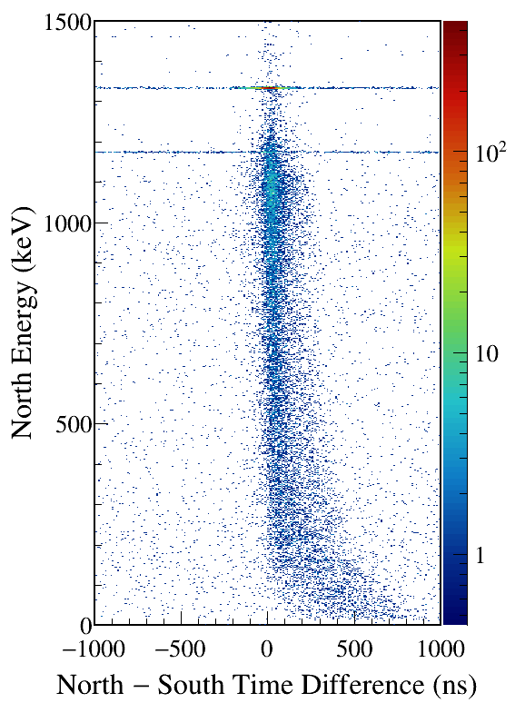
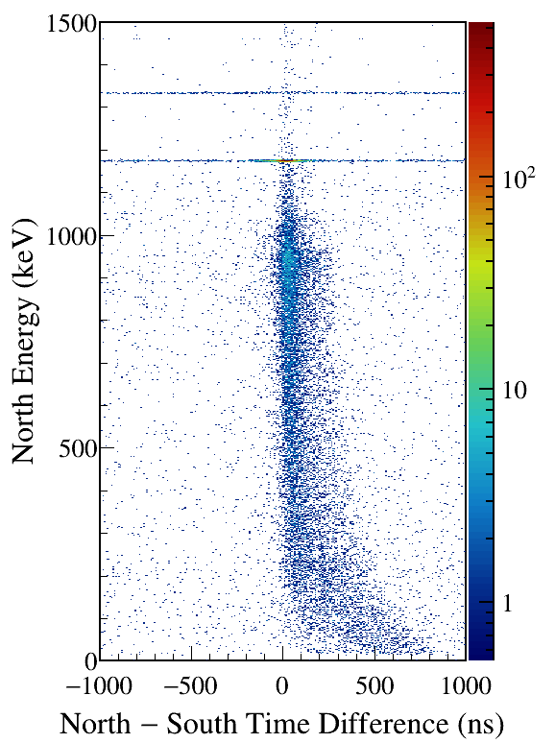
Notes:
TFile *_file0 = TFile::Open("F:/e21010/pxct/run0240_LEGe_XtRa_60Co_I7281_MiddleXtRa_window1us_TrigRise0.016us_TrigGap1.000us_ThN500_ThS950_LED_cal.root");
TCanvas* canvaspeak = new TCanvas("canvaspeak", "canvaspeak", 580, 800);
canvaspeak->cd();
canvaspeak->SetTopMargin(0.03);
canvaspeak->SetRightMargin(0.16);
canvaspeak->SetLeftMargin(0.18);
canvaspeak->SetBottomMargin(0.11);
canvaspeak->SetFrameLineWidth(2);
canvaspeak->SetLogz();
TH2D* het = new TH2D("het", "het", 250,-1000,1000,750,0,1500); //x,y
//tree->Draw("north_e:north_t-south_t>>het","north_e>1&&north_e<1500&&south_e>1170&&south_e<1176","colz"); //y:x
tree->Draw("north_e:north_t-south_t>>het","north_e>1&&north_e<1500&&south_e>1330&&south_e<1336","colz"); //y:x
het->SetStats(0);
het->SetTitle("");
het->GetXaxis()->SetTitle("North #minus South Time Difference (ns)");
het->GetYaxis()->SetTitle("North Energy (keV)");
het->GetXaxis()->CenterTitle();
het->GetYaxis()->CenterTitle();
het->GetXaxis()->SetLabelFont(132);
het->GetYaxis()->SetLabelFont(132);
het->GetXaxis()->SetLabelSize(0.05);
het->GetYaxis()->SetLabelSize(0.05);
het->GetXaxis()->SetTitleFont(132);
het->GetYaxis()->SetTitleFont(132);
het->GetXaxis()->SetTitleOffset(0.9);
het->GetYaxis()->SetTitleOffset(1.4);
het->GetXaxis()->SetTitleSize(0.06);
het->GetYaxis()->SetTitleSize(0.06);
het->GetXaxis()->SetNdivisions(505);
het->GetYaxis()->SetNdivisions(505);
//het->GetXaxis()->SetRangeUser(2001,4500);
//het->GetYaxis()->SetRangeUser(1000,2800);
//het->SetMinimum(2);
//het->SetMaximum(100);
het->SetContour(99);
gStyle->SetPalette(kRainbow);
//gPad->SetLogz();
TPaletteAxis *palette = (TPaletteAxis*)het->GetListOfFunctions()->FindObject("palette");
palette->SetTitleFont(132);
palette->SetTitleSize(0.05);
palette->SetLabelFont(132);
palette->SetLabelSize(0.05);
palette->SetLineWidth(2);
canvaspeak->SaveAs("F:/e21010/pxct/1.png");
canvaspeak->cd();
tree->Draw("north_e:north_t-south_t>>het","north_e>1&&north_e<1500&&south_e>1170&&south_e<1176","colz"); //y:x
het->SetContour(99);
canvaspeak->SaveAs("F:/e21010/pxct/2.png");

Slide 34
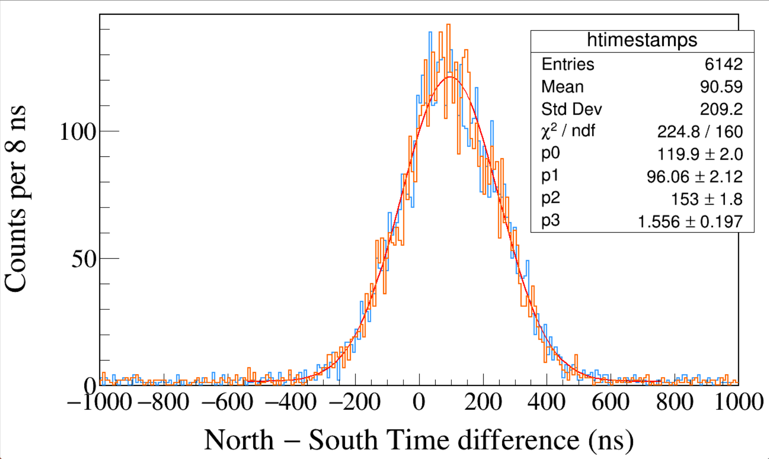
Run0242
60Co
CFD Delay 0.504 μs
CFD Scale 0
Trigger Rise 0.016 μs
Trigger Gap 1.000 μs
Trigger Threshold 530, 1050
South 1173 && North 1332
South 1332 && North 1173
CFD in DDAS has 2 parameters: CFD Delay 0.008-0.504 μs; Scale Factor 0-7.
Under good LED, CFD is bad with large Delay and small Scale.
Notes:
TFile *_file0 = TFile::Open("F:/e21010/pxct/run0242_LEGe_XtRa_60Co_I7281_MiddleXtRa_window1us_TrigRise0.016us_TrigGap1.000us_ThN530_ThS1050_CFDDelay0.504us_cal.root");
TCanvas* canvaspeak = new TCanvas("canvaspeak", "canvaspeak", 1300, 800);//
canvaspeak->cd();//
canvaspeak->SetTopMargin(0.03);
canvaspeak->SetRightMargin(0.04);
canvaspeak->SetLeftMargin(0.13);
canvaspeak->SetBottomMargin(0.16);
canvaspeak->SetFrameLineWidth(2);
TH1D* htimestamps = new TH1D("htimestamps", "htimestamps", 250,-1000,1000);
htimestamps->SetLineWidth(2);
htimestamps->Rebin(1);
//htimestamps->SetStats(0);
htimestamps->SetTitle("");
htimestamps->GetXaxis()->SetTitle("North #minus South Time difference (ns)");
htimestamps->GetYaxis()->SetTitle("Counts per 8 ns");
htimestamps->GetXaxis()->CenterTitle();
htimestamps->GetYaxis()->CenterTitle();
htimestamps->GetXaxis()->SetLabelFont(132);
htimestamps->GetYaxis()->SetLabelFont(132);
htimestamps->GetXaxis()->SetLabelSize(0.06);
htimestamps->GetYaxis()->SetLabelSize(0.06);
htimestamps->GetXaxis()->SetTitleFont(132);
htimestamps->GetYaxis()->SetTitleFont(132);
htimestamps->GetXaxis()->SetTitleOffset(1.1);
htimestamps->GetYaxis()->SetTitleOffset(0.95);
htimestamps->GetXaxis()->SetTitleSize(0.07);
htimestamps->GetYaxis()->SetTitleSize(0.07);
htimestamps->GetXaxis()->SetRangeUser(-1000,1000);
//htimestamps->GetYaxis()->SetRangeUser(0,1700);
htimestamps->GetYaxis()->SetNdivisions(505);
htimestamps->SetLineWidth(2);
htimestamps->SetLineColor(kAzure+1);
tree->Draw("north_t-south_t>>htimestamps","south_e>1170&&south_e<1176&&north_e>1330&&north_e<1336");
tree->SetLineColor(kOrange+7);
tree->SetLineWidth(2);
tree->Draw("north_t-south_t","north_e>1170&&north_e<1176&&south_e>1330&&south_e<1336","same");

Slide 35
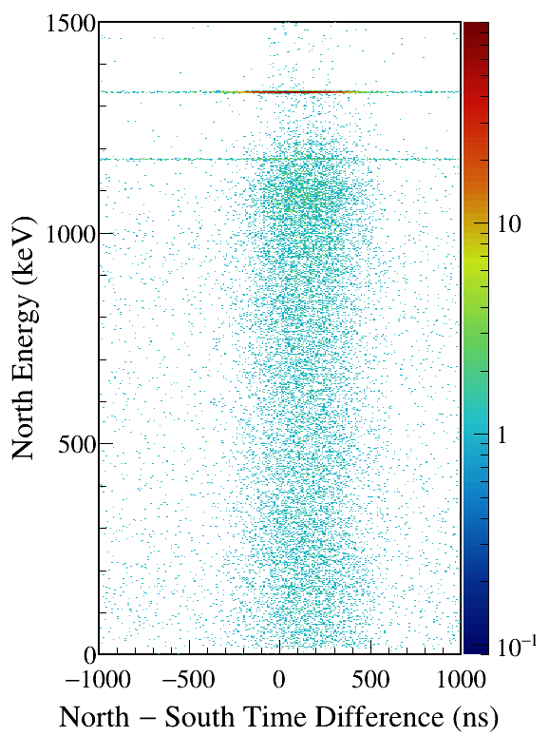
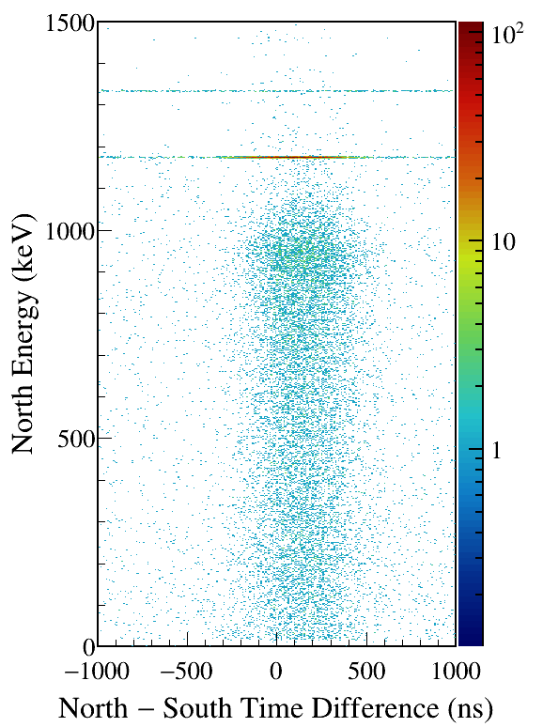
Notes:
TFile *_file0 = TFile::Open("F:/e21010/pxct/run0242_LEGe_XtRa_60Co_I7281_MiddleXtRa_window1us_TrigRise0.016us_TrigGap1.000us_ThN530_ThS1050_CFDDelay0.504us_cal.root");
TCanvas* canvaspeak = new TCanvas("canvaspeak", "canvaspeak", 580, 800);
canvaspeak->cd();
canvaspeak->SetTopMargin(0.03);
canvaspeak->SetRightMargin(0.16);
canvaspeak->SetLeftMargin(0.18);
canvaspeak->SetBottomMargin(0.11);
canvaspeak->SetFrameLineWidth(2);
canvaspeak->SetLogz();
TH2D* het = new TH2D("het", "het", 250,-1000,1000,750,0,1500); //x,y
//tree->Draw("north_e:north_t-south_t>>het","north_e>1&&north_e<1500&&south_e>1170&&south_e<1176","colz"); //y:x
tree->Draw("north_e:north_t-south_t>>het","north_e>1&&north_e<1500&&south_e>1330&&south_e<1336","colz"); //y:x
het->SetStats(0);
het->SetTitle("");
het->GetXaxis()->SetTitle("North #minus South Time Difference (ns)");
het->GetYaxis()->SetTitle("North Energy (keV)");
het->GetXaxis()->CenterTitle();
het->GetYaxis()->CenterTitle();
het->GetXaxis()->SetLabelFont(132);
het->GetYaxis()->SetLabelFont(132);
het->GetXaxis()->SetLabelSize(0.05);
het->GetYaxis()->SetLabelSize(0.05);
het->GetXaxis()->SetTitleFont(132);
het->GetYaxis()->SetTitleFont(132);
het->GetXaxis()->SetTitleOffset(0.9);
het->GetYaxis()->SetTitleOffset(1.4);
het->GetXaxis()->SetTitleSize(0.06);
het->GetYaxis()->SetTitleSize(0.06);
het->GetXaxis()->SetNdivisions(505);
het->GetYaxis()->SetNdivisions(505);
//het->GetXaxis()->SetRangeUser(2001,4500);
//het->GetYaxis()->SetRangeUser(1000,2800);
//het->SetMinimum(2);
//het->SetMaximum(100);
het->SetContour(99);
gStyle->SetPalette(kRainbow);
//gPad->SetLogz();
TPaletteAxis *palette = (TPaletteAxis*)het->GetListOfFunctions()->FindObject("palette");
palette->SetTitleFont(132);
palette->SetTitleSize(0.05);
palette->SetLabelFont(132);
palette->SetLabelSize(0.05);
palette->SetLineWidth(2);
canvaspeak->SaveAs("F:/e21010/pxct/1.png");
canvaspeak->cd();
tree->Draw("north_e:north_t-south_t>>het","north_e>1&&north_e<1500&&south_e>1170&&south_e<1176","colz"); //y:x
het->SetContour(99);
canvaspeak->SaveAs("F:/e21010/pxct/2.png");

Slide 36
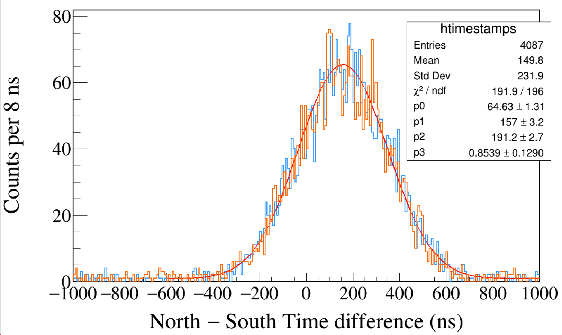
Run0243
60Co
CFD Delay 0.104 μs
CFD Scale 0
Trigger Rise 0.016 μs
Trigger Gap 1.000 μs
Trigger Threshold 530, 1050
South 1173 && North 1332
South 1332 && North 1173
CFD in DDAS has 2 parameters: CFD Delay 0.008-0.504 μs; Scale Factor 0-7.
Under good LED, CFD is bad with small Delay and small Scale.
Notes:
TFile *_file0 = TFile::Open("F:/e21010/pxct/run0243_LEGe_XtRa_60Co_I7281_MiddleXtRa_window1us_TrigRise0.016us_TrigGap1.000us_ThN530_ThS1050_CFDDelay0.104us_cal.root");
TCanvas* canvaspeak = new TCanvas("canvaspeak", "canvaspeak", 1300, 800);//
canvaspeak->cd();//
canvaspeak->SetTopMargin(0.03);
canvaspeak->SetRightMargin(0.04);
canvaspeak->SetLeftMargin(0.13);
canvaspeak->SetBottomMargin(0.16);
canvaspeak->SetFrameLineWidth(2);
TH1D* htimestamps = new TH1D("htimestamps", "htimestamps", 250,-1000,1000);
htimestamps->SetLineWidth(2);
htimestamps->Rebin(1);
//htimestamps->SetStats(0);
htimestamps->SetTitle("");
htimestamps->GetXaxis()->SetTitle("North #minus South Time difference (ns)");
htimestamps->GetYaxis()->SetTitle("Counts per 8 ns");
htimestamps->GetXaxis()->CenterTitle();
htimestamps->GetYaxis()->CenterTitle();
htimestamps->GetXaxis()->SetLabelFont(132);
htimestamps->GetYaxis()->SetLabelFont(132);
htimestamps->GetXaxis()->SetLabelSize(0.06);
htimestamps->GetYaxis()->SetLabelSize(0.06);
htimestamps->GetXaxis()->SetTitleFont(132);
htimestamps->GetYaxis()->SetTitleFont(132);
htimestamps->GetXaxis()->SetTitleOffset(1.1);
htimestamps->GetYaxis()->SetTitleOffset(0.95);
htimestamps->GetXaxis()->SetTitleSize(0.07);
htimestamps->GetYaxis()->SetTitleSize(0.07);
htimestamps->GetXaxis()->SetRangeUser(-1000,1000);
//htimestamps->GetYaxis()->SetRangeUser(0,1700);
htimestamps->GetYaxis()->SetNdivisions(505);
htimestamps->SetLineWidth(2);
htimestamps->SetLineColor(kAzure+1);
tree->Draw("north_t-south_t>>htimestamps","south_e>1170&&south_e<1176&&north_e>1330&&north_e<1336");
tree->SetLineColor(kOrange+7);
tree->SetLineWidth(2);
tree->Draw("north_t-south_t","north_e>1170&&north_e<1176&&south_e>1330&&south_e<1336","same");

Slide 37
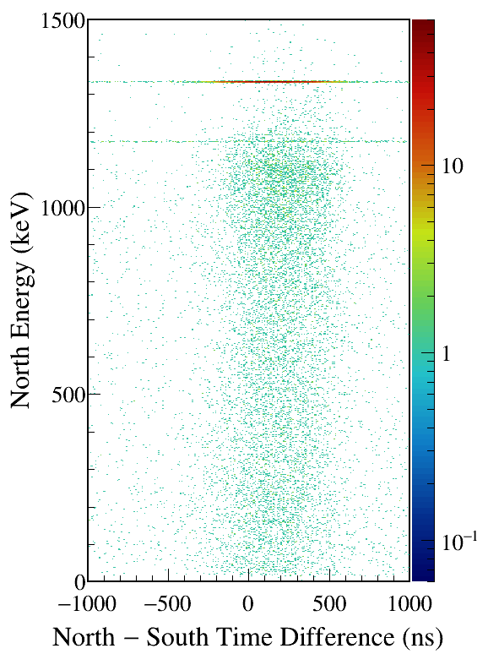
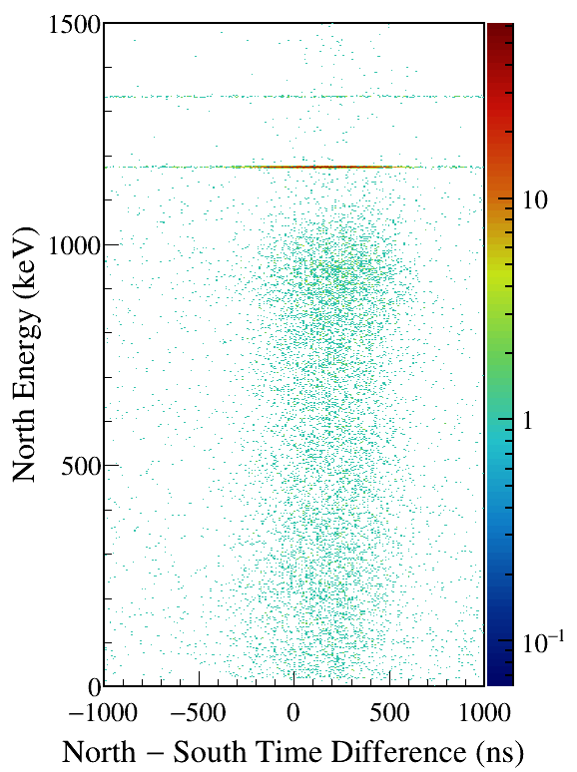
Notes:
TFile *_file0 = TFile::Open("F:/e21010/pxct/run0243_LEGe_XtRa_60Co_I7281_MiddleXtRa_window1us_TrigRise0.016us_TrigGap1.000us_ThN530_ThS1050_CFDDelay0.104us_cal.root");
TCanvas* canvaspeak = new TCanvas("canvaspeak", "canvaspeak", 580, 800);
canvaspeak->cd();
canvaspeak->SetTopMargin(0.03);
canvaspeak->SetRightMargin(0.16);
canvaspeak->SetLeftMargin(0.18);
canvaspeak->SetBottomMargin(0.11);
canvaspeak->SetFrameLineWidth(2);
canvaspeak->SetLogz();
TH2D* het = new TH2D("het", "het", 250,-1000,1000,750,0,1500); //x,y
//tree->Draw("north_e:north_t-south_t>>het","north_e>1&&north_e<1500&&south_e>1170&&south_e<1176","colz"); //y:x
tree->Draw("north_e:north_t-south_t>>het","north_e>1&&north_e<1500&&south_e>1330&&south_e<1336","colz"); //y:x
het->SetStats(0);
het->SetTitle("");
het->GetXaxis()->SetTitle("North #minus South Time Difference (ns)");
het->GetYaxis()->SetTitle("North Energy (keV)");
het->GetXaxis()->CenterTitle();
het->GetYaxis()->CenterTitle();
het->GetXaxis()->SetLabelFont(132);
het->GetYaxis()->SetLabelFont(132);
het->GetXaxis()->SetLabelSize(0.05);
het->GetYaxis()->SetLabelSize(0.05);
het->GetXaxis()->SetTitleFont(132);
het->GetYaxis()->SetTitleFont(132);
het->GetXaxis()->SetTitleOffset(0.9);
het->GetYaxis()->SetTitleOffset(1.4);
het->GetXaxis()->SetTitleSize(0.06);
het->GetYaxis()->SetTitleSize(0.06);
het->GetXaxis()->SetNdivisions(505);
het->GetYaxis()->SetNdivisions(505);
//het->GetXaxis()->SetRangeUser(2001,4500);
//het->GetYaxis()->SetRangeUser(1000,2800);
//het->SetMinimum(2);
//het->SetMaximum(100);
het->SetContour(99);
gStyle->SetPalette(kRainbow);
//gPad->SetLogz();
TPaletteAxis *palette = (TPaletteAxis*)het->GetListOfFunctions()->FindObject("palette");
palette->SetTitleFont(132);
palette->SetTitleSize(0.05);
palette->SetLabelFont(132);
palette->SetLabelSize(0.05);
palette->SetLineWidth(2);
canvaspeak->SaveAs("F:/e21010/pxct/1.png");
canvaspeak->cd();
tree->Draw("north_e:north_t-south_t>>het","north_e>1&&north_e<1500&&south_e>1170&&south_e<1176","colz"); //y:x
het->SetContour(99);
canvaspeak->SaveAs("F:/e21010/pxct/2.png");

Slide 38
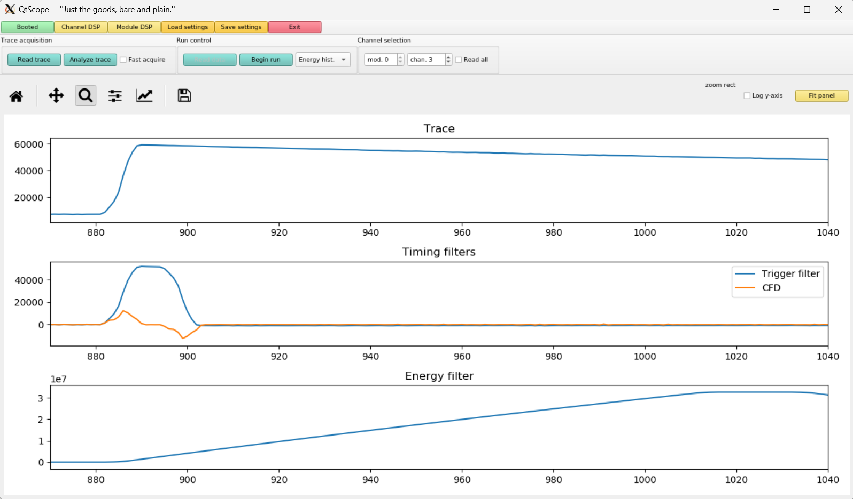
Run0243
60Co
CFD Delay 0.104 μs, CFD Scale 0
Trigger Rise 0.016 μs
Trigger Gap 1.000 μs
Trigger Threshold 530, 1050

Slide 39
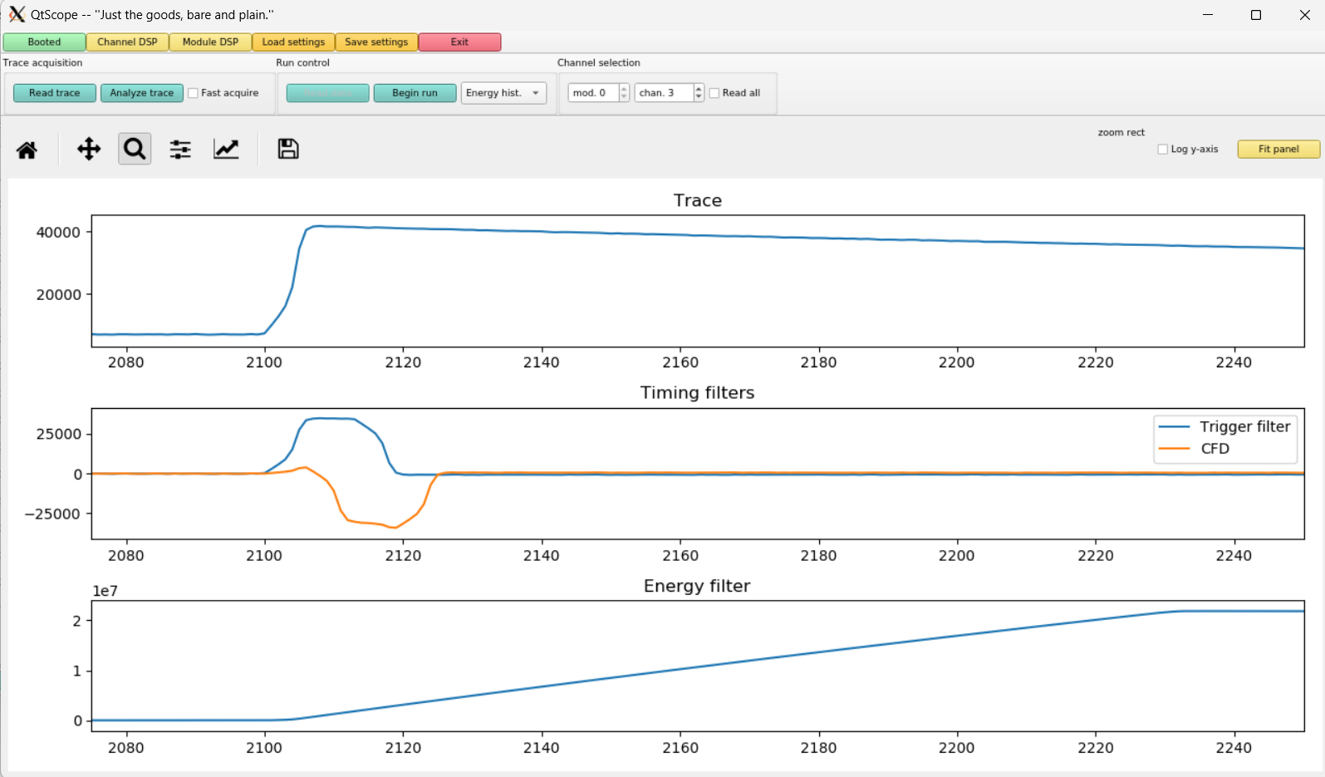
60Co
CFD Delay 0.504 μs, CFD Scale 7
Trigger Rise 0.016 μs
Trigger Gap 1.000 μs
Trigger Threshold 530, 1050

Slide 40
Run0254
60Co
Leading Edge
Trigger Rise 0.032 μs
Trigger Gap 0.984 μs
Trigger Threshold 330, 860
South 1173 && North 1332
South 1332 && North 1173
With a slightly larger Trigger Rise and a slightly smaller Trigger Gap, the LED is equally good.
Notes:
TFile *_file0 = TFile::Open("F:/e21010/pxct/run0254_LEGe_XtRa_60Co_I7281_MiddleXtRa_window1us_TrigRise0.032us_TrigGap0.984us_ThN330_ThS860_LED_cal.root");
TCanvas* canvaspeak = new TCanvas("canvaspeak", "canvaspeak", 1300, 800);//
canvaspeak->cd();//
canvaspeak->SetTopMargin(0.03);
canvaspeak->SetRightMargin(0.04);
canvaspeak->SetLeftMargin(0.13);
canvaspeak->SetBottomMargin(0.16);
canvaspeak->SetFrameLineWidth(2);
TH1D* htimestamps = new TH1D("htimestamps", "htimestamps", 250,-1000,1000);
htimestamps->SetLineWidth(2);
htimestamps->Rebin(1);
//htimestamps->SetStats(0);
htimestamps->SetTitle("");
htimestamps->GetXaxis()->SetTitle("North #minus South Time difference (ns)");
htimestamps->GetYaxis()->SetTitle("Counts per 8 ns");
htimestamps->GetXaxis()->CenterTitle();
htimestamps->GetYaxis()->CenterTitle();
htimestamps->GetXaxis()->SetLabelFont(132);
htimestamps->GetYaxis()->SetLabelFont(132);
htimestamps->GetXaxis()->SetLabelSize(0.06);
htimestamps->GetYaxis()->SetLabelSize(0.06);
htimestamps->GetXaxis()->SetTitleFont(132);
htimestamps->GetYaxis()->SetTitleFont(132);
htimestamps->GetXaxis()->SetTitleOffset(1.1);
htimestamps->GetYaxis()->SetTitleOffset(0.95);
htimestamps->GetXaxis()->SetTitleSize(0.07);
htimestamps->GetYaxis()->SetTitleSize(0.07);
htimestamps->GetXaxis()->SetRangeUser(-500,500);
//htimestamps->GetYaxis()->SetRangeUser(0,1700);
htimestamps->GetYaxis()->SetNdivisions(505);
htimestamps->SetLineWidth(2);
htimestamps->SetLineColor(kAzure+1);
tree->Draw("north_t-south_t>>htimestamps","south_e>1170&&south_e<1176&&north_e>1330&&north_e<1336");
tree->SetLineColor(kOrange+7);
tree->SetLineWidth(2);
tree->Draw("north_t-south_t","north_e>1170&&north_e<1176&&south_e>1330&&south_e<1336","same");

Slide 41
Notes:
TFile *_file0 = TFile::Open("F:/e21010/pxct/run0254_LEGe_XtRa_60Co_I7281_MiddleXtRa_window1us_TrigRise0.032us_TrigGap0.984us_ThN330_ThS860_LED_cal.root");
TCanvas* canvaspeak = new TCanvas("canvaspeak", "canvaspeak", 580, 800);
canvaspeak->cd();
canvaspeak->SetTopMargin(0.03);
canvaspeak->SetRightMargin(0.16);
canvaspeak->SetLeftMargin(0.18);
canvaspeak->SetBottomMargin(0.11);
canvaspeak->SetFrameLineWidth(2);
canvaspeak->SetLogz();
TH2D* het = new TH2D("het", "het", 250,-1000,1000,750,0,1500); //x,y
//tree->Draw("north_e:north_t-south_t>>het","north_e>1&&north_e<1500&&south_e>1170&&south_e<1176","colz"); //y:x
tree->Draw("north_e:north_t-south_t>>het","north_e>1&&north_e<1500&&south_e>1330&&south_e<1336","colz"); //y:x
het->SetStats(0);
het->SetTitle("");
het->GetXaxis()->SetTitle("North #minus South Time Difference (ns)");
het->GetYaxis()->SetTitle("North Energy (keV)");
het->GetXaxis()->CenterTitle();
het->GetYaxis()->CenterTitle();
het->GetXaxis()->SetLabelFont(132);
het->GetYaxis()->SetLabelFont(132);
het->GetXaxis()->SetLabelSize(0.05);
het->GetYaxis()->SetLabelSize(0.05);
het->GetXaxis()->SetTitleFont(132);
het->GetYaxis()->SetTitleFont(132);
het->GetXaxis()->SetTitleOffset(0.9);
het->GetYaxis()->SetTitleOffset(1.4);
het->GetXaxis()->SetTitleSize(0.06);
het->GetYaxis()->SetTitleSize(0.06);
het->GetXaxis()->SetNdivisions(505);
het->GetYaxis()->SetNdivisions(505);
//het->GetXaxis()->SetRangeUser(2001,4500);
//het->GetYaxis()->SetRangeUser(1000,2800);
//het->SetMinimum(2);
//het->SetMaximum(100);
het->SetContour(99);
gStyle->SetPalette(kRainbow);
//gPad->SetLogz();
TPaletteAxis *palette = (TPaletteAxis*)het->GetListOfFunctions()->FindObject("palette");
palette->SetTitleFont(132);
palette->SetTitleSize(0.05);
palette->SetLabelFont(132);
palette->SetLabelSize(0.05);
palette->SetLineWidth(2);
canvaspeak->SaveAs("F:/e21010/pxct/1.png");
canvaspeak->cd();
tree->Draw("north_e:north_t-south_t>>het","north_e>1&&north_e<1500&&south_e>1170&&south_e<1176","colz"); //y:x
het->SetContour(99);
canvaspeak->SaveAs("F:/e21010/pxct/2.png");

Slide 42
Run0253
60Co
Leading Edge
Trigger Rise 0.048 μs
Trigger Gap 0.968 μs
Trigger Threshold 270, 720
South 1173 && North 1332
South 1332 && North 1173
With a slightly larger Trigger Rise and a slightly smaller Trigger Gap, the LED is equally good.
Notes:
TFile *_file0 = TFile::Open("F:/e21010/pxct/run0253_LEGe_XtRa_60Co_I7281_MiddleXtRa_window1us_TrigRise0.048us_TrigGap0.968us_ThN270_ThS720_LED_cal.root");
TCanvas* canvaspeak = new TCanvas("canvaspeak", "canvaspeak", 1300, 800);//
canvaspeak->cd();//
canvaspeak->SetTopMargin(0.03);
canvaspeak->SetRightMargin(0.04);
canvaspeak->SetLeftMargin(0.13);
canvaspeak->SetBottomMargin(0.16);
canvaspeak->SetFrameLineWidth(2);
TH1D* htimestamps = new TH1D("htimestamps", "htimestamps", 250,-1000,1000);
htimestamps->SetLineWidth(2);
htimestamps->Rebin(1);
//htimestamps->SetStats(0);
htimestamps->SetTitle("");
htimestamps->GetXaxis()->SetTitle("North #minus South Time difference (ns)");
htimestamps->GetYaxis()->SetTitle("Counts per 8 ns");
htimestamps->GetXaxis()->CenterTitle();
htimestamps->GetYaxis()->CenterTitle();
htimestamps->GetXaxis()->SetLabelFont(132);
htimestamps->GetYaxis()->SetLabelFont(132);
htimestamps->GetXaxis()->SetLabelSize(0.06);
htimestamps->GetYaxis()->SetLabelSize(0.06);
htimestamps->GetXaxis()->SetTitleFont(132);
htimestamps->GetYaxis()->SetTitleFont(132);
htimestamps->GetXaxis()->SetTitleOffset(1.1);
htimestamps->GetYaxis()->SetTitleOffset(0.95);
htimestamps->GetXaxis()->SetTitleSize(0.07);
htimestamps->GetYaxis()->SetTitleSize(0.07);
htimestamps->GetXaxis()->SetRangeUser(-500,500);
//htimestamps->GetYaxis()->SetRangeUser(0,1700);
htimestamps->GetYaxis()->SetNdivisions(505);
htimestamps->SetLineWidth(2);
htimestamps->SetLineColor(kAzure+1);
tree->Draw("north_t-south_t>>htimestamps","south_e>1170&&south_e<1176&&north_e>1330&&north_e<1336");
tree->SetLineColor(kOrange+7);
tree->SetLineWidth(2);
tree->Draw("north_t-south_t","north_e>1170&&north_e<1176&&south_e>1330&&south_e<1336","same");

Slide 43
Notes:
TFile *_file0 = TFile::Open("F:/e21010/pxct/run0253_LEGe_XtRa_60Co_I7281_MiddleXtRa_window1us_TrigRise0.048us_TrigGap0.968us_ThN270_ThS720_LED_cal.root");
TCanvas* canvaspeak = new TCanvas("canvaspeak", "canvaspeak", 580, 800);
canvaspeak->cd();
canvaspeak->SetTopMargin(0.03);
canvaspeak->SetRightMargin(0.16);
canvaspeak->SetLeftMargin(0.18);
canvaspeak->SetBottomMargin(0.11);
canvaspeak->SetFrameLineWidth(2);
canvaspeak->SetLogz();
TH2D* het = new TH2D("het", "het", 250,-1000,1000,750,0,1500); //x,y
//tree->Draw("north_e:north_t-south_t>>het","north_e>1&&north_e<1500&&south_e>1170&&south_e<1176","colz"); //y:x
tree->Draw("north_e:north_t-south_t>>het","north_e>1&&north_e<1500&&south_e>1330&&south_e<1336","colz"); //y:x
het->SetStats(0);
het->SetTitle("");
het->GetXaxis()->SetTitle("North #minus South Time Difference (ns)");
het->GetYaxis()->SetTitle("North Energy (keV)");
het->GetXaxis()->CenterTitle();
het->GetYaxis()->CenterTitle();
het->GetXaxis()->SetLabelFont(132);
het->GetYaxis()->SetLabelFont(132);
het->GetXaxis()->SetLabelSize(0.05);
het->GetYaxis()->SetLabelSize(0.05);
het->GetXaxis()->SetTitleFont(132);
het->GetYaxis()->SetTitleFont(132);
het->GetXaxis()->SetTitleOffset(0.9);
het->GetYaxis()->SetTitleOffset(1.4);
het->GetXaxis()->SetTitleSize(0.06);
het->GetYaxis()->SetTitleSize(0.06);
het->GetXaxis()->SetNdivisions(505);
het->GetYaxis()->SetNdivisions(505);
//het->GetXaxis()->SetRangeUser(2001,4500);
//het->GetYaxis()->SetRangeUser(1000,2800);
//het->SetMinimum(2);
//het->SetMaximum(100);
het->SetContour(99);
gStyle->SetPalette(kRainbow);
//gPad->SetLogz();
TPaletteAxis *palette = (TPaletteAxis*)het->GetListOfFunctions()->FindObject("palette");
palette->SetTitleFont(132);
palette->SetTitleSize(0.05);
palette->SetLabelFont(132);
palette->SetLabelSize(0.05);
palette->SetLineWidth(2);
canvaspeak->SaveAs("F:/e21010/pxct/1.png");
canvaspeak->cd();
tree->Draw("north_e:north_t-south_t>>het","north_e>1&&north_e<1500&&south_e>1170&&south_e<1176","colz"); //y:x
het->SetContour(99);
canvaspeak->SaveAs("F:/e21010/pxct/2.png");

Slide 44
Run0244
60Co
Leading Edge
Trigger Rise 0.064 μs
Trigger Gap 0.952 μs
Trigger Threshold 260, 610
South 1173 && North 1332
South 1332 && North 1173
With a slightly larger Trigger Rise and a slightly smaller Trigger Gap, the LED is equally good, and we are able to set a lower threshold.
Notes:
TFile *_file0 = TFile::Open("F:/e21010/pxct/run0244_LEGe_XtRa_60Co_I7281_MiddleXtRa_window1us_TrigRise0.064us_TrigGap0.952us_ThN260_ThS610_LED_cal.root");
TCanvas* canvaspeak = new TCanvas("canvaspeak", "canvaspeak", 1300, 800);//
canvaspeak->cd();//
canvaspeak->SetTopMargin(0.03);
canvaspeak->SetRightMargin(0.04);
canvaspeak->SetLeftMargin(0.13);
canvaspeak->SetBottomMargin(0.16);
canvaspeak->SetFrameLineWidth(2);
TH1D* htimestamps = new TH1D("htimestamps", "htimestamps", 250,-1000,1000);
htimestamps->SetLineWidth(2);
htimestamps->Rebin(1);
//htimestamps->SetStats(0);
htimestamps->SetTitle("");
htimestamps->GetXaxis()->SetTitle("North #minus South Time difference (ns)");
htimestamps->GetYaxis()->SetTitle("Counts per 8 ns");
htimestamps->GetXaxis()->CenterTitle();
htimestamps->GetYaxis()->CenterTitle();
htimestamps->GetXaxis()->SetLabelFont(132);
htimestamps->GetYaxis()->SetLabelFont(132);
htimestamps->GetXaxis()->SetLabelSize(0.06);
htimestamps->GetYaxis()->SetLabelSize(0.06);
htimestamps->GetXaxis()->SetTitleFont(132);
htimestamps->GetYaxis()->SetTitleFont(132);
htimestamps->GetXaxis()->SetTitleOffset(1.1);
htimestamps->GetYaxis()->SetTitleOffset(0.95);
htimestamps->GetXaxis()->SetTitleSize(0.07);
htimestamps->GetYaxis()->SetTitleSize(0.07);
htimestamps->GetXaxis()->SetRangeUser(-1000,1000);
//htimestamps->GetYaxis()->SetRangeUser(0,1700);
htimestamps->GetYaxis()->SetNdivisions(505);
htimestamps->SetLineWidth(2);
htimestamps->SetLineColor(kAzure+1);
tree->Draw("north_t-south_t>>htimestamps","south_e>1170&&south_e<1176&&north_e>1330&&north_e<1336");
tree->SetLineColor(kOrange+7);
tree->SetLineWidth(2);
tree->Draw("north_t-south_t","north_e>1170&&north_e<1176&&south_e>1330&&south_e<1336","same");

Slide 45
Notes:
TFile *_file0 = TFile::Open("F:/e21010/pxct/run0244_LEGe_XtRa_60Co_I7281_MiddleXtRa_window1us_TrigRise0.064us_TrigGap0.952us_ThN260_ThS610_LED_cal.root");
TCanvas* canvaspeak = new TCanvas("canvaspeak", "canvaspeak", 580, 800);
canvaspeak->cd();
canvaspeak->SetTopMargin(0.03);
canvaspeak->SetRightMargin(0.16);
canvaspeak->SetLeftMargin(0.18);
canvaspeak->SetBottomMargin(0.11);
canvaspeak->SetFrameLineWidth(2);
canvaspeak->SetLogz();
TH2D* het = new TH2D("het", "het", 250,-1000,1000,750,0,1500); //x,y
//tree->Draw("north_e:north_t-south_t>>het","north_e>1&&north_e<1500&&south_e>1170&&south_e<1176","colz"); //y:x
tree->Draw("north_e:north_t-south_t>>het","north_e>1&&north_e<1500&&south_e>1330&&south_e<1336","colz"); //y:x
het->SetStats(0);
het->SetTitle("");
het->GetXaxis()->SetTitle("North #minus South Time Difference (ns)");
het->GetYaxis()->SetTitle("North Energy (keV)");
het->GetXaxis()->CenterTitle();
het->GetYaxis()->CenterTitle();
het->GetXaxis()->SetLabelFont(132);
het->GetYaxis()->SetLabelFont(132);
het->GetXaxis()->SetLabelSize(0.05);
het->GetYaxis()->SetLabelSize(0.05);
het->GetXaxis()->SetTitleFont(132);
het->GetYaxis()->SetTitleFont(132);
het->GetXaxis()->SetTitleOffset(0.9);
het->GetYaxis()->SetTitleOffset(1.4);
het->GetXaxis()->SetTitleSize(0.06);
het->GetYaxis()->SetTitleSize(0.06);
het->GetXaxis()->SetNdivisions(505);
het->GetYaxis()->SetNdivisions(505);
//het->GetXaxis()->SetRangeUser(2001,4500);
//het->GetYaxis()->SetRangeUser(1000,2800);
//het->SetMinimum(2);
//het->SetMaximum(100);
het->SetContour(99);
gStyle->SetPalette(kRainbow);
//gPad->SetLogz();
TPaletteAxis *palette = (TPaletteAxis*)het->GetListOfFunctions()->FindObject("palette");
palette->SetTitleFont(132);
palette->SetTitleSize(0.05);
palette->SetLabelFont(132);
palette->SetLabelSize(0.05);
palette->SetLineWidth(2);
canvaspeak->SaveAs("F:/e21010/pxct/1.png");
canvaspeak->cd();
tree->Draw("north_e:north_t-south_t>>het","north_e>1&&north_e<1500&&south_e>1170&&south_e<1176","colz"); //y:x
het->SetContour(99);
canvaspeak->SaveAs("F:/e21010/pxct/2.png");

Slide 46
Run0261
60Co
Leading Edge
Trigger Rise 0.064 μs
Trigger Gap 0.952 μs
Trigger Threshold 300, 700
South 1173 && North 1332
South 1332 && North 1173
Leading Edge Timing optimized. FWHM = 53 ns. Single Ge FWHM = 37 ns.
Notes:
TFile *_file0 = TFile::Open("F:/e21010/pxct/run0261_LEGe_XtRa_60Co_I7281_MiddleXtRa_window1us_TrigRise0.064us_TrigGap0.952us_ThN300_ThS700_LED_cal.root");
TCanvas* canvaspeak = new TCanvas("canvaspeak", "canvaspeak", 1300, 800);//
canvaspeak->cd();//
canvaspeak->SetTopMargin(0.03);
canvaspeak->SetRightMargin(0.04);
canvaspeak->SetLeftMargin(0.13);
canvaspeak->SetBottomMargin(0.16);
canvaspeak->SetFrameLineWidth(2);
TH1D* htimestamps = new TH1D("htimestamps", "htimestamps", 250,-1000,1000);
htimestamps->SetLineWidth(2);
htimestamps->Rebin(1);
//htimestamps->SetStats(0);
htimestamps->SetTitle("");
htimestamps->GetXaxis()->SetTitle("North #minus South Time difference (ns)");
htimestamps->GetYaxis()->SetTitle("Counts per 8 ns");
htimestamps->GetXaxis()->CenterTitle();
htimestamps->GetYaxis()->CenterTitle();
htimestamps->GetXaxis()->SetLabelFont(132);
htimestamps->GetYaxis()->SetLabelFont(132);
htimestamps->GetXaxis()->SetLabelSize(0.06);
htimestamps->GetYaxis()->SetLabelSize(0.06);
htimestamps->GetXaxis()->SetTitleFont(132);
htimestamps->GetYaxis()->SetTitleFont(132);
htimestamps->GetXaxis()->SetTitleOffset(1.1);
htimestamps->GetYaxis()->SetTitleOffset(0.95);
htimestamps->GetXaxis()->SetTitleSize(0.07);
htimestamps->GetYaxis()->SetTitleSize(0.07);
htimestamps->GetXaxis()->SetRangeUser(-500,500);
//htimestamps->GetYaxis()->SetRangeUser(0,1700);
htimestamps->GetYaxis()->SetNdivisions(505);
htimestamps->SetLineWidth(2);
htimestamps->SetLineColor(kAzure+1);
tree->Draw("north_t-south_t>>htimestamps","south_e>1170&&south_e<1176&&north_e>1330&&north_e<1336");
tree->SetLineColor(kOrange+7);
tree->SetLineWidth(2);
tree->Draw("north_t-south_t","north_e>1170&&north_e<1176&&south_e>1330&&south_e<1336","same");

Slide 47
Run0261
60Co
Leading Edge
Trigger Rise 0.064 μs
Trigger Gap 0.952 μs
Trigger Threshold 300, 700
South 1173 && North 1332
South 1332 && North 1173
Notes:
TFile *_file0 = TFile::Open("F:/e21010/pxct/run0261_LEGe_XtRa_60Co_I7281_MiddleXtRa_window1us_TrigRise0.064us_TrigGap0.952us_ThN300_ThS700_LED_cal.root");
TCanvas* canvaspeak = new TCanvas("canvaspeak", "canvaspeak", 1300, 800);//
canvaspeak->cd();//
canvaspeak->SetTopMargin(0.03);
canvaspeak->SetRightMargin(0.04);
canvaspeak->SetLeftMargin(0.13);
canvaspeak->SetBottomMargin(0.16);
canvaspeak->SetFrameLineWidth(2);
TH1D* htimestamps = new TH1D("htimestamps", "htimestamps", 500,-1000,1000);
htimestamps->SetLineWidth(2);
htimestamps->Rebin(1);
//htimestamps->SetStats(0);
htimestamps->SetTitle("");
htimestamps->GetXaxis()->SetTitle("North #minus South Time difference (ns)");
htimestamps->GetYaxis()->SetTitle("Counts per 4 ns");
htimestamps->GetXaxis()->CenterTitle();
htimestamps->GetYaxis()->CenterTitle();
htimestamps->GetXaxis()->SetLabelFont(132);
htimestamps->GetYaxis()->SetLabelFont(132);
htimestamps->GetXaxis()->SetLabelSize(0.06);
htimestamps->GetYaxis()->SetLabelSize(0.06);
htimestamps->GetXaxis()->SetTitleFont(132);
htimestamps->GetYaxis()->SetTitleFont(132);
htimestamps->GetXaxis()->SetTitleOffset(1.1);
htimestamps->GetYaxis()->SetTitleOffset(0.95);
htimestamps->GetXaxis()->SetTitleSize(0.07);
htimestamps->GetYaxis()->SetTitleSize(0.07);
htimestamps->GetXaxis()->SetRangeUser(-500,500);
//htimestamps->GetYaxis()->SetRangeUser(0,1700);
htimestamps->GetYaxis()->SetNdivisions(505);
htimestamps->SetLineWidth(2);
htimestamps->SetLineColor(kAzure+1);
tree->Draw("north_t-south_t>>htimestamps","south_e>1170&&south_e<1176&&north_e>1330&&north_e<1336");
tree->SetLineColor(kOrange+7);
tree->SetLineWidth(2);
tree->Draw("north_t-south_t","north_e>1170&&north_e<1176&&south_e>1330&&south_e<1336","same");

Slide 48
Notes:
TFile *_file0 = TFile::Open("F:/e21010/pxct/run0261_LEGe_XtRa_60Co_I7281_MiddleXtRa_window1us_TrigRise0.064us_TrigGap0.952us_ThN300_ThS700_LED_cal.root");
TCanvas* canvaspeak = new TCanvas("canvaspeak", "canvaspeak", 580, 800);
canvaspeak->cd();
canvaspeak->SetTopMargin(0.03);
canvaspeak->SetRightMargin(0.16);
canvaspeak->SetLeftMargin(0.18);
canvaspeak->SetBottomMargin(0.11);
canvaspeak->SetFrameLineWidth(2);
canvaspeak->SetLogz();
TH2D* het = new TH2D("het", "het", 250,-1000,1000,750,0,1500); //x,y
//tree->Draw("north_e:north_t-south_t>>het","north_e>1&&north_e<1500&&south_e>1170&&south_e<1176","colz"); //y:x
tree->Draw("north_e:north_t-south_t>>het","north_e>1&&north_e<1500&&south_e>1330&&south_e<1336","colz"); //y:x
het->SetStats(0);
het->SetTitle("");
het->GetXaxis()->SetTitle("North #minus South Time Difference (ns)");
het->GetYaxis()->SetTitle("North Energy (keV)");
het->GetXaxis()->CenterTitle();
het->GetYaxis()->CenterTitle();
het->GetXaxis()->SetLabelFont(132);
het->GetYaxis()->SetLabelFont(132);
het->GetXaxis()->SetLabelSize(0.05);
het->GetYaxis()->SetLabelSize(0.05);
het->GetXaxis()->SetTitleFont(132);
het->GetYaxis()->SetTitleFont(132);
het->GetXaxis()->SetTitleOffset(0.9);
het->GetYaxis()->SetTitleOffset(1.4);
het->GetXaxis()->SetTitleSize(0.06);
het->GetYaxis()->SetTitleSize(0.06);
het->GetXaxis()->SetNdivisions(505);
het->GetYaxis()->SetNdivisions(505);
//het->GetXaxis()->SetRangeUser(2001,4500);
//het->GetYaxis()->SetRangeUser(1000,2800);
//het->SetMinimum(2);
//het->SetMaximum(100);
het->SetContour(99);
gStyle->SetPalette(kRainbow);
//gPad->SetLogz();
TPaletteAxis *palette = (TPaletteAxis*)het->GetListOfFunctions()->FindObject("palette");
palette->SetTitleFont(132);
palette->SetTitleSize(0.05);
palette->SetLabelFont(132);
palette->SetLabelSize(0.05);
palette->SetLineWidth(2);
canvaspeak->SaveAs("F:/e21010/pxct/1.png");
canvaspeak->cd();
tree->Draw("north_e:north_t-south_t>>het","north_e>1&&north_e<1500&&south_e>1170&&south_e<1176","colz"); //y:x
het->SetContour(99);
canvaspeak->SaveAs("F:/e21010/pxct/2.png");

Slide 50
Run0245
60Co
Leading Edge
Trigger Rise 0.104 μs
Trigger Gap 0.912 μs
Trigger Threshold 210, 340
South 1173 && North 1332
South 1332 && North 1173
With Trigger Rise > 0.1 μs and Trigger Gap <0.9 μs, the LED is less optimal.
Notes:
TFile *_file0 = TFile::Open("F:/e21010/pxct/run0245_LEGe_XtRa_60Co_I7281_MiddleXtRa_window1us_TrigRise0.104us_TrigGap0.912us_ThN210_ThS340_LED_cal.root");
TCanvas* canvaspeak = new TCanvas("canvaspeak", "canvaspeak", 1300, 800);//
canvaspeak->cd();//
canvaspeak->SetTopMargin(0.03);
canvaspeak->SetRightMargin(0.04);
canvaspeak->SetLeftMargin(0.13);
canvaspeak->SetBottomMargin(0.16);
canvaspeak->SetFrameLineWidth(2);
TH1D* htimestamps = new TH1D("htimestamps", "htimestamps", 250,-1000,1000);
htimestamps->SetLineWidth(2);
htimestamps->Rebin(1);
//htimestamps->SetStats(0);
htimestamps->SetTitle("");
htimestamps->GetXaxis()->SetTitle("North #minus South Time difference (ns)");
htimestamps->GetYaxis()->SetTitle("Counts per 8 ns");
htimestamps->GetXaxis()->CenterTitle();
htimestamps->GetYaxis()->CenterTitle();
htimestamps->GetXaxis()->SetLabelFont(132);
htimestamps->GetYaxis()->SetLabelFont(132);
htimestamps->GetXaxis()->SetLabelSize(0.06);
htimestamps->GetYaxis()->SetLabelSize(0.06);
htimestamps->GetXaxis()->SetTitleFont(132);
htimestamps->GetYaxis()->SetTitleFont(132);
htimestamps->GetXaxis()->SetTitleOffset(1.1);
htimestamps->GetYaxis()->SetTitleOffset(0.95);
htimestamps->GetXaxis()->SetTitleSize(0.07);
htimestamps->GetYaxis()->SetTitleSize(0.07);
htimestamps->GetXaxis()->SetRangeUser(-1000,1000);
//htimestamps->GetYaxis()->SetRangeUser(0,1700);
htimestamps->GetYaxis()->SetNdivisions(505);
htimestamps->SetLineWidth(2);
htimestamps->SetLineColor(kAzure+1);
tree->Draw("north_t-south_t>>htimestamps","south_e>1170&&south_e<1176&&north_e>1330&&north_e<1336");
tree->SetLineColor(kOrange+7);
tree->SetLineWidth(2);
tree->Draw("north_t-south_t","north_e>1170&&north_e<1176&&south_e>1330&&south_e<1336","same");

Slide 51
Notes:
TFile *_file0 = TFile::Open("F:/e21010/pxct/run0245_LEGe_XtRa_60Co_I7281_MiddleXtRa_window1us_TrigRise0.104us_TrigGap0.912us_ThN210_ThS340_LED_cal.root");
TCanvas* canvaspeak = new TCanvas("canvaspeak", "canvaspeak", 580, 800);
canvaspeak->cd();
canvaspeak->SetTopMargin(0.03);
canvaspeak->SetRightMargin(0.16);
canvaspeak->SetLeftMargin(0.18);
canvaspeak->SetBottomMargin(0.11);
canvaspeak->SetFrameLineWidth(2);
canvaspeak->SetLogz();
TH2D* het = new TH2D("het", "het", 250,-1000,1000,750,0,1500); //x,y
//tree->Draw("north_e:north_t-south_t>>het","north_e>1&&north_e<1500&&south_e>1170&&south_e<1176","colz"); //y:x
tree->Draw("north_e:north_t-south_t>>het","north_e>1&&north_e<1500&&south_e>1330&&south_e<1336","colz"); //y:x
het->SetStats(0);
het->SetTitle("");
het->GetXaxis()->SetTitle("North #minus South Time Difference (ns)");
het->GetYaxis()->SetTitle("North Energy (keV)");
het->GetXaxis()->CenterTitle();
het->GetYaxis()->CenterTitle();
het->GetXaxis()->SetLabelFont(132);
het->GetYaxis()->SetLabelFont(132);
het->GetXaxis()->SetLabelSize(0.05);
het->GetYaxis()->SetLabelSize(0.05);
het->GetXaxis()->SetTitleFont(132);
het->GetYaxis()->SetTitleFont(132);
het->GetXaxis()->SetTitleOffset(0.9);
het->GetYaxis()->SetTitleOffset(1.4);
het->GetXaxis()->SetTitleSize(0.06);
het->GetYaxis()->SetTitleSize(0.06);
het->GetXaxis()->SetNdivisions(505);
het->GetYaxis()->SetNdivisions(505);
//het->GetXaxis()->SetRangeUser(2001,4500);
//het->GetYaxis()->SetRangeUser(1000,2800);
//het->SetMinimum(2);
//het->SetMaximum(100);
het->SetContour(99);
gStyle->SetPalette(kRainbow);
//gPad->SetLogz();
TPaletteAxis *palette = (TPaletteAxis*)het->GetListOfFunctions()->FindObject("palette");
palette->SetTitleFont(132);
palette->SetTitleSize(0.05);
palette->SetLabelFont(132);
palette->SetLabelSize(0.05);
palette->SetLineWidth(2);
canvaspeak->SaveAs("F:/e21010/pxct/1.png");
canvaspeak->cd();
tree->Draw("north_e:north_t-south_t>>het","north_e>1&&north_e<1500&&south_e>1170&&south_e<1176","colz"); //y:x
het->SetContour(99);
canvaspeak->SaveAs("F:/e21010/pxct/2.png");

Slide 52
Run0247
60Co
Leading Edge
Trigger Rise 0.104 μs
Trigger Gap 0.912 μs
Trigger Threshold 2520
South 1173 && North 1332
South 1332 && North 1173
With Trigger Rise > 0.1 μs and Trigger Gap <0.9 μs, the LED is less optimal.
Higher Threshold is always bad.
Notes:
TFile *_file0 = TFile::Open("F:/e21010/pxct/run0247_LEGe_XtRa_60Co_I7281_MiddleXtRa_window1us_TrigRise0.104us_TrigGap0.912us_ThN2520_ThS2520_LED_cal.root");
TCanvas* canvaspeak = new TCanvas("canvaspeak", "canvaspeak", 1300, 800);//
canvaspeak->cd();//
canvaspeak->SetTopMargin(0.03);
canvaspeak->SetRightMargin(0.04);
canvaspeak->SetLeftMargin(0.13);
canvaspeak->SetBottomMargin(0.16);
canvaspeak->SetFrameLineWidth(2);
TH1D* htimestamps = new TH1D("htimestamps", "htimestamps", 250,-1000,1000);
htimestamps->SetLineWidth(2);
htimestamps->Rebin(1);
//htimestamps->SetStats(0);
htimestamps->SetTitle("");
htimestamps->GetXaxis()->SetTitle("North #minus South Time difference (ns)");
htimestamps->GetYaxis()->SetTitle("Counts per 8 ns");
htimestamps->GetXaxis()->CenterTitle();
htimestamps->GetYaxis()->CenterTitle();
htimestamps->GetXaxis()->SetLabelFont(132);
htimestamps->GetYaxis()->SetLabelFont(132);
htimestamps->GetXaxis()->SetLabelSize(0.06);
htimestamps->GetYaxis()->SetLabelSize(0.06);
htimestamps->GetXaxis()->SetTitleFont(132);
htimestamps->GetYaxis()->SetTitleFont(132);
htimestamps->GetXaxis()->SetTitleOffset(1.1);
htimestamps->GetYaxis()->SetTitleOffset(0.95);
htimestamps->GetXaxis()->SetTitleSize(0.07);
htimestamps->GetYaxis()->SetTitleSize(0.07);
htimestamps->GetXaxis()->SetRangeUser(-1000,1000);
//htimestamps->GetYaxis()->SetRangeUser(0,1700);
htimestamps->GetYaxis()->SetNdivisions(505);
htimestamps->SetLineWidth(2);
htimestamps->SetLineColor(kAzure+1);
tree->Draw("north_t-south_t>>htimestamps","south_e>1170&&south_e<1176&&north_e>1330&&north_e<1336");
tree->SetLineColor(kOrange+7);
tree->SetLineWidth(2);
tree->Draw("north_t-south_t","north_e>1170&&north_e<1176&&south_e>1330&&south_e<1336","same");

Slide 53
Notes:
TFile *_file0 = TFile::Open("F:/e21010/pxct/run0247_LEGe_XtRa_60Co_I7281_MiddleXtRa_window1us_TrigRise0.104us_TrigGap0.912us_ThN2520_ThS2520_LED_cal.root");
TCanvas* canvaspeak = new TCanvas("canvaspeak", "canvaspeak", 580, 800);
canvaspeak->cd();
canvaspeak->SetTopMargin(0.03);
canvaspeak->SetRightMargin(0.16);
canvaspeak->SetLeftMargin(0.18);
canvaspeak->SetBottomMargin(0.11);
canvaspeak->SetFrameLineWidth(2);
canvaspeak->SetLogz();
TH2D* het = new TH2D("het", "het", 250,-1000,1000,750,0,1500); //x,y
//tree->Draw("north_e:north_t-south_t>>het","north_e>1&&north_e<1500&&south_e>1170&&south_e<1176","colz"); //y:x
tree->Draw("north_e:north_t-south_t>>het","north_e>1&&north_e<1500&&south_e>1330&&south_e<1336","colz"); //y:x
het->SetStats(0);
het->SetTitle("");
het->GetXaxis()->SetTitle("North #minus South Time Difference (ns)");
het->GetYaxis()->SetTitle("North Energy (keV)");
het->GetXaxis()->CenterTitle();
het->GetYaxis()->CenterTitle();
het->GetXaxis()->SetLabelFont(132);
het->GetYaxis()->SetLabelFont(132);
het->GetXaxis()->SetLabelSize(0.05);
het->GetYaxis()->SetLabelSize(0.05);
het->GetXaxis()->SetTitleFont(132);
het->GetYaxis()->SetTitleFont(132);
het->GetXaxis()->SetTitleOffset(0.9);
het->GetYaxis()->SetTitleOffset(1.4);
het->GetXaxis()->SetTitleSize(0.06);
het->GetYaxis()->SetTitleSize(0.06);
het->GetXaxis()->SetNdivisions(505);
het->GetYaxis()->SetNdivisions(505);
//het->GetXaxis()->SetRangeUser(2001,4500);
//het->GetYaxis()->SetRangeUser(1000,2800);
//het->SetMinimum(2);
//het->SetMaximum(100);
het->SetContour(99);
gStyle->SetPalette(kRainbow);
//gPad->SetLogz();
TPaletteAxis *palette = (TPaletteAxis*)het->GetListOfFunctions()->FindObject("palette");
palette->SetTitleFont(132);
palette->SetTitleSize(0.05);
palette->SetLabelFont(132);
palette->SetLabelSize(0.05);
palette->SetLineWidth(2);
canvaspeak->SaveAs("F:/e21010/pxct/1.png");
canvaspeak->cd();
tree->Draw("north_e:north_t-south_t>>het","north_e>1&&north_e<1500&&south_e>1170&&south_e<1176","colz"); //y:x
het->SetContour(99);
canvaspeak->SaveAs("F:/e21010/pxct/2.png");

Slide 54
Run0246
60Co
Leading Edge
Trigger Rise 0.200 μs
Trigger Gap 0.816 μs
Trigger Threshold 190, 330
South 1173 && North 1332
South 1332 && North 1173
With Trigger Rise > 0.1 μs and Trigger Gap <0.9 μs, the LED is less optimal.
Notes:
TFile *_file0 = TFile::Open("F:/e21010/pxct/run0246_LEGe_XtRa_60Co_I7281_MiddleXtRa_window1us_TrigRise0.200us_TrigGap0.816us_ThN190_ThS330_LED_cal.root");
TCanvas* canvaspeak = new TCanvas("canvaspeak", "canvaspeak", 1300, 800);//
canvaspeak->cd();//
canvaspeak->SetTopMargin(0.03);
canvaspeak->SetRightMargin(0.04);
canvaspeak->SetLeftMargin(0.13);
canvaspeak->SetBottomMargin(0.16);
canvaspeak->SetFrameLineWidth(2);
TH1D* htimestamps = new TH1D("htimestamps", "htimestamps", 250,-1000,1000);
htimestamps->SetLineWidth(2);
htimestamps->Rebin(1);
//htimestamps->SetStats(0);
htimestamps->SetTitle("");
htimestamps->GetXaxis()->SetTitle("North #minus South Time difference (ns)");
htimestamps->GetYaxis()->SetTitle("Counts per 8 ns");
htimestamps->GetXaxis()->CenterTitle();
htimestamps->GetYaxis()->CenterTitle();
htimestamps->GetXaxis()->SetLabelFont(132);
htimestamps->GetYaxis()->SetLabelFont(132);
htimestamps->GetXaxis()->SetLabelSize(0.06);
htimestamps->GetYaxis()->SetLabelSize(0.06);
htimestamps->GetXaxis()->SetTitleFont(132);
htimestamps->GetYaxis()->SetTitleFont(132);
htimestamps->GetXaxis()->SetTitleOffset(1.1);
htimestamps->GetYaxis()->SetTitleOffset(0.95);
htimestamps->GetXaxis()->SetTitleSize(0.07);
htimestamps->GetYaxis()->SetTitleSize(0.07);
htimestamps->GetXaxis()->SetRangeUser(-1000,1000);
//htimestamps->GetYaxis()->SetRangeUser(0,1700);
htimestamps->GetYaxis()->SetNdivisions(505);
htimestamps->SetLineWidth(2);
htimestamps->SetLineColor(kAzure+1);
tree->Draw("north_t-south_t>>htimestamps","south_e>1170&&south_e<1176&&north_e>1330&&north_e<1336");
tree->SetLineColor(kOrange+7);
tree->SetLineWidth(2);
tree->Draw("north_t-south_t","north_e>1170&&north_e<1176&&south_e>1330&&south_e<1336","same");

Slide 55
Notes:
TFile *_file0 = TFile::Open("F:/e21010/pxct/run0246_LEGe_XtRa_60Co_I7281_MiddleXtRa_window1us_TrigRise0.200us_TrigGap0.816us_ThN190_ThS330_LED_cal.root");
TCanvas* canvaspeak = new TCanvas("canvaspeak", "canvaspeak", 580, 800);
canvaspeak->cd();
canvaspeak->SetTopMargin(0.03);
canvaspeak->SetRightMargin(0.16);
canvaspeak->SetLeftMargin(0.18);
canvaspeak->SetBottomMargin(0.11);
canvaspeak->SetFrameLineWidth(2);
canvaspeak->SetLogz();
TH2D* het = new TH2D("het", "het", 250,-1000,1000,750,0,1500); //x,y
//tree->Draw("north_e:north_t-south_t>>het","north_e>1&&north_e<1500&&south_e>1170&&south_e<1176","colz"); //y:x
tree->Draw("north_e:north_t-south_t>>het","north_e>1&&north_e<1500&&south_e>1330&&south_e<1336","colz"); //y:x
het->SetStats(0);
het->SetTitle("");
het->GetXaxis()->SetTitle("North #minus South Time Difference (ns)");
het->GetYaxis()->SetTitle("North Energy (keV)");
het->GetXaxis()->CenterTitle();
het->GetYaxis()->CenterTitle();
het->GetXaxis()->SetLabelFont(132);
het->GetYaxis()->SetLabelFont(132);
het->GetXaxis()->SetLabelSize(0.05);
het->GetYaxis()->SetLabelSize(0.05);
het->GetXaxis()->SetTitleFont(132);
het->GetYaxis()->SetTitleFont(132);
het->GetXaxis()->SetTitleOffset(0.9);
het->GetYaxis()->SetTitleOffset(1.4);
het->GetXaxis()->SetTitleSize(0.06);
het->GetYaxis()->SetTitleSize(0.06);
het->GetXaxis()->SetNdivisions(505);
het->GetYaxis()->SetNdivisions(505);
//het->GetXaxis()->SetRangeUser(2001,4500);
//het->GetYaxis()->SetRangeUser(1000,2800);
//het->SetMinimum(2);
//het->SetMaximum(100);
het->SetContour(99);
gStyle->SetPalette(kRainbow);
//gPad->SetLogz();
TPaletteAxis *palette = (TPaletteAxis*)het->GetListOfFunctions()->FindObject("palette");
palette->SetTitleFont(132);
palette->SetTitleSize(0.05);
palette->SetLabelFont(132);
palette->SetLabelSize(0.05);
palette->SetLineWidth(2);
canvaspeak->SaveAs("F:/e21010/pxct/1.png");
canvaspeak->cd();
tree->Draw("north_e:north_t-south_t>>het","north_e>1&&north_e<1500&&south_e>1170&&south_e<1176","colz"); //y:x
het->SetContour(99);
canvaspeak->SaveAs("F:/e21010/pxct/2.png");

Slide 56
Run0249
60Co
CFD Delay 0.504 μs
CFD Scale 0
Trigger Rise 0.064 μs
Trigger Gap 0.952 μs
Trigger Threshold 260, 610
South 1173 && North 1332
South 1332 && North 1173
CFD in DDAS has 2 parameters: CFD Delay 0.008-0.504 μs; Scale Factor 0-7.
Under good LED, CFD is bad with large Delay and small Scale. Same as Run242.
Notes:
TFile *_file0 = TFile::Open("F:/e21010/pxct/run0249_LEGe_XtRa_60Co_I7281_MiddleXtRa_window1us_TrigRise0.064us_TrigGap0.952us_ThN260_ThS610_CFDDelay0.504us_cal.root");
TCanvas* canvaspeak = new TCanvas("canvaspeak", "canvaspeak", 1300, 800);//
canvaspeak->cd();//
canvaspeak->SetTopMargin(0.03);
canvaspeak->SetRightMargin(0.04);
canvaspeak->SetLeftMargin(0.13);
canvaspeak->SetBottomMargin(0.16);
canvaspeak->SetFrameLineWidth(2);
TH1D* htimestamps = new TH1D("htimestamps", "htimestamps", 250,-1000,1000);
htimestamps->SetLineWidth(2);
htimestamps->Rebin(1);
//htimestamps->SetStats(0);
htimestamps->SetTitle("");
htimestamps->GetXaxis()->SetTitle("North #minus South Time difference (ns)");
htimestamps->GetYaxis()->SetTitle("Counts per 8 ns");
htimestamps->GetXaxis()->CenterTitle();
htimestamps->GetYaxis()->CenterTitle();
htimestamps->GetXaxis()->SetLabelFont(132);
htimestamps->GetYaxis()->SetLabelFont(132);
htimestamps->GetXaxis()->SetLabelSize(0.06);
htimestamps->GetYaxis()->SetLabelSize(0.06);
htimestamps->GetXaxis()->SetTitleFont(132);
htimestamps->GetYaxis()->SetTitleFont(132);
htimestamps->GetXaxis()->SetTitleOffset(1.1);
htimestamps->GetYaxis()->SetTitleOffset(0.95);
htimestamps->GetXaxis()->SetTitleSize(0.07);
htimestamps->GetYaxis()->SetTitleSize(0.07);
htimestamps->GetXaxis()->SetRangeUser(-1000,1000);
//htimestamps->GetYaxis()->SetRangeUser(0,1700);
htimestamps->GetYaxis()->SetNdivisions(505);
htimestamps->SetLineWidth(2);
htimestamps->SetLineColor(kAzure+1);
tree->Draw("north_t-south_t>>htimestamps","south_e>1170&&south_e<1176&&north_e>1330&&north_e<1336");
tree->SetLineColor(kOrange+7);
tree->SetLineWidth(2);
tree->Draw("north_t-south_t","north_e>1170&&north_e<1176&&south_e>1330&&south_e<1336","same");

Slide 57
Notes:
TFile *_file0 = TFile::Open("F:/e21010/pxct/run0249_LEGe_XtRa_60Co_I7281_MiddleXtRa_window1us_TrigRise0.064us_TrigGap0.952us_ThN260_ThS610_CFDDelay0.504us_cal.root");
TCanvas* canvaspeak = new TCanvas("canvaspeak", "canvaspeak", 580, 800);
canvaspeak->cd();
canvaspeak->SetTopMargin(0.03);
canvaspeak->SetRightMargin(0.16);
canvaspeak->SetLeftMargin(0.18);
canvaspeak->SetBottomMargin(0.11);
canvaspeak->SetFrameLineWidth(2);
canvaspeak->SetLogz();
TH2D* het = new TH2D("het", "het", 250,-1000,1000,750,0,1500); //x,y
//tree->Draw("north_e:north_t-south_t>>het","north_e>1&&north_e<1500&&south_e>1170&&south_e<1176","colz"); //y:x
tree->Draw("north_e:north_t-south_t>>het","north_e>1&&north_e<1500&&south_e>1330&&south_e<1336","colz"); //y:x
het->SetStats(0);
het->SetTitle("");
het->GetXaxis()->SetTitle("North #minus South Time Difference (ns)");
het->GetYaxis()->SetTitle("North Energy (keV)");
het->GetXaxis()->CenterTitle();
het->GetYaxis()->CenterTitle();
het->GetXaxis()->SetLabelFont(132);
het->GetYaxis()->SetLabelFont(132);
het->GetXaxis()->SetLabelSize(0.05);
het->GetYaxis()->SetLabelSize(0.05);
het->GetXaxis()->SetTitleFont(132);
het->GetYaxis()->SetTitleFont(132);
het->GetXaxis()->SetTitleOffset(0.9);
het->GetYaxis()->SetTitleOffset(1.4);
het->GetXaxis()->SetTitleSize(0.06);
het->GetYaxis()->SetTitleSize(0.06);
het->GetXaxis()->SetNdivisions(505);
het->GetYaxis()->SetNdivisions(505);
//het->GetXaxis()->SetRangeUser(2001,4500);
//het->GetYaxis()->SetRangeUser(1000,2800);
//het->SetMinimum(2);
//het->SetMaximum(100);
het->SetContour(99);
gStyle->SetPalette(kRainbow);
//gPad->SetLogz();
TPaletteAxis *palette = (TPaletteAxis*)het->GetListOfFunctions()->FindObject("palette");
palette->SetTitleFont(132);
palette->SetTitleSize(0.05);
palette->SetLabelFont(132);
palette->SetLabelSize(0.05);
palette->SetLineWidth(2);
canvaspeak->SaveAs("F:/e21010/pxct/1.png");
canvaspeak->cd();
tree->Draw("north_e:north_t-south_t>>het","north_e>1&&north_e<1500&&south_e>1170&&south_e<1176","colz"); //y:x
het->SetContour(99);
canvaspeak->SaveAs("F:/e21010/pxct/2.png");

Slide 58
Run0248
60Co
CFD Delay 0.504 μs
CFD Scale 0
Trigger Rise 0.064 μs
Trigger Gap 0.504 μs
Trigger Threshold 260, 610
South 1173 && North 1332
South 1332 && North 1173
Reducing Trigger Gap to 0.504 μs to accommodate CFD_{max} = 0.504 μs makes it even worse.
Notes:
TFile *_file0 = TFile::Open("F:/e21010/pxct/run0248_LEGe_XtRa_60Co_I7281_MiddleXtRa_window1us_TrigRise0.064us_TrigGap0.504us_ThN260_ThS610_CFDDelay0.504us_cal.root");
TCanvas* canvaspeak = new TCanvas("canvaspeak", "canvaspeak", 1300, 800);//
canvaspeak->cd();//
canvaspeak->SetTopMargin(0.03);
canvaspeak->SetRightMargin(0.04);
canvaspeak->SetLeftMargin(0.13);
canvaspeak->SetBottomMargin(0.16);
canvaspeak->SetFrameLineWidth(2);
TH1D* htimestamps = new TH1D("htimestamps", "htimestamps", 250,-1000,1000);
htimestamps->SetLineWidth(2);
htimestamps->Rebin(1);
//htimestamps->SetStats(0);
htimestamps->SetTitle("");
htimestamps->GetXaxis()->SetTitle("North #minus South Time difference (ns)");
htimestamps->GetYaxis()->SetTitle("Counts per 8 ns");
htimestamps->GetXaxis()->CenterTitle();
htimestamps->GetYaxis()->CenterTitle();
htimestamps->GetXaxis()->SetLabelFont(132);
htimestamps->GetYaxis()->SetLabelFont(132);
htimestamps->GetXaxis()->SetLabelSize(0.06);
htimestamps->GetYaxis()->SetLabelSize(0.06);
htimestamps->GetXaxis()->SetTitleFont(132);
htimestamps->GetYaxis()->SetTitleFont(132);
htimestamps->GetXaxis()->SetTitleOffset(1.1);
htimestamps->GetYaxis()->SetTitleOffset(0.95);
htimestamps->GetXaxis()->SetTitleSize(0.07);
htimestamps->GetYaxis()->SetTitleSize(0.07);
htimestamps->GetXaxis()->SetRangeUser(-1000,1000);
//htimestamps->GetYaxis()->SetRangeUser(0,1700);
htimestamps->GetYaxis()->SetNdivisions(505);
htimestamps->SetLineWidth(2);
htimestamps->SetLineColor(kAzure+1);
tree->Draw("north_t-south_t>>htimestamps","south_e>1170&&south_e<1176&&north_e>1330&&north_e<1336");
tree->SetLineColor(kOrange+7);
tree->SetLineWidth(2);
tree->Draw("north_t-south_t","north_e>1170&&north_e<1176&&south_e>1330&&south_e<1336","same");

Slide 59
Notes:
TFile *_file0 = TFile::Open("F:/e21010/pxct/run0248_LEGe_XtRa_60Co_I7281_MiddleXtRa_window1us_TrigRise0.064us_TrigGap0.504us_ThN260_ThS610_CFDDelay0.504us_cal.root");
TCanvas* canvaspeak = new TCanvas("canvaspeak", "canvaspeak", 580, 800);
canvaspeak->cd();
canvaspeak->SetTopMargin(0.03);
canvaspeak->SetRightMargin(0.16);
canvaspeak->SetLeftMargin(0.18);
canvaspeak->SetBottomMargin(0.11);
canvaspeak->SetFrameLineWidth(2);
canvaspeak->SetLogz();
TH2D* het = new TH2D("het", "het", 250,-1000,1000,750,0,1500); //x,y
//tree->Draw("north_e:north_t-south_t>>het","north_e>1&&north_e<1500&&south_e>1170&&south_e<1176","colz"); //y:x
tree->Draw("north_e:north_t-south_t>>het","north_e>1&&north_e<1500&&south_e>1330&&south_e<1336","colz"); //y:x
het->SetStats(0);
het->SetTitle("");
het->GetXaxis()->SetTitle("North #minus South Time Difference (ns)");
het->GetYaxis()->SetTitle("North Energy (keV)");
het->GetXaxis()->CenterTitle();
het->GetYaxis()->CenterTitle();
het->GetXaxis()->SetLabelFont(132);
het->GetYaxis()->SetLabelFont(132);
het->GetXaxis()->SetLabelSize(0.05);
het->GetYaxis()->SetLabelSize(0.05);
het->GetXaxis()->SetTitleFont(132);
het->GetYaxis()->SetTitleFont(132);
het->GetXaxis()->SetTitleOffset(0.9);
het->GetYaxis()->SetTitleOffset(1.4);
het->GetXaxis()->SetTitleSize(0.06);
het->GetYaxis()->SetTitleSize(0.06);
het->GetXaxis()->SetNdivisions(505);
het->GetYaxis()->SetNdivisions(505);
//het->GetXaxis()->SetRangeUser(2001,4500);
//het->GetYaxis()->SetRangeUser(1000,2800);
//het->SetMinimum(2);
//het->SetMaximum(100);
het->SetContour(99);
gStyle->SetPalette(kRainbow);
//gPad->SetLogz();
TPaletteAxis *palette = (TPaletteAxis*)het->GetListOfFunctions()->FindObject("palette");
palette->SetTitleFont(132);
palette->SetTitleSize(0.05);
palette->SetLabelFont(132);
palette->SetLabelSize(0.05);
palette->SetLineWidth(2);
canvaspeak->SaveAs("F:/e21010/pxct/1.png");
canvaspeak->cd();
tree->Draw("north_e:north_t-south_t>>het","north_e>1&&north_e<1500&&south_e>1170&&south_e<1176","colz"); //y:x
het->SetContour(99);
canvaspeak->SaveAs("F:/e21010/pxct/2.png");

Slide 60
Run0250
60Co
CFD Delay 0.504 μs
CFD Scale 4
Trigger Rise 0.064 μs
Trigger Gap 0.952 μs
Trigger Threshold 260, 610
South 1173 && North 1332
South 1332 && North 1173
CFD in DDAS has 2 parameters: CFD Delay 0.008-0.504 μs; Scale Factor 0-7.
Under good LED, CFD is bad with large Delay and medium Scale.
Notes:
TFile *_file0 = TFile::Open("F:/e21010/pxct/run0250_LEGe_XtRa_60Co_I7281_MiddleXtRa_window1us_TrigRise0.064us_TrigGap0.952us_ThN260_ThS610_CFDDelay0.504us_Scale4_cal.root");
TCanvas* canvaspeak = new TCanvas("canvaspeak", "canvaspeak", 1300, 800);//
canvaspeak->cd();//
canvaspeak->SetTopMargin(0.03);
canvaspeak->SetRightMargin(0.04);
canvaspeak->SetLeftMargin(0.13);
canvaspeak->SetBottomMargin(0.16);
canvaspeak->SetFrameLineWidth(2);
TH1D* htimestamps = new TH1D("htimestamps", "htimestamps", 250,-1000,1000);
htimestamps->SetLineWidth(2);
htimestamps->Rebin(1);
//htimestamps->SetStats(0);
htimestamps->SetTitle("");
htimestamps->GetXaxis()->SetTitle("North #minus South Time difference (ns)");
htimestamps->GetYaxis()->SetTitle("Counts per 8 ns");
htimestamps->GetXaxis()->CenterTitle();
htimestamps->GetYaxis()->CenterTitle();
htimestamps->GetXaxis()->SetLabelFont(132);
htimestamps->GetYaxis()->SetLabelFont(132);
htimestamps->GetXaxis()->SetLabelSize(0.06);
htimestamps->GetYaxis()->SetLabelSize(0.06);
htimestamps->GetXaxis()->SetTitleFont(132);
htimestamps->GetYaxis()->SetTitleFont(132);
htimestamps->GetXaxis()->SetTitleOffset(1.1);
htimestamps->GetYaxis()->SetTitleOffset(0.95);
htimestamps->GetXaxis()->SetTitleSize(0.07);
htimestamps->GetYaxis()->SetTitleSize(0.07);
htimestamps->GetXaxis()->SetRangeUser(-500,500);
//htimestamps->GetYaxis()->SetRangeUser(0,1700);
htimestamps->GetYaxis()->SetNdivisions(505);
htimestamps->SetLineWidth(2);
htimestamps->SetLineColor(kAzure+1);
tree->Draw("north_t-south_t>>htimestamps","south_e>1170&&south_e<1176&&north_e>1330&&north_e<1336");
tree->SetLineColor(kOrange+7);
tree->SetLineWidth(2);
tree->Draw("north_t-south_t","north_e>1170&&north_e<1176&&south_e>1330&&south_e<1336","same");

Slide 61
Notes:
TFile *_file0 = TFile::Open("F:/e21010/pxct/run0250_LEGe_XtRa_60Co_I7281_MiddleXtRa_window1us_TrigRise0.064us_TrigGap0.952us_ThN260_ThS610_CFDDelay0.504us_Scale4_cal.root");
TCanvas* canvaspeak = new TCanvas("canvaspeak", "canvaspeak", 580, 800);
canvaspeak->cd();
canvaspeak->SetTopMargin(0.03);
canvaspeak->SetRightMargin(0.16);
canvaspeak->SetLeftMargin(0.18);
canvaspeak->SetBottomMargin(0.11);
canvaspeak->SetFrameLineWidth(2);
canvaspeak->SetLogz();
TH2D* het = new TH2D("het", "het", 250,-1000,1000,750,0,1500); //x,y
//tree->Draw("north_e:north_t-south_t>>het","north_e>1&&north_e<1500&&south_e>1170&&south_e<1176","colz"); //y:x
tree->Draw("north_e:north_t-south_t>>het","north_e>1&&north_e<1500&&south_e>1330&&south_e<1336","colz"); //y:x
het->SetStats(0);
het->SetTitle("");
het->GetXaxis()->SetTitle("North #minus South Time Difference (ns)");
het->GetYaxis()->SetTitle("North Energy (keV)");
het->GetXaxis()->CenterTitle();
het->GetYaxis()->CenterTitle();
het->GetXaxis()->SetLabelFont(132);
het->GetYaxis()->SetLabelFont(132);
het->GetXaxis()->SetLabelSize(0.05);
het->GetYaxis()->SetLabelSize(0.05);
het->GetXaxis()->SetTitleFont(132);
het->GetYaxis()->SetTitleFont(132);
het->GetXaxis()->SetTitleOffset(0.9);
het->GetYaxis()->SetTitleOffset(1.4);
het->GetXaxis()->SetTitleSize(0.06);
het->GetYaxis()->SetTitleSize(0.06);
het->GetXaxis()->SetNdivisions(505);
het->GetYaxis()->SetNdivisions(505);
//het->GetXaxis()->SetRangeUser(2001,4500);
//het->GetYaxis()->SetRangeUser(1000,2800);
//het->SetMinimum(2);
//het->SetMaximum(100);
het->SetContour(99);
gStyle->SetPalette(kRainbow);
//gPad->SetLogz();
TPaletteAxis *palette = (TPaletteAxis*)het->GetListOfFunctions()->FindObject("palette");
palette->SetTitleFont(132);
palette->SetTitleSize(0.05);
palette->SetLabelFont(132);
palette->SetLabelSize(0.05);
palette->SetLineWidth(2);
canvaspeak->SaveAs("F:/e21010/pxct/1.png");
canvaspeak->cd();
tree->Draw("north_e:north_t-south_t>>het","north_e>1&&north_e<1500&&south_e>1170&&south_e<1176","colz"); //y:x
het->SetContour(99);
canvaspeak->SaveAs("F:/e21010/pxct/2.png");

Slide 62
Run0251
60Co
CFD Delay 0.504 μs
CFD Scale 7
Trigger Rise 0.064 μs
Trigger Gap 0.952 μs
Trigger Threshold 260, 610
South 1173 && North 1332
South 1332 && North 1173
CFD in DDAS has 2 parameters: CFD Delay 0.008-0.504 μs; Scale Factor 0-7.
Under good LED, CFD is better with larger Scale.
Notes:
TFile *_file0 = TFile::Open("F:/e21010/pxct/run0251_LEGe_XtRa_60Co_I7281_MiddleXtRa_window1us_TrigRise0.064us_TrigGap0.952us_ThN260_ThS610_CFDDelay0.504us_Scale7_cal.root");
TCanvas* canvaspeak = new TCanvas("canvaspeak", "canvaspeak", 1300, 800);//
canvaspeak->cd();//
canvaspeak->SetTopMargin(0.03);
canvaspeak->SetRightMargin(0.04);
canvaspeak->SetLeftMargin(0.13);
canvaspeak->SetBottomMargin(0.16);
canvaspeak->SetFrameLineWidth(2);
TH1D* htimestamps = new TH1D("htimestamps", "htimestamps", 250,-1000,1000);
htimestamps->SetLineWidth(2);
htimestamps->Rebin(1);
//htimestamps->SetStats(0);
htimestamps->SetTitle("");
htimestamps->GetXaxis()->SetTitle("North #minus South Time difference (ns)");
htimestamps->GetYaxis()->SetTitle("Counts per 8 ns");
htimestamps->GetXaxis()->CenterTitle();
htimestamps->GetYaxis()->CenterTitle();
htimestamps->GetXaxis()->SetLabelFont(132);
htimestamps->GetYaxis()->SetLabelFont(132);
htimestamps->GetXaxis()->SetLabelSize(0.06);
htimestamps->GetYaxis()->SetLabelSize(0.06);
htimestamps->GetXaxis()->SetTitleFont(132);
htimestamps->GetYaxis()->SetTitleFont(132);
htimestamps->GetXaxis()->SetTitleOffset(1.1);
htimestamps->GetYaxis()->SetTitleOffset(0.95);
htimestamps->GetXaxis()->SetTitleSize(0.07);
htimestamps->GetYaxis()->SetTitleSize(0.07);
htimestamps->GetXaxis()->SetRangeUser(-1000,1000);
//htimestamps->GetYaxis()->SetRangeUser(0,1700);
htimestamps->GetYaxis()->SetNdivisions(505);
htimestamps->SetLineWidth(2);
htimestamps->SetLineColor(kAzure+1);
tree->Draw("north_t-south_t>>htimestamps","south_e>1170&&south_e<1176&&north_e>1330&&north_e<1336");
tree->SetLineColor(kOrange+7);
tree->SetLineWidth(2);
tree->Draw("north_t-south_t","north_e>1170&&north_e<1176&&south_e>1330&&south_e<1336","same");

Slide 63
Notes:
TFile *_file0 = TFile::Open("F:/e21010/pxct/run0251_LEGe_XtRa_60Co_I7281_MiddleXtRa_window1us_TrigRise0.064us_TrigGap0.952us_ThN260_ThS610_CFDDelay0.504us_Scale7_cal.root");
TCanvas* canvaspeak = new TCanvas("canvaspeak", "canvaspeak", 580, 800);
canvaspeak->cd();
canvaspeak->SetTopMargin(0.03);
canvaspeak->SetRightMargin(0.16);
canvaspeak->SetLeftMargin(0.18);
canvaspeak->SetBottomMargin(0.11);
canvaspeak->SetFrameLineWidth(2);
canvaspeak->SetLogz();
TH2D* het = new TH2D("het", "het", 250,-1000,1000,750,0,1500); //x,y
//tree->Draw("north_e:north_t-south_t>>het","north_e>1&&north_e<1500&&south_e>1170&&south_e<1176","colz"); //y:x
tree->Draw("north_e:north_t-south_t>>het","north_e>1&&north_e<1500&&south_e>1330&&south_e<1336","colz"); //y:x
het->SetStats(0);
het->SetTitle("");
het->GetXaxis()->SetTitle("North #minus South Time Difference (ns)");
het->GetYaxis()->SetTitle("North Energy (keV)");
het->GetXaxis()->CenterTitle();
het->GetYaxis()->CenterTitle();
het->GetXaxis()->SetLabelFont(132);
het->GetYaxis()->SetLabelFont(132);
het->GetXaxis()->SetLabelSize(0.05);
het->GetYaxis()->SetLabelSize(0.05);
het->GetXaxis()->SetTitleFont(132);
het->GetYaxis()->SetTitleFont(132);
het->GetXaxis()->SetTitleOffset(0.9);
het->GetYaxis()->SetTitleOffset(1.4);
het->GetXaxis()->SetTitleSize(0.06);
het->GetYaxis()->SetTitleSize(0.06);
het->GetXaxis()->SetNdivisions(505);
het->GetYaxis()->SetNdivisions(505);
//het->GetXaxis()->SetRangeUser(2001,4500);
//het->GetYaxis()->SetRangeUser(1000,2800);
//het->SetMinimum(2);
//het->SetMaximum(100);
het->SetContour(99);
gStyle->SetPalette(kRainbow);
//gPad->SetLogz();
TPaletteAxis *palette = (TPaletteAxis*)het->GetListOfFunctions()->FindObject("palette");
palette->SetTitleFont(132);
palette->SetTitleSize(0.05);
palette->SetLabelFont(132);
palette->SetLabelSize(0.05);
palette->SetLineWidth(2);
canvaspeak->SaveAs("F:/e21010/pxct/1.png");
canvaspeak->cd();
tree->Draw("north_e:north_t-south_t>>het","north_e>1&&north_e<1500&&south_e>1170&&south_e<1176","colz"); //y:x
het->SetContour(99);
canvaspeak->SaveAs("F:/e21010/pxct/2.png");

Slide 64
σT = 111 ns
Run0251 60Co
CFD Delay 0.504 μs
CFD Scale 7
Trigger Rise 0.064 μs
Trigger Gap 0.952 μs
Trigger Threshold 260, 610

Slide 65
Run0255
60Co
CFD Delay 0.008 μs
CFD Scale 7
Trigger Rise 0.064 μs
Trigger Gap 0.952 μs
Trigger Threshold 300, 700
South 1173 && North 1332
South 1332 && North 1173
CFD in DDAS has 2 parameters: CFD Delay 0.008-0.504 μs; Scale Factor 0-7.
CFD doesn't seem to do anything (equivalent to LED) if using Delay_{min} = 0.008 μs.
Notes:
TFile *_file0 = TFile::Open("F:/e21010/pxct/run0255_LEGe_XtRa_60Co_I7281_MiddleXtRa_window1us_TrigRise0.064us_TrigGap0.952us_ThN300_ThS700_CFDDelay0.008us_Scale7_cal.root");
TCanvas* canvaspeak = new TCanvas("canvaspeak", "canvaspeak", 1300, 800);//
canvaspeak->cd();//
canvaspeak->SetTopMargin(0.03);
canvaspeak->SetRightMargin(0.04);
canvaspeak->SetLeftMargin(0.13);
canvaspeak->SetBottomMargin(0.16);
canvaspeak->SetFrameLineWidth(2);
TH1D* htimestamps = new TH1D("htimestamps", "htimestamps", 250,-1000,1000);
htimestamps->SetLineWidth(2);
htimestamps->Rebin(1);
//htimestamps->SetStats(0);
htimestamps->SetTitle("");
htimestamps->GetXaxis()->SetTitle("North #minus South Time difference (ns)");
htimestamps->GetYaxis()->SetTitle("Counts per 8 ns");
htimestamps->GetXaxis()->CenterTitle();
htimestamps->GetYaxis()->CenterTitle();
htimestamps->GetXaxis()->SetLabelFont(132);
htimestamps->GetYaxis()->SetLabelFont(132);
htimestamps->GetXaxis()->SetLabelSize(0.06);
htimestamps->GetYaxis()->SetLabelSize(0.06);
htimestamps->GetXaxis()->SetTitleFont(132);
htimestamps->GetYaxis()->SetTitleFont(132);
htimestamps->GetXaxis()->SetTitleOffset(1.1);
htimestamps->GetYaxis()->SetTitleOffset(0.95);
htimestamps->GetXaxis()->SetTitleSize(0.07);
htimestamps->GetYaxis()->SetTitleSize(0.07);
htimestamps->GetXaxis()->SetRangeUser(-500,500);
//htimestamps->GetYaxis()->SetRangeUser(0,1700);
htimestamps->GetYaxis()->SetNdivisions(505);
htimestamps->SetLineWidth(2);
htimestamps->SetLineColor(kAzure+1);
tree->Draw("north_t-south_t>>htimestamps","south_e>1170&&south_e<1176&&north_e>1330&&north_e<1336");
tree->SetLineColor(kOrange+7);
tree->SetLineWidth(2);
tree->Draw("north_t-south_t","north_e>1170&&north_e<1176&&south_e>1330&&south_e<1336","same");

Slide 66
Notes:
TFile *_file0 = TFile::Open("F:/e21010/pxct/run0255_LEGe_XtRa_60Co_I7281_MiddleXtRa_window1us_TrigRise0.064us_TrigGap0.952us_ThN300_ThS700_CFDDelay0.008us_Scale7_cal.root");
TCanvas* canvaspeak = new TCanvas("canvaspeak", "canvaspeak", 580, 800);
canvaspeak->cd();
canvaspeak->SetTopMargin(0.03);
canvaspeak->SetRightMargin(0.16);
canvaspeak->SetLeftMargin(0.18);
canvaspeak->SetBottomMargin(0.11);
canvaspeak->SetFrameLineWidth(2);
canvaspeak->SetLogz();
TH2D* het = new TH2D("het", "het", 250,-1000,1000,750,0,1500); //x,y
//tree->Draw("north_e:north_t-south_t>>het","north_e>1&&north_e<1500&&south_e>1170&&south_e<1176","colz"); //y:x
tree->Draw("north_e:north_t-south_t>>het","north_e>1&&north_e<1500&&south_e>1330&&south_e<1336","colz"); //y:x
het->SetStats(0);
het->SetTitle("");
het->GetXaxis()->SetTitle("North #minus South Time Difference (ns)");
het->GetYaxis()->SetTitle("North Energy (keV)");
het->GetXaxis()->CenterTitle();
het->GetYaxis()->CenterTitle();
het->GetXaxis()->SetLabelFont(132);
het->GetYaxis()->SetLabelFont(132);
het->GetXaxis()->SetLabelSize(0.05);
het->GetYaxis()->SetLabelSize(0.05);
het->GetXaxis()->SetTitleFont(132);
het->GetYaxis()->SetTitleFont(132);
het->GetXaxis()->SetTitleOffset(0.9);
het->GetYaxis()->SetTitleOffset(1.4);
het->GetXaxis()->SetTitleSize(0.06);
het->GetYaxis()->SetTitleSize(0.06);
het->GetXaxis()->SetNdivisions(505);
het->GetYaxis()->SetNdivisions(505);
//het->GetXaxis()->SetRangeUser(2001,4500);
//het->GetYaxis()->SetRangeUser(1000,2800);
//het->SetMinimum(2);
//het->SetMaximum(100);
het->SetContour(99);
gStyle->SetPalette(kRainbow);
//gPad->SetLogz();
TPaletteAxis *palette = (TPaletteAxis*)het->GetListOfFunctions()->FindObject("palette");
palette->SetTitleFont(132);
palette->SetTitleSize(0.05);
palette->SetLabelFont(132);
palette->SetLabelSize(0.05);
palette->SetLineWidth(2);
canvaspeak->SaveAs("F:/e21010/pxct/1.png");
canvaspeak->cd();
tree->Draw("north_e:north_t-south_t>>het","north_e>1&&north_e<1500&&south_e>1170&&south_e<1176","colz"); //y:x
het->SetContour(99);
canvaspeak->SaveAs("F:/e21010/pxct/2.png");

Slide 67
Run0258
60Co
CFD Delay 0.064 μs
CFD Scale 7
Trigger Rise 0.064 μs
Trigger Gap 0.952 μs
Trigger Threshold 300, 700
South 1173 && North 1332
South 1332 && North 1173
CFD in DDAS has 2 parameters: CFD Delay 0.008-0.504 μs; Scale Factor 0-7.
Under good LED, CFD is surprisingly good with small Delay and large Scale, but it fails to correctly discriminate signals with large time differences.
Notes:
TFile *_file0 = TFile::Open("F:/e21010/pxct/run0258_LEGe_XtRa_60Co_I7281_MiddleXtRa_window1us_TrigRise0.064us_TrigGap0.952us_ThN300_ThS700_CFDDelay0.064us_Scale7_cal.root");
TCanvas* canvaspeak = new TCanvas("canvaspeak", "canvaspeak", 1300, 800);//
canvaspeak->cd();//
canvaspeak->SetTopMargin(0.03);
canvaspeak->SetRightMargin(0.04);
canvaspeak->SetLeftMargin(0.13);
canvaspeak->SetBottomMargin(0.16);
canvaspeak->SetFrameLineWidth(2);
TH1D* htimestamps = new TH1D("htimestamps", "htimestamps", 1000,-1000,1000);
htimestamps->SetLineWidth(2);
htimestamps->Rebin(1);
//htimestamps->SetStats(0);
htimestamps->SetTitle("");
htimestamps->GetXaxis()->SetTitle("North #minus South Time difference (ns)");
htimestamps->GetYaxis()->SetTitle("Counts per 2 ns");
htimestamps->GetXaxis()->CenterTitle();
htimestamps->GetYaxis()->CenterTitle();
htimestamps->GetXaxis()->SetLabelFont(132);
htimestamps->GetYaxis()->SetLabelFont(132);
htimestamps->GetXaxis()->SetLabelSize(0.06);
htimestamps->GetYaxis()->SetLabelSize(0.06);
htimestamps->GetXaxis()->SetTitleFont(132);
htimestamps->GetYaxis()->SetTitleFont(132);
htimestamps->GetXaxis()->SetTitleOffset(1.1);
htimestamps->GetYaxis()->SetTitleOffset(0.95);
htimestamps->GetXaxis()->SetTitleSize(0.07);
htimestamps->GetYaxis()->SetTitleSize(0.07);
htimestamps->GetXaxis()->SetRangeUser(-500,500);
//htimestamps->GetYaxis()->SetRangeUser(0,1700);
htimestamps->GetYaxis()->SetNdivisions(505);
htimestamps->SetLineWidth(2);
htimestamps->SetLineColor(kAzure+1);
tree->Draw("north_t-south_t>>htimestamps","south_e>1170&&south_e<1176&&north_e>1330&&north_e<1336");
tree->SetLineColor(kOrange+7);
tree->SetLineWidth(2);
tree->Draw("north_t-south_t","north_e>1170&&north_e<1176&&south_e>1330&&south_e<1336","same");

Slide 68
Notes:
TFile *_file0 = TFile::Open("F:/e21010/pxct/run0258_LEGe_XtRa_60Co_I7281_MiddleXtRa_window1us_TrigRise0.064us_TrigGap0.952us_ThN300_ThS700_CFDDelay0.064us_Scale7_cal.root");
TCanvas* canvaspeak = new TCanvas("canvaspeak", "canvaspeak", 580, 800);
canvaspeak->cd();
canvaspeak->SetTopMargin(0.03);
canvaspeak->SetRightMargin(0.16);
canvaspeak->SetLeftMargin(0.18);
canvaspeak->SetBottomMargin(0.11);
canvaspeak->SetFrameLineWidth(2);
canvaspeak->SetLogz();
TH2D* het = new TH2D("het", "het", 250,-1000,1000,750,0,1500); //x,y
//tree->Draw("north_e:north_t-south_t>>het","north_e>1&&north_e<1500&&south_e>1170&&south_e<1176","colz"); //y:x
tree->Draw("north_e:north_t-south_t>>het","north_e>1&&north_e<1500&&south_e>1330&&south_e<1336","colz"); //y:x
het->SetStats(0);
het->SetTitle("");
het->GetXaxis()->SetTitle("North #minus South Time Difference (ns)");
het->GetYaxis()->SetTitle("North Energy (keV)");
het->GetXaxis()->CenterTitle();
het->GetYaxis()->CenterTitle();
het->GetXaxis()->SetLabelFont(132);
het->GetYaxis()->SetLabelFont(132);
het->GetXaxis()->SetLabelSize(0.05);
het->GetYaxis()->SetLabelSize(0.05);
het->GetXaxis()->SetTitleFont(132);
het->GetYaxis()->SetTitleFont(132);
het->GetXaxis()->SetTitleOffset(0.9);
het->GetYaxis()->SetTitleOffset(1.4);
het->GetXaxis()->SetTitleSize(0.06);
het->GetYaxis()->SetTitleSize(0.06);
het->GetXaxis()->SetNdivisions(505);
het->GetYaxis()->SetNdivisions(505);
//het->GetXaxis()->SetRangeUser(2001,4500);
//het->GetYaxis()->SetRangeUser(1000,2800);
//het->SetMinimum(2);
//het->SetMaximum(100);
het->SetContour(99);
gStyle->SetPalette(kRainbow);
//gPad->SetLogz();
TPaletteAxis *palette = (TPaletteAxis*)het->GetListOfFunctions()->FindObject("palette");
palette->SetTitleFont(132);
palette->SetTitleSize(0.05);
palette->SetLabelFont(132);
palette->SetLabelSize(0.05);
palette->SetLineWidth(2);
canvaspeak->SaveAs("F:/e21010/pxct/1.png");
canvaspeak->cd();
tree->Draw("north_e:north_t-south_t>>het","north_e>1&&north_e<1500&&south_e>1170&&south_e<1176","colz"); //y:x
het->SetContour(99);
canvaspeak->SaveAs("F:/e21010/pxct/2.png");

Slide 69
Run0252
60Co
CFD Delay 0.104 μs
CFD Scale 7
Trigger Rise 0.064 μs
Trigger Gap 0.952 μs
Trigger Threshold 260, 610
South 1173 && North 1332
South 1332 && North 1173
CFD in DDAS has 2 parameters: CFD Delay 0.008-0.504 μs; Scale Factor 0-7.
A slightly larger CFD Delay = 0.104 μs would help.
Notes:
TFile *_file0 = TFile::Open("F:/e21010/pxct/run0252_LEGe_XtRa_60Co_I7281_MiddleXtRa_window1us_TrigRise0.064us_TrigGap0.952us_ThN260_ThS610_CFDDelay0.104us_Scale7_cal.root");
TCanvas* canvaspeak = new TCanvas("canvaspeak", "canvaspeak", 1300, 800);//
canvaspeak->cd();//
canvaspeak->SetTopMargin(0.03);
canvaspeak->SetRightMargin(0.04);
canvaspeak->SetLeftMargin(0.13);
canvaspeak->SetBottomMargin(0.16);
canvaspeak->SetFrameLineWidth(2);
TH1D* htimestamps = new TH1D("htimestamps", "htimestamps", 500,-1000,1000);
htimestamps->SetLineWidth(2);
htimestamps->Rebin(1);
//htimestamps->SetStats(0);
htimestamps->SetTitle("");
htimestamps->GetXaxis()->SetTitle("North #minus South Time difference (ns)");
htimestamps->GetYaxis()->SetTitle("Counts per 4 ns");
htimestamps->GetXaxis()->CenterTitle();
htimestamps->GetYaxis()->CenterTitle();
htimestamps->GetXaxis()->SetLabelFont(132);
htimestamps->GetYaxis()->SetLabelFont(132);
htimestamps->GetXaxis()->SetLabelSize(0.06);
htimestamps->GetYaxis()->SetLabelSize(0.06);
htimestamps->GetXaxis()->SetTitleFont(132);
htimestamps->GetYaxis()->SetTitleFont(132);
htimestamps->GetXaxis()->SetTitleOffset(1.1);
htimestamps->GetYaxis()->SetTitleOffset(0.95);
htimestamps->GetXaxis()->SetTitleSize(0.07);
htimestamps->GetYaxis()->SetTitleSize(0.07);
htimestamps->GetXaxis()->SetRangeUser(-1000,1000);
//htimestamps->GetYaxis()->SetRangeUser(0,1700);
htimestamps->GetYaxis()->SetNdivisions(505);
htimestamps->SetLineWidth(2);
htimestamps->SetLineColor(kAzure+1);
tree->Draw("north_t-south_t>>htimestamps","south_e>1170&&south_e<1176&&north_e>1330&&north_e<1336");
tree->SetLineColor(kOrange+7);
tree->SetLineWidth(2);
tree->Draw("north_t-south_t","north_e>1170&&north_e<1176&&south_e>1330&&south_e<1336","same");

Slide 70
Notes:
TFile *_file0 = TFile::Open("F:/e21010/pxct/run0252_LEGe_XtRa_60Co_I7281_MiddleXtRa_window1us_TrigRise0.064us_TrigGap0.952us_ThN260_ThS610_CFDDelay0.104us_Scale7_cal.root");
TCanvas* canvaspeak = new TCanvas("canvaspeak", "canvaspeak", 580, 800);
canvaspeak->cd();
canvaspeak->SetTopMargin(0.03);
canvaspeak->SetRightMargin(0.16);
canvaspeak->SetLeftMargin(0.18);
canvaspeak->SetBottomMargin(0.11);
canvaspeak->SetFrameLineWidth(2);
canvaspeak->SetLogz();
TH2D* het = new TH2D("het", "het", 250,-1000,1000,750,0,1500); //x,y
//tree->Draw("north_e:north_t-south_t>>het","north_e>1&&north_e<1500&&south_e>1170&&south_e<1176","colz"); //y:x
tree->Draw("north_e:north_t-south_t>>het","north_e>1&&north_e<1500&&south_e>1330&&south_e<1336","colz"); //y:x
het->SetStats(0);
het->SetTitle("");
het->GetXaxis()->SetTitle("North #minus South Time Difference (ns)");
het->GetYaxis()->SetTitle("North Energy (keV)");
het->GetXaxis()->CenterTitle();
het->GetYaxis()->CenterTitle();
het->GetXaxis()->SetLabelFont(132);
het->GetYaxis()->SetLabelFont(132);
het->GetXaxis()->SetLabelSize(0.05);
het->GetYaxis()->SetLabelSize(0.05);
het->GetXaxis()->SetTitleFont(132);
het->GetYaxis()->SetTitleFont(132);
het->GetXaxis()->SetTitleOffset(0.9);
het->GetYaxis()->SetTitleOffset(1.4);
het->GetXaxis()->SetTitleSize(0.06);
het->GetYaxis()->SetTitleSize(0.06);
het->GetXaxis()->SetNdivisions(505);
het->GetYaxis()->SetNdivisions(505);
//het->GetXaxis()->SetRangeUser(2001,4500);
//het->GetYaxis()->SetRangeUser(1000,2800);
//het->SetMinimum(2);
//het->SetMaximum(100);
het->SetContour(99);
gStyle->SetPalette(kRainbow);
//gPad->SetLogz();
TPaletteAxis *palette = (TPaletteAxis*)het->GetListOfFunctions()->FindObject("palette");
palette->SetTitleFont(132);
palette->SetTitleSize(0.05);
palette->SetLabelFont(132);
palette->SetLabelSize(0.05);
palette->SetLineWidth(2);
canvaspeak->SaveAs("F:/e21010/pxct/1.png");
canvaspeak->cd();
tree->Draw("north_e:north_t-south_t>>het","north_e>1&&north_e<1500&&south_e>1170&&south_e<1176","colz"); //y:x
het->SetContour(99);
canvaspeak->SaveAs("F:/e21010/pxct/2.png");

Slide 71
σT = 10 ns
Run0252 60Co
CFD Delay 0.104 μs
CFD Scale 7
Trigger Rise 0.064 μs
Trigger Gap 0.952 μs
Trigger Threshold 300, 700

Slide 72
σT = 10 ns
Run0252 60Co
CFD Delay 0.104 μs
CFD Scale 7
Trigger Rise 0.064 μs
Trigger Gap 0.952 μs
Trigger Threshold 300, 700

Slide 73
σT = 10 ns
Run0252 60Co
CFD Delay 0.104 μs
CFD Scale 7
Trigger Rise 0.064 μs
Trigger Gap 0.952 μs
Trigger Threshold 300, 700

Slide 74
Run0257
60Co
CFD Delay 0.200 μs
CFD Scale 7
Trigger Rise 0.064 μs
Trigger Gap 0.952 μs
Trigger Threshold 300, 700
South 1173 && North 1332
South 1332 && North 1173
Further increasing CFD Delay to 0.200 μs makes the resolution a bit worse.
Notes:
TFile *_file0 = TFile::Open("F:/e21010/pxct/run0257_LEGe_XtRa_60Co_I7281_MiddleXtRa_window1us_TrigRise0.064us_TrigGap0.952us_ThN300_ThS700_CFDDelay0.200us_Scale7_cal.root");
TCanvas* canvaspeak = new TCanvas("canvaspeak", "canvaspeak", 1300, 800);//
canvaspeak->cd();//
canvaspeak->SetTopMargin(0.03);
canvaspeak->SetRightMargin(0.04);
canvaspeak->SetLeftMargin(0.13);
canvaspeak->SetBottomMargin(0.16);
canvaspeak->SetFrameLineWidth(2);
TH1D* htimestamps = new TH1D("htimestamps", "htimestamps", 1000,-1000,1000);
htimestamps->SetLineWidth(2);
htimestamps->Rebin(1);
//htimestamps->SetStats(0);
htimestamps->SetTitle("");
htimestamps->GetXaxis()->SetTitle("North #minus South Time difference (ns)");
htimestamps->GetYaxis()->SetTitle("Counts per 2 ns");
htimestamps->GetXaxis()->CenterTitle();
htimestamps->GetYaxis()->CenterTitle();
htimestamps->GetXaxis()->SetLabelFont(132);
htimestamps->GetYaxis()->SetLabelFont(132);
htimestamps->GetXaxis()->SetLabelSize(0.06);
htimestamps->GetYaxis()->SetLabelSize(0.06);
htimestamps->GetXaxis()->SetTitleFont(132);
htimestamps->GetYaxis()->SetTitleFont(132);
htimestamps->GetXaxis()->SetTitleOffset(1.1);
htimestamps->GetYaxis()->SetTitleOffset(0.95);
htimestamps->GetXaxis()->SetTitleSize(0.07);
htimestamps->GetYaxis()->SetTitleSize(0.07);
htimestamps->GetXaxis()->SetRangeUser(-500,500);
//htimestamps->GetYaxis()->SetRangeUser(0,1700);
htimestamps->GetYaxis()->SetNdivisions(505);
htimestamps->SetLineWidth(2);
htimestamps->SetLineColor(kAzure+1);
tree->Draw("north_t-south_t>>htimestamps","south_e>1170&&south_e<1176&&north_e>1330&&north_e<1336");
tree->SetLineColor(kOrange+7);
tree->SetLineWidth(2);
tree->Draw("north_t-south_t","north_e>1170&&north_e<1176&&south_e>1330&&south_e<1336","same");

Slide 75
Notes:
TFile *_file0 = TFile::Open("F:/e21010/pxct/run0257_LEGe_XtRa_60Co_I7281_MiddleXtRa_window1us_TrigRise0.064us_TrigGap0.952us_ThN300_ThS700_CFDDelay0.200us_Scale7_cal.root");
TCanvas* canvaspeak = new TCanvas("canvaspeak", "canvaspeak", 580, 800);
canvaspeak->cd();
canvaspeak->SetTopMargin(0.03);
canvaspeak->SetRightMargin(0.16);
canvaspeak->SetLeftMargin(0.18);
canvaspeak->SetBottomMargin(0.11);
canvaspeak->SetFrameLineWidth(2);
canvaspeak->SetLogz();
TH2D* het = new TH2D("het", "het", 250,-1000,1000,750,0,1500); //x,y
//tree->Draw("north_e:north_t-south_t>>het","north_e>1&&north_e<1500&&south_e>1170&&south_e<1176","colz"); //y:x
tree->Draw("north_e:north_t-south_t>>het","north_e>1&&north_e<1500&&south_e>1330&&south_e<1336","colz"); //y:x
het->SetStats(0);
het->SetTitle("");
het->GetXaxis()->SetTitle("North #minus South Time Difference (ns)");
het->GetYaxis()->SetTitle("North Energy (keV)");
het->GetXaxis()->CenterTitle();
het->GetYaxis()->CenterTitle();
het->GetXaxis()->SetLabelFont(132);
het->GetYaxis()->SetLabelFont(132);
het->GetXaxis()->SetLabelSize(0.05);
het->GetYaxis()->SetLabelSize(0.05);
het->GetXaxis()->SetTitleFont(132);
het->GetYaxis()->SetTitleFont(132);
het->GetXaxis()->SetTitleOffset(0.9);
het->GetYaxis()->SetTitleOffset(1.4);
het->GetXaxis()->SetTitleSize(0.06);
het->GetYaxis()->SetTitleSize(0.06);
het->GetXaxis()->SetNdivisions(505);
het->GetYaxis()->SetNdivisions(505);
//het->GetXaxis()->SetRangeUser(2001,4500);
//het->GetYaxis()->SetRangeUser(1000,2800);
//het->SetMinimum(2);
//het->SetMaximum(100);
het->SetContour(99);
gStyle->SetPalette(kRainbow);
//gPad->SetLogz();
TPaletteAxis *palette = (TPaletteAxis*)het->GetListOfFunctions()->FindObject("palette");
palette->SetTitleFont(132);
palette->SetTitleSize(0.05);
palette->SetLabelFont(132);
palette->SetLabelSize(0.05);
palette->SetLineWidth(2);
canvaspeak->SaveAs("F:/e21010/pxct/1.png");
canvaspeak->cd();
tree->Draw("north_e:north_t-south_t>>het","north_e>1&&north_e<1500&&south_e>1170&&south_e<1176","colz"); //y:x
het->SetContour(99);
canvaspeak->SaveAs("F:/e21010/pxct/2.png");

Slide 76
Run0259
60Co
CFD Delay 0.064 μs
CFD Scale 4
Trigger Rise 0.064 μs
Trigger Gap 0.952 μs
Trigger Threshold 300, 700
South 1173 && North 1332
South 1332 && North 1173
Reducing the CFD Scale to 4 makes the resolution a bit worse.
Notes:
TFile *_file0 = TFile::Open("F:/e21010/pxct/run0259_LEGe_XtRa_60Co_I7281_MiddleXtRa_window1us_TrigRise0.064us_TrigGap0.952us_ThN300_ThS700_CFDDelay0.064us_Scale4_cal.root");
TCanvas* canvaspeak = new TCanvas("canvaspeak", "canvaspeak", 1300, 800);//
canvaspeak->cd();//
canvaspeak->SetTopMargin(0.03);
canvaspeak->SetRightMargin(0.04);
canvaspeak->SetLeftMargin(0.13);
canvaspeak->SetBottomMargin(0.16);
canvaspeak->SetFrameLineWidth(2);
TH1D* htimestamps = new TH1D("htimestamps", "htimestamps", 1000,-1000,1000);
htimestamps->SetLineWidth(2);
htimestamps->Rebin(1);
//htimestamps->SetStats(0);
htimestamps->SetTitle("");
htimestamps->GetXaxis()->SetTitle("North #minus South Time difference (ns)");
htimestamps->GetYaxis()->SetTitle("Counts per 2 ns");
htimestamps->GetXaxis()->CenterTitle();
htimestamps->GetYaxis()->CenterTitle();
htimestamps->GetXaxis()->SetLabelFont(132);
htimestamps->GetYaxis()->SetLabelFont(132);
htimestamps->GetXaxis()->SetLabelSize(0.06);
htimestamps->GetYaxis()->SetLabelSize(0.06);
htimestamps->GetXaxis()->SetTitleFont(132);
htimestamps->GetYaxis()->SetTitleFont(132);
htimestamps->GetXaxis()->SetTitleOffset(1.1);
htimestamps->GetYaxis()->SetTitleOffset(0.95);
htimestamps->GetXaxis()->SetTitleSize(0.07);
htimestamps->GetYaxis()->SetTitleSize(0.07);
htimestamps->GetXaxis()->SetRangeUser(-500,500);
//htimestamps->GetYaxis()->SetRangeUser(0,1700);
htimestamps->GetYaxis()->SetNdivisions(505);
htimestamps->SetLineWidth(2);
htimestamps->SetLineColor(kAzure+1);
tree->Draw("north_t-south_t>>htimestamps","south_e>1170&&south_e<1176&&north_e>1330&&north_e<1336");
tree->SetLineColor(kOrange+7);
tree->SetLineWidth(2);
tree->Draw("north_t-south_t","north_e>1170&&north_e<1176&&south_e>1330&&south_e<1336","same");

Slide 77
Notes:
TFile *_file0 = TFile::Open("F:/e21010/pxct/run0259_LEGe_XtRa_60Co_I7281_MiddleXtRa_window1us_TrigRise0.064us_TrigGap0.952us_ThN300_ThS700_CFDDelay0.064us_Scale4_cal.root");
TCanvas* canvaspeak = new TCanvas("canvaspeak", "canvaspeak", 580, 800);
canvaspeak->cd();
canvaspeak->SetTopMargin(0.03);
canvaspeak->SetRightMargin(0.16);
canvaspeak->SetLeftMargin(0.18);
canvaspeak->SetBottomMargin(0.11);
canvaspeak->SetFrameLineWidth(2);
canvaspeak->SetLogz();
TH2D* het = new TH2D("het", "het", 250,-1000,1000,750,0,1500); //x,y
//tree->Draw("north_e:north_t-south_t>>het","north_e>1&&north_e<1500&&south_e>1170&&south_e<1176","colz"); //y:x
tree->Draw("north_e:north_t-south_t>>het","north_e>1&&north_e<1500&&south_e>1330&&south_e<1336","colz"); //y:x
het->SetStats(0);
het->SetTitle("");
het->GetXaxis()->SetTitle("North #minus South Time Difference (ns)");
het->GetYaxis()->SetTitle("North Energy (keV)");
het->GetXaxis()->CenterTitle();
het->GetYaxis()->CenterTitle();
het->GetXaxis()->SetLabelFont(132);
het->GetYaxis()->SetLabelFont(132);
het->GetXaxis()->SetLabelSize(0.05);
het->GetYaxis()->SetLabelSize(0.05);
het->GetXaxis()->SetTitleFont(132);
het->GetYaxis()->SetTitleFont(132);
het->GetXaxis()->SetTitleOffset(0.9);
het->GetYaxis()->SetTitleOffset(1.4);
het->GetXaxis()->SetTitleSize(0.06);
het->GetYaxis()->SetTitleSize(0.06);
het->GetXaxis()->SetNdivisions(505);
het->GetYaxis()->SetNdivisions(505);
//het->GetXaxis()->SetRangeUser(2001,4500);
//het->GetYaxis()->SetRangeUser(1000,2800);
//het->SetMinimum(2);
//het->SetMaximum(100);
het->SetContour(99);
gStyle->SetPalette(kRainbow);
//gPad->SetLogz();
TPaletteAxis *palette = (TPaletteAxis*)het->GetListOfFunctions()->FindObject("palette");
palette->SetTitleFont(132);
palette->SetTitleSize(0.05);
palette->SetLabelFont(132);
palette->SetLabelSize(0.05);
palette->SetLineWidth(2);
canvaspeak->SaveAs("F:/e21010/pxct/1.png");
canvaspeak->cd();
tree->Draw("north_e:north_t-south_t>>het","north_e>1&&north_e<1500&&south_e>1170&&south_e<1176","colz"); //y:x
het->SetContour(99);
canvaspeak->SaveAs("F:/e21010/pxct/2.png");

Slide 78
Run0260
60Co
CFD Delay 0.120 μs
CFD Scale 7
Trigger Rise 0.064 μs
Trigger Gap 0.952 μs
Trigger Threshold 300, 700
South 1173 && North 1332
South 1332 && North 1173
FWHM = 27 ns. Single Ge FWHM = 19 ns.
Notes:
TFile *_file0 = TFile::Open("F:/e21010/pxct/run0260_LEGe_XtRa_60Co_I7281_MiddleXtRa_window1us_TrigRise0.064us_TrigGap0.952us_ThN300_ThS700_CFDDelay0.120us_Scale7_cal.root");
TCanvas* canvaspeak = new TCanvas("canvaspeak", "canvaspeak", 1300, 800);//
canvaspeak->cd();//
canvaspeak->SetTopMargin(0.03);
canvaspeak->SetRightMargin(0.04);
canvaspeak->SetLeftMargin(0.13);
canvaspeak->SetBottomMargin(0.16);
canvaspeak->SetFrameLineWidth(2);
TH1D* htimestamps = new TH1D("htimestamps", "htimestamps", 1000,-1000,1000);
htimestamps->SetLineWidth(2);
htimestamps->Rebin(1);
//htimestamps->SetStats(0);
htimestamps->SetTitle("");
htimestamps->GetXaxis()->SetTitle("North #minus South Time difference (ns)");
htimestamps->GetYaxis()->SetTitle("Counts per 2 ns");
htimestamps->GetXaxis()->CenterTitle();
htimestamps->GetYaxis()->CenterTitle();
htimestamps->GetXaxis()->SetLabelFont(132);
htimestamps->GetYaxis()->SetLabelFont(132);
htimestamps->GetXaxis()->SetLabelSize(0.06);
htimestamps->GetYaxis()->SetLabelSize(0.06);
htimestamps->GetXaxis()->SetTitleFont(132);
htimestamps->GetYaxis()->SetTitleFont(132);
htimestamps->GetXaxis()->SetTitleOffset(1.1);
htimestamps->GetYaxis()->SetTitleOffset(0.95);
htimestamps->GetXaxis()->SetTitleSize(0.07);
htimestamps->GetYaxis()->SetTitleSize(0.07);
htimestamps->GetXaxis()->SetRangeUser(-500,500);
//htimestamps->GetYaxis()->SetRangeUser(0,1700);
htimestamps->GetYaxis()->SetNdivisions(505);
htimestamps->SetLineWidth(2);
htimestamps->SetLineColor(kAzure+1);
tree->Draw("north_t-south_t>>htimestamps","south_e>1170&&south_e<1176&&north_e>1330&&north_e<1336");
tree->SetLineColor(kOrange+7);
tree->SetLineWidth(2);
tree->Draw("north_t-south_t","north_e>1170&&north_e<1176&&south_e>1330&&south_e<1336","same");

Slide 79
Notes:
TFile *_file0 = TFile::Open("F:/e21010/pxct/run0260_LEGe_XtRa_60Co_I7281_MiddleXtRa_window1us_TrigRise0.064us_TrigGap0.952us_ThN300_ThS700_CFDDelay0.120us_Scale7_cal.root");
TCanvas* canvaspeak = new TCanvas("canvaspeak", "canvaspeak", 580, 800);
canvaspeak->cd();
canvaspeak->SetTopMargin(0.03);
canvaspeak->SetRightMargin(0.16);
canvaspeak->SetLeftMargin(0.18);
canvaspeak->SetBottomMargin(0.11);
canvaspeak->SetFrameLineWidth(2);
canvaspeak->SetLogz();
TH2D* het = new TH2D("het", "het", 250,-1000,1000,750,0,1500); //x,y
//tree->Draw("north_e:north_t-south_t>>het","north_e>1&&north_e<1500&&south_e>1170&&south_e<1176","colz"); //y:x
tree->Draw("north_e:north_t-south_t>>het","north_e>1&&north_e<1500&&south_e>1330&&south_e<1336","colz"); //y:x
het->SetStats(0);
het->SetTitle("");
het->GetXaxis()->SetTitle("North #minus South Time Difference (ns)");
het->GetYaxis()->SetTitle("North Energy (keV)");
het->GetXaxis()->CenterTitle();
het->GetYaxis()->CenterTitle();
het->GetXaxis()->SetLabelFont(132);
het->GetYaxis()->SetLabelFont(132);
het->GetXaxis()->SetLabelSize(0.05);
het->GetYaxis()->SetLabelSize(0.05);
het->GetXaxis()->SetTitleFont(132);
het->GetYaxis()->SetTitleFont(132);
het->GetXaxis()->SetTitleOffset(0.9);
het->GetYaxis()->SetTitleOffset(1.4);
het->GetXaxis()->SetTitleSize(0.06);
het->GetYaxis()->SetTitleSize(0.06);
het->GetXaxis()->SetNdivisions(505);
het->GetYaxis()->SetNdivisions(505);
//het->GetXaxis()->SetRangeUser(2001,4500);
//het->GetYaxis()->SetRangeUser(1000,2800);
//het->SetMinimum(2);
//het->SetMaximum(100);
het->SetContour(99);
gStyle->SetPalette(kRainbow);
//gPad->SetLogz();
TPaletteAxis *palette = (TPaletteAxis*)het->GetListOfFunctions()->FindObject("palette");
palette->SetTitleFont(132);
palette->SetTitleSize(0.05);
palette->SetLabelFont(132);
palette->SetLabelSize(0.05);
palette->SetLineWidth(2);
canvaspeak->SaveAs("F:/e21010/pxct/1.png");
canvaspeak->cd();
tree->Draw("north_e:north_t-south_t>>het","north_e>1&&north_e<1500&&south_e>1170&&south_e<1176","colz"); //y:x
het->SetContour(99);
canvaspeak->SaveAs("F:/e21010/pxct/2.png");

Slide 80
Run0263
60Co 8-hour long run
CFD Delay 0.120 μs
CFD Scale 7
Trigger Rise 0.064 μs
Trigger Gap 0.952 μs
Trigger Threshold 300, 700
South 1173 && North 1332
South 1332 && North 1173
CFD optimized. FWHM = 24 ns. Single Ge FWHM = 17 ns.
Notes:
TFile *_file0 = TFile::Open("F:/e21010/pxct/run0263_LEGe_XtRa_60Co_I7281_OnLEGeCap_window1us_TrigRise0.064us_TrigGap0.952us_ThL150_N300_S700_CFDDelay0.120us_Scale7_cal.root");
TCanvas* canvaspeak = new TCanvas("canvaspeak", "canvaspeak", 1300, 800);//
canvaspeak->cd();//
canvaspeak->SetTopMargin(0.03);
canvaspeak->SetRightMargin(0.04);
canvaspeak->SetLeftMargin(0.13);
canvaspeak->SetBottomMargin(0.16);
canvaspeak->SetFrameLineWidth(2);
TH1D* htimestamps = new TH1D("htimestamps", "htimestamps", 2000,-1000,1000);
htimestamps->SetLineWidth(2);
htimestamps->Rebin(1);
//htimestamps->SetStats(0);
htimestamps->SetTitle("");
htimestamps->GetXaxis()->SetTitle("North #minus South Time difference (ns)");
htimestamps->GetYaxis()->SetTitle("Counts per 1 ns");
htimestamps->GetXaxis()->CenterTitle();
htimestamps->GetYaxis()->CenterTitle();
htimestamps->GetXaxis()->SetLabelFont(132);
htimestamps->GetYaxis()->SetLabelFont(132);
htimestamps->GetXaxis()->SetLabelSize(0.06);
htimestamps->GetYaxis()->SetLabelSize(0.06);
htimestamps->GetXaxis()->SetTitleFont(132);
htimestamps->GetYaxis()->SetTitleFont(132);
htimestamps->GetXaxis()->SetTitleOffset(1.1);
htimestamps->GetYaxis()->SetTitleOffset(0.95);
htimestamps->GetXaxis()->SetTitleSize(0.07);
htimestamps->GetYaxis()->SetTitleSize(0.07);
htimestamps->GetXaxis()->SetRangeUser(-150,150);
//htimestamps->GetYaxis()->SetRangeUser(0,1700);
htimestamps->GetYaxis()->SetNdivisions(505);
htimestamps->SetLineWidth(2);
htimestamps->SetLineColor(kAzure+1);
tree->Draw("north_t-south_t>>htimestamps","south_e>1170&&south_e<1176&&north_e>1330&&north_e<1336","e");
htimestamps->Sumw2(kFALSE);
htimestamps->SetBinErrorOption(TH1::kPoisson);//TH1::kNormal or TH1::kPoisson
tree->SetLineColor(kOrange+7);
tree->SetLineWidth(2);
tree->Draw("north_t-south_t","north_e>1170&&north_e<1176&&south_e>1330&&south_e<1336","esame");

Slide 81
Notes:
TFile *_file0 = TFile::Open("F:/e21010/pxct/run0263_LEGe_XtRa_60Co_I7281_OnLEGeCap_window1us_TrigRise0.064us_TrigGap0.952us_ThL150_N300_S700_CFDDelay0.120us_Scale7_cal.root");
TCanvas* canvaspeak = new TCanvas("canvaspeak", "canvaspeak", 580, 800);
canvaspeak->cd();
canvaspeak->SetTopMargin(0.03);
canvaspeak->SetRightMargin(0.16);
canvaspeak->SetLeftMargin(0.18);
canvaspeak->SetBottomMargin(0.11);
canvaspeak->SetFrameLineWidth(2);
canvaspeak->SetLogz();
TH2D* het = new TH2D("het", "het", 250,-1000,1000,750,0,1500); //x,y
//tree->Draw("north_e:north_t-south_t>>het","north_e>1&&north_e<1500&&south_e>1170&&south_e<1176","colz"); //y:x
tree->Draw("north_e:north_t-south_t>>het","north_e>1&&north_e<1500&&south_e>1330&&south_e<1336","colz"); //y:x
het->SetStats(0);
het->SetTitle("");
het->GetXaxis()->SetTitle("North #minus South Time Difference (ns)");
het->GetYaxis()->SetTitle("North Energy (keV)");
het->GetXaxis()->CenterTitle();
het->GetYaxis()->CenterTitle();
het->GetXaxis()->SetLabelFont(132);
het->GetYaxis()->SetLabelFont(132);
het->GetXaxis()->SetLabelSize(0.05);
het->GetYaxis()->SetLabelSize(0.05);
het->GetXaxis()->SetTitleFont(132);
het->GetYaxis()->SetTitleFont(132);
het->GetXaxis()->SetTitleOffset(0.9);
het->GetYaxis()->SetTitleOffset(1.4);
het->GetXaxis()->SetTitleSize(0.06);
het->GetYaxis()->SetTitleSize(0.06);
het->GetXaxis()->SetNdivisions(505);
het->GetYaxis()->SetNdivisions(505);
//het->GetXaxis()->SetRangeUser(2001,4500);
//het->GetYaxis()->SetRangeUser(1000,2800);
het->SetMinimum(2);
//het->SetMaximum(100);
het->SetContour(99);
gStyle->SetPalette(kRainbow);
//gPad->SetLogz();
TPaletteAxis *palette = (TPaletteAxis*)het->GetListOfFunctions()->FindObject("palette");
palette->SetTitleFont(132);
palette->SetTitleSize(0.05);
palette->SetLabelFont(132);
palette->SetLabelSize(0.05);
palette->SetLineWidth(2);
canvaspeak->SaveAs("F:/e21010/pxct/1.png");
canvaspeak->cd();
tree->Draw("north_e:north_t-south_t>>het","north_e>1&&north_e<1500&&south_e>1170&&south_e<1176","colz"); //y:x
het->SetContour(99);
canvaspeak->SaveAs("F:/e21010/pxct/2.png");

Slide 82
Run0263
60Co 8-hour long run
CFD Delay 0.120 μs
CFD Scale 7
Trigger Rise 0.064 μs
Trigger Gap 0.952 μs
Trigger Threshold 300, 700
South 1173 && North 1332
South 1332 && North 1173

Slide 83
Run0263
60Co 8-hour long run
CFD Delay 0.120 μs
CFD Scale 7
Trigger Rise 0.064 μs
Trigger Gap 0.952 μs
Trigger Threshold 300, 700
South 1173 && North 1332
South All && North All
FWHM = 37 ns
FWHM = 24 ns

Slide 84
Run0263
60Co 8-hour long run
CFD Delay 0.120 μs
CFD Scale 7
Trigger Rise 0.064 μs
Trigger Gap 0.952 μs
Trigger Threshold 150, 300, 700
LEGe 1173 && South 1332
LEGe 1332 && South 1173
Run0263
60Co 8-hour long run
CFD Delay 0.120 μs
CFD Scale 7
Trigger Rise 0.064 μs
Trigger Gap 0.952 μs
Trigger Threshold 150, 300, 700
LEGe 1173 && North 1332
LEGe 1332 && North 1173
Notes:
TFile *_file0 = TFile::Open("F:/e21010/pxct/run0263_LEGe_XtRa_60Co_I7281_OnLEGeCap_window1us_TrigRise0.064us_TrigGap0.952us_ThL150_N300_S700_CFDDelay0.120us_Scale7_cal.root");
TCanvas* canvaspeak = new TCanvas("canvaspeak", "canvaspeak", 1300, 800);//
canvaspeak->cd();//
canvaspeak->SetTopMargin(0.03);
canvaspeak->SetRightMargin(0.04);
canvaspeak->SetLeftMargin(0.13);
canvaspeak->SetBottomMargin(0.16);
canvaspeak->SetFrameLineWidth(2);
TH1D* htimestamps = new TH1D("htimestamps", "htimestamps", 2000,-1000,1000);
htimestamps->SetLineWidth(2);
htimestamps->Rebin(1);
//htimestamps->SetStats(0);
htimestamps->SetTitle("");
htimestamps->GetXaxis()->SetTitle("North #minus LEGe Time difference (ns)");
htimestamps->GetYaxis()->SetTitle("Counts per 1 ns");
htimestamps->GetXaxis()->CenterTitle();
htimestamps->GetYaxis()->CenterTitle();
htimestamps->GetXaxis()->SetLabelFont(132);
htimestamps->GetYaxis()->SetLabelFont(132);
htimestamps->GetXaxis()->SetLabelSize(0.06);
htimestamps->GetYaxis()->SetLabelSize(0.06);
htimestamps->GetXaxis()->SetTitleFont(132);
htimestamps->GetYaxis()->SetTitleFont(132);
htimestamps->GetXaxis()->SetTitleOffset(1.1);
htimestamps->GetYaxis()->SetTitleOffset(0.95);
htimestamps->GetXaxis()->SetTitleSize(0.07);
htimestamps->GetYaxis()->SetTitleSize(0.07);
htimestamps->GetXaxis()->SetRangeUser(-150,150);
//htimestamps->GetYaxis()->SetRangeUser(0,1700);
htimestamps->GetYaxis()->SetNdivisions(505);
htimestamps->SetLineWidth(2);
htimestamps->SetLineColor(kAzure+1);
tree->Draw("north_t-lege_t>>htimestamps","lege_e>1170&&lege_e<1176&&north_e>1330&&north_e<1336","e");
htimestamps->Sumw2(kFALSE);
htimestamps->SetBinErrorOption(TH1::kPoisson);//TH1::kNormal or TH1::kPoisson
tree->SetLineColor(kOrange+7);
tree->SetLineWidth(2);
tree->Draw("north_t-lege_t","north_e>1170&&north_e<1176&&lege_e>1330&&lege_e<1336","esame");

Slide 85
σT = 23 ns
Run0263
60Co 8-hour long run
CFD Delay 0.120 μs
CFD Scale 7
Trigger Rise 0.064 μs
Trigger Gap 0.952 μs
Trigger Threshold 150, 300, 700
LEGe 1173 && South 1332
LEGe 1332 && South 1173

Slide 86
Notes:
TFile *_file0 = TFile::Open("F:/e21010/pxct/run0263_LEGe_XtRa_60Co_I7281_OnLEGeCap_window1us_TrigRise0.064us_TrigGap0.952us_ThL150_N300_S700_CFDDelay0.120us_Scale7_cal.root");
TCanvas* canvaspeak = new TCanvas("canvaspeak", "canvaspeak", 580, 800);
canvaspeak->cd();
canvaspeak->SetTopMargin(0.03);
canvaspeak->SetRightMargin(0.16);
canvaspeak->SetLeftMargin(0.18);
canvaspeak->SetBottomMargin(0.11);
canvaspeak->SetFrameLineWidth(2);
canvaspeak->SetLogz();
TH2D* het = new TH2D("het", "het", 250,-1000,1000,750,0,1500); //x,y
//tree->Draw("north_e:north_t-lege_t>>het","north_e>1&&north_e<1500&&lege_e>1170&&lege_e<1176","colz"); //y:x
tree->Draw("north_e:north_t-lege_t>>het","north_e>1&&north_e<1500&&lege_e>1330&&lege_e<1336","colz"); //y:x
het->SetStats(0);
het->SetTitle("");
het->GetXaxis()->SetTitle("North #minus LEGe Time Difference (ns)");
het->GetYaxis()->SetTitle("North Energy (keV)");
het->GetXaxis()->CenterTitle();
het->GetYaxis()->CenterTitle();
het->GetXaxis()->SetLabelFont(132);
het->GetYaxis()->SetLabelFont(132);
het->GetXaxis()->SetLabelSize(0.05);
het->GetYaxis()->SetLabelSize(0.05);
het->GetXaxis()->SetTitleFont(132);
het->GetYaxis()->SetTitleFont(132);
het->GetXaxis()->SetTitleOffset(0.9);
het->GetYaxis()->SetTitleOffset(1.4);
het->GetXaxis()->SetTitleSize(0.06);
het->GetYaxis()->SetTitleSize(0.06);
het->GetXaxis()->SetNdivisions(505);
het->GetYaxis()->SetNdivisions(505);
//het->GetXaxis()->SetRangeUser(2001,4500);
//het->GetYaxis()->SetRangeUser(1000,2800);
//het->SetMinimum(2);
//het->SetMaximum(100);
het->SetContour(99);
gStyle->SetPalette(kRainbow);
//gPad->SetLogz();
TPaletteAxis *palette = (TPaletteAxis*)het->GetListOfFunctions()->FindObject("palette");
palette->SetTitleFont(132);
palette->SetTitleSize(0.05);
palette->SetLabelFont(132);
palette->SetLabelSize(0.05);
palette->SetLineWidth(2);
canvaspeak->SaveAs("F:/e21010/pxct/1.png");
canvaspeak->cd();
tree->Draw("north_e:north_t-lege_t>>het","north_e>1&&north_e<1500&&lege_e>1170&&lege_e<1176","colz"); //y:x
het->SetContour(99);
canvaspeak->SaveAs("F:/e21010/pxct/2.png");

Slide 87
Using a 152Eu source may be more suitable due to the extremely low efficiency of LEGe for 60Co γ rays.
Notes:
TFile *_file0 = TFile::Open("F:/e21010/pxct/run0263_LEGe_XtRa_60Co_I7281_OnLEGeCap_window1us_TrigRise0.064us_TrigGap0.952us_ThL150_N300_S700_CFDDelay0.120us_Scale7_cal.root");
TCanvas* canvaspeak = new TCanvas("canvaspeak", "canvaspeak", 580, 800);
canvaspeak->cd();
canvaspeak->SetTopMargin(0.03);
canvaspeak->SetRightMargin(0.16);
canvaspeak->SetLeftMargin(0.18);
canvaspeak->SetBottomMargin(0.11);
canvaspeak->SetFrameLineWidth(2);
canvaspeak->SetLogz();
TH2D* het = new TH2D("het", "het", 250,-1000,1000,750,0,1500); //x,y
//tree->Draw("south_e:south_t-lege_t>>het","south_e>1&&south_e<1500&&lege_e>1170&&lege_e<1176","colz"); //y:x
tree->Draw("south_e:south_t-lege_t>>het","south_e>1&&south_e<1500&&lege_e>1330&&lege_e<1336","colz"); //y:x
het->SetStats(0);
het->SetTitle("");
het->GetXaxis()->SetTitle("South #minus LEGe Time Difference (ns)");
het->GetYaxis()->SetTitle("South Energy (keV)");
het->GetXaxis()->CenterTitle();
het->GetYaxis()->CenterTitle();
het->GetXaxis()->SetLabelFont(132);
het->GetYaxis()->SetLabelFont(132);
het->GetXaxis()->SetLabelSize(0.05);
het->GetYaxis()->SetLabelSize(0.05);
het->GetXaxis()->SetTitleFont(132);
het->GetYaxis()->SetTitleFont(132);
het->GetXaxis()->SetTitleOffset(0.9);
het->GetYaxis()->SetTitleOffset(1.4);
het->GetXaxis()->SetTitleSize(0.06);
het->GetYaxis()->SetTitleSize(0.06);
het->GetXaxis()->SetNdivisions(505);
het->GetYaxis()->SetNdivisions(505);
//het->GetXaxis()->SetRangeUser(2001,4500);
//het->GetYaxis()->SetRangeUser(1000,2800);
//het->SetMinimum(2);
//het->SetMaximum(100);
het->SetContour(99);
gStyle->SetPalette(kRainbow);
//gPad->SetLogz();
TPaletteAxis *palette = (TPaletteAxis*)het->GetListOfFunctions()->FindObject("palette");
palette->SetTitleFont(132);
palette->SetTitleSize(0.05);
palette->SetLabelFont(132);
palette->SetLabelSize(0.05);
palette->SetLineWidth(2);
canvaspeak->SaveAs("F:/e21010/pxct/1.png");
canvaspeak->cd();
tree->Draw("south_e:south_t-lege_t>>het","south_e>1&&south_e<1500&&lege_e>1170&&lege_e<1176","colz"); //y:x
het->SetContour(99);
canvaspeak->SaveAs("F:/e21010/pxct/2.png");

