Slide 1
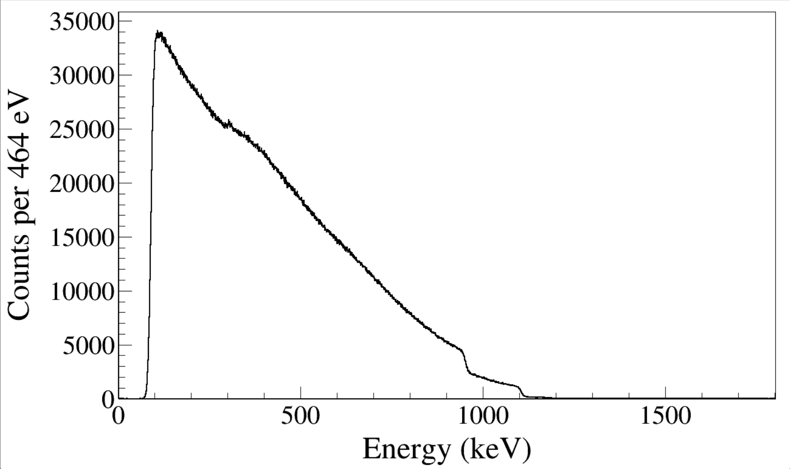
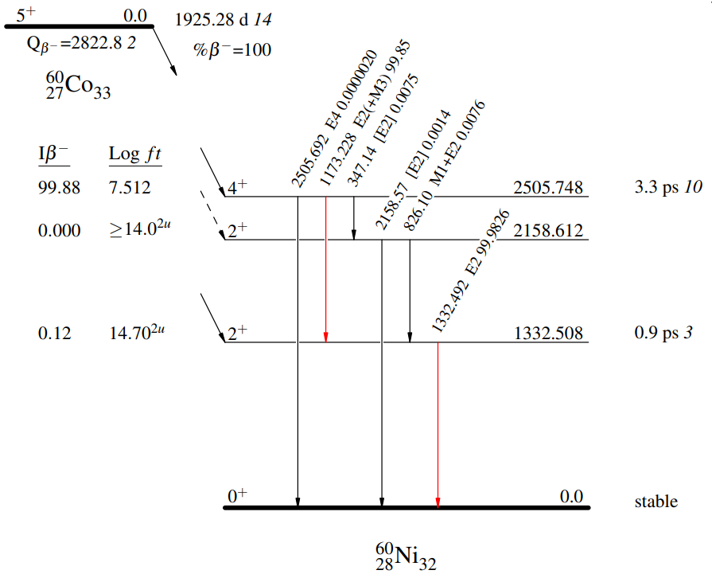
960 keV
1110 keV
Run0216-0218
60Co beta electron?
By MSD26
Notes:
Beta spectrum
Electron spectrum
TFile *_file0 = TFile::Open("F:/e21010/pxct/run0216_0217_0218_LEGe_XtRa_MSD26_60Co_I7281_inChamber_vacuum_XtRa_12mm_away_window1us_CFDdelay_adjusted_AnalogGain1.0_cal.root");
TCanvas* canvaspeak = new TCanvas("MSD", "MSD", 1300, 800);//
canvaspeak->cd();//
canvaspeak->SetTopMargin(0.025);
canvaspeak->SetRightMargin(0.04);
canvaspeak->SetLeftMargin(0.15);
canvaspeak->SetBottomMargin(0.15);
canvaspeak->SetFrameLineWidth(2);
hmsd26_e->SetLineWidth(2);
hmsd26_e->Rebin(4);
hmsd26_e->SetLineColor(1);
hmsd26_e->SetStats(0);
hmsd26_e->SetTitle("");
hmsd26_e->GetXaxis()->SetTitle("Energy (keV)");
hmsd26_e->GetYaxis()->SetTitle("Counts per 464 eV");
hmsd26_e->GetXaxis()->CenterTitle();
hmsd26_e->GetYaxis()->CenterTitle();
hmsd26_e->GetXaxis()->SetLabelFont(132);
hmsd26_e->GetYaxis()->SetLabelFont(132);
hmsd26_e->GetXaxis()->SetLabelSize(0.06);
hmsd26_e->GetYaxis()->SetLabelSize(0.06);
hmsd26_e->GetXaxis()->SetTitleFont(132);
hmsd26_e->GetYaxis()->SetTitleFont(132);
hmsd26_e->GetXaxis()->SetTitleOffset(1.0);
hmsd26_e->GetYaxis()->SetTitleOffset(1.1);
hmsd26_e->GetXaxis()->SetTitleSize(0.07);
hmsd26_e->GetYaxis()->SetTitleSize(0.07);
hmsd26_e->GetXaxis()->SetNdivisions(505);
hmsd26_e->GetXaxis()->SetRangeUser(0,1800);
//hmsd26_e->GetYaxis()->SetRangeUser(1,20000);
hmsd26_e->GetYaxis()->SetTickLength(0.02);
hmsd26_e->Draw("hist");
gPad->SetFrameLineWidth(2);
//gPad->SetLogy();

Slide 2
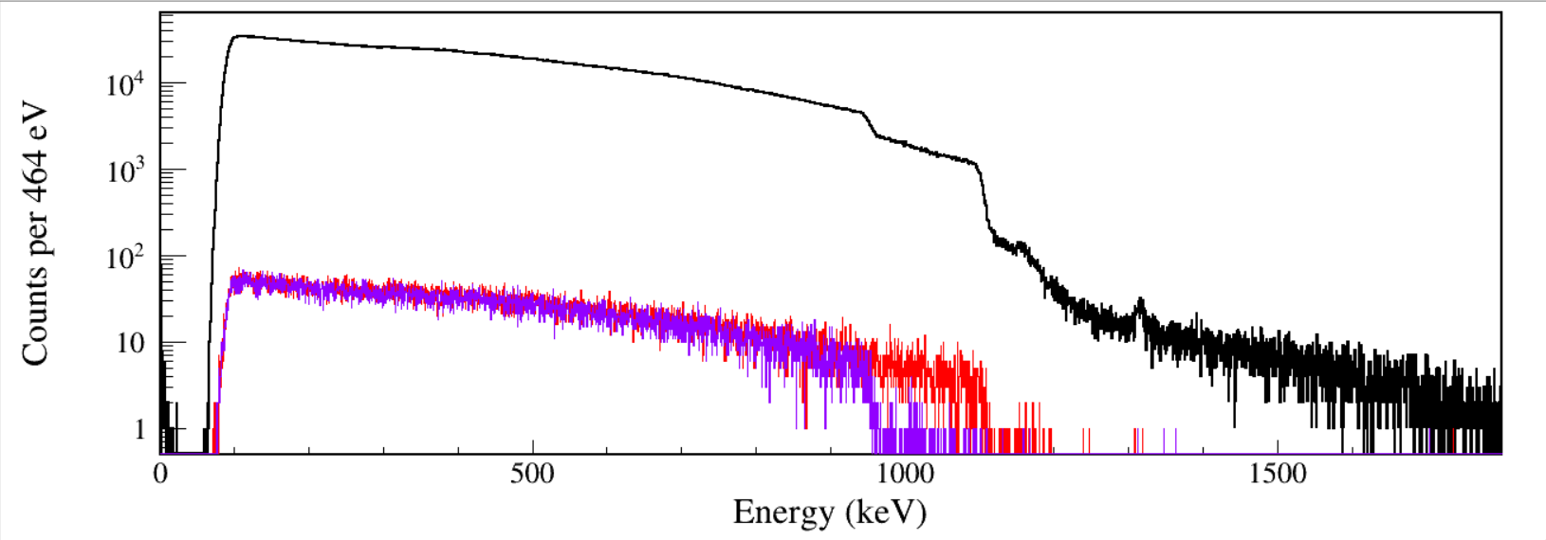
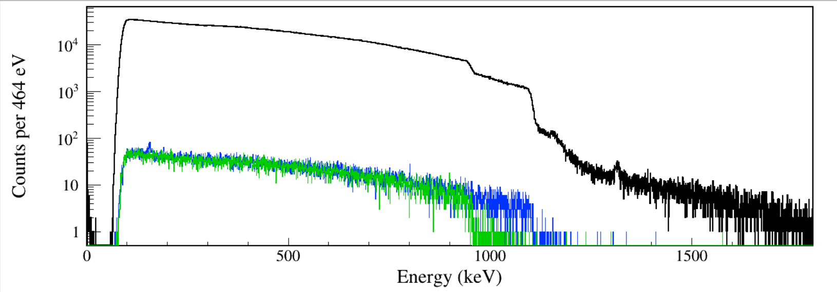
Raw MSD26
North 1173-gated MSD26
North 1332-gated MSD26
Raw MSD26
South 1173-gated MSD26
South 1332-gated MSD26
Notes:
TFile *_file0 = TFile::Open("F:/e21010/pxct/run0216_0217_0218_LEGe_XtRa_MSD26_60Co_I7281_inChamber_vacuum_XtRa_12mm_away_window1us_CFDdelay_adjusted_AnalogGain1.0_cal.root");
TCanvas* canvaspeak = new TCanvas("MSD", "MSD", 1300, 800);//
canvaspeak->cd();//
canvaspeak->SetTopMargin(0.025);
canvaspeak->SetRightMargin(0.04);
canvaspeak->SetLeftMargin(0.15);
canvaspeak->SetBottomMargin(0.15);
canvaspeak->SetFrameLineWidth(2);
hmsd26_e->SetLineWidth(2);
hmsd26_e->Rebin(4);
hmsd26_e->SetLineColor(1);
hmsd26_e->SetStats(0);
hmsd26_e->SetTitle("");
hmsd26_e->GetXaxis()->SetTitle("Energy (keV)");
hmsd26_e->GetYaxis()->SetTitle("Counts per 464 eV");
hmsd26_e->GetXaxis()->CenterTitle();
hmsd26_e->GetYaxis()->CenterTitle();
hmsd26_e->GetXaxis()->SetLabelFont(132);
hmsd26_e->GetYaxis()->SetLabelFont(132);
hmsd26_e->GetXaxis()->SetLabelSize(0.06);
hmsd26_e->GetYaxis()->SetLabelSize(0.06);
hmsd26_e->GetXaxis()->SetTitleFont(132);
hmsd26_e->GetYaxis()->SetTitleFont(132);
hmsd26_e->GetXaxis()->SetTitleOffset(1.0);
hmsd26_e->GetYaxis()->SetTitleOffset(1.1);
hmsd26_e->GetXaxis()->SetTitleSize(0.07);
hmsd26_e->GetYaxis()->SetTitleSize(0.07);
hmsd26_e->GetXaxis()->SetNdivisions(505);
hmsd26_e->GetXaxis()->SetRangeUser(0,1800);
//hmsd26_e->GetYaxis()->SetRangeUser(1,20000);
hmsd26_e->GetYaxis()->SetTickLength(0.02);
hmsd26_e->Draw("hist");
gPad->SetFrameLineWidth(2);
//gPad->SetLogy();
tree->SetLineColor(2);
tree->Draw("msd26_e","north_e>1171&&north_e<1176&&msd26_e>0&&msd26_e<1800&&north_t-msd26_t>-500&&north_t-msd26_t<300","same");
tree->SetLineColor(kViolet);
tree->Draw("msd26_e","north_e>1330&&north_e<1335&&msd26_e>0&&msd26_e<1800&&north_t-msd26_t>-500&&north_t-msd26_t<300","same");
tree->SetLineColor(kAzure);
tree->Draw("msd26_e","south_e>1171&&south_e<1176&&msd26_e>0&&msd26_e<1800&&south_t-msd26_t>-500&&south_t-msd26_t<300","same");
tree->SetLineColor(kGreen+1);
tree->Draw("msd26_e","south_e>1330&&south_e<1335&&msd26_e>0&&msd26_e<1800&&south_t-msd26_t>-500&&south_t-msd26_t<300","same");

Slide 3
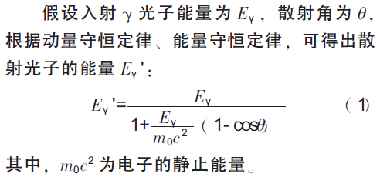
L. J. Sun et al., Radiat. Prot. 32, 155 (2012).
E_{γ} (keV) | θ (deg) | E_{γ}' (keV) | E_{e} (keV)
1173 | 0 | 1173 | 0
1173 | 45 | 701 | 471
1173 | 90 | 356 | 817
1173 | 180 | 210 | 963
1332 | 0 | 1332 | 0
1332 | 45 | 755 | 577
1332 | 90 | 369 | 962
1332 | 180 | 214 | 1118

Slide 4
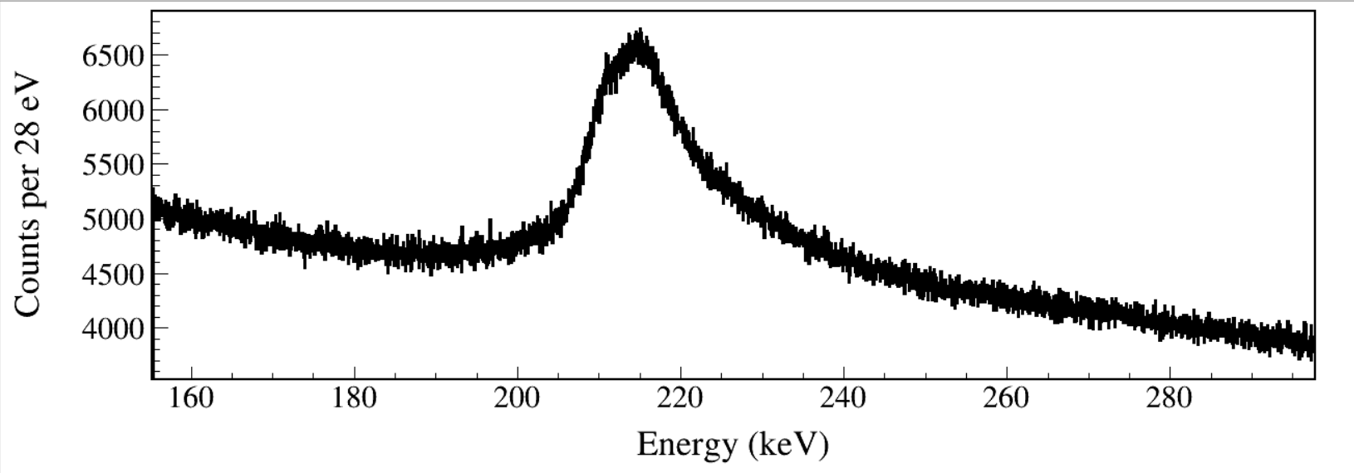
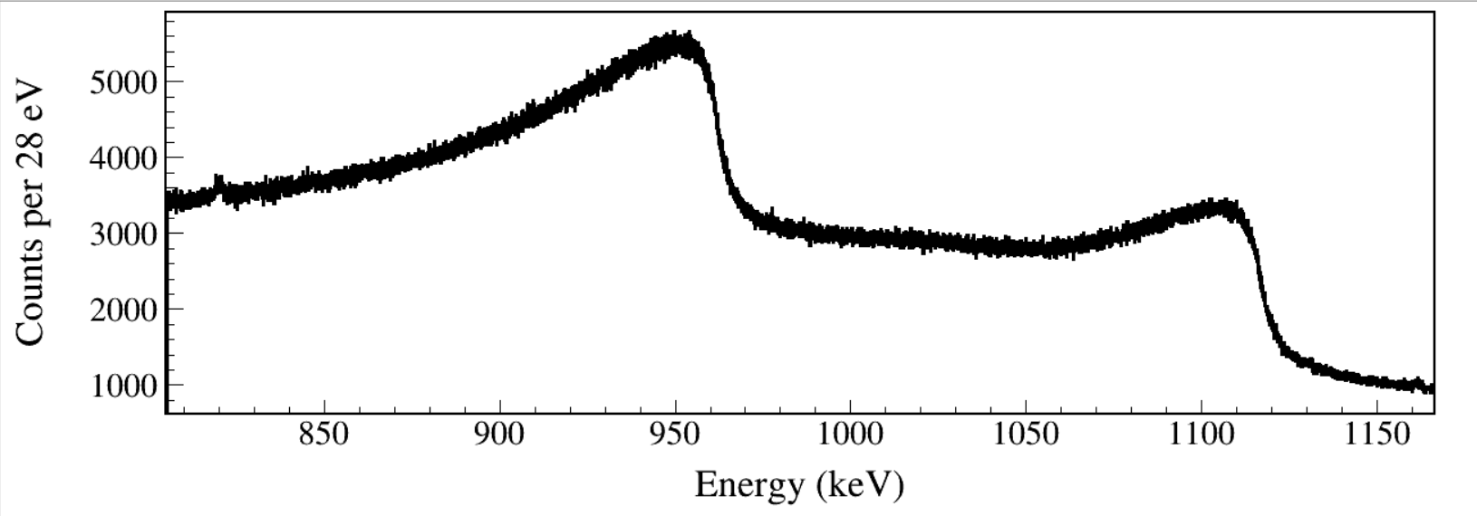
E_{γ} (keV) | θ (deg) | E_{γ}' (keV) | E_{e} (keV)
1173 | 180 | 210 | 963
1332 | 180 | 214 | 1118
Notes:
TFile *_file0 = TFile::Open("F:/e21010/pxct/run0216_0217_0218_LEGe_XtRa_MSD26_60Co_I7281_inChamber_vacuum_XtRa_12mm_away_window1us_CFDdelay_adjusted_AnalogGain1.0_cal.root");
canvaspeak->cd();
hlege_e->SetLineWidth(3);
hlege_e->Rebin(1);
hlege_e->SetLineColor(1);
hlege_e->SetStats(0);
hlege_e->SetTitle("");
hlege_e->GetXaxis()->SetTitle("Energy (keV)");
hlege_e->GetYaxis()->SetTitle("Counts per 28 eV");
hlege_e->GetXaxis()->CenterTitle();
hlege_e->GetYaxis()->CenterTitle();
hlege_e->GetXaxis()->SetLabelFont(132);
hlege_e->GetYaxis()->SetLabelFont(132);
hlege_e->GetXaxis()->SetLabelSize(0.07);
hlege_e->GetYaxis()->SetLabelSize(0.07);
hlege_e->GetXaxis()->SetTitleFont(132);
hlege_e->GetYaxis()->SetTitleFont(132);
hlege_e->GetXaxis()->SetTitleOffset(1.1);
hlege_e->GetYaxis()->SetTitleOffset(0.70);
hlege_e->GetXaxis()->SetTitleSize(0.08);
hlege_e->GetYaxis()->SetTitleSize(0.08);
hlege_e->GetYaxis()->SetTickLength(0.015);
hlege_e->GetYaxis()->SetNdivisions(505);
hlege_e->Draw("hist");

Slide 5
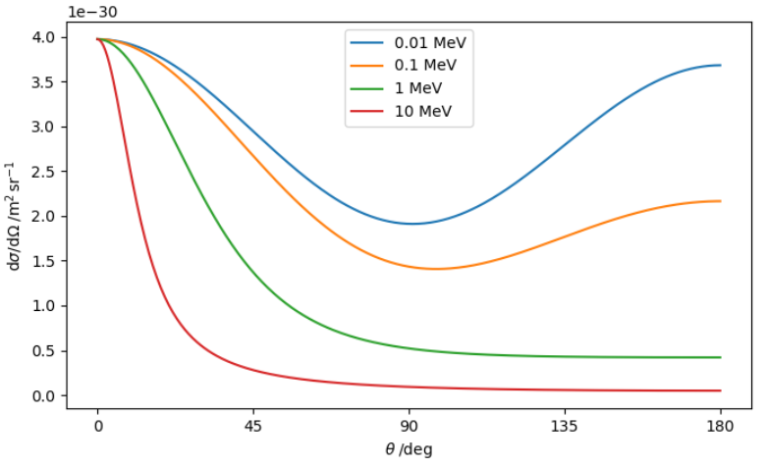
The Klein–Nishina formula

