Slide 1
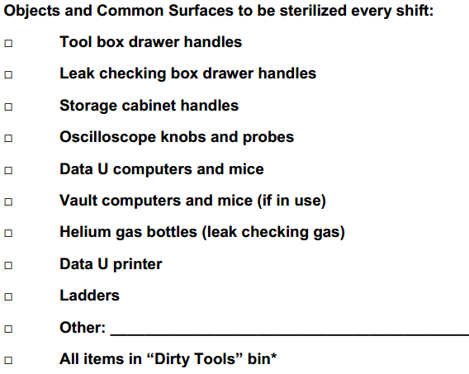
You must fill out the daily FRIB access form https://frib.msu.edu/q. Maintain at least 6 ft distance.
Wear face mask and gloves at all times when working in the lab. Do not exceed the posted occupancy limit of each office/room.

Slide 2
I had one idea that might be completely wrong. I wonder if back-scattering of the 31S nuclei from head-on collisions with gold nuclei might be able to modify the energy we measure for the long-lived 31S first excited state to be lower than the rest energy. The Rutherford cross section gets very large at low energies, increasing the chance of back-scattering for 31S ions that are almost stopped. I know that Oliver's simulation includes a parameterization for scattering of the 31S, but does it include the possibility of nuclear backscattering? Maybe something to consider.
Chris
Since your analysis seems to favor a value for the 31S 1st excited state energy between 1246 and 1247 keV, whereas NNDC evaluates the number to be 1248.87 +/- 0.09 keV, I spent a little bit of time looking at the values from past measurements for the 31S 1st excited state energy that go into the NNDC value. I mainly looked at the Ouellet's 2013 A=31 evaluation.
I found a value as low as 1247.6 +/- 0.3 keV from Antti Saastamoinen's work on 31Cl decay, which NNDC disregards for being too different from other measurements and for not fitting well with the other gamma-ray energies in their 31S gamma-decay scheme.
As you know, Mike Bennett's value was 1248.4 +/- 0.2 keV, also from 31Cl decay, which also suggests a somewhat lower value than NNDC.
The value from 32Ar(beta p) decay is 1248.4 +/- 0.3 keV, which is also lower than NNDC.
So I think it is possible that the true energy could be significantly lower than the NNDC value and probably their 90 eV uncertainty is unrealistic.

Slide 3
Somehow the reaction experiments tend to yield higher values. I didn't have time to check, but I wonder if they make Doppler-shift corrections based on literature values of the lifetime. If the lifetime they use is wrong it might influence their deduced energy.
I would be amazed if the true value is less than Antti's value. That would be a 14-sigma discrepancy with NNDC! But maybe it is possible.
If we want to understand the NNDC value better, then we probably need to read the reaction papers to understand what they did.
Chris
A little bit more:
In the attached paper by Doherty (after the A=31 evaluation) they measure 1248.5 +/- 0.1 keV, which is also lower than NNDC.
I see that the NNDC value is strongly influenced by the value of 1248.9 +/- 0.1 keV from Jenkins et al. (attached). For quite a while, I have had concerns about the accuracy of the energies reported in that paper, so I don't really trust that number.
The papers I haven't had a chance to look at are the (3He,n gamma) measurements from many decades ago, which also apparently report precise values around 1248.9 +/- 0.2 keV.
Chris

Slide 4
³²S(³He,α)³¹S
Offline Ion Source (OLIS)
Radiofrequency Quadrupole (RFQ)
Carbon foil for charge stripping
Drift-Tube Linac (DTL)
Au target foil implanted with ³He.
target ladder LN₂ cooled copper shroud
Dopppler Shift Liftetimes (DSL) chamber
Cooling of the target a surrounding cold trap
Condensation of water
Electrical beam currents from collimator and target ladder.
Ortec B Series silicon surface barrier detectors with 150 mm² active area.
solid angle coverage
α-gated γ spectrum
No need to make thinner target, which will reduce the conduction of heat.
If τ ≈ 10 fs, we may be able to obtain the result with 1-fs uncertainty.
If τ < 1 fs, we may be able to obtain the upper limit

Slide 5
Beam / Projectile / Incident particle | ³²S
Target | ³He
Foil | Au
Beam energy | 128 MeV
Implanted areal density | 6×10¹⁷ ions/cm²
Center of mass energy | 10.97 MeV
Thickness of Au foil | 25 μm
Range of ³²S in Au | 12.5 μm
Coulomb barrier V_{B} | 5.532 MeV
R_{C} | 7.4 fm
b_{gr} | 5 fm
Ejectile / Fragment / Projectile-like fragment | ³²S
Recoil / Residual / Target-like fragment | ³He
Kinematically allowed θ_{lab} for Ejectile | 0°– 5.38°
Kinematically allowed θ_{lab} for Recoil | 0°– 90°
Kinematically allowed E_{lab} for Ejectile | 87.88–128 MeV
Kinematically allowed E_{lab} for Recoil | 0 MeV@90°– 40.12 MeV@0°
Grazing angle θ_{gr(cm)} | 38.7°
Grazing angle θ_{gr(lab)} | 3.1°
Compound nucleus | ³⁵Ar
Q value of ³²S(³He,α)³¹S | 5.533 MeV
Q value of ³²S(³He)³⁵Ar | 11.963 MeV
Compound nucleus excitation energy | 10.97 + 11.963 = 22.934 MeV
Compound nucleus recoil energy | 117.029 MeV
Experimental fusion cross section | 823 mb
Compound nucleus formation cross section | 822 mb
Energy range for α particle | 0.64–45.06
³²S(³He,α)³¹S cross section | 95 mb

Slide 6
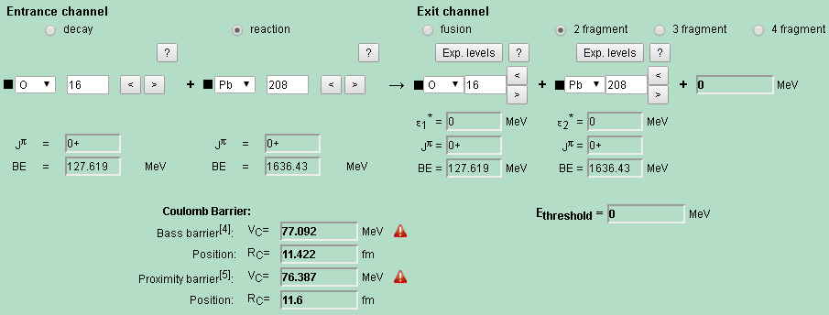
http://nrv.jinr.ru/nrv/webnrv/qcalc/
Catkin2.03.xls

Slide 7
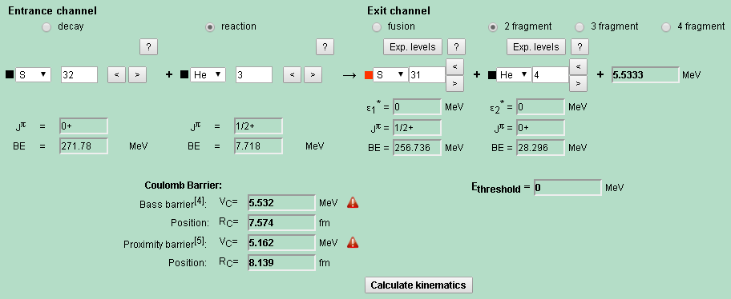
128 MeV ³²S beam = 12 MeV ³He beam
Center of mass kinetic energy of E_{CM}: 128*3/(3+32)=12*32/(3+32)≈11 MeV
2.585 MeV ¹⁰⁰Ru beam = 0.02585 MeV ¹H beam
Center of mass kinetic energy of E_{CM}: 2.585*1/(1+100)=0.02585*100/(1+100)=0.02559 MeV

Slide 8
Notes:
Center-of-mass energy
Relative kinetic energy
E_{CM} 卢希庭《原子核物理》

Slide 9
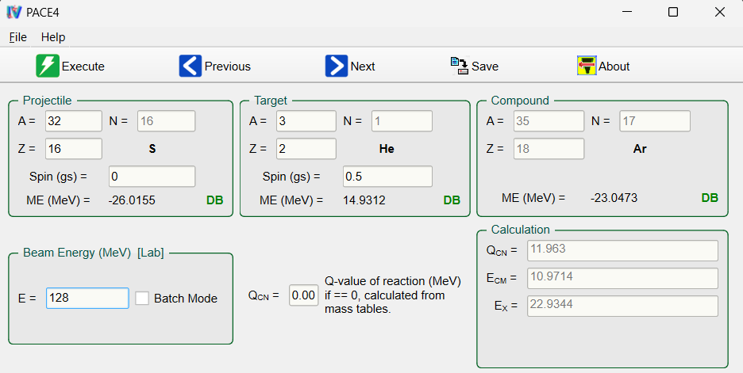
128 MeV ³²S beam = 12 MeV ³He beam
Center of mass kinetic energy of E_{CM}: 128*3/(3+32)=12*32/(3+32)≈11 MeV

Slide 10
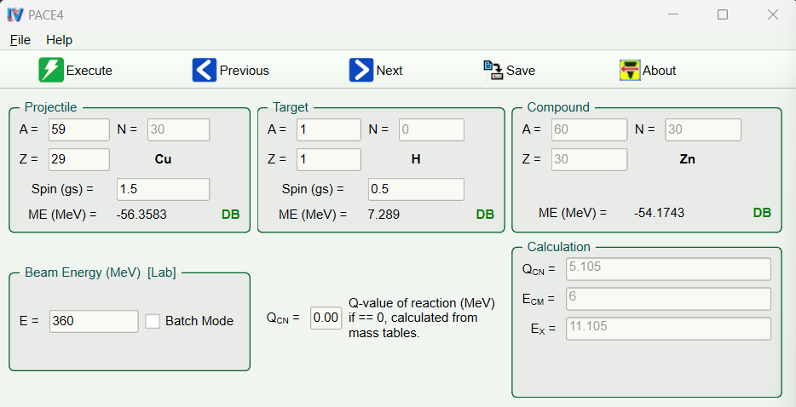
358 MeV ⁵⁹Cu beam
Center of mass kinetic energy of E_{CM}: 358*1/(1+59)=6 MeV

Slide 11
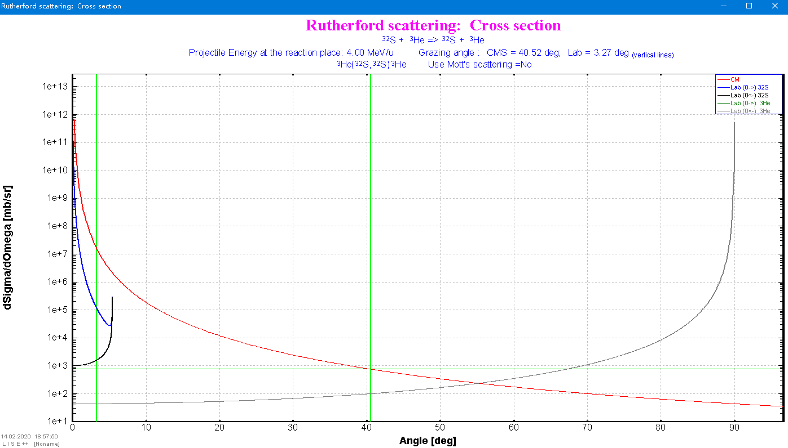
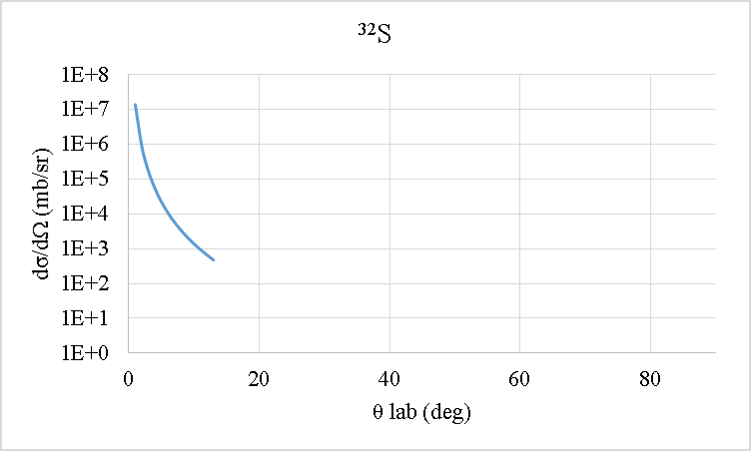
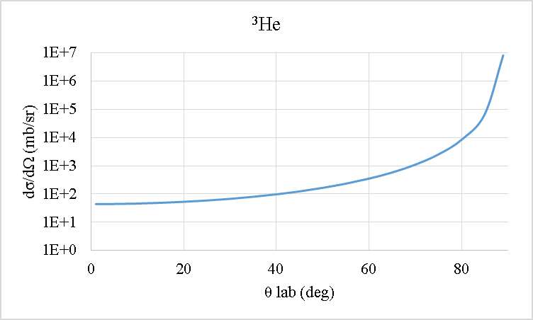
Textbook

Slide 12
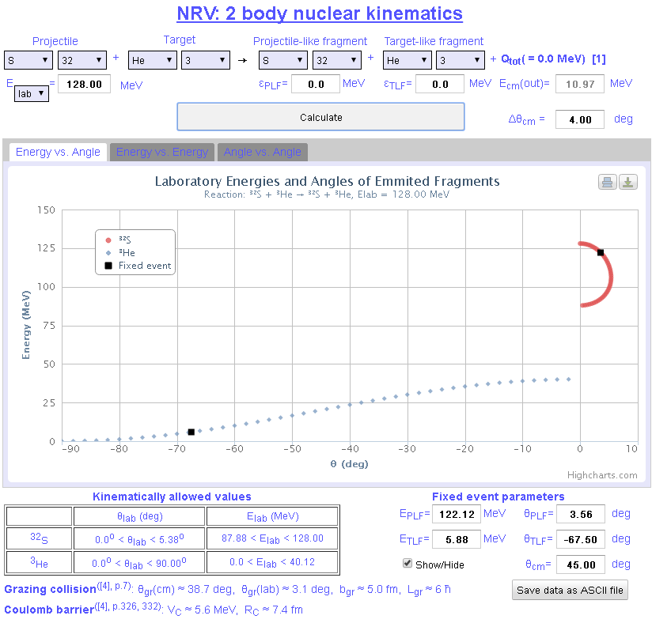
http://nrv.jinr.ru/nrv/mobilenrv/kinematics/Kinematics2Body.html

Slide 14
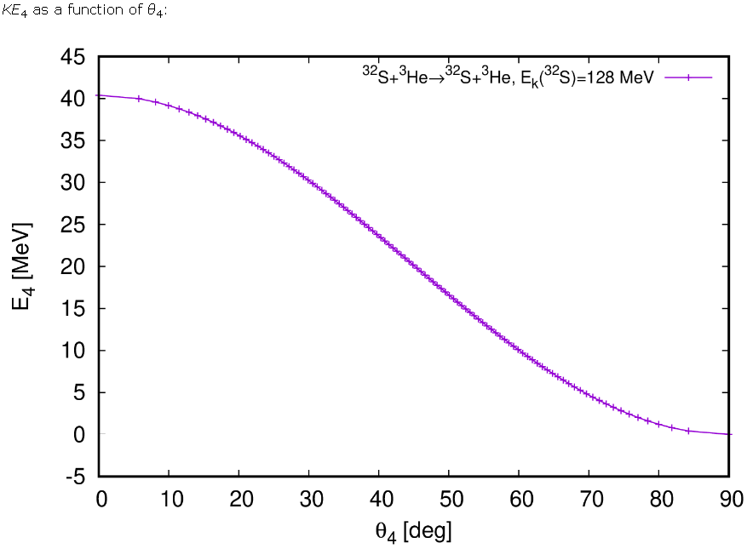
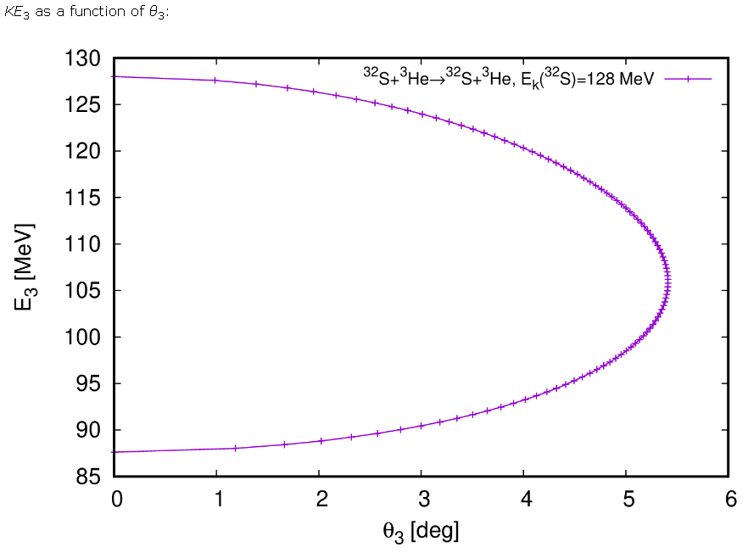
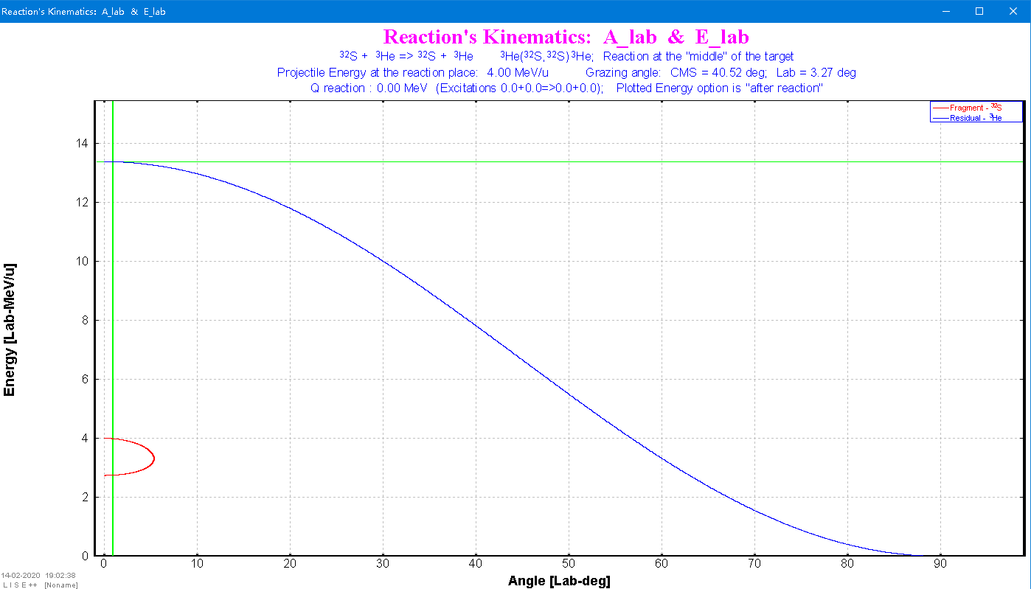
http://skisickness.com/2010/04/relativistic-kinematics-calculator/

Slide 15
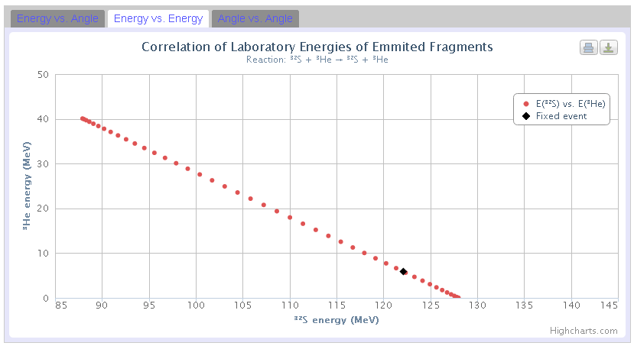
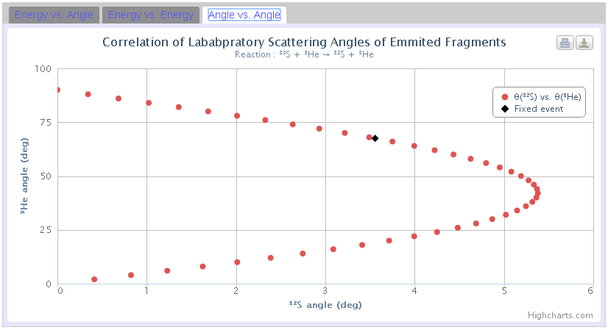
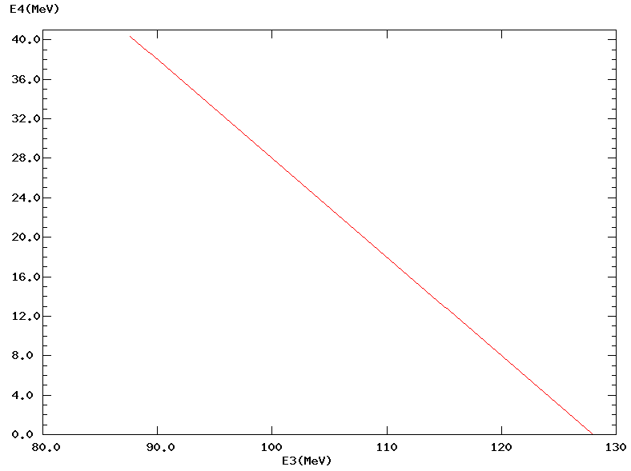
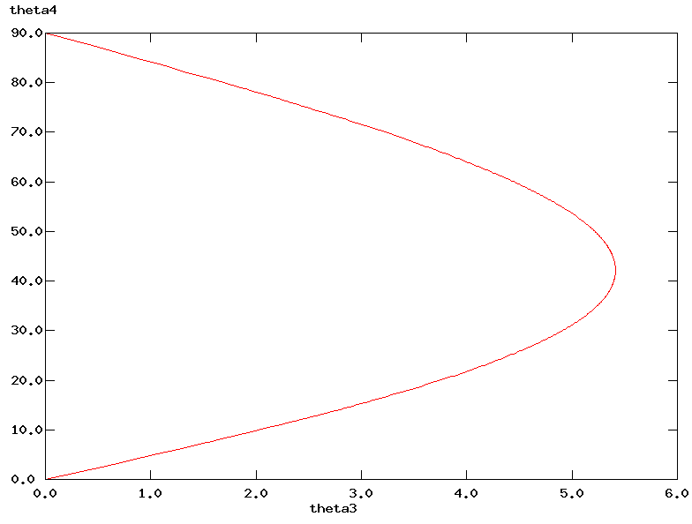
http://nrv.jinr.ru/nrv/mobilenrv/kinematics/Kinematics2Body.html
http://skisickness.com/2010/04/21/

Slide 16
http://skisickness.com/2010/04/relativistic-kinematics-calculator/

Slide 17
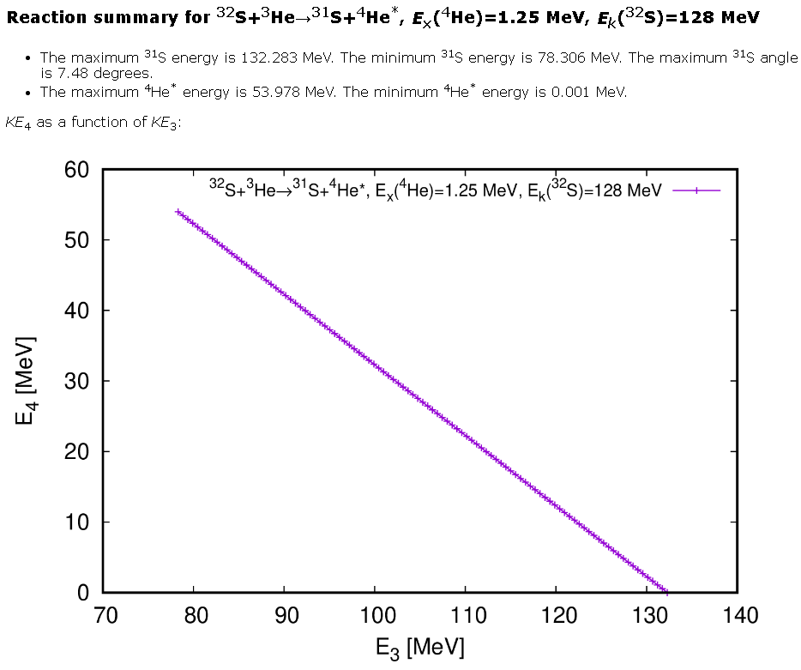
Eα gate = 49±1 MeV
51.1 < E_{α} < 53.0 MeV
81.2 > E_{31S} > 79.3 MeV

Slide 18
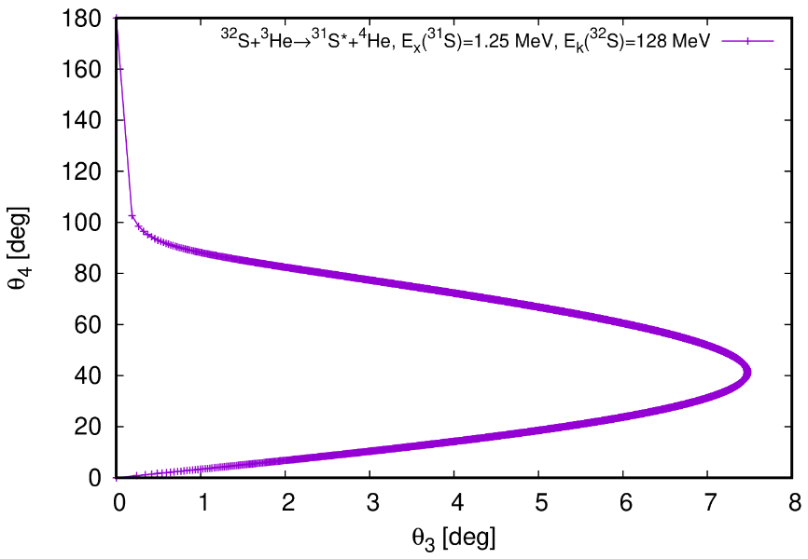
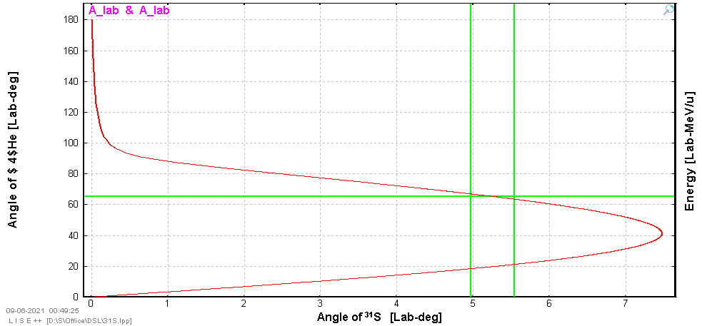
Acceptance angle α < 14°
corresponds to
³¹S < 4°

Slide 19
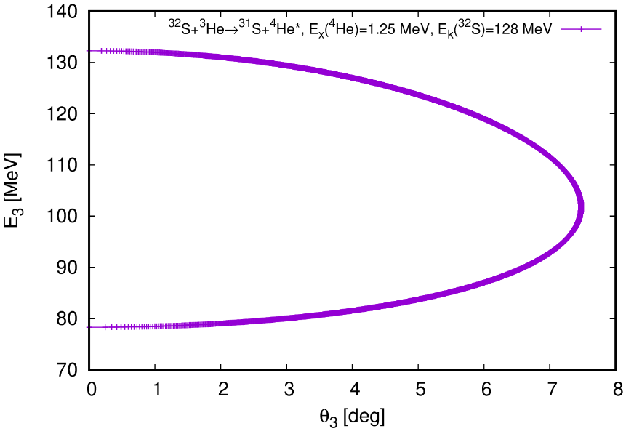
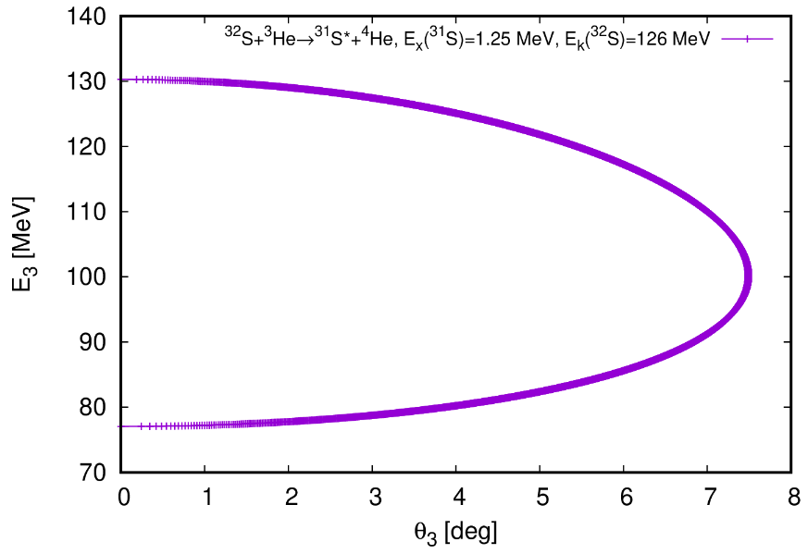
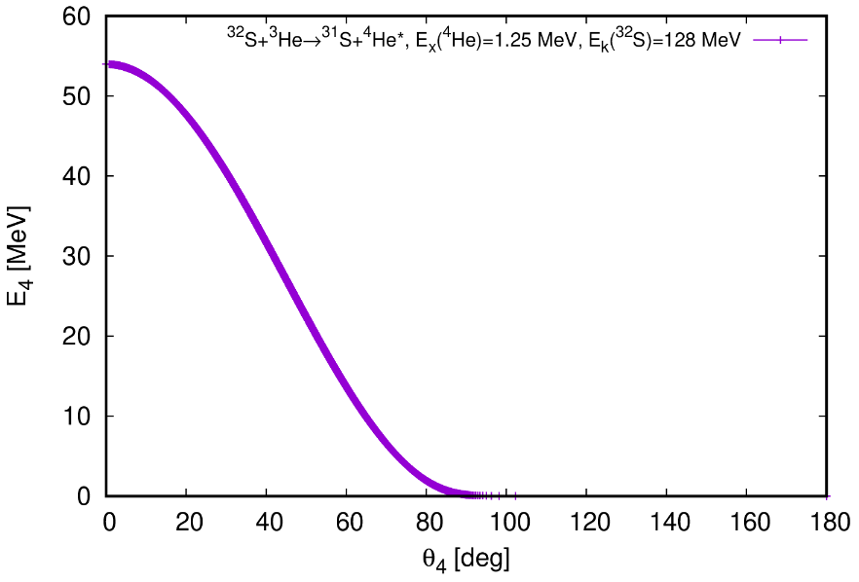
78.3 < E_{31S} < 81.6 MeV
77.0 < E_{31S} < 80.2 MeV
Eα gate = 49±1 MeV
51.1 < E_{α} < 53.0 MeV
Acceptance angle α < 14°
corresponds to
50.8 < E_{α} < 54.0 MeV

Slide 20
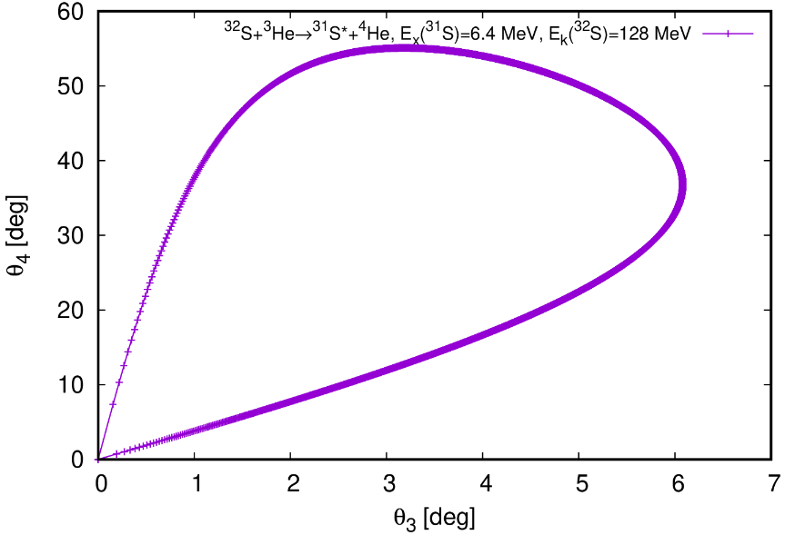
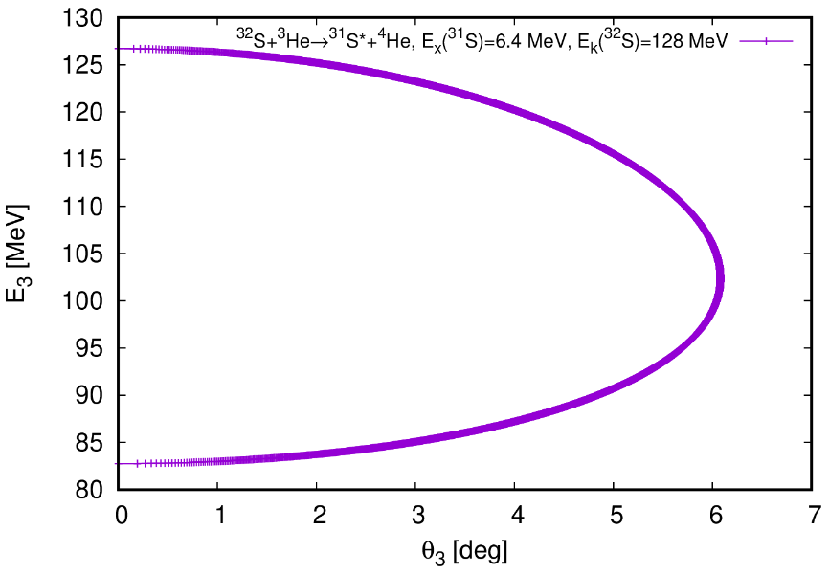
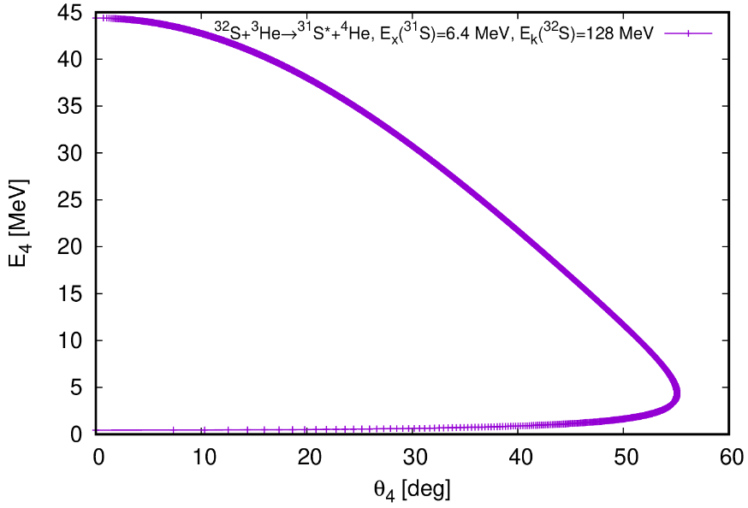
Acceptance angle α < 14°
corresponds to
³¹S < 3.5°

Slide 21
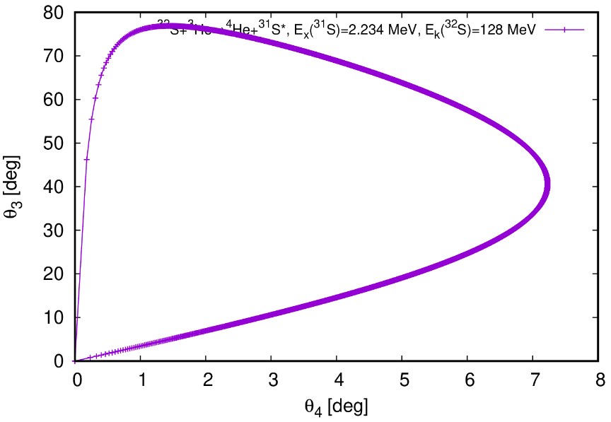
Acceptance angle α < 14°
corresponds to
³¹S < 3.9°

Slide 22
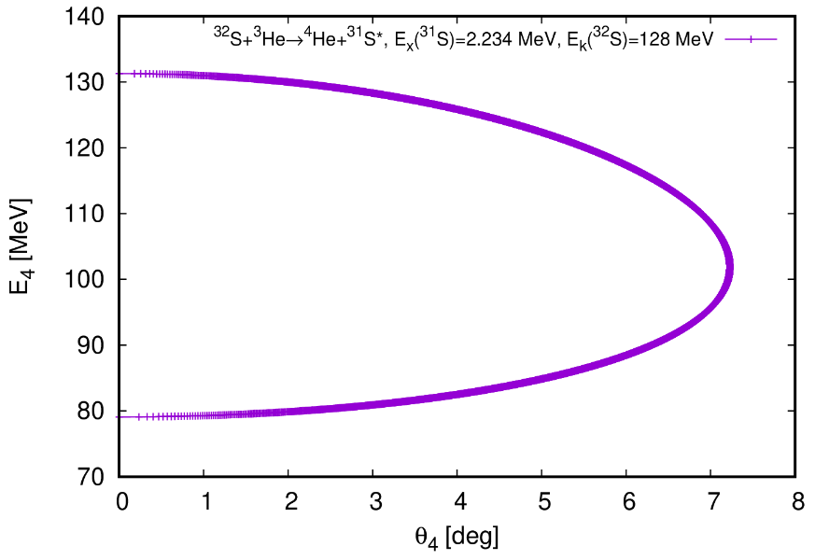
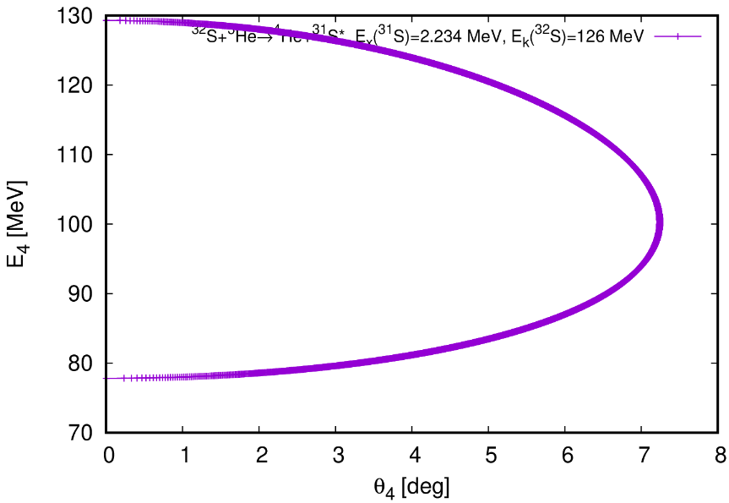
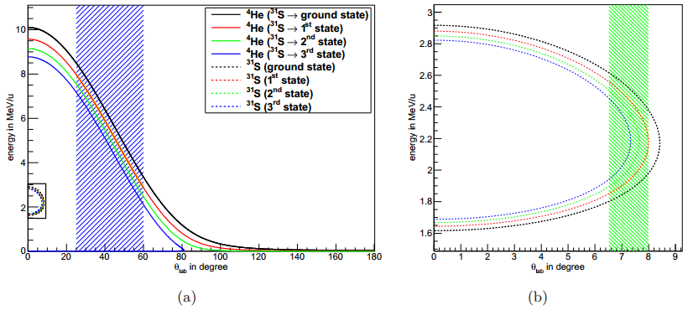
79.1 < E_{31S} < 82.3 MeV
77.8 < E_{31S} < 81.0 MeV

Slide 23
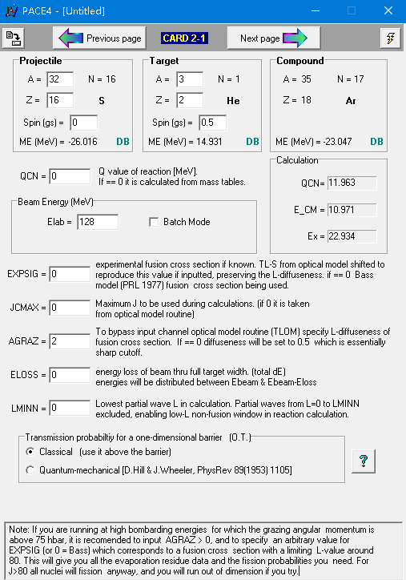
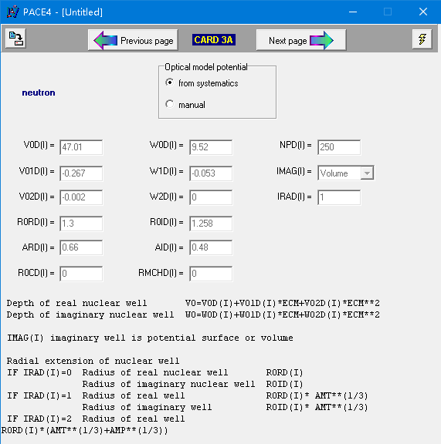
Seems no difference between quantum-mechanical option or classical option.

Slide 24
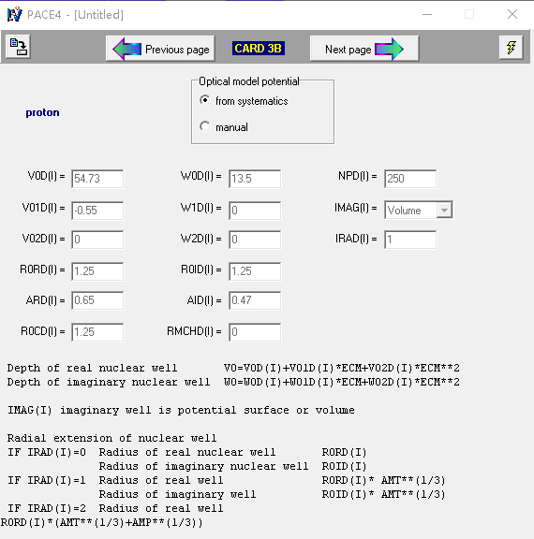

Slide 25
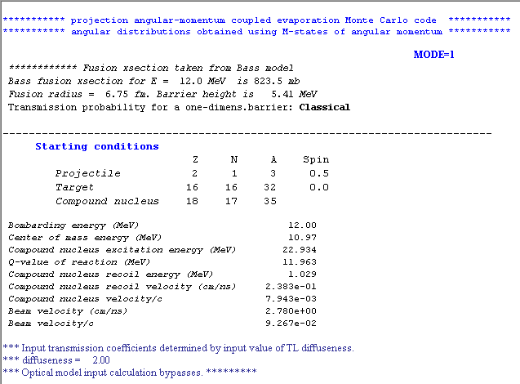

Slide 26
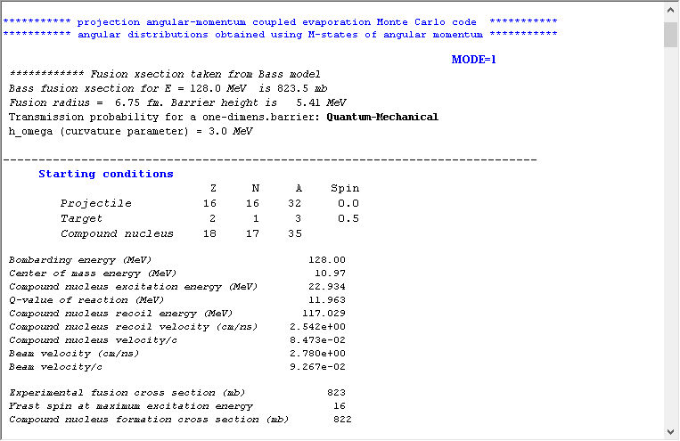

Slide 27
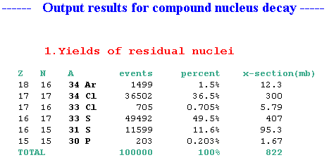
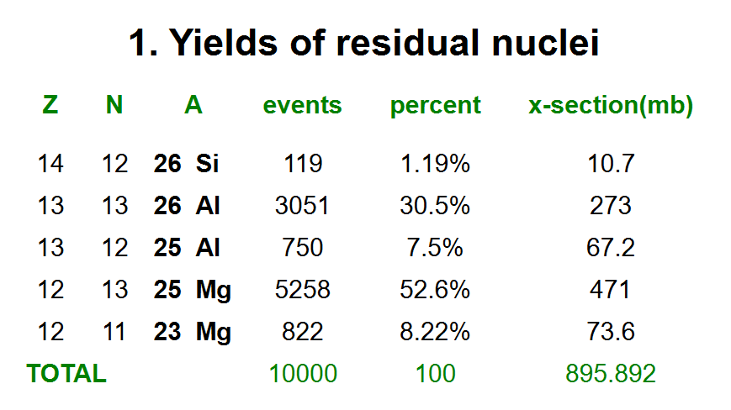
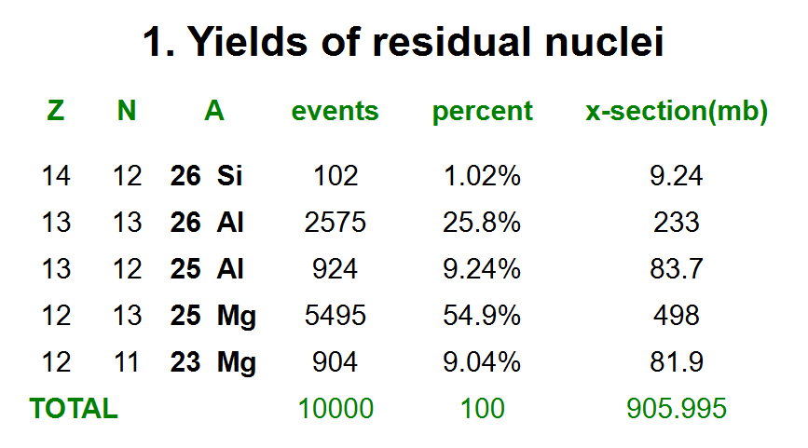
Cathleen's Thesis Page 51
E_{24Mg} = 105 MeV
E_{24Mg} = 110 MeV

Slide 28
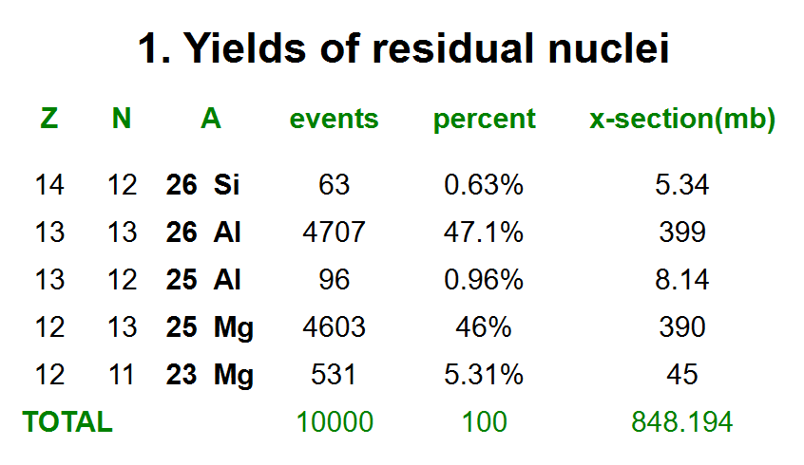
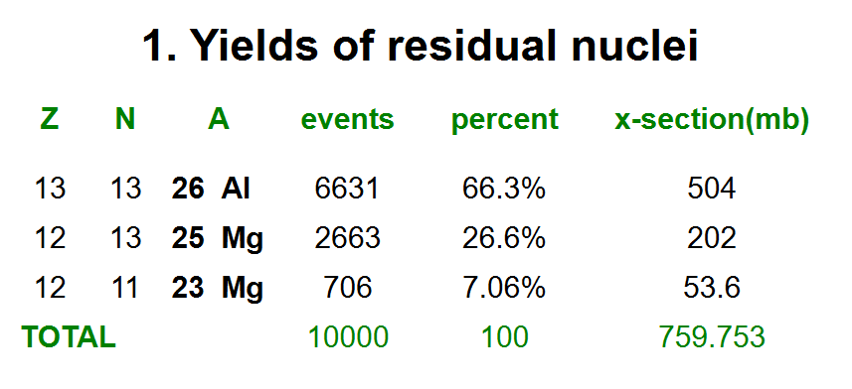
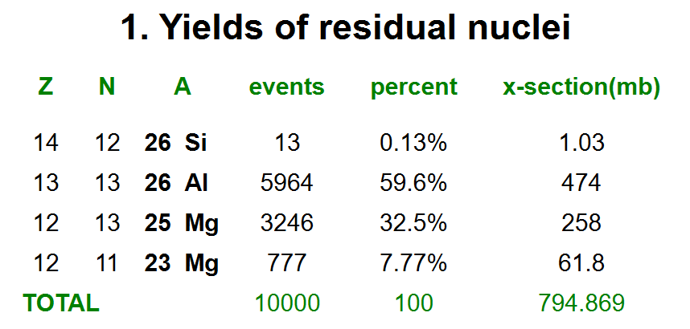
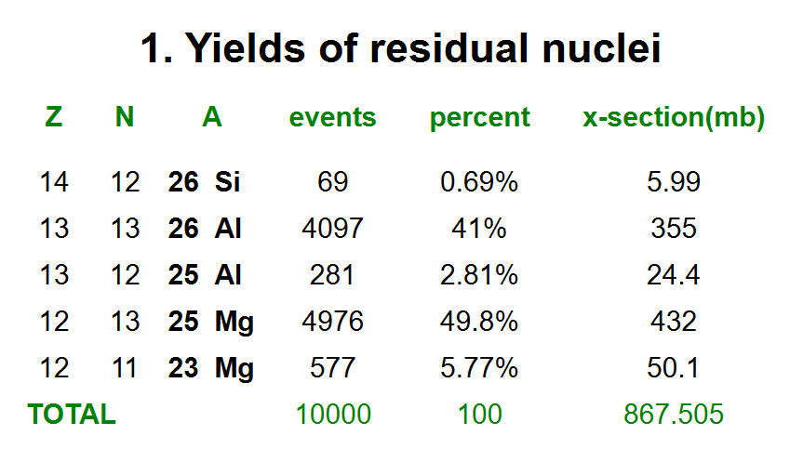
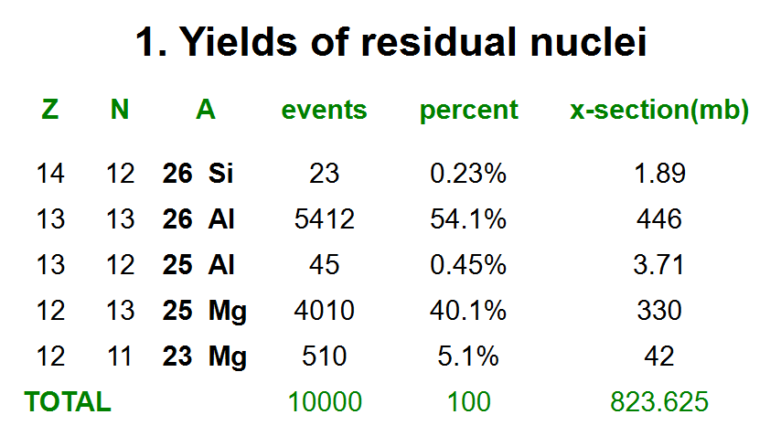
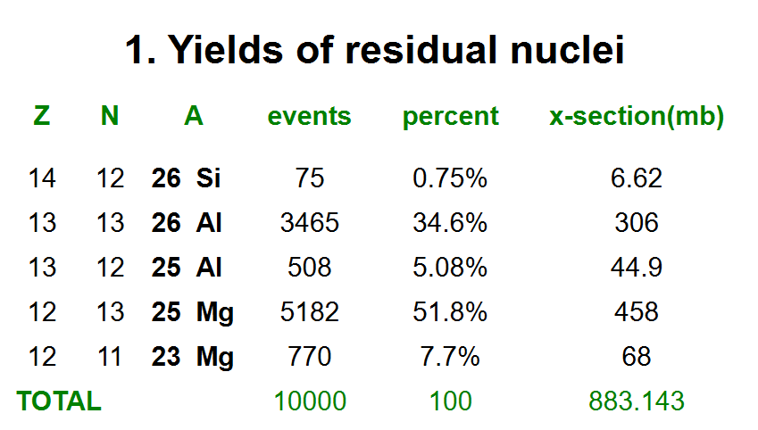
PACE4
E_{24Mg} = 90 MeV
E_{24Mg} = 75 MeV
E_{24Mg} = 80 MeV
E_{24Mg} = 95 MeV
E_{24Mg} = 85 MeV
E_{24Mg} = 100 MeV

Slide 30
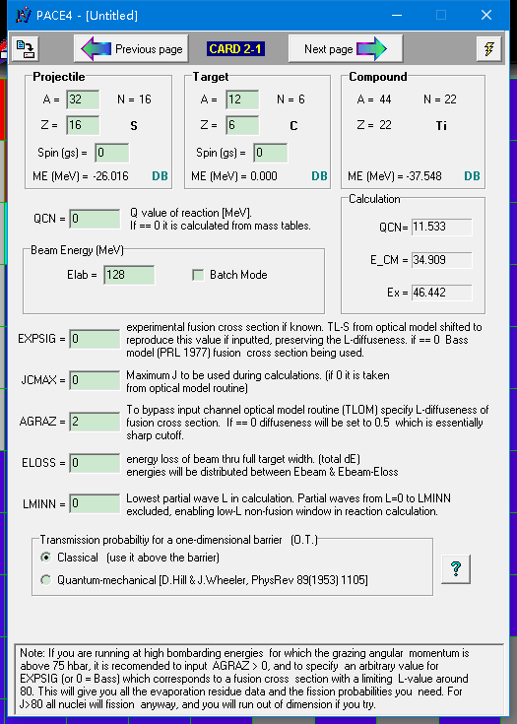
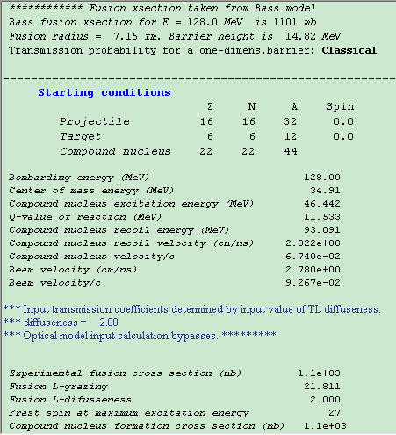

Slide 31
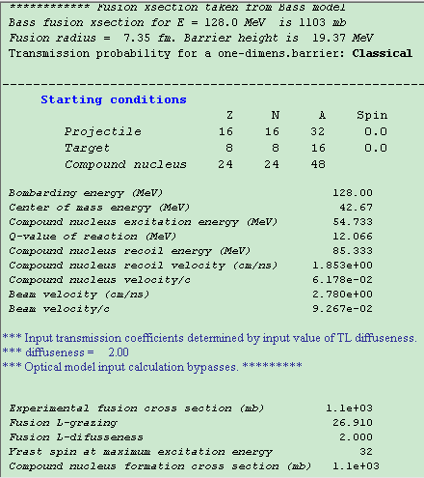

Slide 32
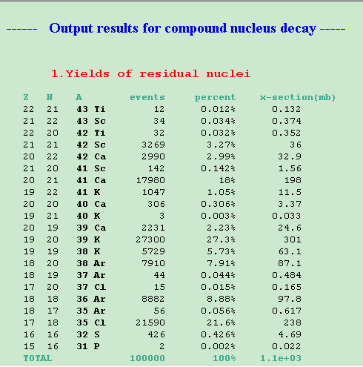
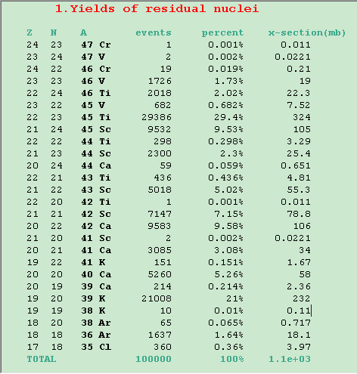

Slide 33
23Mg
LISE++
31S
LISE++
23Mg
31S
PACE4
PACE4
I wouldn't put a whole lot of trust in the PACE4 angular distribution, we just used it because we lacked a better number. You would expect transfer in inverse kinematics to be more backward focused than that, I think. There also exists some normal kinematics transfer data at that beam energy that you could also look at, being careful about the transformation to inverse kinematics.

Slide 34
For the ²⁴Mg(³He,α)²³Mg reaction, the angular range of the α particles corresponding to the astrophysically important resonances are fully covered by our detectors.

Slide 35
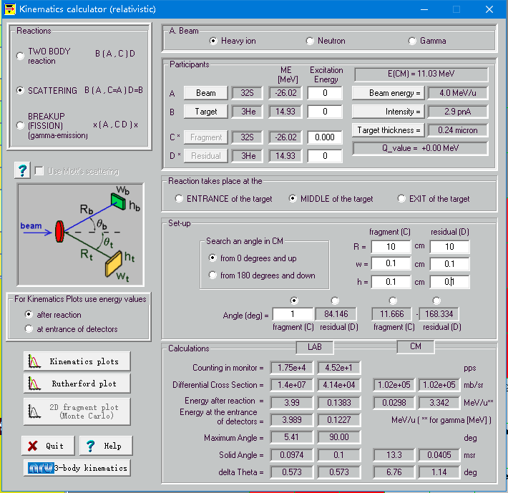

Slide 36
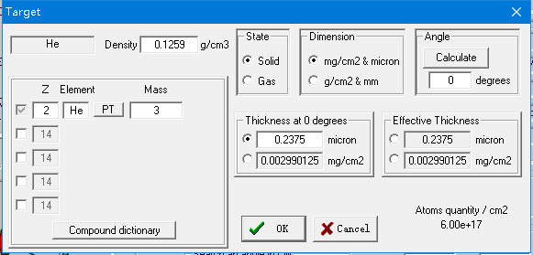
Catkin2.03.xls

Slide 37
LISE Kinematics calculator
³He(³²S,³¹S)α

Slide 38
LISE Kinematics calculator
³He(³²S,³¹S)α

Slide 39
LISE Kinematics calculator
³He(³²S,³¹S)α
11 MeV/u
Sometimes, the energy shown in the table is wrong because of "double valued energy".
Find the energy in the graph.

Slide 40
LISE Kinematics calculator
³He(³²S,³¹S)α
4 MeV/u

Slide 41
LISE Kinematics calculator
³He(³²S,³¹S)α

Slide 42
LISE Kinematics calculator
³He(³²S,³¹S)α

Slide 43
Ex(31S) gs
E(⁴He) ≤ 56 MeV
θ(⁴He)_{lab} ≤ 180°
Ex(31S) 6.4 MeV
E(⁴He) _{lab} ≤ 44 MeV
θ(⁴He)_{lab} ≤ 55°

Slide 44
³He(²⁴Mg,²³Mg)α

Slide 45
³He(²⁴Mg,²³Mg)α

Slide 46
³He(²⁴Mg,²³Mg)α

Slide 47
³He(²⁴Mg,²³Mg)α

Slide 48
Q function The kinematics of the transfer reaction in the lab frame
³He(²⁴Mg,²³Mg)α

Slide 49
³He(²⁴Mg,²³Mg)α

Slide 50
³He(²⁴Mg,²³Mg)α

Slide 51
5.7 mm
18.4 mm
24.1 mm
DSL2
25 mm
46°
SD
DSSD
Target
5.7 mm
18.4 mm
24.1 mm
DSL2
25 mm
54°
SD
DSSD
Target
Angular coverage

Slide 52
5.7 mm
18.4 mm
24.1 mm
DSL2
25 mm
46°
SD
DSSD
Target
5.7 mm
18.4 mm
24.1 mm
DSL2
25 mm
56°
SD
DSSD
Target
corner
Angular coverage

Slide 53
8.4 mm
13.2 mm
DSL2
49°
25 mm
SD
DSSD
Target
5 mm
17.5 mm
DSL2
48°
25 mm
SD
DSSD
Target

Slide 54
³²S
1
³¹S*
2

Slide 55
Author | Literature | Reaction
Rituparna Kanungo | PRC2006 | ³He(²⁰Ne,α)¹⁹Ne
Subramanian Mythili | PRC2008 | ³He(²⁰Ne,α)¹⁹Ne
Naomi Galinski | PRC2014 | ³He(¹⁶O,α)¹⁵O
Oliver Kirsebom | PRC2016 | ³He(²⁴Mg,α)²³Mg

Slide 56
Good point Cathleen. I usually tried to select a delta E detector thickness that would allow for it to absorb ~10-30% of the alpha energy. These experiments have been mounted at incident energies from 1.7-4 A MeV. It might be best to err on the thinner side. We’ve used delta E thicknesses from 25 to 500 µm.
Barry
Has the DSSD been purchased yet? If not, I would very highly encourage you to consider a thinner detector (my guess is ~200 um, but calculations should back this up). If you try to run the 23Mg at a similar beam energy to last time, the alphas will lose most (if not all, I haven't actually calculated) of their energy in the dE. The choice of 500 um dE in the first 32S run was a choice driven by budget, not physics. It meant we only had to buy one detector instead of two.
Cathleen

Slide 57
5/2⁺
²³Al
7335
5735
7802
7352
5752
5/2⁺
7803 T = 3/2 IAS
$$B_{p}=6.5\left(8\right)×{10}^{−3}$$
7/2⁺
7787 <12 fs or 10(3) fs
3⁺
S_{p} = 7581
²²Na
2052
1599
7/2⁺
2052 79(20) fs
452
5/2⁺
451 1.80(12) ps
3/2⁺
0
²³Mg

Slide 58
$$ωγ=\frac{2J_{r}+1}{\left(2J_{p}+1\right)\left({2J}_{T}+1\right)}\frac{Γ_{p}Γ_{γ}}{Γ_{p}+Γ_{γ}}=\frac{2J_{r}+1}{\left(2J_{p}+1\right)\left({2J}_{T}+1\right)}B_{p}\left(1−B_{p}\right)\frac{ℏ}{τ}$$
$$J_{p}=1/2$$
$$J_{T}=3$$
$$J_{T}=7/2$$

Slide 59
Author | Rituparna Kanungo | Subramanian Mythili | Naomi Galinski | Oliver Kirsebom
Literature | PRC2006 | PRC2008 | PRC2014 | PRC2016
Reaction | ³He(²⁰Ne,α)¹⁹Ne | ³He(²⁰Ne,α)¹⁹Ne | ³He(¹⁶O,α)¹⁵O | ³He(²⁴Mg,α)²³Mg
Beam | ²⁰Ne⁵⁺ | ²⁰Ne⁵⁺ | ¹⁶O⁵⁺ | ²⁴Mg
Beam energy | 34 MeV | 34 MeV | 50 MeV | 75 MeV
Beam current |  | 75 nA | 40 nA
Beam spot | 2 mm diameter | <2 mm diameter | 3 mm diameter | 2.5 mm diameter
Target | ³He-implanted Au foil | ³He-implanted Au foil | ³He-implanted Au foil | ³He-implanted Au foil
Au foil | 12.5 μm | 1 cm×1 cm×12.5 μm | 25.4 μm | 22.6(2) μm
Implanted ³He | 30 keV 0.1 μm | 30 keV 0.1 μm | 30 keV 0.1 μm | 30 keV 0.07 μm
areal density | 6×10¹⁷ cm^{–2} | 6×10¹⁷ cm^{–2} | 6.6×10¹⁷ cm^{–2} | 6.6×10¹⁷ cm^{–2}
ΔE thickness | 25 μm | 25 μm | 100 μm | 100 μm
E thickness | 500 μm | 500 μm | 500 μm | 500 μm
Active area | 150 mm² | 150 mm² | 150 mm² | 150 mm²
Angular acceptance | <20° | 19°
Solid angle | 360 msr | 350 msr
ΔE range | 4 MeV |  | 11 MeV | 25 MeV
Remaining E range | 30 MeV |  | 35 MeV | 40 MeV
E_{α} of astrophysically | 12 MeV | 12 MeV | 20 MeV | 21 MeV
E_{α} in ΔE | 2 MeV | 2 MeV | 6 MeV
E_{α} in E | 10 MeV | 10 MeV | 14 MeV

Slide 60
Author | Rituparna Kanungo | Subramanian Mythili | Naomi Galinski | Oliver Kirsebom
Literature | PRC2006 | PRC2008 | PRC2014 | PRC2016
Reaction | ³He(²⁰Ne,α)¹⁹Ne | ³He(²⁰Ne,α)¹⁹Ne | ³He(¹⁶O,α)¹⁵O | ³He(²⁴Mg,α)²³Mg
Lifetime (fs)

Slide 61
Author | Oliver Kirsebom | Cathleen Fry
Literature | PRC2016
Reaction | ³He(²⁴Mg, ²³Mg)α | ³He(³²S,³¹S)α
Beam | ²⁴Mg | ³²S
Beam energy | 75 MeV | 128 MeV
Beam current
Beam spot | 2.5 mm diameter
Target | ³He-implanted Au foil | ³He-implanted Au foil
Au foil | 22.6(2) μm | 2.5 cm×2.5 cm×25 μm
Implanted ³He | 30 keV 0.07 μm | 35 keV
areal density | 6.6×10¹⁷ cm^{–2} | 6×10¹⁷ cm^{–2}
ΔE thickness | 100 μm | 500 or 87 μm
E thickness | 500 μm | 1000 μm
Active area | 150 mm² | 150 mm²
ΔE range | 25 MeV | 40 or 25 MeV
Remaining E range | 40 MeV | 50 or 80 MeV

Slide 64
The delays outlined above mean that we are expecting an overall curtailed user program for 2020. As a consequence of this, we are cancelling the Summer 2020 Call for Proposals and both the SAP and MMS-EEC Meetings. Shifts that were due to expire in June 2020 will be extended by 6 months at least.
Structurally interesting:
Shape Transition
Shape Coexistence
Soft/Rigid Triaxiality
Subshell Evolution

Slide 65
A. Goldkuhle et al., Phys. Rev. C 102, 054334 (2020). Lifetime measurements of excited states in neutron-rich 53Ti Benchmarking effective shell-model interactions

Slide 66
C. Morse et al., Phys. Rev. C 102, 054328 (2020). Quadrupole and octupole collectivity in 143Ba

Slide 67
P. Petkov et al., Phys. Rev. C 96, 034326 (2017). Lifetime measurements with improved precision in 30,32S and possible influence of large-scale clustering on the appearance of strongly deformed states

Slide 68
lowSiBias.root
highSiBias.root
lowBiasCuts.root
highBiasCuts.root

Slide 69
finalSort.root PID
moreAlphaEgates.root PID
firstAddback.root PID
Cathleen's Thesis

Slide 70
α
pα
d
³He
³He_ex
Notes:
TCanvas *c1 = new TCanvas("c1", "c1",1200,800);
c1->SetFillColor(0);
c1->SetBorderMode(0);
c1->SetBorderSize(2);
c1->SetFrameBorderMode(0);
c1->SetFrameBorderMode(0);
PID->GetXaxis()->SetTitle("E (MeV)");
PID->GetXaxis()->SetRangeUser(0,70);
PID->GetXaxis()->CenterTitle(true);
PID->GetXaxis()->SetLabelFont(132);
PID->GetXaxis()->SetLabelSize(0.06);
PID->GetXaxis()->SetTitleSize(0.06);
PID->GetXaxis()->SetTitleOffset(1.1);
PID->GetXaxis()->SetTitleFont(132);
PID->GetYaxis()->SetTitle("#DeltaE (MeV)");
PID->GetYaxis()->SetRangeUser(0,20);
PID->GetYaxis()->CenterTitle(true);
PID->GetYaxis()->SetLabelFont(132);
PID->GetYaxis()->SetLabelSize(0.06);
PID->GetYaxis()->SetTitleSize(0.06);
PID->GetYaxis()->SetTitleOffset(0.8);
PID->GetYaxis()->SetTitleFont(132);
PID->GetYaxis()->SetNdivisions(505);
PID->GetZaxis()->SetLabelFont(132);
PID->GetZaxis()->SetLabelSize(0.05);
PID->GetZaxis()->SetTitleSize(0.05);
PID->GetZaxis()->SetTitleFont(132);
PID->Draw("colz");
gPad->SetLogz();
TFile *_file0 = TFile::Open("lowBiasCuts.root");
alphas->SetLineColor(2);
alphas->SetLineWidth(4);
alphas->Draw();

Slide 71
Notes:
TCanvas *c1 = new TCanvas("c1", "c1",1200,800);
c1->SetFillColor(0);
c1->SetBorderMode(0);
c1->SetBorderSize(2);
c1->SetFrameBorderMode(0);
c1->SetFrameBorderMode(0);
PID->GetXaxis()->SetTitle("E (MeV)");
PID->GetXaxis()->SetRangeUser(0,70);
PID->GetXaxis()->CenterTitle(true);
PID->GetXaxis()->SetLabelFont(132);
PID->GetXaxis()->SetLabelSize(0.06);
PID->GetXaxis()->SetTitleSize(0.06);
PID->GetXaxis()->SetTitleOffset(1.1);
PID->GetXaxis()->SetTitleFont(132);
PID->GetYaxis()->SetTitle("#DeltaE (MeV)");
PID->GetYaxis()->SetRangeUser(0,20);
PID->GetYaxis()->CenterTitle(true);
PID->GetYaxis()->SetLabelFont(132);
PID->GetYaxis()->SetLabelSize(0.06);
PID->GetYaxis()->SetTitleSize(0.06);
PID->GetYaxis()->SetTitleOffset(0.8);
PID->GetYaxis()->SetTitleFont(132);
PID->GetYaxis()->SetNdivisions(505);
PID->GetZaxis()->SetLabelFont(132);
PID->GetZaxis()->SetLabelSize(0.05);
PID->GetZaxis()->SetTitleSize(0.05);
PID->GetZaxis()->SetTitleFont(132);
PID->Draw("colz");

Slide 72
³²S
1
³¹S*
2

Slide 73
moreAlphaEgates.root
hGriffinAddback_alpha_t0
Cathleen's Thesis

Slide 74
moreAlphaEgates.root
nice.root
divide.root

Slide 75
moreAlphaEgates.root
nice.root
Cathleen's Thesis

Slide 76
τ = 200 fs
τ = 320 fs
τ = 480 fs
20000 # number of simulated DETECTED events
128000 # beam energy (keV)
16 # Z beam
32 # A beam
2 # Z target
3 # A target
2 # Z ejectile
4 # A ejectile
2234 # excitation energy of initial state in 23Mg (keV)
0 # excitation energy of final state in 23Mg (keV)
180.2783 # lifetime of initial state in 23Mg (fs)
../SimOutput/S31_Eg2234_tau180.root # name of ROOT output file

Slide 77
Ex6000->Ex4000
Eg2000
Ex2000->Ex0
Eg2000
Counts per kev
Emean
Emax
Ex

Slide 78
τ=289±37 fs
τ=320±79 fs (NuDat)

Slide 79
50 MeV α gated 1249 keV γ
τ=721±173 fs (NuDat)

Slide 80
49 MeV α gated 1247 keV γ
τ=721±173 fs (NuDat)

Slide 81
48-MeV α gated 2234 keV γ ray from the 2234-keV second excited state of ³¹S

Slide 82
50-MeV α gated 1248 keV γ ray from the 1248-keV first excited state of ³¹S

Slide 83
49-MeV α gated 1248 keV γ ray from the 1248-keV second excited state of ³¹S

Slide 84
47-MeV α gated 3076 keV γ ray from the 3076-keV third excited state of ³¹S

Slide 85
50 MeV α gated 1247 keV γ
τ=721±173 fs (NuDat)

Slide 86
τ=1821 fs
2130/ln(2)=3072.94043709 fs

Slide 87
Six unshifted peaks for energy calibration

Slide 88
E_{γ} = 7631.7(20) and 7645.5(20) keV
⁵⁶Fe(n,γ)⁵⁷Fe

Slide 89
0 deg GRIFFIN
0 deg GRIFFIN with addback

Slide 90
E_{γ} = 6128.50(14) keV (Present data)
E_{γ} = 6128.63(4) keV (NuDat)

Slide 91
Measured spectrum
E_{mean} = 2815.20(4) keV
E_{max} = 2813.99(11) keV
NuDat
E_{γ} = 2814.06(20) keV
Simulated spectrum
E_{mean} = 2814.04(0) keV
E_{max} = 2812.81(0) keV
Notes:
hGriffinAddback_0->Draw

Slide 94
(keV) | Description
6129.89 | The excitation energy from NuDat, input to the simulation
6129.24 | The equivalent parameter μ for the EMG in the simulation if this is a ³¹S γ-ray line
6128.63 | The equivalent parameter μ for the EMG in the simulation if this is a ¹⁶O γ-ray line
6129.23 | Parameter μ from the EMG fit of the simulated peak
6127.09 | The maximum from the EMG fit of the simulated peak
6130.62 | Parameter μ from the EMG fit of the measured peak
6128.49 | The maximum from the EMG fit of the measured peak
6126.54 | The equivalent maximum for the EMG in the simulation if this is a ¹⁶O γ-ray line
6127.88 | The maximum corresponding to the minimum χ² when the simulated peak is compared with the measured peak
E_{in} → recoil correction → Simulation (μ→max) → Comparison → χ² minimization → E_{out}

Slide 95
Maximum (keV) | Description
6128.59 | EMG fit the simulated peak
6128.49 | EMG fit the data
6128.67 | χ² minimization simu vs simu
6128.49 | χ² minimization data vs simu
6128.63 | NuDat
Six unshifted peaks as energy calibration standards
DSL E_{γ} (keV) | NuDat E_{γ} (keV) | Origin
279.0(5) | 279.01(5) | ¹⁹⁷Au
547.6(4) | 547.5(3) | ¹⁹⁷Au
2813.99(11) | 2814.06(20) | ³⁹K
3597.0(3) | 3597.26(25) | ³⁹K
3735.90(21) | 3736.5(3) | ⁴⁰Ca
6128.49(25) | 6128.63(4) | ¹⁶O
Maximum (keV) | Description
2814.04 | EMG fit the simulated peak
2813.99 | EMG fit the data
2814.10 | χ² minimization simu vs simu
2813.96 | χ² minimization data vs simu
2814.06 | NuDat
Calibration seems accurate.
EMG fit or χ² minimization yield the same energy values

Slide 96
Range for calculating χ²

Slide 97
Range for calculating χ²

Slide 98
Range for bkg fit
Range for bkg fit

Slide 99
Range for bkg fit
Range for bkg fit

Slide 100
Range for calculating χ²

Slide 101
Range for calculating χ²

Slide 102
Range for bkg fit
Range for bkg fit

Slide 103
Range for bkg fit
Range for bkg fit

Slide 104
ROOT6
ROOT5

Slide 105
Measured spectrum
E_{mean} = 6130.62(7) keV
E_{max} = 6128.49(25) keV
NuDat
E_{γ} = 6128.63(4) keV
Simulated spectrum
E_{mean} = 6129.23(4) keV
E_{max} = 6127.09(8) keV

Slide 106
Oliver
EMG
E_{γ} = 1248.4 keV
τ = 4 ps

Slide 107
GRIFFIN 0 deg
GRIFFIN 90 deg
GRIFFIN 0 deg crystal 0
GRIFFIN 0 deg crystal 1
GRIFFIN 0 deg crystal 2
GRIFFIN 0 deg crystal 3
GRIFFIN 90 deg crystal 4
GRIFFIN 90 deg crystal 5
GRIFFIN 90 deg crystal 6
GRIFFIN 90 deg crystal 7
hGriff_0->Draw("")
hGriff_90->Draw("same")
hGriffin_0->Draw("same")
hGriffin_1->Draw("same")
hGriffin_2->Draw("same")
hGriffin_3->Draw("same")
hGriffin_4->Draw("same")
hGriffin_5->Draw("same")
hGriffin_6->Draw("same")
hGriffin_7->Draw("same")

Slide 108
GRIFFIN 0 deg
GRIFFIN 0 deg crystal 0
GRIFFIN 0 deg crystal 1
GRIFFIN 0 deg crystal 2
GRIFFIN 0 deg crystal 3
GRIFFIN 90 deg
GRIFFIN 90 deg crystal 4 correct calibration
GRIFFIN 90 deg crystal 5 incorrect calibration
GRIFFIN 90 deg crystal 6 incorrect calibration
GRIFFIN 90 deg crystal 7 incorrect calibration
Crystal 5\6\7 the 547-keV line was aligned with the 279-keV line

Slide 109
GRIFFIN 0 deg crystal 0
GRIFFIN 0 deg crystal 1
GRIFFIN 0 deg crystal 2
GRIFFIN 0 deg crystal 3
GRIFFIN 90 deg crystal 4

Slide 110
GRIFFIN 0 deg
GRIFFIN 0 deg crystal 0+1+2+3 histogram-level summing
GRIFFIN 0 deg addback event-level summing
TH1F*h0=new TH1F(*hGriffin_0);
h0->Add(h0,hGriffin_1);
h0->Add(h0,hGriffin_2);
h0->Add(h0,hGriffin_3);
h0->Draw();
hGriff_0->Draw("same");
hGriffinAddback_0->Draw("same"); //for response function

Slide 111
hGriff_0->Draw("");
hGriffinAddback_0->Draw("same");
hGriffin_0->Draw("same")
hGriffin_1->Draw("same")
hGriffin_2->Draw("same")
hGriffin_3->Draw("same")

Slide 113
hGriffinAddback_alpha0->Draw(""); //gated on alpha particles
hGriffinAddback_alpha_t0->Draw("same"); //gated on alpha particles and time
hGriffinAddback_alpha50_t0->Draw("same"); //part of the blue spectrum, for lifetime analysis
hGriffinAddback_alpha44_t0->Draw("same"); //part of the blue spectrum, for lifetime analysis

Slide 114
TCanvas *c1 = new TCanvas("c1", "c1",1200,800);
hGriff_0->SetLineColor(1);
hGriff_0->GetYaxis()->SetRangeUser(0.5,1E9);
hGriff_0->Draw();
gPad->SetLogy(1);
hGriffinAddback_alpha_t0->SetLineColor(2);
hGriffinAddback_alpha_t0->Draw("same");
hGriffinAddback_alpha39_t0->SetLineColor(4);
hGriffinAddback_alpha39_t0->Draw("same");

Slide 115
hGriff_0g_alphas->Draw(""); //gated on alpha particles
hGriff_0g_alphas_t->Draw("same"); //gated on alpha particles and time

Slide 116
hGriff_0g_alphas->Draw(""); //gated on alpha particles
hGriffinAddback_alpha0->Draw("same"); //gated on alpha particles

Slide 117
hGriff_0g_alphas_t->Draw(""); //gated on alpha particles and time
hGriffinAddback_alpha_t0->Draw("same"); //gated on alpha particles and time

Slide 118
Constant
Linear
Quadratic
Cubic
Quartic
Quintic
Sextic
Septic
Octic
Degree of a polynomial

Slide 119
EMG
$$τ_{1248}={2008}_{−230}^{+331} fs$$

Slide 120
$$τ_{1248}={2008}_{−230}^{+331} fs$$

Slide 121
$$τ_{2234}={270}_{−33}^{+34} fs$$
$$τ_{2234}={255}_{−28}^{+29} fs$$

Slide 122
SimS31_Ea48_Eg2234_tau270.png

Slide 123
SimS31_Ea47_Eg2234_tau270.png

Slide 126
17 E_{γ}
43 τ

Slide 127
731 χ²

Slide 128
basin / well / bowl

Slide 131
$$τ_{2234}={250}_{−28}^{+29} fs$$
$$E_{γ}={2232.4}_{−2.8}^{+2.8} keV$$

Slide 132
$$τ_{2234}={250}_{−28}^{+29}{\left(stat\right)}_{−4}^{+4}\left(syst\right) fs$$

Slide 133
valley / canyon / trench

Slide 135
$$τ_{1248}={1199}_{−79}^{+87} fs$$
$$E_{γ}={1246.0}_{−0.3}^{+0.3} keV$$

Slide 136
$$τ_{1248}={1199}_{−79}^{+87}{\left(stat\right)}_{−332}^{+730}\left(syst\right) fs$$

Slide 140
$$τ_{3076}={0.02}_{−0.02}^{+3.89} fs$$
$$τ_{3076}={0.6}_{−0.6}^{+1.9} fs$$

Slide 141
$$τ_{4971}={0.9}_{−0.9}^{+1.8} fs$$
$$τ_{4971}={0.7}_{−0.7}^{+1.9} fs$$

Slide 142
$$τ_{5156}={0.0}_{−?}^{+1.9} fs$$
$$τ_{5156}={0.0}_{−?}^{+1.9} fs$$

Slide 144
α window
E_{x} (keV) | E_{γ} (keV) | BR (%) | E_{α} (MeV) Oliver's simulation | E_{α} (MeV) LISE calculation
1248.43(20) | 1248.40(20) | 100 | 49.2 | 49.2
2234.06(20) | 2233.97(20) | 99.7(62) | 47.3 | 47.3
3076.40(31) | 3076.24(20) | 93(6) | 45.7 | 45.7
4970.7(9) | 4970.2(9) | 100 | 42.0 | 42.0
5156.1(6) | 5155.7(6) | 90(11) | 41.6 | 41.6
6279.0(6) | 4044.7(30) | 60.6(37) | 39.3 | 39.3
6390.2(7) | 4155.84(31) | 44.4(27) | 39.1 | 39.1

Slide 145
E_{γ} = 4045 keV, τ = 1 fs
E_{γ} = 4045 keV, τ = 20 fs

Slide 149
Oliver
EMG
E_{γ} = 3000 keV
τ = 20 ps
E_{max}
E_{mean}
1.3 keV
E_{x} = 3000 keV
E_{γ} = 2999.84 keV
E_{mean} = 2999.84 keV
E_{max} = 2998.57 keV

Slide 150
Emax_Emean_EMG.C//The energy difference between Emax and Emean (μ) for the EMG function used by DSL simulation

Slide 158
Fit slice
$$E_{γ}={2232.4}_{−2.8}^{+2.8} keV$$
Fit projection
$$E_{γ}=2232.1±2.5 keV$$
Last week
$$τ={250}_{−28}^{+29} fs$$
Fit projection
$$τ=254.3±26.8 fs$$

Slide 159
E_{γ} = 2234 keV, τ = 480 fs
Blue: before
Red: now

Slide 161
smooth the wrinkle
$${2234}_{−4}^{+3} keV$$
1σ
2D χ²
1σ
$${250}_{−40}^{+39} fs$$

Slide 162
Prob_Ea47Eg2234_2D->Draw("colz")
Prob_Ea47Eg2234_2D->Draw("cont4")
Prob_Ea47Eg2234_2D->Draw("surf2")

Slide 165
Prob_Ea47Eg2234_2D_x->Draw()
Prob_Ea47Eg2234_2D_y->Draw()
Prob_Ea47Eg2234_2Dinterpolate_x->Draw()
Prob_Ea47Eg2234_2Dinterpolate_y->Draw()
16% 50% 84%

Slide 166
No smooth
Smooth

Slide 167
Smooth
No smooth
Chi2_Ea46Eg3076_2D->Draw("cont4 or colz or surf2")

Slide 168
No smooth
$${2232}_{−3}^{+4} keV$$
1σ
1σ
$${270}_{−21}^{+10} fs$$
Chi2_Ea47Eg2234_2Dmin->Draw("colz")

Slide 169
No smooth
$${1246.0}_{−0.1}^{+0.1} keV$$
1σ
1σ
$${1400}_{−152}^{+208} fs$$

Slide 173
Smooth
$${1246.0}_{−0.2}^{+0.1} keV$$
1σ
1σ
$${1400}_{−118}^{+280} fs$$

Slide 174
E_{γ} = 1247 keV slice
E_{γ} = 1248 keV slice
E_{γ} = 1246 keV slice

Slide 175
E_{x} = 1248.43(20) keV | E_{γ} (keV) | τ (fs)
Literature | 1248.40(20)
χ² 2D | $${1246.0}_{−0.2}^{+0.1}$$ | $${1400}_{−118}^{+280}$$
χ² 2D | $${1246.0}_{−0.2}^{+0.3}$$ | $${1400}_{−100}^{+280}$$
χ² 1D 1246-keV slice |  | $${1401}_{−111}^{+123}$$
χ² 1D 1247-keV slice |  | $${1754}_{−180}^{+219}$$
χ² 1D 1248-keV slice |  | $${2619}_{−297}^{+364}$$
χ² 1D 1400-fs slice | $${1246.2}_{−0.23}^{+0.24}$$
χ² 1D 1400-fs slice | $${1246.2}_{−0.24}^{+0.25}$$
χ² 1D 2600-fs slice | $${1247.2}_{−0.27}^{+0.22}$$

Slide 176
χ² | 1240 | 1241 | 1242 | 1243 | 1244 | 1245 | 1246 | 1247 | 1248 | 1249 | 1250 | 1251 | 1252 | 1253 | 1254 | 1255 | 1256
200 | 479 | 489 | 496 | 507 | 516 | 522 | 530 | 537 | 543 | 549 | 552 | 556 | 559 | 562 | 565 | 568 | 571
400 | 258 | 261 | 268 | 278 | 293 | 311 | 334 | 375 | 412 | 446 | 470 | 485 | 494 | 503 | 511 | 518 | 524
600 | 213 | 207 | 201 | 196 | 199 | 200 | 224 | 257 | 318 | 375 | 425 | 453 | 472 | 486 | 494 | 504 | 511
800 | 214 | 203 | 195 | 180 | 168 | 160 | 170 | 200 | 259 | 326 | 389 | 434 | 463 | 479 | 494 | 502 | 512
1000 | 232 | 221 | 205 | 189 | 166 | 144 | 143 | 165 | 221 | 292 | 362 | 419 | 455 | 481 | 494 | 506 | 515
1200 | 258 | 247 | 227 | 202 | 171 | 141 | 130 | 146 | 194 | 263 | 337 | 406 | 449 | 480 | 496 | 510 | 519
1400 | 288 | 271 | 248 | 222 | 180 | 147 | 127 | 138 | 180 | 242 | 320 | 389 | 448 | 480 | 502 | 513 | 523
1600 | 318 | 297 | 273 | 237 | 195 | 154 | 128 | 130 | 166 | 223 | 306 | 377 | 442 | 479 | 503 | 516 | 527
1800 | 338 | 315 | 293 | 255 | 212 | 162 | 133 | 131 | 160 | 217 | 294 | 373 | 438 | 481 | 505 | 520 | 530
2000 | 357 | 341 | 309 | 276 | 227 | 175 | 140 | 132 | 155 | 207 | 286 | 366 | 437 | 483 | 509 | 524 | 534
2200 | 375 | 354 | 329 | 289 | 239 | 186 | 147 | 136 | 151 | 198 | 275 | 356 | 433 | 481 | 510 | 525 | 536
2400 | 395 | 375 | 348 | 306 | 257 | 195 | 154 | 138 | 152 | 197 | 270 | 358 | 432 | 485 | 515 | 529 | 540
2600 | 411 | 390 | 360 | 322 | 265 | 206 | 160 | 141 | 150 | 192 | 267 | 350 | 429 | 484 | 515 | 531 | 541
2800 | 425 | 408 | 376 | 339 | 277 | 218 | 166 | 144 | 151 | 193 | 265 | 353 | 433 | 489 | 518 | 535 | 545
3000 | 441 | 419 | 389 | 349 | 291 | 227 | 175 | 148 | 151 | 191 | 260 | 348 | 429 | 486 | 519 | 535 | 547
3200 | 456 | 438 | 404 | 363 | 302 | 237 | 182 | 155 | 152 | 192 | 256 | 352 | 425 | 492 | 520 | 539 | 547
3400 | 467 | 453 | 416 | 380 | 313 | 246 | 189 | 158 | 156 | 192 | 259 | 351 | 432 | 495 | 524 | 542 | 551
3600 | 475 | 457 | 426 | 384 | 321 | 253 | 194 | 161 | 156 | 189 | 259 | 346 | 433 | 493 | 526 | 541 | 553
3800 | 485 | 464 | 433 | 392 | 330 | 262 | 200 | 165 | 156 | 190 | 252 | 349 | 424 | 496 | 524 | 544 | 553
4000 | 496 | 475 | 444 | 401 | 339 | 266 | 207 | 167 | 159 | 190 | 256 | 345 | 431 | 495 | 528 | 545 | 556
4200 | 499 | 485 | 449 | 413 | 344 | 277 | 212 | 171 | 160 | 190 | 252 | 346 | 428 | 496 | 527 | 547 | 556
4400 | 513 | 495 | 465 | 419 | 357 | 281 | 216 | 176 | 163 | 191 | 255 | 349 | 431 | 501 | 531 | 549 | 558
4600 | 523 | 500 | 475 | 428 | 364 | 289 | 223 | 177 | 165 | 192 | 254 | 346 | 432 | 499 | 534 | 550 | 560
4800 | 531 | 506 | 484 | 433 | 373 | 295 | 227 | 181 | 167 | 192 | 255 | 344 | 432 | 497 | 533 | 550 | 562
5000 | 534 | 516 | 485 | 443 | 378 | 304 | 231 | 185 | 168 | 189 | 253 | 345 | 431 | 501 | 534 | 552 | 562
5200 | 540 | 525 | 493 | 451 | 387 | 311 | 238 | 188 | 169 | 193 | 253 | 348 | 433 | 502 | 537 | 554 | 563
5400 | 546 | 531 | 498 | 460 | 388 | 314 | 239 | 191 | 171 | 194 | 253 | 347 | 433 | 503 | 537 | 555 | 564
The bottom 10% χ² values are highlighted in red.

Slide 177
τ = 200–5400 fs projection
E_{γ} = 1232–1264 keV projection

Slide 178
E_{γ} = 1248 keV slice
E_{γ} = 1248 keV slice

Slide 179
E_{x} = 1248.43(20) keV | E_{γ} (keV) | τ (fs)
Literature | 1248.40(20)
χ² 2D | $${1246.0}_{−0.2}^{+0.1}$$ | $${1400}_{−118}^{+280}$$
χ² 1D 1246-keV slice |  | $${1401}_{−111}^{+123}$$
χ² 1D 1248-keV slice |  | $${2619}_{−297}^{+364}$$
χ² 1D 1400-fs slice | $${1246.2}_{−0.23}^{+0.24}$$
χ² 1D 2600-fs slice | $${1247.2}_{−0.27}^{+0.22}$$
τ = 2600 fs slice
E_{γ} = 1248 keV slice
τ = 1400 fs slice

Slide 180
pol6
pol3

Slide 181
τ = 270 fs slice
E_{γ} = 2232 keV slice
τ = 0 fs slice
E_{γ} = 3076 keV slice

Slide 182
τ = 2 fs slice
E_{γ} = 4969 keV slice

Slide 183
χ² | 2218 | 2220 | 2222 | 2224 | 2226 | 2228 | 2230 | 2232 | 2234 | 2236 | 2238 | 2240 | 2242 | 2244 | 2246 | 2248 | 2250
80 | 349.9 | 351.8 | 350.4 | 348.2 | 345.0 | 344.7 | 345.4 | 349.2 | 354.5 | 360.0 | 367.3 | 374.1 | 382.4 | 392.5 | 401.6 | 410.3 | 420.0
90 | 343.3 | 345.6 | 344.2 | 341.2 | 337.9 | 336.8 | 336.9 | 340.6 | 345.1 | 351.7 | 356.7 | 364.9 | 372.8 | 382.1 | 390.3 | 399.6 | 410.2
100 | 337.4 | 338.7 | 338.1 | 333.9 | 330.7 | 328.2 | 328.7 | 333.1 | 336.3 | 342.4 | 348.9 | 357.4 | 365.0 | 375.0 | 383.9 | 392.1 | 402.8
110 | 330.7 | 333.1 | 332.0 | 329.0 | 324.6 | 322.5 | 323.1 | 325.1 | 326.5 | 332.5 | 338.0 | 346.1 | 355.2 | 364.7 | 373.0 | 380.6 | 392.7
120 | 327.3 | 327.3 | 324.8 | 325.1 | 319.3 | 316.1 | 316.4 | 318.6 | 322.1 | 324.4 | 331.7 | 338.4 | 349.0 | 355.2 | 366.2 | 375.4 | 385.4
130 | 321.9 | 323.3 | 322.0 | 320.2 | 318.0 | 312.0 | 312.5 | 314.1 | 317.2 | 322.2 | 326.4 | 332.8 | 340.1 | 349.8 | 358.9 | 366.8 | 379.3
140 | 318.2 | 318.2 | 318.1 | 314.6 | 310.2 | 306.7 | 307.7 | 308.8 | 310.5 | 313.3 | 320.1 | 326.0 | 332.8 | 341.8 | 349.1 | 360.6 | 367.2
150 | 316.9 | 314.5 | 313.0 | 309.7 | 307.1 | 302.3 | 302.4 | 303.6 | 302.2 | 309.4 | 314.0 | 317.7 | 327.6 | 335.4 | 344.3 | 353.0 | 360.8
160 | 312.6 | 313.4 | 309.9 | 305.7 | 300.6 | 299.7 | 297.0 | 301.4 | 302.0 | 305.5 | 310.6 | 316.3 | 324.1 | 330.2 | 338.2 | 347.4 | 355.1
170 | 314.4 | 309.7 | 308.8 | 302.7 | 300.4 | 298.1 | 296.1 | 296.4 | 297.0 | 302.5 | 305.1 | 309.1 | 320.3 | 325.0 | 331.5 | 341.8 | 347.6
180 | 310.1 | 307.9 | 304.7 | 302.0 | 298.1 | 297.3 | 295.3 | 292.1 | 293.6 | 297.3 | 300.2 | 308.3 | 313.4 | 320.5 | 326.7 | 337.9 | 345.2
190 | 306.4 | 304.7 | 303.6 | 300.9 | 294.9 | 292.1 | 289.8 | 291.2 | 291.9 | 296.0 | 300.2 | 303.5 | 310.5 | 314.4 | 322.8 | 333.2 | 341.0
200 | 305.0 | 303.0 | 301.4 | 296.8 | 291.8 | 291.9 | 290.5 | 289.7 | 290.5 | 290.9 | 295.7 | 300.8 | 306.4 | 313.9 | 320.7 | 328.1 | 335.1
210 | 305.6 | 304.2 | 302.4 | 297.7 | 292.3 | 290.8 | 286.6 | 286.7 | 288.2 | 291.3 | 295.8 | 299.3 | 304.8 | 308.5 | 317.5 | 326.2 | 334.1
220 | 303.7 | 305.2 | 300.9 | 295.9 | 290.8 | 290.2 | 286.0 | 288.2 | 287.9 | 288.2 | 294.3 | 298.1 | 302.6 | 309.2 | 315.9 | 325.6 | 332.2
230 | 306.6 | 303.3 | 299.2 | 293.9 | 291.6 | 286.7 | 287.8 | 286.3 | 286.9 | 289.0 | 293.1 | 297.7 | 299.3 | 308.7 | 311.1 | 318.6 | 326.7
240 | 304.0 | 302.4 | 302.3 | 295.0 | 290.9 | 288.9 | 285.0 | 286.2 | 287.9 | 287.2 | 291.0 | 293.4 | 296.6 | 303.7 | 307.7 | 316.9 | 322.0
250 | 304.6 | 303.5 | 300.1 | 296.4 | 292.4 | 287.9 | 287.7 | 286.2 | 284.7 | 285.4 | 290.5 | 293.6 | 297.1 | 306.3 | 309.9 | 315.2 | 322.1
260 | 305.9 | 303.8 | 297.8 | 294.7 | 293.1 | 287.1 | 286.0 | 285.8 | 285.2 | 284.8 | 291.3 | 295.9 | 300.2 | 304.3 | 310.4 | 315.3 | 321.4
270 | 306.0 | 301.8 | 303.7 | 299.9 | 290.7 | 288.9 | 283.7 | 282.7 | 287.0 | 289.2 | 291.8 | 294.2 | 299.3 | 303.8 | 310.5 | 313.4 | 318.0
280 | 308.5 | 303.3 | 303.2 | 298.7 | 291.7 | 289.5 | 284.6 | 285.3 | 287.0 | 288.3 | 290.1 | 291.8 | 298.8 | 302.9 | 310.3 | 314.2 | 319.2
290 | 309.0 | 305.7 | 303.0 | 295.2 | 294.3 | 289.1 | 290.8 | 286.0 | 286.0 | 287.1 | 290.6 | 291.7 | 297.7 | 302.8 | 308.0 | 312.2 | 316.0
300 | 310.7 | 307.8 | 305.6 | 300.5 | 293.2 | 293.3 | 287.5 | 290.8 | 291.0 | 287.8 | 290.6 | 295.4 | 297.9 | 302.8 | 308.3 | 313.3 | 318.4
310 | 310.5 | 310.1 | 305.9 | 300.6 | 294.0 | 294.4 | 287.5 | 287.4 | 289.8 | 290.8 | 294.1 | 297.8 | 300.8 | 300.1 | 306.7 | 314.6 | 313.8
320 | 315.1 | 312.0 | 310.9 | 302.8 | 296.8 | 293.5 | 292.5 | 292.1 | 290.4 | 292.3 | 293.9 | 296.9 | 300.8 | 301.0 | 308.2 | 315.7 | 317.3
330 | 317.2 | 313.5 | 308.6 | 302.1 | 299.4 | 293.2 | 291.4 | 293.5 | 293.2 | 295.7 | 297.2 | 298.3 | 298.8 | 306.5 | 310.0 | 312.0 | 318.6
340 | 318.6 | 316.4 | 311.1 | 304.1 | 300.4 | 296.9 | 294.4 | 292.6 | 293.9 | 294.1 | 296.5 | 301.4 | 301.4 | 303.9 | 312.0 | 314.9 | 320.9
350 | 321.9 | 317.6 | 312.5 | 311.6 | 301.2 | 297.8 | 295.4 | 294.8 | 295.0 | 296.8 | 298.8 | 300.4 | 302.8 | 306.6 | 314.7 | 314.2 | 320.0
360 | 320.5 | 322.6 | 316.3 | 309.0 | 305.4 | 297.2 | 297.8 | 295.1 | 297.2 | 297.8 | 299.5 | 301.8 | 306.6 | 308.8 | 316.7 | 316.0 | 319.7
370 | 328.0 | 323.2 | 315.7 | 309.1 | 303.8 | 300.0 | 296.7 | 295.3 | 298.4 | 299.3 | 300.8 | 304.2 | 305.0 | 312.8 | 312.8 | 320.2 | 323.3
380 | 326.9 | 323.2 | 318.3 | 311.8 | 305.7 | 302.6 | 300.0 | 297.8 | 299.6 | 300.6 | 302.9 | 307.8 | 305.6 | 310.5 | 315.8 | 318.8 | 323.1
390 | 329.7 | 327.5 | 322.7 | 315.3 | 309.6 | 306.5 | 301.9 | 300.4 | 299.7 | 303.2 | 302.6 | 308.1 | 309.1 | 312.4 | 314.5 | 319.2 | 324.0
400 | 331.0 | 329.2 | 322.2 | 316.9 | 309.9 | 307.7 | 305.7 | 305.0 | 303.8 | 302.2 | 304.4 | 307.4 | 310.1 | 311.2 | 321.8 | 322.7 | 326.7
410 | 333.6 | 333.7 | 325.5 | 320.7 | 316.5 | 312.1 | 304.0 | 305.4 | 303.6 | 305.3 | 310.9 | 311.9 | 313.5 | 315.4 | 319.5 | 324.0 | 328.1
420 | 337.3 | 335.9 | 331.9 | 321.4 | 316.3 | 311.6 | 307.2 | 306.6 | 308.2 | 309.0 | 310.1 | 314.1 | 312.6 | 315.7 | 321.7 | 328.2 | 327.3
430 | 337.2 | 336.9 | 329.6 | 323.2 | 315.6 | 312.4 | 310.2 | 311.3 | 309.2 | 309.2 | 313.6 | 316.3 | 316.3 | 317.3 | 322.5 | 326.3 | 331.2
440 | 341.2 | 337.4 | 331.2 | 325.2 | 319.2 | 313.1 | 312.7 | 312.1 | 312.6 | 309.4 | 315.3 | 316.2 | 315.9 | 322.6 | 326.1 | 326.7 | 332.4
450 | 344.7 | 340.6 | 334.4 | 329.0 | 320.6 | 315.0 | 313.2 | 313.5 | 315.4 | 317.3 | 318.0 | 318.0 | 319.9 | 323.3 | 329.5 | 333.0 | 335.3
460 | 341.9 | 340.7 | 333.8 | 330.4 | 321.7 | 316.2 | 316.4 | 315.1 | 315.0 | 312.2 | 317.6 | 319.1 | 321.7 | 323.8 | 325.2 | 329.7 | 333.6
470 | 347.3 | 343.7 | 339.6 | 332.8 | 323.9 | 320.9 | 316.0 | 316.7 | 316.4 | 319.7 | 318.3 | 323.6 | 323.9 | 325.1 | 330.7 | 332.7 | 335.3
480 | 350.3 | 348.8 | 340.8 | 337.1 | 328.4 | 323.8 | 321.1 | 321.5 | 321.2 | 322.0 | 323.1 | 323.3 | 323.3 | 327.1 | 329.7 | 333.1 | 337.8
490 | 350.1 | 349.1 | 342.8 | 336.9 | 327.3 | 324.0 | 321.8 | 321.2 | 319.8 | 322.5 | 325.4 | 325.1 | 327.3 | 328.1 | 331.3 | 336.8 | 338.1
500 | 352.9 | 352.7 | 348.7 | 341.5 | 334.0 | 328.7 | 326.0 | 323.7 | 325.4 | 326.5 | 327.8 | 328.9 | 328.5 | 329.0 | 334.1 | 335.8 | 341.4
The bottom 10% χ² values are highlighted in red.

Slide 184
Smooth
$${2232.0}_{−3.1}^{+3.8} keV$$
1σ
1σ
$${270}_{−49}^{+22} fs$$
Chi2_Ea47Eg2234_2Dmin->Draw("colz")

Slide 185
E_{x} = 2234.06(20) keV | E_{γ} (keV) | τ (fs)
Literature | 2233.97(20) | unknown
χ² 2D | $${2232.0}_{−3.1}^{+3.8}$$ | $${270}_{−49}^{+22}$$
χ² 1D 2232-keV slice |  | $${251}_{−27}^{+30}$$
χ² 1D 2234-keV slice |  | $${249}_{−26}^{+29}$$
χ² 1D 270-fs slice | $${2232.7}_{−2.5}^{+2.5}$$
τ = 270 fs slice
E_{γ} = 2234 keV slice
E_{γ} = 2232 keV slice

Slide 186
χ² | 3060 | 3062 | 3064 | 3066 | 3068 | 3070 | 3072 | 3074 | 3076 | 3078 | 3080 | 3082 | 3084 | 3086 | 3088 | 3090 | 3092
0 | 223.6 | 210.3 | 195.0 | 177.2 | 155.4 | 130.3 | 109.3 | 97.2 | 94.7 | 100.0 | 111.9 | 125.8 | 141.5 | 159.1 | 177.6 | 194.8 | 210.0
1 | 225.6 | 212.5 | 197.8 | 179.7 | 159.0 | 134.0 | 112.3 | 99.4 | 95.3 | 98.9 | 108.9 | 122.5 | 139.6 | 154.8 | 172.4 | 189.9 | 206.5
2 | 226.8 | 214.5 | 199.8 | 183.4 | 161.8 | 136.8 | 114.8 | 100.4 | 95.7 | 98.5 | 106.7 | 120.0 | 135.3 | 152.6 | 169.8 | 187.6 | 204.1
3 | 228.4 | 216.2 | 201.9 | 184.7 | 164.5 | 139.9 | 117.4 | 101.9 | 95.4 | 97.1 | 105.4 | 118.9 | 134.3 | 150.5 | 168.8 | 186.3 | 203.0
4 | 229.6 | 217.9 | 204.0 | 187.9 | 167.4 | 143.1 | 119.1 | 103.5 | 96.2 | 97.6 | 103.3 | 115.2 | 130.5 | 147.7 | 165.2 | 182.2 | 198.4
5 | 231.7 | 219.4 | 206.1 | 190.0 | 171.2 | 146.1 | 122.6 | 104.9 | 97.5 | 97.0 | 103.3 | 113.3 | 128.3 | 143.3 | 162.5 | 180.2 | 196.9
6 | 232.7 | 221.6 | 207.8 | 192.1 | 173.6 | 149.8 | 124.8 | 107.1 | 97.8 | 97.3 | 102.1 | 111.8 | 124.8 | 141.1 | 158.8 | 176.2 | 193.0
7 | 233.3 | 222.1 | 208.9 | 192.9 | 173.1 | 150.1 | 127.6 | 109.0 | 99.5 | 96.1 | 100.7 | 110.5 | 123.9 | 139.8 | 156.4 | 175.3 | 192.5
8 | 235.8 | 224.9 | 212.4 | 196.7 | 178.8 | 156.1 | 132.5 | 112.4 | 100.7 | 97.0 | 100.7 | 107.4 | 119.1 | 133.4 | 150.9 | 168.3 | 185.9
9 | 236.6 | 226.7 | 214.1 | 199.2 | 180.5 | 158.3 | 134.7 | 115.5 | 103.2 | 97.7 | 98.4 | 106.6 | 117.9 | 132.6 | 147.7 | 164.7 | 181.5
10 | 237.7 | 227.6 | 215.4 | 200.7 | 182.7 | 160.4 | 135.8 | 116.2 | 103.7 | 99.2 | 99.9 | 106.0 | 116.5 | 129.8 | 145.1 | 161.4 | 178.1
11 | 238.3 | 228.5 | 216.6 | 201.9 | 184.1 | 161.9 | 138.1 | 118.5 | 105.3 | 98.7 | 99.6 | 105.5 | 115.8 | 128.3 | 142.8 | 159.2 | 176.6
12 | 239.9 | 230.6 | 219.0 | 204.6 | 186.8 | 165.7 | 142.4 | 122.9 | 107.7 | 99.3 | 98.9 | 104.8 | 114.2 | 125.7 | 139.6 | 155.5 | 172.0
13 | 240.0 | 230.9 | 219.2 | 204.9 | 187.8 | 166.2 | 143.5 | 122.5 | 108.9 | 101.0 | 99.3 | 104.1 | 113.2 | 125.5 | 139.4 | 154.6 | 170.7
14 | 241.4 | 232.4 | 221.0 | 207.6 | 190.5 | 170.1 | 146.5 | 124.9 | 109.7 | 102.2 | 101.1 | 104.1 | 110.8 | 121.9 | 136.3 | 152.1 | 167.2
15 | 242.5 | 234.0 | 222.8 | 209.6 | 193.6 | 172.6 | 148.4 | 127.6 | 113.1 | 104.3 | 99.8 | 102.7 | 109.7 | 120.8 | 134.4 | 148.8 | 165.0
16 | 243.5 | 234.9 | 224.2 | 211.6 | 195.1 | 175.6 | 151.7 | 131.6 | 115.1 | 104.0 | 100.1 | 103.0 | 110.7 | 120.6 | 131.8 | 146.3 | 163.0
17 | 243.8 | 235.6 | 225.1 | 212.4 | 196.4 | 175.9 | 153.1 | 131.7 | 115.8 | 106.0 | 102.1 | 103.7 | 109.9 | 118.9 | 131.1 | 144.4 | 158.4
18 | 245.0 | 236.7 | 226.2 | 213.6 | 198.7 | 178.5 | 155.9 | 134.4 | 117.9 | 107.6 | 103.2 | 103.0 | 108.5 | 117.5 | 129.4 | 142.8 | 157.3
19 | 245.5 | 237.8 | 227.5 | 214.9 | 200.0 | 181.0 | 158.1 | 136.5 | 119.0 | 108.7 | 103.9 | 103.6 | 108.8 | 117.1 | 128.0 | 141.0 | 155.1
20 | 246.2 | 238.4 | 228.5 | 216.6 | 201.6 | 182.6 | 160.4 | 138.1 | 121.8 | 109.4 | 104.6 | 104.2 | 108.9 | 115.6 | 126.7 | 139.9 | 153.7
21 | 247.3 | 239.9 | 230.6 | 219.0 | 204.5 | 185.6 | 163.6 | 141.2 | 124.3 | 112.5 | 106.2 | 104.6 | 107.8 | 115.4 | 125.0 | 135.8 | 149.2
22 | 247.5 | 240.3 | 231.1 | 219.7 | 204.9 | 187.2 | 165.9 | 143.6 | 125.4 | 113.1 | 106.4 | 105.7 | 108.2 | 115.0 | 123.8 | 135.9 | 149.2
23 | 248.2 | 241.1 | 232.0 | 221.0 | 206.5 | 189.0 | 167.1 | 146.3 | 126.9 | 114.2 | 107.0 | 105.8 | 108.7 | 114.9 | 123.8 | 135.1 | 147.0
24 | 248.6 | 241.7 | 232.6 | 221.1 | 207.6 | 190.0 | 169.1 | 146.4 | 128.0 | 115.0 | 109.0 | 107.2 | 108.9 | 113.2 | 122.8 | 133.7 | 146.5
The bottom 10% χ² values are highlighted in red.

Slide 187
Smooth
$${3076.0}_{−1.2}^{+2.8} keV$$
1σ
1σ
$${0.0}_{−0.0}^{+9.5} fs$$

Slide 188
E_{x} = 3076.40(31) keV | E_{γ} (keV) | τ (fs)
Literature | 3076.24(20) | unknown
χ² 2D | $${3076.0}_{−1.2}^{+2.8}$$ | $${0.0}_{−0.0}^{+9.5}$$
χ² 1D 3076-keV slice |  | $${0.0}^{+3.1}$$
χ² 1D 0-fs slice | $${3076.3}_{−1.1}^{+1.1}$$
χ² 1D 1-fs slice | $${3076.6}_{−1.1}^{+1.1}$$
τ = 0 fs slice
E_{γ} = 3076 keV slice
τ = 1 fs slice

Slide 189
χ² | 4955 | 4957 | 4959 | 4961 | 4963 | 4965 | 4967 | 4969 | 4971 | 4973 | 4975 | 4977 | 4979 | 4981 | 4983 | 4985 | 4987
0 | 204.4 | 187.5 | 169.5 | 153.5 | 139.4 | 129.4 | 123.3 | 120.3 | 123.0 | 127.6 | 136.6 | 146.3 | 158.1 | 169.0 | 180.1 | 192.9 | 203.6
1 | 206.8 | 190.9 | 173.6 | 156.4 | 141.4 | 129.7 | 122.7 | 120.2 | 122.6 | 127.5 | 134.5 | 143.9 | 154.5 | 166.3 | 178.8 | 190.9 | 201.2
2 | 211.8 | 195.7 | 178.4 | 161.5 | 145.4 | 132.8 | 125.3 | 120.1 | 121.4 | 124.9 | 132.8 | 140.6 | 151.3 | 162.2 | 173.7 | 185.7 | 198.8
3 | 213.3 | 199.1 | 181.8 | 164.7 | 149.2 | 135.7 | 125.4 | 121.3 | 120.9 | 125.0 | 130.8 | 139.7 | 148.8 | 160.9 | 171.6 | 183.3 | 194.1
4 | 218.0 | 202.8 | 186.9 | 168.8 | 153.1 | 139.9 | 128.2 | 123.4 | 120.5 | 123.4 | 127.7 | 136.5 | 146.1 | 155.7 | 168.1 | 179.7 | 191.5
5 | 219.5 | 206.4 | 191.0 | 172.3 | 155.9 | 142.2 | 130.9 | 125.0 | 122.9 | 122.3 | 127.3 | 135.0 | 143.7 | 153.2 | 163.8 | 175.5 | 186.6
6 | 221.7 | 208.5 | 194.0 | 175.5 | 160.3 | 145.1 | 133.8 | 126.1 | 122.8 | 121.9 | 127.2 | 131.8 | 141.7 | 151.1 | 161.8 | 171.4 | 184.5
7 | 224.8 | 212.1 | 196.5 | 181.1 | 163.9 | 150.2 | 137.2 | 128.1 | 123.5 | 123.9 | 125.7 | 132.7 | 139.5 | 148.8 | 158.2 | 170.3 | 180.1
8 | 228.0 | 214.4 | 200.6 | 184.0 | 167.8 | 151.9 | 139.6 | 130.8 | 125.3 | 122.5 | 124.6 | 129.8 | 138.0 | 145.4 | 156.6 | 165.7 | 177.0
9 | 228.4 | 215.2 | 201.5 | 184.6 | 168.6 | 154.0 | 140.5 | 130.8 | 125.1 | 125.0 | 125.4 | 131.2 | 136.3 | 144.9 | 155.5 | 165.1 | 176.6
10 | 232.0 | 219.5 | 204.8 | 188.7 | 173.0 | 158.6 | 145.6 | 135.9 | 129.4 | 126.6 | 126.9 | 129.2 | 134.4 | 142.0 | 150.6 | 161.7 | 171.9
11 | 233.0 | 220.8 | 207.2 | 191.8 | 175.4 | 159.8 | 146.3 | 135.5 | 129.9 | 126.0 | 126.5 | 128.7 | 133.8 | 141.6 | 148.8 | 159.4 | 169.7
12 | 235.5 | 222.9 | 209.9 | 194.6 | 179.6 | 163.1 | 151.1 | 139.0 | 132.2 | 125.6 | 126.6 | 128.6 | 134.1 | 139.5 | 148.8 | 157.6 | 167.3
13 | 237.6 | 225.2 | 213.2 | 198.2 | 183.0 | 167.2 | 154.1 | 140.8 | 132.5 | 128.3 | 127.0 | 129.3 | 132.3 | 138.0 | 146.3 | 154.6 | 166.0
14 | 238.7 | 227.1 | 214.4 | 199.9 | 184.6 | 168.9 | 155.4 | 144.0 | 135.5 | 130.5 | 129.5 | 131.6 | 135.1 | 138.3 | 145.6 | 153.7 | 162.5
15 | 239.5 | 229.0 | 217.3 | 203.1 | 187.4 | 172.1 | 158.7 | 146.7 | 138.7 | 132.8 | 130.9 | 130.3 | 134.1 | 137.2 | 142.7 | 150.9 | 160.4
16 | 240.9 | 231.0 | 218.2 | 205.3 | 190.8 | 175.7 | 160.8 | 148.6 | 139.7 | 133.9 | 129.1 | 129.3 | 130.7 | 136.2 | 143.2 | 150.8 | 158.7
17 | 242.9 | 232.4 | 220.8 | 206.4 | 193.9 | 176.3 | 162.7 | 148.8 | 140.3 | 134.3 | 131.4 | 130.7 | 131.6 | 135.3 | 142.7 | 149.4 | 157.8
18 | 243.8 | 234.2 | 221.9 | 210.2 | 195.0 | 179.5 | 165.1 | 152.9 | 143.0 | 137.5 | 134.2 | 132.7 | 131.9 | 136.2 | 142.6 | 150.0 | 155.4
19 | 244.9 | 235.0 | 223.3 | 209.7 | 196.5 | 182.5 | 166.7 | 153.7 | 144.7 | 138.0 | 133.9 | 133.3 | 133.0 | 136.1 | 143.1 | 147.7 | 155.7
20 | 245.0 | 235.7 | 224.1 | 212.4 | 197.1 | 182.5 | 168.7 | 156.3 | 145.6 | 140.7 | 135.1 | 132.9 | 134.0 | 138.2 | 141.5 | 147.7 | 155.2
21 | 246.9 | 238.2 | 226.2 | 213.6 | 198.7 | 184.3 | 171.4 | 157.6 | 147.8 | 139.8 | 135.2 | 135.0 | 133.8 | 137.6 | 140.4 | 148.1 | 153.3
22 | 247.4 | 238.6 | 228.0 | 216.4 | 202.1 | 187.6 | 173.3 | 160.9 | 150.4 | 143.5 | 137.5 | 135.2 | 135.6 | 139.6 | 141.8 | 146.4 | 152.8
23 | 248.7 | 239.2 | 228.6 | 216.8 | 203.3 | 188.5 | 175.0 | 161.4 | 150.8 | 141.7 | 137.5 | 135.2 | 136.1 | 137.2 | 141.2 | 146.3 | 152.7
24 | 249.7 | 241.0 | 229.6 | 218.9 | 205.2 | 191.7 | 176.9 | 165.3 | 152.2 | 145.5 | 138.1 | 136.9 | 135.4 | 137.7 | 140.3 | 145.0 | 150.6
The bottom 10% χ² values are highlighted in red.

Slide 190
Smooth
$${4969.0}_{−1.8}^{+4.4} keV$$
1σ
$${0.0}_{−0.0}^{+8.0} fs$$

Slide 191
E_{γ} = 4969 keV slice
E_{γ} = 4971 keV slice

Slide 192
E_{x} = 4970.7(9) keV | E_{γ} (keV) | τ (fs)
Literature | 4970.2(9) | unknown
χ² 2D | $${4969.0}_{−1.8}^{+4.4}$$ | $${0.0}_{−0.0}^{+8.0}$$
χ² 1D 4969-keV slice |  | $${0.9}^{+1.4}$$
χ² 1D 4971-keV slice |  | $${3.1}_{−2.2}^{+2.4}$$
χ² 1D 0-fs slice | $${4969.5}_{−1.5}^{+1.5}$$
χ² 1D 1-fs slice | $${4969.9}_{−1.5}^{+1.5}$$
χ² 1D 2-fs slice | $${4970.4}_{−1.5}^{+1.5}$$
τ = 0 fs slice
τ = 2 fs slice
τ = 1 fs slice

Slide 193
Smooth
$${5158.0}_{−4.5}^{+10.2} keV$$
1σ
$${2.0}_{−2.0}^{+13.4} fs$$

Slide 194
χ² | 5140 | 5142 | 5144 | 5146 | 5148 | 5150 | 5152 | 5154 | 5156 | 5158 | 5160 | 5162 | 5164 | 5166 | 5168 | 5170 | 5172
0 | 174.9 | 169.4 | 163.8 | 159.5 | 154.3 | 151.3 | 148.3 | 146.9 | 144.8 | 145.5 | 146.4 | 146.9 | 149.4 | 152.4 | 157.1 | 160.4 | 165.5
1 | 176.8 | 170.5 | 164.7 | 160.2 | 155.3 | 152.1 | 148.4 | 146.6 | 145.2 | 145.5 | 145.5 | 146.5 | 148.3 | 151.3 | 155.3 | 158.9 | 163.8
2 | 179.3 | 172.8 | 166.5 | 161.1 | 156.6 | 152.7 | 148.9 | 146.8 | 145.6 | 144.9 | 143.9 | 145.5 | 147.8 | 150.5 | 153.4 | 157.7 | 162.1
3 | 180.6 | 174.3 | 168.4 | 162.4 | 157.4 | 153.3 | 149.8 | 147.4 | 145.3 | 144.8 | 145.0 | 146.1 | 147.6 | 148.8 | 152.8 | 156.8 | 161.1
4 | 182.6 | 176.2 | 169.6 | 164.7 | 159.7 | 155.4 | 151.0 | 148.2 | 145.9 | 145.4 | 144.2 | 145.6 | 146.2 | 148.5 | 150.9 | 155.3 | 159.5
5 | 184.1 | 177.8 | 171.5 | 166.2 | 160.5 | 156.5 | 152.2 | 149.5 | 147.2 | 145.6 | 145.0 | 145.4 | 146.6 | 148.2 | 150.8 | 154.3 | 158.4
6 | 185.2 | 179.2 | 172.8 | 167.4 | 161.6 | 157.0 | 152.6 | 149.8 | 147.4 | 145.4 | 144.7 | 144.8 | 145.2 | 148.0 | 149.8 | 152.8 | 157.0
7 | 186.3 | 180.2 | 174.0 | 168.5 | 163.0 | 158.1 | 153.9 | 150.2 | 148.0 | 146.5 | 144.9 | 145.2 | 144.9 | 146.7 | 149.5 | 152.5 | 156.2
8 | 188.6 | 182.3 | 176.3 | 170.7 | 165.1 | 160.1 | 155.1 | 151.7 | 148.9 | 147.1 | 145.7 | 145.2 | 146.2 | 146.9 | 149.5 | 151.5 | 155.3
9 | 190.0 | 183.7 | 177.6 | 171.5 | 166.4 | 160.7 | 156.1 | 152.0 | 149.5 | 147.3 | 145.4 | 144.8 | 144.9 | 146.3 | 147.8 | 150.2 | 153.8
10 | 191.5 | 186.0 | 179.6 | 173.6 | 167.5 | 162.8 | 157.8 | 153.7 | 150.7 | 147.4 | 145.5 | 145.2 | 145.0 | 146.2 | 147.0 | 149.7 | 152.6
11 | 192.3 | 186.8 | 180.4 | 174.4 | 169.4 | 164.2 | 158.8 | 154.4 | 150.9 | 149.5 | 147.3 | 145.6 | 146.0 | 147.0 | 148.3 | 150.3 | 152.3
12 | 193.4 | 188.0 | 181.9 | 176.5 | 170.6 | 165.4 | 160.3 | 156.3 | 152.7 | 149.2 | 147.7 | 146.4 | 145.5 | 145.9 | 147.6 | 149.6 | 151.8
13 | 195.0 | 189.2 | 183.8 | 177.0 | 171.8 | 166.4 | 161.4 | 157.4 | 153.5 | 150.4 | 148.3 | 147.1 | 146.2 | 146.0 | 146.9 | 149.0 | 150.5
14 | 196.3 | 190.8 | 185.4 | 179.5 | 173.8 | 168.1 | 163.3 | 158.6 | 154.7 | 151.9 | 149.3 | 147.3 | 146.7 | 145.9 | 146.9 | 148.1 | 150.5
15 | 196.6 | 191.6 | 186.4 | 180.5 | 174.7 | 168.9 | 164.1 | 160.2 | 155.9 | 153.4 | 150.1 | 148.3 | 147.2 | 147.1 | 147.8 | 148.6 | 150.7
16 | 197.7 | 192.6 | 186.8 | 181.3 | 175.7 | 170.5 | 165.2 | 161.1 | 156.6 | 153.8 | 149.9 | 149.2 | 147.1 | 147.5 | 147.0 | 148.1 | 150.2
17 | 198.5 | 193.3 | 188.3 | 182.3 | 177.1 | 171.4 | 167.1 | 162.2 | 157.9 | 154.6 | 151.7 | 149.9 | 148.5 | 147.5 | 148.6 | 149.1 | 150.8
18 | 199.2 | 194.3 | 189.3 | 183.6 | 178.1 | 173.2 | 168.1 | 163.6 | 159.2 | 155.9 | 153.7 | 150.7 | 149.5 | 148.2 | 148.8 | 148.9 | 150.8
19 | 199.6 | 195.4 | 189.8 | 184.8 | 178.8 | 174.0 | 168.9 | 164.7 | 160.0 | 156.5 | 153.9 | 151.4 | 150.0 | 149.3 | 149.3 | 150.0 | 150.4
20 | 200.2 | 195.8 | 190.6 | 185.1 | 180.1 | 174.4 | 170.0 | 165.5 | 161.4 | 157.8 | 155.0 | 152.5 | 150.3 | 149.2 | 149.5 | 149.8 | 151.2
21 | 200.7 | 196.7 | 191.3 | 186.4 | 181.7 | 176.1 | 170.9 | 166.7 | 162.7 | 159.3 | 154.6 | 153.3 | 151.8 | 150.3 | 150.0 | 149.4 | 151.2
22 | 201.9 | 198.1 | 193.1 | 187.9 | 182.8 | 177.7 | 173.0 | 167.9 | 163.6 | 159.9 | 156.8 | 154.3 | 151.8 | 150.3 | 149.9 | 150.2 | 150.6
23 | 201.9 | 198.3 | 193.3 | 188.1 | 183.6 | 178.2 | 173.3 | 168.2 | 164.3 | 160.8 | 157.5 | 154.4 | 152.3 | 151.6 | 150.5 | 150.5 | 151.4
24 | 202.7 | 198.7 | 194.4 | 189.7 | 184.4 | 179.8 | 174.7 | 170.2 | 165.9 | 162.2 | 159.1 | 155.7 | 154.2 | 152.1 | 152.0 | 150.5 | 151.9
The bottom 10% χ² values are highlighted in red.

Slide 195
τ = 2 fs slice
τ = 0 fs slice

Slide 196
E_{x} = 5156.1(6) keV | E_{γ} (keV) | τ (fs)
Literature | 5155.7(6) | unknown
χ² 2D | $${5158.0}_{−4.5}^{+10.2}$$ | $${2.0}_{−2.0}^{+13.4}$$
χ² 1D 5156-keV slice |  | $${0.0}^{+3.2}$$
χ² 1D 5158-keV slice |  | $${2.0}^{+4.4}$$
χ² 1D 5160-keV slice |  | $${3.5}_{−2.8}^{+4.6}$$
χ² 1D 0-fs slice | $${5157.7}_{−3.2}^{+3.2}$$
χ² 1D 2-fs slice | $${5158.8}_{−3.1}^{+3.1}$$
E_{γ} = 5158 keV slice
E_{γ} = 5156 keV slice
E_{γ} = 5160 keV slice

Slide 197
TH2F *hChisquare2D = new TH2F(h_name,h_name, Nbinsx_Tau, Xlow, Xup, Nbinsy_Eg, Ylow, Yup);
hChisquare2D->Draw("surf2");
TH1D* px=Chi2_Ea49Eg1248_2D->ProjectionX("px")
TH1D* py=Chi2_Ea49Eg1248_2D->ProjectionY("py")

Slide 198
No smooth

Slide 199
TGraph2D *gChisquare2D = new TGraph2D();
gChisquare2D->Draw("surf2");
gChisquare2D->SetNpx(default = 40);
Sum of E_{γ}
Sum of τ
TH1D *hChisquare1DX=gChisquare2D->Project("x");
TH1D *hChisquare1DY=gChisquare2D->Project("y");

Slide 202
Red: stopping power * 1
Blue: stopping power * 1.1
Red: stopping power * 1
Blue: stopping power * 0.3
Green: stopping power * 3.0

Slide 206
~1000 χ² values

Slide 207
~1000 χ² values
Stopping power +10%

Slide 208
~1000 χ² values
Stopping power –10%

Slide 214
E_{x} = 1248.43(20) keV | E_{γ} (keV) | τ (fs)
Literature | 1248.40(20)
χ² 2D | $${1246.0}_{−0.1}^{+1.0}$$ | $${1400}_{−60}^{+820}$$
χ² 2D SP–10% | $${1246.0}_{−0.1}^{+1.0}$$ | $${1600}_{−60}^{+840}$$
χ² 2D SP+10% | $${1246.0}_{−0.1}^{+1.0}$$ | $${1400}_{−220}^{+800}$$
χ² 1D 1400-fs slice | $${1246.0}_{−0.28}^{+0.28}$$
χ² 1D 1400-fs slice SP–10% | $${1245.9}_{−0.28}^{+0.28}$$
χ² 1D 1400-fs slice SP+10% | $${1246.2}_{−0.28}^{+0.28}$$
χ² 1D 1400-fs slice fit range | $$1245.2−1245.9$$
χ² 1D 1246-keV slice |  | $${1469}_{−147}^{+176}$$
χ² 1D 1246-keV slice SP–10% |  | $${1660}_{−158}^{+183}$$
χ² 1D 1246-keV slice SP+10% |  | $${1291}_{−140}^{+117}$$
χ² 1D 1246-keV slice fit range |  | $$1382−1482$$
Tentative result | $${1246.0}_{−0.8}^{+1.0}$$ | $${1400}_{−63}^{+824}$$

Slide 222
20 keV
³¹S

Slide 224
ionIoni->SetStepFunction(0.1, 0.05*um);
ionIoni->SetStepFunction(0.1, 0.05*um);

Slide 225
2006 keV
1994 keV
²⁶Mg
111.11 keV
E_{γ} = 2000 keV
τ = 0
τ = 100 ps

Slide 226
6278
5030
4045
2995
6390
5141
4156
3314
3106
2183
3/2⁺
6390
3/2⁺
6279 T = 3/2 IAS
1⁺
S_{p} = 6130.9(4)
³⁰P
5156
4970
5156
1/2⁺
3/2–
4971
3/2⁺
4208
5/2⁺
3076
3284
1/2⁺
3076
2234
5/2⁺
2234 222(55) fs
1248
3/2⁺
1249 0.50(12) ps
1/2⁺
0
³¹S

Slide 240
1248

Slide 249
Regardless of α window,
the 1525 peak is always there.

Slide 250
Regardless of α window,
the 1525 peak is always there.

Slide 251
Regardless of α window,
the 1227 and 1248 peaks are always there.

Slide 320
6390
5141
4156
3314
3106
2183
3/2⁺
3/2⁺
1/2⁺
3/2–
3/2⁺
5/2⁺
1/2⁺
5/2⁺
3/2⁺
1/2⁺
³¹S

Slide 321
6390
5141
4156
3314
3106
2183
3/2⁺
3/2⁺
1/2⁺
3/2–
3/2⁺
5/2⁺
1/2⁺
5/2⁺
3/2⁺
1/2⁺
³¹S

Slide 322
6390
5141
4156
3314
3106
2183
3/2⁺
3/2⁺
1/2⁺
3/2–
3/2⁺
5/2⁺
1/2⁺
5/2⁺
3/2⁺
1/2⁺
³¹S

Slide 323
6390
5141
4156
3314
3106
2183
3/2⁺
3/2⁺
1/2⁺
3/2–
3/2⁺
5/2⁺
1/2⁺
5/2⁺
3/2⁺
1/2⁺
³¹S

Slide 324
6390
5141
4156
3314
3106
2183
3/2⁺
3/2⁺
1/2⁺
3/2–
3/2⁺
5/2⁺
1/2⁺
5/2⁺
3/2⁺
1/2⁺
³¹S

Slide 325
6390
5141
4156
3314
3106
2183
3/2⁺
3/2⁺
1/2⁺
3/2–
3/2⁺
5/2⁺
1/2⁺
5/2⁺
3/2⁺
1/2⁺
³¹S

Slide 326
E_{α} = 42 MeV
E_{α} = 39 MeV
E_{α} = 40 MeV
E_{α} = 41 MeV

Slide 327
E_{α} = 37 MeV
E_{α} = 39 MeV
E_{α} = 38 MeV

Slide 345
bkghigh = average

Slide 346
base delete above average

Slide 347
base delete above average+sqrt(average)

Slide 348
bkglow = 0

Slide 349
bkglow delete above average-sqrt(average)

Slide 356
Bkg fitexclude.c

Slide 366
A zoomed-in view of the background

Slide 370
A zoomed-in view of the background

Slide 374
χ² = 23/42
b = 1.78(20)
χ² = 13/37
b = 1.49(20)

Slide 375
χ² = 35/60
b = 1.92(18)
χ² = 11/35
b = 1.45(20)

Slide 376
χ² = 22/35
b = 1.39(20)
χ² = 13.6/33
b = 1.31(20)

Slide 377
χ² = 7.3/31
b = 1.23(21)
χ² = 7.2/30
b = 1.18(21)

Slide 378
χ² = 77/41
b = 3.35(28)
χ² = 45.8/32
b = 2.91(30)

Slide 379
χ² = 58/40
b = 3.01(28)
χ² = 34.8/29
b = 2.59(32)

Slide 380
Normal error
χ² fit
Normal error
Likelihood fit

Slide 381
Poisson error
χ² fit
Poisson error
Likelihood fit

Slide 382
1σ uncertainty band
3σ uncertainty band

Slide 383
hSega->SetBinErrorOption(TH1::kPoisson);
hSega->SetBinErrorOption(TH1::kNormal);
Empty bins are ignored

Slide 384
68% uncertainty band

Slide 385
90% uncertainty band

Slide 388
D = 14 mm
D = 19 mm
D = 24 mm

Slide 389
Poisson error
Maximum Likelihood fit

Slide 390
Poisson error
Maximum Likelihood fit

Slide 391
Poisson error
Maximum Likelihood fit

Slide 392
Poisson error
Maximum Likelihood fit

Slide 393
Poisson error
Maximum Likelihood fit

Slide 394
Poisson error
Maximum Likelihood fit

Slide 395
Poisson error
Maximum Likelihood fit

Slide 396
Poisson error
Maximum Likelihood fit

Slide 397
Poisson error
Maximum Likelihood fit

Slide 398
Poisson error
Maximum Likelihood fit

Slide 399
Poisson error
Maximum Likelihood fit

Slide 400
Poisson error
Maximum Likelihood fit

Slide 401
Poisson error
Maximum Likelihood fit

Slide 407
E_{α} = 49±1 MeV
E_{α} = 50±1 MeV
E_{α} = 48±1 MeV
E_{α} = 47±1 MeV
E_{x} = 1248 keV
E_{γ} = 1248 keV
γ-ray spectra gated on different α gates
E_{α} = 47±1 MeV
E_{α} = 48±1 MeV
E_{α} = 46±1 MeV
E_{α} = 49±1 MeV
E_{α} = 45±1 MeV
E_{x} = 2234 keV
E_{γ} = 2234 keV
Notes:
const double E0_gamma=1248; //Ex=1248
const int startpeak=1234; //has to be even number
const int endpeak=1352; //has to be even number
const int up=200; //E0_gamma+up has to be even number, if E0 is odd, up should be odd
const int down=100; //E0_gamma-down has to be even number, if E0 is odd, down should be odd
const int Ea=49;
double T0_lifetime = 0;
int Lifetimestep = 100; // read in simulation files
double centroid=E0_gamma; //centroid=E0_gamma; for even energy 1246, 1248, 1250, etc; centroid=E0_gamma-1; for odd energy 1245, 1247, 1249, etc;
int Yaxisrange=60;
const double Ebin_gamma=E0_gamma;
const double minrange=Ebin_gamma-down;
const double maxrange=Ebin_gamma+up;
hGriffinAddback_alpha49_t0->GetXaxis()->SetRangeUser(minrange,maxrange)
hGriffinAddback_alpha49_t0->Draw()
hGriffinAddback_alpha50_t0->SetLineWidth(2)
hGriffinAddback_alpha50_t0->SetLineColor(1)
hGriffinAddback_alpha50_t0->Draw("same")
hGriffinAddback_alpha48_t0->SetLineWidth(2)
hGriffinAddback_alpha48_t0->SetLineColor(3)
hGriffinAddback_alpha48_t0->Draw("same")
hGriffinAddback_alpha47_t0->SetLineWidth(2)
hGriffinAddback_alpha47_t0->SetLineColor(4)
hGriffinAddback_alpha47_t0->Draw("same")
hGriffinAddback_alpha49_t0->SetLineWidth(2)
hGriffinAddback_alpha49_t0->SetLineColor(2)
hGriffinAddback_alpha49_t0->Draw("sames")
const double E0_gamma=2234; //Ex=2234
const int startpeak=2222; //has to be even number
const int endpeak=2420; //has to be even number
const int up=320; //E0_gamma+up has to be even number, if E0 is odd, up should be odd
const int down=140; //E0_gamma-down has to be even number, if E0 is odd, down should be odd
const int Ea=47;
double T0_lifetime = 80; //=80
int Lifetimestep = 10;
double centroid=E0_gamma;
int Yaxisrange=20;
const double Ebin_gamma=E0_gamma;
const double minrange=Ebin_gamma-down;
const double maxrange=Ebin_gamma+up;
hGriffinAddback_alpha47_t0->GetXaxis()->SetRangeUser(minrange,maxrange)
hGriffinAddback_alpha47_t0->Draw()
hGriffinAddback_alpha48_t0->SetLineWidth(2)
hGriffinAddback_alpha48_t0->SetLineColor(1)
hGriffinAddback_alpha48_t0->Draw("same")
hGriffinAddback_alpha46_t0->SetLineWidth(2)
hGriffinAddback_alpha46_t0->SetLineColor(3)
hGriffinAddback_alpha46_t0->Draw("same")
hGriffinAddback_alpha49_t0->SetLineWidth(2)
hGriffinAddback_alpha49_t0->SetLineColor(6)
hGriffinAddback_alpha49_t0->Draw("same")
hGriffinAddback_alpha45_t0->SetLineWidth(2)
hGriffinAddback_alpha45_t0->SetLineColor(4)
hGriffinAddback_alpha45_t0->Draw("same")
hGriffinAddback_alpha47_t0->SetLineWidth(2)
hGriffinAddback_alpha47_t0->SetLineColor(2)
hGriffinAddback_alpha47_t0->Draw("sames")

Slide 408
E_{x} = 1248 keV
E_{γ} = 1248 keV
Escape peak check
Notes:
int E1, E2, E3, E4, start, end;
E1=1248; E2=E1+511; E3=E1+511*2; E4=E1-511;
start = E1-1050; end = E1+2050;
hGriffinAddback_alpha49_t0->GetXaxis()->SetRangeUser(start,end);
hGriffinAddback_alpha49_t0->GetYaxis()->SetRangeUser(0,85);
hGriffinAddback_alpha49_t0->Draw();
int bin1, bin2, bin3, bin4;
int Y1, Y2, Y3, Y4;
bin1=hGriffinAddback_alpha49_t0->FindBin(E1);
bin2=hGriffinAddback_alpha49_t0->FindBin(E2);
bin3=hGriffinAddback_alpha49_t0->FindBin(E3);
bin4=hGriffinAddback_alpha49_t0->FindBin(E4);
Y1=hGriffinAddback_alpha49_t0->GetBinContent(bin1)+2;
Y2=hGriffinAddback_alpha49_t0->GetBinContent(bin2)+5;
Y3=hGriffinAddback_alpha49_t0->GetBinContent(bin3)+5;
Y4=hGriffinAddback_alpha49_t0->GetBinContent(bin4)+10;
TArrow *ar1 = new TArrow(E1,Y1,E1,Y1+3,0.01,"<|"); ar1->SetLineWidth(2); ar1->SetLineColor(4); ar1->SetAngle(40); ar1->Draw();
TText *tx1=new TText(E1,Y1+3,"1248"); tx1->SetTextColor(4); tx1->Draw();
TArrow *ar2 = new TArrow(E2,Y2,E2,Y2+3,0.01,"<|"); ar2->SetLineWidth(2); ar2->SetAngle(40); ar2->Draw();
TText *tx2=new TText(E2,Y2+3,"1248+511"); tx2->Draw();
TArrow *ar3 = new TArrow(E3,Y3,E3,Y3+3,0.01,"<|"); ar3->SetLineWidth(2); ar3->SetAngle(40); ar3->Draw();
TText *tx3=new TText(E3,Y3+3,"1248+1022"); tx3->Draw();
TArrow *ar4 = new TArrow(E4,Y4,E4,Y4+3,0.01,"<|"); ar4->SetLineWidth(2); ar4->SetAngle(40); ar4->Draw();
TText *tx4=new TText(E4,Y4+3,"1248-511"); tx4->Draw();
TArrow *ar5 = new TArrow(1283,13,1283,17,0.01,"<|"); ar5->SetLineWidth(2); ar5->SetLineColor(2); ar5->SetAngle(40); ar5->Draw();
TText *tx5=new TText(1283,17,"1283"); tx5->SetTextColor(2); tx5->Draw();
TArrow *ar6 = new TArrow(1794,13,1794,17,0.01,"<|"); ar6->SetLineWidth(2); ar6->SetLineColor(2); ar6->SetAngle(40); ar6->Draw();
TText *tx6=new TText(1794,17,"1283+511"); tx6->SetTextColor(2); tx6->Draw();
TArrow *ar7 = new TArrow(2305,13,2305,17,0.01,"<|"); ar7->SetLineWidth(2); ar7->SetLineColor(2); ar7->SetAngle(40); ar7->Draw();
TText *tx7=new TText(2305,17,"1283+1022"); tx7->SetTextColor(2); tx7->Draw();
TArrow *ar8 = new TArrow(772,13, 772,17,0.01,"<|"); ar8->SetLineWidth(2); ar8->SetLineColor(2); ar8->SetAngle(40); ar8->Draw();
TText *tx8=new TText(772,17,"1283-511"); tx8->SetTextColor(2); tx8->Draw();

Slide 409
Notes:
hGriffinAddback_alpha49_t0->Draw();
hGriffinAddback_alpha49_t0->GetXaxis()->SetRangeUser(200,3000);
TArrow *ar5 = new TArrow(1283,13,1283,17,0.01,"<|"); ar5->SetLineWidth(2); ar5->SetLineColor(2); ar5->SetAngle(40); ar5->Draw();
TText *tx5=new TText(1283,17,"1283"); tx5->SetTextColor(2); tx5->Draw();
TArrow *ar6 = new TArrow(1794,8,1794,12,0.01,"<|"); ar6->SetLineWidth(2); ar6->SetLineColor(2); ar6->SetAngle(40); ar6->Draw();
TText *tx6=new TText(1794,12,"1283+511"); tx6->SetTextColor(2); tx6->Draw();
TArrow *ar7 = new TArrow(2305,13,2305,17,0.01,"<|"); ar7->SetLineWidth(2); ar7->SetLineColor(2); ar7->SetAngle(40); ar7->Draw();
TText *tx7=new TText(2305,17,"1283+1022"); tx7->SetTextColor(2); tx7->Draw();
TArrow *ar8 = new TArrow(772,13, 772,17,0.01,"<|"); ar8->SetLineWidth(2); ar8->SetLineColor(2); ar8->SetAngle(40); ar8->Draw();
TText *tx8=new TText(772,17,"1283-511"); tx8->SetTextColor(2); tx8->Draw();
hGriffinAddback_alpha49_t0->Draw();
hGriffinAddback_alpha49_t0->GetXaxis()->SetRangeUser(200,3000);
TArrow *ar5 = new TArrow(1254,13,1254,17,0.01,"<|"); ar5->SetLineWidth(2); ar5->SetLineColor(4); ar5->SetAngle(40); ar5->Draw();
TText *tx5=new TText(1254,17,"1254"); tx5->SetTextColor(4); tx5->Draw();
TArrow *ar6 = new TArrow(1765,13,1765,17,0.01,"<|"); ar6->SetLineWidth(2); ar6->SetLineColor(4); ar6->SetAngle(40); ar6->Draw();
TText *tx6=new TText(1765,17,"1254+511"); tx6->SetTextColor(4); tx6->Draw();
TArrow *ar7 = new TArrow(2276,13,2276,17,0.01,"<|"); ar7->SetLineWidth(2); ar7->SetLineColor(4); ar7->SetAngle(40); ar7->Draw();
TText *tx7=new TText(2276,17,"1254+1022"); tx7->SetTextColor(4); tx7->Draw();
TArrow *ar8 = new TArrow(743,13,743,17,0.01,"<|"); ar8->SetLineWidth(2); ar8->SetLineColor(4); ar8->SetAngle(40); ar8->Draw();
TText *tx8=new TText(743,17,"1254-511"); tx8->SetTextColor(4); tx8->Draw();

Slide 410
E_{α} = 46±1 MeV
E_{α} = 47±1 MeV
E_{α} = 45±1 MeV
E_{α} = 48±1 MeV
E_{α} = 44±1 MeV
E_{x} = 3076 keV
E_{γ} = 3076 keV
E_{α} = 42±1 MeV
E_{α} = 43±1 MeV
E_{α} = 41±1 MeV
E_{α} = 44±1 MeV
E_{α} = 40±1 MeV
E_{x} = 4971 keV
E_{γ} = 4970 keV
Notes:
const double E0_gamma=3076; //Ex=3076
const int startpeak=3246; //has to be even number
const int endpeak=3326; //has to be even number
const int up=354; //E0_gamma+up has to be even number, if E0 is odd, up should be odd
const int down=-70; //E0_gamma-down has to be even number, if E0 is odd, down should be odd
const int Ea=46;
double T0_lifetime = 0;
int Lifetimestep = 1;
double centroid=E0_gamma;
int Yaxisrange=15;
const double Ebin_gamma=E0_gamma;
const double minrange=Ebin_gamma-down;
const double maxrange=Ebin_gamma+up;
hGriffinAddback_alpha46_t0->GetXaxis()->SetRangeUser(minrange,maxrange)
hGriffinAddback_alpha46_t0->Draw()
hGriffinAddback_alpha47_t0->SetLineWidth(2)
hGriffinAddback_alpha47_t0->SetLineColor(1)
hGriffinAddback_alpha47_t0->Draw("same")
hGriffinAddback_alpha45_t0->SetLineWidth(2)
hGriffinAddback_alpha45_t0->SetLineColor(3)
hGriffinAddback_alpha45_t0->Draw("same")
hGriffinAddback_alpha48_t0->SetLineWidth(2)
hGriffinAddback_alpha48_t0->SetLineColor(6)
hGriffinAddback_alpha48_t0->Draw("same")
hGriffinAddback_alpha44_t0->SetLineWidth(2)
hGriffinAddback_alpha44_t0->SetLineColor(4)
hGriffinAddback_alpha44_t0->Draw("same")
hGriffinAddback_alpha46_t0->SetLineWidth(2)
hGriffinAddback_alpha46_t0->SetLineColor(2)
hGriffinAddback_alpha46_t0->Draw("sames")
const double E0_gamma=4971; //Ex=4971
const int startpeak=5268; //has to be even number
const int endpeak=5370; //has to be even number
const int up=531; //E0_gamma+up has to be even number, if E0 is odd, up should be odd
const int down=-153; //E0_gamma-down has to be even number, if E0 is odd, down should be odd
const int Ea=42;
double T0_lifetime = 0;
int Lifetimestep = 1;
double centroid=E0_gamma-1;
int Yaxisrange=15;
const double Ebin_gamma=E0_gamma;
const double minrange=Ebin_gamma-down;
const double maxrange=Ebin_gamma+up;
hGriffinAddback_alpha42_t0->GetXaxis()->SetRangeUser(minrange,maxrange)
hGriffinAddback_alpha42_t0->Draw()
hGriffinAddback_alpha43_t0->SetLineWidth(2)
hGriffinAddback_alpha43_t0->SetLineColor(1)
hGriffinAddback_alpha43_t0->Draw("same")
hGriffinAddback_alpha41_t0->SetLineWidth(2)
hGriffinAddback_alpha41_t0->SetLineColor(3)
hGriffinAddback_alpha41_t0->Draw("same")
hGriffinAddback_alpha44_t0->SetLineWidth(2)
hGriffinAddback_alpha44_t0->SetLineColor(6)
hGriffinAddback_alpha44_t0->Draw("same")
hGriffinAddback_alpha40_t0->SetLineWidth(2)
hGriffinAddback_alpha40_t0->SetLineColor(4)
hGriffinAddback_alpha40_t0->Draw("same")
hGriffinAddback_alpha42_t0->SetLineWidth(2)
hGriffinAddback_alpha42_t0->SetLineColor(2)
hGriffinAddback_alpha42_t0->Draw("sames")

Slide 411
E_{x} = 4971 keV
E_{γ} = 4970 keV
Notes:
hGriffinAddback_alpha46_t0->Rebin(2);
int E1, E2, E3, E4, start, end;
E1=3302; E2=E1+511; E3=E1+511*2; E4=E1-511;
start = E1-550; end = E1+1150;
hGriffinAddback_alpha46_t0->GetXaxis()->SetRangeUser(start,end);
hGriffinAddback_alpha46_t0->GetYaxis()->SetRangeUser(0,50);
hGriffinAddback_alpha46_t0->Draw();
int bin1, bin2, bin3, bin4;
int Y1, Y2, Y3, Y4;
bin1=hGriffinAddback_alpha46_t0->FindBin(E1);
bin2=hGriffinAddback_alpha46_t0->FindBin(E2);
bin3=hGriffinAddback_alpha46_t0->FindBin(E3);
bin4=hGriffinAddback_alpha46_t0->FindBin(E4);
Y1=hGriffinAddback_alpha46_t0->GetBinContent(bin1)+7;
Y2=hGriffinAddback_alpha46_t0->GetBinContent(bin2)+2;
Y3=hGriffinAddback_alpha46_t0->GetBinContent(bin3)+3;
Y4=hGriffinAddback_alpha46_t0->GetBinContent(bin4)+5;
TArrow *ar1 = new TArrow(E1,Y1,E1,Y1+3,0.01,"<|"); ar1->SetLineWidth(2); ar1->SetLineColor(4); ar1->SetAngle(40); ar1->Draw();
TText *tx1=new TText(E1,Y1+3,"3076"); tx1->SetTextColor(4); tx1->Draw();
TArrow *ar2 = new TArrow(E2,Y2,E2,Y2+3,0.01,"<|"); ar2->SetLineWidth(2); ar2->SetAngle(40); ar2->Draw();
TText *tx2=new TText(E2,Y2+3,"+511"); tx2->Draw();
TArrow *ar3 = new TArrow(E3,Y3,E3,Y3+3,0.01,"<|"); ar3->SetLineWidth(2); ar3->SetAngle(40); ar3->Draw();
TText *tx3=new TText(E3,Y3+3,"+511*2"); tx3->Draw();
TArrow *ar4 = new TArrow(E4,Y4,E4,Y4+3,0.01,"<|"); ar4->SetLineWidth(2); ar4->SetAngle(40); ar4->Draw();
TText *tx4=new TText(E4,Y4+3,"-511"); tx4->Draw();

Slide 412
E_{α} = 42±1 MeV
E_{α} = 43±1 MeV
E_{α} = 41±1 MeV
E_{α} = 44±1 MeV
E_{α} = 40±1 MeV
E_{x} = 5156 keV
E_{γ} = 5156 keV
Red: the most probable alpha energy window
Notes:
const double E0_gamma=5156; //Ex=5156
const int startpeak=5450; //has to be even number
const int endpeak=5584; //has to be even number
const int up=570; //E0_gamma+up has to be even number, if E0 is odd, up should be odd
const int down=-198; //E0_gamma-down has to be even number, if E0 is odd, down should be odd
const int Ea=42;
double T0_lifetime = 0;
int Lifetimestep = 1;
double centroid=E0_gamma;
int Yaxisrange=15;
const double Ebin_gamma=E0_gamma;
const double minrange=Ebin_gamma-down;
const double maxrange=Ebin_gamma+up;
hGriffinAddback_alpha38_t0->GetXaxis()->UnZoom();
hGriffinAddback_alpha39_t0->GetXaxis()->UnZoom();
hGriffinAddback_alpha40_t0->GetXaxis()->UnZoom();
hGriffinAddback_alpha41_t0->GetXaxis()->UnZoom();
hGriffinAddback_alpha42_t0->GetXaxis()->UnZoom();
hGriffinAddback_alpha43_t0->GetXaxis()->UnZoom();
hGriffinAddback_alpha44_t0->GetXaxis()->UnZoom();
hGriffinAddback_alpha45_t0->GetXaxis()->UnZoom();
hGriffinAddback_alpha46_t0->GetXaxis()->UnZoom();
hGriffinAddback_alpha47_t0->GetXaxis()->UnZoom();
hGriffinAddback_alpha42_t0->GetXaxis()->SetRangeUser(minrange,maxrange)
hGriffinAddback_alpha42_t0->Draw()
hGriffinAddback_alpha43_t0->SetLineWidth(2)
hGriffinAddback_alpha43_t0->SetLineColor(1)
hGriffinAddback_alpha43_t0->Draw("same")
hGriffinAddback_alpha41_t0->SetLineWidth(2)
hGriffinAddback_alpha41_t0->SetLineColor(3)
hGriffinAddback_alpha41_t0->Draw("same")
hGriffinAddback_alpha44_t0->SetLineWidth(2)
hGriffinAddback_alpha44_t0->SetLineColor(6)
hGriffinAddback_alpha44_t0->Draw("same")
hGriffinAddback_alpha40_t0->SetLineWidth(2)
hGriffinAddback_alpha40_t0->SetLineColor(4)
hGriffinAddback_alpha40_t0->Draw("same")
hGriffinAddback_alpha42_t0->SetLineWidth(2)
hGriffinAddback_alpha42_t0->SetLineColor(2)
hGriffinAddback_alpha42_t0->Draw("sames")

Slide 413
E_{x} = 5156 keV
E_{γ} = 5156 keV
Notes:
int E1, E2, E3, E4, start, end;
E1=5537; E2=E1+511; E3=E1+511*2; E4=E1-511;
start = E1-550; end = E1+1150;
hGriffinAddback_alpha42_t0->GetXaxis()->SetRangeUser(start,end);
//hGriffinAddback_alpha42_t0->GetYaxis()->SetRangeUser(0,62);
hGriffinAddback_alpha42_t0->Draw();
int bin1, bin2, bin3, bin4;
int Y1, Y2, Y3, Y4;
bin1=hGriffinAddback_alpha42_t0->FindBin(E1);
bin2=hGriffinAddback_alpha42_t0->FindBin(E2);
bin3=hGriffinAddback_alpha42_t0->FindBin(E3);
bin4=hGriffinAddback_alpha42_t0->FindBin(E4);
Y1=hGriffinAddback_alpha42_t0->GetBinContent(bin1)+2;
Y2=hGriffinAddback_alpha42_t0->GetBinContent(bin2)+2;
Y3=hGriffinAddback_alpha42_t0->GetBinContent(bin3)+2;
Y4=hGriffinAddback_alpha42_t0->GetBinContent(bin4)+6;
TArrow *ar1 = new TArrow(E1,Y1,E1,Y1+3,0.01,"<|"); ar1->SetLineWidth(2); ar1->SetLineColor(4); ar1->SetAngle(40); ar1->Draw();
TText *tx1=new TText(E1,Y1+3,"5156"); tx1->SetTextColor(4); tx1->Draw();
TArrow *ar2 = new TArrow(E2,Y2,E2,Y2+3,0.01,"<|"); ar2->SetLineWidth(2); ar2->SetAngle(40); ar2->Draw();
TText *tx2=new TText(E2,Y2+3,"+511"); tx2->Draw();
TArrow *ar3 = new TArrow(E3,Y3,E3,Y3+3,0.01,"<|"); ar3->SetLineWidth(2); ar3->SetAngle(40); ar3->Draw();
TText *tx3=new TText(E3,Y3+3,"+511*2"); tx3->Draw();
TArrow *ar4 = new TArrow(E4,Y4,E4,Y4+3,0.01,"<|"); ar4->SetLineWidth(2); ar4->SetAngle(40); ar4->Draw();
TText *tx4=new TText(E4,Y4+3,"-511"); tx4->Draw();

Slide 414
E_{α} = 45±1 MeV
E_{α} = 46±1 MeV
E_{α} = 44±1 MeV
E_{α} = 47±1 MeV
E_{α} = 43±1 MeV
E_{x} = 3435 keV
E_{γ} = 3435 keV
E_{α} = 45±1 MeV
E_{α} = 46±1 MeV
E_{α} = 44±1 MeV
E_{α} = 47±1 MeV
E_{α} = 43±1 MeV
E_{x} = 3435 keV
E_{γ} = 2186 keV
Notes:
const double E0_gamma=3435; //Ex=3435
const int startpeak=3636; //has to be even number
const int endpeak=3716; //has to be even number
const int up=381; //E0_gamma+up has to be even number, if E0 is odd, up should be odd
const int down=-81; //E0_gamma-down has to be even number, if E0 is odd, down should be odd
const int Ea=45;
double T0_lifetime = 0;
int Lifetimestep = 1;
double centroid=E0_gamma;
int Yaxisrange=15;
const double Ebin_gamma=E0_gamma;
const double minrange=Ebin_gamma-down;
const double maxrange=Ebin_gamma+up;
hGriffinAddback_alpha38_t0->GetXaxis()->UnZoom();
hGriffinAddback_alpha39_t0->GetXaxis()->UnZoom();
hGriffinAddback_alpha40_t0->GetXaxis()->UnZoom();
hGriffinAddback_alpha41_t0->GetXaxis()->UnZoom();
hGriffinAddback_alpha42_t0->GetXaxis()->UnZoom();
hGriffinAddback_alpha43_t0->GetXaxis()->UnZoom();
hGriffinAddback_alpha44_t0->GetXaxis()->UnZoom();
hGriffinAddback_alpha45_t0->GetXaxis()->UnZoom();
hGriffinAddback_alpha46_t0->GetXaxis()->UnZoom();
hGriffinAddback_alpha47_t0->GetXaxis()->UnZoom();
hGriffinAddback_alpha45_t0->GetXaxis()->SetRangeUser(minrange,maxrange)
hGriffinAddback_alpha45_t0->Draw()
hGriffinAddback_alpha46_t0->SetLineWidth(2)
hGriffinAddback_alpha46_t0->SetLineColor(1)
hGriffinAddback_alpha46_t0->Draw("same")
hGriffinAddback_alpha44_t0->SetLineWidth(2)
hGriffinAddback_alpha44_t0->SetLineColor(3)
hGriffinAddback_alpha44_t0->Draw("same")
hGriffinAddback_alpha47_t0->SetLineWidth(2)
hGriffinAddback_alpha47_t0->SetLineColor(6)
hGriffinAddback_alpha47_t0->Draw("same")
hGriffinAddback_alpha43_t0->SetLineWidth(2)
hGriffinAddback_alpha43_t0->SetLineColor(4)
hGriffinAddback_alpha43_t0->Draw("same")
hGriffinAddback_alpha45_t0->SetLineWidth(2)
hGriffinAddback_alpha45_t0->SetLineColor(2)
hGriffinAddback_alpha45_t0->Draw("sames")
const double E0_gamma=2186; //Ex=3435
const int startpeak=2314; //has to be even number
const int endpeak=2364; //has to be even number
const int up=242; //E0_gamma+up has to be even number, if E0 is odd, up should be odd
const int down=-40; //E0_gamma-down has to be even number, if E0 is odd, down should be odd
const int Ea=45;
double T0_lifetime = 0;
int Lifetimestep = 1;
double centroid=E0_gamma;
int Yaxisrange=15;
const double Ebin_gamma=E0_gamma;
const double minrange=Ebin_gamma-down;
const double maxrange=Ebin_gamma+up;
hGriffinAddback_alpha38_t0->GetXaxis()->UnZoom();
hGriffinAddback_alpha39_t0->GetXaxis()->UnZoom();
hGriffinAddback_alpha40_t0->GetXaxis()->UnZoom();
hGriffinAddback_alpha41_t0->GetXaxis()->UnZoom();
hGriffinAddback_alpha42_t0->GetXaxis()->UnZoom();
hGriffinAddback_alpha43_t0->GetXaxis()->UnZoom();
hGriffinAddback_alpha44_t0->GetXaxis()->UnZoom();
hGriffinAddback_alpha45_t0->GetXaxis()->UnZoom();
hGriffinAddback_alpha46_t0->GetXaxis()->UnZoom();
hGriffinAddback_alpha47_t0->GetXaxis()->UnZoom();
hGriffinAddback_alpha45_t0->GetXaxis()->SetRangeUser(minrange,maxrange)
hGriffinAddback_alpha45_t0->Draw()
hGriffinAddback_alpha46_t0->SetLineWidth(2)
hGriffinAddback_alpha46_t0->SetLineColor(1)
hGriffinAddback_alpha46_t0->Draw("same")
hGriffinAddback_alpha44_t0->SetLineWidth(2)
hGriffinAddback_alpha44_t0->SetLineColor(3)
hGriffinAddback_alpha44_t0->Draw("same")
hGriffinAddback_alpha47_t0->SetLineWidth(2)
hGriffinAddback_alpha47_t0->SetLineColor(6)
hGriffinAddback_alpha47_t0->Draw("same")
hGriffinAddback_alpha43_t0->SetLineWidth(2)
hGriffinAddback_alpha43_t0->SetLineColor(4)
hGriffinAddback_alpha43_t0->Draw("same")
hGriffinAddback_alpha45_t0->SetLineWidth(2)
hGriffinAddback_alpha45_t0->SetLineColor(2)
hGriffinAddback_alpha45_t0->Draw("sames")

Slide 415
E_{x} = 3435 keV
E_{γ} = 3435 keV
E_{x} = 3435 keV
E_{γ} = 2186 keV
Notes:
int E1, E2, E3, E4, start, end;
E1=3685; E2=E1+511; E3=E1+511*2; E4=E1-511;
start = E1-550; end = E1+1150;
hGriffinAddback_alpha45_t0->GetXaxis()->SetRangeUser(start,end);
hGriffinAddback_alpha45_t0->GetYaxis()->SetRangeUser(0,15);
hGriffinAddback_alpha45_t0->Draw();
int bin1, bin2, bin3, bin4;
int Y1, Y2, Y3, Y4;
bin1=hGriffinAddback_alpha45_t0->FindBin(E1);
bin2=hGriffinAddback_alpha45_t0->FindBin(E2);
bin3=hGriffinAddback_alpha45_t0->FindBin(E3);
bin4=hGriffinAddback_alpha45_t0->FindBin(E4);
Y1=hGriffinAddback_alpha45_t0->GetBinContent(bin1)+2;
Y2=hGriffinAddback_alpha45_t0->GetBinContent(bin2)+2;
Y3=hGriffinAddback_alpha45_t0->GetBinContent(bin3)+2;
Y4=hGriffinAddback_alpha45_t0->GetBinContent(bin4)+5;
TArrow *ar1 = new TArrow(E1,Y1,E1,Y1+3,0.01,"<|"); ar1->SetLineWidth(2); ar1->SetLineColor(4); ar1->SetAngle(40); ar1->Draw();
TText *tx1=new TText(E1,Y1+3,"3435"); tx1->SetTextColor(4); tx1->Draw();
TArrow *ar2 = new TArrow(E2,Y2,E2,Y2+3,0.01,"<|"); ar2->SetLineWidth(2); ar2->SetAngle(40); ar2->Draw();
TText *tx2=new TText(E2,Y2+3,"+511"); tx2->Draw();
TArrow *ar3 = new TArrow(E3,Y3,E3,Y3+3,0.01,"<|"); ar3->SetLineWidth(2); ar3->SetAngle(40); ar3->Draw();
TText *tx3=new TText(E3,Y3+3,"+511*2"); tx3->Draw();
TArrow *ar4 = new TArrow(E4,Y4,E4,Y4+3,0.01,"<|"); ar4->SetLineWidth(2); ar4->SetAngle(40); ar4->Draw();
TText *tx4=new TText(E4,Y4+3,"-511"); tx4->Draw();
hGriffinAddback_alpha45_t0->Rebin(2);
int E1, E2, E3, E4, start, end;
E1=2345; E2=E1+511; E3=E1+511*2; E4=E1-511;
start = E1-550; end = E1+1150;
hGriffinAddback_alpha45_t0->GetXaxis()->SetRangeUser(start,end);
hGriffinAddback_alpha45_t0->GetYaxis()->SetRangeUser(0,62);
hGriffinAddback_alpha45_t0->Draw();
int bin1, bin2, bin3, bin4;
int Y1, Y2, Y3, Y4;
bin1=hGriffinAddback_alpha45_t0->FindBin(E1);
bin2=hGriffinAddback_alpha45_t0->FindBin(E2);
bin3=hGriffinAddback_alpha45_t0->FindBin(E3);
bin4=hGriffinAddback_alpha45_t0->FindBin(E4);
Y1=hGriffinAddback_alpha45_t0->GetBinContent(bin1)+6;
Y2=hGriffinAddback_alpha45_t0->GetBinContent(bin2)+2;
Y3=hGriffinAddback_alpha45_t0->GetBinContent(bin3)+4;
Y4=hGriffinAddback_alpha45_t0->GetBinContent(bin4)+6;
TArrow *ar1 = new TArrow(E1,Y1,E1,Y1+3,0.01,"<|"); ar1->SetLineWidth(2); ar1->SetLineColor(4); ar1->SetAngle(40); ar1->Draw();
TText *tx1=new TText(E1,Y1+3,"2345"); tx1->SetTextColor(4); tx1->Draw();
TArrow *ar2 = new TArrow(E2,Y2,E2,Y2+3,0.01,"<|"); ar2->SetLineWidth(2); ar2->SetAngle(40); ar2->Draw();
TText *tx2=new TText(E2,Y2+3,"+511"); tx2->Draw();
TArrow *ar3 = new TArrow(E3,Y3,E3,Y3+3,0.01,"<|"); ar3->SetLineWidth(2); ar3->SetAngle(40); ar3->Draw();
TText *tx3=new TText(E3,Y3+3,"+511*2"); tx3->Draw();
TArrow *ar4 = new TArrow(E4,Y4,E4,Y4+3,0.01,"<|"); ar4->SetLineWidth(2); ar4->SetAngle(40); ar4->Draw();
TText *tx4=new TText(E4,Y4+3,"-511"); tx4->Draw();

Slide 416
E_{α} = 44±1 MeV
E_{α} = 45±1 MeV
E_{α} = 43±1 MeV
E_{α} = 46±1 MeV
E_{α} = 42±1 MeV
E_{x} = 4085 keV
E_{γ} = 2838 keV
E_{α} = 41±1 MeV
E_{α} = 42±1 MeV
E_{α} = 40±1 MeV
E_{α} = 43±1 MeV
E_{α} = 39±1 MeV
E_{x} = 5518 keV
E_{γ} = 4270 keV
Notes:
const double E0_gamma=2838; //Ex=4085
const int startpeak=2998; //has to be even number
const int endpeak=3070; //has to be even number
const int up=316; //E0_gamma+up has to be even number, if E0 is odd, up should be odd
const int down=-66; //E0_gamma-down has to be even number, if E0 is odd, down should be odd
const int Ea=44;
double T0_lifetime = 0;
int Lifetimestep = 1;
double centroid=E0_gamma;
int Yaxisrange=15;
const double Ebin_gamma=E0_gamma;
const double minrange=Ebin_gamma-down;
const double maxrange=Ebin_gamma+up;
hGriffinAddback_alpha38_t0->GetXaxis()->UnZoom();
hGriffinAddback_alpha39_t0->GetXaxis()->UnZoom();
hGriffinAddback_alpha40_t0->GetXaxis()->UnZoom();
hGriffinAddback_alpha41_t0->GetXaxis()->UnZoom();
hGriffinAddback_alpha42_t0->GetXaxis()->UnZoom();
hGriffinAddback_alpha43_t0->GetXaxis()->UnZoom();
hGriffinAddback_alpha44_t0->GetXaxis()->UnZoom();
hGriffinAddback_alpha45_t0->GetXaxis()->UnZoom();
hGriffinAddback_alpha46_t0->GetXaxis()->UnZoom();
hGriffinAddback_alpha47_t0->GetXaxis()->UnZoom();
hGriffinAddback_alpha44_t0->GetXaxis()->SetRangeUser(minrange,maxrange)
hGriffinAddback_alpha44_t0->Draw()
hGriffinAddback_alpha45_t0->SetLineWidth(2)
hGriffinAddback_alpha45_t0->SetLineColor(1)
hGriffinAddback_alpha45_t0->Draw("same")
hGriffinAddback_alpha43_t0->SetLineWidth(2)
hGriffinAddback_alpha43_t0->SetLineColor(3)
hGriffinAddback_alpha43_t0->Draw("same")
hGriffinAddback_alpha46_t0->SetLineWidth(2)
hGriffinAddback_alpha46_t0->SetLineColor(6)
hGriffinAddback_alpha46_t0->Draw("same")
hGriffinAddback_alpha42_t0->SetLineWidth(2)
hGriffinAddback_alpha42_t0->SetLineColor(4)
hGriffinAddback_alpha42_t0->Draw("same")
hGriffinAddback_alpha44_t0->SetLineWidth(2)
hGriffinAddback_alpha44_t0->SetLineColor(2)
hGriffinAddback_alpha44_t0->Draw("sames")
const double E0_gamma=4270; //Ex=5518
const int startpeak=4520; //has to be even number
const int endpeak=4610; //has to be even number
const int up=452; //E0_gamma+up has to be even number, if E0 is odd, up should be odd
const int down=-126; //E0_gamma-down has to be even number, if E0 is odd, down should be odd
const int Ea=41;
double T0_lifetime = 0;
int Lifetimestep = 1;
double centroid=E0_gamma;
int Yaxisrange=15;
const double Ebin_gamma=E0_gamma;
const double minrange=Ebin_gamma-down;
const double maxrange=Ebin_gamma+up;
hGriffinAddback_alpha38_t0->GetXaxis()->UnZoom();
hGriffinAddback_alpha39_t0->GetXaxis()->UnZoom();
hGriffinAddback_alpha40_t0->GetXaxis()->UnZoom();
hGriffinAddback_alpha41_t0->GetXaxis()->UnZoom();
hGriffinAddback_alpha42_t0->GetXaxis()->UnZoom();
hGriffinAddback_alpha43_t0->GetXaxis()->UnZoom();
hGriffinAddback_alpha44_t0->GetXaxis()->UnZoom();
hGriffinAddback_alpha45_t0->GetXaxis()->UnZoom();
hGriffinAddback_alpha46_t0->GetXaxis()->UnZoom();
hGriffinAddback_alpha47_t0->GetXaxis()->UnZoom();
hGriffinAddback_alpha41_t0->GetXaxis()->SetRangeUser(minrange,maxrange)
hGriffinAddback_alpha41_t0->Draw()
hGriffinAddback_alpha42_t0->SetLineWidth(2)
hGriffinAddback_alpha42_t0->SetLineColor(1)
hGriffinAddback_alpha42_t0->Draw("same")
hGriffinAddback_alpha40_t0->SetLineWidth(2)
hGriffinAddback_alpha40_t0->SetLineColor(3)
hGriffinAddback_alpha40_t0->Draw("same")
hGriffinAddback_alpha43_t0->SetLineWidth(2)
hGriffinAddback_alpha43_t0->SetLineColor(6)
hGriffinAddback_alpha43_t0->Draw("same")
hGriffinAddback_alpha39_t0->SetLineWidth(2)
hGriffinAddback_alpha39_t0->SetLineColor(4)
hGriffinAddback_alpha39_t0->Draw("same")
hGriffinAddback_alpha41_t0->SetLineWidth(2)
hGriffinAddback_alpha41_t0->SetLineColor(2)
hGriffinAddback_alpha41_t0->Draw("sames")

Slide 417
E_{x} = 4085 keV
E_{γ} = 2838 keV
E_{x} = 5518 keV
E_{γ} = 4270 keV
Notes:
hGriffinAddback_alpha44_t0->Rebin(2);
hGriffinAddback_alpha44_t0->GetXaxis()->SetRangeUser(2450,4150);
hGriffinAddback_alpha44_t0->GetYaxis()->SetRangeUser(0,70);
hGriffinAddback_alpha44_t0->Draw();
int E1, E2, E3, E4;
E1=3049; E2=E1+511; E3=E1+511*2; E4=E1-511;
TArrow *ar1 = new TArrow(E1,20,E1,25,0.01,"<|"); ar1->SetLineWidth(2); ar1->SetLineColor(4); ar1->SetAngle(40); ar1->Draw();
TText *tx1=new TText(E1,25,"2838"); tx1->SetTextColor(4); tx1->Draw();
TArrow *ar2 = new TArrow(E2,10,E2,15,0.01,"<|"); ar2->SetLineWidth(2); ar2->SetAngle(40); ar2->Draw();
TText *tx2=new TText(E2,15,"3349"); tx2->Draw();
TArrow *ar3 = new TArrow(E3,8,E3,13,0.01,"<|"); ar3->SetLineWidth(2); ar3->SetAngle(40); ar3->Draw();
TText *tx3=new TText(E3,13,"3860"); tx3->Draw();
TArrow *ar4 = new TArrow(E4,16,E4,21,0.01,"<|"); ar4->SetLineWidth(2); ar4->SetAngle(40); ar4->Draw();
TText *tx4=new TText(E4,21,"2327"); tx4->Draw();
hGriffinAddback_alpha41_t0->Rebin(2);
int E1, E2, E3, E4, start, end;
E1=4580; E2=E1+511; E3=E1+511*2; E4=E1-511;
start = E1-550; end = E1+1150;
hGriffinAddback_alpha41_t0->GetXaxis()->SetRangeUser(start,end);
hGriffinAddback_alpha41_t0->GetYaxis()->SetRangeUser(0,19);
hGriffinAddback_alpha41_t0->Draw();
int bin1, bin2, bin3, bin4;
int Y1, Y2, Y3, Y4;
bin1=hGriffinAddback_alpha41_t0->FindBin(E1);
bin2=hGriffinAddback_alpha41_t0->FindBin(E2);
bin3=hGriffinAddback_alpha41_t0->FindBin(E3);
bin4=hGriffinAddback_alpha41_t0->FindBin(E4);
Y1=hGriffinAddback_alpha41_t0->GetBinContent(bin1)+2;
Y2=hGriffinAddback_alpha41_t0->GetBinContent(bin2)+2;
Y3=hGriffinAddback_alpha41_t0->GetBinContent(bin3)+2;
Y4=hGriffinAddback_alpha41_t0->GetBinContent(bin4)+2;
TArrow *ar1 = new TArrow(E1,Y1,E1,Y1+3,0.01,"<|"); ar1->SetLineWidth(2); ar1->SetLineColor(4); ar1->SetAngle(40); ar1->Draw();
TText *tx1=new TText(E1,Y1+3,"4270"); tx1->SetTextColor(4); tx1->Draw();
TArrow *ar2 = new TArrow(E2,Y2,E2,Y2+3,0.01,"<|"); ar2->SetLineWidth(2); ar2->SetAngle(40); ar2->Draw();
TText *tx2=new TText(E2,Y2+3,"+511"); tx2->Draw();
TArrow *ar3 = new TArrow(E3,Y3,E3,Y3+3,0.01,"<|"); ar3->SetLineWidth(2); ar3->SetAngle(40); ar3->Draw();
TText *tx3=new TText(E3,Y3+3,"+511*2"); tx3->Draw();
TArrow *ar4 = new TArrow(E4,Y4,E4,Y4+3,0.01,"<|"); ar4->SetLineWidth(2); ar4->SetAngle(40); ar4->Draw();
TText *tx4=new TText(E4,Y4+3,"-511"); tx4->Draw();

Slide 418
E_{α} = 40±1 MeV
E_{α} = 41±1 MeV
E_{α} = 39±1 MeV
E_{α} = 42±1 MeV
E_{α} = 38±1 MeV
E_{x} = 5775 keV
E_{γ} = 3541 keV
E_{α} = 39±1 MeV
E_{α} = 40±1 MeV
E_{α} = 38±1 MeV
E_{α} = 41±1 MeV
E_{α} = 37±1 MeV
E_{x} = 6542 keV
E_{γ} = 5293 keV
Notes:
const double E0_gamma=3541; //Ex=5775
const int startpeak=3742; //has to be even number
const int endpeak=3834; //has to be even number
const int up=415; //E0_gamma+up has to be even number, if E0 is odd, up should be odd
const int down=-71; //E0_gamma-down has to be even number, if E0 is odd, down should be odd
const int Ea=40;
double T0_lifetime = 0;
int Lifetimestep = 1;
double centroid=E0_gamma;
int Yaxisrange=15;
const double Ebin_gamma=E0_gamma;
const double minrange=Ebin_gamma-down;
const double maxrange=Ebin_gamma+up;
hGriffinAddback_alpha38_t0->GetXaxis()->UnZoom();
hGriffinAddback_alpha39_t0->GetXaxis()->UnZoom();
hGriffinAddback_alpha40_t0->GetXaxis()->UnZoom();
hGriffinAddback_alpha41_t0->GetXaxis()->UnZoom();
hGriffinAddback_alpha42_t0->GetXaxis()->UnZoom();
hGriffinAddback_alpha43_t0->GetXaxis()->UnZoom();
hGriffinAddback_alpha44_t0->GetXaxis()->UnZoom();
hGriffinAddback_alpha45_t0->GetXaxis()->UnZoom();
hGriffinAddback_alpha46_t0->GetXaxis()->UnZoom();
hGriffinAddback_alpha47_t0->GetXaxis()->UnZoom();
hGriffinAddback_alpha40_t0->GetXaxis()->SetRangeUser(minrange,maxrange)
hGriffinAddback_alpha40_t0->Draw()
hGriffinAddback_alpha41_t0->SetLineWidth(2)
hGriffinAddback_alpha41_t0->SetLineColor(1)
hGriffinAddback_alpha41_t0->Draw("same")
hGriffinAddback_alpha39_t0->SetLineWidth(2)
hGriffinAddback_alpha39_t0->SetLineColor(3)
hGriffinAddback_alpha39_t0->Draw("same")
hGriffinAddback_alpha42_t0->SetLineWidth(2)
hGriffinAddback_alpha42_t0->SetLineColor(6)
hGriffinAddback_alpha42_t0->Draw("same")
hGriffinAddback_alpha38_t0->SetLineWidth(2)
hGriffinAddback_alpha38_t0->SetLineColor(4)
hGriffinAddback_alpha38_t0->Draw("same")
hGriffinAddback_alpha40_t0->SetLineWidth(2)
hGriffinAddback_alpha40_t0->SetLineColor(2)
hGriffinAddback_alpha40_t0->Draw("sames")
const double E0_gamma=5294; //Ex=6542
const int startpeak=5600; //has to be even number
const int endpeak=5720; //has to be even number
const int up=560; //E0_gamma+up has to be even number, if E0 is odd, up should be odd
const int down=-150; //E0_gamma-down has to be even number, if E0 is odd, down should be odd
const int Ea=39;
double T0_lifetime = 0;
int Lifetimestep = 1;
double centroid=E0_gamma-1;
int Yaxisrange=15;
const double Ebin_gamma=E0_gamma;
const double minrange=Ebin_gamma-down;
const double maxrange=Ebin_gamma+up;
hGriffinAddback_alpha37_t0->GetXaxis()->UnZoom();
hGriffinAddback_alpha38_t0->GetXaxis()->UnZoom();
hGriffinAddback_alpha39_t0->GetXaxis()->UnZoom();
hGriffinAddback_alpha40_t0->GetXaxis()->UnZoom();
hGriffinAddback_alpha41_t0->GetXaxis()->UnZoom();
hGriffinAddback_alpha42_t0->GetXaxis()->UnZoom();
hGriffinAddback_alpha43_t0->GetXaxis()->UnZoom();
hGriffinAddback_alpha44_t0->GetXaxis()->UnZoom();
hGriffinAddback_alpha45_t0->GetXaxis()->UnZoom();
hGriffinAddback_alpha46_t0->GetXaxis()->UnZoom();
hGriffinAddback_alpha47_t0->GetXaxis()->UnZoom();
hGriffinAddback_alpha39_t0->GetXaxis()->SetRangeUser(minrange,maxrange)
hGriffinAddback_alpha39_t0->Draw()
hGriffinAddback_alpha40_t0->SetLineWidth(2)
hGriffinAddback_alpha40_t0->SetLineColor(1)
hGriffinAddback_alpha40_t0->Draw("same")
hGriffinAddback_alpha38_t0->SetLineWidth(2)
hGriffinAddback_alpha38_t0->SetLineColor(3)
hGriffinAddback_alpha38_t0->Draw("same")
hGriffinAddback_alpha41_t0->SetLineWidth(2)
hGriffinAddback_alpha41_t0->SetLineColor(6)
hGriffinAddback_alpha41_t0->Draw("same")
hGriffinAddback_alpha37_t0->SetLineWidth(2)
hGriffinAddback_alpha37_t0->SetLineColor(4)
hGriffinAddback_alpha37_t0->Draw("same")
hGriffinAddback_alpha39_t0->SetLineWidth(2)
hGriffinAddback_alpha39_t0->SetLineColor(2)
hGriffinAddback_alpha39_t0->Draw("sames")

Slide 419
E_{x} = 5775 keV
E_{γ} = 3541 keV
E_{x} = 6542 keV
E_{γ} = 5293 keV
3541+511=4052, 3541+511*2=4563
Are there any known 4052/4563 keV γ rays originating from a 31S state around 5.9 MeV?
No.
5293+511=5804, 5293+511*2=6315
Are there any known 5804/6315 keV γ rays originating from a 31S state around 6.4 MeV?
No.
Notes:
//hGriffinAddback_alpha40_t0->Rebin(2);
int E1, E2, E3, E4, start, end;
E1=3803; E2=E1+511; E3=E1+511*2; E4=E1-511;
start = E1-550; end = E1+1150;
hGriffinAddback_alpha40_t0->GetXaxis()->SetRangeUser(start,end);
hGriffinAddback_alpha40_t0->GetYaxis()->SetRangeUser(0,38);
hGriffinAddback_alpha40_t0->Draw();
int bin1, bin2, bin3, bin4;
int Y1, Y2, Y3, Y4;
bin1=hGriffinAddback_alpha40_t0->FindBin(E1);
bin2=hGriffinAddback_alpha40_t0->FindBin(E2);
bin3=hGriffinAddback_alpha40_t0->FindBin(E3);
bin4=hGriffinAddback_alpha40_t0->FindBin(E4);
Y1=hGriffinAddback_alpha40_t0->GetBinContent(bin1)+3;
Y2=hGriffinAddback_alpha40_t0->GetBinContent(bin2)+10;
Y3=hGriffinAddback_alpha40_t0->GetBinContent(bin3)+10;
Y4=hGriffinAddback_alpha40_t0->GetBinContent(bin4)+2;
TArrow *ar1 = new TArrow(E1,Y1,E1,Y1+3,0.01,"<|"); ar1->SetLineWidth(2); ar1->SetLineColor(4); ar1->SetAngle(40); ar1->Draw();
TText *tx1=new TText(E1,Y1+3,"3541"); tx1->SetTextColor(4); tx1->Draw();
TArrow *ar2 = new TArrow(E2,Y2,E2,Y2+3,0.01,"<|"); ar2->SetLineWidth(2); ar2->SetAngle(40); ar2->Draw();
TText *tx2=new TText(E2,Y2+3,"+511"); tx2->Draw();
TArrow *ar3 = new TArrow(E3,Y3,E3,Y3+3,0.01,"<|"); ar3->SetLineWidth(2); ar3->SetAngle(40); ar3->Draw();
TText *tx3=new TText(E3,Y3+3,"+511*2"); tx3->Draw();
TArrow *ar4 = new TArrow(E4,Y4,E4,Y4+3,0.01,"<|"); ar4->SetLineWidth(2); ar4->SetAngle(40); ar4->Draw();
TText *tx4=new TText(E4,Y4+3,"-511"); tx4->Draw();
int E1, E2, E3, E4, start, end;
E1=5673; E2=E1+511; E3=E1+511*2; E4=E1-511;
start = E1-550; end = E1+1150;
hGriffinAddback_alpha39_t0->GetXaxis()->SetRangeUser(start,end);
hGriffinAddback_alpha39_t0->GetYaxis()->SetRangeUser(0,16);
hGriffinAddback_alpha39_t0->Draw();
int bin1, bin2, bin3, bin4;
int Y1, Y2, Y3, Y4;
bin1=hGriffinAddback_alpha39_t0->FindBin(E1);
bin2=hGriffinAddback_alpha39_t0->FindBin(E2);
bin3=hGriffinAddback_alpha39_t0->FindBin(E3);
bin4=hGriffinAddback_alpha39_t0->FindBin(E4);
Y1=hGriffinAddback_alpha39_t0->GetBinContent(bin1)+1;
Y2=hGriffinAddback_alpha39_t0->GetBinContent(bin2)+1;
Y3=hGriffinAddback_alpha39_t0->GetBinContent(bin3)+1;
Y4=hGriffinAddback_alpha39_t0->GetBinContent(bin4)+2;
TArrow *ar1 = new TArrow(E1,Y1,E1,Y1+3,0.01,"<|"); ar1->SetLineWidth(2); ar1->SetLineColor(4); ar1->SetAngle(40); ar1->Draw();
TText *tx1=new TText(E1,Y1+3,"5293"); tx1->SetTextColor(4); tx1->Draw();
TArrow *ar2 = new TArrow(E2,Y2,E2,Y2+3,0.01,"<|"); ar2->SetLineWidth(2); ar2->SetAngle(40); ar2->Draw();
TText *tx2=new TText(E2,Y2+3,"+511"); tx2->Draw();
TArrow *ar3 = new TArrow(E3,Y3,E3,Y3+3,0.01,"<|"); ar3->SetLineWidth(2); ar3->SetAngle(40); ar3->Draw();
TText *tx3=new TText(E3,Y3+3,"+511*2"); tx3->Draw();
TArrow *ar4 = new TArrow(E4,Y4,E4,Y4+3,0.01,"<|"); ar4->SetLineWidth(2); ar4->SetAngle(40); ar4->Draw();
TText *tx4=new TText(E4,Y4+3,"-511"); tx4->Draw();

Slide 420
E_{α} = 39±1 MeV
E_{α} = 40±1 MeV
E_{α} = 38±1 MeV
E_{α} = 41±1 MeV
E_{α} = 37±1 MeV
E_{x} = 6390 keV
E_{γ} = 4156 keV
E_{α} = 39±1 MeV
E_{α} = 40±1 MeV
E_{α} = 38±1 MeV
E_{α} = 41±1 MeV
E_{α} = 37±1 MeV
E_{x} = 6390 keV
E_{γ} = 5141 keV
Notes:
const double E0_gamma=4156; //Ex=6390
const int startpeak=4404; //has to be even number
const int endpeak=4494; //has to be even number
const int up=450; //E0_gamma+up has to be even number, if E0 is odd, up should be odd
const int down=-110; //E0_gamma-down has to be even number, if E0 is odd, down should be odd
const int Ea=39;
double T0_lifetime = 0;
int Lifetimestep = 1;
double centroid=E0_gamma;
int Yaxisrange=15;
const double Ebin_gamma=E0_gamma;
const double minrange=Ebin_gamma-down;
const double maxrange=Ebin_gamma+up;
hGriffinAddback_alpha37_t0->GetXaxis()->UnZoom();
hGriffinAddback_alpha38_t0->GetXaxis()->UnZoom();
hGriffinAddback_alpha39_t0->GetXaxis()->UnZoom();
hGriffinAddback_alpha40_t0->GetXaxis()->UnZoom();
hGriffinAddback_alpha41_t0->GetXaxis()->UnZoom();
hGriffinAddback_alpha42_t0->GetXaxis()->UnZoom();
hGriffinAddback_alpha43_t0->GetXaxis()->UnZoom();
hGriffinAddback_alpha44_t0->GetXaxis()->UnZoom();
hGriffinAddback_alpha45_t0->GetXaxis()->UnZoom();
hGriffinAddback_alpha46_t0->GetXaxis()->UnZoom();
hGriffinAddback_alpha47_t0->GetXaxis()->UnZoom();
hGriffinAddback_alpha39_t0->GetXaxis()->SetRangeUser(minrange,maxrange)
hGriffinAddback_alpha39_t0->Draw()
hGriffinAddback_alpha40_t0->SetLineWidth(2)
hGriffinAddback_alpha40_t0->SetLineColor(1)
hGriffinAddback_alpha40_t0->Draw("same")
hGriffinAddback_alpha38_t0->SetLineWidth(2)
hGriffinAddback_alpha38_t0->SetLineColor(3)
hGriffinAddback_alpha38_t0->Draw("same")
hGriffinAddback_alpha41_t0->SetLineWidth(2)
hGriffinAddback_alpha41_t0->SetLineColor(6)
hGriffinAddback_alpha41_t0->Draw("same")
hGriffinAddback_alpha37_t0->SetLineWidth(2)
hGriffinAddback_alpha37_t0->SetLineColor(4)
hGriffinAddback_alpha37_t0->Draw("same")
hGriffinAddback_alpha39_t0->SetLineWidth(2)
hGriffinAddback_alpha39_t0->SetLineColor(2)
hGriffinAddback_alpha39_t0->Draw("sames")
const double E0_gamma=5141; //Ex=6390
const int startpeak=5464; //has to be even number
const int endpeak=5554; //has to be even number
const int up=551; //E0_gamma+up has to be even number, if E0 is odd, up should be odd
const int down=-181; //E0_gamma-down has to be even number, if E0 is odd, down should be odd
const int Ea=39;
double T0_lifetime = 0;
int Lifetimestep = 1;
double centroid=E0_gamma;
int Yaxisrange=15;
const double Ebin_gamma=E0_gamma;
const double minrange=Ebin_gamma-down;
const double maxrange=Ebin_gamma+up;
hGriffinAddback_alpha37_t0->GetXaxis()->UnZoom();
hGriffinAddback_alpha38_t0->GetXaxis()->UnZoom();
hGriffinAddback_alpha39_t0->GetXaxis()->UnZoom();
hGriffinAddback_alpha40_t0->GetXaxis()->UnZoom();
hGriffinAddback_alpha41_t0->GetXaxis()->UnZoom();
hGriffinAddback_alpha42_t0->GetXaxis()->UnZoom();
hGriffinAddback_alpha43_t0->GetXaxis()->UnZoom();
hGriffinAddback_alpha44_t0->GetXaxis()->UnZoom();
hGriffinAddback_alpha45_t0->GetXaxis()->UnZoom();
hGriffinAddback_alpha46_t0->GetXaxis()->UnZoom();
hGriffinAddback_alpha47_t0->GetXaxis()->UnZoom();
hGriffinAddback_alpha39_t0->GetXaxis()->SetRangeUser(minrange,maxrange)
hGriffinAddback_alpha39_t0->Draw()
hGriffinAddback_alpha40_t0->SetLineWidth(2)
hGriffinAddback_alpha40_t0->SetLineColor(1)
hGriffinAddback_alpha40_t0->Draw("same")
hGriffinAddback_alpha38_t0->SetLineWidth(2)
hGriffinAddback_alpha38_t0->SetLineColor(3)
hGriffinAddback_alpha38_t0->Draw("same")
hGriffinAddback_alpha41_t0->SetLineWidth(2)
hGriffinAddback_alpha41_t0->SetLineColor(6)
hGriffinAddback_alpha41_t0->Draw("same")
hGriffinAddback_alpha37_t0->SetLineWidth(2)
hGriffinAddback_alpha37_t0->SetLineColor(4)
hGriffinAddback_alpha37_t0->Draw("same")
hGriffinAddback_alpha39_t0->SetLineWidth(2)
hGriffinAddback_alpha39_t0->SetLineColor(2)
hGriffinAddback_alpha39_t0->Draw("sames")

Slide 421
E_{x} = 6390 keV
E_{γ} = 4156 keV
E_{x} = 6390 keV
E_{γ} = 5141 keV
Notes:
//hGriffinAddback_alpha39_t0->Rebin(2);
int E1, E2, E3, E4, start, end;
E1=4470; E2=E1+511; E3=E1+511*2; E4=E1-511;
start = E1-550; end = E1+1150;
hGriffinAddback_alpha39_t0->GetXaxis()->SetRangeUser(start,end);
hGriffinAddback_alpha39_t0->GetYaxis()->SetRangeUser(0,26);
hGriffinAddback_alpha39_t0->Draw();
int bin1, bin2, bin3, bin4;
int Y1, Y2, Y3, Y4;
bin1=hGriffinAddback_alpha39_t0->FindBin(E1);
bin2=hGriffinAddback_alpha39_t0->FindBin(E2);
bin3=hGriffinAddback_alpha39_t0->FindBin(E3);
bin4=hGriffinAddback_alpha39_t0->FindBin(E4);
Y1=hGriffinAddback_alpha39_t0->GetBinContent(bin1)+1;
Y2=hGriffinAddback_alpha39_t0->GetBinContent(bin2)+3;
Y3=hGriffinAddback_alpha39_t0->GetBinContent(bin3)+3;
Y4=hGriffinAddback_alpha39_t0->GetBinContent(bin4)+7;
TArrow *ar1 = new TArrow(E1,Y1,E1,Y1+3,0.01,"<|"); ar1->SetLineWidth(2); ar1->SetLineColor(4); ar1->SetAngle(40); ar1->Draw();
TText *tx1=new TText(E1,Y1+3,"4156"); tx1->SetTextColor(4); tx1->Draw();
TArrow *ar2 = new TArrow(E2,Y2,E2,Y2+3,0.01,"<|"); ar2->SetLineWidth(2); ar2->SetAngle(40); ar2->Draw();
TText *tx2=new TText(E2,Y2+3,"+511"); tx2->Draw();
TArrow *ar3 = new TArrow(E3,Y3,E3,Y3+3,0.01,"<|"); ar3->SetLineWidth(2); ar3->SetAngle(40); ar3->Draw();
TText *tx3=new TText(E3,Y3+3,"+511*2"); tx3->Draw();
TArrow *ar4 = new TArrow(E4,Y4,E4,Y4+3,0.01,"<|"); ar4->SetLineWidth(2); ar4->SetAngle(40); ar4->Draw();
TText *tx4=new TText(E4,Y4+3,"-511"); tx4->Draw();
//hGriffinAddback_alpha39_t0->Rebin(2);
int E1, E2, E3, E4, start, end;
E1=5525; E2=E1+511; E3=E1+511*2; E4=E1-511;
start = E1-550; end = E1+1150;
hGriffinAddback_alpha39_t0->GetXaxis()->SetRangeUser(start,end);
hGriffinAddback_alpha39_t0->GetYaxis()->SetRangeUser(0,14);
hGriffinAddback_alpha39_t0->Draw();
int bin1, bin2, bin3, bin4;
int Y1, Y2, Y3, Y4;
bin1=hGriffinAddback_alpha39_t0->FindBin(E1);
bin2=hGriffinAddback_alpha39_t0->FindBin(E2);
bin3=hGriffinAddback_alpha39_t0->FindBin(E3);
bin4=hGriffinAddback_alpha39_t0->FindBin(E4);
Y1=hGriffinAddback_alpha39_t0->GetBinContent(bin1)+1;
Y2=hGriffinAddback_alpha39_t0->GetBinContent(bin2)+3;
Y3=hGriffinAddback_alpha39_t0->GetBinContent(bin3)+2;
Y4=hGriffinAddback_alpha39_t0->GetBinContent(bin4)+2;
TArrow *ar1 = new TArrow(E1,Y1,E1,Y1+3,0.01,"<|"); ar1->SetLineWidth(2); ar1->SetLineColor(4); ar1->SetAngle(40); ar1->Draw();
TText *tx1=new TText(E1,Y1+3,"5141"); tx1->SetTextColor(4); tx1->Draw();
TArrow *ar2 = new TArrow(E2,Y2,E2,Y2+3,0.01,"<|"); ar2->SetLineWidth(2); ar2->SetAngle(40); ar2->Draw();
TText *tx2=new TText(E2,Y2+3,"+511"); tx2->Draw();
TArrow *ar3 = new TArrow(E3,Y3,E3,Y3+3,0.01,"<|"); ar3->SetLineWidth(2); ar3->SetAngle(40); ar3->Draw();
TText *tx3=new TText(E3,Y3+3,"+511*2"); tx3->Draw();
TArrow *ar4 = new TArrow(E4,Y4,E4,Y4+3,0.01,"<|"); ar4->SetLineWidth(2); ar4->SetAngle(40); ar4->Draw();
TText *tx4=new TText(E4,Y4+3,"-511"); tx4->Draw();

Slide 422
Peak shape animations
Bayesian posterior distribution (only statistical uncertainty) in the bottom right corner.

Slide 424
Background function:
One linear

Slide 425
Background function:
Two linear + step

Slide 436
4156 final test

Slide 446
Ungated γ ray spectrum
1248 invisible
Ungated 0 deg detector
Notes:
int E1, E2, E3, E4, start, end;
double Length, Above;
E1=1248; E2=E1+511; E3=E1+511*2; E4=E1-511;
start = 500; end = 2500;
hGriff_0->GetXaxis()->SetRangeUser(start,end);
//hGriff_0->GetYaxis()->SetRangeUser(0,85);
hGriff_0->Draw();
Above = 1.3;
Length = 2;
int bin1, bin2, bin3, bin4;
int Y1, Y2, Y3, Y4;
bin1=hGriff_0->FindBin(E1);
bin2=hGriff_0->FindBin(E2);
bin3=hGriff_0->FindBin(E3);
bin4=hGriff_0->FindBin(E4);
Y1=hGriff_0->GetBinContent(bin1)*Above;
Y2=hGriff_0->GetBinContent(bin2)*Above;
Y3=hGriff_0->GetBinContent(bin3)*Above;
Y4=hGriff_0->GetBinContent(bin4)*Above;
TArrow *ar1 = new TArrow(E1,Y1,E1,Y1*Length,0.01,"<|"); ar1->SetLineWidth(2); ar1->SetLineColor(2); ar1->SetAngle(40); ar1->Draw();
TText *tx1=new TText(E1,Y1*Length,"1248"); tx1->SetTextColor(2); tx1->Draw();
TArrow *ar2 = new TArrow(E2,Y2,E2,Y2*Length,0.01,"<|"); ar2->SetLineWidth(2); ar2->SetLineColor(2); ar2->SetAngle(40); ar2->Draw();
TText *tx2=new TText(E2,Y2*Length,"1248+511"); tx2->SetTextColor(2); tx2->Draw();
TArrow *ar3 = new TArrow(E3,Y3,E3,Y3*Length,0.01,"<|"); ar3->SetLineWidth(2); ar3->SetLineColor(2); ar3->SetAngle(40); ar3->Draw();
TText *tx3=new TText(E3,Y3*Length,"1248+1022"); tx3->SetTextColor(2); tx3->Draw();
TArrow *ar4 = new TArrow(E4,Y4,E4,Y4*Length,0.01,"<|"); ar4->SetLineWidth(2); ar4->SetLineColor(2); ar4->SetAngle(40); ar4->Draw();
TText *tx4=new TText(E4,Y4*Length,"1248-511"); tx4->SetTextColor(2); tx4->Draw();

Slide 447
Ungated 0 deg detector

Slide 448
Ungated γ ray spectrum
1254 invisible
Ungated 0 deg detector
Notes:
int E1, E2, E3, E4, start, end;
double Length, Above;
E1=1254; E2=E1+511; E3=E1+511*2; E4=E1-511;
start = 500; end = 2500;
hGriff_0->GetXaxis()->SetRangeUser(start,end);
//hGriff_0->GetYaxis()->SetRangeUser(0,85);
hGriff_0->Draw();
Above = 1.3;
Length = 2;
int bin1, bin2, bin3, bin4;
int Y1, Y2, Y3, Y4;
bin1=hGriff_0->FindBin(E1);
bin2=hGriff_0->FindBin(E2);
bin3=hGriff_0->FindBin(E3);
bin4=hGriff_0->FindBin(E4);
Y1=hGriff_0->GetBinContent(bin1)*Above;
Y2=hGriff_0->GetBinContent(bin2)*Above;
Y3=hGriff_0->GetBinContent(bin3)*Above;
Y4=hGriff_0->GetBinContent(bin4)*Above;
TArrow *ar1 = new TArrow(E1,Y1,E1,Y1*Length,0.01,"<|"); ar1->SetLineWidth(2); ar1->SetLineColor(2); ar1->SetAngle(40); ar1->Draw();
TText *tx1=new TText(E1,Y1*Length,"1254"); tx1->SetTextColor(2); tx1->Draw();
TArrow *ar2 = new TArrow(E2,Y2,E2,Y2*Length,0.01,"<|"); ar2->SetLineWidth(2); ar2->SetLineColor(2); ar2->SetAngle(40); ar2->Draw();
TText *tx2=new TText(E2,Y2*Length,"1254+511"); tx2->SetTextColor(2); tx2->Draw();
TArrow *ar3 = new TArrow(E3,Y3,E3,Y3*Length,0.01,"<|"); ar3->SetLineWidth(2); ar3->SetLineColor(2); ar3->SetAngle(40); ar3->Draw();
TText *tx3=new TText(E3,Y3*Length,"1254+1022"); tx3->SetTextColor(2); tx3->Draw();
TArrow *ar4 = new TArrow(E4,Y4,E4,Y4*Length,0.01,"<|"); ar4->SetLineWidth(2); ar4->SetLineColor(2); ar4->SetAngle(40); ar4->Draw();
TText *tx4=new TText(E4,Y4*Length,"1254-511"); tx4->SetTextColor(2); tx4->Draw();

Slide 449
Ungated 0 deg detector

Slide 450
Ungated 0 deg detector
Notes:
int E1, E2, E3, E4, start, end;
double Length, Above;
E1=1283; E2=E1+511; E3=E1+511*2; E4=E1-511;
start = 500; end = 2500;
hGriff_0->GetXaxis()->SetRangeUser(start,end);
//hGriff_0->GetYaxis()->SetRangeUser(0,85);
hGriff_0->Draw();
Above = 1.3;
Length = 2;
int bin1, bin2, bin3, bin4;
int Y1, Y2, Y3, Y4;
bin1=hGriff_0->FindBin(E1);
bin2=hGriff_0->FindBin(E2);
bin3=hGriff_0->FindBin(E3);
bin4=hGriff_0->FindBin(E4);
Y1=hGriff_0->GetBinContent(bin1)*Above;
Y2=hGriff_0->GetBinContent(bin2)*Above;
Y3=hGriff_0->GetBinContent(bin3)*Above;
Y4=hGriff_0->GetBinContent(bin4)*Above;
TArrow *ar1 = new TArrow(E1,Y1,E1,Y1*Length,0.01,"<|"); ar1->SetLineWidth(2); ar1->SetLineColor(2); ar1->SetAngle(40); ar1->Draw();
TText *tx1=new TText(E1,Y1*Length,"1283"); tx1->SetTextColor(2); tx1->Draw();
TArrow *ar2 = new TArrow(E2,Y2,E2,Y2*Length,0.01,"<|"); ar2->SetLineWidth(2); ar2->SetLineColor(2); ar2->SetAngle(40); ar2->Draw();
TText *tx2=new TText(E2,Y2*Length,"1283+511"); tx2->SetTextColor(2); tx2->Draw();
TArrow *ar3 = new TArrow(E3,Y3,E3,Y3*Length,0.01,"<|"); ar3->SetLineWidth(2); ar3->SetLineColor(2); ar3->SetAngle(40); ar3->Draw();
TText *tx3=new TText(E3,Y3*Length,"1283+1022"); tx3->SetTextColor(2); tx3->Draw();
TArrow *ar4 = new TArrow(E4,Y4,E4,Y4*Length,0.01,"<|"); ar4->SetLineWidth(2); ar4->SetLineColor(2); ar4->SetAngle(40); ar4->Draw();
TText *tx4=new TText(E4,Y4*Length,"1283-511"); tx4->SetTextColor(2); tx4->Draw();

Slide 451
All PID gated
Notes:
int E1, E2, E3, E4, start, end;
double Length, Above;
E1=1248; E2=E1+511; E3=E1+511*2; E4=E1-511;
start = 500; end = 2500;
hGriff_0g_all->GetXaxis()->SetRangeUser(start,end);
//hGriff_0g_all->GetYaxis()->SetRangeUser(0,85);
hGriff_0g_all->Draw();
Above = 1.3;
Length = 2;
int bin1, bin2, bin3, bin4;
int Y1, Y2, Y3, Y4;
bin1=hGriff_0g_all->FindBin(E1);
bin2=hGriff_0g_all->FindBin(E2);
bin3=hGriff_0g_all->FindBin(E3);
bin4=hGriff_0g_all->FindBin(E4);
Y1=hGriff_0g_all->GetBinContent(bin1)*Above;
Y2=hGriff_0g_all->GetBinContent(bin2)*Above;
Y3=hGriff_0g_all->GetBinContent(bin3)*Above;
Y4=hGriff_0g_all->GetBinContent(bin4)*Above;
TArrow *ar1 = new TArrow(E1,Y1,E1,Y1*Length,0.01,"<|"); ar1->SetLineWidth(2); ar1->SetLineColor(2); ar1->SetAngle(40); ar1->Draw();
TText *tx1=new TText(E1,Y1*Length,"1248"); tx1->SetTextColor(2); tx1->Draw();
TArrow *ar2 = new TArrow(E2,Y2,E2,Y2*Length,0.01,"<|"); ar2->SetLineWidth(2); ar2->SetLineColor(2); ar2->SetAngle(40); ar2->Draw();
TText *tx2=new TText(E2,Y2*Length,"1248+511"); tx2->SetTextColor(2); tx2->Draw();
TArrow *ar3 = new TArrow(E3,Y3,E3,Y3*Length,0.01,"<|"); ar3->SetLineWidth(2); ar3->SetLineColor(2); ar3->SetAngle(40); ar3->Draw();
TText *tx3=new TText(E3,Y3*Length,"1248+1022"); tx3->SetTextColor(2); tx3->Draw();
TArrow *ar4 = new TArrow(E4,Y4,E4,Y4*Length,0.01,"<|"); ar4->SetLineWidth(2); ar4->SetLineColor(2); ar4->SetAngle(40); ar4->Draw();
TText *tx4=new TText(E4,Y4*Length,"1248-511"); tx4->SetTextColor(2); tx4->Draw();

Slide 452
All PID gated
Notes:
int E1, E2, E3, E4, start, end;
double Length, Above;
E1=1251; E2=E1+511; E3=E1+511*2; E4=E1-511;
start = 500; end = 2500;
hGriff_0g_all->GetXaxis()->SetRangeUser(start,end);
//hGriff_0g_all->GetYaxis()->SetRangeUser(0,85);
hGriff_0g_all->Draw();
Above = 1.3;
Length = 2;
int bin1, bin2, bin3, bin4;
int Y1, Y2, Y3, Y4;
bin1=hGriff_0g_all->FindBin(E1);
bin2=hGriff_0g_all->FindBin(E2);
bin3=hGriff_0g_all->FindBin(E3);
bin4=hGriff_0g_all->FindBin(E4);
Y1=hGriff_0g_all->GetBinContent(bin1)*Above;
Y2=hGriff_0g_all->GetBinContent(bin2)*Above;
Y3=hGriff_0g_all->GetBinContent(bin3)*Above;
Y4=hGriff_0g_all->GetBinContent(bin4)*Above;
TArrow *ar1 = new TArrow(E1,Y1,E1,Y1*Length,0.01,"<|"); ar1->SetLineWidth(2); ar1->SetLineColor(2); ar1->SetAngle(40); ar1->Draw();
TText *tx1=new TText(E1,Y1*Length,"1251"); tx1->SetTextColor(2); tx1->Draw();
TArrow *ar2 = new TArrow(E2,Y2,E2,Y2*Length,0.01,"<|"); ar2->SetLineWidth(2); ar2->SetLineColor(2); ar2->SetAngle(40); ar2->Draw();
TText *tx2=new TText(E2,Y2*Length,"1251+511"); tx2->SetTextColor(2); tx2->Draw();
TArrow *ar3 = new TArrow(E3,Y3,E3,Y3*Length,0.01,"<|"); ar3->SetLineWidth(2); ar3->SetLineColor(2); ar3->SetAngle(40); ar3->Draw();
TText *tx3=new TText(E3,Y3*Length,"1251+1022"); tx3->SetTextColor(2); tx3->Draw();
TArrow *ar4 = new TArrow(E4,Y4,E4,Y4*Length,0.01,"<|"); ar4->SetLineWidth(2); ar4->SetLineColor(2); ar4->SetAngle(40); ar4->Draw();
TText *tx4=new TText(E4,Y4*Length,"1251-511"); tx4->SetTextColor(2); tx4->Draw();

Slide 453
All PID gated
Notes:
int E1, E2, E3, E4, start, end;
double Length, Above;
E1=1254; E2=E1+511; E3=E1+511*2; E4=E1-511;
start = 500; end = 2500;
hGriff_0g_all->GetXaxis()->SetRangeUser(start,end);
//hGriff_0g_all->GetYaxis()->SetRangeUser(0,85);
hGriff_0g_all->Draw();
Above = 1.3;
Length = 2;
int bin1, bin2, bin3, bin4;
int Y1, Y2, Y3, Y4;
bin1=hGriff_0g_all->FindBin(E1);
bin2=hGriff_0g_all->FindBin(E2);
bin3=hGriff_0g_all->FindBin(E3);
bin4=hGriff_0g_all->FindBin(E4);
Y1=hGriff_0g_all->GetBinContent(bin1)*Above;
Y2=hGriff_0g_all->GetBinContent(bin2)*Above;
Y3=hGriff_0g_all->GetBinContent(bin3)*Above;
Y4=hGriff_0g_all->GetBinContent(bin4)*Above;
TArrow *ar1 = new TArrow(E1,Y1,E1,Y1*Length,0.01,"<|"); ar1->SetLineWidth(2); ar1->SetLineColor(2); ar1->SetAngle(40); ar1->Draw();
TText *tx1=new TText(E1,Y1*Length,"1254"); tx1->SetTextColor(2); tx1->Draw();
TArrow *ar2 = new TArrow(E2,Y2,E2,Y2*Length,0.01,"<|"); ar2->SetLineWidth(2); ar2->SetLineColor(2); ar2->SetAngle(40); ar2->Draw();
TText *tx2=new TText(E2,Y2*Length,"1254+511"); tx2->SetTextColor(2); tx2->Draw();
TArrow *ar3 = new TArrow(E3,Y3,E3,Y3*Length,0.01,"<|"); ar3->SetLineWidth(2); ar3->SetLineColor(2); ar3->SetAngle(40); ar3->Draw();
TText *tx3=new TText(E3,Y3*Length,"1254+1022"); tx3->SetTextColor(2); tx3->Draw();
TArrow *ar4 = new TArrow(E4,Y4,E4,Y4*Length,0.01,"<|"); ar4->SetLineWidth(2); ar4->SetLineColor(2); ar4->SetAngle(40); ar4->Draw();
TText *tx4=new TText(E4,Y4*Length,"1254-511"); tx4->SetTextColor(2); tx4->Draw();

Slide 454
All PID gated
Notes:
int E1, E2, E3, E4, start, end;
double Length, Above;
E1=1265; E2=E1+511; E3=E1+511*2; E4=E1-511;
start = 500; end = 2500;
hGriff_0g_all->GetXaxis()->SetRangeUser(start,end);
//hGriff_0g_all->GetYaxis()->SetRangeUser(0,85);
hGriff_0g_all->Draw();
Above = 1.3;
Length = 2;
int bin1, bin2, bin3, bin4;
int Y1, Y2, Y3, Y4;
bin1=hGriff_0g_all->FindBin(E1);
bin2=hGriff_0g_all->FindBin(E2);
bin3=hGriff_0g_all->FindBin(E3);
bin4=hGriff_0g_all->FindBin(E4);
Y1=hGriff_0g_all->GetBinContent(bin1)*Above;
Y2=hGriff_0g_all->GetBinContent(bin2)*Above;
Y3=hGriff_0g_all->GetBinContent(bin3)*Above;
Y4=hGriff_0g_all->GetBinContent(bin4)*Above;
TArrow *ar1 = new TArrow(E1,Y1,E1,Y1*Length,0.01,"<|"); ar1->SetLineWidth(2); ar1->SetLineColor(2); ar1->SetAngle(40); ar1->Draw();
TText *tx1=new TText(E1,Y1*Length,"1265"); tx1->SetTextColor(2); tx1->Draw();
TArrow *ar2 = new TArrow(E2,Y2,E2,Y2*Length,0.01,"<|"); ar2->SetLineWidth(2); ar2->SetLineColor(2); ar2->SetAngle(40); ar2->Draw();
TText *tx2=new TText(E2,Y2*Length,"1265+511"); tx2->SetTextColor(2); tx2->Draw();
TArrow *ar3 = new TArrow(E3,Y3,E3,Y3*Length,0.01,"<|"); ar3->SetLineWidth(2); ar3->SetLineColor(2); ar3->SetAngle(40); ar3->Draw();
TText *tx3=new TText(E3,Y3*Length,"1265+1022"); tx3->SetTextColor(2); tx3->Draw();
TArrow *ar4 = new TArrow(E4,Y4,E4,Y4*Length,0.01,"<|"); ar4->SetLineWidth(2); ar4->SetLineColor(2); ar4->SetAngle(40); ar4->Draw();
TText *tx4=new TText(E4,Y4*Length,"1265-511"); tx4->SetTextColor(2); tx4->Draw();

Slide 455
All PID gated
Notes:
int E1, E2, E3, E4, start, end;
double Length, Above;
E1=1283; E2=E1+511; E3=E1+511*2; E4=E1-511;
start = 500; end = 2500;
hGriff_0g_all->GetXaxis()->SetRangeUser(start,end);
//hGriff_0g_all->GetYaxis()->SetRangeUser(0,85);
hGriff_0g_all->Draw();
Above = 1.3;
Length = 2;
int bin1, bin2, bin3, bin4;
int Y1, Y2, Y3, Y4;
bin1=hGriff_0g_all->FindBin(E1);
bin2=hGriff_0g_all->FindBin(E2);
bin3=hGriff_0g_all->FindBin(E3);
bin4=hGriff_0g_all->FindBin(E4);
Y1=hGriff_0g_all->GetBinContent(bin1)*Above;
Y2=hGriff_0g_all->GetBinContent(bin2)*Above;
Y3=hGriff_0g_all->GetBinContent(bin3)*Above;
Y4=hGriff_0g_all->GetBinContent(bin4)*Above;
TArrow *ar1 = new TArrow(E1,Y1,E1,Y1*Length,0.01,"<|"); ar1->SetLineWidth(2); ar1->SetLineColor(2); ar1->SetAngle(40); ar1->Draw();
TText *tx1=new TText(E1,Y1*Length,"1283"); tx1->SetTextColor(2); tx1->Draw();
TArrow *ar2 = new TArrow(E2,Y2,E2,Y2*Length,0.01,"<|"); ar2->SetLineWidth(2); ar2->SetLineColor(2); ar2->SetAngle(40); ar2->Draw();
TText *tx2=new TText(E2,Y2*Length,"1283+511"); tx2->SetTextColor(2); tx2->Draw();
TArrow *ar3 = new TArrow(E3,Y3,E3,Y3*Length,0.01,"<|"); ar3->SetLineWidth(2); ar3->SetLineColor(2); ar3->SetAngle(40); ar3->Draw();
TText *tx3=new TText(E3,Y3*Length,"1283+1022"); tx3->SetTextColor(2); tx3->Draw();
TArrow *ar4 = new TArrow(E4,Y4,E4,Y4*Length,0.01,"<|"); ar4->SetLineWidth(2); ar4->SetLineColor(2); ar4->SetAngle(40); ar4->Draw();
TText *tx4=new TText(E4,Y4*Length,"1283-511"); tx4->SetTextColor(2); tx4->Draw();

Slide 456
α gated (no time gate)
Notes:
int E1, E2, E3, E4, start, end;
double Length, Above;
E1=1248; E2=E1+511; E3=E1+511*2; E4=E1-511;
start = 500; end = 2500;
hGriff_0g_alphas->GetXaxis()->SetRangeUser(start,end);
//hGriff_0g_alphas->GetYaxis()->SetRangeUser(0,85);
hGriff_0g_alphas->Draw();
Above = 1.3;
Length = 2;
int bin1, bin2, bin3, bin4;
int Y1, Y2, Y3, Y4;
bin1=hGriff_0g_alphas->FindBin(E1);
bin2=hGriff_0g_alphas->FindBin(E2);
bin3=hGriff_0g_alphas->FindBin(E3);
bin4=hGriff_0g_alphas->FindBin(E4);
Y1=hGriff_0g_alphas->GetBinContent(bin1)*Above;
Y2=hGriff_0g_alphas->GetBinContent(bin2)*Above;
Y3=hGriff_0g_alphas->GetBinContent(bin3)*Above*1.1;
Y4=hGriff_0g_alphas->GetBinContent(bin4)*Above;
TArrow *ar1 = new TArrow(E1,Y1,E1,Y1*Length,0.01,"<|"); ar1->SetLineWidth(2); ar1->SetLineColor(2); ar1->SetAngle(40); ar1->Draw();
TText *tx1=new TText(E1,Y1*Length,"1248"); tx1->SetTextColor(2); tx1->Draw();
TArrow *ar2 = new TArrow(E2,Y2,E2,Y2*Length,0.01,"<|"); ar2->SetLineWidth(2); ar2->SetLineColor(2); ar2->SetAngle(40); ar2->Draw();
TText *tx2=new TText(E2,Y2*Length,"1248+511"); tx2->SetTextColor(2); tx2->Draw();
TArrow *ar3 = new TArrow(E3,Y3,E3,Y3*Length,0.01,"<|"); ar3->SetLineWidth(2); ar3->SetLineColor(2); ar3->SetAngle(40); ar3->Draw();
TText *tx3=new TText(E3,Y3*Length,"1248+1022"); tx3->SetTextColor(2); tx3->Draw();
TArrow *ar4 = new TArrow(E4,Y4,E4,Y4*Length,0.01,"<|"); ar4->SetLineWidth(2); ar4->SetLineColor(2); ar4->SetAngle(40); ar4->Draw();
TText *tx4=new TText(E4,Y4*Length,"1248-511"); tx4->SetTextColor(2); tx4->Draw();

Slide 457
α gated (no time gate)
Notes:
int E1, E2, E3, E4, start, end;
double Length, Above;
E1=1251; E2=E1+511; E3=E1+511*2; E4=E1-511;
start = 500; end = 2500;
hGriff_0g_alphas->GetXaxis()->SetRangeUser(start,end);
//hGriff_0g_alphas->GetYaxis()->SetRangeUser(0,85);
hGriff_0g_alphas->Draw();
Above = 1.3;
Length = 2;
int bin1, bin2, bin3, bin4;
int Y1, Y2, Y3, Y4;
bin1=hGriff_0g_alphas->FindBin(E1);
bin2=hGriff_0g_alphas->FindBin(E2);
bin3=hGriff_0g_alphas->FindBin(E3);
bin4=hGriff_0g_alphas->FindBin(E4);
Y1=hGriff_0g_alphas->GetBinContent(bin1)*Above;
Y2=hGriff_0g_alphas->GetBinContent(bin2)*Above;
Y3=hGriff_0g_alphas->GetBinContent(bin3)*Above*1.1;
Y4=hGriff_0g_alphas->GetBinContent(bin4)*Above;
TArrow *ar1 = new TArrow(E1,Y1,E1,Y1*Length,0.01,"<|"); ar1->SetLineWidth(2); ar1->SetLineColor(2); ar1->SetAngle(40); ar1->Draw();
TText *tx1=new TText(E1,Y1*Length,"1251"); tx1->SetTextColor(2); tx1->Draw();
TArrow *ar2 = new TArrow(E2,Y2,E2,Y2*Length,0.01,"<|"); ar2->SetLineWidth(2); ar2->SetLineColor(2); ar2->SetAngle(40); ar2->Draw();
TText *tx2=new TText(E2,Y2*Length,"1251+511"); tx2->SetTextColor(2); tx2->Draw();
TArrow *ar3 = new TArrow(E3,Y3,E3,Y3*Length,0.01,"<|"); ar3->SetLineWidth(2); ar3->SetLineColor(2); ar3->SetAngle(40); ar3->Draw();
TText *tx3=new TText(E3,Y3*Length,"1251+1022"); tx3->SetTextColor(2); tx3->Draw();
TArrow *ar4 = new TArrow(E4,Y4,E4,Y4*Length,0.01,"<|"); ar4->SetLineWidth(2); ar4->SetLineColor(2); ar4->SetAngle(40); ar4->Draw();
TText *tx4=new TText(E4,Y4*Length,"1251-511"); tx4->SetTextColor(2); tx4->Draw();

Slide 458
α gated (no time gate)
Notes:
int E1, E2, E3, E4, start, end;
double Length, Above;
E1=1254; E2=E1+511; E3=E1+511*2; E4=E1-511;
start = 500; end = 2500;
hGriff_0g_alphas->GetXaxis()->SetRangeUser(start,end);
//hGriff_0g_alphas->GetYaxis()->SetRangeUser(0,85);
hGriff_0g_alphas->Draw();
Above = 1.3;
Length = 2;
int bin1, bin2, bin3, bin4;
int Y1, Y2, Y3, Y4;
bin1=hGriff_0g_alphas->FindBin(E1);
bin2=hGriff_0g_alphas->FindBin(E2);
bin3=hGriff_0g_alphas->FindBin(E3);
bin4=hGriff_0g_alphas->FindBin(E4);
Y1=hGriff_0g_alphas->GetBinContent(bin1)*Above;
Y2=hGriff_0g_alphas->GetBinContent(bin2)*Above;
Y3=hGriff_0g_alphas->GetBinContent(bin3)*Above*1.1;
Y4=hGriff_0g_alphas->GetBinContent(bin4)*Above;
TArrow *ar1 = new TArrow(E1,Y1,E1,Y1*Length,0.01,"<|"); ar1->SetLineWidth(2); ar1->SetLineColor(2); ar1->SetAngle(40); ar1->Draw();
TText *tx1=new TText(E1,Y1*Length,"1254"); tx1->SetTextColor(2); tx1->Draw();
TArrow *ar2 = new TArrow(E2,Y2,E2,Y2*Length,0.01,"<|"); ar2->SetLineWidth(2); ar2->SetLineColor(2); ar2->SetAngle(40); ar2->Draw();
TText *tx2=new TText(E2,Y2*Length,"1254+511"); tx2->SetTextColor(2); tx2->Draw();
TArrow *ar3 = new TArrow(E3,Y3,E3,Y3*Length,0.01,"<|"); ar3->SetLineWidth(2); ar3->SetLineColor(2); ar3->SetAngle(40); ar3->Draw();
TText *tx3=new TText(E3,Y3*Length,"1254+1022"); tx3->SetTextColor(2); tx3->Draw();
TArrow *ar4 = new TArrow(E4,Y4,E4,Y4*Length,0.01,"<|"); ar4->SetLineWidth(2); ar4->SetLineColor(2); ar4->SetAngle(40); ar4->Draw();
TText *tx4=new TText(E4,Y4*Length,"1254-511"); tx4->SetTextColor(2); tx4->Draw();

Slide 459
α gated (no time gate)
Notes:
int E1, E2, E3, E4, start, end;
double Length, Above;
E1=1265; E2=E1+511; E3=E1+511*2; E4=E1-511;
start = 500; end = 2500;
hGriff_0g_alphas->GetXaxis()->SetRangeUser(start,end);
//hGriff_0g_alphas->GetYaxis()->SetRangeUser(0,85);
hGriff_0g_alphas->Draw();
Above = 1.3;
Length = 2;
int bin1, bin2, bin3, bin4;
int Y1, Y2, Y3, Y4;
bin1=hGriff_0g_alphas->FindBin(E1);
bin2=hGriff_0g_alphas->FindBin(E2);
bin3=hGriff_0g_alphas->FindBin(E3);
bin4=hGriff_0g_alphas->FindBin(E4);
Y1=hGriff_0g_alphas->GetBinContent(bin1)*Above;
Y2=hGriff_0g_alphas->GetBinContent(bin2)*Above;
Y3=hGriff_0g_alphas->GetBinContent(bin3)*Above*1.1;
Y4=hGriff_0g_alphas->GetBinContent(bin4)*Above;
TArrow *ar1 = new TArrow(E1,Y1,E1,Y1*Length,0.01,"<|"); ar1->SetLineWidth(2); ar1->SetLineColor(2); ar1->SetAngle(40); ar1->Draw();
TText *tx1=new TText(E1,Y1*Length,"1265"); tx1->SetTextColor(2); tx1->Draw();
TArrow *ar2 = new TArrow(E2,Y2,E2,Y2*Length,0.01,"<|"); ar2->SetLineWidth(2); ar2->SetLineColor(2); ar2->SetAngle(40); ar2->Draw();
TText *tx2=new TText(E2,Y2*Length,"1265+511"); tx2->SetTextColor(2); tx2->Draw();
TArrow *ar3 = new TArrow(E3,Y3,E3,Y3*Length,0.01,"<|"); ar3->SetLineWidth(2); ar3->SetLineColor(2); ar3->SetAngle(40); ar3->Draw();
TText *tx3=new TText(E3,Y3*Length,"1265+1022"); tx3->SetTextColor(2); tx3->Draw();
TArrow *ar4 = new TArrow(E4,Y4,E4,Y4*Length,0.01,"<|"); ar4->SetLineWidth(2); ar4->SetLineColor(2); ar4->SetAngle(40); ar4->Draw();
TText *tx4=new TText(E4,Y4*Length,"1265-511"); tx4->SetTextColor(2); tx4->Draw();

Slide 460
³⁸Ar
α gated (no time gate)
Notes:
int E1, E2, E3, E4, start, end;
double Length, Above;
E1=1283; E2=E1+511; E3=E1+511*2; E4=E1-511;
start = 500; end = 2500;
hGriff_0g_alphas->GetXaxis()->SetRangeUser(start,end);
//hGriff_0g_alphas->GetYaxis()->SetRangeUser(0,85);
hGriff_0g_alphas->Draw();
Above = 1.3;
Length = 2;
int bin1, bin2, bin3, bin4;
int Y1, Y2, Y3, Y4;
bin1=hGriff_0g_alphas->FindBin(E1);
bin2=hGriff_0g_alphas->FindBin(E2);
bin3=hGriff_0g_alphas->FindBin(E3);
bin4=hGriff_0g_alphas->FindBin(E4);
Y1=hGriff_0g_alphas->GetBinContent(bin1)*Above;
Y2=hGriff_0g_alphas->GetBinContent(bin2)*Above;
Y3=hGriff_0g_alphas->GetBinContent(bin3)*Above*1.1;
Y4=hGriff_0g_alphas->GetBinContent(bin4)*Above;
TArrow *ar1 = new TArrow(E1,Y1,E1,Y1*Length,0.01,"<|"); ar1->SetLineWidth(2); ar1->SetLineColor(2); ar1->SetAngle(40); ar1->Draw();
TText *tx1=new TText(E1,Y1*Length,"1283"); tx1->SetTextColor(2); tx1->Draw();
TArrow *ar2 = new TArrow(E2,Y2,E2,Y2*Length,0.01,"<|"); ar2->SetLineWidth(2); ar2->SetLineColor(2); ar2->SetAngle(40); ar2->Draw();
TText *tx2=new TText(E2,Y2*Length,"1283+511"); tx2->SetTextColor(2); tx2->Draw();
TArrow *ar3 = new TArrow(E3,Y3,E3,Y3*Length,0.01,"<|"); ar3->SetLineWidth(2); ar3->SetLineColor(2); ar3->SetAngle(40); ar3->Draw();
TText *tx3=new TText(E3,Y3*Length,"1283+1022"); tx3->SetTextColor(2); tx3->Draw();
TArrow *ar4 = new TArrow(E4,Y4,E4,Y4*Length,0.01,"<|"); ar4->SetLineWidth(2); ar4->SetLineColor(2); ar4->SetAngle(40); ar4->Draw();
TText *tx4=new TText(E4,Y4*Length,"1283-511"); tx4->SetTextColor(2); tx4->Draw();

Slide 461
α gated (with time gate)
Notes:
int E1, E2, E3, E4, start, end;
double Length, Above;
E1=1248; E2=E1+511; E3=E1+511*2; E4=E1-511;
start = 500; end = 2500;
hGriff_0g_alphas_t->GetXaxis()->SetRangeUser(start,end);
//hGriff_0g_alphas_t->GetYaxis()->SetRangeUser(0,85);
hGriff_0g_alphas_t->Draw();
Above = 1.3;
Length = 2;
int bin1, bin2, bin3, bin4;
int Y1, Y2, Y3, Y4;
bin1=hGriff_0g_alphas_t->FindBin(E1);
bin2=hGriff_0g_alphas_t->FindBin(E2);
bin3=hGriff_0g_alphas_t->FindBin(E3);
bin4=hGriff_0g_alphas_t->FindBin(E4);
Y1=hGriff_0g_alphas_t->GetBinContent(bin1)*Above;
Y2=hGriff_0g_alphas_t->GetBinContent(bin2)*Above;
Y3=hGriff_0g_alphas_t->GetBinContent(bin3)*Above*1.1;
Y4=hGriff_0g_alphas_t->GetBinContent(bin4)*Above;
TArrow *ar1 = new TArrow(E1,Y1,E1,Y1*Length,0.01,"<|"); ar1->SetLineWidth(2); ar1->SetLineColor(2); ar1->SetAngle(40); ar1->Draw();
TText *tx1=new TText(E1,Y1*Length,"1248"); tx1->SetTextColor(2); tx1->Draw();
TArrow *ar2 = new TArrow(E2,Y2,E2,Y2*Length,0.01,"<|"); ar2->SetLineWidth(2); ar2->SetLineColor(2); ar2->SetAngle(40); ar2->Draw();
TText *tx2=new TText(E2,Y2*Length,"1248+511"); tx2->SetTextColor(2); tx2->Draw();
TArrow *ar3 = new TArrow(E3,Y3,E3,Y3*Length,0.01,"<|"); ar3->SetLineWidth(2); ar3->SetLineColor(2); ar3->SetAngle(40); ar3->Draw();
TText *tx3=new TText(E3,Y3*Length,"1248+1022"); tx3->SetTextColor(2); tx3->Draw();
TArrow *ar4 = new TArrow(E4,Y4,E4,Y4*Length,0.01,"<|"); ar4->SetLineWidth(2); ar4->SetLineColor(2); ar4->SetAngle(40); ar4->Draw();
TText *tx4=new TText(E4,Y4*Length,"1248-511"); tx4->SetTextColor(2); tx4->Draw();

Slide 462
α gated (with time gate)
Notes:
int E1, E2, E3, E4, start, end;
double Length, Above;
E1=1251; E2=E1+511; E3=E1+511*2; E4=E1-511;
start = 500; end = 2500;
hGriff_0g_alphas_t->GetXaxis()->SetRangeUser(start,end);
//hGriff_0g_alphas_t->GetYaxis()->SetRangeUser(0,85);
hGriff_0g_alphas_t->Draw();
Above = 1.3;
Length = 2;
int bin1, bin2, bin3, bin4;
int Y1, Y2, Y3, Y4;
bin1=hGriff_0g_alphas_t->FindBin(E1);
bin2=hGriff_0g_alphas_t->FindBin(E2);
bin3=hGriff_0g_alphas_t->FindBin(E3);
bin4=hGriff_0g_alphas_t->FindBin(E4);
Y1=hGriff_0g_alphas_t->GetBinContent(bin1)*Above;
Y2=hGriff_0g_alphas_t->GetBinContent(bin2)*Above;
Y3=hGriff_0g_alphas_t->GetBinContent(bin3)*Above*1.1;
Y4=hGriff_0g_alphas_t->GetBinContent(bin4)*Above;
TArrow *ar1 = new TArrow(E1,Y1,E1,Y1*Length,0.01,"<|"); ar1->SetLineWidth(2); ar1->SetLineColor(2); ar1->SetAngle(40); ar1->Draw();
TText *tx1=new TText(E1,Y1*Length,"1251"); tx1->SetTextColor(2); tx1->Draw();
TArrow *ar2 = new TArrow(E2,Y2,E2,Y2*Length,0.01,"<|"); ar2->SetLineWidth(2); ar2->SetLineColor(2); ar2->SetAngle(40); ar2->Draw();
TText *tx2=new TText(E2,Y2*Length,"1251+511"); tx2->SetTextColor(2); tx2->Draw();
TArrow *ar3 = new TArrow(E3,Y3,E3,Y3*Length,0.01,"<|"); ar3->SetLineWidth(2); ar3->SetLineColor(2); ar3->SetAngle(40); ar3->Draw();
TText *tx3=new TText(E3,Y3*Length,"1251+1022"); tx3->SetTextColor(2); tx3->Draw();
TArrow *ar4 = new TArrow(E4,Y4,E4,Y4*Length,0.01,"<|"); ar4->SetLineWidth(2); ar4->SetLineColor(2); ar4->SetAngle(40); ar4->Draw();
TText *tx4=new TText(E4,Y4*Length,"1251-511"); tx4->SetTextColor(2); tx4->Draw();

Slide 463
α gated (with time gate)
Notes:
int E1, E2, E3, E4, start, end;
double Length, Above;
E1=1254; E2=E1+511; E3=E1+511*2; E4=E1-511;
start = 500; end = 2500;
hGriff_0g_alphas_t->GetXaxis()->SetRangeUser(start,end);
//hGriff_0g_alphas_t->GetYaxis()->SetRangeUser(0,85);
hGriff_0g_alphas_t->Draw();
Above = 1.3;
Length = 2;
int bin1, bin2, bin3, bin4;
int Y1, Y2, Y3, Y4;
bin1=hGriff_0g_alphas_t->FindBin(E1);
bin2=hGriff_0g_alphas_t->FindBin(E2);
bin3=hGriff_0g_alphas_t->FindBin(E3);
bin4=hGriff_0g_alphas_t->FindBin(E4);
Y1=hGriff_0g_alphas_t->GetBinContent(bin1)*Above;
Y2=hGriff_0g_alphas_t->GetBinContent(bin2)*Above;
Y3=hGriff_0g_alphas_t->GetBinContent(bin3)*Above*1.1;
Y4=hGriff_0g_alphas_t->GetBinContent(bin4)*Above;
TArrow *ar1 = new TArrow(E1,Y1,E1,Y1*Length,0.01,"<|"); ar1->SetLineWidth(2); ar1->SetLineColor(2); ar1->SetAngle(40); ar1->Draw();
TText *tx1=new TText(E1,Y1*Length,"1254"); tx1->SetTextColor(2); tx1->Draw();
TArrow *ar2 = new TArrow(E2,Y2,E2,Y2*Length,0.01,"<|"); ar2->SetLineWidth(2); ar2->SetLineColor(2); ar2->SetAngle(40); ar2->Draw();
TText *tx2=new TText(E2,Y2*Length,"1254+511"); tx2->SetTextColor(2); tx2->Draw();
TArrow *ar3 = new TArrow(E3,Y3,E3,Y3*Length,0.01,"<|"); ar3->SetLineWidth(2); ar3->SetLineColor(2); ar3->SetAngle(40); ar3->Draw();
TText *tx3=new TText(E3,Y3*Length,"1254+1022"); tx3->SetTextColor(2); tx3->Draw();
TArrow *ar4 = new TArrow(E4,Y4,E4,Y4*Length,0.01,"<|"); ar4->SetLineWidth(2); ar4->SetLineColor(2); ar4->SetAngle(40); ar4->Draw();
TText *tx4=new TText(E4,Y4*Length,"1254-511"); tx4->SetTextColor(2); tx4->Draw();

Slide 464
α gated (with time gate)
Notes:
int E1, E2, E3, E4, start, end;
double Length, Above;
E1=1265; E2=E1+511; E3=E1+511*2; E4=E1-511;
start = 500; end = 2500;
hGriff_0g_alphas_t->GetXaxis()->SetRangeUser(start,end);
//hGriff_0g_alphas_t->GetYaxis()->SetRangeUser(0,85);
hGriff_0g_alphas_t->Draw();
Above = 1.3;
Length = 2;
int bin1, bin2, bin3, bin4;
int Y1, Y2, Y3, Y4;
bin1=hGriff_0g_alphas_t->FindBin(E1);
bin2=hGriff_0g_alphas_t->FindBin(E2);
bin3=hGriff_0g_alphas_t->FindBin(E3);
bin4=hGriff_0g_alphas_t->FindBin(E4);
Y1=hGriff_0g_alphas_t->GetBinContent(bin1)*Above;
Y2=hGriff_0g_alphas_t->GetBinContent(bin2)*Above;
Y3=hGriff_0g_alphas_t->GetBinContent(bin3)*Above*1.1;
Y4=hGriff_0g_alphas_t->GetBinContent(bin4)*Above;
TArrow *ar1 = new TArrow(E1,Y1,E1,Y1*Length,0.01,"<|"); ar1->SetLineWidth(2); ar1->SetLineColor(2); ar1->SetAngle(40); ar1->Draw();
TText *tx1=new TText(E1,Y1*Length,"1265"); tx1->SetTextColor(2); tx1->Draw();
TArrow *ar2 = new TArrow(E2,Y2,E2,Y2*Length,0.01,"<|"); ar2->SetLineWidth(2); ar2->SetLineColor(2); ar2->SetAngle(40); ar2->Draw();
TText *tx2=new TText(E2,Y2*Length,"1265+511"); tx2->SetTextColor(2); tx2->Draw();
TArrow *ar3 = new TArrow(E3,Y3,E3,Y3*Length,0.01,"<|"); ar3->SetLineWidth(2); ar3->SetLineColor(2); ar3->SetAngle(40); ar3->Draw();
TText *tx3=new TText(E3,Y3*Length,"1265+1022"); tx3->SetTextColor(2); tx3->Draw();
TArrow *ar4 = new TArrow(E4,Y4,E4,Y4*Length,0.01,"<|"); ar4->SetLineWidth(2); ar4->SetLineColor(2); ar4->SetAngle(40); ar4->Draw();
TText *tx4=new TText(E4,Y4*Length,"1265-511"); tx4->SetTextColor(2); tx4->Draw();

Slide 465
³⁸Ar
α gated (with time gate)
Notes:
int E1, E2, E3, E4, start, end;
double Length, Above;
E1=1283; E2=E1+511; E3=E1+511*2; E4=E1-511;
start = 500; end = 2500;
hGriff_0g_alphas_t->GetXaxis()->SetRangeUser(start,end);
//hGriff_0g_alphas_t->GetYaxis()->SetRangeUser(0,85);
hGriff_0g_alphas_t->Draw();
Above = 1.3;
Length = 2;
int bin1, bin2, bin3, bin4;
int Y1, Y2, Y3, Y4;
bin1=hGriff_0g_alphas_t->FindBin(E1);
bin2=hGriff_0g_alphas_t->FindBin(E2);
bin3=hGriff_0g_alphas_t->FindBin(E3);
bin4=hGriff_0g_alphas_t->FindBin(E4);
Y1=hGriff_0g_alphas_t->GetBinContent(bin1)*Above;
Y2=hGriff_0g_alphas_t->GetBinContent(bin2)*Above;
Y3=hGriff_0g_alphas_t->GetBinContent(bin3)*Above*1.1;
Y4=hGriff_0g_alphas_t->GetBinContent(bin4)*Above;
TArrow *ar1 = new TArrow(E1,Y1,E1,Y1*Length,0.01,"<|"); ar1->SetLineWidth(2); ar1->SetLineColor(2); ar1->SetAngle(40); ar1->Draw();
TText *tx1=new TText(E1,Y1*Length,"1283"); tx1->SetTextColor(2); tx1->Draw();
TArrow *ar2 = new TArrow(E2,Y2,E2,Y2*Length,0.01,"<|"); ar2->SetLineWidth(2); ar2->SetLineColor(2); ar2->SetAngle(40); ar2->Draw();
TText *tx2=new TText(E2,Y2*Length,"1283+511"); tx2->SetTextColor(2); tx2->Draw();
TArrow *ar3 = new TArrow(E3,Y3,E3,Y3*Length,0.01,"<|"); ar3->SetLineWidth(2); ar3->SetLineColor(2); ar3->SetAngle(40); ar3->Draw();
TText *tx3=new TText(E3,Y3*Length,"1283+1022"); tx3->SetTextColor(2); tx3->Draw();
TArrow *ar4 = new TArrow(E4,Y4,E4,Y4*Length,0.01,"<|"); ar4->SetLineWidth(2); ar4->SetLineColor(2); ar4->SetAngle(40); ar4->Draw();
TText *tx4=new TText(E4,Y4*Length,"1283-511"); tx4->SetTextColor(2); tx4->Draw();

Slide 466
3He gated
Notes:
int E1, E2, E3, E4, start, end;
double Length, Above;
E1=1248; E2=E1+511; E3=E1+511*2; E4=E1-511;
start = 500; end = 2500;
hGriff_0g_He3_all->GetXaxis()->SetRangeUser(start,end);
//hGriff_0g_He3_all->GetYaxis()->SetRangeUser(0,85);
hGriff_0g_He3_all->Draw();
Above = 1.3;
Length = 2;
int bin1, bin2, bin3, bin4;
int Y1, Y2, Y3, Y4;
bin1=hGriff_0g_He3_all->FindBin(E1);
bin2=hGriff_0g_He3_all->FindBin(E2);
bin3=hGriff_0g_He3_all->FindBin(E3);
bin4=hGriff_0g_He3_all->FindBin(E4);
Y1=hGriff_0g_He3_all->GetBinContent(bin1)*Above;
Y2=hGriff_0g_He3_all->GetBinContent(bin2)*Above;
Y3=hGriff_0g_He3_all->GetBinContent(bin3)*Above*1.1;
Y4=hGriff_0g_He3_all->GetBinContent(bin4)*Above;
TArrow *ar1 = new TArrow(E1,Y1,E1,Y1*Length,0.01,"<|"); ar1->SetLineWidth(2); ar1->SetLineColor(2); ar1->SetAngle(40); ar1->Draw();
TText *tx1=new TText(E1,Y1*Length,"1248"); tx1->SetTextColor(2); tx1->Draw();
TArrow *ar2 = new TArrow(E2,Y2,E2,Y2*Length,0.01,"<|"); ar2->SetLineWidth(2); ar2->SetLineColor(2); ar2->SetAngle(40); ar2->Draw();
TText *tx2=new TText(E2,Y2*Length,"1248+511"); tx2->SetTextColor(2); tx2->Draw();
TArrow *ar3 = new TArrow(E3,Y3,E3,Y3*Length,0.01,"<|"); ar3->SetLineWidth(2); ar3->SetLineColor(2); ar3->SetAngle(40); ar3->Draw();
TText *tx3=new TText(E3,Y3*Length,"1248+1022"); tx3->SetTextColor(2); tx3->Draw();
TArrow *ar4 = new TArrow(E4,Y4,E4,Y4*Length,0.01,"<|"); ar4->SetLineWidth(2); ar4->SetLineColor(2); ar4->SetAngle(40); ar4->Draw();
TText *tx4=new TText(E4,Y4*Length,"1248-511"); tx4->SetTextColor(2); tx4->Draw();

Slide 467
3He gated
Notes:
int E1, E2, E3, E4, start, end;
double Length, Above;
E1=1265; E2=E1+511; E3=E1+511*2; E4=E1-511;
start = 500; end = 2500;
hGriff_0g_He3_all->GetXaxis()->SetRangeUser(start,end);
//hGriff_0g_He3_all->GetYaxis()->SetRangeUser(0,85);
hGriff_0g_He3_all->Draw();
Above = 1.3;
Length = 2;
int bin1, bin2, bin3, bin4;
int Y1, Y2, Y3, Y4;
bin1=hGriff_0g_He3_all->FindBin(E1);
bin2=hGriff_0g_He3_all->FindBin(E2);
bin3=hGriff_0g_He3_all->FindBin(E3);
bin4=hGriff_0g_He3_all->FindBin(E4);
Y1=hGriff_0g_He3_all->GetBinContent(bin1)*Above;
Y2=hGriff_0g_He3_all->GetBinContent(bin2)*Above;
Y3=hGriff_0g_He3_all->GetBinContent(bin3)*Above*1.1;
Y4=hGriff_0g_He3_all->GetBinContent(bin4)*Above;
TArrow *ar1 = new TArrow(E1,Y1,E1,Y1*Length,0.01,"<|"); ar1->SetLineWidth(2); ar1->SetLineColor(2); ar1->SetAngle(40); ar1->Draw();
TText *tx1=new TText(E1,Y1*Length,"1265"); tx1->SetTextColor(2); tx1->Draw();
TArrow *ar2 = new TArrow(E2,Y2,E2,Y2*Length,0.01,"<|"); ar2->SetLineWidth(2); ar2->SetLineColor(2); ar2->SetAngle(40); ar2->Draw();
TText *tx2=new TText(E2,Y2*Length,"1265+511"); tx2->SetTextColor(2); tx2->Draw();
TArrow *ar3 = new TArrow(E3,Y3,E3,Y3*Length,0.01,"<|"); ar3->SetLineWidth(2); ar3->SetLineColor(2); ar3->SetAngle(40); ar3->Draw();
TText *tx3=new TText(E3,Y3*Length,"1265+1022"); tx3->SetTextColor(2); tx3->Draw();
TArrow *ar4 = new TArrow(E4,Y4,E4,Y4*Length,0.01,"<|"); ar4->SetLineWidth(2); ar4->SetLineColor(2); ar4->SetAngle(40); ar4->Draw();
TText *tx4=new TText(E4,Y4*Length,"1265-511"); tx4->SetTextColor(2); tx4->Draw();

Slide 468
3He gated
Notes:
int E1, E2, E3, E4, start, end;
double Length, Above;
E1=1283; E2=E1+511; E3=E1+511*2; E4=E1-511;
start = 500; end = 2500;
hGriff_0g_He3_all->GetXaxis()->SetRangeUser(start,end);
//hGriff_0g_He3_all->GetYaxis()->SetRangeUser(0,85);
hGriff_0g_He3_all->Draw();
Above = 1.3;
Length = 2;
int bin1, bin2, bin3, bin4;
int Y1, Y2, Y3, Y4;
bin1=hGriff_0g_He3_all->FindBin(E1);
bin2=hGriff_0g_He3_all->FindBin(E2);
bin3=hGriff_0g_He3_all->FindBin(E3);
bin4=hGriff_0g_He3_all->FindBin(E4);
Y1=hGriff_0g_He3_all->GetBinContent(bin1)*Above;
Y2=hGriff_0g_He3_all->GetBinContent(bin2)*Above;
Y3=hGriff_0g_He3_all->GetBinContent(bin3)*Above*1.1;
Y4=hGriff_0g_He3_all->GetBinContent(bin4)*Above;
TArrow *ar1 = new TArrow(E1,Y1,E1,Y1*Length,0.01,"<|"); ar1->SetLineWidth(2); ar1->SetLineColor(2); ar1->SetAngle(40); ar1->Draw();
TText *tx1=new TText(E1,Y1*Length,"1283"); tx1->SetTextColor(2); tx1->Draw();
TArrow *ar2 = new TArrow(E2,Y2,E2,Y2*Length,0.01,"<|"); ar2->SetLineWidth(2); ar2->SetLineColor(2); ar2->SetAngle(40); ar2->Draw();
TText *tx2=new TText(E2,Y2*Length,"1283+511"); tx2->SetTextColor(2); tx2->Draw();
TArrow *ar3 = new TArrow(E3,Y3,E3,Y3*Length,0.01,"<|"); ar3->SetLineWidth(2); ar3->SetLineColor(2); ar3->SetAngle(40); ar3->Draw();
TText *tx3=new TText(E3,Y3*Length,"1283+1022"); tx3->SetTextColor(2); tx3->Draw();
TArrow *ar4 = new TArrow(E4,Y4,E4,Y4*Length,0.01,"<|"); ar4->SetLineWidth(2); ar4->SetLineColor(2); ar4->SetAngle(40); ar4->Draw();
TText *tx4=new TText(E4,Y4*Length,"1283-511"); tx4->SetTextColor(2); tx4->Draw();

Slide 469
proton gated
proton gated
Notes:
int E1, E2, E3, E4, start, end;
double Length, Above;
E1=1251; E2=E1+511; E3=E1+511*2; E4=E1-511;
start = 500; end = 2500;
hGriff_0g_protons->GetXaxis()->SetRangeUser(start,end);
//hGriff_0g_protons->GetYaxis()->SetRangeUser(0,85);
hGriff_0g_protons->Draw();
Above = 1.3;
Length = 2;
int bin1, bin2, bin3, bin4;
int Y1, Y2, Y3, Y4;
bin1=hGriff_0g_protons->FindBin(E1);
bin2=hGriff_0g_protons->FindBin(E2);
bin3=hGriff_0g_protons->FindBin(E3);
bin4=hGriff_0g_protons->FindBin(E4);
Y1=hGriff_0g_protons->GetBinContent(bin1)*Above;
Y2=hGriff_0g_protons->GetBinContent(bin2)*Above;
Y3=hGriff_0g_protons->GetBinContent(bin3)*Above*1.1;
Y4=hGriff_0g_protons->GetBinContent(bin4)*Above;
TArrow *ar1 = new TArrow(E1,Y1,E1,Y1*Length,0.01,"<|"); ar1->SetLineWidth(2); ar1->SetLineColor(2); ar1->SetAngle(40); ar1->Draw();
TText *tx1=new TText(E1,Y1*Length,"1251"); tx1->SetTextColor(2); tx1->Draw();
TArrow *ar2 = new TArrow(E2,Y2,E2,Y2*Length,0.01,"<|"); ar2->SetLineWidth(2); ar2->SetLineColor(2); ar2->SetAngle(40); ar2->Draw();
TText *tx2=new TText(E2,Y2*Length,"1251+511"); tx2->SetTextColor(2); tx2->Draw();
TArrow *ar3 = new TArrow(E3,Y3,E3,Y3*Length,0.01,"<|"); ar3->SetLineWidth(2); ar3->SetLineColor(2); ar3->SetAngle(40); ar3->Draw();
TText *tx3=new TText(E3,Y3*Length,"1251+1022"); tx3->SetTextColor(2); tx3->Draw();
TArrow *ar4 = new TArrow(E4,Y4,E4,Y4*Length,0.01,"<|"); ar4->SetLineWidth(2); ar4->SetLineColor(2); ar4->SetAngle(40); ar4->Draw();
TText *tx4=new TText(E4,Y4*Length,"1251-511"); tx4->SetTextColor(2); tx4->Draw();

Slide 470
D. T. Doherty et al., Phys. Rev. C 89, 045804 (2014).
The 31S 4450 keV state was also populated by the 32S(3He,α) reaction
C. E. Moss et al., Nucl. Phys. A 145, 423 (1970).
Beam-off runs
1283
1254 might be 31S 4450 keV → 3285 keV shifted

Slide 471
PACE4:
32S+3He: 33S, 34Cl
32S+12C: 41Ca, 39K, 35Cl
32S+16O: 45Ti, 45Sc, 42Ca, 39K
Cathleen: 36Ar/37Ar/38Ar/39K/40Ca/42Ca/43Sc/65Cu/66Zn/67Ga/88Nb/90Zr
1251: 42Ca? Ex = 4505 keV, Eγ = 2980 keV invisible
1254: 31S? Ex = 4450 keV → 3285 keV shifted
1265: 40Ca? Ex = 6543 keV, Eγ = 2638 keV invisible
1283: 36Ar? Ex = 7140 keV, Eγ = 2699 keV invisible

Slide 472
Ungated 90 deg detector (Griffin_4)
Notes:
int E1, E2, E3, E4, E5, start, end;
double Length, Above;
E1=1248; E2=1251; E3=1254; E4=1265; E5=1283;
start = 1200; end = 1350;
hGriffin_4->GetXaxis()->SetRangeUser(start,end);
//hGriffin_4->GetYaxis()->SetRangeUser(0,85);
hGriffin_4->Draw();
Above = 1.1;
Length = 1.3;
int bin1, bin2, bin3, bin4, bin5;
int Y1, Y2, Y3, Y4, Y5;
bin1=hGriffin_4->FindBin(E1);
bin2=hGriffin_4->FindBin(E2);
bin3=hGriffin_4->FindBin(E3);
bin4=hGriffin_4->FindBin(E4);
bin5=hGriffin_4->FindBin(E5);
Y1=hGriffin_4->GetBinContent(bin1)*Above;
Y2=hGriffin_4->GetBinContent(bin2)*Above;
Y3=hGriffin_4->GetBinContent(bin3)*Above;
Y4=hGriffin_4->GetBinContent(bin4)*Above;
Y5=hGriffin_4->GetBinContent(bin5)*Above;
TArrow *ar1 = new TArrow(E1,Y1,E1,Y1*Length,0.01,"<|"); ar1->SetLineWidth(2); ar1->SetLineColor(2); ar1->SetAngle(40); ar1->Draw();
TText *tx1=new TText(E1,Y1*Length,"1248"); tx1->SetTextColor(2); tx1->Draw();
TArrow *ar2 = new TArrow(E2,Y2,E2,Y2*Length,0.01,"<|"); ar2->SetLineWidth(2); ar2->SetLineColor(2); ar2->SetAngle(40); ar2->Draw();
TText *tx2=new TText(E2,Y2*Length,"1251"); tx2->SetTextColor(2); tx2->Draw();
TArrow *ar3 = new TArrow(E3,Y3,E3,Y3*Length,0.01,"<|"); ar3->SetLineWidth(2); ar3->SetLineColor(2); ar3->SetAngle(40); ar3->Draw();
TText *tx3=new TText(E3,Y3*Length,"1254"); tx3->SetTextColor(2); tx3->Draw();
TArrow *ar4 = new TArrow(E4,Y4,E4,Y4*Length,0.01,"<|"); ar4->SetLineWidth(2); ar4->SetLineColor(2); ar4->SetAngle(40); ar4->Draw();
TText *tx4=new TText(E4,Y4*Length,"1265"); tx4->SetTextColor(2); tx4->Draw();
TArrow *ar5 = new TArrow(E5,Y5,E5,Y5*Length,0.01,"<|"); ar5->SetLineWidth(2); ar5->SetLineColor(2); ar5->SetAngle(40); ar5->Draw();
TText *tx5=new TText(E5,Y5*Length,"1283"); tx5->SetTextColor(2); tx5->Draw();

Slide 473
Ungated 0 deg detector
Ungated 0 deg detector (Addback)
Notes:
int E1, E2, E3, E4, E5, start, end;
double Length, Above;
E1=1248; E2=1251; E3=1254; E4=1265; E5=1283;
start = 1200; end = 1350;
hGriffinAddback_0->GetXaxis()->SetRangeUser(start,end);
//hGriffinAddback_0->GetYaxis()->SetRangeUser(0,85);
hGriffinAddback_0->Draw();
Above = 1.1;
Length = 1.3;
int bin1, bin2, bin3, bin4, bin5;
int Y1, Y2, Y3, Y4, Y5;
bin1=hGriffinAddback_0->FindBin(E1);
bin2=hGriffinAddback_0->FindBin(E2);
bin3=hGriffinAddback_0->FindBin(E3);
bin4=hGriffinAddback_0->FindBin(E4);
bin5=hGriffinAddback_0->FindBin(E5);
Y1=hGriffinAddback_0->GetBinContent(bin1)*Above;
Y2=hGriffinAddback_0->GetBinContent(bin2)*Above;
Y3=hGriffinAddback_0->GetBinContent(bin3)*Above;
Y4=hGriffinAddback_0->GetBinContent(bin4)*Above;
Y5=hGriffinAddback_0->GetBinContent(bin5)*Above;
TArrow *ar1 = new TArrow(E1,Y1,E1,Y1*Length,0.01,"<|"); ar1->SetLineWidth(2); ar1->SetLineColor(2); ar1->SetAngle(40); ar1->Draw();
TText *tx1=new TText(E1,Y1*Length,"1248"); tx1->SetTextColor(2); tx1->Draw();
TArrow *ar2 = new TArrow(E2,Y2,E2,Y2*Length,0.01,"<|"); ar2->SetLineWidth(2); ar2->SetLineColor(2); ar2->SetAngle(40); ar2->Draw();
TText *tx2=new TText(E2,Y2*Length,"1251"); tx2->SetTextColor(2); tx2->Draw();
TArrow *ar3 = new TArrow(E3,Y3,E3,Y3*Length,0.01,"<|"); ar3->SetLineWidth(2); ar3->SetLineColor(2); ar3->SetAngle(40); ar3->Draw();
TText *tx3=new TText(E3,Y3*Length,"1254"); tx3->SetTextColor(2); tx3->Draw();
TArrow *ar4 = new TArrow(E4,Y4,E4,Y4*Length,0.01,"<|"); ar4->SetLineWidth(2); ar4->SetLineColor(2); ar4->SetAngle(40); ar4->Draw();
TText *tx4=new TText(E4,Y4*Length,"1265"); tx4->SetTextColor(2); tx4->Draw();
TArrow *ar5 = new TArrow(E5,Y5,E5,Y5*Length,0.01,"<|"); ar5->SetLineWidth(2); ar5->SetLineColor(2); ar5->SetAngle(40); ar5->Draw();
TText *tx5=new TText(E5,Y5*Length,"1283"); tx5->SetTextColor(2); tx5->Draw();

Slide 474
All PID gated 0 deg detector
All PID gated 0 deg detector (time gate+Addback)
Notes:
int E1, E2, E3, E4, E5, start, end;
double Length, Above;
E1=1248; E2=1251; E3=1254; E4=1265; E5=1283;
start = 1200; end = 1350;
hGriff_0g_all->GetXaxis()->SetRangeUser(start,end);
//hGriff_0g_all->GetYaxis()->SetRangeUser(0,85);
hGriff_0g_all->Draw();
Above = 1.1;
Length = 1.3;
int bin1, bin2, bin3, bin4, bin5;
int Y1, Y2, Y3, Y4, Y5;
bin1=hGriff_0g_all->FindBin(E1);
bin2=hGriff_0g_all->FindBin(E2);
bin3=hGriff_0g_all->FindBin(E3);
bin4=hGriff_0g_all->FindBin(E4);
bin5=hGriff_0g_all->FindBin(E5);
Y1=hGriff_0g_all->GetBinContent(bin1)*Above;
Y2=hGriff_0g_all->GetBinContent(bin2)*Above;
Y3=hGriff_0g_all->GetBinContent(bin3)*Above;
Y4=hGriff_0g_all->GetBinContent(bin4)*Above;
Y5=hGriff_0g_all->GetBinContent(bin5)*Above;
TArrow *ar1 = new TArrow(E1,Y1,E1,Y1*Length,0.01,"<|"); ar1->SetLineWidth(2); ar1->SetLineColor(2); ar1->SetAngle(40); ar1->Draw();
TText *tx1=new TText(E1,Y1*Length,"1248"); tx1->SetTextColor(2); tx1->Draw();
TArrow *ar2 = new TArrow(E2,Y2,E2,Y2*Length,0.01,"<|"); ar2->SetLineWidth(2); ar2->SetLineColor(2); ar2->SetAngle(40); ar2->Draw();
TText *tx2=new TText(E2,Y2*Length,"1251"); tx2->SetTextColor(2); tx2->Draw();
TArrow *ar3 = new TArrow(E3,Y3,E3,Y3*Length,0.01,"<|"); ar3->SetLineWidth(2); ar3->SetLineColor(2); ar3->SetAngle(40); ar3->Draw();
TText *tx3=new TText(E3,Y3*Length,"1254"); tx3->SetTextColor(2); tx3->Draw();
TArrow *ar4 = new TArrow(E4,Y4,E4,Y4*Length,0.01,"<|"); ar4->SetLineWidth(2); ar4->SetLineColor(2); ar4->SetAngle(40); ar4->Draw();
TText *tx4=new TText(E4,Y4*Length,"1265"); tx4->SetTextColor(2); tx4->Draw();
TArrow *ar5 = new TArrow(E5,Y5,E5,Y5*Length,0.01,"<|"); ar5->SetLineWidth(2); ar5->SetLineColor(2); ar5->SetAngle(40); ar5->Draw();
TText *tx5=new TText(E5,Y5*Length,"1283"); tx5->SetTextColor(2); tx5->Draw();
int E1, E2, E3, E4, E5, start, end;
double Length, Above;
E1=1248; E2=1251; E3=1254; E4=1265; E5=1283;
start = 1200; end = 1350;
hGriffinAddback_t0->GetXaxis()->SetRangeUser(start,end);
//hGriffinAddback_t0->GetYaxis()->SetRangeUser(0,85);
hGriffinAddback_t0->Draw();
Above = 1.1;
Length = 1.3;
int bin1, bin2, bin3, bin4, bin5;
int Y1, Y2, Y3, Y4, Y5;
bin1=hGriffinAddback_t0->FindBin(E1);
bin2=hGriffinAddback_t0->FindBin(E2);
bin3=hGriffinAddback_t0->FindBin(E3);
bin4=hGriffinAddback_t0->FindBin(E4);
bin5=hGriffinAddback_t0->FindBin(E5);
Y1=hGriffinAddback_t0->GetBinContent(bin1)*Above;
Y2=hGriffinAddback_t0->GetBinContent(bin2)*Above;
Y3=hGriffinAddback_t0->GetBinContent(bin3)*Above;
Y4=hGriffinAddback_t0->GetBinContent(bin4)*Above;
Y5=hGriffinAddback_t0->GetBinContent(bin5)*Above;
TArrow *ar1 = new TArrow(E1,Y1,E1,Y1*Length,0.01,"<|"); ar1->SetLineWidth(2); ar1->SetLineColor(2); ar1->SetAngle(40); ar1->Draw();
TText *tx1=new TText(E1,Y1*Length,"1248"); tx1->SetTextColor(2); tx1->Draw();
TArrow *ar2 = new TArrow(E2,Y2,E2,Y2*Length,0.01,"<|"); ar2->SetLineWidth(2); ar2->SetLineColor(2); ar2->SetAngle(40); ar2->Draw();
TText *tx2=new TText(E2,Y2*Length,"1251"); tx2->SetTextColor(2); tx2->Draw();
TArrow *ar3 = new TArrow(E3,Y3,E3,Y3*Length,0.01,"<|"); ar3->SetLineWidth(2); ar3->SetLineColor(2); ar3->SetAngle(40); ar3->Draw();
TText *tx3=new TText(E3,Y3*Length,"1254"); tx3->SetTextColor(2); tx3->Draw();
TArrow *ar4 = new TArrow(E4,Y4,E4,Y4*Length,0.01,"<|"); ar4->SetLineWidth(2); ar4->SetLineColor(2); ar4->SetAngle(40); ar4->Draw();
TText *tx4=new TText(E4,Y4*Length,"1265"); tx4->SetTextColor(2); tx4->Draw();
TArrow *ar5 = new TArrow(E5,Y5,E5,Y5*Length,0.01,"<|"); ar5->SetLineWidth(2); ar5->SetLineColor(2); ar5->SetAngle(40); ar5->Draw();
TText *tx5=new TText(E5,Y5*Length,"1283"); tx5->SetTextColor(2); tx5->Draw();

Slide 475
α gated 0 deg detector (time gate)
α gated 0 deg detector
Notes:
int E1, E2, E3, E4, E5, start, end;
double Length, Above;
E1=1248; E2=1251; E3=1254; E4=1265; E5=1283;
start = 1200; end = 1350;
hGriff_0g_alphas_t->GetXaxis()->SetRangeUser(start,end);
//hGriff_0g_alphas_t->GetYaxis()->SetRangeUser(0,85);
hGriff_0g_alphas_t->Draw();
Above = 1.1;
Length = 1.3;
int bin1, bin2, bin3, bin4, bin5;
int Y1, Y2, Y3, Y4, Y5;
bin1=hGriff_0g_alphas_t->FindBin(E1);
bin2=hGriff_0g_alphas_t->FindBin(E2);
bin3=hGriff_0g_alphas_t->FindBin(E3);
bin4=hGriff_0g_alphas_t->FindBin(E4);
bin5=hGriff_0g_alphas_t->FindBin(E5);
Y1=hGriff_0g_alphas_t->GetBinContent(bin1)*Above;
Y2=hGriff_0g_alphas_t->GetBinContent(bin2)*Above;
Y3=hGriff_0g_alphas_t->GetBinContent(bin3)*Above;
Y4=hGriff_0g_alphas_t->GetBinContent(bin4)*Above;
Y5=hGriff_0g_alphas_t->GetBinContent(bin5)*Above;
TArrow *ar1 = new TArrow(E1,Y1,E1,Y1*Length,0.01,"<|"); ar1->SetLineWidth(2); ar1->SetLineColor(2); ar1->SetAngle(40); ar1->Draw();
TText *tx1=new TText(E1,Y1*Length,"1248"); tx1->SetTextColor(2); tx1->Draw();
TArrow *ar2 = new TArrow(E2,Y2,E2,Y2*Length,0.01,"<|"); ar2->SetLineWidth(2); ar2->SetLineColor(2); ar2->SetAngle(40); ar2->Draw();
TText *tx2=new TText(E2,Y2*Length,"1251"); tx2->SetTextColor(2); tx2->Draw();
TArrow *ar3 = new TArrow(E3,Y3,E3,Y3*Length,0.01,"<|"); ar3->SetLineWidth(2); ar3->SetLineColor(2); ar3->SetAngle(40); ar3->Draw();
TText *tx3=new TText(E3,Y3*Length,"1254"); tx3->SetTextColor(2); tx3->Draw();
TArrow *ar4 = new TArrow(E4,Y4,E4,Y4*Length,0.01,"<|"); ar4->SetLineWidth(2); ar4->SetLineColor(2); ar4->SetAngle(40); ar4->Draw();
TText *tx4=new TText(E4,Y4*Length,"1265"); tx4->SetTextColor(2); tx4->Draw();
TArrow *ar5 = new TArrow(E5,Y5,E5,Y5*Length,0.01,"<|"); ar5->SetLineWidth(2); ar5->SetLineColor(2); ar5->SetAngle(40); ar5->Draw();
TText *tx5=new TText(E5,Y5*Length,"1283"); tx5->SetTextColor(2); tx5->Draw();
int E1, E2, E3, E4, E5, start, end;
double Length, Above;
E1=1248; E2=1251; E3=1254; E4=1265; E5=1283;
start = 1200; end = 1350;
hGriff_0g_alphas->GetXaxis()->SetRangeUser(start,end);
//hGriff_0g_alphas->GetYaxis()->SetRangeUser(0,85);
hGriff_0g_alphas->Draw();
Above = 1.1;
Length = 1.3;
int bin1, bin2, bin3, bin4, bin5;
int Y1, Y2, Y3, Y4, Y5;
bin1=hGriff_0g_alphas->FindBin(E1);
bin2=hGriff_0g_alphas->FindBin(E2);
bin3=hGriff_0g_alphas->FindBin(E3);
bin4=hGriff_0g_alphas->FindBin(E4);
bin5=hGriff_0g_alphas->FindBin(E5);
Y1=hGriff_0g_alphas->GetBinContent(bin1)*Above;
Y2=hGriff_0g_alphas->GetBinContent(bin2)*Above;
Y3=hGriff_0g_alphas->GetBinContent(bin3)*Above;
Y4=hGriff_0g_alphas->GetBinContent(bin4)*Above;
Y5=hGriff_0g_alphas->GetBinContent(bin5)*Above;
TArrow *ar1 = new TArrow(E1,Y1,E1,Y1*Length,0.01,"<|"); ar1->SetLineWidth(2); ar1->SetLineColor(2); ar1->SetAngle(40); ar1->Draw();
TText *tx1=new TText(E1,Y1*Length,"1248"); tx1->SetTextColor(2); tx1->Draw();
TArrow *ar2 = new TArrow(E2,Y2,E2,Y2*Length,0.01,"<|"); ar2->SetLineWidth(2); ar2->SetLineColor(2); ar2->SetAngle(40); ar2->Draw();
TText *tx2=new TText(E2,Y2*Length,"1251"); tx2->SetTextColor(2); tx2->Draw();
TArrow *ar3 = new TArrow(E3,Y3,E3,Y3*Length,0.01,"<|"); ar3->SetLineWidth(2); ar3->SetLineColor(2); ar3->SetAngle(40); ar3->Draw();
TText *tx3=new TText(E3,Y3*Length,"1254"); tx3->SetTextColor(2); tx3->Draw();
TArrow *ar4 = new TArrow(E4,Y4,E4,Y4*Length,0.01,"<|"); ar4->SetLineWidth(2); ar4->SetLineColor(2); ar4->SetAngle(40); ar4->Draw();
TText *tx4=new TText(E4,Y4*Length,"1265"); tx4->SetTextColor(2); tx4->Draw();
TArrow *ar5 = new TArrow(E5,Y5,E5,Y5*Length,0.01,"<|"); ar5->SetLineWidth(2); ar5->SetLineColor(2); ar5->SetAngle(40); ar5->Draw();
TText *tx5=new TText(E5,Y5*Length,"1283"); tx5->SetTextColor(2); tx5->Draw();

Slide 476
α gated 0 deg detector (time gate+Addback)
α gated 0 deg detector (Addback)
Notes:
int E1, E2, E3, E4, E5, start, end;
double Length, Above;
E1=1248; E2=1251; E3=1254; E4=1265; E5=1283;
start = 1200; end = 1350;
hGriffinAddback_alpha_t0->GetXaxis()->SetRangeUser(start,end);
//hGriffinAddback_alpha_t0->GetYaxis()->SetRangeUser(0,85);
hGriffinAddback_alpha_t0->Draw();
Above = 1.1;
Length = 1.3;
int bin1, bin2, bin3, bin4, bin5;
int Y1, Y2, Y3, Y4, Y5;
bin1=hGriffinAddback_alpha_t0->FindBin(E1);
bin2=hGriffinAddback_alpha_t0->FindBin(E2);
bin3=hGriffinAddback_alpha_t0->FindBin(E3);
bin4=hGriffinAddback_alpha_t0->FindBin(E4);
bin5=hGriffinAddback_alpha_t0->FindBin(E5);
Y1=hGriffinAddback_alpha_t0->GetBinContent(bin1)*Above;
Y2=hGriffinAddback_alpha_t0->GetBinContent(bin2)*Above;
Y3=hGriffinAddback_alpha_t0->GetBinContent(bin3)*Above;
Y4=hGriffinAddback_alpha_t0->GetBinContent(bin4)*Above;
Y5=hGriffinAddback_alpha_t0->GetBinContent(bin5)*Above;
TArrow *ar1 = new TArrow(E1,Y1,E1,Y1*Length,0.01,"<|"); ar1->SetLineWidth(2); ar1->SetLineColor(2); ar1->SetAngle(40); ar1->Draw();
TText *tx1=new TText(E1,Y1*Length,"1248"); tx1->SetTextColor(2); tx1->Draw();
TArrow *ar2 = new TArrow(E2,Y2,E2,Y2*Length,0.01,"<|"); ar2->SetLineWidth(2); ar2->SetLineColor(2); ar2->SetAngle(40); ar2->Draw();
TText *tx2=new TText(E2,Y2*Length,"1251"); tx2->SetTextColor(2); tx2->Draw();
TArrow *ar3 = new TArrow(E3,Y3,E3,Y3*Length,0.01,"<|"); ar3->SetLineWidth(2); ar3->SetLineColor(2); ar3->SetAngle(40); ar3->Draw();
TText *tx3=new TText(E3,Y3*Length,"1254"); tx3->SetTextColor(2); tx3->Draw();
TArrow *ar4 = new TArrow(E4,Y4,E4,Y4*Length,0.01,"<|"); ar4->SetLineWidth(2); ar4->SetLineColor(2); ar4->SetAngle(40); ar4->Draw();
TText *tx4=new TText(E4,Y4*Length,"1265"); tx4->SetTextColor(2); tx4->Draw();
TArrow *ar5 = new TArrow(E5,Y5,E5,Y5*Length,0.01,"<|"); ar5->SetLineWidth(2); ar5->SetLineColor(2); ar5->SetAngle(40); ar5->Draw();
TText *tx5=new TText(E5,Y5*Length,"1283"); tx5->SetTextColor(2); tx5->Draw();
int E1, E2, E3, E4, E5, start, end;
double Length, Above;
E1=1248; E2=1251; E3=1254; E4=1265; E5=1283;
start = 1200; end = 1350;
hGriffinAddback_alpha0->GetXaxis()->SetRangeUser(start,end);
//hGriffinAddback_alpha0->GetYaxis()->SetRangeUser(0,85);
hGriffinAddback_alpha0->Draw();
Above = 1.1;
Length = 1.3;
int bin1, bin2, bin3, bin4, bin5;
int Y1, Y2, Y3, Y4, Y5;
bin1=hGriffinAddback_alpha0->FindBin(E1);
bin2=hGriffinAddback_alpha0->FindBin(E2);
bin3=hGriffinAddback_alpha0->FindBin(E3);
bin4=hGriffinAddback_alpha0->FindBin(E4);
bin5=hGriffinAddback_alpha0->FindBin(E5);
Y1=hGriffinAddback_alpha0->GetBinContent(bin1)*Above;
Y2=hGriffinAddback_alpha0->GetBinContent(bin2)*Above;
Y3=hGriffinAddback_alpha0->GetBinContent(bin3)*Above;
Y4=hGriffinAddback_alpha0->GetBinContent(bin4)*Above;
Y5=hGriffinAddback_alpha0->GetBinContent(bin5)*Above;
TArrow *ar1 = new TArrow(E1,Y1,E1,Y1*Length,0.01,"<|"); ar1->SetLineWidth(2); ar1->SetLineColor(2); ar1->SetAngle(40); ar1->Draw();
TText *tx1=new TText(E1,Y1*Length,"1248"); tx1->SetTextColor(2); tx1->Draw();
TArrow *ar2 = new TArrow(E2,Y2,E2,Y2*Length,0.01,"<|"); ar2->SetLineWidth(2); ar2->SetLineColor(2); ar2->SetAngle(40); ar2->Draw();
TText *tx2=new TText(E2,Y2*Length,"1251"); tx2->SetTextColor(2); tx2->Draw();
TArrow *ar3 = new TArrow(E3,Y3,E3,Y3*Length,0.01,"<|"); ar3->SetLineWidth(2); ar3->SetLineColor(2); ar3->SetAngle(40); ar3->Draw();
TText *tx3=new TText(E3,Y3*Length,"1254"); tx3->SetTextColor(2); tx3->Draw();
TArrow *ar4 = new TArrow(E4,Y4,E4,Y4*Length,0.01,"<|"); ar4->SetLineWidth(2); ar4->SetLineColor(2); ar4->SetAngle(40); ar4->Draw();
TText *tx4=new TText(E4,Y4*Length,"1265"); tx4->SetTextColor(2); tx4->Draw();
TArrow *ar5 = new TArrow(E5,Y5,E5,Y5*Length,0.01,"<|"); ar5->SetLineWidth(2); ar5->SetLineColor(2); ar5->SetAngle(40); ar5->Draw();
TText *tx5=new TText(E5,Y5*Length,"1283"); tx5->SetTextColor(2); tx5->Draw();

Slide 477
49-MeV α gated 0 deg detector (time gate+Addback)
⁴²Ca
43-MeV α gated 0 deg detector(time gate+Addback)
Notes:
int E1, E2, E3, E4, E5, start, end;
double Length, Above;
E1=1248; E2=1251; E3=1254; E4=1265; E5=1283;
start = 1200; end = 1350;
hGriffinAddback_alpha43_t0->GetXaxis()->SetRangeUser(start,end);
//hGriffinAddback_alpha43_t0->GetYaxis()->SetRangeUser(0,85);
hGriffinAddback_alpha43_t0->Draw();
Above = 1.3;
Length = 2;
int bin1, bin2, bin3, bin4, bin5;
int Y1, Y2, Y3, Y4, Y5;
bin1=hGriffinAddback_alpha43_t0->FindBin(E1);
bin2=hGriffinAddback_alpha43_t0->FindBin(E2);
bin3=hGriffinAddback_alpha43_t0->FindBin(E3);
bin4=hGriffinAddback_alpha43_t0->FindBin(E4);
bin5=hGriffinAddback_alpha43_t0->FindBin(E5);
Y1=hGriffinAddback_alpha43_t0->GetBinContent(bin1)*Above/1.2;
Y2=hGriffinAddback_alpha43_t0->GetBinContent(bin2)*Above;
Y3=hGriffinAddback_alpha43_t0->GetBinContent(bin3)*Above;
Y4=hGriffinAddback_alpha43_t0->GetBinContent(bin4)*Above;
Y5=hGriffinAddback_alpha43_t0->GetBinContent(bin5)*Above;
TArrow *ar1 = new TArrow(E1,Y1,E1,Y1*Length/1.5,0.01,"<|"); ar1->SetLineWidth(2); ar1->SetLineColor(2); ar1->SetAngle(40); ar1->Draw();
TText *tx1=new TText(E1,Y1*Length/1.5,"1248"); tx1->SetTextColor(2); tx1->Draw();
TArrow *ar2 = new TArrow(E2,Y2,E2,Y2*Length,0.01,"<|"); ar2->SetLineWidth(2); ar2->SetLineColor(2); ar2->SetAngle(40); ar2->Draw();
TText *tx2=new TText(E2,Y2*Length,"1251"); tx2->SetTextColor(2); tx2->Draw();
TArrow *ar3 = new TArrow(E3,Y3,E3,Y3*Length,0.01,"<|"); ar3->SetLineWidth(2); ar3->SetLineColor(2); ar3->SetAngle(40); ar3->Draw();
TText *tx3=new TText(E3,Y3*Length,"1254"); tx3->SetTextColor(2); tx3->Draw();
TArrow *ar4 = new TArrow(E4,Y4,E4,Y4*Length,0.01,"<|"); ar4->SetLineWidth(2); ar4->SetLineColor(2); ar4->SetAngle(40); ar4->Draw();
TText *tx4=new TText(E4,Y4*Length,"1265"); tx4->SetTextColor(2); tx4->Draw();
TArrow *ar5 = new TArrow(E5,Y5,E5,Y5*Length,0.01,"<|"); ar5->SetLineWidth(2); ar5->SetLineColor(2); ar5->SetAngle(40); ar5->Draw();
TText *tx5=new TText(E5,Y5*Length,"1283"); tx5->SetTextColor(2); tx5->Draw();

Slide 478
⁴²Ca
39-MeV α gated 0 deg detector (time gate+Addback)
Notes:
int E1, E2, E3, E4, E5, start, end;
double Length, Above;
E1=1248; E2=1251; E3=1254; E4=1265; E5=1283;
start = 1200; end = 1350;
hGriffinAddback_alpha43_t0->GetXaxis()->SetRangeUser(start,end);
//hGriffinAddback_alpha43_t0->GetYaxis()->SetRangeUser(0,85);
hGriffinAddback_alpha43_t0->Draw();
Above = 1.3;
Length = 2;
int bin1, bin2, bin3, bin4, bin5;
int Y1, Y2, Y3, Y4, Y5;
bin1=hGriffinAddback_alpha43_t0->FindBin(E1);
bin2=hGriffinAddback_alpha43_t0->FindBin(E2);
bin3=hGriffinAddback_alpha43_t0->FindBin(E3);
bin4=hGriffinAddback_alpha43_t0->FindBin(E4);
bin5=hGriffinAddback_alpha43_t0->FindBin(E5);
Y1=hGriffinAddback_alpha43_t0->GetBinContent(bin1)*Above/1.2;
Y2=hGriffinAddback_alpha43_t0->GetBinContent(bin2)*Above;
Y3=hGriffinAddback_alpha43_t0->GetBinContent(bin3)*Above;
Y4=hGriffinAddback_alpha43_t0->GetBinContent(bin4)*Above;
Y5=hGriffinAddback_alpha43_t0->GetBinContent(bin5)*Above;
TArrow *ar1 = new TArrow(E1,Y1,E1,Y1*Length/1.5,0.01,"<|"); ar1->SetLineWidth(2); ar1->SetLineColor(2); ar1->SetAngle(40); ar1->Draw();
TText *tx1=new TText(E1,Y1*Length/1.5,"1248"); tx1->SetTextColor(2); tx1->Draw();
TArrow *ar2 = new TArrow(E2,Y2,E2,Y2*Length,0.01,"<|"); ar2->SetLineWidth(2); ar2->SetLineColor(2); ar2->SetAngle(40); ar2->Draw();
TText *tx2=new TText(E2,Y2*Length,"1251"); tx2->SetTextColor(2); tx2->Draw();
TArrow *ar3 = new TArrow(E3,Y3,E3,Y3*Length,0.01,"<|"); ar3->SetLineWidth(2); ar3->SetLineColor(2); ar3->SetAngle(40); ar3->Draw();
TText *tx3=new TText(E3,Y3*Length,"1254"); tx3->SetTextColor(2); tx3->Draw();
TArrow *ar4 = new TArrow(E4,Y4,E4,Y4*Length,0.01,"<|"); ar4->SetLineWidth(2); ar4->SetLineColor(2); ar4->SetAngle(40); ar4->Draw();
TText *tx4=new TText(E4,Y4*Length,"1265"); tx4->SetTextColor(2); tx4->Draw();
TArrow *ar5 = new TArrow(E5,Y5,E5,Y5*Length,0.01,"<|"); ar5->SetLineWidth(2); ar5->SetLineColor(2); ar5->SetAngle(40); ar5->Draw();
TText *tx5=new TText(E5,Y5*Length,"1283"); tx5->SetTextColor(2); tx5->Draw();

Slide 479
<35-MeV α gated 0 deg detector (time gate+Addback)
35-39-MeV α gated 0 deg detector (time gate+Addback)
Notes:
int E1, E2, E3, E4, E5, start, end;
double Length, Above;
E1=1248; E2=1251; E3=1254; E4=1265; E5=1283;
start = 1200; end = 1350;
hGriffinAddback_alpha35down_t0->GetXaxis()->SetRangeUser(start,end);
//hGriffinAddback_alpha35down_t0->GetYaxis()->SetRangeUser(0,85);
hGriffinAddback_alpha35down_t0->Draw();
Above = 1.1;
Length = 1.3;
int bin1, bin2, bin3, bin4, bin5;
int Y1, Y2, Y3, Y4, Y5;
bin1=hGriffinAddback_alpha35down_t0->FindBin(E1);
bin2=hGriffinAddback_alpha35down_t0->FindBin(E2);
bin3=hGriffinAddback_alpha35down_t0->FindBin(E3);
bin4=hGriffinAddback_alpha35down_t0->FindBin(E4);
bin5=hGriffinAddback_alpha35down_t0->FindBin(E5);
Y1=hGriffinAddback_alpha35down_t0->GetBinContent(bin1)*Above;
Y2=hGriffinAddback_alpha35down_t0->GetBinContent(bin2)*Above;
Y3=hGriffinAddback_alpha35down_t0->GetBinContent(bin3)*Above;
Y4=hGriffinAddback_alpha35down_t0->GetBinContent(bin4)*Above;
Y5=hGriffinAddback_alpha35down_t0->GetBinContent(bin5)*Above;
TArrow *ar1 = new TArrow(E1,Y1,E1,Y1*Length,0.01,"<|"); ar1->SetLineWidth(2); ar1->SetLineColor(2); ar1->SetAngle(40); ar1->Draw();
TText *tx1=new TText(E1,Y1*Length,"1248"); tx1->SetTextColor(2); tx1->Draw();
TArrow *ar2 = new TArrow(E2,Y2,E2,Y2*Length,0.01,"<|"); ar2->SetLineWidth(2); ar2->SetLineColor(2); ar2->SetAngle(40); ar2->Draw();
TText *tx2=new TText(E2,Y2*Length,"1251"); tx2->SetTextColor(2); tx2->Draw();
TArrow *ar3 = new TArrow(E3,Y3,E3,Y3*Length,0.01,"<|"); ar3->SetLineWidth(2); ar3->SetLineColor(2); ar3->SetAngle(40); ar3->Draw();
TText *tx3=new TText(E3,Y3*Length,"1254"); tx3->SetTextColor(2); tx3->Draw();
TArrow *ar4 = new TArrow(E4,Y4,E4,Y4*Length,0.01,"<|"); ar4->SetLineWidth(2); ar4->SetLineColor(2); ar4->SetAngle(40); ar4->Draw();
TText *tx4=new TText(E4,Y4*Length,"1265"); tx4->SetTextColor(2); tx4->Draw();
TArrow *ar5 = new TArrow(E5,Y5,E5,Y5*Length,0.01,"<|"); ar5->SetLineWidth(2); ar5->SetLineColor(2); ar5->SetAngle(40); ar5->Draw();
TText *tx5=new TText(E5,Y5*Length,"1283"); tx5->SetTextColor(2); tx5->Draw();
int E1, E2, E3, E4, E5, start, end;
double Length, Above;
E1=1248; E2=1251; E3=1254; E4=1265; E5=1283;
start = 1200; end = 1350;
hGriffinAddback_alpha5up_t0->GetXaxis()->SetRangeUser(start,end);
//hGriffinAddback_alpha5up_t0->GetYaxis()->SetRangeUser(0,85);
hGriffinAddback_alpha5up_t0->Draw();
Above = 1.1;
Length = 1.3;
int bin1, bin2, bin3, bin4, bin5;
int Y1, Y2, Y3, Y4, Y5;
bin1=hGriffinAddback_alpha5up_t0->FindBin(E1);
bin2=hGriffinAddback_alpha5up_t0->FindBin(E2);
bin3=hGriffinAddback_alpha5up_t0->FindBin(E3);
bin4=hGriffinAddback_alpha5up_t0->FindBin(E4);
bin5=hGriffinAddback_alpha5up_t0->FindBin(E5);
Y1=hGriffinAddback_alpha5up_t0->GetBinContent(bin1)*Above;
Y2=hGriffinAddback_alpha5up_t0->GetBinContent(bin2)*Above;
Y3=hGriffinAddback_alpha5up_t0->GetBinContent(bin3)*Above;
Y4=hGriffinAddback_alpha5up_t0->GetBinContent(bin4)*Above;
Y5=hGriffinAddback_alpha5up_t0->GetBinContent(bin5)*Above;
TArrow *ar1 = new TArrow(E1,Y1,E1,Y1*Length,0.01,"<|"); ar1->SetLineWidth(2); ar1->SetLineColor(2); ar1->SetAngle(40); ar1->Draw();
TText *tx1=new TText(E1,Y1*Length,"1248"); tx1->SetTextColor(2); tx1->Draw();
TArrow *ar2 = new TArrow(E2,Y2,E2,Y2*Length,0.01,"<|"); ar2->SetLineWidth(2); ar2->SetLineColor(2); ar2->SetAngle(40); ar2->Draw();
TText *tx2=new TText(E2,Y2*Length,"1251"); tx2->SetTextColor(2); tx2->Draw();
TArrow *ar3 = new TArrow(E3,Y3,E3,Y3*Length,0.01,"<|"); ar3->SetLineWidth(2); ar3->SetLineColor(2); ar3->SetAngle(40); ar3->Draw();
TText *tx3=new TText(E3,Y3*Length,"1254"); tx3->SetTextColor(2); tx3->Draw();
TArrow *ar4 = new TArrow(E4,Y4,E4,Y4*Length,0.01,"<|"); ar4->SetLineWidth(2); ar4->SetLineColor(2); ar4->SetAngle(40); ar4->Draw();
TText *tx4=new TText(E4,Y4*Length,"1265"); tx4->SetTextColor(2); tx4->Draw();
TArrow *ar5 = new TArrow(E5,Y5,E5,Y5*Length,0.01,"<|"); ar5->SetLineWidth(2); ar5->SetLineColor(2); ar5->SetAngle(40); ar5->Draw();
TText *tx5=new TText(E5,Y5*Length,"1283"); tx5->SetTextColor(2); tx5->Draw();

Slide 480
35-45-MeV α gated 0 deg detector (time gate+Addback)
Notes:
int E1, E2, E3, E4, E5, start, end;
double Length, Above;
E1=1248; E2=1251; E3=1254; E4=1265; E5=1283;
start = 1200; end = 1350;
hGriffinAddback_alpha31S_t0->GetXaxis()->SetRangeUser(start,end);
//hGriffinAddback_alpha31S_t0->GetYaxis()->SetRangeUser(0,85);
hGriffinAddback_alpha31S_t0->Draw();
Above = 1.1;
Length = 1.3;
int bin1, bin2, bin3, bin4, bin5;
int Y1, Y2, Y3, Y4, Y5;
bin1=hGriffinAddback_alpha31S_t0->FindBin(E1);
bin2=hGriffinAddback_alpha31S_t0->FindBin(E2);
bin3=hGriffinAddback_alpha31S_t0->FindBin(E3);
bin4=hGriffinAddback_alpha31S_t0->FindBin(E4);
bin5=hGriffinAddback_alpha31S_t0->FindBin(E5);
Y1=hGriffinAddback_alpha31S_t0->GetBinContent(bin1)*Above;
Y2=hGriffinAddback_alpha31S_t0->GetBinContent(bin2)*Above;
Y3=hGriffinAddback_alpha31S_t0->GetBinContent(bin3)*Above;
Y4=hGriffinAddback_alpha31S_t0->GetBinContent(bin4)*Above;
Y5=hGriffinAddback_alpha31S_t0->GetBinContent(bin5)*Above;
TArrow *ar1 = new TArrow(E1,Y1,E1,Y1*Length/1.2,0.01,"<|"); ar1->SetLineWidth(2); ar1->SetLineColor(2); ar1->SetAngle(40); ar1->Draw();
TText *tx1=new TText(E1,Y1*Length/1.5,"1248"); tx1->SetTextColor(2); tx1->Draw();
TArrow *ar2 = new TArrow(E2,Y2,E2,Y2*Length,0.01,"<|"); ar2->SetLineWidth(2); ar2->SetLineColor(2); ar2->SetAngle(40); ar2->Draw();
TText *tx2=new TText(E2,Y2*Length,"1251"); tx2->SetTextColor(2); tx2->Draw();
TArrow *ar3 = new TArrow(E3,Y3,E3,Y3*Length,0.01,"<|"); ar3->SetLineWidth(2); ar3->SetLineColor(2); ar3->SetAngle(40); ar3->Draw();
TText *tx3=new TText(E3,Y3*Length,"1254"); tx3->SetTextColor(2); tx3->Draw();
TArrow *ar4 = new TArrow(E4,Y4,E4,Y4*Length,0.01,"<|"); ar4->SetLineWidth(2); ar4->SetLineColor(2); ar4->SetAngle(40); ar4->Draw();
TText *tx4=new TText(E4,Y4*Length,"1265"); tx4->SetTextColor(2); tx4->Draw();
TArrow *ar5 = new TArrow(E5,Y5,E5,Y5*Length,0.01,"<|"); ar5->SetLineWidth(2); ar5->SetLineColor(2); ar5->SetAngle(40); ar5->Draw();
TText *tx5=new TText(E5,Y5*Length,"1283"); tx5->SetTextColor(2); tx5->Draw();

Slide 481
p gated 0 deg detector
Notes:
int E1, E2, E3, E4, E5, start, end;
double Length, Above;
E1=1248; E2=1251; E3=1254; E4=1265; E5=1283;
start = 1200; end = 1350;
hGriff_0g_protons->GetXaxis()->SetRangeUser(start,end);
//hGriff_0g_protons->GetYaxis()->SetRangeUser(0,85);
hGriff_0g_protons->Draw();
Above = 1.1;
Length = 1.3;
int bin1, bin2, bin3, bin4, bin5;
int Y1, Y2, Y3, Y4, Y5;
bin1=hGriff_0g_protons->FindBin(E1);
bin2=hGriff_0g_protons->FindBin(E2);
bin3=hGriff_0g_protons->FindBin(E3);
bin4=hGriff_0g_protons->FindBin(E4);
bin5=hGriff_0g_protons->FindBin(E5);
Y1=hGriff_0g_protons->GetBinContent(bin1)*Above;
Y2=hGriff_0g_protons->GetBinContent(bin2)*Above;
Y3=hGriff_0g_protons->GetBinContent(bin3)*Above;
Y4=hGriff_0g_protons->GetBinContent(bin4)*Above;
Y5=hGriff_0g_protons->GetBinContent(bin5)*Above;
TArrow *ar1 = new TArrow(E1,Y1,E1,Y1*Length,0.01,"<|"); ar1->SetLineWidth(2); ar1->SetLineColor(2); ar1->SetAngle(40); ar1->Draw();
TText *tx1=new TText(E1,Y1*Length,"1248"); tx1->SetTextColor(2); tx1->Draw();
TArrow *ar2 = new TArrow(E2,Y2,E2,Y2*Length,0.01,"<|"); ar2->SetLineWidth(2); ar2->SetLineColor(2); ar2->SetAngle(40); ar2->Draw();
TText *tx2=new TText(E2,Y2*Length,"1251"); tx2->SetTextColor(2); tx2->Draw();
TArrow *ar3 = new TArrow(E3,Y3,E3,Y3*Length,0.01,"<|"); ar3->SetLineWidth(2); ar3->SetLineColor(2); ar3->SetAngle(40); ar3->Draw();
TText *tx3=new TText(E3,Y3*Length,"1254"); tx3->SetTextColor(2); tx3->Draw();
TArrow *ar4 = new TArrow(E4,Y4,E4,Y4*Length,0.01,"<|"); ar4->SetLineWidth(2); ar4->SetLineColor(2); ar4->SetAngle(40); ar4->Draw();
TText *tx4=new TText(E4,Y4*Length,"1265"); tx4->SetTextColor(2); tx4->Draw();
TArrow *ar5 = new TArrow(E5,Y5,E5,Y5*Length,0.01,"<|"); ar5->SetLineWidth(2); ar5->SetLineColor(2); ar5->SetAngle(40); ar5->Draw();
TText *tx5=new TText(E5,Y5*Length,"1283"); tx5->SetTextColor(2); tx5->Draw();

Slide 482
p gated 0 deg detector (time gate+Addback)
p gated 0 deg detector (Addback)
Notes:
int E1, E2, E3, E4, E5, start, end;
double Length, Above;
E1=1248; E2=1251; E3=1254; E4=1265; E5=1283;
start = 1200; end = 1350;
hGriffinAddback_proton_t0->GetXaxis()->SetRangeUser(start,end);
//hGriffinAddback_proton_t0->GetYaxis()->SetRangeUser(0,85);
hGriffinAddback_proton_t0->Draw();
Above = 1.1;
Length = 1.3;
int bin1, bin2, bin3, bin4, bin5;
int Y1, Y2, Y3, Y4, Y5;
bin1=hGriffinAddback_proton_t0->FindBin(E1);
bin2=hGriffinAddback_proton_t0->FindBin(E2);
bin3=hGriffinAddback_proton_t0->FindBin(E3);
bin4=hGriffinAddback_proton_t0->FindBin(E4);
bin5=hGriffinAddback_proton_t0->FindBin(E5);
Y1=hGriffinAddback_proton_t0->GetBinContent(bin1)*Above;
Y2=hGriffinAddback_proton_t0->GetBinContent(bin2)*Above;
Y3=hGriffinAddback_proton_t0->GetBinContent(bin3)*Above;
Y4=hGriffinAddback_proton_t0->GetBinContent(bin4)*Above;
Y5=hGriffinAddback_proton_t0->GetBinContent(bin5)*Above;
TArrow *ar1 = new TArrow(E1,Y1,E1,Y1*Length,0.01,"<|"); ar1->SetLineWidth(2); ar1->SetLineColor(2); ar1->SetAngle(40); ar1->Draw();
TText *tx1=new TText(E1,Y1*Length,"1248"); tx1->SetTextColor(2); tx1->Draw();
TArrow *ar2 = new TArrow(E2,Y2,E2,Y2*Length,0.01,"<|"); ar2->SetLineWidth(2); ar2->SetLineColor(2); ar2->SetAngle(40); ar2->Draw();
TText *tx2=new TText(E2,Y2*Length,"1251"); tx2->SetTextColor(2); tx2->Draw();
TArrow *ar3 = new TArrow(E3,Y3,E3,Y3*Length,0.01,"<|"); ar3->SetLineWidth(2); ar3->SetLineColor(2); ar3->SetAngle(40); ar3->Draw();
TText *tx3=new TText(E3,Y3*Length,"1254"); tx3->SetTextColor(2); tx3->Draw();
TArrow *ar4 = new TArrow(E4,Y4,E4,Y4*Length,0.01,"<|"); ar4->SetLineWidth(2); ar4->SetLineColor(2); ar4->SetAngle(40); ar4->Draw();
TText *tx4=new TText(E4,Y4*Length,"1265"); tx4->SetTextColor(2); tx4->Draw();
TArrow *ar5 = new TArrow(E5,Y5,E5,Y5*Length,0.01,"<|"); ar5->SetLineWidth(2); ar5->SetLineColor(2); ar5->SetAngle(40); ar5->Draw();
TText *tx5=new TText(E5,Y5*Length,"1283"); tx5->SetTextColor(2); tx5->Draw();
int E1, E2, E3, E4, E5, start, end;
double Length, Above;
E1=1248; E2=1251; E3=1254; E4=1265; E5=1283;
start = 1200; end = 1350;
hGriffinAddback_proton0->GetXaxis()->SetRangeUser(start,end);
//hGriffinAddback_proton0->GetYaxis()->SetRangeUser(0,85);
hGriffinAddback_proton0->Draw();
Above = 1.1;
Length = 1.3;
int bin1, bin2, bin3, bin4, bin5;
int Y1, Y2, Y3, Y4, Y5;
bin1=hGriffinAddback_proton0->FindBin(E1);
bin2=hGriffinAddback_proton0->FindBin(E2);
bin3=hGriffinAddback_proton0->FindBin(E3);
bin4=hGriffinAddback_proton0->FindBin(E4);
bin5=hGriffinAddback_proton0->FindBin(E5);
Y1=hGriffinAddback_proton0->GetBinContent(bin1)*Above;
Y2=hGriffinAddback_proton0->GetBinContent(bin2)*Above;
Y3=hGriffinAddback_proton0->GetBinContent(bin3)*Above;
Y4=hGriffinAddback_proton0->GetBinContent(bin4)*Above;
Y5=hGriffinAddback_proton0->GetBinContent(bin5)*Above;
TArrow *ar1 = new TArrow(E1,Y1,E1,Y1*Length,0.01,"<|"); ar1->SetLineWidth(2); ar1->SetLineColor(2); ar1->SetAngle(40); ar1->Draw();
TText *tx1=new TText(E1,Y1*Length,"1248"); tx1->SetTextColor(2); tx1->Draw();
TArrow *ar2 = new TArrow(E2,Y2,E2,Y2*Length,0.01,"<|"); ar2->SetLineWidth(2); ar2->SetLineColor(2); ar2->SetAngle(40); ar2->Draw();
TText *tx2=new TText(E2,Y2*Length,"1251"); tx2->SetTextColor(2); tx2->Draw();
TArrow *ar3 = new TArrow(E3,Y3,E3,Y3*Length,0.01,"<|"); ar3->SetLineWidth(2); ar3->SetLineColor(2); ar3->SetAngle(40); ar3->Draw();
TText *tx3=new TText(E3,Y3*Length,"1254"); tx3->SetTextColor(2); tx3->Draw();
TArrow *ar4 = new TArrow(E4,Y4,E4,Y4*Length,0.01,"<|"); ar4->SetLineWidth(2); ar4->SetLineColor(2); ar4->SetAngle(40); ar4->Draw();
TText *tx4=new TText(E4,Y4*Length,"1265"); tx4->SetTextColor(2); tx4->Draw();
TArrow *ar5 = new TArrow(E5,Y5,E5,Y5*Length,0.01,"<|"); ar5->SetLineWidth(2); ar5->SetLineColor(2); ar5->SetAngle(40); ar5->Draw();
TText *tx5=new TText(E5,Y5*Length,"1283"); tx5->SetTextColor(2); tx5->Draw();

Slide 483
pα gated 0 deg detector (time gate+Addback)
d gated 0 deg detector (time gate+Addback)
Notes:
int E1, E2, E3, E4, E5, start, end;
double Length, Above;
E1=1248; E2=1251; E3=1254; E4=1265; E5=1283;
start = 1200; end = 1350;
hGriffinAddback_protonAlpha_t0->GetXaxis()->SetRangeUser(start,end);
//hGriffinAddback_protonAlpha_t0->GetYaxis()->SetRangeUser(0,85);
hGriffinAddback_protonAlpha_t0->Draw();
Above = 1.1;
Length = 1.3;
int bin1, bin2, bin3, bin4, bin5;
int Y1, Y2, Y3, Y4, Y5;
bin1=hGriffinAddback_protonAlpha_t0->FindBin(E1);
bin2=hGriffinAddback_protonAlpha_t0->FindBin(E2);
bin3=hGriffinAddback_protonAlpha_t0->FindBin(E3);
bin4=hGriffinAddback_protonAlpha_t0->FindBin(E4);
bin5=hGriffinAddback_protonAlpha_t0->FindBin(E5);
Y1=hGriffinAddback_protonAlpha_t0->GetBinContent(bin1)*Above;
Y2=hGriffinAddback_protonAlpha_t0->GetBinContent(bin2)*Above;
Y3=hGriffinAddback_protonAlpha_t0->GetBinContent(bin3)*Above;
Y4=hGriffinAddback_protonAlpha_t0->GetBinContent(bin4)*Above;
Y5=hGriffinAddback_protonAlpha_t0->GetBinContent(bin5)*Above;
TArrow *ar1 = new TArrow(E1,Y1,E1,Y1*Length,0.01,"<|"); ar1->SetLineWidth(2); ar1->SetLineColor(2); ar1->SetAngle(40); ar1->Draw();
TText *tx1=new TText(E1,Y1*Length,"1248"); tx1->SetTextColor(2); tx1->Draw();
TArrow *ar2 = new TArrow(E2,Y2,E2,Y2*Length,0.01,"<|"); ar2->SetLineWidth(2); ar2->SetLineColor(2); ar2->SetAngle(40); ar2->Draw();
TText *tx2=new TText(E2,Y2*Length,"1251"); tx2->SetTextColor(2); tx2->Draw();
TArrow *ar3 = new TArrow(E3,Y3,E3,Y3*Length,0.01,"<|"); ar3->SetLineWidth(2); ar3->SetLineColor(2); ar3->SetAngle(40); ar3->Draw();
TText *tx3=new TText(E3,Y3*Length,"1254"); tx3->SetTextColor(2); tx3->Draw();
TArrow *ar4 = new TArrow(E4,Y4,E4,Y4*Length/1.2,0.01,"<|"); ar4->SetLineWidth(2); ar4->SetLineColor(2); ar4->SetAngle(40); ar4->Draw();
TText *tx4=new TText(E4,Y4*Length/1.2,"1265"); tx4->SetTextColor(2); tx4->Draw();
TArrow *ar5 = new TArrow(E5,Y5,E5,Y5*Length,0.01,"<|"); ar5->SetLineWidth(2); ar5->SetLineColor(2); ar5->SetAngle(40); ar5->Draw();
TText *tx5=new TText(E5,Y5*Length,"1283"); tx5->SetTextColor(2); tx5->Draw();
int E1, E2, E3, E4, E5, start, end;
double Length, Above;
E1=1248; E2=1251; E3=1254; E4=1265; E5=1283;
start = 1200; end = 1350;
hGriffinAddback_deuteron_t0->GetXaxis()->SetRangeUser(start,end);
//hGriffinAddback_deuteron_t0->GetYaxis()->SetRangeUser(0,85);
hGriffinAddback_deuteron_t0->Draw();
Above = 1.1;
Length = 1.3;
int bin1, bin2, bin3, bin4, bin5;
int Y1, Y2, Y3, Y4, Y5;
bin1=hGriffinAddback_deuteron_t0->FindBin(E1);
bin2=hGriffinAddback_deuteron_t0->FindBin(E2);
bin3=hGriffinAddback_deuteron_t0->FindBin(E3);
bin4=hGriffinAddback_deuteron_t0->FindBin(E4);
bin5=hGriffinAddback_deuteron_t0->FindBin(E5);
Y1=hGriffinAddback_deuteron_t0->GetBinContent(bin1)*Above;
Y2=hGriffinAddback_deuteron_t0->GetBinContent(bin2)*Above;
Y3=hGriffinAddback_deuteron_t0->GetBinContent(bin3)*Above;
Y4=hGriffinAddback_deuteron_t0->GetBinContent(bin4)*Above;
Y5=hGriffinAddback_deuteron_t0->GetBinContent(bin5)*Above;
TArrow *ar1 = new TArrow(E1,Y1,E1,Y1*Length,0.01,"<|"); ar1->SetLineWidth(2); ar1->SetLineColor(2); ar1->SetAngle(40); ar1->Draw();
TText *tx1=new TText(E1,Y1*Length,"1248"); tx1->SetTextColor(2); tx1->Draw();
TArrow *ar2 = new TArrow(E2,Y2,E2,Y2*Length,0.01,"<|"); ar2->SetLineWidth(2); ar2->SetLineColor(2); ar2->SetAngle(40); ar2->Draw();
TText *tx2=new TText(E2,Y2*Length,"1251"); tx2->SetTextColor(2); tx2->Draw();
TArrow *ar3 = new TArrow(E3,Y3,E3,Y3*Length,0.01,"<|"); ar3->SetLineWidth(2); ar3->SetLineColor(2); ar3->SetAngle(40); ar3->Draw();
TText *tx3=new TText(E3,Y3*Length,"1254"); tx3->SetTextColor(2); tx3->Draw();
TArrow *ar4 = new TArrow(E4,Y4,E4,Y4*Length,0.01,"<|"); ar4->SetLineWidth(2); ar4->SetLineColor(2); ar4->SetAngle(40); ar4->Draw();
TText *tx4=new TText(E4,Y4*Length,"1265"); tx4->SetTextColor(2); tx4->Draw();
TArrow *ar5 = new TArrow(E5,Y5,E5,Y5*Length,0.01,"<|"); ar5->SetLineWidth(2); ar5->SetLineColor(2); ar5->SetAngle(40); ar5->Draw();
TText *tx5=new TText(E5,Y5*Length,"1283"); tx5->SetTextColor(2); tx5->Draw();

Slide 484
3He gated 0 deg detector
3He 1st excited state gated 0 deg detector
Notes:
int E1, E2, E3, E4, E5, start, end;
double Length, Above;
E1=1248; E2=1251; E3=1254; E4=1265; E5=1283;
start = 1200; end = 1350;
hGriff_0g_He3_ex->GetXaxis()->SetRangeUser(start,end);
//hGriff_0g_He3_ex->GetYaxis()->SetRangeUser(0,85);
hGriff_0g_He3_ex->Draw();
Above = 1.1;
Length = 1.3;
int bin1, bin2, bin3, bin4, bin5;
int Y1, Y2, Y3, Y4, Y5;
bin1=hGriff_0g_He3_ex->FindBin(E1);
bin2=hGriff_0g_He3_ex->FindBin(E2);
bin3=hGriff_0g_He3_ex->FindBin(E3);
bin4=hGriff_0g_He3_ex->FindBin(E4);
bin5=hGriff_0g_He3_ex->FindBin(E5);
Y1=hGriff_0g_He3_ex->GetBinContent(bin1)*Above;
Y2=hGriff_0g_He3_ex->GetBinContent(bin2)*Above;
Y3=hGriff_0g_He3_ex->GetBinContent(bin3)*Above;
Y4=hGriff_0g_He3_ex->GetBinContent(bin4)*Above;
Y5=hGriff_0g_He3_ex->GetBinContent(bin5)*Above;
TArrow *ar1 = new TArrow(E1,Y1,E1,Y1*Length,0.01,"<|"); ar1->SetLineWidth(2); ar1->SetLineColor(2); ar1->SetAngle(40); ar1->Draw();
TText *tx1=new TText(E1,Y1*Length,"1248"); tx1->SetTextColor(2); tx1->Draw();
TArrow *ar2 = new TArrow(E2,Y2,E2,Y2*Length,0.01,"<|"); ar2->SetLineWidth(2); ar2->SetLineColor(2); ar2->SetAngle(40); ar2->Draw();
TText *tx2=new TText(E2,Y2*Length,"1251"); tx2->SetTextColor(2); tx2->Draw();
TArrow *ar3 = new TArrow(E3,Y3,E3,Y3*Length,0.01,"<|"); ar3->SetLineWidth(2); ar3->SetLineColor(2); ar3->SetAngle(40); ar3->Draw();
TText *tx3=new TText(E3,Y3*Length,"1254"); tx3->SetTextColor(2); tx3->Draw();
TArrow *ar4 = new TArrow(E4,Y4,E4,Y4*Length,0.01,"<|"); ar4->SetLineWidth(2); ar4->SetLineColor(2); ar4->SetAngle(40); ar4->Draw();
TText *tx4=new TText(E4,Y4*Length,"1265"); tx4->SetTextColor(2); tx4->Draw();
TArrow *ar5 = new TArrow(E5,Y5,E5,Y5*Length,0.01,"<|"); ar5->SetLineWidth(2); ar5->SetLineColor(2); ar5->SetAngle(40); ar5->Draw();
TText *tx5=new TText(E5,Y5*Length,"1283"); tx5->SetTextColor(2); tx5->Draw();

Slide 485
3He 1st excited state gated 0 deg detector (time gate+Addback)
Notes:
int E1, E2, E3, E4, E5, start, end;
double Length, Above;
E1=1248; E2=1251; E3=1254; E4=1265; E5=1283;
start = 1200; end = 1350;
hGriffinAddback_he3ex_t0->GetXaxis()->SetRangeUser(start,end);
//hGriffinAddback_he3ex_t0->GetYaxis()->SetRangeUser(0,85);
hGriffinAddback_he3ex_t0->Draw();
Above = 1.1;
Length = 1.3;
int bin1, bin2, bin3, bin4, bin5;
int Y1, Y2, Y3, Y4, Y5;
bin1=hGriffinAddback_he3ex_t0->FindBin(E1);
bin2=hGriffinAddback_he3ex_t0->FindBin(E2);
bin3=hGriffinAddback_he3ex_t0->FindBin(E3);
bin4=hGriffinAddback_he3ex_t0->FindBin(E4);
bin5=hGriffinAddback_he3ex_t0->FindBin(E5);
Y1=hGriffinAddback_he3ex_t0->GetBinContent(bin1)*Above;
Y2=hGriffinAddback_he3ex_t0->GetBinContent(bin2)*Above;
Y3=hGriffinAddback_he3ex_t0->GetBinContent(bin3)*Above;
Y4=hGriffinAddback_he3ex_t0->GetBinContent(bin4)*Above;
Y5=hGriffinAddback_he3ex_t0->GetBinContent(bin5)*Above;
TArrow *ar1 = new TArrow(E1,Y1,E1,Y1*Length,0.01,"<|"); ar1->SetLineWidth(2); ar1->SetLineColor(2); ar1->SetAngle(40); ar1->Draw();
TText *tx1=new TText(E1,Y1*Length,"1248"); tx1->SetTextColor(2); tx1->Draw();
TArrow *ar2 = new TArrow(E2,Y2,E2,Y2*Length,0.01,"<|"); ar2->SetLineWidth(2); ar2->SetLineColor(2); ar2->SetAngle(40); ar2->Draw();
TText *tx2=new TText(E2,Y2*Length,"1251"); tx2->SetTextColor(2); tx2->Draw();
TArrow *ar3 = new TArrow(E3,Y3,E3,Y3*Length,0.01,"<|"); ar3->SetLineWidth(2); ar3->SetLineColor(2); ar3->SetAngle(40); ar3->Draw();
TText *tx3=new TText(E3,Y3*Length,"1254"); tx3->SetTextColor(2); tx3->Draw();
TArrow *ar4 = new TArrow(E4,Y4,E4,Y4*Length,0.01,"<|"); ar4->SetLineWidth(2); ar4->SetLineColor(2); ar4->SetAngle(40); ar4->Draw();
TText *tx4=new TText(E4,Y4*Length,"1265"); tx4->SetTextColor(2); tx4->Draw();
TArrow *ar5 = new TArrow(E5,Y5,E5,Y5*Length,0.01,"<|"); ar5->SetLineWidth(2); ar5->SetLineColor(2); ar5->SetAngle(40); ar5->Draw();
TText *tx5=new TText(E5,Y5*Length,"1283"); tx5->SetTextColor(2); tx5->Draw();

Slide 486
Red: hGriffinAddback_proton_t0
Blue: hGriffinAddback_alpha_t0
Notes:
int E1, E2, E3, E4, E5, start, end;
double Length, Above;
E1=1248; E2=1251; E3=1254; E4=1265; E5=1283;
start = 1200; end = 1350;
hGriffinAddback_proton_t0->GetXaxis()->SetRangeUser(start,end);
//hGriffinAddback_proton_t0->GetYaxis()->SetRangeUser(0,85);
hGriffinAddback_proton_t0->Draw();
hGriffinAddback_alpha_t0->Draw("same");
Above = 1.1;
Length = 1.3;
int bin1, bin2, bin3, bin4, bin5;
int Y1, Y2, Y3, Y4, Y5;
bin1=hGriffinAddback_proton_t0->FindBin(E1);
bin2=hGriffinAddback_proton_t0->FindBin(E2);
bin3=hGriffinAddback_proton_t0->FindBin(E3);
bin4=hGriffinAddback_proton_t0->FindBin(E4);
bin5=hGriffinAddback_proton_t0->FindBin(E5);
Y1=hGriffinAddback_proton_t0->GetBinContent(bin1)*Above;
Y2=hGriffinAddback_proton_t0->GetBinContent(bin2)*Above;
Y3=hGriffinAddback_proton_t0->GetBinContent(bin3)*Above;
Y4=hGriffinAddback_proton_t0->GetBinContent(bin4)*Above;
Y5=hGriffinAddback_proton_t0->GetBinContent(bin5)*Above;
TArrow *ar1 = new TArrow(E1,Y1,E1,Y1*Length,0.01,"<|"); ar1->SetLineWidth(2); ar1->SetLineColor(2); ar1->SetAngle(40); ar1->Draw();
TText *tx1=new TText(E1,Y1*Length,"1248"); tx1->SetTextColor(2); tx1->Draw();
TArrow *ar2 = new TArrow(E2,Y2,E2,Y2*Length,0.01,"<|"); ar2->SetLineWidth(2); ar2->SetLineColor(2); ar2->SetAngle(40); ar2->Draw();
TText *tx2=new TText(E2,Y2*Length,"1251"); tx2->SetTextColor(2); tx2->Draw();
TArrow *ar3 = new TArrow(E3,Y3,E3,Y3*Length,0.01,"<|"); ar3->SetLineWidth(2); ar3->SetLineColor(2); ar3->SetAngle(40); ar3->Draw();
TText *tx3=new TText(E3,Y3*Length,"1254"); tx3->SetTextColor(2); tx3->Draw();
TArrow *ar4 = new TArrow(E4,Y4,E4,Y4*Length,0.01,"<|"); ar4->SetLineWidth(2); ar4->SetLineColor(2); ar4->SetAngle(40); ar4->Draw();
TText *tx4=new TText(E4,Y4*Length,"1265"); tx4->SetTextColor(2); tx4->Draw();
TArrow *ar5 = new TArrow(E5,Y5,E5,Y5*Length,0.01,"<|"); ar5->SetLineWidth(2); ar5->SetLineColor(2); ar5->SetAngle(40); ar5->Draw();
TText *tx5=new TText(E5,Y5*Length,"1283"); tx5->SetTextColor(2); tx5->Draw();

Slide 487
If peak is observed in spectrum | 1248 | 1251 | 1254 | 1265 | 1283 | Escape? | Sum?
Beam off runs | No | No | No | No | Yes | No | No
Ungated 90 deg | No | Yes | No | No | Yes | No | No
Ungated 0 deg | No | Yes | No | Yes | Yes | No | No
Ungated 0 deg with Addback | No | Yes | No | Yes | Yes | No | No
All PID gated 0 deg | Yes | Yes | No | Yes | Yes | No | No
All PID gated 0 deg | Yes | Yes | No | Yes | Yes | No | No
p gated 0 deg | No | Yes | No | Yes | Maybe | No | No
p gated 0 deg with Addback | No | Yes | No | Yes | Maybe | No | No
p gated 0 deg with time gate and Addback | No | Yes | No | Yes | Maybe | No | No
pα gated 0 deg with time gate and Addback | No | Yes | No | Yes | Maybe | No | No
d gated 0 deg with time gate and Addback | Yes | No | No | No | No | No | No
3He gated 0 deg | Yes | Maybe | No | Yes | Yes | No | No
3He ex gated 0 deg | Yes | No | No | Yes | Yes | No | No
3He ex gated 0 deg with time gate and Addback | Yes | Maybe | No | Yes | Yes | No | No
α gated 0 deg | Yes | Maybe | No | Yes | Yes | No | No
α gated 0 deg with time gate | Yes | Maybe | No | Yes | Yes | No | No
α gated 0 deg with Addback | Yes | Maybe | No | Yes | Yes | No | No
α gated 0 deg with time gate and Addback | Yes | Maybe | No | Yes | Yes | No | No
<35-MeV α gated 0 deg with time gate and Addback | No | Yes | No | Yes | Yes | No | No
35-39-MeV α gated 0 deg with time gate and Addback | Yes | No | No | No | Yes | No | No
35-45-MeV α gated 0 deg with time gate and Addback | Yes | No | No | No | Yes | No | No
49-MeV α gated 0 deg with time gate and Addback | Yes | No | No | No | Yes | No | No
43-MeV α gated 0 deg with time gate and Addback | Yes | Maybe | No | No | Maybe | No | No
39-MeV α gated 0 deg with time gate and Addback | Yes | No | No | No | Yes | No | No

Slide 488
Observed in hGriffinAddback_proton_t0
But not observed in hGriffinAddback_alpha_t0
Z | N | A |  | Percent | σ (mb) | Reaction channels
2 | 0 | 2 | He | 49.70% | 408 | 32S+3He→pp+33S

Slide 489
Observed in hGriffinAddback_proton_t0
Also observed in hGriffinAddback_alpha_t0
Maybe 34Cl continues emitting particles
Z | N | A |  | Percent | σ (mb) | Reaction channels
1 | 0 | 1 | H | 36.40% | 299 | 32S+3He→p+34Cl

Slide 490
Z | N | A |  | Percent | σ (mb) | Reaction channels
0 | 1 | 1 | n | 1.46% | 12 | 32S+3He→n+34Ar
None is observed in hGriffinAddback_0

Slide 491
Z | N | A |  | Percent | σ (mb) | Reaction channels
1 | 1 | 2 | H | 0.71% | 5.85 | 32S+3He→d+33Cl
None observed in hGriffinAddback_deuteron_t0

Slide 492
Observed in hGriffinAddback_protonAlpha_t0
Observed in hGriffinAddback_alpha_t0
Observed in hGriffinAddback_proton_t0
Z | N | A |  | Percent | σ (mb) | Reaction channels
3 | 2 | 5 | Li | 0.23% | 1.87 | 32S+3He→pα+30P

Slide 493
Observed in hGriffinAddback_protonAlpha_t0
Observed in hGriffinAddback_alpha_t0
Observed in hGriffinAddback_proton_t0
Z | N | A |  | Percent | σ (mb) | Reaction channels
3 | 2 | 5 | Li | 0.23% | 1.87 | 32S+3He→pα+30P

Slide 494
Observed in hGriffinAddback_protonAlpha_t0
Observed in hGriffinAddback_alpha_t0
Observed in hGriffinAddback_proton_t0
Z | N | A |  | Percent | σ (mb) | Reaction channels
3 | 2 | 5 | Li | 27.50% | 303 | 32S+12C→pα+39K

Slide 495
Z | N | A |  | Percent | σ (mb) | Reaction channels
3 | 2 | 5 | Li | 27.50% | 303 | 32S+12C→pα+39K

Slide 496
Maybe observed in hGriffinAddback_protonAlpha_t0
Observed in hGriffinAddback_alpha_t0
None is observed in hGriffinAddback_proton_t0
Z | N | A |  | Percent | σ (mb) | Reaction channels
5 | 4 | 9 | B | 21.60% | 238 | 32S+12C→pαα+35Cl

Slide 497
None is observed in hGriffinAddback_he3ex_t0
None is observed in hGriff_0g_He3_all
None is observed in hGriff_0g_He3_ex
None is observed in hGriffinAddback_t0
None is observed in hGriffinAddback_alpha_t0
Z | N | A |  | Percent | σ (mb) | Reaction channels
2 | 1 | 3 | He | 18.00% | 198 | 32S+12C→3He+41Ca

Slide 498
Z | N | A |  | Percent | σ (mb) | Reaction channels
4 | 4 | 8 | Be | 8.67% | 95.5 | 32S+12C→αα+36Ar
Observed in hGriffinAddback_alpha_t0
1970 is observed in hGriffinAddback_proton_t0

Slide 499
Observed in hGriffinAddback_protonAlpha_t0
Observed in hGriffinAddback_alpha_t0
106 is not observed in hGriffinAddback_proton_t0
Z | N | A |  | Percent | σ (mb) | Reaction channels
4 | 2 | 6 | Be | 7.81% | 86 | 32S+12C→ppα+38Ar

Slide 500
None is observed in hGriffinAddback_deuteron_t0
None is observed in hGriffinAddback_alpha_t0
None is observed in hGriffinAddback_proton_t0
Z | N | A |  | Percent | σ (mb) | Reaction channels
3 | 3 | 6 | Li | 5.80% | 63.9 | 32S+12C→dα+38K

Slide 501
709 is observed in both proton and alpha, but 1586/975 are not.
None is observed in hGriffinAddback_deuteron_t0
709 is observed in hGriffinAddback_proton_t0
709 is observed in hGriffinAddback_alpha_t0
Z | N | A |  | Percent | σ (mb) | Reaction channels
1 | 1 | 2 | H | 3.33% | 36.7 | 32S+12C→d+42Sc

Slide 502
Observed in hGriffinAddback_proton_t0
Observed in hGriffinAddback_alpha_t0
2129 only in alpha
Z | N | A |  | Percent | σ (mb) | Reaction channels
2 | 0 | 2 | He | 2.89% | 31.8 | 32S+12C→pp+42Ca

Slide 503
Z | N | A |  | Percent | σ (mb) | Reaction channels
2 | 0 | 2 | He | 2.89% | 31.8 | 32S+12C→pp+42Ca
Observed in hGriffinAddback_proton_t0
Observed in hGriffinAddback_alpha_t0

Slide 504
Z | N | A |  | Percent | σ (mb) | Reaction channels
2 | 0 | 2 | He | 2.89% | 31.8 | 32S+12C→pp+42Ca
Observed in hGriffinAddback_proton_t0
Observed in hGriffinAddback_alpha_t0

Slide 505
Z | N | A |  | Percent | σ (mb) | Reaction channels
2 | 0 | 2 | He | 2.89% | 31.8 | 32S+12C→pp+42Ca
Observed in hGriffinAddback_proton_t0
Observed in hGriffinAddback_alpha_t0

Slide 506
Z | N | A |  | Percent | σ (mb) | Reaction channels
2 | 0 | 2 | He | 2.89% | 31.8 | 32S+12C→pp+42Ca
Observed in hGriffinAddback_proton_t0
Observed in hGriffinAddback_alpha_t0

Slide 507
Observed in hGriffinAddback_proton_t0
Observed in hGriffinAddback_alpha_t0
1644,2554 only in alpha
Z | N | A |  | Percent | σ (mb) | Reaction channels
2 | 0 | 2 | He | 2.89% | 31.8 | 32S+12C→pp+42Ca

Slide 508
Z | N | A |  | Percent | σ (mb) | Reaction channels
2 | 3 | 5 | He | 2.25% | 24.7 | 32S+12C→nα+39Ca
None is observed in hGriffinAddback_alpha_t0

Slide 509
Z | N | A |  | Percent | σ (mb) | Reaction channels
3 | 0 | 3 | Li | 1.05% | 11.6 | 32S+12C→ppp+41K
1293, 1581, 2167, and 1023 are observed in Addback_proton_t0
are observed in hGriffinAddback_alpha_t0

Slide 510
Z | N | A |  | Percent | σ (mb) | Reaction channels
3 | 0 | 3 | Li | 1.05% | 11.6 | 32S+12C→ppp+41K
None is observed in hGriffinAddback_proton_t0
None is observed in hGriffinAddback_alpha_t0

Slide 511
Z | N | A |  | Percent | σ (mb) | Reaction channels
6 | 6 | 12 | C | 0.41% | 4.54 | 32S+12C→ααα+32S
None is observed in hGriffinAddback_alpha_t0

Slide 512
Z | N | A |  | Percent | σ (mb) | Reaction channels
2 | 2 | 4 | He | 0.33% | 3.64 | 32S+12C→α+40Ca
Observed in hGriffinAddback_alpha_t0
None is observed in hGriffinAddback_proton_t0

Slide 513
Z | N | A |  | Percent | σ (mb) | Reaction channels
1 | 2 | 3 | H | 0.13% | 1.45 | 32S+12C→t+41Sc
None is observed in hGriffinAddback_alpha_t0

Slide 514
Z | N | A |  | Percent | σ (mb) | Reaction channels
2 | 1 | 3 | He | 29.40% | 324 | 32S+16O→3He+45Ti
None is observed in hGriffinAddback_alpha_t0
None is observed in hGriff_0g_He3_all

Slide 515
Observed in hGriffinAddback_protonAlpha_t0
Observed in hGriffinAddback_alpha_t0
Observed in hGriffinAddback_proton_t0
Z | N | A |  | Percent | σ (mb) | Reaction channels
5 | 4 | 9 | B | 21.00% | 232 | 32S+16O→pαα+39K

Slide 516
None is observed in hGriffinAddback_protonAlpha_t0
None is observed in hGriffinAddback_alpha_t0
None is observed in hGriffinAddback_proton_t0
Z | N | A |  | Percent | σ (mb) | Reaction channels
5 | 4 | 9 | B | 21.00% | 232 | 32S+16O→pαα+39K

Slide 517
Z | N | A |  | Percent | σ (mb) | Reaction channels
4 | 2 | 6 | Be | 9.58% | 106 | 32S+16O→ppα+42Ca
Observed in hGriffinAddback_proton_t0
Observed in hGriffinAddback_alpha_t0

Slide 518
Z | N | A |  | Percent | σ (mb) | Reaction channels
3 | 0 | 3 | Li | 9.53% | 105 | 32S+16O→ppp+45Sc
1237 and 1408 are observed in hGriffinAddback_proton_t0
1408 is observed in hGriffinAddback_alpha_t0

Slide 519
Z | N | A |  | Percent | σ (mb) | Reaction channels
3 | 0 | 3 | Li | 9.53% | 105 | 32S+16O→ppp+45Sc
None is observed in hGriffinAddback_proton_t0
1788 may be observed in hGriffinAddback_alpha_t0

Slide 520
709 is observed in both proton and alpha, but 1586/975 are not.
None is observed in hGriffinAddback_deuteron_t0
709 is observed in hGriffinAddback_proton_t0
709 is observed in hGriffinAddback_alpha_t0
Z | N | A |  | Percent | σ (mb) | Reaction channels
3 | 3 | 6 | Li | 7.15% | 78.8 | 32S+16O→dα+42Sc

Slide 521
Z | N | A |  | Percent | σ (mb) | Reaction channels
4 | 4 | 8 | Be | 5.26% | 58 | 32S+16O→αα+40Ca
Observed in hGriffinAddback_alpha_t0
None is observed in hGriffinAddback_proton_t0

Slide 522
Z | N | A |  | Percent | σ (mb) | Reaction channels
3 | 2 | 5 | Li | 5.02% | 55.3 | 32S+16O→pα+43Sc
None is observed in hGriffinAddback_alpha_t0
None is observed in hGriffinAddback_proton_t0

Slide 523
None is observed in hGriffinAddback_he3ex_t0
None is observed in hGriff_0g_He3_all
None is observed in hGriff_0g_He3_ex
None is observed in hGriffinAddback_t0
None is observed in hGriffinAddback_proton_t0
None is observed in hGriffinAddback_alpha_t0
Z | N | A |  | Percent | σ (mb) | Reaction channels
4 | 3 | 7 | Be | 3.08% | 34 | 32S+16O→pdα+41Ca

Slide 524
Z | N | A |  | Percent | σ (mb) | Reaction channels
3 | 1 | 4 | Li | 2.30% | 25.4 | 32S+16O→ppd+44Sc
Observed in hGriffinAddback_alpha_t0
Observed in hGriffinAddback_proton_t0

Slide 525
Z | N | A |  | Percent | σ (mb) | Reaction channels
3 | 1 | 4 | Li | 2.30% | 25.4 | 32S+16O→ppd+44Sc
None is observed in hGriffinAddback_alpha_t0
None is observed in hGriffinAddback_proton_t0

Slide 526
Z | N | A |  | Percent | σ (mb) | Reaction channels
2 | 0 | 2 | He | 2.02% | 22.3 | 32S+16O→pp+46Ti
1121 and 1289 may be observed in hGriffinAddback_alpha_t0
1289 may be observed in hGriffinAddback_proton_t0

Slide 527
Z | N | A |  | Percent | σ (mb) | Reaction channels
1 | 1 | 2 | H | 1.73% | 19 | 32S+16O→d+46V
Observed in hGriffinAddback_alpha_t0

Slide 528
Z | N | A |  | Percent | σ (mb) | Reaction channels
6 | 6 | 12 | C | 1.64% | 18.1 | 32S+16O→ααα+36Ar
Observed in hGriffinAddback_alpha_t0
1970 is observed in hGriffinAddback_proton_t0

Slide 529
Z | N | A |  | Percent | σ (mb) | Reaction channels
1 | 2 | 3 | H | 0.68% | 7.52 | 32S+16O→t+45V
Observed in hGriffinAddback_alpha_t0

Slide 530
Z | N | A |  | Percent | σ (mb) | Reaction channels
2 | 3 | 5 | He | 0.44% | 4.81 | 32S+16O→nα+43Ti
Observed in hGriffinAddback_alpha_t0
Observed in hGriffinAddback_proton_t0

Slide 531
Red: Proton
Blue: Alpha
1121
1289

Slide 532
Red: hGriff_0
279
¹⁹⁷Au Coulomb excitation
E_{γ} = 279.01(5) keV
T_{1/2} = 18.6(15) ps
Black: hGriffin0g_alphas
Blue: hGriffin0g_alphas_t
547
¹⁹⁷Au Coulomb excitation
E_{γ} = 547.5(3) keV
T_{1/2} = ${4.61}_{−0.13}^{+0.19}$ ps

Slide 533
2814
³²S+¹²C fusion evaporation
³²S(¹²C,pα)³⁹K
E_{γ} = 2814.06(20) keV
E_{x} = 2814.17(16) keV
T_{1/2} = 47(4) ps
3597
³²S+¹²C fusion evaporation
³²S(¹²C,pα)³⁹K
E_{γ} = 3597.26(25) keV
E_{x} = 3597.41(17) keV
T_{1/2} = 38(3) ps

Slide 534
3737
³²S+¹²C fusion evaporation
³²S(¹²C,α)⁴⁰Ca
E_{γ} = 3736.5(3) keV
E_{x} = 3736.69(5) keV
T_{1/2} = 41(4) ps

Slide 535
6129-1022
6129-511
6129
¹⁶O (where did it come from, who knows --- Cathleen)
E_{γ} = 6128.63(4) keV
E_{x} = 6129.89(4) keV
T_{1/2} = 18.4(5) ps
6129
6129 also observed by 90 deg detector

Slide 536
Data: hGriffinAddback_he3ex_t0
32S(3He,3He')32S* first excited state of 32S

Slide 537
Red: depth
Blue: depth*10
Green: depth*100

Slide 539
E_{x} (keV) ³¹S Literature | E_{γ} (keV) Literature | τ (fs) DSL |  | τ (fs) Literature | E_{x} (keV) ³¹P | τ (fs)
1248.43(20) | 1248.40(20) | $${3375}_{−1190}^{+1020}$$ $${1060}_{−108}^{+125}$$ |  | $720±180±144$ ª | 1266.13(12) | 523(18)
 |  |  |  | ${1200±700}_{−900}^{+1300}$ ^{b}
 |  |  |  | $3200±4800±5200$ ^{b}
 |  |  |  | $624±24±\sim 62$ ^{c}
 |  |  |  | ${964±19}_{−89}^{+311}$ ^{d}
2234.06(20) | 2233.97(20) | $${229}_{−75}^{+78}$$ $${221}_{−26}^{+30}$$ |  | $320±80$ ª | 2233.6(1) | 269(18)
3076.40(31) | 3076.24(20) | <11 |  | unknown | 3134.3(4) | 7.2(6)
3434.90(33) | 3434.70(32) | infinity | <14 | unknown | 3506.1(6) | 8.8(13)
3434.90(33) | 2186.33(33) | <14
4085.4(8) | 2837.60(32) | infinity |  | unknown | 4190.9(10) | 4.9(21)
4970.7(9) | 4970.2(9) | <7 |  | unknown | 5015.2(8) | 7.6(5)
5156.1(6) | 5155.7(6) | <15 |  | unknown | 5256.8(15) | <10
5518.3(3) | 4269.5(3) | Infinity |  | unknown | 5672.1(20) | 25(6)
5775.1(15) | 3541.10(27) | <23 |  | unknown | 5987.9(14) | unknown
6390.2(7) | 5141.3(6) | infinity |  | unknown
6390.2(7) | 4155.84(31) | infinity |  | unknown
6541.9(4) | 5292.5(4) | infinity |  | unknown | 6610.4(12) | unknown
Notes:
a Engmann_NPA1971
b Doornenbal_NIMA2010
c Tonev_JPConf2011
d Herlitzius_Thesis2013

Slide 540
32S+3He→35Ar(Ex=22.9 MeV)
32S+12C→44Ti(Ex=46.4 MeV)
32S+16O→48Cr(Ex=54.7 MeV)
32S+197Au→229Am(Ex=–15.8 MeV)
The αs from evaporation are isotropically emitted.
The evaporation residuals are toward a forward angle.
S(n)= 16299 keV 8 | S(p)= 8649.4 keV 20 | Q(α)= -5127.1 keV 7
S(n)= 16332 keV 11 | S(p)= 8105 keV 8 | Q(α)= -7698 keV 8
Z | N | A |  | Z | N | A | Residual | Events | Percent | σ (mb) | Reaction channels
2 | 0 | 2 | He | 16 | 17 | 33 | S | 49689 | 49.70% | 408 | 32S+3He→pp+33S
1 | 0 | 1 | H | 17 | 17 | 34 | Cl | 36436 | 36.40% | 299 | 32S+3He→p+34Cl
2 | 2 | 4 | He | 16 | 15 | 31 | S | 11480 | 11.50% | 94.3 | 32S+3He→α+31S
0 | 1 | 1 | n | 18 | 16 | 34 | Ar | 1456 | 1.46% | 12 | 32S+3He→n+34Ar
1 | 1 | 2 | H | 17 | 16 | 33 | Cl | 712 | 0.71% | 5.85 | 32S+3He→d+33Cl
3 | 2 | 5 | Li | 15 | 15 | 30 | P | 227 | 0.23% | 1.87 | 32S+3He→pα+30P

Slide 541
Z | N | A |  | Z | N | A | Residual | Events | Percent | σ (mb) | Reaction channels
3 | 2 | 5 | Li | 19 | 20 | 39 | K | 27518 | 27.50% | 303 | 32S+12C→pα+39K
5 | 4 | 9 | B | 17 | 18 | 35 | Cl | 21609 | 21.60% | 238 | 32S+12C→pαα+35Cl
2 | 1 | 3 | He | 20 | 21 | 41 | Ca | 18027 | 18.00% | 198 | 32S+12C→3He+41Ca
4 | 4 | 8 | Be | 18 | 18 | 36 | Ar | 8669 | 8.67% | 95.5 | 32S+12C→αα+36Ar
4 | 2 | 6 | Be | 18 | 20 | 38 | Ar | 7812 | 7.81% | 86 | 32S+12C→ppα+38Ar
3 | 3 | 6 | Li | 19 | 19 | 38 | K | 5800 | 5.80% | 63.9 | 32S+12C→dα+38K
1 | 1 | 2 | H | 21 | 21 | 42 | Sc | 3330 | 3.33% | 36.7 | 32S+12C→d+42Sc
2 | 0 | 2 | He | 20 | 22 | 42 | Ca | 2888 | 2.89% | 31.8 | 32S+12C→pp+42Ca
2 | 3 | 5 | He | 20 | 19 | 39 | Ca | 2245 | 2.25% | 24.7 | 32S+12C→nα+39Ca
3 | 0 | 3 | Li | 19 | 22 | 41 | K | 1053 | 1.05% | 11.6 | 32S+12C→ppp+41K
6 | 6 | 12 | C | 16 | 16 | 32 | S | 412 | 0.41% | 4.54 | 32S+12C→ααα+32S
2 | 2 | 4 | He | 20 | 20 | 40 | Ca | 331 | 0.33% | 3.64 | 32S+12C→α+40Ca
1 | 2 | 3 | H | 21 | 20 | 41 | Sc | 132 | 0.13% | 1.45 | 32S+12C→t+41Sc
4 | 5 | 9 | Be | 18 | 17 | 35 | Ar | 58 | 0.06% | 0.639 | 32S+12C→nαα+35Ar
4 | 3 | 7 | Be | 18 | 19 | 37 | Ar | 43 | 0.04% | 0.473 | 32S+12C→pdα+37Ar
1 | 0 | 1 | H | 21 | 22 | 43 | Sc | 35 | 0.04% | 0.385 | 32S+12C→p+43Sc
0 | 2 | 2 | n | 22 | 20 | 42 | Ti | 22 | 0.02% | 0.242 | 32S+12C→nn+42Ti
0 | 1 | 1 | n | 22 | 21 | 43 | Ti | 11 | 0.01% | 0.121 | 32S+12C→nn+43Ti
7 | 6 | 13 | N | 15 | 16 | 31 | P | 3 | 0.00% | 0.033 | 32S+12C→pααα+31P
5 | 2 | 7 | B | 17 | 20 | 37 | Cl | 2 | 0.00% | 0.022 | 32S+12C→pppα+37Cl

Slide 542
Z | N | A |  | Z | N | A | Residual | Events | Percent | σ (mb) | Reaction channels
2 | 1 | 3 | He | 22 | 23 | 45 | Ti | 29386 | 29.40% | 324 | 32S+16O→3He+45Ti
5 | 4 | 9 | B | 19 | 20 | 39 | K | 21008 | 21.00% | 232 | 32S+16O→pαα+39K
4 | 2 | 6 | Be | 20 | 22 | 42 | Ca | 9583 | 9.58% | 106 | 32S+16O→ppα+42Ca
3 | 0 | 3 | Li | 21 | 24 | 45 | Sc | 9532 | 9.53% | 105 | 32S+16O→ppp+45Sc
3 | 3 | 6 | Li | 21 | 21 | 42 | Sc | 7147 | 7.15% | 78.8 | 32S+16O→ddd+42Sc
4 | 4 | 8 | Be | 20 | 20 | 40 | Ca | 5260 | 5.26% | 58 | 32S+16O→αα+40Ca
3 | 2 | 5 | Li | 21 | 22 | 43 | Sc | 5018 | 5.02% | 55.3 | 32S+16O→pα+43Sc
4 | 3 | 7 | Be | 20 | 21 | 41 | Ca | 3085 | 3.08% | 34 | 32S+16O→pdα+41Ca
3 | 1 | 4 | Li | 21 | 23 | 44 | Sc | 2300 | 2.30% | 25.4 | 32S+16O→ppd+44Sc
2 | 0 | 2 | He | 22 | 24 | 46 | Ti | 2018 | 2.02% | 22.3 | 32S+16O→pp+46Ti
1 | 1 | 2 | H | 23 | 23 | 46 | V | 1726 | 1.73% | 19 | 32S+16O→d+46V
6 | 6 | 12 | C | 18 | 18 | 36 | Ar | 1637 | 1.64% | 18.1 | 32S+16O→ααα+36Ar
1 | 2 | 3 | H | 23 | 22 | 45 | V | 682 | 0.68% | 7.52 | 32S+16O→t+45V
2 | 3 | 5 | He | 22 | 21 | 43 | Ti | 436 | 0.44% | 4.81 | 32S+16O→nα+43Ti
7 | 6 | 13 | N | 17 | 18 | 35 | Cl | 360 | 0.36% | 3.97 | 32S+16O→pααα+35Cl
2 | 2 | 4 | He | 22 | 22 | 44 | Ti | 298 | 0.30% | 3.29 | 32S+16O→α+44Ti
4 | 5 | 9 | Be | 20 | 19 | 39 | Ca | 214 | 0.21% | 2.36 | 32S+16O→pαα+39Ca
5 | 2 | 7 | B | 19 | 22 | 41 | K | 151 | 0.15% | 1.67 | 32S+16O→pppα+41K
6 | 4 | 10 | C | 18 | 20 | 38 | Ar | 65 | 0.07% | 0.717 | 32S+16O→10C+38Ar
4 | 0 | 4 | Be | 20 | 24 | 44 | Ca | 59 | 0.06% | 0.651 | 32S+16O→4Be+44Ca
0 | 2 | 2 | n | 24 | 22 | 46 | Cr | 19 | 0.02% | 0.21 | 32S+16O→2n+46Cr
5 | 5 | 10 | B | 19 | 19 | 38 | K | 10 | 0.01% | 0.11 | 32S+16O→10B+38K
1 | 0 | 1 | H | 23 | 24 | 47 | V | 2 | 0.00% | 0.0221 | 32S+16O→1H+47V
3 | 4 | 7 | Li | 21 | 20 | 41 | Sc | 2 | 0.00% | 0.0221 | 32S+16O→7Li+41Sc
0 | 1 | 1 | n | 24 | 23 | 47 | Cr | 1 | 0.00% | 0.011 | 32S+16O→1n+47Cr
2 | 4 | 6 | He | 22 | 20 | 42 | Ti | 1 | 0.00% | 0.011 | 32S+16O→6He+42Ti

Slide 543
C
~fs
B
~ps
A
~ps
unshifted
0

Slide 545
Experiment Number | Contact Spokesperson | Title | Beam on Target Hours Approved | Beam Tuning Hours
21024 | Crawford, H. | Reaction Cross-Section Measurement in 40Mg: A Halo Candidate? | 144 | 24
21010 | Fynbo, H. | Study of the beta-decays of 22Al and 26P | 48 | 36

Slide 546
Proposal | Case | Feasibility | FRIB-PAC1
Andy Rogers | ⁷¹Kr(βpγ)⁷⁰S | Terrible | Failed
 | ⁷²Rb(pγ)⁷¹Kr | Terrible
Hans Fynbo | ²²Al(βpγ)²¹Na | Excellent | Succeeded
 | ²⁶P(βpγ)²⁵Al | Excellent
 | ²²Al(β2pγ)²⁰Ne | Excellent
 | ²⁶P(β2pγ)²⁴Mg | Excellent
Vandana Tripathi Heather Crawford | ⁴³P(βnγ)⁴²S | Good | Succeeded
 | ⁴⁴P(βnγ)⁴³S | Fair
 | ³¹Ne(βnγ)³⁰Na | Fair
 | ²⁹F(βnγ)²⁸Ne | Fair
 | ⁴¹Si(βnγ)⁴⁰P | Fair
 | ⁴²Si(βnγ)⁴¹P | Fair
Miguel Madurga | ³¹F(βnγ)³⁰Ne | Terrible | Failed
 | ³⁴Ne(βnγ)³³Na | Terrible
 | ³²Ne(βnγ)³¹Na | Bad
Notes:
The feasibility of applying the Doppler broadening analysis to their data.

Slide 547
³²S+³He→α+³¹S
10 fs
Identical Doppler shift regardless of final states.
Verified.
6390
10 fs
4156
4156
4156
2234
2234
0
0
Make sure they have the same effective Q value: Q – E_{x} = –0.86 MeV

Slide 548
3983
131 fs
2721
1262
2721
2721
E_{calc} = 1379
E_{simu} = 1351
0
32S+3He→p+34Cl

Slide 549
3334
47 fs
2158
1176
2158
E_{calc} = 1285
2158
E_{simu} = 1266
0
32S+3He→p+34Cl

Slide 550
2376
150 fs
1146
1230
1230
0
32S+3He→p+34Cl

Slide 551
1986
55 fs
1176
811
811
0
32S+3He→d+33Cl

Slide 552
5249
83 fs
1344
E_{calc} = 1441
3904
E_{simu} = 1406
3904
32S+12C→α+40Ca
0
4116
110 fs
1229
E_{calc} = 1310
2887
E_{simu} = 1278
2887
32S+16O→α+44Ti
0

Slide 553
3731
45 fs
E_{calc} = 1240
1156
E_{simu} = 1215
2576
2576
32S+12C→3He+41Ca
0
3740
<35 fs
E_{calc} = 1217
E_{simu} = 1196
1135
2605
2605
32S+12C→3He+41Ca
0

Slide 554
5249
83 fs
1344
E_{calc} = 1441
3904
E_{simu} = 1406
3904
32S+12C→α+40Ca
0
0 deg
E32S = 127 MeV, V = 2.8 cm/ns, P = 2764 MeV/c
Q = 6 MeV
Ex = 5 MeV
E(44Ti) = 93 MeV, V = 2.0 cm/ns, P = 2764 MeV/c
E(40Ca) = 102 MeV, V = 2.2 cm/ns, P = 2764 MeV/c
Eα = 74 MeV, V = 5.9 cm/ns, P = 746 MeV/c
E(40Ca) = 54 MeV, V = 1.6 cm/ns, P = 2006 MeV/c
1421

Slide 555
1127→1184 keV
1127→1182 keV

Slide 556
E_p1= 53.7747 MeV theta_p1= 0 deg P_p1= 635.31 MeV/c
E_recoil= 78.510 MeV theta_recoil= 0 deg P_recoil= 2130.81 MeV/c
E_p1= 0.138 MeV theta_p1= 90 deg P_p1= 32.09 MeV/c
E_recoil= 132.147 MeV theta_recoil= 0.66 deg P_recoil= 2765.74 MeV/c
E_p1= 0.00035 MeV theta_p1= 180 deg P_p1= 1.63 MeV/c
E_recoil= 132.285 MeV theta_recoil= 0 deg P_recoil= 2767.18 MeV/c
1247
120 keV
1367
1338

Slide 557
153 reaction channels populated 153 states that could generate γ rays within 1.1-1.3 MeV.
C
~fs
153
B
~ps
23
A
~ps
unshifted
0
11

Slide 558
σ (mb) | Reaction channel | Residual | Ei (keV) | Ef (keV) | τ | Eγ (keV)
299 | 32S+3He→1H+34Cl | 34Cl | 3631.8 | 2375.7 | 194 ps 42 | 1256.1
86 | 32S+12C→6Be+38Ar | 38Ar | 5083.6 | 3810.2 | 39 fs 10 | 1273.4
0.72 | 32S+16O→10C+38Ar
86 | 32S+12C→6Be+38Ar | 38Ar | 5157.3 | 3936.5 | 23 fs 7 | 1220.8
0.72 | 32S+16O→10C+38Ar
86 | 32S+12C→6Be+38Ar | 38Ar | 7350 | 6250 |  | 1100
0.72 | 32S+16O→10C+38Ar
86 | 32S+12C→6Be+38Ar | 38Ar | 7376 | 6250 |  | 1126
0.72 | 32S+16O→10C+38Ar
86 | 32S+12C→6Be+38Ar | 38Ar | 7508.12 | 6408.12 | ≥ 42 fs | 1100 1
0.72 | 32S+16O→10C+38Ar
86 | 32S+12C→6Be+38Ar | 38Ar | 7858.9 | 6674.4 |  | 1184.5 0.4
0.72 | 32S+16O→10C+38Ar
86 | 32S+12C→6Be+38Ar | 38Ar | 7899 | 6674 |  | 1225
0.72 | 32S+16O→10C+38Ar
303 | 32S+12C→5Li+39K | 39K | 5010.9 | 3883.2 | 35 fs 10 | 1127.7
232 | 32S+16O→9B+39K
303 | 32S+12C→5Li+39K | 39K | 5164.22 | 3944.12 | 55 fs 14 | 1220.1 0.2
232 | 32S+16O→9B+39K
303 | 32S+12C→5Li+39K | 39K | 5801.5 | 4520.8 | 14 fs 7 | 1280.7 0.4
232 | 32S+16O→9B+39K
31.8 | 32S+12C→2He+42Ca | 42Ca | 3999.66 | 2752.46 |  | 1247.2
106 | 32S+16O→6Be+42Ca
31.8 | 32S+12C→2He+42Ca | 42Ca | 4505 | 3253.9 |  | 1251.1
106 | 32S+16O→6Be+42Ca
36.7 | 32S+12C→2H+42Sc | 42Sc | 1873.7 | 611.2 | < 70 fs | 1262.5 0.7
78.8 | 32S+16O→6Li+42Sc
36.7 | 32S+12C→2H+42Sc | 42Sc | 2833.2 | 1586.6 | 0.21 ps 0.11 | 1246.6 0.9
78.8 | 32S+16O→6Li+42Sc
36.7 | 32S+12C→2H+42Sc | 42Sc | 2847.7 | 1586.5 | 0.20 ps 0.13 | 1261.2 1.1
78.8 | 32S+16O→6Li+42Sc
36.7 | 32S+12C→2H+42Sc | 42Sc | 3884.04 | 2606.94 |  | 1277.1 0.1
78.8 | 32S+16O→6Li+42Sc

Slide 559
S2193 ²³Mg resonance lifetime

Slide 560
451 keV state in 23Mg, 5 bins/keV (counts/0.2 keV)
LLNL Target
TRIUMF Target

Slide 561
Comparison of run 1 data gated on all alphas to Oliver’s data
Counts / 12.8 keV

Slide 562
Comparison of run 1 data gated on 19-23 MeV alphas to Oliver’s
Counts / 12.8 keV

Slide 564
19-23 MeV gate applied to charged particle spectrum, all runs
19-23 MeV alpha gate applied to charged particle spectrum, single sample run

Slide 565
24Mg+12C
24Mg+16O

