Slide 1
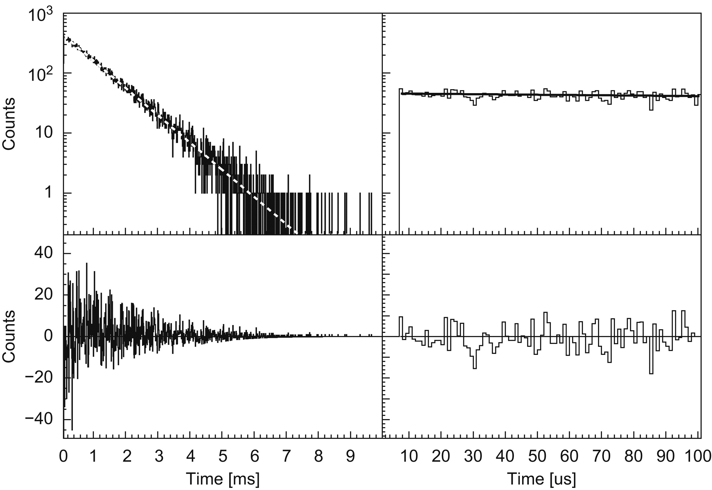
K. Starosta et al., Nucl. Instrum. Methods Phys. Res. A 610, 700 (2009).

Slide 2
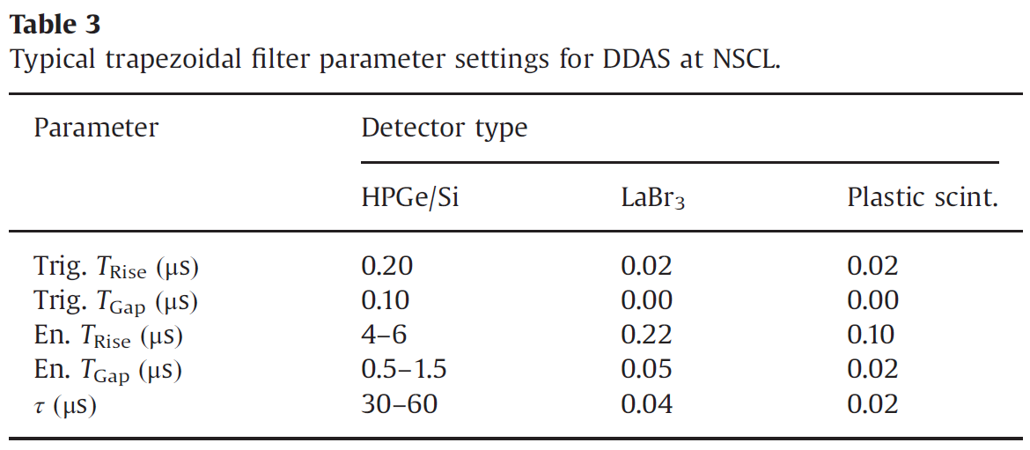
C.J. Prokop et al., Nucl. Instrum. Methods Phys. Res. A 741, 163 (2014).

Slide 3
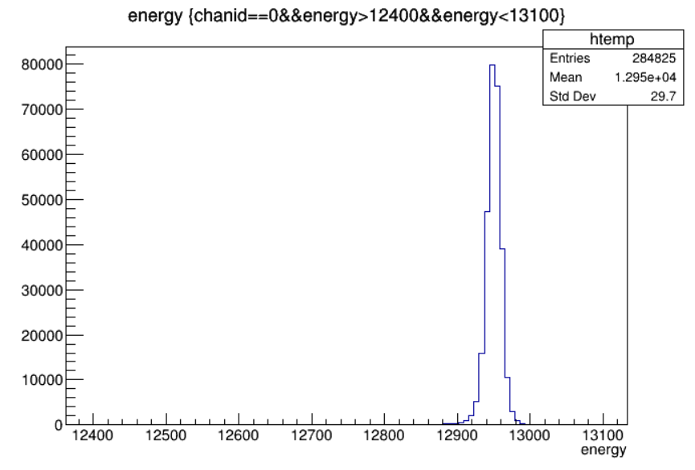
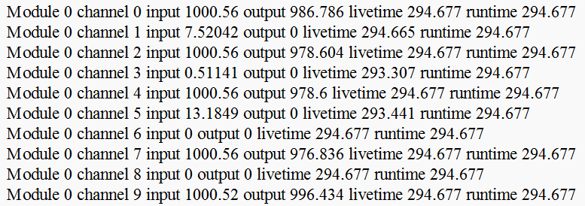
Counts in the full-energy peak:
284825/288649867928.5*1e9 = 986.7 cps
Notes:
run0326_Pulser_Ch02479_1kHz_Random_1000nsWindow.root

Slide 4
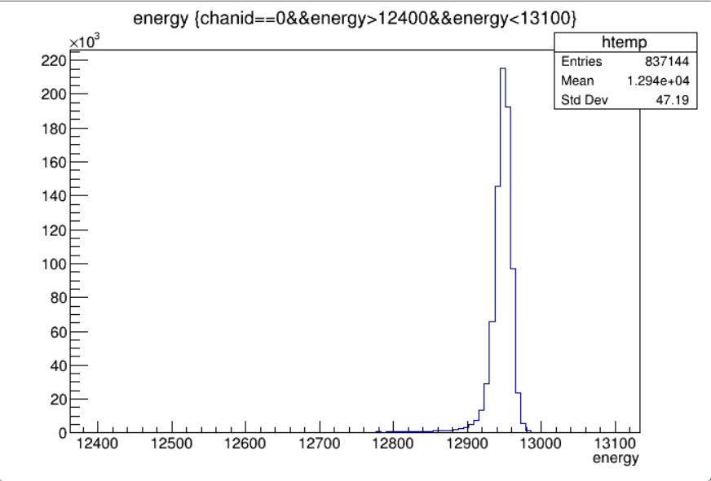
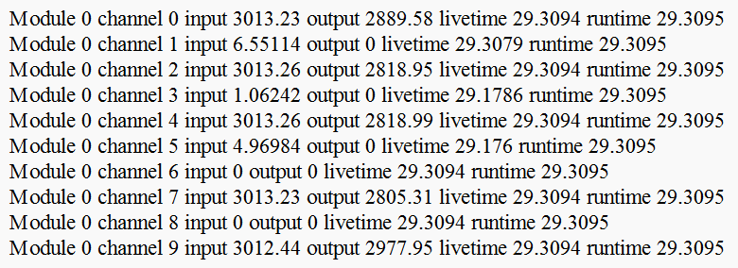
Counts in the full-energy peak:
837144/289709443537*1e9 = 2889.6 cps
Notes:
run0324_Pulser_Ch02479_3kHz_Random_1000nsWindow.root

Slide 5
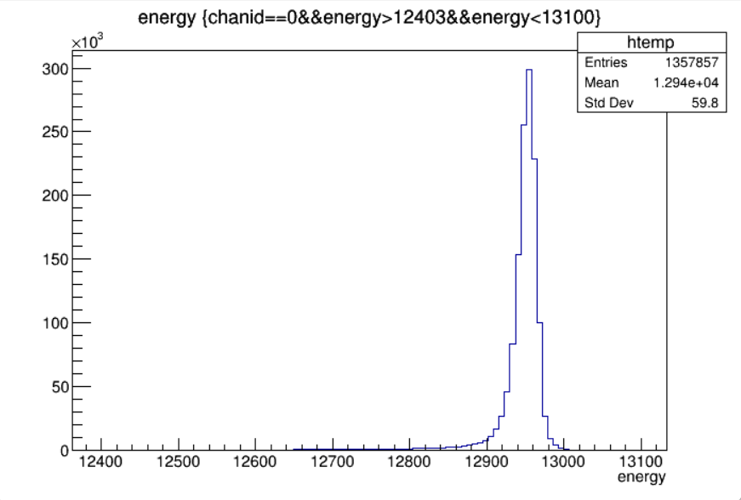
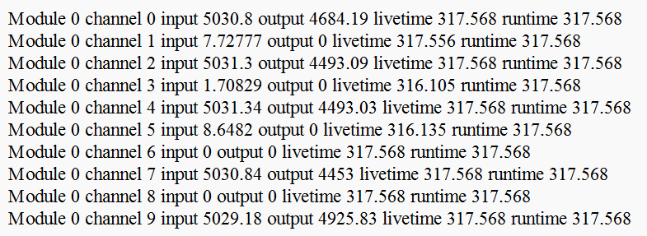
Counts in the full-energy peak:
1357857/289879707564.4*1e9 = 4684.21 cps
Notes:
run0325_Pulser_Ch02479_5kHz_Random_1000nsWindow.root
dchan->Draw("energy","chanid==0&&energy>12403&&energy<13100")

Slide 6
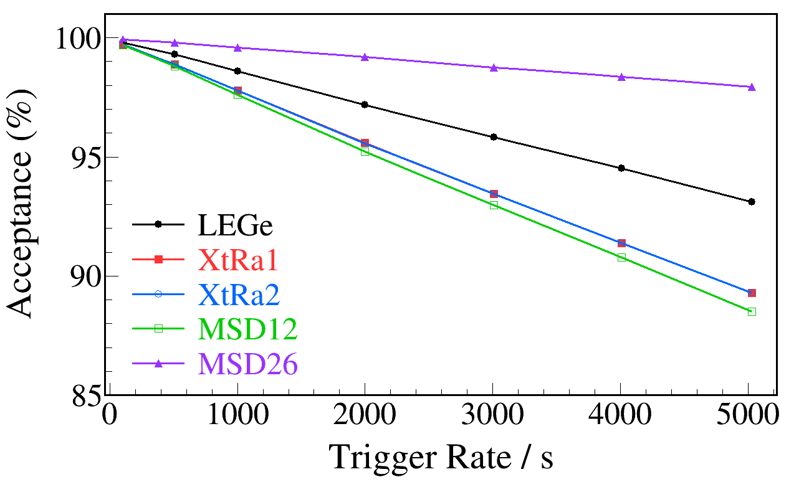
Notes:
Best figure DDAS dead time
multigraph_plot_by_xy_ddas_dead_time.C

Slide 7
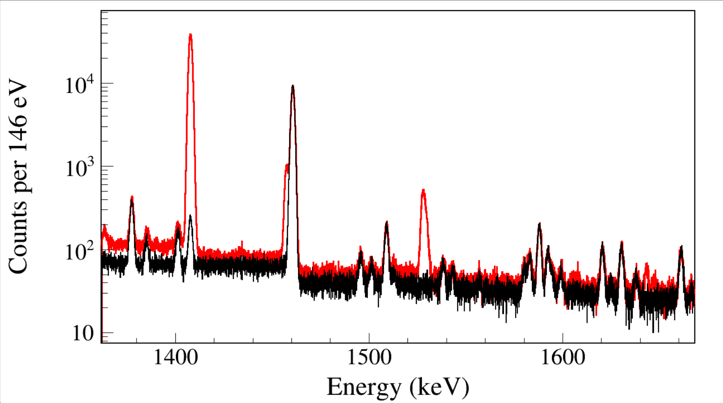
Run Time: 124512211965269 ns
1408
152Sm
1408
214Po
1457
152Sm
1461
40Ar
1528
152Sm
122+1408
152Sm
Notes:
TFile *_file0 = TFile::Open("F:/e21010/pxct/run0228_0229_0230_LEGe_XtRa_MSD26_152Eu_Z2707_inChamber_vacuum_XtRa_12mm_away_window1us_XtRaCFDdelay_0.2us_for_efficiency_cal.root");
TCanvas* canvaspeak = new TCanvas("canvaspeak", "canvaspeak", 1300, 750);//
canvaspeak->cd();//
canvaspeak->SetTopMargin(0.025);
canvaspeak->SetRightMargin(0.04);
canvaspeak->SetLeftMargin(0.14);
canvaspeak->SetBottomMargin(0.15);
canvaspeak->SetFrameLineWidth(2);
hnorth_e->SetLineWidth(3);
//hnorth_e->Rebin(2);
hnorth_e->SetLineColor(kRed);
hnorth_e->SetStats(0);
hnorth_e->SetTitle("");
hnorth_e->GetXaxis()->SetTitle("Energy (keV)");
hnorth_e->GetYaxis()->SetTitle("Counts per 38 eV");
hnorth_e->GetXaxis()->CenterTitle();
hnorth_e->GetYaxis()->CenterTitle();
hnorth_e->GetXaxis()->SetLabelFont(132);
hnorth_e->GetYaxis()->SetLabelFont(132);
hnorth_e->GetXaxis()->SetLabelSize(0.06);
hnorth_e->GetYaxis()->SetLabelSize(0.06);
hnorth_e->GetXaxis()->SetTitleFont(132);
hnorth_e->GetYaxis()->SetTitleFont(132);
hnorth_e->GetXaxis()->SetTitleOffset(1.0);
hnorth_e->GetYaxis()->SetTitleOffset(1.0);
hnorth_e->GetXaxis()->SetTitleSize(0.07);
hnorth_e->GetYaxis()->SetTitleSize(0.07);
hnorth_e->GetXaxis()->SetNdivisions(505);
hnorth_e->GetYaxis()->SetNdivisions(510);
//hnorth_e->GetXaxis()->SetRangeUser(900,1500);
//hnorth_e->GetYaxis()->SetRangeUser(100,4e6);
hnorth_e->GetYaxis()->SetTickLength(0.02);
hnorth_e->Draw("hist");
gPad->RedrawAxis();
gPad->SetLogy();
TFile *_file1 = TFile::Open("F:/e21010/pxct/run0233_LEGe_XtRa_Room_background_XtRa_12mm_away_window1us_for_background_subtraction_cal.root");
tree->SetLineWidth(2);
tree->SetLineColor(1);
tree->Draw("north_e","north_e>0&&north_t<124512211965269","same");

Slide 8
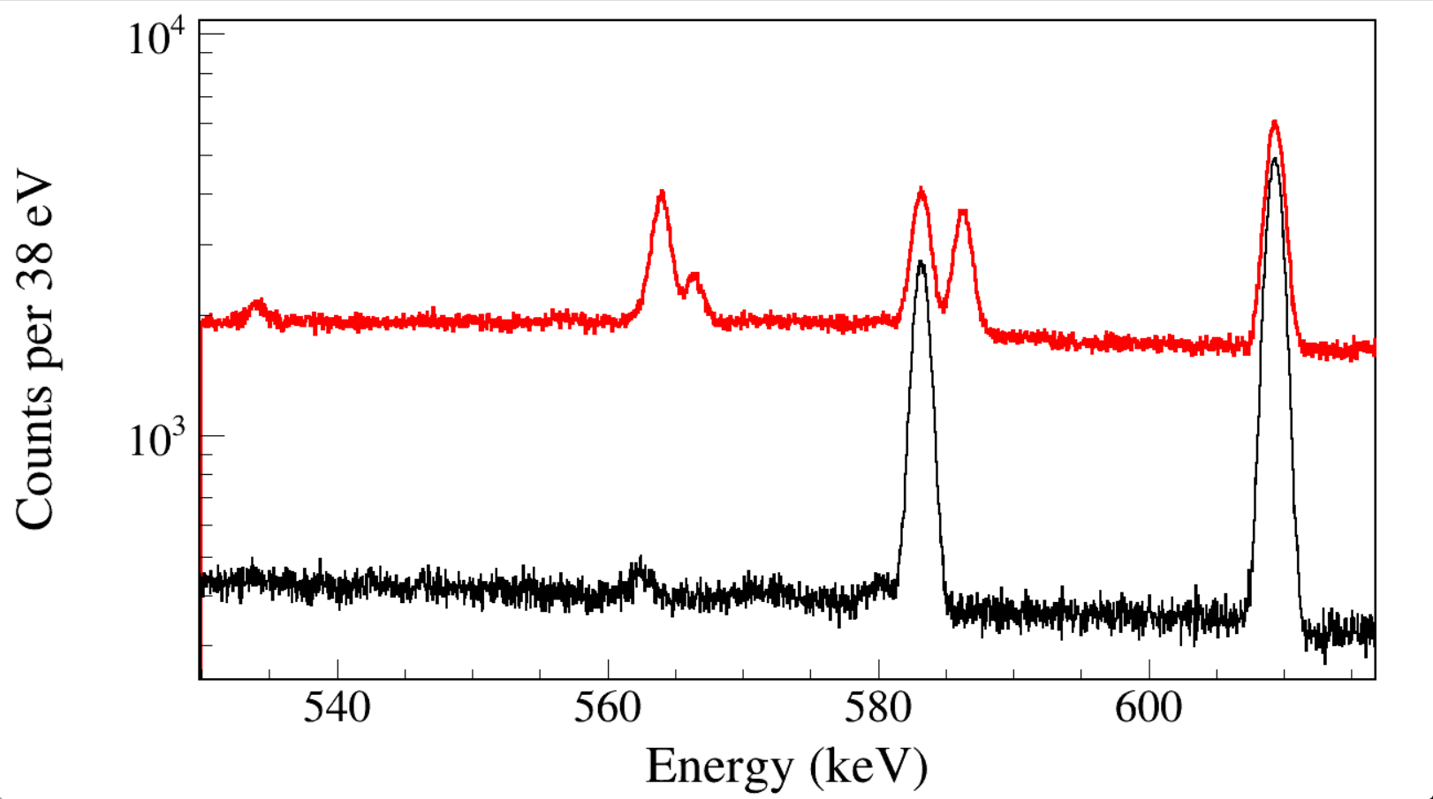
Run Time: 124512211965269 ns
583
208Pb
564
152Sm
586
152Gd
563
228Th
566
152Sm
Notes:
TFile *_file0 = TFile::Open("F:/e21010/pxct/run0228_0229_0230_LEGe_XtRa_MSD26_152Eu_Z2707_inChamber_vacuum_XtRa_12mm_away_window1us_XtRaCFDdelay_0.2us_for_efficiency_cal.root");
TCanvas* canvaspeak = new TCanvas("canvaspeak", "canvaspeak", 1300, 750);//
canvaspeak->cd();//
canvaspeak->SetTopMargin(0.025);
canvaspeak->SetRightMargin(0.04);
canvaspeak->SetLeftMargin(0.14);
canvaspeak->SetBottomMargin(0.15);
canvaspeak->SetFrameLineWidth(2);
hnorth_e->SetLineWidth(3);
//hnorth_e->Rebin(2);
hnorth_e->SetLineColor(kRed);
hnorth_e->SetStats(0);
hnorth_e->SetTitle("");
hnorth_e->GetXaxis()->SetTitle("Energy (keV)");
hnorth_e->GetYaxis()->SetTitle("Counts per 38 eV");
hnorth_e->GetXaxis()->CenterTitle();
hnorth_e->GetYaxis()->CenterTitle();
hnorth_e->GetXaxis()->SetLabelFont(132);
hnorth_e->GetYaxis()->SetLabelFont(132);
hnorth_e->GetXaxis()->SetLabelSize(0.06);
hnorth_e->GetYaxis()->SetLabelSize(0.06);
hnorth_e->GetXaxis()->SetTitleFont(132);
hnorth_e->GetYaxis()->SetTitleFont(132);
hnorth_e->GetXaxis()->SetTitleOffset(1.0);
hnorth_e->GetYaxis()->SetTitleOffset(1.0);
hnorth_e->GetXaxis()->SetTitleSize(0.07);
hnorth_e->GetYaxis()->SetTitleSize(0.07);
hnorth_e->GetXaxis()->SetNdivisions(505);
hnorth_e->GetYaxis()->SetNdivisions(510);
//hnorth_e->GetXaxis()->SetRangeUser(900,1500);
//hnorth_e->GetYaxis()->SetRangeUser(100,4e6);
hnorth_e->GetYaxis()->SetTickLength(0.02);
hnorth_e->Draw("hist");
gPad->RedrawAxis();
gPad->SetLogy();
TFile *_file1 = TFile::Open("F:/e21010/pxct/run0233_LEGe_XtRa_Room_background_XtRa_12mm_away_window1us_for_background_subtraction_cal.root");
tree->SetLineWidth(2);
tree->SetLineColor(1);
tree->Draw("north_e","north_e>0&&north_t<124512211965269","same");

Slide 9
Rahul Jain, 2023 FRIB-TA Summer School on practical uncertainty quantification and emulation

Slide 10
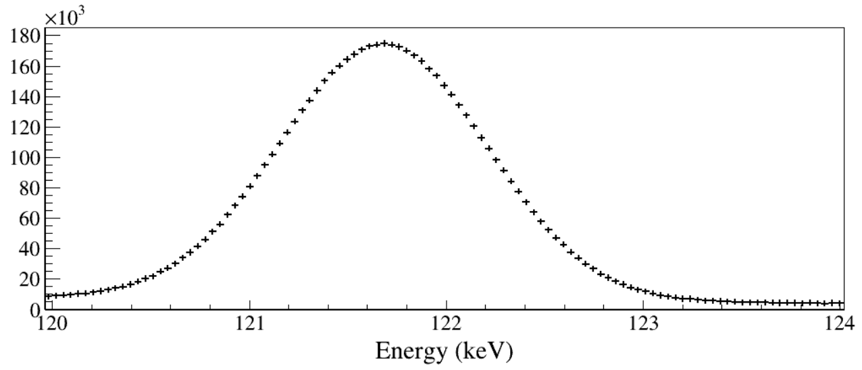
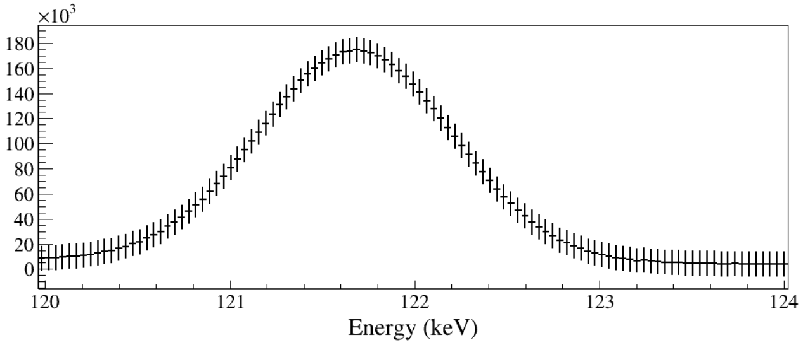
hsouth_e_pure->SetBinError(i,Nsquaredsum);

Slide 11
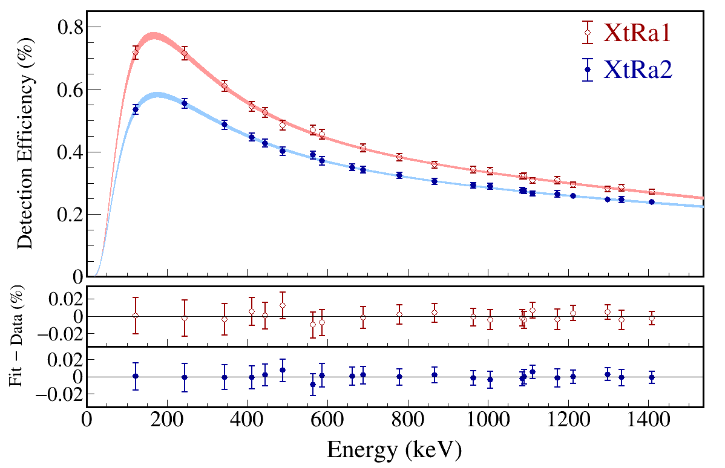
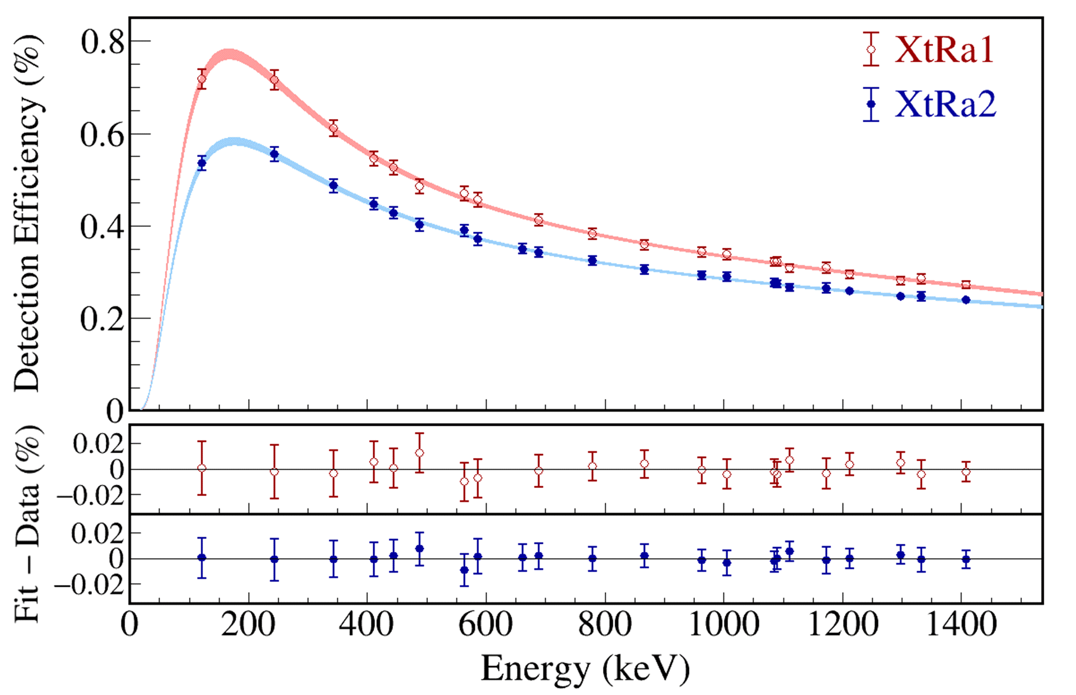
Notes:
Best figure Gamma Efficiency XtRa
multigrapherror_plot_by_xy_pxct_xtra_efficiency.C

Slide 12
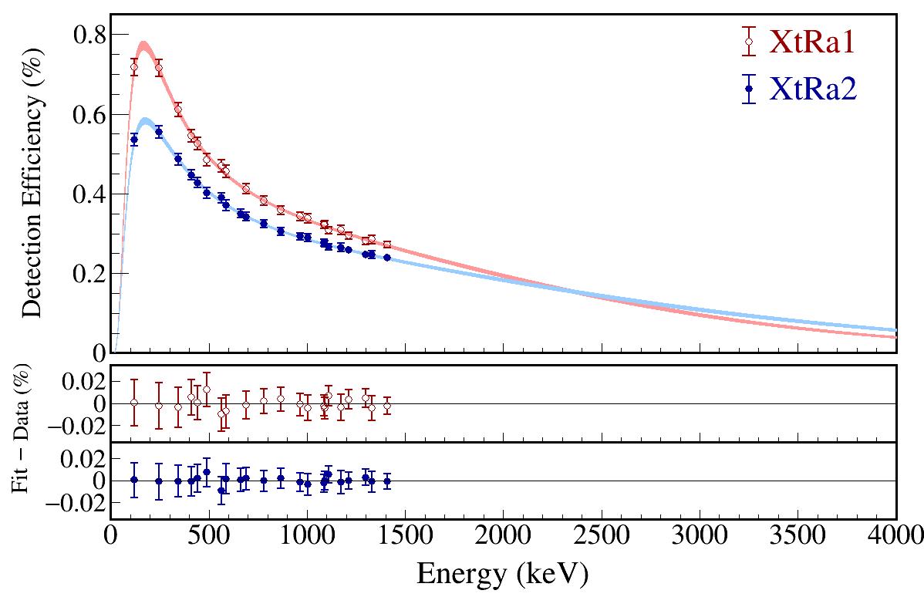

Slide 13
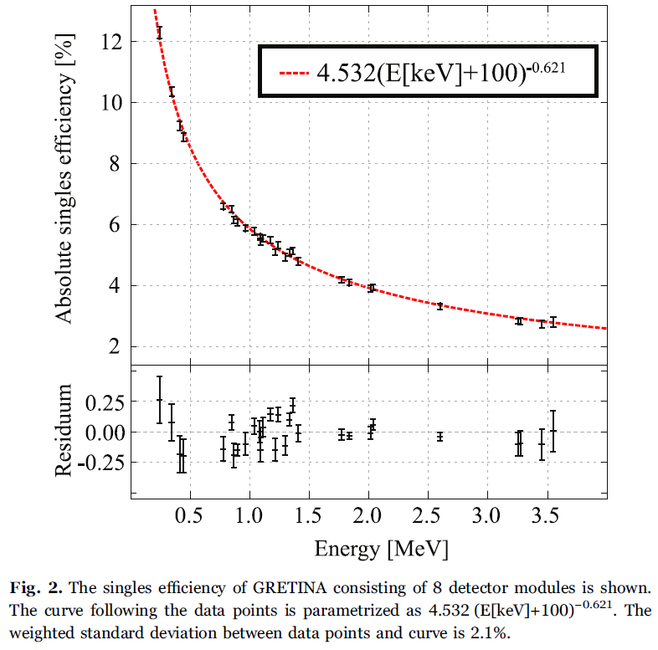
This processing takes approximately 15–20 μs and acts as a channel deadtime since the local buffering of any other hit in the same detector occurring during this time window will be discarded.
Typical Ge detector rates in in-beam experiments
at NSCL were well below 1 kHz which translates into a channel deadtime of 2% or less. The sources produced a rate of several hundred Hz per Ge crystal.
The absolute efficiency of the array was extracted using a 152Eu source with known activity, the peak integrals in the acquired spectra, the γ-ray yield per disintegration [22], and the acquisition time corrected for the deadtime.
This deadtime correction is small(<2%) in the case that the GRETINA readout was triggered locally by the GRETINA Trigger Timing & Control logic since only the channel deadtime of 15 μs has to be considered.
A singles measurement with a 56Co source was used for accessing the efficiency beyond 1.84 MeV. The activity of that source was unknown and so the relative efficiency was extracted and scaled to best fit with the absolute efficiency points.
The error bars for the 152Eu data points are given by the uncertainty of the γ-ray yields and the source activity. The activity of the 152Eu calibration source is quoted with 1.4% accuracy by the manufacturer.
One may conclude that the efficiency curve overall describes the efficiency within 2–3% accuracy.
D. Weisshaar et al., Nucl. Instrum. Methods Phys. Res. A 847, 187 (2017).

Slide 14
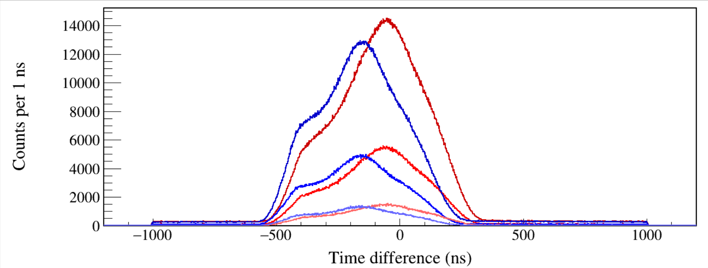
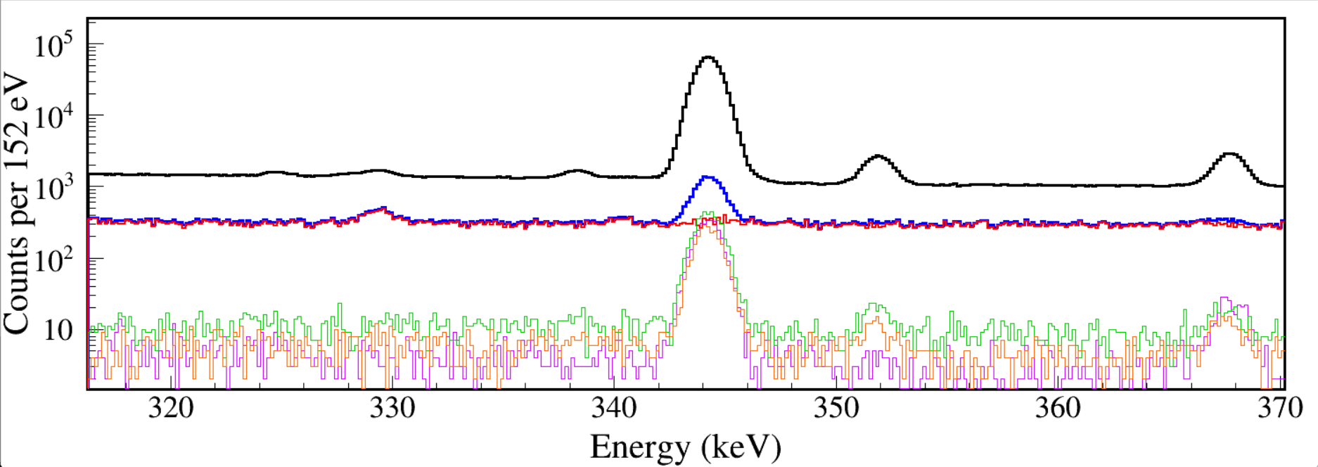
north_t–lege_t
north_t–lege_t (gated by 39 keV X ray)
north_t–lege_t (gated by 45 keV X ray)
south_t–lege_t
south_t–lege_t (gated by 39 keV X ray)
south_t–lege_t (gated by 45 keV X ray)
hnorth_e_raw
hnorth_e_Kagated
hnorth_e_t1bkg hnorth_e_t2bkg
hnorth_e_ebkg
hnorth_e_pure
Both energy background subtraction and time background subtraction are necessary.
Notes:
TFile *_file1 = TFile::Open("F:/e21010/pxct/run0228_0229_0230_LEGe_XtRa_MSD26_152Eu_Z2707_inChamber_vacuum_XtRa_12mm_away_window1us_XtRaCFDdelay_0.2us_for_efficiency_cal.root");
TCanvas* canvaspeak = new TCanvas("canvaspeak", "canvaspeak", 1300, 800);//
canvaspeak->cd();//
canvaspeak->SetTopMargin(0.03);
canvaspeak->SetRightMargin(0.04);
canvaspeak->SetLeftMargin(0.17);
canvaspeak->SetBottomMargin(0.16);
gStyle->SetFrameLineWidth(3);
canvaspeak->SetFrameLineWidth(3);
TH1D* htimestamps = new TH1D("htimestamps", "htimestamps", 3000,-1500,1500);
htimestamps->SetLineWidth(2);
htimestamps->Rebin(1);
htimestamps->SetStats(0);
htimestamps->SetTitle("");
htimestamps->GetXaxis()->SetTitle("Time difference (ns)");
htimestamps->GetYaxis()->SetTitle("Counts per 1 ns");
htimestamps->GetXaxis()->CenterTitle();
htimestamps->GetYaxis()->CenterTitle();
htimestamps->GetXaxis()->SetLabelFont(132);
htimestamps->GetYaxis()->SetLabelFont(132);
htimestamps->GetXaxis()->SetLabelSize(0.06);
htimestamps->GetYaxis()->SetLabelSize(0.06);
htimestamps->GetXaxis()->SetTitleFont(132);
htimestamps->GetYaxis()->SetTitleFont(132);
htimestamps->GetXaxis()->SetTitleOffset(1.1);
htimestamps->GetYaxis()->SetTitleOffset(1.05);
htimestamps->GetXaxis()->SetTitleSize(0.07);
htimestamps->GetYaxis()->SetTitleSize(0.07);
htimestamps->GetXaxis()->SetRangeUser(-1000,1000);
//htimestamps->GetYaxis()->SetRangeUser(0,200);
htimestamps->SetLineWidth(2);
htimestamps->SetLineColor(kRed+2);
tree->Draw("north_t-lege_t>>htimestamps","lege_e>5&&lege_e<400&&north_e>100&&north_e<2000");
tree->SetLineColor(kRed);
tree->SetLineWidth(2);
tree->Draw("north_t-lege_t","lege_e>38.8&&lege_e<40.8&&north_e>100&&north_e<2000","same");
tree->SetLineColor(kRed-7);
tree->SetLineWidth(2);
tree->Draw("north_t-lege_t","lege_e>44.8&&lege_e<47.2&&north_e>100&&north_e<2000","same");
tree->SetLineColor(kBlue+2);
tree->SetLineWidth(2);
tree->Draw("south_t-lege_t","lege_e>5&&lege_e<400&&south_e>100&&south_e<2000","same");
tree->SetLineColor(kBlue);
tree->SetLineWidth(2);
tree->Draw("south_t-lege_t","lege_e>38.8&&lege_e<40.8&&south_e>100&&south_e<2000","same");
tree->SetLineColor(kBlue-7);
tree->SetLineWidth(2);
tree->Draw("south_t-lege_t","lege_e>44.8&&lege_e<47.2&&south_e>100&&south_e<2000","same");

Slide 15
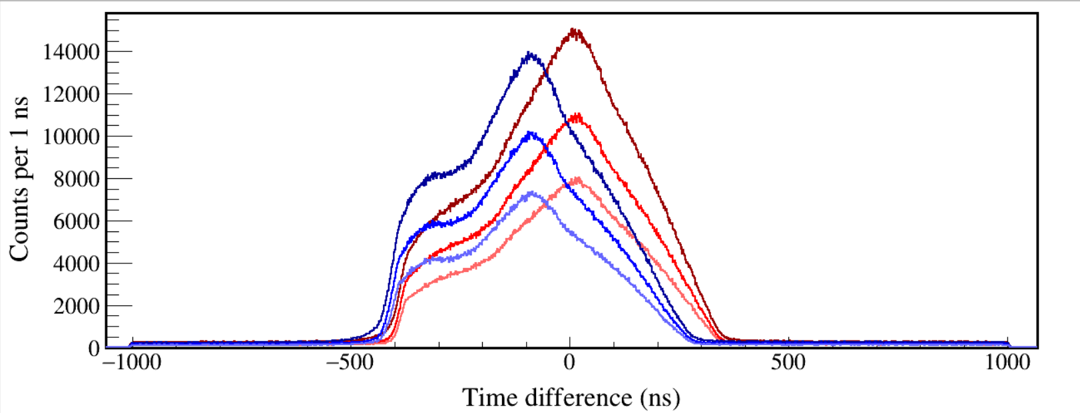
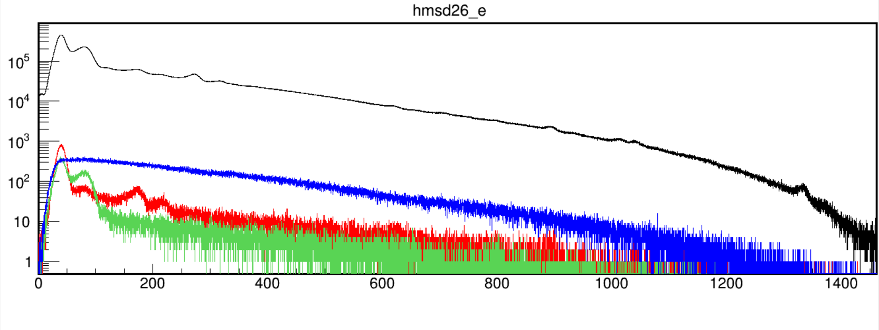
north_t–msd26_t (20-1400 keV)
north_t–msd26_t (60-1400 keV)
north_t–msd26_t (100-1400 keV)
south_t–msd26_t (20-1400 keV)
south_t–msd26_t (60-1400 keV)
south_t–msd26_t (100-1400 keV)
hmsd26_e->Draw();
tree->Draw("msd26_e","north_e>120&&north_e<124&&msd26_e>0&&msd26_e<2000&&north_t-msd26_t>-500&&north_t-msd26_t<400","same");
tree->Draw("msd26_e","north_e>243&&north_e<246&&msd26_e>0&&msd26_e<2000&&north_t-msd26_t>-500&&north_t-msd26_t<400","same");
tree->Draw("msd26_e","north_e>342&&north_e<346&&msd26_e>0&&msd26_e<2000&&north_t-msd26_t>-500&&north_t-msd26_t<400","same");
msd_26
344 gated
245 gated
122 gated
Notes:
TFile *_file1 = TFile::Open("F:/e21010/pxct/run0228_0229_0230_LEGe_XtRa_MSD26_152Eu_Z2707_inChamber_vacuum_XtRa_12mm_away_window1us_XtRaCFDdelay_0.2us_for_efficiency_cal.root");
TCanvas* canvaspeak = new TCanvas("canvaspeak", "canvaspeak", 1300, 800);//
canvaspeak->cd();//
canvaspeak->SetTopMargin(0.03);
canvaspeak->SetRightMargin(0.04);
canvaspeak->SetLeftMargin(0.17);
canvaspeak->SetBottomMargin(0.16);
gStyle->SetFrameLineWidth(3);
canvaspeak->SetFrameLineWidth(3);
TH1D* htimestamps = new TH1D("htimestamps", "htimestamps", 3000,-1500,1500);
htimestamps->SetLineWidth(2);
htimestamps->Rebin(1);
htimestamps->SetStats(0);
htimestamps->SetTitle("");
htimestamps->GetXaxis()->SetTitle("Time difference (ns)");
htimestamps->GetYaxis()->SetTitle("Counts per 1 ns");
htimestamps->GetXaxis()->CenterTitle();
htimestamps->GetYaxis()->CenterTitle();
htimestamps->GetXaxis()->SetLabelFont(132);
htimestamps->GetYaxis()->SetLabelFont(132);
htimestamps->GetXaxis()->SetLabelSize(0.06);
htimestamps->GetYaxis()->SetLabelSize(0.06);
htimestamps->GetXaxis()->SetTitleFont(132);
htimestamps->GetYaxis()->SetTitleFont(132);
htimestamps->GetXaxis()->SetTitleOffset(1.1);
htimestamps->GetYaxis()->SetTitleOffset(1.05);
htimestamps->GetXaxis()->SetTitleSize(0.07);
htimestamps->GetYaxis()->SetTitleSize(0.07);
htimestamps->GetXaxis()->SetRangeUser(-1000,1000);
//htimestamps->GetYaxis()->SetRangeUser(0,200);
htimestamps->SetLineWidth(2);
htimestamps->SetLineColor(kRed+2);
tree->Draw("north_t-msd26_t>>htimestamps","msd26_e>20&&msd26_e<1400&&north_e>100&&north_e<2000");
tree->SetLineColor(kRed);
tree->SetLineWidth(2);
tree->Draw("north_t-msd26_t","msd26_e>60&&msd26_e<1400&&north_e>100&&north_e<2000","same");
tree->SetLineColor(kRed-7);
tree->SetLineWidth(2);
tree->Draw("north_t-msd26_t","msd26_e>100&&msd26_e<1400&&north_e>100&&north_e<2000","same");
tree->SetLineColor(kBlue+2);
tree->SetLineWidth(2);
tree->Draw("south_t-msd26_t","msd26_e>20&&msd26_e<1400&&south_e>100&&south_e<2000","same");
tree->SetLineColor(kBlue);
tree->SetLineWidth(2);
tree->Draw("south_t-msd26_t","msd26_e>60&&msd26_e<1400&&south_e>100&&south_e<2000","same");
tree->SetLineColor(kBlue-7);
tree->SetLineWidth(2);
tree->Draw("south_t-msd26_t","msd26_e>100&&msd26_e<1400&&south_e>100&&south_e<2000","same");

Slide 16
Notes:
Best figure xgamma/betagamma coincidence spec 152Eu in Chamber XtRa LEGe MSD26
TFile *_file1 = TFile::Open("F:/e21010/pxct/run0228_0229_0230_LEGe_XtRa_MSD26_152Eu_Z2707_inChamber_vacuum_XtRa_12mm_away_window1us_XtRaCFDdelay_0.2us_for_efficiency_cal.root");
TCanvas* canvaspeak = new TCanvas("canvaspeak", "canvaspeak", 1500, 400);
canvaspeak->cd();//
canvaspeak->SetTopMargin(0.038);
canvaspeak->SetRightMargin(0.025);
canvaspeak->SetLeftMargin(0.066);
canvaspeak->SetBottomMargin(0.17);
gStyle->SetFrameLineWidth(3);
canvaspeak->SetFrameLineWidth(3);
gPad->SetLogy();
hnorth_e->SetLineWidth(3);
hnorth_e->Rebin(4);
hnorth_e->SetLineColor(1);
hnorth_e->SetStats(0);
hnorth_e->SetTitle("");
hnorth_e->GetXaxis()->SetTitle("Energy (keV)");
hnorth_e->GetYaxis()->SetTitle("Counts per 152 eV");
hnorth_e->GetXaxis()->CenterTitle();
hnorth_e->GetYaxis()->CenterTitle();
hnorth_e->GetXaxis()->SetLabelFont(132);
hnorth_e->GetYaxis()->SetLabelFont(132);
hnorth_e->GetXaxis()->SetLabelSize(0.07);
hnorth_e->GetYaxis()->SetLabelSize(0.07);
hnorth_e->GetXaxis()->SetTitleFont(132);
hnorth_e->GetYaxis()->SetTitleFont(132);
hnorth_e->GetXaxis()->SetTitleOffset(1.0);
hnorth_e->GetYaxis()->SetTitleOffset(0.41);
hnorth_e->GetXaxis()->SetTitleSize(0.08);
hnorth_e->GetYaxis()->SetTitleSize(0.08);
hnorth_e->GetYaxis()->SetTickLength(0.015);
hnorth_e->GetXaxis()->SetRangeUser(0,2000);
hnorth_e->Scale(0.2);
hnorth_e->GetYaxis()->SetRangeUser(1,200000);
const Int_t numBins = hnorth_e->GetNbinsX();
const Double_t xMin = hnorth_e->GetXaxis()->GetXmin();
const Double_t xMax = hnorth_e->GetXaxis()->GetXmax();
TH1D* hnorth_e_t1bkg = new TH1D("hnorth_e_t1bkg", "hnorth_e_t1bkg", numBins, xMin, xMax);
TH1D* hnorth_e_t2bkg = new TH1D("hnorth_e_t2bkg", "hnorth_e_t2bkg", numBins, xMin, xMax);
TH1D* hnorth_e_ebkg = new TH1D("hnorth_e_ebkg", "hnorth_e_ebkg", numBins, xMin, xMax);
TH1D* hnorth_e_pureKaKb = new TH1D("hnorth_e_pureKaKb", "hnorth_e_pureKaKb", numBins, xMin, xMax);
TH1D* hnorth_e_KaKbgated = new TH1D("hnorth_e_KaKbgated", "hnorth_e_KaKbgated", numBins, xMin, xMax);
hnorth_e_KaKbgated->SetLineColor(4);
tree->Draw("north_e>>hnorth_e_KaKbgated","north_e>0&&north_e<2000&&((lege_e>38.8&&lege_e<40.8)||(lege_e>44.8&&lege_e<47.2))&&north_t-lege_t>-600&&north_t-lege_t<350");
hnorth_e_t1bkg->SetLineColor(kGreen+1);
tree->Draw("north_e>>hnorth_e_t1bkg","north_e>0&&north_e<2000&&((lege_e>38.8&&lege_e<40.8)||(lege_e>44.8&&lege_e<47.2))&&north_t-lege_t>400&&north_t-lege_t<1000","");
hnorth_e_t2bkg->SetLineColor(kOrange+7);
tree->Draw("north_e>>hnorth_e_t2bkg","north_e>0&&north_e<2000&&((lege_e>38.8&&lege_e<40.8)||(lege_e>44.8&&lege_e<47.2))&&north_t-lege_t>-1000&&north_t-lege_t<-650","");
hnorth_e_ebkg->SetLineColor(kViolet);
tree->Draw("north_e>>hnorth_e_ebkg","north_e>0&&north_e<2000&&lege_e>60&&lege_e<64.4&&north_t-lege_t>-600&&north_t-lege_t<350","");
hnorth_e_KaKbgated->SetLineWidth(3);
hnorth_e_pureKaKb->Add(hnorth_e_KaKbgated,hnorth_e_ebkg,1,-1);
hnorth_e_pureKaKb->Add(hnorth_e_pureKaKb,hnorth_e_t1bkg,1,-1);
hnorth_e_pureKaKb->Add(hnorth_e_pureKaKb,hnorth_e_t2bkg,1,-1);
hnorth_e_pureKaKb->SetLineColor(2);
hnorth_e_pureKaKb->SetLineWidth(2);
hnorth_e->Draw("hist");
//hnorth_e_KaKbgated->Draw("same");
hnorth_e_pureKaKb->Draw("same");
//hnorth_e_t1bkg->Draw("same");
//hnorth_e_t2bkg->Draw("same");
//hnorth_e_ebkg->Draw("same");
TH1D* hnorth_e_tbkg1 = new TH1D("hnorth_e_tbkg1", "hnorth_e_tbkg1", numBins, xMin, xMax);
TH1D* hnorth_e_tbkg2 = new TH1D("hnorth_e_tbkg2", "hnorth_e_tbkg2", numBins, xMin, xMax);
TH1D* hnorth_e_purebeta = new TH1D("hnorth_e_purebeta", "hnorth_e_purebeta", numBins, xMin, xMax);
TH1D* hnorth_e_betagated20 = new TH1D("hnorth_e_betagated20", "hnorth_e_betagated20", numBins, xMin, xMax);
TH1D* hnorth_e_betagated60 = new TH1D("hnorth_e_betagated60", "hnorth_e_betagated60", numBins, xMin, xMax);
TH1D* hnorth_e_betagated100 = new TH1D("hnorth_e_betagated100", "hnorth_e_betagated100", numBins, xMin, xMax);
//tree->Draw("north_e>>hnorth_e_betagated20","north_e>0&&north_e<2000&&msd26_e>20&&msd26_e<1400&&north_t-msd26_t>-500&&north_t-msd26_t<400","");
//tree->Draw("north_e>>hnorth_e_betagated60","north_e>0&&north_e<2000&&msd26_e>60&&msd26_e<1400&&north_t-msd26_t>-500&&north_t-msd26_t<400","");
tree->Draw("north_e>>hnorth_e_betagated100","north_e>0&&north_e<2000&&msd26_e>100&&msd26_e<1400&&north_t-msd26_t>-500&&north_t-msd26_t<400","");
tree->Draw("north_e>>hnorth_e_tbkg1","north_e>0&&north_e<2000&&msd26_e>100&&msd26_e<1400&&north_t-msd26_t>-1000&&north_t-msd26_t<-500","");
tree->Draw("north_e>>hnorth_e_tbkg2","north_e>0&&north_e<2000&&msd26_e>100&&msd26_e<1400&&north_t-msd26_t>500&&north_t-msd26_t<900","");
hnorth_e_purebeta->Add(hnorth_e_betagated100,hnorth_e_tbkg1,1,-1);
hnorth_e_purebeta->Add(hnorth_e_purebeta,hnorth_e_tbkg2,1,-1);
hnorth_e_purebeta->SetLineColor(kAzure);
hnorth_e_purebeta->SetLineWidth(2);
hnorth_e->Draw("hist");
//hnorth_e->Scale(0.20);
hnorth_e_purebeta->Rebin(1);
//hnorth_e_betagated20->Draw("same");
//hnorth_e_betagated60->Draw("same");
//hnorth_e_betagated100->Draw("same");
hnorth_e_purebeta->Draw("same");
hmsd26_e->Draw();
tree->Draw("msd26_e","north_e>120&&north_e<124&&msd26_e>0&&msd26_e<2000&&north_t-msd26_t>-500&&north_t-msd26_t<400","same");
tree->Draw("msd26_e","north_e>243&&north_e<246&&msd26_e>0&&msd26_e<2000&&north_t-msd26_t>-500&&north_t-msd26_t<400","same");
tree->Draw("msd26_e","north_e>342&&north_e<346&&msd26_e>0&&msd26_e<2000&&north_t-msd26_t>-500&&north_t-msd26_t<400","same");
hnorth_e->GetXaxis()->SetRangeUser(100,400);
hnorth_e->GetYaxis()->SetRangeUser(10,3e6);
gPad->RedrawAxis();
canvaspeak->SaveAs("F:/e21010/pxct/xgamma_coincidence_152Eu_inChamber_run0228_0229_0230_100-400keV.png");
hnorth_e->GetXaxis()->SetRangeUser(400,700);
hnorth_e->GetYaxis()->SetRangeUser(10,5e4);
gPad->RedrawAxis();
canvaspeak->SaveAs("F:/e21010/pxct/xgamma_coincidence_152Eu_inChamber_run0228_0229_0230_400-700keV.png");
hnorth_e->GetXaxis()->SetRangeUser(700,1000);
hnorth_e->GetYaxis()->SetRangeUser(10,1e5);
gPad->RedrawAxis();
canvaspeak->SaveAs("F:/e21010/pxct/xgamma_coincidence_152Eu_inChamber_run0228_0229_0230_700-1000keV.png");
hnorth_e->GetXaxis()->SetRangeUser(1000,1300);
hnorth_e->GetYaxis()->SetRangeUser(4,1e5);
gPad->RedrawAxis();
canvaspeak->SaveAs("F:/e21010/pxct/xgamma_coincidence_152Eu_inChamber_run0228_0229_0230_1000-1300keV.png");
hnorth_e->GetXaxis()->SetRangeUser(1300,1600);
hnorth_e->GetYaxis()->SetRangeUser(1,5e5);
gPad->RedrawAxis();
canvaspeak->SaveAs("F:/e21010/pxct/xgamma_coincidence_152Eu_inChamber_run0228_0229_0230_1300-1600keV.png");

Slide 18
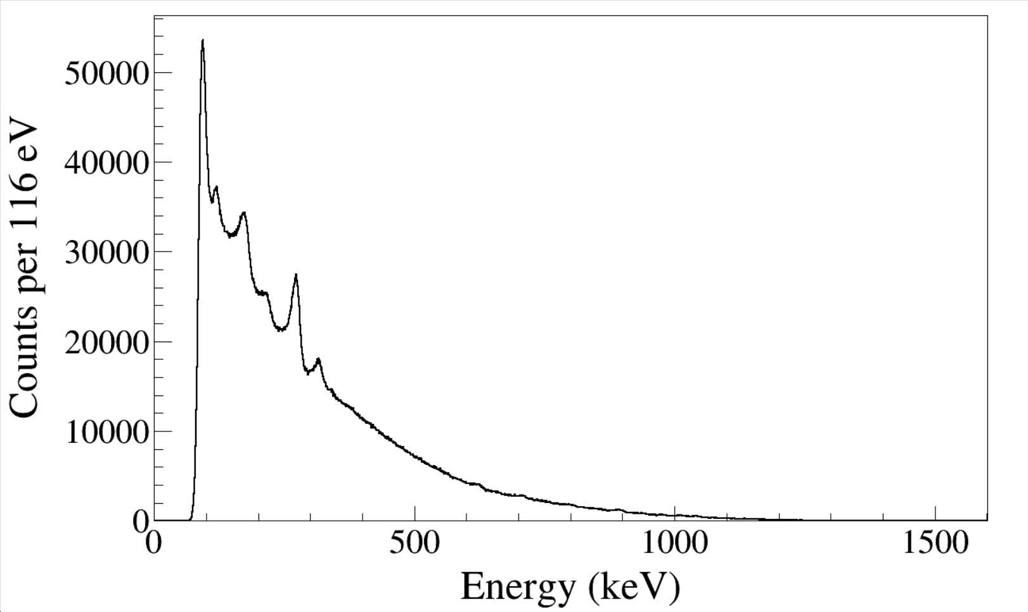
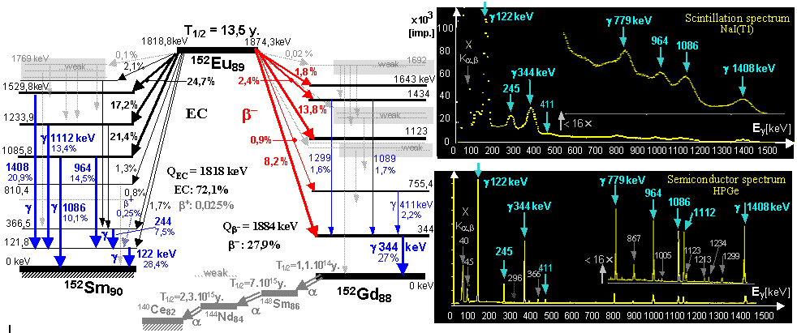
Notes:
TFile *_file1 = TFile::Open("F:/e21010/pxct/run0203_LEGe_XtRa_MSD26_152Eu_Z2707_inChamber_vacuum_XtRa_12mm_away_window1.5us_CFDdelay_adjusted_cal.root");
TCanvas* canvaspeak = new TCanvas("MSD", "MSD", 1300, 800);//
canvaspeak->cd();//
canvaspeak->SetTopMargin(0.025);
canvaspeak->SetRightMargin(0.04);
canvaspeak->SetLeftMargin(0.15);
canvaspeak->SetBottomMargin(0.15);
canvaspeak->SetFrameLineWidth(2);
hmsd26_e->SetLineWidth(2);
hmsd26_e->Rebin(4);
hmsd26_e->SetLineColor(1);
hmsd26_e->SetStats(0);
hmsd26_e->SetTitle("");
hmsd26_e->GetXaxis()->SetTitle("Energy (keV)");
hmsd26_e->GetYaxis()->SetTitle("Counts per 116 eV");
hmsd26_e->GetXaxis()->CenterTitle();
hmsd26_e->GetYaxis()->CenterTitle();
hmsd26_e->GetXaxis()->SetLabelFont(132);
hmsd26_e->GetYaxis()->SetLabelFont(132);
hmsd26_e->GetXaxis()->SetLabelSize(0.06);
hmsd26_e->GetYaxis()->SetLabelSize(0.06);
hmsd26_e->GetXaxis()->SetTitleFont(132);
hmsd26_e->GetYaxis()->SetTitleFont(132);
hmsd26_e->GetXaxis()->SetTitleOffset(1.0);
hmsd26_e->GetYaxis()->SetTitleOffset(1.1);
hmsd26_e->GetXaxis()->SetTitleSize(0.07);
hmsd26_e->GetYaxis()->SetTitleSize(0.07);
hmsd26_e->GetXaxis()->SetNdivisions(505);
hmsd26_e->GetXaxis()->SetRangeUser(0,1600);
//hmsd26_e->GetYaxis()->SetRangeUser(1,20000);
hmsd26_e->GetYaxis()->SetTickLength(0.02);
hmsd26_e->Draw("hist");
gPad->SetFrameLineWidth(2);
//gPad->SetLogy();

Slide 19
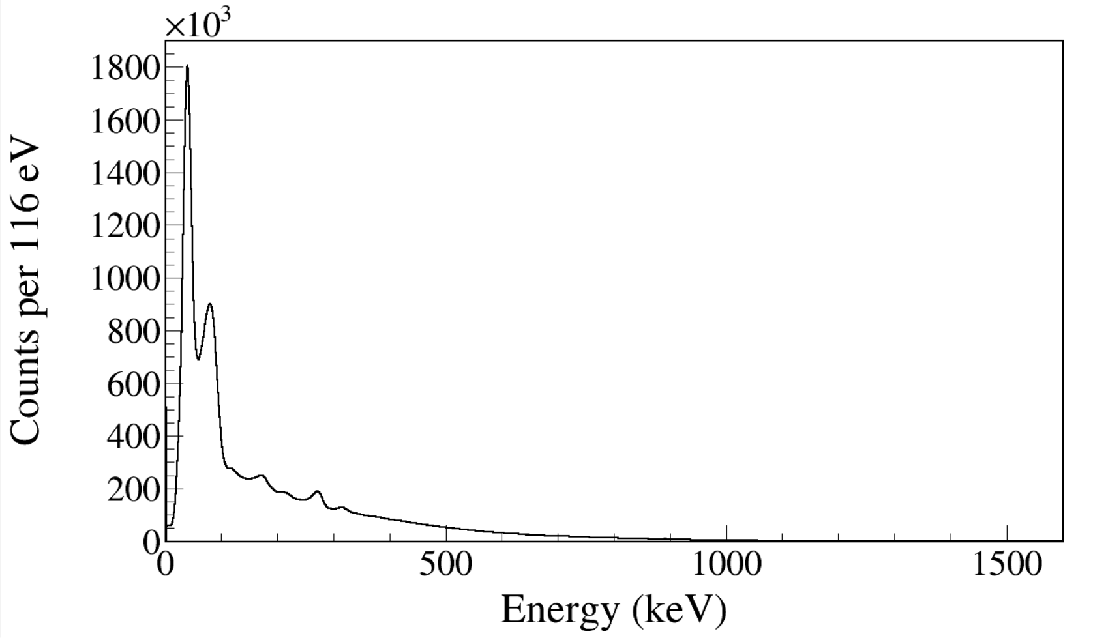
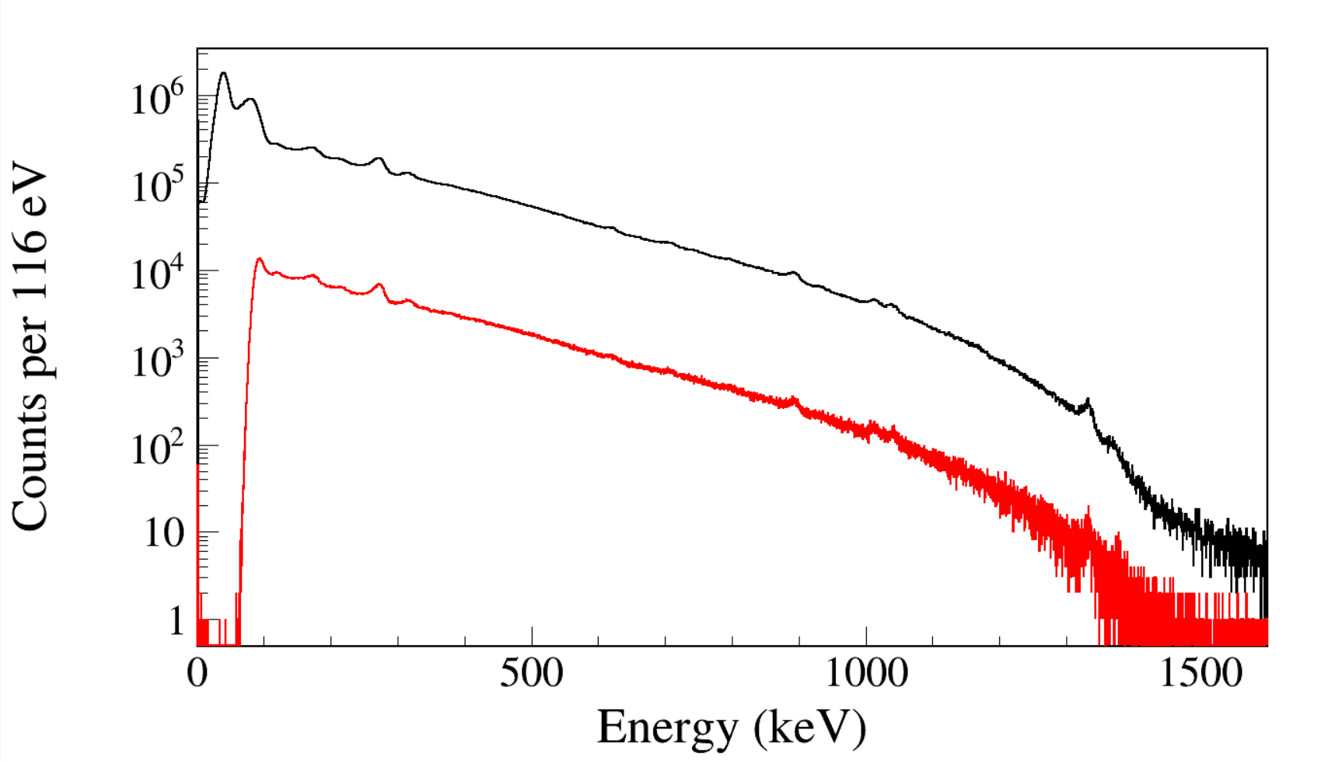
run0203
run0228_0229_0230
Notes:
TFile *_file1 = TFile::Open("F:/e21010/pxct/run0228_0229_0230_LEGe_XtRa_MSD26_152Eu_Z2707_inChamber_vacuum_XtRa_12mm_away_window1us_XtRaCFDdelay_0.2us_for_efficiency_cal.root");
TCanvas* canvaspeak = new TCanvas("MSD", "MSD", 1300, 800);//
canvaspeak->cd();//
canvaspeak->SetTopMargin(0.025);
canvaspeak->SetRightMargin(0.04);
canvaspeak->SetLeftMargin(0.15);
canvaspeak->SetBottomMargin(0.15);
canvaspeak->SetFrameLineWidth(2);
hmsd26_e->SetLineWidth(2);
hmsd26_e->Rebin(4);
hmsd26_e->SetLineColor(1);
hmsd26_e->SetStats(0);
hmsd26_e->SetTitle("");
hmsd26_e->GetXaxis()->SetTitle("Energy (keV)");
hmsd26_e->GetYaxis()->SetTitle("Counts per 116 eV");
hmsd26_e->GetXaxis()->CenterTitle();
hmsd26_e->GetYaxis()->CenterTitle();
hmsd26_e->GetXaxis()->SetLabelFont(132);
hmsd26_e->GetYaxis()->SetLabelFont(132);
hmsd26_e->GetXaxis()->SetLabelSize(0.06);
hmsd26_e->GetYaxis()->SetLabelSize(0.06);
hmsd26_e->GetXaxis()->SetTitleFont(132);
hmsd26_e->GetYaxis()->SetTitleFont(132);
hmsd26_e->GetXaxis()->SetTitleOffset(1.0);
hmsd26_e->GetYaxis()->SetTitleOffset(1.1);
hmsd26_e->GetXaxis()->SetTitleSize(0.07);
hmsd26_e->GetYaxis()->SetTitleSize(0.07);
hmsd26_e->GetXaxis()->SetNdivisions(505);
hmsd26_e->GetXaxis()->SetRangeUser(0,1600);
//hmsd26_e->GetYaxis()->SetRangeUser(1,20000);
hmsd26_e->GetYaxis()->SetTickLength(0.02);
hmsd26_e->Draw("hist");
gPad->SetFrameLineWidth(2);
//gPad->SetLogy();

Slide 20
344-keV ¹⁵²Eu(βγ)
ε_{β} = 12.1%
779-keV ¹⁵²Eu(βγ)
ε_{β} = 12.7%
Notes:
Beta efficiency/β efficiency
TFile *_file1 = TFile::Open("F:/e21010/pxct/run0228_0229_0230_LEGe_XtRa_MSD26_152Eu_Z2707_inChamber_vacuum_XtRa_12mm_away_window1us_XtRaCFDdelay_0.2us_for_efficiency_cal.root");
hnorth_e->Draw("hist");
hnorth_e_purebeta->Draw("same");

Slide 21
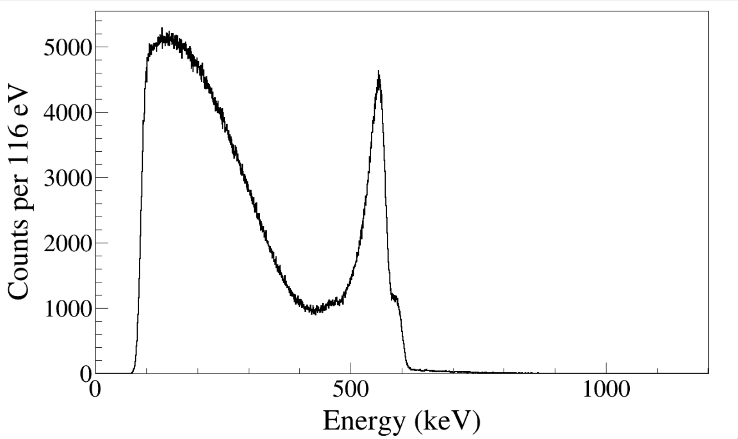
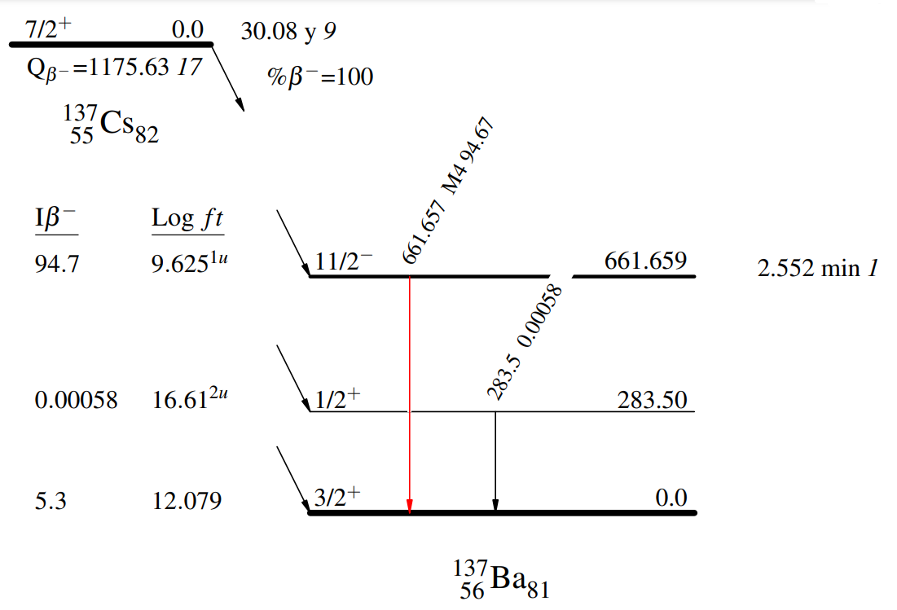
Notes:
TFile *_file0 = TFile::Open("F:/e21010/pxct/run0200_0201_0202_LEGe_MSD26_137Cs_M4038_inChamber_vacuum_North_16mm_South_12mm_away_window1.5us_CFDdelay_adjusted_cal.root");
TCanvas* canvaspeak = new TCanvas("MSD", "MSD", 1300, 800);//
canvaspeak->cd();//
canvaspeak->SetTopMargin(0.025);
canvaspeak->SetRightMargin(0.04);
canvaspeak->SetLeftMargin(0.13);
canvaspeak->SetBottomMargin(0.15);
canvaspeak->SetFrameLineWidth(2);
hmsd26_e->SetLineWidth(2);
hmsd26_e->Rebin(4);
hmsd26_e->SetLineColor(1);
hmsd26_e->SetStats(0);
hmsd26_e->SetTitle("");
hmsd26_e->GetXaxis()->SetTitle("Energy (keV)");
hmsd26_e->GetYaxis()->SetTitle("Counts per 116 eV");
hmsd26_e->GetXaxis()->CenterTitle();
hmsd26_e->GetYaxis()->CenterTitle();
hmsd26_e->GetXaxis()->SetLabelFont(132);
hmsd26_e->GetYaxis()->SetLabelFont(132);
hmsd26_e->GetXaxis()->SetLabelSize(0.06);
hmsd26_e->GetYaxis()->SetLabelSize(0.06);
hmsd26_e->GetXaxis()->SetTitleFont(132);
hmsd26_e->GetYaxis()->SetTitleFont(132);
hmsd26_e->GetXaxis()->SetTitleOffset(1.0);
hmsd26_e->GetYaxis()->SetTitleOffset(0.9);
hmsd26_e->GetXaxis()->SetTitleSize(0.07);
hmsd26_e->GetYaxis()->SetTitleSize(0.07);
hmsd26_e->GetXaxis()->SetNdivisions(505);
hmsd26_e->GetXaxis()->SetRangeUser(0,1200);
//hmsd26_e->GetYaxis()->SetRangeUser(1,20000);
hmsd26_e->GetYaxis()->SetTickLength(0.02);
hmsd26_e->Draw("hist");
//gPad->SetLogy();

Slide 22
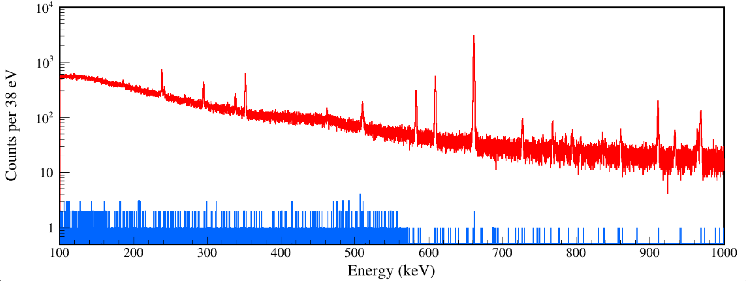
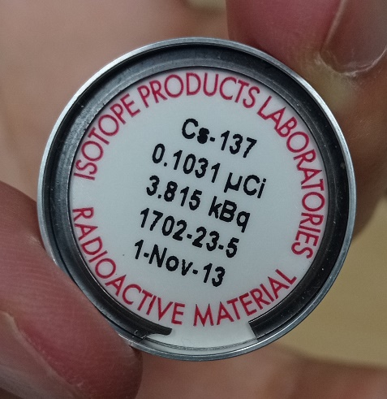
662
Notes:
TFile *_file0 = TFile::Open("F:/e21010/pxct/run0200_0201_0202_LEGe_MSD26_137Cs_M4038_inChamber_vacuum_North_16mm_South_12mm_away_window1.5us_CFDdelay_adjusted_cal.root");
TCanvas* canvaspeak = new TCanvas("XtRa", "XtRa", 1400, 553);
canvaspeak->cd();
canvaspeak->SetTopMargin(0.025);
canvaspeak->SetRightMargin(0.03);
canvaspeak->SetLeftMargin(0.08);
canvaspeak->SetBottomMargin(0.13);
gStyle->SetFrameLineWidth(3);
gPad->SetLogy();
hsouth_e->SetLineWidth(2);
hsouth_e->Rebin(4);
hsouth_e->SetLineColor(2);
hsouth_e->SetStats(0);
hsouth_e->SetTitle("");
hsouth_e->GetXaxis()->SetTitle("Energy (keV)");
hsouth_e->GetYaxis()->SetTitle("Counts per 152 eV");
hsouth_e->GetXaxis()->CenterTitle();
hsouth_e->GetYaxis()->CenterTitle();
hsouth_e->GetXaxis()->SetLabelFont(132);
hsouth_e->GetYaxis()->SetLabelFont(132);
hsouth_e->GetXaxis()->SetLabelSize(0.05);
hsouth_e->GetYaxis()->SetLabelSize(0.05);
hsouth_e->GetXaxis()->SetTitleFont(132);
hsouth_e->GetYaxis()->SetTitleFont(132);
hsouth_e->GetXaxis()->SetTitleOffset(1.0);
hsouth_e->GetYaxis()->SetTitleOffset(0.66);
hsouth_e->GetXaxis()->SetTitleSize(0.06);
hsouth_e->GetYaxis()->SetTitleSize(0.06);
hsouth_e->GetYaxis()->SetTickLength(0.015);
hsouth_e->GetXaxis()->SetRangeUser(100,1000);
hsouth_e->GetYaxis()->SetRangeUser(0.5,1e4);
//tree->SetLineColor(kGreen+1);
//tree->Draw("south_e","south_e>95&&msd26_e>100&&msd26_e<1400","same");
const Int_t numBins = hsouth_e->GetNbinsX();
const Double_t xMin = hsouth_e->GetXaxis()->GetXmin();
const Double_t xMax = hsouth_e->GetXaxis()->GetXmax();
TH1D* hsouth_e_tbkg1 = new TH1D("hsouth_e_tbkg1", "hsouth_e_tbkg1", numBins, xMin, xMax);
TH1D* hsouth_e_tbkg2 = new TH1D("hsouth_e_tbkg2", "hsouth_e_tbkg2", numBins, xMin, xMax);
TH1D* hsouth_e_purebetagated = new TH1D("hsouth_e_purebetagated", "hsouth_e_purebetagated", numBins, xMin, xMax);
TH1D* hsouth_e_betagated = new TH1D("hsouth_e_betagated", "hsouth_e_betagated", numBins, xMin, xMax);
tree->Draw("south_e>>hsouth_e_betagated","south_e>99&&south_e<3000&&msd26_e>100&&msd26_e<1400&&south_t-msd26_t>-500&&south_t-msd26_t<300","");
tree->Draw("south_e>>hsouth_e_tbkg1","south_e>99&&south_e<3000&&msd26_e>100&&msd26_e<1400&&south_t-msd26_t>-900&&south_t-msd26_t<-500","");
tree->Draw("south_e>>hsouth_e_tbkg2","south_e>99&&south_e<3000&&msd26_e>100&&msd26_e<1400&&south_t-msd26_t>400&&south_t-msd26_t<800","");
hsouth_e_purebetagated->Add(hsouth_e_betagated,hsouth_e_tbkg1,1,-1);
hsouth_e_purebetagated->Add(hsouth_e_purebetagated,hsouth_e_tbkg2,1,-1);
hsouth_e_purebetagated->SetLineColor(kAzure-3);
hsouth_e_purebetagated->SetLineWidth(2);
hsouth_e->Draw("hist");
hsouth_e_purebetagated->Rebin(4);
hsouth_e_purebetagated->Draw("same");
gPad->RedrawAxis();

Slide 23
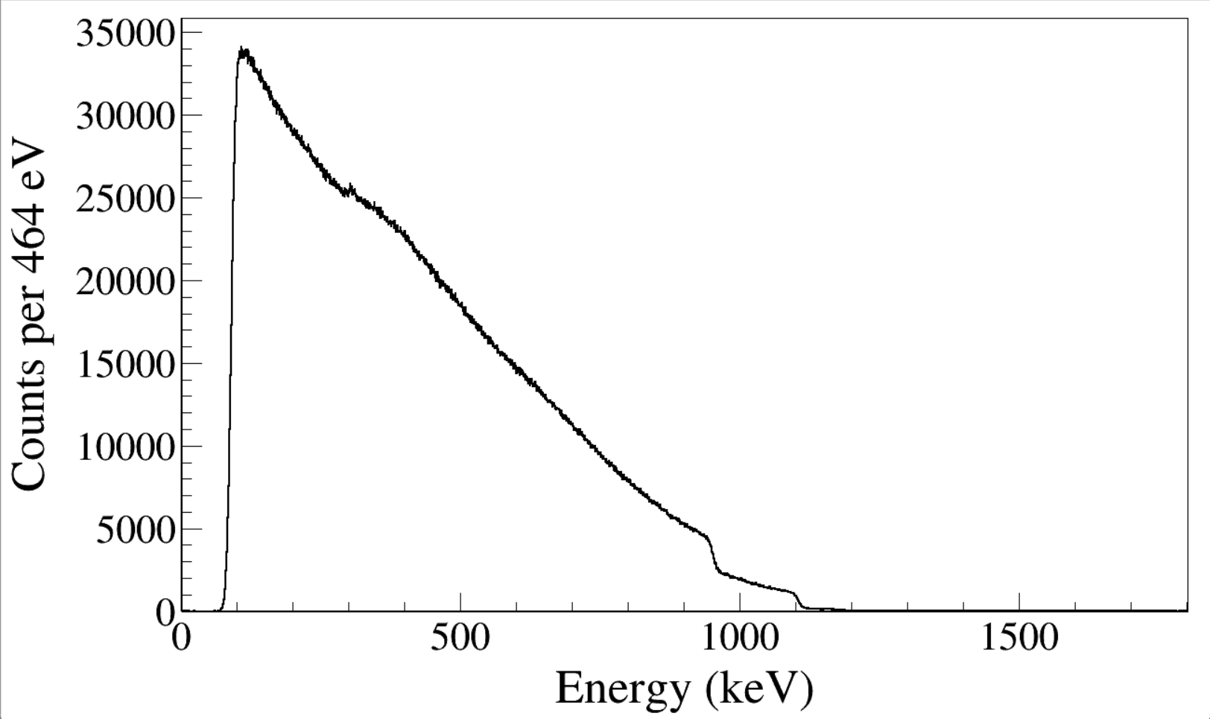
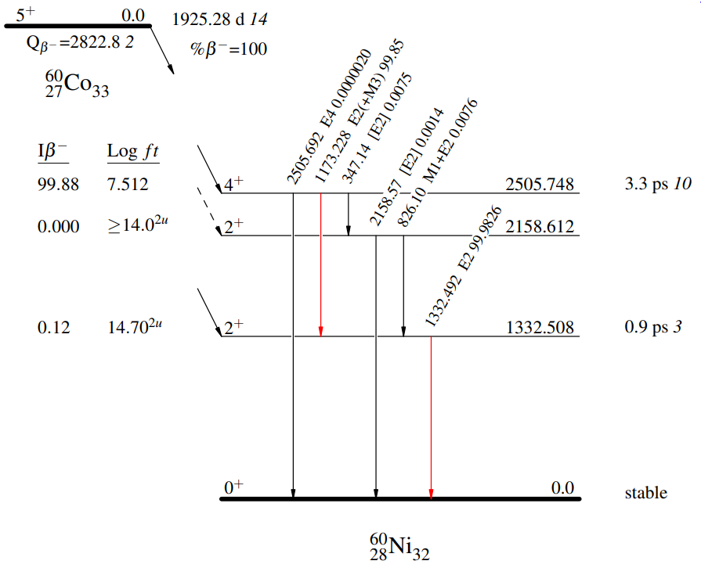
Run0216-0218
60Co beta electron
By MSD26
Notes:
Beta spectrum
Electron spectrum
TFile *_file0 = TFile::Open("F:/e21010/pxct/run0216_0217_0218_LEGe_XtRa_MSD26_60Co_I7281_inChamber_vacuum_XtRa_12mm_away_window1us_CFDdelay_adjusted_AnalogGain1.0_cal.root");
TCanvas* canvaspeak = new TCanvas("MSD", "MSD", 1300, 800);//
canvaspeak->cd();//
canvaspeak->SetTopMargin(0.025);
canvaspeak->SetRightMargin(0.04);
canvaspeak->SetLeftMargin(0.15);
canvaspeak->SetBottomMargin(0.15);
canvaspeak->SetFrameLineWidth(2);
hmsd26_e->SetLineWidth(2);
hmsd26_e->Rebin(4);
hmsd26_e->SetLineColor(1);
hmsd26_e->SetStats(0);
hmsd26_e->SetTitle("");
hmsd26_e->GetXaxis()->SetTitle("Energy (keV)");
hmsd26_e->GetYaxis()->SetTitle("Counts per 464 eV");
hmsd26_e->GetXaxis()->CenterTitle();
hmsd26_e->GetYaxis()->CenterTitle();
hmsd26_e->GetXaxis()->SetLabelFont(132);
hmsd26_e->GetYaxis()->SetLabelFont(132);
hmsd26_e->GetXaxis()->SetLabelSize(0.06);
hmsd26_e->GetYaxis()->SetLabelSize(0.06);
hmsd26_e->GetXaxis()->SetTitleFont(132);
hmsd26_e->GetYaxis()->SetTitleFont(132);
hmsd26_e->GetXaxis()->SetTitleOffset(1.0);
hmsd26_e->GetYaxis()->SetTitleOffset(1.1);
hmsd26_e->GetXaxis()->SetTitleSize(0.07);
hmsd26_e->GetYaxis()->SetTitleSize(0.07);
hmsd26_e->GetXaxis()->SetNdivisions(505);
hmsd26_e->GetXaxis()->SetRangeUser(0,1800);
//hmsd26_e->GetYaxis()->SetRangeUser(1,20000);
hmsd26_e->GetYaxis()->SetTickLength(0.02);
hmsd26_e->Draw("hist");
gPad->SetFrameLineWidth(2);
//gPad->SetLogy();

Slide 24
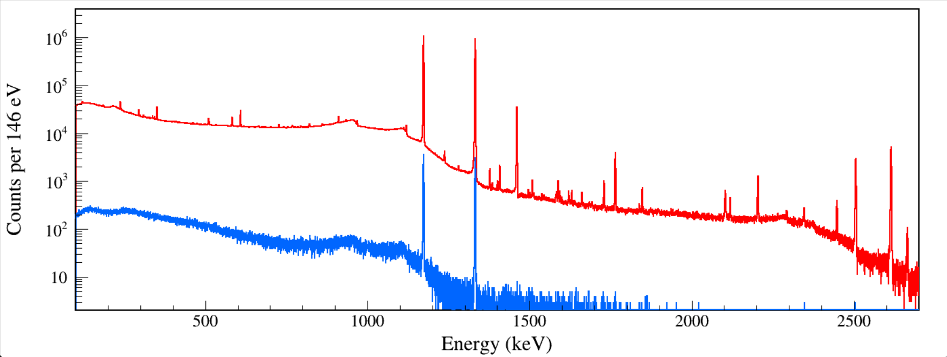
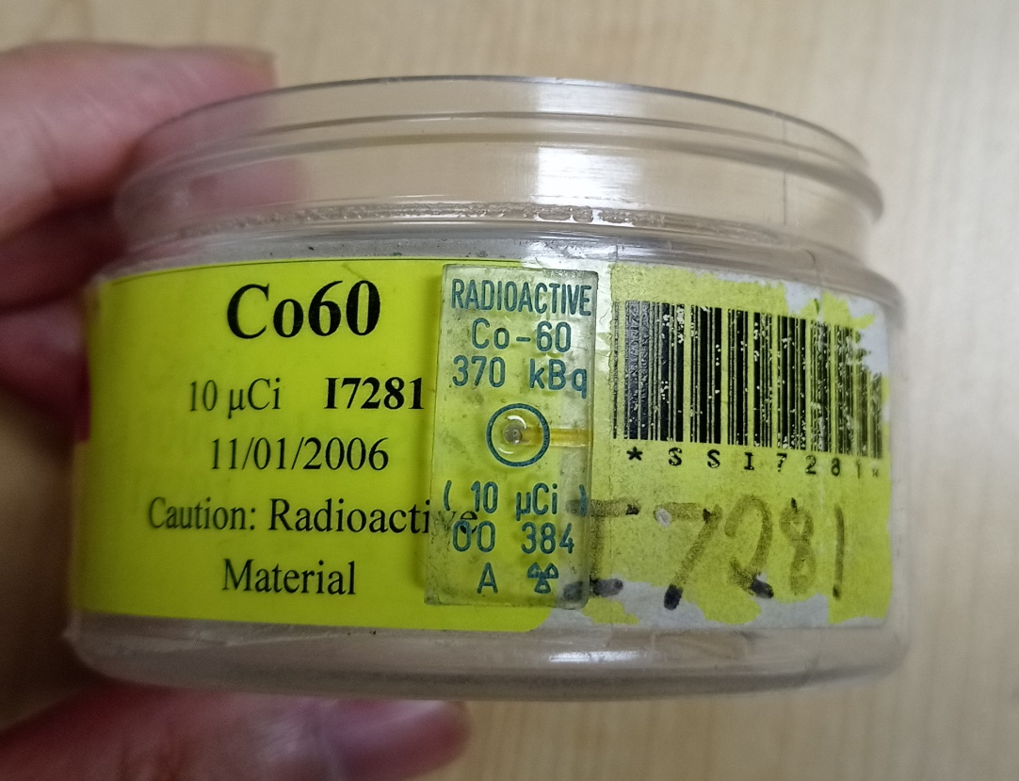
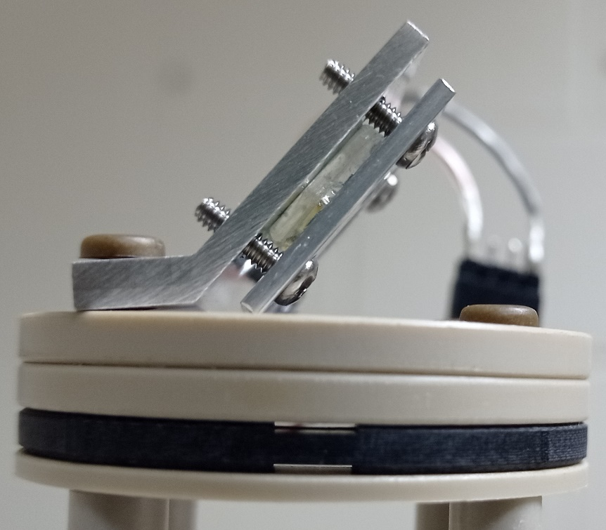
60Co
North
β-gated North
ε_{β} = 0.33%
ε_{β} = 0.32%
Notes:
TFile *_file0 = TFile::Open("F:/e21010/pxct/run0216_0217_0218_LEGe_XtRa_MSD26_60Co_I7281_inChamber_vacuum_XtRa_12mm_away_window1us_CFDdelay_adjusted_AnalogGain1.0_cal.root");
TCanvas* canvaspeak = new TCanvas("XtRa", "XtRa", 1400, 553);
canvaspeak->cd();
canvaspeak->SetTopMargin(0.025);
canvaspeak->SetRightMargin(0.03);
canvaspeak->SetLeftMargin(0.08);
canvaspeak->SetBottomMargin(0.13);
gStyle->SetFrameLineWidth(3);
gPad->SetLogy();
hnorth_e->SetLineWidth(2);
hnorth_e->Rebin(1);
hnorth_e->SetLineColor(2);
hnorth_e->SetStats(0);
hnorth_e->SetTitle("");
hnorth_e->GetXaxis()->SetTitle("Energy (keV)");
hnorth_e->GetYaxis()->SetTitle("Counts per 146 eV");
hnorth_e->GetXaxis()->CenterTitle();
hnorth_e->GetYaxis()->CenterTitle();
hnorth_e->GetXaxis()->SetLabelFont(132);
hnorth_e->GetYaxis()->SetLabelFont(132);
hnorth_e->GetXaxis()->SetLabelSize(0.05);
hnorth_e->GetYaxis()->SetLabelSize(0.05);
hnorth_e->GetXaxis()->SetTitleFont(132);
hnorth_e->GetYaxis()->SetTitleFont(132);
hnorth_e->GetXaxis()->SetTitleOffset(1.0);
hnorth_e->GetYaxis()->SetTitleOffset(0.66);
hnorth_e->GetXaxis()->SetTitleSize(0.06);
hnorth_e->GetYaxis()->SetTitleSize(0.06);
hnorth_e->GetYaxis()->SetTickLength(0.015);
hnorth_e->GetXaxis()->SetRangeUser(100,2700);
hnorth_e->GetYaxis()->SetRangeUser(2,4e6);
//tree->SetLineColor(kGreen+1);
//tree->Draw("north_e","north_e>95&&msd26_e>100&&msd26_e<1400","same");
const Int_t numBins = hnorth_e->GetNbinsX();
const Double_t xMin = hnorth_e->GetXaxis()->GetXmin();
const Double_t xMax = hnorth_e->GetXaxis()->GetXmax();
TH1D* hnorth_e_tbkg1 = new TH1D("hnorth_e_tbkg1", "hnorth_e_tbkg1", numBins, xMin, xMax);
TH1D* hnorth_e_tbkg2 = new TH1D("hnorth_e_tbkg2", "hnorth_e_tbkg2", numBins, xMin, xMax);
TH1D* hnorth_e_purebetagated = new TH1D("hnorth_e_purebetagated", "hnorth_e_purebetagated", numBins, xMin, xMax);
TH1D* hnorth_e_betagated = new TH1D("hnorth_e_betagated", "hnorth_e_betagated", numBins, xMin, xMax);
tree->Draw("north_e>>hnorth_e_betagated","north_e>99&&north_e<3000&&msd26_e>100&&msd26_e<1400&&north_t-msd26_t>-500&&north_t-msd26_t<300","");
tree->Draw("north_e>>hnorth_e_tbkg1","north_e>99&&north_e<3000&&msd26_e>100&&msd26_e<1400&&north_t-msd26_t>-900&&north_t-msd26_t<-500","");
tree->Draw("north_e>>hnorth_e_tbkg2","north_e>99&&north_e<3000&&msd26_e>100&&msd26_e<1400&&north_t-msd26_t>400&&north_t-msd26_t<800","");
hnorth_e_purebetagated->Add(hnorth_e_betagated,hnorth_e_tbkg1,1,-1);
hnorth_e_purebetagated->Add(hnorth_e_purebetagated,hnorth_e_tbkg2,1,-1);
hnorth_e_purebetagated->SetLineColor(kAzure-3);
hnorth_e_purebetagated->SetLineWidth(2);
hnorth_e->Draw("hist");
hnorth_e_purebetagated->Rebin(1);
hnorth_e_purebetagated->Draw("same");
gPad->RedrawAxis();

Slide 25
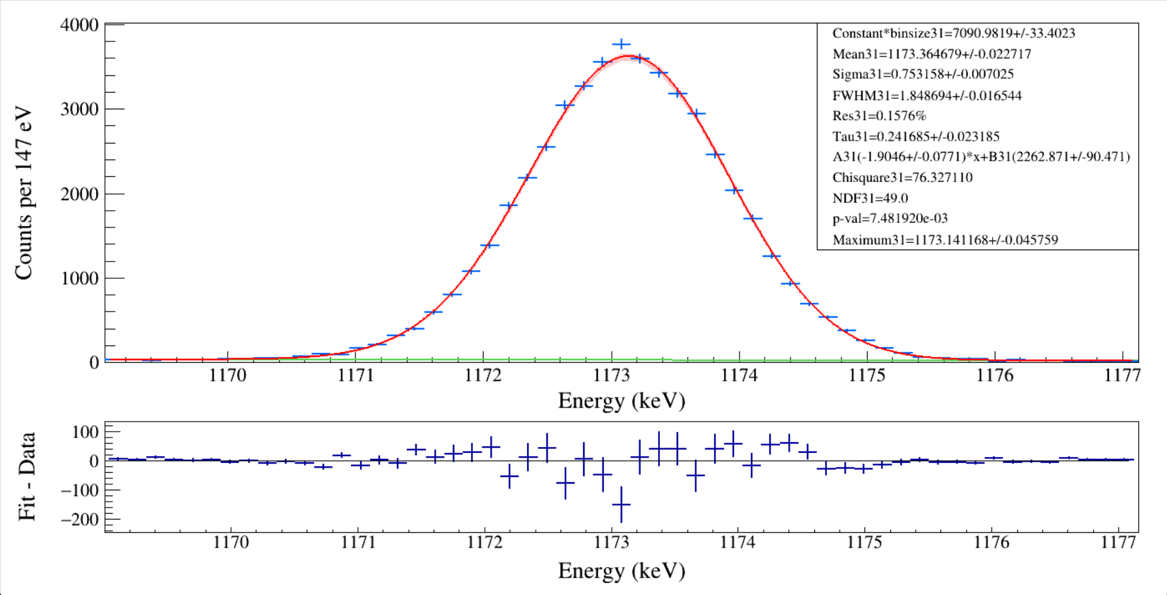
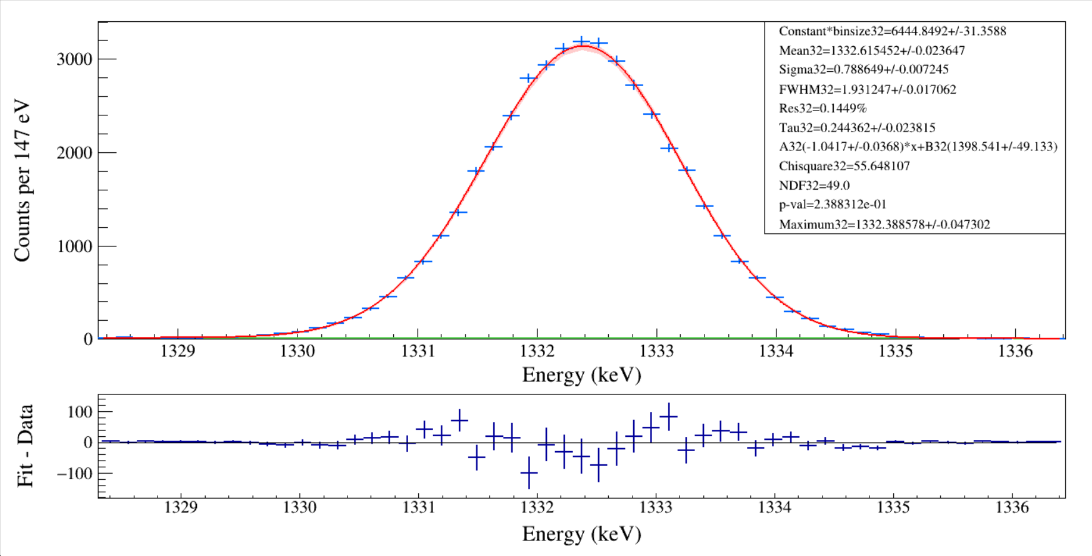
Notes:
#include <iostream>
#include <fstream>
#include <iomanip>
#include <math.h>
#include <time.h>
#include <map>
#include <TROOT.h>
#include <TSystem.h>
#include <TCutG.h>
#include "TChain.h"
#include "TStyle.h"
#include "TLine.h"
#include "TCanvas.h"
#include "TEllipse.h"
#include "TString.h"
#include "TGraph.h"
#include "TGraphErrors.h"
#include "TSpectrum.h"
#include "TVirtualFitter.h"
#include "TFitResult.h"
#include "TFitResultPtr.h"
#include "TMatrixDSymfwd.h"
#include "TRandom.h"
#include "TFile.h"
#include "TTree.h"
#include "TH1.h"
#include "TH1D.h"
#include "TH2.h"
#include "TF1.h"
#include "TMath.h"
#include "TPaveText.h"
#include "TPad.h"
#include "TAxis.h"
#include "TClass.h"
#include "TMatrixD.h"
#include "TVectorD.h"
#include "string.h"
#include "stdlib.h"
#include "stdio.h"
#include "TLegend.h"
using namespace std;
void peakfit_gausnerfcpol1_band_pxct() // get histogram and EMG fit one peak
{
const int ID1 = 0;// i=ID1//which detector
const int ID2 = 0;// i<=ID2// which detector
double binwidth;
double fitrange_min = 0, fitrange_max = 0;
double histomin = 0, histomax = 0, histoNbins = 0;
int minbin = 0, maxbin = 0;
float Eg, Eg2nd, gaplow = 70., gaphigh = 70.;//fitting range随分辨不同调整
int i, ii, jj, ibin;
char paraprint[300], histo_name[300], hfit_name[300], tempname[300];
TH1D* histo[ID2 + 1];//TH1D peak search+gauss fit, create histograms
int fit_Nbins;
const int peaknum = 50;//search peak numbers
TGraph* graph_residual[ID2 + 1];//create graphs
TF1* fEMG[peaknum];//create function
TF1* p[peaknum], * g[peaknum], * b[peaknum], * p2[peaknum];
Double_t peakx[peaknum], peakxerr[peaknum];
Double_t peaky[peaknum], peakyerr[peaknum];
Double_t constant[peaknum], constant_err[peaknum];
Double_t sig[peaknum], sig_err[peaknum];
Double_t tau[peaknum], tau_err[peaknum];
Double_t mean[peaknum], mean_err[peaknum];
Double_t FWHM[peaknum], FWHM_err[peaknum];
double inflation_factor = 1.0;
TH1D* h_confidence_interval[ID2 + 1][peaknum];
TCanvas* canvaspeak[ID2 + 1][peaknum];
char pathname[300];
char filename[300];
sprintf(pathname, "%s", "F:/e21010/pxct/");
sprintf(filename, "%s%s", pathname, "lower_bounds.dat");
ifstream infilelowerbounds(filename, ios::in);
sprintf(filename, "%s%s", pathname, "upper_bounds.dat");
ifstream infileupperbounds(filename, ios::in);
double par[peaknum][10], par_err[peaknum][10];
double parChi[peaknum], parNDF[peaknum], p_value[peaknum];
double lower_search_bound[ID2 + 1][peaknum], upper_search_bound[ID2 + 1][peaknum];
for (i = ID1; i <= ID2; i++)//which detector no need to change
{
for (ii = 0; ii < peaknum; ii++)//which peak
{
lower_search_bound[i][ii] = 0;
upper_search_bound[i][ii] = 30000;
}
}
lower_search_bound[0][0] = 5; upper_search_bound[0][0] = 7; //55Fe 5.9 and 6.5 LEGe
lower_search_bound[0][1] = 6; upper_search_bound[0][1] = 7; //55Fe 6.5 LEGe
lower_search_bound[0][2] = 119; upper_search_bound[0][2] = 124; //152Eu 122 LEGe
lower_search_bound[0][3] = 44; upper_search_bound[0][3] = 46; //152Eu 45.3 and 45.4 LEGe
lower_search_bound[0][4] = 58; upper_search_bound[0][4] = 61; //241Am 59.5 LEGe
lower_search_bound[0][5] = 25; upper_search_bound[0][5] = 27; //241Am 26.3 LEGe
lower_search_bound[0][6] = 38; upper_search_bound[0][6] = 43; //152Eu 40.1 and 39.5 LEGe
lower_search_bound[0][7] = 32; upper_search_bound[0][7] = 34; //241Am 33.2 LEGe
lower_search_bound[0][8] = 12; upper_search_bound[0][8] = 14; //241Am 13.9 and 13.8 LEGe
lower_search_bound[0][9] = 119; upper_search_bound[0][9] = 125; //152Eu 122 XtRa
lower_search_bound[0][10] = 335; upper_search_bound[0][10] = 350; //152Eu 344 XtRa
lower_search_bound[0][11] = 1296; upper_search_bound[0][11] = 1302; //152Eu 1299 XtRa
lower_search_bound[0][12] = 5440; upper_search_bound[0][12] = 5500; //241Am 5486 MSD26
lower_search_bound[0][13] = 11.6; upper_search_bound[0][13] = 12.2; //241Am 11.89 LEGe
lower_search_bound[0][14] = 1405; upper_search_bound[0][14] = 1411; //152Eu 1408 XtRa
lower_search_bound[0][15] = 3100; upper_search_bound[0][15] = 3200; //148Gd 3183 MSD26
lower_search_bound[0][16] = 241; upper_search_bound[0][16] = 246; //152Eu 245 XtRa
lower_search_bound[0][17] = 409; upper_search_bound[0][17] = 415; //152Eu 411 XtRa
lower_search_bound[0][18] = 441; upper_search_bound[0][18] = 447; //152Eu 444 XtRa
lower_search_bound[0][19] = 776; upper_search_bound[0][19] = 782; //152Eu 779 XtRa
lower_search_bound[0][20] = 863; upper_search_bound[0][20] = 870; //152Eu 867 XtRa
lower_search_bound[0][21] = 960; upper_search_bound[0][21] = 968; //152Eu 964 XtRa
lower_search_bound[0][22] = 1109; upper_search_bound[0][22] = 1115; //152Eu 1112 XtRa
lower_search_bound[0][23] = -1000; upper_search_bound[0][23] = 1000; //241Am Timing LEGe-MSD
lower_search_bound[0][24] = 483; upper_search_bound[0][24] = 493; //152Eu 489 XtRa
lower_search_bound[0][25] = 560; upper_search_bound[0][25] = 568; //152Eu 564 XtRa
lower_search_bound[0][26] = 585; upper_search_bound[0][26] = 588; //152Eu 586 XtRa
lower_search_bound[0][27] = 683; upper_search_bound[0][27] = 693; //152Eu 689 XtRa
lower_search_bound[0][28] = 1002; upper_search_bound[0][28] = 1008; //152Eu 1005 XtRa
lower_search_bound[0][29] = 1209; upper_search_bound[0][29] = 1216; //152Eu 1213 XtRa
lower_search_bound[0][30] = 1524; upper_search_bound[0][30] = 1532; //152Eu 1528 XtRa
lower_search_bound[0][31] = 1169; upper_search_bound[0][31] = 1177; //60Co 1173.228 XtRa
lower_search_bound[0][32] = 1327; upper_search_bound[0][32] = 1337; //60Co 1332.501 XtRa
lower_search_bound[0][33] = 2500; upper_search_bound[0][33] = 2510; //60Co sum peak XtRa
lower_search_bound[0][34] = 658; upper_search_bound[0][34] = 665; //137Cs 662 South
for (i = ID1; i <= ID2; i++)//which detector no need to change
{
for (ii = 0; ii < peaknum; ii++)//which peak
{
cout << lower_search_bound[i][ii] << " ";
cout << upper_search_bound[i][ii] << " ";
}
cout << endl;
}
sprintf(filename, "%s%s", pathname, "peakpara.dat");
ofstream outfile(filename, ios::out);
//sprintf(filename, "%s%s", pathname, "run0200_0201_0202_LEGe_MSD26_137Cs_M4038_inChamber_vacuum_North_16mm_South_12mm_away_window1.5us_CFDdelay_adjusted_cal.root"); // modify
//sprintf(filename, "%s%s", pathname, "run0228_0229_0230_LEGe_XtRa_MSD26_152Eu_Z2707_inChamber_vacuum_XtRa_12mm_away_window1us_XtRaCFDdelay_0.2us_for_efficiency_cal_South_bkgsubtracted.root"); // modify
sprintf(filename, "%s%s", pathname, "run0216_0217_0218_LEGe_XtRa_MSD26_60Co_I7281_inChamber_vacuum_XtRa_12mm_away_window1us_CFDdelay_adjusted_AnalogGain1.0_cal_North_betagated.root"); // modify
TFile* fin = new TFile(filename);//after this statement, you can use any ROOT command1 for this rootfile
cout << filename << endl;
for (i = ID1; i <= ID2; i++)//which detector no need to change
{
//sprintf(histo_name, "%s", "hnorth_e_pure"); // modify
sprintf(histo_name, "%s", "hnorth_e_purebetagated"); // modify
histo[i] = (TH1D*)fin->Get(histo_name); //Get spectrum
histo[i]->Rebin(1);
histo[i]->Sumw2(kFALSE);
histo[i]->SetBinErrorOption(TH1::kPoisson);
binwidth = histo[i]->GetBinWidth(1);
}
for (i = ID1; i <= ID2; i++) // no need to change
{
for (ii = 32; ii <= 32; ii++)// modify which peak in one detector =0<=13
{
sprintf(hfit_name, "%s%d%s%d", histo_name, i, "_peak", ii);
canvaspeak[i][ii] = new TCanvas(hfit_name, hfit_name, 1400, 740);//建立画布
canvaspeak[i][ii]->cd();//进入画布
// canvaspeak[i][ii]->SetTopMargin(0.02);
// canvaspeak[i][ii]->SetRightMargin(0.03);
// canvaspeak[i][ii]->SetLeftMargin(0.09);
// canvaspeak[i][ii]->SetBottomMargin(0.13);
TPad* pad1 = new TPad("pad1", "The pad 70% of the height", 0.0, 0.3, 1.0, 1.0);
// xlow, ylow, xup, yup
TPad* pad2 = new TPad("pad2", "The pad 30% of the height", 0.0, 0.0, 1.0, 0.3);
// Set margins for pad1
pad1->SetTopMargin(0.055); // relative to pad1 height
pad1->SetBottomMargin(0.13); // no bottom margin
pad1->SetLeftMargin(0.09); // relative to pad1 width
pad1->SetRightMargin(0.025); // relative to pad1 width
// Set margins for pad2
pad2->SetTopMargin(0.03); // no top margin
pad2->SetBottomMargin(0.35); // relative to pad2 height
pad2->SetLeftMargin(0.09); // relative to pad2 width
pad2->SetRightMargin(0.025); // relative to pad2 width
pad1->Draw();
pad1->cd();
//gStyle->SetOptTitle(0);
histo[i]->SetTitle("");//图名
histo[i]->GetXaxis()->SetTitle("Energy (keV)");//轴名
sprintf(tempname, "%s%.0f%s", "Counts per ", binwidth*1000, " eV");
histo[i]->GetYaxis()->SetTitle(tempname);
histo[i]->GetXaxis()->CenterTitle();//居中
histo[i]->GetYaxis()->CenterTitle();//居中
histo[i]->GetXaxis()->SetLabelFont(132);//坐标字体
histo[i]->GetYaxis()->SetLabelFont(132);//坐标字体
histo[i]->GetXaxis()->SetLabelSize(0.05);
histo[i]->GetYaxis()->SetLabelSize(0.05);
histo[i]->GetXaxis()->SetTitleFont(132);//轴名字体
histo[i]->GetYaxis()->SetTitleFont(132);//轴名字体
histo[i]->GetXaxis()->SetTitleOffset(1.0);//轴名偏移
histo[i]->GetYaxis()->SetTitleOffset(0.7);//轴名偏移
histo[i]->GetXaxis()->SetTitleSize(0.06);
histo[i]->GetYaxis()->SetTitleSize(0.06);
histo[i]->GetYaxis()->SetNdivisions(505);
histo[i]->GetYaxis()->SetTickLength(0.02);
histo[i]->SetLineWidth(2);
histo[i]->SetStats(0);
histo[i]->Draw("e");
peaky[ii] = 0; peakx[ii] = 0; sig[ii] = 0; tau[ii] = 0; mean[ii] = 0; FWHM[ii] = 0;
histo[i]->GetXaxis()->SetRangeUser(lower_search_bound[i][ii], upper_search_bound[i][ii]);
peaky[ii] = histo[i]->GetMaximum();
peakx[ii] = histo[i]->GetBinCenter(histo[i]->GetMaximumBin());
cout << " MaxX = " << peakx[ii] << " MaxY = " << peaky[ii] << endl;
if (ii == 0) { gaplow = 0.5; gaphigh = 0.4; Eg = 5895; Eg2nd = 6490; }//55Fe 5.9 and 6.5 LEGe
if (ii == 2) { gaplow = 1.4; gaphigh = 1.4; Eg = 121.7817; }//152Eu 122 LEGe
if (ii == 4) { gaplow = 1.0; gaphigh = 1.0; Eg = 59.541; }//241Am 59.5 LEGe
if (ii == 5) { gaplow = 0.8; gaphigh = 0.8; Eg = 26.345; }//241Am 26.3 LEGe
if (ii == 7) { gaplow = 0.7; gaphigh = 0.7; Eg = 33.196; }//241Am 33.2 LEGe
if (ii == 9) { gaplow = 2.1; gaphigh = 2.1; Eg = 121.7817; }//152Eu 122 XtRa
if (ii == 10) { gaplow = 2.5; gaphigh = 2.5; Eg = 344.2785; }//152Eu 344 XtRa
if (ii == 11) { gaplow = 3.2; gaphigh = 3.0; Eg = 1299.1420; }//152Eu 1299 XtRa
if (ii == 12) { gaplow = 120; gaphigh = 90; Eg = 5486; }//241Am 5486 MSD26
if (ii == 13) { gaplow = 0.4; gaphigh = 0.4; Eg = 11.89; }//241Am 11.89 LEGe
if (ii == 14) { gaplow = 3.5; gaphigh = 3.5; Eg = 1408.013; }//152Eu 1408 XtRa
if (ii == 15) { gaplow = 100; gaphigh = 60; Eg = 3182.69; }//148Gd 3183 MSD26
if (ii == 16) { gaplow = 2.0; gaphigh = 2.1; Eg = 244.6974; }//152Eu 245 XtRa
if (ii == 17) { gaplow = 2.5; gaphigh = 2.5; Eg = 411.1165; }//152Eu 411 XtRa
if (ii == 18) { gaplow = 2.5; gaphigh = 2.5; Eg = 443.9606; }//152Eu 444 XtRa
if (ii == 19) { gaplow = 2.7; gaphigh = 2.7; Eg = 778.9045; }//152Eu 779 XtRa
if (ii == 20) { gaplow = 2.7; gaphigh = 2.7; Eg = 867.380; }//152Eu 867 XtRa
if (ii == 21) { gaplow = 2.9; gaphigh = 2.9; Eg = 964.057; }//152Eu 964 XtRa
if (ii == 22) { gaplow = 3.2; gaphigh = 3.2; Eg = 1112.076; }//152Eu 1112 XtRa
if (ii == 23) { gaplow = 300; gaphigh = 1000; Eg = 59.541; }//241Am Timing MSD-LEGe
if (ii == 24) { gaplow = 2.9; gaphigh = 2.9; Eg = 488.6792; }//152Eu 489 XtRa
if (ii == 25) { gaplow = 4.0; gaphigh = 6.0; Eg = 563.986; }//152Eu 564 XtRa double peak needed
if (ii == 26) { gaplow = 3.7; gaphigh = 2.8; Eg = 586.2648; }//152Eu 586 XtRa double peak needed
if (ii == 27) { gaplow = 2.7; gaphigh = 2.7; Eg = 688.670; }//152Eu 689 XtRa
if (ii == 28) { gaplow = 2.9; gaphigh = 3.0; Eg = 1005.27; }//152Eu 1005 XtRa
if (ii == 29) { gaplow = 3.2; gaphigh = 3.3; Eg = 1212.948; }//152Eu 1213 XtRa
if (ii == 30) { gaplow = 4.0; gaphigh = 5.3; Eg = 1528.10; }//152Eu 1528 XtRa
if (ii == 31) { gaplow = 4.0; gaphigh = 4.0; Eg = 1173.228; } //60Co 1173.228 XtRa
if (ii == 32) { gaplow = 4.0; gaphigh = 4.0; Eg = 1332.501; } //60Co 1332.501 XtRa
if (ii == 33) { gaplow = 4.3; gaphigh = 4.3; Eg = 2505.692; } //60Co sum peak XtRa
if (ii == 34) { gaplow = 2.8; gaphigh = 2.8; Eg = 661.657; } //137Cs 662 South
histomin = histo[i]->GetXaxis()->GetXmin();
histomax = histo[i]->GetXaxis()->GetXmax();
histoNbins = histo[i]->GetNbinsX();
fitrange_min = peakx[ii] - gaplow;
fitrange_max = peakx[ii] + gaphigh;
// cout << histomin << " " << histomax << " " << histoNbins << endl;
histo[i]->GetXaxis()->SetRangeUser(fitrange_min, fitrange_max);//zoom the axis
//cout<<"************"<<peakx[ii]<<" "<<peaky[ii]<<endl;
minbin = histo[i]->FindBin(fitrange_min);
maxbin = histo[i]->FindBin(fitrange_max);
fit_Nbins = maxbin - minbin + 1; // Don't forget the +1, or you lose the last bin!
// cout << "minbin = " << minbin << " maxbin = " << maxbin << " fit_Nbins = " << fit_Nbins << " fitrange_min = " << fitrange_min << " fitrange_max = " << fitrange_max << endl;
ibin = minbin;
while (histo[i]->GetBinContent(ibin) < (peaky[ii] / 2)) { ibin++; if (ibin >= maxbin)break; }
double sigmaguess = 2 * (peakx[ii] - histo[i]->GetBinCenter(ibin)) / 2.355;
float highcounts = 0, lowcounts = 0;
for (jj = 0; jj < 10; jj++)
{
highcounts += histo[i]->GetBinContent(maxbin - jj);
lowcounts += histo[i]->GetBinContent(minbin + jj);
}
highcounts = highcounts / 10; lowcounts = lowcounts / 10;
double aguess = (highcounts - lowcounts) / (fitrange_max - fitrange_min);
double bguess = lowcounts - fitrange_min * aguess;
cout << "initial guesses= " << aguess << ", " << bguess << ", " << sigmaguess << ", " << peakx[ii] << ", " << peaky[ii] << endl;
fEMG[ii] = new TF1("fEMG", "[0]*x+[1]+[2]/2/[3]*exp(0.5*([4]*[4]/([3]*[3]))+(x-[5])/[3])*ROOT::Math::erfc(1/sqrt(2)*([4]/[3]+(x-[5])/[4]))", histomin, histomax);// Sun PRC2021 low-energy tail
//fEMG[ii] = new TF1("fEMG", "[0]*x+[1]+[2]/2/[3]*exp(0.5*([4]*[4]/([3]*[3]))-(x-[5])/[3])*ROOT::Math::erfc(1/sqrt(2)*([4]/[3]-(x-[5])/[4]))", histomin, histomax);// Sun PRC2021 high-energy tail
g[ii] = new TF1("g", "gausn", histomin, histomax);// The [2]-N parameter in total is equivalent to the Constant in gausn
p[ii] = new TF1("p", "[0]*x+[1]-[0]*x-[1]+[2]/2/[3]*exp(0.5*([4]*[4]/([3]*[3]))+(x-[5])/[3])*ROOT::Math::erfc(1/sqrt(2)*([4]/[3]+(x-[5])/[4]))", histomin, histomax);//pure peak low-energy tail
//p2[ii] = new TF1("p2", "[0]*exp(-0.5*((x-[1])/[2])^2) / (sqrt(2*3.141592654)*[2])", histomin, histomax);//pure peak2
b[ii] = new TF1("b", "[0]*x+[1]", histomin, histomax);//pure bkg
// fEMG[ii]=new TF1("total","[0]*x+[1]+sqrt(3.141592654/2)*[2]/[3]*[4]*exp(0.5*([4]*[4]/([3]*[3]))+(x-[5])/[3])*ROOT::Math::erfc(1/sqrt(2)*([4]/[3]+(x-[5])/[4]))",histomin, histomax);// Glassman PRC2019 low-energy tail
// g[ii]=new TF1("g","gausn",histomin, histomax);// The [2]-N parameter in total is equivalent to the Constant in gausn
// p[ii]=new TF1("p","[0]*x+[1]-[0]*x-[1]+sqrt(3.141592654/2)*[2]/[3]*[4]*exp(0.5*([4]*[4]/([3]*[3]))+(x-[5])/[3])*ROOT::Math::erfc(1/sqrt(2)*([4]/[3]+(x-[5])/[4]))",histomin, histomax);//pure peak
// b[ii]=new TF1("b","[0]*x+[1]",histomin, histomax);//pure bkg
fEMG[ii]->SetNpx(histoNbins * 10);
g[ii]->SetNpx(histoNbins * 10);
p[ii]->SetNpx(histoNbins * 10);
// p2[ii]->SetNpx(histoNbins);
b[ii]->SetNpx(histoNbins * 10);
//fEMG[ii]->SetParameters(0.1,15,peaky[ii],10,10,peakx[ii]);//initial value [0]-A, [1]-B, [2]-N, [3]-τ, [4]-σ, [5]-μ
fEMG[ii]->SetParameters(aguess, bguess, peaky[ii], 0.2, sigmaguess, peakx[ii]);//initial value [0]-A, [1]-B, [2]-N, [3]-τ, [4]-σ, [5]-μ
// fEMG[ii]->SetParLimits(0,-500,500);//Bkg A
// fEMG[ii]->SetParLimits(1,-50000,300000);//Bkg B
fEMG[ii]->SetParLimits(2, 1.5e2, 3e6);//Constant,min,max
fEMG[ii]->SetParLimits(3, 0.04, 1.1);//Tau
fEMG[ii]->SetParLimits(4, 0.2, 1.1);//Sigma
fEMG[ii]->SetParLimits(5, peakx[ii] - gaplow / 3, peakx[ii] + gaphigh / 2);//Mean
//fEMG[ii]->SetParLimits(5, 1298.8, 1299.9);//Mean
fEMG[ii]->SetParNames("BkgA", "BkgB", "Const*bin", "Tau", "Sigma", "Mean");
histo[i]->Fit("fEMG", "MLE", "", fitrange_min, fitrange_max);
TFitResultPtr Fit_result_pointer = histo[i]->Fit("fEMG", "MLES", "", fitrange_min, fitrange_max);
//"S" means the result of the fit is returned in the TFitResultPtr
//“E” Perform better errors estimation using the Minos technique.
//“M” Improve fit results, by using the IMPROVE algorithm of TMinuit.
//If the option "S" is instead used, TFitResultPtr contains the TFitResult and behaves as a smart pointer to it.
//The fit parameters, error and chi2 (but not covariance matrix) can be retrieved also from the fitted function.
fEMG[ii]->GetParameters(par[ii]);//二维数组的par[ii]是地址,pointer to the TF1, GetParameters的数组得是double类型Obtaining the value of parameters and saving them to par[];
par_err[ii][0] = fEMG[ii]->GetParError(0);//Obtaining the error of the 1st parameter
par_err[ii][1] = fEMG[ii]->GetParError(1);//Obtaining the error of the 2nd parameter
par_err[ii][2] = fEMG[ii]->GetParError(2);//Obtaining the error of the 3rd parameter
par_err[ii][3] = fEMG[ii]->GetParError(3);//Obtaining the error of the 4th parameter
par_err[ii][4] = fEMG[ii]->GetParError(4);//Obtaining the error of the 5th parameter
par_err[ii][5] = fEMG[ii]->GetParError(5);//Obtaining the error of the 6th parameter
parChi[ii] = fEMG[ii]->GetChisquare();
parNDF[ii] = fEMG[ii]->GetNDF();
p_value[ii] = fEMG[ii]->GetProb();//This probability is not the “probability that your fit is good.” If you did many fake experiments (draw many random samples of data points from the assumed distribution (your fit function)), this is the percentage of experiments that would give χ2 values ≥ to the one you got in this experiment.
g[ii]->SetParameters(par[ii][2], par[ii][5], par[ii][4]);//set parameters for drawing gausn
g[ii]->SetLineColor(kGreen + 1);
p[ii]->SetParameters(par[ii][0], par[ii][1], par[ii][2], par[ii][3], par[ii][4], par[ii][5]);//set parameters for drawing peak
p[ii]->SetLineColor(kGreen + 1);
// p2[ii]->SetParameters(par[ii][6], par[ii][7], par[ii][8]);//set parameters for drawing peak
// p2[ii]->SetLineColor(4);
b[ii]->SetParameters(par[ii][0], par[ii][1]);//set parameters for drawing bkg
b[ii]->SetLineColor(8);
fEMG[ii]->SetLineWidth(2);
// The confidence band is not always properly displayed.
// Uncertainty Band
sprintf(filename, "%s%s%d%s%d", "h_confidence_interval", "_", i, "_", ii);
h_confidence_interval[i][ii] = (TH1D*)histo[i]->Clone(filename);//Create a histogram to hold the confidence intervals
TVirtualFitter* fitter = TVirtualFitter::GetFitter();//The method TVirtualFitter::GetFitter())->Get the parameters of your fitting function after having it fitted to an histogram.
fitter->GetConfidenceIntervals(h_confidence_interval[i][ii], 0.95);//By default the intervals are inflated using the chi2/ndf value of the fit if a chi2 fit is performed
//confidence interval for the colored band: 1σ confidence interval: P=0.683, 1σ confidence interval: P=0.95, 3σ confidence interval: P=0.997
//h_confidence_interval will contain the CL result that you can draw on top of your fitted graph.
//where h_confidence_interval will hold the errors and could superimpose it on the same canvas where you plot central values.
h_confidence_interval[i][ii]->SetStats(kFALSE);
h_confidence_interval[i][ii]->SetFillColor(kRed - 10);
//histo[i]->SetLineColor(kGreen+1);
//histo[i]->SetMarkerColor(kGreen+1);
h_confidence_interval[i][ii]->Draw("e3 same"); // plot the uncertainty band
fEMG[ii]->Draw("same");
//g[ii]->Draw("same");
//p[ii]->Draw("same");
//p2[ii]->Draw("same");
b[ii]->Draw("same");
histo[i]->Draw("e same");
TMatrixD cov = Fit_result_pointer->GetCovarianceMatrix();//error matrix
TMatrixD cor = Fit_result_pointer->GetCorrelationMatrix();//parameter correlation coefficients
cov.Print();
cor.Print();
double Utau_Utau = fitter->GetCovarianceMatrixElement(3, 3);//(Utau)^2
double Usigma_Usigma = fitter->GetCovarianceMatrixElement(4, 4);//(Usigma)^2
double Umean_Umean = fitter->GetCovarianceMatrixElement(5, 5);//(Umean)^2
double rou_Utau_Umean = fitter->GetCovarianceMatrixElement(3, 5);//(ρ*Utau*Umean), (3,5) (5,3) doesn't matter.
double rou_Usigma_Umean = fitter->GetCovarianceMatrixElement(4, 5);//
// cout << rou_Usigma_Umean << endl;
peaky[ii] = fEMG[ii]->GetMaximum(fitrange_min, fitrange_max);
peakx[ii] = fEMG[ii]->GetMaximumX(fitrange_min, fitrange_max);
peakxerr[ii] = sqrt(Utau_Utau + Umean_Umean + 2 * rou_Utau_Umean);
//FWHM[ii] = par[ii][4] / par[ii][5] * 2.355 * Eg;
//FWHM_err[ii] = 2.355 * Eg * sqrt(Usigma_Usigma / (par[ii][5] * par[ii][5]) + Umean_Umean * (-par[ii][4] / par[ii][5] / par[ii][5]) * (-par[ii][4] / par[ii][5] / par[ii][5]) + 2 * rou_Usigma_Umean / par[ii][5] * (-par[ii][4] / par[ii][5] / par[ii][5]));
// inflation_factor = sqrt(parChi[ii] / parNDF[ii]);
// if (inflation_factor < 1)
inflation_factor = 1;
constant[ii] = par[ii][2]; constant_err[ii] = par_err[ii][2] * inflation_factor;
tau[ii] = par[ii][3]; tau_err[ii] = par_err[ii][3] * inflation_factor;
sig[ii] = par[ii][4]; sig_err[ii] = par_err[ii][4] * inflation_factor;
mean[ii] = par[ii][5]; mean_err[ii] = par_err[ii][5] * inflation_factor;
FWHM[ii] = par[ii][4] * 2.355; FWHM_err[ii] = par_err[ii][4] * 2.355 * inflation_factor;
Double_t topy, topx, lower_half, higher_half;
topy = p[ii]->GetMaximum(fitrange_min, fitrange_max);
topx = p[ii]->GetMaximumX(fitrange_min, fitrange_max);
lower_half = p[ii]->GetX(topy / 2.0, fitrange_min, topx, 1E-12);
higher_half = p[ii]->GetX(topy / 2.0, topx, fitrange_max, 1E-12);
FWHM[ii] = higher_half - lower_half;
outfile << histo_name << i << " Constant*binsize" << ii << "= " << constant[ii] << " +/- " << constant_err[ii] << " Mean" << ii << "= " << mean[ii] << " +/- " << mean_err[ii] << " Maximum" << ii << "= " << peakx[ii] << " +/- " << peakxerr[ii] << " Sigma" << ii << "= " << sig[ii] << " +/- " << sig_err[ii] << " Tau" << ii << "= " << tau[ii] << " +/- " << tau_err[ii] << " A" << ii << "= " << par[ii][0] << " +/- " << par_err[ii][0] << " B" << ii << "= " << par[ii][1] << " +/- " << par_err[ii][1] << " Chi2" << ii << "= " << parChi[ii] << " NDF" << ii << "= " << parNDF[ii] << " Area" << ii << "= " << par[ii][2] / binwidth << " FWHM" << ii << "= " << FWHM[ii] << " +/- " << FWHM_err[ii] << endl;
TPaveText* textgaus = new TPaveText(0.7, 0.4, 0.975, 0.945, "brNDC");//加标注left, down, right, up
textgaus->SetBorderSize(1);//边框宽度
textgaus->SetFillColor(0);//填充颜色
textgaus->SetTextAlign(12);//align = 10*HorizontalAlign + VerticalAlign, 12 means水平左对齐、垂直居中对齐
textgaus->SetTextFont(132);//font = 10 * fontID + precision, 12+2,12 means Symbol; 13+2, 13 means News Times Roman
//text->SetTextColor(2);//文本颜色
sprintf(paraprint, "Constant*binsize%d=%.4f%s%.4f", ii, par[ii][2], "+/-", par_err[ii][2]);//par数组还保持着刚才的参数
textgaus->AddText(paraprint);
sprintf(paraprint, "Mean%d=%.6f%s%.6f", ii, par[ii][5], "+/-", par_err[ii][5]);
textgaus->AddText(paraprint);
sprintf(paraprint, "Sigma%d=%.6f%s%.6f", ii, par[ii][4], "+/-", par_err[ii][4]);
textgaus->AddText(paraprint);
sprintf(paraprint, "FWHM%d=%.6f%s%.6f", ii, FWHM[ii], "+/-", FWHM_err[ii]);
textgaus->AddText(paraprint);
sprintf(paraprint, "Res%d=%.4f%%", ii, FWHM[ii] / par[ii][5] * 100);
textgaus->AddText(paraprint);
sprintf(paraprint, "Tau%d=%.6f%s%.6f", ii, par[ii][3], "+/-", par_err[ii][3]);
textgaus->AddText(paraprint);
sprintf(paraprint, "A%d(%.4f%s%.4f)*x+B%d(%.3f%s%.3f)", ii, par[ii][0], "+/-", par_err[ii][0], ii, par[ii][1], "+/-", par_err[ii][1]);
textgaus->AddText(paraprint);
sprintf(paraprint, "Chisquare%d=%.6f", ii, parChi[ii]);
textgaus->AddText(paraprint);
sprintf(paraprint, "NDF%d=%.1f", ii, parNDF[ii]);
textgaus->AddText(paraprint);
sprintf(paraprint, "p-val=%e", p_value[ii]);
textgaus->AddText(paraprint);
sprintf(paraprint, "Maximum%d=%.6f%s%.6f", ii, peakx[ii], "+/-", peakxerr[ii]);
textgaus->AddText(paraprint);
textgaus->Draw();
// for residuals plot
double x_values[fit_Nbins], y_values[fit_Nbins], y_fit_values[fit_Nbins], y_residuals[fit_Nbins], x_errors[fit_Nbins], y_errors[fit_Nbins];
for (ibin = 1; ibin <= fit_Nbins; ibin++)
{ // data array starts from [0], bin starts from [1]
x_values[ibin - 1] = histo[i]->GetBinCenter(minbin + ibin - 1);
// cout << x_values[ibin - 1] << " " << minbin+ibin-1 << endl;
x_errors[ibin - 1] = binwidth / 2.0;
y_values[ibin - 1] = histo[i]->GetBinContent(minbin + ibin - 1);
y_errors[ibin - 1] = (histo[i]->GetBinErrorUp(minbin + ibin - 1) + histo[i]->GetBinErrorLow(minbin + ibin - 1)) / 2.0;
y_fit_values[ibin - 1] = fEMG[ii]->Eval(x_values[ibin - 1]);
y_residuals[ibin - 1] = y_fit_values[ibin - 1] - y_values[ibin - 1];
}
graph_residual[i] = new TGraphErrors(fit_Nbins, x_values, y_residuals, x_errors, y_errors); //TGraph(n,x,y,ex,ey);
graph_residual[i]->SetTitle("");//图名
graph_residual[i]->GetXaxis()->SetTitle("Energy (keV)");//轴名
graph_residual[i]->GetYaxis()->SetTitle("Fit - Data");//轴名
graph_residual[i]->GetXaxis()->CenterTitle();//居中
graph_residual[i]->GetYaxis()->CenterTitle();//居中
graph_residual[i]->GetXaxis()->SetLabelFont(132);//坐标字体
graph_residual[i]->GetYaxis()->SetLabelFont(132);//坐标字体
graph_residual[i]->GetXaxis()->SetLabelSize(0.11);
graph_residual[i]->GetYaxis()->SetLabelSize(0.11);
graph_residual[i]->GetXaxis()->SetTitleFont(132);//轴名字体
graph_residual[i]->GetYaxis()->SetTitleFont(132);//轴名字体
graph_residual[i]->GetXaxis()->SetTitleOffset(1.0);//轴名偏移
graph_residual[i]->GetYaxis()->SetTitleOffset(0.3);//轴名偏移
graph_residual[i]->GetXaxis()->SetTitleSize(0.14);
graph_residual[i]->GetYaxis()->SetTitleSize(0.14);
graph_residual[i]->GetYaxis()->SetNdivisions(505);
graph_residual[i]->GetYaxis()->SetTickLength(0.02);
graph_residual[i]->SetStats(0);
graph_residual[i]->GetXaxis()->SetRangeUser(fitrange_min, fitrange_max);
// graph_residual[i]->GetYaxis()->SetRangeUser(-50, 50);
graph_residual[i]->SetLineWidth(2);
graph_residual[i]->SetLineColor(kBlue + 2);
graph_residual[i]->SetMarkerStyle(6);
graph_residual[i]->SetMarkerColor(kBlue + 2);
canvaspeak[i][ii]->cd();//进入画布
pad2->Draw();
pad2->cd();
graph_residual[i]->Draw("APZ");//"A": Axis are drawn around the graph, "P": The current marker is plotted at each point, "Z": Do not draw small horizontal and vertical lines the end of the error bars. Without "Z", the default is to draw these.
TLine* T1 = new TLine(fitrange_min, 0, fitrange_max, 0);
T1->Draw("R");//"R" means the line is drawn with the current line attributes
sprintf(filename, "%s%s%s", pathname, hfit_name, ".png");
canvaspeak[i][ii]->SaveAs(filename);
}//for(ii=0;ii<peaknum;ii++)
outfile << "\n\n" << endl;
}//for (i=0;i<ID;i++)
}//peakcali main

