Slide 1
Fusion evaporation residuals in coincidence with α particles. If there are evaporated α’s, they should also be in the α loci on PID. ΔE-E doesn’t select reaction mechanisms. Evaporated α’s are of several MeV, much lower than the α of interest. Evaporated α’s are isotropic, not much at forward angles.
We assume all the uncertainties are of a Gaussian nature. Can we change those to Poisson errors.
The source of uncertainty comes from the degrees of freedom left out of the model space might already be included in the theoretical uncertainties due to imperfect models.
The remaining variables are hyperparameters which we determine by maximum likelihood estimation. We validate the Gaussian process emulator by comparing its predictions to full model calculations at a set of validation points. —— Bernhard. We didn’t have that in MADAI.
Propagate lifetime uncertainties through reaction rate calculation.

Slide 2
p.2 Section Simulation:
Our peaks have always been sharper than the simulated peaks. How do we know the spread in beam energy? If it was smaller, would it make a significant difference in the sharpness of the simulated peaks? I think +/-0.2% in energy is +/-0.1% in velocity, which is +/-5 keV for a 5-MeV gamma ray. This might not be negligible.
The beam energy spread was mentioned by:
Cathleen:
In ISAC-II, typical beam characteristics include a 0.2% FWHM energy spread and 2 mm beam spot size.
Oliver:
a spread in the Doppler shift. In the present experiment the energy spread of the beam was 0.2% (FWHM).
Naomi:
a 1σ energy spread of ±0.1%.
As for the peak shape, I did a "Sharpness Test". See the next 9 slides for details.

Slide 3
Sharpness Test

Slide 4
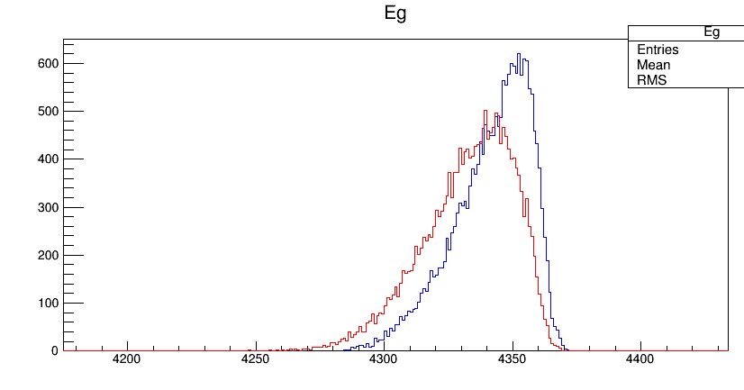
1) Lifetime ↑, sharpness ↓, which is reasonable.
E_{γ} = 4045 keV, τ = 1 fs
E_{γ} = 4045 keV, τ = 20 fs

Slide 5
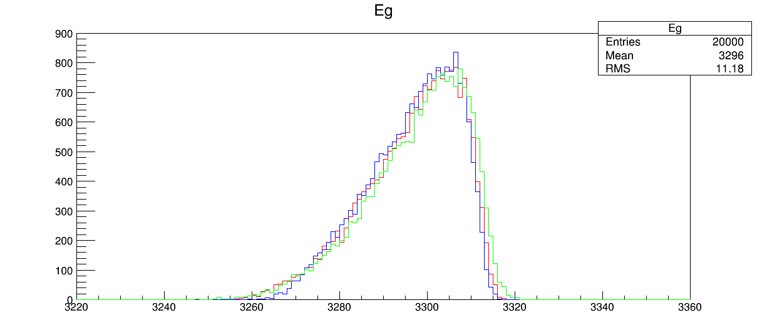
2) Collimator diameter ↓, sharpness slightly ↑
Diameter (Φ)
Green: 6.4 mm
Red: 4 mm
Blue: 2 mm

Slide 6
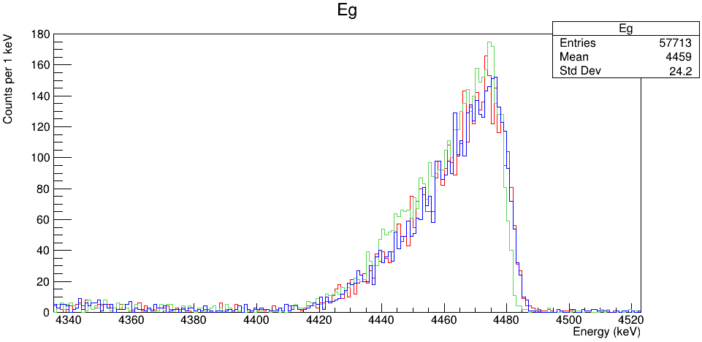
2) Collimator diameter ↓, sharpness slightly ↑
3) Beam energy spread ↓, sharpness doesn't seem to change, or maybe slightly ↑
Normal beam spread = 0.2% FWHM
cosθ_{α} > 0.97 (collimator)
Beam spread = 0
cosθ_{α} > 0.97 (collimator)
Beam spread = 0.2%
cosθ_{α} > 0.999 (unrealistic small collimator)
Notes:
TH1F *Eg=new TH1F("Eg","Eg",8000,0.,8000);
tree->Draw("Clovere>>Eg","Clovere>4266&&Clovere<4606&&DSSD1e+DSSD2e>20000","");
tree->Draw("Clovere","Clovere>4266&&Clovere<4606&&DSSD1e+DSSD2e>39000&&DSSD1e+DSSD2e<40000","same");
TH1F *Eg2=new TH1F("Eg2","Eg2",8000,0.,8000);
tree->Draw("Clovere>>Eg2","Clovere>4266&&Clovere<4606&&DSSD1e+DSSD2e>39000&&DSSD1e+DSSD2e<40000","");
Eg2->Scale(2.2)

Slide 7
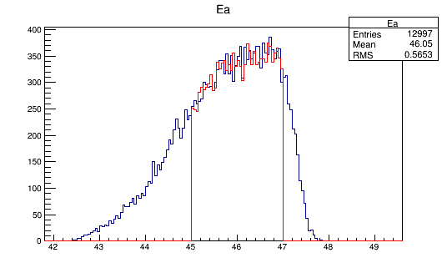
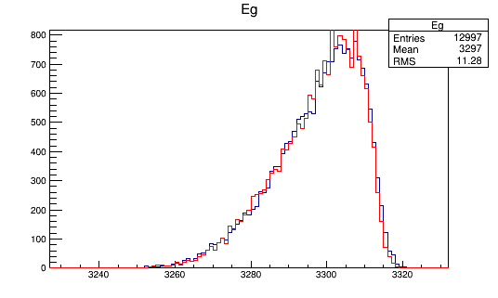
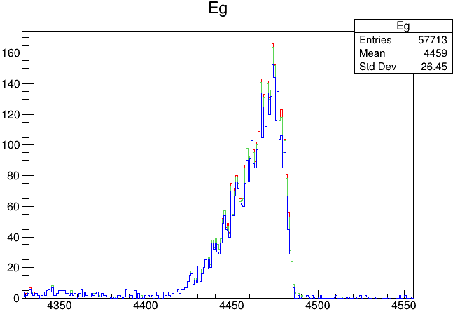
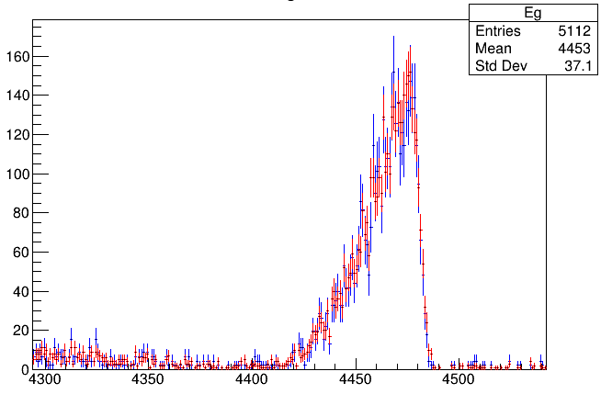
4) Make the α gate narrower, sharpness doesn't seem to change
Beam spread = 0
E_{α} > 38 MeV
Beam spread = 0
E_{α} > 30 MeV
Beam spread = 0
E_{α} > 10 MeV
Beam spread = 0
39 MeV < E_{α} < 40 MeV
normalized
Beam spread = 0
20 MeV < E_{α} < 50 MeV

Slide 8
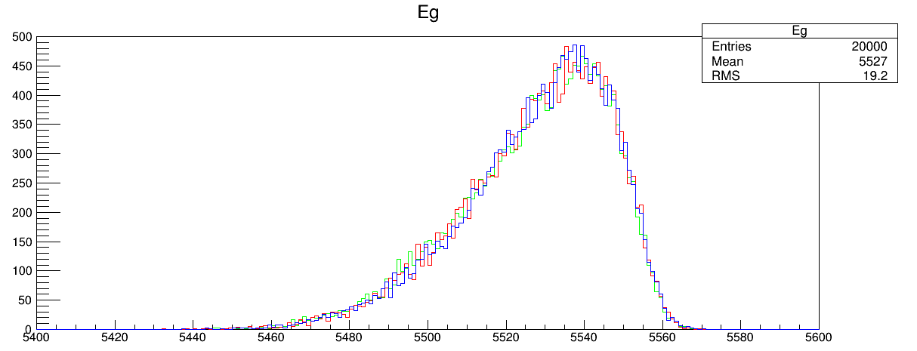
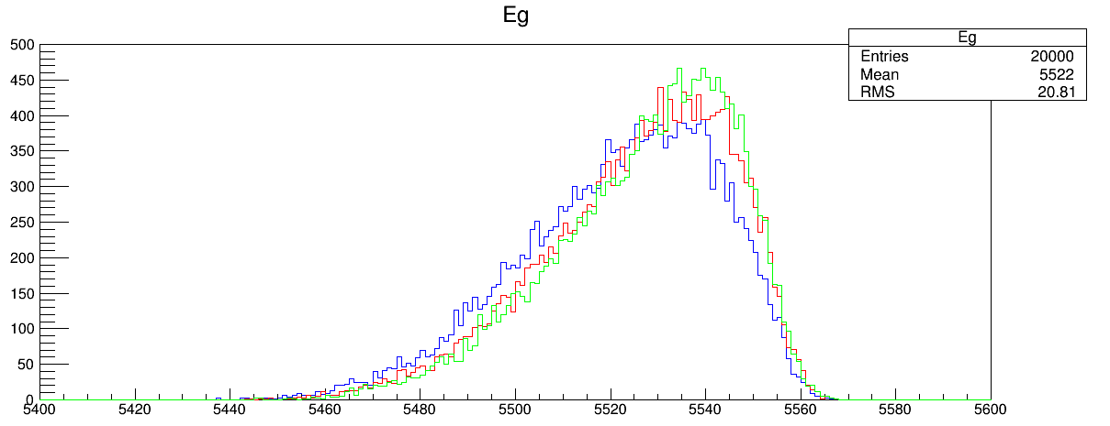
5) Angular correlation forward, sharpness doesn't change
Angular correlation backward, sharpness ↓
A2 = 0
A2 = +0.4
A2 = +0.8
A2 = 0
A2 = –0.4
A2 = –0.8

Slide 9
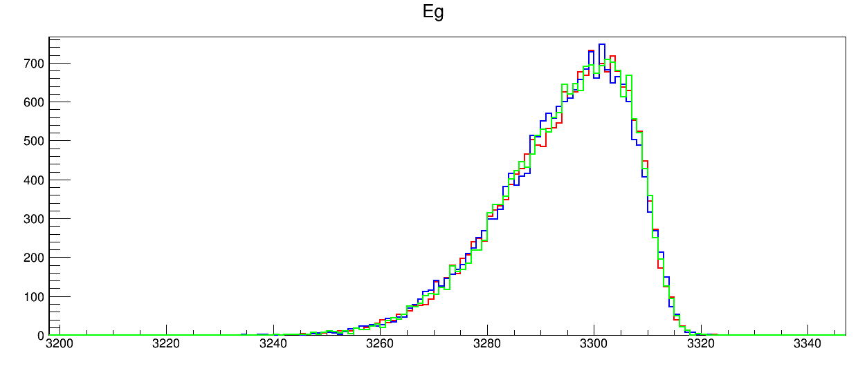
6) EMG response function parameters σ and τ don't affect sharpness, unless … (next slide)
baseline
σ↑
σ↓
baseline
τ↑
τ↓

Slide 10
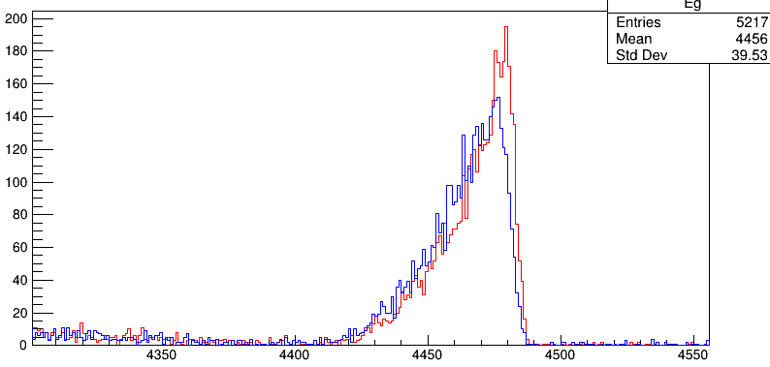
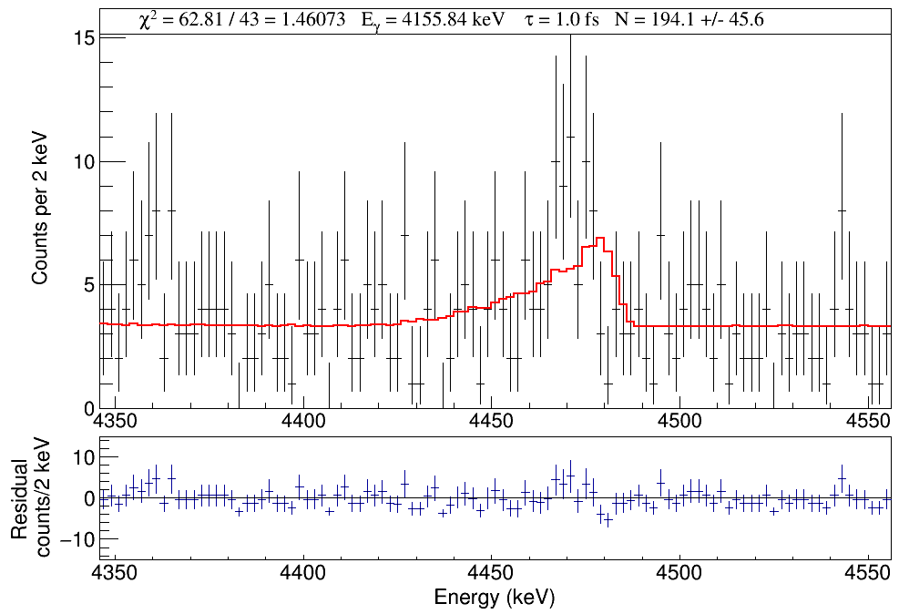
EMG enabled
EMG disabled
6) We disable EMG, i.e., set the HPGe intrinsic resolution = 0%, sharpness ↑
The parameters of the EMG function could be well characterized as a linear function of energy (0.2–6.1 MeV) by fitting unshifted γ-ray peaks. I don't see how EMG could completely fail at 4.4 MeV (4156 keV shifted).
Also, even fitting the "No EMG" simulation to the data, the peak shape doesn't look better.
Notes:
TFile *_file0 = TFile::Open("Test/S31_Gamma4156_Eg4155.84_Tau1.0_SP1.00_AD0.0_noEMG_DSL1.root");
TFile *_file0 = TFile::Open("Test/S31_Gamma4156_Eg4155.84_Tau1.0_SP1.00_AD0.0_DSL1.root");
TH1F *Eg=new TH1F("Eg","Eg",8000,0.,8000);
tree->Draw("Clovere>>Eg","Clovere>4266&&Clovere<4606&&DSSD1e+DSSD2e>20000","");

Slide 11
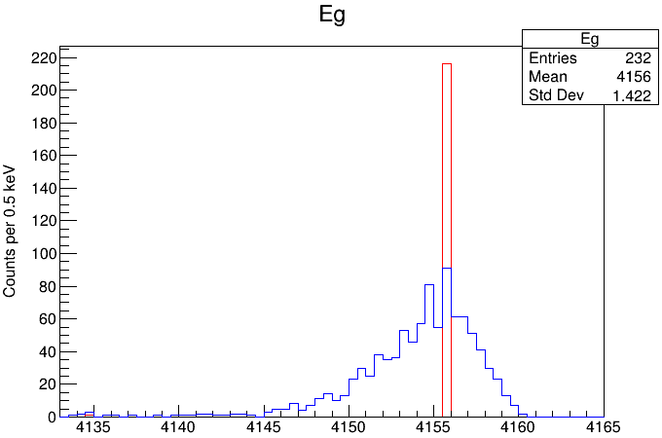
Thanks also for doing those additional tests and providing the slides. It all seems OK except I was curious why enabling the EMG shifts everything to the left. It should just broaden everything with some counts moving to the left and some to the right. I hope this is accounted for properly in your analysis.
Doppler shift disabled
EMG enabled
Doppler shift disabled
EMG disabled
I should have removed the energy correction. There was a small difference between the peak maximum and the parameter mean, which was accounted for individually for each peak in the simulation. For a 4-MeV γ ray peak, the mean-max difference is ~1.6 keV. Anyway, let's remove the Doppler shift and only look at the EMG effect on the 4156-keV γ ray peak emitted from a stopped 31S.
It looks reasonable.

Slide 12
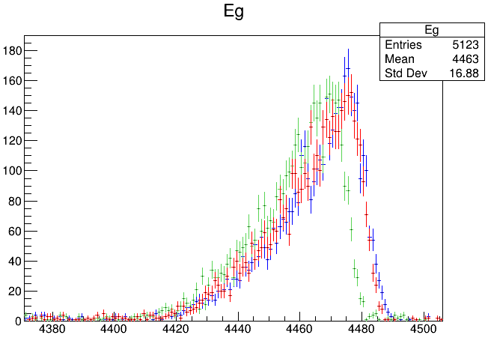
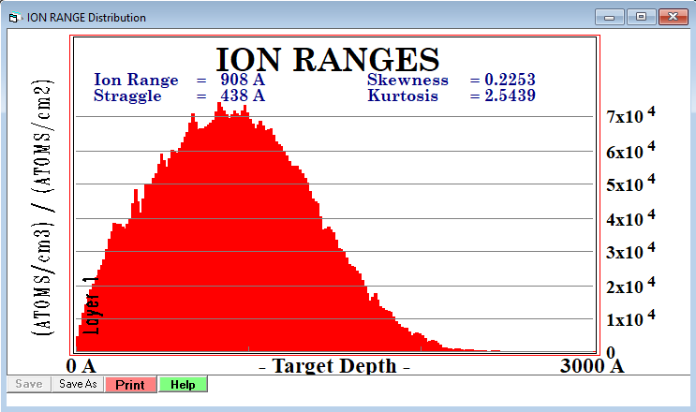
7) Varying the 3He implantation depth changes Doppler shift a little bit but doesn't seem to change the sharpness.
Depth = 0
Depth = 0-0.2 μm according to SRIM
Depth = 5.0 μm

Slide 13
Other issues

Slide 14
p.1 Section Introduction. After the 1st paragraph:
Maybe we should include a short paragraph about what is previously known about 31S lifetimes?
p.1 Section Introduction. The last paragraph:
This sentence seems out of place here. I think you already said it in the first paragraph, or could say it there.
Done. See p.1 Section Introduction in the new draft.
I think it will make the paper more clear if you explicitly define your language regarding statistical significance in terms of standard deviations. Then there will be no ambiguity.
For the 5141-keV peak, I think the fit tells you if it is there or not. The fit says its significance is more than 3 standard deviations above zero, which is not completely insignificant. I agree that some of the counts might be from the 5/2+ state, so it is unclear if the excess is from the transition from the 6390-keV state and we shouldn’t use it for lifetime analysis of the 6390-keV state.
Done. See p.3 Section Simulation in the new draft.
I would separate the discussion of analysis techniques from the discussion of 31S in the Conclusions and Outlook. You could have a paragraph with Conclusions and Outlook for analysis. Then another paragraph for Conclusion and Outlook for 31S.
Done. See p.9 Section Conclusion & Outlook in the new draft.

Slide 15
"While the other branches were not statistically significant, we searched for them to estimate the..." (however, I think you shouldn't report the insignificant values, just the ratio of 5141 to 4156)
See Table below. Just showing the ratio seems less convincing. How about saying the six branching ratios and also pointing out those are tentative estimates?
Did you use both gammas to measure the 6390-keV lifetime, or just one? If you don't say it in the paper, should say it.
Good point. As the 4156-keV branch is uniquely associated with the resonance of interest, we will extract the lifetime from the 4156-keV γ-ray lineshape analysis.
E_{γ} (keV) | BR (%) Bennett | BR (%) DSL
6390 | 5.4±0.6 | 1.1±0.6
5141 | 10.8±1.1 | 28±8
4156 | 44.4±2.7 | 38±9
3314 | 11.8±0.7 | 17±8
3106 | 21.6±1.2 | 6±8
2183 | 6.0±0.5 | 10±7
maybe move this immediately after "theoretical uncertainties" above and start a new paragraph to discuss the 6390-keV level
Done. See p.8 Section Results in the new draft.
Ratio of 4156/5141 | 4.1±1.6 | 1.4±0.4

Slide 16
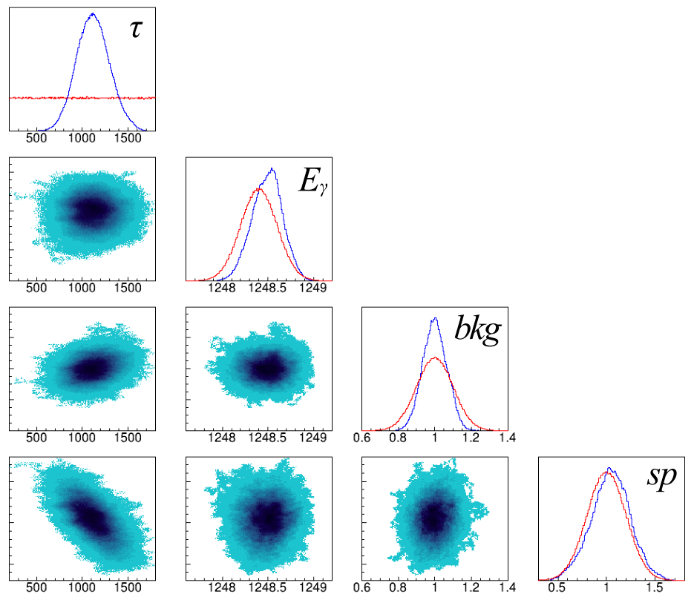
This was from your comments on the first version of the draft. "These figures need legends to describe the blue probability scale."
I'm wondering what kind of legend?
See the next two slides. It seems that people usually don't put a probability scale.

Slide 17
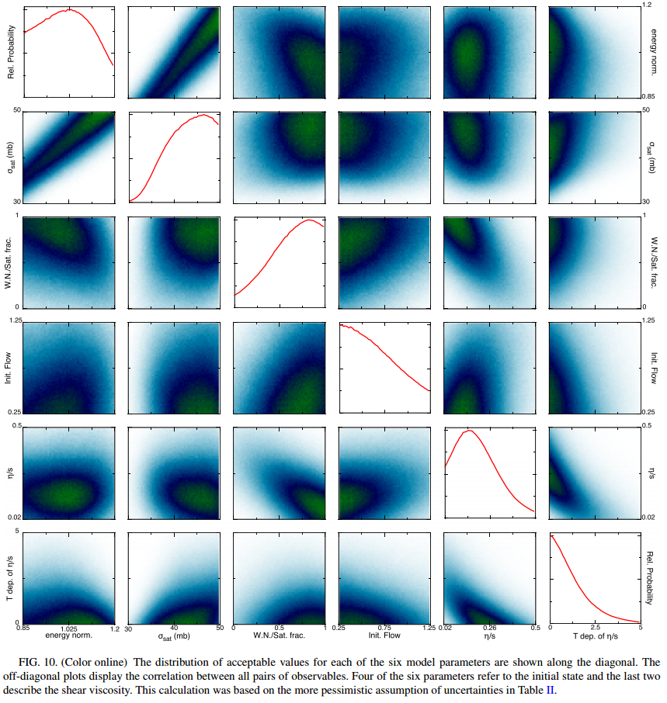
J. Novak et al., Phys. Rev. C 89, 034917 (2014). Determining fundamental properties of matter created in ultrarelativistic heavy-ion collisions

Slide 18
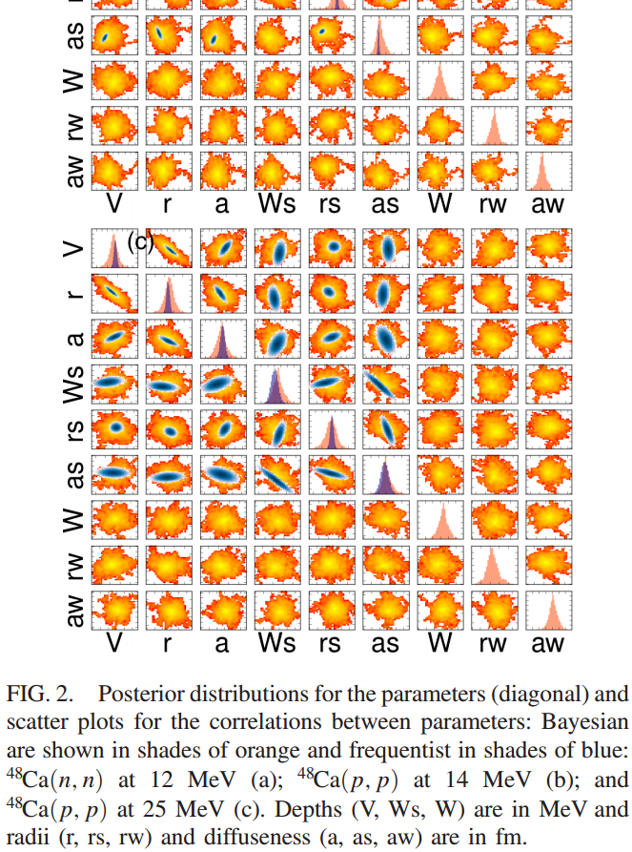
G. B. King et al., Phys. Rev. Lett. 122, 232502 (2019). Direct Comparison between Bayesian and Frequentist Uncertainty Quantification for Nuclear Reactions

Slide 19
Physics Letters B Letters. The total length of the paper should preferably not exceed six journal pages, equivalent to ten typewritten pages with double spacing, excluding the list of authors, abstract, references, figure captions and three figures. In the case that more figures are required, the text should be shortened accordingly. Authors should check their papers carefully before submission, because there is no proofreading possibility for the author once the paper is submitted. It should be noted that papers submitted to Physics Letters B should be interesting and likely to significantly influence the research of the physics community.
I tried removing the parts highlighted in red. Our draft is at the length limit now, about six-seven pages.
To-do: p. 4 The "best-fit" simulated γ spectra will be updated, but they won't be too different from the ones shown in the current Figures 2–8.

Slide 20
Hi Lijie,
Thanks, I read it and provided comments in the attached pdf.
Thanks also for doing those additional tests and providing the slides. It all seems OK except I was curious why enabling the EMG shifts everything to the left. It should just broaden everything with some counts moving to the left and some to the right. I hope this is accounted for properly in your analysis.
It was interesting to see that Tonev’s value for the 4 MeV state is also lower than literature. I had either forgotten about that, or didn’t realize. Obviously it may help to explain why his value is low and ours is high for the 1st excited state. It definitely makes me feel more comfortable about our value.
I made a note about comparing to the measured lifetimes in the mirror 31P. I’m sure we discussed this before, but I don’t remember the conclusion we came to. Making the comparison might help to make the discussion more interesting.
I think you should circulate the next version to Cathleen, Nick, Barry, and I.
Chris
Tonev reported the lifetimes for the 1248- and 4450-keV states. The lifetime value for the 1248-keV state is 2.6σ lower than ours and lower than all the other literature values. Tonev's 4450 lifetime is also 2.3σ lower than the only other literature value. I thought we should mention this discrepancy in the paper (not try to make Tonev look bad).
3) I added the lifetimes of 31P states to the Table. The mirror symmetry looks "fine".
Other minor issues:
4) It does seem odd to report the values of the six branchings, so I removed those numbers.
5) I kept Doornenbal's lifetime values (the ones with huge errors) as those are their formal results. NuDat also incorporated their results.
6) We obtained τ = 1.3 fs using a shifted USDC Hamiltonian. Alex did this calculation for Tamas, but the lifetime value was not explicitly mentioned in Tamas' paper. I guess it's okay to report this value in the DSL paper. Also, both Alex and Tamas are on the author list of this paper.
I just circulated the fifth version to our collaborators, including Alex Brown. It doesn’t hurt to hear some advice on appropriately describing the theory part.

Slide 21
31S V5 20220304
Response to Cathleen's comments

Slide 22
Hi all,
I've got plans to do a more detailed read probably early next week, but here's what I got on a first pass:
-We know the 260 keV dominates, but last I heard we thought it was only about half the contribution. Are we OK with ignoring the other contributions/how tight do we need rate uncertainties?
The 260-keV resonance has six known γ branches. Chris and I discussed that before. None of its γ branches reached 5σ significance in this data set. The 4156 and 5141-keV branches were observed in this data set with significances over 4σ and 3σ, respectively. The 5141-keV peak is shown in the next slides (hard to see by eye). When fitting the spectrum below with a simulated Doppler-shifted 5141-keV line + a linear bkg function, we obtained roughly N = 29(9) counts. There is another concern: the 5/2+ 6392.5(2)-keV state generates a 5143.1(2)-keV branch, which is inseparable in the spectrum. Incorporating the 5141-keV peak in determining the lifetime for the 3/2+ resonance seems risky, not to mention the statistics were not sufficient to provide a conclusive observation. See figure below. Unlike those "good" posterior distributions shown in the paper, the 5141-keV γ ray yields a posterior almost the same as the prior, which means the walker just randomly walks through the parameter space with no purpose. I would say low statistics peaks provide no constraints on the posterior of the lifetime.

Slide 23
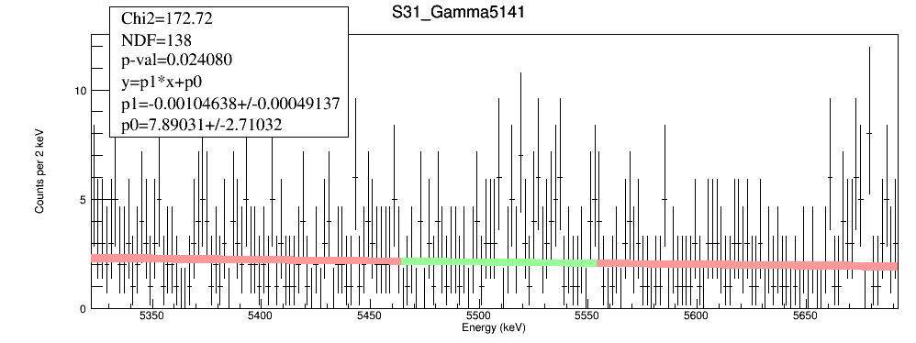
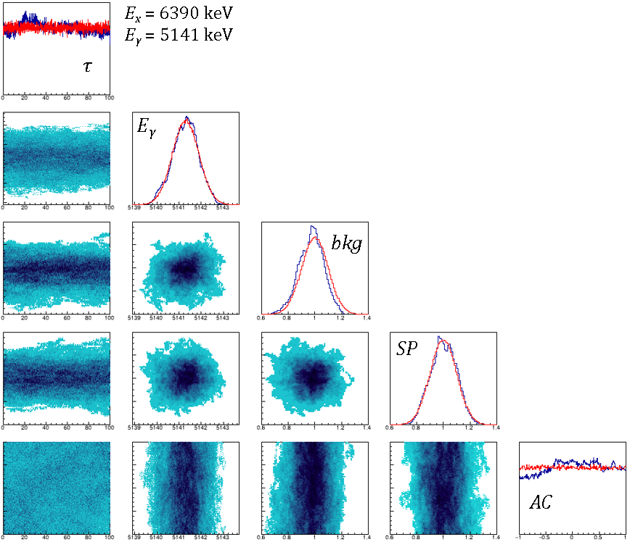

Slide 24
-We should probably mention the Si detector collimator.
I'll add "A collimator with a diameter of 6.4~mm was placed in front of the silicon detectors to avoid edge effects.".
The current draft is already at the length limit. I guess we can focus on reporting new stuff, such as new lifetimes of ³¹S states, new Bayesian analysis, new shell-model calculations. The DSL experimental method has been detailed in multiple previous papers. We might have to be concise in this part.
-It might be worth mentioning that we did a cross check on the extrapolation of the Si detector energies using alpha and proton punch through (and it was fine within our broad resolution).
That's a good point. I’ll add "A linear calibration was applied and used to extrapolate to higher energies. The extrapolation was verified by comparing the energy loss of punch-through particles to SRIM calculations."
-You mention that charged particle distribution effects are negligible, and they are for the "long" lifetimes we're looking at but get really important around 2-3 fs. This and the excitation energy resolution are both benefits from DSL2 angular resolution.
See the next few slides for details.
-Just out of curiousity, what reduces the gamma attenuation in DSL2? Thinner chamber, getting rid of the collimator for the Si, or something I'm not thinking of?
See the last slide. It's mainly the collimator and detector mounts. I estimated that for the 1248-keV γ ray from the 31S 1st excited state, the counts could increase by a factor of 1.6 just because of the less material between the target and the Ge detector.

Slide 25
There are two angular distributions involved:
angular distribution function of the ejectile α particles (θ_{α})
$$W\left(θ_{α}\right)=1+{AD}_{2}P_{2}\left(cosθ_{α}\right)+{AD}_{4}P_{4}\left(cosθ_{α}\right)$$
2) α-γ angular-correlation function (θ_{αγ})
$$W\left(θ_{αγ}\right)=1+{AC}_{2}P_{2}\left(cosθ_{αγ}\right)+{AC}_{4}P_{4}\left(cosθ_{αγ}\right)$$
Naomi Galinski:
We report the lifetime uncertainty due to the excitation energy and ejectile angular distribution Legendre polynomial coefficient.
The angle of the γ ray was chosen from an isotropic distribution in the c.m. system since the results differed negligibly from those calculated with an anisotropic distribution.
Oliver Kirsebom:
In principle knowledge of the angular distribution of the α particles and the γ-α angular-correlation function is also required, but their effect on the line shape is rather small due to the limited angular acceptance.
For the emission angles, we generally assume isotropic distributions. The error introduced by this simplifying assumption has been estimated by trying a few different realistic anisotropic distributions and has been found to be negligible compared to other errors for all the transitions considered, except the 2908 keV → g.s. transition where it gives an error of ±2 fs.

Slide 26
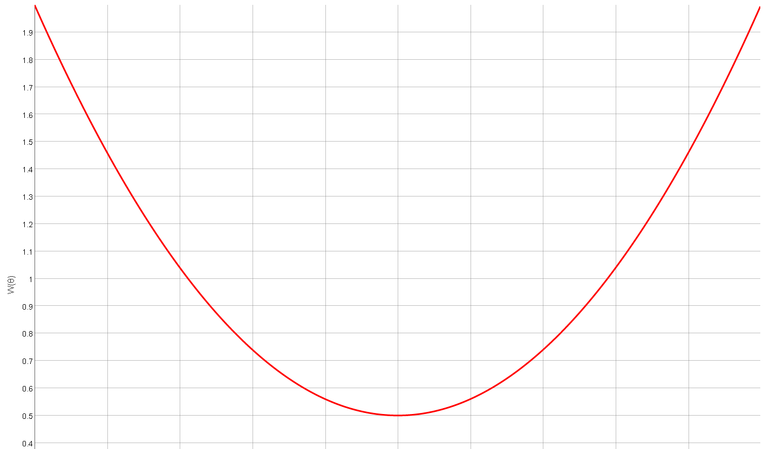
1) $W\left(θ_{α}\right)=1+{AD}_{2}P_{2}\left(cosθ_{α}\right)+{AD}_{4}P_{4}\left(cosθ_{α}\right)$
θ_{α}: α emission angle with respect to the beam axis
Let's assume ${AD}_{2}=1,{AD}_{4}=0$. This may be an unrealistically strong forwarding distribution.
³¹S
6390-keV state
cosθ > 0.71
Reaction kinematics

Slide 27
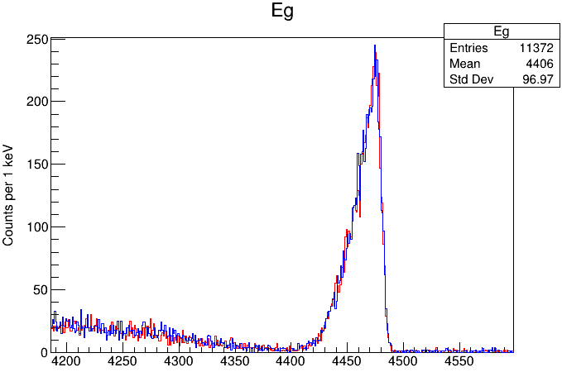
$${AD}_{2}=0, {AD}_{4}=0$$
Assuming τ = 1 fs
DSL1
3/2⁺
6390
γ
$${AD}_{2}=1, {AD}_{4}=0$$
5/2⁺
2234
1/2⁺
0
³¹S
Very little difference was found for the shapes of γ rays from both short- and long-lived states.
So, for the α emission angles, I generally assume isotropic distributions.

Slide 28
2) α-γ angular-correlation function (θ_{αγ})
$$W\left(θ_{αγ}\right)=1+{AC}_{2}P_{2}\left(cosθ_{αγ}\right)+{AC}_{4}P_{4}\left(cosθ_{αγ}\right)$$
Varying AC₂, some small changes were found for the shapes of γ rays from short-lived states, but not for long-lived states. So, I included the parameter AC₂ as a source of uncertainty in the Bayesian analysis.
AC2 = 0
AC2 = +0.4
AC2 = +0.8
1/2⁺
5156
γ
1/2⁺
0
³¹S
AC2 = 0
AC2 = –0.4
AC2 = –0.8

Slide 29
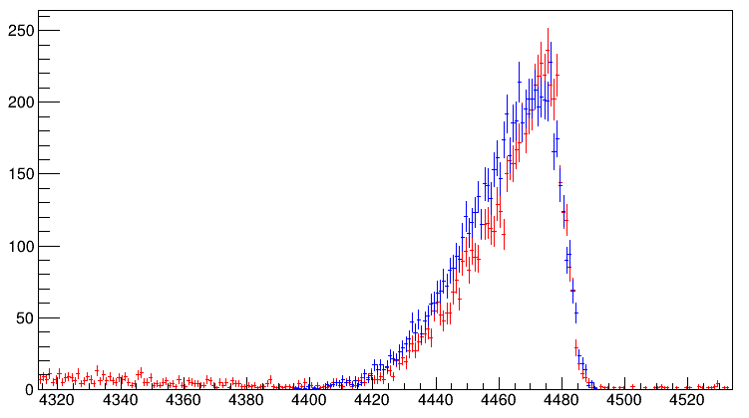
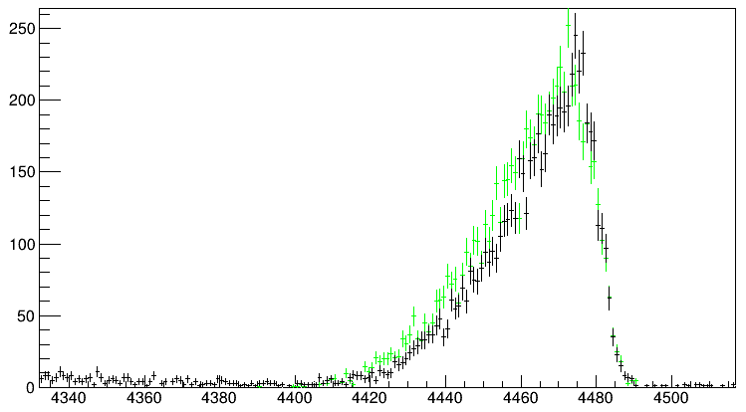
Red: Geant4 DSL1
AC=0, AD=0
Blue: Oliver DSL1
AC=0, AD=0
Black: Geant4 DSL1
AC=0, AD=1
Green: Oliver DSL1
AC=0, AD=1
Notes:
root Test/S31_Gamma4156_Eg4155.84_Tau1.0_SP1.00_AD0.0_DSL1.root
TH1F *Eg1=new TH1F("Eg1","Eg1",8000,0.,8000);
tree->Draw("Clovere>>Eg1","Clovere>4066&&Clovere<4606&&DSSD1e+DSSD2e>20000");
TFile *_file0 = TFile::Open("Test/S31_Gamma4156_Eg4155.84_Tau1.0_SP1.00_AD0.0_AC0.0.root");
Eg->Scale(0.90);
Eg->Draw("same");

Slide 30
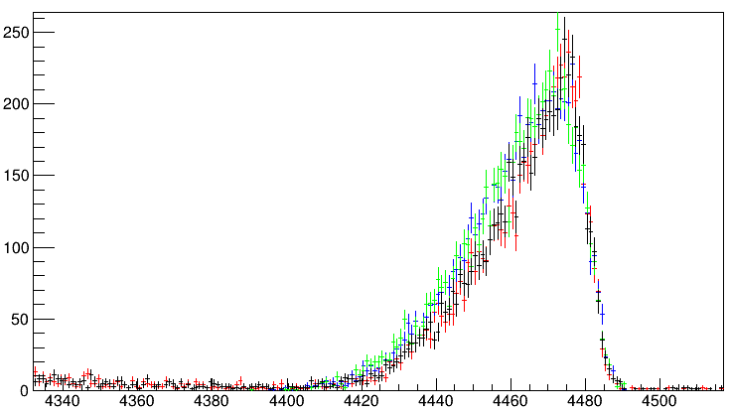
Red: Geant4 DSL1
AC=0, AD=0
Blue: Oliver DSL1
AC=0, AD=0
Black: Geant4 DSL1
AC=0, AD=1
Green: Oliver DSL1
AC=0, AD=1

Slide 31
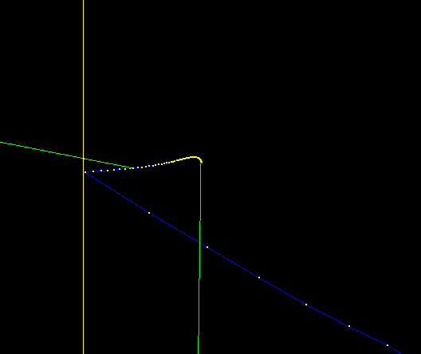
Vacuum
Target
When the γ ray is emitted from a long-live state, the emission usually happens when the recoil has undergone a series of collisions with the target atoms. The emission point is far away from the reaction point. Hence the observed lineshape is even less sensitive to varying the angular correlation. I therefore omitted the α-γ angular-correlation parameter AC₂ for long-lived states, which means I adopted isotropic distribution (AC₂ = 0) for long-lived states.
γ₁
γ₂
α
When choosing model parameters for an MCMC-based Bayesian analysis, there is a rule of thumb: "As many parameters as necessary, as few as possible". It is important to vary parameters that have a meaningful impact on the behavior of the model. I chose lifetime, γ-ray energy, background level, and stopping power as the four main parameters to vary. I further added an α-γ angular correlation parameter for short-lived states only. More parameters require more training points, which means more computation time. To be honest, the four-parameter Bayesian analysis is already a very laborious process. Hopefully, after the MSU BAND Collaboration releases their advanced Bayesian analysis tool, this analysis will be less painful.
Notes:
/vis/viewer/set/viewpointThetaPhi 90. 180.

Slide 32
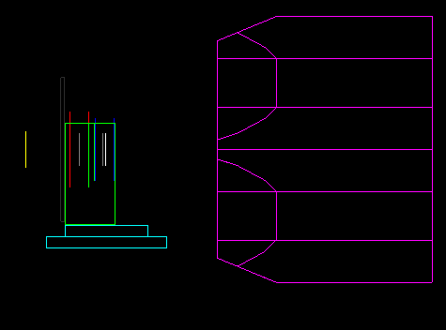
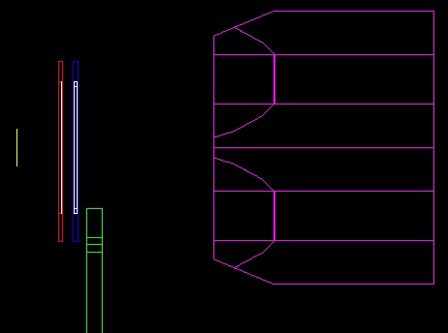
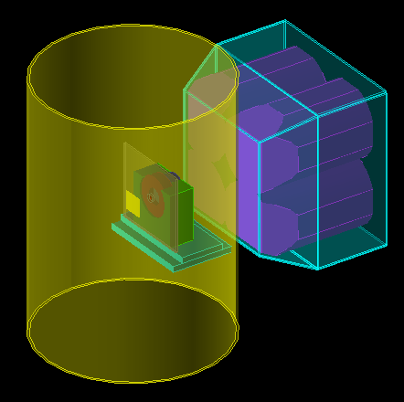
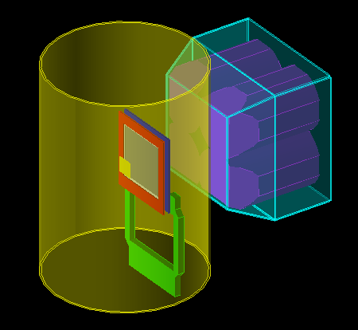
DSL1
DSL2

Slide 33
31S V6 20220305
Response to Alex's comments

Slide 34
It is great to see you new data. Let me start with the lifetime of the 3/2+. You half-life is 0.428 ps The calculation is a mixture of M1 and E2. For pure E2 the half-life is 6.0 ps. This implies your partial M1 half life is 0.46 ps. This gives a exp B(M1) = 0.044 In this attached paper we compared to all M1 data in 2006. The quantity in Fig. 4 is M(M1) where B(M1) = M(M1)^2/(2J_i+1) The exp M(M1) = 0.419 The usdbpn M(M1) = 0.165 I have included that point (red dot) as an update to Fig. 4 in the attached. That point is within the error band for exp-th. The error for M(M1) is about 0.3 independent of the size of the M(M1). I attach the results for the most recent Hamilonian USDC (see attached)
Alex 10/19/2021
The calculated gamma decay of the first 3/2+ state is dominated by M1.
Correcting for the calculated partial half-life for E2 of 4.8 ps, the experimental partial half-life for M1 is 0.79(13) ps.
This gives an experimental value of B(M1)_(exp) = 0.026(4) mu_N^2.
With B(M1) = M(M1)^2/(2J_i+1), we have M(M1)_(exp) = 0.32(3) mu_N to be compared with, for example, M(M1)_(USBC) = 0.175 mu_n.
The comparison between theory and experiment for other M(M1) values in the sd shell is shown in Fig. 4 of [a]. It is observed that theory and experiment differ by about \pm 0.3 mu_N independent of the size of M(M1). The present results are consistent with this observation.
Alex 3/8/2022

Slide 35
The calculated gamma decay of the first 3/2+ state is dominated by M1.
Correcting for the calculated partial half-life for E2 of 4.8 ps, the experimental partial half-life for M1 is 0.79(13) ps.
This gives an experimental value of B(M1)_(exp) = 0.026(4) mu_N^2.
With B(M1) = M(M1)^2/(2J_i+1), we have M(M1)_(exp) = 0.32(3) mu_N to be compared with, for example, M(M1)_(USBC) = 0.175 mu_n.
The comparison between theory and experiment for other M(M1) values in the sd shell is shown in Fig. 4 of [a]. It is observed that theory and experiment differ by about \pm 0.3 mu_N independent of the size of M(M1). The present results are consistent with this observation.
Alex 3/8/2022
The calculated gamma decay of the first 3/2+ state is dominated by M1.
Correcting for the USDB-calculated partial half-life for E2 of 4.8 ps, the experimental partial half-life for M1 is 0.92(18) ps.
This gives an experimental value of B(M1)_(exp) = 0.022(4) mu_N^2.
With B(M1) = M(M1)^2/(2J_i+1), we have M(M1)_(exp) = 0.30(3) mu_N to be compared with, for example, M(M1)_(USBC) = 0.175 mu_n.
The comparison between theory and experiment for other M(M1) values in the sd shell is shown in Fig. 4 of [a]. It is observed that theory and experiment differ by about \pm 0.3 mu_N independent of the size of M(M1). The present results are consistent with this observation.
Lijie 3/10/2022

Slide 36
The calculation is a mixture of M1 and E2. For pure E2 the half-life is 6.0 ps. Alex 10/19/2021
T_{E2} = 6.0 ps means $τ_{E2}$ = 8.6 ps
$$Γ_{M1}=1.16×{10}^{−2}E_{γ}^{3}\left[MeV\right]B\left(M1\right)\left[μ_{N}^{2}\right]=0.134 meV$$
$$τ_{M1}=\frac{ℏ}{Γ_{M1}}=4.9 ps$$
$$Γ_{E2}=8.13×{10}^{−7}E_{γ}^{5}[MeV]B\left(E2\right)[e^{2}{fm}^{4}]=\text{0.07}\text{7} \text{meV}$$
$$τ_{E2}=\frac{ℏ}{Γ_{E2}}=8.6 ps$$
the calculated partial half-life for E2 of 4.8 ps
T_{E2} = 4.8 ps means $τ_{E2}$ = 6.9 ps Alex 3/8/2022
$$Γ_{M1}=1.16×{10}^{−2}E_{γ}^{3}\left[MeV\right]B\left(M1\right)\left[μ_{N}^{2}\right]=0.154 meV$$
$$τ_{M1}=\frac{ℏ}{Γ_{M1}}=4.3 ps$$
$$Γ_{E2}=8.13×{10}^{−7}E_{γ}^{5}[MeV]B\left(E2\right)[e^{2}{fm}^{4}]=\text{0.0}\text{9}\text{6} \text{meV}$$
$$τ_{E2}=\frac{ℏ}{Γ_{E2}}=6.9 ps$$
USDB
E_{γ} (MeV) | B(M1) $[μ_{N}^{2}$] | B(E2) [$e^{2}{fm}^{4}$]
1.193 | 0.006815 | 39
Yes!
Yes!
exp E_{γ} + USDB
E_{γ} (MeV) | B(M1) $[μ_{N}^{2}$] | B(E2) [$e^{2}{fm}^{4}$]
1.248 | 0.006815 | 39

Slide 37
The calculated gamma decay of the first 3/2+ state is dominated by M1. Correcting for the calculated partial half-life for E2 of 4.8 ps, the experimental partial half-life for M1 is 0.79(13) ps.
T_{E2} = 4.8 ps means $τ_{E2}$ = 6.9 ps Alex 3/8/2022
T_{M1} = 0.79 ps means $τ_{M1}$ = 1.140 ps Alex 3/8/2022
$$Γ_{exp}=Γ_{M1}+Γ_{E2}=\frac{ℏ}{τ_{exp}}=\frac{ℏ}{1.12 ps}=0.59(10) meV$$
$$Γ_{E2}=8.13×{10}^{−7}E_{γ}^{5}[MeV]B\left(E2\right)[e^{2}{fm}^{4}]=\text{0.0}\text{9}\text{6} \text{meV}$$
$$τ_{E2}=\frac{ℏ}{Γ_{E2}}=6.9 ps$$
$$Γ_{M1}=Γ_{exp}−Γ_{E2}=0.49(10) meV$$
$$τ_{M1}=\frac{ℏ}{Γ_{M1}}=1.33\left(27\right)ps⇒T_{M1}=0.92\left(18\right) ps$$
$${B\left(M1\right)}_{exp}=\frac{Γ_{M1}}{1.16}×\frac{{10}^{−2}}{E_{γ}^{3}\left[MeV\right]}=0.022\left(4\right) μ_{N}^{2}$$
$$M\left(M1\right)=\sqrt{(2J_{i}+1)B\left(M1\right)}=2\sqrt{B\left(M1\right)}=0.30(3){ μ}_{N}$$
$${M\left(M1\right)}_{USDA}=0.22{ μ}_{N}$$
$${M\left(M1\right)}_{USDB}=0.17{ μ}_{N}$$

Slide 38
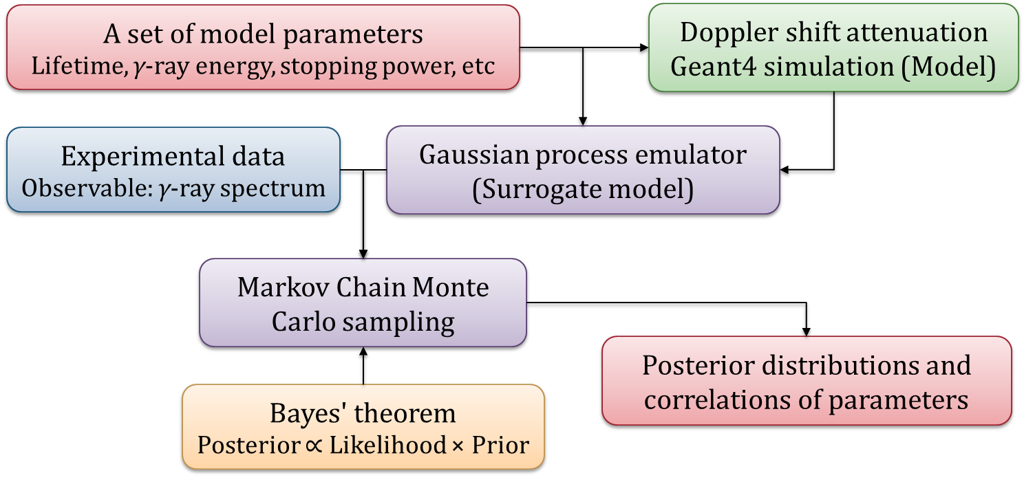
J. Novak et al., Phys. Rev. C 89, 034917 (2014).
S. Pratt et al., Phys. Rev. Lett. 114, 202301 (2015).
P. Morfouace et al., Phys. Lett. B 799, 135045 (2019).
Jonah E. Bernhard et al., Phys. Rev. C 91, 054910 (2015).
Jonah E. Bernhard et al., Phys. Rev. C 94, 024907 (2016).
Jonah E. Bernhard et al., Nat. Phys. 15, 1113 (2019).
J. Scott Moreland et al., Phys. Rev. C 101, 024911 (2020).
G.B. King et al., Phys. Rev. Lett. 122, 232502 (2019).
A. E. Lovell et al., Phys. Rev. C 97, 064612 (2018).
C. Marshall et al., Phys. Rev. C 102, 024609 (2020).
C. D. Pruitt et al., Phys. Rev. C 102, 034601 (2020).
L. Yang et al., Phys. Lett. B 807, 135540 (2020).
heavy-ion collisions
transfer reactions

Slide 39
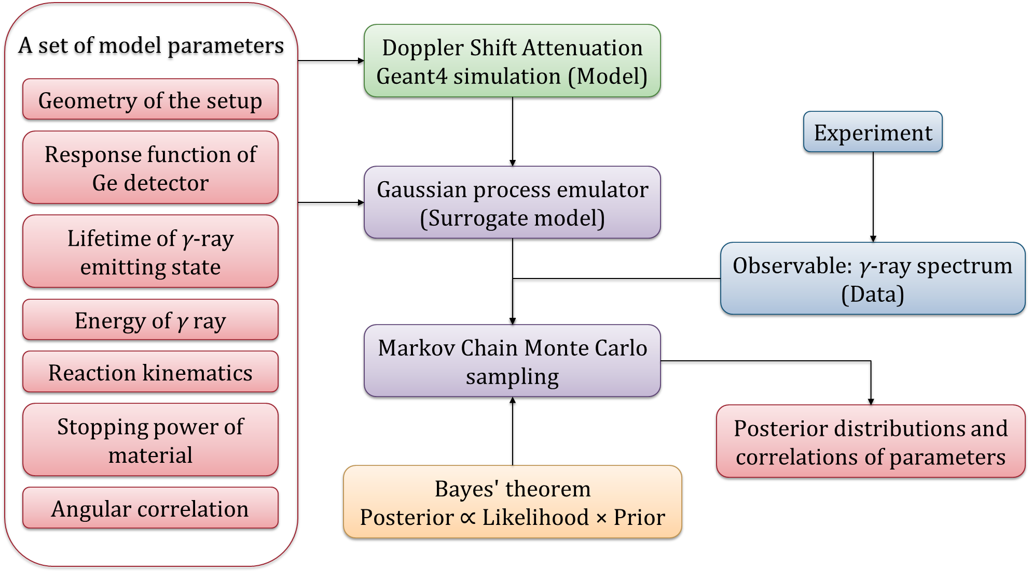
J. Novak et al., Phys. Rev. C 89, 034917 (2014).
S. Pratt et al., Phys. Rev. Lett. 114, 202301 (2015).
P. Morfouace et al., Phys. Lett. B 799, 135045 (2019).
Jonah E. Bernhard et al., Phys. Rev. C 91, 054910 (2015).
Jonah E. Bernhard et al., Phys. Rev. C 94, 024907 (2016).
Jonah E. Bernhard et al., Nat. Phys. 15, 1113 (2019).
J. Scott Moreland et al., Phys. Rev. C 101, 024911 (2020).
G.B. King et al., Phys. Rev. Lett. 122, 232502 (2019).
A. E. Lovell et al., Phys. Rev. C 97, 064612 (2018).
C. Marshall et al., Phys. Rev. C 102, 024609 (2020).
C. D. Pruitt et al., Phys. Rev. C 102, 034601 (2020).
L. Yang et al., Phys. Lett. B 807, 135540 (2020).
heavy-ion collisions
transfer reactions

Slide 40
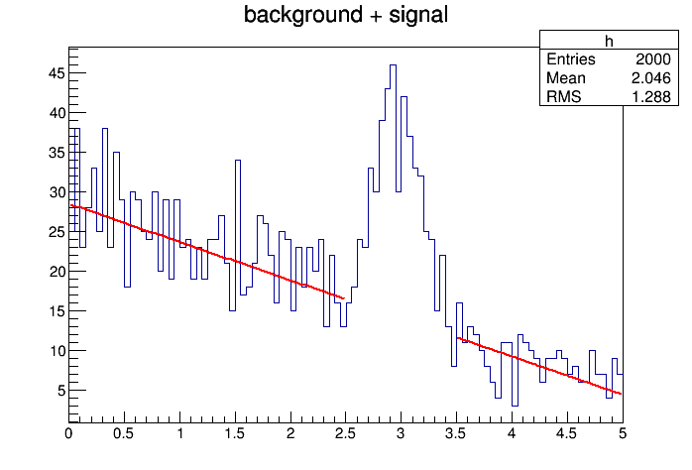
Bkg fitexclude.c

Slide 41
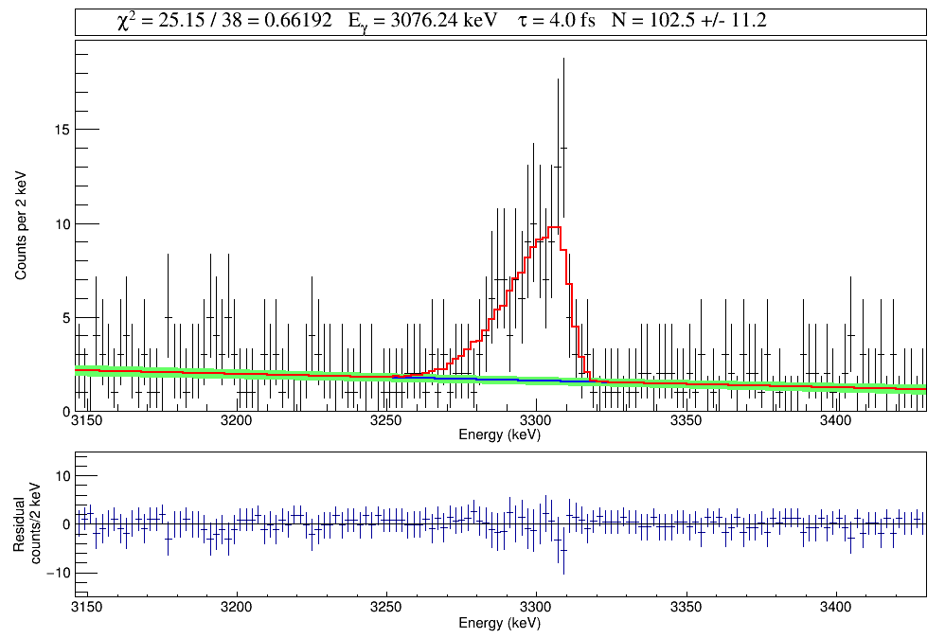

Slide 42
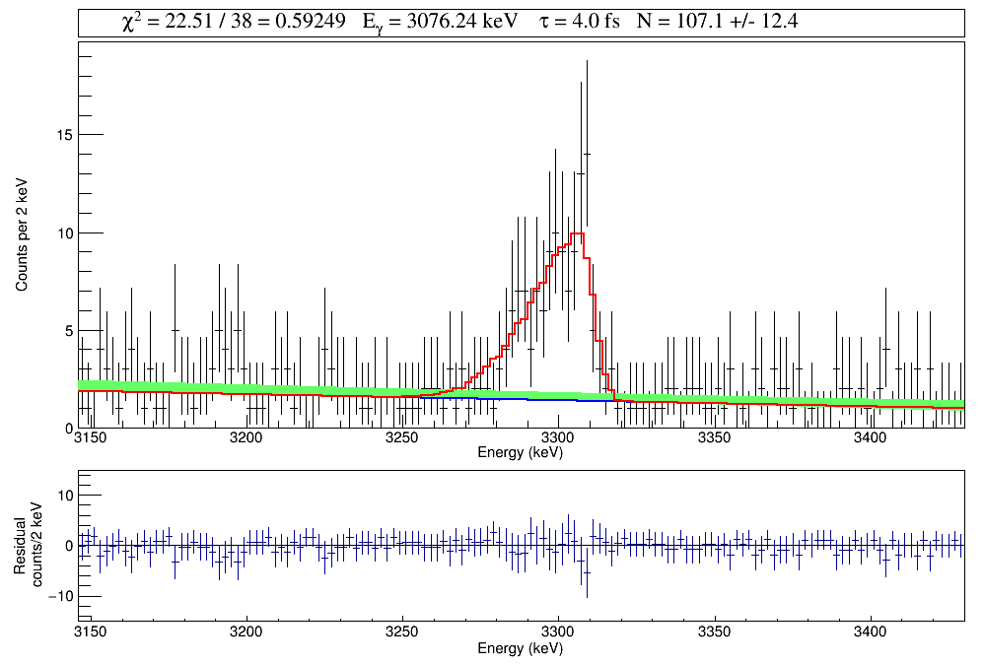

Slide 44
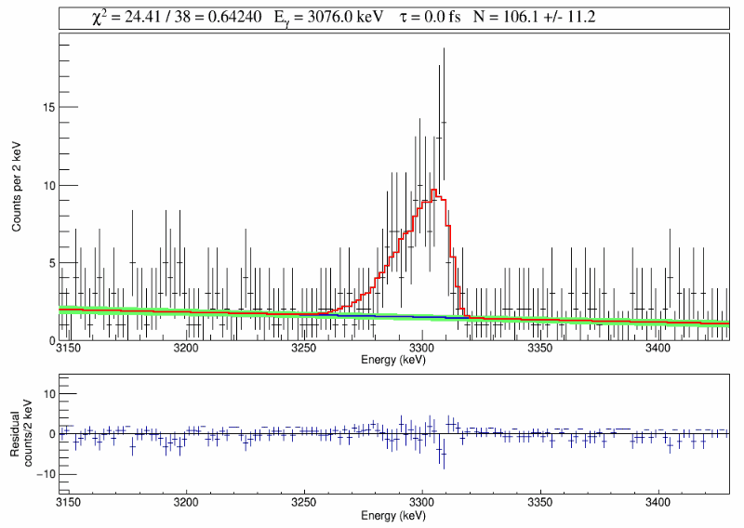
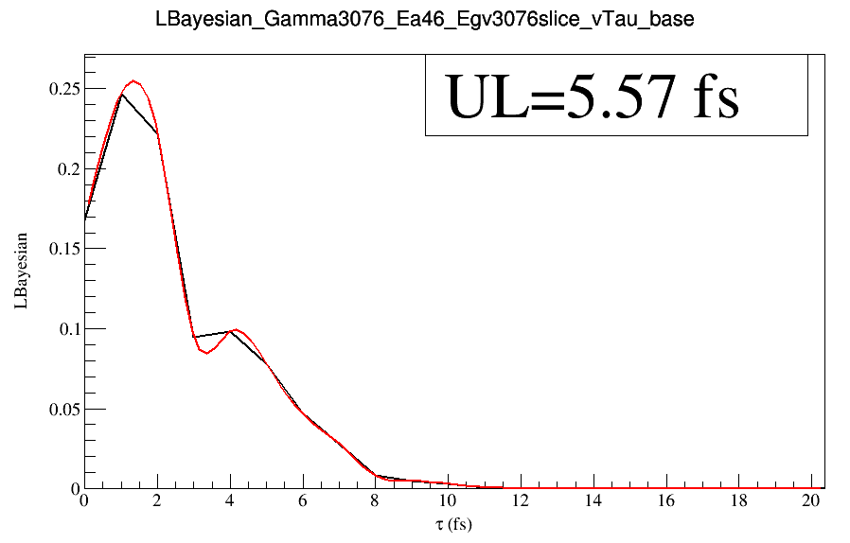

Slide 45
31S V7 20220315
Response to DSL-ers comments

Slide 46
Introduction Section of V6
In classical novae, the 30P(p, γ)31S reaction acts as a nucleosynthesis bottleneck in the flow of material to heavier masses [3]. The large uncertainty in the 30P(p, γ)31S rate impacts the classification of certain presolar nova grains [4], the calibration of nova thermometers [5], and the precision of nuclear mixing meters [6].
Barry thinks "nuclear mixing meters" is ill-defined. So, I changed it to
Introduction Section of V7
In classical novae, the 30P(p, γ)31S reaction acts as a nucleosynthesis bottleneck in the flow of material to heavier masses [3]. The large uncertainty in the 30P(p, γ)31S rate impacts the classification of certain presolar nova grains [4], the calibration of nova thermometers [5], and the Si/H abundance ratio, which can be used to constrain the degree of mixing between the outer white dwarf layers and the accreted envelope [6].
If you have a better way to express "nuclear mixing meters" accurately (and concisely) , please let me know.

Slide 47
Experiment Section of V6
The target foil was produced at the Universitéde Montréal, Canada, by implanting 35-keV ³He ions into a 25 µm-thick Au foil to an areal density of 6 × 10¹⁷ ions/cm².
The “35 keV” was mentioned in Cathleen's thesis, Barry said it could be “30 keV”. Maybe Cathleen could confirm this?

Slide 48
Both "Bayes' theorem" and "Bayes's theorem" have been used in literature. Barry expressed a strong preference for the latter, though the former is far more common.
There is no real difference, but in our paper we have to choose one. If you have a preference, please let me know.
Who uses "Bayes' theorem"?
Who uses "Bayes's theorem"?
J. Novak et al., Phys. Rev. C 89, 034917 (2014).
C. Marshall et al., Phys. Rev. C 102, 024609 (2020).
A. E. Lovell et al., Phys. Rev. C 97, 064612 (2018).
N. Galinski et al., Phys. Rev. C 90, 035803 (2014).
Jonah E. Bernhard et al., Nat. Phys. 15, 1113 (2019).
J. Scott Moreland et al., Phys. Rev. C 101, 024911 (2020).
Cade R. Rodgers et al., Nucl. Instrum. Methods Phys. Res. A 998, 165172 (2021).
D. R. Phillips et al., J. Phys. G Nucl. Part. Phys. 48, 072001 (2021).
P.A. Zyla et al. (Particle Data Group), Prog. Theor. Exp. Phys. 2020, 083C01 (2020).

Slide 49
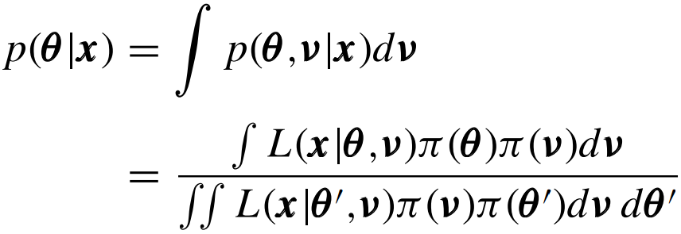
J. Novak et al., Phys. Rev. C 89, 034917 (2014).
N. Galinski et al., Phys. Rev. C 90, 035803 (2014).
Jonah E. Bernhard et al., Nat. Phys. 15, 1113 (2019).
People express Bayes' theorem in different ways. They are obviously all correct.
I suggest that we be consistent with the form used by the MADAI package.
A. E. Lovell et al., Phys. Rev. C 97, 064612 (2018).
Jonah E. Bernhard et al., Phys. Rev. C 94, 024907 (2016).
P.A. Zyla et al. (Particle Data Group), Prog. Theor. Exp. Phys. 2020, 083C01 (2020).

Slide 50
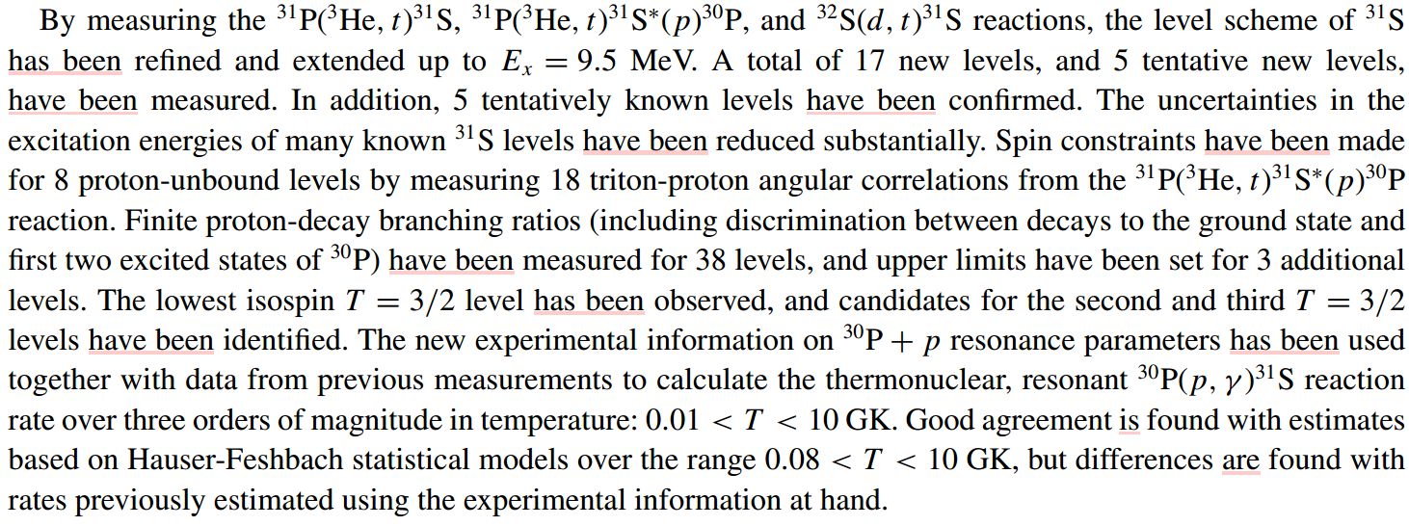
Nick suggested I change the "present perfect" to "simple past" in the abstract. I looked at Chris's papers, like the one below. Chris seems to prefer "present perfect". I'd appreciate it if anyone could explain a little bit more.

Slide 51
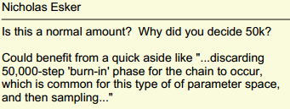
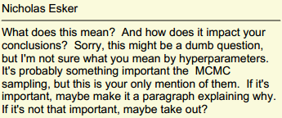
MCMC Section
We ran the full DSL simulation at these points and used the results to train the emulator. We explored a five-dimensional parameter space by discarding a 50,000-step ``burn in'' phase for the chain to converge and then sampling for another one million \mbox{MCMC} steps. We estimated the hyperparameters by numerically maximizing the likelihood but found that varying hyperparameters only weakly affects the actual emulator predictions.
The next four slides are for Nick.

Slide 52
This slide is for Alex.
I think this correction is small, and I would suggest just comparing to the calculated half-life without any E_(gamma) correction.
Alex
With or without the $E_{γ}^{2L+1}$ correction, the discrepancy between the theoretical and experimental lifetimes for the first excited state is shown below. Because the correction reduces the discrepancy and our M(M1) discussion in the paper also included this correction, I feel that I'd just keep it for consistency.
τ (fs) DSL1 | E_{x} (keV) ³¹S USDA | τ (fs) USDA | τ (fs) USDA $$E_{γ}^{2L+1}$$ | E_{x} (keV) ³¹S USDB | τ (fs) USDB | τ (fs) USDB $$E_{γ}^{2L+1}$$ | E_{x} (keV) ³¹S USDC | τ (fs) USDC | τ (fs) USDC $$E_{γ}^{2L+1}$$ | E_{x} (keV) ³¹S USDE | τ (fs) USDE | τ (fs) USDE $$E_{γ}^{2L+1}$$ | E_{x} (keV) ³¹S USDI | τ (fs) USDI | τ (fs) USDI $$E_{γ}^{2L+1}$$
$${1116}_{−177}^{+183}$$ | 1125 | 2598 | 1794 | 1193 | 3133 | 2633 | 1186 | 2942 | 2428 | 1212 | 3071 | 2735 | 1204 | 3142 | 2734

Slide 53
Response to Cathleen's comments on V7

Slide 54
Hi all,
Sorry I've been a bit slower than expected to respond, I've had a couple interviews get scheduled fairly last minute, so I'm running behind on other things.
A few more points:
-I don't have strong feelings about which possessive of Bayes we use.
Okay. I'll just follow Barry's advice.
-I would only trust my thesis for the implant we did for run 1 unless I explicitly quote separate numbers for the second implant. The first target was definitely 35 keV, but the second could be 30 keV implant. I'd check the log book.
I didn't see the implantation energy mentioned in the log book. I had a hard time reading a lot of handwriting in it, so I could miss something.
-The point I was trying to make about focusing on the 260 keV resonance in the intro isn't concern about what we see in our data, more about how much the other resonances potentially matter to the reaction rate at relevant temperatures
Thank, Chris, for explaining this. The understanding of the 30P(p,γ)31S reaction has been rapidly evolving, mostly because of Chris's (and collaborators) work in the past two decades.
Briefly, about the 260-keV resonance contribution, Tamas’ GADGET experiment has shown that it dominates by an order of magnitude or more at peak nova temperatures.
Chris

Slide 55
-BN was selected because the thermal conductivity is OK but not great. You do want to maintain a temperature differential so something that's not the target is the coldest thing around, so any junk in the chamber will preferentially condense on that rather than the target.
I tried to keep it simple as the experimental method has been detailed in multiple previous DSL papers. I've rephrased this part:
"During the experiment, the target was kept cryogenically cool via BeCu fingers in contact with a BN plate attached to a Cu shroud. The thermal gradient between the target ladder and the Cu shroud prevents losses of the implanted 3He through heating while mitigating the condensation of contaminants on the surface of the target."
Hope this one sounds better.
-The recent GRIFFIN papers use "addback" rather than "add-back".
I've changed accordingly.
-Do we really need three citations to justify an EMG? I checked and Bennett and Galinski don't cite anyone, Kirsebom cites Galinski, and Mythili cites RADWARE. Three feels a bit like a self-citation grab to me.
There were several EMG scripts circulating in our group. I used the one shown in my PRC2021 paper, which was different from what Mike and David used. I derived that EMG from Brent's scrip with small changes. So I guess I'll only keep two citations (Brent's and mine) here.

Slide 56
-I would cut the bit about fitting the 4156 with an EMG, since it's not actually at 4156 and we know it's shifted. I got myself confused for a minute and I don't think it adds to the story enough to keep.
-Technically shifting the alpha gate doesn't strictly rule out 40Ca or 44Ti (12C or 16O+32S evaporating only one alpha). We have plenty of other evidence that it's the 6390, so I'm not actually worried, just pedantic.
Could you please advise on what evidence we should write in the paper?
What I could think of is to rule out the possibilities of the 4470-keV peak from other sources. 1) not a sum/escape peak; 2) not a stopped line cuz it's much broader; 3) the 4156/5141 branching ratios seem plausible; 4) not from fusion evaporation residuals. This one is difficult; 5) not from the closely lying 6392 or 6394-keV states.
-It may be worth pointing out that the position granularity in DSL2 buys us excitation energy resolution (through angular resolution).
Thanks for point it out. I try to rephrase this part in the Conclusion & Outlook paragraph:
"Complimenting this work will be the DSL2 facility, consisting of a segmented Si detector telescope with higher solid angle coverage and reduced γ-ray attenuation. The granularity of the new telescope provides the position resolution necessary to maintain the angular/kinematic resolution that enables gating on excitation energies. The lifetime sensitivity will benefit greatly from the higher statistics and position resolution of the new telescope."
Please feel free to change anything sounds awkward.

Slide 57
I'll do a bit of word smithing later. You could estimate what sort of excitation energy you expect for the 40Ca and 44Ti, and it's unlikely those states could give you similar gamma branches. The shape of the alphas might be different as well. This doesn't have to be super robust, if it's simple the way the sim is written, replacing the 3He in the target with 12C for a quick simulation should tell you plenty. I think I might have done this too, and that might be why I'm not worried. But it's implausible that all of those signatures, the alpha energy and different gamma branches coming together are from something else. If I remember correctly, the single alpha emission cross sections are a fair bit smaller than the multiple particle evaporation at these energies. Not only would you need the branches to come out right, but also a similar lifetime to get the right shifts.
I know that's a bit of an info dump and there's no reason we need to put it all in there. We could probably cut down the justification.
Hi all,
I don’t feel strongly about Bayes’ vs. Bayes’s.
Chris

Slide 58
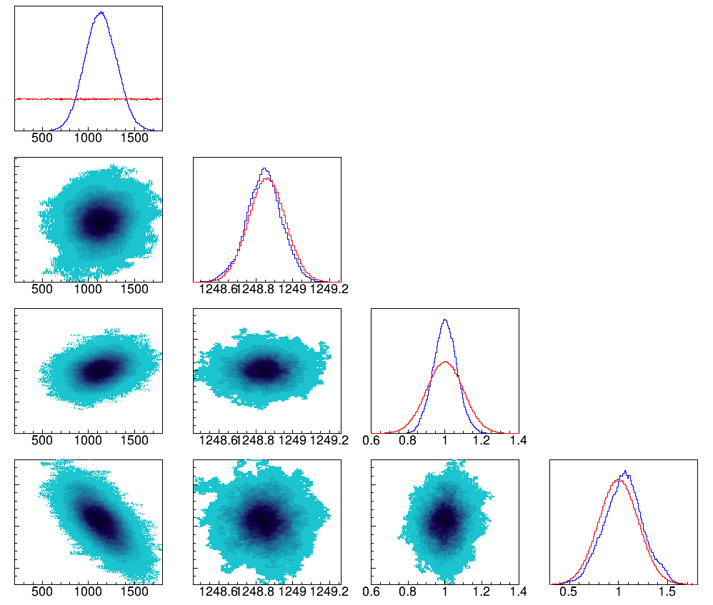
For the choice of the E_{γ} prior, I tried replacing Mike's 1248.40(20) keV with NuDat's 1248.86(10) keV and reran the MCMC analysis. I got a very similar posterior. I think to keep things simple, I'd refer to E_{γ} by their nominal values and cite Mike's paper appropriately.
$${τ=1116}_{−177}^{+183} fs using \text{Mike}\text{′}\text{s}\text{ 1248.40(20) }\text{keV}$$
$${τ=1133}_{−170}^{+173} fs using \text{NuDat}\text{′}\text{s}\text{ 1248.86(10) }\text{keV}$$

Slide 59
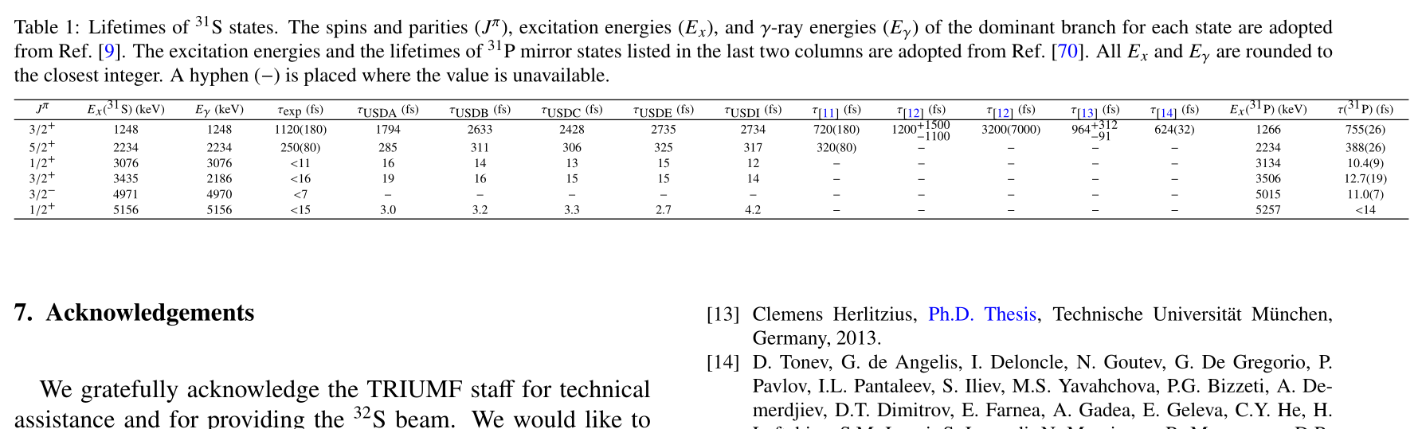
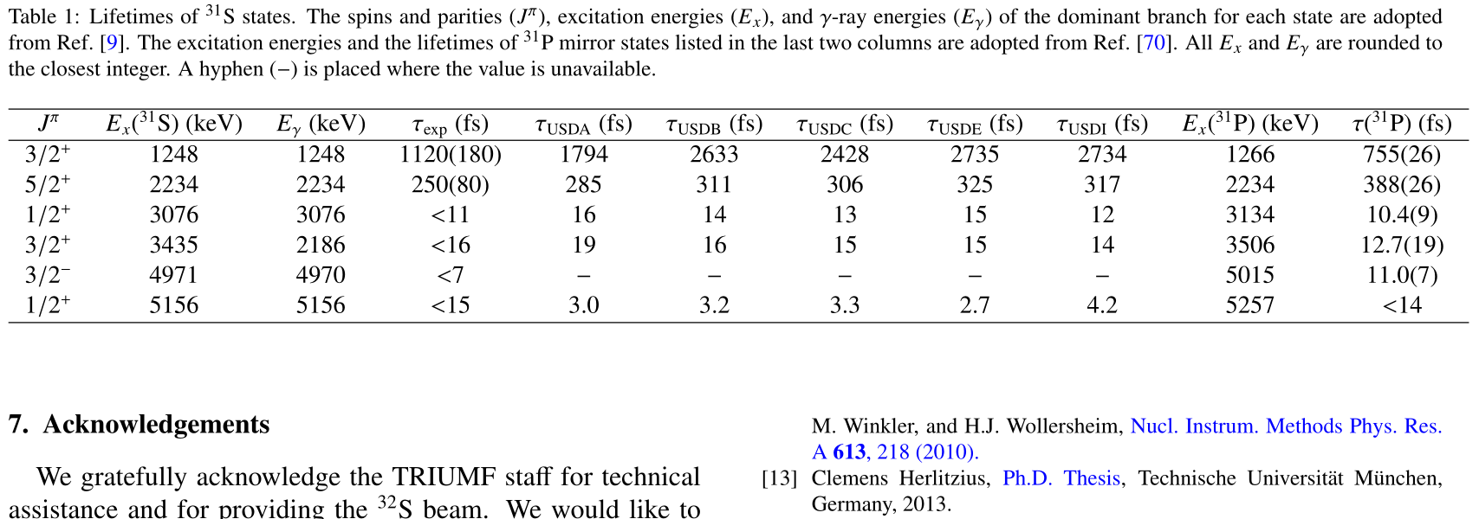
I tried to include all the values in one table, but found that the wide table didn't look nice. As all the literature values are mentioned in the text. I suggest we focus on reporting our results in the table.

Slide 60
Thanks for sending this example. I’ll try to read it in a day or so, so I apologize if my response is easily answered in the paper.
Multiplying independent pdfs is the way to make a joint pdf. However, the question I raised in group meeting is about extracting some measure of the agreement between the individual pdfs. In a chi-squared analysis of four values with error bars against the average value, I can extract a p-value and have some sort of understanding the internal agreement if I were to find that p=0.5 (average overlap of pdf, average amounts of agreement across measurements), p=0.001 (small overlap, large disagreement), and p=0.999 (lots of overlap, suspiciously too much agreement). By multiplying the individual pdfs to form a joint pdf, I could consider the integral of the joint pdf. Qualitatively, I understand that a larger integral indicates a greater overlap and agreement of the individual pdfs than a smaller integral. What I don’t understand is how to generate a quantitative measure of agreeableness, like a p-value, from a joint pdf. Do you know if such a metric makes sense here and what it would be?
I wrote my own code. I use the Metropolis-Hastings algorithm, which is fairly straightforward. The whole of the analysis is simpler in my case than yours as I don’t have to perform any sort of simulations or emulations of simulations.
Best,
Jason

Slide 61
Hi Lijie,
The draft you uploaded to the arXiv is excellent. Nevertheless, as every paper can be improved, I offer a few more suggestions below.
p. 1
abstract: delete “the” before “shell-model calculations
last paragraph of 2nd column: change “femtoseconds" and “picoseconds" to fs and ps, respectively
p. 2
1st paragraph of Section II:
change “ions/cm^2” to “cm^-2”
change "4 MeV/u" to 128 MeV
eliminate “cryogenically” and in the same sentence add “LN_2-cooled” directly in front of “Cu shroud”
last paragraph of 2nd column: eliminate “DSL”
p. 5
Replace the beginning of the sentence at the very top of the 2nd column with the following:
“The prior on the coefficient of the Legendre polynomial P_2(costheta) of the alpha-gamma angular correlation function . . .” The rest of the sentence was fine
In the next sentence, change “longer” to “long” and “when” to “after”

Slide 62
Replace the next sentence with the slight variation:
“Hence, the gamma-ray lineshape is quite insensitive to variations of the angular correlation function.”
last sentence of the 2nd column: replace “through” with “in”
p. 6
Fig. 11 caption: reword the description of A2 as above, “. . . the coefficient of the Legendre polynomial P_2(costheta) of the alpha-gamma angular correlation function, A2.”
last paragraph, 1st sentence: add “-lying” after “lowest”
p. 8
1st column, 3rd sentence: add an “s” at the end of “M1 transition”
2nd column, 1st sentence: change the ending from “do the simulation-to-data comparison” to “compare simulations with data”
2nd to last sentence: change “higher statistics” to “large solid angle” since statistics are not a property of the telescope
Consider eliminating the last sentence.
Excellent work!
Cheers,
Barry

Slide 63
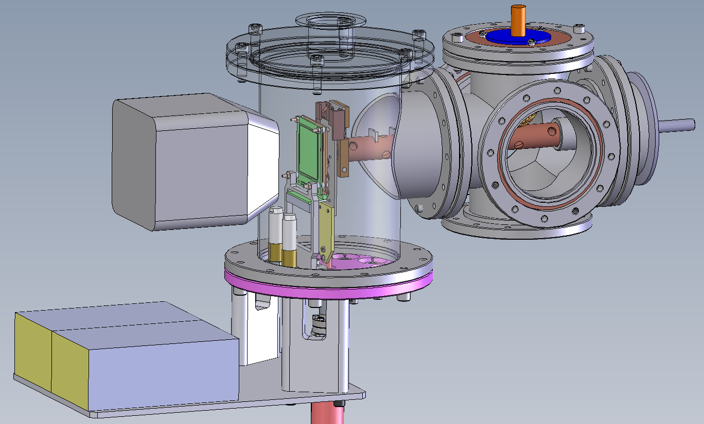
Si detector
telescope
beam
Ge detector
target ladder
preamplifier

Slide 64
We got away with a linear calibration from the 2.point run by run calibration, and this is actually sufficient for the griffin detector we used, including a cross check up at 7 MeV (I can dig up details if you're interested) in addition to the 6.1 from O16.
So, I made a vague comment about a 7 MeV cross check in my comments last night, and curiosity got the better of me this morning, so I worked out what it was that I used for that. There's background from 56Fe(n,g). Where is it coming from and/or why? No idea (and it seems to be a lot of them, somewhere, which maybe should be concerning, but not the point here). But, 57Fe has a low lying state at 14.4 keV, and we see the 7646 keV first resonance to both ground and first excited state with the right proportions with the right spacing. Our linear extrapolation out that far holds to about a keV.
Thanks, Cathleen! It's good to know.
The 57Fe lines may be a more useful test for the 23Mg DSL2 experiment as the γ-ray peak of interest will be at 7.8 MeV.
Are you using two different codes? How does the transition region work? I know the old code had issues for complete stopping, so I'm not surprised a supplement was needed, but I'm concerned about the details.
Yes, I noticed that but didn't figure out which part in Oliver's code caused the problem, so I wrote a new one using Geant4. I compared the new simulation with Oliver's and found the line shapes for short-lived states are consistent. I used the new simulation for the two long-lived states. Also, the new simulation includes the DSL2 setup, which may be useful for DSL2 data analyses, as well.

Slide 65
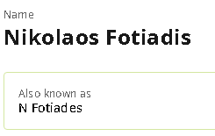
His name in that paper was "Fotiades", so I have no choice.

Slide 66
This is a pretty quick pass at the comments, if there's anything in particular that I need to respond to, let me know. I'll likely be flaky for the next few weeks.
Alpha particle energy gates were set using the extension I wrote to Oliver's simulation, it does the reaction kinematics then propagates the outgoing alpha through the rest of the foil and both silicon detectors.
Realistically, the new ps code was developed because we knew the old one didn't work right. There's probably an argument to be made about the new code being more adaptable. Changing some things in the old code were pretty hacky and required pretty good knowledge of what was going on in all the source code.
1 fs lifetimes were always going to be tricky with DSAM generally, moreso with this setup in particular because of the lack of information on the angular distributions. But even with DSL2, 1 fs is going to be tricky.
For high energy gamma calibration, we have the cross check of 6129 keV from O16, and that's good to about a keV. However, we just do not have the statistics to distinguish the 6390 at a slightly shorter lifetime to 6393 at slightly longer. You would need a very good width determination, and we just don't. The argument will have to come from somewhere else.
Cathleen

Slide 67
Yes, it is run 1 data. I thought I'd left it in the analysis code to create the gamma gated alpha spectra for the second run, but maybe not.
And given we know the kinematics and energy loss, there are two potential problem points I can see someone suggesting, that our gold thickness is wrong or our silicon energy calibration is bad. Here are ways to refute both:
For foil thickness, we can also reproduce energy loss for the 3He inelastic to the first excited state in 32S, so any variation in foil thickness is not at a level that's impactful.
Sure, we calibrated our silicon with a triple alpha source, so we're extrapolating a good bit in energy, but we can reproduce the location on the delta E-E plot of the punch through/incomplete energy deposition for both alphas and protons to better than an MeV, which is all we need here.
Cathleen
Basically 3He inelastic is a very clean channel because fusion evaporation doesn't add background. I did a fit with run 1 data and was within one sigma of the lit value, which is promising validation.
Cathleen

Slide 68
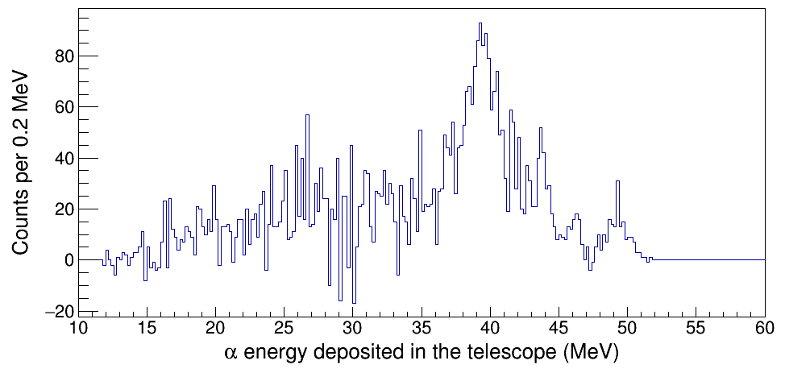
E_{x}(³¹S) = 5-7 MeV
Direct population of
the first excited state

Slide 69
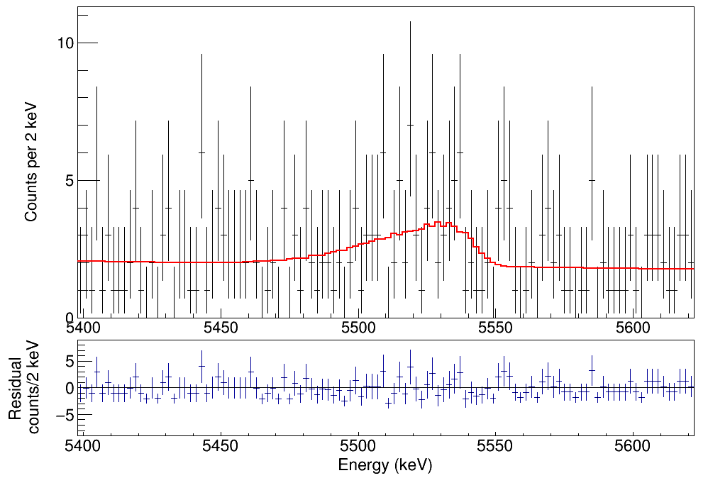
τ = 5 fs
E_{γ} = 5142 keV
N = 33±10

Slide 70
Hi All,
Sorry for the late response, I've been swamped this week.
While I agree with Barry that it's likely just a boilerplate email from Blank, I think we still have a strong case to keep it a Letter to PLB. Maybe I'm not reading in-between the lines enough, but the actual criticism from Reviewer 1 don't seem insurmountable to me. If expand our explanation of DSAM just a tad bit more, that would go a long way to addressing their concern. Yes, that does seem a bit silly considering how widely used DSAM is a technique, but a short paragraph to address their concerns about general introduction & alpha gating could help (either in the letter itself or in a supplemental section, as you suggested Lijie).
I also think shifting / removing some of the figures would help Refview1 see it more as a "letter". I'm also not sure if PLB would count this towards our page number, but we could shift some of the figures / discussion of the figures to an Appendix / Supplemental Materials? For example, if we only report 1 lineshape and 1 of the posterior distribution after the MCMC as a representative, then just report all the results via Table 1 and gesture to the appendix, that would help sharpen the document and make it more of a "Letter". Just my two cents!
I'm happy to wait for Chris to get back from vacation. Good luck writing the response, Lijie!
Cheers,
Nick

Slide 71
The revised letter looks good. Thanks for highlighting the new parts of that and the response letter. I am in agreement with Chris’s comments. Here are my suggestions re: the response.
p.4: Change “less sophisticated” to easier
p. 8: Eliminate the sentence “In short, lineshape analysis . . . “
and, lower down, the phrase “of the confidence interval”
p. 10: add a comma after “new shell-model calculations”
and, lower on the page, replace “determines” with implies
p. 11: Replace the ~ with a - so it says 3-4 MeV
p. 15: The lab in the Netherlands is in the city of Utrecht, not Ufrecht. It’s a lovely city.
Cheers,
Barry

Slide 72
Hi Lijie,
The astrophysical impact of adjusting the lower limit on the resonance strength would be limited. In terms of the presolar grains, we currently overpredict the amount of 30Si we should expect in ONe nova ejecta quite substantially if the candidate SiC grains originate in novae. This change to the lifetime would only shrink the upper limit on the 30Si/28Si ratio.
With regards to the thermometer stuff, we are currently in agreement with S/Al and O/S observations for the V838 Herculis nova, but it looks like simulations overpredict the observed range of possible N/O and N/Al ratios for V838 Her. I doubt any changes to the 30(p,gamma)31S reaction rate would have any real effect on the abundance of oxygen, nitrogen, or aluminum in nova ejecta, but a reduced uncertainty on the lower limit of the resonance strength might bring us out of 1-sigma agreement with the observed S/Al ratio for V838 Her. This is the only obvious astrophysical impact (albeit still limited) that I can think of at the moment without diving into all of Jordi’s predicted abundances or doing more simulations.
Still, I think your analysis methods are worth publication, and experimental constraints/verification of theoretical shell model predictions are still a valuable contribution to the literature. Not sure I can advise you on how to proceed other than these comments.
Good luck,
Tamas

Slide 73
The plot you made with the decay constants is nice because it demonstrates that the upper limit on the lifetime, hence the lower limit on the resonance strength, yields an upper limit on the temperature at which the decay constants cross. I think this crossing point affects all of the interesting nova observables that are normally associated with the 30P(p,gamma)31S reaction. Therefore, it might be worth showing this figure in the paper to demonstrate the astrophysical impact, although I know we are short on space.
By the way, I also worry a little bit about your statement in the response, “We confirm that the net abundance flow always prefers to follow the 30P(p,gamma)31S path instead of the competing 30P(beta+)30Si over most of the peak ONe nova temperature range”. On the surface, it makes it sound like there will be no 30Si excesses, but this contradicts the conclusions of Tamas’ paper (that there will always be 30Si excesses for any peak nova temp), which were derived using a full nova simulation. I think this is because the conditions of a realistic nova simulation are dynamic, unlike the graph. So I think it may be better to simply state qualitatively that the value of the crossing point affects the observables as long as the limit on the lifetime is strong enough to place the crossing point below 0.4 GK.
Chris

Slide 74
6390-keV 3/2⁺ ³¹S state | GADGET I + Theory | DSL1 | 10×DSL1 | DSL2
γ-decay width | $${210<Γ}_{γ}<770 meV$$
Lifetime | $$0.9<τ<3.1 fs$$ | $$τ<20 fs$$ | $$τ<7.2 fs$$ | $$τ<1.8 fs$$
Resonance strength | $$32<ωγ<128 μeV$$ | $$ωγ>5.5 μeV$$ | $$ωγ>15 μeV$$ | $$ωγ>61 μeV$$

Slide 75
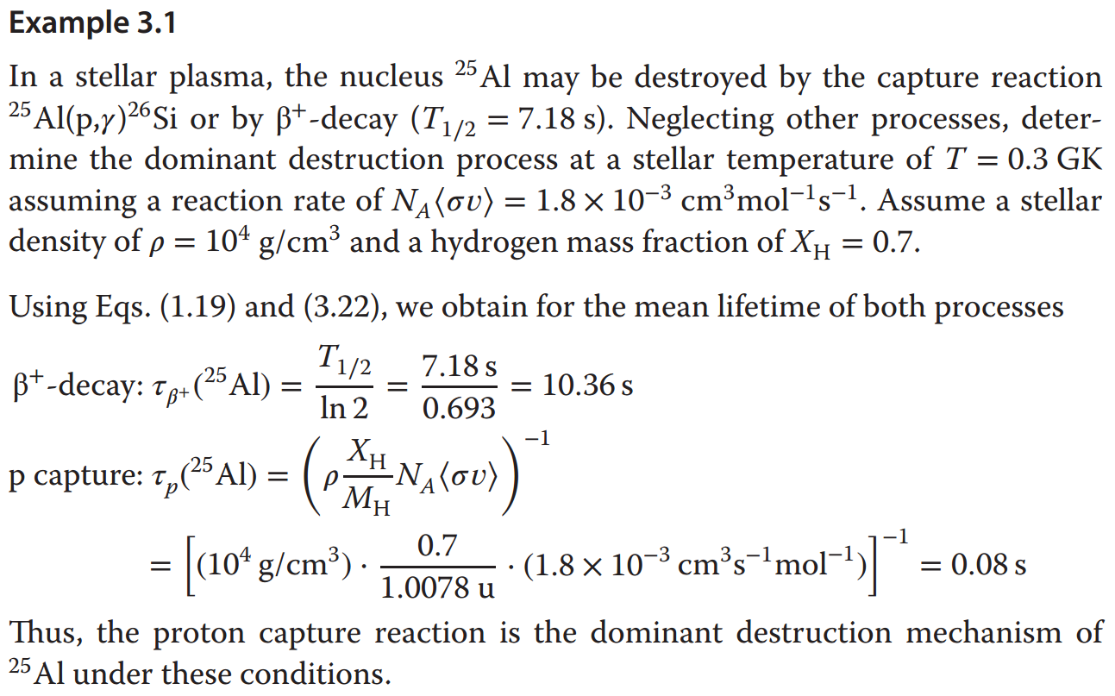

Slide 76
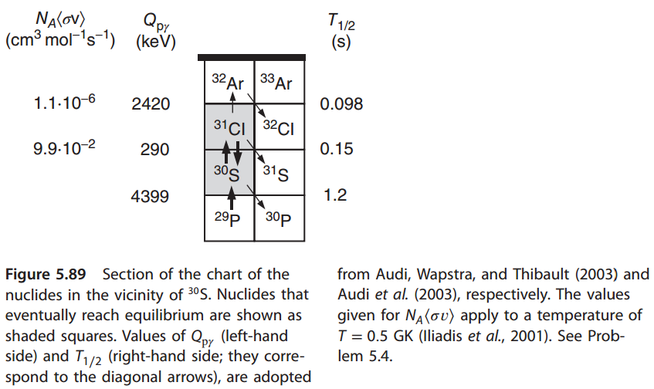

Slide 77
Hi Chris,
I've revised the manuscript and response based on your comments (see below).
I've also included Barry's feedback. Thanks, Barry, for correcting the language in my response.
The latest changes are highlighted with a yellow shading background. Corrections to minor language issues are omitted.
Thanks, and have a nice weekend!
I read the response and summary. Again, I think they are well written and very thorough. Here are my comments:
I would keep the font size of the referee comments the same as ours. We don't want to give the impression that we are minimizing them. And making the font size smaller doesn't make the response shorter, it just reduces the number of pages and makes it more difficult to read.
The comments and responses are both size 11pt now.
I still think the response is extremely long: the longest I can recall seeing as an author or referee. I am OK with that because you have laid out your case very thoroughly and clearly, but I worry that the referee can argue that the need for such a long response is more evidence that this should be a longer paper.
It seems a lot of the stuff in the response are just trying to convince the referees and are not "worth" being included in the paper. I tried removing the list of authors, abstract, references, three figures, etc., and the resultant length would be six pages exactly.
You address the referees directly as "you," which might come across as more confrontational than writing to the editors about what the referees wrote. I usually do the latter, but it is a matter of personal preference.
The referee asked questions in a tone like "did you fix the lifetime to 1 fs for the figure?" I thought we should reply directly. Anyway, I've rephrased the responses in the third person.

Slide 78
For the impact of the upper limit, you might try plotting the decay constant for 30P beta decay to the decay constant for 30P(p,g)31S in a nova environment as a function of temperature (using your lower limit on the resonance strength) as a function of temperature. Your limit will rule out a massive region of parameter space in that plot. It should be possible to demonstrate that the reaction is always faster than the decay above some temperature. If that temperature is below the maximum nova temperature of 0.4 GK then you have a concrete scientific result: that 30P does not all end up decaying to 30Si in the hottest novae, and that there is substantial nucleosynthesis flow to higher masses. Even if it is above 0.4 GK we might be able to argue that we are tantalizingly close.
Good point. I've added a figure to the response. Following the exercises in Iliadis's book, I got a figure like this. Please let me know if I misunderstood anything

Slide 79
I think Table 3 would be more meaningful if you included the reaction/decay channels for each observation.
Done.
I think most of your response to Referee #2's comment about the 4156-keV gamma ray is repeating things the referee already knows. When I was reading it, the first part seemed like you were trying to dodge the question by producing a smokescreen of redundant information. However, when you got to "From a theoretical perspective…" I thought you provided a new, simple, and relevant argument that may be the best way we can satisfy the referee. Do we lose anything if we delete the part before that?
You're right. I should be more specific to the referee's question. Their major concern is "could the 4156-keV transition observed here not simply be a previously unreported branch from the previously-identified state?"
I need to explain that there is no evidence that the 6392- and 6394-keV states would contribute γ-ray transitions around that energy.
It's relatively easy to justify why we ruled out the 6394-keV states. For the 6392-keV state, the referee pointed out that Doherty's observation might not be convincing enough, so I provide two more pieces of evidence: Kankainen's observation and our shell-model calculation. I'm unsure if the referee knows about all the related work besides Doherty's.
I feel it's worthwhile to provide an informative response and show a full picture to the referees. I also feel that spending 15 pages responding to Referee 1 but only 4 pages to Referee 2 seems a bit unfair.

Slide 80
Thanks. I’m OK with it except one remaining issue.
The plot you made with the decay constants is nice because it demonstrates that the upper limit on the lifetime, hence the lower limit on the resonance strength, yields an upper limit on the temperature at which the decay constants cross. I think this crossing point affects all of the interesting nova observables that are normally associated with the 30P(p,gamma)31S reaction. Therefore, it might be worth showing this figure in the paper to demonstrate the astrophysical impact, although I know we are short on space.
By the way, I also worry a little bit about your statement in the response, “We confirm that the net abundance flow always prefers to follow the 30P(p,gamma)31S path instead of the competing 30P(beta+)30Si over most of the peak ONe nova temperature range”. On the surface, it makes it sound like there will be no 30Si excesses, but this contradicts the conclusions of Tamas’ paper (that there will always be 30Si excesses for any peak nova temp), which were derived using a full nova simulation. I think this is because the conditions of a realistic nova simulation are dynamic, unlike the graph. So I think it may be better to simply state qualitatively that the value of the crossing point affects the observables as long as the limit on the lifetime is strong enough to place the crossing point below 0.4 GK.
Best,
Chris

Slide 81
Hi Chris,
Thanks for pointing it out! I agree that a qualitative statement is more appropriate. I’ve revised that part of the response (see attached).
The realistic temperature and density change dramatically with time, but the density and hydrogen mass fraction I previously chose seem too high. I’ve recalculated the decay constants based on the representative values reported on pages 476-479 of Iliadis’ book. The crossing point changed accordingly, a lot, actually.
Also, it should be noted that the 20-fs limit does not have rigorous statistical meaning. The long tail of the posterior distribution prevents us from extracting a finite limit. The 20 fs does not correspond to a 90% confidence interval or any confidence interval. I feel more comfortable talking about the astrophysical impact of a loosely defined “limit” in the response instead of in the paper, but I could be persuaded otherwise.
By the way, should we circulate the response to the whole Collaboration/authorlist at some point?
Thanks!

Slide 82
Hi Lijie,
I think in the reply to reviewer #1, you missed the mark in the response ending in “The ability to set a finite value around 1 fs would be highly valuable.”
The reviewer asked “Are the upper limits entirely limited by the statistics, or is it just very difficult to obtain 1 fs lifetimes with the method?” In the method-limited option, it’s not clear to me what part of the method the reviewer is asking about, whether it’s the DSAM facility or the Bayesian framework used in the analysis. I think it is the Bayesian analysis method that the reviewer is challenging here as, earlier, the reviewer said the impact of the Bayesian method is not clear. I imagine the reviewer saying “It’s great that Galinski and Frentz can do ~1 fs, but they didn’t use your fancy new Bayesian analysis. Do the readers of PLB need to read about a Bayesian lineshape method when Galinski and Frentz can do it without a Bayesian method and it is not clear to me that this new Bayesian method can reach 1 fs lifetimes?”
Is there a way to show that your current analysis can do finite 1 fs measurements, if given sufficient statistics?
Otherwise, I think it’s a good paper on a really neat technique.
Jason

Slide 83
Hi Jason,
That’s a good question. The typical slowing down time of the nuclei recoiling from a nuclear reaction is a few hundred femtoseconds in solid materials. 1 fs is gonna be tricky. I believe neither of the referees is familiar with Bayesian methods. I feel they questioned the lifetime limitation caused by the DSAM.
1) I don’t think the Bayesian method itself would introduce additional uncertainties/limits. Compared with Frequentist methods, Bayesian methods should quantify the uncertainty more accurately, and that’s one of the reasons why it is becoming increasingly popular. You are a Bayesian expert; I’m curious why you chose Bayesian?
2) Galinski achieved 1.8 fs (68% CL) using DSAM. She did use Bayesian analysis in a 2-dimensional parameter space but still combined different upper limits in quadrature. Chris said it doesn’t make sense. Frentz even achieved 0.6 fs using DSAM. Barry said, I quote, “Do you really believe that?”
I’m in no position to criticize their uncertainty analyses. They obtained much higher statistics and demonstrated DSAM is able to reach 1 fs, which would indeed be highly valuable.
In DSL1, we collected 50 counts in the 4156-keV peak (the astrophysically key resonance). DSL2 will probably give us an order of magnitude higher statistics. What if I fabricate a peak with 500 counts at that energy? I got a posterior distribution like this. I assume we can also do better if given more statistics.
3) Can we achieve 1 fs if given sufficient statistics? The simulated peak shapes with high statistics assuming 1 fs or 2 fs or 3 fs look the same to me. If they fit the measured peak equally well (similar χ²), how would Bayesian tell the difference? I assume there is a sensitivity limitation, but it’s not caused by the Bayesian method itself.
Thanks so much for your feedback!

Slide 84
Hi Lijie,
I read through the response again. Just two suggestions:
When you talk about the nova observables associated with the crossing point, you could list the interesting scientific aspects instead. The main things are nuclear thermometers, identification of pre-solar nova grains, and nuclear mixing meters. The first and third ones depend on elemental abundance ratios (observables) while the second one depends on isotopic abundance ratios (observables).
I've listed the three interesting scientific aspects associated with the crossing point (page 10).
I think you don’t need to address the 11/2+ state for Referee #2. That referee explicitly states that it is clear that the 11/2+ state is ruled out. Since the response is generally very long, I think we should take every opportunity to remove information that is not needed to address the referees’ questions and comments.
I've deleted the paragraph "Why we rule out the 6394-keV state".
Hope that helps.
Best,
Chris

