Slide 1
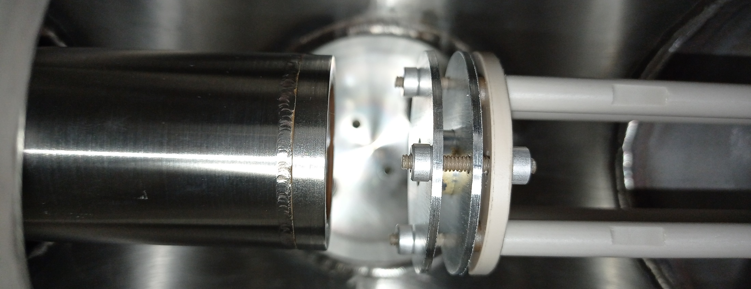
23 mm
55Fe Source-Window distance: 23 mm Air Run time: 14987 s
152Eu Source-Window distance: 132 mm Air Run time: 17286 s
241Am Source-Window distance: 130 mm Air Run time: 7990 s
Notes:
"F:/e21010/pxct/LEGe_55Fe_Ch13_Timing_Tau50us_BLcut500us.root"

Slide 2
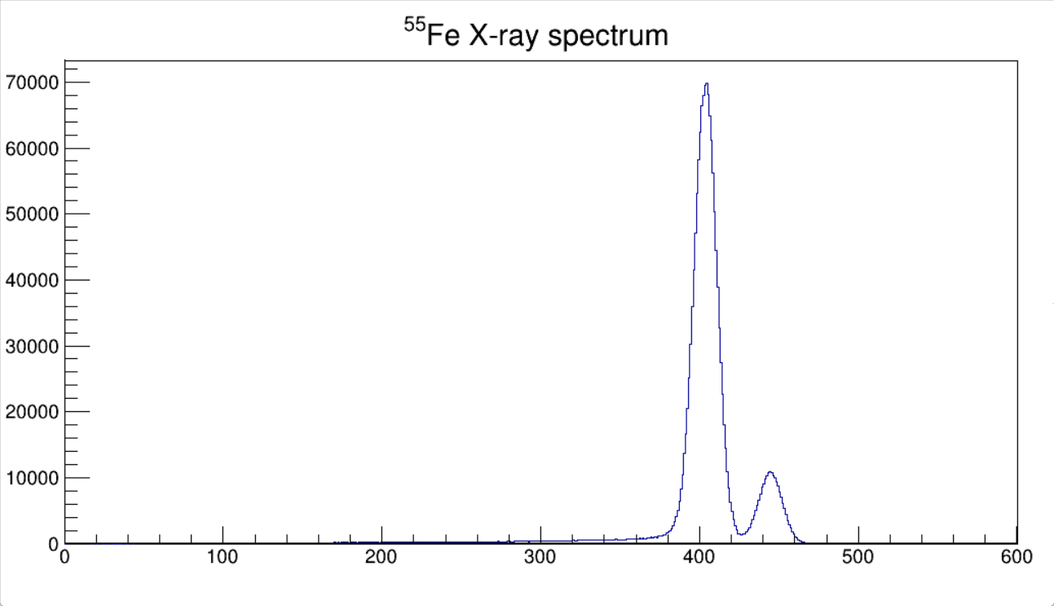
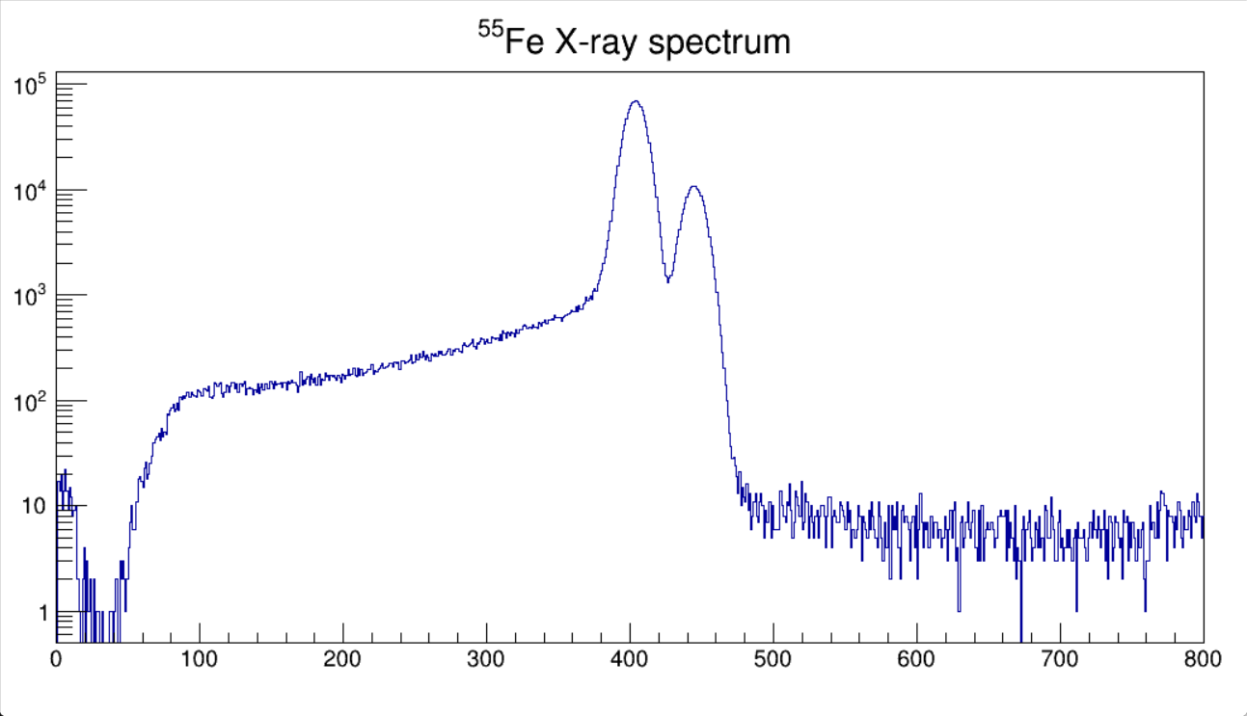
5.895 keV
⁵⁵Mn K_{α}
6.491 keV
⁵⁵Mn K_{β}

Slide 3
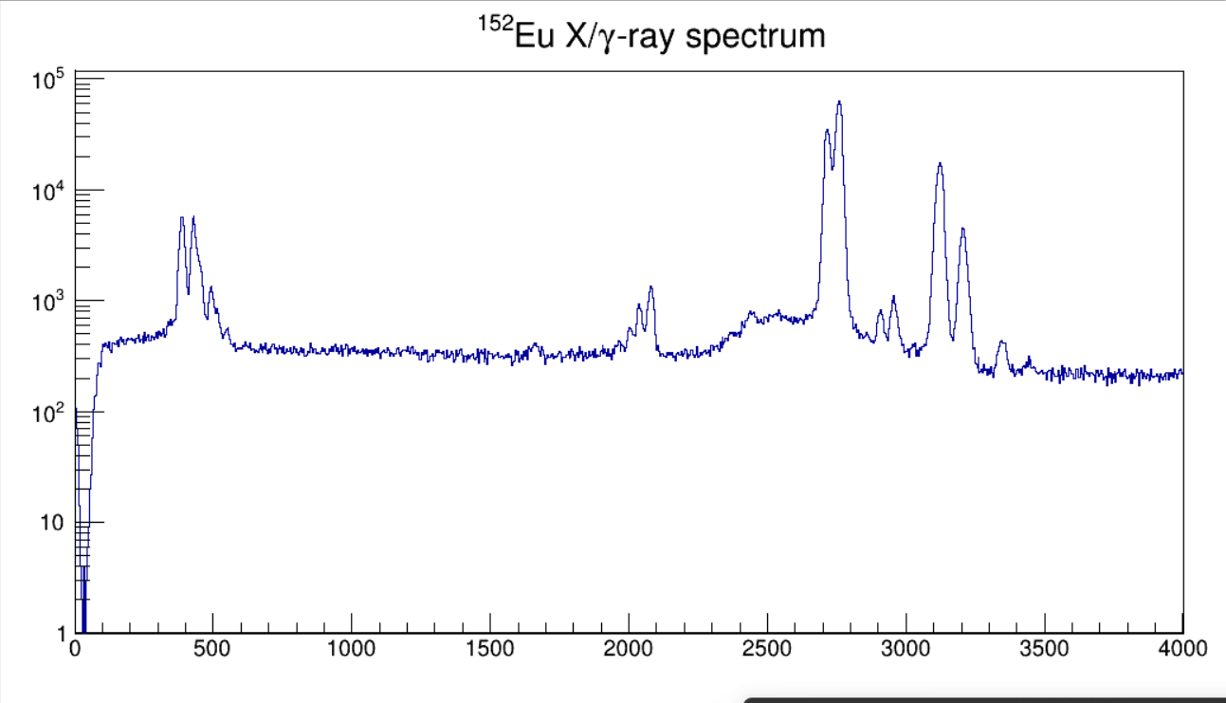

Slide 4
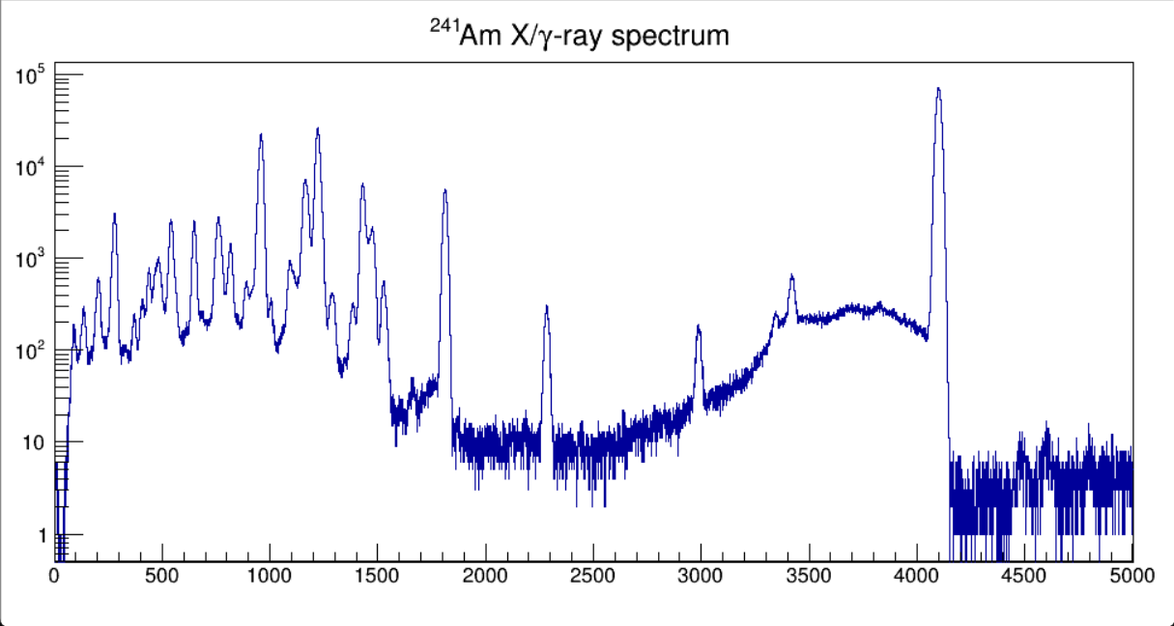
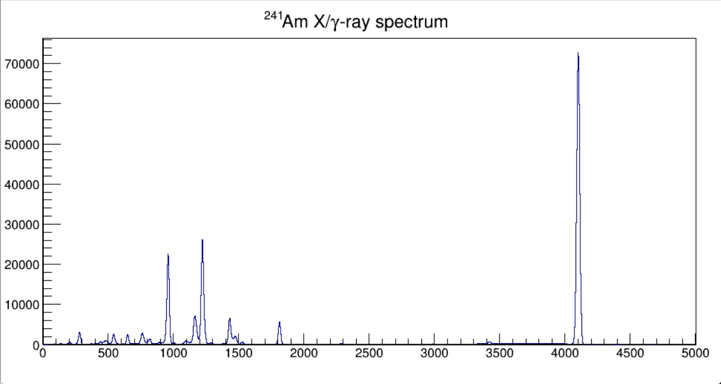

Slide 5
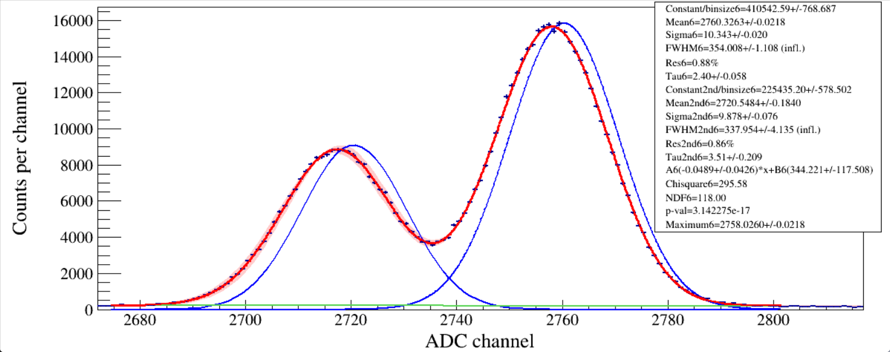
¹⁵²Eu EC→¹⁵²Sm
39.522 keV Sm K_{α2} X ray
40.118 keV Sm K_{α1} X ray
Notes:
peakfit_gausnerfcpol1_band_doublepeak_pxct.C
#include <iostream>
#include <fstream>
//#include <iomanip.h>
#include <math.h>
#include <time.h>
#include <map>
#include <TROOT.h>
#include <TSystem.h>#include <TCutG.h>
#include "TChain.h"
#include "TStyle.h"
#include "TLine.h"
#include "TCanvas.h"
#include "TEllipse.h"
#include "TString.h"
#include "TGraph.h"
#include "TGraphErrors.h"
#include "TSpectrum.h"
#include "TVirtualFitter.h"
#include "TFitResult.h"
#include "TFitResultPtr.h"
#include "TMatrixDSymfwd.h"
#include "TRandom.h"
#include "TFile.h"
#include "TTree.h"
#include "TH1.h"
#include "TH1D.h"
#include "TH2.h"
#include "TF1.h"
#include "TMath.h"
#include "TPaveText.h"
#include "TPad.h"
#include "TAxis.h"
#include "TClass.h"
#include "TMatrixD.h"
#include "TVectorD.h"
#include "string.h"
#include "stdlib.h"
#include "stdio.h"
#include "TLegend.h"
using namespace std;
void peakfit_gausnerfcpol1_band_doublepeak_pxct() // get histogram and EMG fit two peaks
{
const int ID1 = 0;// i=ID1//which detector
const int ID2 = 0;// i<=ID2// modify which detector
double binwidth = 1;
int minrange = 0, maxrange = 0, minbin, maxbin;
float Eg, Eg2nd, gaplow = 70., gaphigh = 70.;//fitting range随分辨不同调整
int i, ii, jj, ibin;
char paraprint[100], histo_name[200], hfit_name[200];
TH1F* histo[ID2 + 1];//TH1F peak search+gauss fit, create histograms
const int peaknum = 7;//search peak numbers, modify
TF1* fEMG[peaknum];//create function
TF1* p[peaknum], * g[peaknum], * b[peaknum], * g2[peaknum];
Double_t peakx[peaknum], peakxerr[peaknum];
Double_t peaky[peaknum], peakyerr[peaknum];
Double_t sig[peaknum], sig_err[peaknum];
Double_t tau[peaknum], tau_err[peaknum];
Double_t mean[peaknum], mean_err[peaknum];
Double_t FWHM[peaknum], FWHM_err[peaknum];
Double_t FWHM2nd[peaknum], FWHM2nd_err[peaknum];
double inflation_factor = 1.0;
TH1D* h_confidence_interval[ID2 + 1][peaknum];
TCanvas* canvaspeak[ID2 + 1][peaknum];
char pathname[150];
char filename[150];
sprintf(pathname, "%s", "F:/e21010/pxct/");
sprintf(filename, "%s%s", pathname, "lower_bounds.dat");
ifstream infilelowerbounds(filename, ios::in);
sprintf(filename, "%s%s", pathname, "upper_bounds.dat");
ifstream infileupperbounds(filename, ios::in);
double par[peaknum][10], par_err[peaknum][10];
double parChi[peaknum], parNDF[peaknum], p_value[peaknum];
int lower_bound[ID2 + 1][peaknum], upper_bound[ID2 + 1][peaknum];
for (i = ID1; i <= ID2; i++)//which detector no need to modify
{
for (ii = 0; ii < peaknum; ii++)//which peak
{
infilelowerbounds >> lower_bound[i][ii];
infileupperbounds >> upper_bound[i][ii];
}
}
for (i = ID1; i <= ID2; i++)//which detector no need to modify
{
for (ii = 0; ii < peaknum; ii++)//which peak
{
cout << lower_bound[i][ii] << " ";
cout << upper_bound[i][ii] << " ";
}
cout << endl;
}
sprintf(filename, "%s%s", pathname, "peakpara.dat");
ofstream outfile(filename, ios::out);
sprintf(filename, "%s%s", pathname, "LEGe_152Eu_Ch13_Timing_Tau50us_BLcut500us.root");
TFile* fin = new TFile(filename);//after this statement, you can use any ROOT command1 for this rootfile
cout << filename << endl;
for (i = ID1; i <= ID2; i++)//which detector no need to modify
{
sprintf(histo_name, "%s", "EHist_copy");
histo[i] = (TH1F*)fin->Get(histo_name); //Get spectrum
histo[i]->Rebin(1);
histo[i]->Sumw2(kFALSE);
histo[i]->SetBinErrorOption(TH1::kPoisson);
}
for (i = ID1; i <= ID2; i++) // no need to modify
{
for (ii = 6; ii <= 6; ii++)// modify which peak in one detector =0<=13
{
sprintf(hfit_name, "%s%d%s%d", "EHist_copy", i, "_peak", ii);
canvaspeak[i][ii] = new TCanvas(hfit_name, hfit_name, 1200, 500);//建立画布
canvaspeak[i][ii]->cd();//进入画布
canvaspeak[i][ii]->SetTopMargin(0.02);
canvaspeak[i][ii]->SetRightMargin(0.03);
canvaspeak[i][ii]->SetLeftMargin(0.11);
canvaspeak[i][ii]->SetBottomMargin(0.12);
histo[i]->SetTitle(hfit_name);//图名
histo[i]->GetXaxis()->SetTitle("ADC channel");//轴名
histo[i]->GetYaxis()->SetTitle("Counts per channel");//轴名
histo[i]->GetXaxis()->CenterTitle();//居中
histo[i]->GetYaxis()->CenterTitle();//居中
histo[i]->GetXaxis()->SetLabelFont(132);//坐标字体
histo[i]->GetYaxis()->SetLabelFont(132);//坐标字体
histo[i]->GetXaxis()->SetLabelSize(0.05);
histo[i]->GetYaxis()->SetLabelSize(0.05);
histo[i]->GetXaxis()->SetTitleFont(132);//轴名字体
histo[i]->GetYaxis()->SetTitleFont(132);//轴名字体
histo[i]->GetXaxis()->SetTitleOffset(0.9);//轴名偏移
histo[i]->GetYaxis()->SetTitleOffset(0.9);//轴名偏移
histo[i]->GetXaxis()->SetTitleSize(0.06);
histo[i]->GetYaxis()->SetTitleSize(0.06);
histo[i]->SetLineWidth(2);
histo[i]->Draw("e");
peaky[ii] = 0; peakx[ii] = 0; sig[ii] = 0; tau[ii] = 0; mean[ii] = 0; FWHM[ii] = 0; FWHM2nd[ii] = 0;
histo[i]->GetXaxis()->SetRangeUser(lower_bound[i][ii], upper_bound[i][ii]);
peaky[ii] = histo[i]->GetMaximum();
peakx[ii] = histo[i]->GetBinCenter(histo[i]->GetMaximumBin());
cout << peakx[ii] << " " << peaky[ii] << endl;
if (ii == 0) { gaplow = 32; gaphigh = 24; Eg = 5895; }//55Fe 5.9
if (ii == 1) { gaplow = 18; gaphigh = 24; Eg = 6490; }//55Fe 6.5
if (ii == 2) { gaplow = 75; gaphigh = 79; Eg = 121782; }//152Eu 122
if (ii == 3) { gaplow = 44; gaphigh = 44; Eg = 45372; }//152Eu 45.4
if (ii == 4) { gaplow = 50; gaphigh = 50; Eg = 59541; }//241Am 59.5
if (ii == 5) { gaplow = 42; gaphigh = 42; Eg = 26345; }//241Am 26.3
if (ii == 6) { gaplow = 85; gaphigh = 42; Eg = 40118; Eg2nd = 39522; }//152Eu 40.1 and 39.5
// if (ii == 4) { gaplow = 30; gaphigh = 30; }//152Eu 344
// if (ii == 5) { gaplow = 20; gaphigh = 19; }//152Eu 779
// if (ii == 6) { gaplow = 30; gaphigh = 28; }//152Eu 964
// if (ii == 7) { gaplow = 32; gaphigh = 30; }//152Eu 1408
// if (ii == 8) { gaplow = 15; gaphigh = 14; }//241Am 59.5
// if (ii == 9) { gaplow = 18; gaphigh = 17; }//226Ra 609
// if (ii == 10) { gaplow = 32; gaphigh = 30; }//226Ra 1120
// if (ii == 11) { gaplow = 28; gaphigh = 32; }//226Ra 1764
// if (ii == 12) { gaplow = 48; gaphigh = 46; }//226Ra 2204
// if (ii == 13) { gaplow = 52; gaphigh = 48; }//226Ra 2448
histo[i]->GetXaxis()->SetRangeUser(peakx[ii] - gaplow, peakx[ii] + gaphigh);//zoom the axis
//cout<<"************"<<peakx[ii]<<" "<<peaky[ii]<<endl;
minrange = peakx[ii] - gaplow;
maxrange = peakx[ii] + gaphigh;
minbin = histo[i]->FindBin(minrange);
maxbin = histo[i]->FindBin(maxrange);
ibin = minbin;
while (histo[i]->GetBinContent(ibin) < (peaky[ii] / 2)) { ibin++; if (ibin >= maxbin)break; }
double sigmaguess = 2 * (peakx[ii] - histo[i]->GetBinCenter(ibin)) / 2.355;
float highcounts = 0, lowcounts = 0;
for (jj = 0; jj < 10; jj++)
{
highcounts += histo[i]->GetBinContent(maxbin - jj);
lowcounts += histo[i]->GetBinContent(minbin + jj);
}
highcounts = highcounts / 10; lowcounts = lowcounts / 10;
double aguess = (highcounts - lowcounts) / (maxrange - minrange);
double bguess = lowcounts - minrange * aguess;
cout << aguess << " " << bguess << " " << sigmaguess << " " << peakx[ii] << " " << peaky[ii] << endl;
fEMG[ii] = new TF1("fEMG", "[0]*x+[1]+[2]/2/[3]*exp(0.5*([4]*[4]/([3]*[3]))+(x-[5])/[3])*ROOT::Math::erfc(1/sqrt(2)*([4]/[3]+(x-[5])/[4]))+[6]/2/[7]*exp(0.5*([8]*[8]/([7]*[7]))+(x-[9])/[7])*ROOT::Math::erfc(1/sqrt(2)*([8]/[7]+(x-[9])/[8]))", peakx[ii] - gaplow, peakx[ii] + gaphigh);// Sun PRC2021 low-energy tail
g[ii] = new TF1("g", "gausn", peakx[ii] - gaplow, peakx[ii] + gaphigh);// The [2]-N parameter in total is equivalent to the Constant in gausn
g2[ii] = new TF1("g2", "gausn", peakx[ii] - gaplow, peakx[ii] + gaphigh);// The [2]-N parameter in total is equivalent to the Constant in gausn
p[ii]=new TF1("p","[0]*x+[1]-[0]*x-[1]+[2]/2/[3]*exp(0.5*([4]*[4]/([3]*[3]))+(x-[5])/[3])*ROOT::Math::erfc(1/sqrt(2)*([4]/[3]+(x-[5])/[4]))",peakx[ii]-gaplow,peakx[ii]+gaphigh);//pure peak
//p2[ii] = new TF1("p2", "[0]*exp(-0.5*((x-[1])/[2])^2) / (sqrt(2*3.141592654)*[2])", peakx[ii] - gaplow, peakx[ii] + gaphigh);//pure peak2
b[ii] = new TF1("b", "[0]*x+[1]", peakx[ii] - gaplow, peakx[ii] + gaphigh);//pure bkg
// fEMG[ii]=new TF1("total","[0]*x+[1]+sqrt(3.141592654/2)*[2]/[3]*[4]*exp(0.5*([4]*[4]/([3]*[3]))+(x-[5])/[3])*ROOT::Math::erfc(1/sqrt(2)*([4]/[3]+(x-[5])/[4]))",peakx[ii]-gaplow,peakx[ii]+gaphigh);// Glassman PRC2019 low-energy tail
// g[ii]=new TF1("g","gausn",peakx[ii]-gaplow,peakx[ii]+gaphigh);// The [2]-N parameter in total is equivalent to the Constant in gausn
// p[ii]=new TF1("p","[0]*x+[1]-[0]*x-[1]+sqrt(3.141592654/2)*[2]/[3]*[4]*exp(0.5*([4]*[4]/([3]*[3]))+(x-[5])/[3])*ROOT::Math::erfc(1/sqrt(2)*([4]/[3]+(x-[5])/[4]))",peakx[ii]-gaplow,peakx[ii]+gaphigh);//pure peak
// b[ii]=new TF1("b","[0]*x+[1]",peakx[ii]-gaplow,peakx[ii]+gaphigh);//pure bkg
fEMG[ii]->SetNpx((gaphigh + gaplow) * 10);
g[ii]->SetNpx((gaphigh + gaplow) * 10);
p[ii]->SetNpx((gaphigh+gaplow)*10);
// p2[ii]->SetNpx((gaphigh + gaplow) * 10);
b[ii]->SetNpx((gaphigh + gaplow) * 10);
//fEMG[ii]->SetParameters(0.1,15,peaky[ii],10,10,peakx[ii]);//initial value [0]-A, [1]-B, [2]-N, [3]-τ, [4]-σ, [5]-μ
fEMG[ii]->SetParameters(aguess, bguess, peaky[ii], 0.5, sigmaguess, peakx[ii], peaky[ii], 0.5, sigmaguess, peakx[ii] - gaplow/2);//initial value [0]-A, [1]-B, [2]-N, [3]-τ, [4]-σ, [5]-μ, [6]-N2, [7]-τ2, [8]-σ2, [9]-μ2
// fEMG[ii]->SetParLimits(0,-500,500);//Bkg A
// fEMG[ii]->SetParLimits(1,-50000,300000);//Bkg B
fEMG[ii]->SetParLimits(2, 200000, 600000);//Constant,min,max
fEMG[ii]->SetParLimits(3, 2.4, 5);//Tau
fEMG[ii]->SetParLimits(4, 1, 13);//Sigma
fEMG[ii]->SetParLimits(5, peakx[ii] - gaplow/3, peakx[ii] + gaphigh);//Mean
fEMG[ii]->SetParLimits(5, 2755, 2763);//Mean
fEMG[ii]->SetParLimits(6, 100000, 300000);//Constant_2nd,min,max
fEMG[ii]->SetParLimits(7, 0.5, 5);//Tau_2nd
fEMG[ii]->SetParLimits(8, 1, 13);//Sigma_2nd
fEMG[ii]->SetParLimits(9, peakx[ii] - gaplow, peakx[ii]);//Mean_2nd
fEMG[ii]->SetParLimits(9, 2718, 2723);//Mean_2nd
fEMG[ii]->SetParNames("BkgA", "BkgB", "Const*bin", "Tau", "Sigma", "Mean", "Const_2nd*bin", "Tau_2nd", "Sigma_2nd", "Mean_2nd");
TFitResultPtr Fit_result_pointer = histo[i]->Fit("fEMG", "MLES", "", peakx[ii] - gaplow, peakx[ii] + gaphigh);
//"S" means the result of the fit is returned in the TFitResultPtr
//“E” Perform better errors estimation using the Minos technique.
//“M” Improve fit results, by using the IMPROVE algorithm of TMinuit.
//If the option "S" is instead used, TFitResultPtr contains the TFitResult and behaves as a smart pointer to it.
//The fit parameters, error and chi2 (but not covariance matrix) can be retrieved also from the fitted function.
fEMG[ii]->GetParameters(par[ii]);//二维数组的par[ii]是地址,pointer to the TF1, GetParameters的数组得是double类型Obtaining the value of parameters and saving them to par[];
par_err[ii][0] = fEMG[ii]->GetParError(0);//Obtaining the error of the 1st parameter
par_err[ii][1] = fEMG[ii]->GetParError(1);//Obtaining the error of the 2nd parameter
par_err[ii][2] = fEMG[ii]->GetParError(2);//Obtaining the error of the 3rd parameter
par_err[ii][3] = fEMG[ii]->GetParError(3);//Obtaining the error of the 4th parameter
par_err[ii][4] = fEMG[ii]->GetParError(4);//Obtaining the error of the 5th parameter
par_err[ii][5] = fEMG[ii]->GetParError(5);//Obtaining the error of the 6th parameter
par_err[ii][6] = fEMG[ii]->GetParError(6);//Obtaining the error of the 7th parameter
par_err[ii][7] = fEMG[ii]->GetParError(7);//Obtaining the error of the 8th parameter
par_err[ii][8] = fEMG[ii]->GetParError(8);//Obtaining the error of the 9th parameter
par_err[ii][9] = fEMG[ii]->GetParError(9);//Obtaining the error of the 10th parameter
parChi[ii] = fEMG[ii]->GetChisquare();
parNDF[ii] = fEMG[ii]->GetNDF();
p_value[ii] = fEMG[ii]->GetProb();//This probability is not the “probability that your fit is good.” If you did many fake experiments (draw many random samples of data points from the assumed distribution (your fit function)), this is the percentage of experiments that would give χ2 values ≥ to the one you got in this experiment.
g[ii]->SetParameters(par[ii][2], par[ii][5], par[ii][4]);//set parameters for drawing gausn
g[ii]->SetLineColor(4);
g2[ii]->SetParameters(par[ii][6], par[ii][9], par[ii][8]);//set parameters for drawing gausn
g2[ii]->SetLineColor(4);
p[ii]->SetParameters(par[ii][0],par[ii][1],par[ii][2],par[ii][3],par[ii][4],par[ii][5]);//set parameters for drawing peak
p[ii]->SetLineColor(6);
// p2[ii]->SetParameters(par[ii][6], par[ii][7], par[ii][8]);//set parameters for drawing peak
// p2[ii]->SetLineColor(4);
b[ii]->SetParameters(par[ii][0], par[ii][1]);//set parameters for drawing bkg
b[ii]->SetLineColor(8);
fEMG[ii]->SetLineWidth(3);
// The confidence band is not always properly displayed.
// Uncertainty Band
sprintf(filename, "%s%s%d%s%d", "h_confidence_interval", "_", i, "_", ii);
h_confidence_interval[i][ii] = new TH1D(filename, filename, 10000, 10, 10010);//Create a histogram to hold the confidence intervals
TVirtualFitter* fitter = TVirtualFitter::GetFitter();//The method TVirtualFitter::GetFitter())->Get the parameters of your fitting function after having it fitted to an histogram.
fitter->GetConfidenceIntervals(h_confidence_interval[i][ii], 0.95);//By default the intervals are inflated using the chi2/ndf value of the fit if a chi2 fit is performed
//confidence interval for the colored band: 1σ confidence interval: P=0.683, 1σ confidence interval: P=0.95, 3σ confidence interval: P=0.997
//h_confidence_interval will contain the CL result that you can draw on top of your fitted graph.
//where h_confidence_interval will hold the errors and could superimpose it on the same canvas where you plot central values.
h_confidence_interval[i][ii]->SetStats(kFALSE);
h_confidence_interval[i][ii]->SetFillColor(kRed - 10);
h_confidence_interval[i][ii]->Draw("e3 same"); // plot the uncertainty band
fEMG[ii]->Draw("same");
g[ii]->Draw("same"); // plot the gaussian
g2[ii]->Draw("same"); // plot the gaussian_2nd
// p[ii]->Draw("same");
// p2[ii]->Draw("same");
b[ii]->Draw("same");
histo[i]->Draw("e same");
TMatrixD cov = Fit_result_pointer->GetCovarianceMatrix();//error matrix
TMatrixD cor = Fit_result_pointer->GetCorrelationMatrix();//parameter correlation coefficients
cov.Print();
cor.Print();
double Utau_Utau = fitter->GetCovarianceMatrixElement(3, 3);//(Utau)^2
double Usigma_Usigma = fitter->GetCovarianceMatrixElement(4, 4);//(Usigma)^2
double Umean_Umean = fitter->GetCovarianceMatrixElement(5, 5);//(Umean)^2
double Usigma2nd_Usigma2nd = fitter->GetCovarianceMatrixElement(8, 8);//(Usigma2nd)^2
double Umean2nd_Umean2nd = fitter->GetCovarianceMatrixElement(9, 9);//(Umean2nd)^2
double rou_Utau_Umean = fitter->GetCovarianceMatrixElement(3, 5);//(ρ*Utau*Umean), (3,5) (5,3) doesn't matter.
double rou_Usigma_Umean = fitter->GetCovarianceMatrixElement(4, 5);//
cout << rou_Usigma_Umean << endl;
double rou_Usigma2nd_Umean2nd = fitter->GetCovarianceMatrixElement(8, 9);//
cout << rou_Usigma2nd_Umean2nd << endl;
FWHM[ii] = par[ii][4] / par[ii][5] * 2.355 * Eg;
FWHM_err[ii] = 2.355 * Eg * sqrt(Usigma_Usigma / (par[ii][5] * par[ii][5]) + Umean_Umean * (-par[ii][4] / par[ii][5] / par[ii][5]) * (-par[ii][4] / par[ii][5] / par[ii][5]) + 2 * rou_Usigma_Umean / par[ii][5] * (-par[ii][4] / par[ii][5] / par[ii][5]));
FWHM2nd[ii] = par[ii][8] / par[ii][9] * 2.355 * Eg2nd;
FWHM2nd_err[ii] = 2.355 * Eg2nd * sqrt(Usigma2nd_Usigma2nd / (par[ii][9] * par[ii][9]) + Umean2nd_Umean2nd * (-par[ii][8] / par[ii][9] / par[ii][9]) * (-par[ii][8] / par[ii][9] / par[ii][9]) + 2 * rou_Usigma2nd_Umean2nd / par[ii][9] * (-par[ii][8] / par[ii][9] / par[ii][9]));
inflation_factor = sqrt(parChi[ii] / parNDF[ii]);
if (inflation_factor <1) inflation_factor = 1;
tau[ii] = par[ii][3]; tau_err[ii] = par_err[ii][3] * inflation_factor;
sig[ii] = par[ii][4]; sig_err[ii] = par_err[ii][4] * inflation_factor;
mean[ii] = par[ii][5]; mean_err[ii] = par_err[ii][5] * inflation_factor;
FWHM_err[ii] = FWHM_err[ii] * inflation_factor;
FWHM2nd_err[ii] = FWHM2nd_err[ii] * inflation_factor;
peaky[ii] = fEMG[ii]->GetMaximum();
peakx[ii] = fEMG[ii]->GetMaximumX();
peakxerr[ii] = sqrt(Utau_Utau + Umean_Umean + 2 * rou_Utau_Umean);
outfile << "G" << i << " Constant/binsize" << ii << "= " << par[ii][2] << " +/- " << par_err[ii][2] << " Mean" << ii << "= " << par[ii][5] << " +/- " << par_err[ii][5] << " Maximum" << ii << "= " << peakx[ii] << " +/- " << peakxerr[ii] << " Sigma" << ii << "= " << par[ii][4] << " +/- " << par_err[ii][4] << " Tau" << ii << "= " << par[ii][3] << " +/- " << par_err[ii][3] << " A" << ii << "= " << par[ii][0] << " +/- " << par_err[ii][0] << " B" << ii << "= " << par[ii][1] << " +/- " << par_err[ii][1] << " Chi2" << ii << "= " << parChi[ii] << " NDF" << ii << "= " << parNDF[ii] << " Area" << ii << "= " << par[ii][2] / binwidth << " FWHM" << ii << "= " << FWHM[ii] << " +/- " << FWHM_err[ii] << endl;//输出文本查看
TPaveText* textgaus = new TPaveText(0.7, 0.4, 0.99, 0.97, "brNDC");//加标注left, down, right, up
textgaus->SetBorderSize(1);//边框宽度
textgaus->SetFillColor(0);//填充颜色
textgaus->SetTextAlign(12);//align = 10*HorizontalAlign + VerticalAlign, 12 means水平左对齐、垂直居中对齐
textgaus->SetTextFont(132);//font = 10 * fontID + precision, 12+2,12 means Symbol; 13+2, 13 means News Times Roman
//text->SetTextColor(2);//文本颜色
sprintf(paraprint, "Constant/binsize%d=%.2f%s%.3f", ii, par[ii][2] / binwidth, "+/-", par_err[ii][2] / binwidth);//par数组还保持着刚才的参数
textgaus->AddText(paraprint);
sprintf(paraprint, "Mean%d=%.4f%s%.4f", ii, par[ii][5], "+/-", par_err[ii][5]);
textgaus->AddText(paraprint);
sprintf(paraprint, "Sigma%d=%.3f%s%.3f", ii, par[ii][4], "+/-", par_err[ii][4]);
textgaus->AddText(paraprint);
sprintf(paraprint, "FWHM%d=%.3f%s%.3f (infl.)", ii, FWHM[ii], "+/-", FWHM_err[ii]);
textgaus->AddText(paraprint);
sprintf(paraprint, "Res%d=%.2f%%", ii, par[ii][4] / par[ii][5] * 2.355 * 100);
textgaus->AddText(paraprint);
sprintf(paraprint, "Tau%d=%.2f%s%.3f", ii, par[ii][3], "+/-", par_err[ii][3]);
textgaus->AddText(paraprint);
sprintf(paraprint, "Constant2nd/binsize%d=%.2f%s%.3f", ii, par[ii][6] / binwidth, "+/-", par_err[ii][6] / binwidth);//par数组还保持着刚才的参数
textgaus->AddText(paraprint);
sprintf(paraprint, "Mean2nd%d=%.4f%s%.4f", ii, par[ii][9], "+/-", par_err[ii][9]);
textgaus->AddText(paraprint);
sprintf(paraprint, "Sigma2nd%d=%.3f%s%.3f", ii, par[ii][8], "+/-", par_err[ii][8]);
textgaus->AddText(paraprint);
sprintf(paraprint, "FWHM2nd%d=%.3f%s%.3f (infl.)", ii, FWHM2nd[ii], "+/-", FWHM2nd_err[ii]);
textgaus->AddText(paraprint);
sprintf(paraprint, "Res2nd%d=%.2f%%", ii, par[ii][8] / par[ii][9] * 2.355 * 100);
textgaus->AddText(paraprint);
sprintf(paraprint, "Tau2nd%d=%.2f%s%.3f", ii, par[ii][7], "+/-", par_err[ii][7]);
textgaus->AddText(paraprint);
sprintf(paraprint, "A%d(%.4f%s%.4f)*x+B%d(%.3f%s%.3f)", ii, par[ii][0], "+/-", par_err[ii][0], ii, par[ii][1], "+/-", par_err[ii][1]);
textgaus->AddText(paraprint);
sprintf(paraprint, "Chisquare%d=%.2f", ii, parChi[ii]);
textgaus->AddText(paraprint);
sprintf(paraprint, "NDF%d=%.2f", ii, parNDF[ii]);
textgaus->AddText(paraprint);
sprintf(paraprint, "p-val=%e", p_value[ii]);
textgaus->AddText(paraprint);
sprintf(paraprint, "Maximum%d=%.4f%s%.4f", ii, peakx[ii], "+/-", peakxerr[ii]);
textgaus->AddText(paraprint);
textgaus->Draw();
sprintf(filename, "%s%s%s", pathname, hfit_name, ".png");
canvaspeak[i][ii]->SaveAs(filename);
}//for(ii=0;ii<peaknum;ii++)
outfile << "\n\n" << endl;
}//for (i=0;i<ID;i++)
}//peakcali main

Slide 6
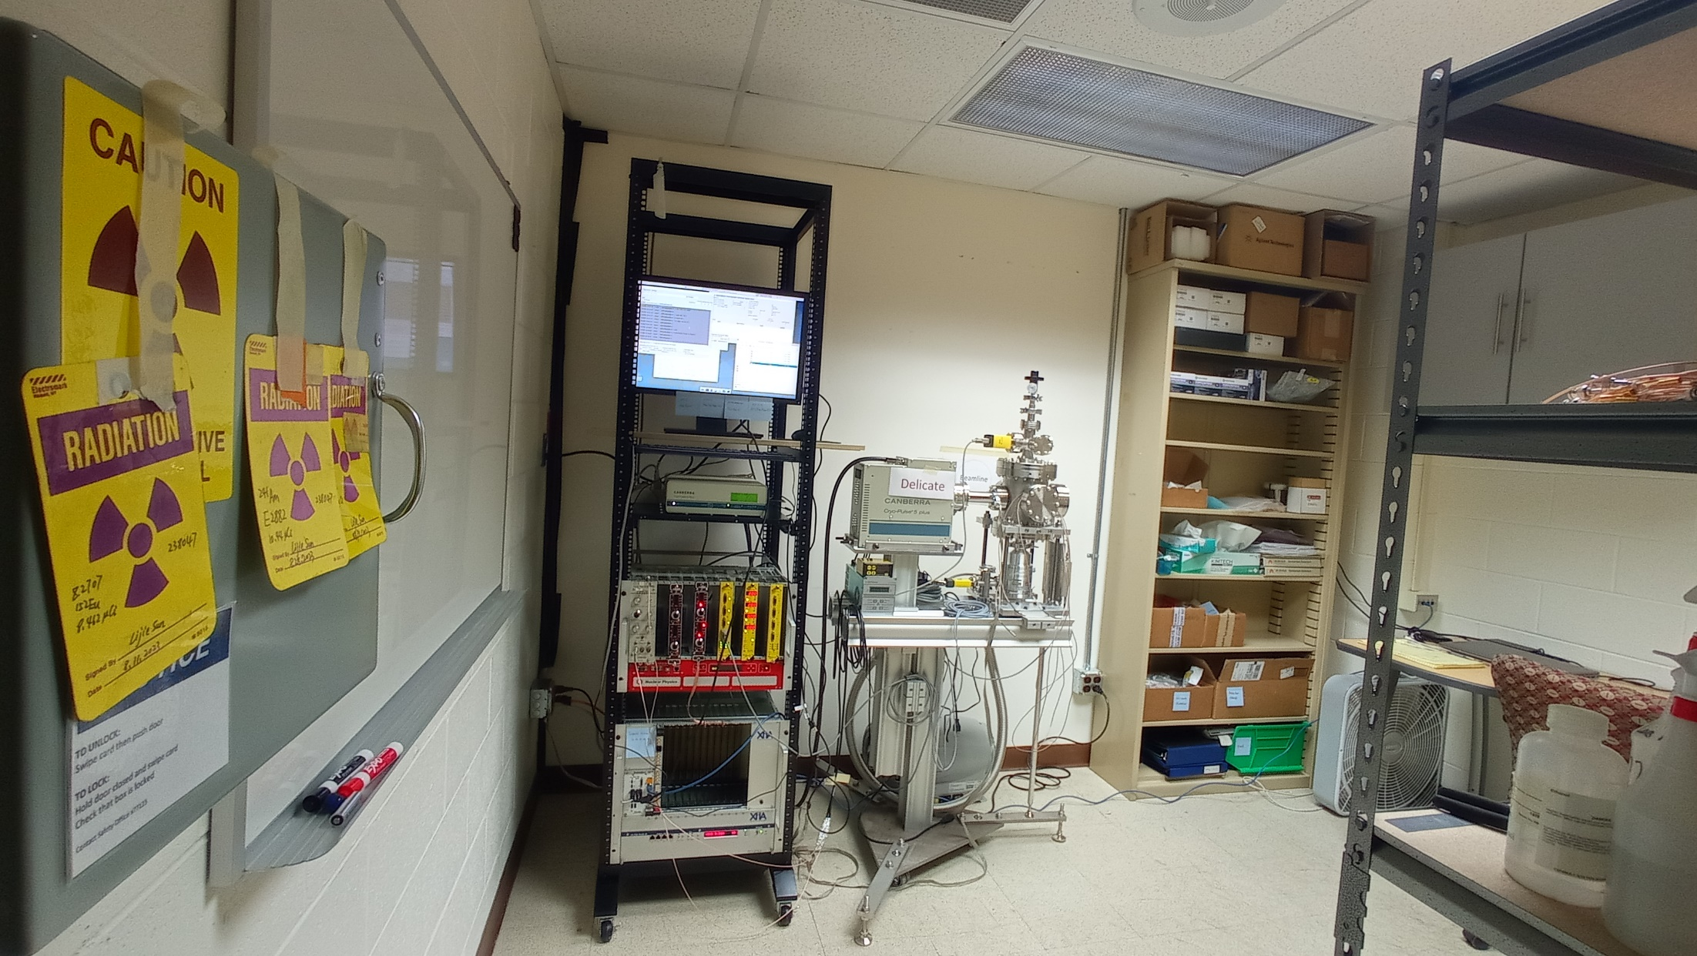

Slide 7
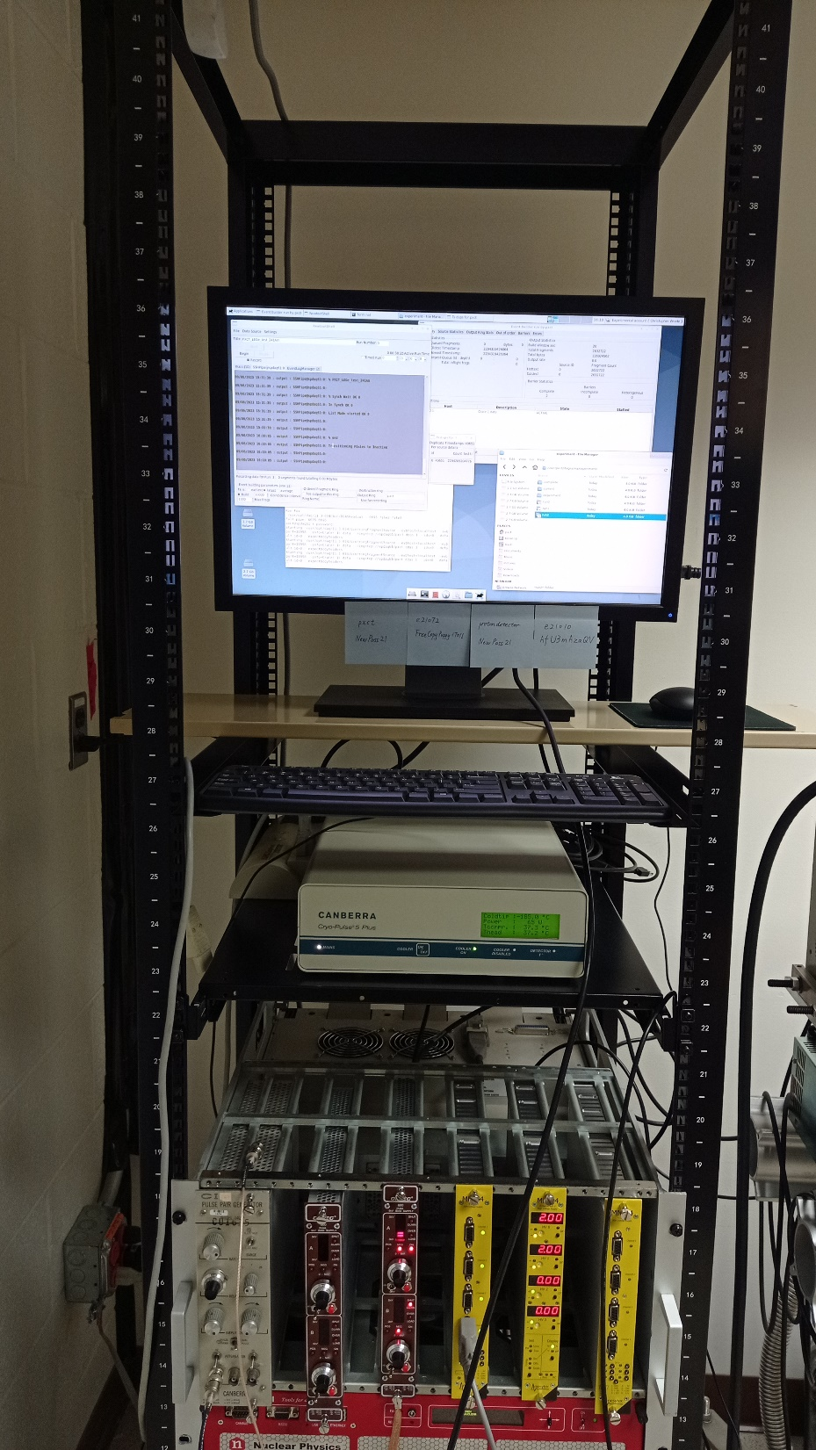
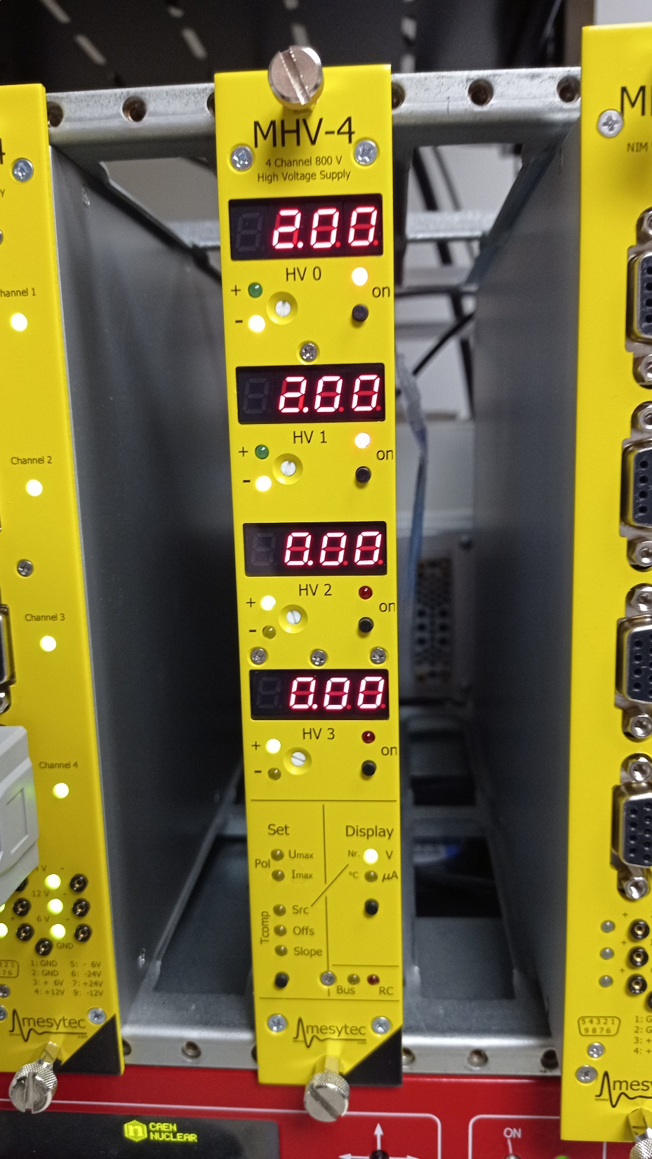

Slide 8
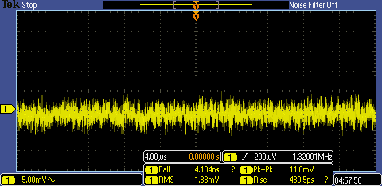
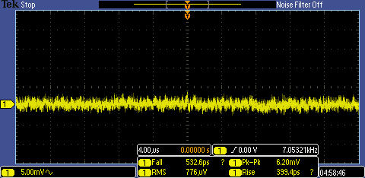
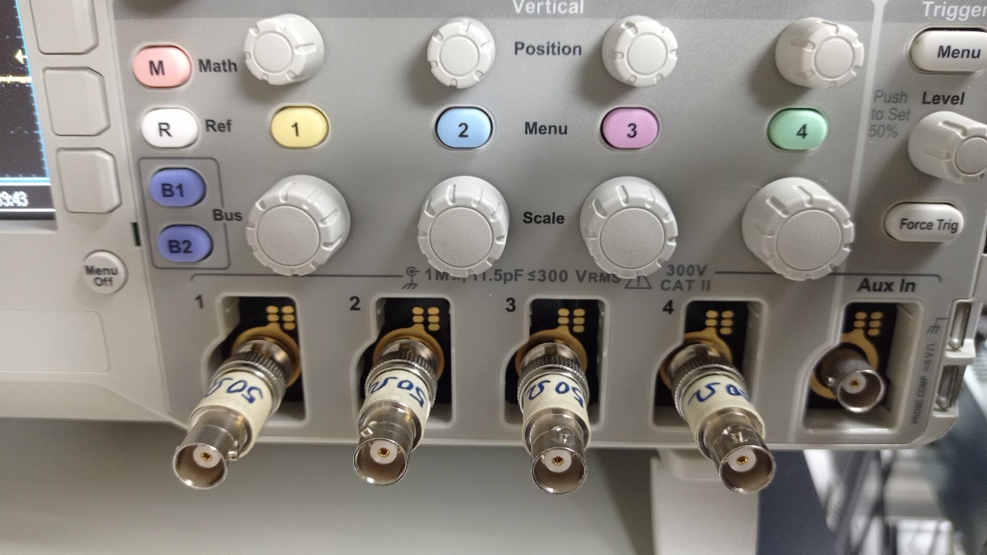
No terminator
With terminator

Slide 9
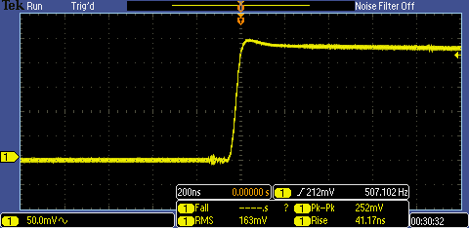
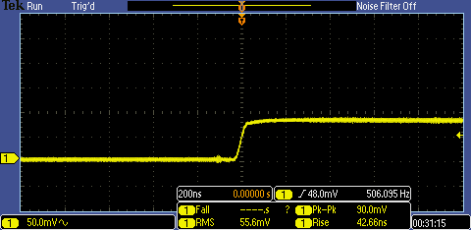
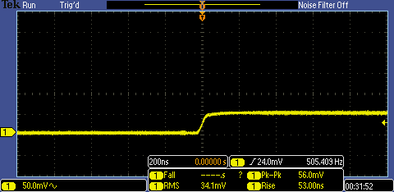
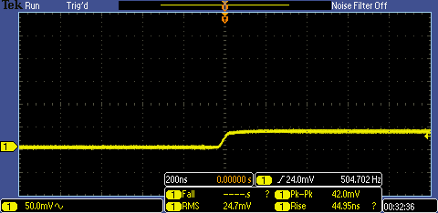
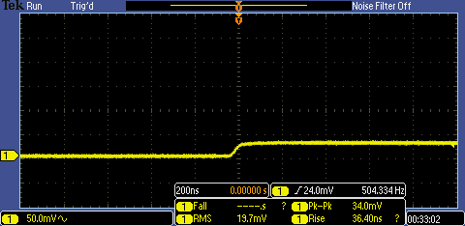
No terminator
With 1 terminator
Pulser
With 2 terminators
With 3 terminators
With 4 terminators

