Slide 1
Probing lifetimes of short-lived nuclear resonances of astrophysical interest
Lijie Sun on behalf of DSL and PXCT Collaborations
August 8th, 2024
Notes:
Good afternoon, everyone! I hope you are all doing well. On behalf of the DSL Collaboration and PXCT Collaboration, I would like to share with you our recent work on the lifetime measurements of the resonances of astrophysical interest, but from the nuclear data perspective.

Slide 2
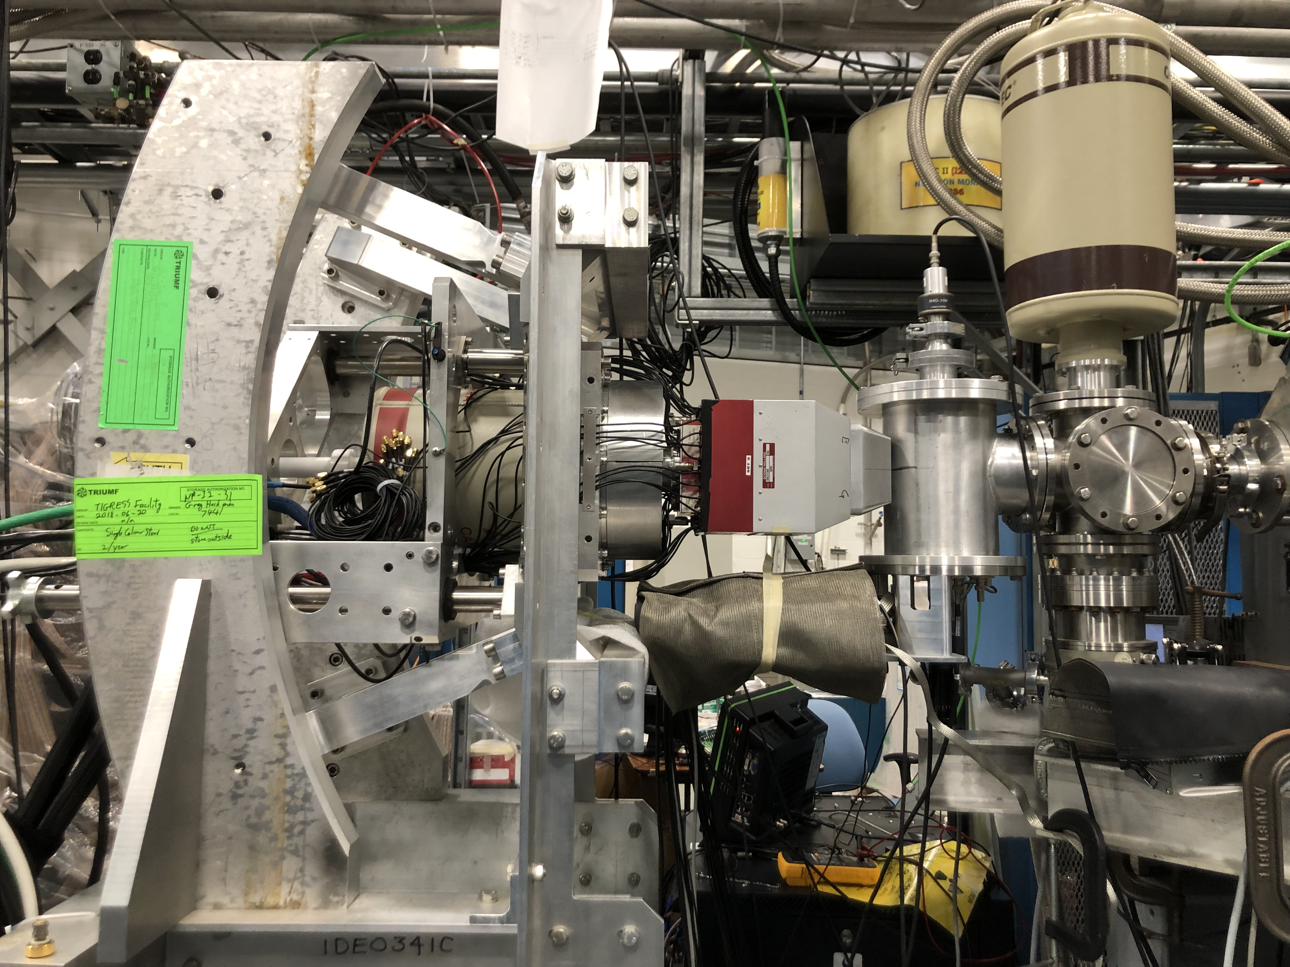
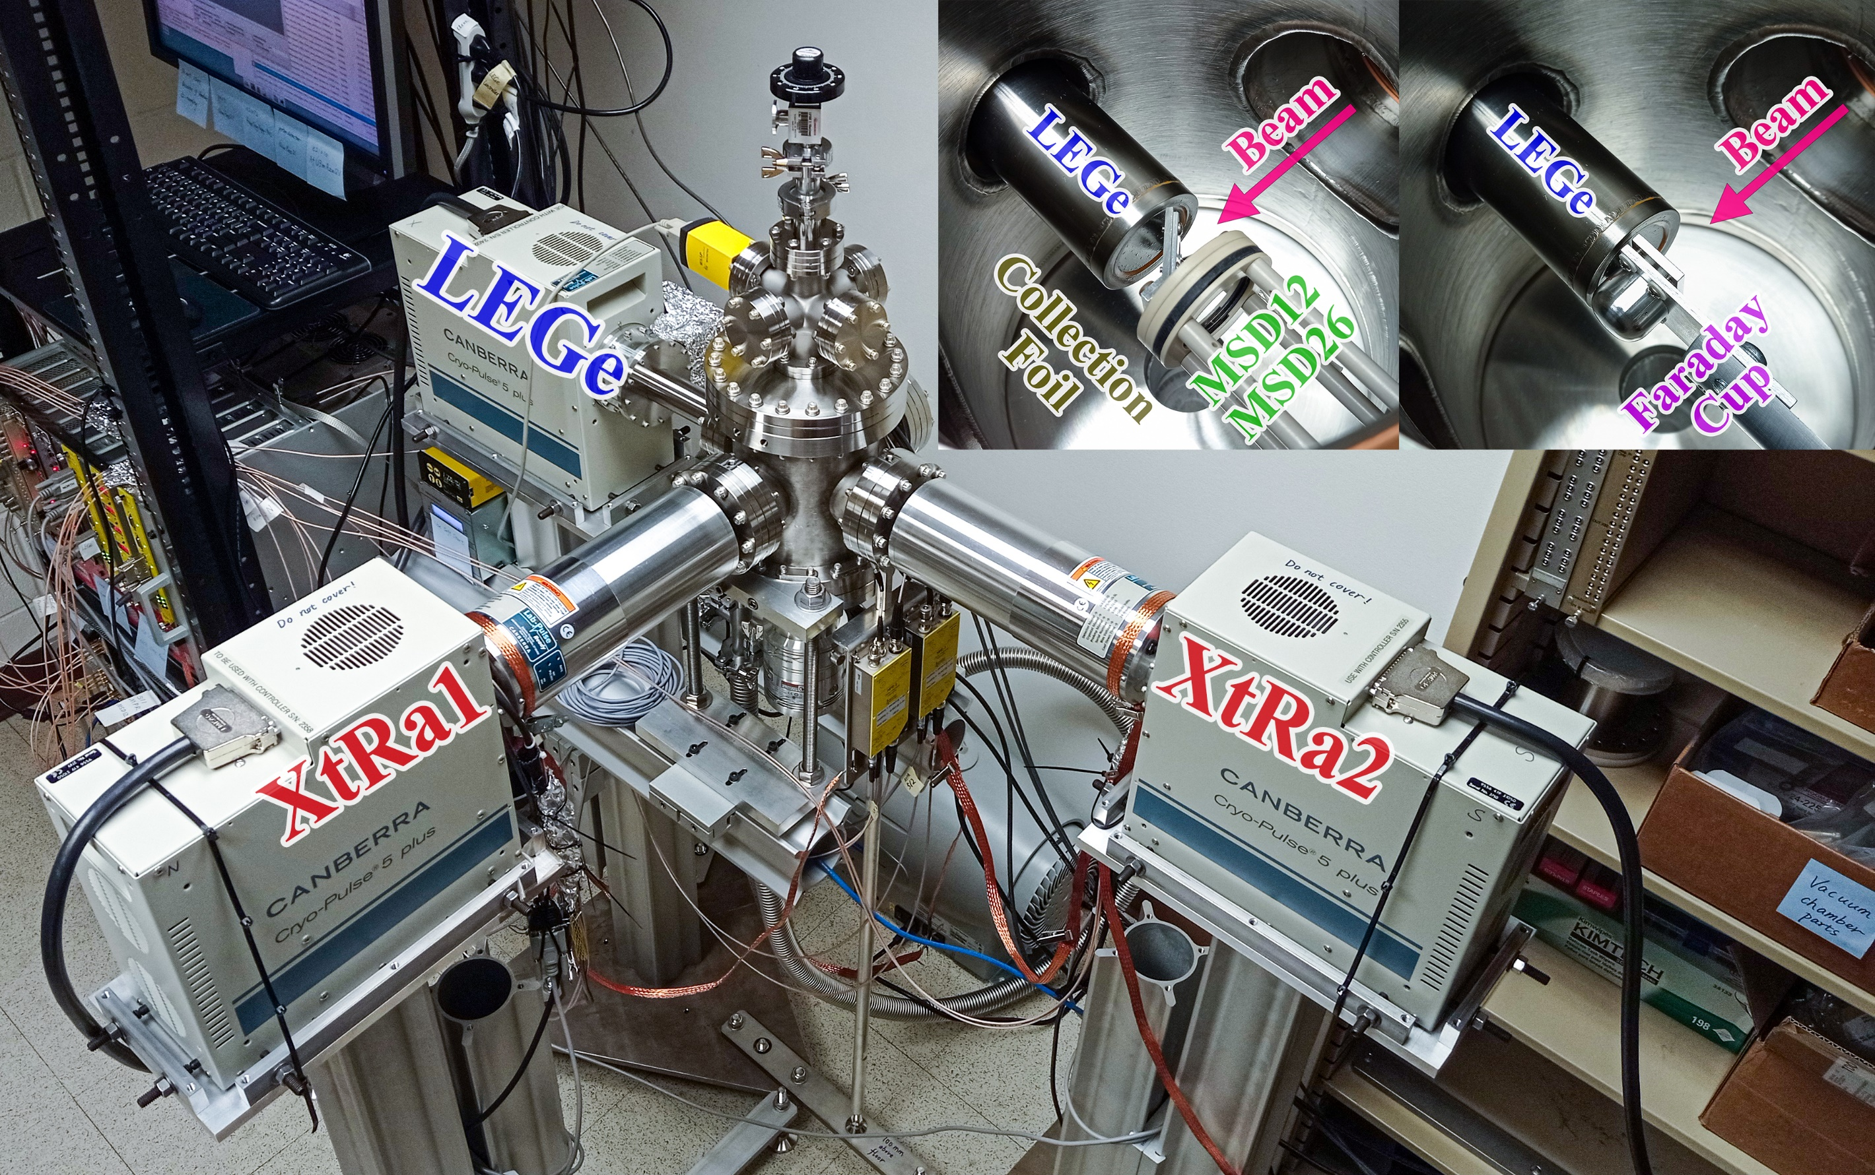
Experimental Systems
DSL @ TRIUMF
PXCT @ FRIB
Doppler Shift Attenuation Method
τ~10^{–15}–10^{–12} s
Proton-X-ray Coincidence Technique
τ~10^{–17}–10^{–15} s
Notes:
On the left is the Doppler Shift Lifetimes (DSL) facility at TRIUMF and our research group has played a leading role in upgrading DSL. It was designed for using (3He,α) transfer reaction in inverse kinematics to populate excited states and measure Doppler-shifted γ rays and determine lifetime using DSAM in the ps to fs range. On the right side, we have designed and built a new detection system for the FRIB low-energy beam area that utilizes the Particle X-ray Coincidence Technique (PXCT) to measure the lifetimes in the fs or even below fs range.

Slide 3
Bayesian-MCMC-DSAM Analysis
Input
Output
Notes:
Using our data from the last DSL experiment as an example. On the top left, we obtain a measured γ-ray spectrum and many simulated spectra by varying the input parameters such as lifetime. Then, we feed these into a Markov Chain Monte Carlo-based Bayesian analysis framework, which offers a statistically rigorous parameter estimation and uncertainty quantification. On the bottom left, we have the outputs, which include the predictive posterior lineshape and the posterior distributions of each input model parameter. Among these parameters, the lifetime is the most important one.

Slide 4
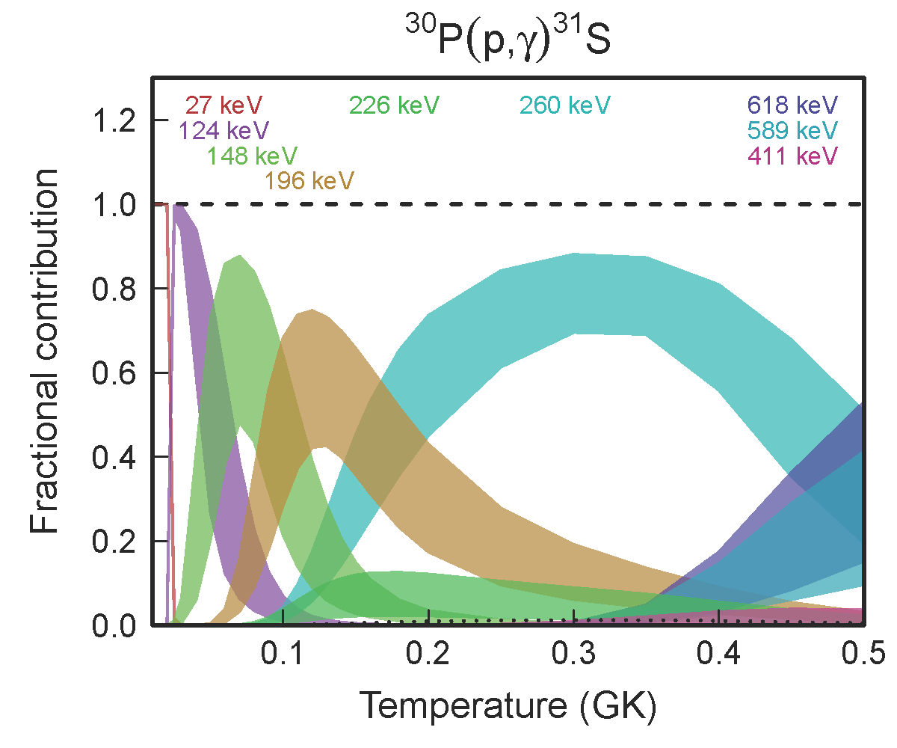
³⁰P(p,γ)³¹S Resonance Strength
Notes:
Then, One important merit of Bayesian methods is that a distribution offers more detailed
information than a point estimate or an interval from frequentist methods, we can propagate the lifetime distribution to the resonance strength distribution. Then, we can apply the Monte Carlo reaction rate calculation developed by the North Carolina folks to consistently account for the uncertainties of all inputs.

Slide 5
Lifetimes of ³¹S Excited States
J^{π} | E_{x} (keV) | ³¹S state | τ (fs) [ENSDF] | τ (fs) [DSL]
3/2⁺ |  | 1248 | 720(180)
5/2⁺ |  | 2234 | 320(80)
1/2⁺ |  | 3076 | Unknown
3/2⁺ |  | 3435 | Unknown
(3/2)– |  | 4971 | Unknown
1/2⁺ |  | 5156 | Unknown
J. Chen et al., NDS 184, 29 (2022).
L. J. Sun et al., PLB 839, 137801 (2023).
Notes:
And from a nuclear data perspective, comparing our result with ENSDF, we can say we confirmed the known lifetimes of two low-lying states and provided upper limits on the lifetimes of four high-lying states in 31S.

Slide 6
Lifetimes of ³¹S Excited States
J^{π} | E_{x} (keV) | ³¹S state | τ (fs) [ENSDF] | τ (fs) [DSL]
3/2⁺ |  | 1248 | 720(180)
5/2⁺ |  | 2234 | 320(80)
 |  | 3076 | A frequentist 68% confidence interval means that with a large number of repeated samples, 68% of such calculated confidence intervals would include the true value. | A Bayesian 68% credible interval means that an unobserved parameter value has a probability of 68% falling within it.
J. Chen et al., NDS 184, 29 (2022).
L. J. Sun et al., PLB 839, 137801 (2023).
Notes:
However, the statistical definitions and meanings of Confidence Intervals and credible intervals are very different. This maybe a question for later discussion.

Slide 7
Particle X-ray Coincidence Technique (PXCT)
Notes:
Let's jump into the 2nd part, PXCT, it is a technique originally introduced by John Hardy in the 1970s. A quick explanation starts with a proton-rich precursor with an atomic number of Z

Slide 8
Particle X-ray Coincidence Technique (PXCT)
Notes:
decays by K-EC to the proton emitter (Z − 1). Due to EC, a proton unbound nuclear state and an atomic shell vacancy are created simultaneously.

Slide 9
Particle X-ray Coincidence Technique (PXCT)
Notes:
the proton-unbound state emits a proton to a state of the daughter (Z −2).

Slide 10
Particle X-ray Coincidence Technique (PXCT)
Notes:
Then the electron in a higher-lying atomic shell fills the vacancy and emits the characteristic X rays.

Slide 11
Particle X-ray Coincidence Technique (PXCT)
Notes:
An alternative would be X-ray emission first

Slide 12
Particle X-ray Coincidence Technique (PXCT)
Notes:
Then proton emission

Slide 13
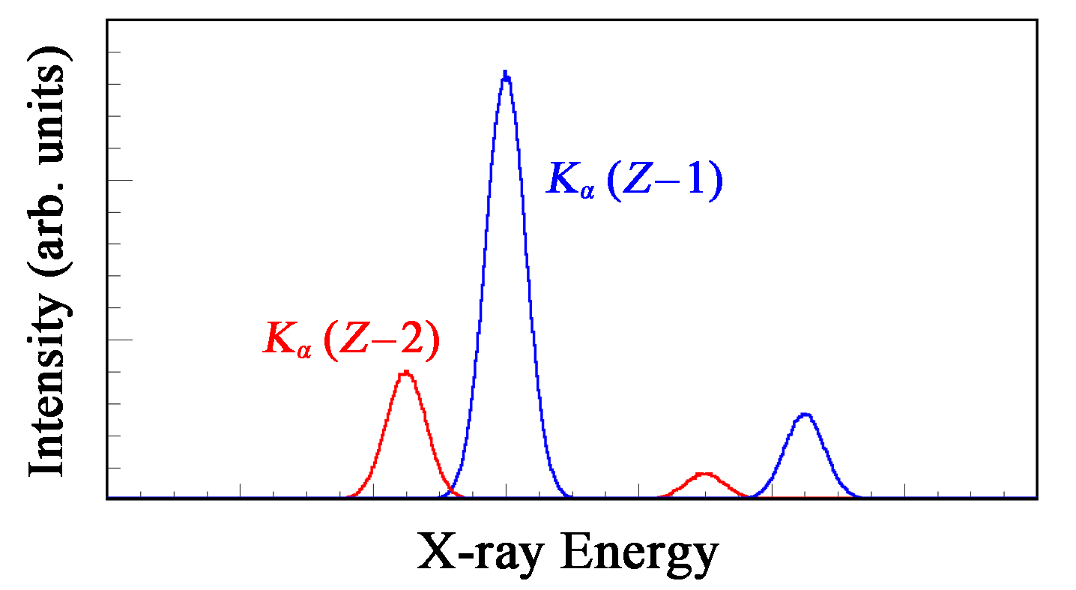
Particle X-ray Coincidence Technique (PXCT)
$$τ_{p−emit}=\frac{I_{KX(Z−1)}}{I_{KX(Z−2)}}τ_{Kshell}$$
Evaluated Atomic Data Library (EADL), 1991
Notes:
By measuring X rays in coincidence with protons, we get two X ray peaks corresponding to the proton emitter's atomic number and the daughter's atomic number. We can establish the relationship between the lifetimes of proton-emitting nuclear states and the lifetimes of the emitter atomic Kshell vacancies by the X-ray count ratio. We have been using EADL for our estimation, which is more than 3 decades old, and if there are any more up to date atomic database, please let us know.

Slide 14
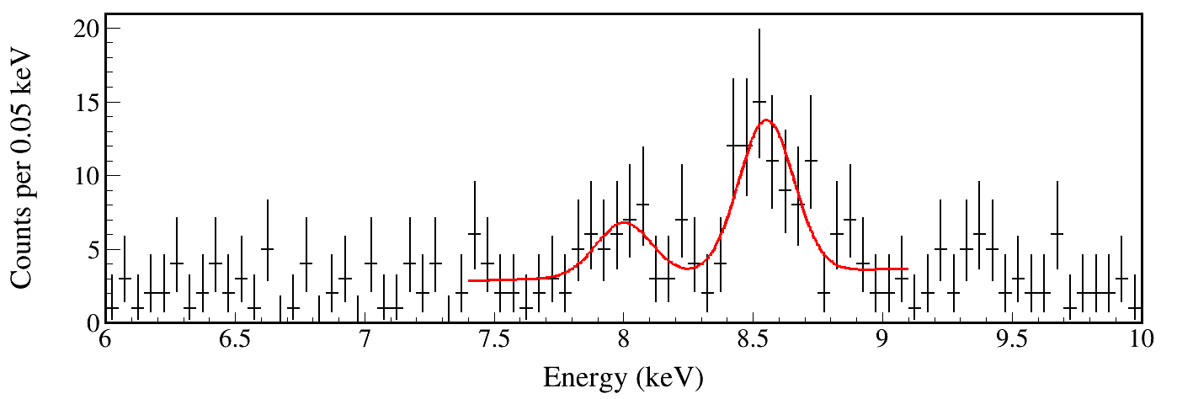
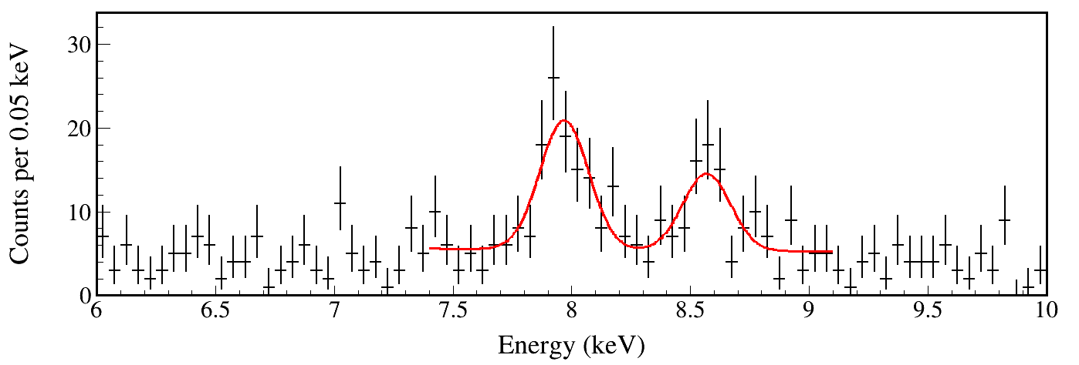
⁶⁰Zn Resonance Lifetime
E_{p} < 2000 keV
R = 2.5(13)
τ = 1.1(6) fs
τ_{Kshell} = 0.422 fs
2000 < E_{p} < 3000 keV
R = 0.51(22)
τ = 0.22(10) fs
τ_{Kshell} = 0.422 fs
Notes:
Here's a simulated example for 60Zn resonances of XRB interest, the X ray peaks are from Zn at 8.6 keV and its daughter Cu at 8 keV. More Zn peak means the nuclear state lifetime is longer than Zn atomic shell vacancy lifetime; More Cu peak means the nuclear state lifetime is shorter than Zn atomic shell vacancy lifetime.

Slide 15
PXCT Detection System
Notes:
Just to be clear, our PXCT setup can also measure proton, α, β, γ, any common observables for a regular decay spectroscopy experiment, plus X-rays for the lifetime.

Slide 16
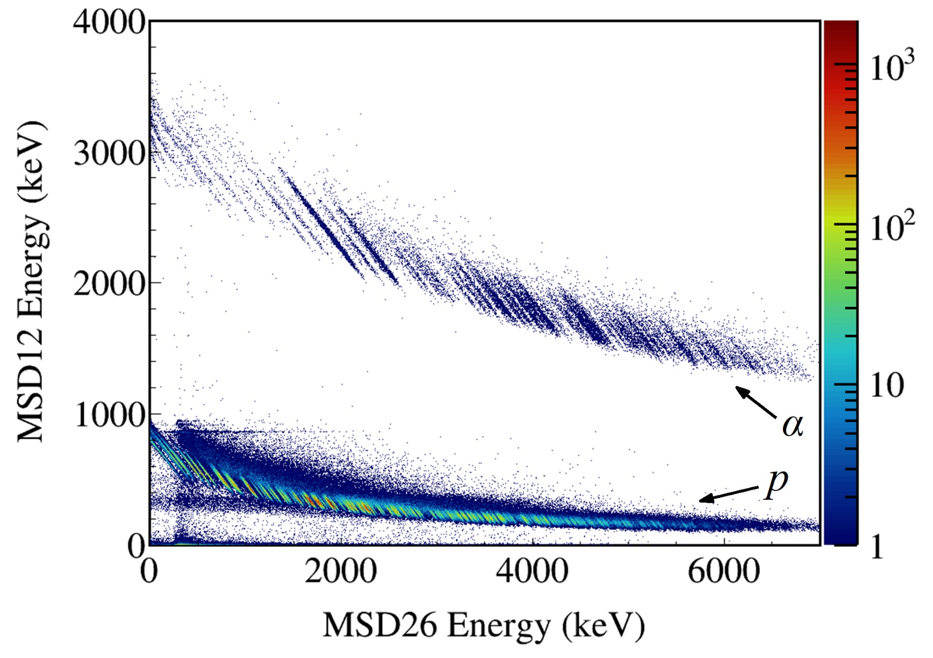
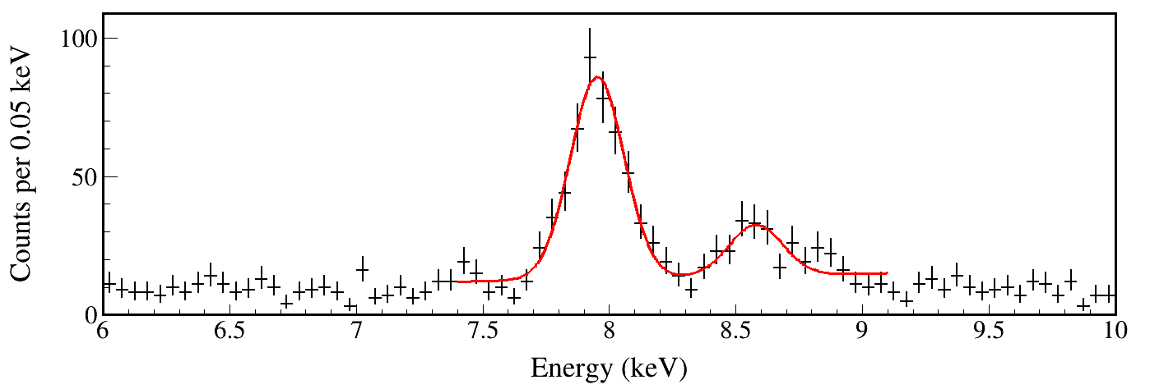
⁶⁰Ga（EC）⁶⁰Zn → ⁵⁹Cu + p
All proton-gated X ray
Notes:
reduce the emphasis on lifetimes of discrete resonances. We should talk more about the fact that we can get all the transmission coefficients for ground and excited state transitions and level density for the statistical model. We can also discover discrete resonances, measure their branching ratios, and for favorable beta feeding and lifetime values possibly measure lifetimes for some discrete resonances.

Slide 17
Future of PXCT
Commissioning cases: ⁶⁵Ge, ⁶⁹Se, ⁷³Kr
Scientific cases: ⁶⁰Ga, ⁶⁴As
Collaborative cases:
Addressing specific data needs and gaps in nuclear data through targeted experiments.
United States Nuclear Data Program Work Plan for FY2024
Notes:
Here's my last slide, for now, our tentative future plan may be to choose one of these nuclei shown in green for commissioning and Ga and As shown in red, both are of XRB interest, for FRIB PAC experiments in the future.
Our system is a also precise offline testing platform, which aligns with one of the four USNDP mission priorities.
So, if you are interested in collaborating on either PAC proposals or offline experiments, feel free to talk to my advisor, Chris Wrede, who's attending the meeting in person. He can explain our system's capability better than anyone else. That's what he looks like.
Thank you very much!

