Slide 1
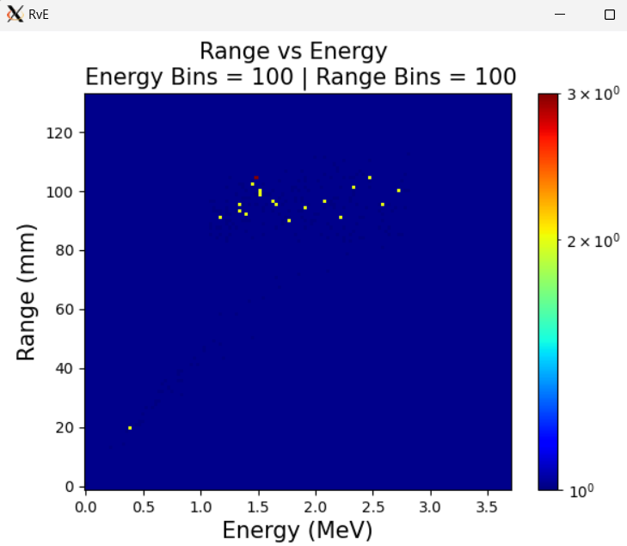
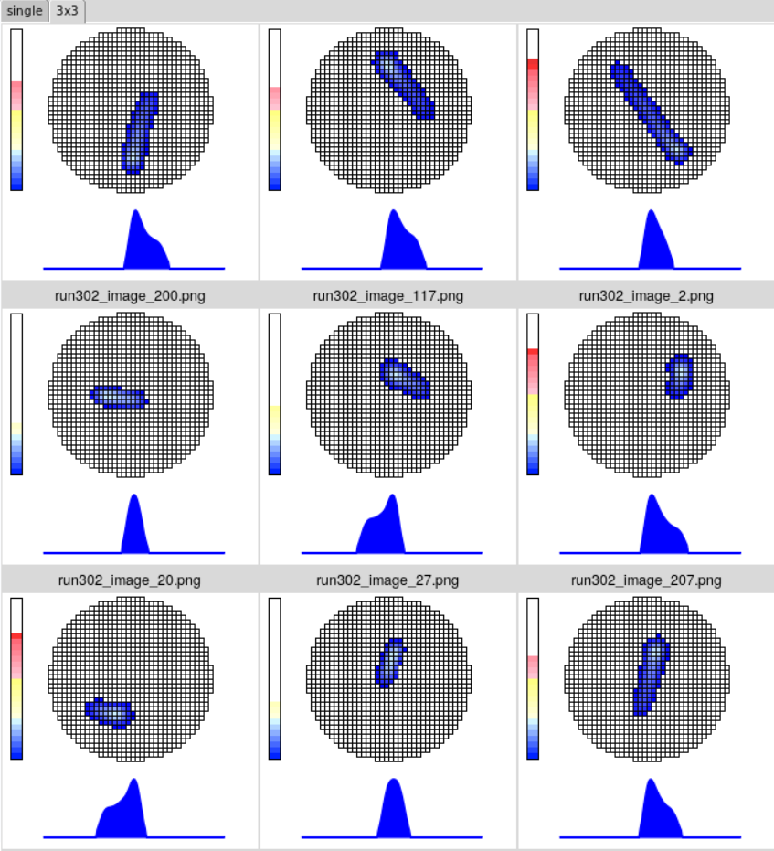
Run0302
2000-keV proton
Below Threshold | Vetoed | Missing | Good | Sum
19 | 1722 | 1 | 258 | 2000

Slide 2
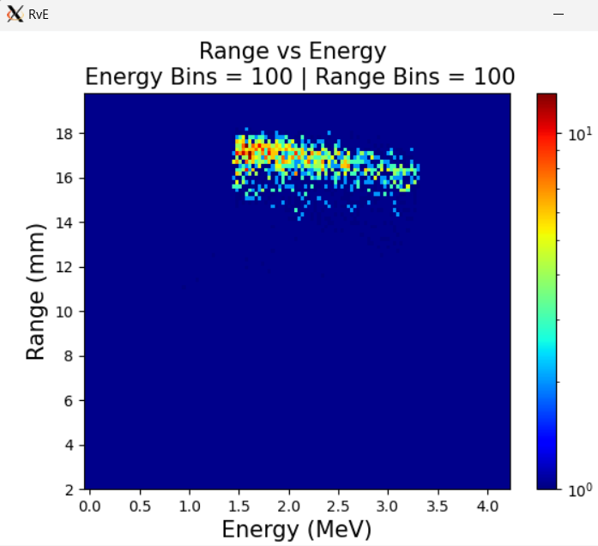
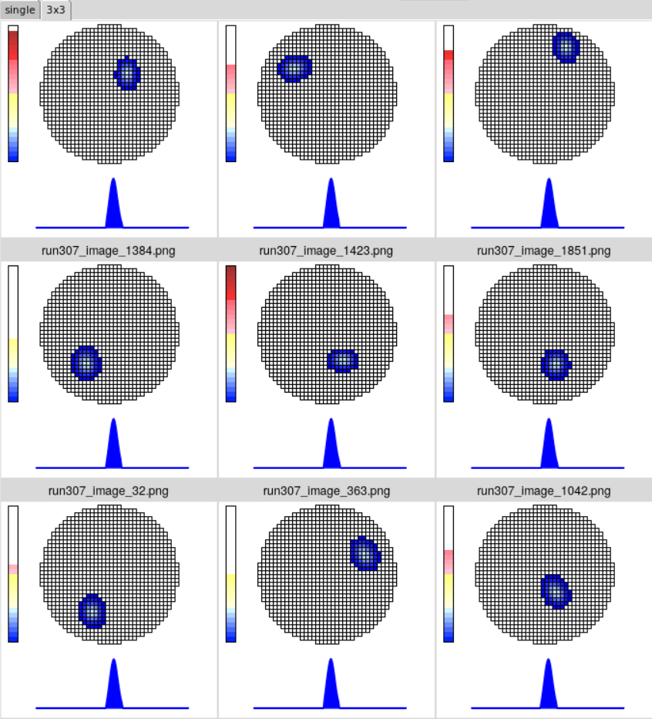
Run0307
2000-keV alpha
Below Threshold | Vetoed | Missing | Good | Sum
4 | 54 | 1 | 1941 | 2000

