Slide 1
Lifetime of ²³Mg 7787 keV state (S2193)
1) Fit range
2) Bin width
3) Angular distribution
4) Bayesian analysis framework
5) Prior choices

Slide 2
Choice of priors

Slide 3
Literature | E_{γ} (keV) | Method
Sallaska_PRC2011 | 7332.7(12) | ²²Na(p,γ)²³Mg
Jenkins_PRC2004 | 7333.7(11) | ¹²C(¹²C,nγ)²³Mg
ENSDF | 7333.2(11) | Weighted average of Sallaska and Jenkins
Goldberg_Thesis2024 | 7335.1(9) | ²³Al(βγ)²³Mg
Zhai_Thesis2006 | 7335.2(6) | ²³Al(βγ)²³Mg

Slide 4
Emulator | PCGP_numPCs | PCGP_numPCs | PCGP_numPCs
Calibrator | directbayeswoodbury | directbayeswoodbury | directbayeswoodbury
Sampler | metropolis_hastings | metropolis_hastings | metropolis_hastings
Prior (keV) | Gaussian Mean = 7332.7 Sigma = 1.2 | Gaussian Mean = 7335.1 Sigma = 0.9 | Uniform [7331.5, 7336.0]
E_{γ} (keV) | 7332.7(12) Sallaska_PRC2011 | 7335.1(9) Goldberg_Thesis2024 | Lower bound Sallaska_PRC2011; Higher bound Goldberg_Thesis2024
τ (fs) | $${6.3}_{−3.3}^{+3.9}$$ | $${9.5}_{−4.0}^{+4.6}$$ | $${15}_{−10}^{+10}$$
90% C.I. (fs) | <11.4 | <15.7 | <27

Slide 5
Gaussian Prior:
Mean = 7335.1
Sigma = 0.9
Uniform Prior:
[7331.5, 7336.0]

Slide 6
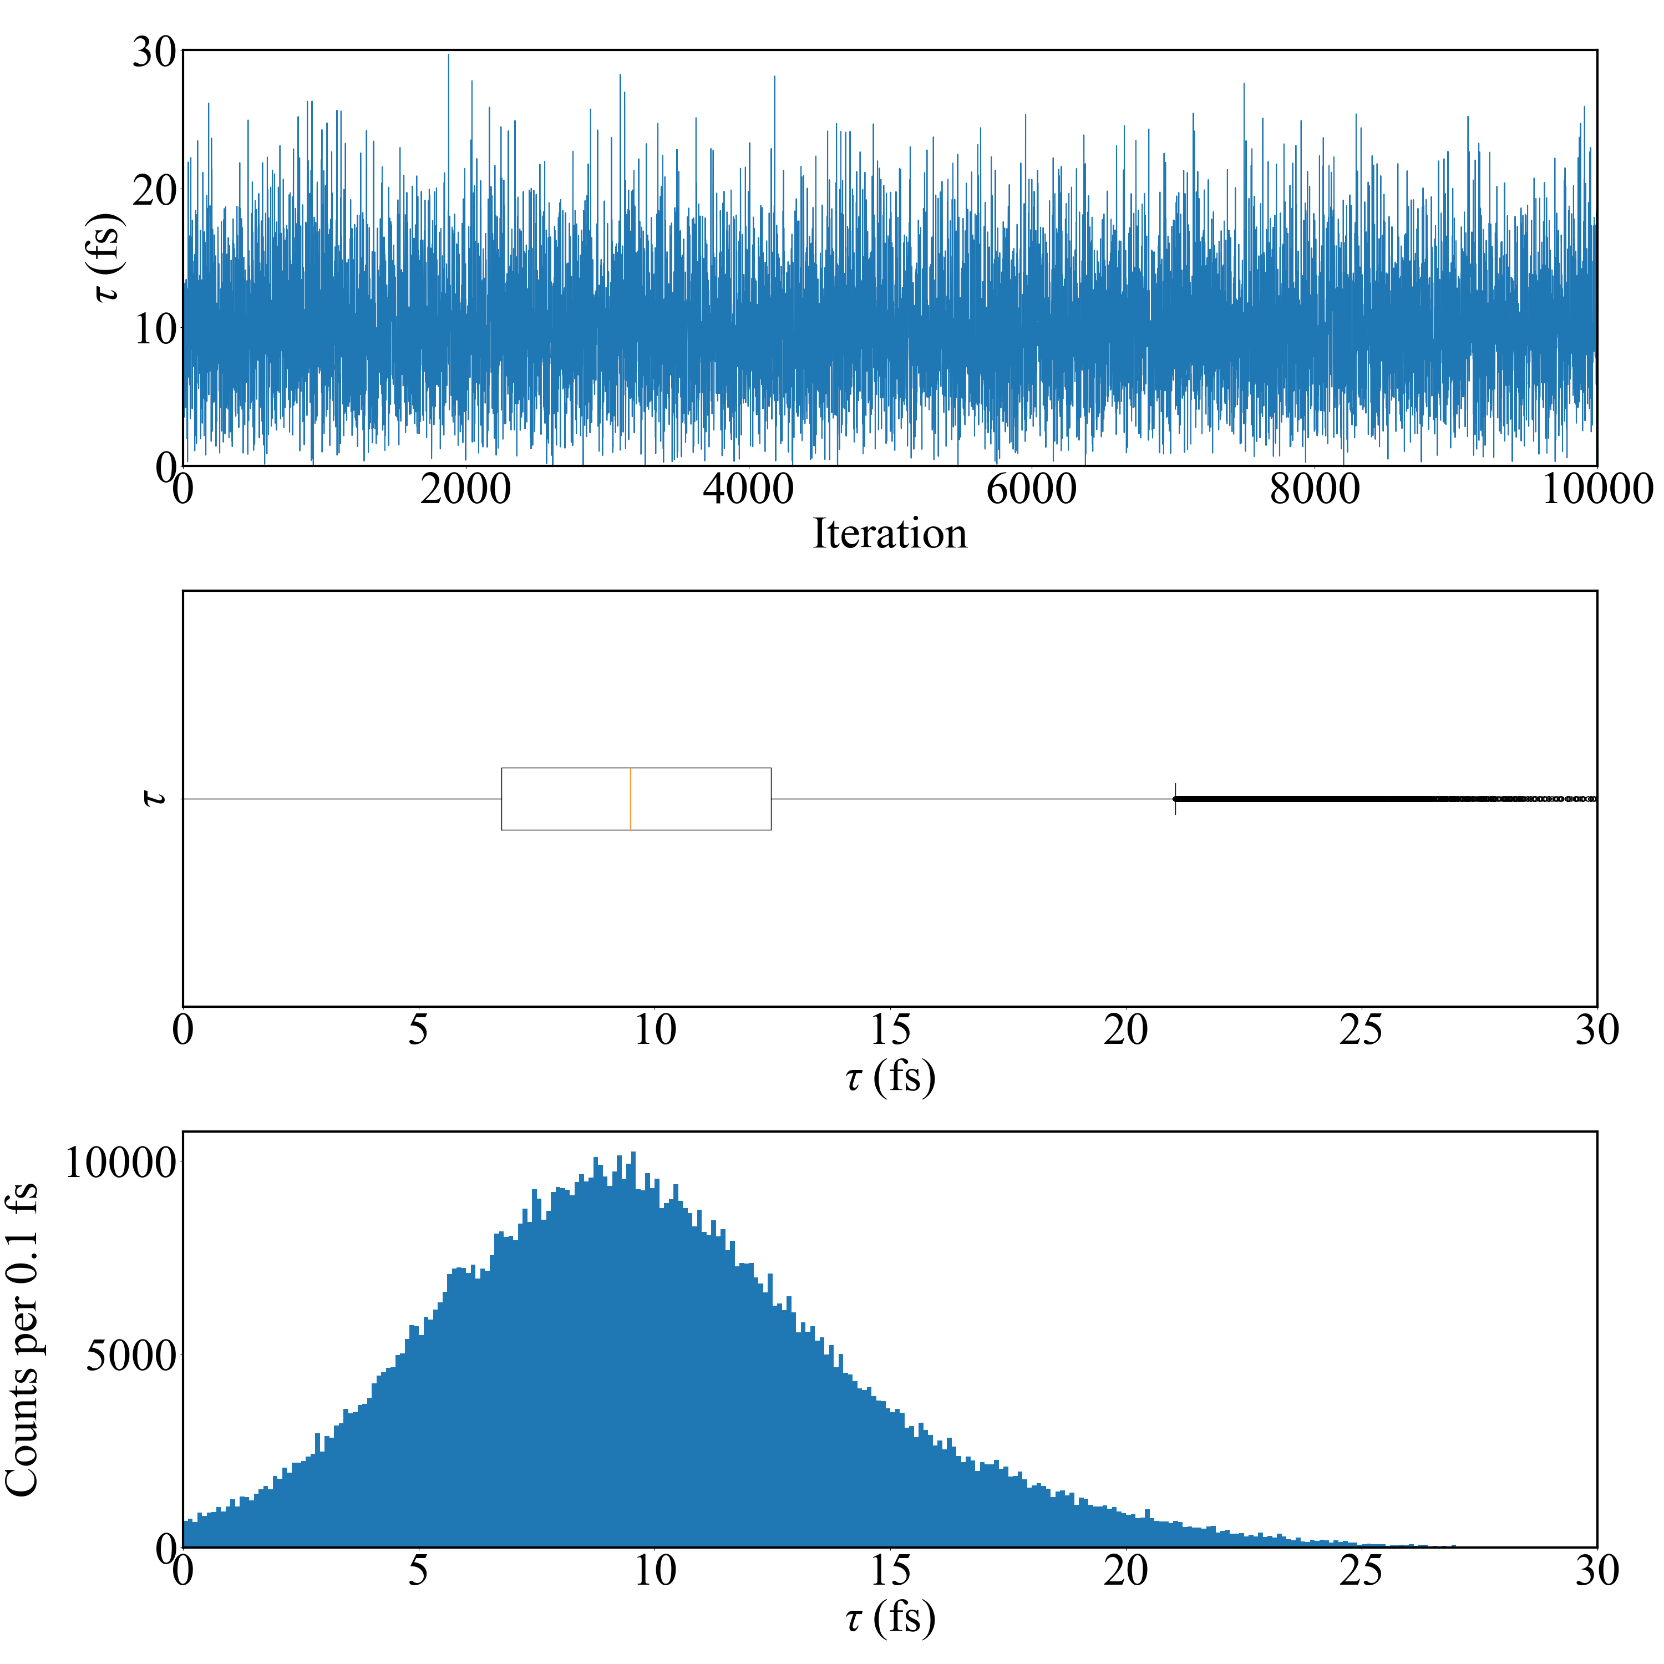
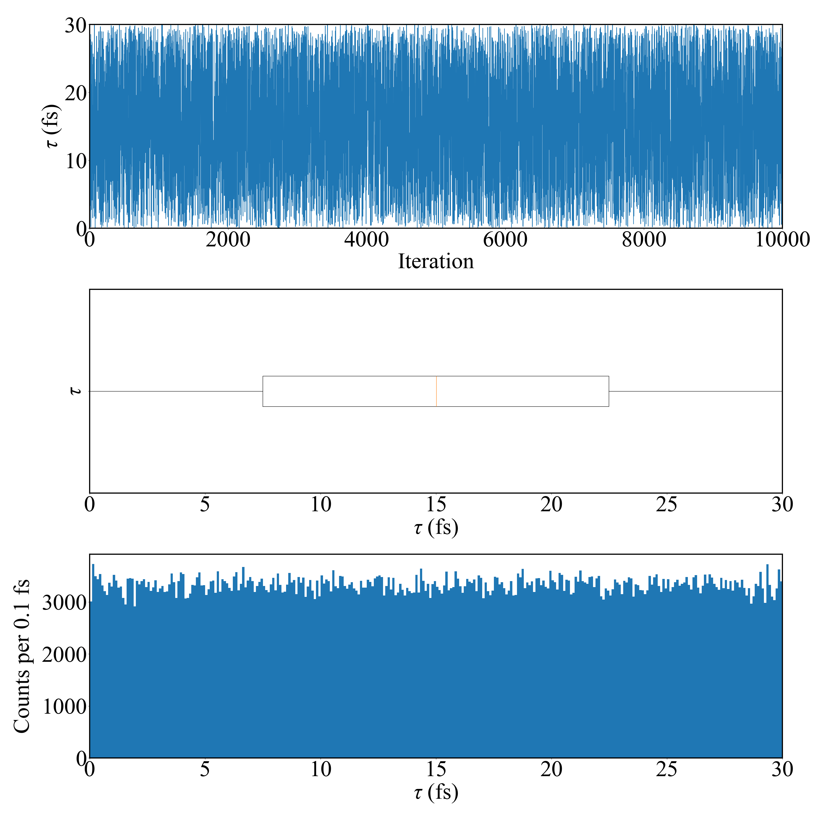
Emulation method: PCGP
Calibration method: directbayeswoodbury
Sampler: metropolis_hastings
Emulation method: PCGP
Calibration method: directbayeswoodbury
Sampler: metropolis_hastings
Eg prior: Sallaska_PRC2011
Tau = 9.488 +4.589 -3.966 fs
Eg prior: Goldberg_Thesis2024
Tau = 15.014 +10.183 -10.200 fs
Final Acceptance Rate: 0.23556
Final Acceptance Rate: 0.31992

Slide 7
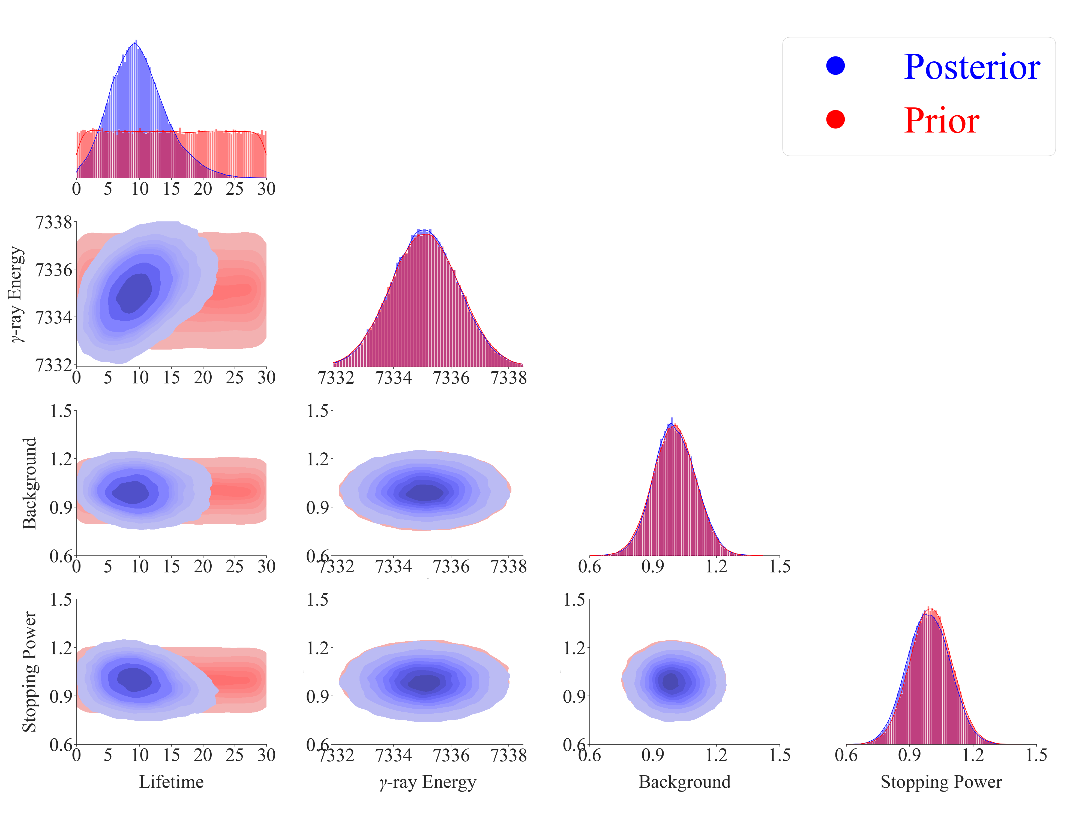
Gaussian Prior:
Mean = 7335.1
Sigma = 0.9

Slide 8
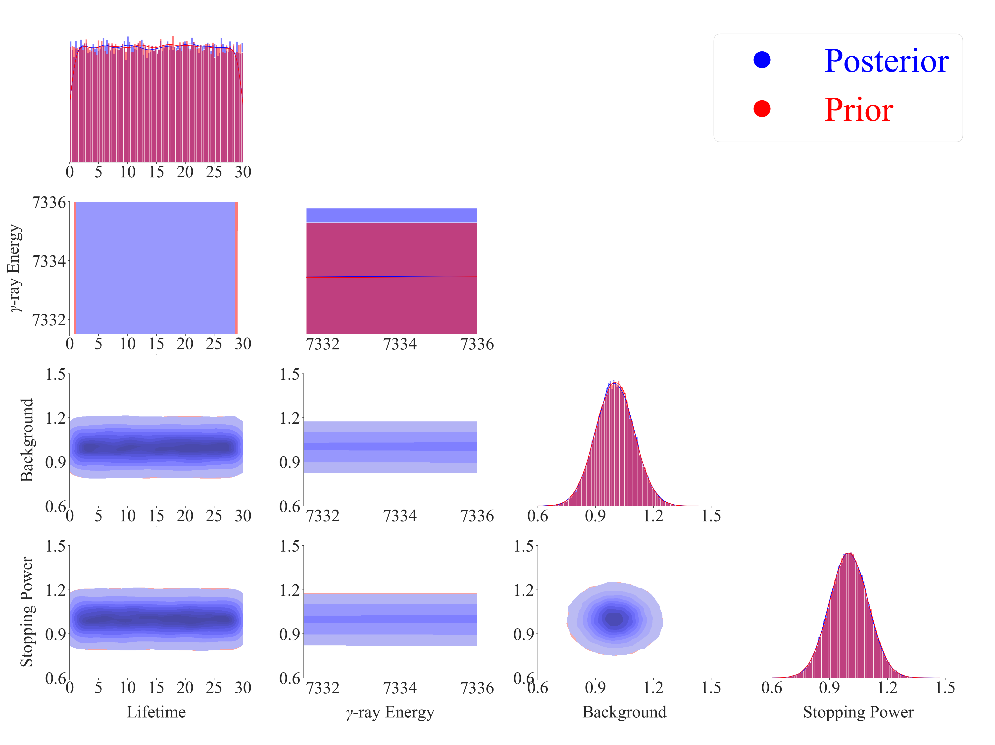
Uniform Prior:
[7331.5, 7336.0]

