Slide 1
Is there a ZnGa Cycle in X-ray Bursts?
--- Chris

Slide 2
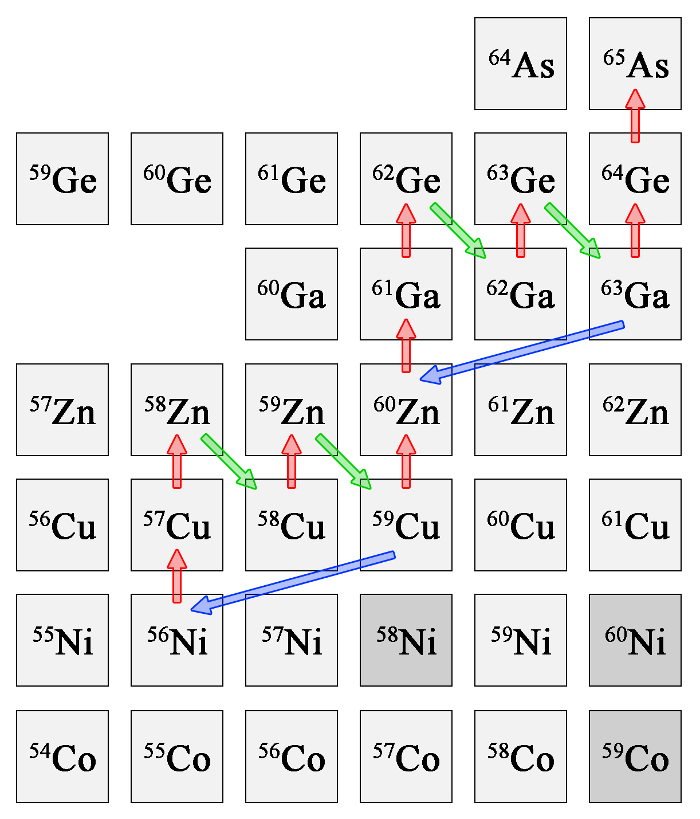
Also important for the light curve are reactions related to the NiCu and ZnGa cycles.
Of key importance here is the branching into the cycle at 59Cu and 63Ga, which is determined by the competition of the proton capture rate and the (p,α) rate. Note the (p,α) reactions are listed as (α,p) reactions.
The NiCu and ZnGa cycles further enhance abundances in A=60–64 mass region.
R. H. Cyburt et al., Astrophys. J. 830, 55 (2016).
FIG. 1 of PXCT draft.
Portion of the rp-process reaction sequence featuring the NiCu and ZnGa cycles.

Slide 3
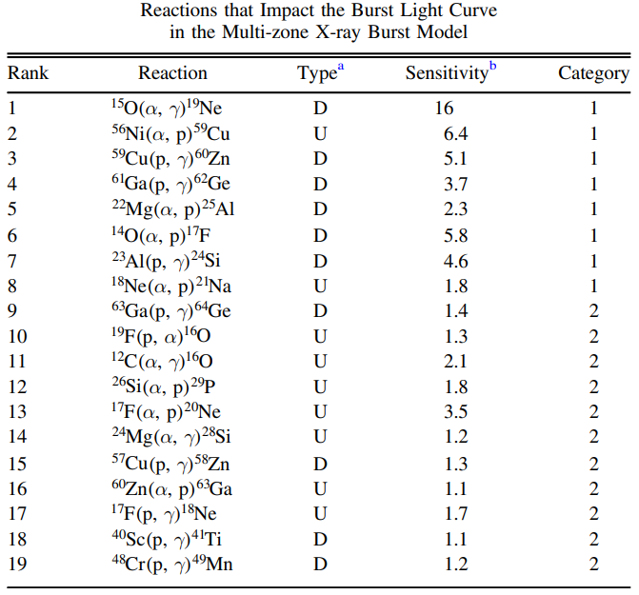
R. H. Cyburt et al., Astrophys. J. 830, 55 (2016).

Slide 4
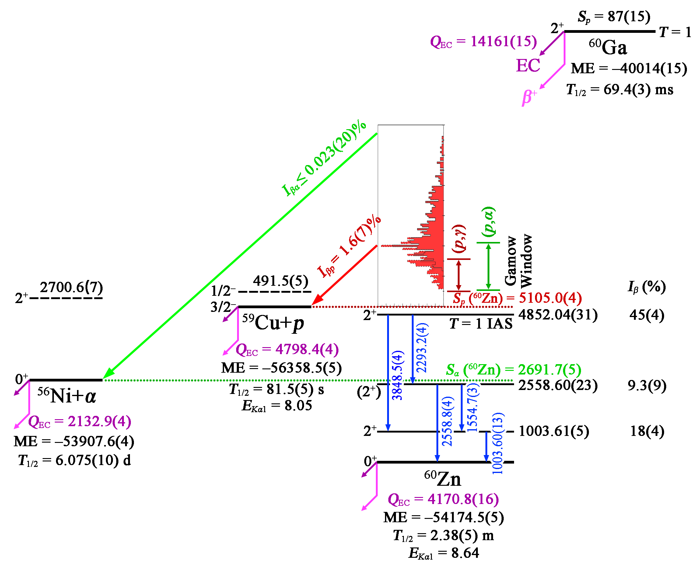
Four ⁶⁰Ga decay measurements:
C. Mazzocchi et al., Eur. Phys. J. A 12, 269 (2001).
⁶⁰Ga 3.2 or 7.6×10⁵ implantations into DSSDs @ BigRIPS, RIKEN
T. Goigoux, Ph.D. Thesis, Universite de Bordeaux, France, 2017.
S. E. A. Orrigo et al., Phys. Rev. C 103, 014324 (2021).
NSCL E17009
FRIB E23035
FIG. 2 of PXCT draft. Evaluated decay scheme of ⁶⁰Ga.

Slide 5
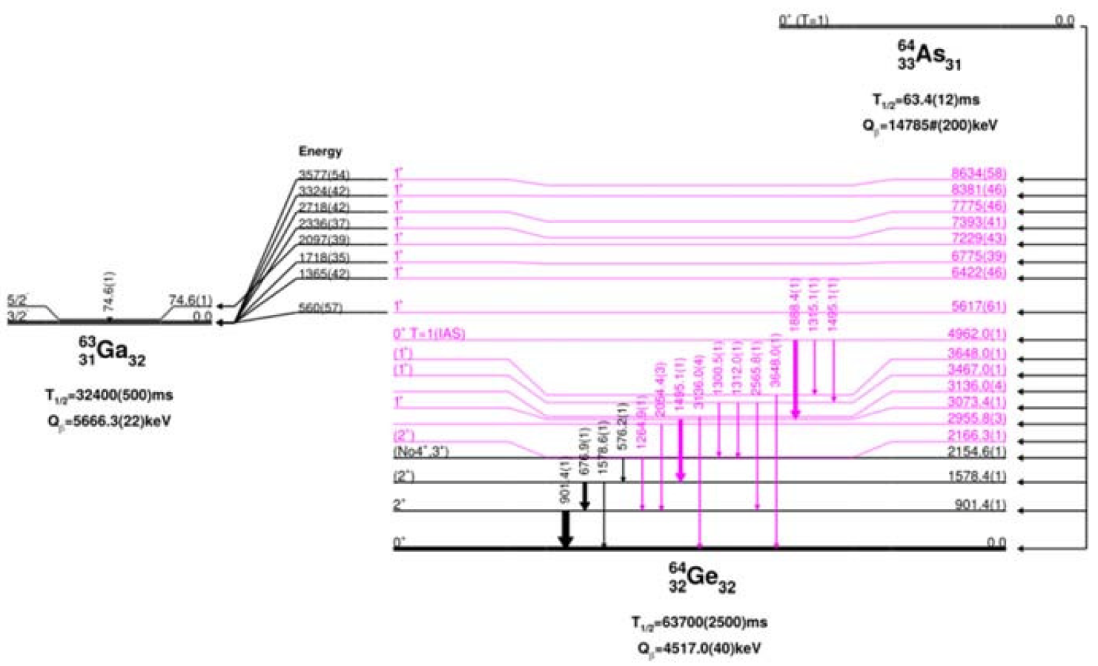
One ⁶⁴As decay measurement:
4.8×10⁵ implantations into DSSDs @ BigRIPS, RIKEN
B. Rubio et al., J. Phys.: Conf. Ser. 1308, 012018 (2019).
Missed by XUNDL. Added to ENSDF in Jun 2024.

Slide 6
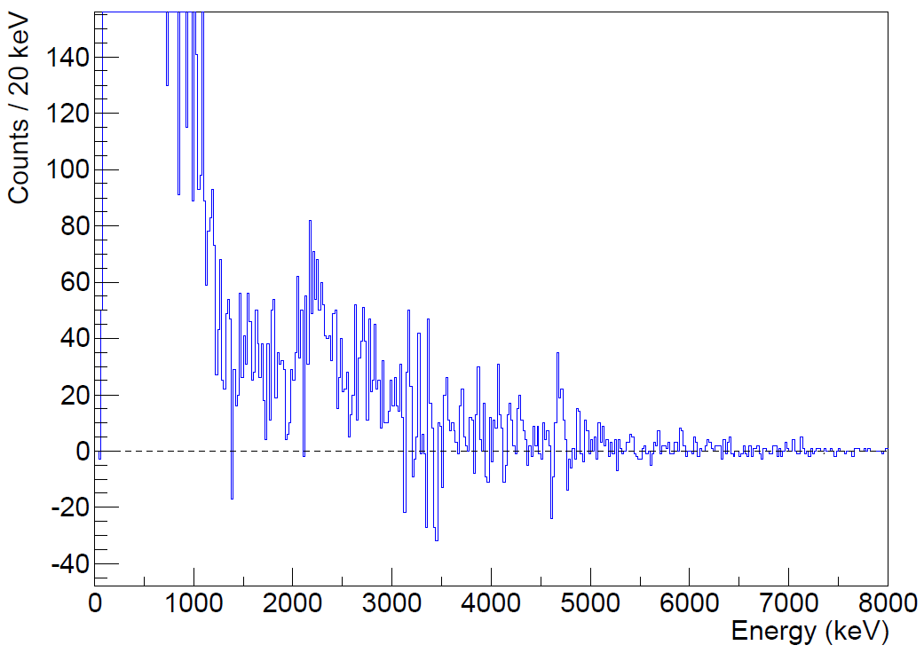
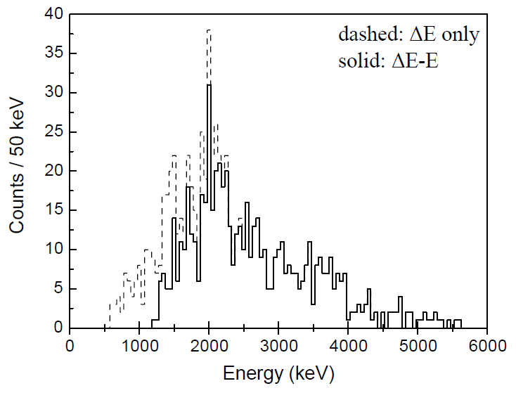
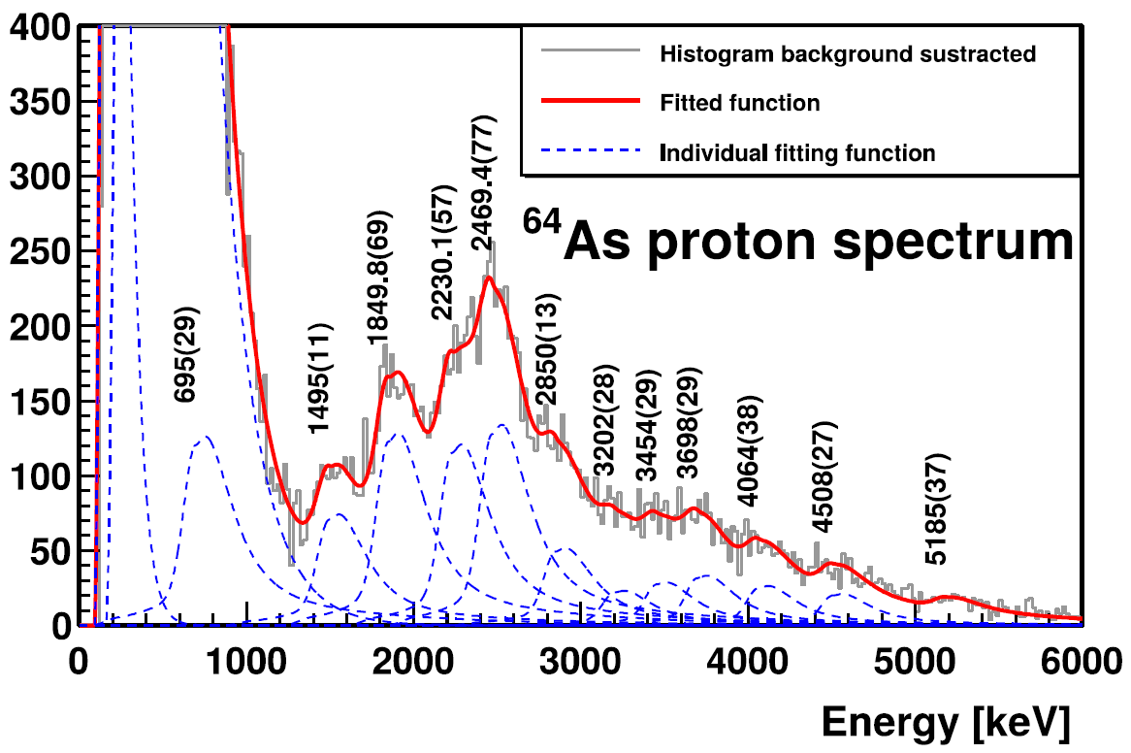
Thomas Goigoux, Ph.D. Thesis, Universite de Bordeaux, France, 2017.
C. Mazzocchi et al., Eur. Phys. J. A 12, 269 (2001).
B. Rubio et al., J. Phys.: Conf. Ser. 1308, 012018 (2019).

Slide 7
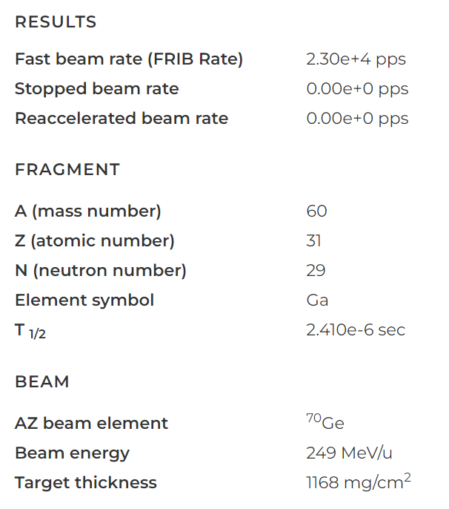
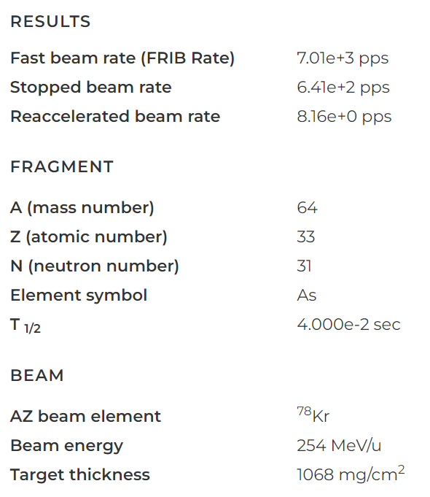

Slide 8
60Ga | Calc v2 | Calc v3 | Calc v2
Primary Beam | 78Kr | 70Ge | 78Kr
Primary Beam Energy (MeV/u) | 256 | 249 | 256
Beam Power (kW) | 10 | 15 | 400
Fast Beam 60Ga (pps) | 6,530 | 23,000 | 304,000
Stopped Beam 60Ga (pps) | 620 | 0 | 30,100
64As | Calc v2 | Calc v3 | Calc v2
Primary Beam | 78Kr | 78Kr | 78Kr
Primary Beam Energy (MeV/u) | 256 | 254 | 256
Beam Power (kW) | 10 | 15 | 400
Fast Beam 64As (pps) | 4,700 | 7,010 | 188,000
Stopped Beam 64As (pps) | 217 | 641 | 8,670
Notes:
https://frib.msu.edu/users/beams/calculator

Slide 9
PXCT future plans:
Precursor | Proton emitter | Daughter
Commissioning cases
⁶⁵Ge | ⁶⁵Ga | ⁶⁴Zn
⁶⁹Se | ⁶⁹As | ⁶⁸Ge
⁷³Kr | ⁷³Br | ⁷²Se
Scientific cases
⁶⁰Ga | ⁶⁰Zn | ⁵⁹Cu
⁶⁴As | ⁶⁴Ge | ⁶³Ga
Collaborative cases
Welcome!

