Slide 1
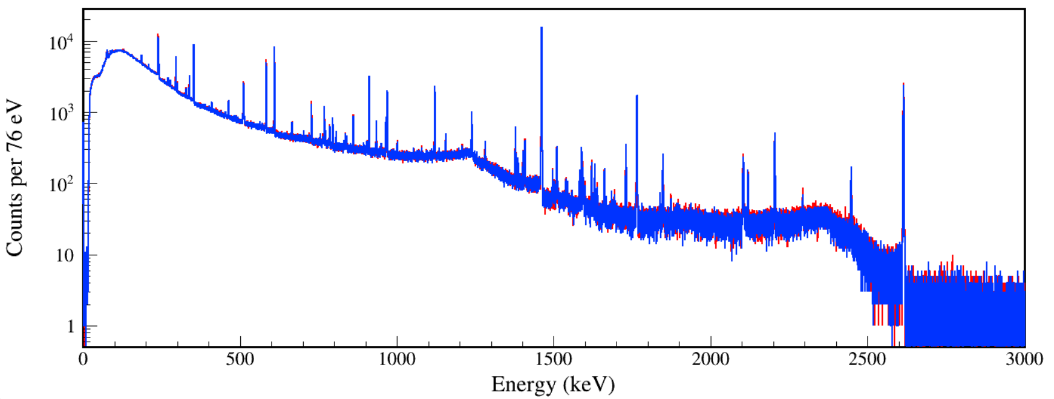
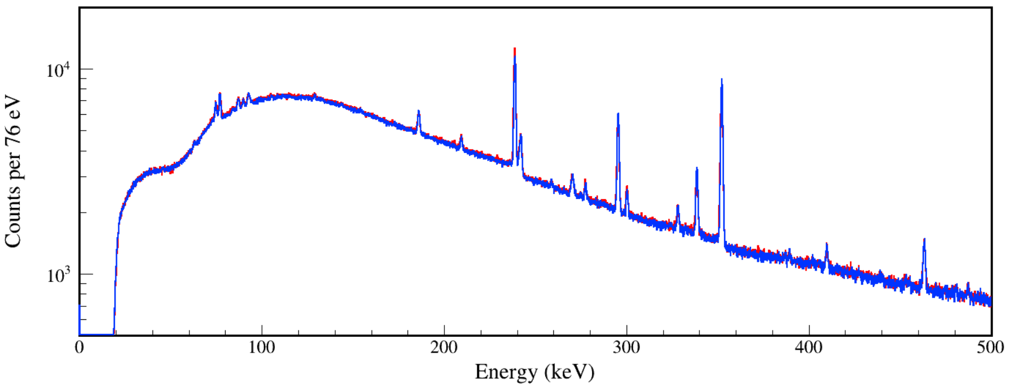
Red: Run332-340, 24 hours (²²⁸Th installed)
Blue: Run807, 24 hours (²²⁸Th removed)

Slide 2
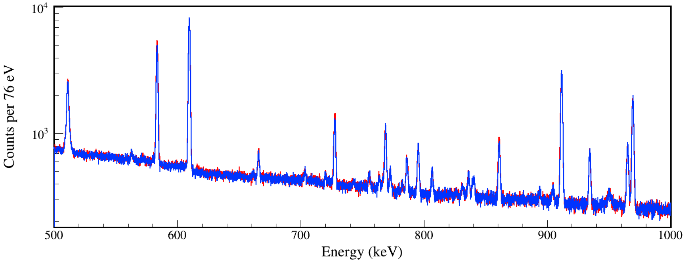
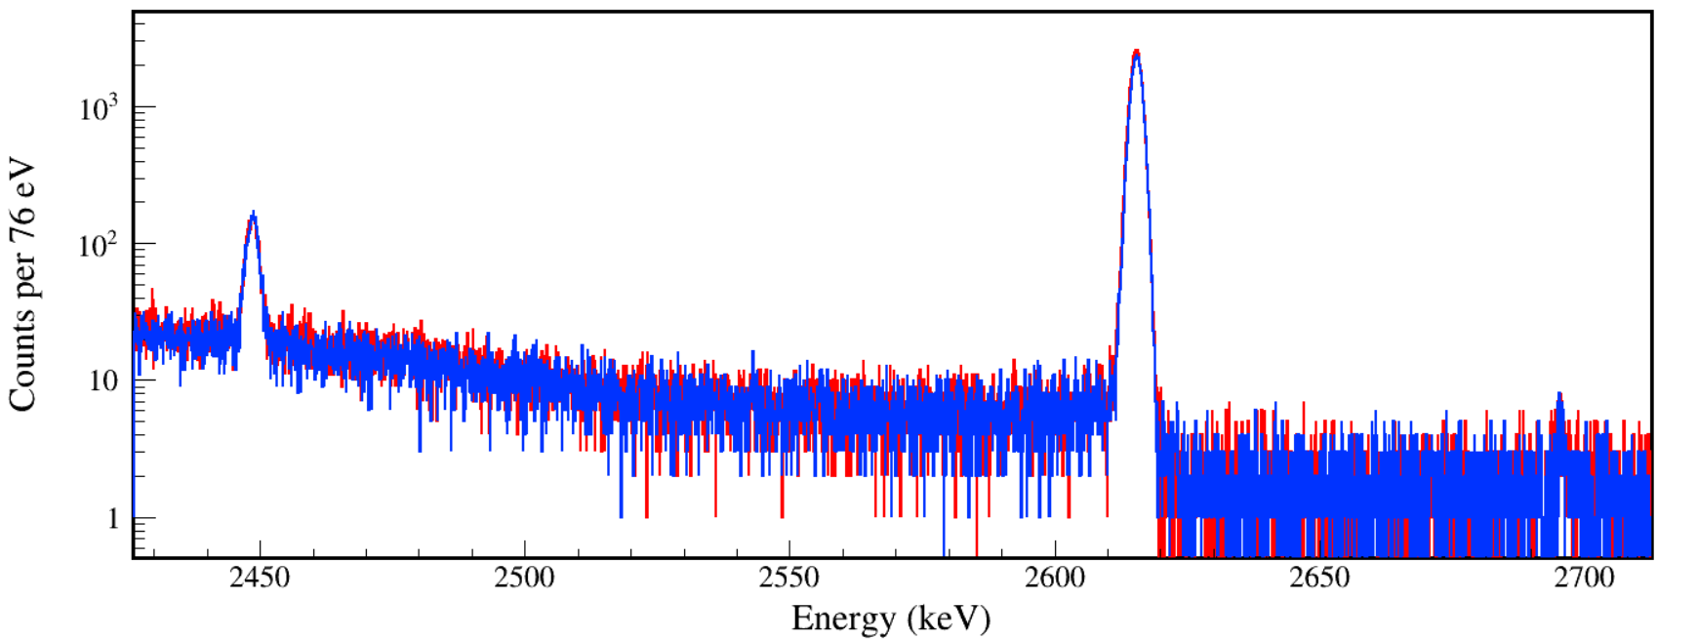
Red: Run332-340, 24 hours (²²⁸Th installed)
Blue: Run807, 24 hours (²²⁸Th removed)
Green: Red – Blue

Slide 3
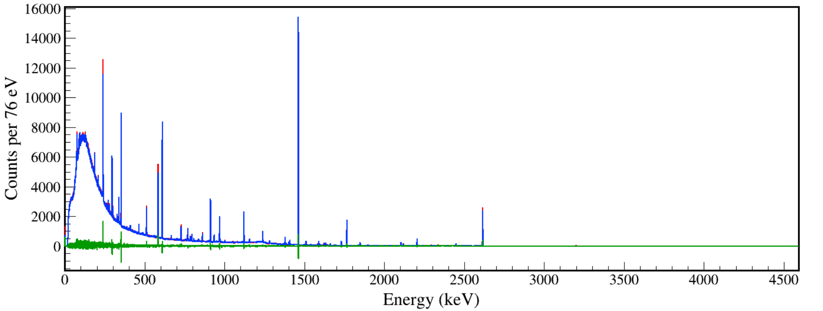
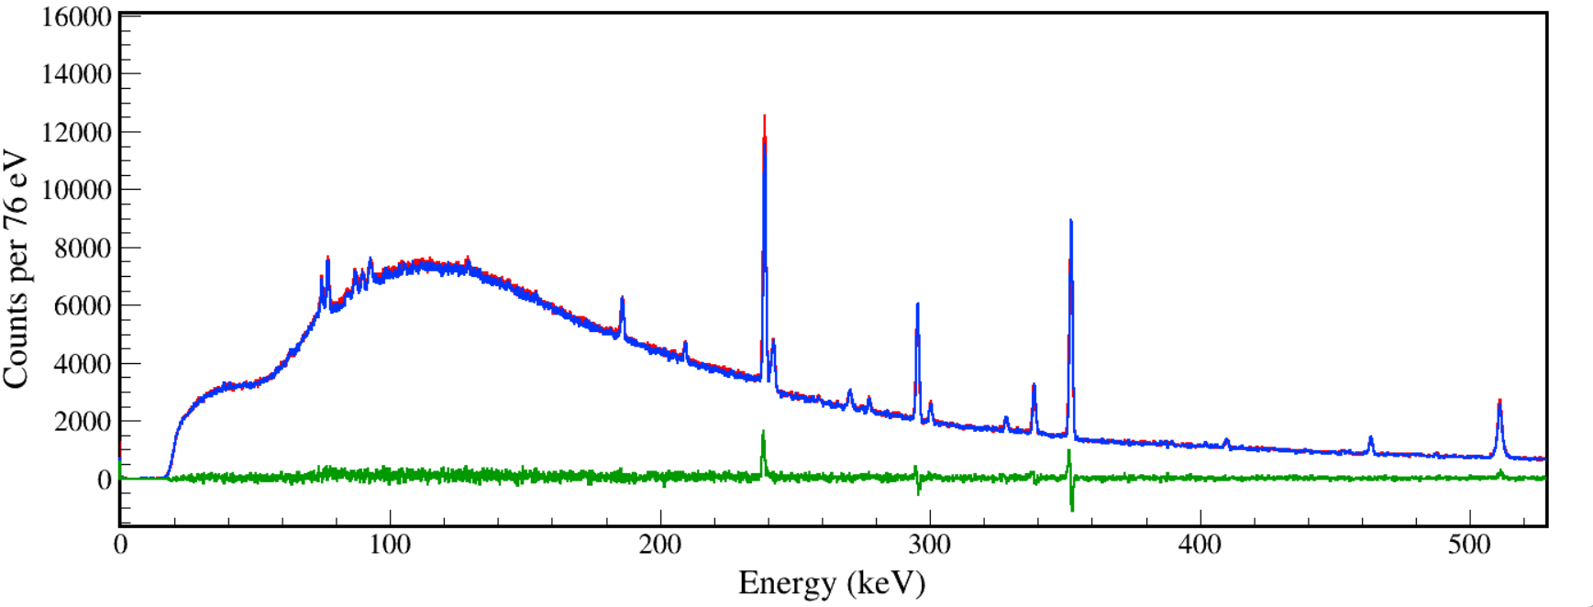
Red: Run332-340, 24 hours (²²⁸Th installed)
Blue: Run807, 24 hours (²²⁸Th removed)
Green: Red – Blue

Slide 4
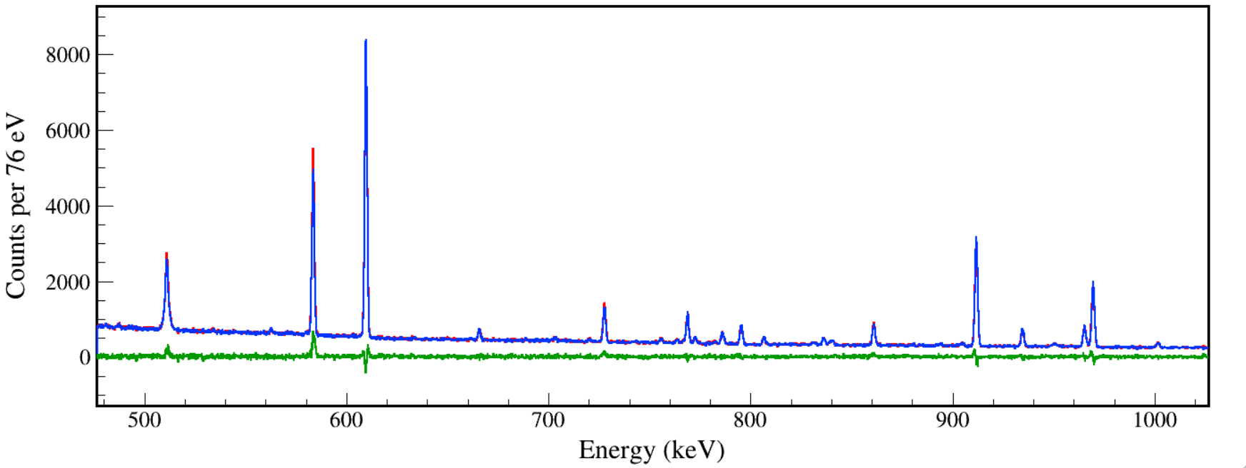
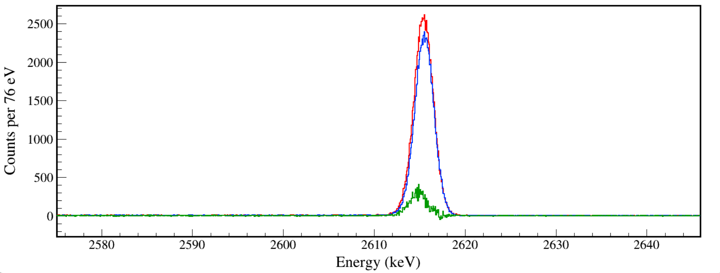
Red: Run332-340, 24 hours (²²⁸Th installed)
Blue: Run807, 24 hours (²²⁸Th removed)
Green: Red – Blue

