Slide 1
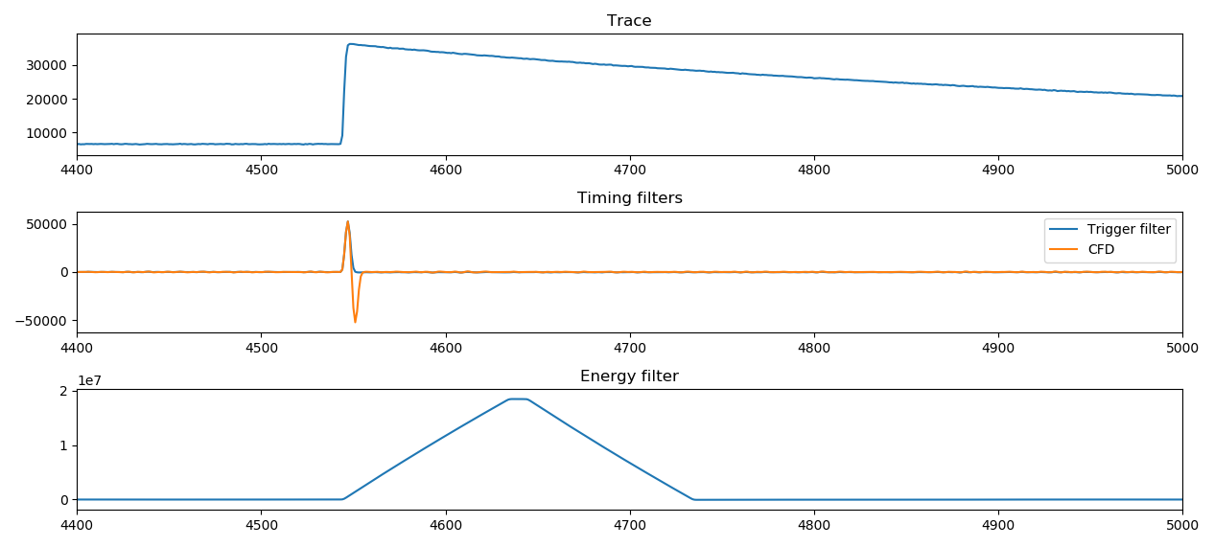

Slide 2
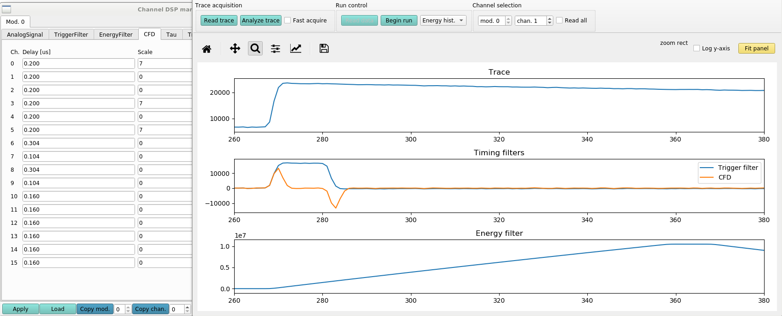
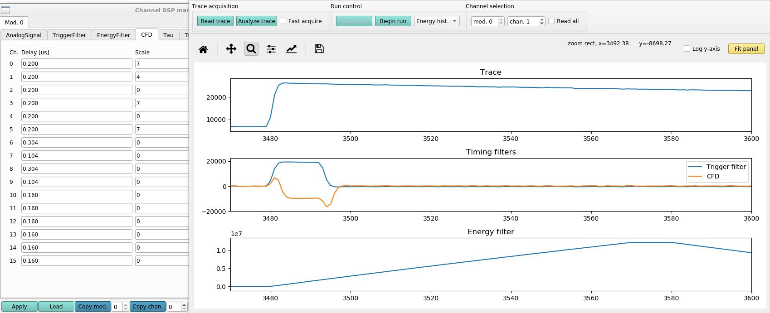
CFD Delay 0.200 μs
CFD Scale 0
CFD Delay 0.200 μs
CFD Scale 4

Slide 3
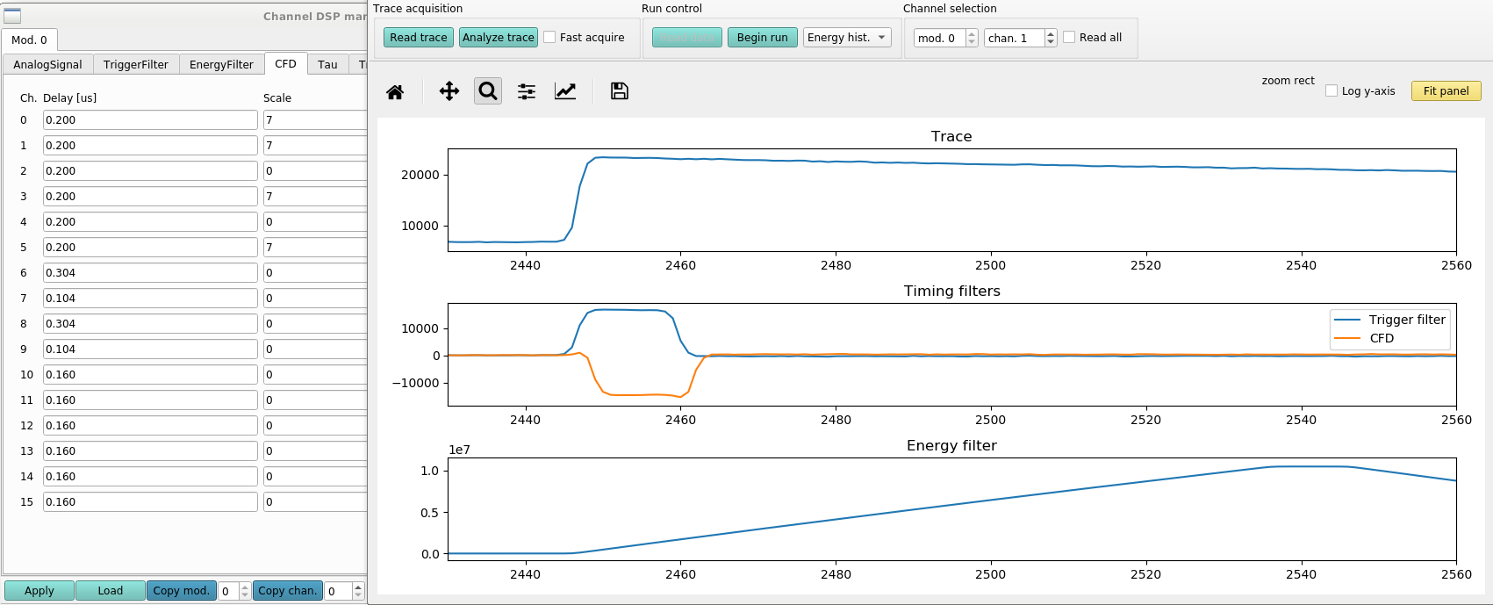
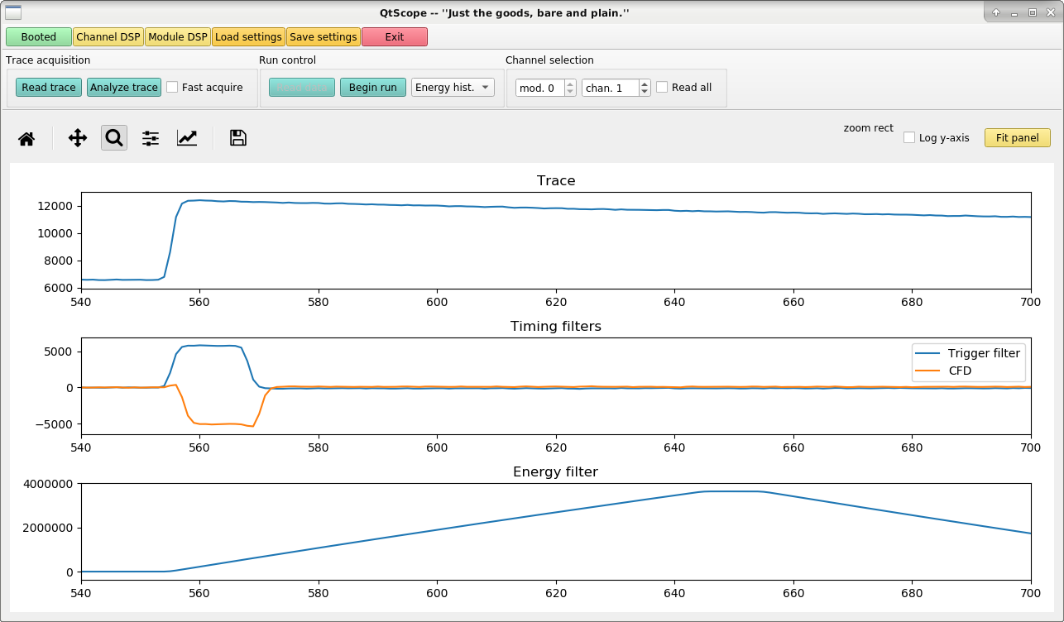
CFD Delay 0.200 μs
CFD Scale 7
CFD Delay 0.120 μs
CFD Scale 7

