Slide 1
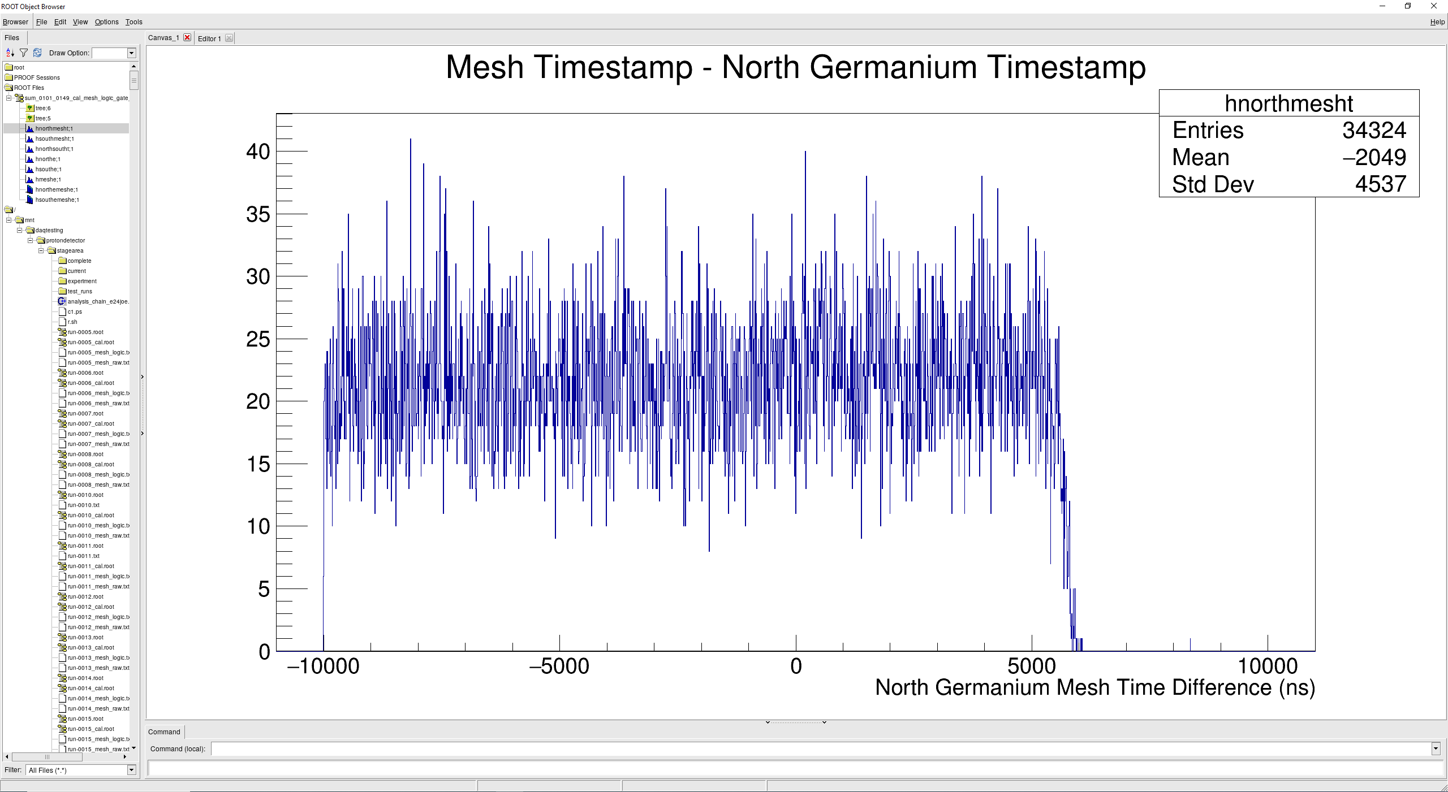
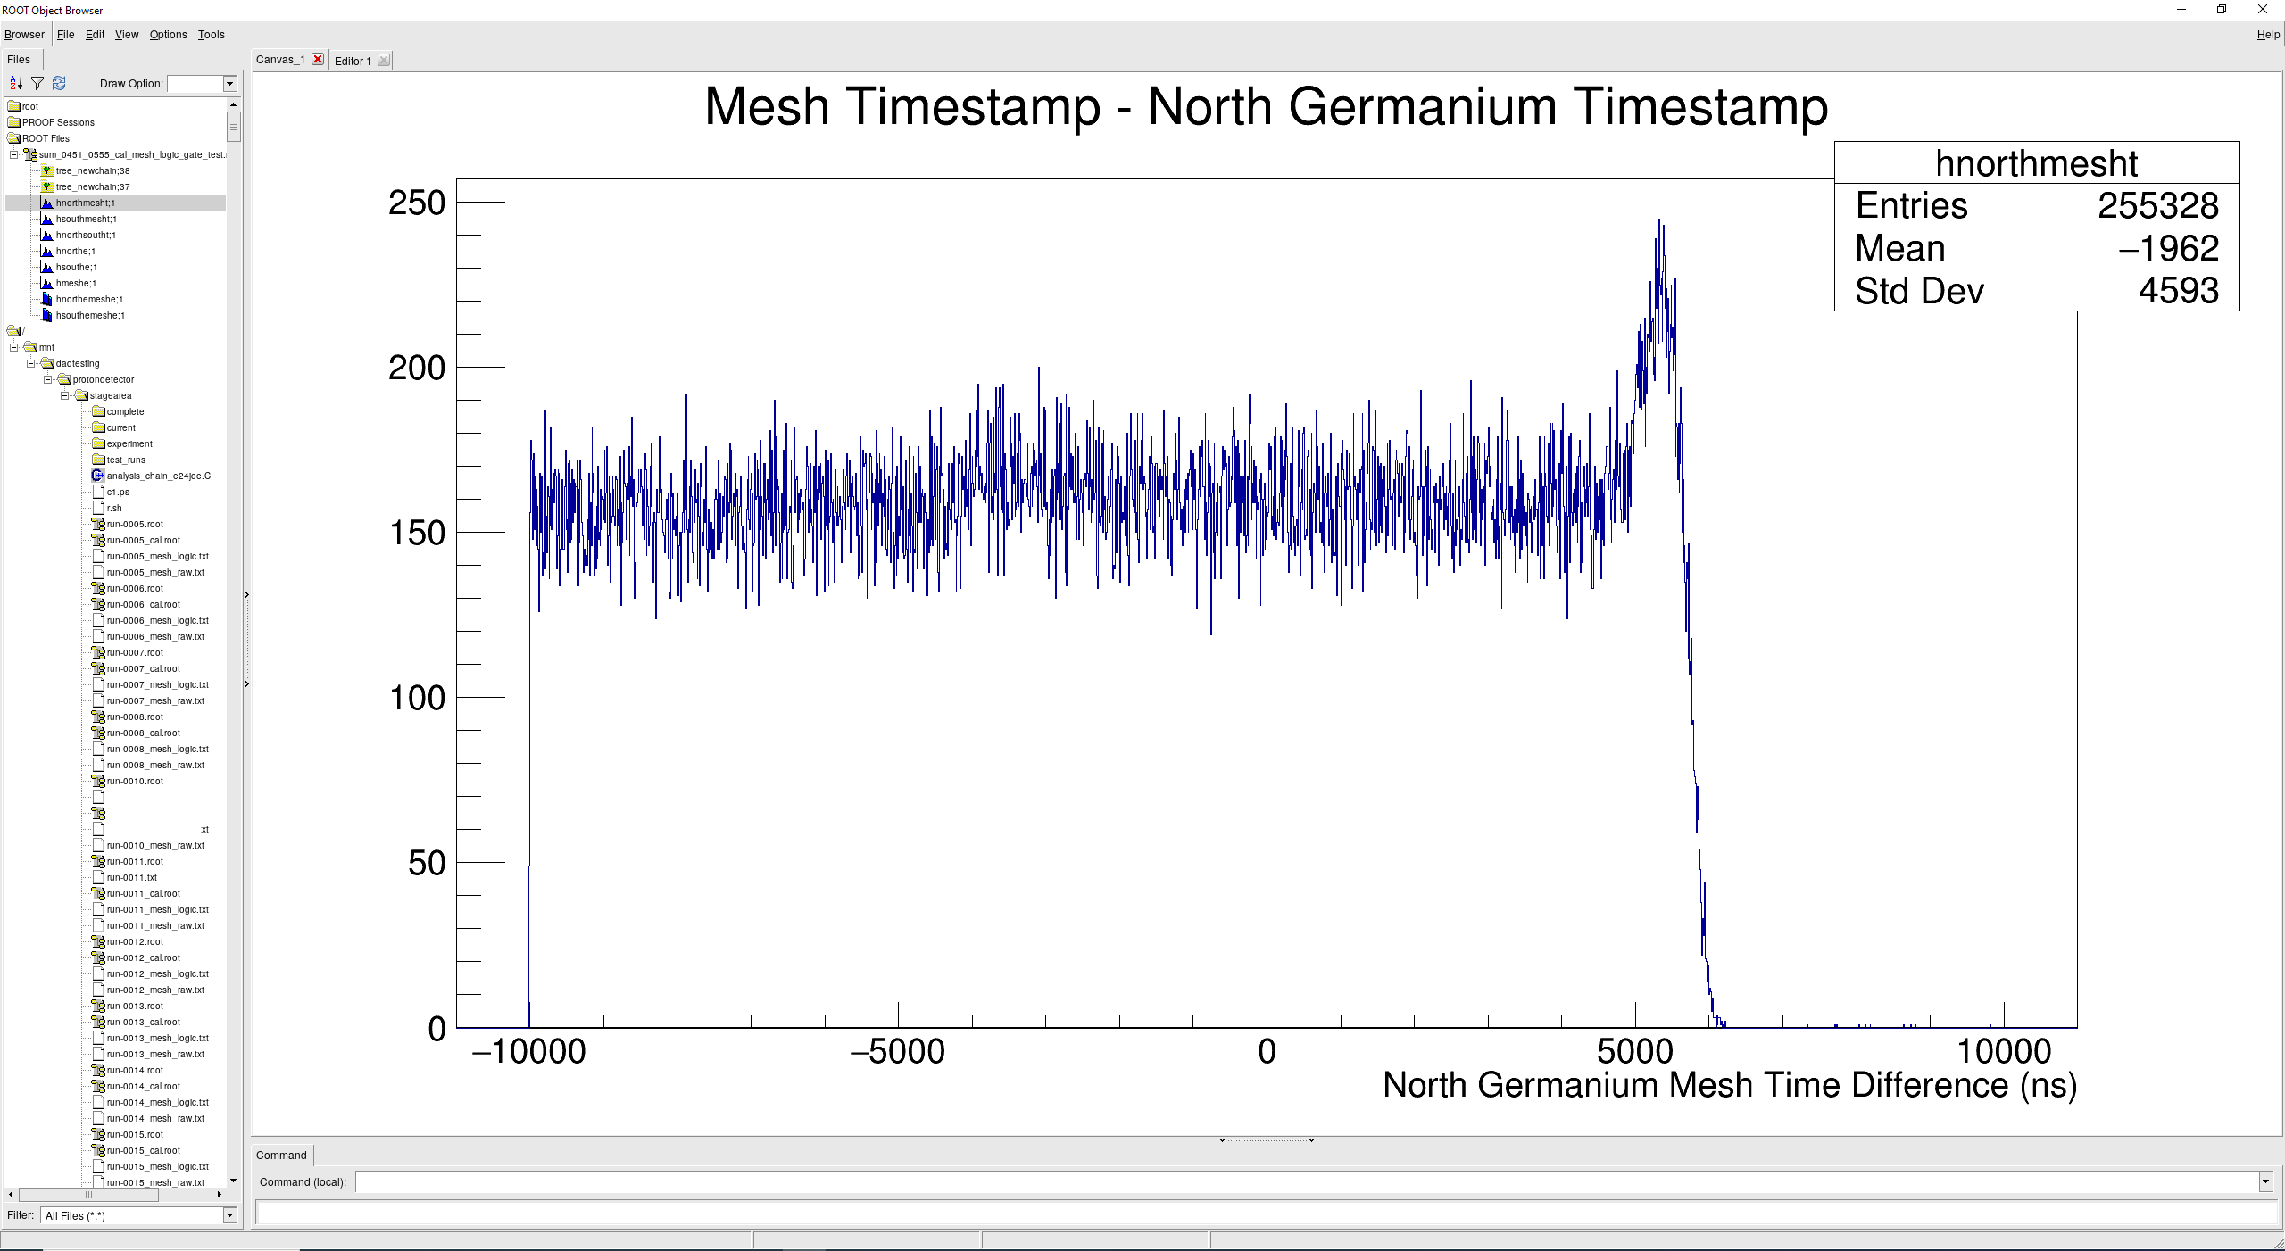
Ge-Mesh Signal Timing Histogram (only events where the mesh triggered)
At run 162 we delayed the Ge signal by 4 us to see the full drift time of the TPC, for some reason both end at +6 us
Runs 101-149 gated on mesh logic
Runs 451-555 gated on mesh logic

Slide 2
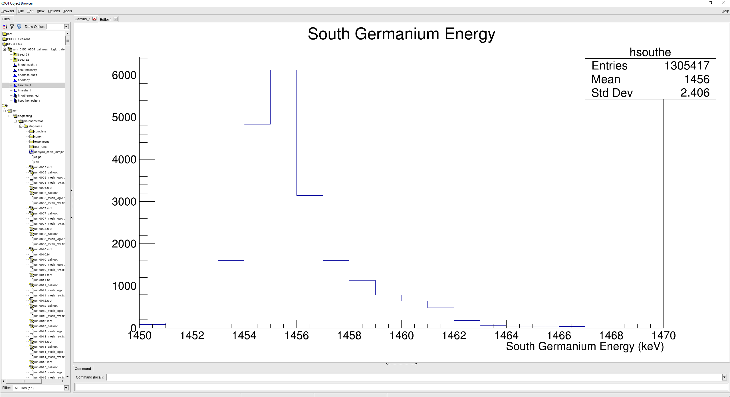
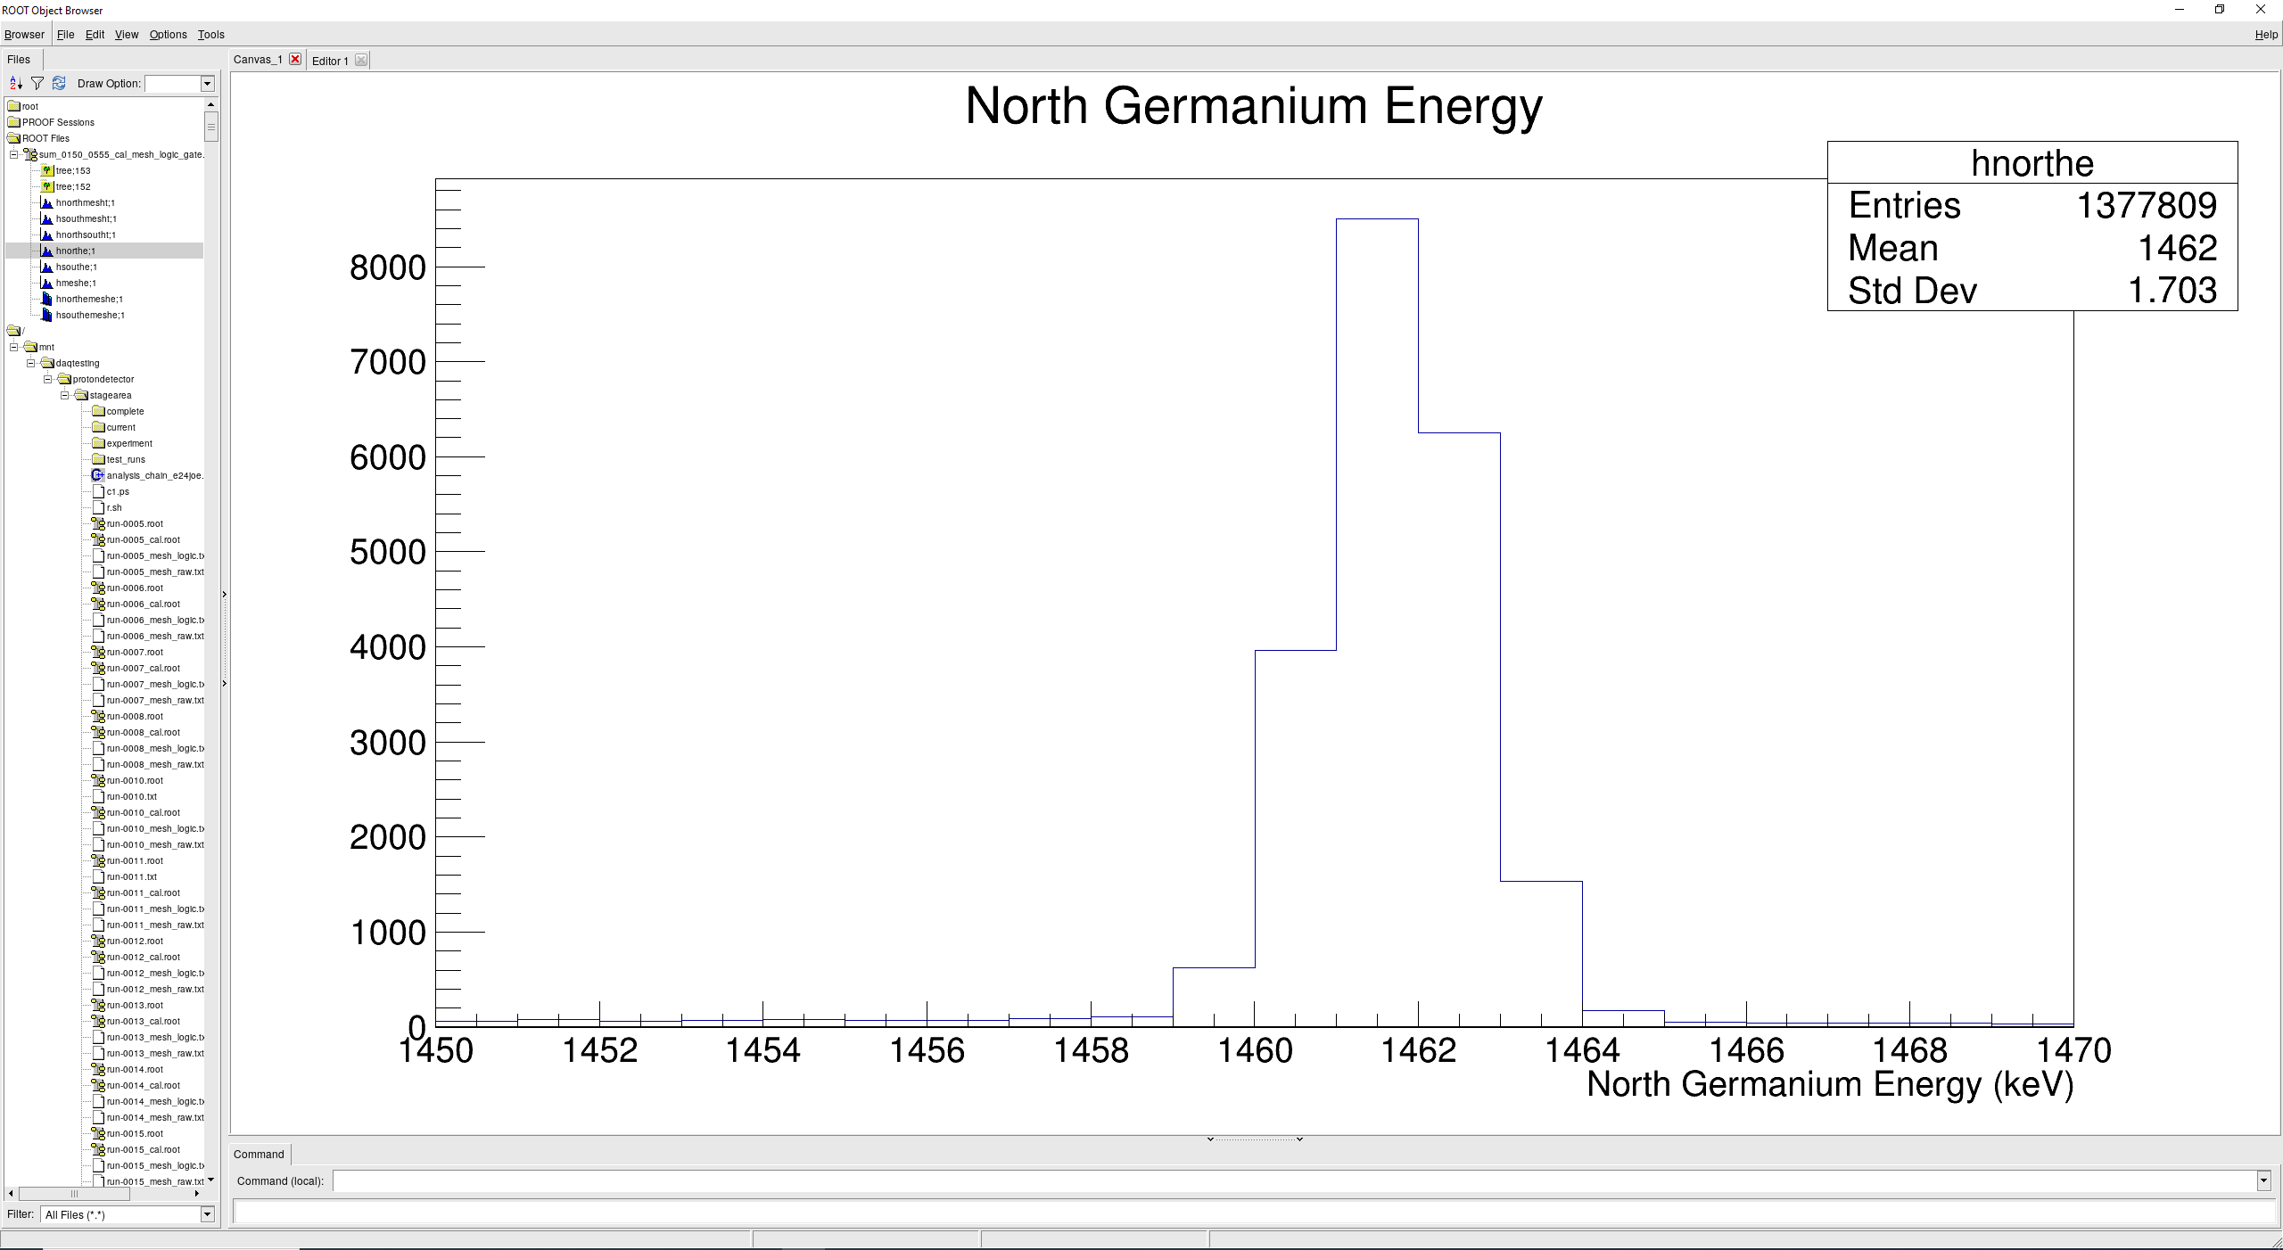
Some gain drift in south germanium
On the order of 0.4% across the runs throughout the experiment
For gammas at 511 keV this is a 2 keV effect
For gammas at 1461 keV this is a ~6 keV effect
Runs 150-555

Slide 3
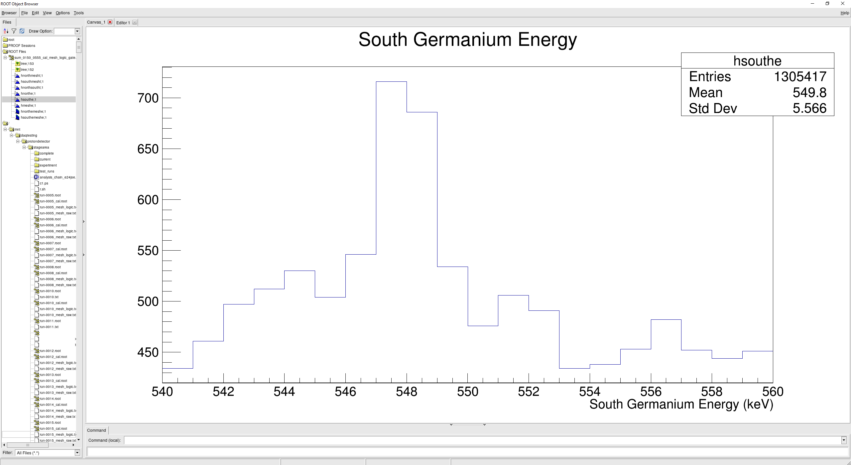
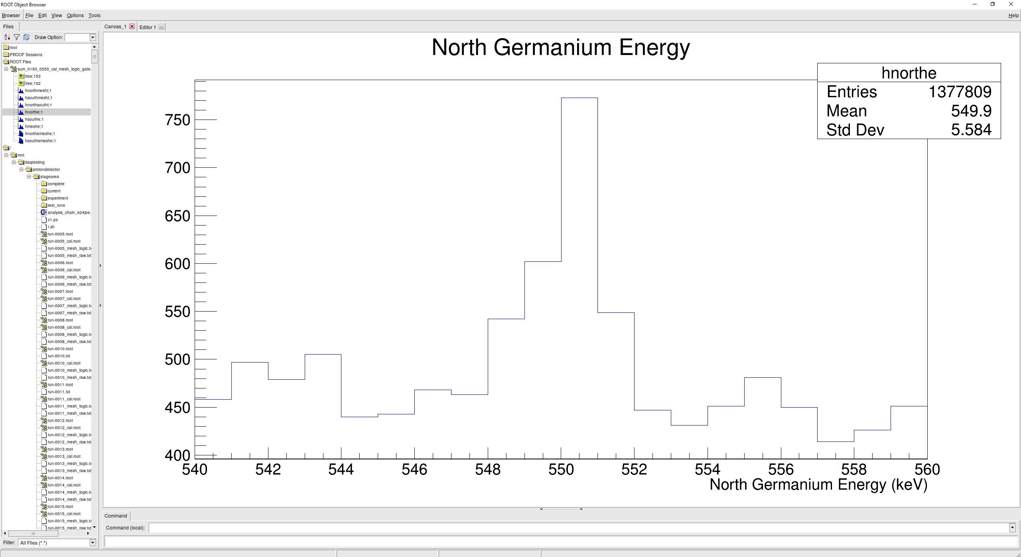
Some gain drift in south germanium
On the order of 0.4% across the runs throughout the experiment
For gammas at 511 keV this is a 2 keV effect
For gammas at 1461 keV this is a ~6 keV effect
Runs 150-555

Slide 4
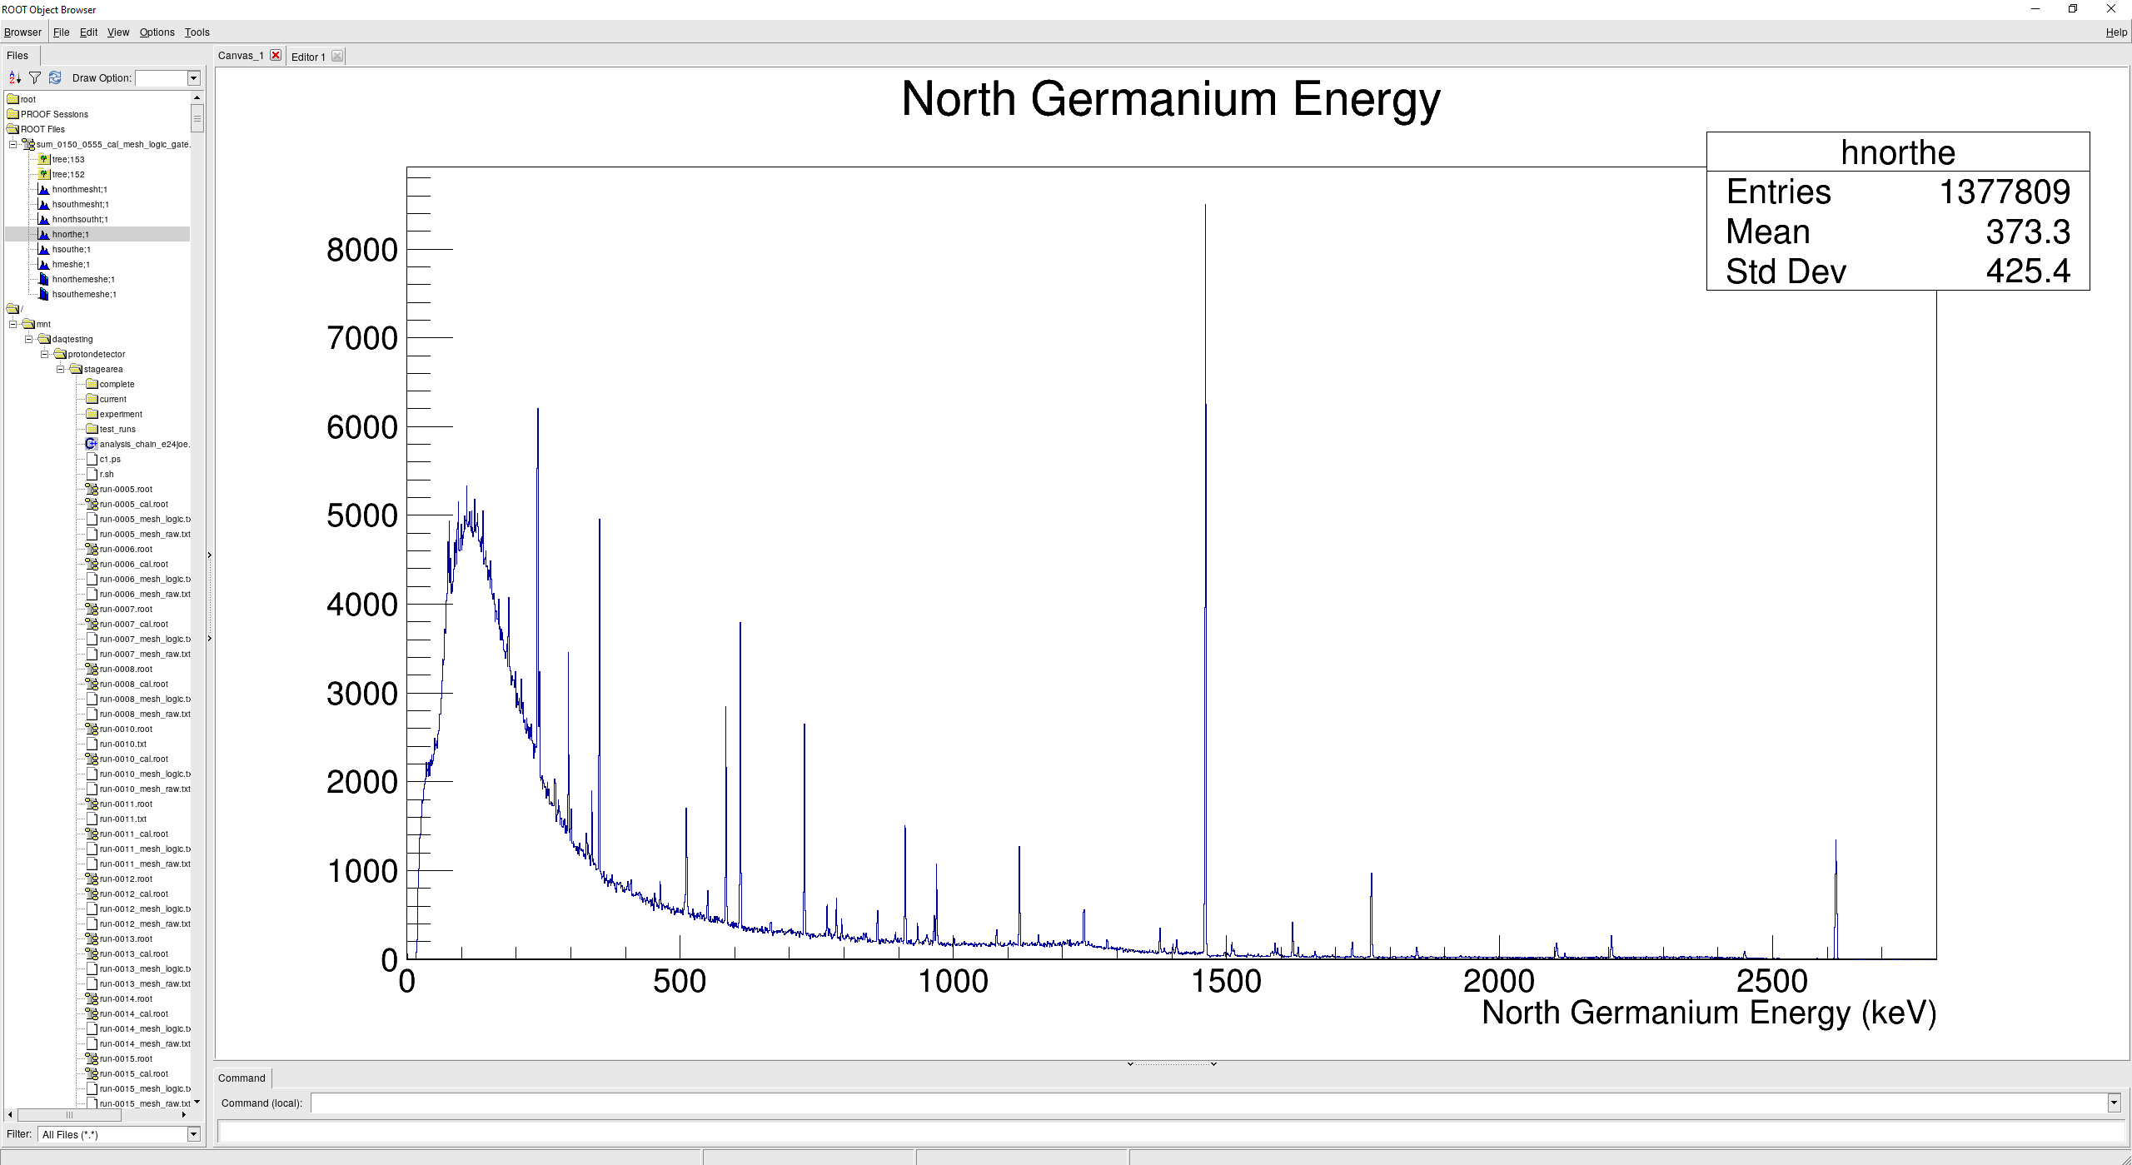
Compton Edge
Compton edge of 1461 keV gamma begins at ~1244 keV
Max E = $\backslash frac\left\{2E_{γ}^{2}\right\}\left\{2E_{γ}+m_{e}\right\}$

Slide 5
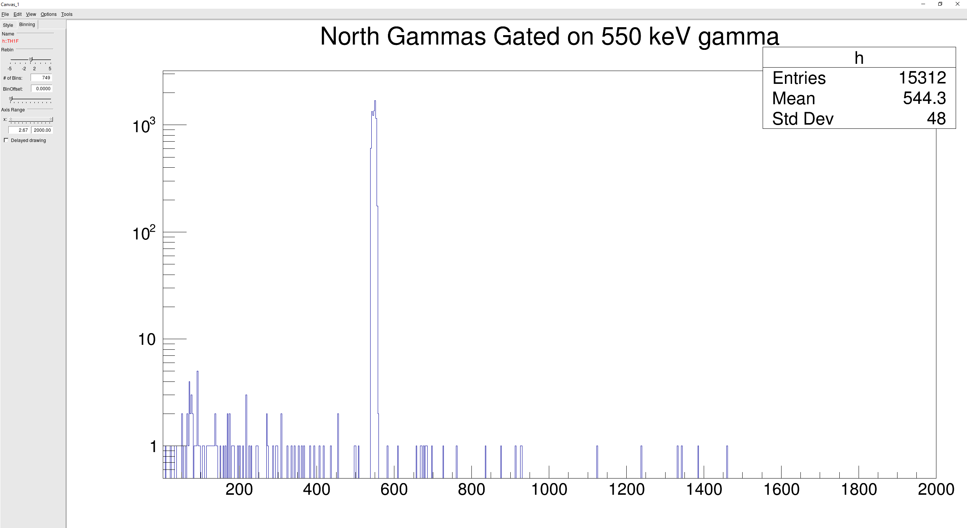
Alpha-550 keV gamma gated North spectrum

