Slide 1
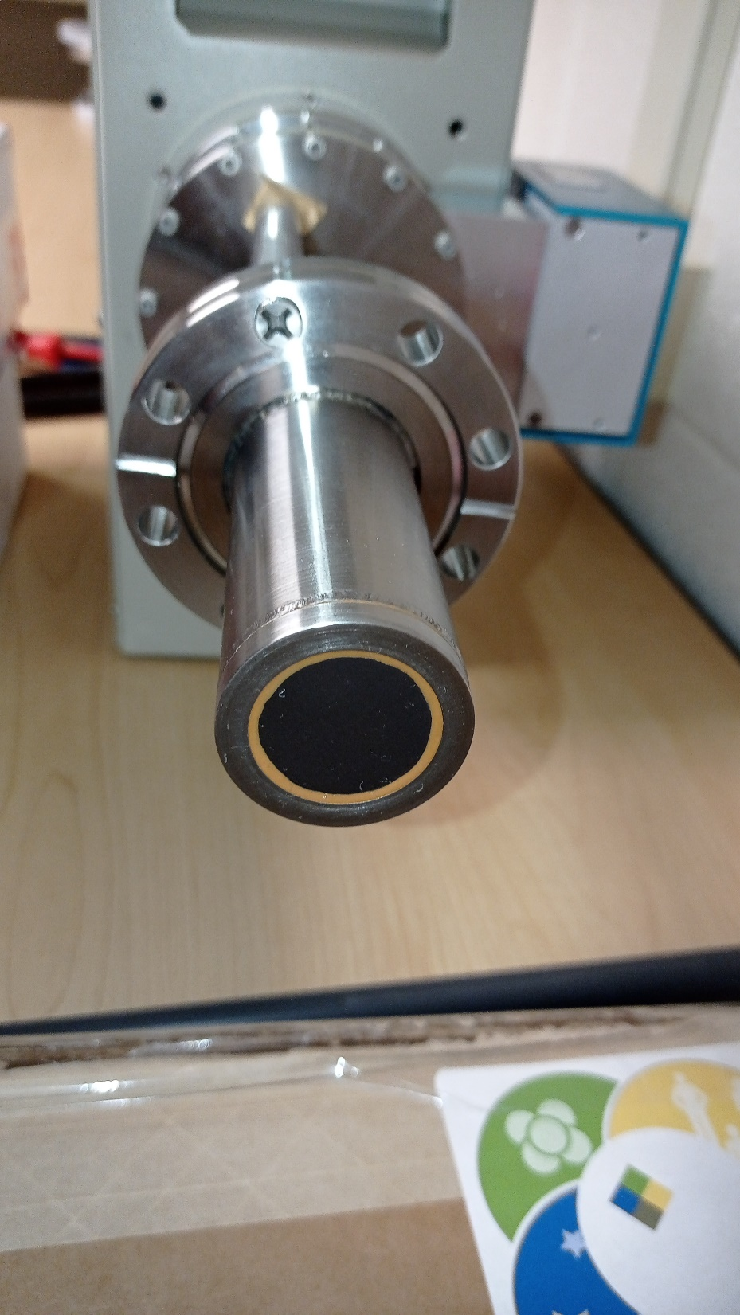
CF50 flange
Diameter: 25.0 mm
Thickness: 10.5 mm
Window Material: Beryllium
Window Thickness: 0.13 mm
Depletion Voltage: –600 V
Recommended Bias: –1100 V

Slide 2
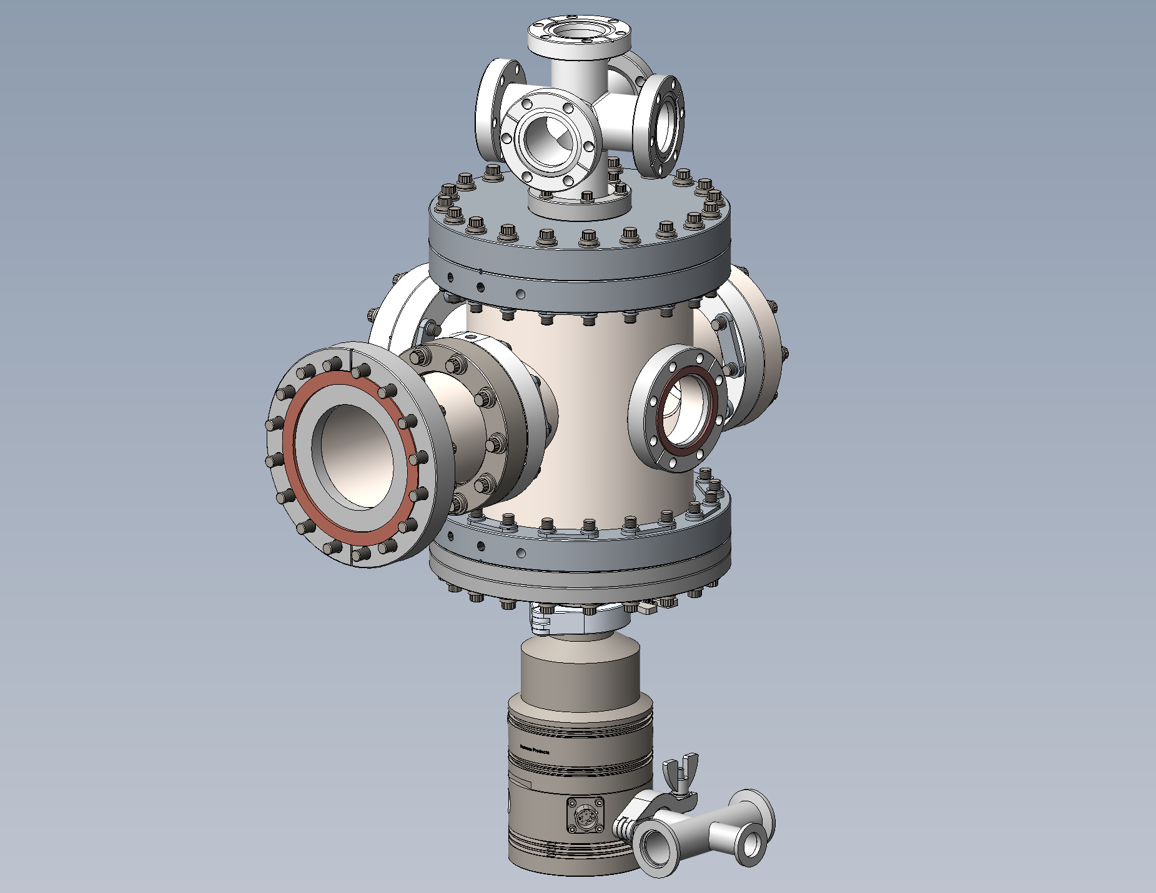
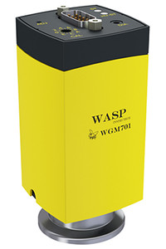
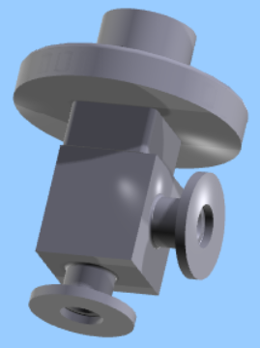
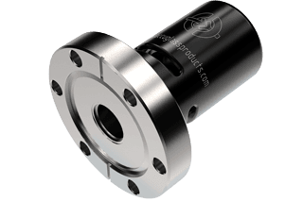
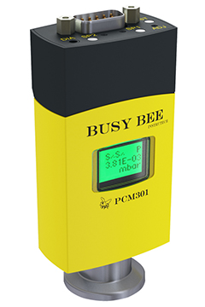
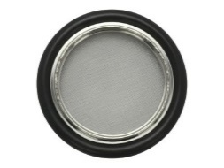
WGM701 Wasp
Cold Cathode Pirani Combination Vacuum Gauge
(2 3/4 in. CF)
AGC302 Single Channel Active Gauge Controller
PS301 Gauge Controller Power Supply
Needle valve
Pressure relief valve
C37102000 valve
(KF10) Unit Price: $548
Centering Ring Assembly KF-10 with Screen
PRV on a 2.75" CF Flange, Pressure Relief Valve - 2 PSI
PS401 Convection & Pirani Vacuum Gauge Power Supply
Inline check valve
Soft Start Valve Series 311 (KF16)
Centering Ring With Screen, NW40 Size ISO-KF Flange, Viton O-ring, 100318605
PCM301 Busy Bee Pirani Capacitance Combination Vacuum Gauge (NW16KF)
Roughing pump

Slide 3
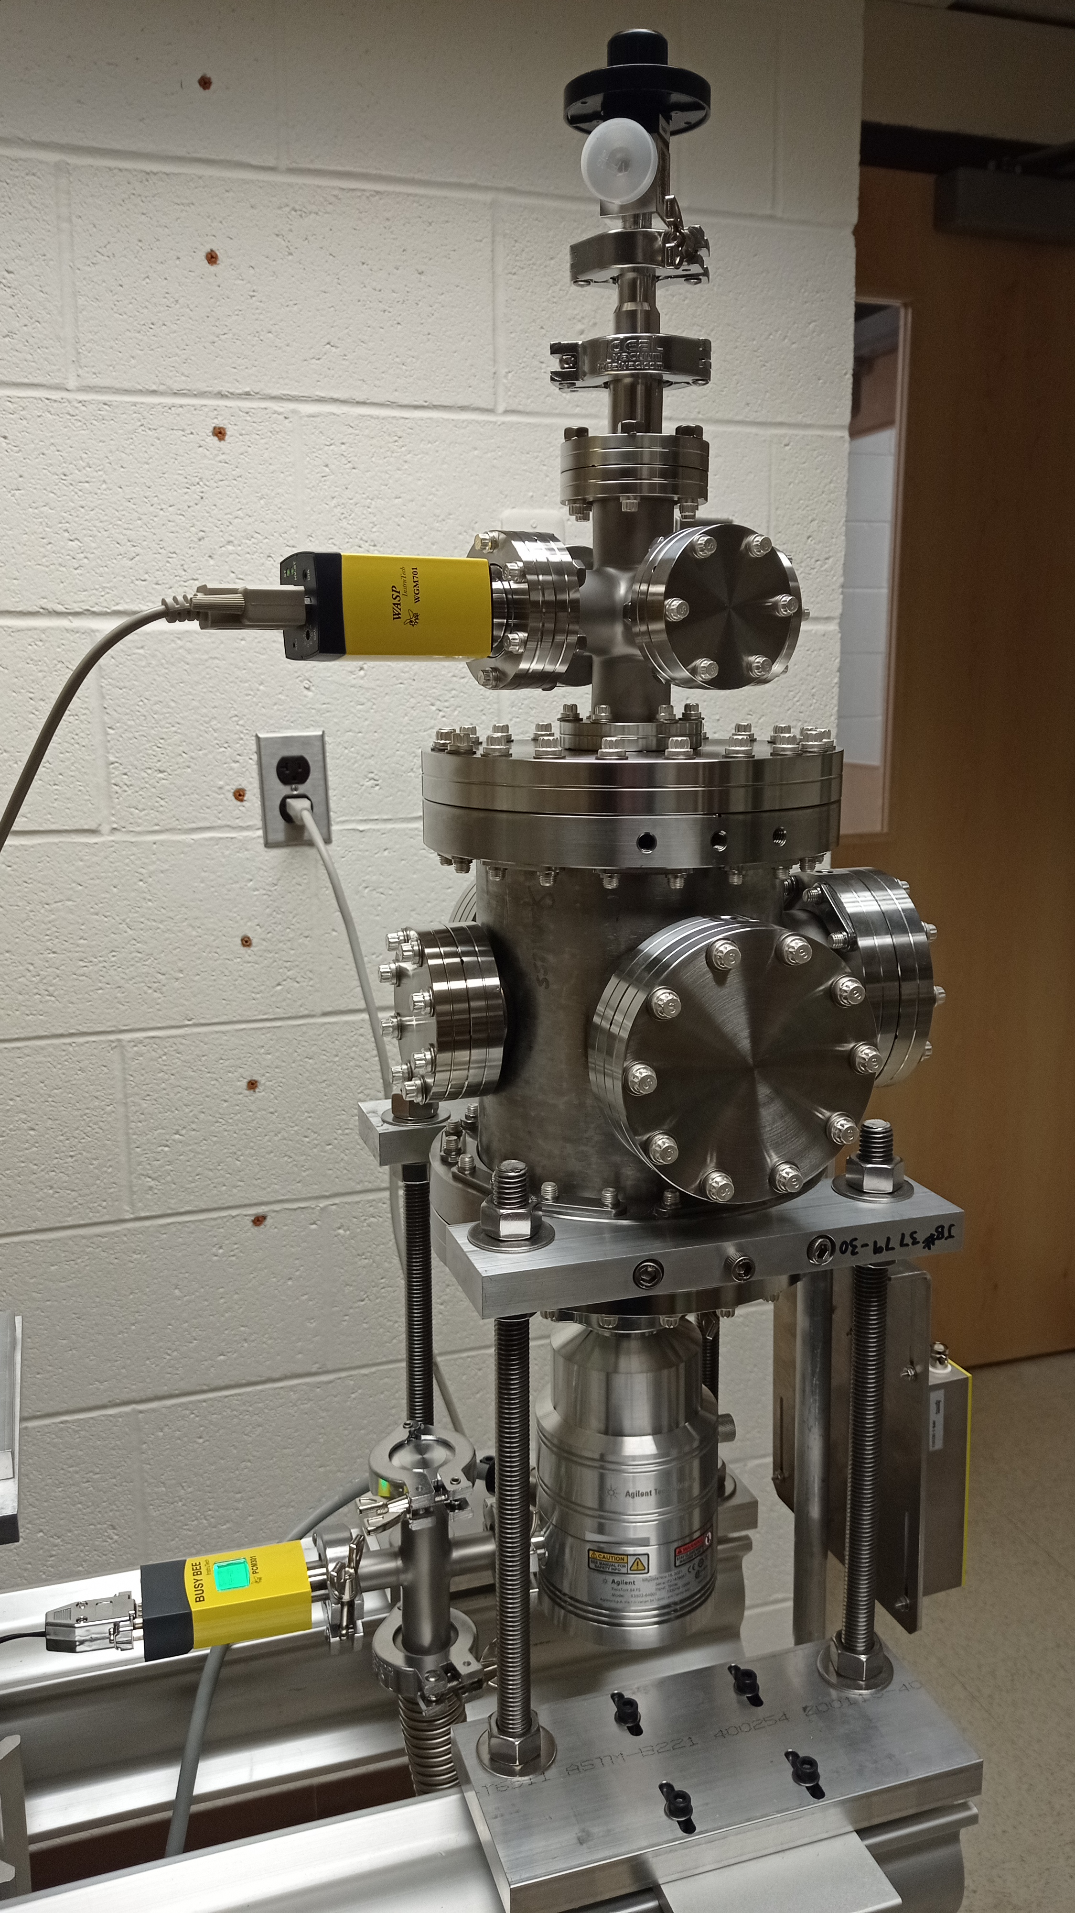
WGM701 Wasp
Cold Cathode Pirani Combination Vacuum Gauge
(2 3/4 in. CF)
AGC302 Single Channel Active Gauge Controller
PS301 Gauge Controller Power Supply
Needle valve
Pressure relief valve
C37102000 valve
(KF10) Unit Price: $548
Centering Ring Assembly KF-10 with Screen
Inline check valve
Soft Start Valve Series 311 (KF16)
When the roughing system goes into operation, a strong airflow occurs in the roughing line, which immediately closes the valve and reduces the pipe section by about 99%. When reaching a differential pressure of approx. 15 mbar, the valve opens and leaves the pipe section nearly unobstructed for further pumping.
Centering Ring With Screen, NW40 Size ISO-KF Flange, Viton O-ring, 100318605
PCM301 Busy Bee Pirani Capacitance Combination Vacuum Gauge (NW16KF)
PS401 Convection & Pirani Vacuum Gauge Power Supply
Threaded plug
Scroll pump

Slide 4
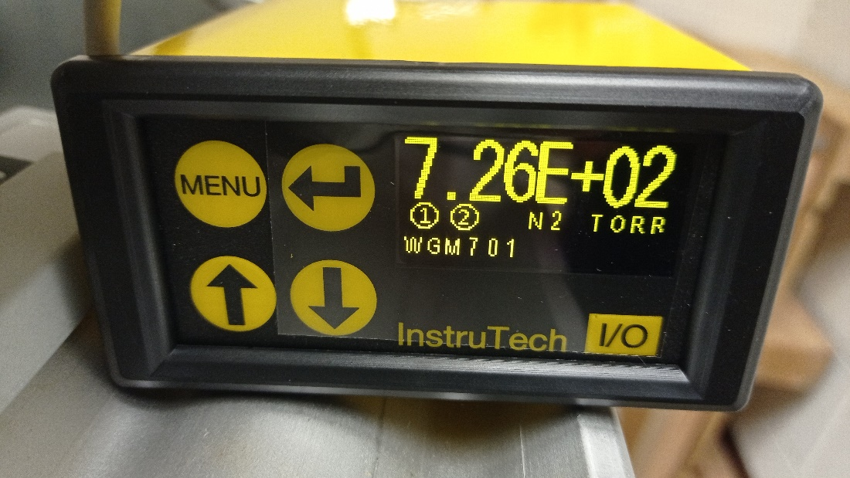
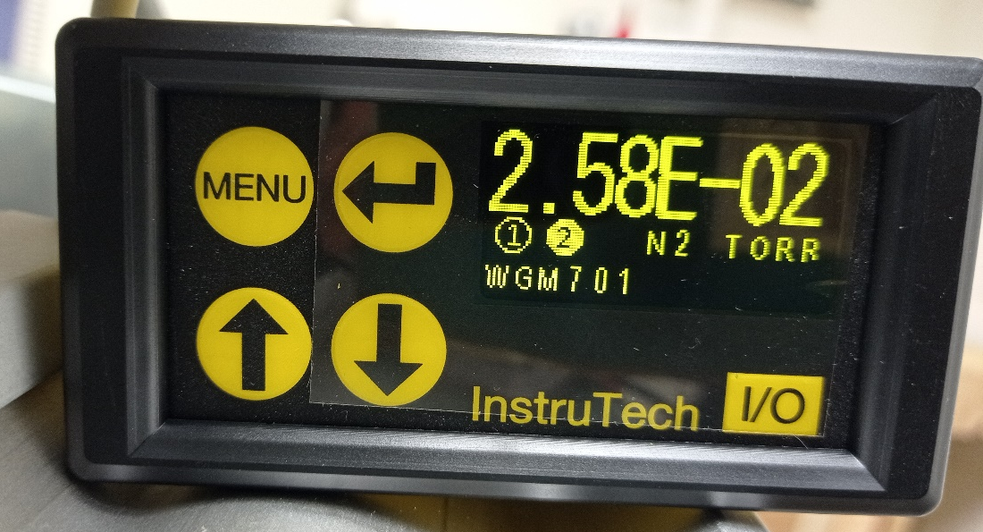
Atmosphere
Scroll pump on

Slide 5
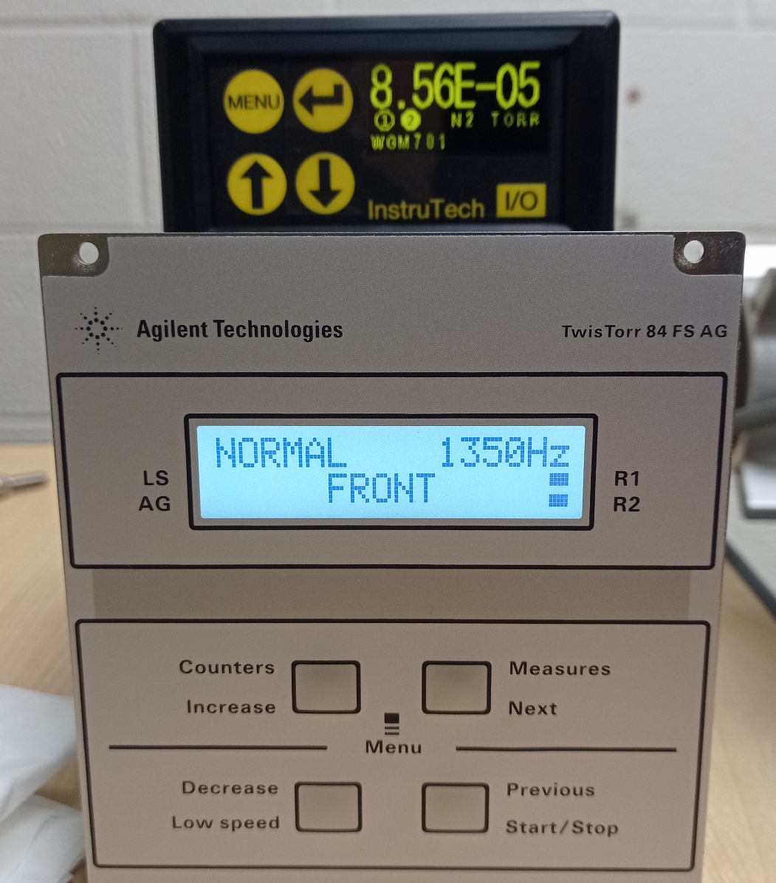
Turbo pump on

Slide 6
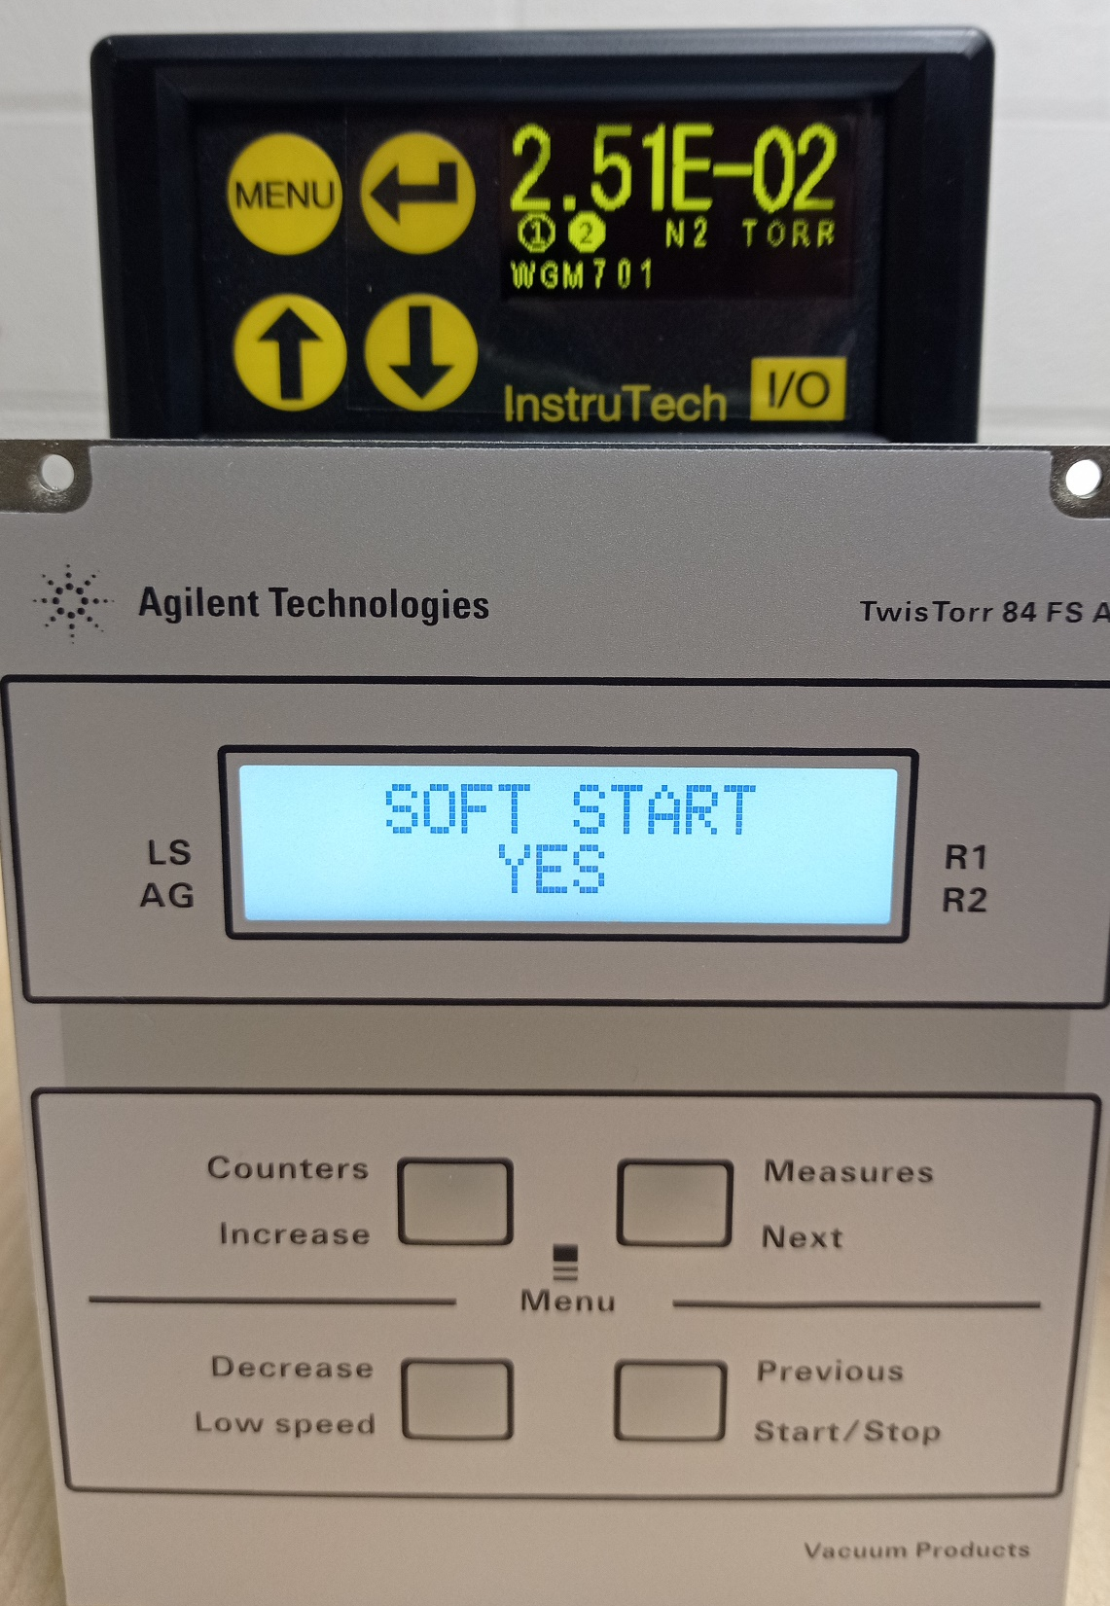
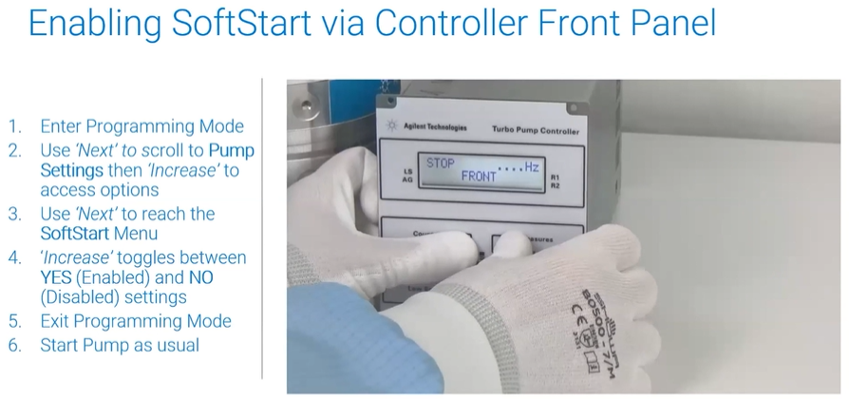
The turbomolecular pumps must always be soft-started when received and operated for the first time by the customer. This allows a better grease distribution in the bearings.
https://www.agilent.com/en/product/vacuum-technologies/turbo-pumps-controllers/2-min-tutorial-turbo-pump-soft-start

Slide 7
▪ START MODE: Permits selection of one of the three types of functioning of the START/STOP and INTERLOCK inputs:
▪ START/INTERLOCK: The pump is started if the START/STOP input is activated and is stopped if the START/STOP input is de-activated. The interlock input must be constantly active (INTERLOCK TYPE parameter = continuous) or may be active only at the time of starting (INTERLOCK TYPE parameter = impulsive)
▪ START/STOP LEVEL The START/STOP input acts as only START command (active on the level) The INTERLOCK input acts as STOP command (active on the level). In the case of concurrent activation of the two inputs, the STOP command takes priority
▪ START/STOP EDGE The START/STOP input acts as START command (active on the edge)
The INTERLOCK input acts as STOP command (active on the edge).

Slide 8
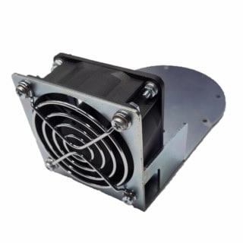
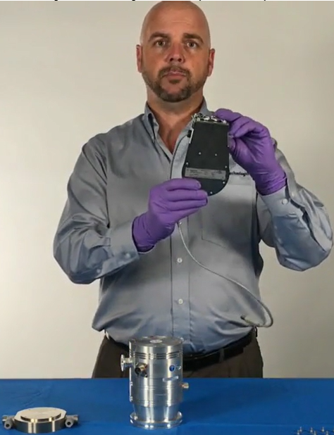
Air cooling kit, available with 0.5 m cable, USB type B connector, for 74 FS, 84 FS and V81 turbo pumps with rack or onboard controllers

