Slide 1
Lifetime of ²³Mg 7787 keV state (S2193)
1) Fit range
2) Bin width
3) Angular distribution
4) Bayesian analysis framework
5) Prior choices

Slide 2
Emulator | PCGP_numPCs | PCGP_numPCs | PCGP_numPCs | PCGP_numPCs | PCGP_numPCs
Calibrator | directbayeswoodbury | directbayeswoodbury | directbayeswoodbury | directbayeswoodbury | directbayeswoodbury
Sampler | metropolis_hastings | metropolis_hastings | metropolis_hastings | metropolis_hastings | metropolis_hastings
Prior (keV) | Gaussian Mean = 7332.7 Sigma = 1.2 | Gaussian Mean = 7335.1 Sigma = 0.9 | Gaussian Mean = 7333.2 Sigma = 1.1 | Bimodal Mean = 7332.7, 7333.7 Sigma = 1.2, 1.1 Weight = 0.5, 0.5 | Trimodal Mean = 7332.7, 7333.7, 7335.1 Sigma = 1.2, 1.1, 0.9 Weight = 0.33, 0.33, 0.33
E_{γ} (keV) | 7332.7(12) Sallaska_PRC2011 | 7335.1(9) Goldberg_Thesis2024 | 7333.2(11) Basunia_NDS2021 | 7332.7(12) Sallaska_PRC2011 7333.7(11) Jenkins_PRL2004 | 7332.7(12) Sallaska_PRC2011 7333.7(11) Jenkins_PRL2004 7335.1(9) Goldberg_Thesis2024
τ (fs) | $${6.3}_{−3.3}^{+3.9}$$ | $${9.5}_{−4.0}^{+4.6}$$ | $${7.0}_{−3.4}^{+3.8}$$ | $${7.2}_{−3.6}^{+3.8}$$ | $${8.1}_{−4.0}^{+4.5}$$
90% C.I. (fs) | <11.4 | <15.7 | <12.1 | <12.2 | <13.5

Slide 3
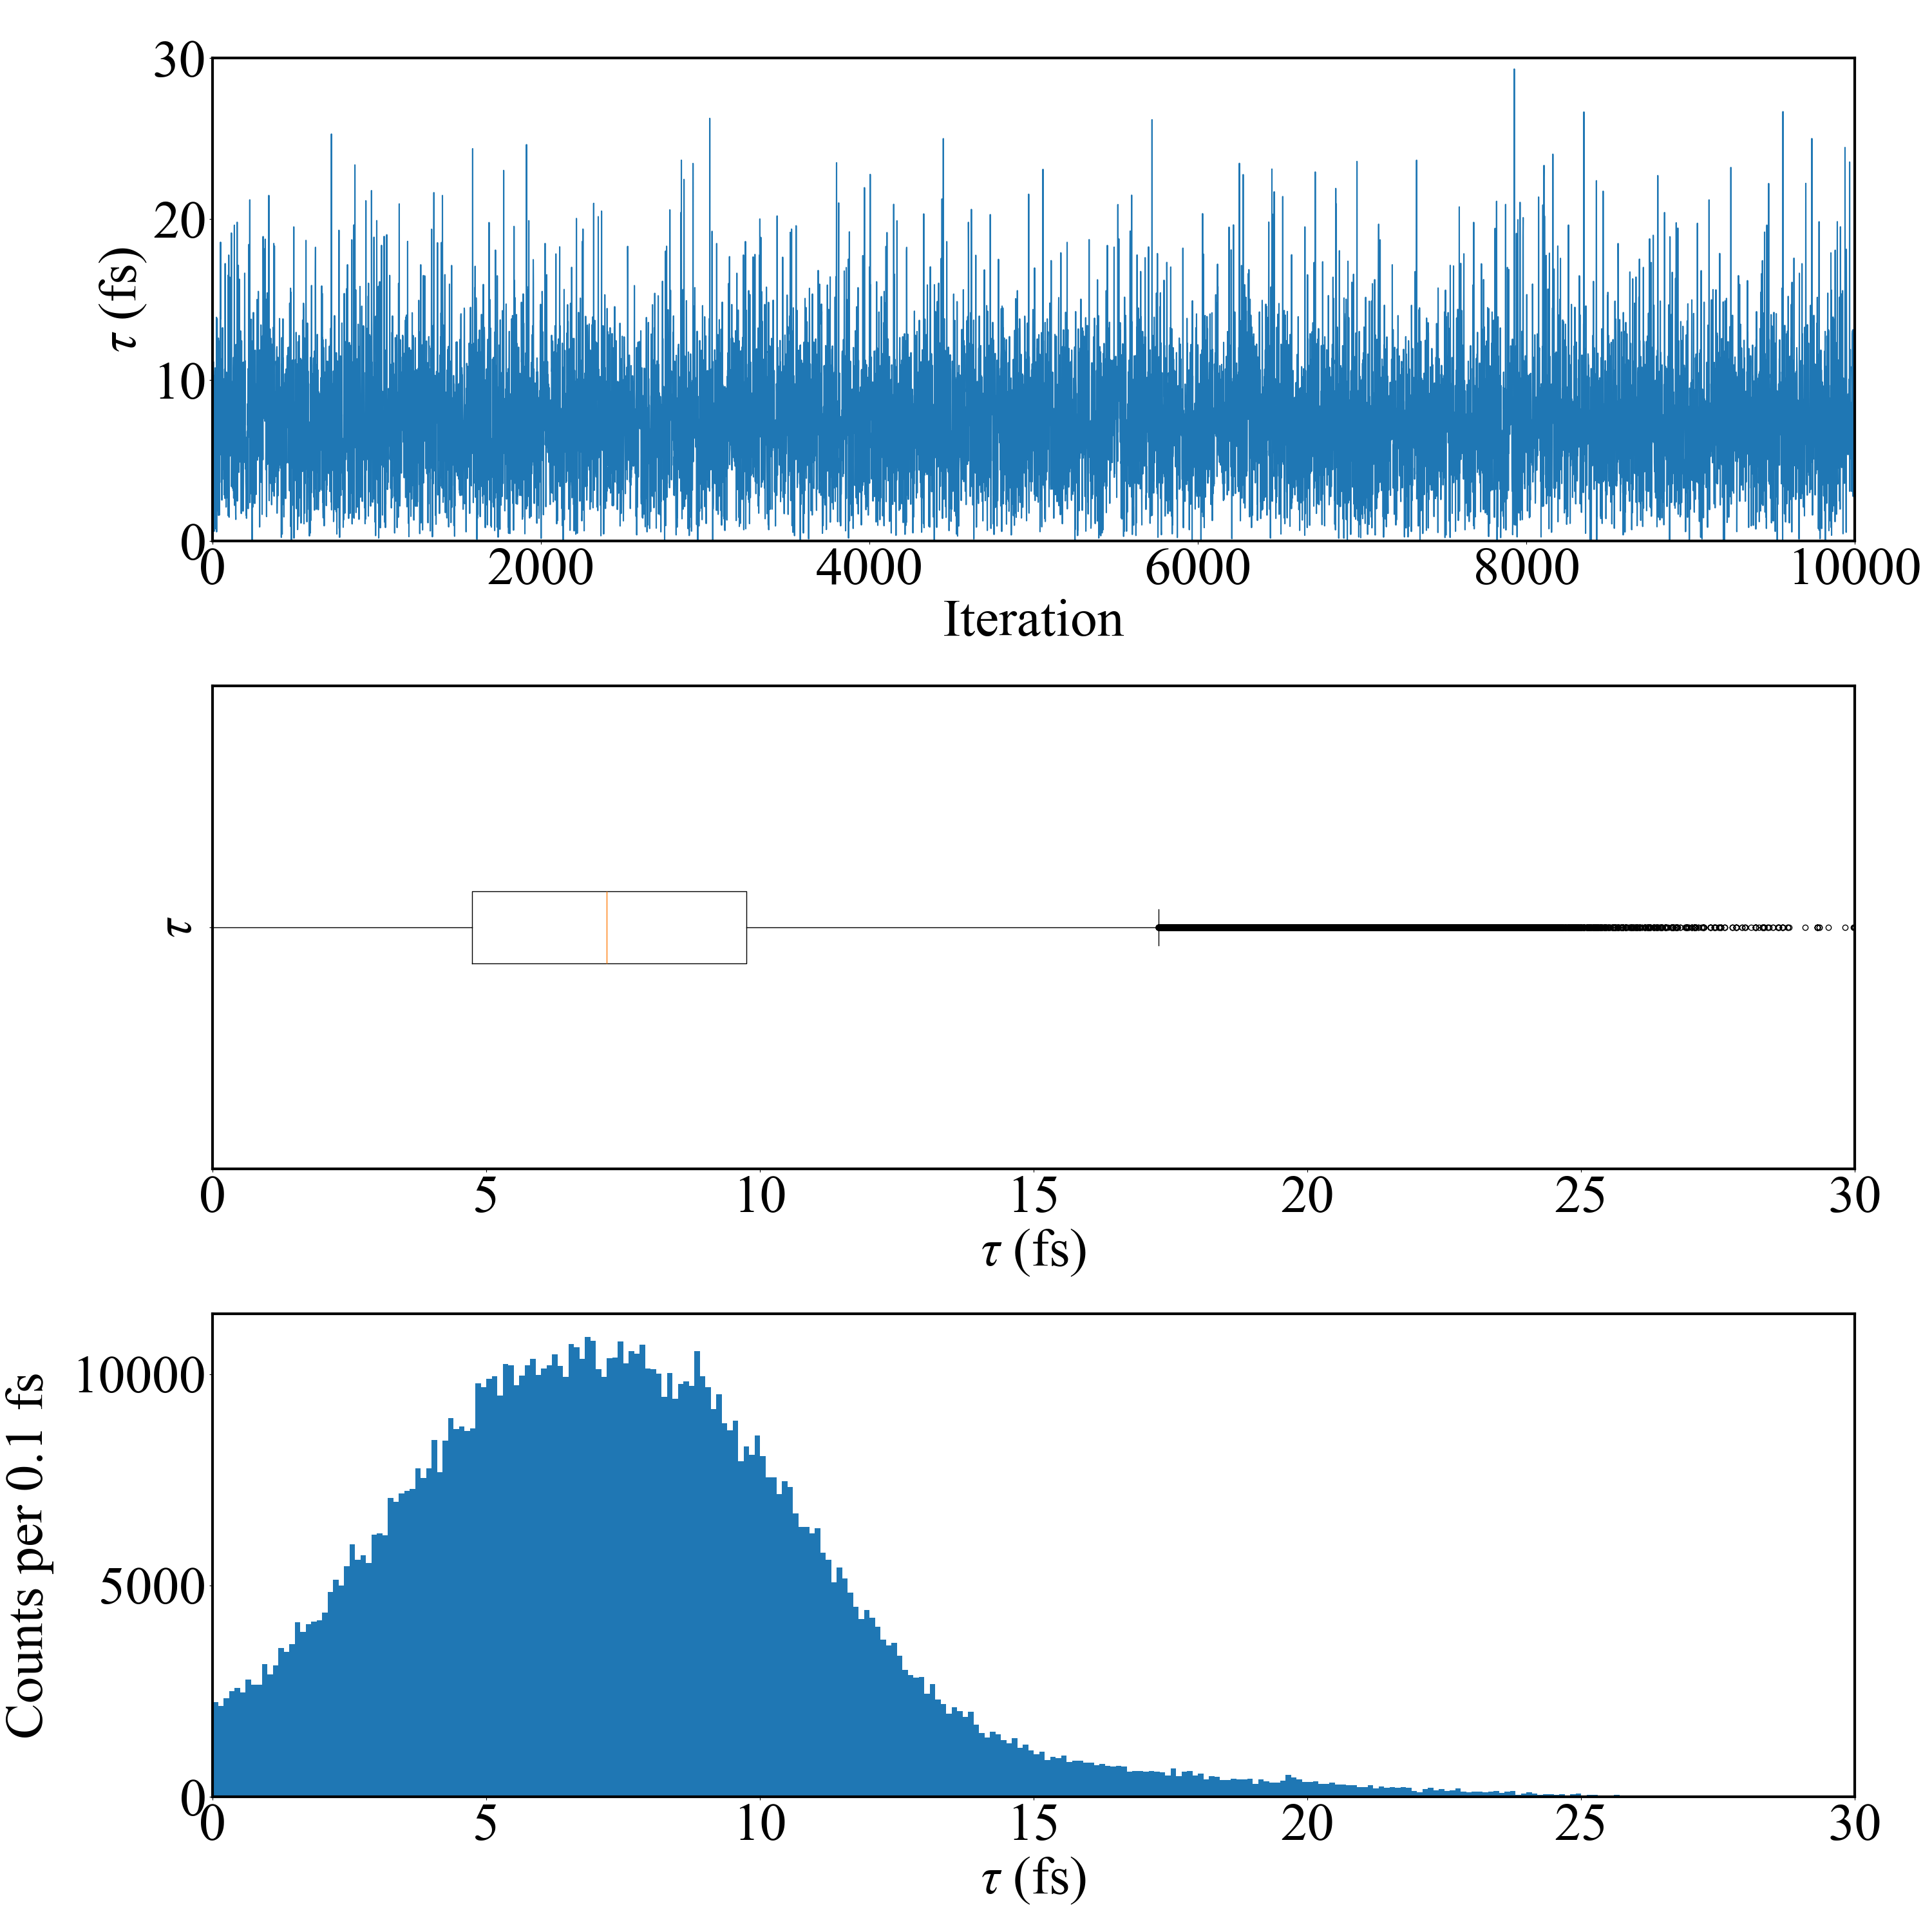
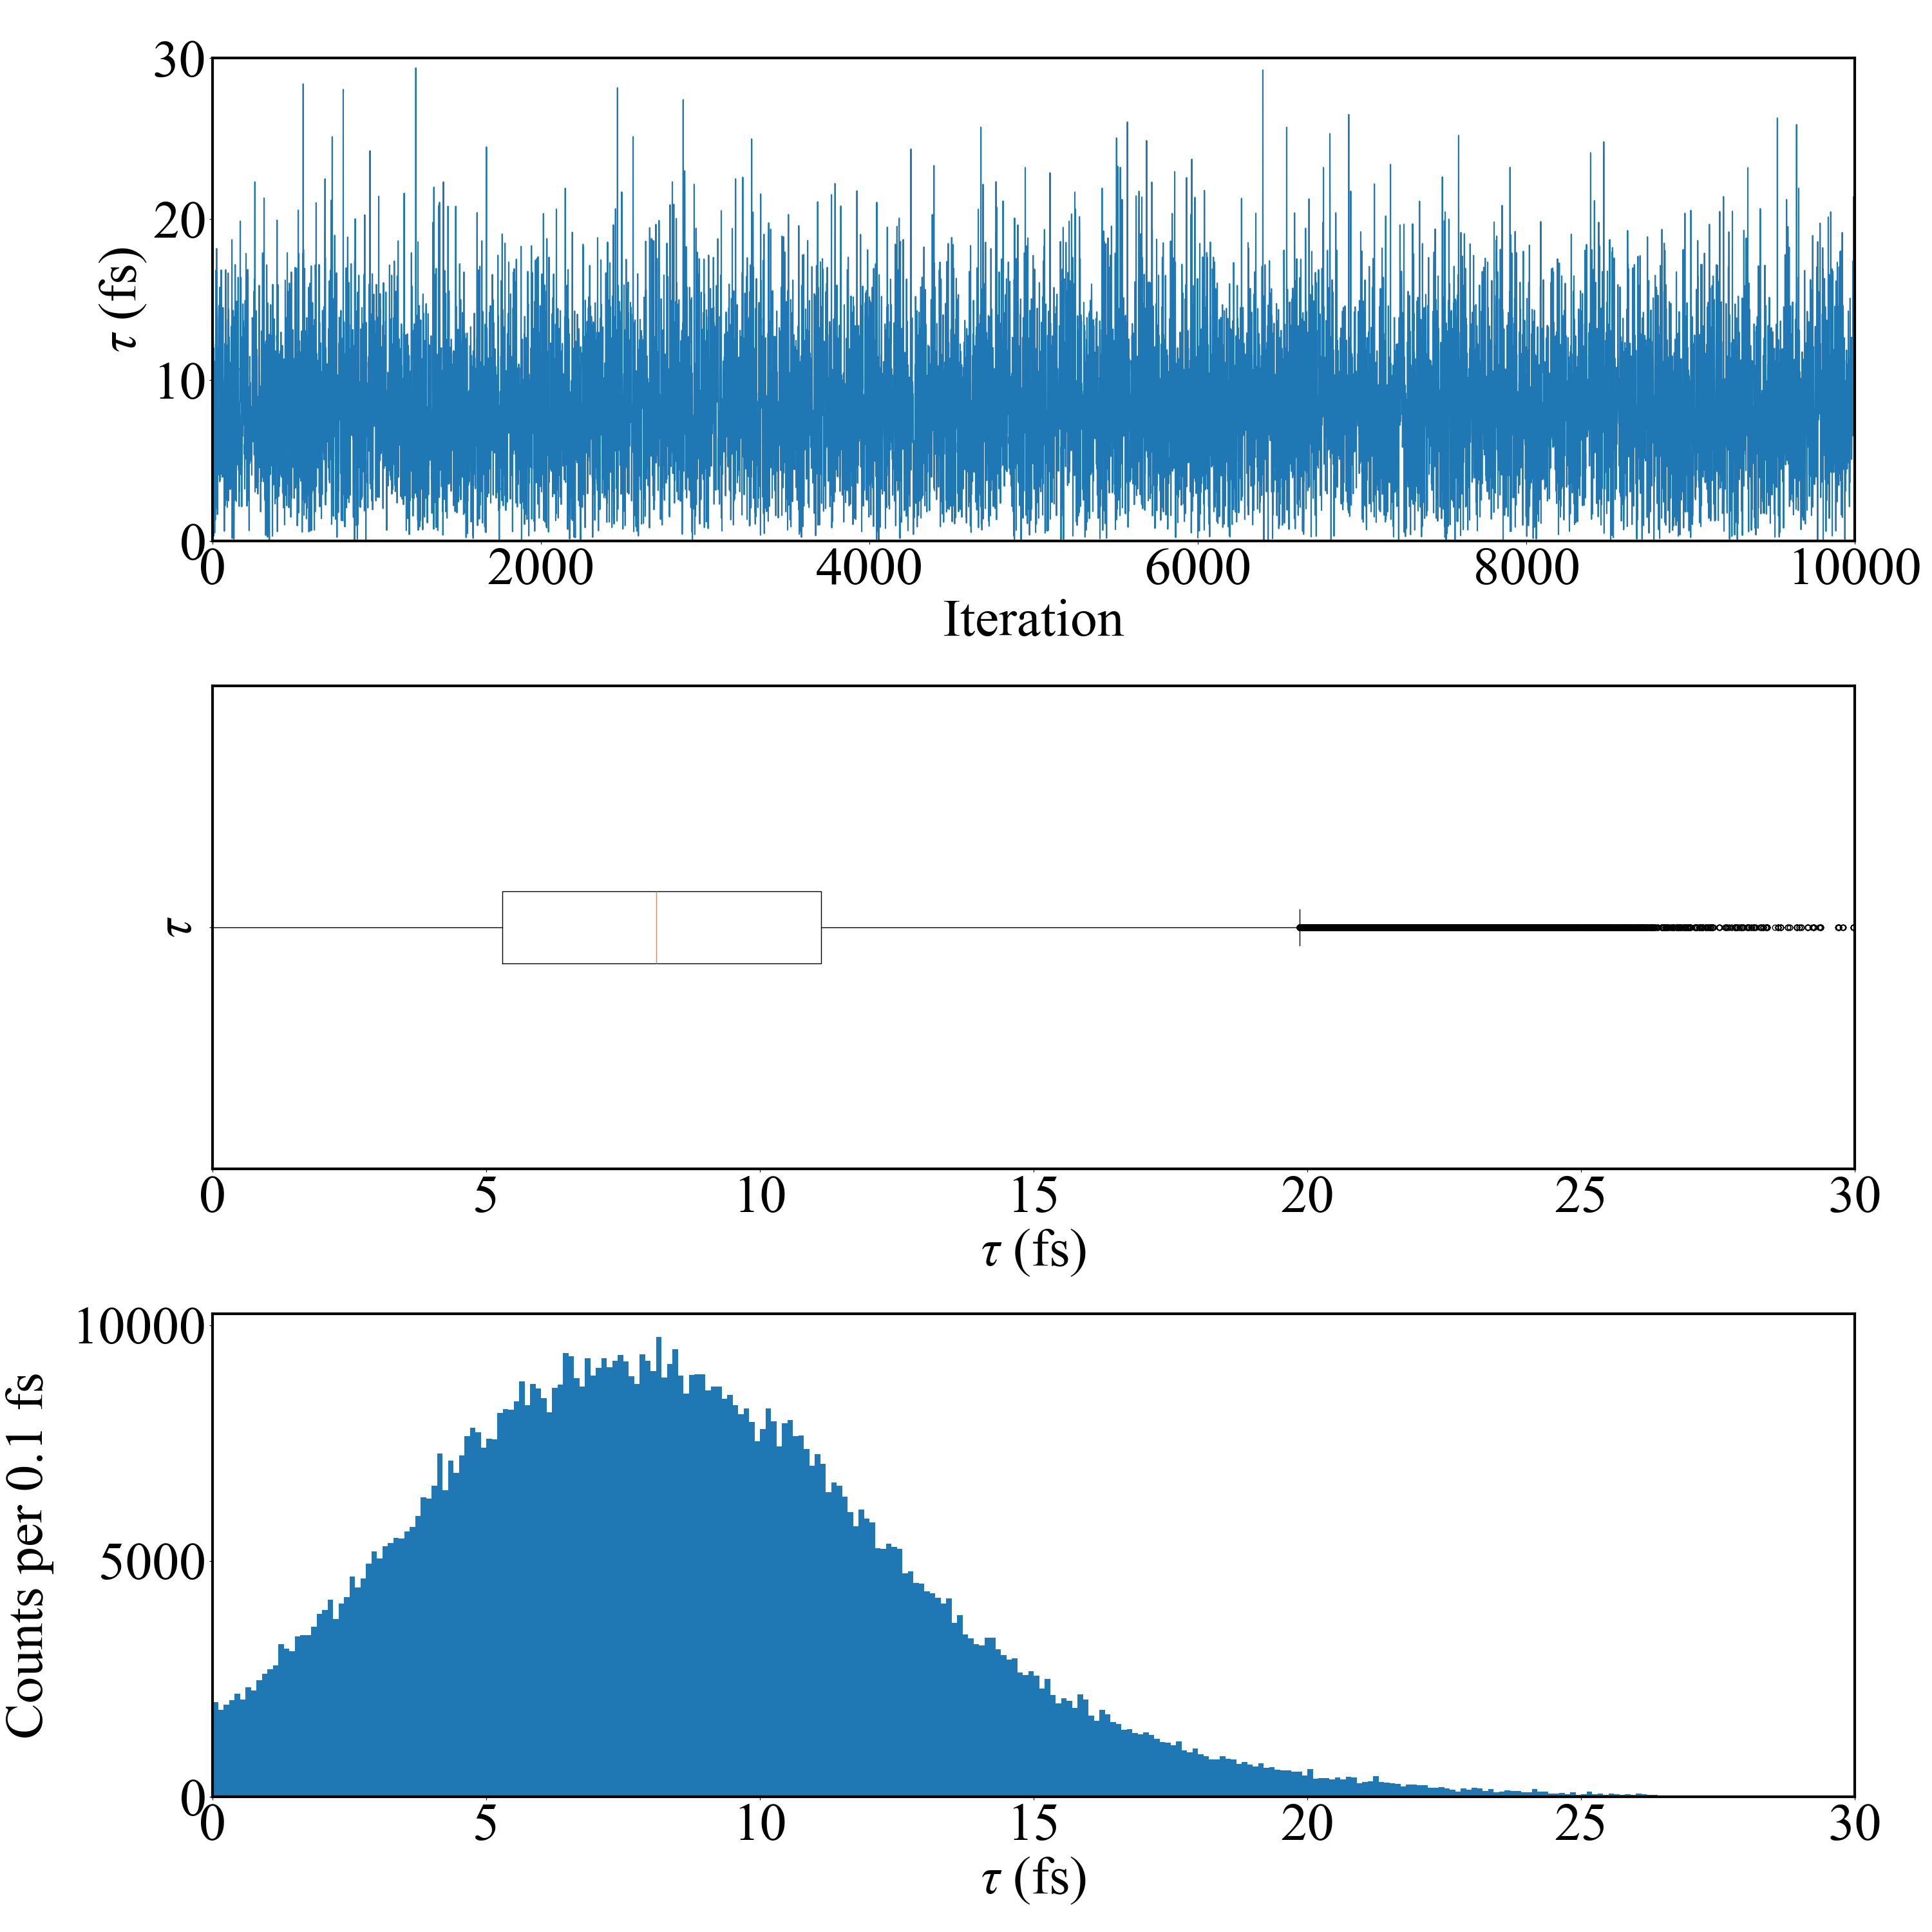
Emulation method: PCGP
Calibration method: directbayeswoodbury
Sampler: metropolis_hastings
Emulation method: PCGP
Calibration method: directbayeswoodbury
Sampler: metropolis_hastings
Eg prior: bimodal of Sallaska_PRC2011 and
Jenkins_PRL2004
Tau = 7.204 +3.788 -3.563 fs
Eg prior: trimodal of Sallaska_PRC2011, Jenkins_PRL2004, Goldberg_Thesis2024
Tau = 8.105 +4.537 -4.033 fs

Slide 4
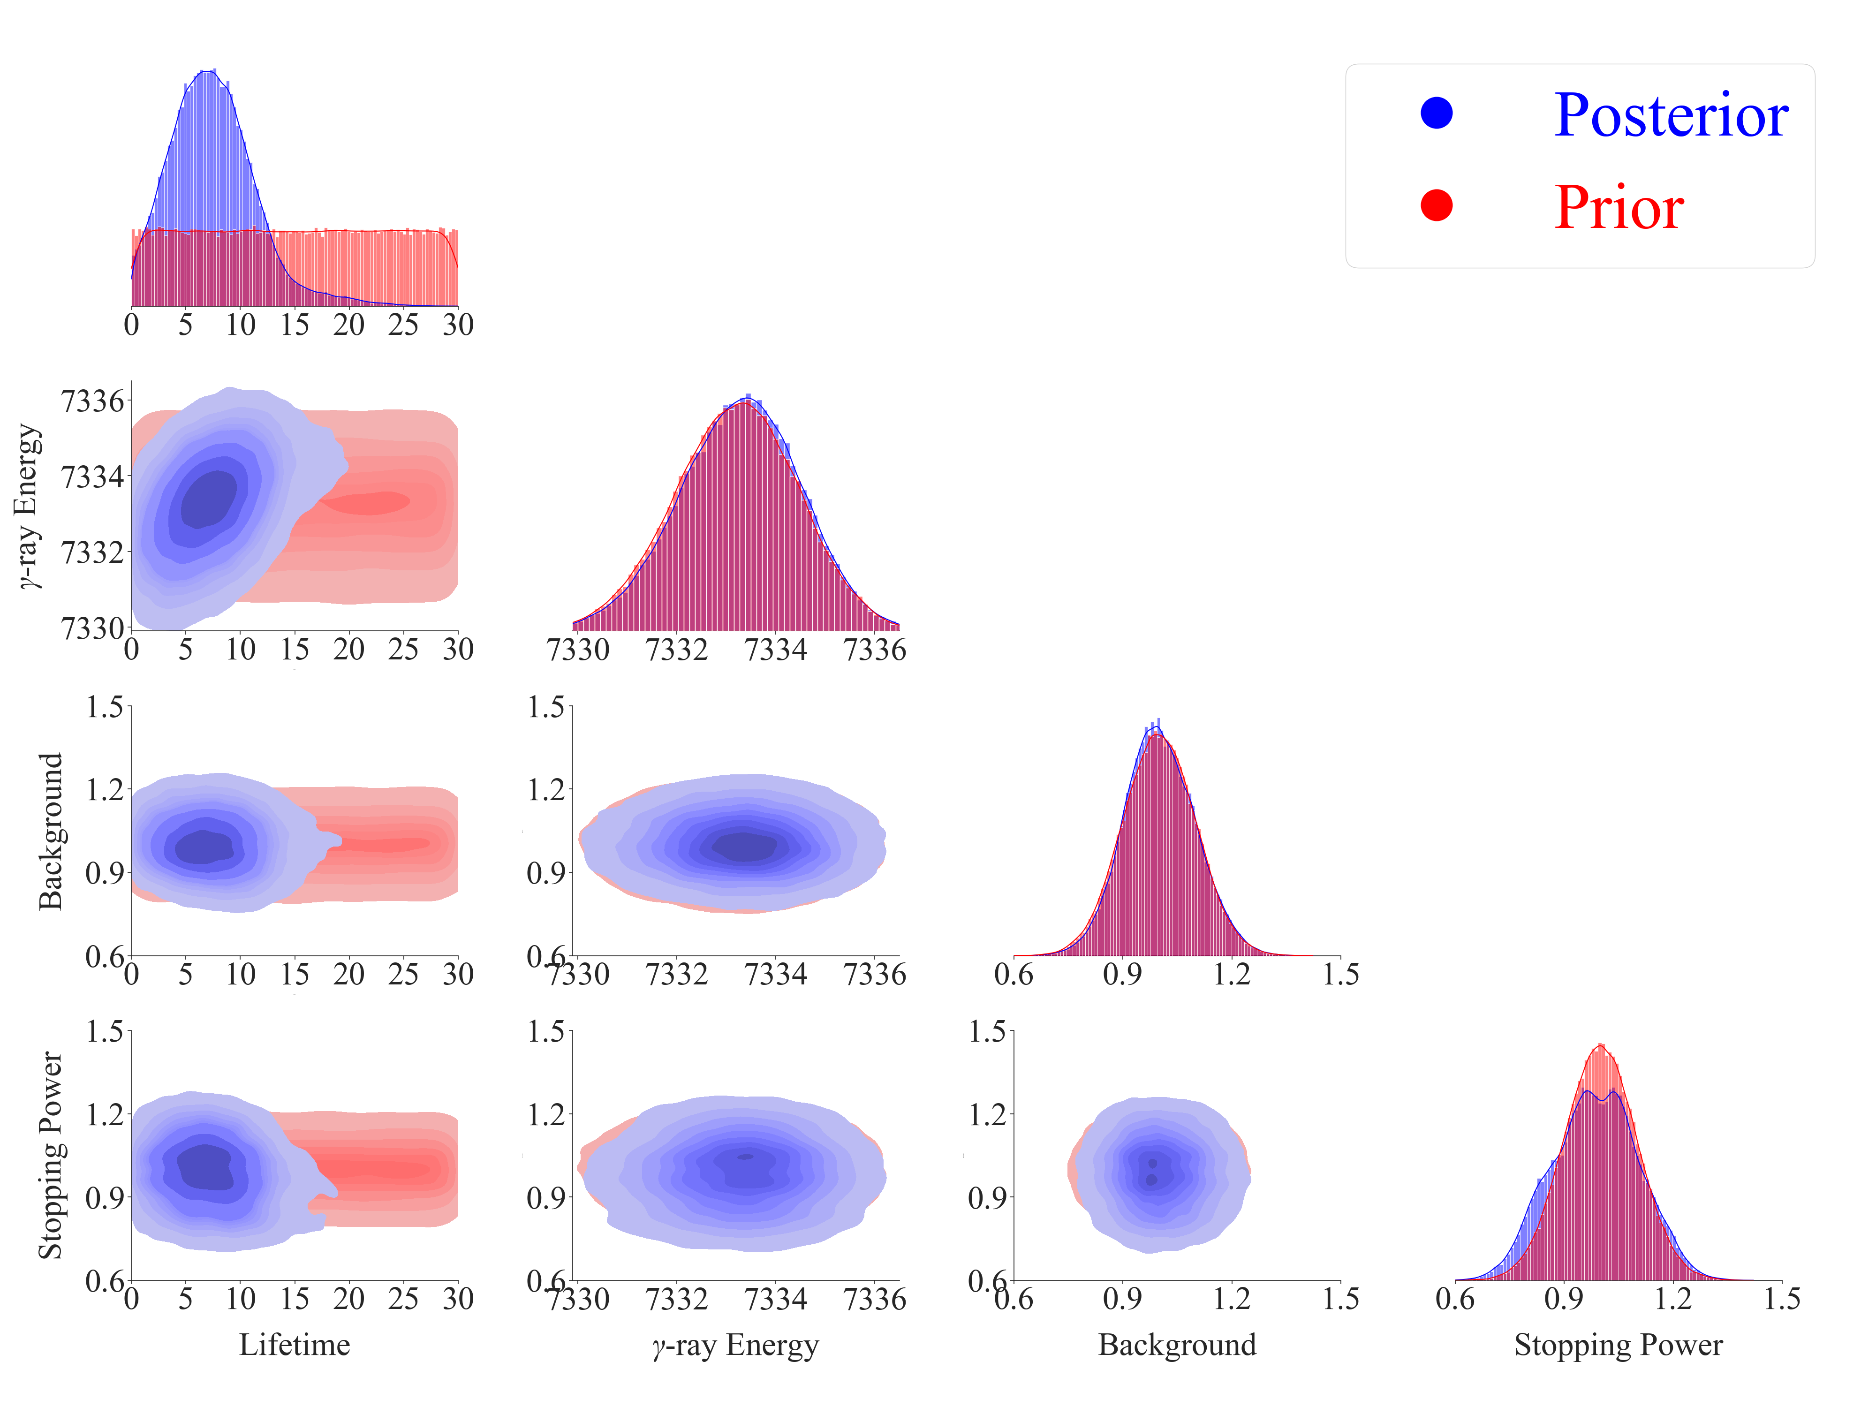
Bimodal Prior:
Mean = 7332.7, 7333.7
Sigma = 1.2, 1.1
Weight = 0.5, 0.5

Slide 5
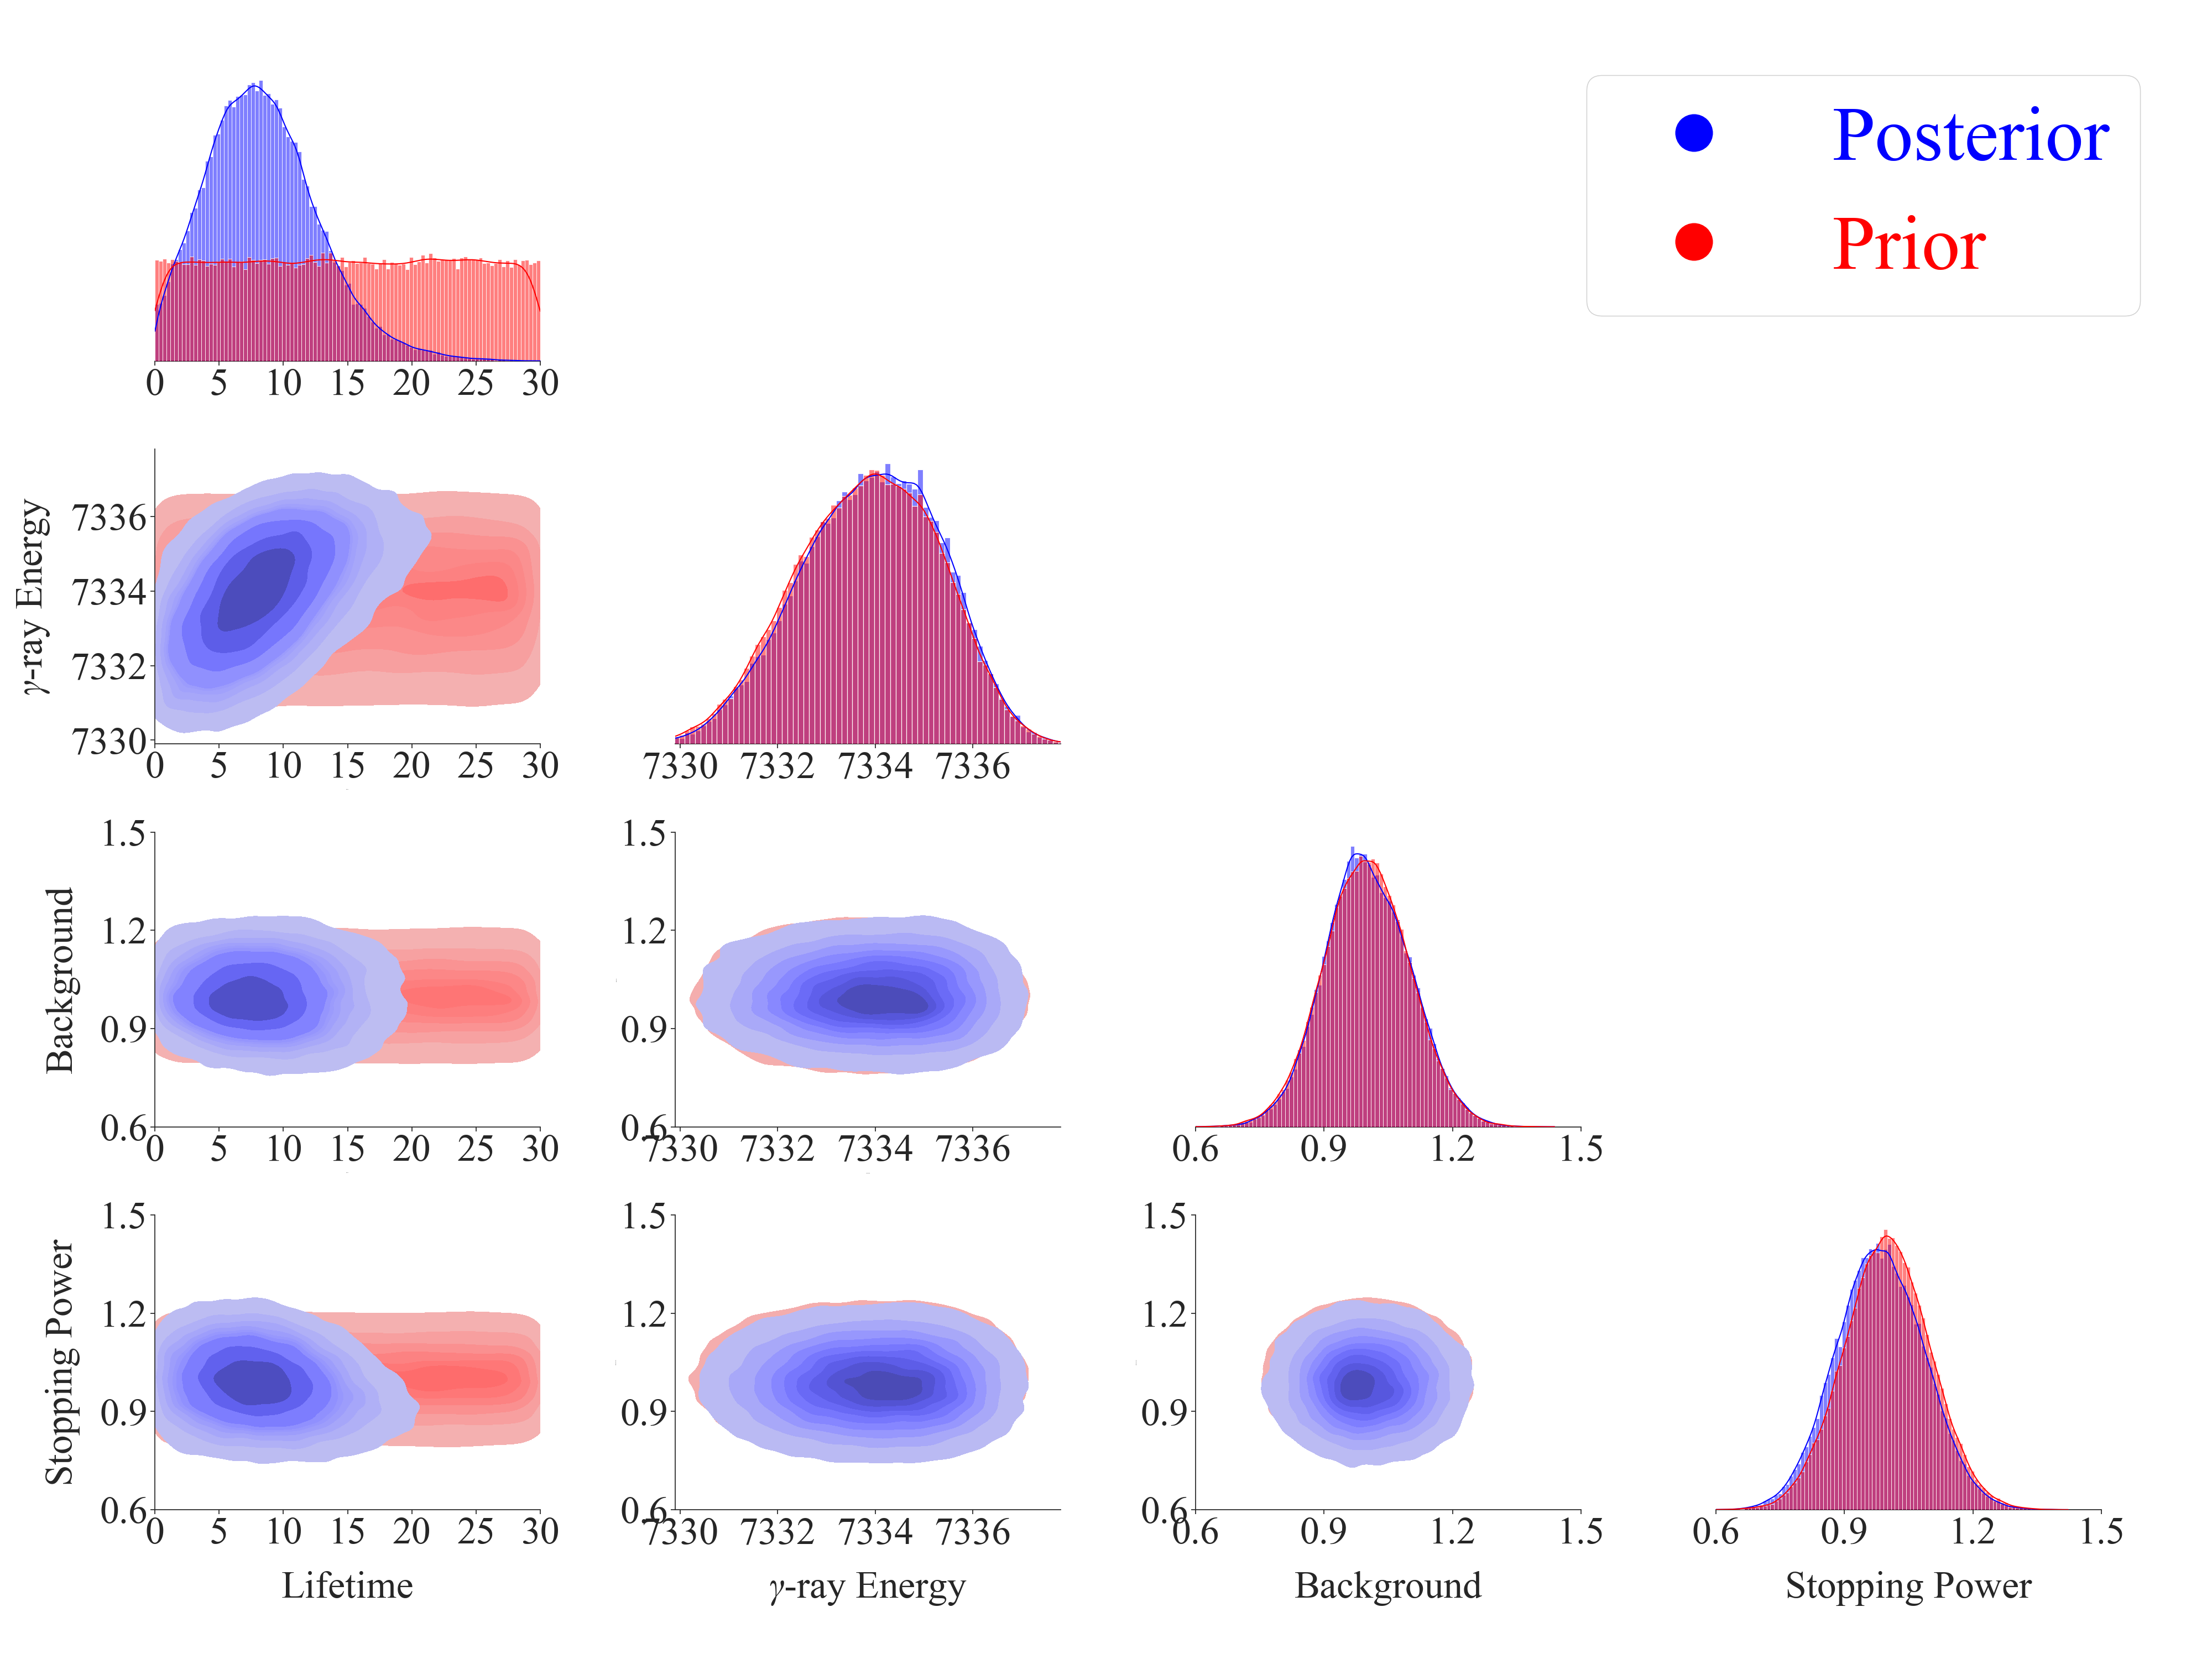
Trimodal Prior:
Mean = 7332.7, 7333.7, 7335.1
Sigma = 1.2, 1.1, 0.9
Weight = 0.33, 0.33, 0.33

Slide 6
Summary of Nuclear Data from Literature
Literature | E_{x} (keV) | E_{γ} (keV) | I_{γ} (%) | R_{7.3/5.7} | Method | Comments
Sallaska_PRL2010 Sallaska_PRC2011 | 7784.7(12) | 5732 | 12(6) | 8.4(42) | ²²Na(p,γ)²³Mg
 |  | 7332.7(12) | 100
Jenkins_PRL2004 Jenkins_PRC2013 | 7784.6(11) | 7333.7(11) | 100 | ∞ | ¹²C(¹²C,nγ)²³Mg | E_{x} = 7785.2(13) by GLSC; E_{x} = 7785.7(11) by Oliver's recalculation
Iacob_PRC2006 | 7787.4 | 5736 | 20(5) | 5.0(12) | ²³Al(βγ)²³Mg
 |  | 7335.1 | 100
 |  | 7786 | 3.8(25)
Zhai_Thesis2007 | 7787.2(6) | 5735.4(7) | 23 | 4.3(12) | ²³Al(βγ)²³Mg
 |  | 7335.2(6) | 100
Fougeres_NC2023 | 7785.0(7) | 5734 | <3 | >32 | ³He(³²S,α)³¹S
 |  | $${7333.0}_{−2}^{+5}$$ | 100
Goldberg_Thesis2024 | 7787.3(5) | 5735.8(6) | 25 | 4.0(4) | ²³Al(βγ)²³Mg | https://arxiv.org/abs/2412.14734
 |  | 7335.1(9) | 100
Basunia_NDS2021 | 7784.7(8) | 5732 | 16(4) | 6.2(22) | Evaluation | E_{γ}: Weighted average of Sallaska and Jenkins; I_{γ}: Unweighted average of Sallaska and Iacob
 |  | 7333.2(11) | 100(6)

Slide 7
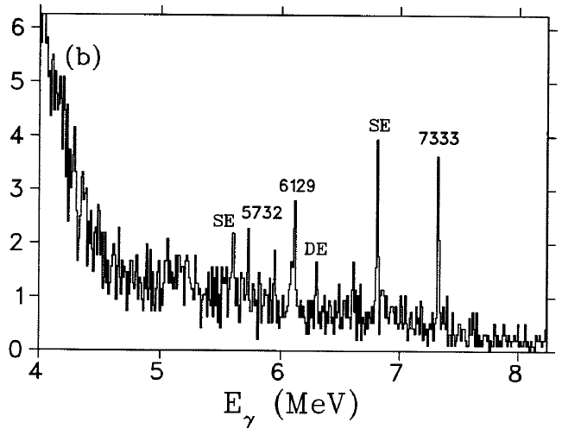
Anne Sallaska, Ph.D. Thesis, University of Washington, USA, 2010.

Slide 8
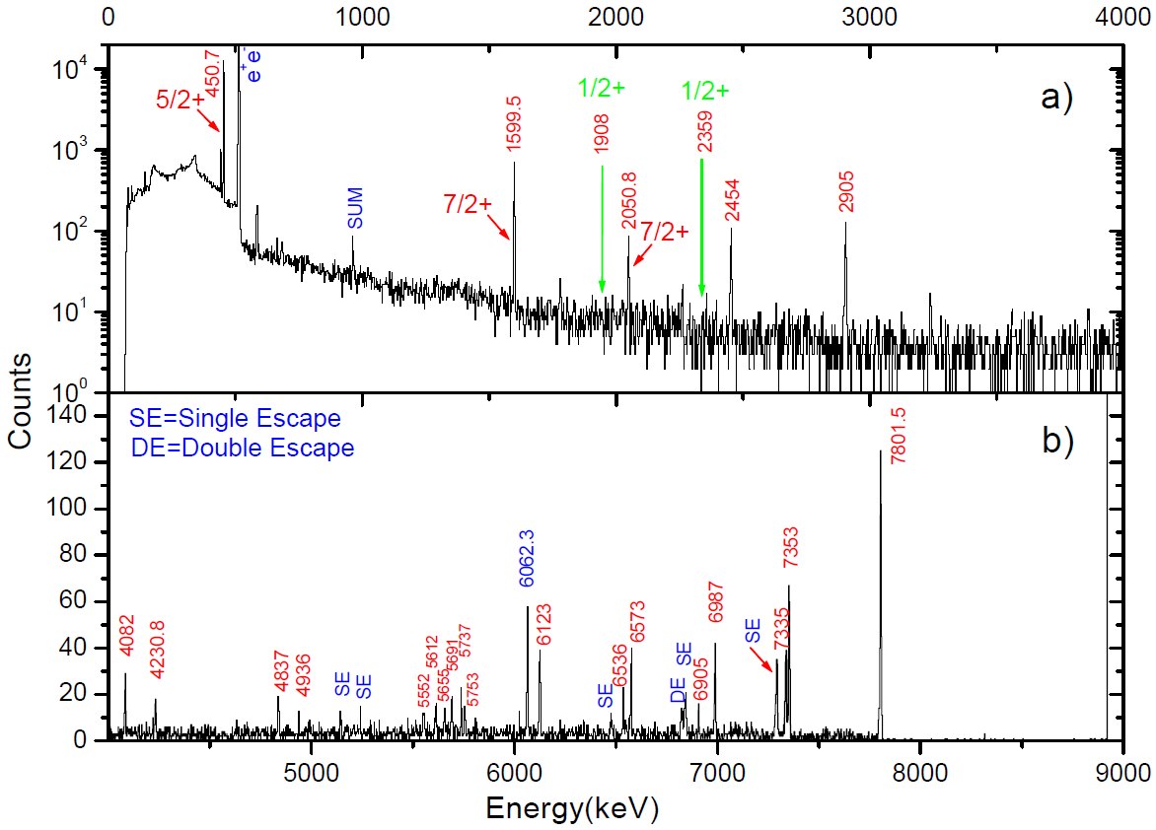
RUN November 2006
Yongjun Zhai, Ph.D. Thesis, Texas A&M University, USA, 2007.

Slide 9
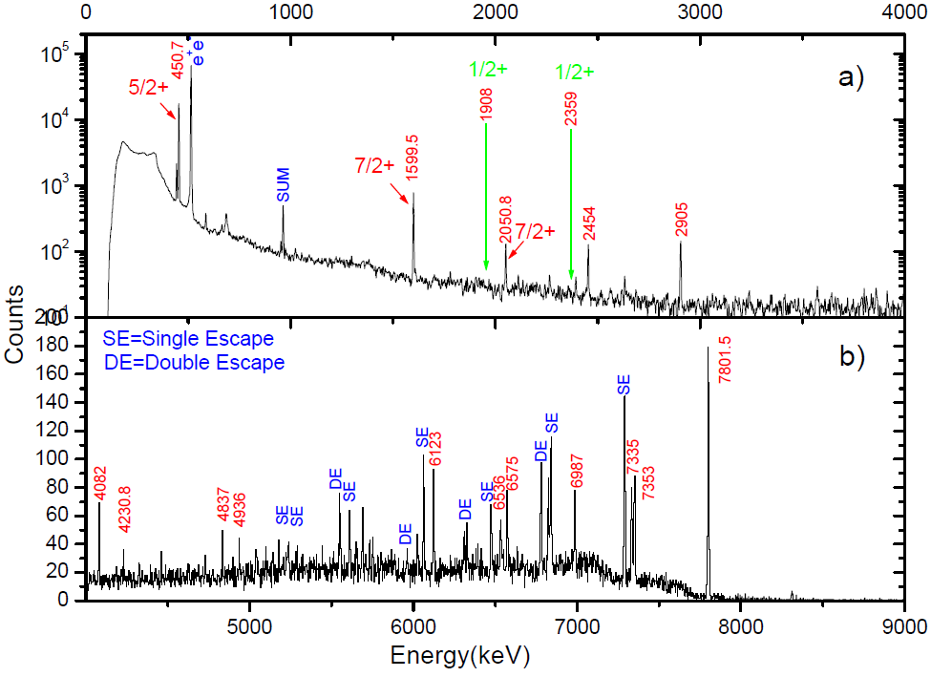
RUN Sept 2006
Yongjun Zhai, Ph.D. Thesis, Texas A&M University, USA, 2007.

Slide 10
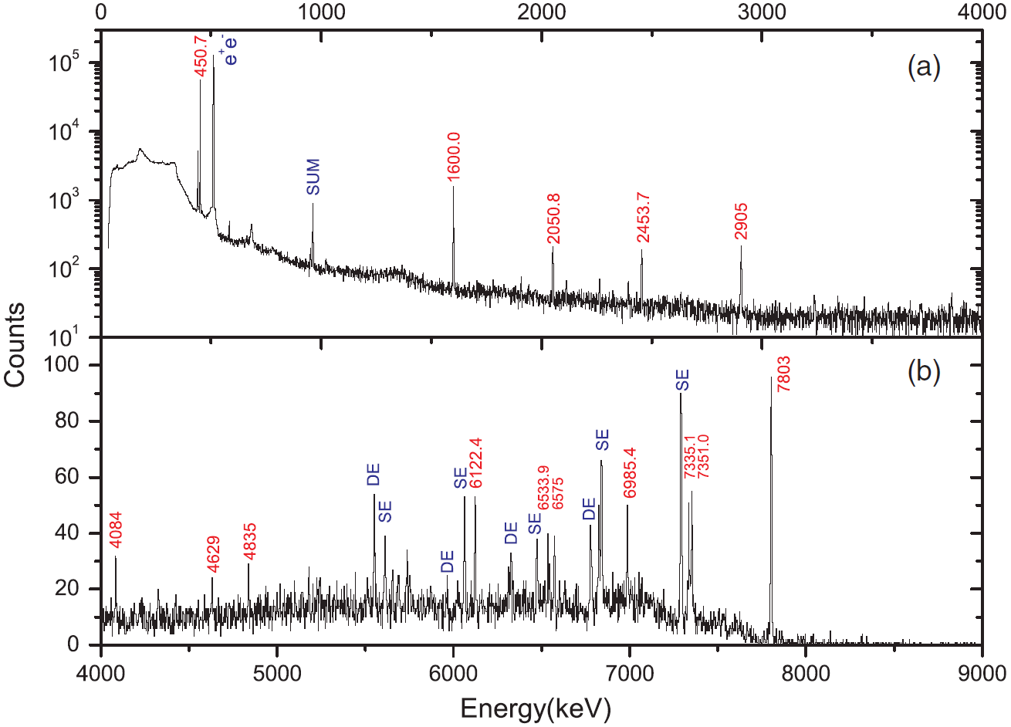
V. E. Iacob et al., Phys. Rev. C 74, 045810 (2006).

Slide 11
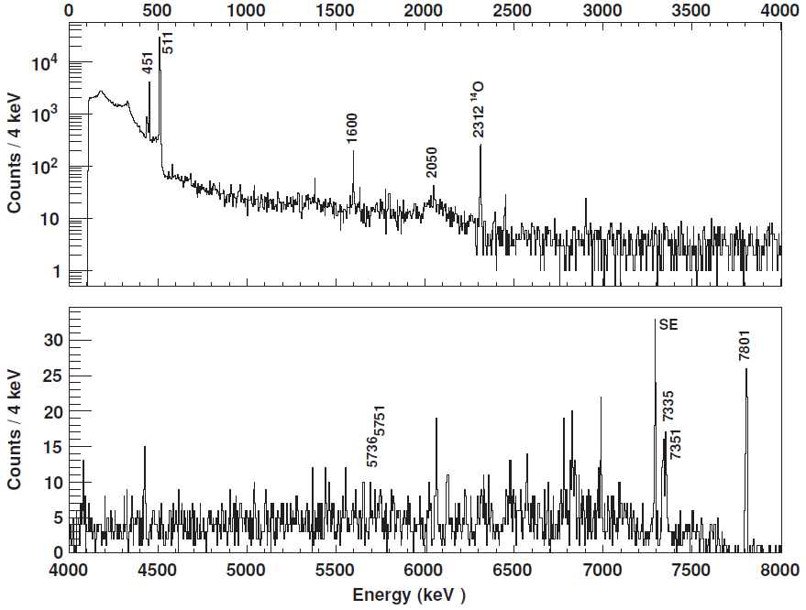
A. Saastamoinen et al., Phys. Rev. C 83, 045808 (2011).

Slide 12
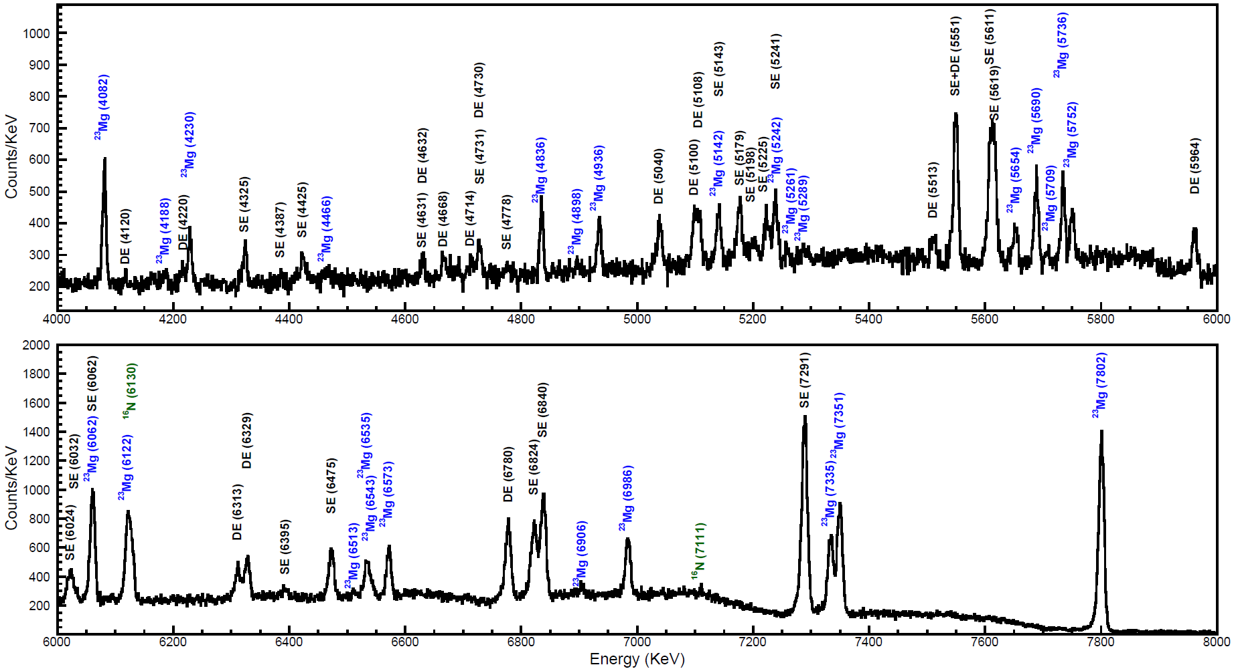
Itay Goldberg, Master Thesis, Hebrew University of Jerusalem, Israel, 2024.

