Slide 1
Refined_PNGs_Weighting_3Class.ipynb

Slide 2
GPU is available
Current device: 0
GPU: NVIDIA RTX A2000 8GB Laptop GPU
Class counts: {'Anomalous_Events': 4975, 'Individual_Events': 16422, 'Two_Particle_Events': 6217}
Target samples per class: 4975
c:\Users\sun\AppData\Local\Programs\Python\Python311\Lib\site-packages\torchvision\models\_utils.py:208: UserWarning: The parameter 'pretrained' is deprecated since 0.13 and may be removed in the future, please use 'weights' instead.
warnings.warn(
c:\Users\sun\AppData\Local\Programs\Python\Python311\Lib\site-packages\torchvision\models\_utils.py:223: UserWarning: Arguments other than a weight enum or `None` for 'weights' are deprecated since 0.13 and may be removed in the future. The current behavior is equivalent to passing `weights=VGG16_Weights.IMAGENET1K_V1`. You can also use `weights=VGG16_Weights.DEFAULT` to get the most up-to-date weights.
warnings.warn(msg)
Epoch 1/50
100%|██████████| 3359/3359 [04:34<00:00, 12.24it/s]
train Loss: 0.6136 Acc: 0.6029
100%|██████████| 373/373 [00:17<00:00, 21.00it/s]
val Loss: 0.4850 Acc: 0.6729
Validation loss decreased (0.484994 --> 0.484994). Saving model...

Slide 3
Epoch 2/50
100%|██████████| 3359/3359 [03:34<00:00, 15.62it/s]
train Loss: 0.4927 Acc: 0.6982
100%|██████████| 373/373 [00:12<00:00, 29.09it/s]
val Loss: 0.4013 Acc: 0.7225
Validation loss decreased (0.401283 --> 0.401283). Saving model...
Epoch 3/50
100%|██████████| 3359/3359 [03:34<00:00, 15.64it/s]
train Loss: 0.4623 Acc: 0.7260
100%|██████████| 373/373 [00:12<00:00, 29.03it/s]
val Loss: 0.4702 Acc: 0.7969
Epoch 49/50
100%|██████████| 3359/3359 [03:32<00:00, 15.77it/s]
train Loss: 0.1989 Acc: 0.8935
100%|██████████| 373/373 [00:12<00:00, 29.25it/s]
val Loss: 0.2331 Acc: 0.8800
Epoch 50/50
100%|██████████| 3359/3359 [03:33<00:00, 15.76it/s]
train Loss: 0.1974 Acc: 0.8935
100%|██████████| 373/373 [00:12<00:00, 29.43it/s]
val Loss: 0.2353 Acc: 0.8794
Test Acc: 0.8467

Slide 4
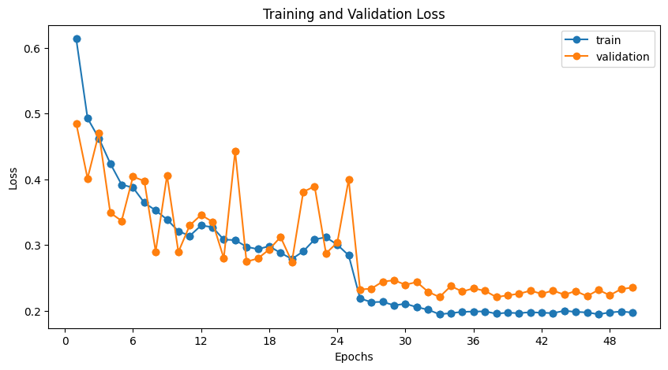
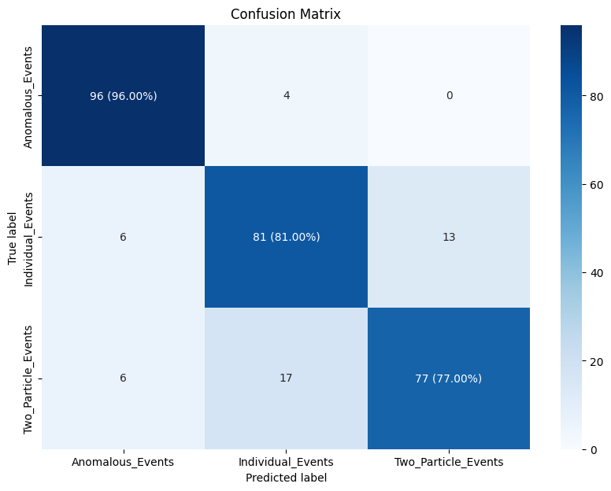
20240617

Slide 5
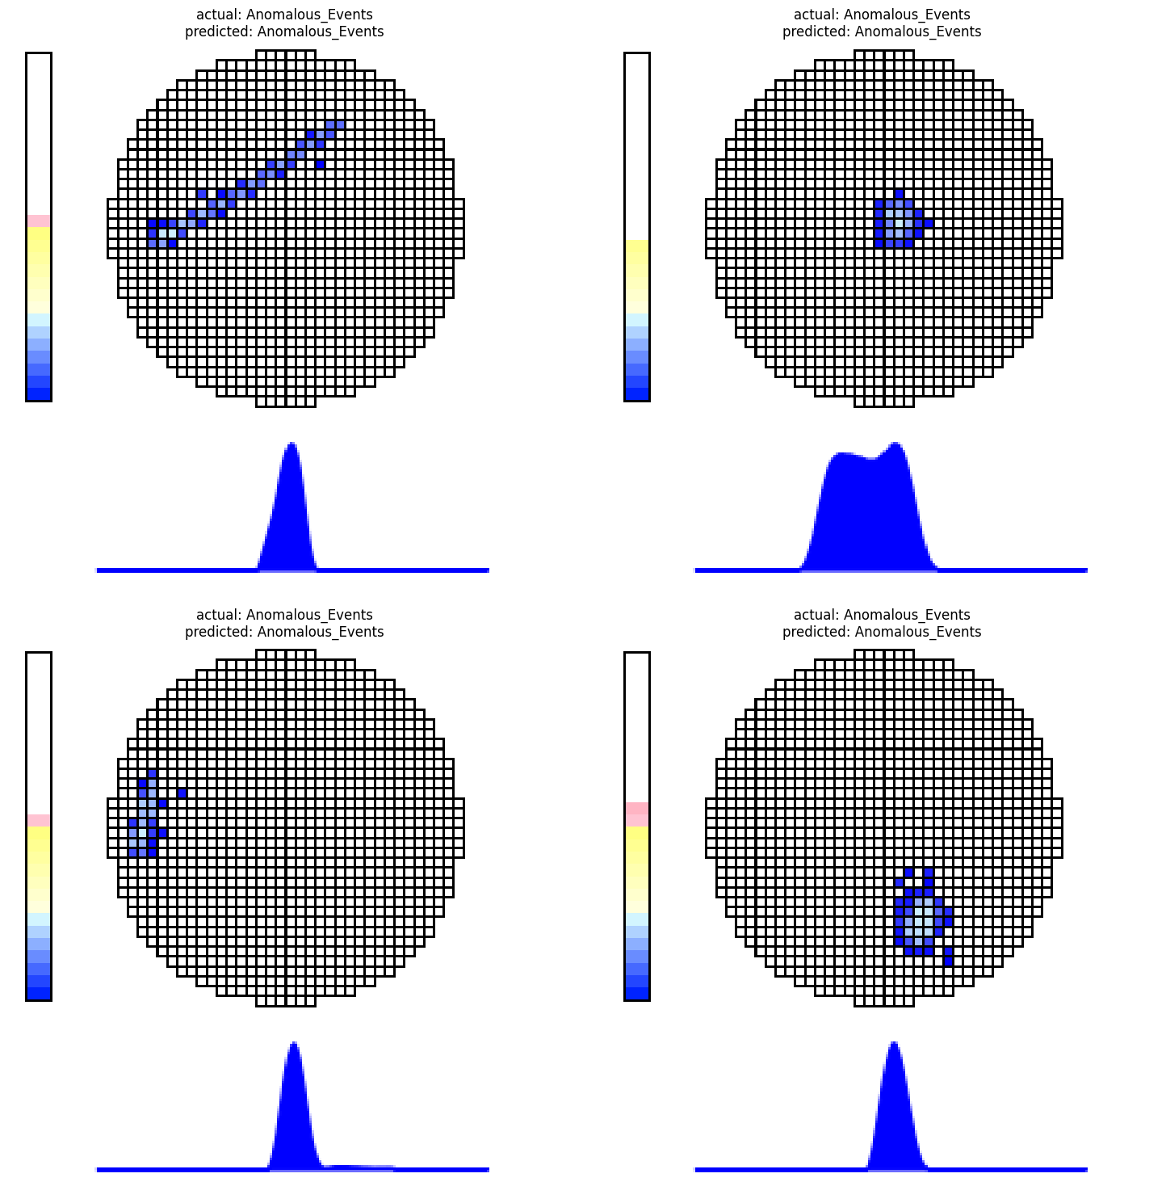

Slide 6
