Slide 1
PXCT Ge Detector Timing Test (Pulser)
20240502

Slide 2
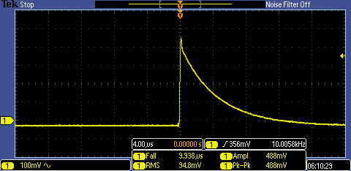
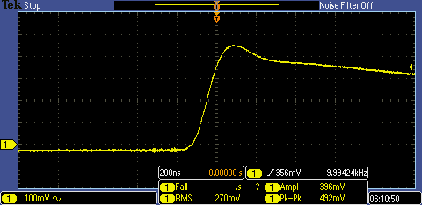
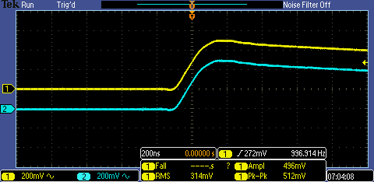
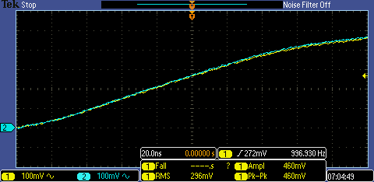
Berkeley Nucleonics Corporation Model DB-2 | NIM Random Pulse Generator
DB- Pulser split with a BNC TEE
DB- Pulser split with a BNC TEE

Slide 3
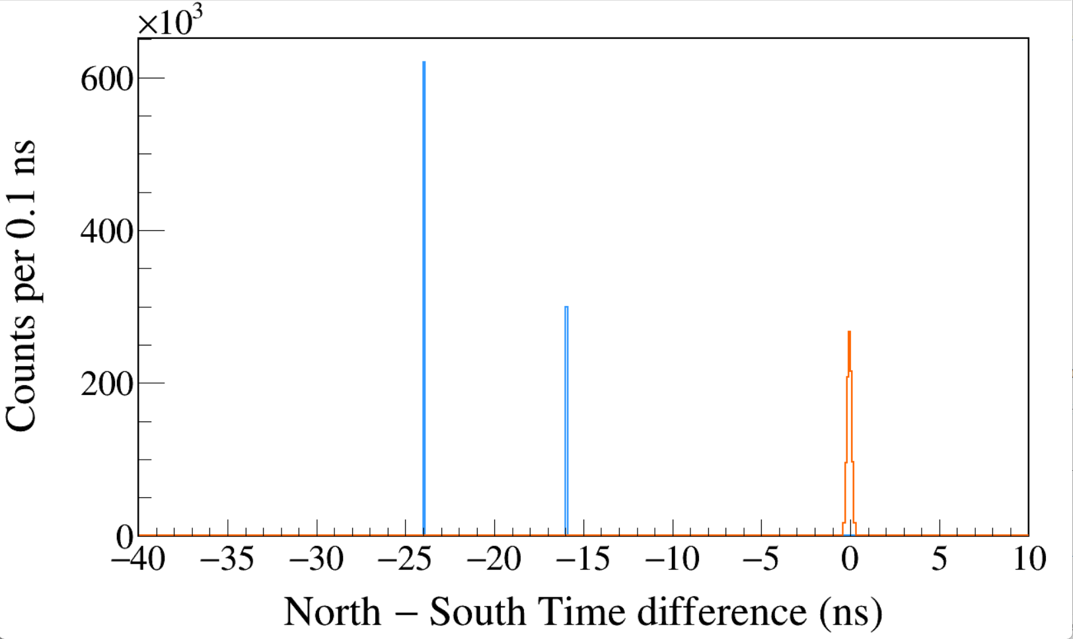
DB-2 Pulser split by a BNC tee adapter and fed into Ch2 and Ch4 directly. No Ge involved.
Trigger Rise 0.064 μs
Trigger Gap 0.952 μs
Threshold 300, 730
CFD Delay 0.304 μs
CFD Scale 7
North – South LED
North – South CFD
FWHM = 0.30 ns
Notes:
TFile *_file0 = TFile::Open("F:/e21010/pxct/run0280_Pulser_window1us_TrigRise0.064us_TrigGap0.952us_ThN300_S730_LED_cal.root");
TCanvas* canvaspeak = new TCanvas("canvaspeak", "canvaspeak", 1300, 800);//
canvaspeak->cd();//
canvaspeak->SetTopMargin(0.06);
canvaspeak->SetRightMargin(0.04);
canvaspeak->SetLeftMargin(0.13);
canvaspeak->SetBottomMargin(0.16);
canvaspeak->SetFrameLineWidth(3);
TH1D* htimestamps = new TH1D("htimestamps", "htimestamps",1600,-80,80);
htimestamps->SetLineWidth(2);
htimestamps->Rebin(1);
htimestamps->SetStats(0);
htimestamps->SetTitle("");
htimestamps->GetXaxis()->SetTitle("North #minus South Time difference (ns)");
htimestamps->GetYaxis()->SetTitle("Counts per 0.1 ns");
htimestamps->GetXaxis()->CenterTitle();
htimestamps->GetYaxis()->CenterTitle();
htimestamps->GetXaxis()->SetLabelFont(132);
htimestamps->GetYaxis()->SetLabelFont(132);
htimestamps->GetXaxis()->SetLabelSize(0.06);
htimestamps->GetYaxis()->SetLabelSize(0.06);
htimestamps->GetXaxis()->SetTitleFont(132);
htimestamps->GetYaxis()->SetTitleFont(132);
htimestamps->GetXaxis()->SetTitleOffset(1.1);
htimestamps->GetYaxis()->SetTitleOffset(0.95);
htimestamps->GetXaxis()->SetTitleSize(0.07);
htimestamps->GetYaxis()->SetTitleSize(0.07);
htimestamps->GetXaxis()->SetRangeUser(-40,10);
//htimestamps->GetYaxis()->SetRangeUser(0,1000);
htimestamps->GetYaxis()->SetNdivisions(505);
htimestamps->SetLineWidth(2);
htimestamps->SetLineColor(kAzure+1);
tree->Draw("north_t_low-south_t_low>>htimestamps","north_e_low>100&&south_e_low>100","");
htimestamps->Sumw2(kFALSE);
htimestamps->SetBinErrorOption(TH1::kPoisson);//TH1::kNormal or TH1::kPoisson
TFile *_file0 = TFile::Open("F:/e21010/pxct/run0281_Pulser_window1us_TrigRise0.064us_TrigGap0.952us_ThN300_S730_CFDDelay0.304us_Scale7_cal.root");
tree->SetLineColor(kOrange+7);
tree->SetLineWidth(2);
tree->Draw("north_t_low-south_t_low","north_e_low>100&&south_e_low>100","same");
gPad->RedrawAxis();

Slide 4
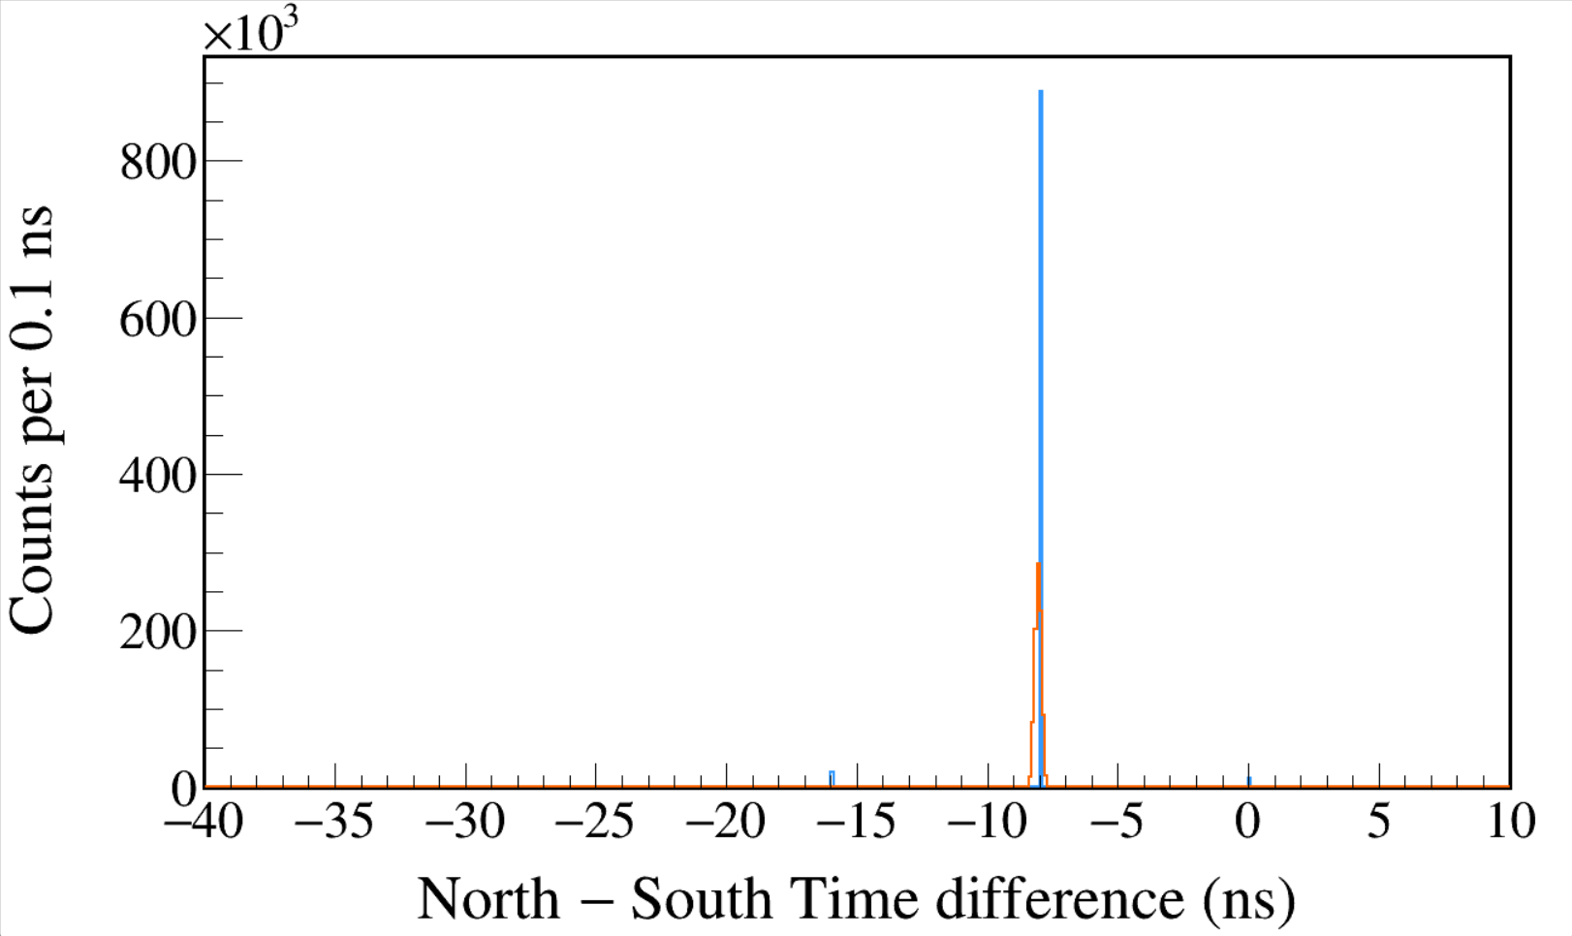
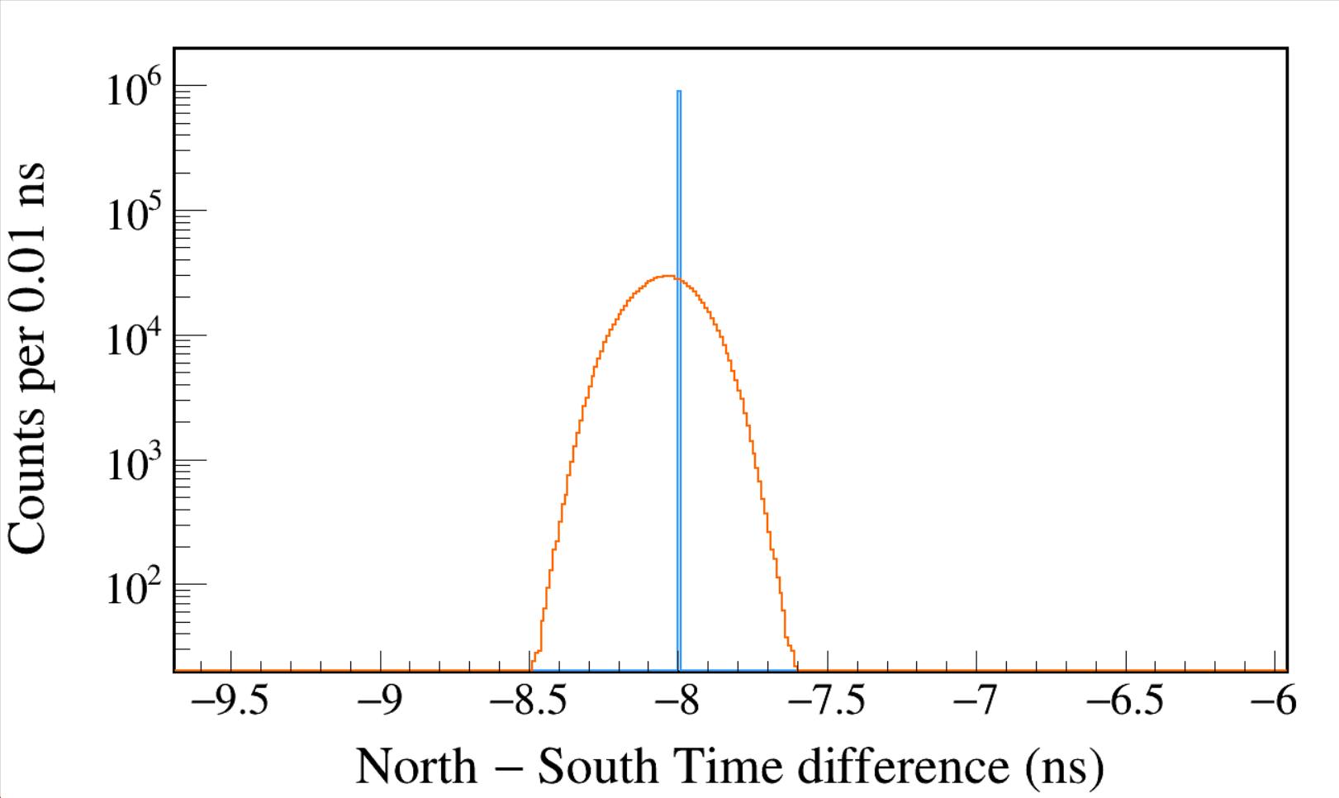
DB-2 Pulser split by a BNC tee adapter and fed into Ch2 and Ch4 directly. No Ge involved.
Changed threshold.
So, every parameter is identical for the two channels.
Trigger Rise 0.064 μs
Trigger Gap 0.952 μs
Threshold 300
CFD Delay 0.304 μs
CFD Scale 7
North – South LED
North – South CFD
FWHM = 0.29 ns
Notes:
TFile *_file0 = TFile::Open("F:/e21010/pxct/run0282_Pulser_window1us_TrigRise0.064us_TrigGap0.952us_ThN300_S300_LED_cal.root");
TCanvas* canvaspeak = new TCanvas("canvaspeak", "canvaspeak", 1300, 800);//
canvaspeak->cd();//
canvaspeak->SetTopMargin(0.06);
canvaspeak->SetRightMargin(0.04);
canvaspeak->SetLeftMargin(0.13);
canvaspeak->SetBottomMargin(0.16);
canvaspeak->SetFrameLineWidth(3);
TH1D* htimestamps = new TH1D("htimestamps", "htimestamps",16000,-80,80);
htimestamps->SetLineWidth(2);
htimestamps->Rebin(1);
htimestamps->SetStats(0);
htimestamps->SetTitle("");
htimestamps->GetXaxis()->SetTitle("North #minus South Time difference (ns)");
htimestamps->GetYaxis()->SetTitle("Counts per 0.01 ns");
htimestamps->GetXaxis()->CenterTitle();
htimestamps->GetYaxis()->CenterTitle();
htimestamps->GetXaxis()->SetLabelFont(132);
htimestamps->GetYaxis()->SetLabelFont(132);
htimestamps->GetXaxis()->SetLabelSize(0.06);
htimestamps->GetYaxis()->SetLabelSize(0.06);
htimestamps->GetXaxis()->SetTitleFont(132);
htimestamps->GetYaxis()->SetTitleFont(132);
htimestamps->GetXaxis()->SetTitleOffset(1.1);
htimestamps->GetYaxis()->SetTitleOffset(0.95);
htimestamps->GetXaxis()->SetTitleSize(0.07);
htimestamps->GetYaxis()->SetTitleSize(0.07);
htimestamps->GetXaxis()->SetRangeUser(-40,10);
//htimestamps->GetYaxis()->SetRangeUser(0,1000);
htimestamps->GetYaxis()->SetNdivisions(505);
htimestamps->SetLineWidth(2);
htimestamps->SetLineColor(kAzure+1);
tree->Draw("north_t_low-south_t_low>>htimestamps","north_e_low>100&&south_e_low>100","");
htimestamps->Sumw2(kFALSE);
htimestamps->SetBinErrorOption(TH1::kPoisson);//TH1::kNormal or TH1::kPoisson
TFile *_file0 = TFile::Open("F:/e21010/pxct/run0283_Pulser_window1us_TrigRise0.064us_TrigGap0.952us_ThN300_S300_CFDDelay0.304us_Scale7_cal.root");
tree->SetLineColor(kOrange+7);
tree->SetLineWidth(2);
tree->Draw("north_t_low-south_t_low","north_e_low>100&&south_e_low>100","same");
gPad->RedrawAxis();

