Slide 1
PXCT XtRa Timing Test
20240417

Slide 2
60Co source I7281 was placed at the edge of the chamber
⁶⁰Co
South Ge
North Ge

Slide 3
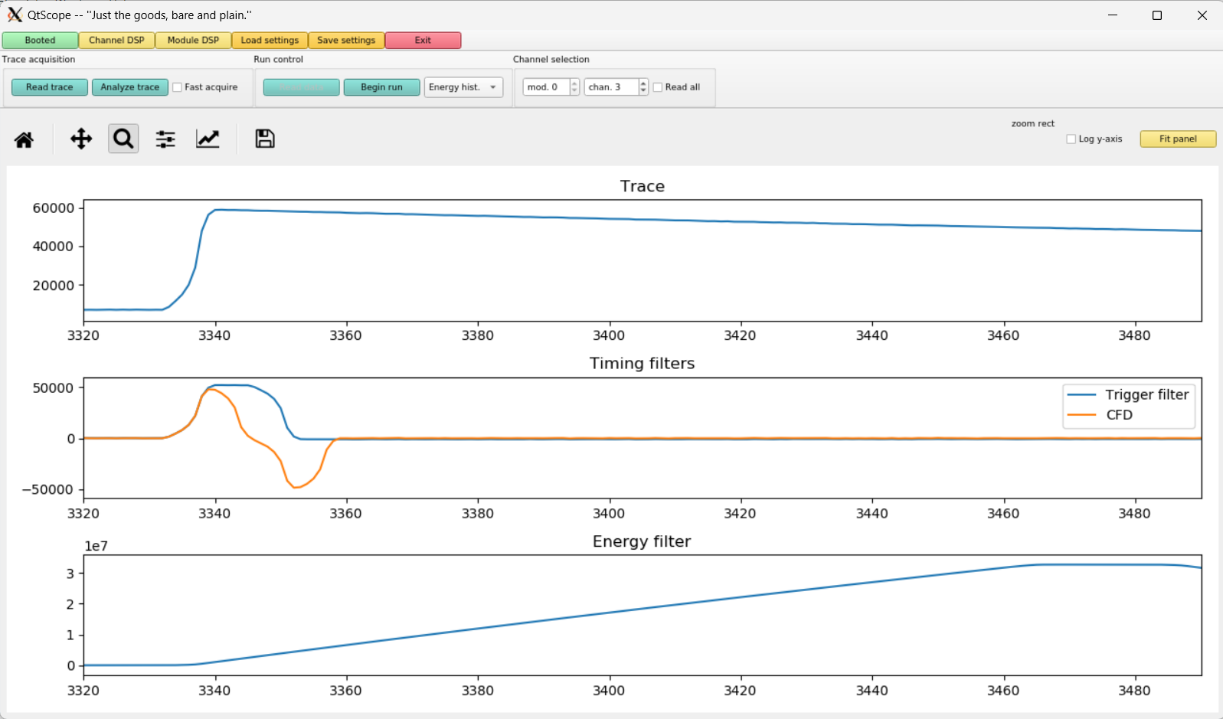
North Ge
80 ns time bin
Trigger Rise 0.016 μs
Trigger Gap 1.000 μs
CFD Delay 0.504 μs
13.6 μs
DDAS allowed inputs:
0.016 μs ≤ Trigger Rise ≤ 1.000 μs; 0.000 μs ≤ Trigger Gap ≤ 1.000 μs
0.016 μs ≤ Trigger Rise + Trigger Gap ≤ 1.016 μs
0.008 μs ≤ CFD Delay ≤ 0.504 μs

Slide 4
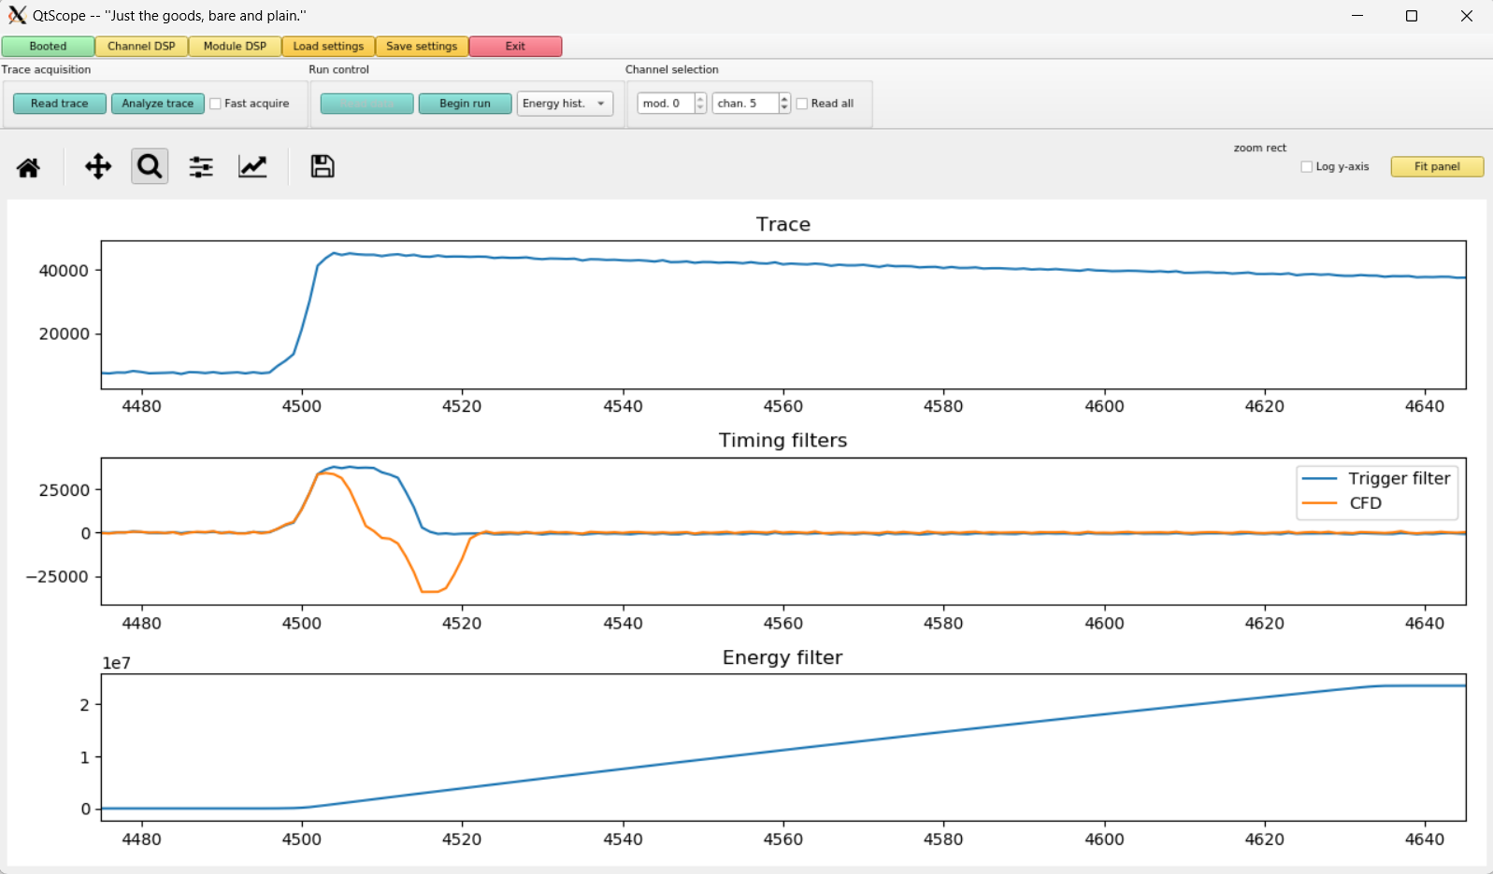
South Ge
80 ns time bin
Trigger Rise 0.016 μs
Trigger Gap 1.000 μs
CFD Delay 0.504 μs
13.6 μs
DDAS allowed inputs:
0.016 μs ≤ Trigger Rise ≤ 1.000 μs; 0.000 μs ≤ Trigger Gap ≤ 1.000 μs
0.016 μs ≤ Trigger Rise + Trigger Gap ≤ 1.016 μs
0.008 μs ≤ CFD Delay ≤ 0.504 μs

Slide 5
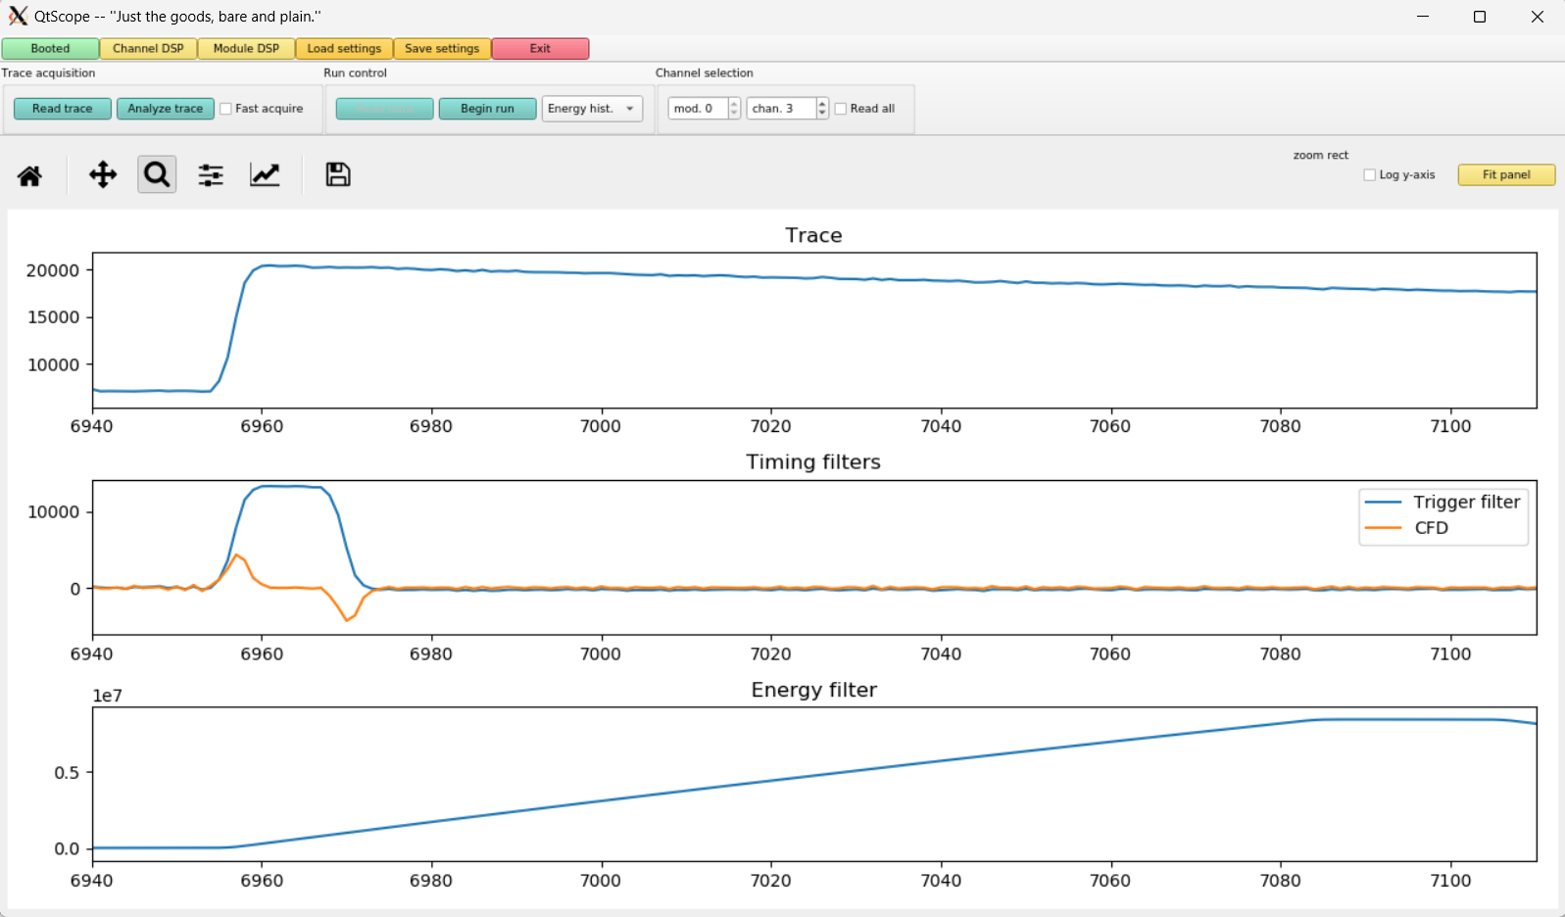
Trigger Rise 0.016 μs
Trigger Gap 1.000 μs
CFD Delay 0.008 μs
DDAS allowed inputs:
0.016 μs ≤ Trigger Rise ≤ 1.000 μs; 0.000 μs ≤ Trigger Gap ≤ 1.000 μs
0.016 μs ≤ Trigger Rise + Trigger Gap ≤ 1.016 μs
0.008 μs ≤ CFD Delay ≤ 0.504 μs

Slide 6
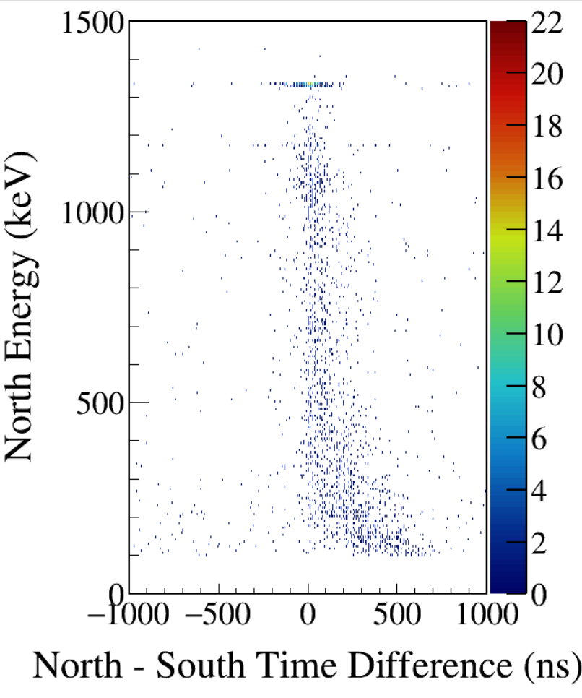
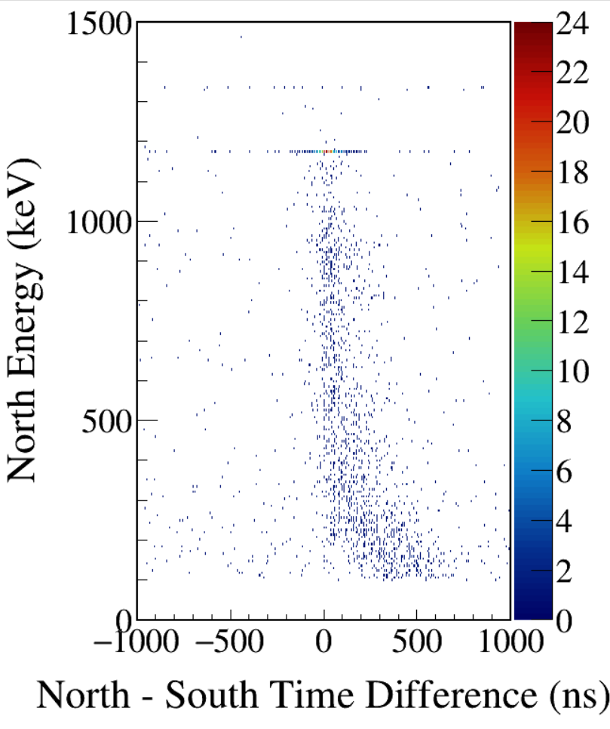
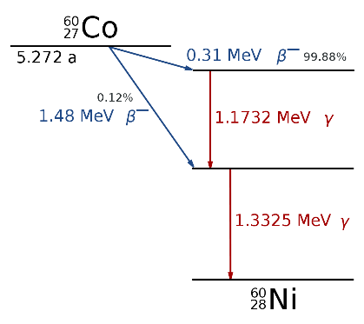
South 1173-gated
South 1332-gated
CFD disabled
Notes:
TFile *_file0 = TFile::Open("F:/e21010/pxct/run0234_LEGe_XtRa_60Co_I7281_onChamberWall_window1us_TrigRise0.016us_TrigGap1.000us_CFDdisabled_cal.root");
TCanvas* canvaspeak = new TCanvas("canvaspeak", "canvaspeak", 890, 800);
canvaspeak->cd();
canvaspeak->SetTopMargin(0.03);
canvaspeak->SetRightMargin(0.12);
canvaspeak->SetLeftMargin(0.17);
canvaspeak->SetBottomMargin(0.15);
canvaspeak->SetFrameLineWidth(2);
//canvaspeak->SetLogz();
TH2D* het = new TH2D("het", "het", 400,-1000,1000,250,0,1500); //x,y
tree->Draw("north_e:north_t-south_t>>het","north_e>100&&north_e<1500&&south_e>1170&&south_e<1176","colz"); //y:x
het->SetStats(0);
het->SetTitle("");
het->GetXaxis()->SetTitle("North - South Time Difference (ns)");
het->GetYaxis()->SetTitle("North Energy (keV)");
het->GetXaxis()->CenterTitle();
het->GetYaxis()->CenterTitle();
het->GetXaxis()->SetLabelFont(132);
het->GetYaxis()->SetLabelFont(132);
het->GetXaxis()->SetLabelSize(0.05);
het->GetYaxis()->SetLabelSize(0.05);
het->GetXaxis()->SetTitleFont(132);
het->GetYaxis()->SetTitleFont(132);
het->GetXaxis()->SetTitleOffset(1.1);
het->GetYaxis()->SetTitleOffset(1.4);
het->GetXaxis()->SetTitleSize(0.06);
het->GetYaxis()->SetTitleSize(0.06);
het->GetXaxis()->SetNdivisions(505);
het->GetYaxis()->SetNdivisions(505);
//het->GetXaxis()->SetRangeUser(2001,4500);
//het->GetYaxis()->SetRangeUser(1000,2800);
//het->SetMinimum(2);
//het->SetMaximum(100);
het->SetContour(99);
gStyle->SetPalette(kRainbow);
TPaletteAxis *palette = (TPaletteAxis*)het->GetListOfFunctions()->FindObject("palette");
palette->SetTitleFont(132);
palette->SetTitleSize(0.05);
palette->SetLabelFont(132);
palette->SetLabelSize(0.05);
palette->SetLineWidth(2);

Slide 7
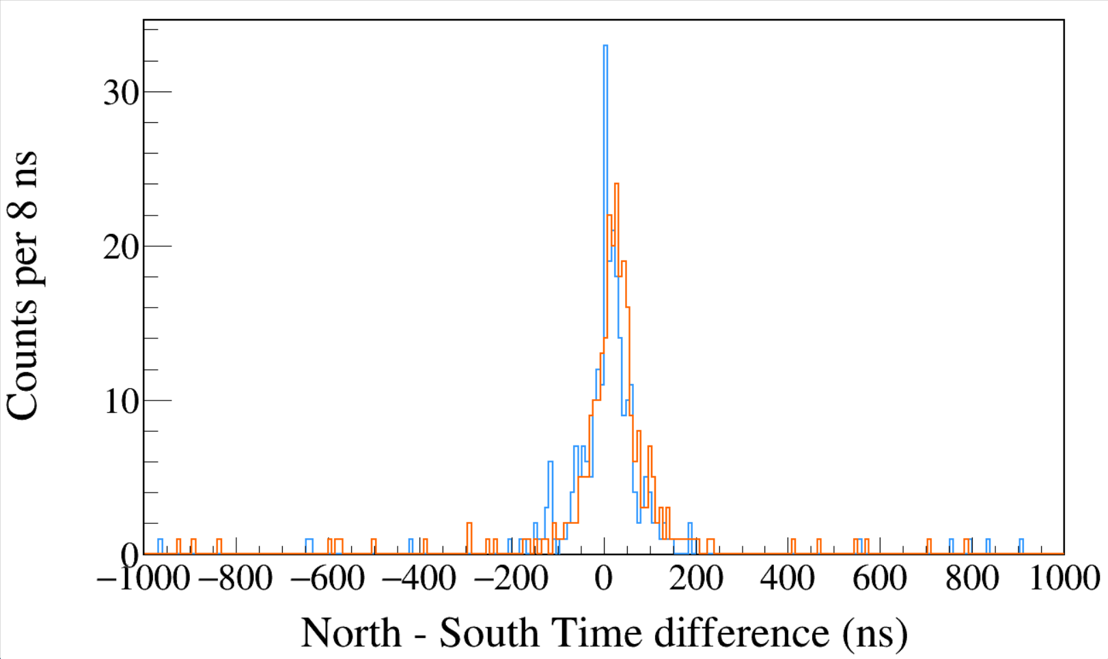
Run0234
60Co
Trigger Rise 0.016 μs
Trigger Gap 1.000 μs
CFD disabled
South 1173 && North 1332
South 1332 && North 1173
Notes:
TFile *_file0 = TFile::Open("F:/e21010/pxct/run0234_LEGe_XtRa_60Co_I7281_onChamberWall_window1us_TrigRise0.016us_TrigGap1.000us_CFDdisabled_cal.root");
TCanvas* canvaspeak = new TCanvas("canvaspeak", "canvaspeak", 1300, 800);//
canvaspeak->cd();//
canvaspeak->SetTopMargin(0.03);
canvaspeak->SetRightMargin(0.04);
canvaspeak->SetLeftMargin(0.13);
canvaspeak->SetBottomMargin(0.16);
canvaspeak->SetFrameLineWidth(2);
TH1D* htimestamps = new TH1D("htimestamps", "htimestamps", 250,-1000,1000);
htimestamps->SetLineWidth(2);
htimestamps->Rebin(1);
htimestamps->SetStats(0);
htimestamps->SetTitle("");
htimestamps->GetXaxis()->SetTitle("North - South Time difference (ns)");
htimestamps->GetYaxis()->SetTitle("Counts per 8 ns");
htimestamps->GetXaxis()->CenterTitle();
htimestamps->GetYaxis()->CenterTitle();
htimestamps->GetXaxis()->SetLabelFont(132);
htimestamps->GetYaxis()->SetLabelFont(132);
htimestamps->GetXaxis()->SetLabelSize(0.06);
htimestamps->GetYaxis()->SetLabelSize(0.06);
htimestamps->GetXaxis()->SetTitleFont(132);
htimestamps->GetYaxis()->SetTitleFont(132);
htimestamps->GetXaxis()->SetTitleOffset(1.1);
htimestamps->GetYaxis()->SetTitleOffset(0.95);
htimestamps->GetXaxis()->SetTitleSize(0.07);
htimestamps->GetYaxis()->SetTitleSize(0.07);
htimestamps->GetXaxis()->SetRangeUser(-1000,1000);
//htimestamps->GetYaxis()->SetRangeUser(0,1700);
htimestamps->GetYaxis()->SetNdivisions(505);
htimestamps->SetLineWidth(2);
htimestamps->SetLineColor(kAzure+1);
tree->Draw("north_t-south_t>>htimestamps","south_e>1170&&south_e<1176&&north_e>1330&&north_e<1336");
tree->SetLineColor(kOrange+7);
tree->SetLineWidth(2);
tree->Draw("north_t-south_t","north_e>1170&&north_e<1176&&south_e>1330&&south_e<1336","same");

Slide 8
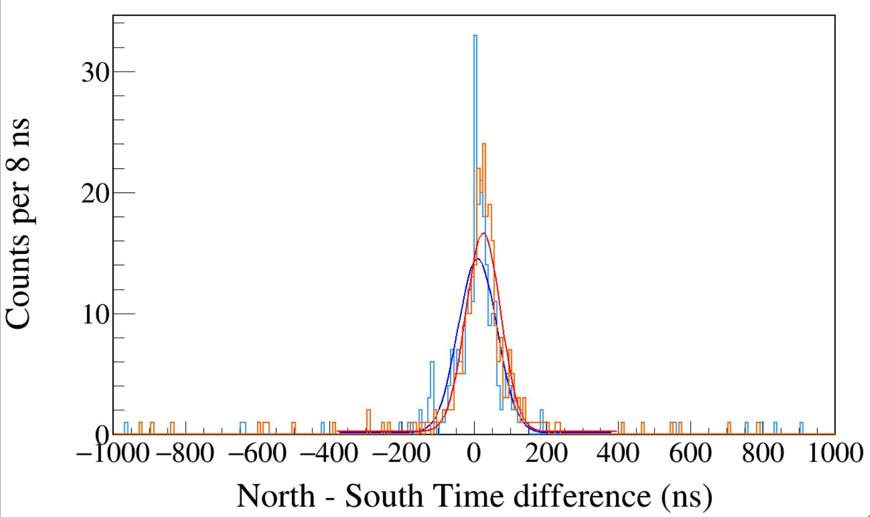
Run0234
60Co
Trigger Rise 0.016 μs
Trigger Gap 1.000 μs
CFD disabled
South 1173 && North 1332
South 1332 && North 1173
Gaus+Pol0
Maximum Likelihood fit
σ = 53.5±4.1 ns
σ = 48.0±3.4 ns
Notes:
1 p0 1.64270e+01 1.41900e+00 6.20346e-05 1.56447e-05
2 p1 2.50753e+01 3.32565e+00 4.67799e-04 5.07087e-06
3 p2 4.80429e+01 3.40137e+00 2.53603e-04 -6.55361e-04
4 p3 2.42054e-01 7.48229e-02 2.66104e-04 -1.07011e-04
1 p0 1.44347e+01 1.28491e+00 9.38742e-04 9.75539e-05
2 p1 9.05892e+00 3.74533e+00 3.67425e-03 1.30510e-06
3 p2 5.35094e+01 4.13808e+00 2.44989e-03 9.89734e-06
4 p3 1.26209e-01 7.07167e-02 5.31291e-05 1.74313e-03

Slide 9
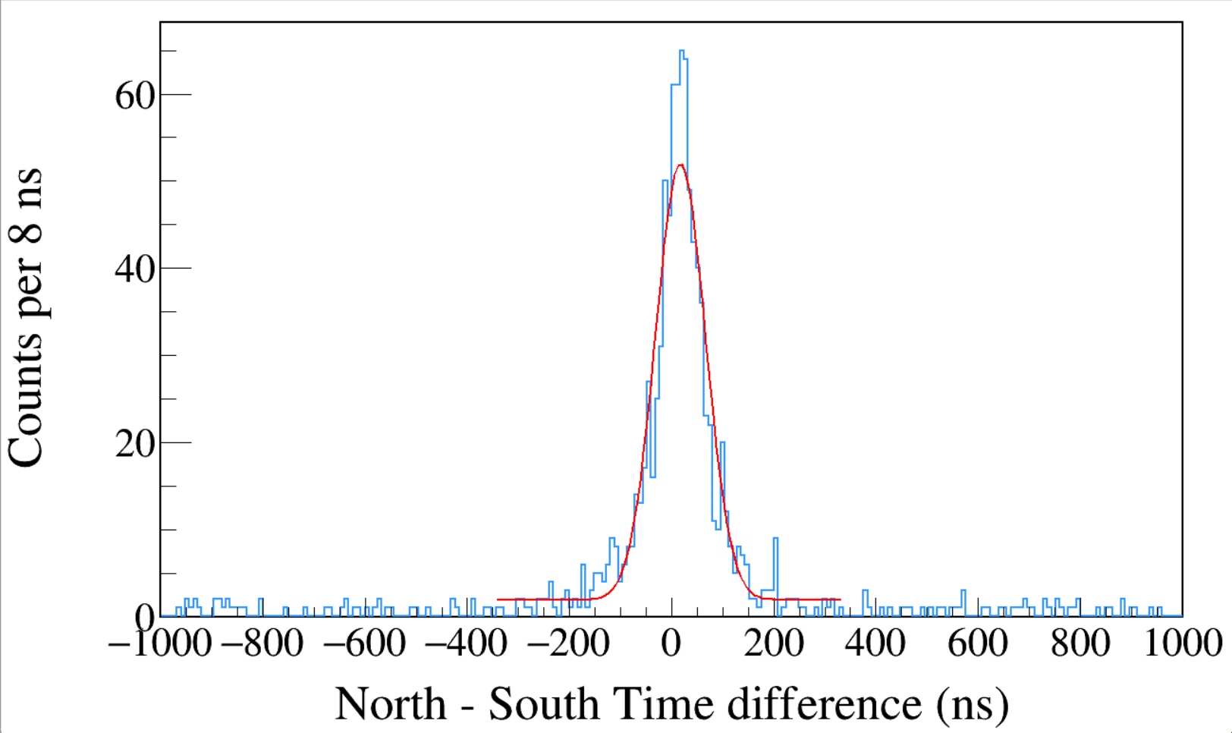
Run0234
60Co
TriggerRise 0.016 μs
TriggerGap 1.000 μs
CFD disabled
1100 < South < 1400
&&
1100 < North < 1400
σ = 48.9±2.2 ns
FWHM = 115 ns
south_e>1100&&south_e<1400&&north_e>1100&&north_e<1400
Notes:
1 p0 5.00736e+01 2.50190e+00 1.07834e-06 -6.15443e-03
2 p1 1.69694e+01 2.03526e+00 4.92766e-05 1.82634e-04
3 p2 4.88717e+01 2.18911e+00 7.07957e-06 2.65064e-05
4 p3 1.92034e+00 2.27605e-01 4.57769e-05 -3.80445e-04

Slide 10
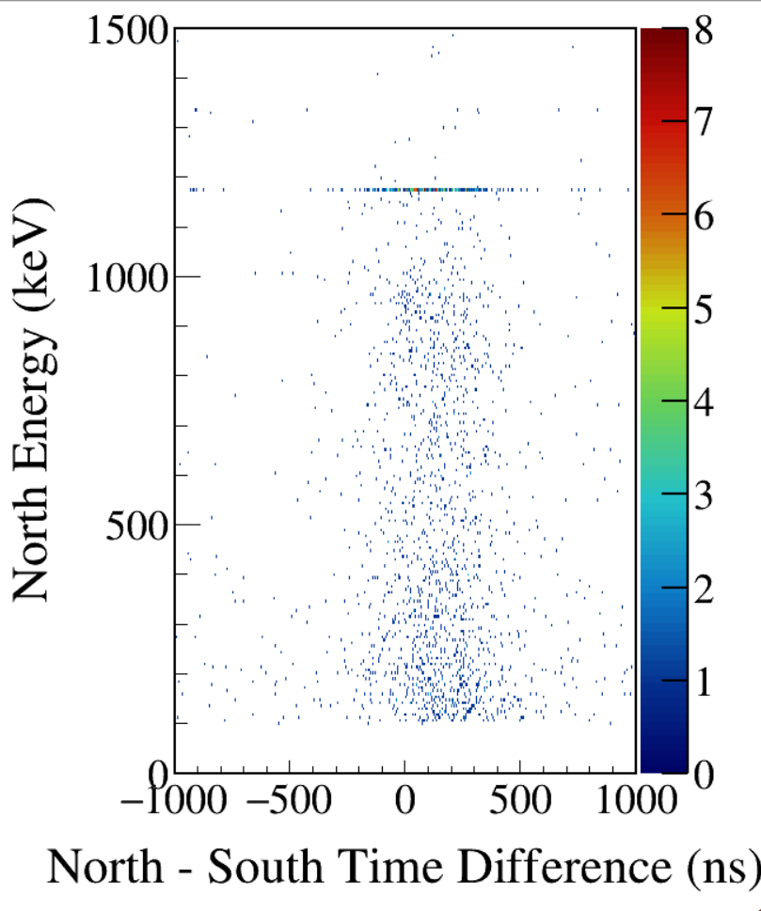
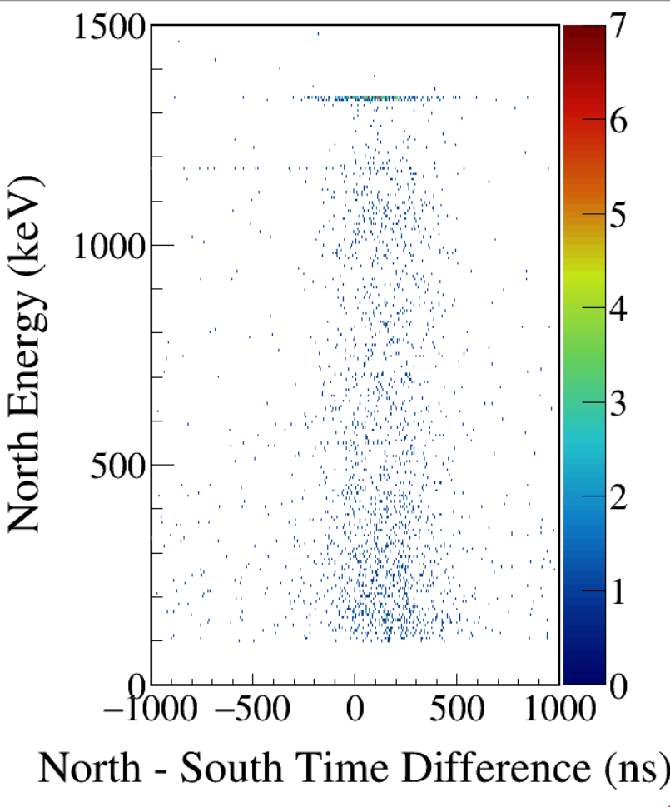
South 1173-gated
South 1332-gated
CFD enabled
Notes:
TFile *_file0 = TFile::Open("F:/e21010/pxct/run0235_LEGe_XtRa_60Co_I7281_onChamberWall_window1us_TrigRise0.016us_TrigGap1.000us_CFDdelay0.504us_cal.root");
TCanvas* canvaspeak = new TCanvas("canvaspeak", "canvaspeak", 890, 800);
canvaspeak->cd();
canvaspeak->SetTopMargin(0.03);
canvaspeak->SetRightMargin(0.12);
canvaspeak->SetLeftMargin(0.17);
canvaspeak->SetBottomMargin(0.15);
canvaspeak->SetFrameLineWidth(2);
//canvaspeak->SetLogz();
TH2D* het = new TH2D("het", "het", 400,-1000,1000,250,0,1500); //x,y
tree->Draw("north_e:north_t-south_t>>het","north_e>100&&north_e<1500&&south_e>1170&&south_e<1176","colz"); //y:x
het->SetStats(0);
het->SetTitle("");
het->GetXaxis()->SetTitle("North - South Time Difference (ns)");
het->GetYaxis()->SetTitle("North Energy (keV)");
het->GetXaxis()->CenterTitle();
het->GetYaxis()->CenterTitle();
het->GetXaxis()->SetLabelFont(132);
het->GetYaxis()->SetLabelFont(132);
het->GetXaxis()->SetLabelSize(0.05);
het->GetYaxis()->SetLabelSize(0.05);
het->GetXaxis()->SetTitleFont(132);
het->GetYaxis()->SetTitleFont(132);
het->GetXaxis()->SetTitleOffset(1.1);
het->GetYaxis()->SetTitleOffset(1.4);
het->GetXaxis()->SetTitleSize(0.06);
het->GetYaxis()->SetTitleSize(0.06);
het->GetXaxis()->SetNdivisions(505);
het->GetYaxis()->SetNdivisions(505);
//het->GetXaxis()->SetRangeUser(2001,4500);
//het->GetYaxis()->SetRangeUser(1000,2800);
//het->SetMinimum(2);
//het->SetMaximum(100);
het->SetContour(99);
gStyle->SetPalette(kRainbow);
TPaletteAxis *palette = (TPaletteAxis*)het->GetListOfFunctions()->FindObject("palette");
palette->SetTitleFont(132);
palette->SetTitleSize(0.05);
palette->SetLabelFont(132);
palette->SetLabelSize(0.05);
palette->SetLineWidth(2);

Slide 11
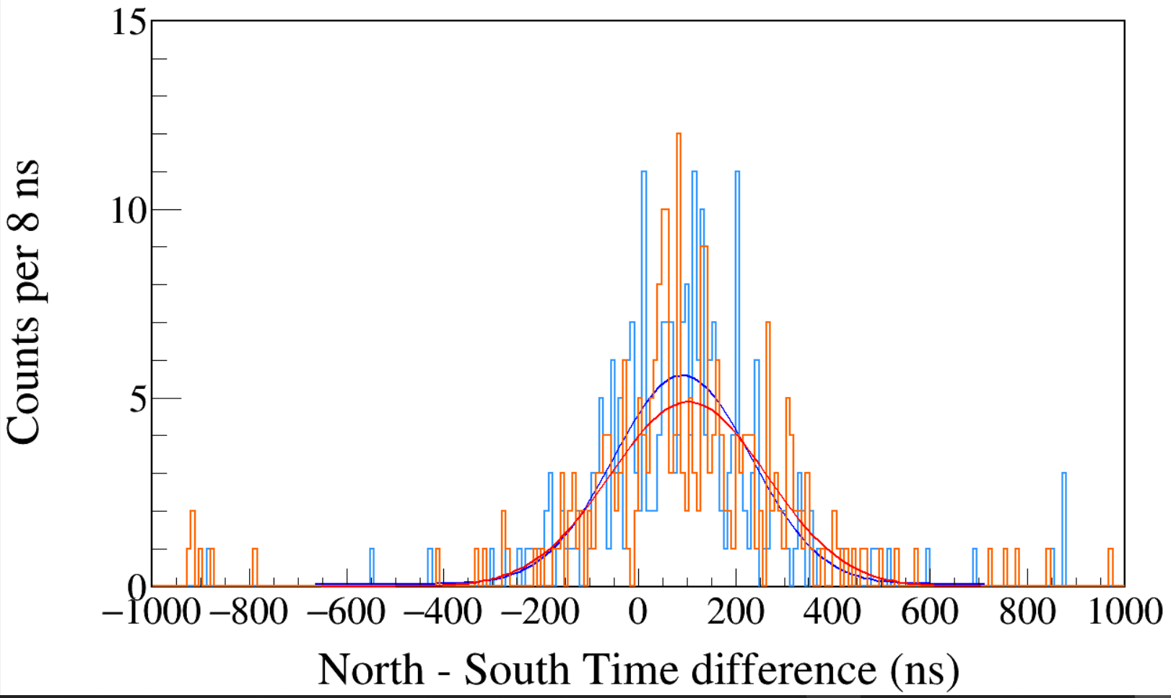
Run0235
60Co
Trigger Rise 0.016 μs
Trigger Gap 1.000 μs
CFD enabled
CFD Delay 0.504 μs
South 1173 && North 1332
South 1332 && North 1173
Gaus+Pol0
Maximum Likelihood fit
σ = 141.5±7.6 ns
σ = 160.4±7.4 ns
Notes:
TFile *_file0 = TFile::Open("F:/e21010/pxct/run0235_LEGe_XtRa_60Co_I7281_onChamberWall_window1us_TrigRise0.016us_TrigGap1.000us_CFDdelay0.504us_cal.root");
TCanvas* canvaspeak = new TCanvas("canvaspeak", "canvaspeak", 1300, 800);//
canvaspeak->cd();//
canvaspeak->SetTopMargin(0.03);
canvaspeak->SetRightMargin(0.04);
canvaspeak->SetLeftMargin(0.13);
canvaspeak->SetBottomMargin(0.16);
canvaspeak->SetFrameLineWidth(2);
TH1D* htimestamps = new TH1D("htimestamps", "htimestamps", 250,-1000,1000);
htimestamps->SetLineWidth(2);
htimestamps->Rebin(1);
htimestamps->SetStats(0);
htimestamps->SetTitle("");
htimestamps->GetXaxis()->SetTitle("North - South Time difference (ns)");
htimestamps->GetYaxis()->SetTitle("Counts per 8 ns");
htimestamps->GetXaxis()->CenterTitle();
htimestamps->GetYaxis()->CenterTitle();
htimestamps->GetXaxis()->SetLabelFont(132);
htimestamps->GetYaxis()->SetLabelFont(132);
htimestamps->GetXaxis()->SetLabelSize(0.06);
htimestamps->GetYaxis()->SetLabelSize(0.06);
htimestamps->GetXaxis()->SetTitleFont(132);
htimestamps->GetYaxis()->SetTitleFont(132);
htimestamps->GetXaxis()->SetTitleOffset(1.1);
htimestamps->GetYaxis()->SetTitleOffset(0.95);
htimestamps->GetXaxis()->SetTitleSize(0.07);
htimestamps->GetYaxis()->SetTitleSize(0.07);
htimestamps->GetXaxis()->SetRangeUser(-1000,1000);
//htimestamps->GetYaxis()->SetRangeUser(0,1700);
htimestamps->GetYaxis()->SetNdivisions(505);
htimestamps->SetLineWidth(2);
htimestamps->SetLineColor(kAzure+1);
tree->Draw("north_t-south_t>>htimestamps","south_e>1170&&south_e<1176&&north_e>1330&&north_e<1336");
tree->SetLineColor(kOrange+7);
tree->SetLineWidth(2);
tree->Draw("north_t-south_t","north_e>1170&&north_e<1176&&south_e>1330&&south_e<1336","same");

Slide 12
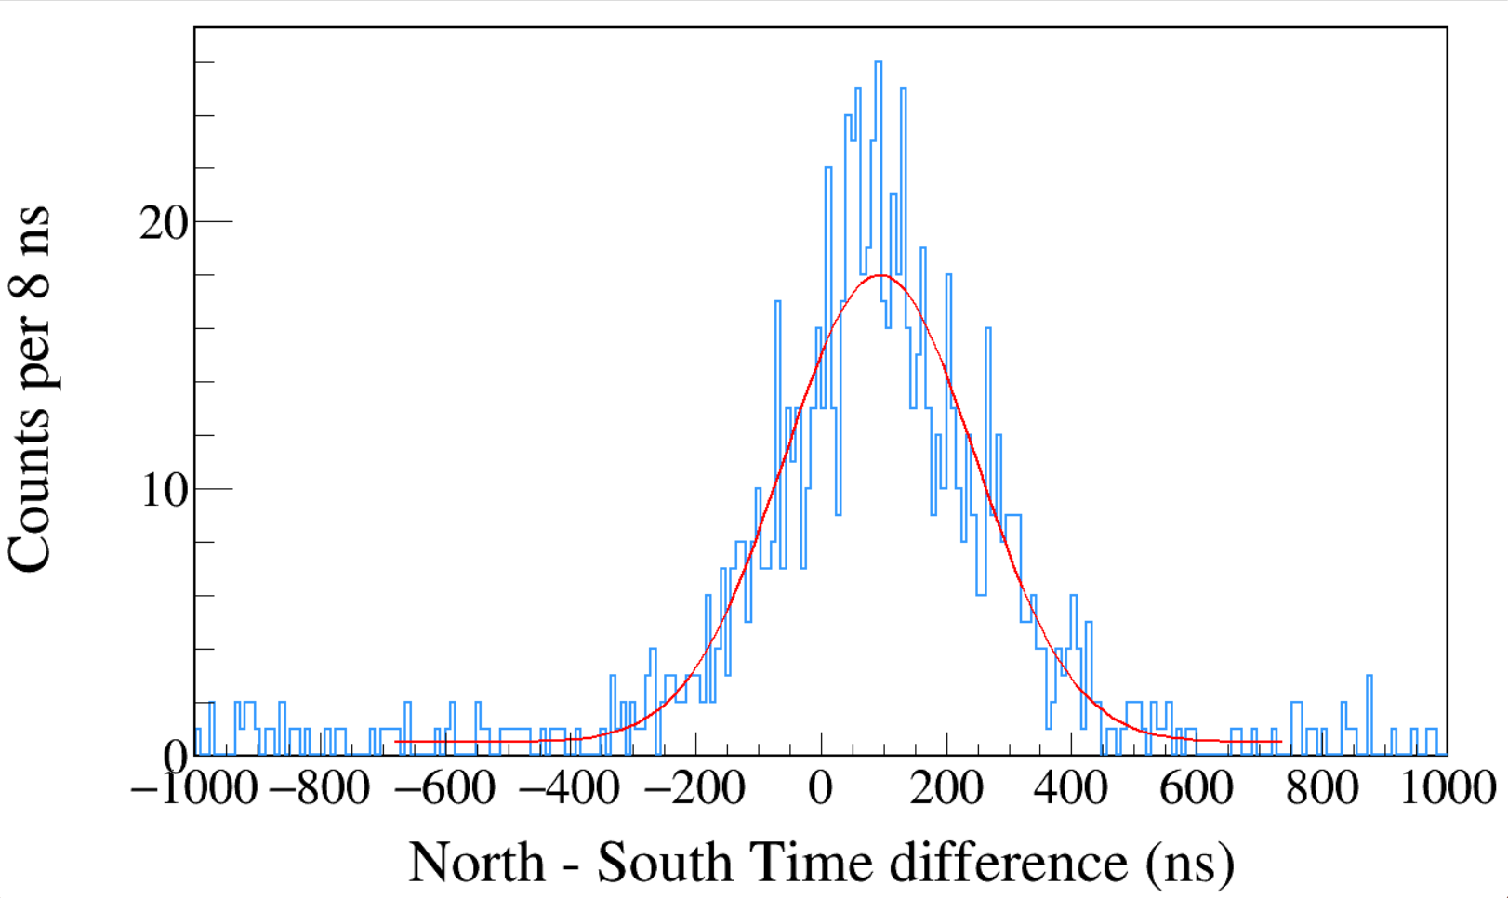
Run0235
60Co
Trigger Rise 0.016 μs
Trigger Gap 1.000 μs
CFD enabled
CFD Delay 0.504 μs
1100 < South < 1400
&&
1100 < North < 1400
σ = 153.3±5.2 ns
FWHM = 361 ns
Notes:
TFile *_file0 = TFile::Open("F:/e21010/pxct/run0235_LEGe_XtRa_60Co_I7281_onChamberWall_window1us_TrigRise0.016us_TrigGap1.000us_CFDdelay0.504us_cal.root");
TCanvas* canvaspeak = new TCanvas("canvaspeak", "canvaspeak", 1300, 800);//
canvaspeak->cd();//
canvaspeak->SetTopMargin(0.03);
canvaspeak->SetRightMargin(0.04);
canvaspeak->SetLeftMargin(0.13);
canvaspeak->SetBottomMargin(0.16);
canvaspeak->SetFrameLineWidth(2);
TH1D* htimestamps = new TH1D("htimestamps", "htimestamps", 250,-1000,1000);
htimestamps->SetLineWidth(2);
htimestamps->Rebin(1);
htimestamps->SetStats(0);
htimestamps->SetTitle("");
htimestamps->GetXaxis()->SetTitle("North - South Time difference (ns)");
htimestamps->GetYaxis()->SetTitle("Counts per 8 ns");
htimestamps->GetXaxis()->CenterTitle();
htimestamps->GetYaxis()->CenterTitle();
htimestamps->GetXaxis()->SetLabelFont(132);
htimestamps->GetYaxis()->SetLabelFont(132);
htimestamps->GetXaxis()->SetLabelSize(0.06);
htimestamps->GetYaxis()->SetLabelSize(0.06);
htimestamps->GetXaxis()->SetTitleFont(132);
htimestamps->GetYaxis()->SetTitleFont(132);
htimestamps->GetXaxis()->SetTitleOffset(1.1);
htimestamps->GetYaxis()->SetTitleOffset(0.95);
htimestamps->GetXaxis()->SetTitleSize(0.07);
htimestamps->GetYaxis()->SetTitleSize(0.07);
htimestamps->GetXaxis()->SetRangeUser(-1000,1000);
//htimestamps->GetYaxis()->SetRangeUser(0,1700);
htimestamps->GetYaxis()->SetNdivisions(505);
htimestamps->SetLineWidth(2);
htimestamps->SetLineColor(kAzure+1);
tree->Draw("north_t-south_t>>htimestamps","south_e>1100&&south_e<1400&&north_e>1100&&north_e<1400");

