Slide 1
Response Function Characterization
S2193

Slide 2
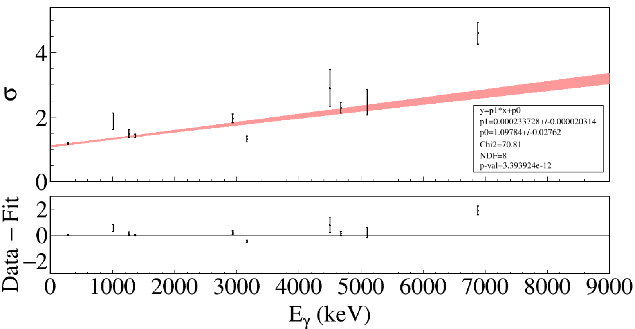
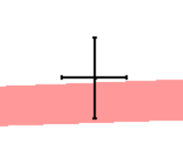
Zoom-in
Unshifted peaks at 279, 1015, 1267, 1369, 2936, 3164, 4497, 4678, 5099, 6877 keV.
Notes:
GRIFFIN_0 y=p1*x+p0 p1= 0.000233728 +/- 2.03E-05 p0= 1.0978361 +/- 0.027623125 Chi2= 70.807157 ndf= 8 p-value= 3.39E-12

Slide 3
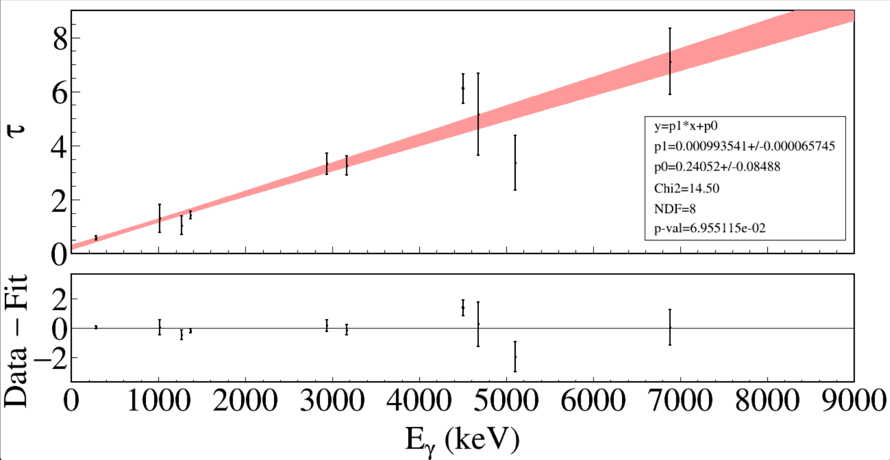
At 7.5 MeV, the uncertainty for σ is ~15%, and the uncertainty for τ is ~8%.
At E_{γ} = 7500 keV, τ = 7.7±0.6
Error inflated by $\sqrt{χ_{ν}^{2}}$.
Notes:
GRIFFIN_0 y=p1*x+p0 p1= 0.000993541 +/- 6.57E-05 p0= 0.2405206 +/- 0.084883542 Chi2= 14.503433 ndf= 8 p-value= 0.069551145

Slide 4
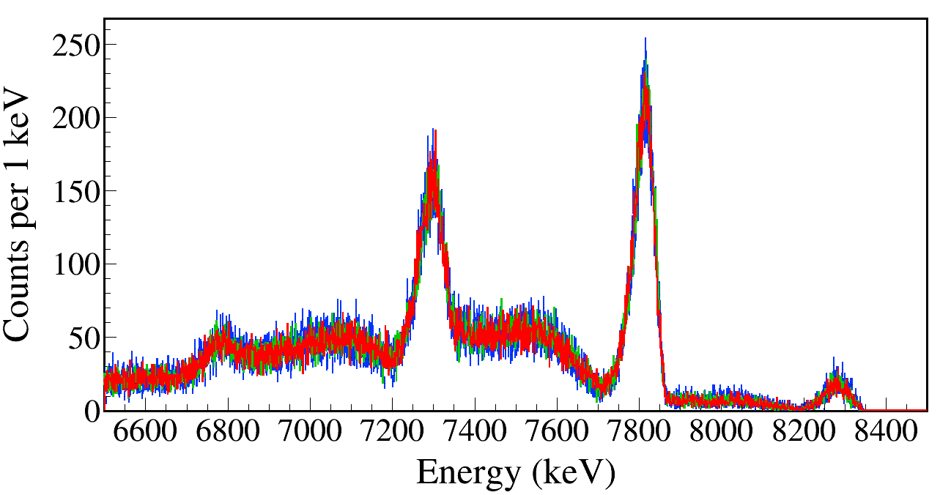
7335
τ – dτ
τ
τ + dτ
escape
escape
7335+451
Varying τ up and down by one sigma up or down in the simulation has little effect on the resulting γ-ray lineshape.

Slide 5
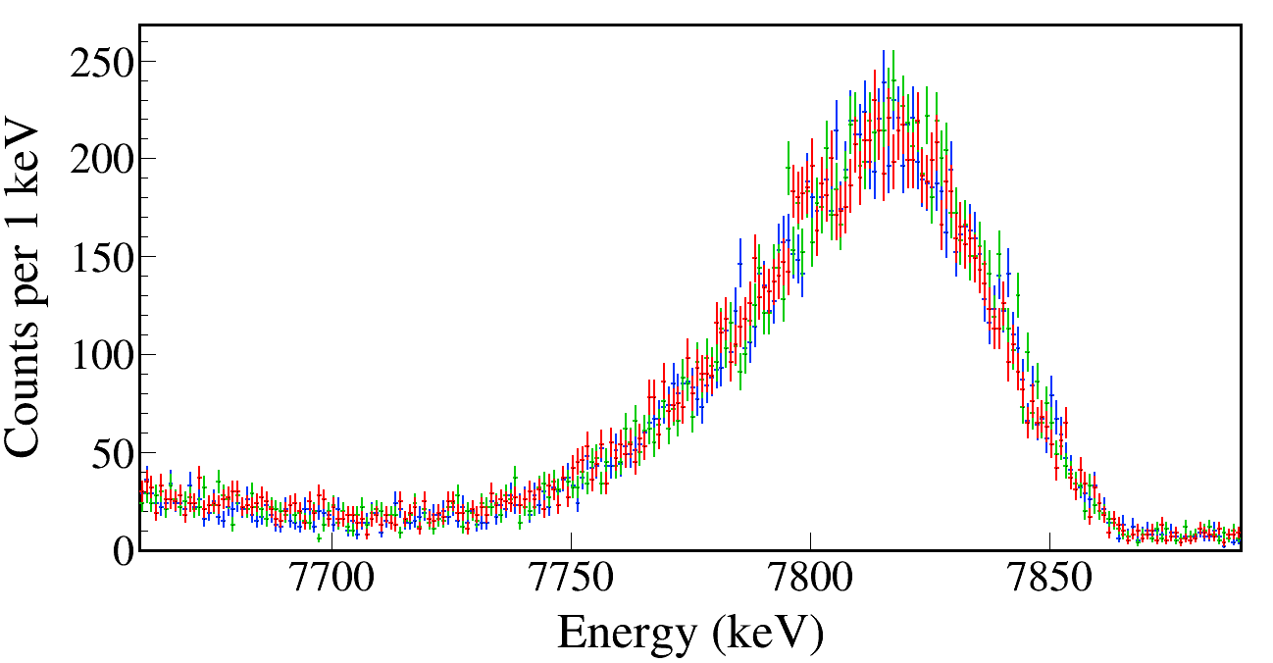
τ – dτ
τ
τ + dτ
Varying τ up and down by one sigma up or down in the simulation has little effect on the resulting γ-ray lineshape.
Notes:
TFile *_file0 = TFile::Open("Test/Mg23_Gamma7787_Eg7787.00_Tau1.0_SP1.00_AD0.0_EMGTauM.root");
TCanvas* canvaspeak = new TCanvas("canvaspeak", "canvaspeak", 1300, 700);
canvaspeak->cd();//
canvaspeak->SetTopMargin(0.038);
canvaspeak->SetRightMargin(0.025);
canvaspeak->SetLeftMargin(0.11);
canvaspeak->SetBottomMargin(0.17);
gStyle->SetFrameLineWidth(2);
canvaspeak->SetFrameLineWidth(3);
//gPad->SetLogy();
TH1F* Eg = new TH1F("Eg", "Eg", 9000, 0, 9000);
Eg->Sumw2(kFALSE);
Eg->SetBinErrorOption(TH1::kPoisson);//TH1::kNormal or TH1::kPoisson
Eg->SetLineWidth(2);
Eg->Rebin(1);
Eg->SetLineColor(kAzure);
Eg->SetStats(0);
Eg->SetTitle("");
Eg->GetXaxis()->SetTitle("Energy (keV)");
Eg->GetYaxis()->SetTitle("Counts per 1 keV");
Eg->GetXaxis()->CenterTitle();
Eg->GetYaxis()->CenterTitle();
Eg->GetXaxis()->SetLabelFont(132);
Eg->GetYaxis()->SetLabelFont(132);
Eg->GetXaxis()->SetLabelSize(0.07);
Eg->GetYaxis()->SetLabelSize(0.07);
Eg->GetXaxis()->SetTitleFont(132);
Eg->GetYaxis()->SetTitleFont(132);
Eg->GetXaxis()->SetTitleOffset(1.0);
Eg->GetYaxis()->SetTitleOffset(0.7);
Eg->GetXaxis()->SetTitleSize(0.08);
Eg->GetYaxis()->SetTitleSize(0.08);
Eg->GetYaxis()->SetTickLength(0.015);
Eg->GetXaxis()->SetRangeUser(7660, 7890);
Eg->GetXaxis()->SetNdivisions(105);
Eg->Scale(0.2);
//Eg->GetYaxis()->SetRangeUser(1, 4e5);
tree->Draw("Clovere>>Eg", Form("Clovere>0&&Clovere<9000&&DSSD1e+DSSD2e>100&&DSSD1e>100&&DSSD2e>100"),"e");
TFile *_file1 = TFile::Open("Test/Mg23_Gamma7787_Eg7787.00_Tau1.0_SP1.00_AD0.0_EMGTauL.root");
tree->SetLineColor(kGreen+1);
tree->SetLineWidth(2);
tree->Draw("Clovere", Form("Clovere>0&&Clovere<9000&&DSSD1e+DSSD2e>100&&DSSD1e>100&&DSSD2e>100"),"esame");
TFile *_file2 = TFile::Open("Test/Mg23_Gamma7787_Eg7787.00_Tau1.0_SP1.00_AD0.0_EMGTauH.root");
tree->SetLineColor(kRed);
tree->SetLineWidth(2);
tree->Draw("Clovere", Form("Clovere>0&&Clovere<9000&&DSSD1e+DSSD2e>100&&DSSD1e>100&&DSSD2e>100"),"esame");
canvaspeak->SaveAs("EMGTau2.png");

