Slide 1
PXCT Simulation
20210526

Slide 2
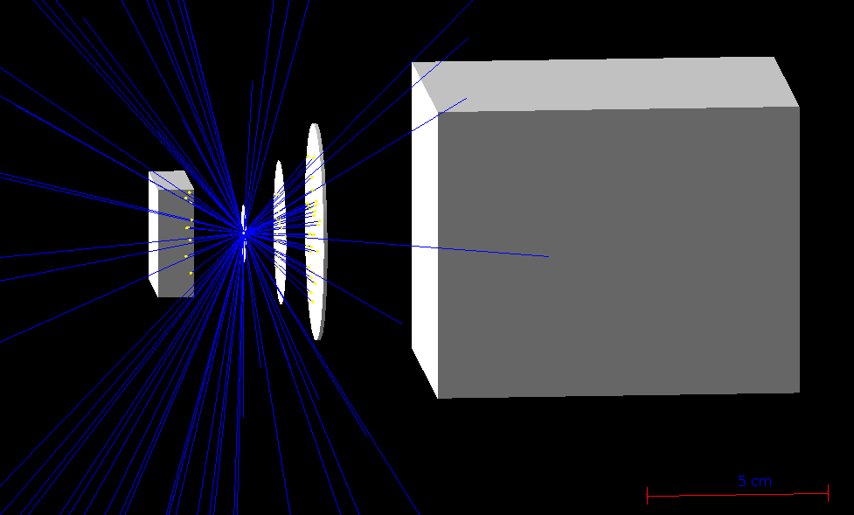
PXCT simulation
Location on fishtank: /mnt/simulations/pxct/lijie/PXCT_Sim/build
cmake -DGeant4_DIR=/mnt/simulations/proton_detector/Geant4/geant4.10.2-install/lib/Geant4-10.2.2 /mnt/simulations/pxct/lijie/PXCT_Sim
make
./tele vis
30 MeV α
C foil
Ge(X)
Si ΔE-E
Ge(γ)
-2
0
1
2
10
z

Slide 3
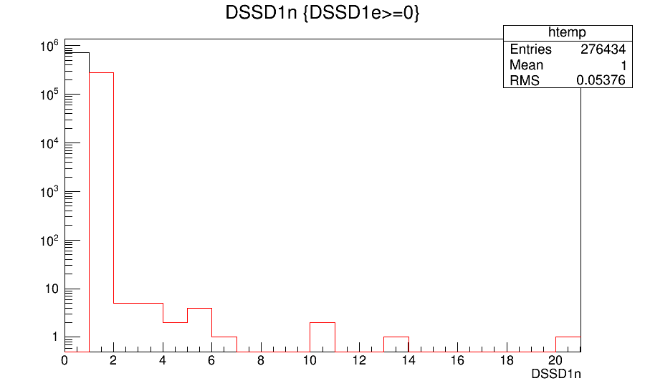
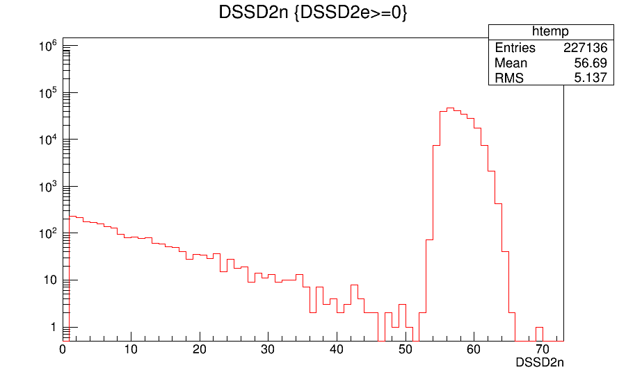
Number of steps in Silicon ΔE Detector
It's thin. Most particles pass through ΔE only interact with silicon once/twice/three times.
Number of steps in Silicon E Detector
It's thick. Most particles deposit all the residual energy in E and interact with silicon 60 times.
Notes:
tree->Draw("DSSD1n","DSSD1e>0")
tree->Draw("DSSD2n","DSSD2e>0")

Slide 4
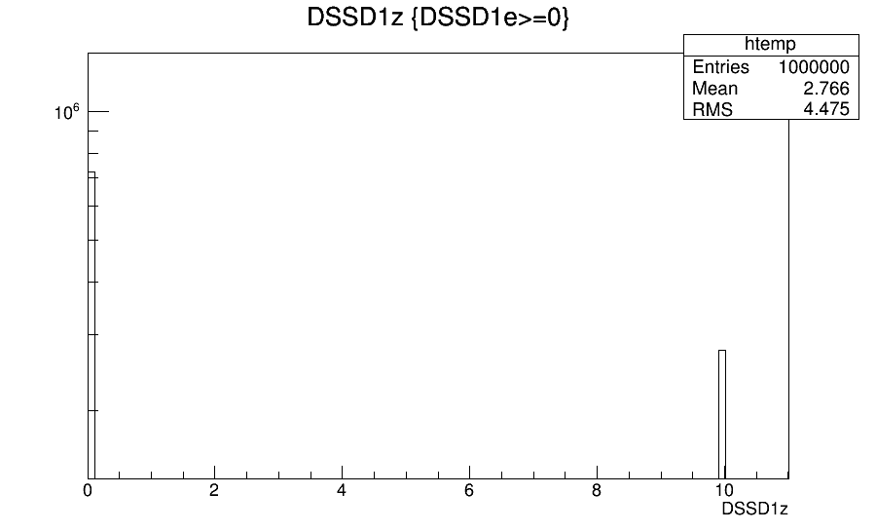
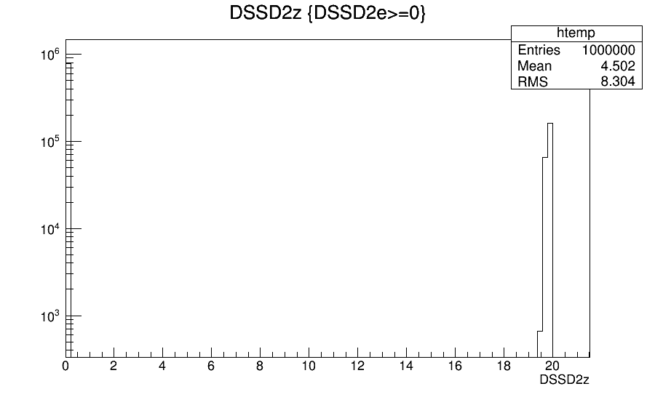
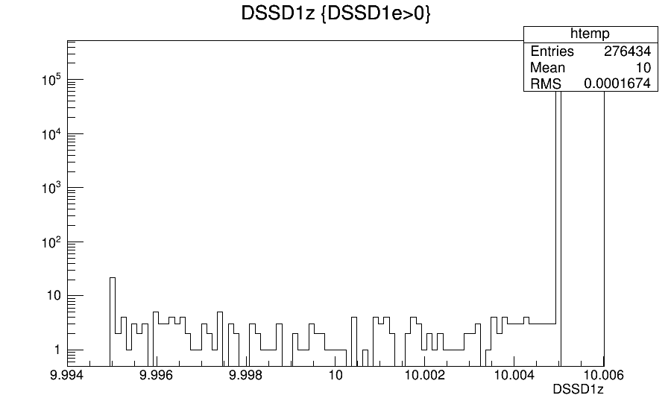
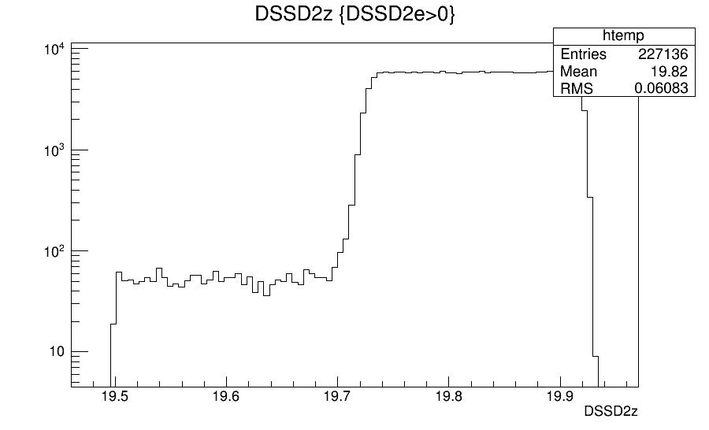
Z position of the last step in Silicon ΔE Detector. ΔE is placed at z = 10 mm. The 10 μm thickness ranges from 9.995 to 10.005 mm.
Z position of the last step in Silicon E Detector. E is placed at z = 20 mm. The 1 mm thickness ranges from z = 19.5 to 20.5 mm. All particles are stopped within 0.44 mm.
Notes:
tree->Draw("DSSD1z","DSSD1e>0")
tree->Draw("DSSD2z","DSSD2e>0")

Slide 5
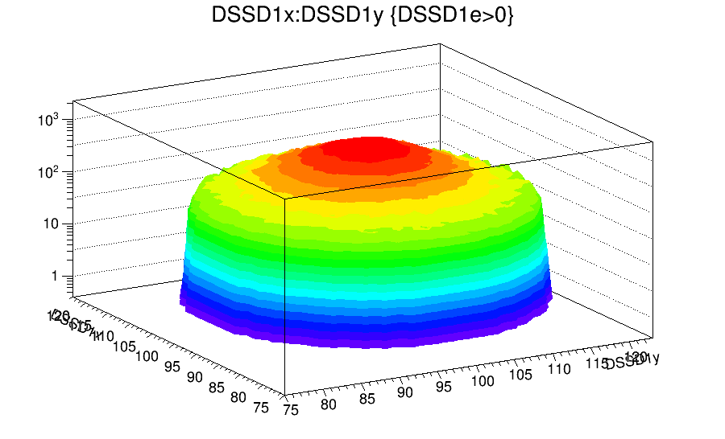
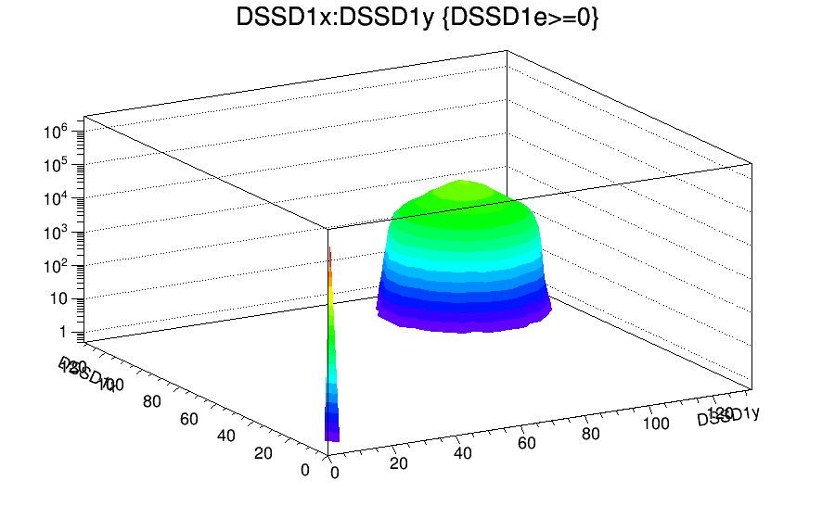
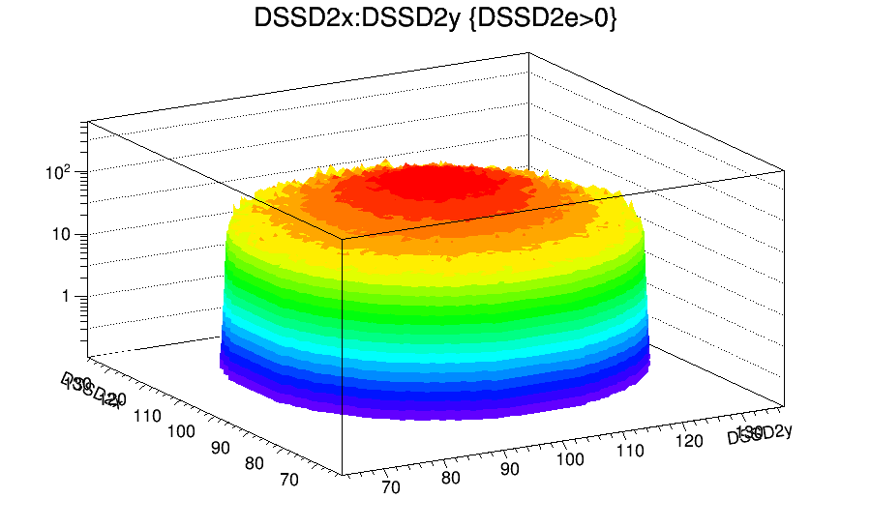
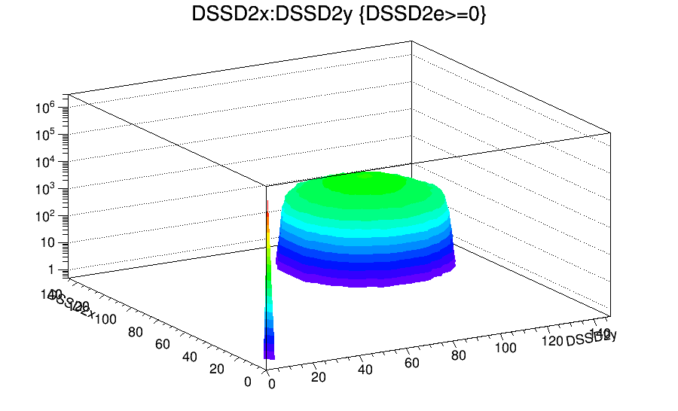
276k
227k
X-Y position of the last step in Silicon ΔE Detector.
Detection efficiency can be obtained from the number of counts. In this case, ε(ΔE) = 27.6%, ε(ΔE) = 22.7%
Notes:
tree->Draw("DSSD1x:DSSD1y","DSSD1e>0","surf2")
tree->Draw("DSSD2x:DSSD2y","DSSD2e>0","surf2")

Slide 6
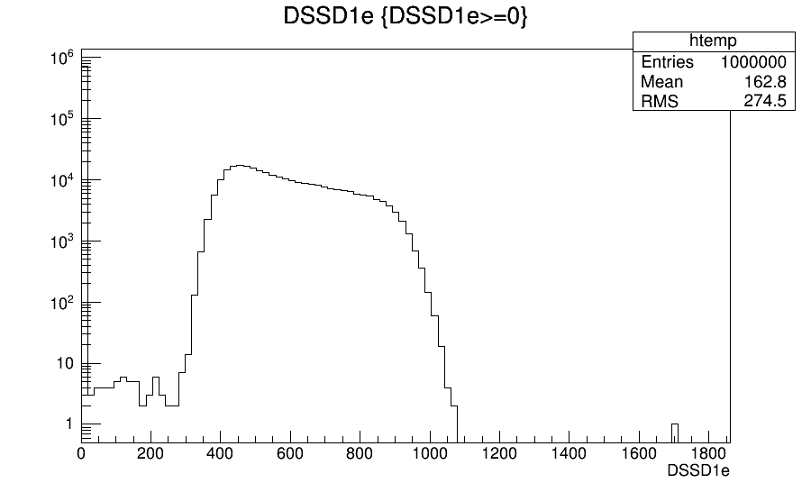
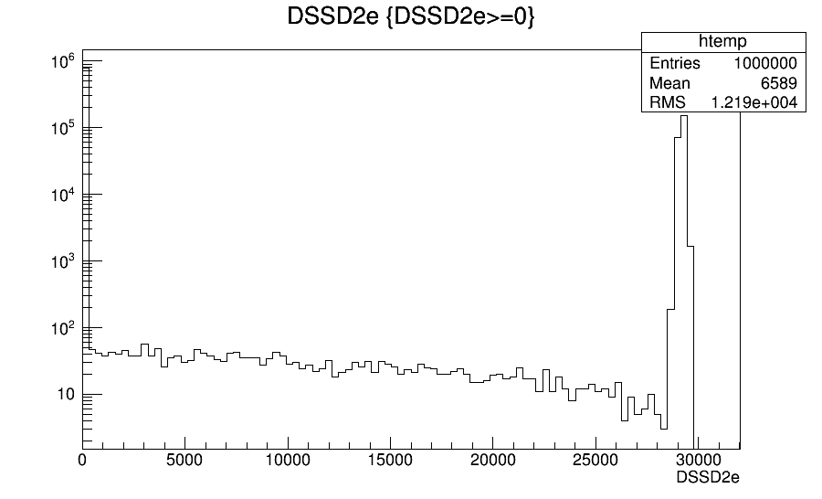
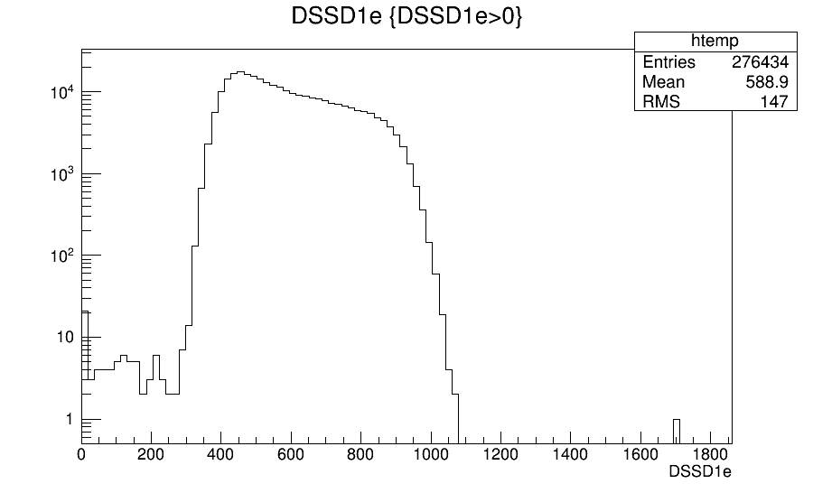
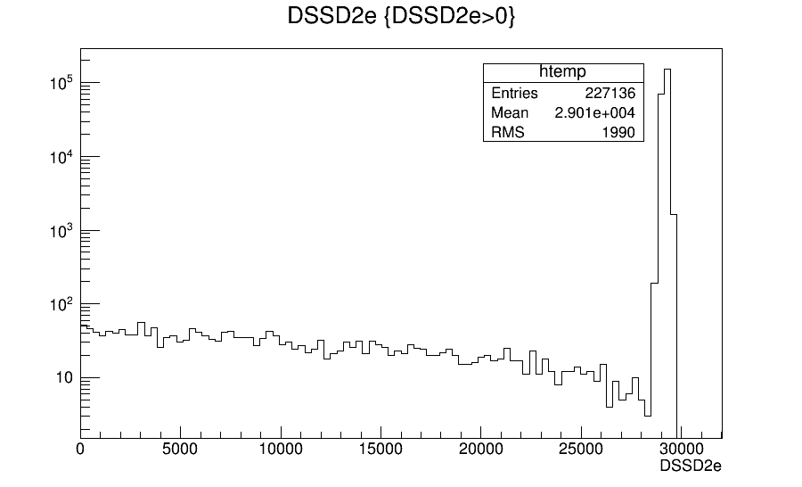
α Particles with 30 MeV
Deposit 300-1100 keV in ΔE
Deposit all the remainder (~29 MeV) in E
Notes:
tree->Draw("DSSD1e","DSSD1e>0")
tree->Draw("DSSD2e","DSSD2e>0")

Slide 7
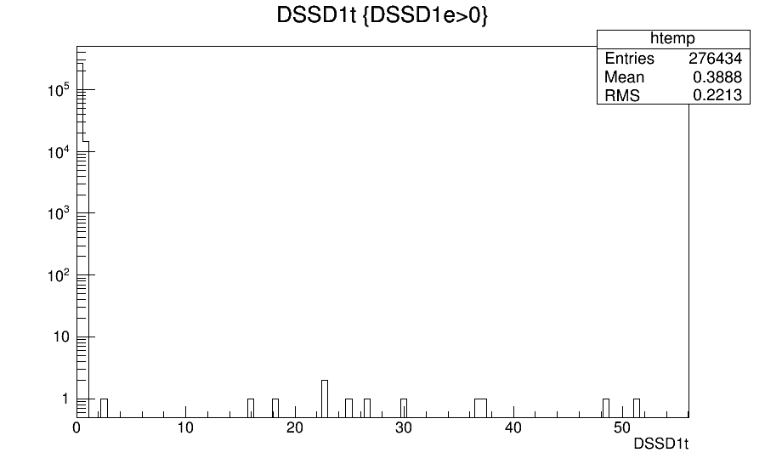
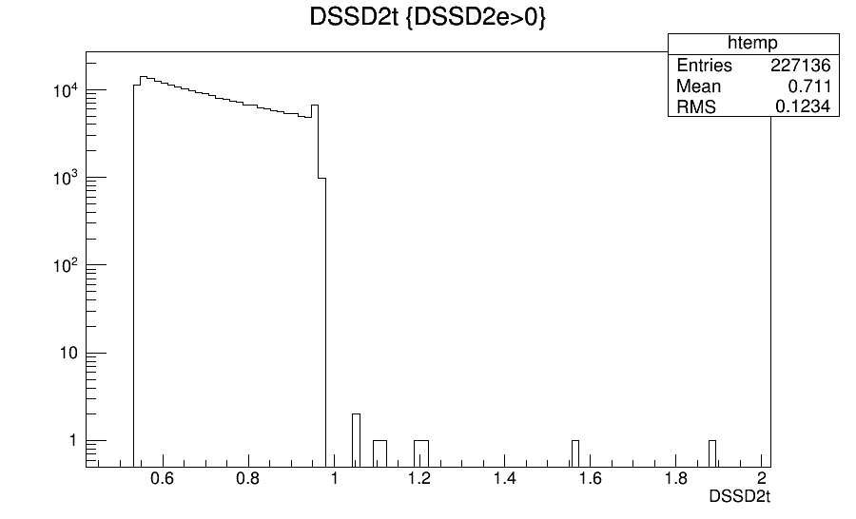
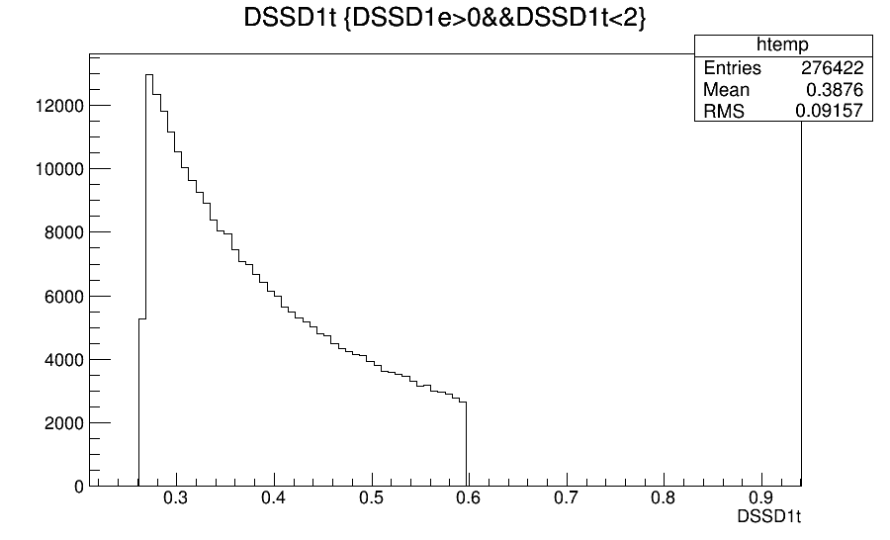
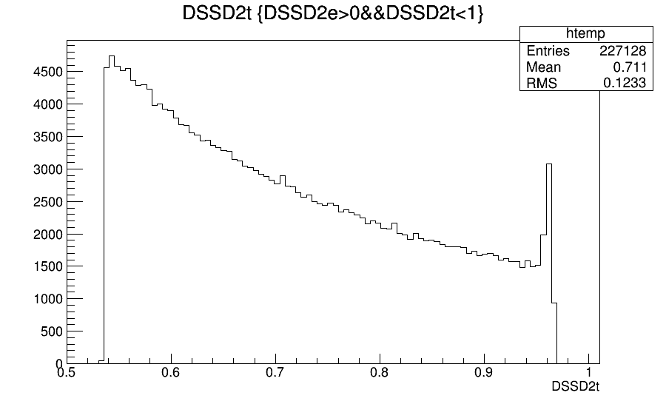
Particles emit at t = 0
Particles escape from the target ~0.2 ns
Then they interact with ΔE 0.2-0.6 ns
Then they interact with E 0.5-1.0 ns
Notes:
tree->Draw("DSSD1t","DSSD1e>0")
tree->Draw("DSSD2t","DSSD2e>0")

