Slide 1
2025-05-19

Slide 2
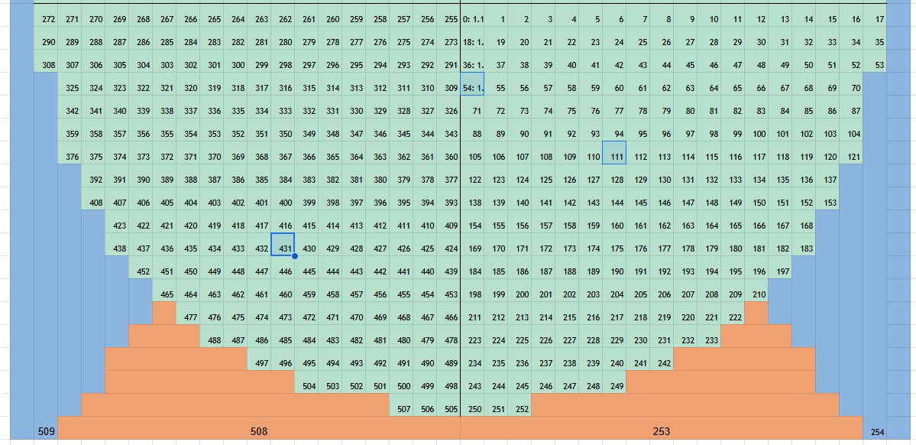
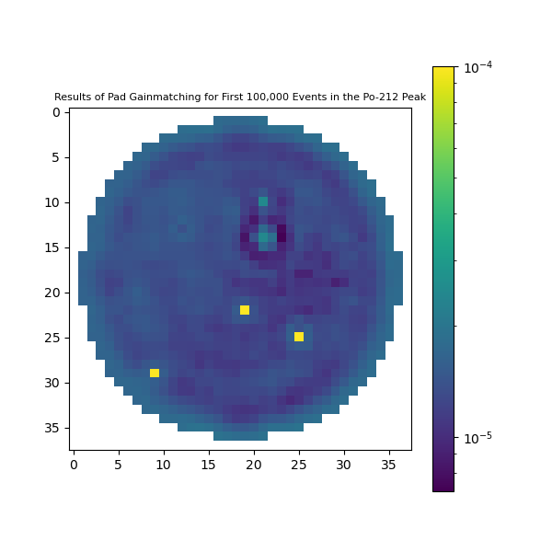
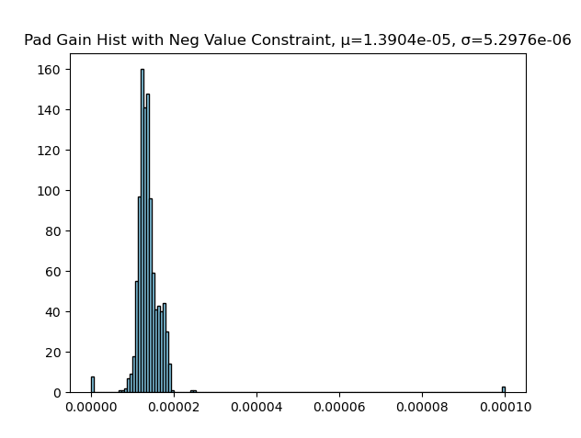
Low Energy Uncertainty
Likely comes from poor estimates of our uncertainties due to noise, pad gain match, etc.
Pad gain match with constraint that the values must be positive:

Slide 3
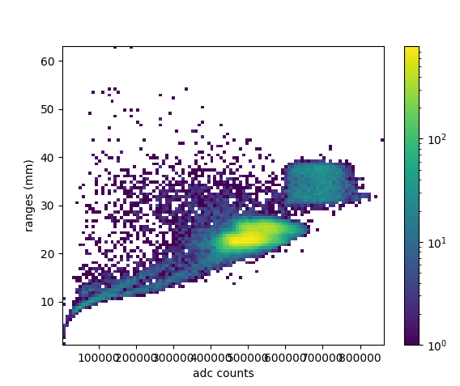
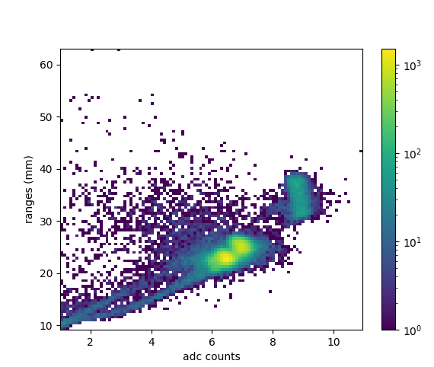
Also the pad gain match seemed to get rid of a few high range, low energy events
Run 0012 Before Pad Gain Match
Run 0012 After Pad Gain Match

Slide 4
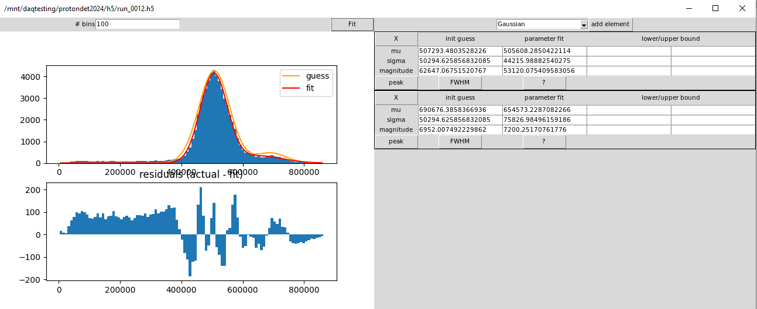
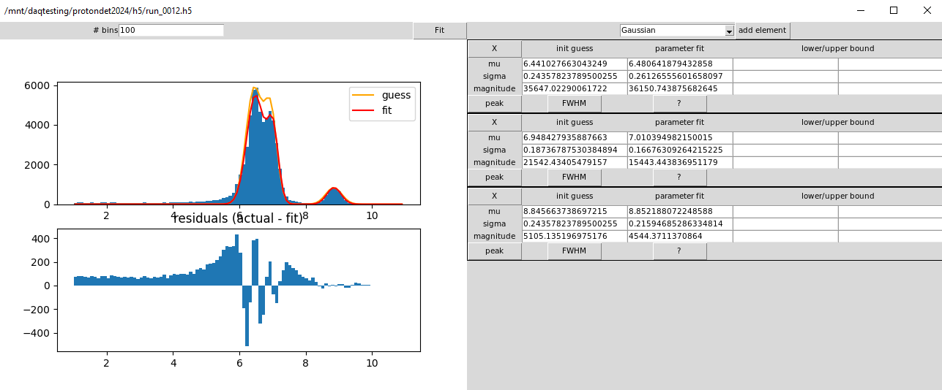
FWHM: 20.6%
FWHM: 27.2%
FWHM: 9.49%
FWHM: 5.60%
FWHM: 5.75%

