Slide 1
NSCL Proton Detector
David Perez Loureiro
September 14th 2015

Slide 2
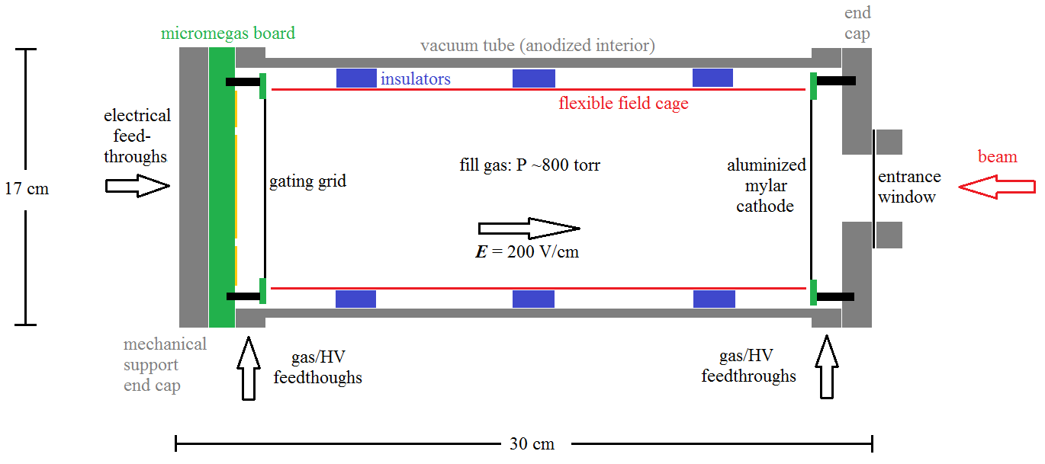
Conceptual Design

Slide 3
MicroMEGAS Detectors
ν_{e}
Drift Region
Particles ionize the gas along their trajectories
Electrons drift to anode pads under an applied field (~100 V/cm)
Amplification Region
Avalanche multiplication
Signal induced in readout pads
Fast timing, robust, cost effective, good energy resolution
Cathode
HV₁
β
Drift Region
p
30 cm
E₁
200 V/cm
e⁻
e⁻
e⁻
e⁻
e⁻
MicroMesh
HV₂
Amplification Region
100 μm
E₂
50 kV/cm
Readout Pad
Y. Giomataris et al. Nucl. Instr. and Meth. A, 376 (1996), p. 29

Slide 4
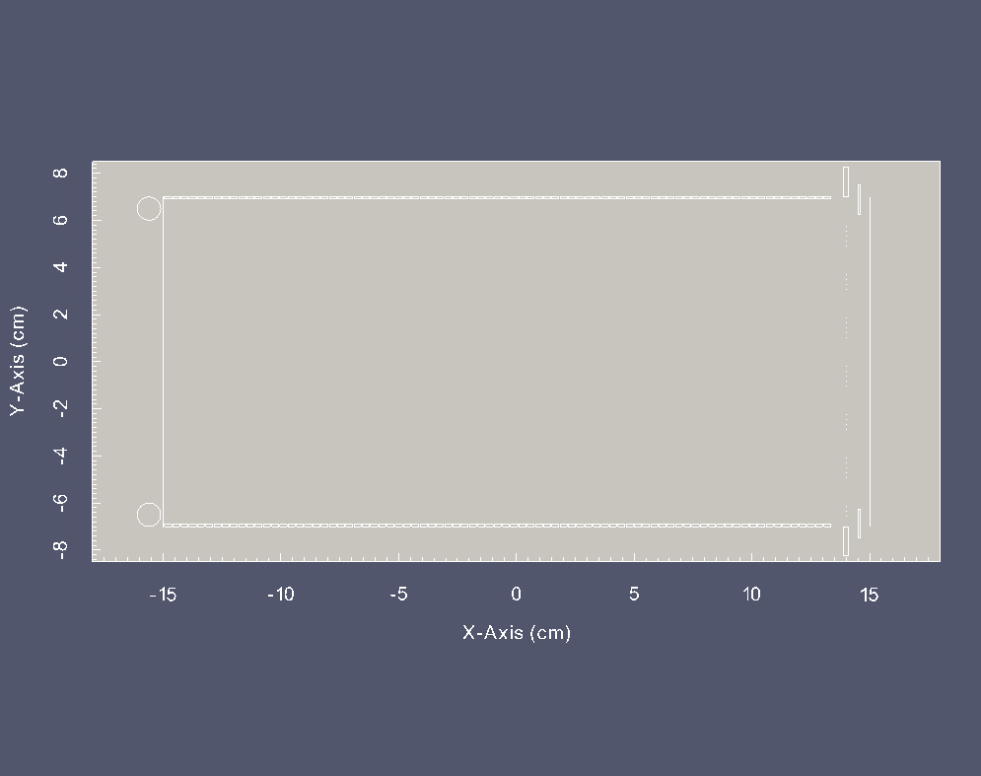
83 equipotential strips
(3mm wide)
0.5 mm gap
Kapton layer (0.3 mm)
1.5cm
Variable Ring
14cm
Gating Grid
Corona Ring 5mm radius
3cm
1cm
Variable ring allows to change the field lines in the region near the mesh placed at 5mm from micromesh

Slide 5
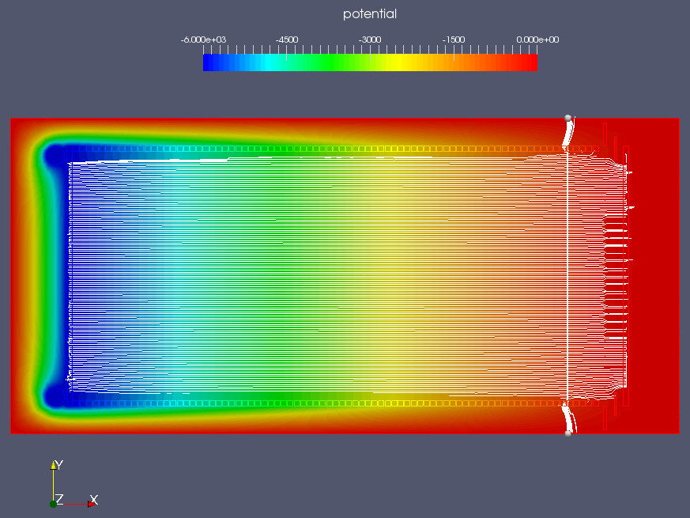

Slide 6
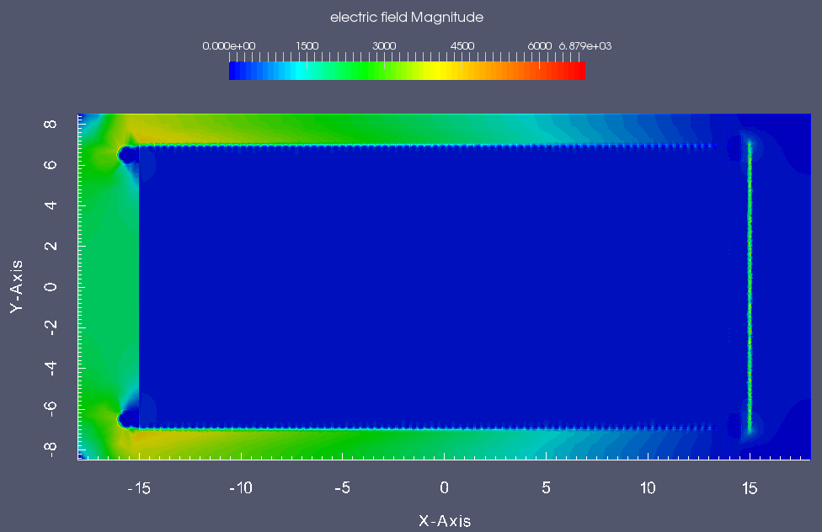
Ar-iso 2.5% 1 atm 1cm
V_{B}= 5981 V
Ar-iso 5% 1 atm 1cm
V_{B}= 7323 V
Ar-iso 10% 1 atm 1cm
V_{B}= 9611 V
Electric field below 5kV/cm. Safe for sparking

Slide 7
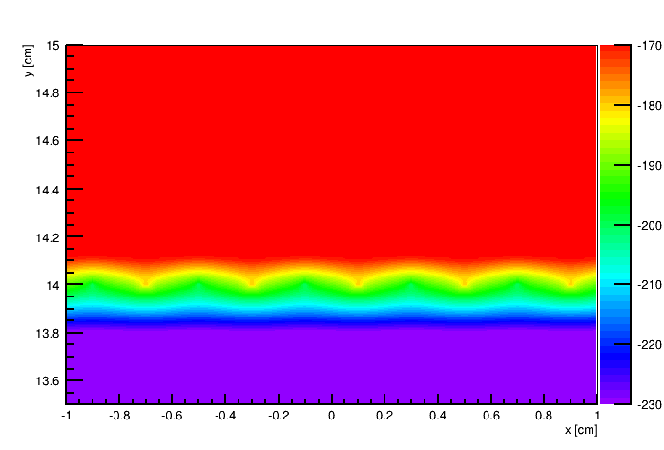
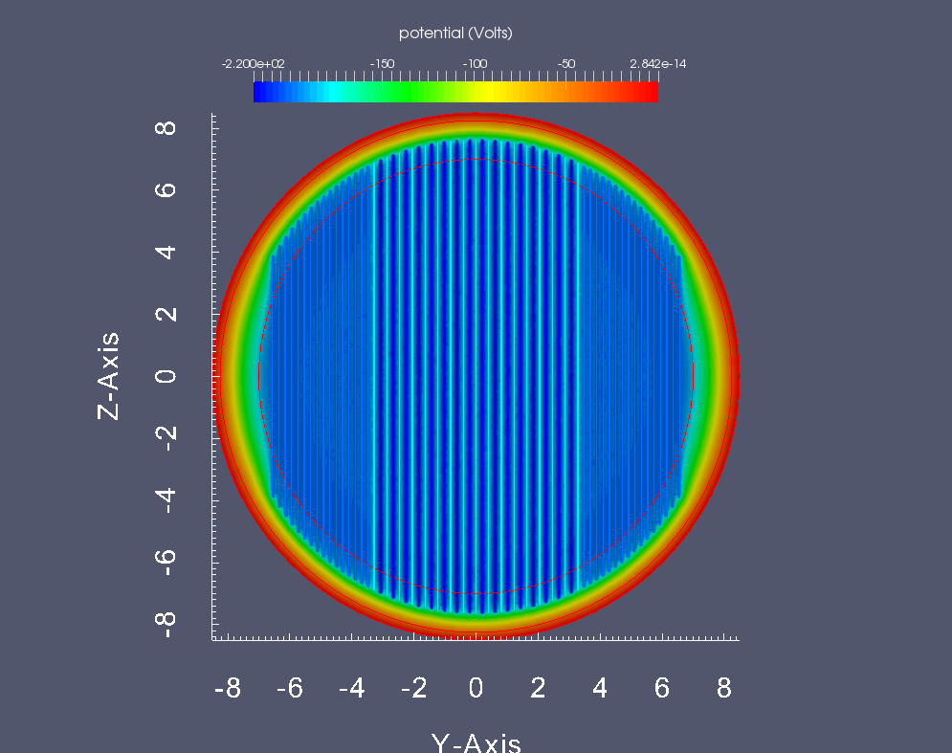
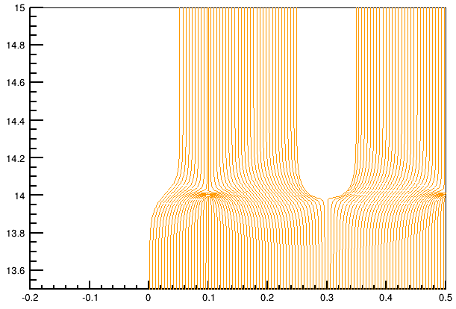
0 V
E
Gating grid: Allows to control the amount of electrons
reaching the amplification area
200 V ± ΔV
+ΔV
-ΔV
+ΔV

Slide 8
Cathode
Katton
Some tabs in the Kapton layer of the cage will hold
it to the cathode and the Gating grid frame
with screws
Katton
GG frame
Bottom view of cathode

