Slide 1
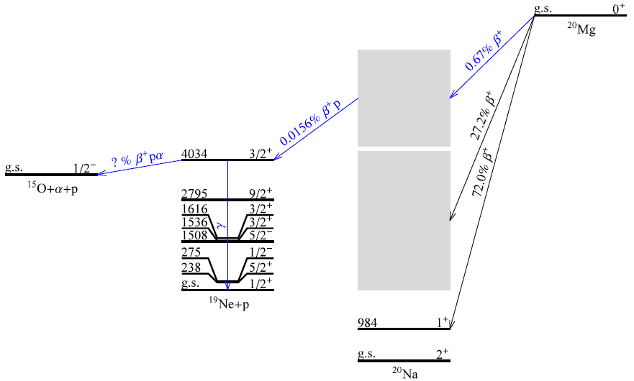
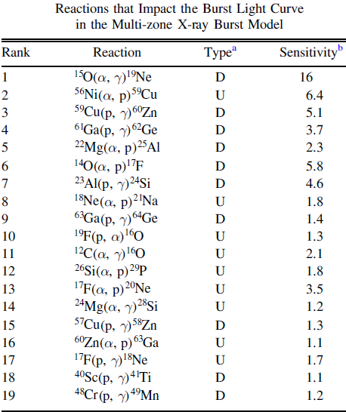
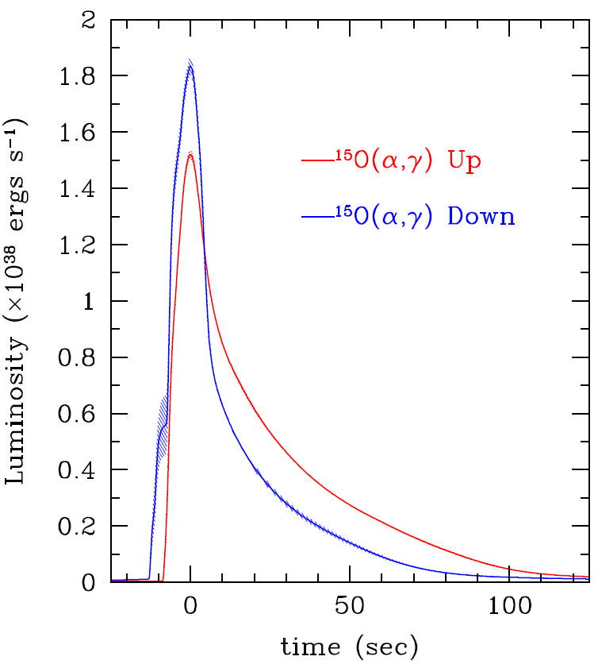
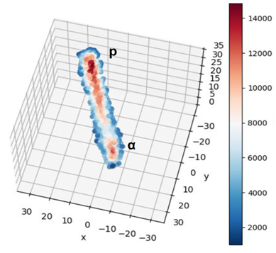
E21072 Motivation: ¹⁵O(α,γ)¹⁹Ne rate for XRBs
Goal: measure Γ_{α}/Γ of key resonance
Use ²⁰Mg(β⁺pα) decay
C. Wrede et al., Phys. Rev. C 96, 032801(R) (2017)
B. E. Glassman et al., Phys. Rev. C 99, 065801 (2019)
Commissioned GADGET II on beam line demonstrating sensitivity to βpα events using ²¹Mg beam contaminant
Developed and verified machine learning techniques to identify βpα events
Insufficient ²⁰Mg beam intensity to reach science goals → Run 2 approved (E25058)
R. Cyburt et al., Astrophys. J. 830, 55 (2016)
Candidate βpα event
T. Wheeler, Ph.D. thesis (Michigan State University, 2024)
T. Wheeler et al. accepted for publication in NIMA, arXiv:2501.17892

