Slide 1
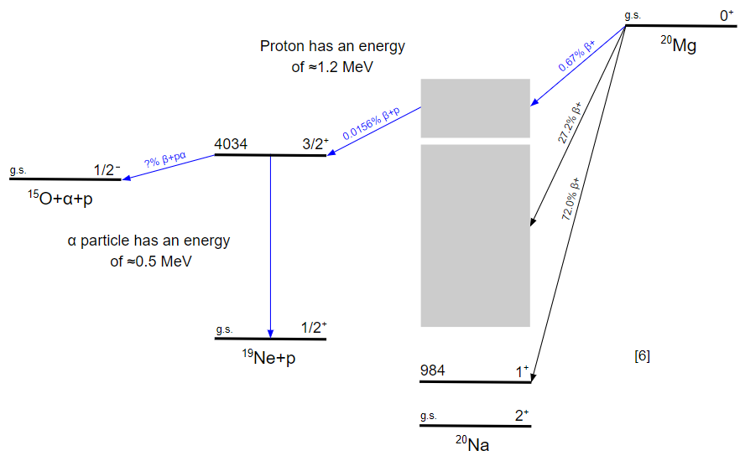
Measuring the¹⁵O(α,γ)¹⁹Ne Reaction in Type I X-ray Bursts using ²⁰Mg β-decay
Astrophysical Motivation
The ¹⁵O(α,γ)¹⁹Ne reaction is the most important thermonuclear reaction rate uncertainty for Type I X-ray bursts [1]
Reaction Dominance
Dominated by a single resonance at E_{CM} = 506 keV (E_{x} = 4034 keV in ¹⁹Ne); only the alpha branching ratio (Γα/Γ) is needed to calculate the reaction rate [2-4]
Experimental Approach
Capture ²⁰Mg(βpα) events using the GADGET II TPC to measure Γα/Γ
[9]
Previous Attempts
Past experiments using transfer reactions could only establish upper limits on the branching ratio. [5-8]
Prior Run (e21072): Demonstrated technique and sensitivity using GADGET II TPC, but was limited by ²⁰Mg beam intensity and purity.
Accepted PAC3 Proposal - E25058 (Spokespeople - Chris Wrede, Ruchi Mahajan, Tyler Wheeler): Strength of the key 15O(a,g)19Ne resonance in X-ray bursts: Run 2
[6] B. Davids et al., PRC 67, 062808 (2003)
[7] K. E. Rehm et al., PRC 67, 065809 (2003)
[8] W. P Tan et al., PRL 98, 242503 (2007)
[9] C. Wrede et al., PRC 96, 032801(R) (2017)
[1] R. Cyburt, et al., APJ 930, 2 (2016)
[2] W. P. Tan et al., PRC 72, 041302 (2005)
[3] R. Kanungo et al., PRC 74, 045803 (2006)
[4] S. Mythili et al., PRC 77, 035803 (2008)
[5] B. Davids et al., ApJ 735 40 (2011)

