Slide 1
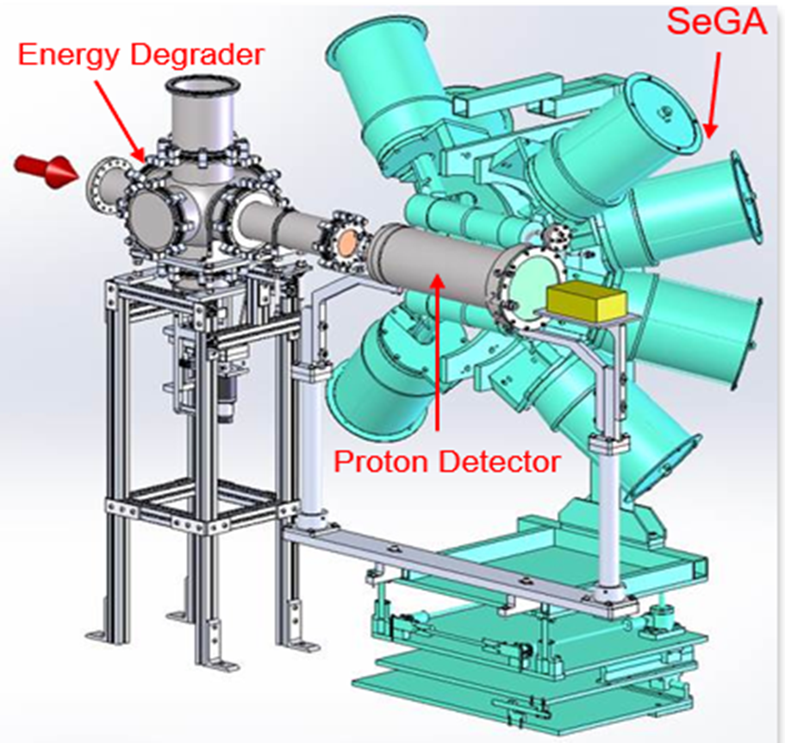
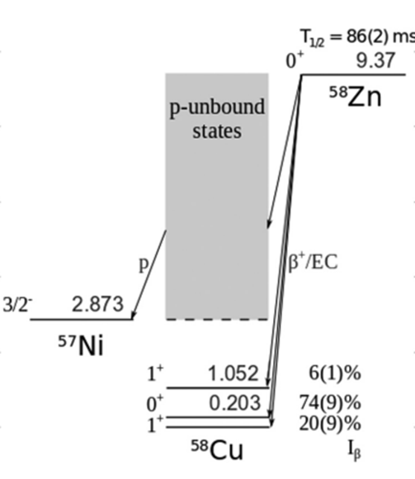
⁵⁷Ni(p, γ )⁵⁸Cu reaction rate: β-decay of ⁵⁸Zn with GADGET I
Goal: To measure the ⁵⁷Ni(p,γ)⁵⁸Cu reaction rate through β-delayed p decay.
Motivation
Understanding nucleosynthesis in CCSN requires better knowledge of ⁴⁴Ti production.
⁴⁴Ti production depends on the ⁵⁷Ni(p,𝛾)⁵⁸Cu reaction rate. [1-2]
Constraining this rate requires better knowledge of the ⁵⁸Cu structure, especially level energies between 3–6 MeV.
[3]
[4]
Protons will be detected in the gaseous proton detector.
The surrounding high-purity germanium array will detect the coincident gamma rays.
No experimental rates exist for this reaction.
Accepted PAC3 Proposal- E25046 (PI- Dr. Ruchi Mahajan, University of Kentucky) : To measure the ⁵⁷Ni(p,γ)⁵⁸Cu reaction rate through β-delayed p decay at FRIB using GADGET I facility.
[1] Magkotsios et. al, ApJ Supp. Series 191, 66-95 (2010).
[2] K. Hermansen et. al, ApJ ​ 901​, 77 (2020)
[3] M. Friedman, et al., NIM A 940, 93 (2019)
[4] A. A. Ciemny et al. PRC 101, 034305 (2020)

