Slide 1
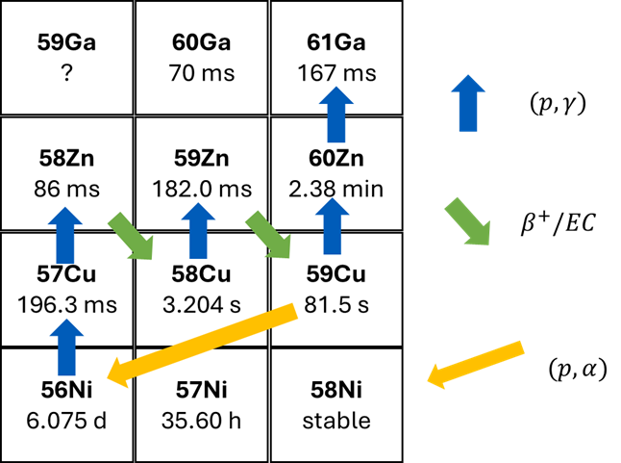
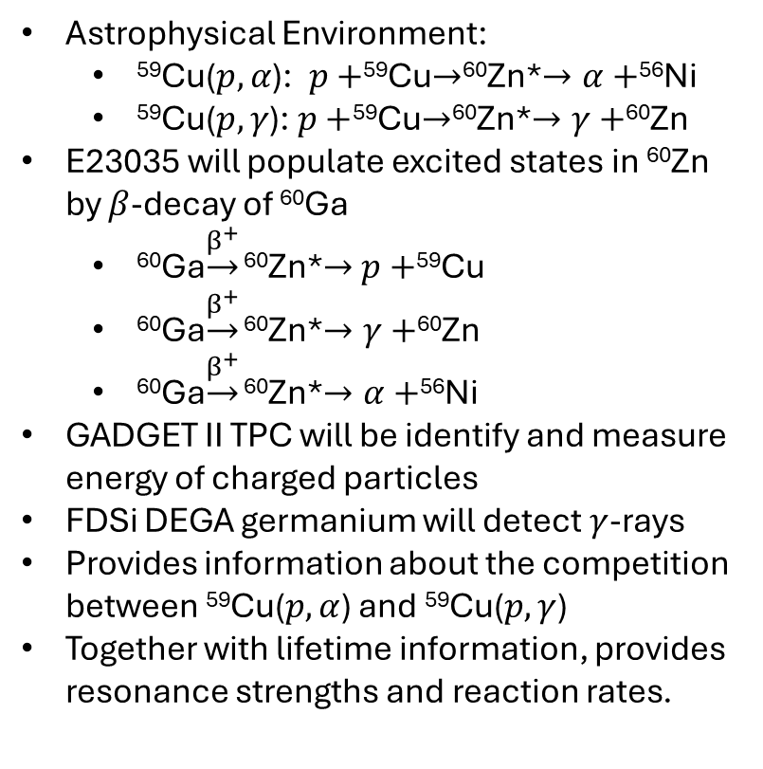
E23035: Is there a NiCu Cycle in X-ray Bursts?
E21072 and 25058 using GADGET II
Astrophysical Environment:
⁵⁹Cu($p, α$): $p+$⁵⁹Cu$→$⁶⁰Zn*$→α+$⁵⁶Ni
⁵⁹Cu($p,γ$): $p+$⁵⁹Cu$→$⁶⁰Zn*$→γ+$⁶⁰Zn
E23035 will populate excited states in ⁶⁰Zn by $β$-decay of ⁶⁰Ga
⁶⁰Ga$\underset{→}{β^{+}}$ ⁶⁰Zn*$→$ $p+$⁵⁹Cu
⁶⁰Ga$\underset{→}{β^{+}}$ ⁶⁰Zn*$→γ+$⁶⁰Zn
⁶⁰Ga$\underset{→}{β^{+}}$ ⁶⁰Zn*$→α+$⁵⁶Ni
GADGET II TPC will be identify and measure energy of charged particles
FDSi DEGA germanium will detect$γ$-rays
Provides information about the competition between ⁵⁹Cu($p,α$) and ⁵⁹Cu($p,γ$)
Together with lifetime information, provides resonance strengths and reaction rates.
NiCu cycle reactions, focus of E23035
Cyburt et al., Astrophys. J. 830, 2 (2016).
$β$-decay half-life

Slide 2
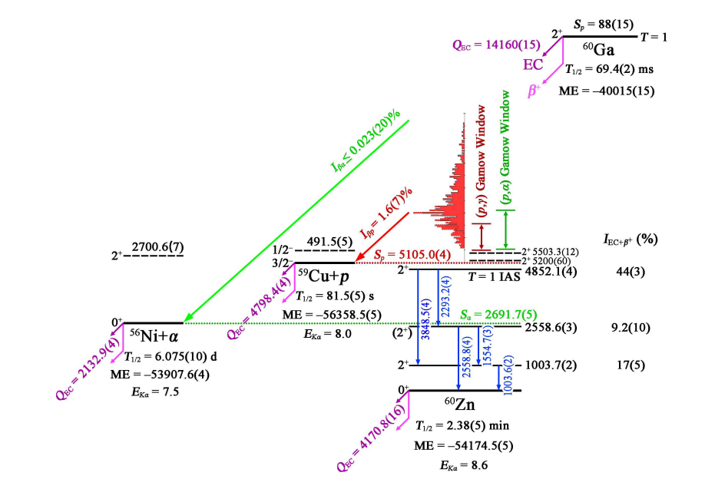
E23035: Is there a NiCu Cycle in X-ray Bursts?
E21072 and 25058 using GADGET II
NiCu cycle reactions, focus of E23035
Cyburt et al., Astrophys. J. 830, 2 (2016).
$β$-decay half-life
Notes:
Motivation: NiCu cycle strongly effects x-ray burst observables, and it’s importance is determined by the competition between 59Cu(p,a) and 59Cu(p,g)
Experiment:

