Slide 1
Double Alpha Decay Search
Fall Meeting of the APS DNP, 2024
Joseph Dopfer

Slide 2
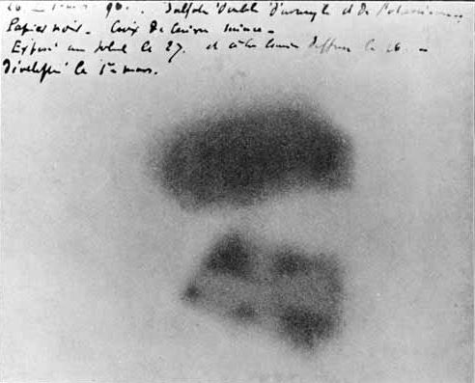
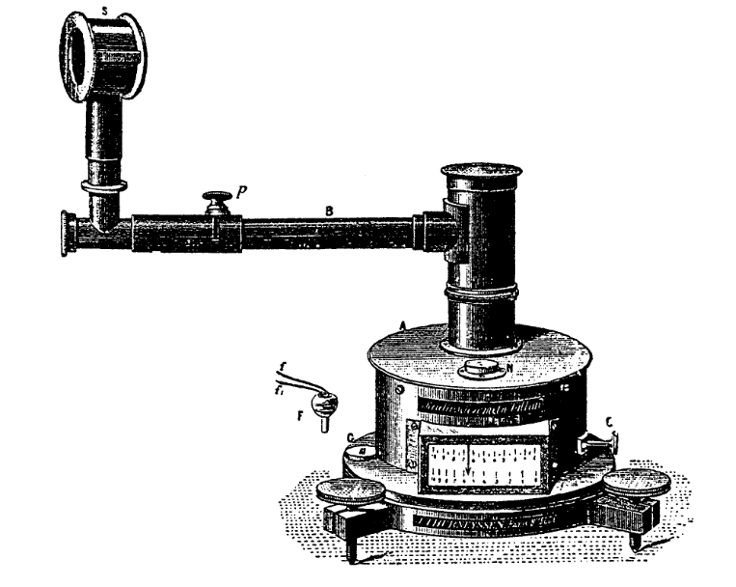
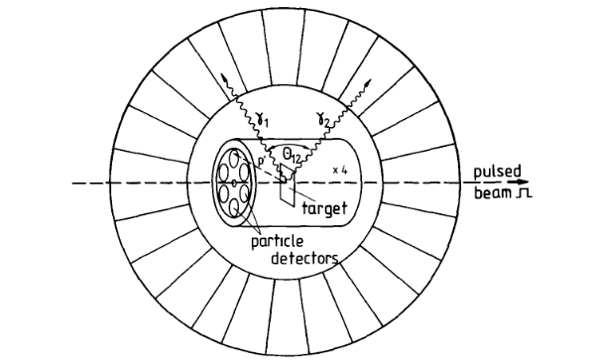
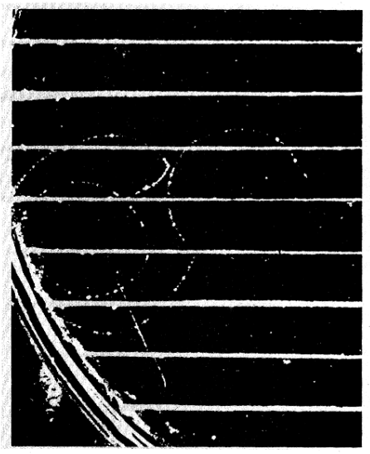
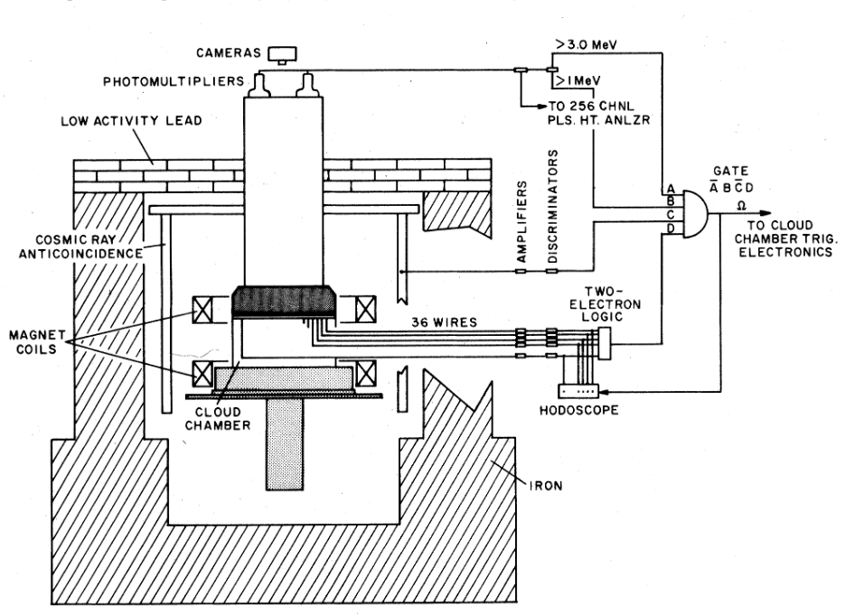
History of Double Decays
Single Decay Modes
α – E. Rutherford (1899)
β – H. Becquerel (1896)
$γ$ – P. Villard (1900)
Double Decay
2$ν$ββ - M. K. Moe, D. D. Lowenthal (1980)
$γγ$ - J. Kramp, et al.(1987)
αα – Undiscovered (????)
Paul Villard, Archives d’électricité médicale, 16, 236–238, (1908).
Image Credit: CERN
J. Kramp et al., Nuclear Phys. A, 474, 2, 412-450, (1987).
M. K. Moe et al., Phys. Rev. C, 22, 2186, (1980).
Notes:
https://timeline.web.cern.ch/becquerel-discovers-radioactivity

Slide 3
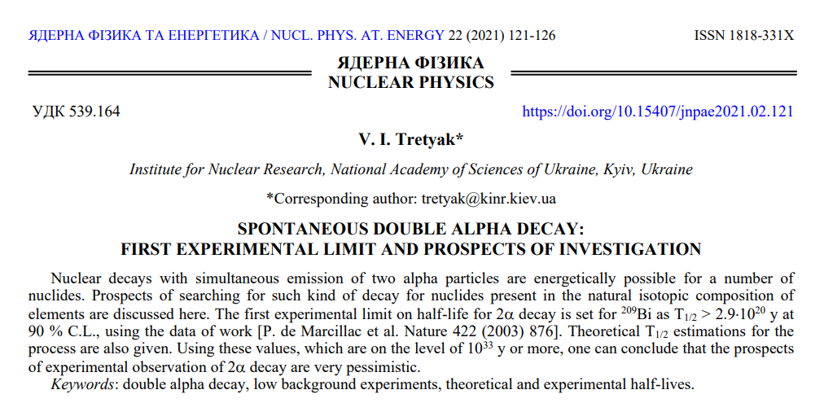
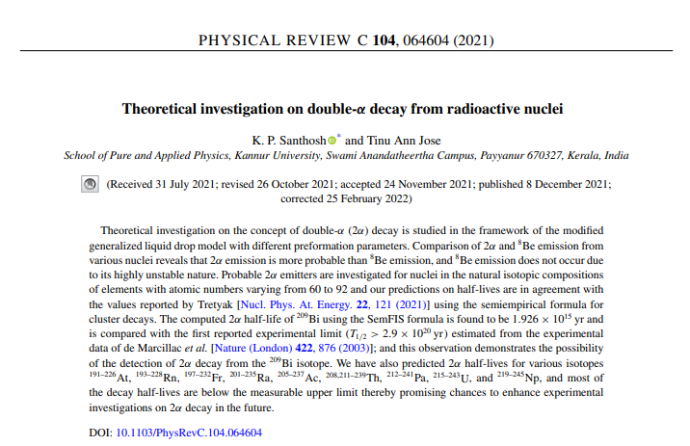
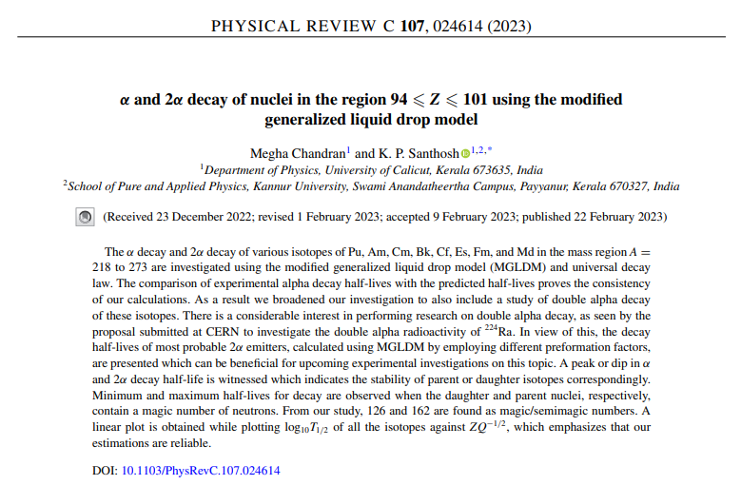
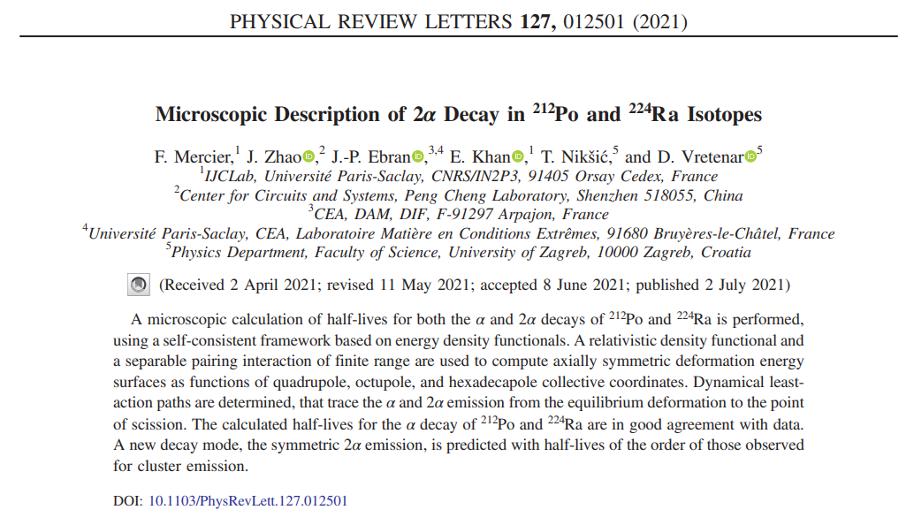
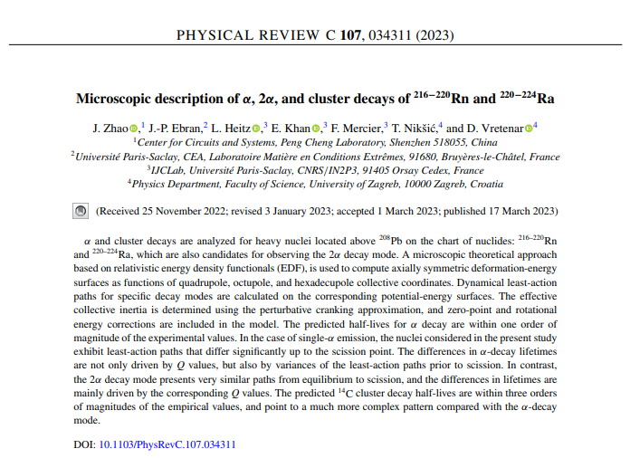
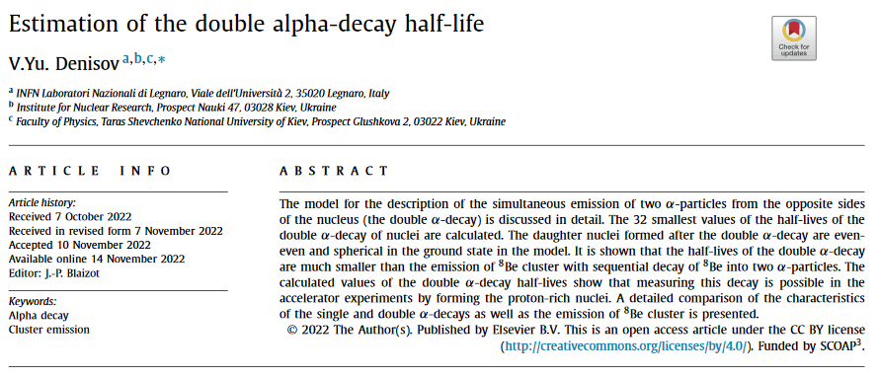
Double Alpha Decay Theory

Slide 4
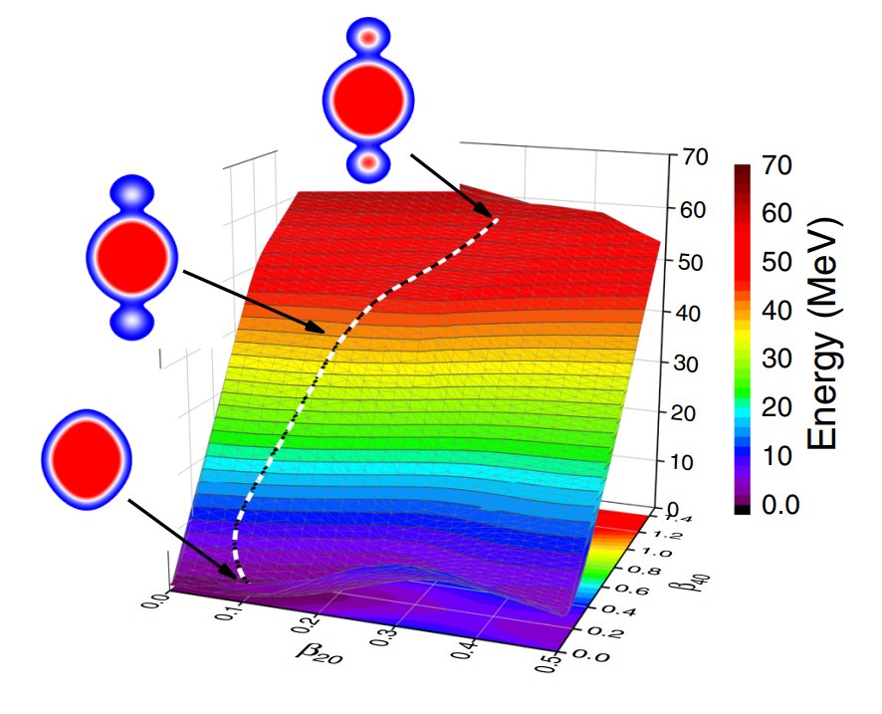
Double Alpha Decay Theory: ²²⁰Rn
The branching ratio of double alpha decay varies widely depending on the theoretical model
Our goal with this experiment is to measure past the microscopic limit
Single alpha decay of ²²⁰Rn t_{1/2}=55.6 s
Theory | Branching Ratio | Half Life
UMADAC [1] | 10^{-2.07} | 6532 s
Microscopic [2] | 10^{-6.4} | 1.1x10⁸ s
MGLDM [3] | ~10⁻²⁰ | ~5.6x10²¹ s
[1] V.Yu. Denisov, Phys. Lett. B, 835, 137569, (2022).
[2] J. Zhao et al., Phys. Rev. C, 107, 034311, (2023).
[3] K. P. Santhosh et al., Phys. Rev. C, 104, 064604, (2021).
F. Mercier et al., Phys. Rev. Lett., 127, 012501, (2021).

Slide 5
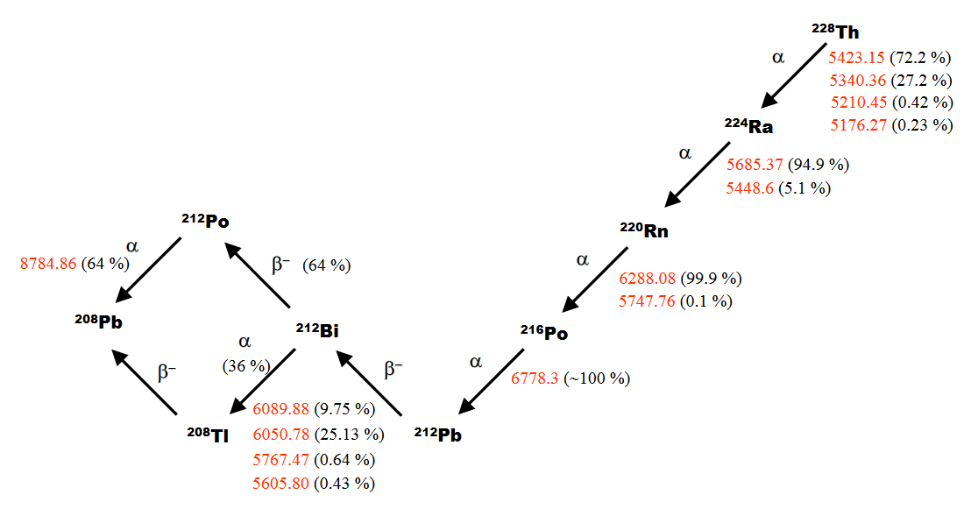
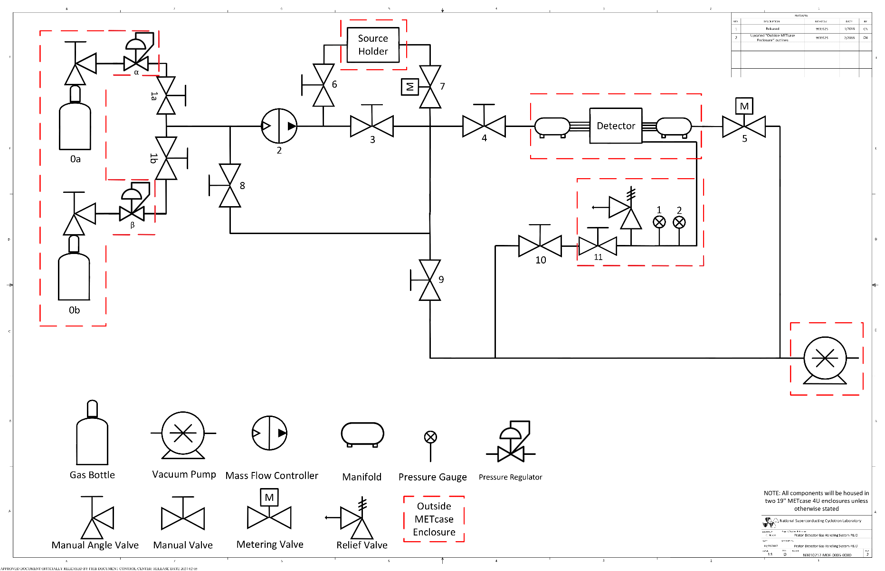
Using the GADGET II TPC to search for ²²⁰Rn double alpha
²²⁸Th
²²⁰Rn
Figure Credit: HiRA Collaboration
²²⁰Rn is a noble gas, so we can flow it from our gas handling system into our detector, where it will alpha decay
M. Friedman et al., NIM, 940, 93-102, (2019).
T. Budner, PhD Thesis, MSU, (2022).

Slide 6
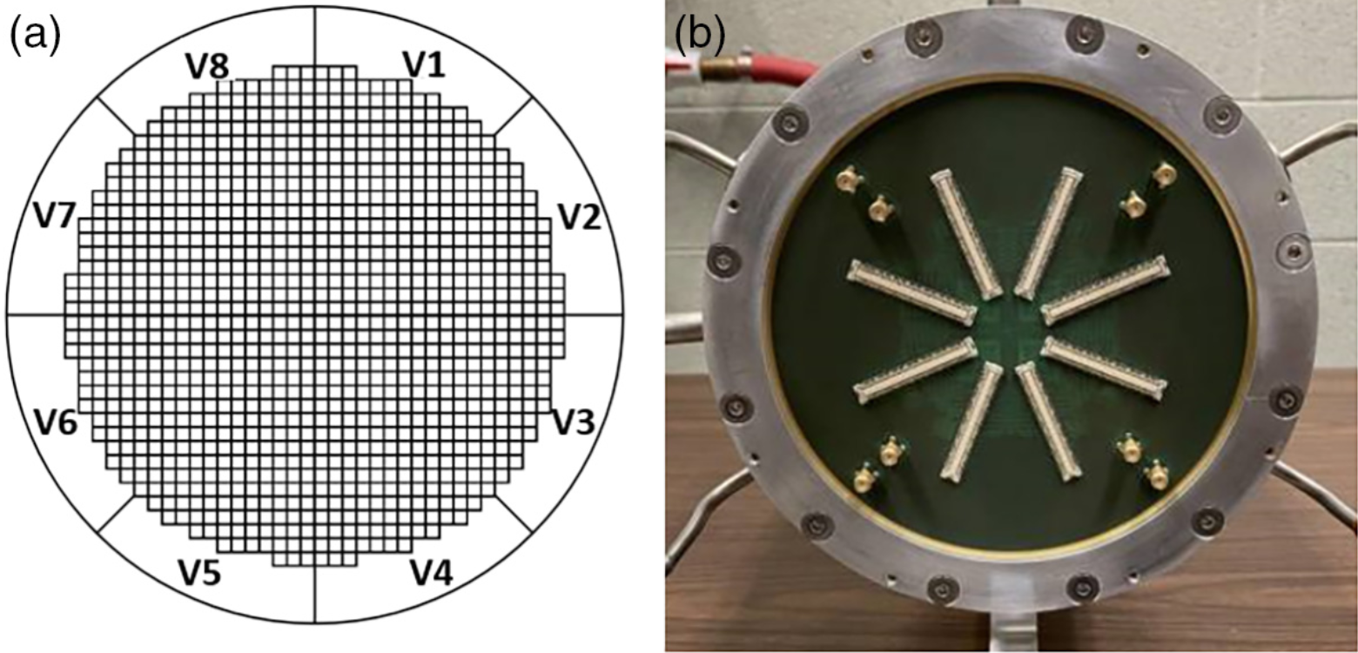
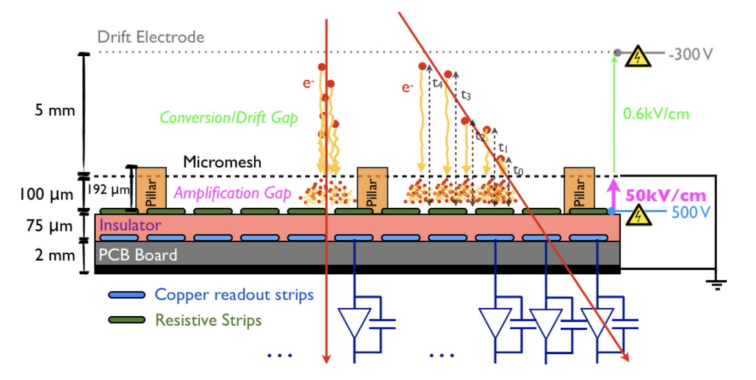
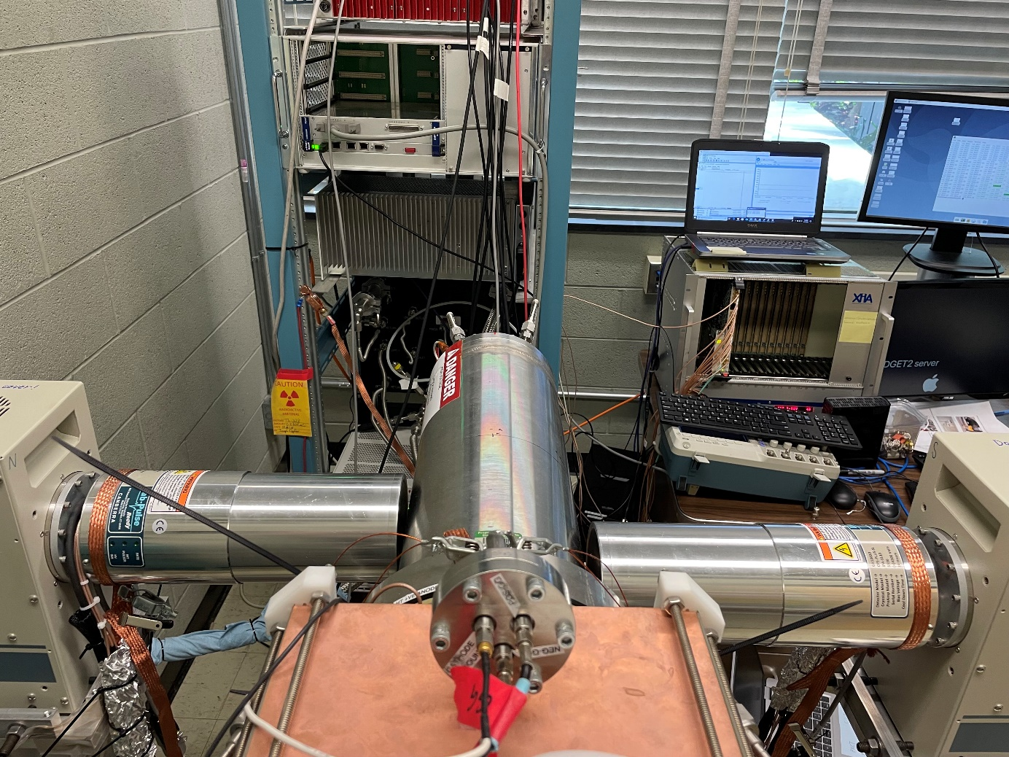
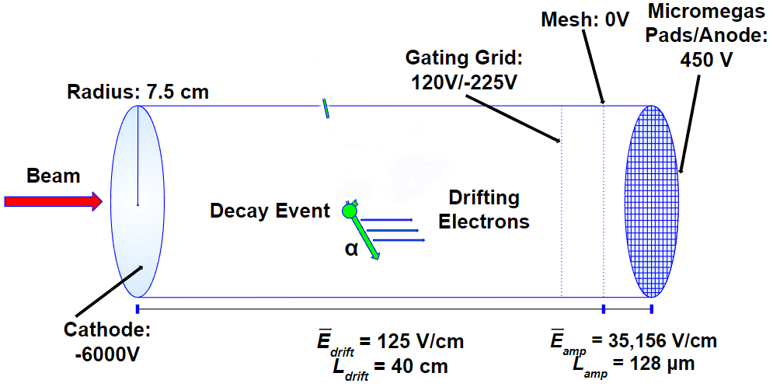
Using the GADGET II TPC to search for ²²⁰Rn double alpha
Pad Plane w/ Vetos
GADGET II TPC
F. Kruger, Nucl. Instr. Meth., A845, 248, (2017).
HPGe Gamma Detectors
R. Mahajan, et al., Phys. Rev. C, 110, 035807, (2024).

Slide 7
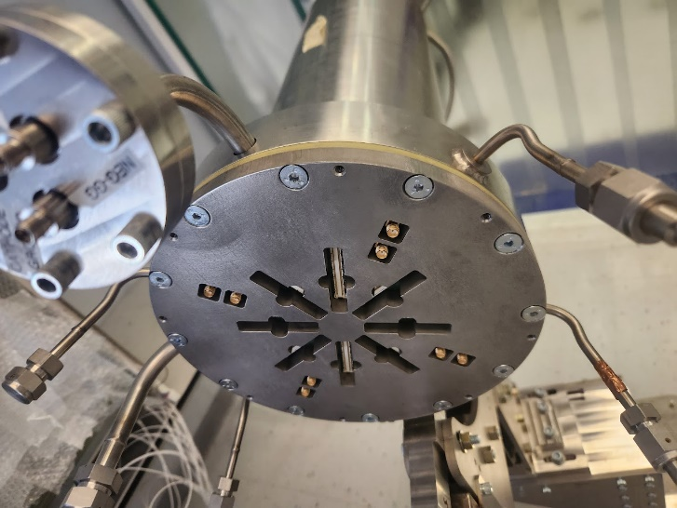
Using the GADGET II TPC to search for ²²⁰Rn double alpha
Pad Plane w/ Vetos
GADGET II TPC
F. Kruger, Nucl. Instr. Meth., A845, 248, (2017).
HPGe Gamma Detectors
R. Mahajan, et al., Phys. Rev. C, 110, 035807, (2024).

Slide 8
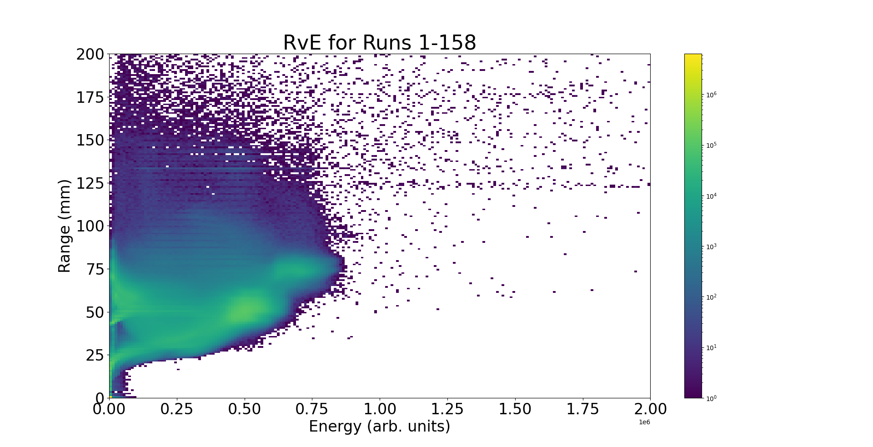
Preliminary Data
These initial runs provide enough data to rule out the Denisov prediction of 1/100 decays being double alphas
10⁶
10⁵
10⁴
10³
10²
10¹
10⁰

Slide 9
Preliminary Data
These initial runs provide enough data to rule out the Denisov prediction of 1/100 decays being double alphas
10⁶
10⁵
10⁴
10³
10²
10¹
10⁰

Slide 10
Preliminary Data
Run 77 Event 487347 – Sequential single-alpha decays of ²²⁰Rn and ²¹⁶Po
Pad Plane Image
Y-axis (2.2 mm)
X-axis (2.2 mm)
Summed Traces
ADC Units (arb. Units)
Time (20 ns per bin)

Slide 11
Preliminary Data
Run 12 Event 176748 – Sequential single-alpha decays of ²²⁰Rn and ²¹⁶Po
Pad Plane Image
Y-axis (2.2 mm)
X-axis (2.2 mm)
Summed Traces
ADC Units (arb. Units)
Time (20 ns per bin)

Slide 12
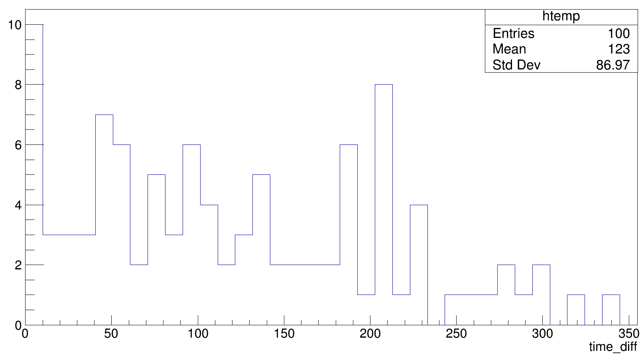
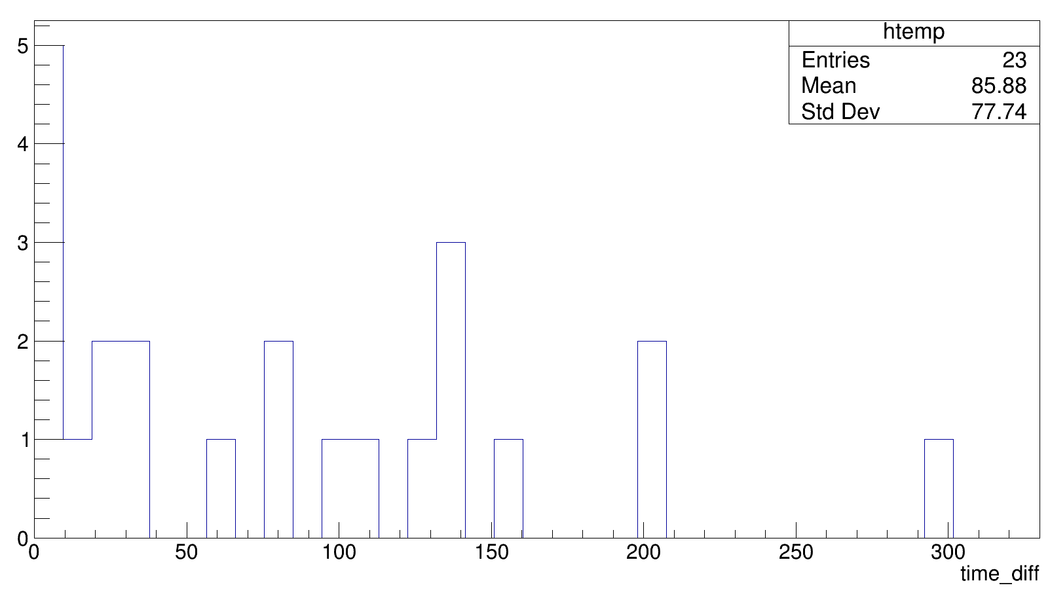
Preliminary Data
Time difference between two alpha events histogram
Time Difference All Angles
Time Difference Angles >160 deg
Counts
Counts
Time Difference (20 ns)
Time Difference (20 ns)

Slide 13
Preliminary Data
Run 10 Event 160001 – Double Alpha Candidate
Pad Plane Image
Y-axis (2.2 mm)
X-axis (2.2 mm)
Summed Traces
ADC Units (arb. Units)
Time (20 ns per bin)

Slide 14
Preliminary Data
Run 86 Event 136154 – Double Alpha Candidate
Pad Plane Image
Y-axis (2.2 mm)
X-axis (2.2 mm)
Summed Traces
ADC Units (arb. Units)
Time (20 ns per bin)

Slide 15
Preliminary Data
Run 92 Event 242519 – Double Alpha Candidate
Pad Plane Image
Y-axis (2.2 mm)
X-axis (2.2 mm)
Summed Traces
ADC Units (arb. Units)
Time (20 ns per bin)

Slide 16
Preliminary Data
Run 95 Event 68242 – Double Alpha Candidate
Pad Plane Image
Y-axis (2.2 mm)
X-axis (2.2 mm)
Summed Traces
ADC Units (arb. Units)
Time (20 ns per bin)

Slide 17
Preliminary Data
Run 101 Event 14362 – Double Alpha Candidate
Pad Plane Image
Y-axis (2.2 mm)
X-axis (2.2 mm)
Summed Traces
ADC Units (arb. Units)
Time (20 ns per bin)

Slide 18
Conclusions
In recent years, there has been increasing interest in predicting the half life of the undiscovered simultaneous double-alpha decay mode, with widely varying results.
We have upgraded the TPC of the GADGET II system to operate at higher pressures (up to 2000 torr), resulting in a higher efficiency to contain the full energy of a particle
The GADGET II system is uniquely prepared to conduct this experiment in a tabletop setting
With the data taken so far, we have ruled out one of the theoretical predictions (Denisov, 2021)
We see candidates whose signals are consistent with what we expect to see for double alpha decay, but further analysis is required to rule out the possibility these come from background
Outlook
We have begun analyzing approximately 20% of the data we will take
Our goal with the full data set is to test the microscopic prediction of Zhao et al.
We will also analyze gamma data taken with two HPGe detectors coupled to the TPC

Slide 19
Collaboration and Funding Acknowledgements
We gratefully acknowledge financial support from the U.S. National Science Foundation under Award Numbers 1913554 & 2209429.
This material is based upon work supported by the U.S. Department of Energy, Office of Science, Office under Award Number(s) DE-SC0016052, DE-SC0023529, DE-SC0022299, & DE-SC0024587
Thanks also to the GADGET double alpha search collaboration: Alex Adams, Daniel Bazin, Ruchi Mahajan, Emanuel Pollacco, Lijie Sun, Tyler Wheeler, Chris Wrede

Slide 20
Experimental Sensitivity

Slide 21
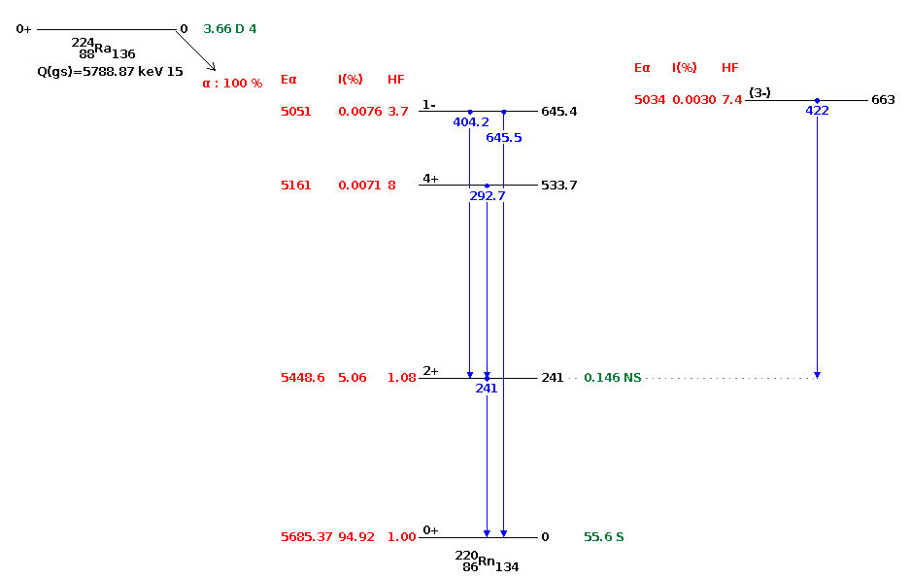
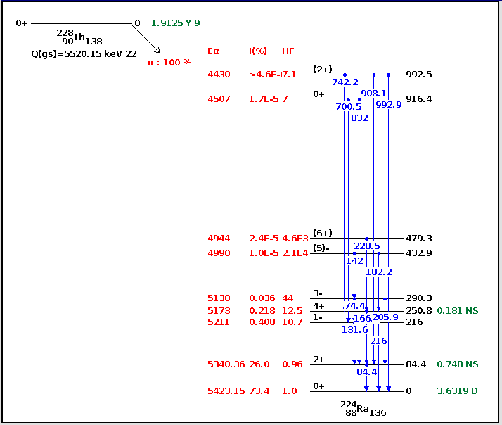
Decay to Excited States
We can see that there is not a lot of information for decays to excited states of both ²¹⁶Po and ²¹²Pb
Figure Credit: NNDC

Slide 22
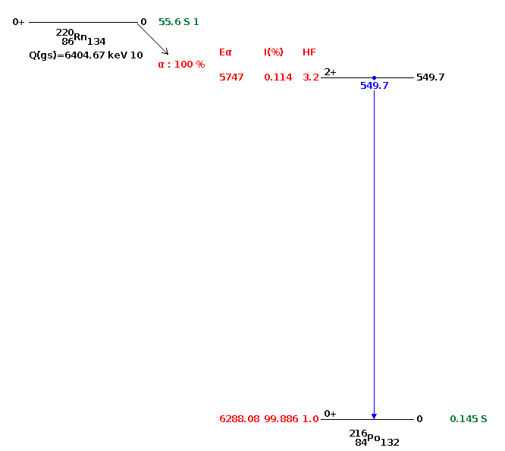
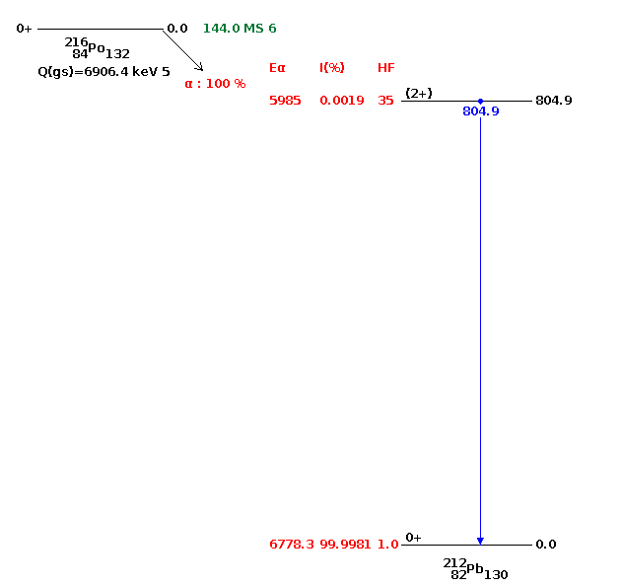
Decay to Excited States
We can see that there is not a lot of information for decays to excited states of both ²¹⁶Po and ²¹²Pb

Slide 23
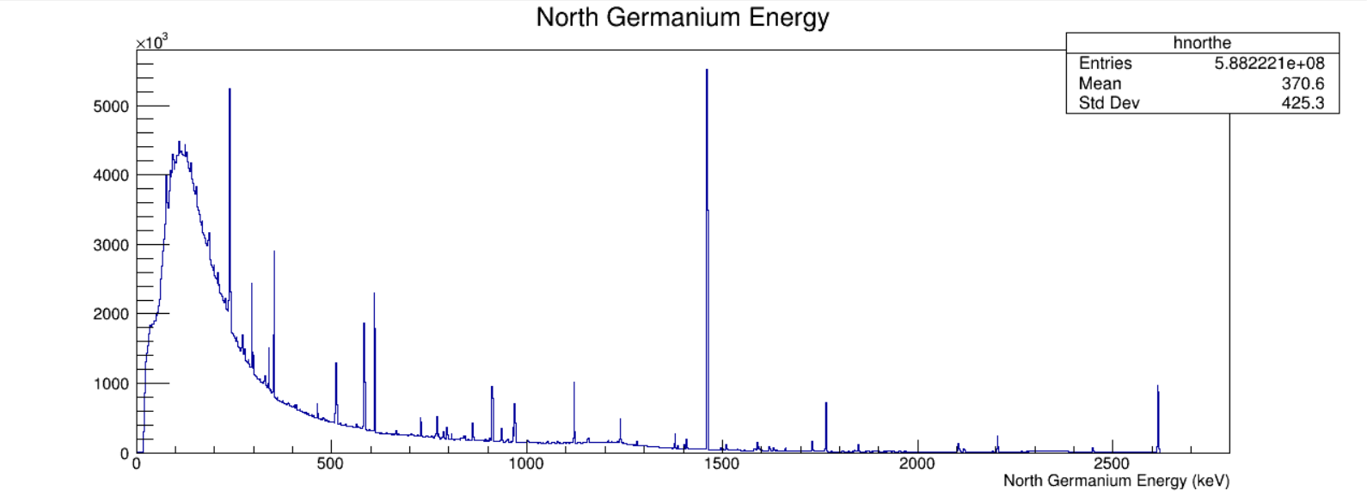
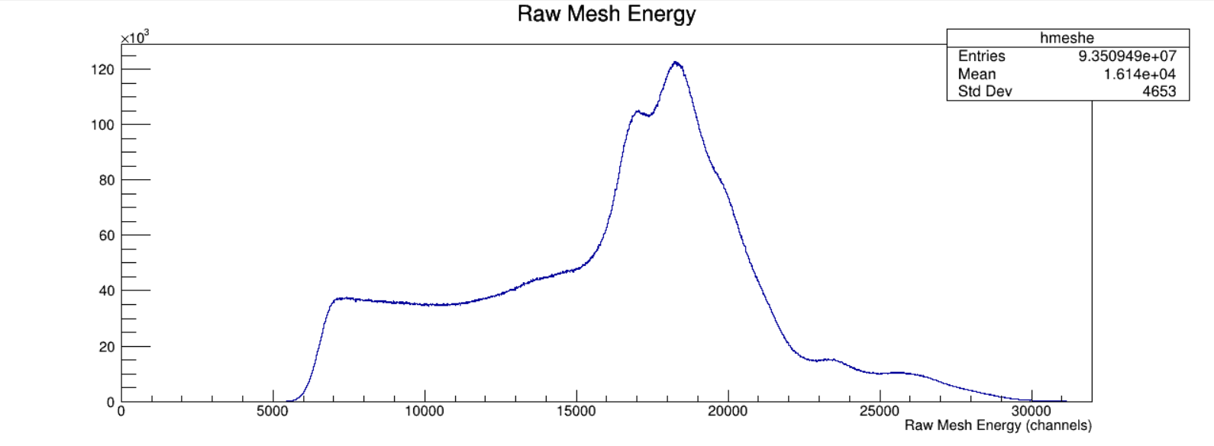
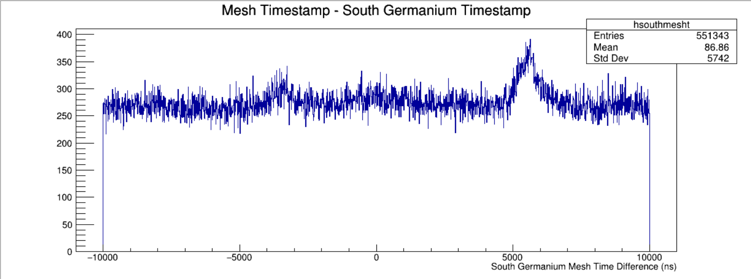
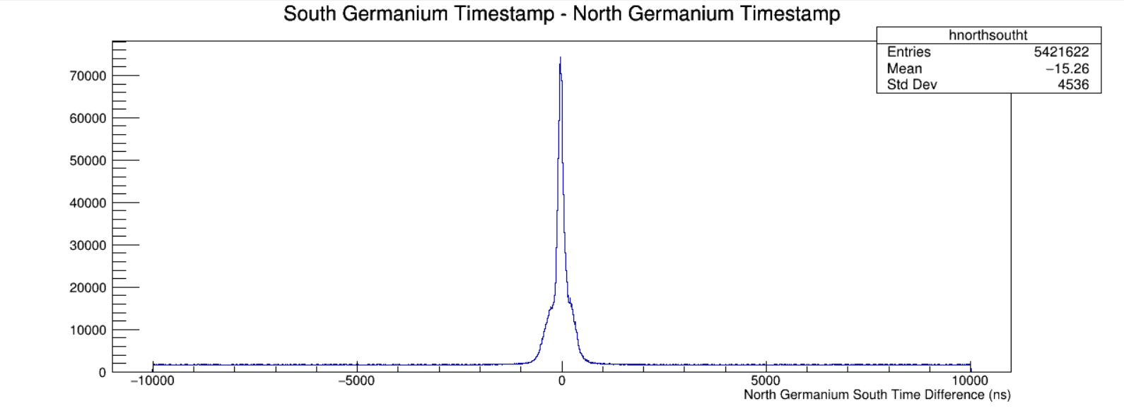
Preliminary Data

Slide 24
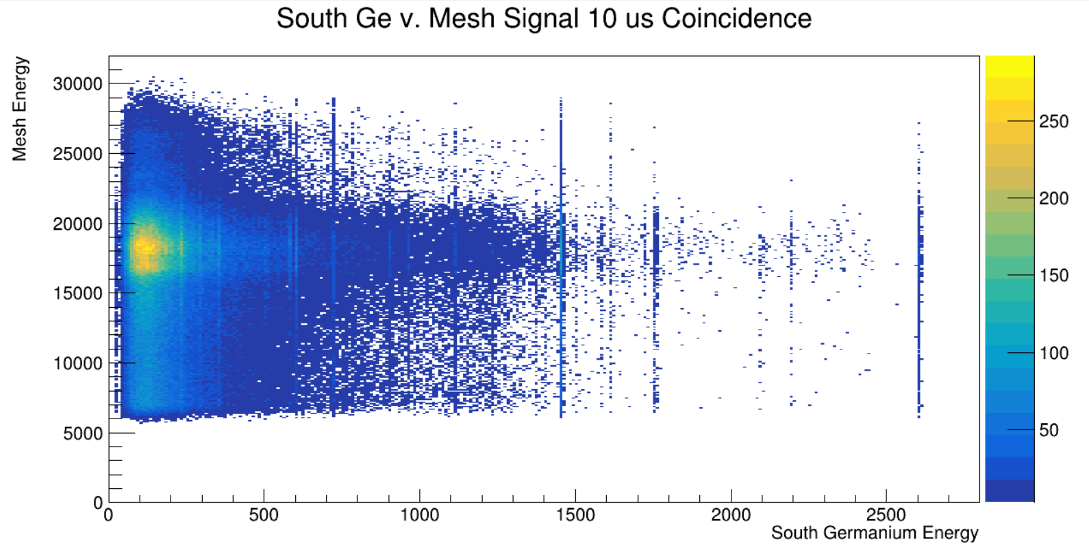
Preliminary Data

Slide 25
Cluster Decay
Discovered by Rose and Jones in 1984 in ²²³Ra -> ¹⁴C + ²⁰⁹Pb / ²²³Ra -> ¹²C + ²¹¹Pb

Slide 26
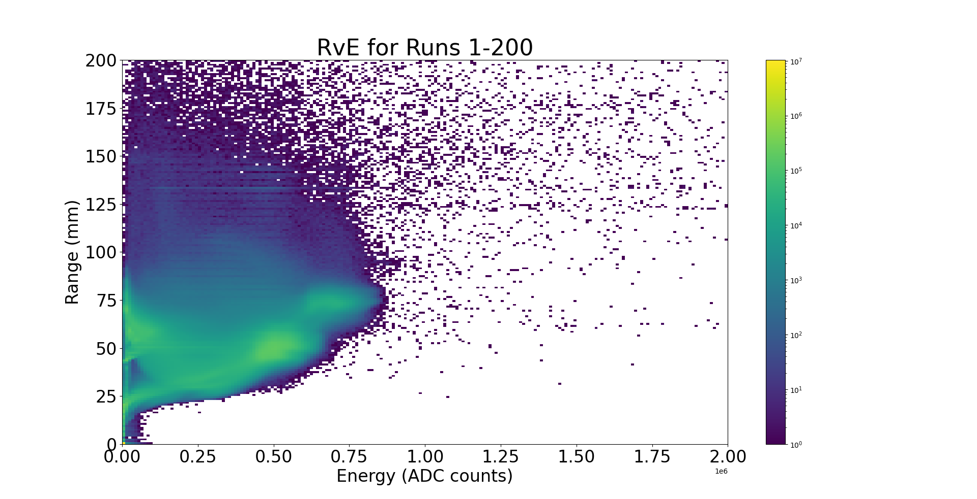
Preliminary Data
These initial runs provide enough data to rule out the Denisov prediction of 1/100 decays being double alphas

Slide 27
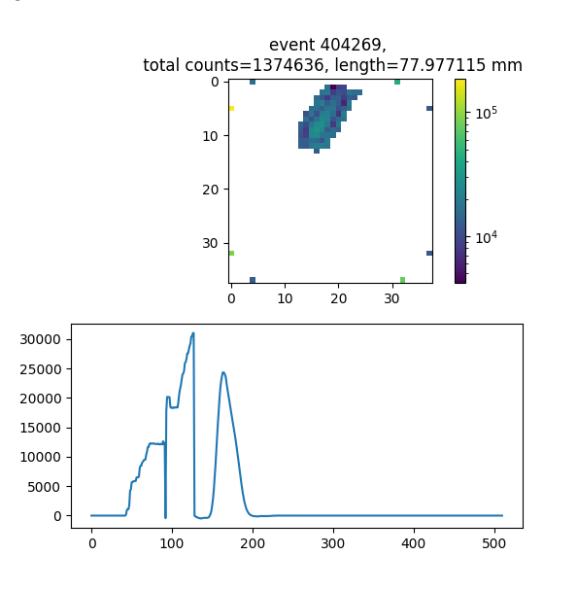
Types of Noise in the TPC Data

Slide 28
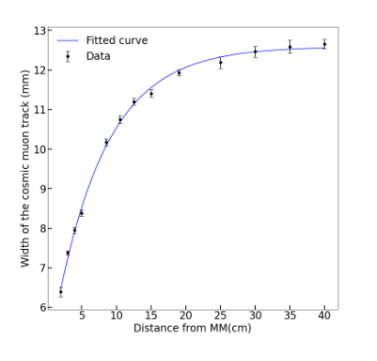
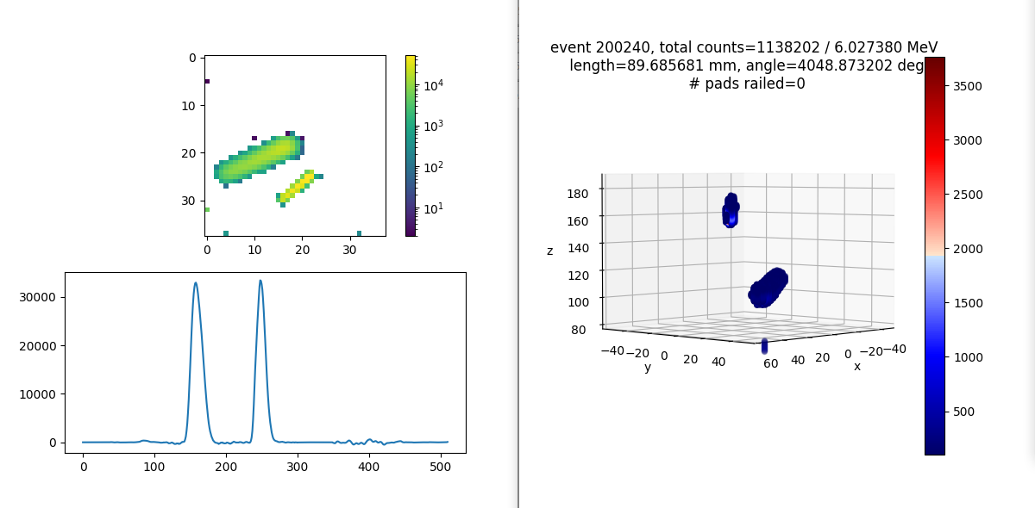
Preliminary Data
Run 69 Event 200240 – Accidental Coincidence: ~2 us difference in time between the 2 events

Slide 29
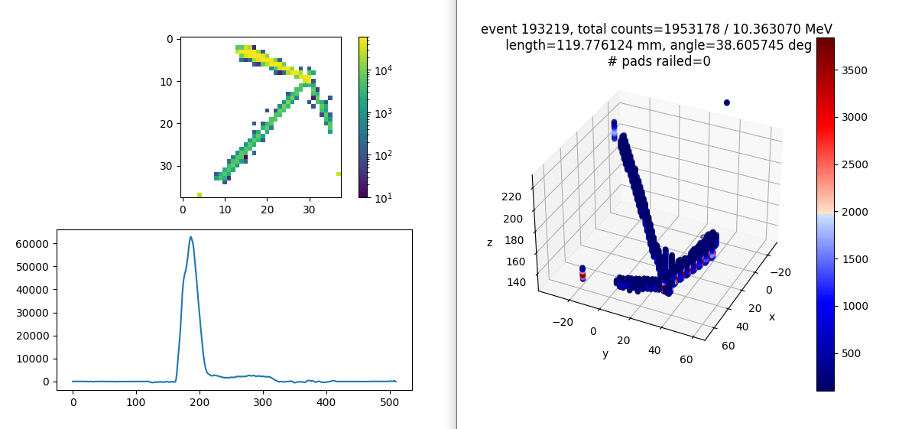
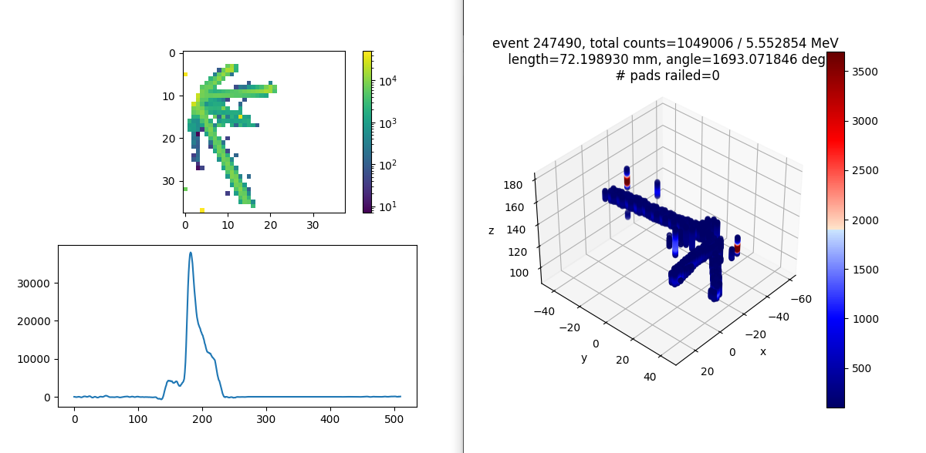
Preliminary Data
Disintegration Events – We’ve seen ~5 of these types of events so far

Slide 30
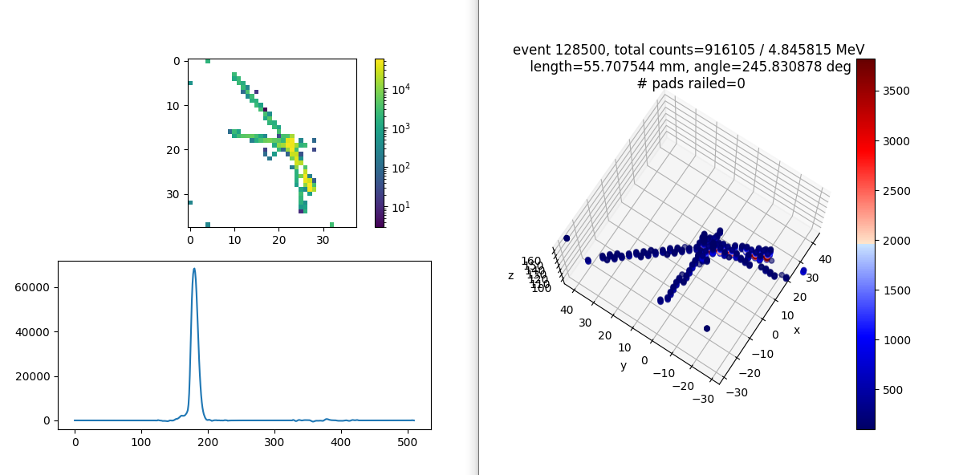
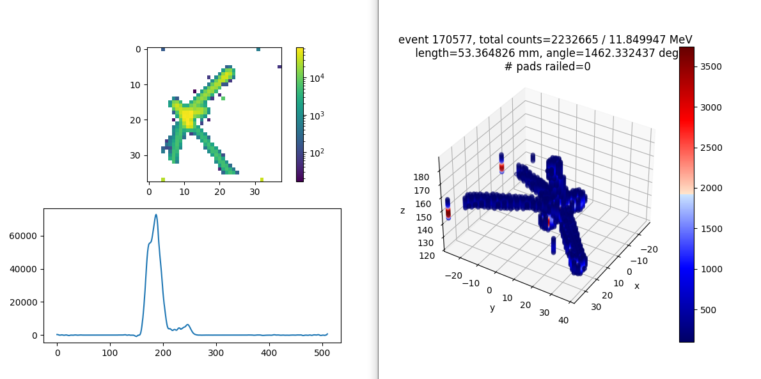
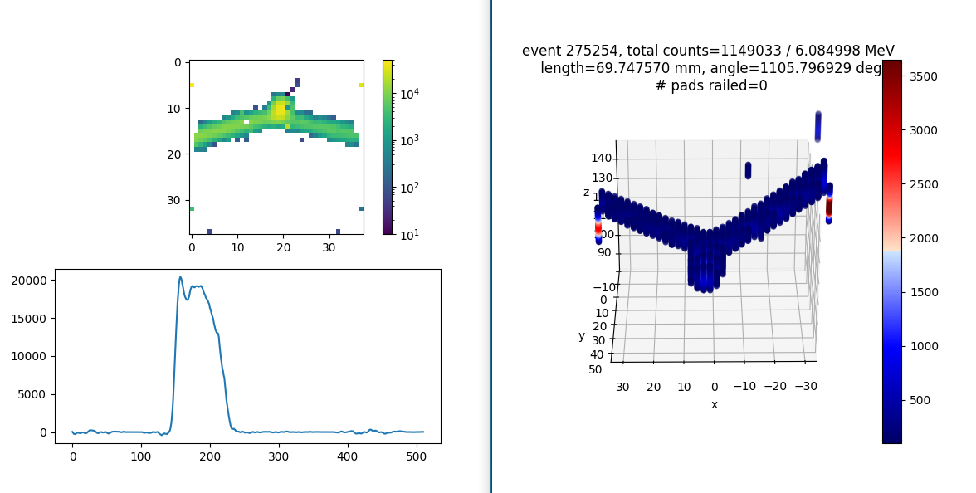
Preliminary Data
Disintegration Events – We’ve seen ~5 of these types of events so far

