Slide 1
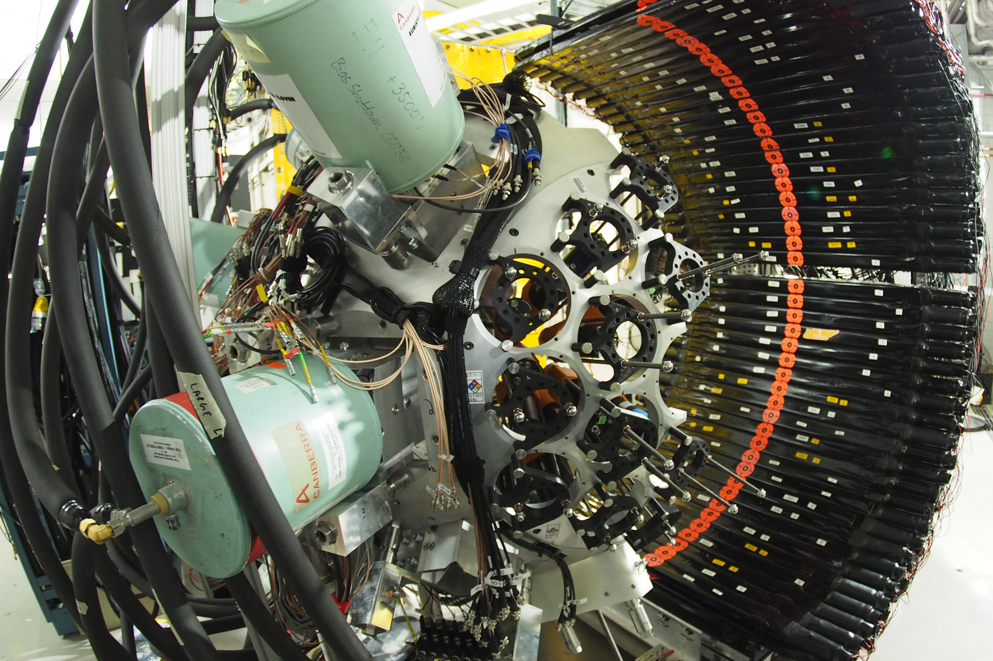
Experiment 25084: Demonstrating new methods for beta-delayed fission
We aim to demonstrate at FRIB a measurement capability for beta-delayed fission using the GADGET II TPC in FDSi. We will measure a rich set of fission properties, including:
Energy sharing between fragments and neutrons
Prompt fission neutron number
Prompt fission neutron energy spectrum
High-multiplicity angular correlations of ejecta
Fission product yields
Initial studies will focus on the sub-Pb region including ¹⁸⁰Tl, ¹⁸⁶Bi, ¹⁹²At
After demonstration in E25084, future studies are planned for many minor actinides and some major actinides ²³²Th and ²³⁸U (by decay of ²³²Ac and ²³⁸Pa)
Neutron detectors
(NEXT or VANDLE)
HPGe γ detectors
(DEGAi)
Fission detector
(GADGET II TPC)
FDSi with partial DEGAi and VANDLE detectors installed at FRIB. The GADGET II TPC (not shown) is housed at the center of the FDSi array to measure charged fission fragments.
LA-UR number goes here

