Slide 1
29-04-2024

Slide 2
1039 is a bit cleaner now
I have added labels to a lot of the boxes that are on the shelves
We have a lot of parts from GADGET I that I am not sure if we still need, we could consider a nicer way to store these
We should still remove one of the tables from 1039 before we bring in the HPGe to create more space
Either table will be a bit tricky to remove

Slide 3
Dirty/Clean Power Sources
The power to our NIM crates, AsAd boards, and oscilloscope are now on clean power
Everything else is on dirty power: scroll pump, computers (including the Mac minis), CoBos

Slide 4
ATTPC Pads

Slide 5
ATTPC Pads

Slide 6
ATTPC does not use wires to ground their AsAd boards

Slide 7
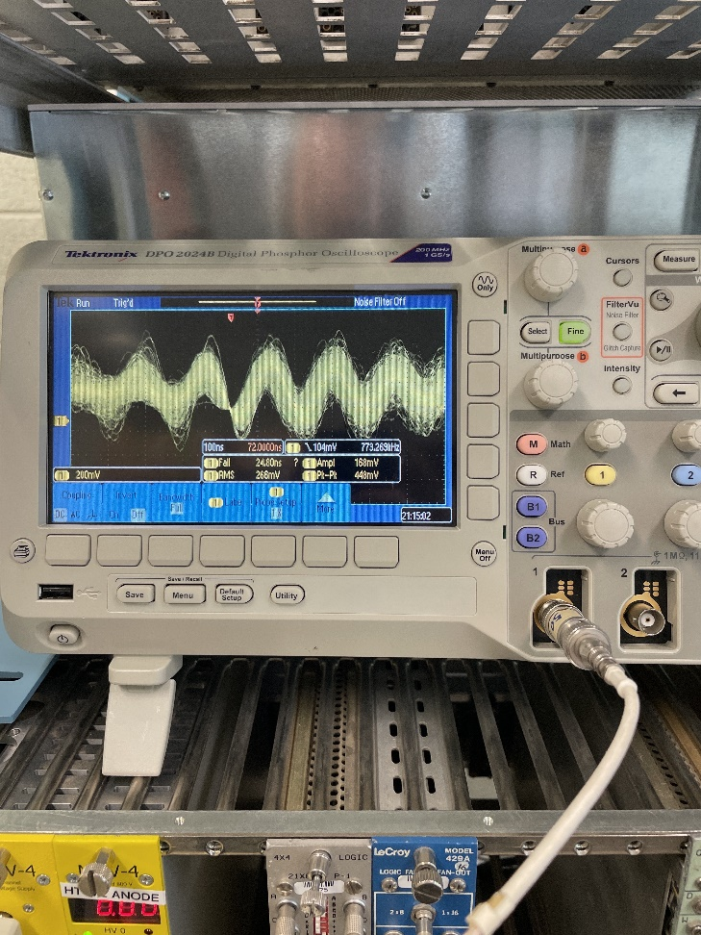
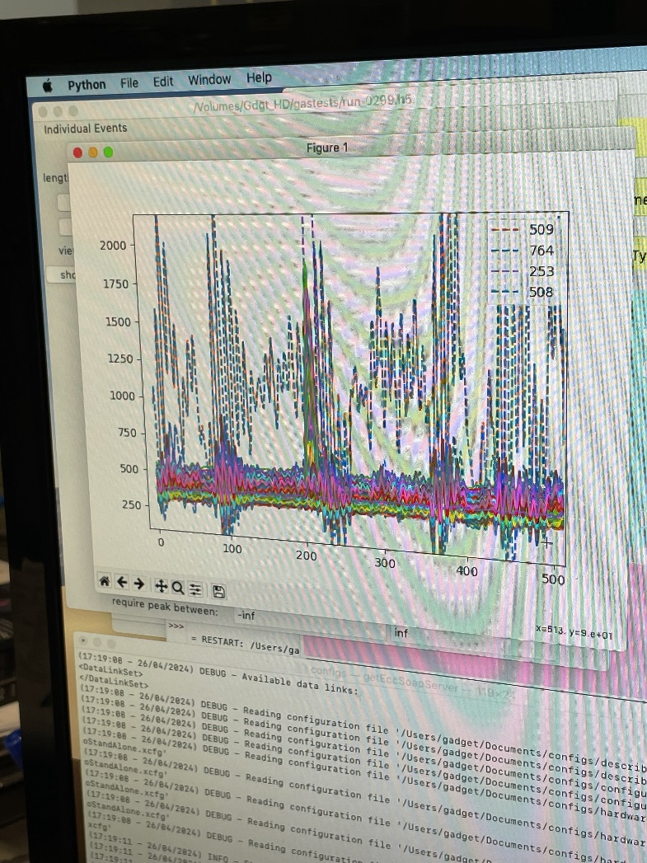
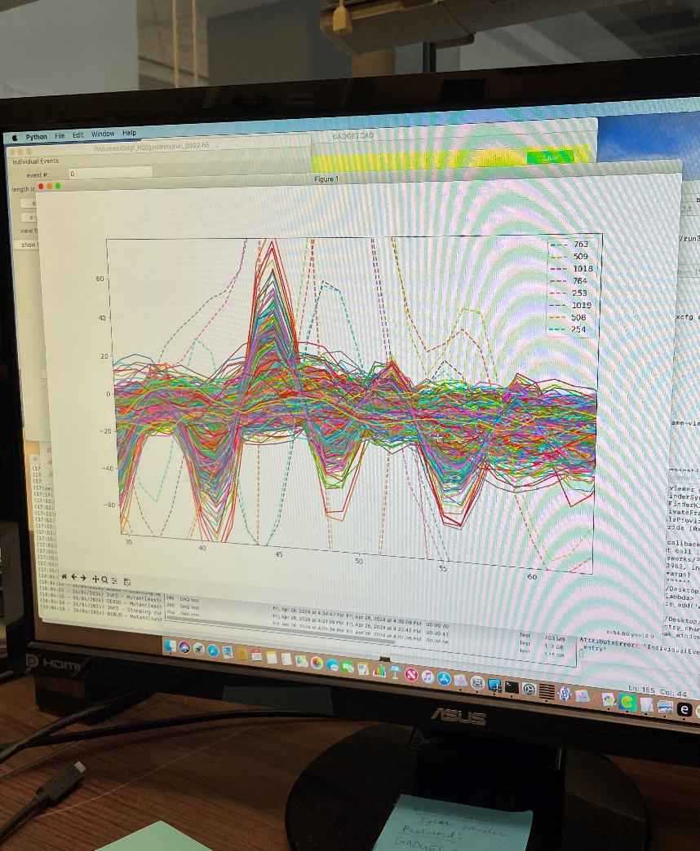
Greatly reduced noise when we use lower impedance grounding wires from the AsAd boards to the support plate/detector

Slide 8
Next:
Get HA doc fully squared away so that we can operate at higher pressure
Buy extra o-ring and union for adding valve and operating at higher pressure (re-check machine shop area for the right size o-ring)

